Slide 1
Installation and testing of regular sections of the NICA Collider beam chamber
А.Pogodin
Аlushta-2024

Slide 3
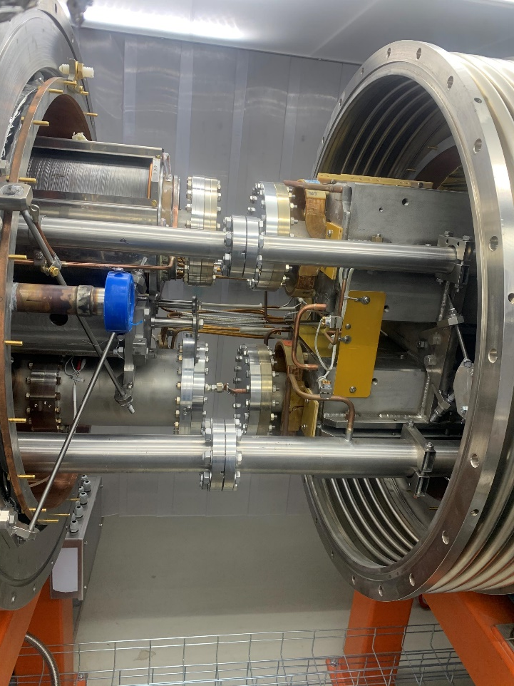
The collider structure includes two rings converging at two meeting points. This allows the beams to move towards each other for a long time and interact with each other only where the apertures of the rings converge. In these areas there are detectors that record the decay products of particles as a result of their interaction. There are two main detectors in the collider: MPD (MultiPurpose Detector) and SPD (Spin Physics Detector).

Slide 4
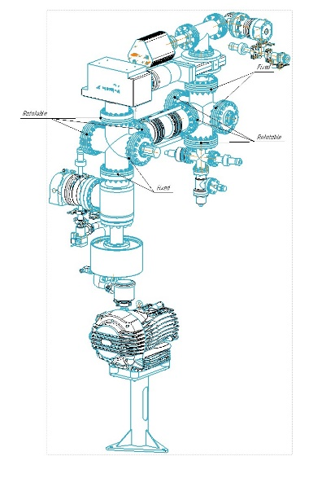
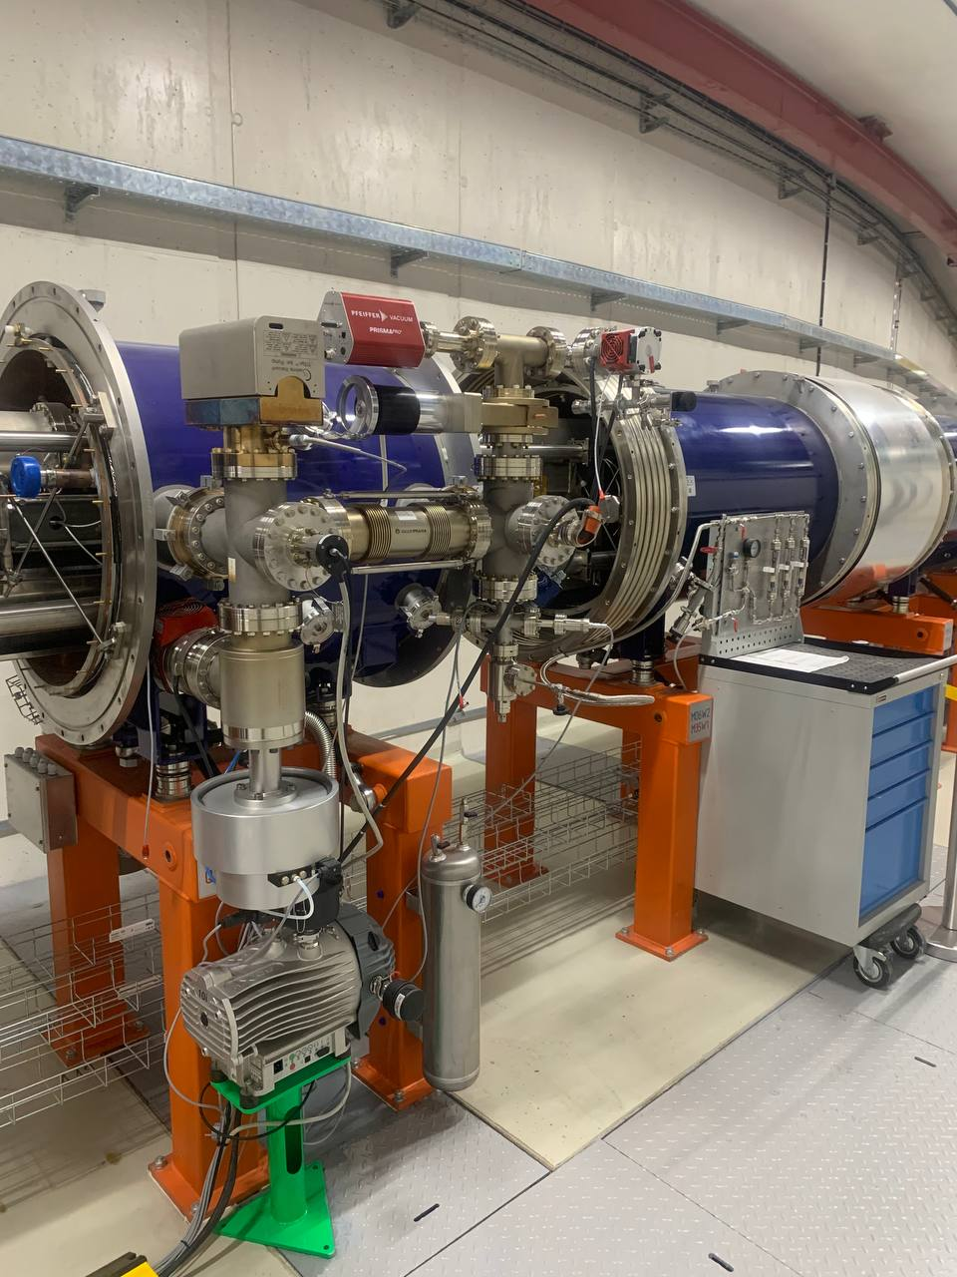
The pumping system of the beam chamber consists of preliminary pumping and ultra-high vacuum pumping posts. Ultra-high-vacuum pumping stations ensure a working vacuum in the accelerator chamber at a level no worse than 2x10^(-9) Pa

Slide 5
Mass spectrum of lens L-19 + ultra-high vacuum post
P=2·10⁻⁶Па Estimated gases: 1 – H₂(2а.е.м.); 2 – H₂O(18а.е.м.); 3 – N₂(28а.е.м.); 4 – CO₂ , Sc (44а.е.м.); 5 - propanol-2 (isopropyl alcohol)

Slide 6
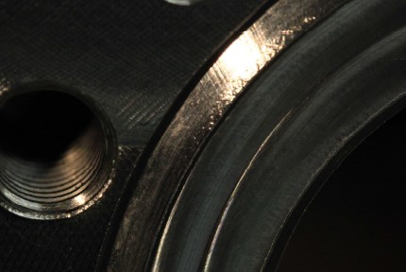
Orange skin flanges Con Flat

Slide 7
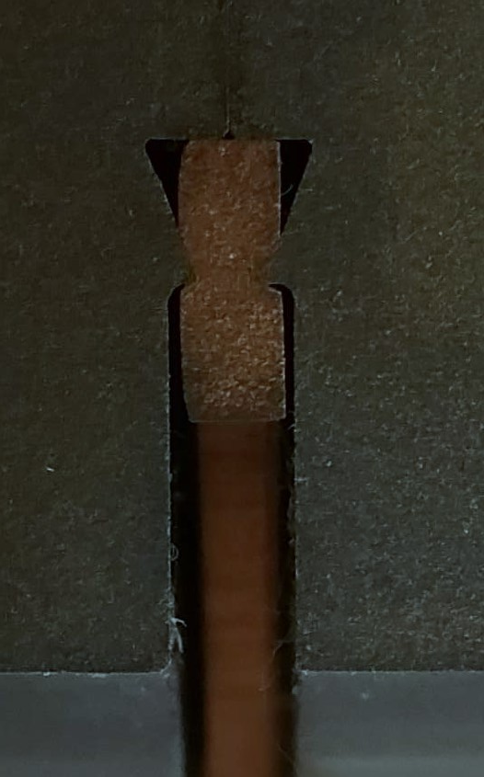
Deformation of copper seal
This picture presents a gasket connection between
two Conflat flanges with different knife edges
This picture is presents pairing of DESY knife edge
with IST/TS 3669-2 knife edge.

Slide 8
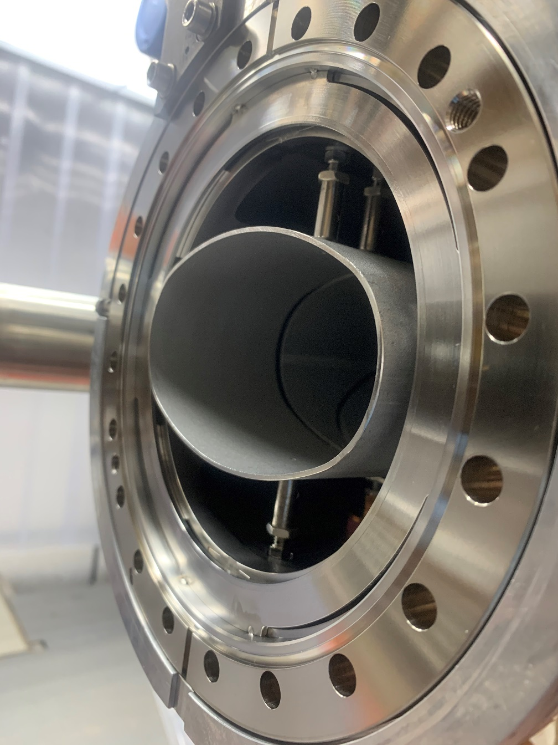
Conclusion
Thus, the installation and testing of regular sections of the Collider vacuum systems has a complex structure, based on the requirements:
• before designing, set the same angles of the teeth of the Con Flat flange;
• parts must be clean and free of coolant;
• anneal elements to remove water vapor. It is necessary to observe the temperature to eliminate tooth deformation and the appearance of peeling of steel and “orange skin” peeling of steel 316LN;
• scratches and other defects on the teeth of the Con Flat flange are also not allowed;
• observe vacuum hygiene requirements when assembling connections• uniform traction of bolted joints of specials is also important. tool.

Slide 9
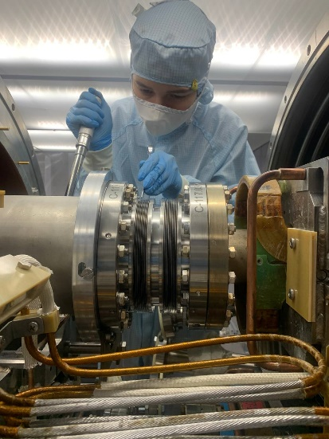
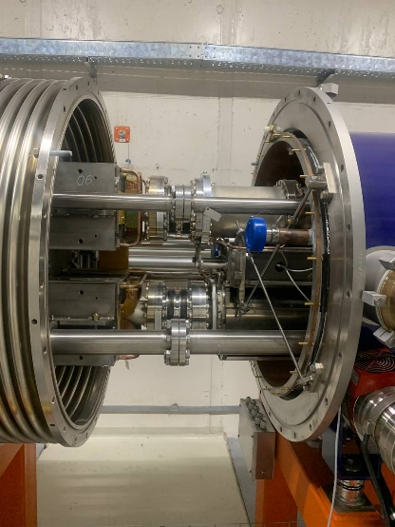
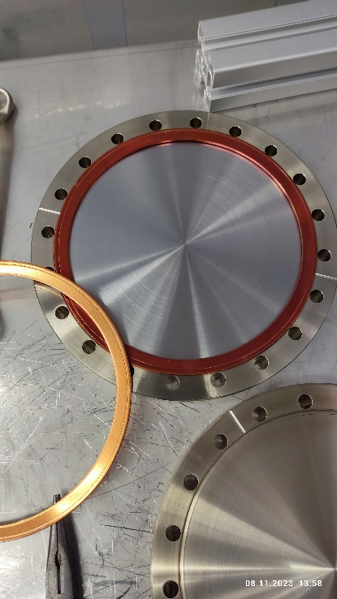
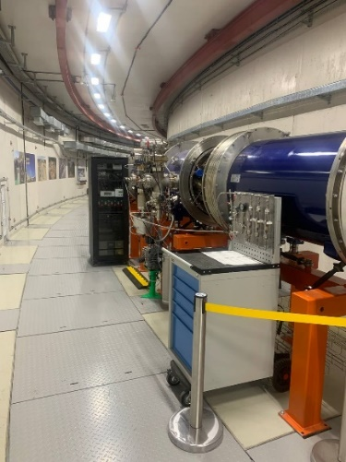
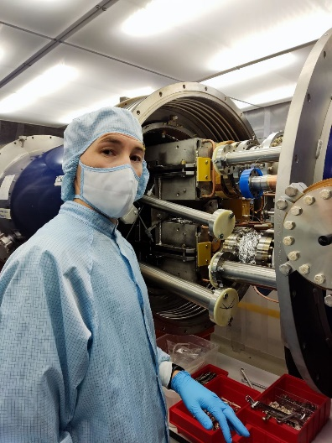
thank you for your attention
Authors: Pogodin Alexandr
Svidetelev Alexey
Galimov Artem

