Slide 1
JINR PROPERTY INVENTORY
Shiryaeva Lubov Andreevna
Senior accountant
Accounts Department, JINR

Slide 2
Relevance
The need to comply with the legislation of the JINR location country.
Held at the Institute annually as ordered by the JINR Director.
Affects every employee who uses in their activities the material values of the Institute acquired through contributions from JINR member countries (from computers to installations and other equipment for conducting scientific research).

Slide 3
Main Governing Law
Federal Law of the Russian Federation
№ 402 of 06.12.2011 (as amended on 12.12.2023)
About Accounting
Article 11. Inventory of assets and liabilities
1. Assets and liabilities are subject to inventory.
2. During the inventory, the actual presence of the relevant objects is revealed, which is compared with the data of the accounting registers.
3. The cases, timing and procedure for conducting an inventory, as well as the list of objects subject to inventory, are determined by the economic entity, with the exception of the mandatory inventory. Mandatory inventory is established by the legislation of the Russian Federation, federal and industry standards.
4. Discrepancies identified during the inventory between the actual availability of objects and the data of the accounting registers are subject to registration in accounting in the reporting period to which the date as of which the inventory was carried out relates.

Slide 4
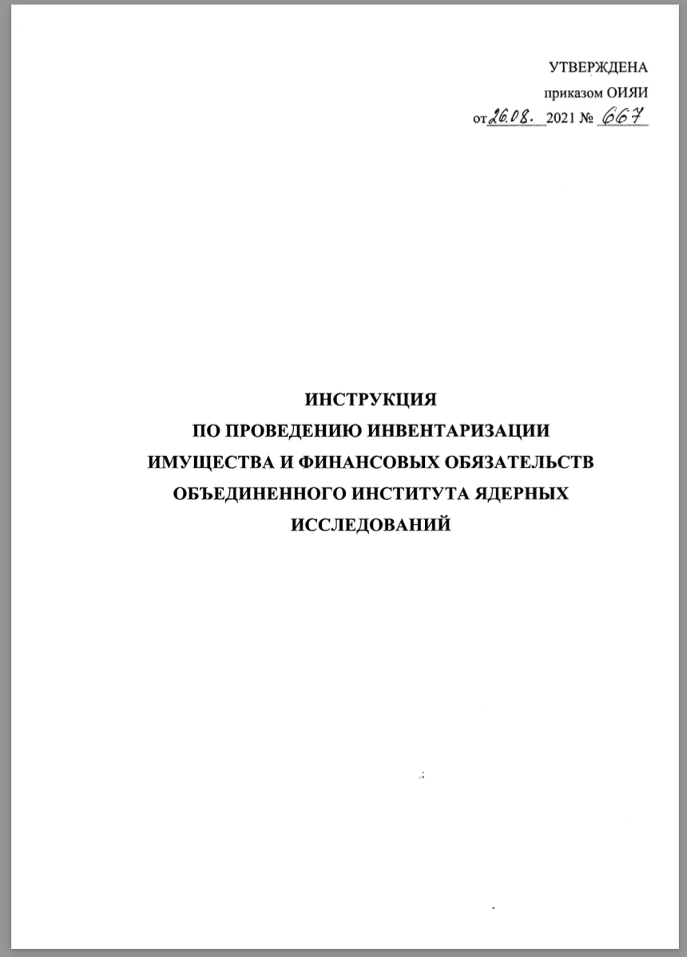
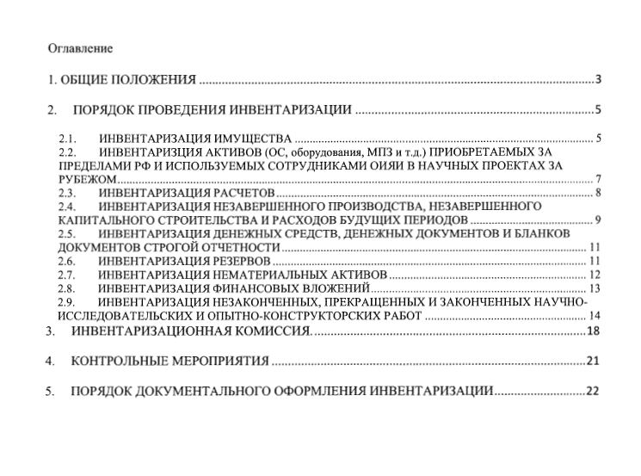
The main local inventory document at JINR

Slide 5
The concept of inventory
(According to the Instructions for conducting an inventory property and financial obligations at JINR)
1.2 Inventory is understood as verification of property and financial obligations by calculating, describing, measuring, evaluating, comparing the data obtained in kind and/or in value with current accounting data in order to identify the actual presence of property, compare the actual presence of property with accounting data and verify the completeness of the reflection of obligations in accounting.
1.3. All property, regardless of its location, and all types of financial obligations are subject to inventory.

Slide 6
Objects to be inventoried
Tangible assets
Intangible assets
For example: programs, inventions, scientific works; trademarks; licenses; know-how (production secrets), etc.
Fixed assets
(more than 100,000 rubles and a long service life)
Assigned a
unique inventory
number
Low-value and fast-wearing items
(less than 100,000 rubles and a shorter period of use)
Assigned an
item number
(one per group of items)
Materials
Raw materials (consumables) for research and development (R&D).
They are transferred: warehouse > division > production

Slide 7
Employees responsible for the values of the Institute
Users
Employees who use goods and materials purchased at the expense of the Institute in their work activities.
They aren’t always materially responsible persons.
Financially responsible persons
Employees directly servicing monetary, commodity values or other property entrusted to them on the basis of a written contract, for which, in case of shortage, they are obliged to compensate the direct damage caused to the employer in full (Articles 242-245 of the Labor Code of the Russian Federation).
Reached the age of 18
Working with cash and material assets
Position of the employee was approved in the List (approved by the resolution of the Ministry of Labor No. 85 dated 12/31/2002)
Written consent

Slide 8
The procedure for conducting an inventory
JINR PROPERTY INVENTORY
8
JINR Director's Order
Preparation
Conducting an inspection
Filling out inventories
Documentation analysis
Summing up the results
Dates, composition members of the Central Inventory Commission, type of inventory (planned/unplanned, complete/selective), etc
Commissions and an inventory schedule are determined, inventories are prepared, goods and materials are sorted and laid out
Counting, weighing, measuring, etc., as well as visual inspection of goods and materials for their further use
Entering of data on the actual availability and location of the goods and materials
Reconciliation of actual availability and accounting data, discrepancies are revealed
The protocols of inventories by departments are reviewed and discussed, the final protocol is drawn up and transmitted to the Director of JINR

Slide 9
preparation
Departments
Accounts department
Financially responsible persons
Issue orders appointing working inventory commissions (financially responsible persons can’t be included in the commission);
Draw up inventory schedules for each Financially responsible person of the department.
Completes the processing of all documents on the arrival and expenditure of valuables and makes appropriate entries in the documents of warehouse and analytical accounting, displaying the balances as of the day of inventory;
Prepares and submits to the chairman of the inventory commissions forms of inventories (acts) for OS, MBP, materials and IA, as well as inventories for valuables that do not belong to JINR, but are in safe custody, etc.
Sort the material values by names, grades, sizes, etc.;
Apply labels with information characterizing values in case of their absence

Slide 10
Conducting an inspection
The availability of valuables is determined by verification of the availability of nomenclature and inventory numbers on the OS and MBP for their identification, counting, weighing, measuring, etc., based on the established appropriate units of measurement, as well as visual inspection for their further use and entering relevant information about the availability and location in the inventory.
The presence of JINR valuables located abroad is necessarily confirmed by photo and video materials.
In addition, the state of the warehouse of the subdivision is checked with mandatory reflection in the protocol of information, including information on the availability of storage facilities, the condition of locks, the presence of bars on windows and other means of protection, the state of storage of material assets, availability of weighing devices, etc.
The inspection is carried out by financially responsible persons and members of the working inventory commissions according to the established schedule.
In case of the absence of more than 20% of the members of the inventory commission, the inspection is not performed.

Slide 11
Filling out inventories
The number of values is indicated, determined by natural counting, weighing, and measuring;
Missing information and technical indicators are entered for objects that are not reflected in the accounting or for which there is no data characterizing them;
Documentary verification confirms the presence of assets that do not have a tangible form (funds in bank accounts, intangible assets, financial investments, etc.).
When identifying valuables that are not suitable for operation and cannot be restored, a Defective Statement and a Withdrawal Actare drawn up, which necessarily indicate the nature and degree of damage, the date of commissioning, as well as the causes and persons responsible for the damage.

Slide 12
Documentation analysis
Inventory lists
The completed inventory lists are transferred by the chairman of the inventory commission to the accounting department.
The Accounts department compares the actual availability of goods and materials with accounting.
In case of discrepancies with accounting data, collation statements are compiled and handed to the chairman of the inventory commission to resolve the discrepancies.
Comparison statements for identified discrepancies
The working inventory commissions sign the collation statement (if there are discrepancies with accounting) and reflect their proposals and conclusions in the protocol.
The protocol provides detailed information about the causes and people responsible for shortages and losses, as well as the formation of surpluses, and indicates the proposed measures of influence in relation to the responsible people.

Slide 13
Summing up the inventory results
Analysis of discrepancies
The inventory commissions of the divisions analyze the identified discrepancies and propose ways to eliminate them, as a result of which minutes of the meeting are drawn up for the department.
Inventory protocols by department
Minutes of meetings of the Working Inventory Commissions of laboratories, divisions and departments of the Institute are submitted for processing to the JINR’s Accounting Department, then the Final Protocol of the Inventory at JINR is compiled and submitted to the Central Inventory Commission for consideration.
The final inventory Protocol for JINR’s director
The final Protocol is approved by the Central Inventory Commission => sent to the JINR Director for signature => sent to responsible persons in laboratories, divisions and departments for execution.

Slide 14
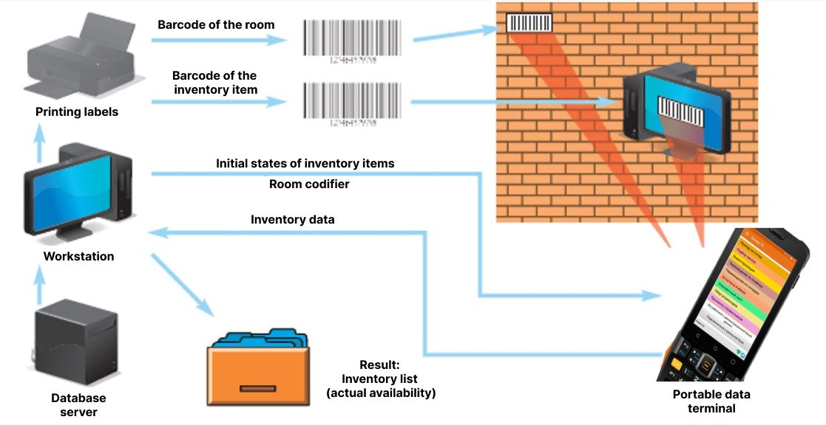
Digitalization of inventory at JINR

Slide 15
conclusion
Inspections by government agencies
Interaction with financially responsible persons
Legislation
Strict state control over funds invested in scientific research, fixed at the legislative level.
Accounting must correspond exactly to the facts in order to avoid discrepancies during inspections by government agencies, and, as a result, legal proceedings.
Financially accountable people must be informed promptly In case of any changes with the goods and materials (transfer, breakdown, etc.), as well as the absence of an inventory or nomenclature number.
Next inventory: October 2024

Slide 16
Thank you for your attention !

