Slide 1
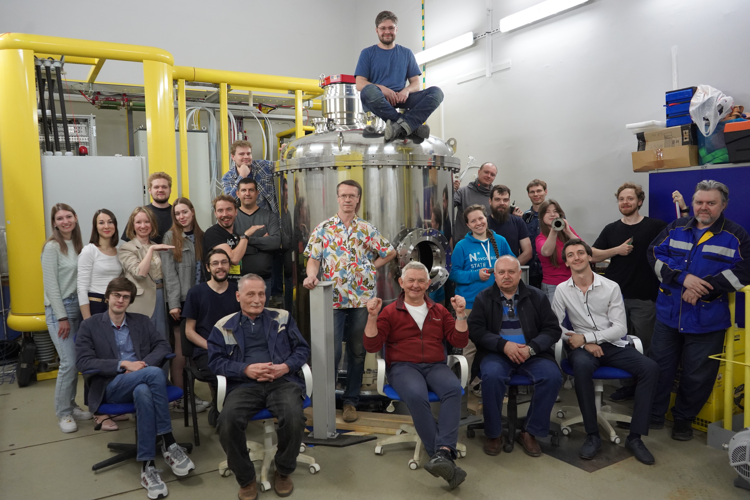
Measurements of nuclear reaction cross-sections at VITA
Sokolova Evgeniia
BINP
JINR Association of Young Scientists and Specialists Conference “Alushta-2024”

Slide 2
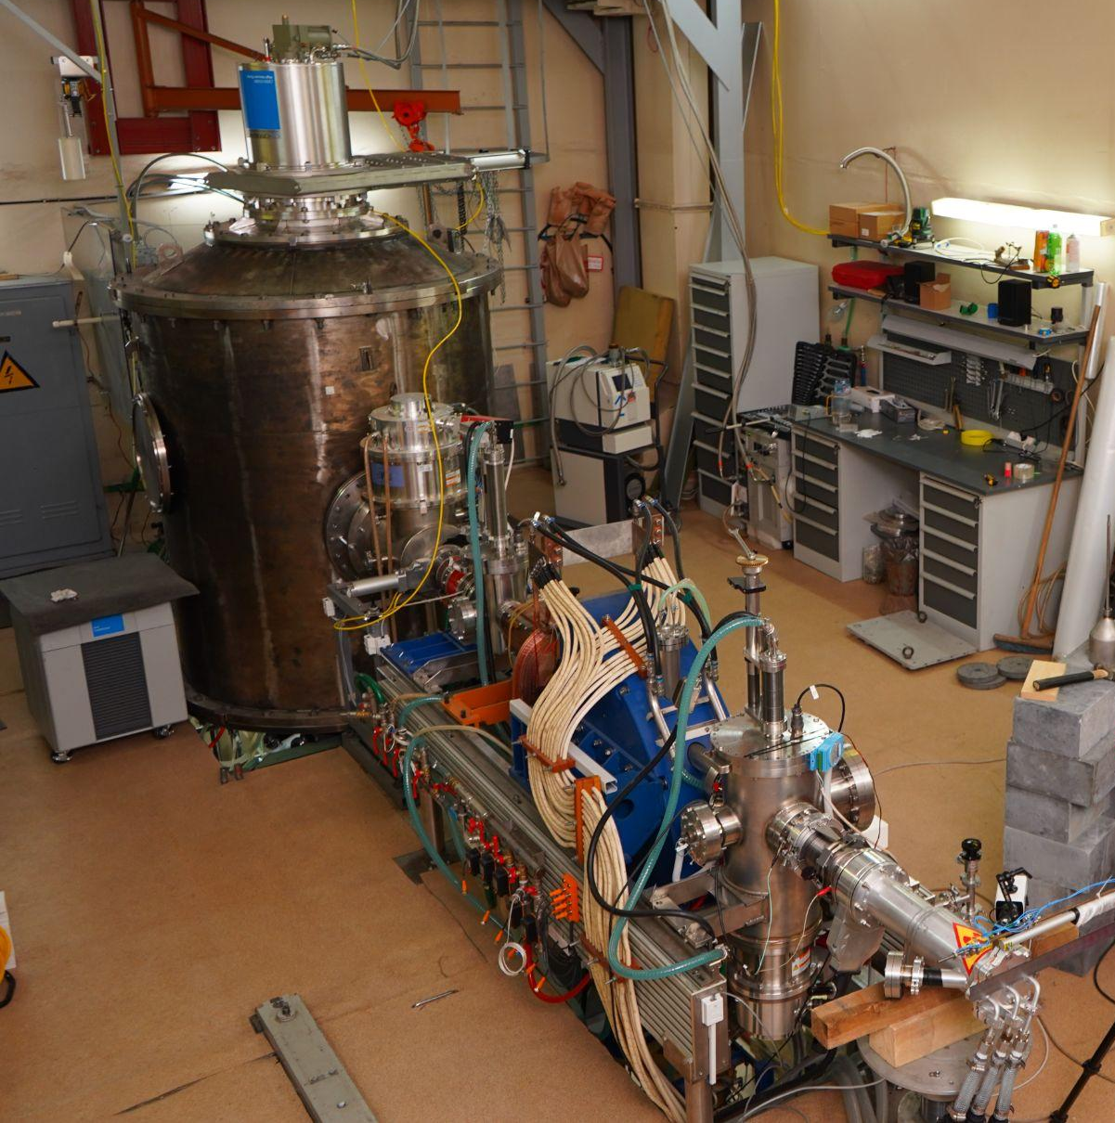
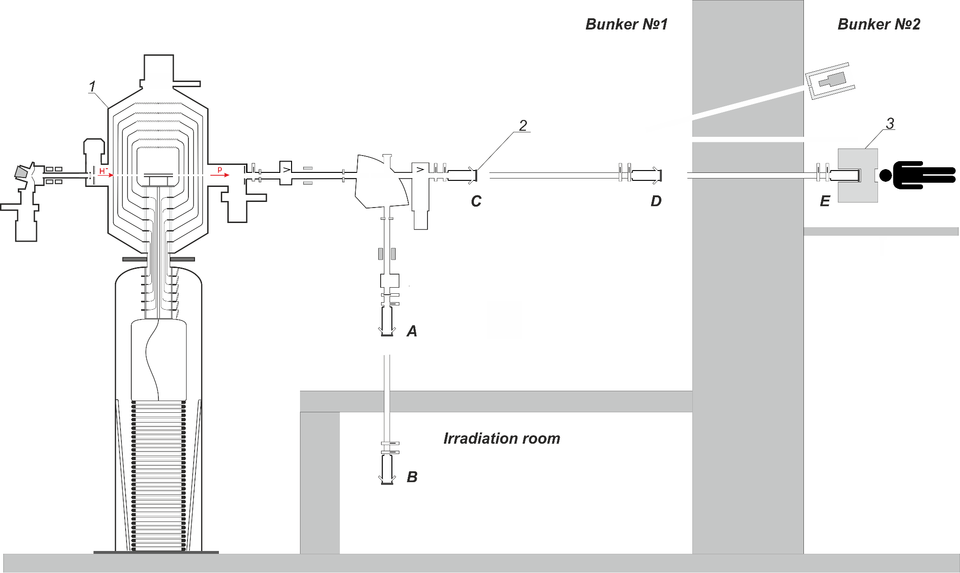
Accelerator based neutron source VITA
1 - vacuum insulated tandem accelerator
2 - target (A, B, C, D, E position)
3 - beam shaping assembly

Slide 3
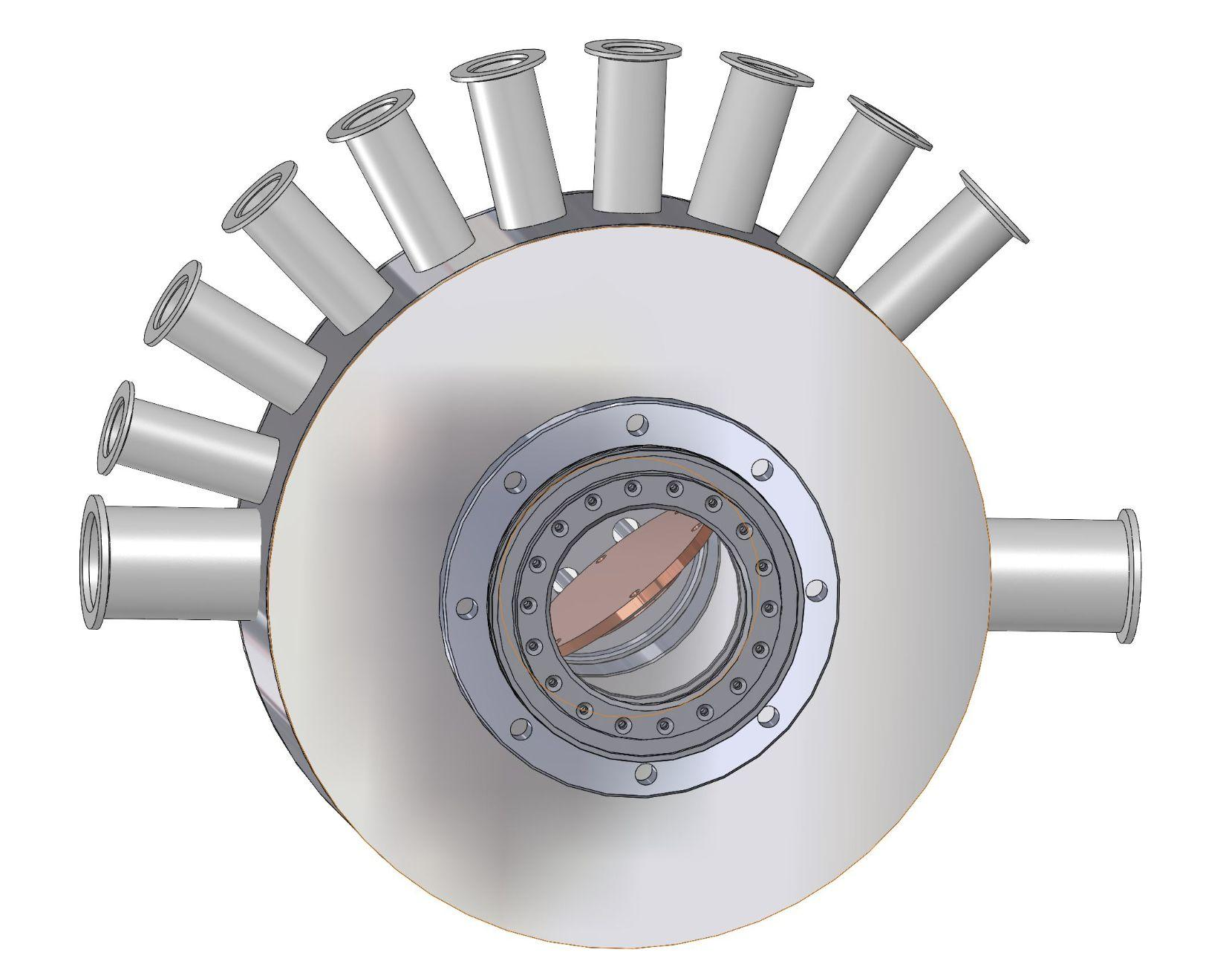
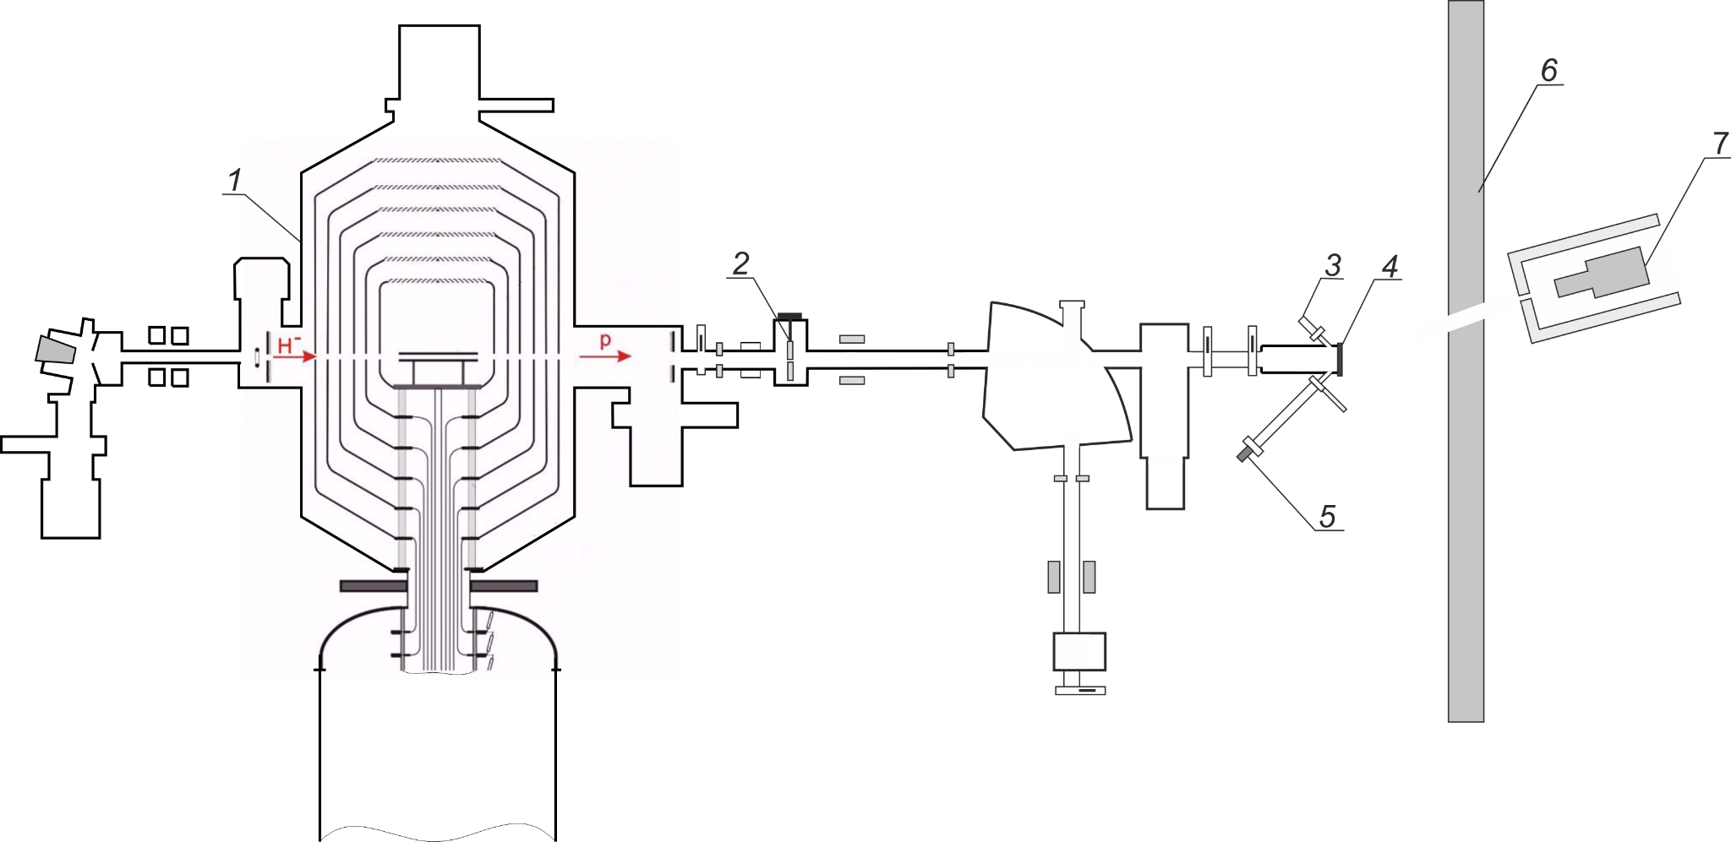
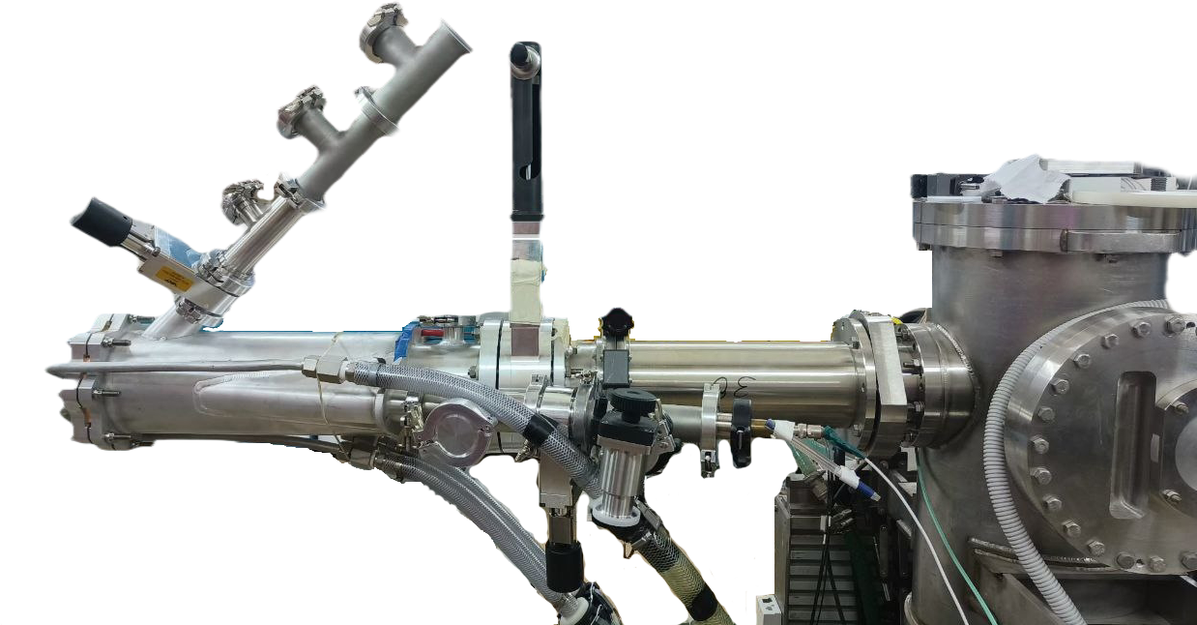
Scheme of the cross-section measuring
15°
168°
1 - vacuum insulated tandem accelerator
2 - collimator
3, 5 - α-spectrometer PDPA-1K (IPTP, Dubna, Russia)
4 - target
6 - radiation shielding
7 - γ-ray spectrometer SEG1KP-IPTP (IPTP, Dubna, Russia)
135°

Slide 4
Li + proton/deuteron
⁷Li(p,n)⁷Be
⁷Li(p,p’g)⁷Li
⁷Li(p,a)⁴He
⁶Li(d,a)⁴He
⁶Li(d,p)⁷Li
⁶Li(d,p)⁷Li*
⁷Li(d,a)⁵He
⁷Li(d,na)⁴He
⁷Li(d,n)⁸Be
Boron neutron capture therapy
Powerful source of fast neutrons

Slide 5
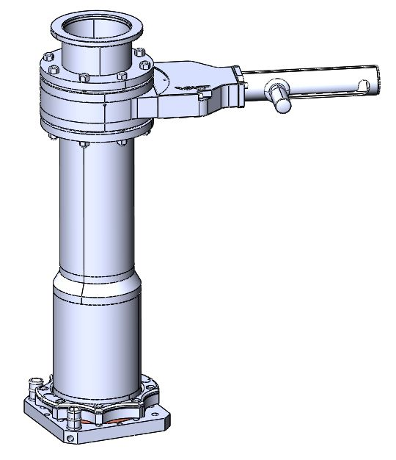
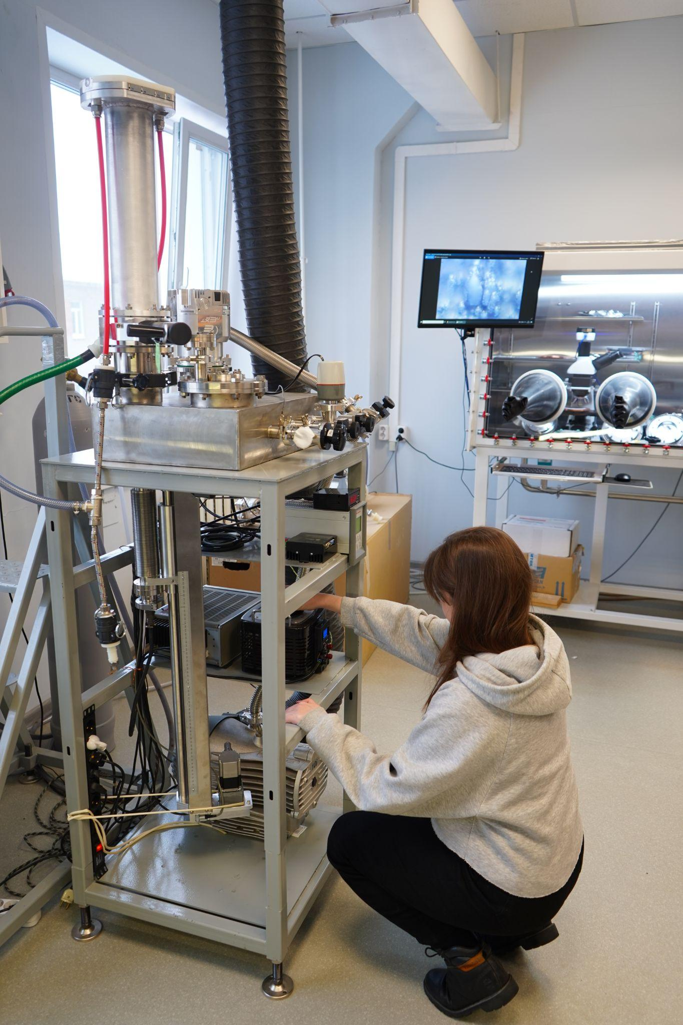
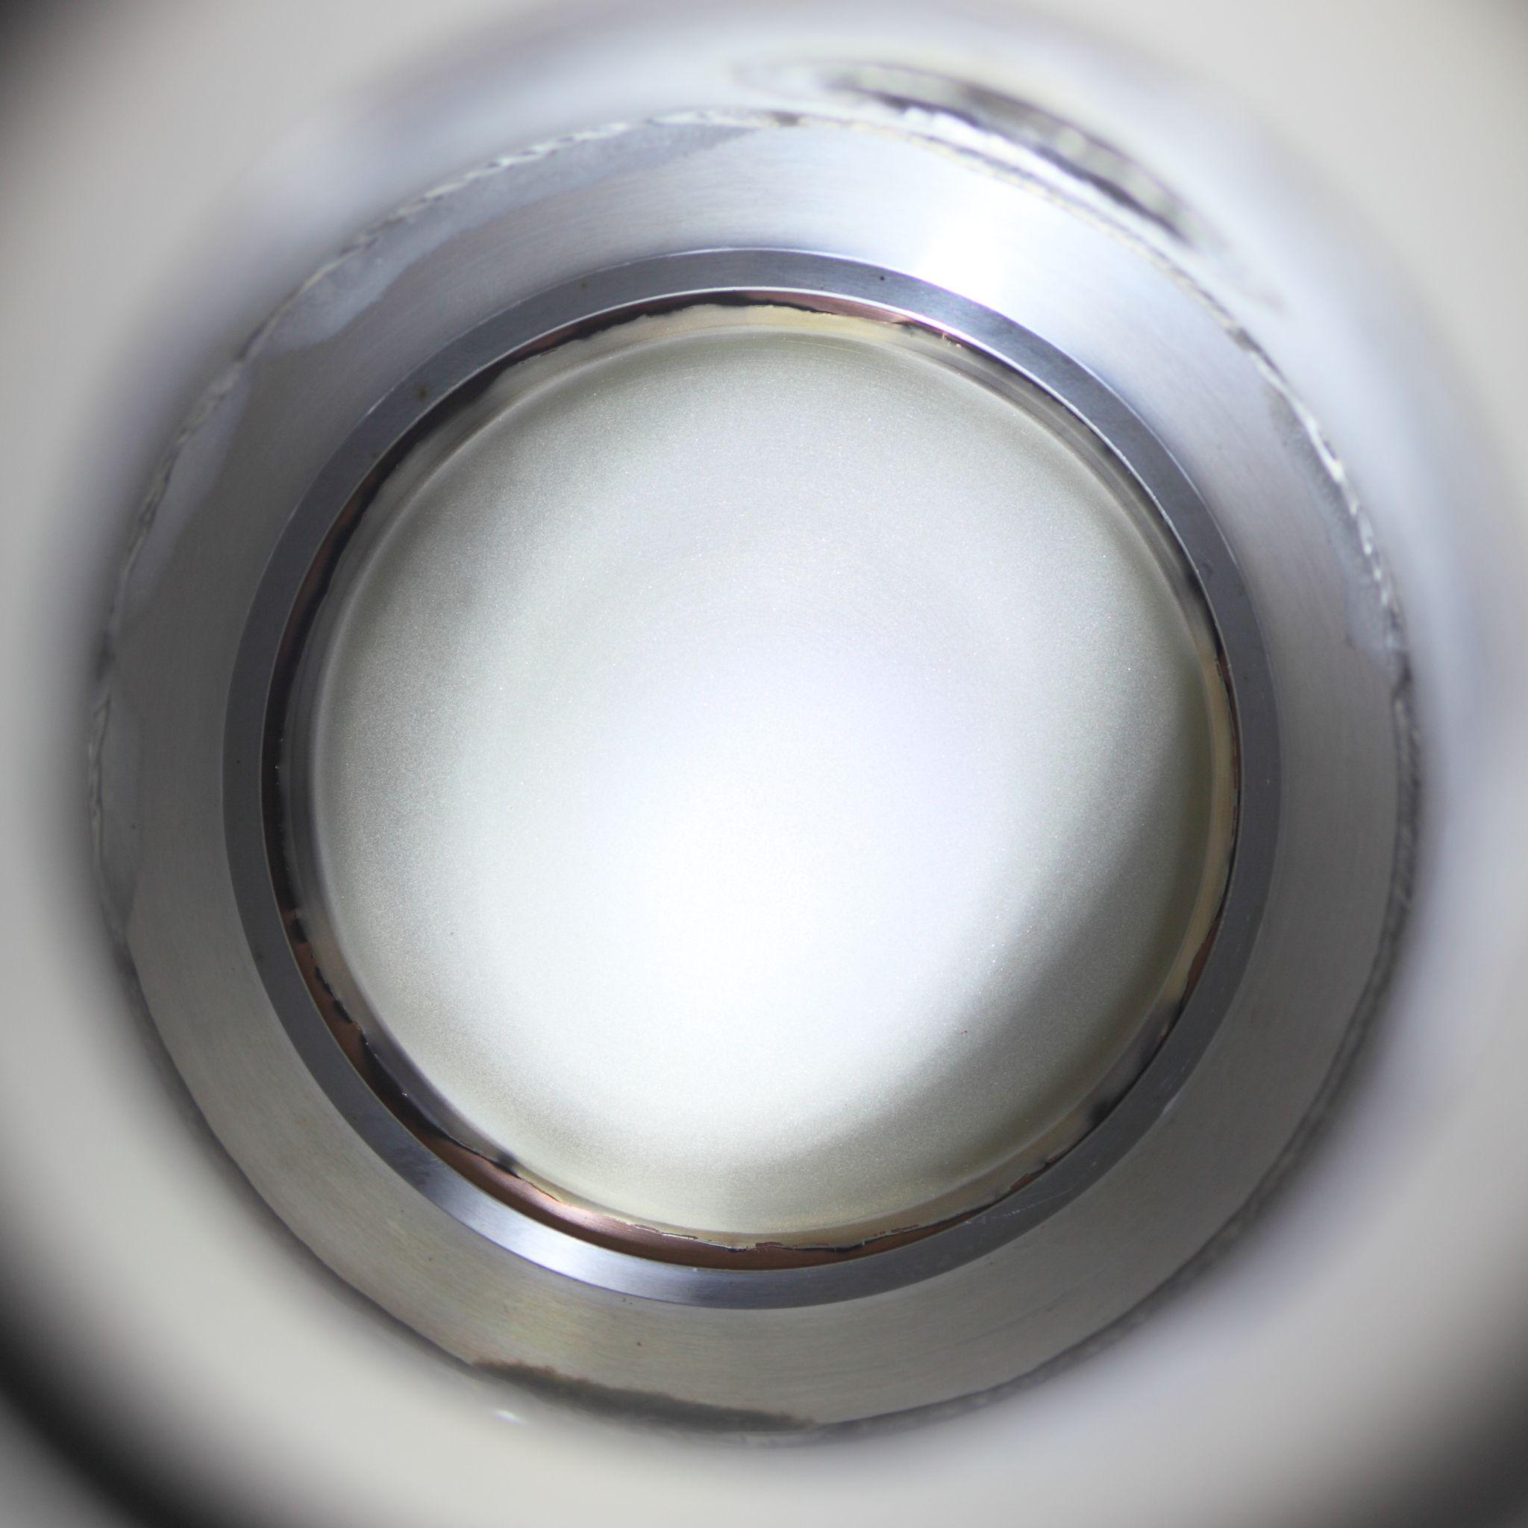
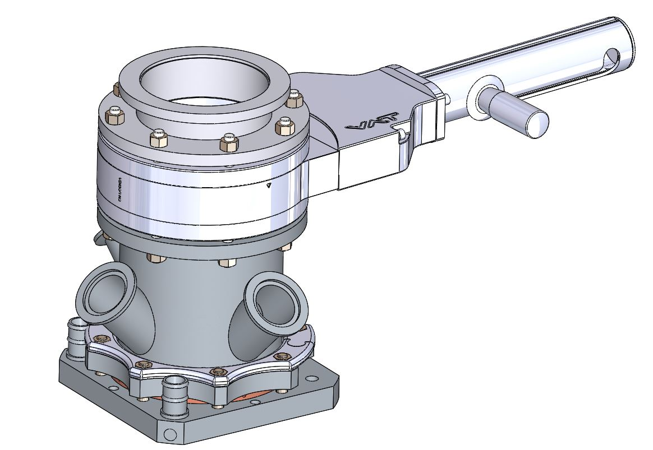
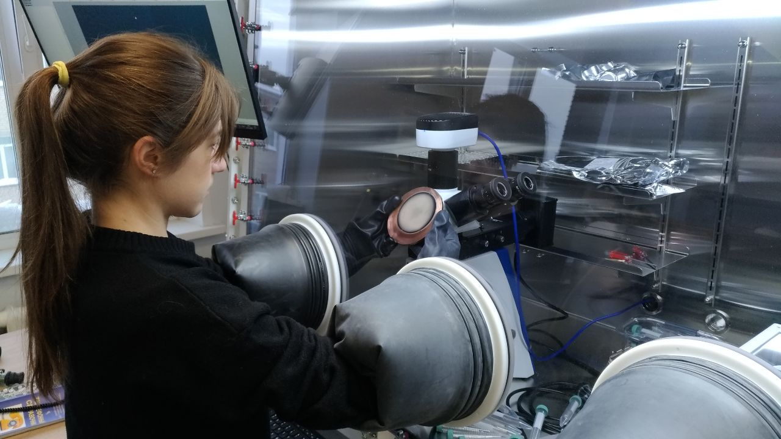
Lithium target manufacturing
Lithium 100 µm
System for thermal vacuum evaporation
Lithium on air
Glove box with argon 99,9998 %

Slide 6
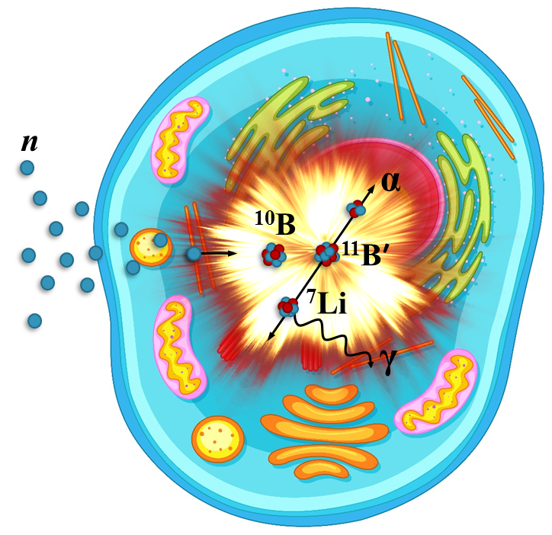
⁷Li(p,n)⁷Be
Neutrons for BNCT (Boron neutron capture therapy)
⁷Li(p,n)⁷Be - is the best reaction for BNCT
only calculations of the neutron yield
the calculations of different groups of scientists vary greatly
Experimental confirmation of neutron yield is needed!

Slide 7
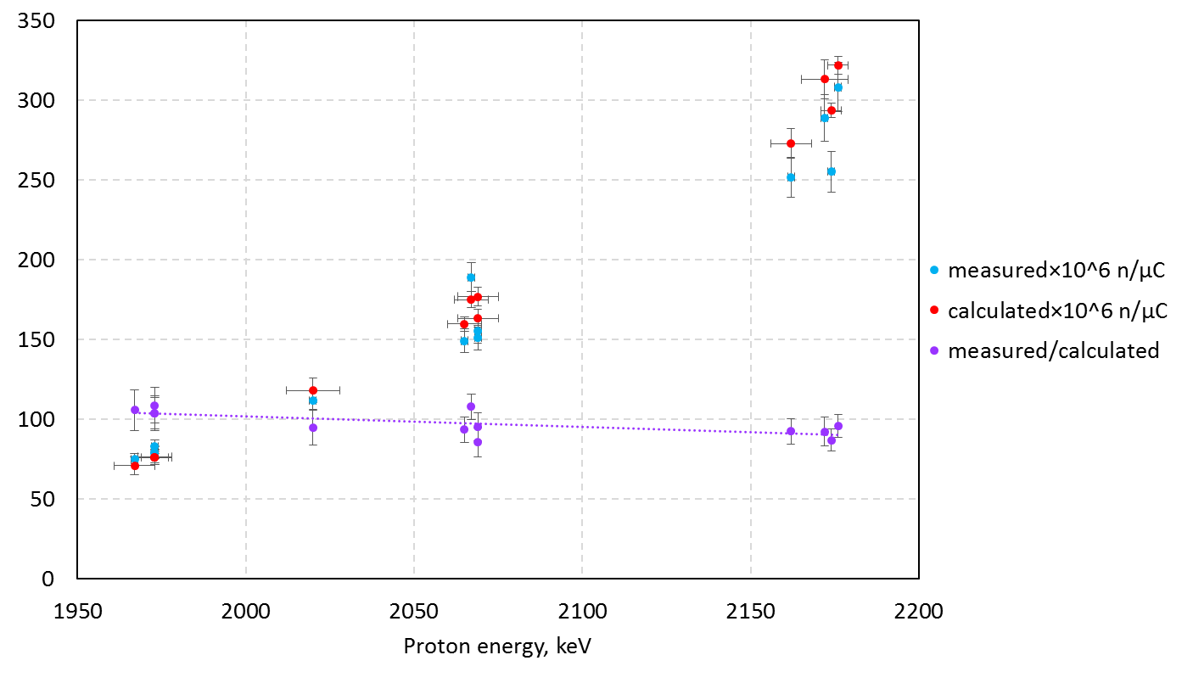
⁷Li(p,n)⁷Be
Neutrons for BNCT (Boron neutron capture therapy)
Precise neutron yield measurements are carried out based on the number of ⁷Be [1]
Result:
The neutron yield from the developed lithium target, measured at proton energies from 2 to 2.2 MeV, agrees with the calculated one with an accuracy of 5%.
[1] M. Bikchurina, et al. Biology 10 (2021) 824.

Slide 8
⁷Li(p,p’γ)⁷Be
γ-quanta in BNCT (Boron neutron capture therapy)
γ-quanta with an energy of 478 keV in the reaction ⁷Li(p,p‘γ)⁷Li are generated from the lithium target
The 478 keV γ-quanta yield is comparable to the neutron yield
γ-quanta provide an undesirable dose of gamma-radiation and must be taken into account when planning therapy
Data on γ-quanta yield are scarce and contradictory
The measurement of γ-quanta yield is needed!

Slide 9
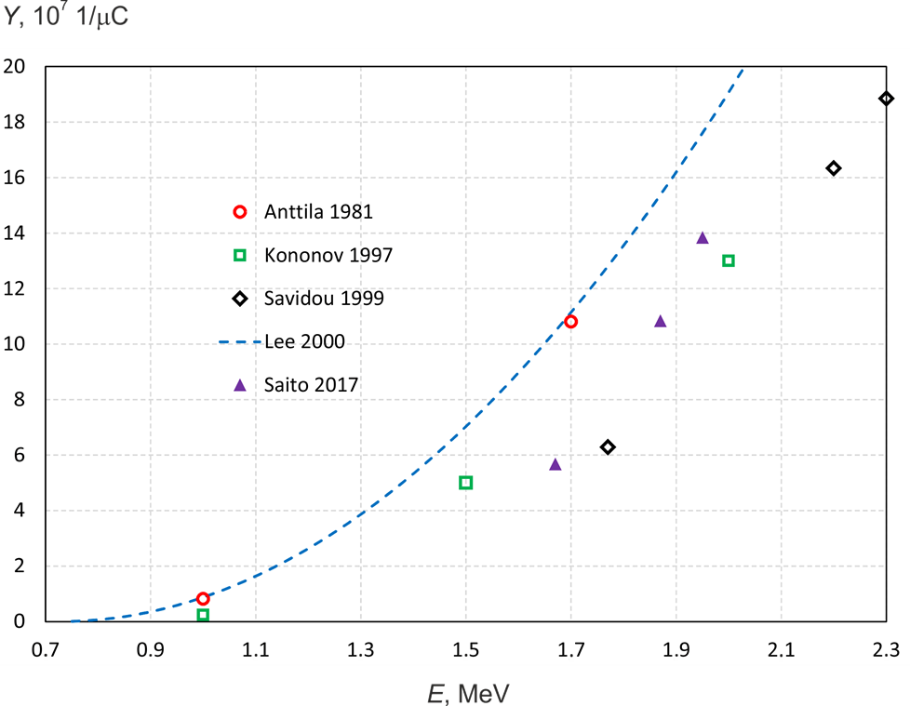
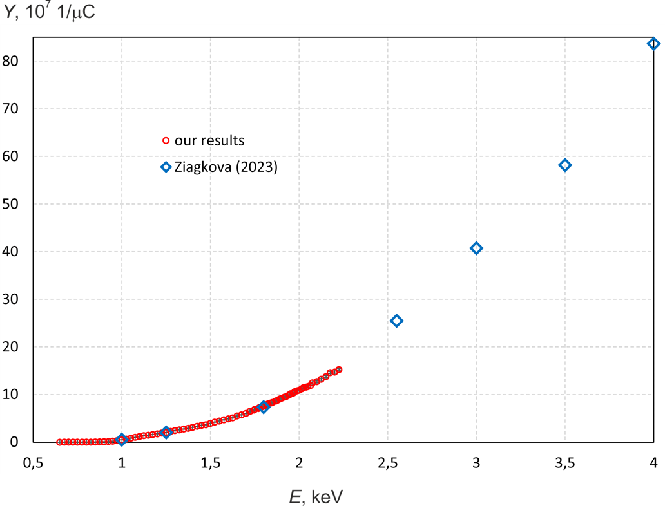
⁷Li(p,p’γ)⁷Be
γ-quanta yield
NIM B 502 (2021) 85
IBANDL
EXFOR
E, MeV

Slide 10
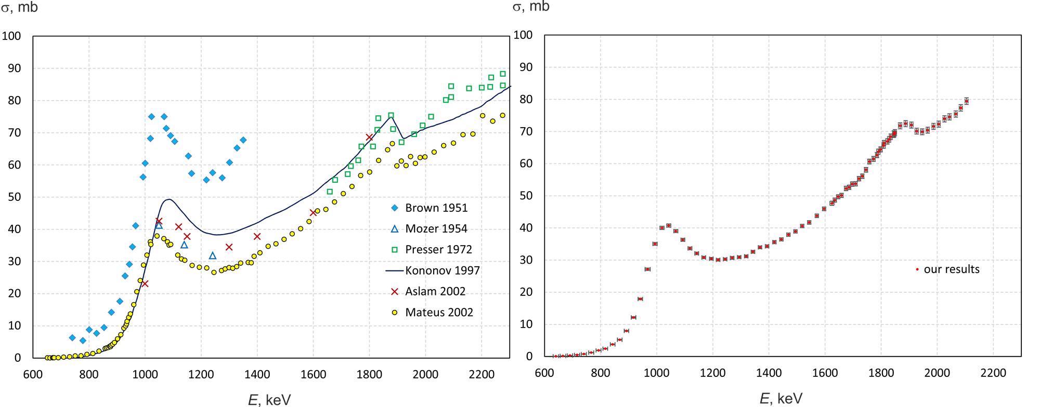
⁷Li(p,p’γ)⁷Be
cross-section of the reaction
NIM B 502 (2021) 85
IBANDL
EXFOR

Slide 11
B + proton/deuteron
¹¹B(p,a₀)⁸Be
¹¹B(p,a₁)⁸Be*
¹⁰B(d,a )⁸Be ¹⁰B(d,p)¹¹B
¹¹B(d,a)⁹Be ¹¹B(d,p)¹²B
3a Aneutronic fusion reaction
Technological applications

Slide 12
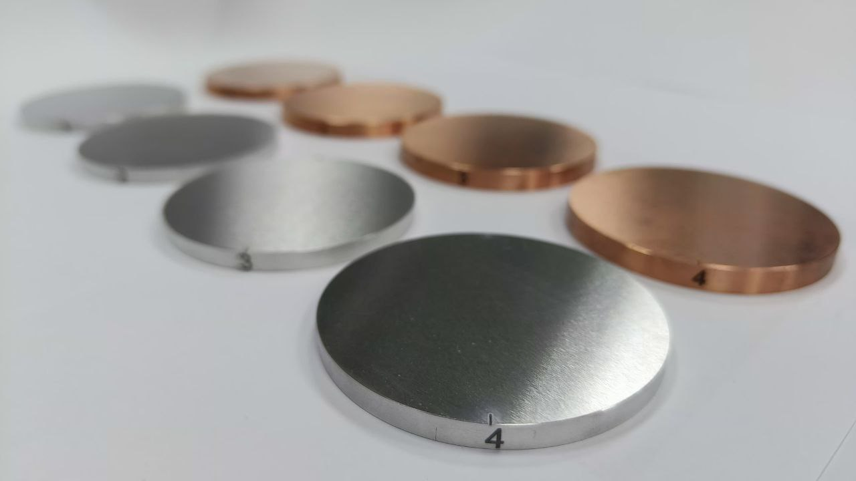
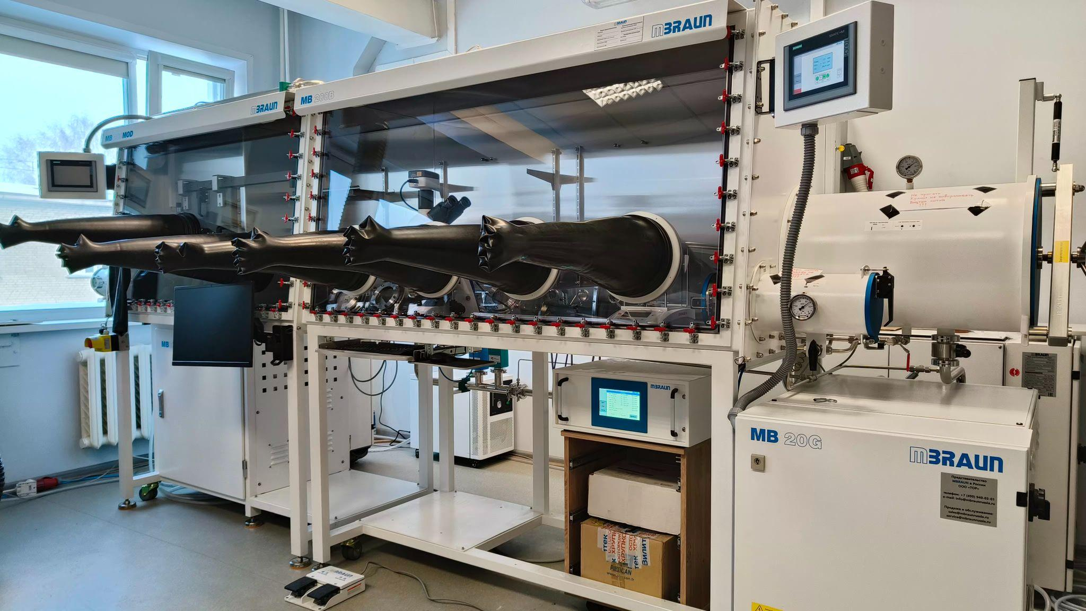
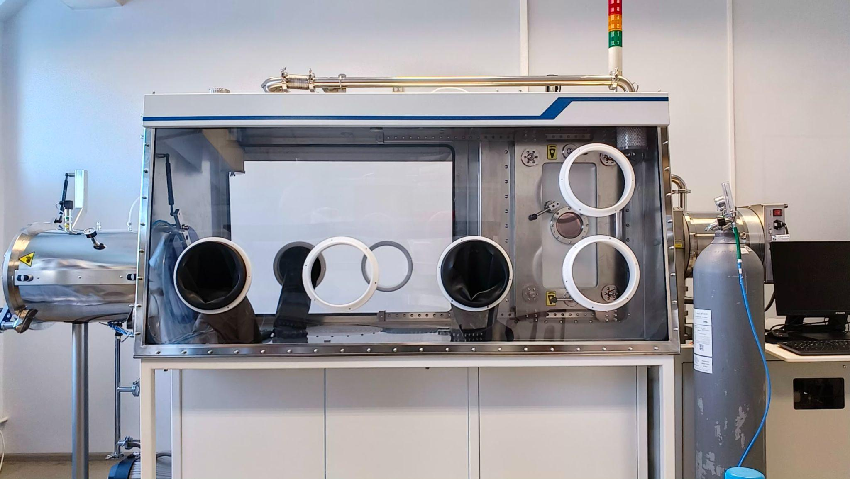
Boron target manufacturing
Laboratory of Plasma Sources HCEI SB RAS
(thanks to Oks E.M., Nikolaev A.G., Yushkov G.Yu.)
Boron 1 µm
Glove box with magnetron sputtering system (Mbraun, Germany)
Glove box with magnetron sputtering system
(Izovac, Belarus)

Slide 13
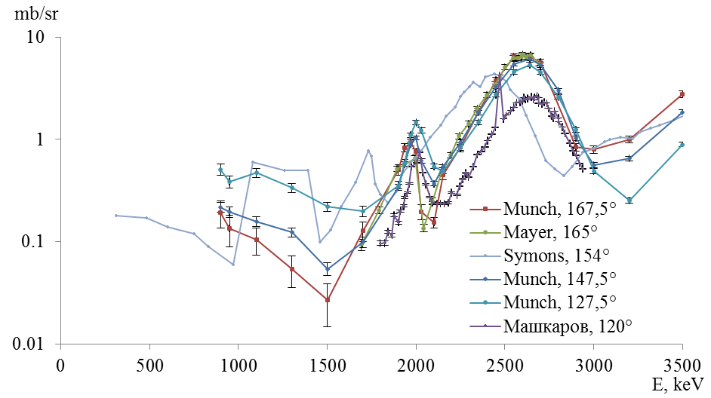
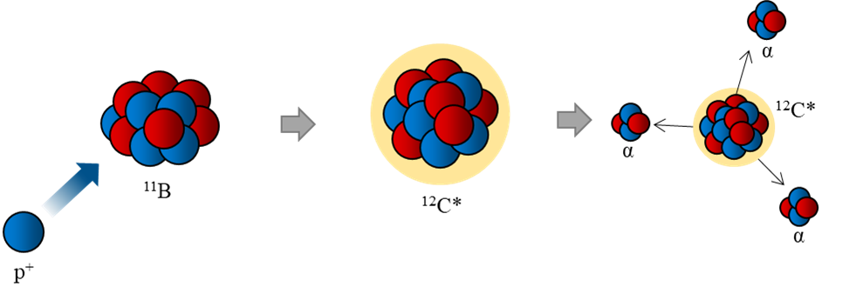
¹¹B(p,a)aa
Reaction mechanism and cross-section
¹¹B + p → ¹²C* → a + a +a + 8.681 MeV
¹¹B + p → ¹²C* → a₀ + ⁸Be + 8.587 MeV
⁸Be → a₀₁ + a₀₂ + 0.094 MeV
¹¹B + p → ¹²C* → a₁ + ⁸Be* + 5.557 MeV
⁸Be → a₁₁ + a₁₂ + 3.124 MeV

Slide 14
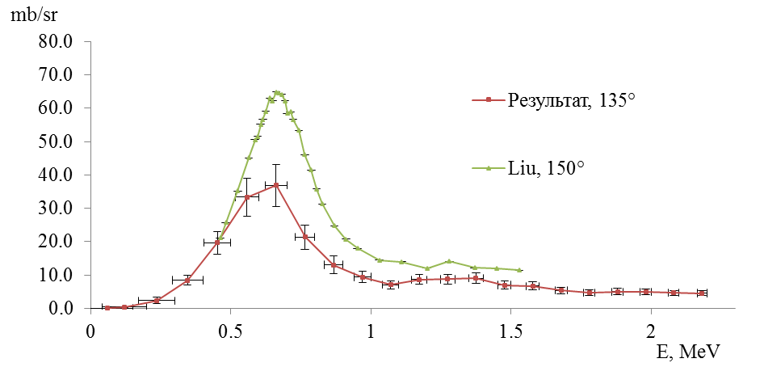
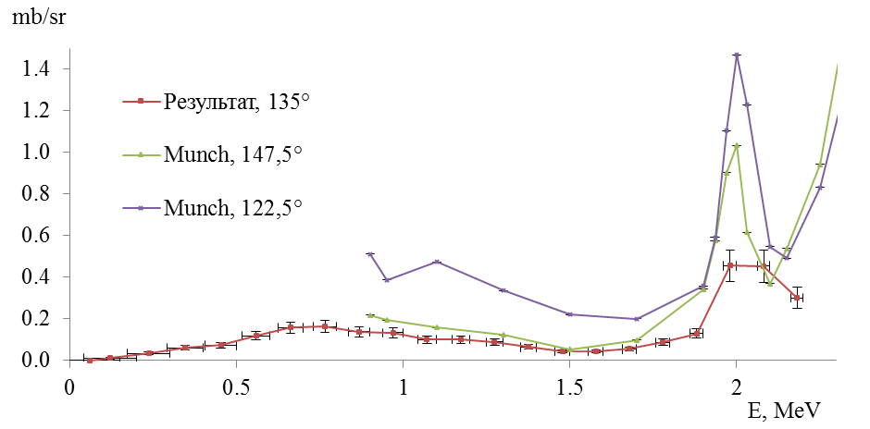
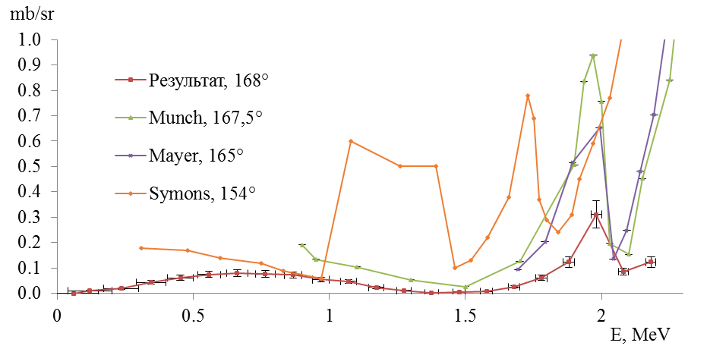
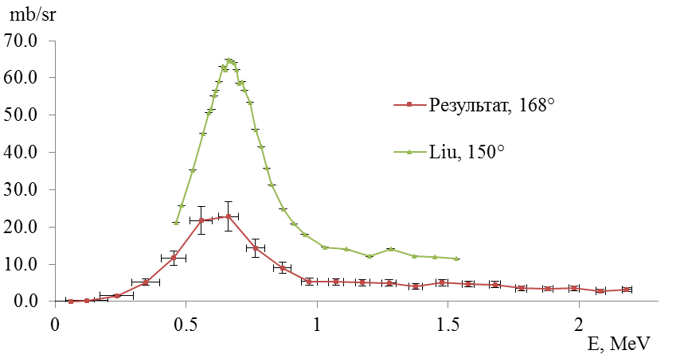
¹¹B(p,α₀)⁸Be
¹¹B(p,α₁)⁸Be*

Slide 15
Conclusion
The cross-sections of 19 nuclear reactions were measured with high accuracy at VITA:
⁷Li(p,n)⁷Be, ⁷Li(p,p’g)⁷Li, ⁷Li(p,a)⁴He, ⁶Li(d,a)⁴He, ⁶Li(d,p)⁷Li, ⁶Li(d,p)⁷Li*, ⁷Li(d,a)⁵He, ⁷Li(d,na)⁴He, ⁷Li(d,n)⁸Be [1, 2];
¹¹B(p,a₀)⁸Be, ¹¹B(p,a₁)⁸Be* [3]; ¹⁰B(d,a)⁸Be, ¹⁰B(d,p)¹¹B, ¹¹B(d,a)⁹Be, ¹¹B(d,p)¹²B.
Cross-sections of the reactions ⁷Li(p,p'g)⁷Li [4] and ⁷Li(p,a)⁴He [5] are included in the IBANDL and EXFOR nuclear reaction databases maintained by the IAEA.
[1] Taskaev et al. NIM B (2024) - sent for publication 02.24, after corrections and responses to comments 05.24
[2] Meshchaninov et al. Physics of Atomic Nuclei (2024) - sent for publication 02.24
[3] Taskaev et al. Physics of Atomic Nuclei (2024) - sent for publication 02.24
[4] Taskaev et al. NIM B 502 (2021) 85-94
[5] Taskaev et al. NIM B 525 (2022) 55-61
Thank you for attention!

