Slide 1
Algorithm for matching the amplitude of the accelerating voltage with the growth rate of the magnetic field
JINR, Accelerator Department
Speaker: Volodin A.A.

Slide 2
Introduction
The preparation of the injection complex NICA for injection into the collider requires an increase in the beam intensity at the Nuclotron exit. This will require an optimization of тany systems of the complex, including a significant losses reduction associated with RF systems.
Four commissioning runs were conducted, during which the Booster's accelerating stations worked in accordance with the specification. The experience allows us to choose the optimal strategy for the further development of RF systems. One of the main directions is to minimize losses during acceleration and beam bypasses. The solution of the task requires a matching of the acceleration rate with the capabilities of existing RF systems.

Slide 3
The acceleration algorithm in the previously conducted commissioning sessions consisted of the following steps:
1. A beam of ions with a kinetic energy of 3.2 MeV/n injected into the Booster in a constant magnetic field. The accelerating voltage is off.
2. After the beam is ungrouped, the accelerating voltage turns on at the 5th harmonic and increases adiabatically causing the beam to be grouped.
3. The magnetic field increases in accordance with the specified program, turning into a linear increase in the magnitude of the field. The amplitude of the accelerating voltage begins to change in accordance with the dependencies determined in advance, and the beam accelerates.
4. When the intermediate "table" of the magnetic field corresponding to the energy of 65 MeV/n is reached, the accelerating voltage is adiabatically switched off, and the beam is ungrouped. At the end of the "table", the beam is grouped again, but now at the first harmonic and accelerated to the energy of transfer to the Nuclotron.

Slide 4
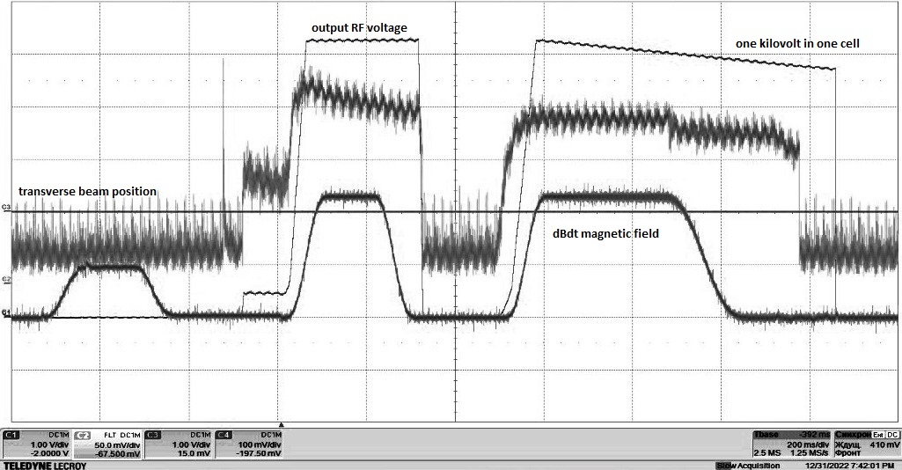
The law of variation of the amplitude of the accelerating voltage across the gap
Fig.1. Time dependence of the accelerating voltage, the derivative of the magnetic field and the beam transverse position sensor. The price of dividing along the time axis is 200 ms. Vertically - Volts

Slide 5
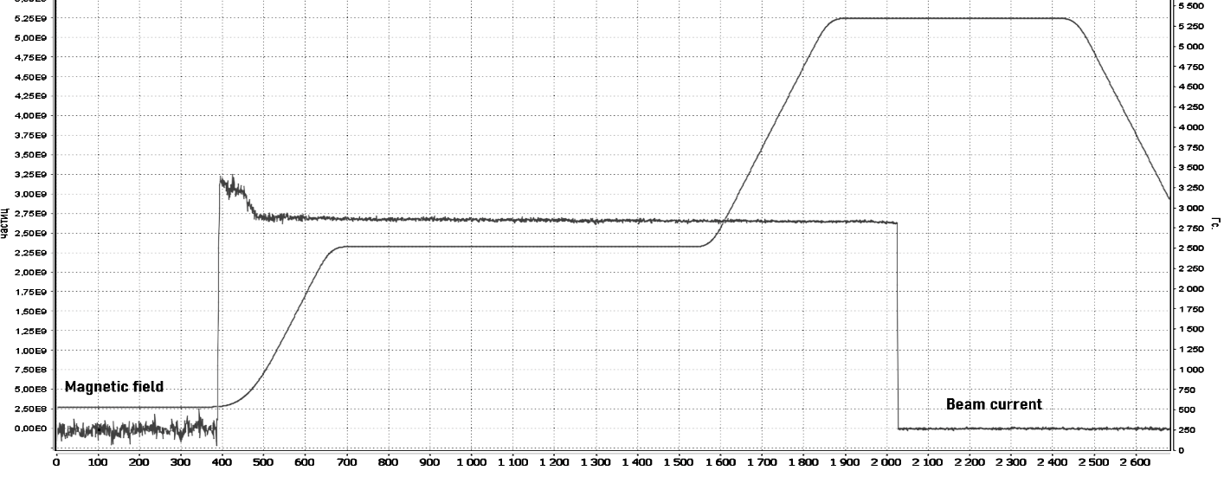
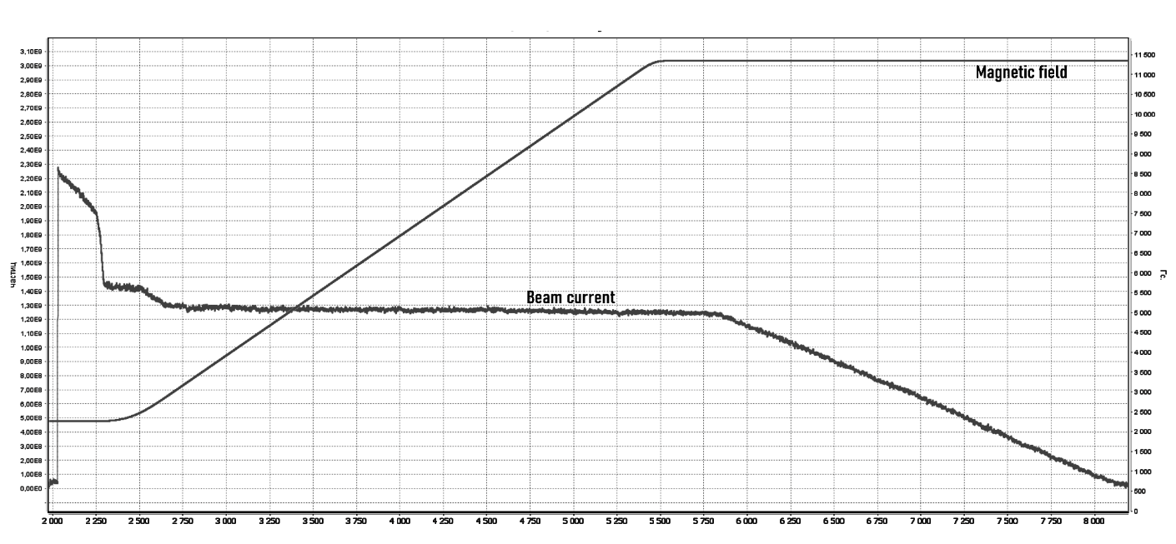
The operation of Booster acceleration stations according to the above was accompanied by particle losses during the transition from the "table" to the growing magnetic field, which amounted to up to 25% of the initial intensity. The most likely cause of the losses is a decrease in the longitudinal acceptance due to the non-optimal law of increasing the voltage amplitude during the transition to beam acceleration.
Fig.2. Beam losses during acceleration

Slide 6
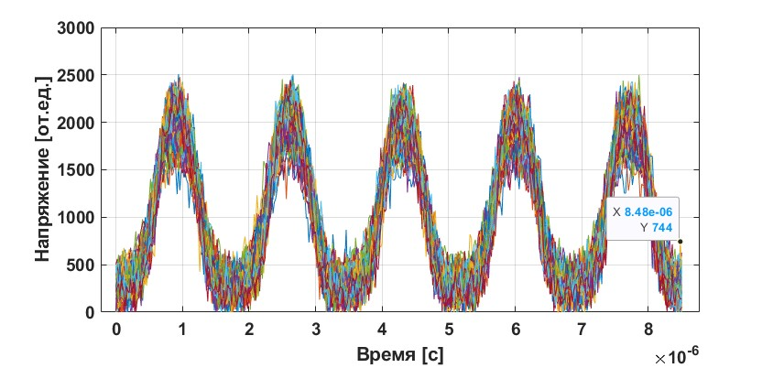
Analysis of experimental results
The dependence of intensity on time during beam circulation on the injection table was measured using a fast current transformer (Fig. 3). When sampling the obtained data, synchronization was realized using an RF reference signal, and the time of one revolution is 8.5 microseconds. The figure shows the dependencies superimposed on each other, obtained over several consecutive turns.
Fig.3 Signals from a current transformer for one revolution

Slide 7
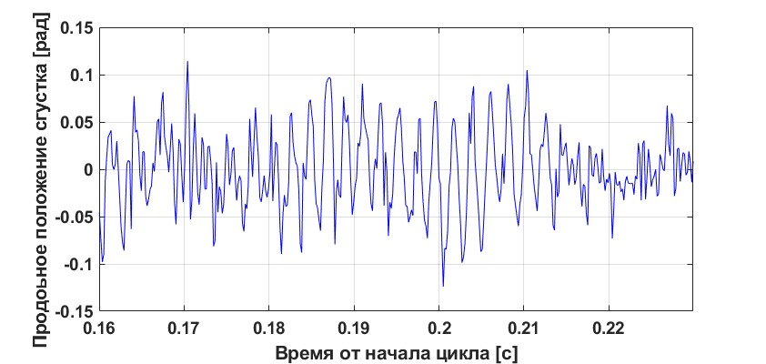
By selecting any of the bunches, it is possible to obtain the dependence of the position of its center of gravity relative to the HF phase on time for several tens of thousands of revolutions (Fig. 3). As can be seen from the figure, small errors in the grouping of the beam lead to small synchrotron oscillations of its center.
$$Ω_{s}=\sqrt{\frac{q_{rf} eZ V_{rf} \left|η\right| cosφ_{S}}{2{πA}_{m} v_{s}{ p}_{s}}} \left(1\right)$$
The FFT of the signal in Fig. 3 gives the frequency of synchrotron oscillations Ωs=430 Hz. The effective voltage calculated according to (1) is approximately 600 V.
Fig.4. Dependence of the position of the center of gravity of the bunch on time

Slide 8
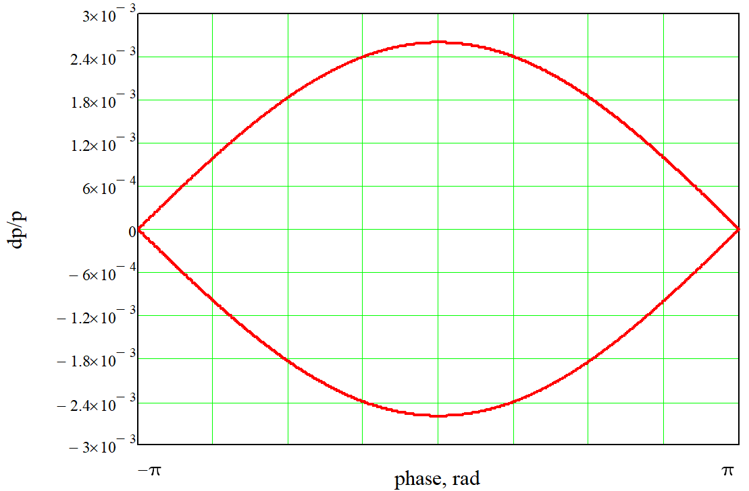
The voltage value can be used to calculate the longitudinal acceptance of the RF Booster system using the Hamiltonian:
$$H\left(∆p, φ\right)=\frac{q_{rf}η frq }{2 p_{S}} ∆p^{2}−Ze\frac{V_{rf}}{2πρ }\left(cosφ − φsinφ_{s}\right) \left(2\right)$$
Fig.5. separatrix for the 1st harmonic of the RF with a voltage of 600 V.

Slide 9
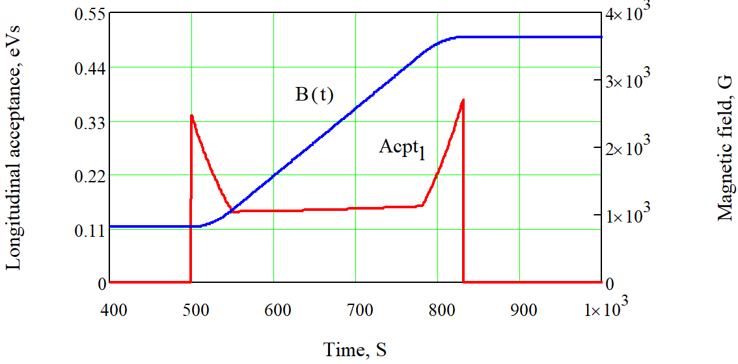
The area inside the separatrix calculated on the phase plane (ΔE, Δt) is usually used as the longitudinal acceptance, which in our case is 0.3 eV·s.
As the beam accelerates and, accordingly, the magnetic field increases, the phase extent of the separatrix decreases, if the RF amplitude does not increase by a sufficient amount, a decrease in the longitudinal acceptance may occur, which, with a sufficiently large longitudinal emittance, may lead to a loss of beam intensity.
Fig.5. The dependence of the longitudinal acceptance and the magnetic field on time

Slide 10
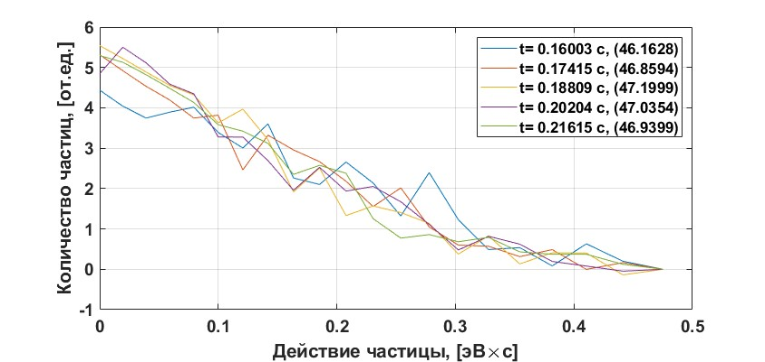
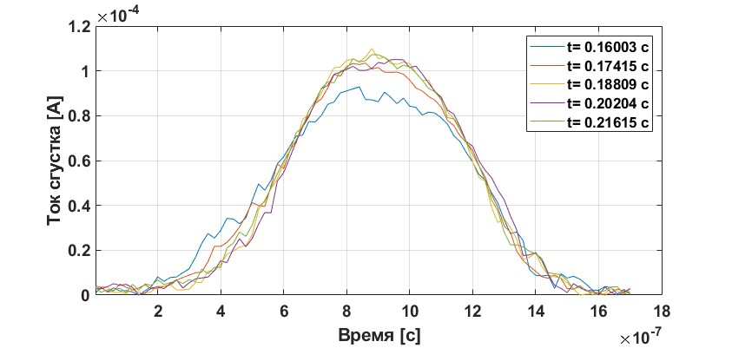
Fig.6
Fig.8
The RMS longitudinal emittance in accordance with (Fig. 8) is estimated as εrms = 0.21 eV·s, and the "tails" of the distribution stretch to about 0.4 eV·s.
The obtained estimates show that after the completion of the adiabatic grouping of the beam, the particles fill the entire separatrix, and the inconsistency of the increase in the amplitude of the accelerating voltage with the magnetic field, which led to a decrease in acceptance, was the cause of particle losses.
Fig.7

Slide 11
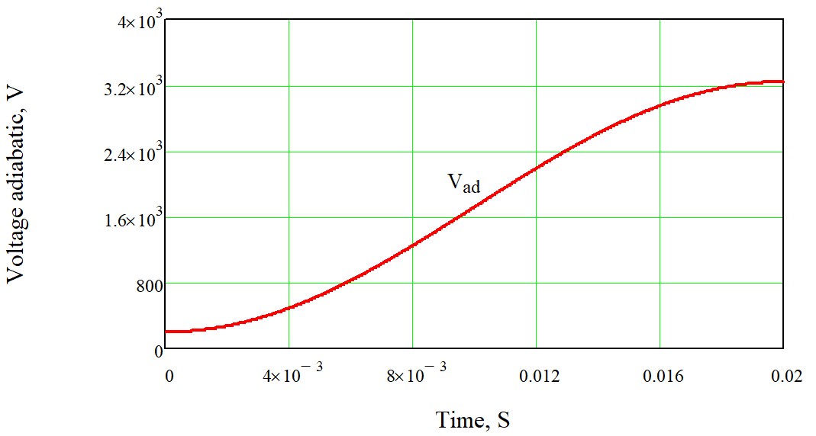
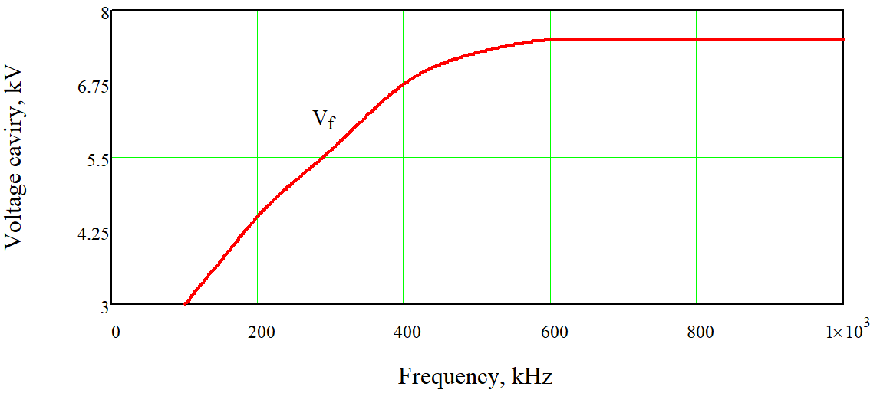
The matching algorithm
The algorithm calculates the value of the magnetic field depending on the amplitude of the accelerating voltage so that acceleration is performed at the maximum rate and minimum losses.
The program builds a function for amplitude of the RF voltage. The function consists of two parts Vad and Vf (Fig. 9).

Slide 12
The algorithm, taking into account the law of variation of the amplitude of the RF voltage Vac (t), performs the following iterations every n turns:
$$v=\frac{c \sqrt{{\left(E_{rest}+E\right)}^{2}−E_{rest}^{2} }}{E_{rest}+E}$$
$$t=\frac{nP}{v}$$
$$f=\frac{v}{P}$$
$$∆E=n\frac{Z}{A_{m}}V_{acc}\left(t\right)sinφ$$
To meet the conditions of the maximum acceleration rate the value of the longitudinal acceptance was constancy during acceleration. The value of sinφ was calculated from the function below.
$$f\left(sinφ,γ,V_{rf},ε\right)≈\frac{8}{π}\frac{E_{m }P}{c}\sqrt{\frac{ZV_{rf}γ}{2πA_{m}q_{rf}\left|η\right|E_{m}}}\frac{1−sinφ}{{\left(1+\frac{sinφ}{2}\right)}^{2}}−ε (2)$$
$$B=\frac{A_{m}}{Z}\sqrt{\frac{2E_{rest}E+E^{2}}{R_{s}^{2}c^{2} }}$$

Slide 13
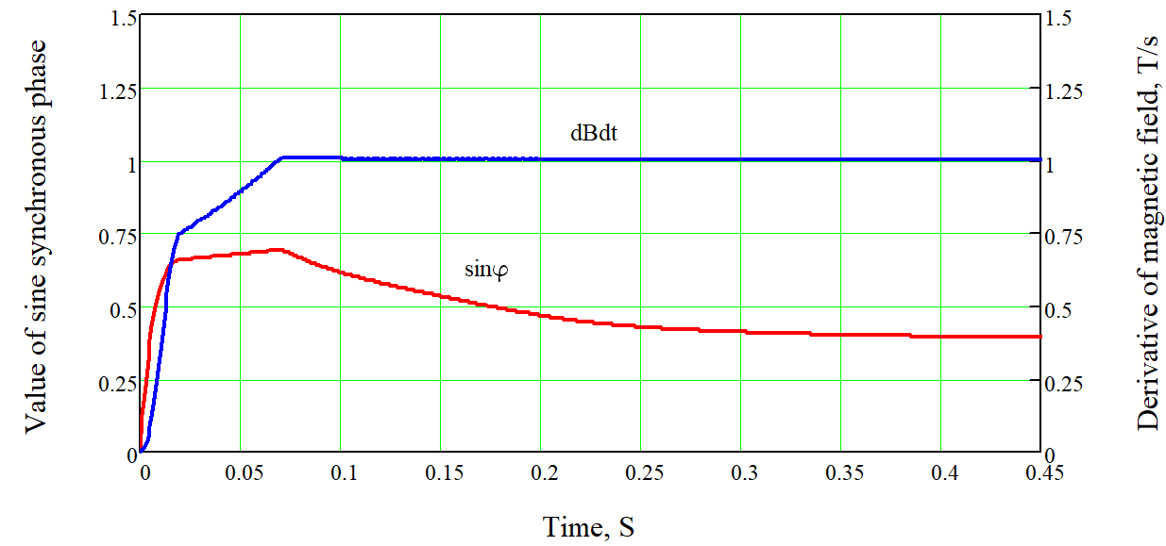
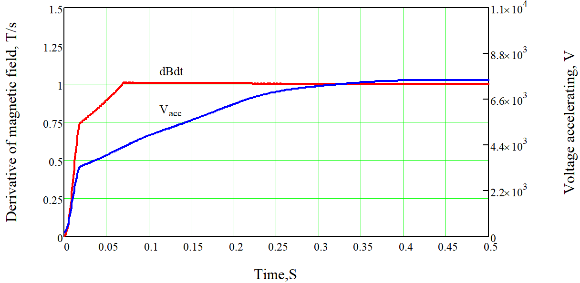
Thus, based on the algorithm presented above, a program has been developed that generates the following dependencies:
the magnetic field of time
2. the derivative of the magnetic field from time
3. The value of the synchronous phase sine from time
The generated laws of change will be used to set the magnetic field.

Slide 14
Conclusion
To improve the efficiency of RF systems, an algorithm for matching the accelerating voltage with the growth rate of the magnetic field has been developed. Based on the algorithm, software has been written that transmits the generated dependencies to the control nodes to set the magnetic field.

