Slide 1
Radioactive and stable enriched isotopes for SHE factory: Application as targets and substances in ECR -sources
JINR Association of Young Scientists and Specialists Conference “Alushta-2024”
Aleksandr Bodrov, Aleksei Sabel’nikov, Yurii Albin, Daler Abdusamadzoda, Nikolay Aksenov
FLNR JINR

Slide 2
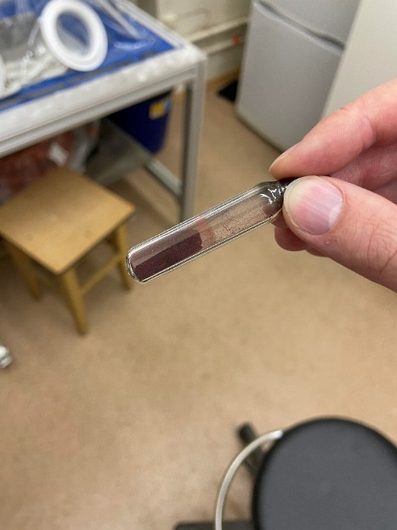
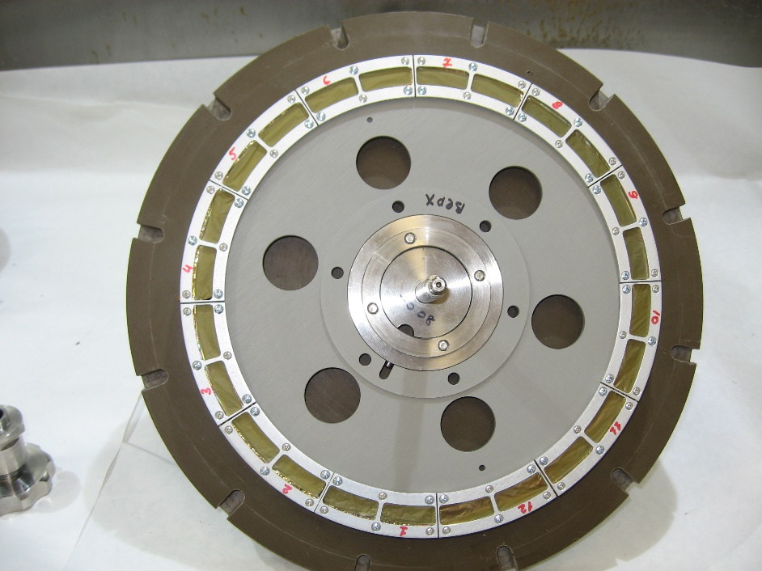
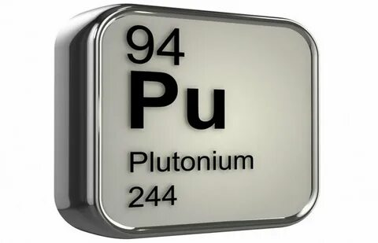
Relevance
For synthesis of SHE nuclei it is necessary to produce more massive and low degradable targets from U, Pu, Am, Cm, Bk, Cf
For intensive beams on ECR-source we should have a high pure metal-organic compounds (⁵⁴Cr - chromocene and ⁵⁰Ti - titanocene)
Developing of regeneration and separation techniques to renew target and ion-source material

Slide 3
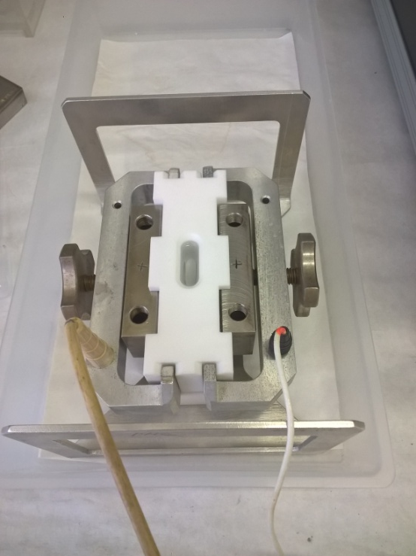
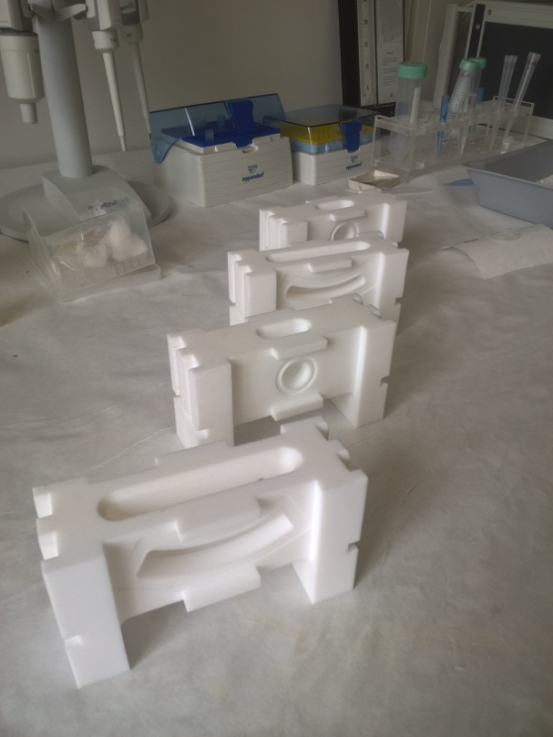
Target production
Clamping screw
Cathode
―
Backing foil
Rubber gasket
Manufacturing conditions
Backing foil – 1,5 μm Ti
Organic solutions– isopropanol/isobutanol
Solutions of Am(NO₃)₃/ Pu(NO₃)₄ UO₂(NO₃)₂/Th(NO₃)₄ are added in isopropanol
Bake backing foil with material for 20 min under 400°C every layer
thermostat
Anode
+
PTFE chamber
PTFE cell in assembly
PTFE cell of different shape

Slide 4
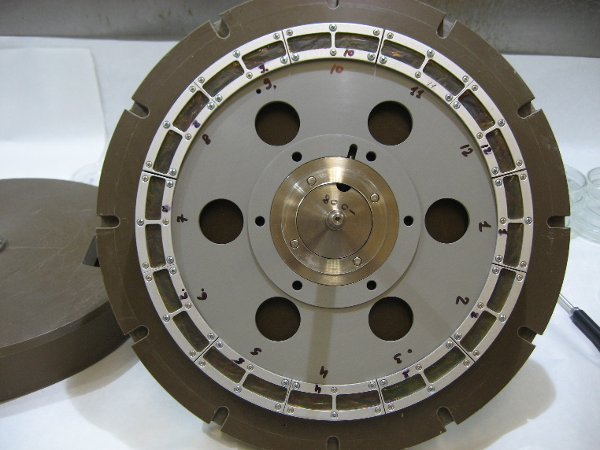
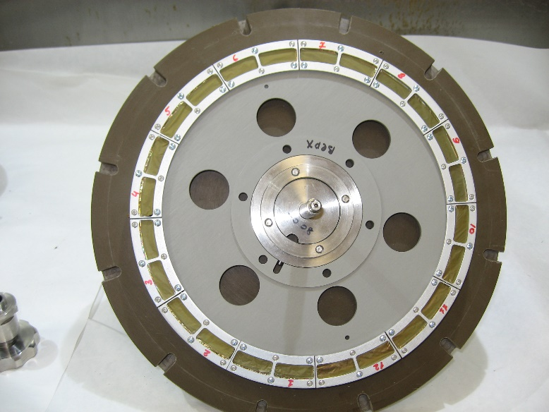
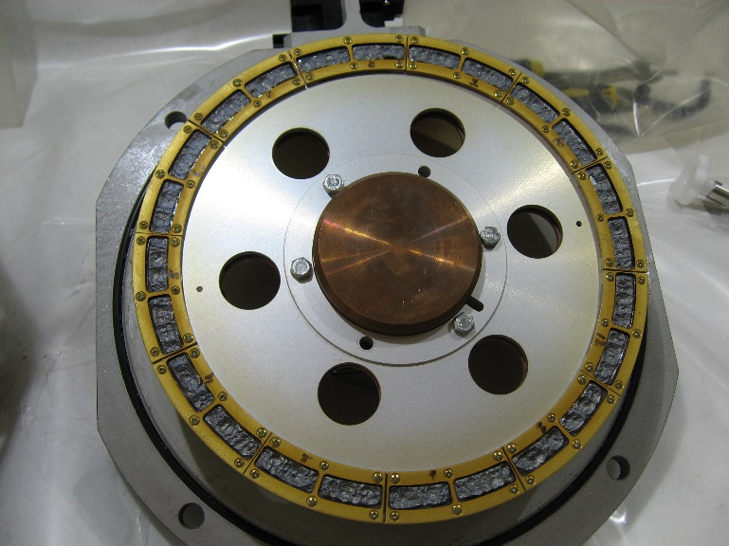
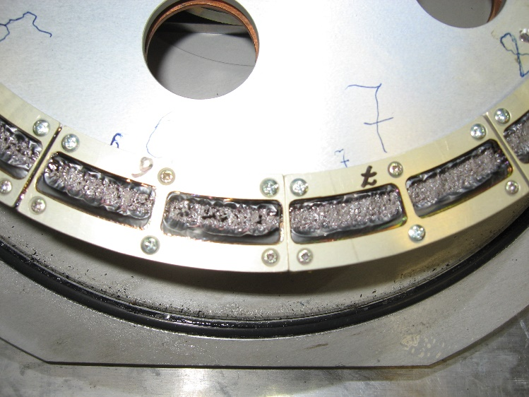
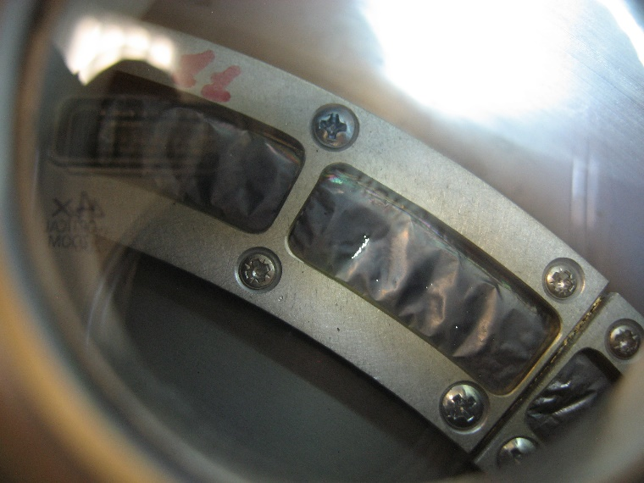
Radioactive targets for SHE factory
Target Th-232
d = 700 μg/cm²
Integral 2.4*10¹⁹
Target U-238
d = 700 μg/cm²
Integral 2.56*10¹⁹
Target Pu-242
d = 700 μg/cm²
Integral 1.62*10¹⁹

Slide 5
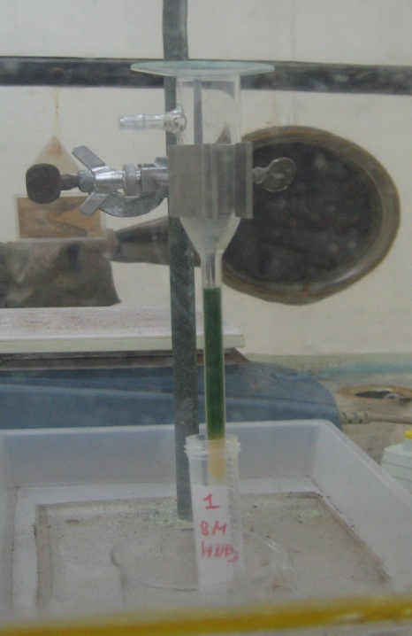
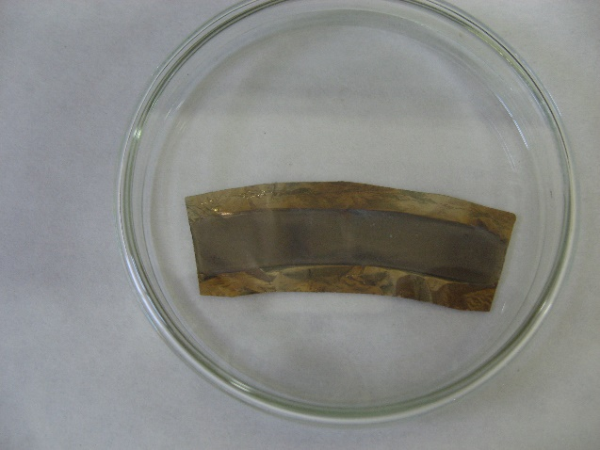
Regeneration of target material
Stage 1
Dissolution of Cm targets in mix of HNO₃ + HF or HNO_{3 (conc)} under IR-lamp.
Stage 2
Loading of Cm solution on anion-exchange column in mix 10М HNO₃ and CH₃OH (volume ratio - 1:10)
Stage 3
Elution of mix 1М HNO₃ and CH₃OH for purification from Ce, Fe, alkaline and alkaline-earth elements
Collection of Cm fraction in 1M HNO₃
Test segment of ²⁴⁵Cm target
²⁴²Pu on the column
Regeneration of actinides is significant stage for manufacturing targets: pure material – satisfactory morphology of layer surface!

Slide 6
Method MIVOC (Metal Ions from Volatile compounds)
This method was developed to vaporize non-volatile metals. For example Ni (nickelocene) and Fe (ferrocene) in Finland [1].
Principle of method is difference of pressure when pressure of volatile compound increases under normal temperature and low pressure.
Ionized in plasma chamber and accelerate.
[1] Metal ion beams from an ECR ion source using volatile compounds, Nucl instr. Meth. B. V. 94. 1994,P.P. 291-296,
https://doi.org/10.1016/0168-583X(94)95368-6.

Slide 7
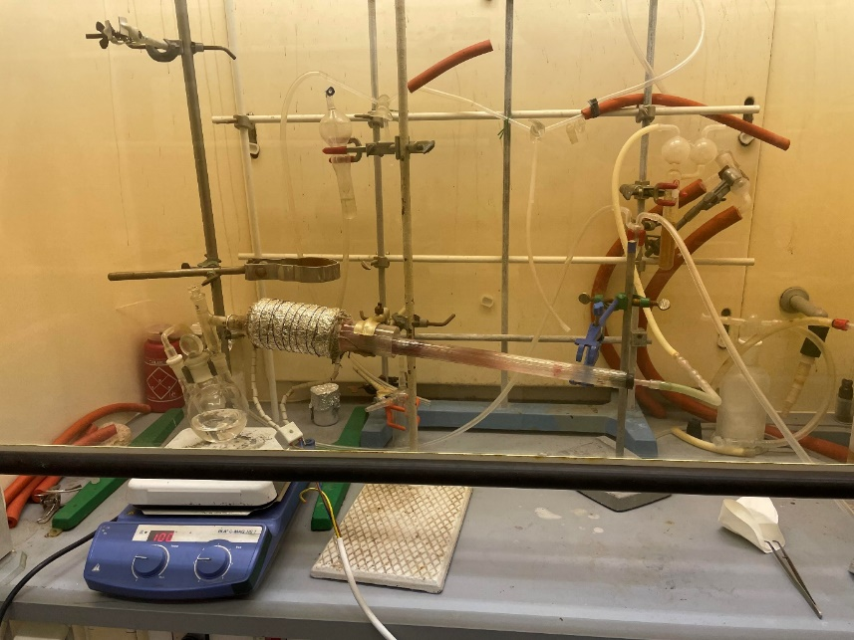
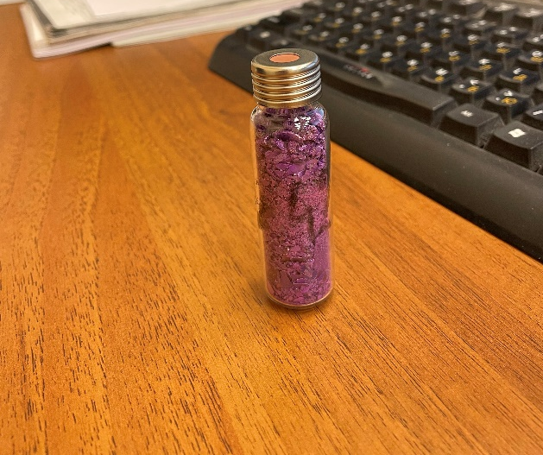
Synthesis of Chromocene
Yield of the 1st stage – maximum 80%
Cp₂⁵⁴Cr
Yield of the 2nd stage – maximum 50%
All stage yield is – 40%,
excluding regeneration on the 2nd stage
Chromium chloride ⁵⁴CrCl₃

Slide 8
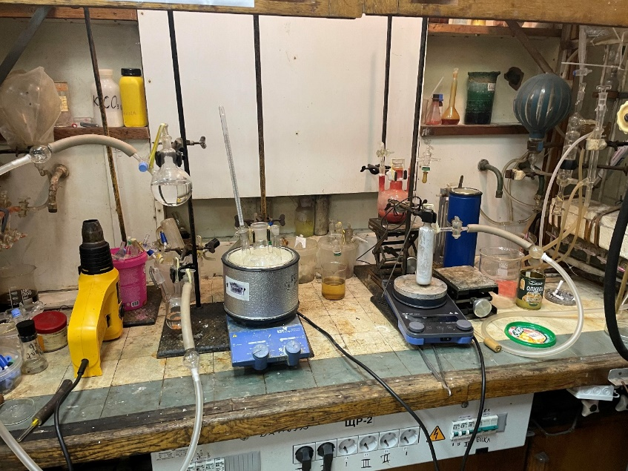
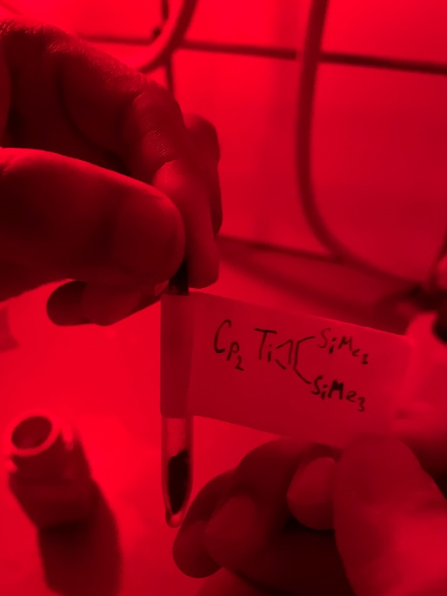
Synthesis of Сp*TiМе₃
trimethyl(pentamethyl-cyclopentadienyl) titanium | Yellow cristals | Neutral compound with chemical formula (C₅Me₅)₂TiMe₃ sublimed in vacuum, soluble in benzene and THF. Thermally unstable, very sensitive to light, oxygen and air moisture.

Slide 9
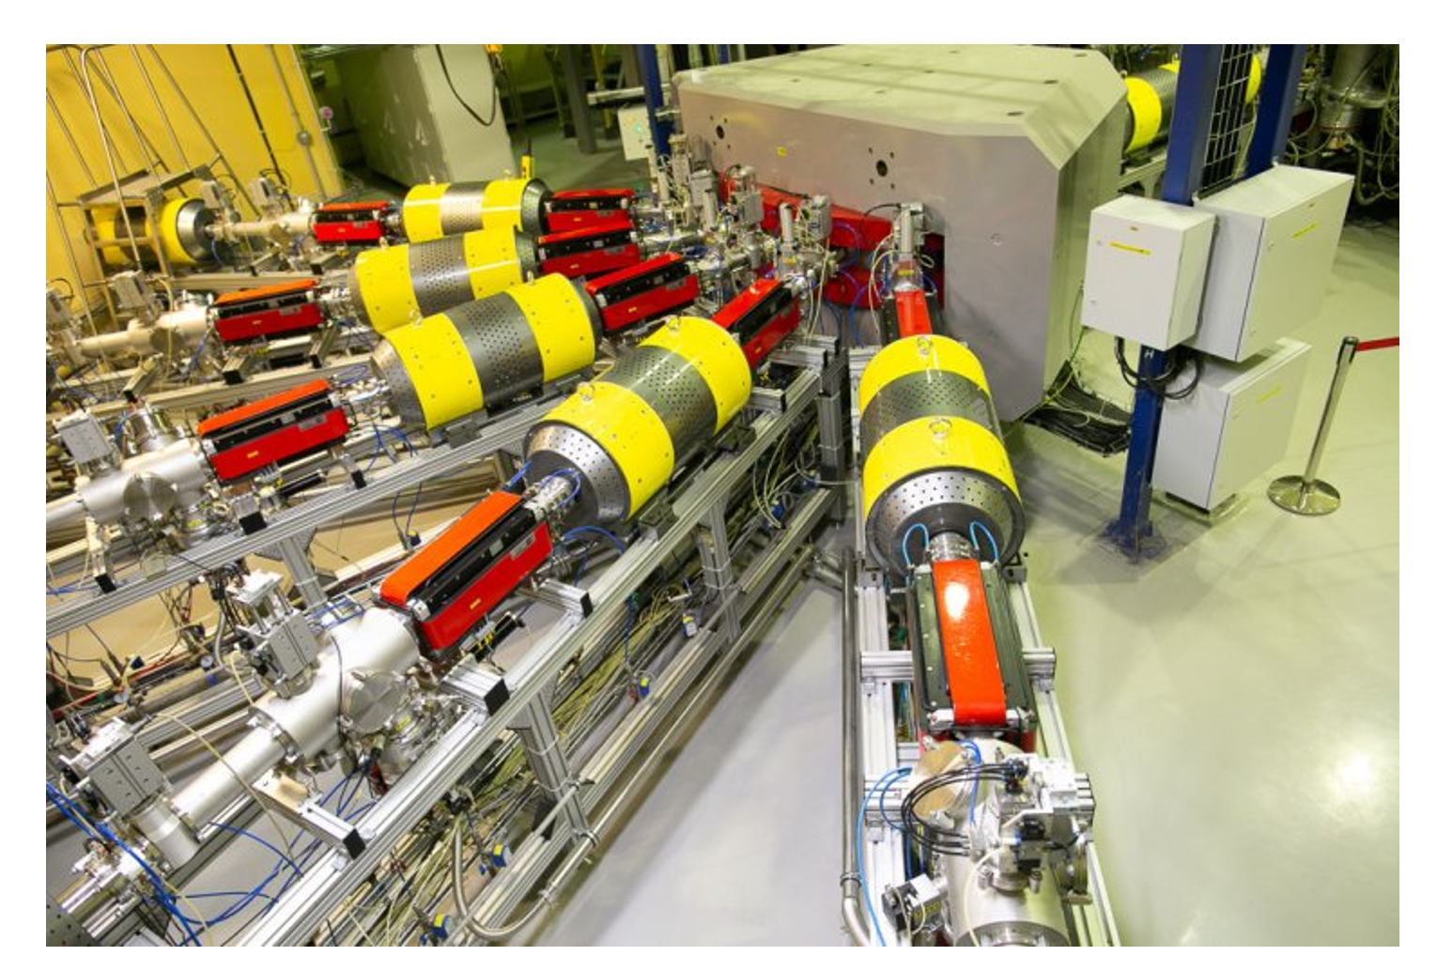
Data about ⁵⁴Cr and ⁵⁰Ti
The consumption in a stable mode is 70 mg / day according to the chromocene.
The maximum beam current of ⁵⁴Cr according to the source sector is 25 µA at the output from the accelerator and ⁵⁰Ti – the maximum current is 17 µA for DC-280.
On domestic Cp₂⁵⁴Cr chromocene, SHE Factory worked 96 days for the reactions ²³⁸U(⁵⁴Cr, 4n)²⁸⁸Lv and ²³⁸U(⁵⁴Cr, 3n)²⁸⁹Lv and U-400 worked 21 days for the reaction of ²⁰⁸Pb(⁵⁴Cr, 4n)²⁵⁸Sg
Two events were obtained for the reaction of ²⁴²Pu(⁵⁰Ti, 4n)²⁸⁸Lv

Slide 10
Conclusions
Techniques have been developed for the synthesis of organometallic compounds of titanium and chromium to produce ion beams of ⁵⁰Ti and ⁵⁴Cr from an ECR source for synthesis of SHE nuclei.
A technique for radiochemical regeneration from irradiated curium targets has been developed and Th, U, and Pu targets have been assembled for experiments on the SHE synthesis.
The first data on the condition of targets after prolonged irradiation were obtained (integral up to 3*10¹⁹)

Slide 11
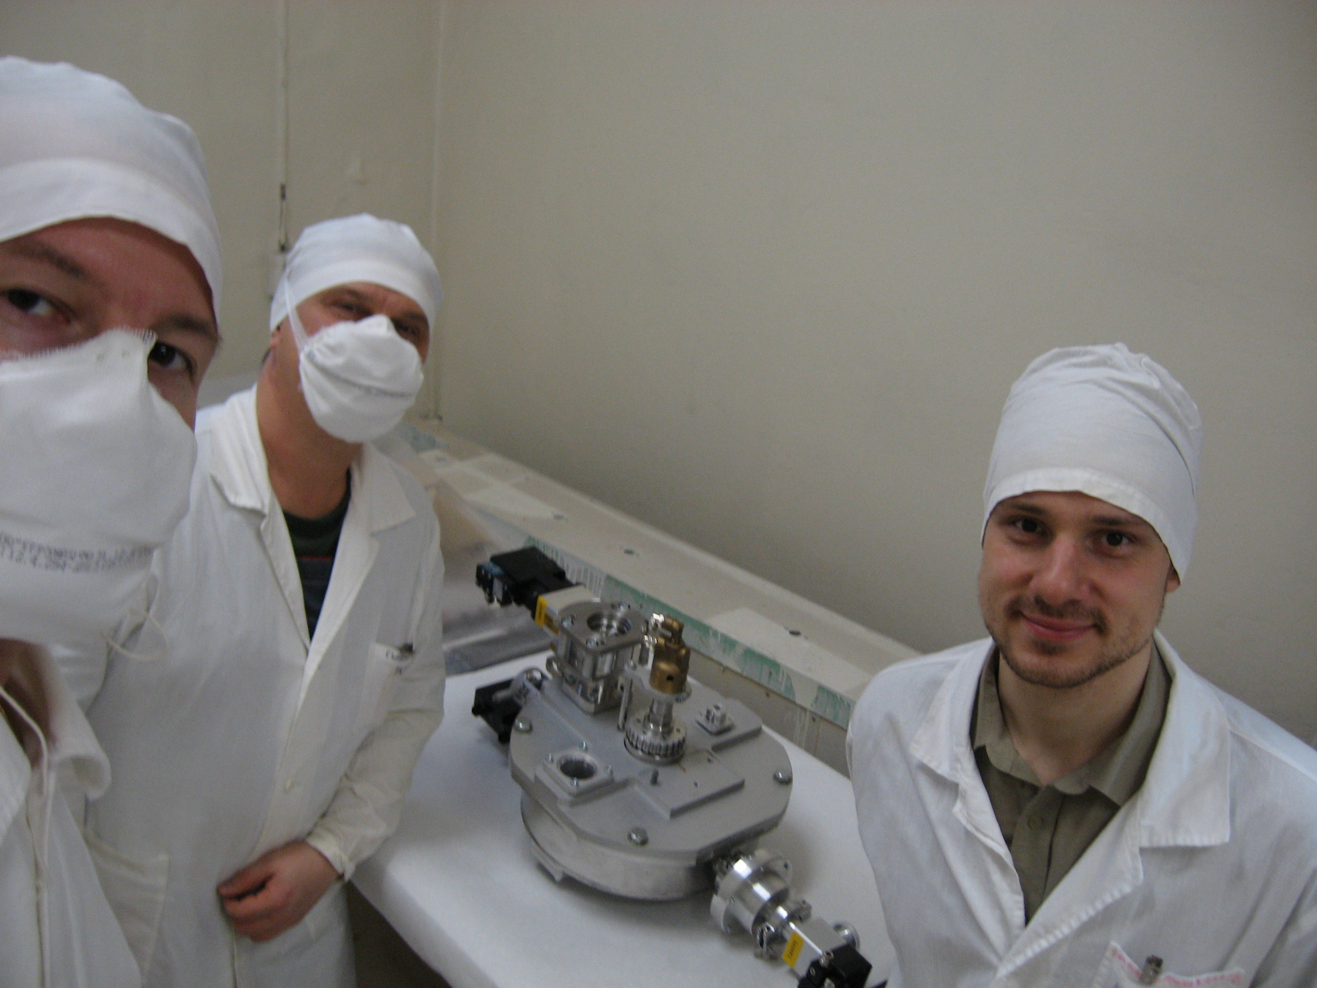
Thank you for kind attention!

