Slide 1
The model solenoid creation of the HTS magnetic energy storage SMES for SC magnets power supply system of NICA Booster and Nuclotron
I.I. Donguzov, O.M. Golubitsky, M.V. Ilin, D.N. Nikiforov, M.S. Novikov, A.A. Kotova,
M.V. Petrov, G.G. Khodzhibagiyan, A.V. Shemchuk

Slide 2
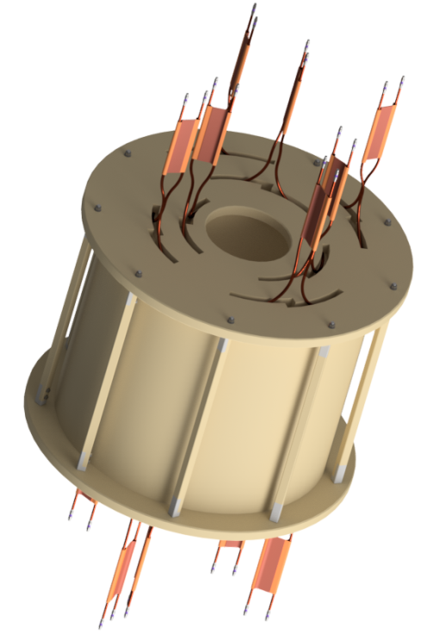
SMES
2
SMES (Superconducting Magnetic Energy Storage)
Parameter | Meaning
Inner diameter | 400 mm
Outer diameter | 960 mm
Height | 900 mm
Number of layers | 14
Operating current | 6.7 kA
Inductance | 120 mH
Stored energy | 2.74 MJ
Operating temperature | 30 K
Refrigerant | Neon
Purposes:
Decreasing pulsations of superconducting magnets operating current
Reducing inductive load influence to the city’s power grid
Minimizing of energy consumption

Slide 3
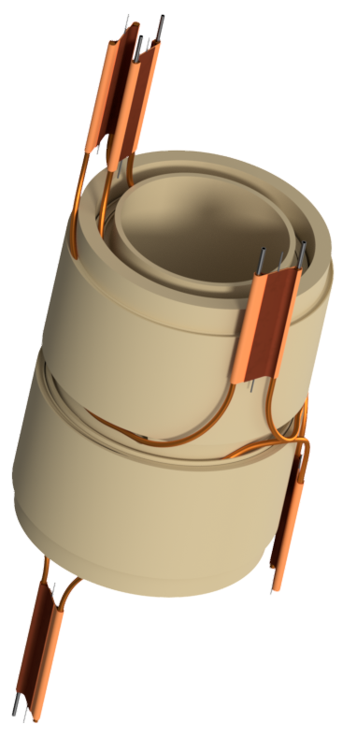
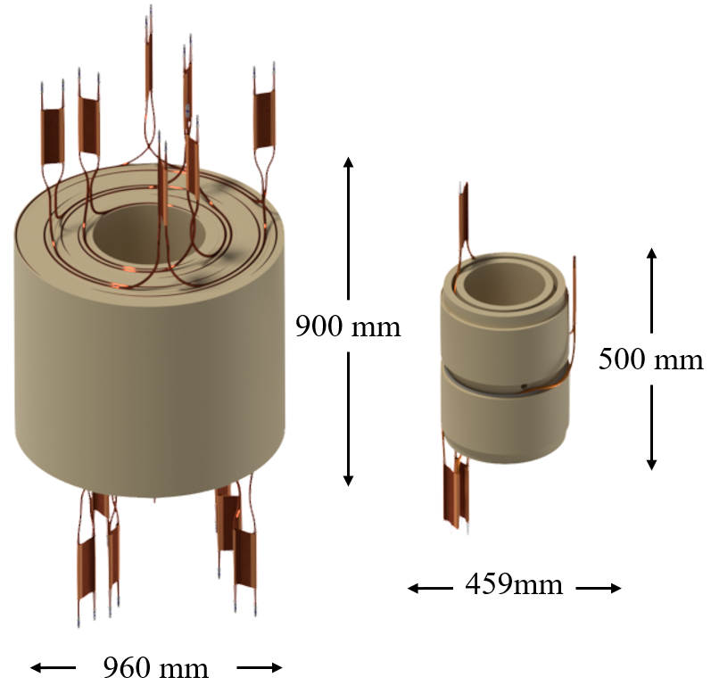
Model SMES
3
Model SMES
Parameter | Meaning
Inner diameter | 290 mm
Outer diameter | 459 mm
Height | 500 mm
Number of layers | 4
Operating current | 13 kA
Inductance | 1,79 mH
Stored energy | 163 kJ
Operating temperature | 4.5 – 50 K
Refrigerant | Helium
Purposes:
Testing technologies of production and assembling of such type HTSC solenoids.
Achieving the same proportions of mechanical deformations like at SMES
SMES vs Model SMES

Slide 4
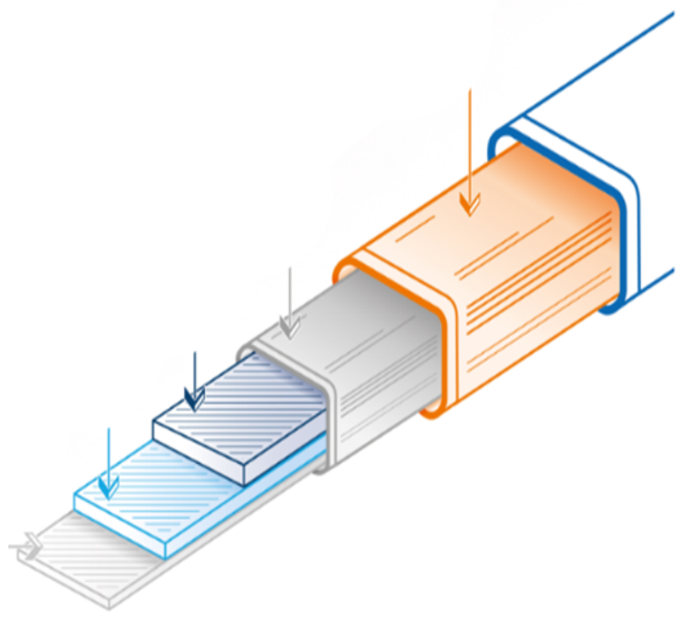
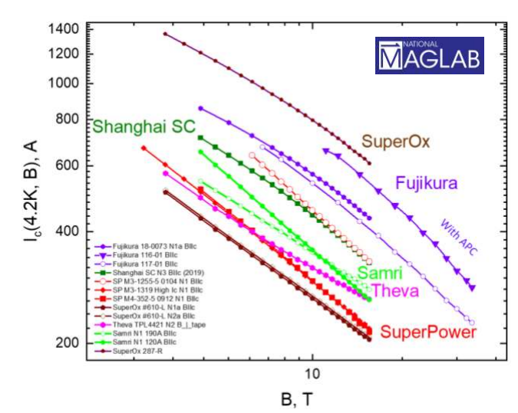
Superconductor
3
ReBCO tape (rare-earth barium copper oxide tape)
Cu
Ag
HTC
Buffer layer
Hastelloy
The structure of the HTS tape
Parameter | Unit | Meaning
Conductive layer |  | ReBCO
The width of the conductor | mm | 4
The Thickness of the conductor | um | 100
Substrate material |  | Hastelloy C276
The thickness of the substrate | um | 100
Crit. current (77 K), | A | 100-150
Layer thickness Ag | um | 1-10
Layer thickness Cu | um | 0-100
Tapes from different manufacturers

Slide 5
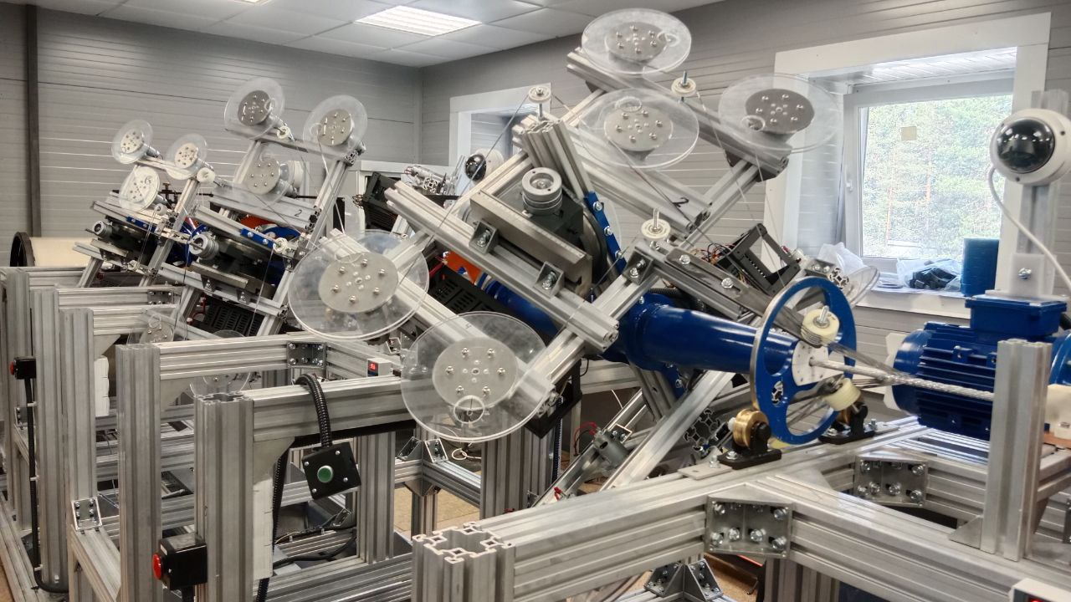
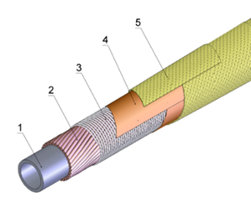
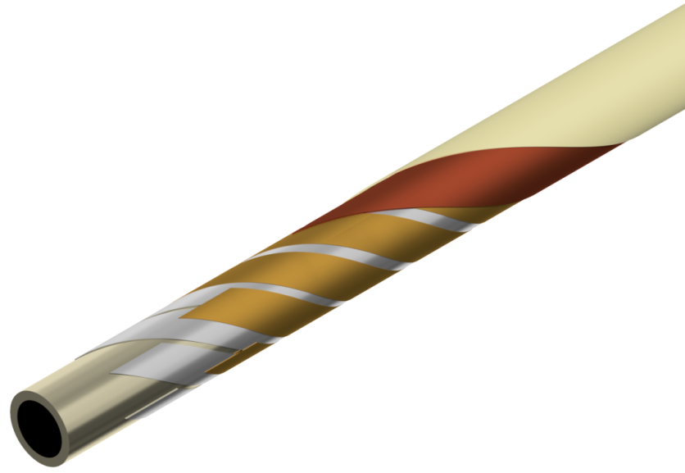
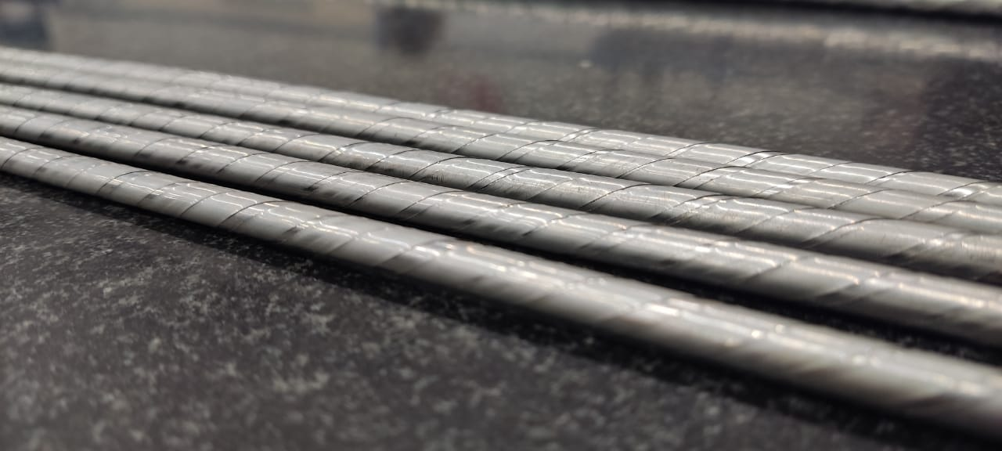
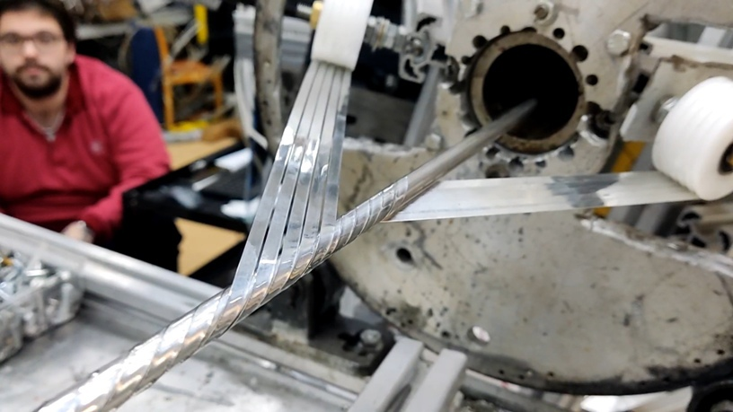
HTSC cable
3
Cu-Ni tube
Strands of the superconductor
Ni-Cr wire
Kapton tape
Fiberglass tape
Nuclotron type tubular cable – created in 1979 and first tested in 1980 at JINR
Cable machine
Cu-Ni tube
Brass tape
HTSC tape (SuperOx)
Kapton tape
Fiberglass tape
HTSC cable SMES
HTSC cable
Winding HTSC tapes on a tube

Slide 6
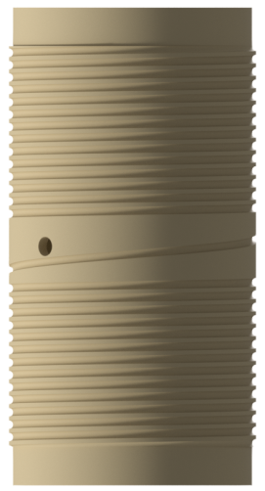
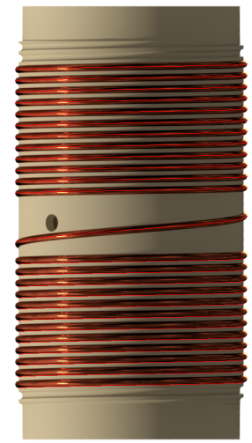
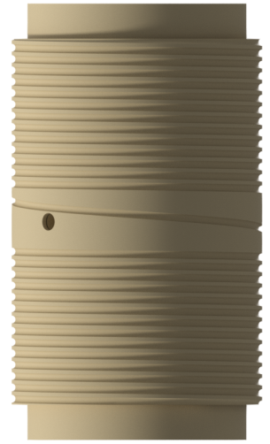
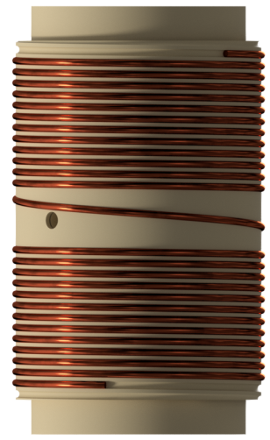
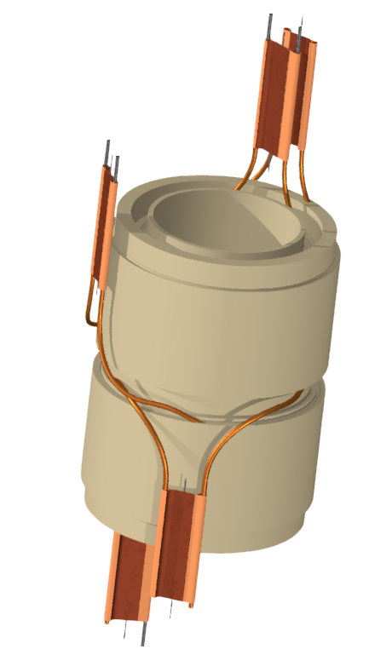
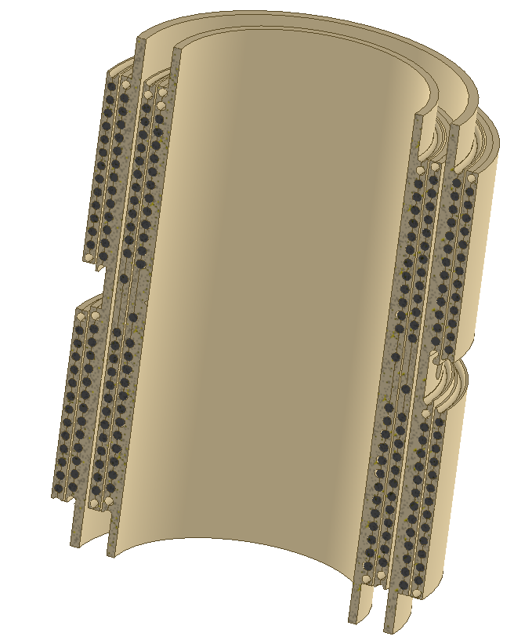
The model solenoid design
4
The assembly consistency of one section of the model solenoid
Half section of the model solenoid
Model SMES

Slide 7
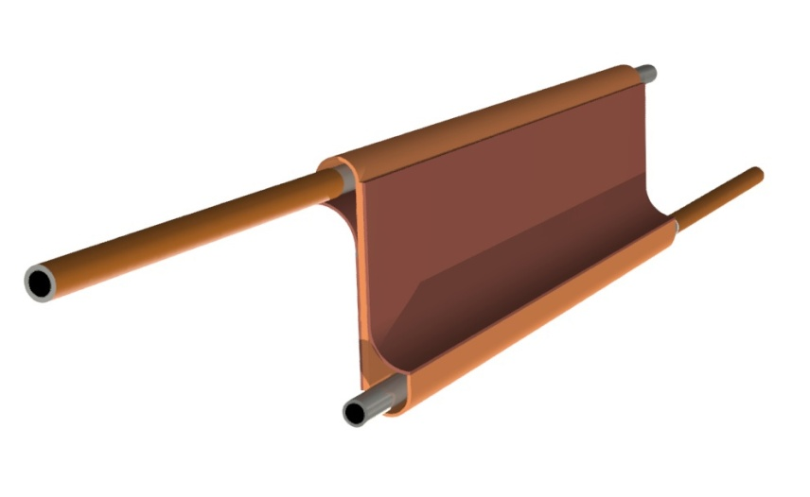
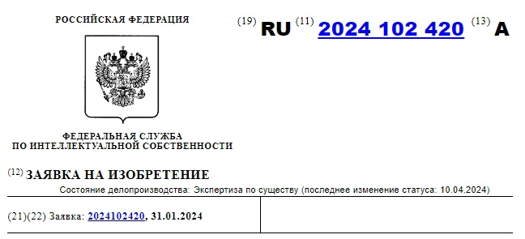
Electrical connection of the cable
9
3D model of the HTSC cable connection
Voltage output circuit for the model solenoid

Slide 8
Quench detection system
8
cRIO-9057
Current sensor LEM ITZ - 16000
Current value
ADC NI-9202
± 10В
Layers
Model SMES
Energy evacuation switch
Energy evacuation signal
DAC NI-9263
± 10В
ADC NI-9238
± 0.5В
Current leads, bridges
Current source
RS-485
MOXA
PC
Ethernet

Slide 9
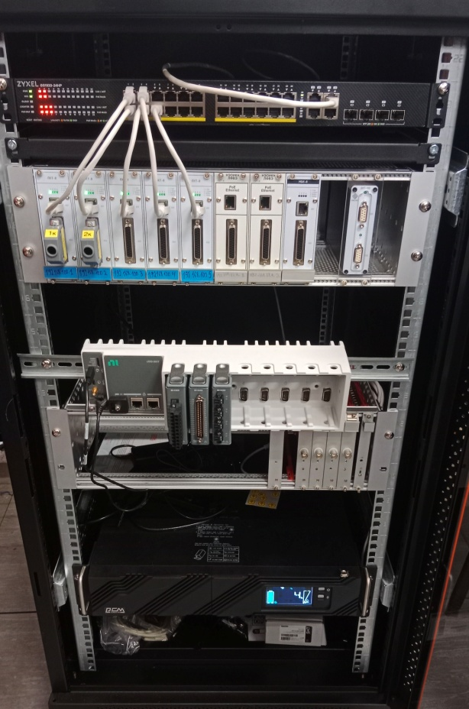
Thermometry system
9
Current source +
Chanel 1 +
Chanel 1 –
Chanel 2 +
Chanel 2 –
Chanel 8 +
Chanel 8 -
Current source -
Connections of temperature sensors
Measuring range: 4 - 300 K;
Accuracy: ± 0,3 % in the range up to 30 K;
Number of voltage measurement channels: 8;
ADC bit rate: 24 bits;
Built-in current source: 10, 100 мкА;
Supply +24 DC / PoE.
Measuring equipment

Slide 10
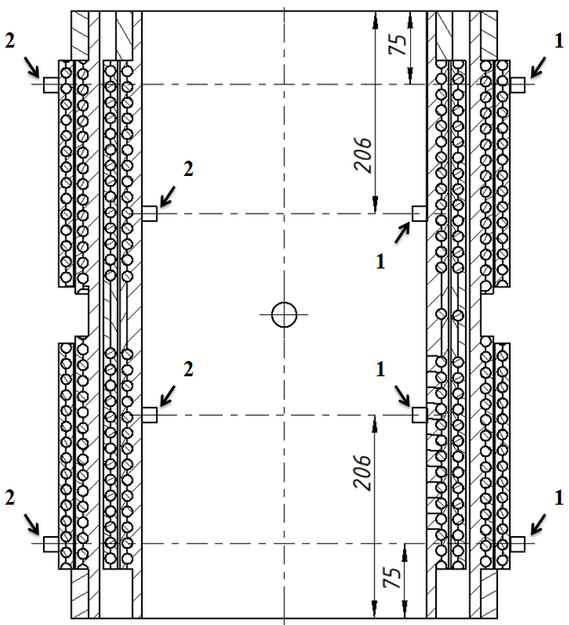
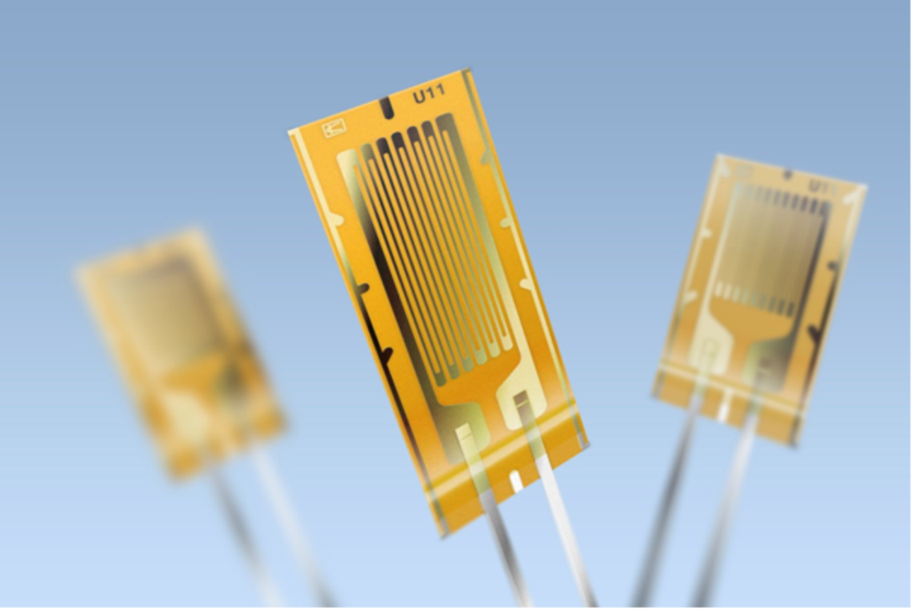
Strain gauge system
9
At a deformation of 1000 microns/m, a resistance change of 0.77 Ω at room temperature will follow
Operating temperature range - -269 - +250 ⁰С
Rated resistance - 350 Ω
The length of the measuring grid - 10 mm
The width of the measuring grid - 3.5 mm
The location of strain gages and temperature sensors on the frame of the model SMES:
1 – temperature sensors, 2 – strain gages.

Slide 11
Conclusion
10
The design of the model solenoid has been developed, technical documentation has been prepared, parts are being manufactured.
A hardware and software complex based on NI equipment is being developed to determine the normal-conducting area in the HTSC cable.
A system for data acquisition on cryogenic parameters, voltages, and mechanical deformations of solenoid is being developed.
The production of the model solenoid is scheduled for autumn 2024.

Slide 12
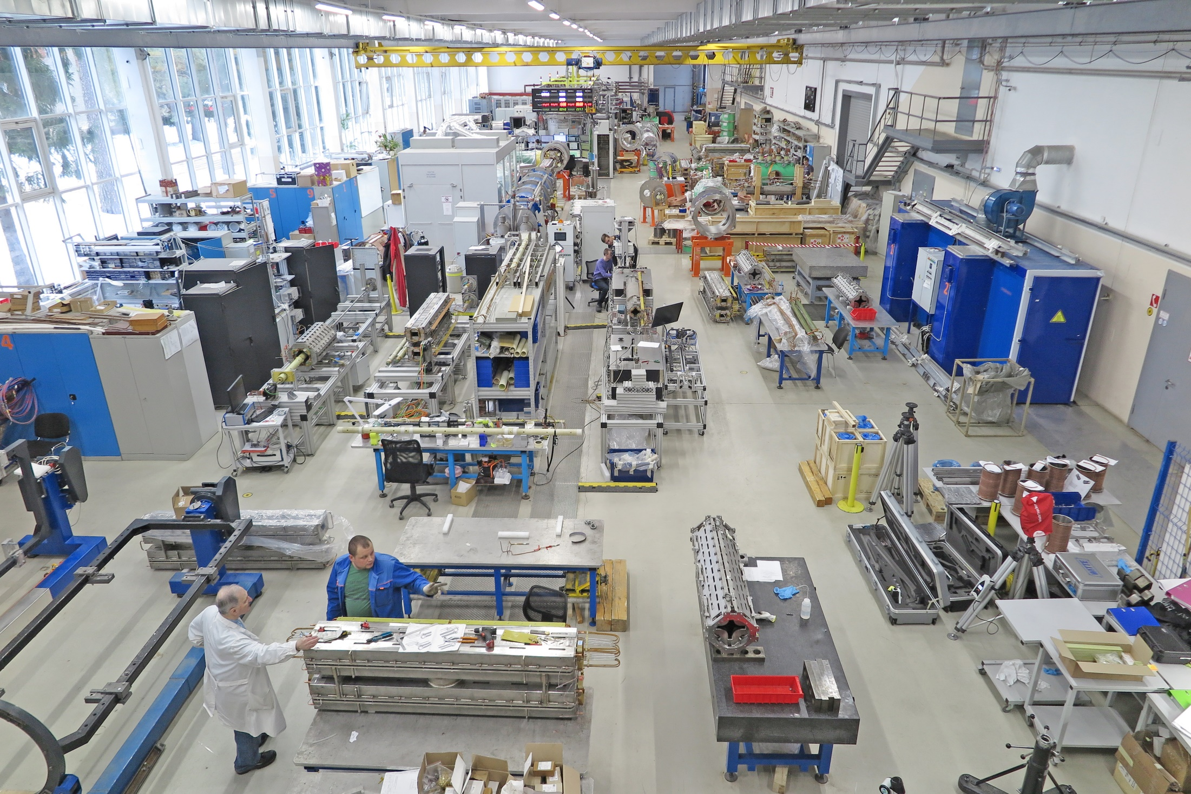
The model solenoid creation of the HTS magnetic energy storage SMES for SC magnets power supply system of NICA Booster and Nuclotron Ilya Donguzov, donguzov@jinr.ru
Thank you for your attention!

Slide 13
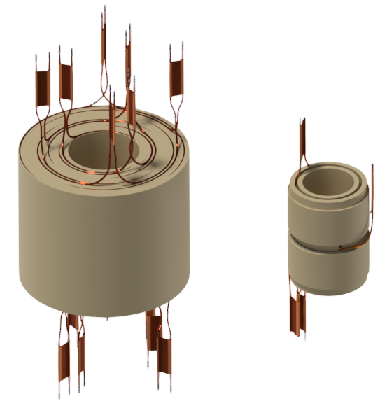
900 mm
500 mm
459mm
960 mm

Slide 14
