Slide 1
Clerk
Ksenuya Ilina

Slide 2
Clerk =)
Ksenuya Ilina

Slide 3
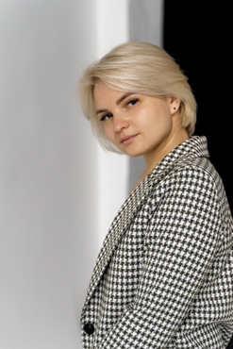
Hello, my name is Ksenia Ilina, and I work as a clerical specialist in the scientific and experimental department of radioelectronic systems. Today I will tell you about the important and irreplaceable role of a clerk in any organization. And yes, I promise, it won't be boring!

Slide 4
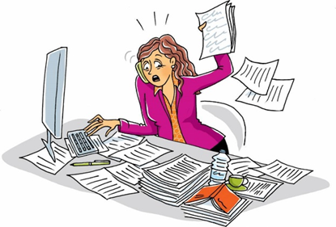
The importance of the Clerk
Each laboratory and department has a specialist who deals with documents.
The position of a clerk may sound difficult, but in fact it includes the functions of a secretary, manager, HR specialist, archivist and a specialist in financial accounting and control. In general, we are real superheroes, but instead of cloaks we have folders and documents.

Slide 5
Main Tasks
The activity of any organization is accompanied by the creation of documents. Registration of documents in accordance with the current rules ensures the protection of the interests of the organization and increases the efficiency of managerial work. It is important not only to know how to draw up and issue a document, but also to be able to organize work with it at all stages of its passage. It's like playing Tetris, but instead of blocks, it's paper.

Slide 6
Role and Responsibility
The clerk is an important and practically irreplaceable employee. He bears great personal responsibility for the organization's workflow and the safety of business documentation. The clerk is the right hand of the head, ensuring coordination of administrative and managerial activities while the head is engaged in scientific work. Yes, without us, the office would be in chaos, like at home after a New Year's party.

Slide 7
Role and Responsibility
The clerk is an important and practically irreplaceable employee. He bears great personal responsibility for the organization's workflow and the safety of business documentation. The clerk is the right hand of the head, ensuring coordination of administrative and managerial activities while the head is engaged in scientific work. Yes, without us, the office would be in chaos, like at home after a New Year's party.

Slide 8
My Main Responsibilities Are
As a clerical specialist, I perform the following tasks:
Drafting and execution of orders and orders for the department and laboratory.
Working with invoices and contracts.
Registration of applications for employment and extension of employment contracts.
Creating job descriptions for employees.
Maintaining a timesheet.
Interaction with the accounting department and other departments of the Institute.
Assistance to colleagues in solving various issues.
Execution of orders from the head of the department.
Keeping logs on labor protection.
Registration of passes.
Participation in the council of the Association of Young Scientists and Specialists, where I help researchers and specialists solve various issues not only in my laboratory, but throughout the Institute.

Slide 9
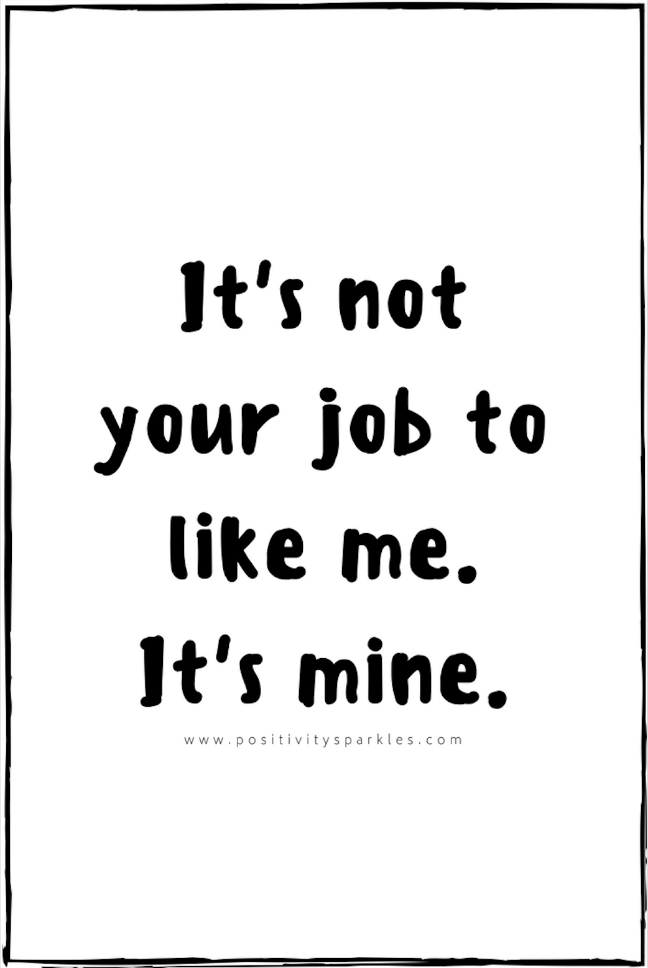
It is Not your job
If you suddenly find yourself doing one of the above-described duties, congratulations — your clerk has decided to take a vacation. Don't panic! Remember that you do not have to deal with these tasks, you are not a secretary, manager, HR officer or archivist. If any of this gets on your desk, just smile and try to find someone who should do it. Or contact me — I will try to help.

Slide 10
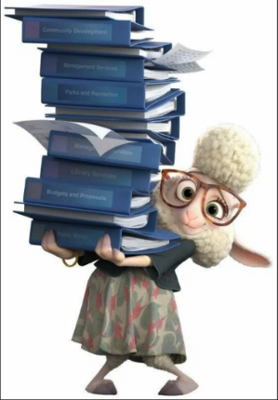
Personal qualities
A good office worker should have qualities such as benevolence, politeness, correctness and communication culture. It is important to remember the smallest details and keep a lot of information in mind. In general, it's like being a computer, only with a sense of humor and without the blue screen of death.

Slide 11
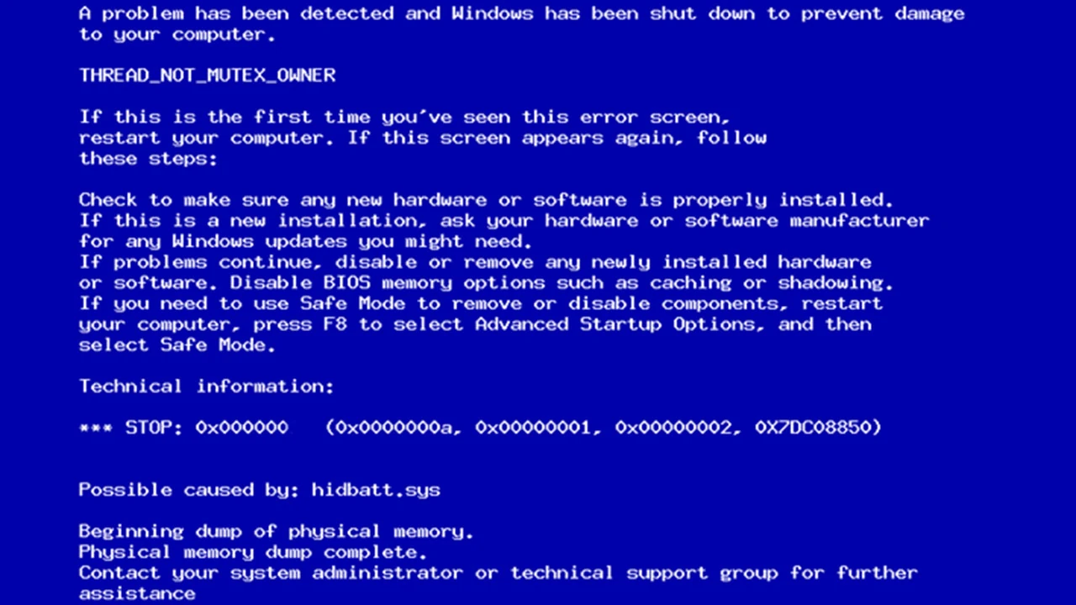

Slide 12
Personal qualities
A good office worker should have qualities such as benevolence, politeness, correctness and communication culture. It is important to remember the smallest details and keep a lot of information in mind. In general, it's like being a computer, only with a sense of humor and without the blue screen of death.

Slide 13
My Plans for the Future
I strive to continue working as a clerk, because I consider this role to be key to the functioning of the entire organization and scientific activities in general. I am ready to work with documents, applying my knowledge and skills, and constantly develop in this field. The normal functioning of the entire organization depends on the successful work of the clerk. Well, if I suddenly decide to change my profession, I always have the skill of "sorting papers in an emergency" — it might come in handy in action films.

Slide 14
Conclusion
I think you've noticed that this is not a scientific report. And the conclusions that I wanted to convey to you could have been blurred, so they are all presented here on this slide:
The clerk is an important and irreplaceable employee who ensures the effective functioning of the organization.
My responsibilities include working with documents, interacting with colleagues, and supporting administrative processes.
A good clerk should have personal qualities such as benevolence, politeness and attention to detail.
If you are fulfilling my duties, it means that your clerk or I... took a vacation — don't worry, it won't be for long.
I am ready to continue working in this field, develop and improve my skills to improve the work of the entire organization.
I will be glad to listen to your comments and observations, which in your opinion will be able to make my work more effective. And I, in turn, will tell you why nothing will work like this

Slide 15
Thanks for your attention!
Ksenuya Ilina

