Slide 1
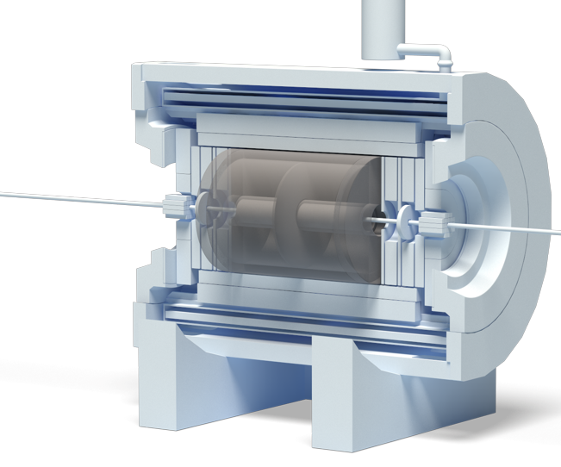
JINR Association of Young Scientists and Specialists Conference "Alushta-2024" Remote reconfiguration, debugging, testing and synchronization of Electronics Cards for the TPC/MPD Detector of the NICA project
Denis Potapov, an engineer of the
TPC/MPD group, VBLHEP, JINR
Alushta, 2024

Slide 2
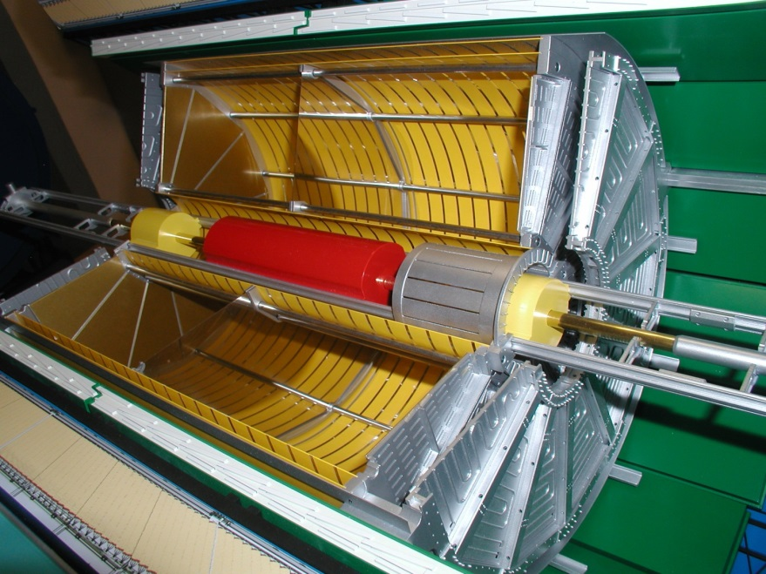
TPC/MPD Detector of NICA Complex
1. Front-End Cards (FECs) position;
2. End cap thermal screen;
3. Read-Out Chamber (ROC) based on Multi-Wire Proportional Chamber (MWPC);
4. High Voltage (HV) electrode;
5. Field cage position.
3
4
5
2
1
MPD layout and TPC section
Time-Projection Chamber (TPC)

Slide 3
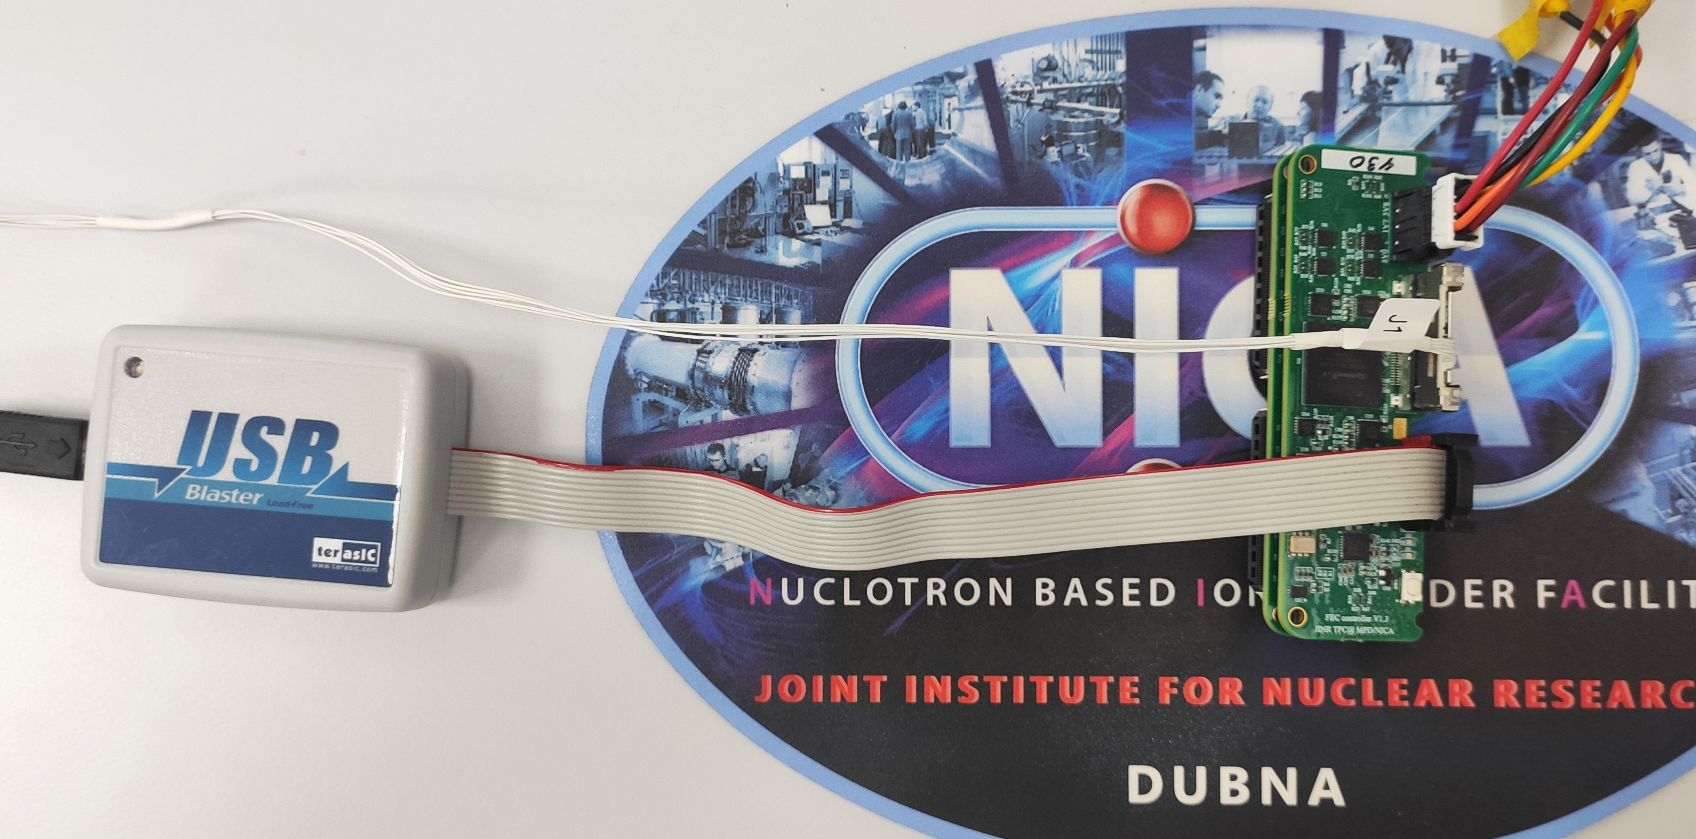
FECs integration on ROC
FEC connection for remote access & synchronization
Micro coaxial cables assemblies
1 ROC:
62 FECs
24 ROCs:
1488 FECs
JTAG programmer USB Blaster
FEC assembly
Test setup of 62 FECs on 1 ROC
SAMPA FEC
FEC controller

Slide 4
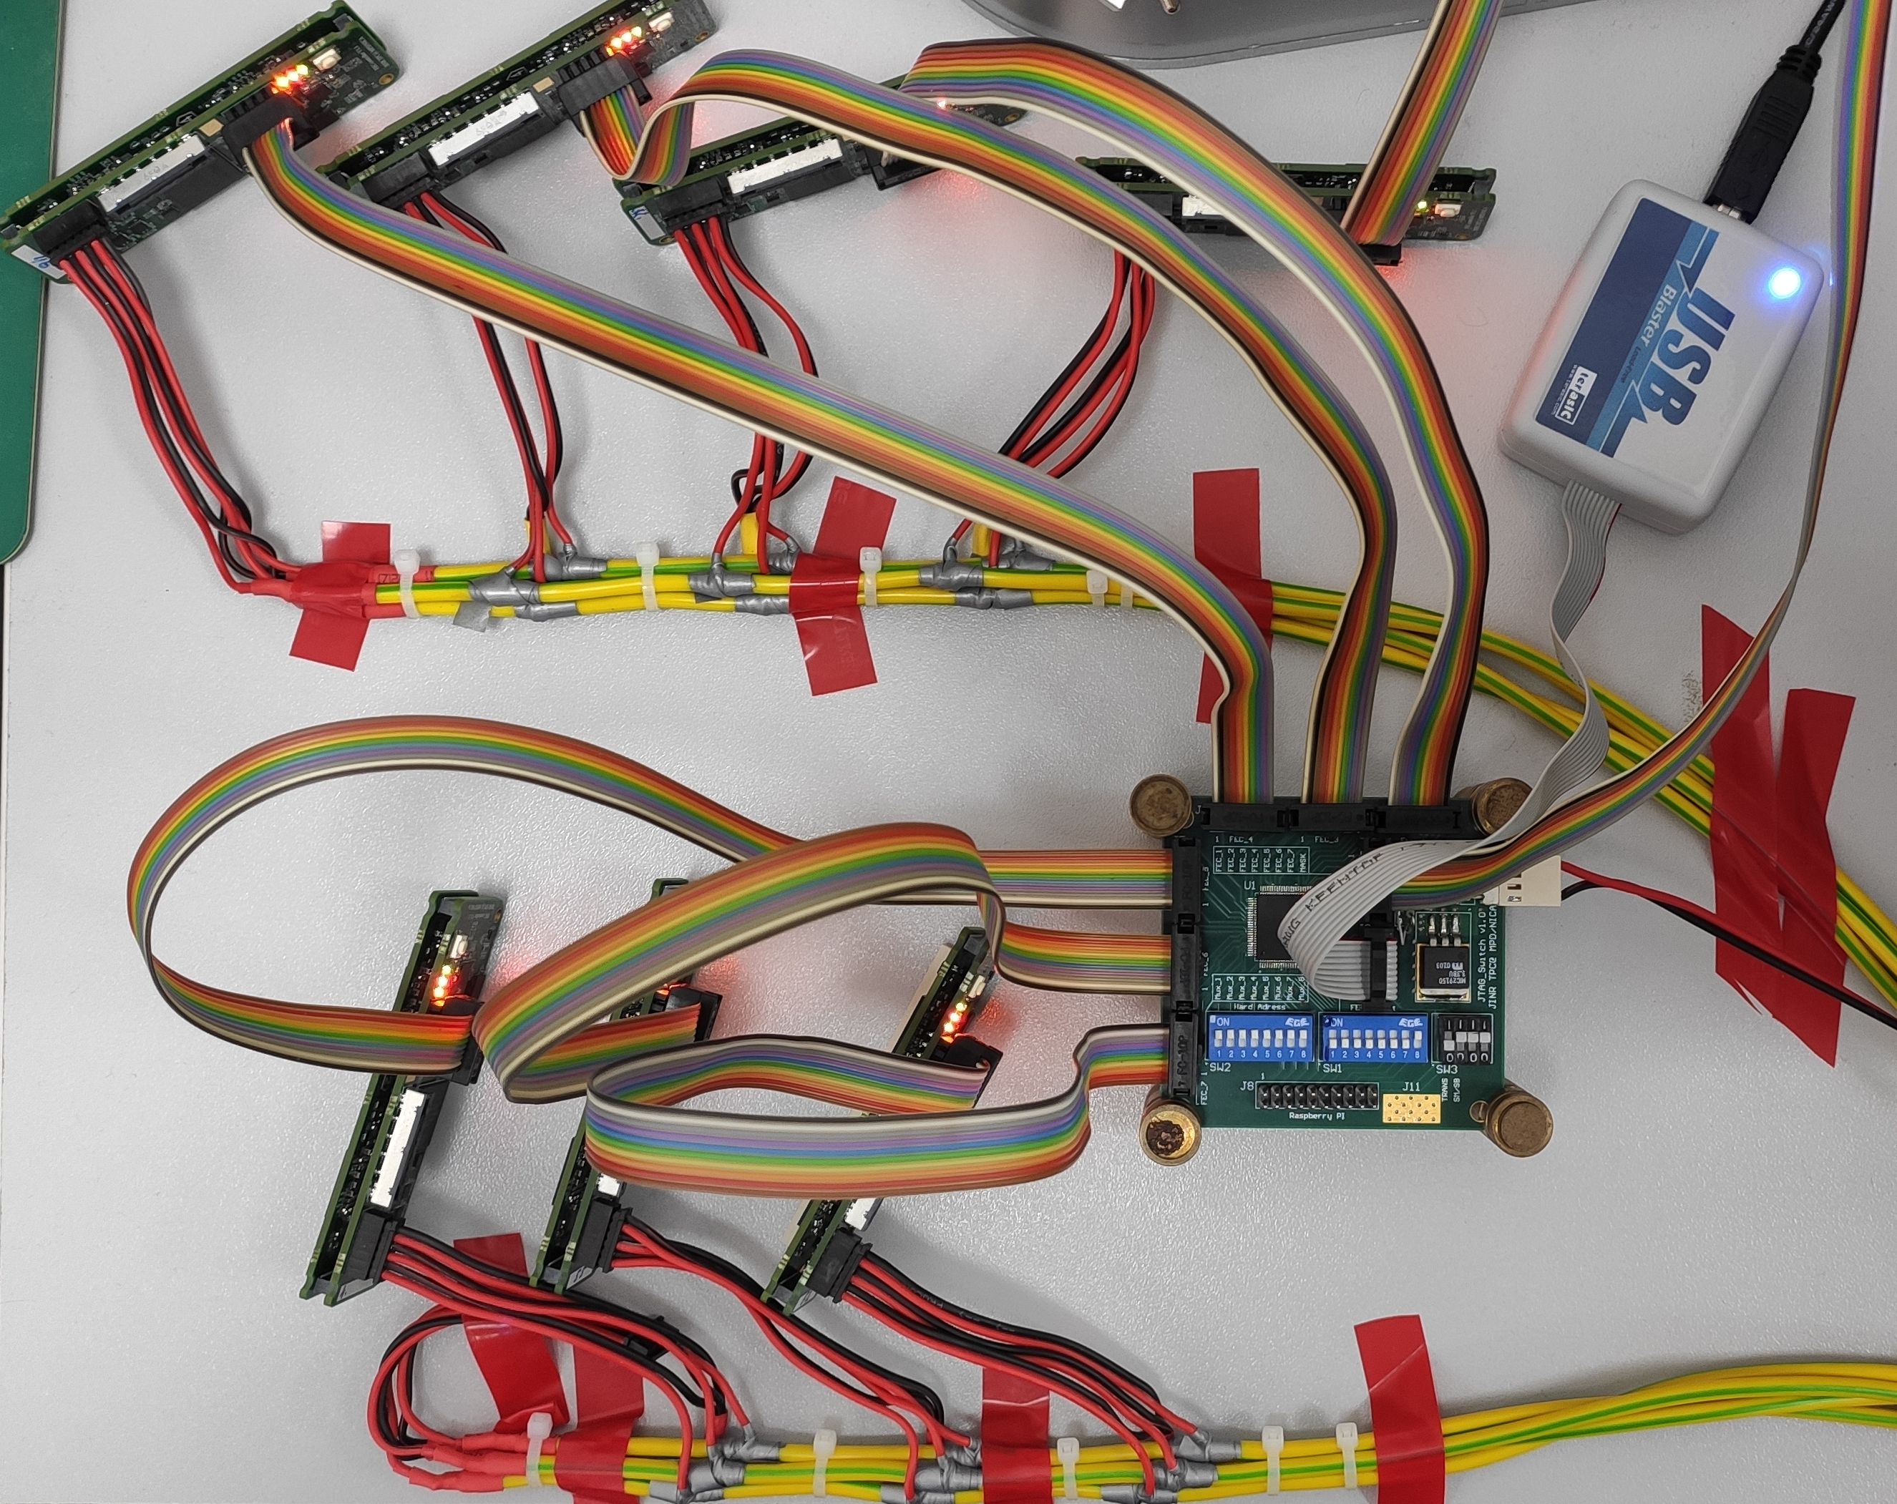
Prototype of functional unit
Tested prototype
This remote access prototype unit uses JTAG (up to x7 FECs) for:
FPGA reprogramming;
FPGA debugging;
An additional channel for accessing the digital part of the Data acquisition subsystem (DAQ).
Test setup for remote access prototype unit

Slide 5
Block diagram of remote access unit for Control & Synchronization System
JTAG via LVDS
JTAG
Out con. (JTAG)
JTAG
FEC_1
JTAG via LVDS
Programmer
USB Blaster
In con. (JTAG)
…
6
SCANSTA112
6
…
Out con. (JTAG)
FEC_6
JTAG
Tested prototype
Same chips
11
…
Remote access unit
for each ROC
JTAG
Out con. (JTAG)
FEC_61
JTAG via LVDS
…
6
6
SCANSTA112
…
Inside
MPD magnet
Control &
Synchronization System
Out con. (JTAG)
RCU-64
JTAG

Slide 6
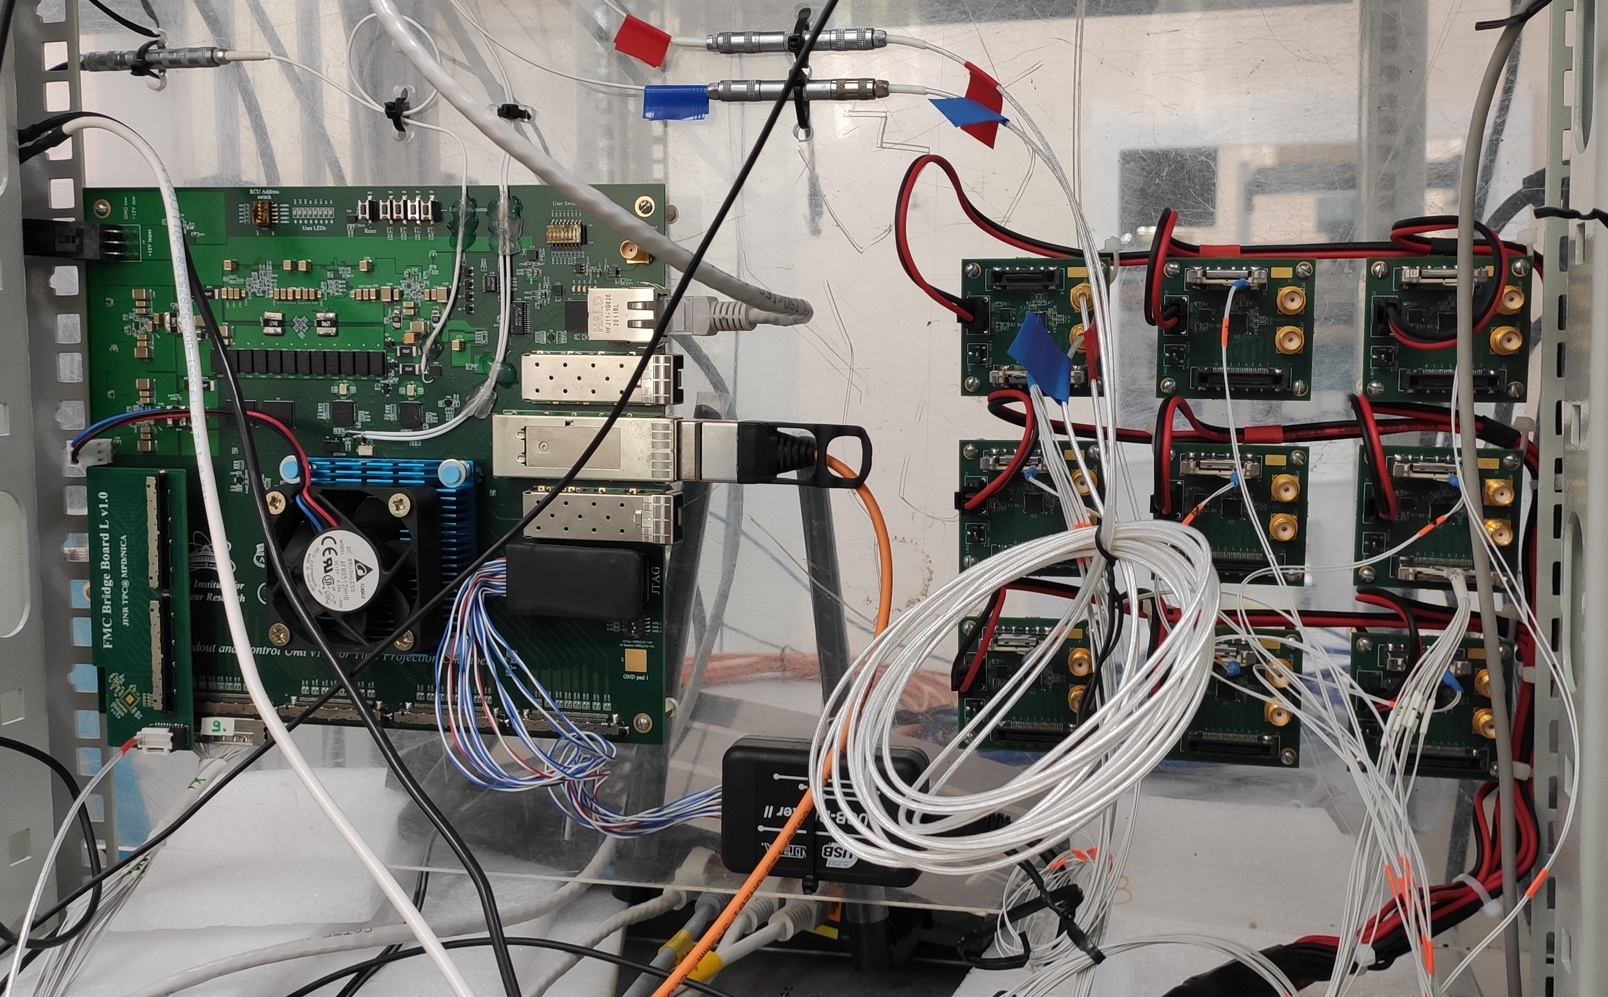
Prototype of functional unit
Readout and Control Unit-64
Tested prototype
This synchronization prototype unit fanout transceiver reference clock to 62 FECs (1 ROC sync.)
Synchronization unit of System will fanout 5 external signals to FECs:
3 types reference clocks;
Data trigger;
Reset.
Test setup for synchronization prototype unit

Slide 7
Block diagram of synchronization unit for Control & Synchronization System
In con. (LVDS)
5
RCU-64
ZL40226
LVDS
Out con. (LVDS)
FEC_1
LVDS
8
…
LVDS
FEC_8
5
5
MAIN
ZL40226
Same chips
8
External
sync. unit
…
Optical links
24
5
…
LVDS
ZL40226
Out con. (LVDS)
FEC_57
LVDS
8
5
Control &
Synchronization System
…
5
FEC_64
RCU-64
Synchronization
unit for each ROC
Tested prototype
Outside MPD magnet
Inside
MPD magnet

Slide 8
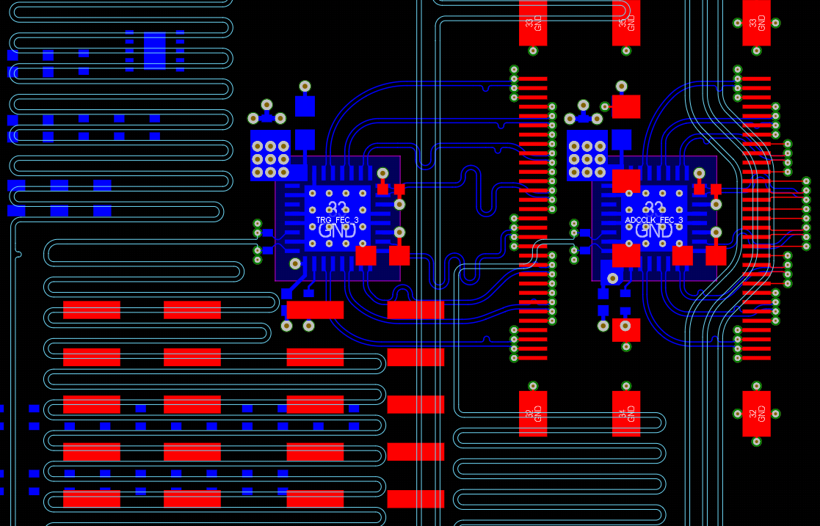
Control & Synchronization System is under design
3D model of device Control & Synchronization System(top/bottom view). Size is 810 x 60 mm
Part of PCB trace
JTAG over LVDS. Сable length is about 2m

Slide 9
Сonclusion
Comprehensive tests of prototypes of remote access and synchronization units have been carried out;
Electrical circuit of control & synchronization units has been developed;
Size and location of control & synchronization units on TPC are determined;
Tracing of PCB has been partially completed.
Future plans:
Accompany production of device;
Perform full-featured device testing;
Develop external fanout (for 24 RCUs).

Slide 10
JINR Association of Young Scientists and Specialists Conference "Alushta-2024" Remote reconfiguration, debugging, testing and synchronization of Electronics Cards for the TPC/MPD Detector of the NICA project
Denis Potapov, an engineer of the
TPC/MPD group, VBLHEP, JINR
Alushta, 2024

