Slide 1
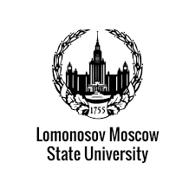
Multi-energy computed tomography aplications
for paleontology and archeology
Rozhkov V., Shelkov G., Shashurin D., Sotenskyi R., Suslova E.
<номер>

Slide 2
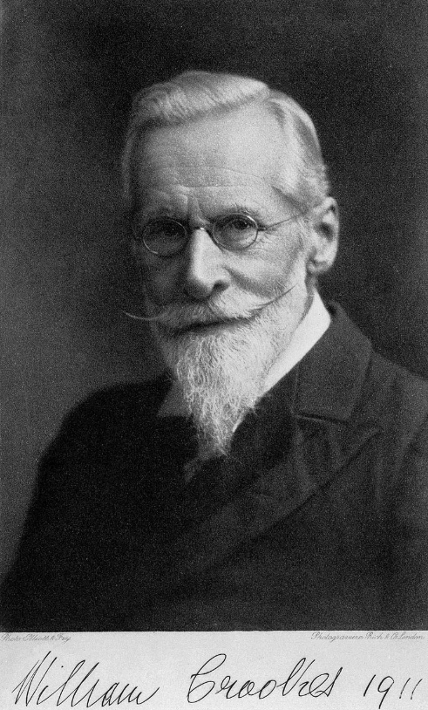
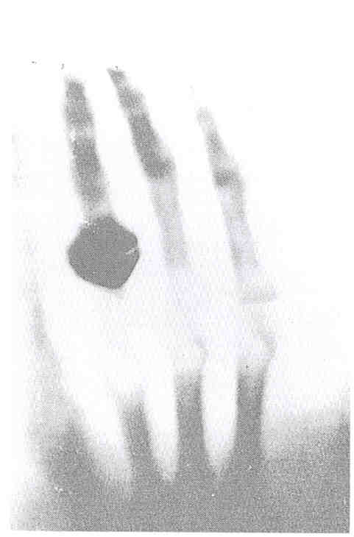
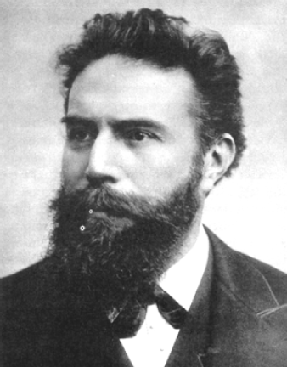
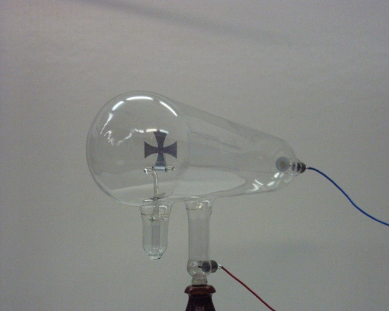
X-rays
<номер>

Slide 3
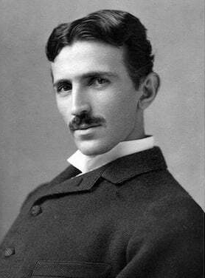
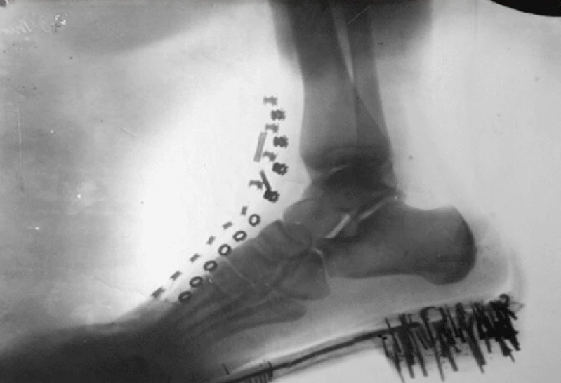
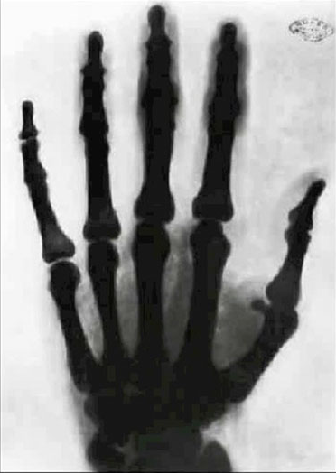
X-rays
In 1887, Nikola Tesla experimented with different types of radiation. He recorded visible light, ultraviolet radiation and special rays that can penetrate objects. It was only with Roentgen's discovery of X-rays in 1895 that Tesla realized what he was dealing with. Subsequently, he even improved the X-ray installation and wrote a dozen scientific articles about the nature of this radiation.
<номер>

Slide 4
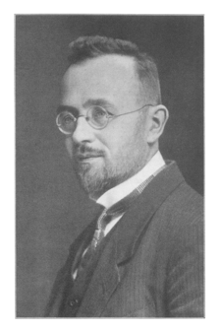
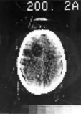
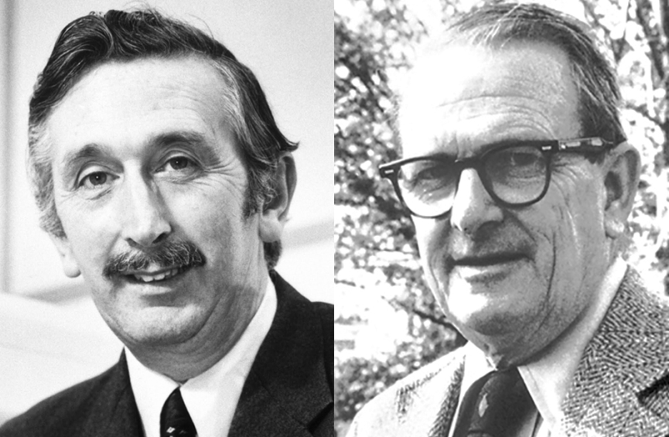
CT
Godfrie
Haunsfield
(1919 - 2004)
Alan
Kormak
(1924 - 1998)
Johan Rodon
(1887 - 1956)
<номер>

Slide 5
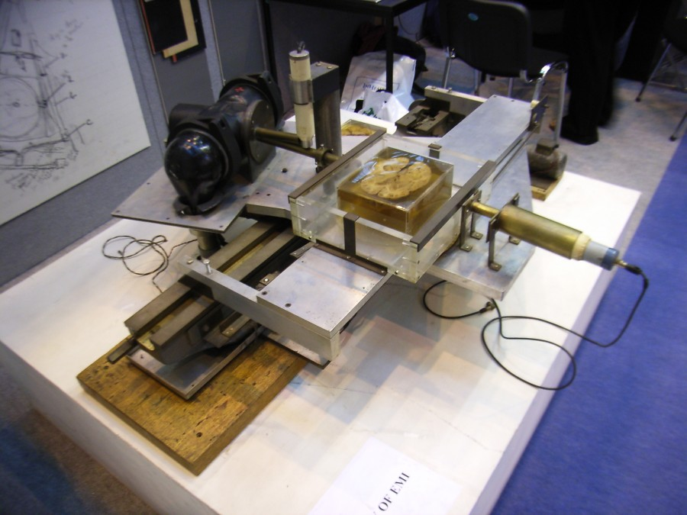
CT
<номер>

Slide 6
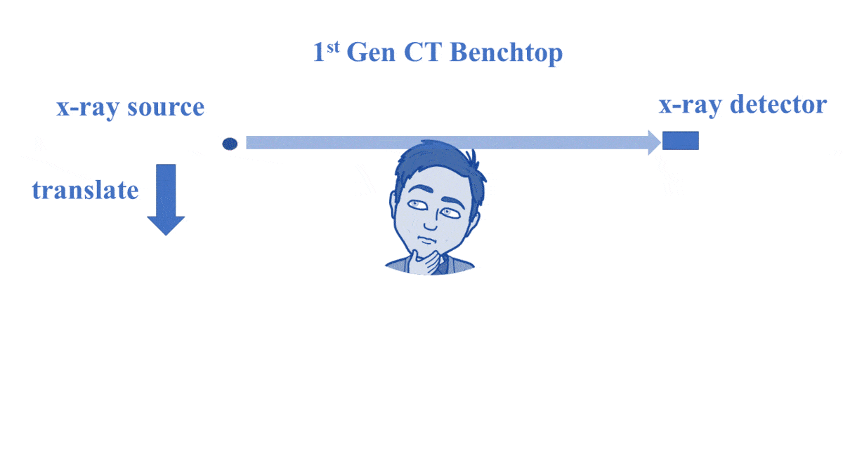
CT
<номер>

Slide 7
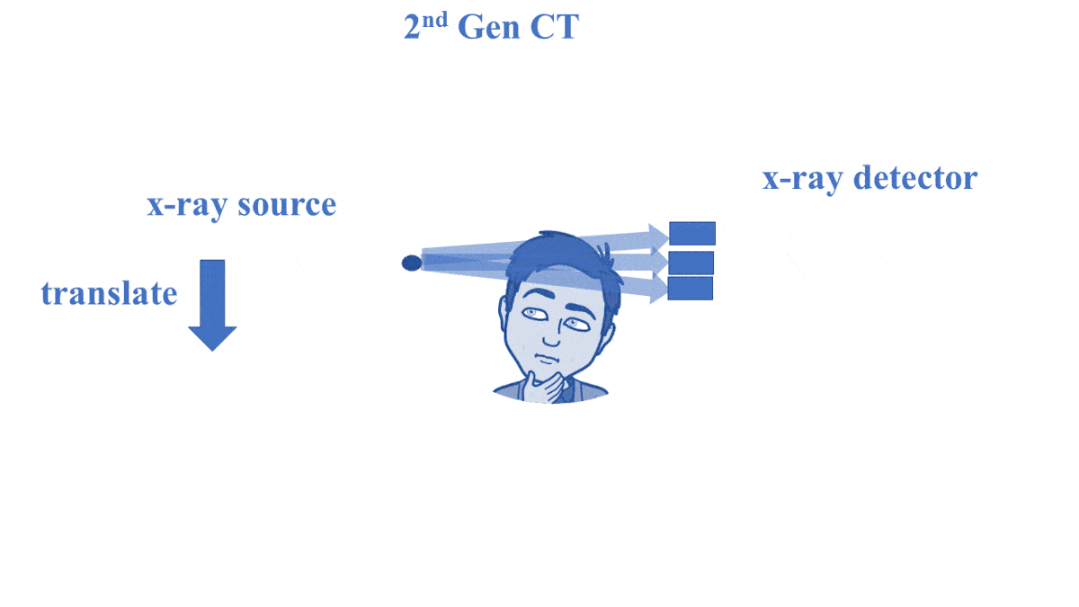
CT
<номер>

Slide 8
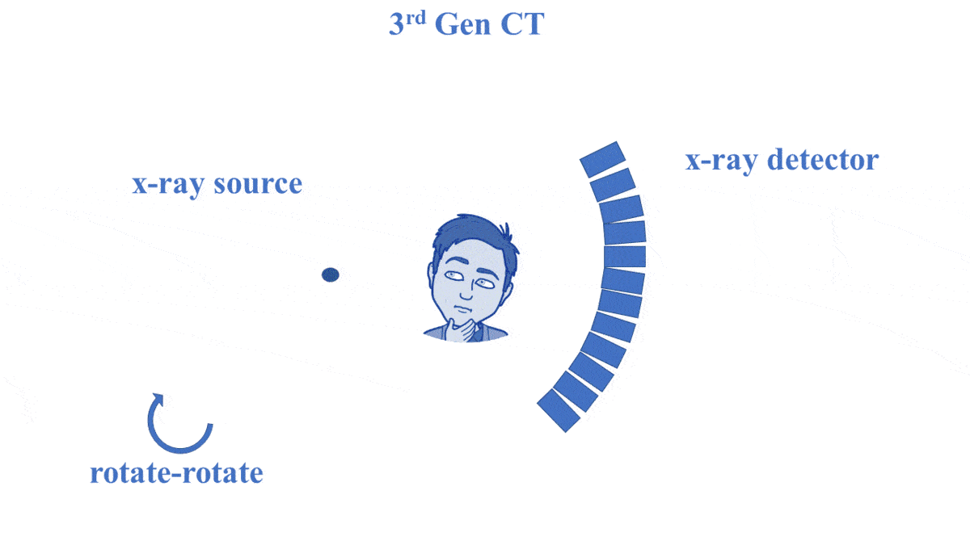
CT
<номер>

Slide 9
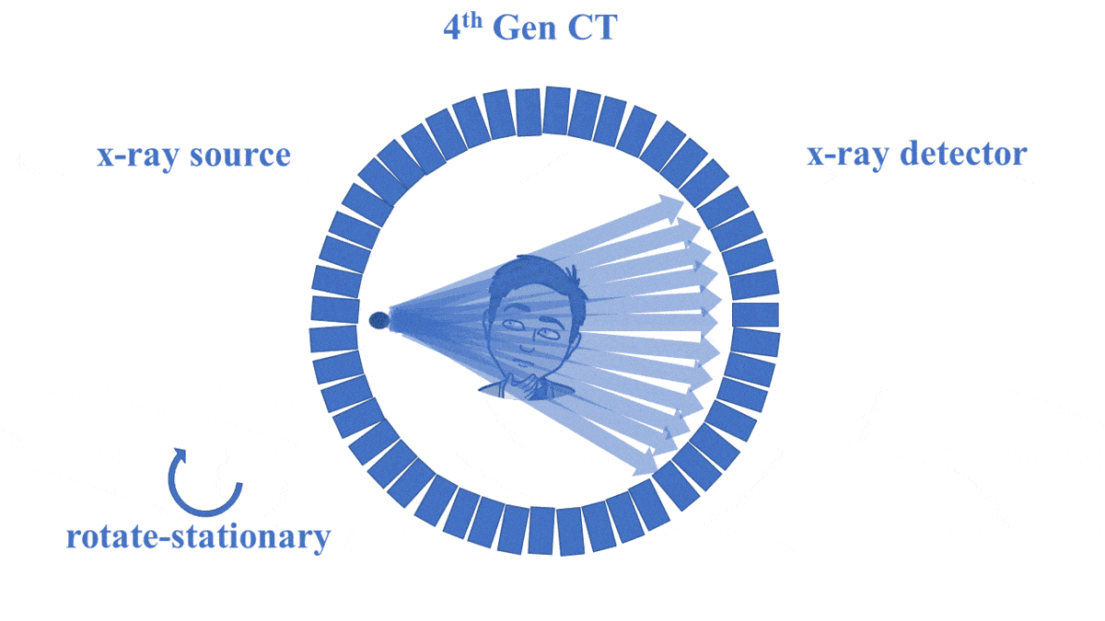
CT
<номер>

Slide 10
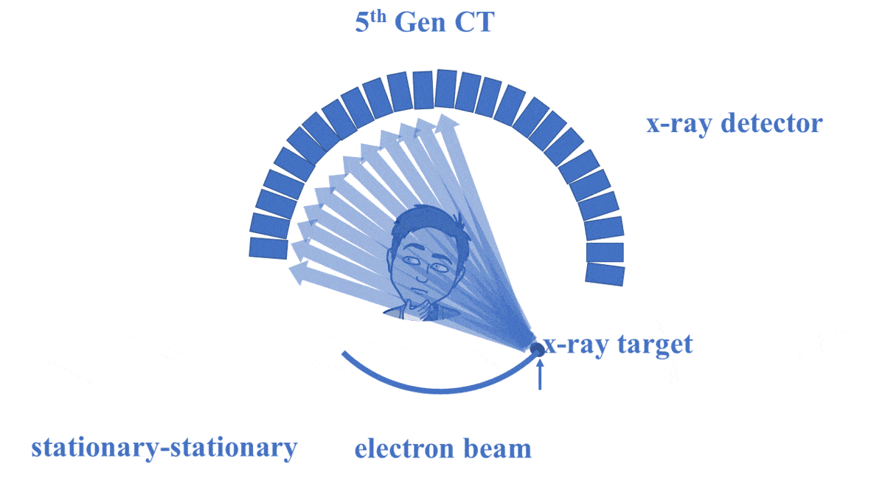
CT
<номер>

Slide 11
CT
<номер>

Slide 12
Detectors
1895
<номер>

Slide 13
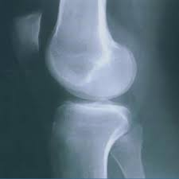
Detectors
1895
1920
<номер>

Slide 14
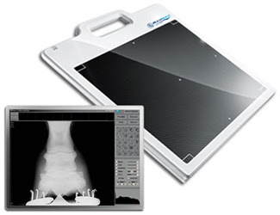
Detectors
1895
1920
1980
<номер>

Slide 15
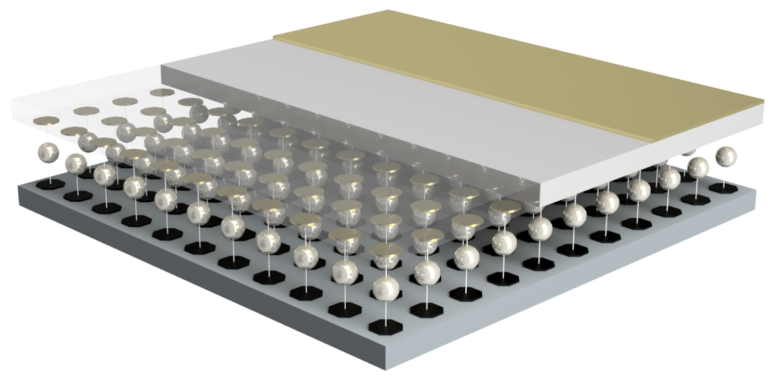
Detectors
1895
1920
1980
1999 - 2005
<номер>

Slide 16
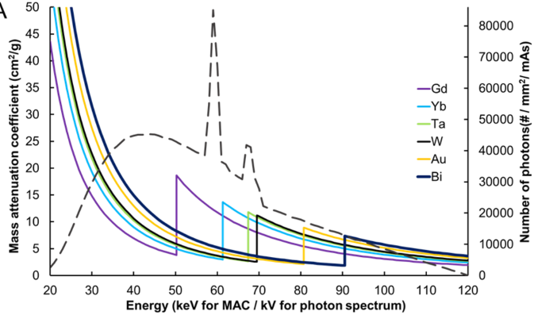
CТ
<номер>

Slide 17
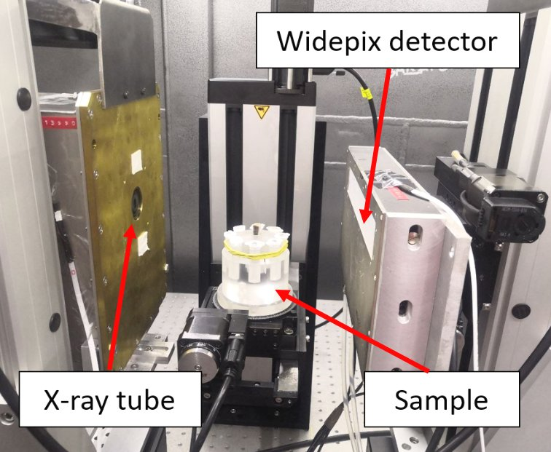
КТ
<номер>

Slide 18
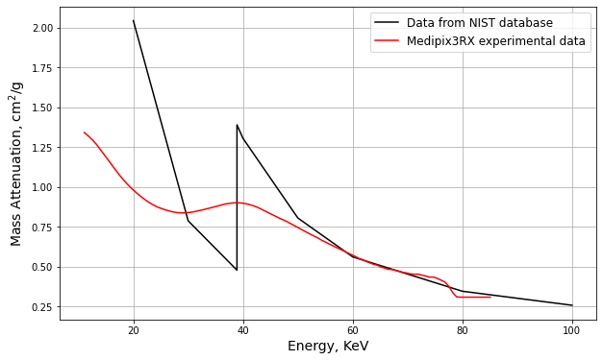
CТ
<номер>

Slide 19
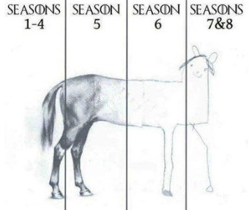
CТ
<номер>

Slide 20
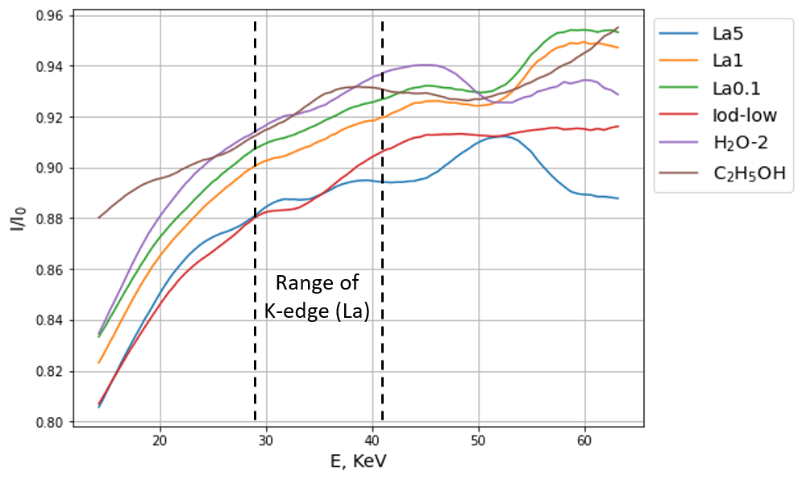
CТ
<номер>

Slide 21
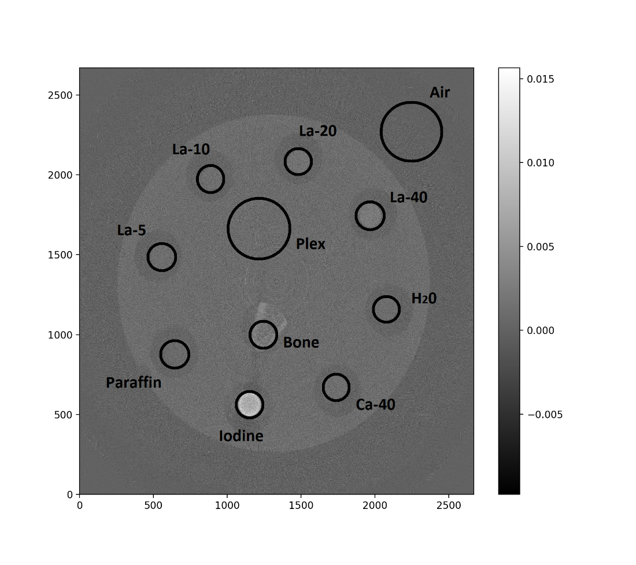
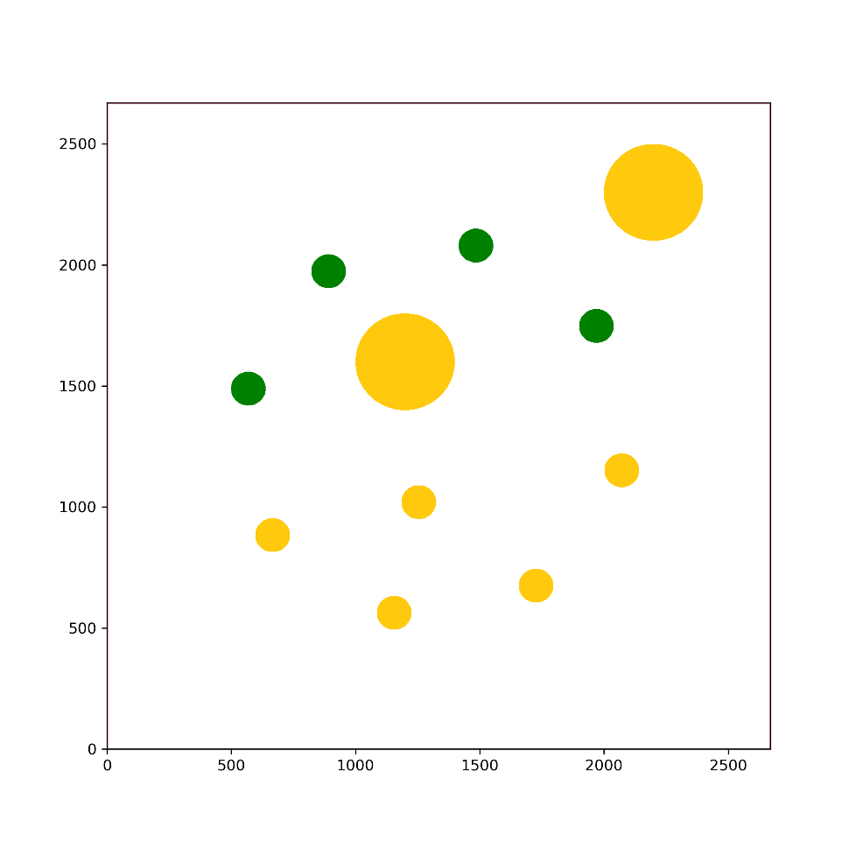
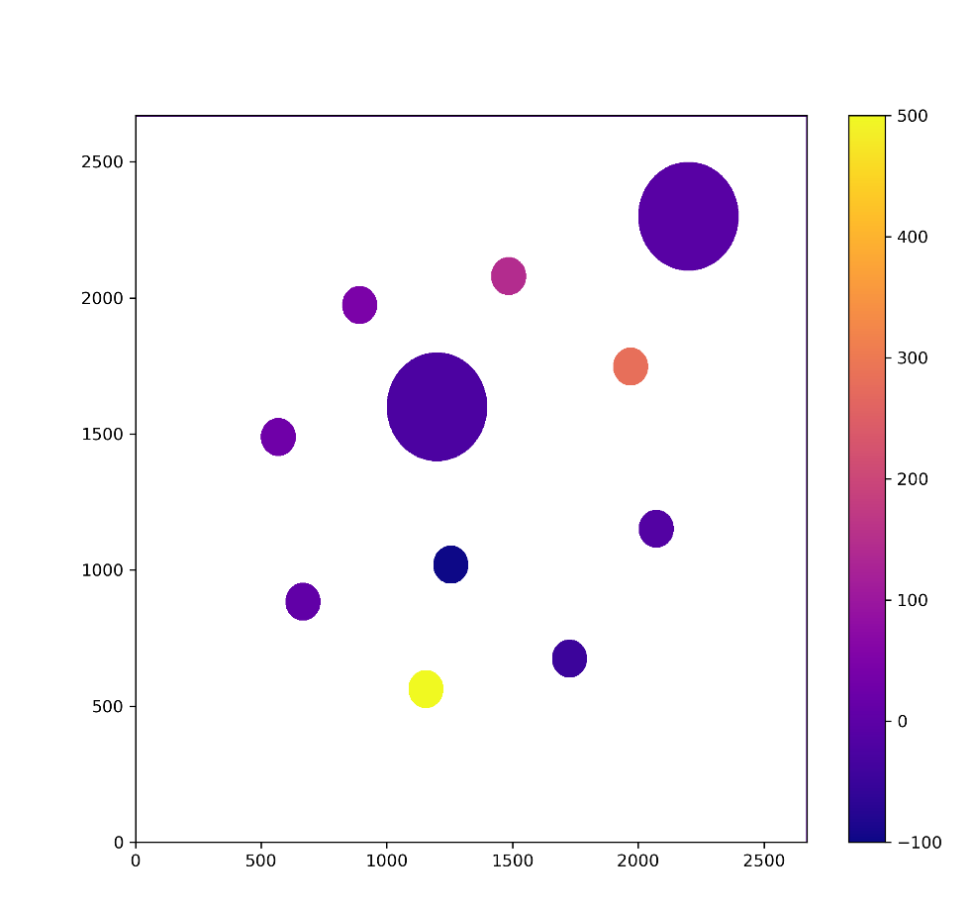
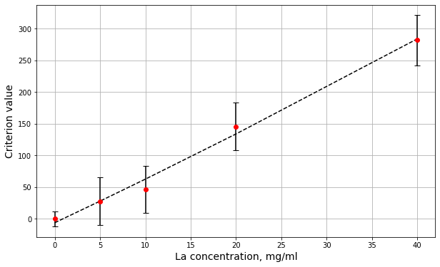
CT
<номер>

Slide 22
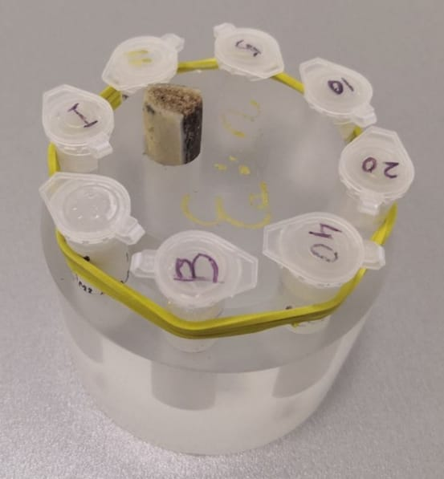
МCТ
Samples with contrasts based on lanthanides: gadolinium, neodymium, lanthanum,
ttps://doi.org/10.3390/nano12234110
<номер>

Slide 23
МCТ
Samples with contrasts based on lanthanides: gadolinium, neodymium, lanthanum,
ttps://doi.org/10.3390/nano12234110
2023
<номер>

Slide 24
MCT
MCT of a mouse with injected Gd/SiO2 contrast. Faculty of Chemistry and Faculty of Fundamental Medicine, Moscow State University. M.V. Lomonosov. RSF grant 22-15-00072.
<номер>

Slide 25
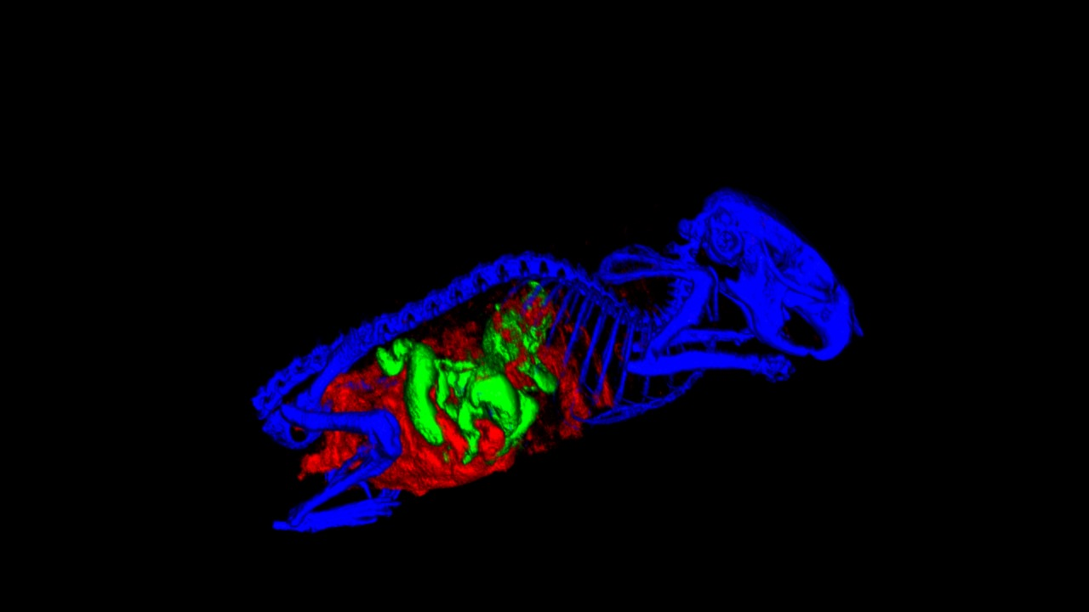
MCT
<номер>

Slide 26
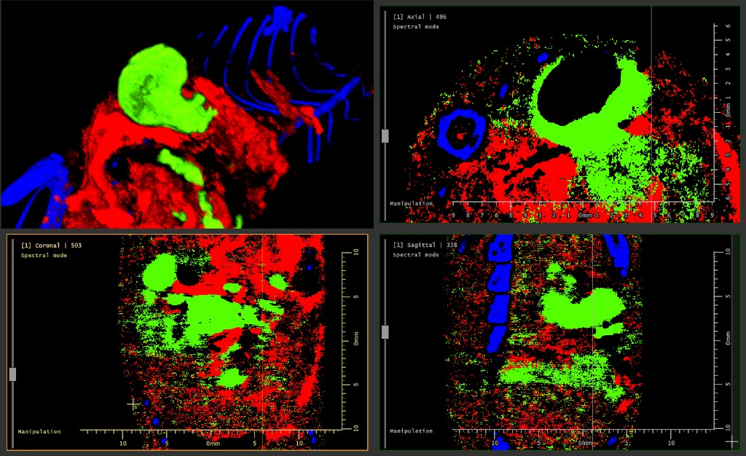
MCT
<номер>

Slide 27
MCT
Kidney stone. Burial 4th millennium BC, Stavropol region. Research Institute and Museum of Anthropology of Moscow State University named after M.V. Lomonosov, Faculty of Chemistry and Faculty of Fundamental Medicine, Moscow State University named after M.V. Lomonosov.
<номер>

Slide 28
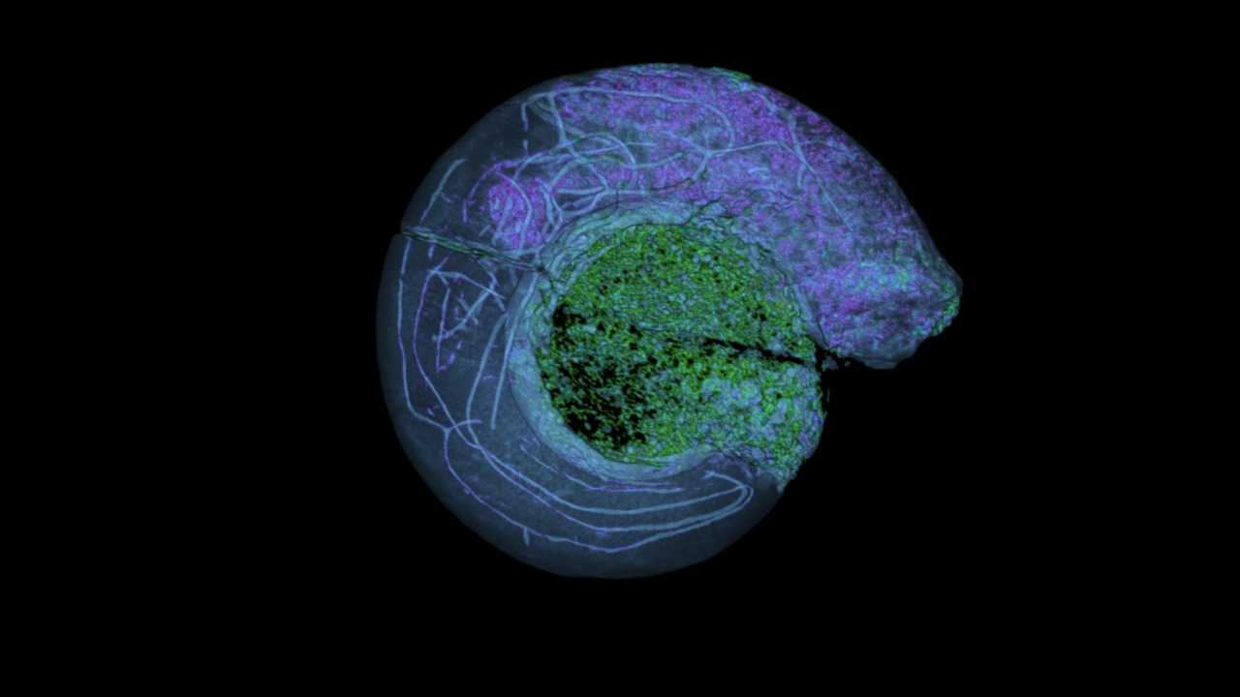
MCT
<номер>

Slide 29
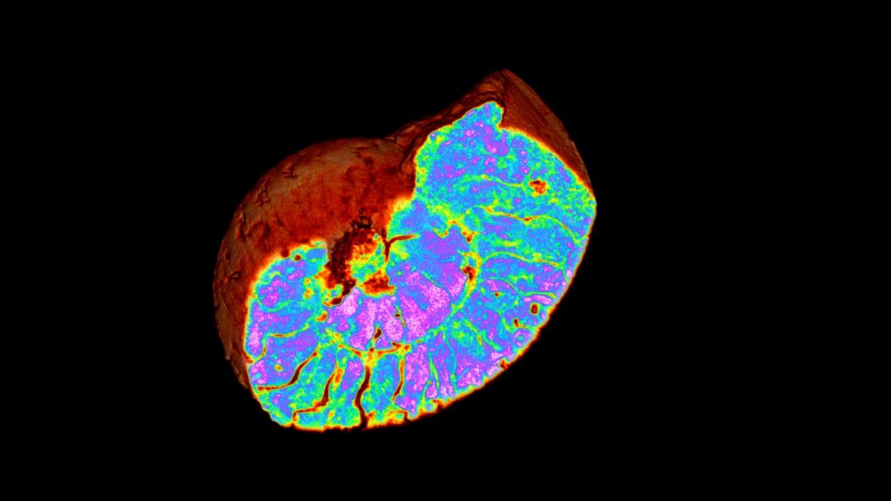
MCT
<номер>

Slide 30
MCT
Metacarpal bone. Burial of the 4th century. BC, Stavropol region. Research Institute and Museum of Anthropology of Moscow State University named after M.V. Lomonosov, Faculty of Fundamental Medicine, Moscow State University named after M.V. Lomonosov.
2024
<номер>

Slide 31
MCT
Metacarpal bone. Burial of the 4th century. BC, Stavropol region. Research Institute and Museum of Anthropology of Moscow State University named after M.V. Lomonosov, Faculty of Fundamental Medicine, Moscow State University named after M.V. Lomonosov.
2024
<номер>

Slide 32
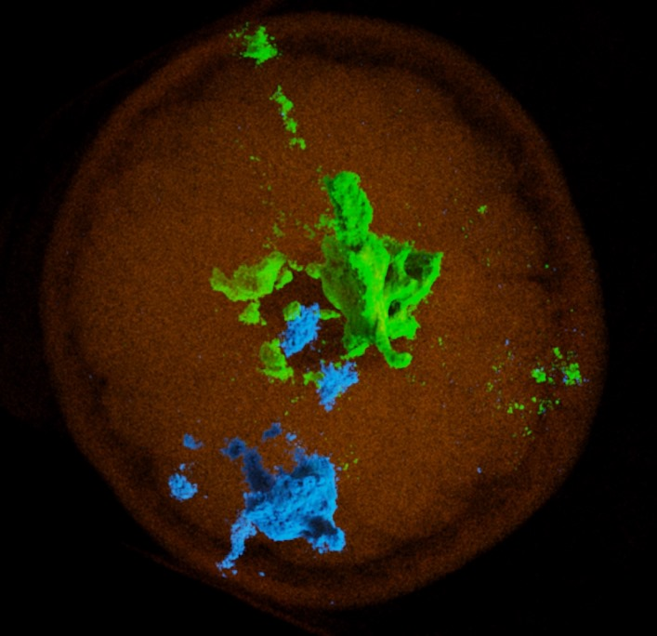
Puzzle
The image shows a study of the processes of diffusion of combinations of salts of rare earth elements in complex aqueous-organic environments, locally limited by compartments of semi-permeable carbohydrate shells.
Question: name the object where the research was carried out?
<номер>

Slide 33
Puzzle
The image shows a study of the processes of diffusion of combinations of salts of rare earth elements in complex aqueous-organic environments, locally limited by compartments of semi-permeable carbohydrate shells.
Question: name the object where the research was carried out?
Hint: we had a dozen such objects, but during the preparation of the experiment, almost all of them were used for their intended purpose.
<номер>

Slide 34
Puzzle
<номер>

Slide 35
Thank you for your attention =)
rozhkov@jinr.ru
Работа выполнена при поддержке Гранта ОМУС №24-201-06
<номер>

