Slide 1
Объединение молодых ученых и специалистов
Международной межправительственной организации Объединенный институт ядерных исследований
Notes:
1

Slide 2
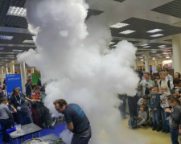
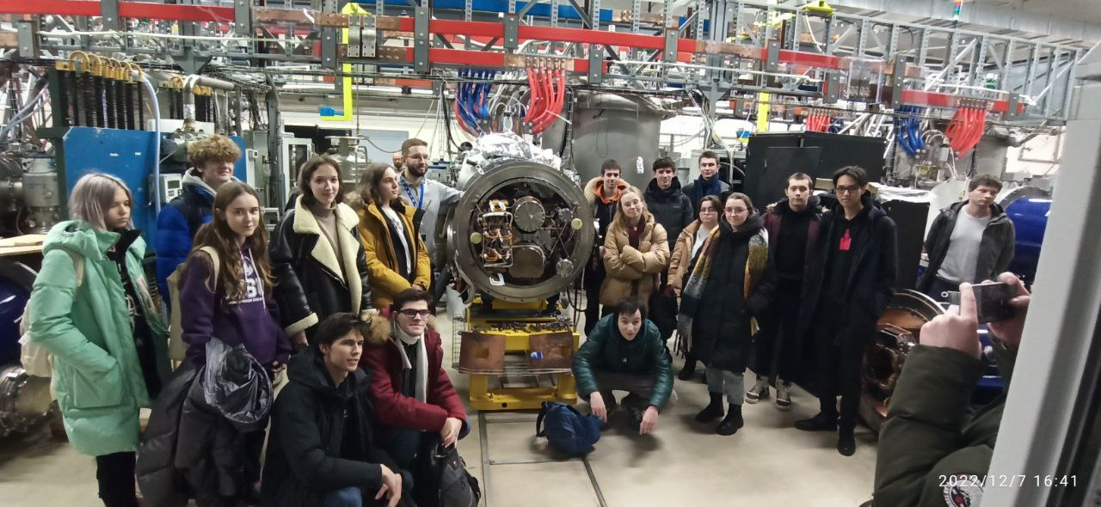
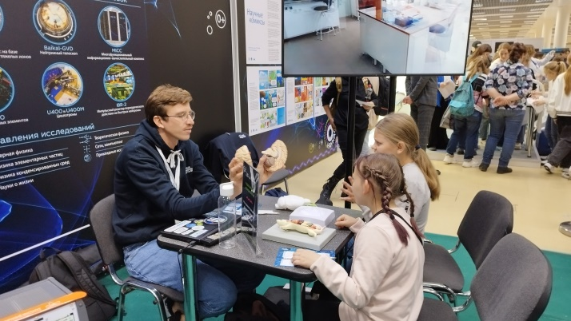
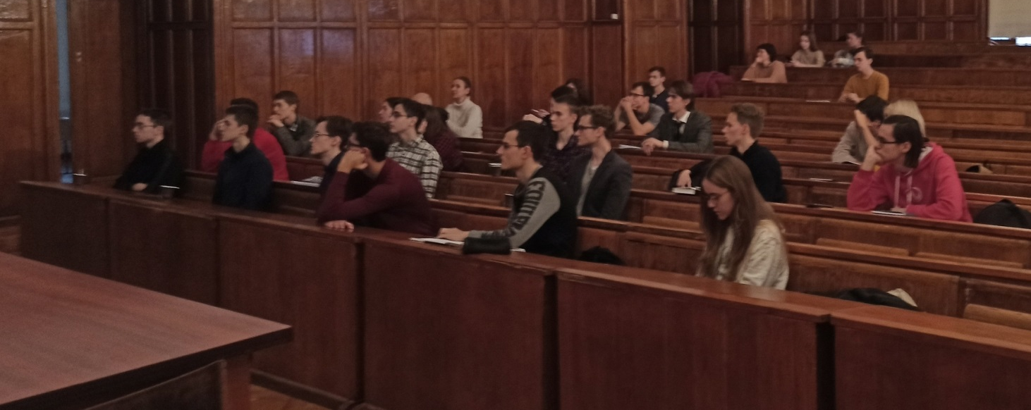
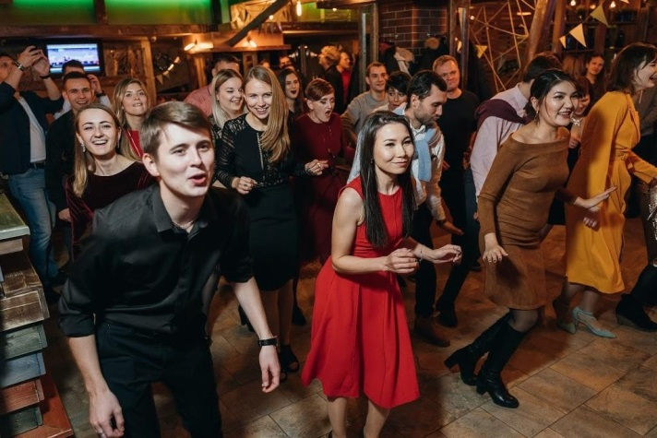
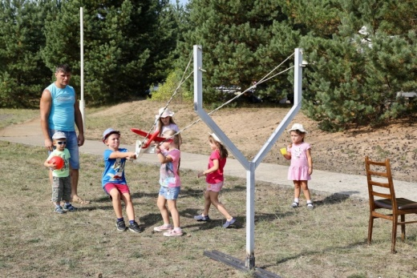
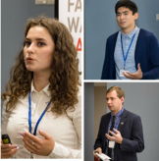
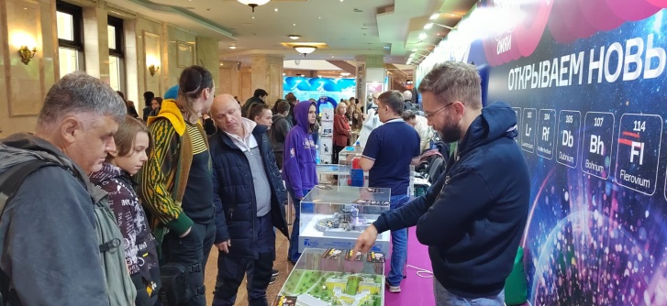
Объединение Молодых Ученых и Специалистов ОИЯИ
~1200 сотрудников возрастом до 36 лет;
Мероприятия ОМУС:
Организация молодёжных конференций и школ;
Популяризация науки (лекции, экскурсии, фестивали) ;
Организация социальных и культурных мероприятий;
Волонтёрство;
Гранты и премии ОМУС;
Продвижение молодёжных инициатив
Notes:
2

Slide 3
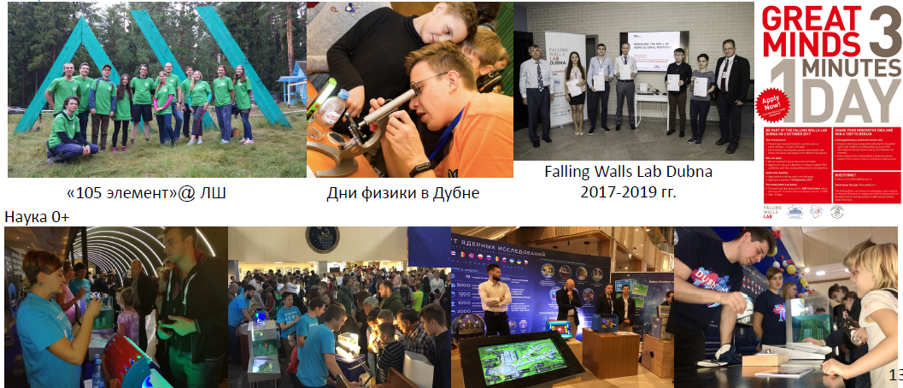
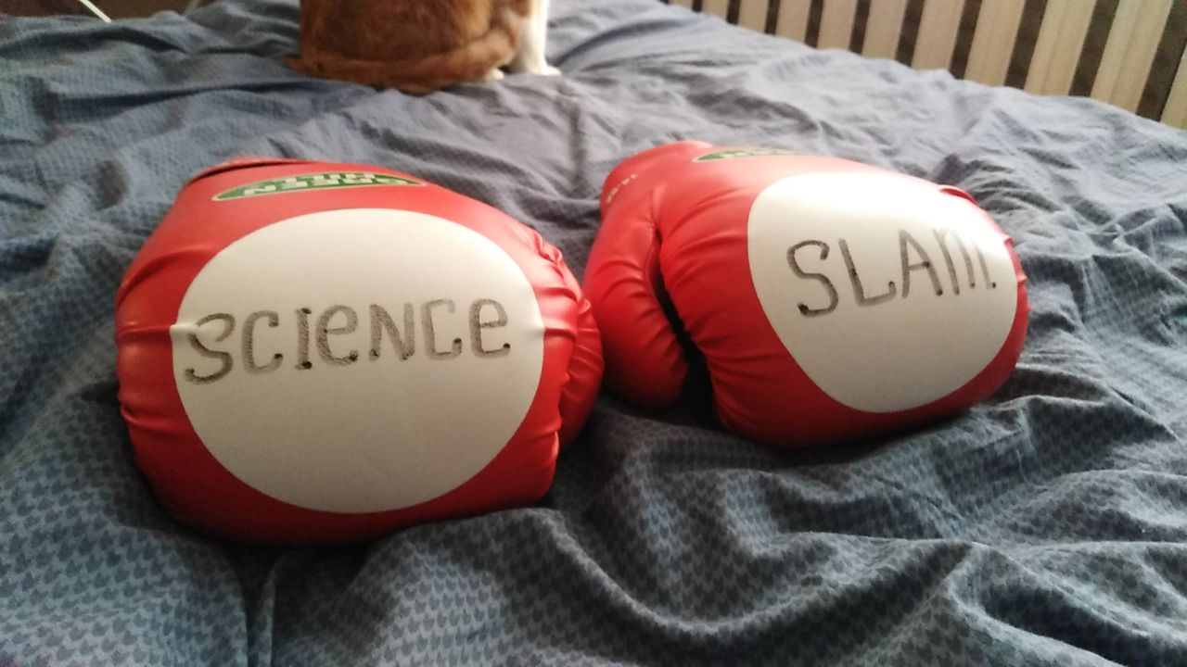
Популяризация науки

Slide 4
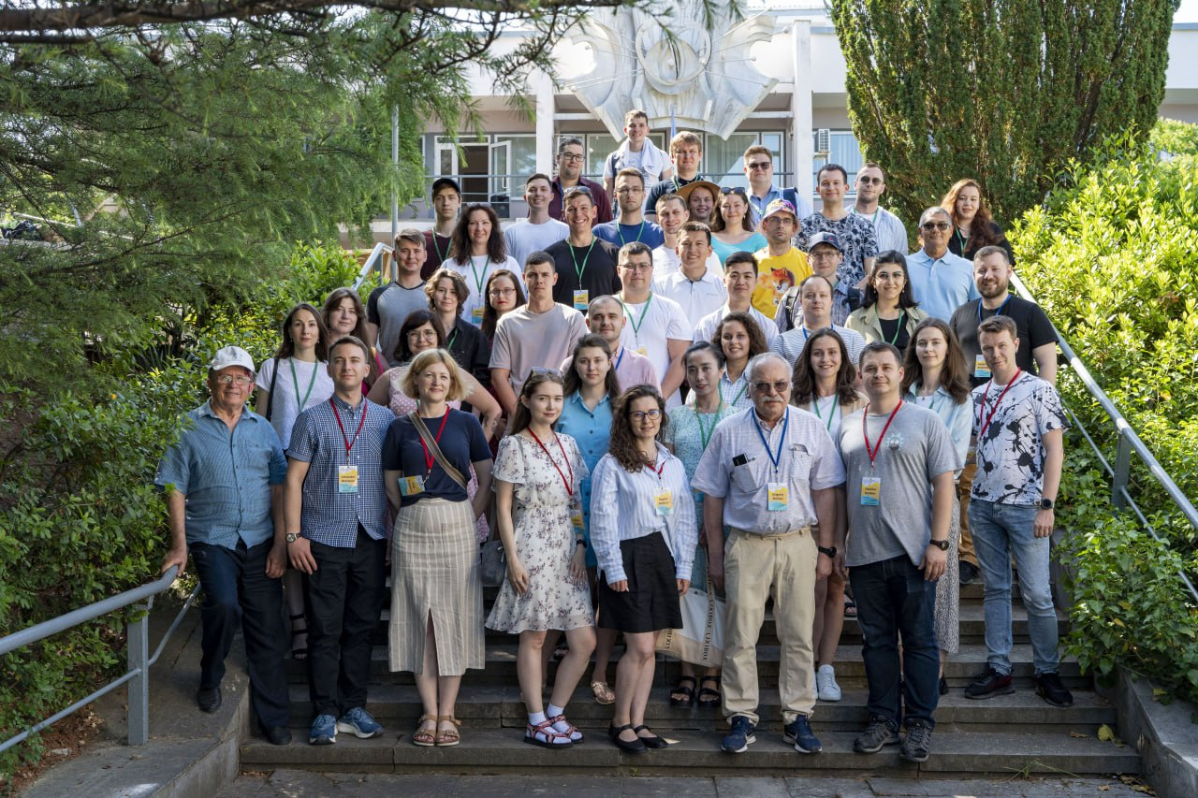
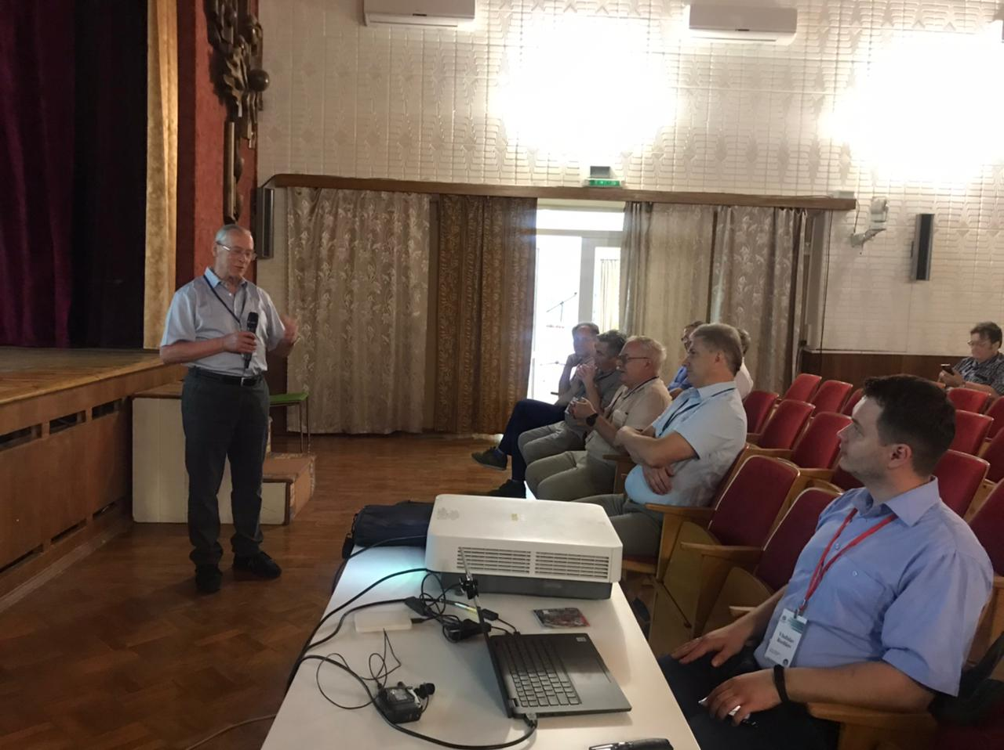
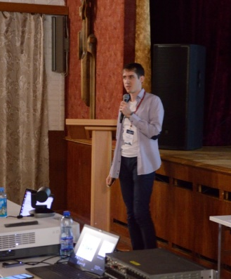
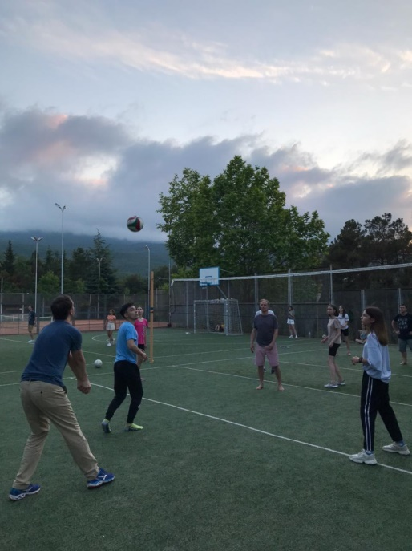
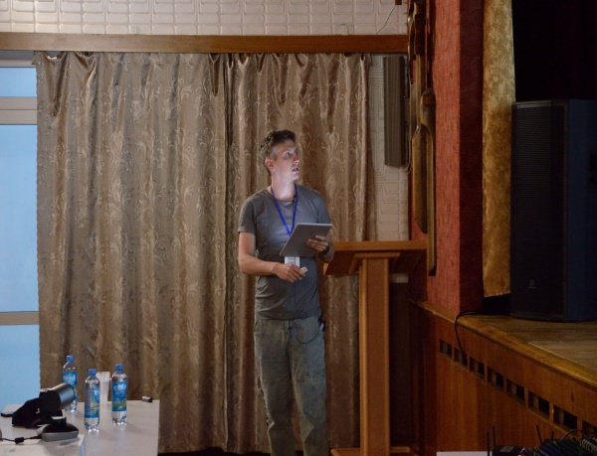
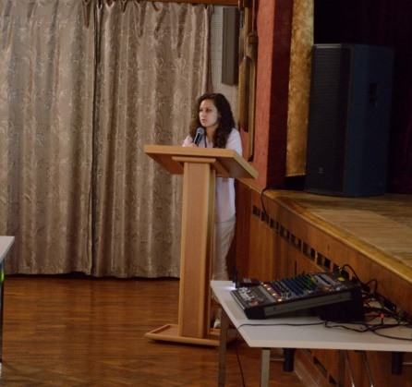
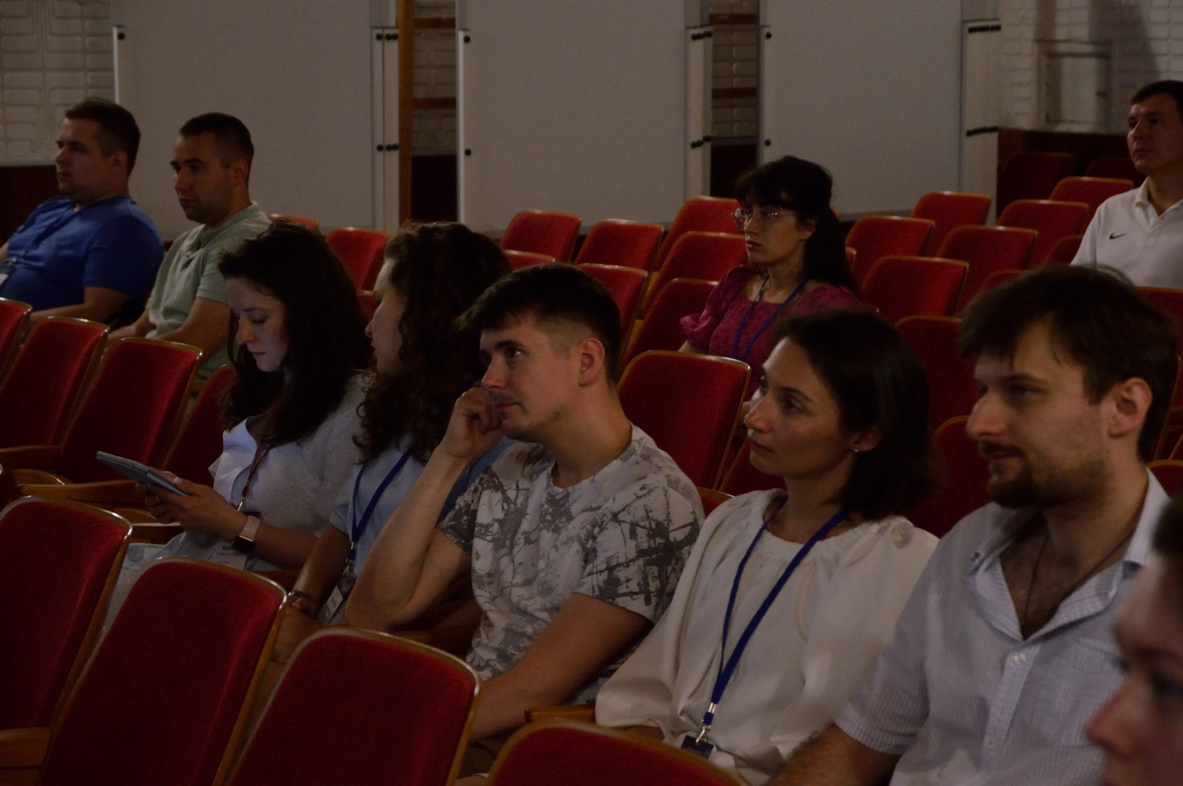
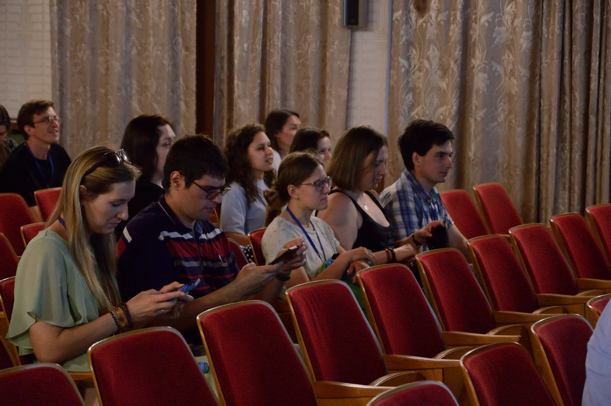
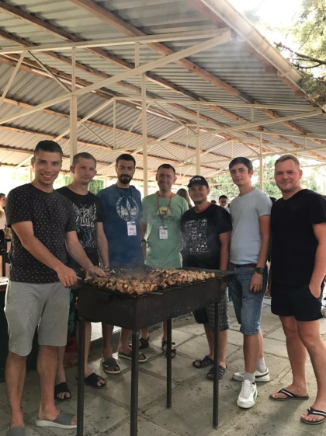
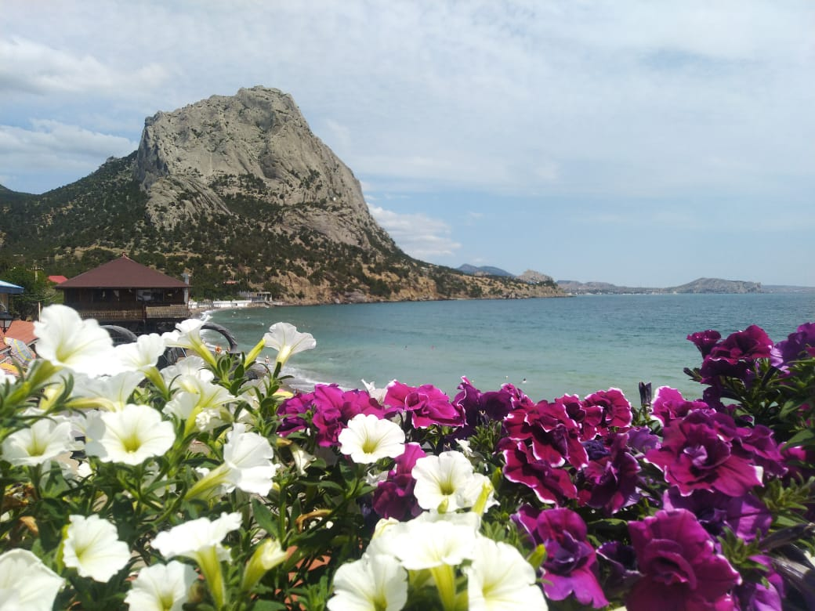
Конференция ОМУС ОИЯИ “Алушта-2024” июня
Notes:
4

Slide 5
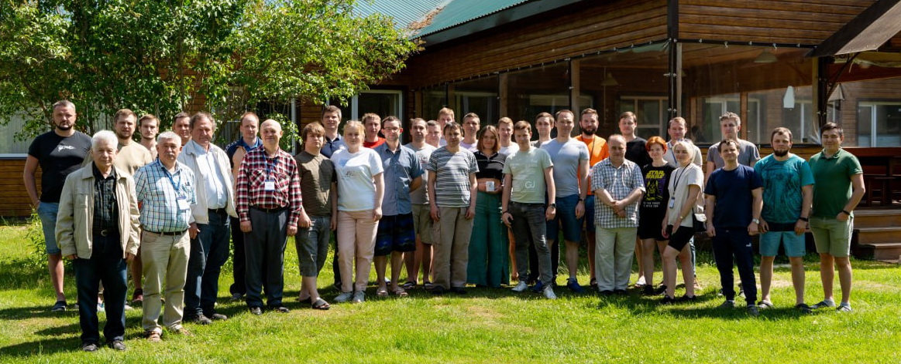
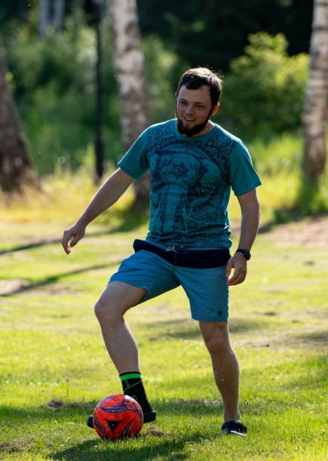
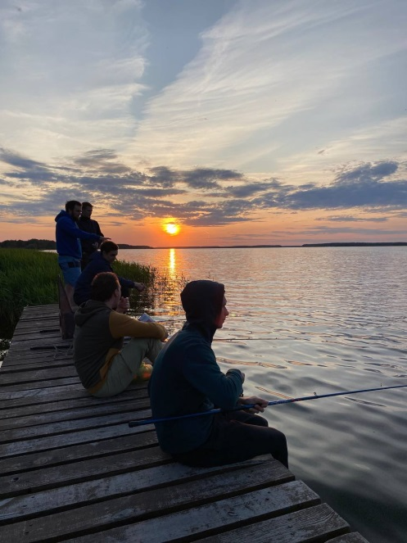
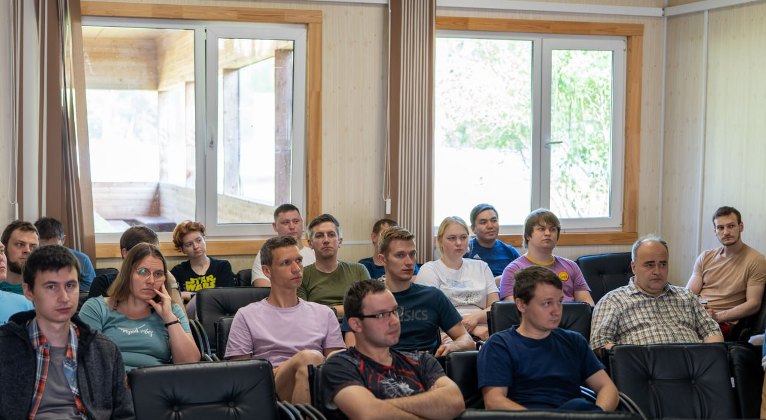
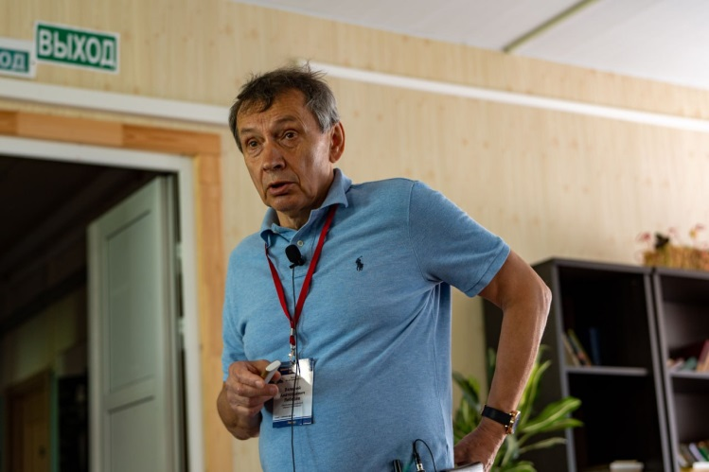
Школа ускорительной физики 19-23 июня 2023
30 участников
(ЛФВЭ, ЛЯР, ЛНФ, ЛЯП)
20 лекций от лекторов из ОИЯИ и МФТИ
Notes:
5

Slide 6
Школа ускорительной физики 19-23 июня 2023
Мешков И.Н. | От Синхрофазотрона до НИКИ (Ускорители и эксперименты)
Апарин А.А. | Структура комплекса NICA. Экспериментальные требования к параметрам пучка
Левтеров К.А. | Источники лёгких частиц
Бойцов А.Ю. | Источники тяжелых ионов
Лебедев В.А. | Синхротроны. Концепция и применение в экспериментах с пучками адронов
 | Коллайдеры
 | Синхротроны. Физика синхротронного излучения
Осипов К.Г. | ВЧ-системы и СВЧ-техника
Седых Г.С. | Системы управления
Зеленский А.Н. | Источники поляризованных пучков и поляриметрия в ускорительном комплексе NICA
Филатов Ю.Н. | Управление поляризацией протонов и дейтронов в ускорительном комплексе NICA
Сыресин Е.М. | Системы электронного охлаждения
Горелышев И.В. | Системы стохастического охлаждения
Константинов А.В. | Криогенная техника СП ускорителей
Галимов А.Р. | Вакуумная техника
Костромин С.А. | Магнитные системы ускорителей
 | Радиационная безопасность и система блокировок
Шурыгин А.А. | Системы электропитания
Сидорин А.О | Линейные ускорители
 | Работа систем ускорительного комплекса в ходе сеанса
Notes:
6

Slide 7
Школа ускорительной физики: Циклотроны. Предварительно - август/сентябрь 2024
Notes:
7

Slide 8
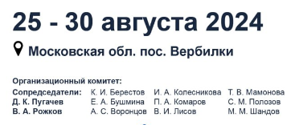
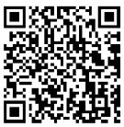
Школа ускорительной физики: Циклотроны. Предварительно - август/сентябрь 2024
Notes:
8

Slide 9
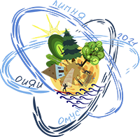
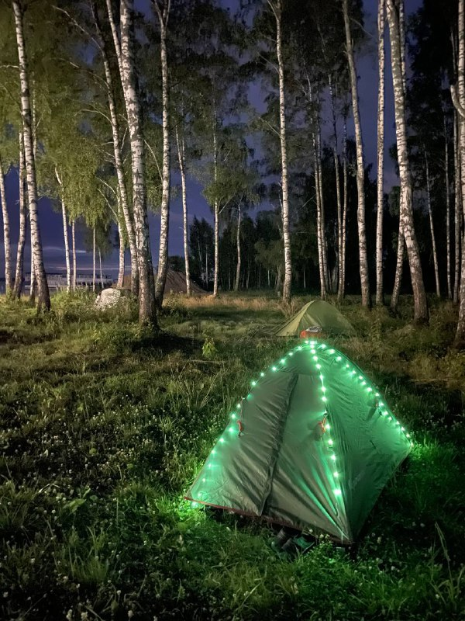
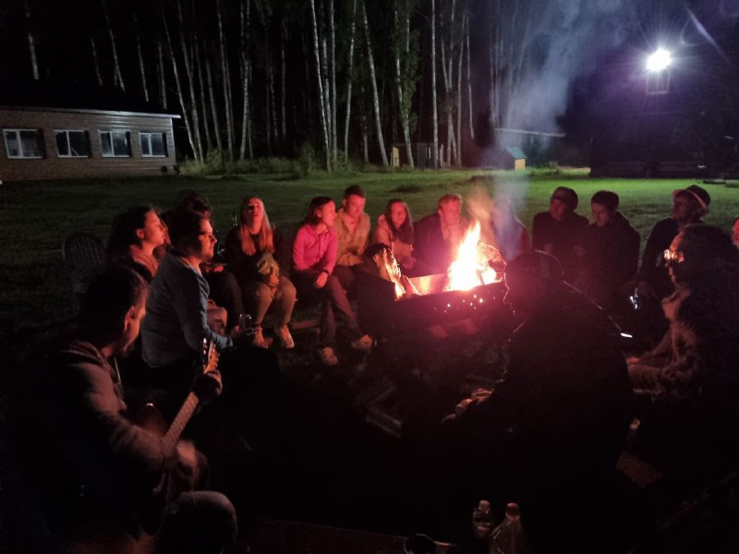
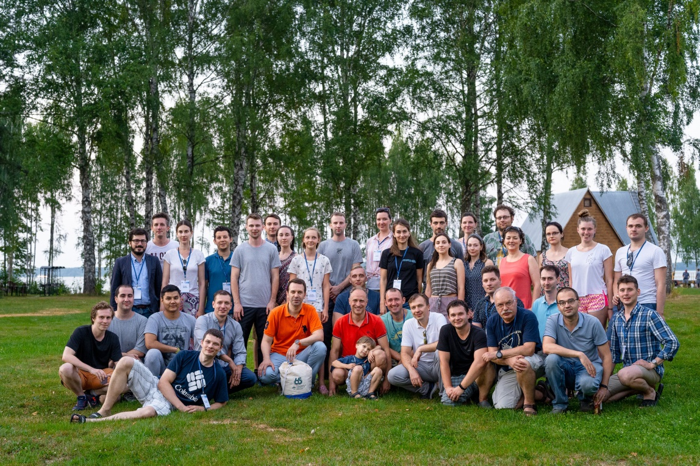
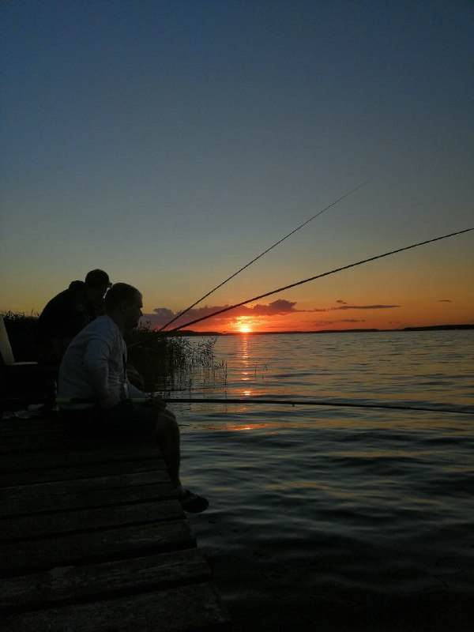
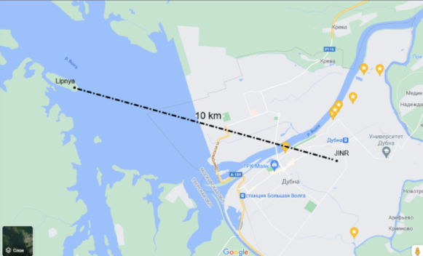
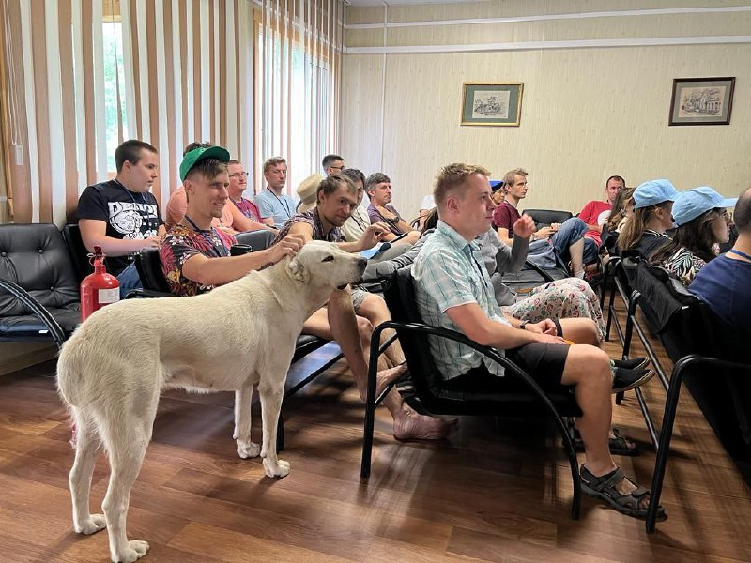
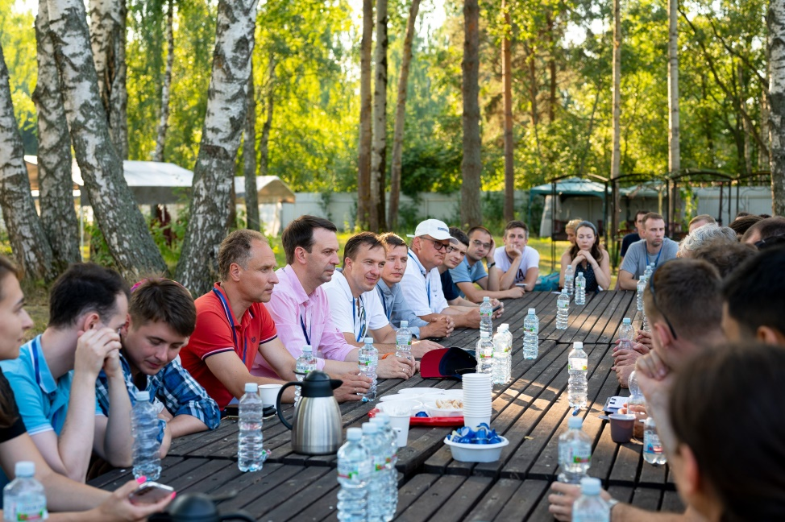
Школа ОМУС ОИЯИ “Липня” 20-21 июля 2024
лекции
Мастер-классы
круглый стол с дирекцией ОИЯИ и
Администрацией городского округа Дубна
песни у костра
Notes:
9

Slide 10
Школа ОМУС ОИЯИ “Липня” 20-21 июля 2024
Участники школы:
Сотрудники ОИЯИ
Сотрудники других
градообразующих
предприятий
лекции
Мастер-классы
круглый стол с дирекцией ОИЯИ и
Администрацией городского округа Дубна
песни у костра
Notes:
10

Slide 11
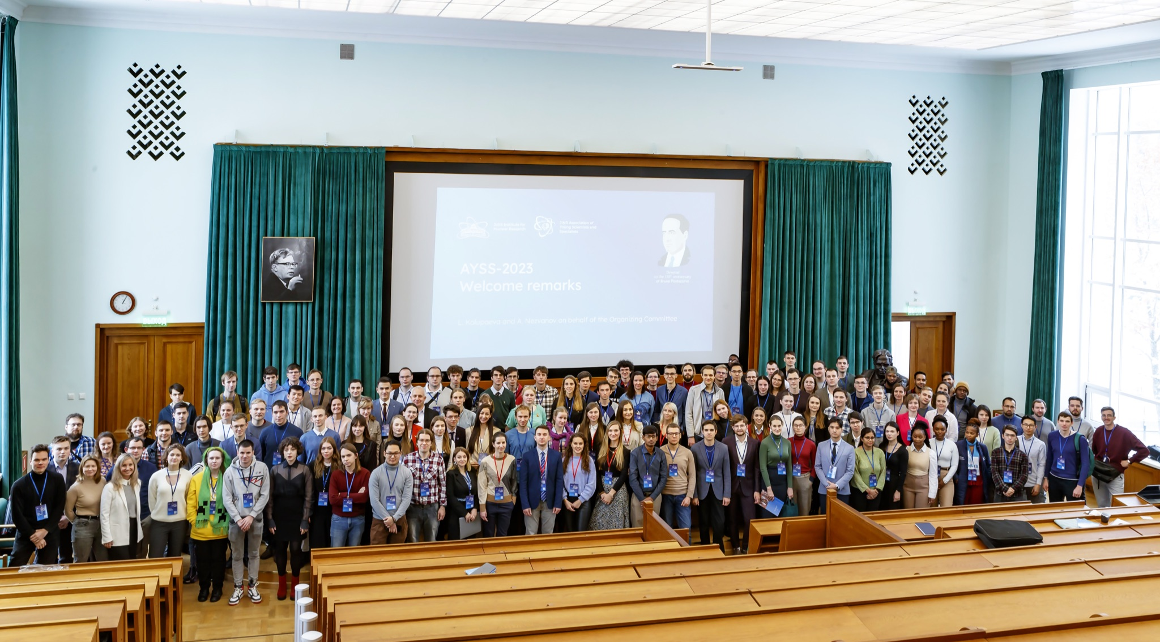
Международная конференция молодых учёных и специалистов AYSS
240 on-site participants: 133 external + 107 JINR young scientists.
12 countries: Armenia, Azerbaijan, Belarus, Cuba, Egypt, India, Kazakhstan, Russia, Serbia, South Africa, Syria, Vietnam.
45 scientific institutes and universities + 7 JINR laboratories.
Notes:
11

Slide 12
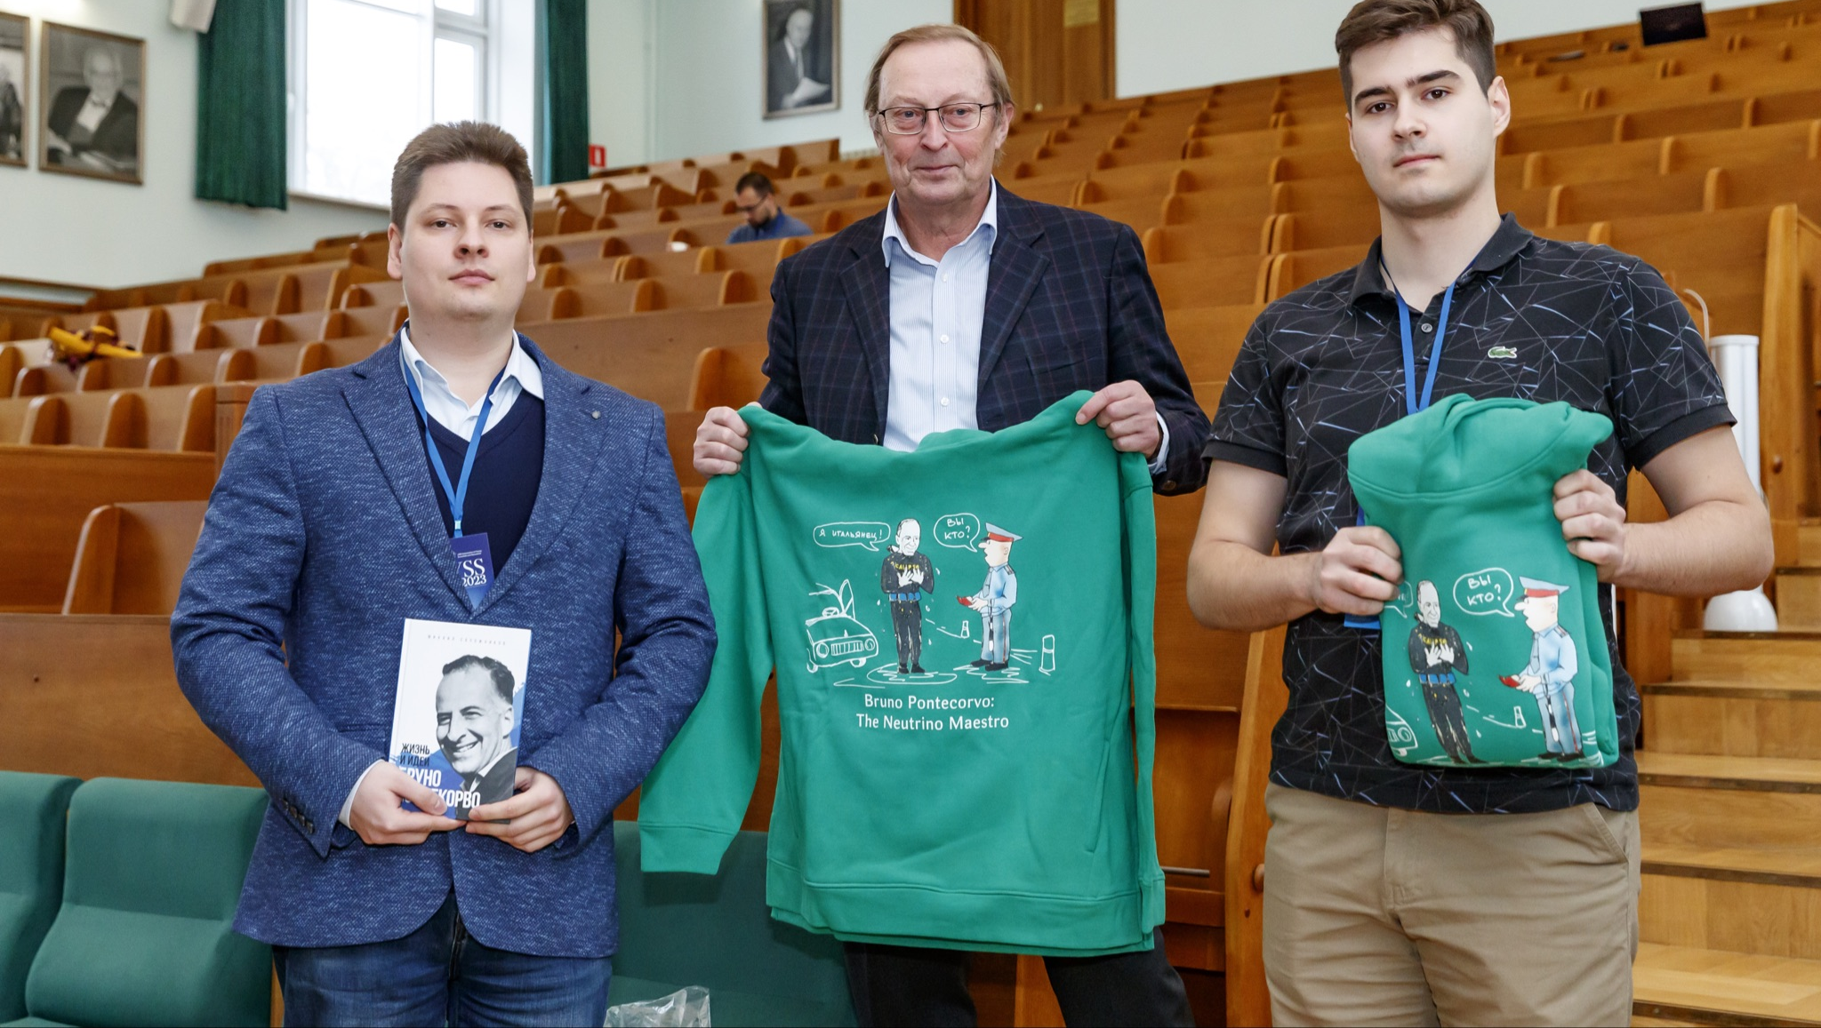
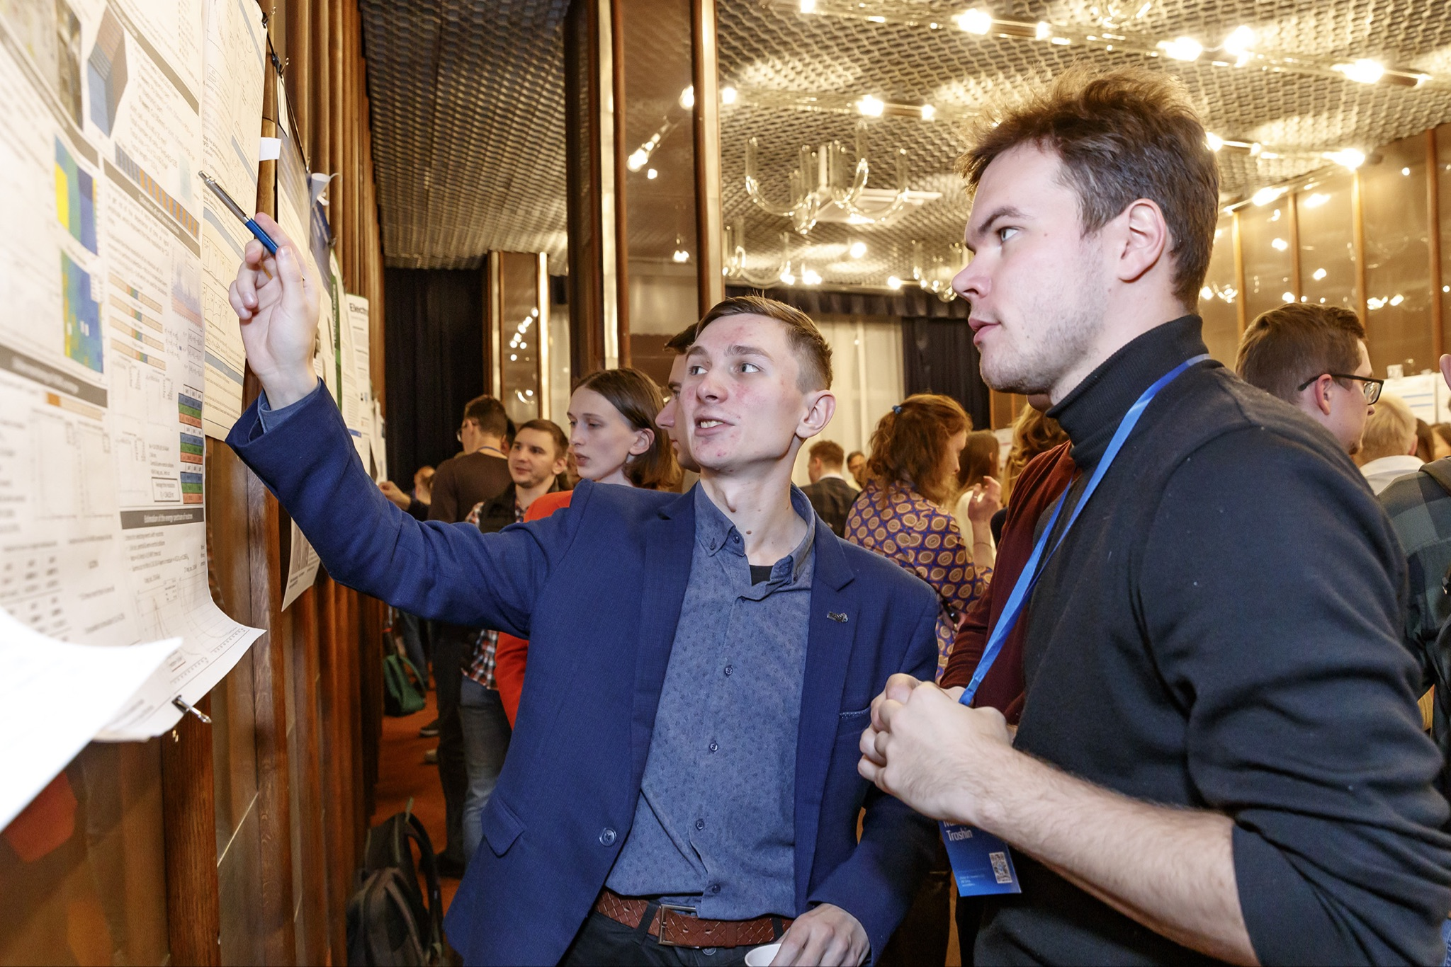
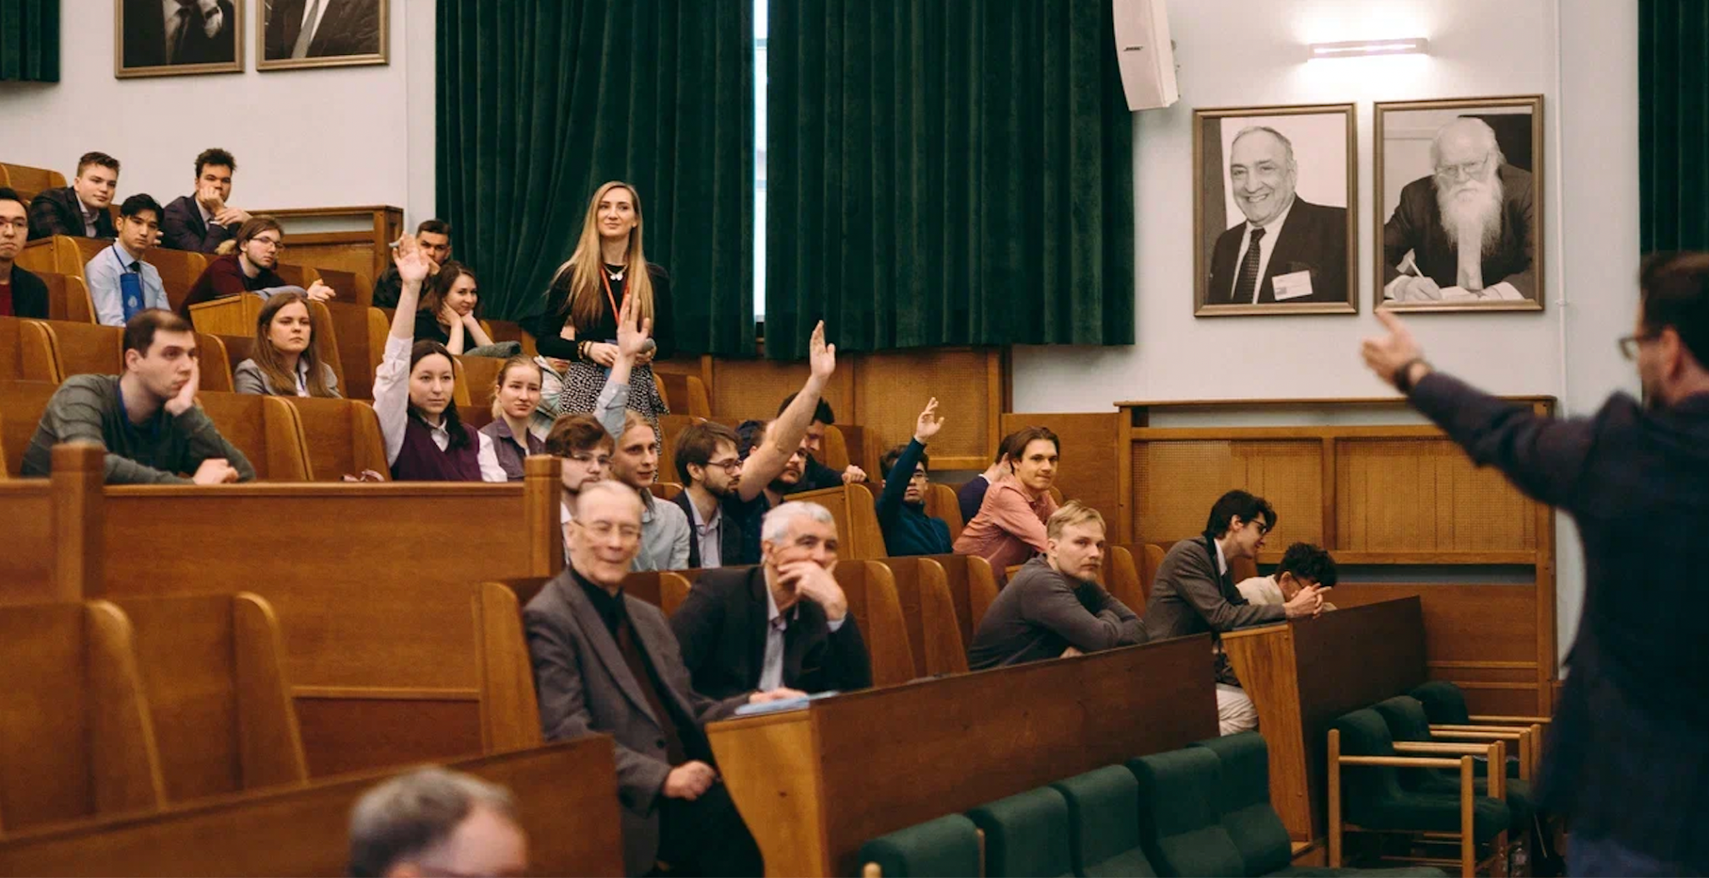
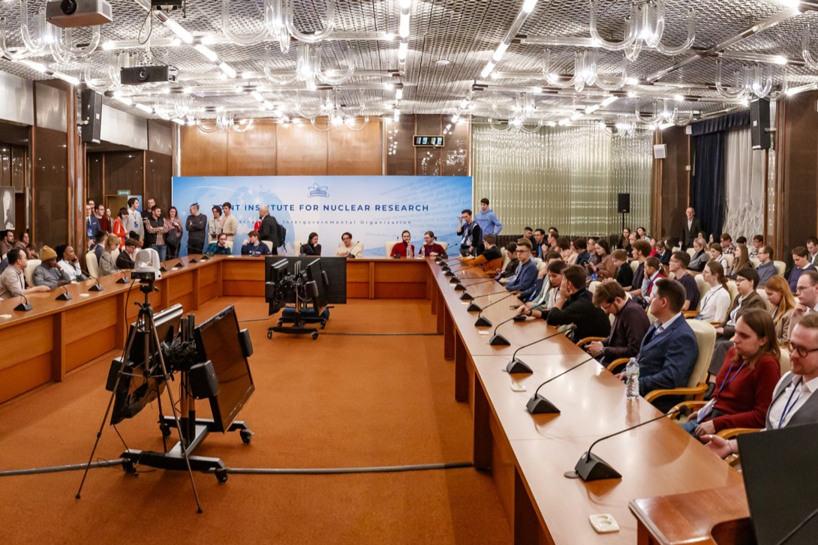
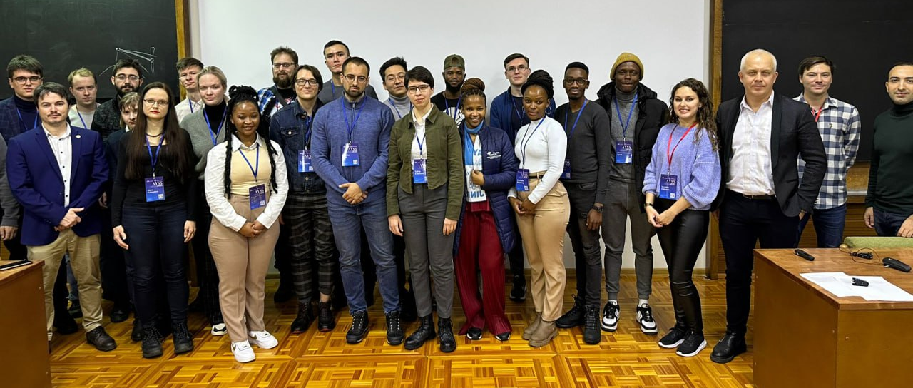
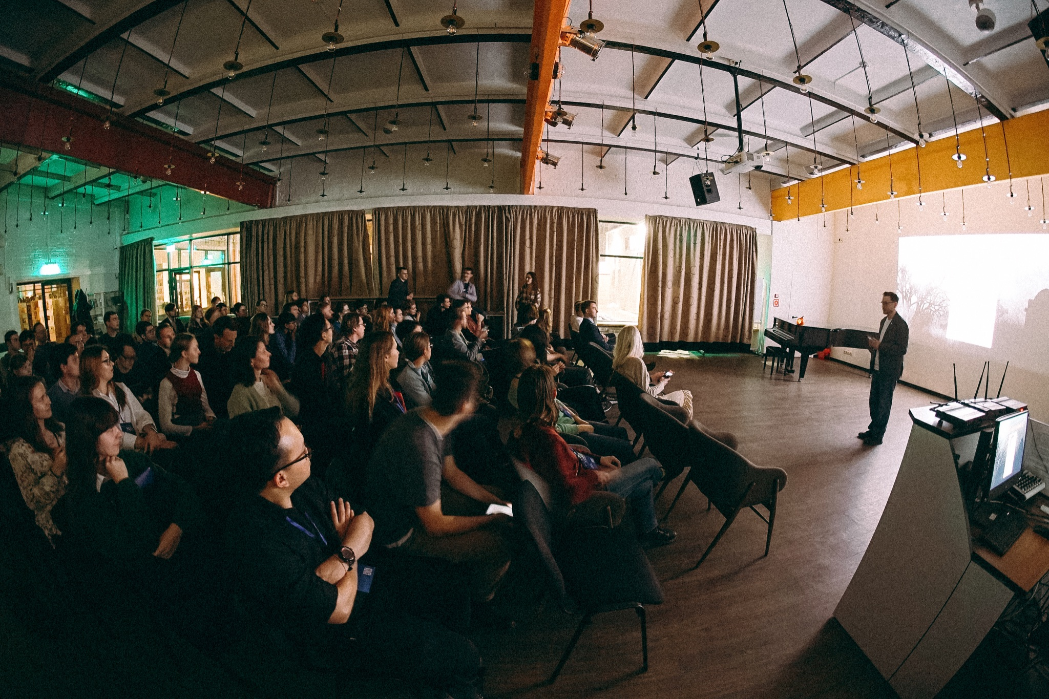
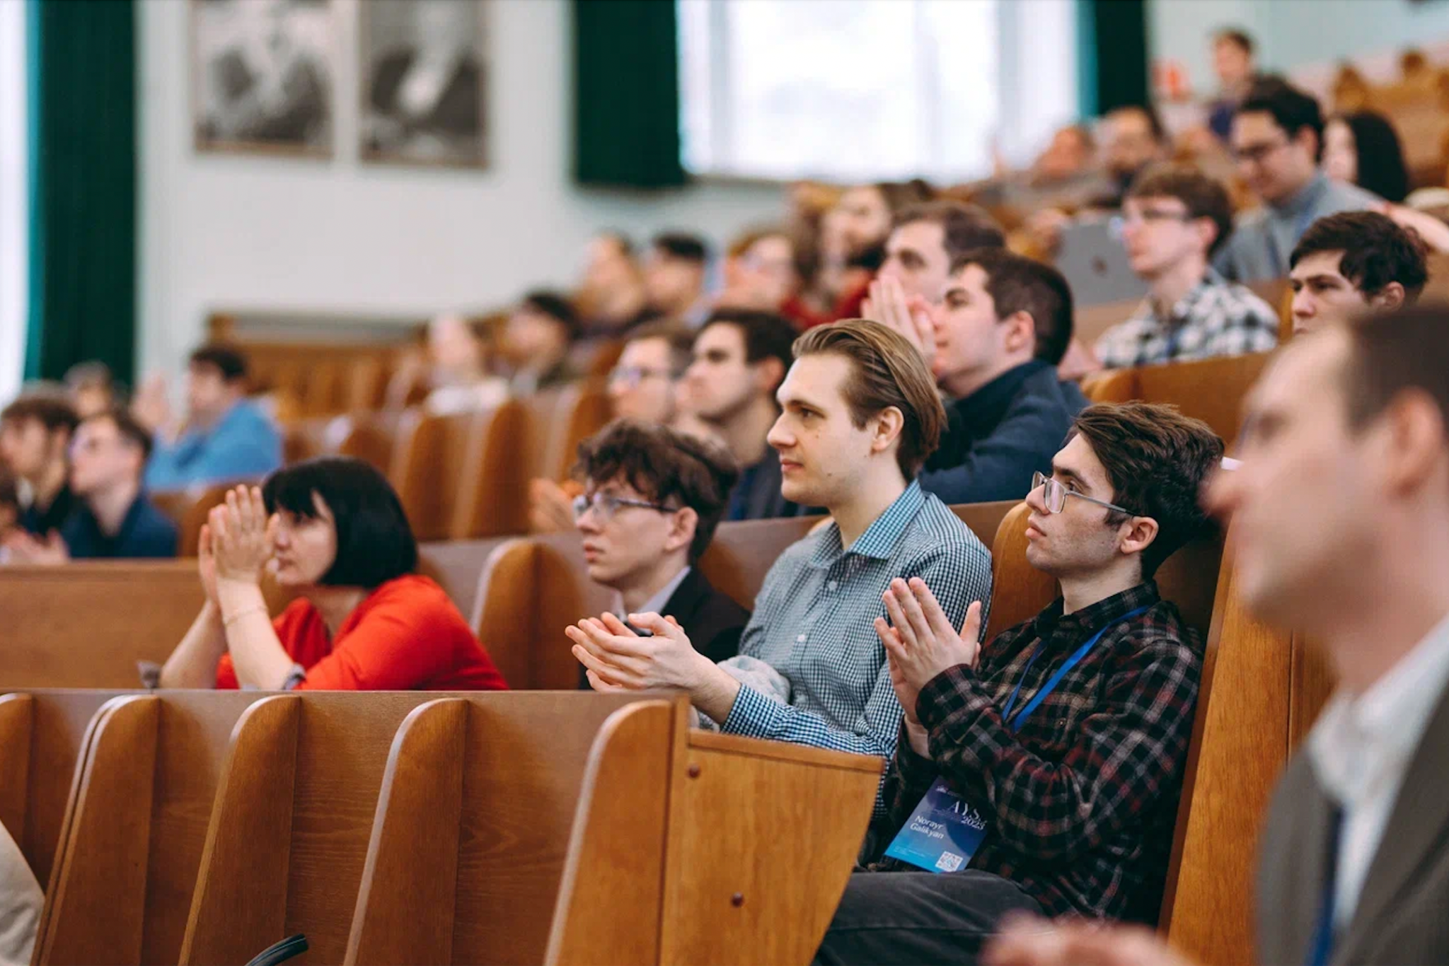
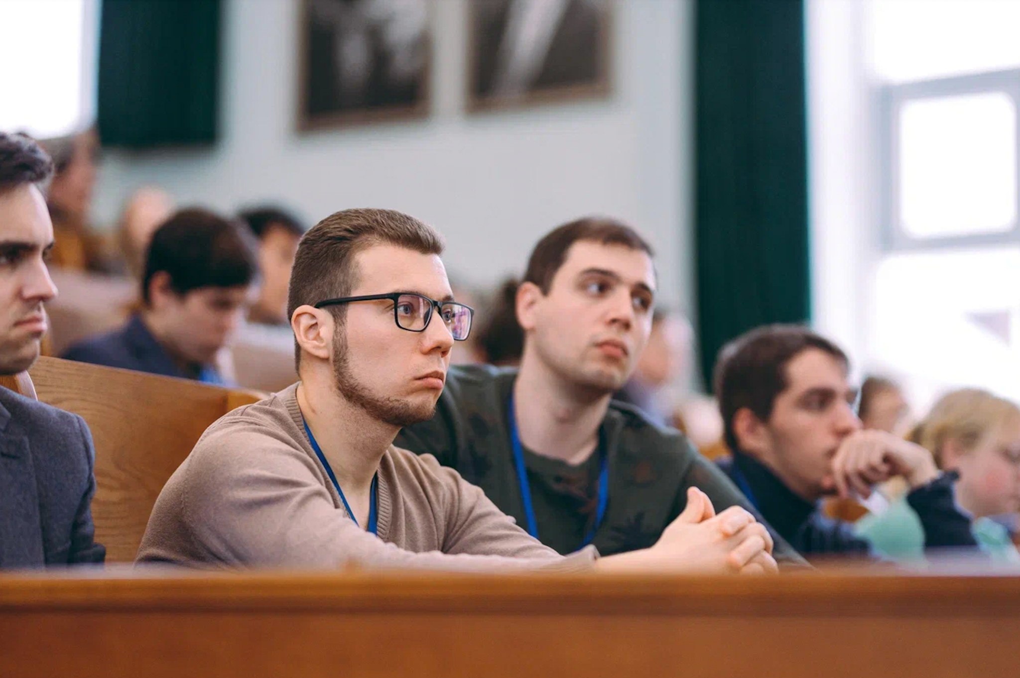
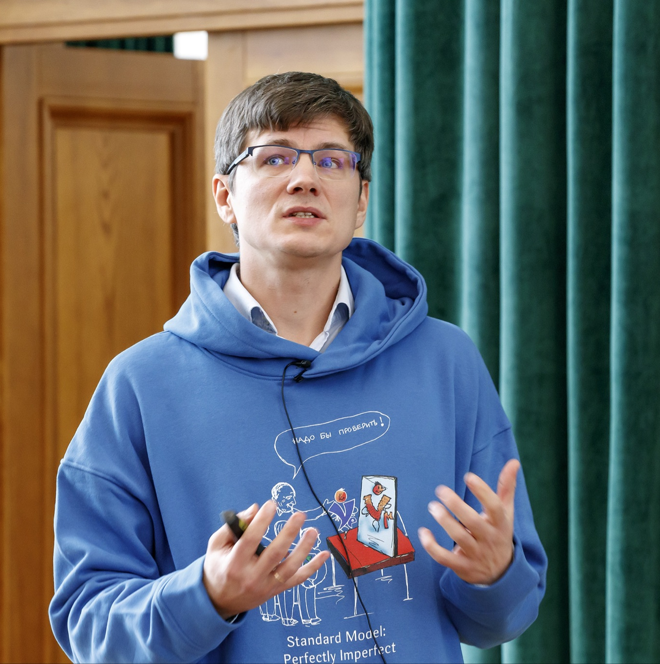
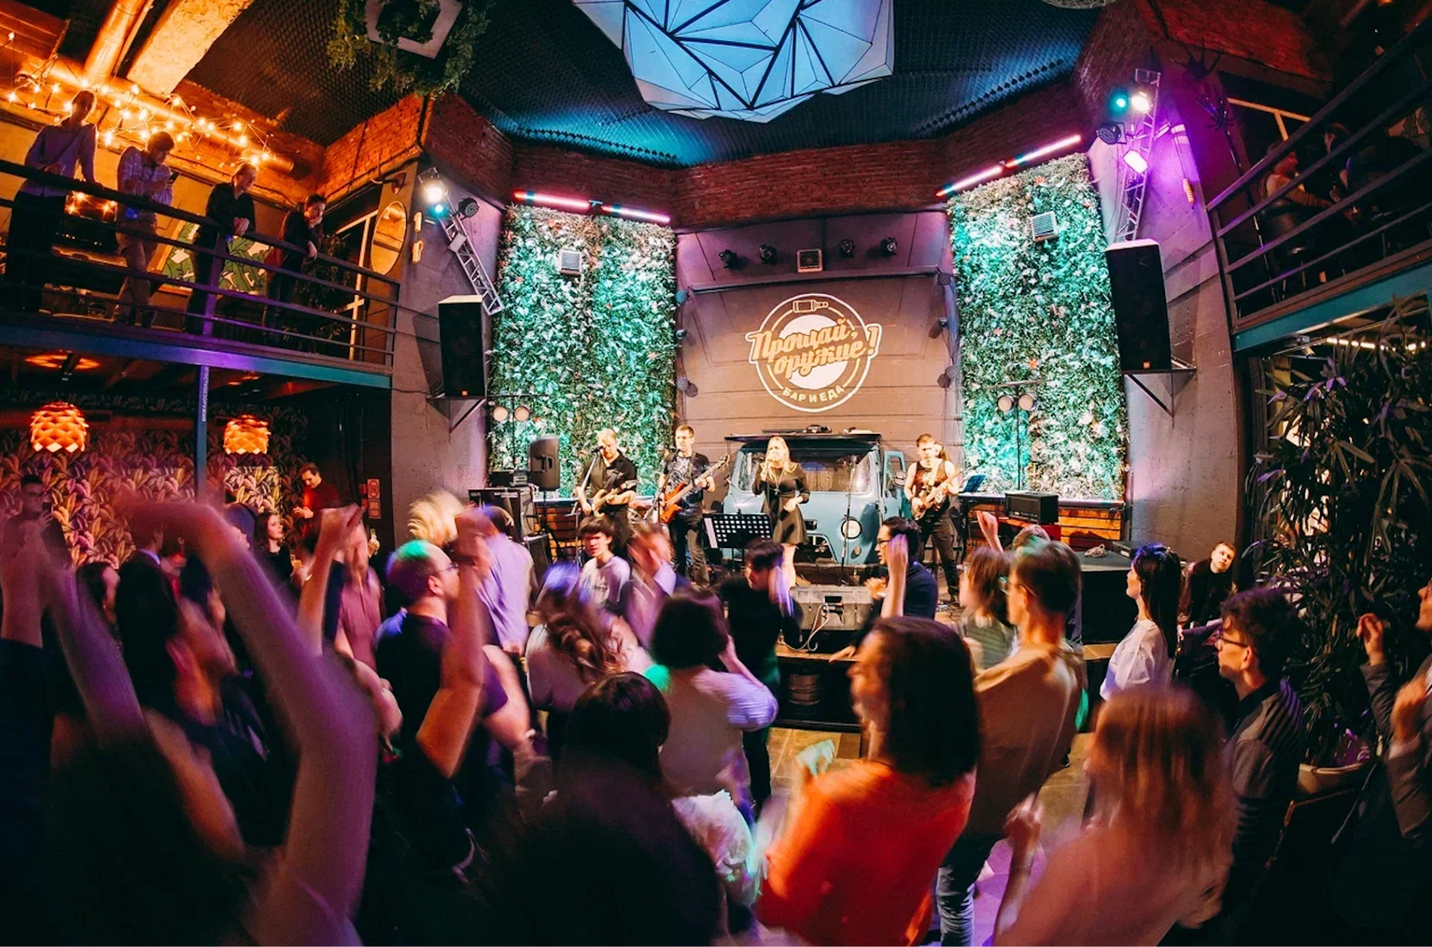
Международная конференция молодых учёных и специалистов AYSS
Notes:
12

Slide 13
Семинары ОМУС в Доме учёных
Notes:
13

Slide 14
Киноклуб ОИЯИ
Notes:
14

Slide 15
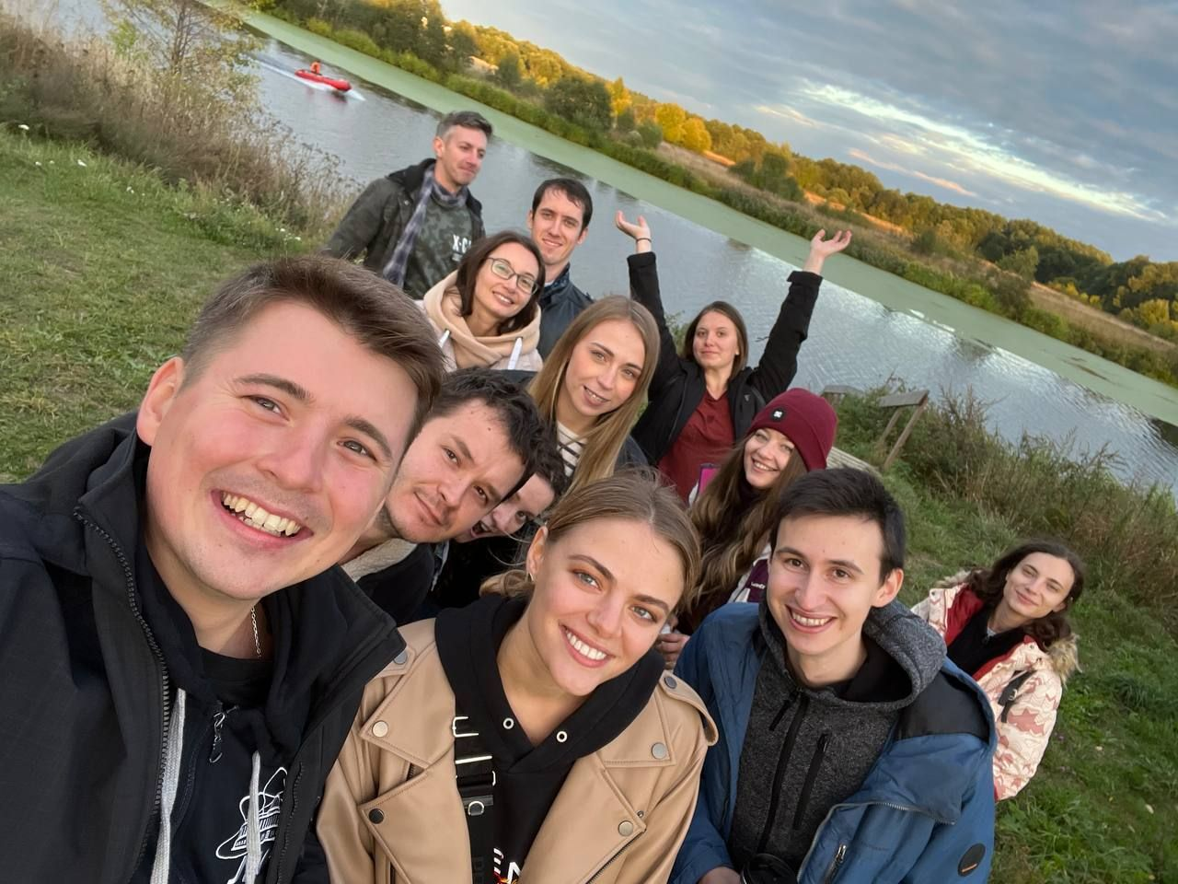
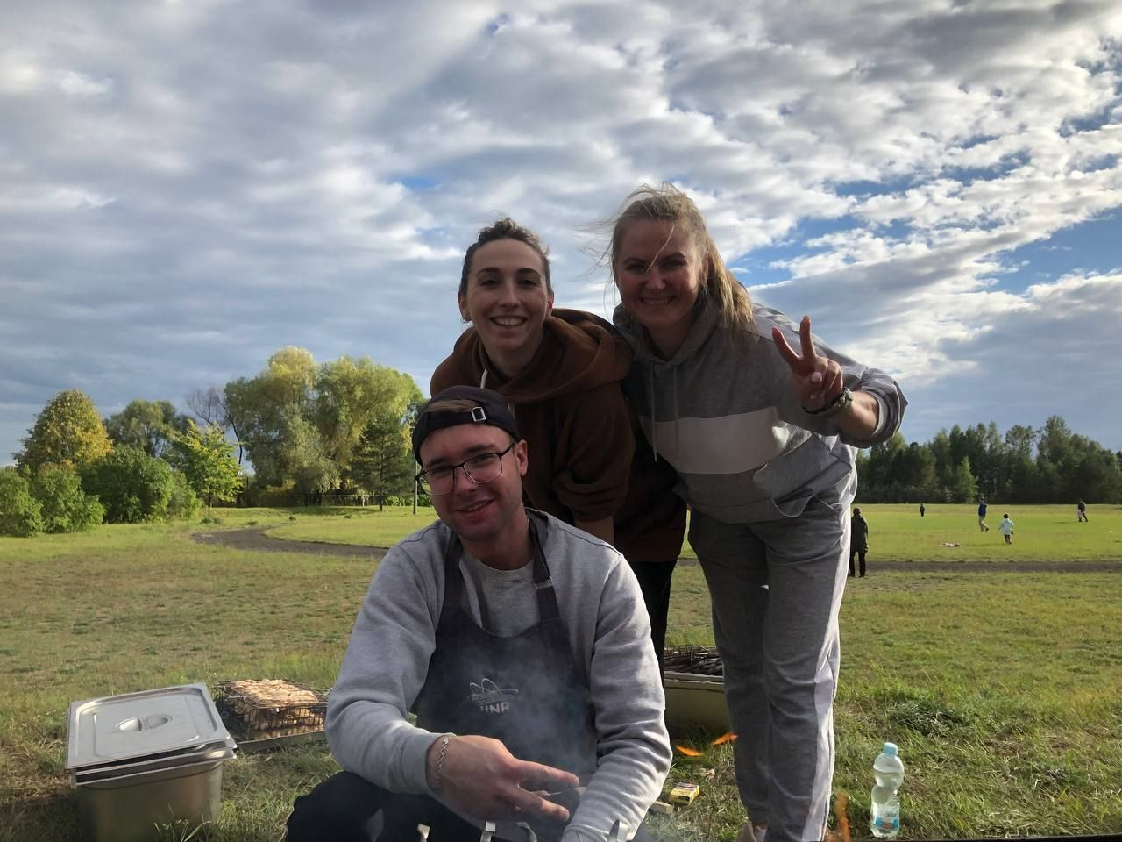
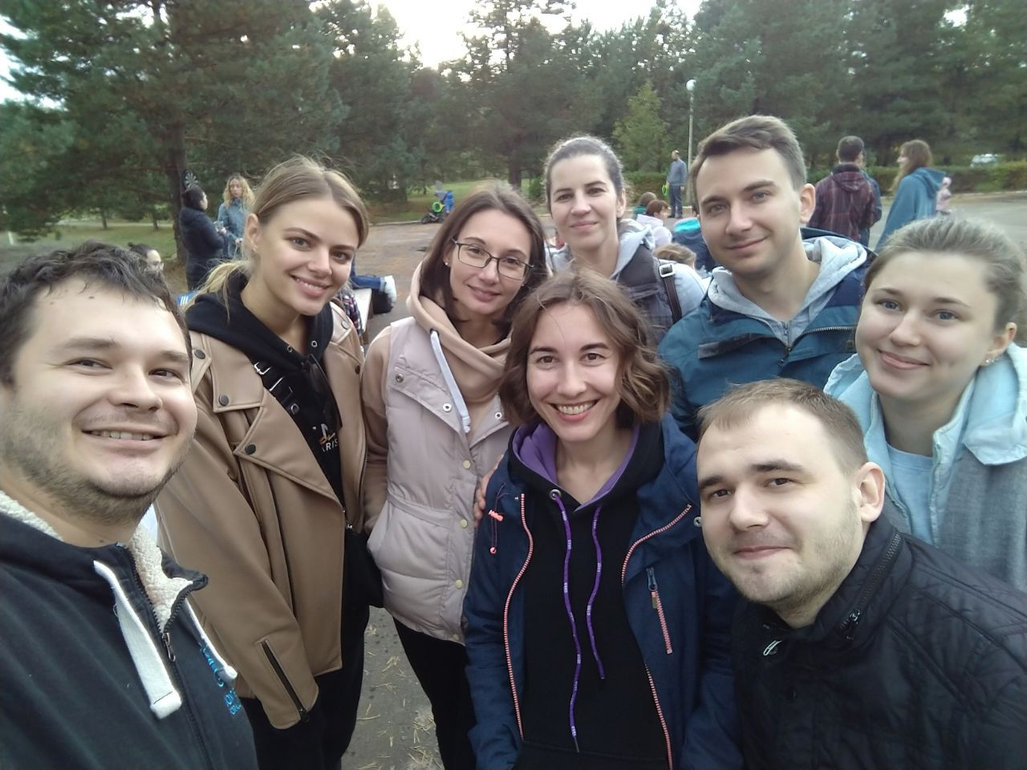
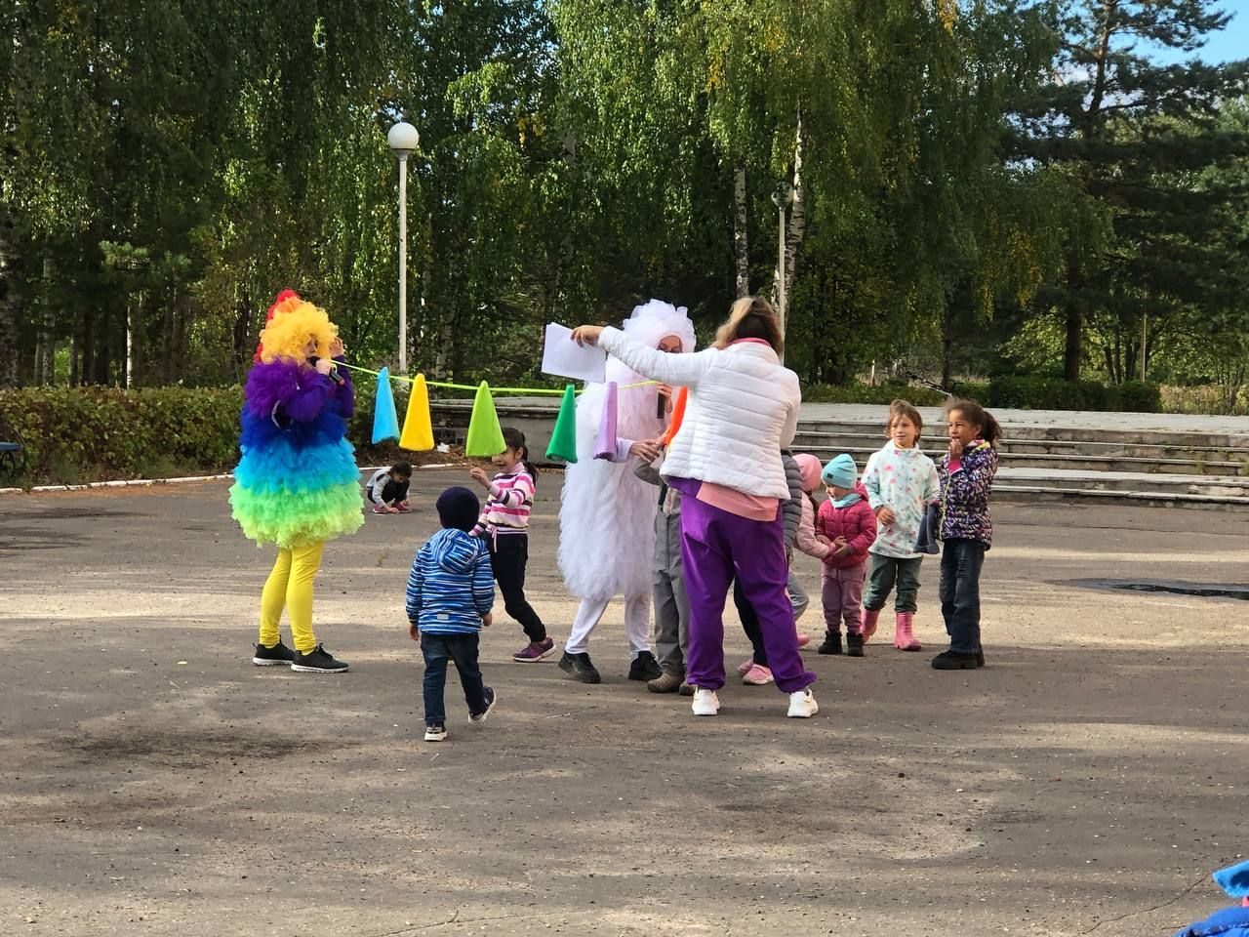
Back to Office

Slide 16
Back to Office

Slide 17
New Year / 8 march

Slide 18
Спортивные мероприятия
Организационная поддержка для участия молодых в городских и областных соревнованиях
Организация базы для тренировок
Организация соревнований внутри Института
ОИЯИ – чемпионы региональной Объединённой
Лиги Дубна - Кимры

Slide 19
Продвижение молодёжных инициатив
Диссертационный клуб
Телеграм-бот
Брошюра для новоприбывших
….

Slide 20
«Субатомные субботы» Совместный проект ОМУС ОИЯИ и СМУ НИИЯФ МГУ
Популяризация ядерной физики под чай с печеньем
Экскурсии в ОИЯИ
Привлечение талантливых студентов на ядерное отделение ФФ и базовые кафедры ОИЯИ
Развиваем сотрудничество с СМУ НИИЯФ и планируем новые совместные мероприятия

Slide 21
https://mc2.ub.am/

Slide 24
Инструменты стимулирования
Материальная форма
Гранты ОМУС;
Надбавка для высококвалифицированного персонала (градация с учетом уч. степени)
Именные стипендии в лабораториях;
Премии ОИЯИ для молодых ученых и специалистов;
Премии за лучшие постерные доклады на постер-сессиях ПКК;
Единоразовая премия от дирекции ОИЯИ за присуждение степени;
Жилищные сертификаты Московской области
Премия Губернатора Московской области
Гранты правительства Московской области
Notes:
24

Slide 25
Информационная поддержка
150 informational emails sent per year (1200 recipients)
Public groups in the majority of social networks
Information posted regarding:
Conferences & schools;
Scholarships and grants;
Cultural and social events;
Major JINR’s news;
…
E-mail: ayss@jinr.ru
VK: https://vk.com/ayssjinr
Telegram: https://t.me/ayssjinr

Slide 26
Информационная поддержка
150 informational emails sent per year (1200 recipients)
Public groups in the majority of social networks
Information posted regarding:
Conferences & schools;
Scholarships and grants;
Cultural and social events;
Major JINR’s news;
…
E-mail: ayss@jinr.ru
VK: https://vk.com/ayssjinr
Telegram: https://t.me/ayssjinr

Slide 27
Notes:
27

Slide 28
Совет ОМУС 2024-2025
Владислав Рожков (ЛЯП)
Ксения Ильина (ЛФВЭ)
Александр Незванов (ЛНФ)
Людмила Колупаева (ЛЯП)
Дина Бадреева (ЛИТ)
Екатерина Колосова (ОГЭ)
Мария Мардыбан (ЛТФ)
Кирилл Берестов (ЛЯР)
Регина Кожина (ЛРБ)
Notes:
28

Slide 29
Notes:
29

Slide 30
Notes:
30

Slide 31
Notes:
31

Slide 32
Notes:
32

Slide 33
Pugwash Conferences on Science and World Affairs
One of the oldest and leading international scientific organizations in the fields of security, disarmament, and scientific cooperation.
“We have to learn to think in a new way. We have to learn to ask ourselves, not what steps can be taken to give military victory to whatever group we prefer, for there no longer are such steps; the question we have to ask ourselves is what steps can be taken to prevent a military contest of which the issue must be disastrous to all parties?”
The document was sighed by Max Born, Percy W. Bridgman, Albert Einstein, Leopold Infeld, Frederic Joliot-Curie, Herman J. Muller, Linus Pauling, Cecil F. Powell, Joseph Rotblat, Lord Bertrand Russell, Hideki Yukawa.
The Manifesto proposed to summon an international conference.
Russell–Einstein Manifesto, London, 1955.

Slide 34
Pugwash Conferences on Science and World Affairs
The first Pugwash conference took place in Pugwash, Canada, on July 7–11, 1957.
22 scientists represented 10 countries, including the participation of 4 Soviet scientists.
All participants had received personal invitations, and they did not represent any country or organization.
Closed-door discussions.
Representatives of different countries, ages, scientific specialties, former high-ranking diplomats and military officers, people of different political and philosophical views participate at one table.
Short statements are presented for the press only after the meeting.
It is the winner of the 1995 Nobel Peace Prize:
“… for their efforts to diminish the part played by nuclear arms in international politics and, in the longer run, to eliminate such arms.”

Slide 35
National Pugwash Groups & Russian Pugwash Committee
On August 13, 1957, a statement by 200 prominent Soviet scientists.
The Presidium of the USSR Academy of Sciences decided to form a group of participants in the Pugwash movement.
In 1964, the Soviet Party Central Committee officially transformed this group into the Soviet Pugwash Committee.
≈50 national Pugwash groups, organized as independent entities.
National groups cannot be excluded from the international Pugwash movement.
The Committee was established to develop and strengthen international scientific relations.
Since June 13, 2023, the Chairman of the Russian Pugwash Committee is Prof. Mikhail KOVALCHUK.
On November 28, 2023, the Secretary General of the Pugwash Movement of Scientists P. Cotta-Ramusino met with Deputy Minister of Foreign Affairs of the Russian Federation S.A. Ryabkov at the Ministry of Foreign Affairs of the Russian Federation.
On January 18, 2024, N5 Expert Dialogue (China, France, Russia, the UK, the USA).

Slide 36
International Student/Young Pugwash (ISYP)
An international organization that was inspired by the Pugwash Conferences and is committed to the spirit and ideals of the Russell-Einstein Manifesto. ISYP is centered on the interplay of science, technology, ethics, and world affairs.
“ISYP not only helps to introduce the younger generation to the principles and objectives of the Pugwash Conferences but also provides a forum for students and young professionals to critically examine and explore the motivations for scientific advancements and the corollaries of technology in the everyday lives of people.”
Since the early 1970s, students have been invited as participants in Pugwash Conferences.
International Student Pugwash (renamed Student Pugwash USA) was founded in 1979.
ISYP Mission:
Foster cross-national dialogue for young professionals.
Interdisciplinary approach: nuclear weapons, climate change, emerging technologies.
Aim to nurture understanding and build personal connections for peace-promoting policymaking.
ISYP Leadership Team*
*Up-to-date report on ISYP activities.

Slide 37
Russian Student/Young Pugwash
HISTORY
In the late 1970s, student Pugwash groups started to form.
Since then, Student/Young Pugwash (SYP) groups have been formed in over 30 countries.
The Russian SYP at the Presidium of the Russian Academy of Sciences (former the Soviet SYP) was formed in 1988 by decision of the Soviet Pugwash Committee.
In 1990, the group organized the 2nd International Student and Young Pugwash Conference in Leningrad.
The members and representatives of the Russian SYP participated in 13 international Pugwash scientific conferences, as well as in a number of international Pugwash symposiums and workshops.
Russian SYP members participates in most of the ISYP conferences, which, as a rule, precede the opening of the international conferences of the Pugwash.

Slide 38
Russian Student/Young Pugwash
ACTIVITIES
Members of the Russian SYP are participants of Pugwash meetings held in various regions of the Russian Federation.
Since 2005, the Russian SYP has been involved in organizing Sir Joseph Rotblat scientific readings in Moscow, St. Petersburg, Vladikavkaz, Grozny, Dubna, and Kislovodsk.
Representatives of the group jointly with the leaders of the Russian Pugwash Committee conduct lectures on the problems of the Pugwash to students and post-graduates of the Russian Academy of Sciences’ institutes and Russian universities.
Members of the Russian SYP also participate in the activities of professional scientific unions and associations as well as of Russian and international non-governmental organizations.
Articles, reports and speeches of members of the Russian SYP are published in international and Russian Pugwash publications.
Leaders of the Russian SYP are elected to the ISYP governing bodies.
The RSYP conducts panel sessions and approves official statements.
Russian young scientists are also among participants of the International School on Disarmament and Research of Conflicts (ISODARCO).

Slide 39
Looking for a Balance Between Physical and Political Scientists
This is a common tendency for Russian SYP, ISYP, and "senior" Pugwash Committees.
Historically, the Pugwash movement was created by nuclear physicists. However, the balance had been shifting to the political scientists.
The current global crises have again shown the importance of representatives of the natural sciences as informal communication channels between governments.
Examples:
Mikhail KOVALCHUK, the member of the RAS (condensed state physics), President of the National Research Center “Kurchatov Institute”, became the new Chairman of the Russian Pugwash Committee.
Talia WEISS, the PhD student in experimental particle physics at Yale University, became the new Director of the ISYP Leadership Team.
Alexander NEZVANOV, the PhD in subatomic physics and astroparticles, the Researcher at the Joint Institute for Nuclear Research, became the new Chairman of the Russian Student/Young Pugwash and the ISYP Member.
The RSYP is being renewed, and as a result, about half of the new members will come from different areas of the natural sciences. Etc.

Slide 40
Join Us
Alexander NEZVANOV, Ph.D.
nezvanov@jinr.int
The Chairman of the Russian Student/Young Pugwash,
the Member of the ISYP Leadership Team.

Slide 41
Notes:
41

Slide 42
Notes:
42

Slide 43
Notes:
43

Slide 44
Notes:
44

Slide 45
Notes:
45

Slide 46
Science brings nations together!
Notes:
46

