Slide 1
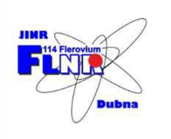
Current status of
the compact 2.45 GHz ECR Ion Source at FLNR JINR
Riyaz Fatkullin (ITEP, JINR)
Sergey Bogomolov (FLNR JINR)
Andrey Efremov (FLNR JINR)
Vladimir Loginov (FLNR JINR)
Yuri Kostukhov (FLNR JINR)
Andrey Bondarchenko (FLNR JINR)
AYSS 2018, 23-27 April 2018

Slide 2
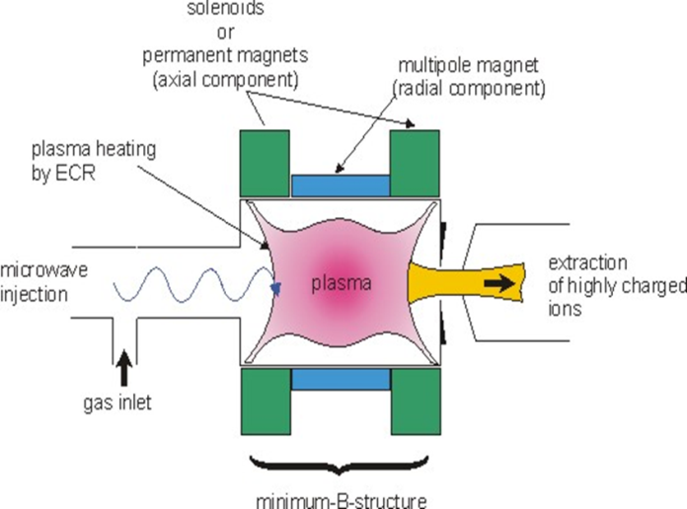
ECR Ion Source
Basic principles
ECR – Electron Cyclotron Resonance
In ECR ion sources the plasma heating is based on the energy transfer from microwaves to electrons via electron cyclotron resonance in external magnetic field. The electron cyclotron frequency is matched with the microwave frequency – heating is mainly transverse

Slide 3
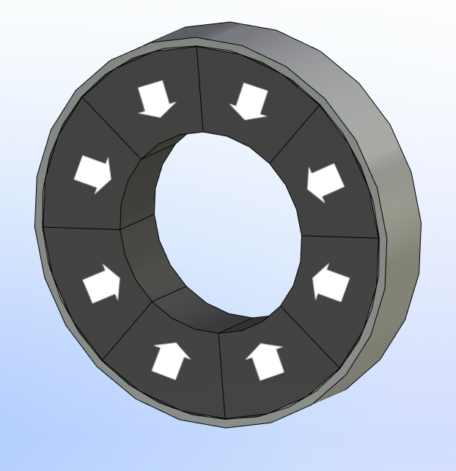
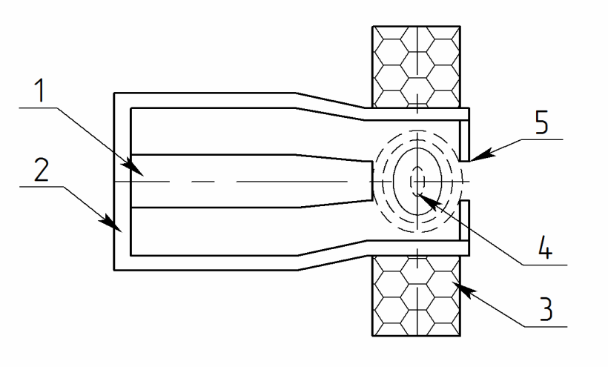
Concept
Compact ion source
Radially magnetized permanent magnet ring
Coaxial resonator
Outline
Size: 120 x 70 x 60 mm
Generation of 1+ ions
Low operation power and production cost
Compact ECR ion source

Slide 4
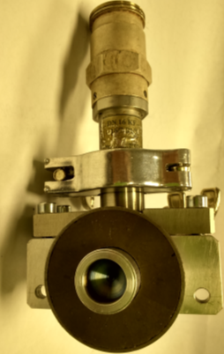
Timeline
Compact 2.45 GHz ECR Ion Source
Summer 2016
January
2018
June
2017
July
2017
Design
Production
First test
Second test
Computer design with CST Studio Suite
(July-August)
Ion source was produced and fully assembled
Measurement of ion current and ignition power
New test stand: ion spectra, higher current

Slide 5
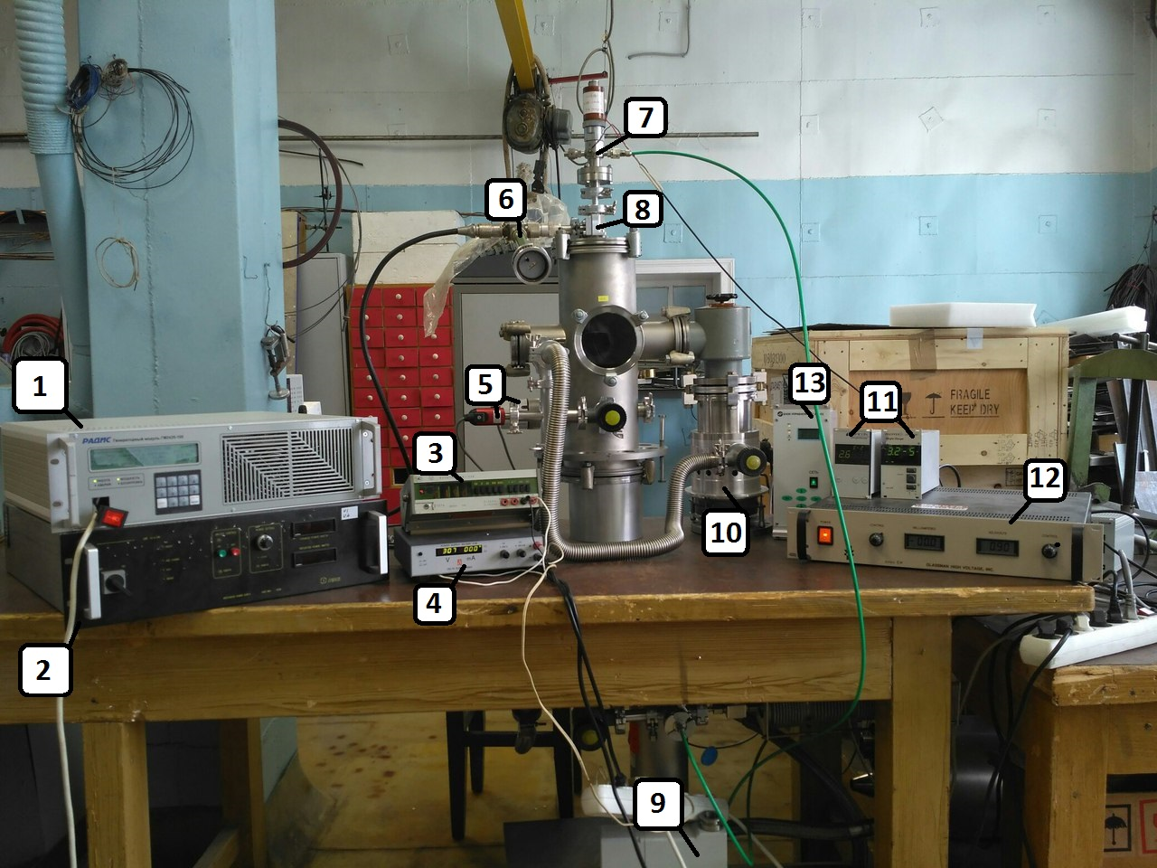
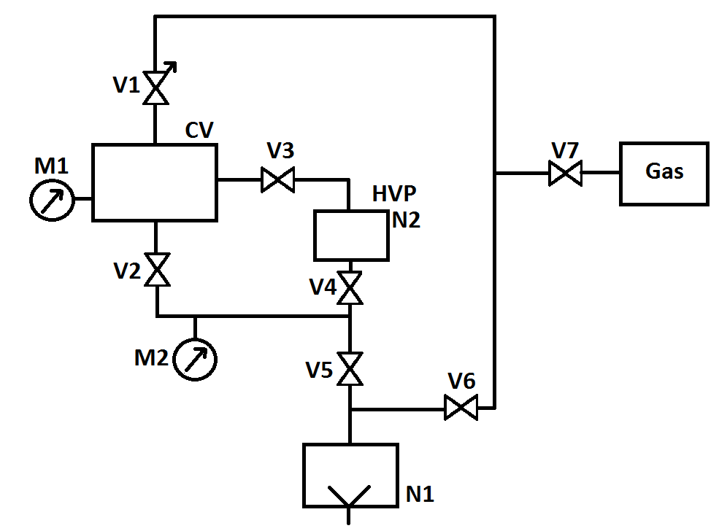
Test stand 2017
Outline
Pressure torr
Voltage at the puller electrode U = - 300V
Generator’s frequency MHz
Injected power W
Gases: Ar, He, Ne

Slide 6
Aim of experiment
1
Determination of lower limit of injected power for discharge ignition for different discharge conditions (discharge gap, frequency, gas flow)
Measurement of extracted current (current of puller electrode) at different discharge parameters (injected power, frequency and gas flow)
2
3
Measurement of puller electrode current for different discharge gaps

Slide 7
Results 2017
1
Max current I = 177 µA (He)
2
Min pressure P = 4.2x10 -6 torr
3
Min ignition power P = 0.5 W
4
2.45 GHz easy to discharge, 2.5 GHz max current

Slide 8
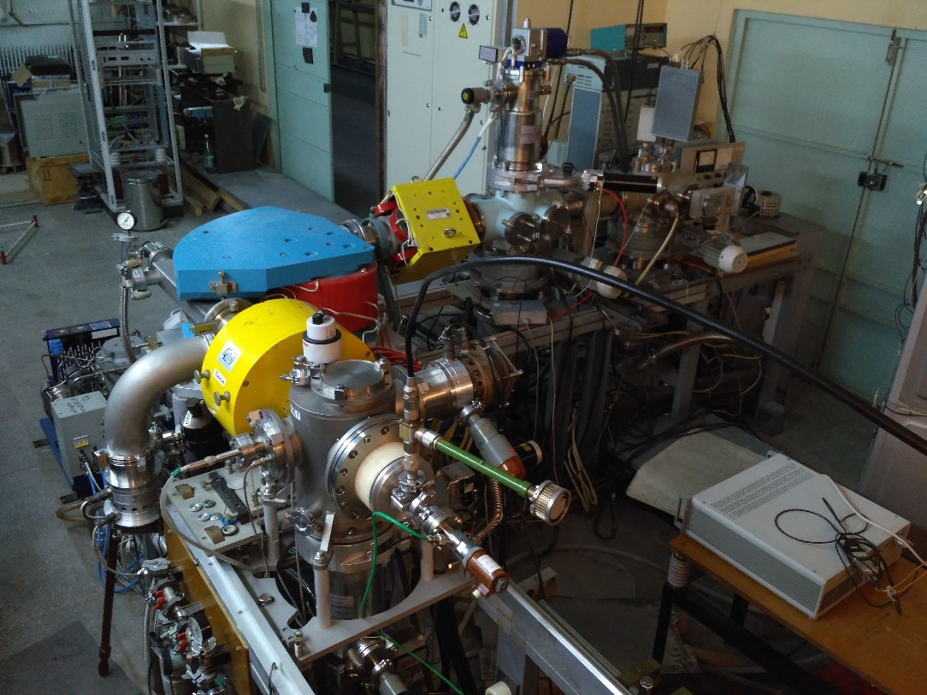
Test stand 2018
Outline
Pressure: 10⁻⁶ ÷ 10⁻⁵ torr
Uex = 9 ÷ 15 kV
Generator’s frequency: 2400÷2500 MHz
Injected power: 0 ÷ 100 W
Gases: He, H2

Slide 9
Aim of experiment
1
To obtain spectra of hydrogen and helium
2
To find solutions to increase output current

Slide 10
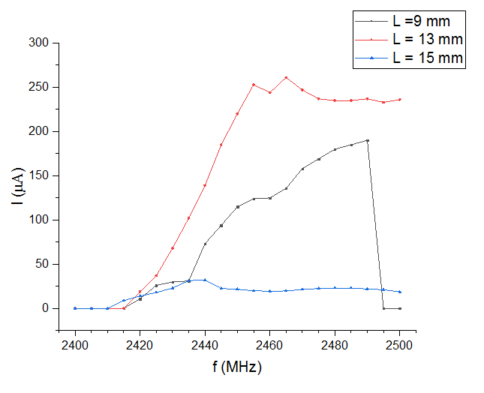
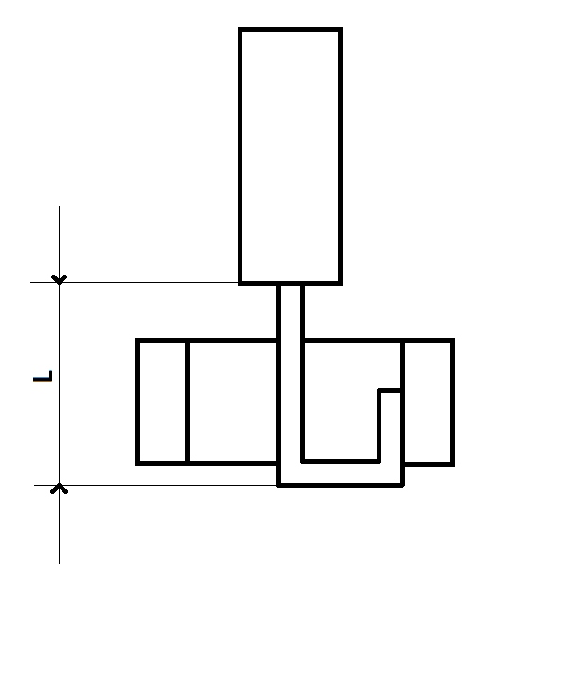
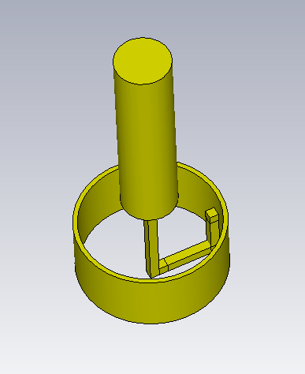
Results
Test 2018
New coupling loop (L = 9, 13, 15 mm)
Extracted current as function of frequency for different coupling loop length (9, 13 and 15 mm, 50 W).

Slide 11
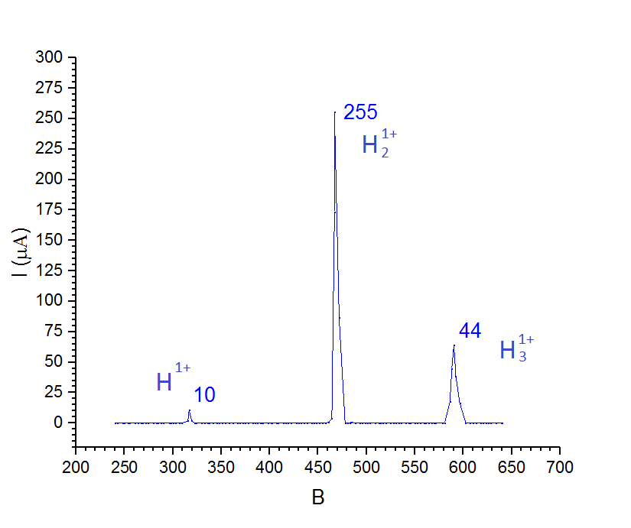
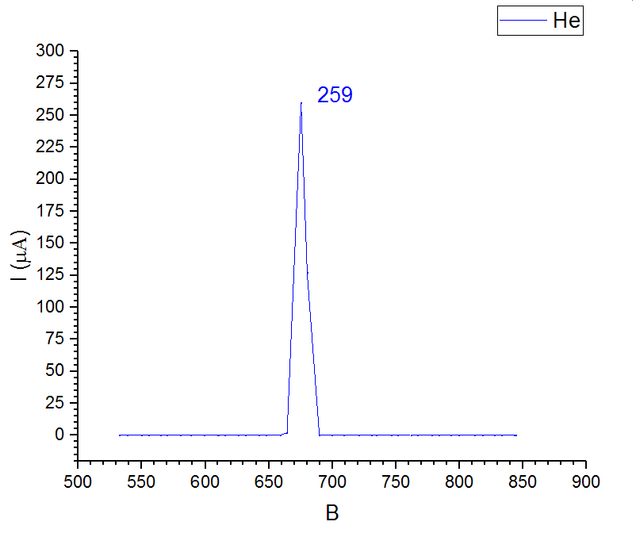
Results
Test 2018
Spectra of hydrogen ions. Dext = 2 mm.
f = 2452 MHz, W = 60 W, 8.9 kV, 3.2 *10⁻⁶ torr.
Spectra of He . Dext = 2 mm, f = 2450 MHz, W = 60 W, 8.9 kV, 2.1 *10⁻⁶ torr.

Slide 12
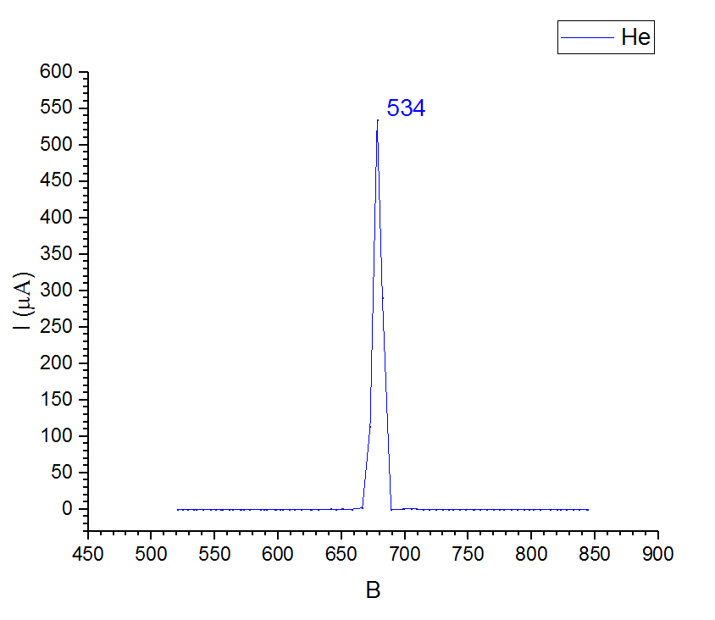
Results
Test 2018
Spectra of helium ions. Dext = 3 mm, f = 2454 MHz, W = 100 W, 8.9 kV, 1.6*10⁻⁵ torr.

Slide 13
Results 2018
1
Max current density of He⁺ ions consists of 7.5 mA/ cm² (255 mkA for Ø 2 mm, and 534 mkA for Ø 3 mm)
2
Spectra of hydrogen contains 3.2% (10 µA) of protons, 82.5% (255 µA) of diatomic molecular ions and 14.3% (44 µA) of triatomic molecular ions
3
Spectra of helium contains 1 spectral line of He⁺ ions

Slide 14
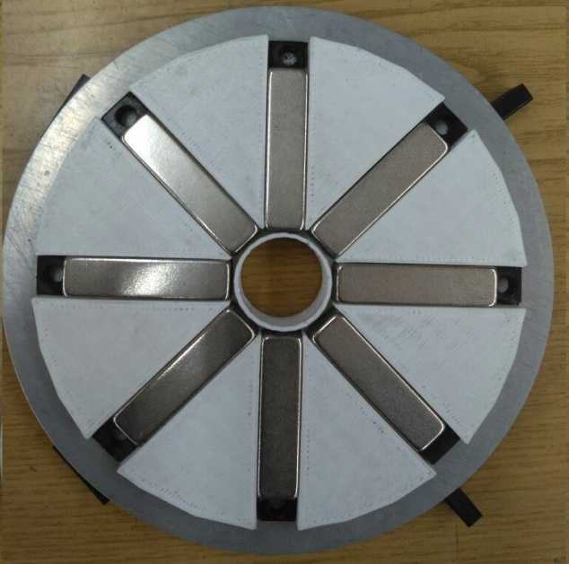
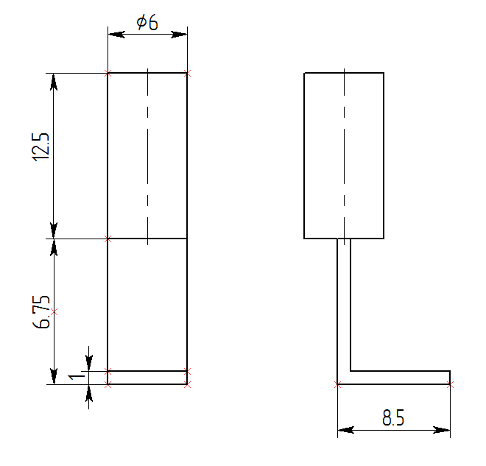
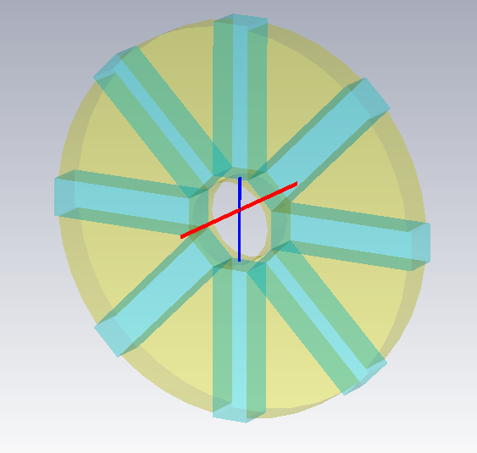
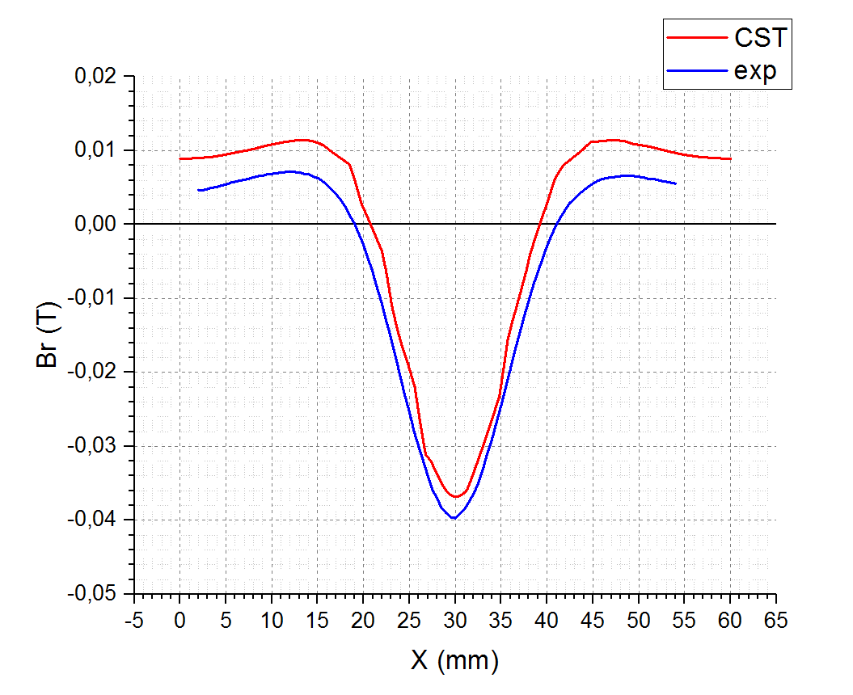
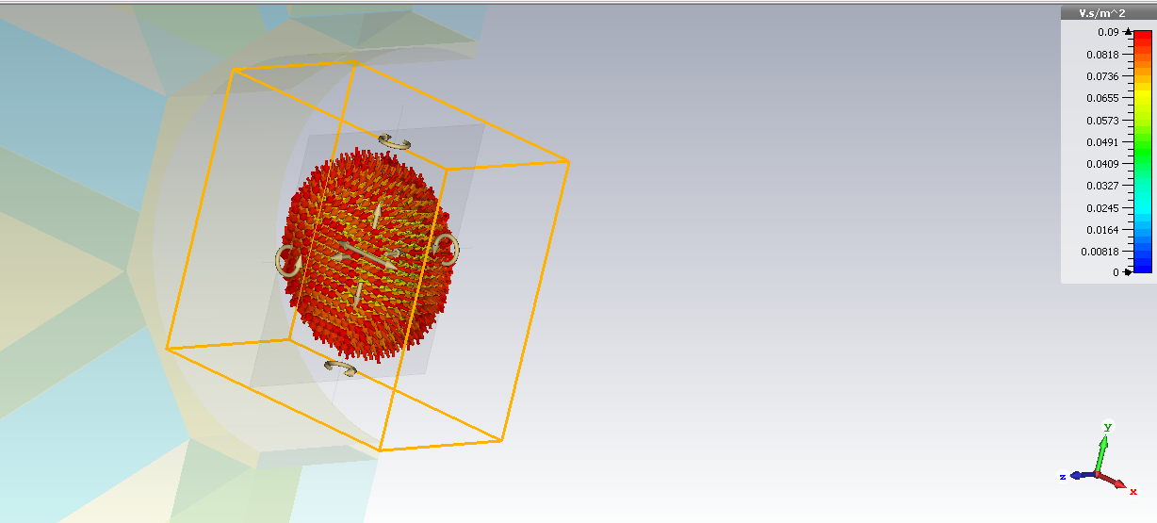
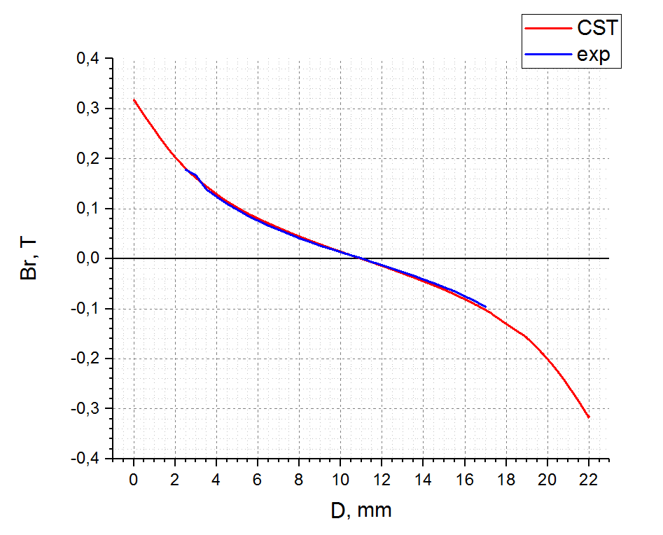
Second compact ECR
ITEP, Moscow

Slide 15
Conclusions
- Beam from the compact ECR source was examined at ECR sources test stand at FLNR
Spectra of hydrogen contains large amount of H₂⁺ molecular ions
Current can be further increased with new remote coupler control device
Future plans:
- Make new adjustment platform for precise positioning of source;
- Control the coupling device remotely;
- Optimize the optical extraction system;
- Try to use well-known and widely used ECR techniques to increase output current (BIAS electrode);
MASHA (Mass-Analyzer of Supper Heavy Atoms):
- Testing source with heavy gases (Ar, Kr, Xe)
- Measurements of the gas efficiency and time response of ion source;

Slide 16
Thank you
for your attention

