Slide 1
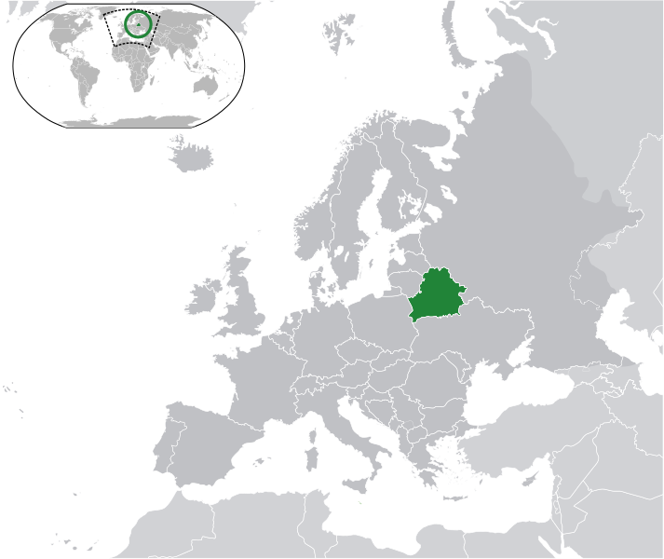



The XXII International Scientific Conference of Young Scientists and Specialists (AYSS-2018)
Simple way of SiO₂/Si
ion-track templates parameters characterization
Scientific-Practical Materials Research
Centre of the NAS of Belarus
Bundyukova Victoria
e-mail: victoria.bundyukova@gmail.com

Slide 2
What is about
1. Swift Heavy Ion Track Technology;
2. SEM;
3. Ellipsometry;
4. ImageJ: pore parameters;
5. Plasmon nanostructures in pores for SERS.

Slide 3
Relevance
Size matters!
Over the past decades, interest in different types of nanosized objects has grown.
Depending on the foreseen applications, materials with different functional properties are sought after.
One of the most interesting methods to fabricate arrays of nanostructured materials is the use of porous matrices (templates). By means of this approach, different structures can be formed by self-organization of other materials within the pores.
In this way, it becomes possible to obtain arrays of nanoparticles, nanorods, nanotubes or dendritic nanostructures of different materials such as semiconductors, metals, metallic multilayers, etc.
AYSS-2018

Slide 4
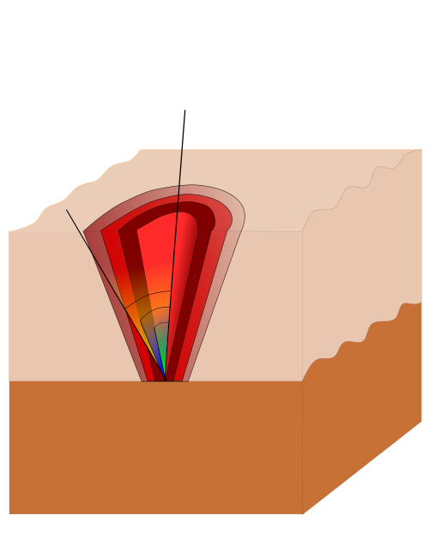
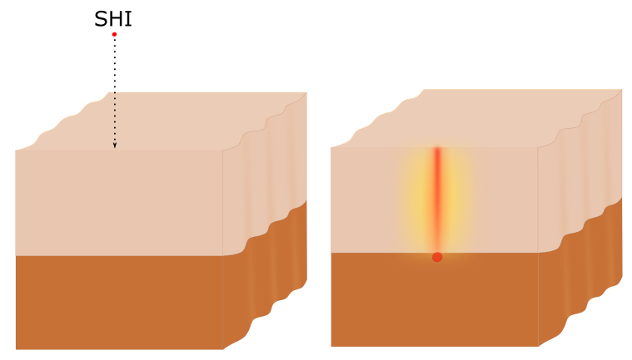
Swift Heavy Ion Track Technology
By the irradiation of a solid material with SHI, the formation of extended highly defect regions with diameters up to 50 nm takes place due to the interactions of the SHI with the irradiated material. These regions are characterized by a local different density and deformed chemical bonds and are hereafter referred to as areas with radiation damage or latent SHI tracks.
When immersing irradiated samples into an etching solution, such damaged areas will be etched at a much faster rate than undamaged SiO₂. This provides the possibility of transforming selectively the latent SHI tracks into pores within the a-SiO₂ layer, by means of controlled chemical etching.
AYSS-2018

Slide 5
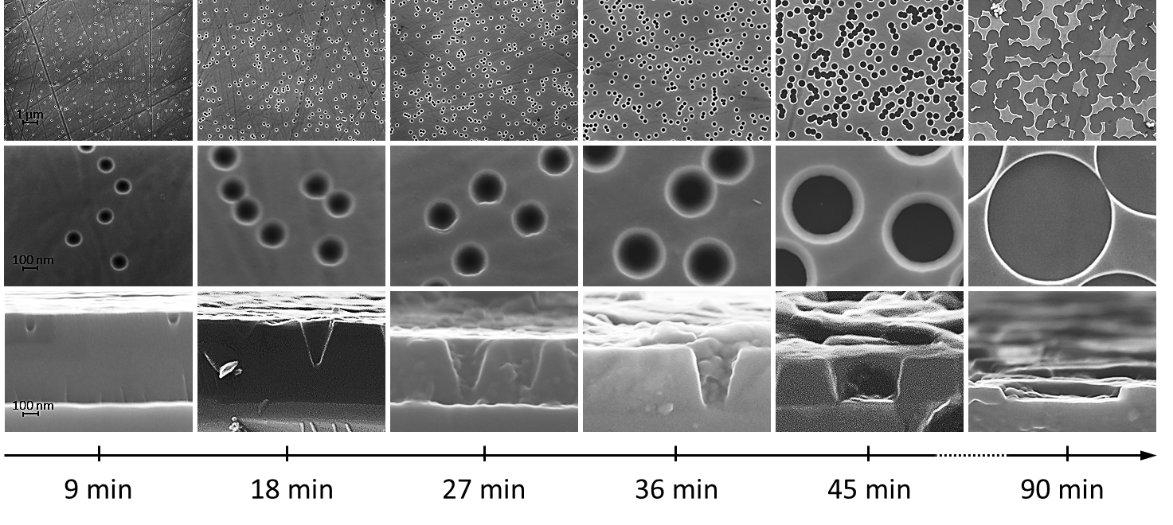
Swift Heavy Ion Track Technology. SEM
The electrons interact with atoms in the sample, producing various signals that contain information about the sample's surface topography and composition.
SEM images of the surfaces and cross-sections of porous SiO₂ layer on various etching stages in the solution with the HF concentration of 1.4 %.

Slide 6
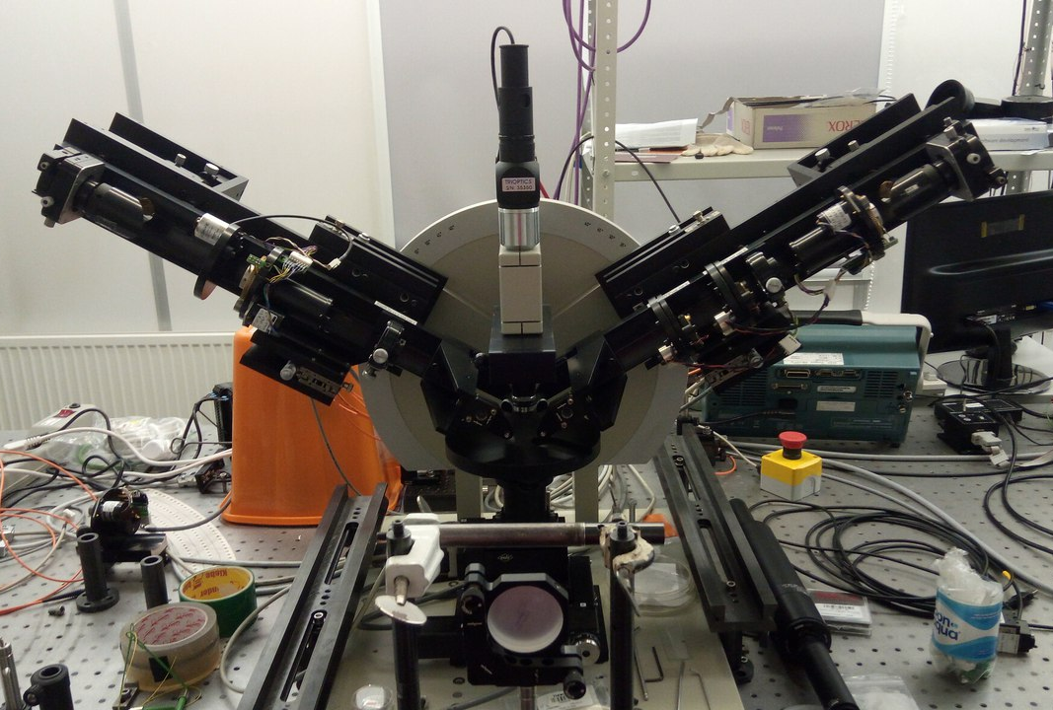
Ellipsometry
Ellipsometry is an optical technique for investigating the dielectric properties (complex refractive index or dielectric function) of thin films. Ellipsometry measures the change of polarization upon reflection or transmission and compares it to a model. It can be used to characterize composition, roughness, thickness (depth), crystalline nature, doping concentration, electrical conductivity and other material properties.
Ellipsometer.
B.I. Stepanov Institute of Physics, NASB
AYSS-2018

Slide 7
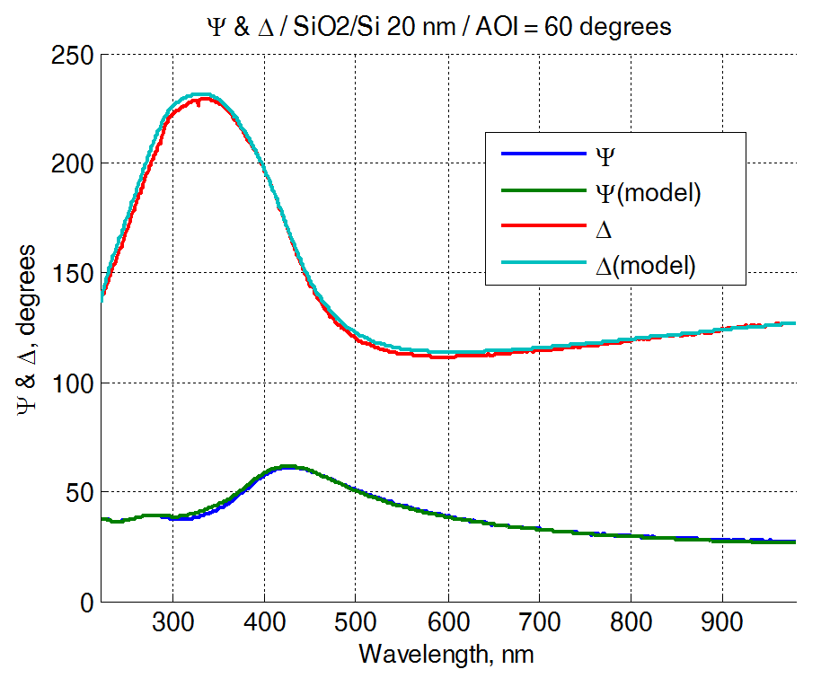
Ellipsometry
The results of a comparison of the physical model of the interaction of a polarized light beam with a layered porous SiO₂/Si structure with experimental data. The thickness of the oxide layer is lell = 314 ± 1 nm.
AYSS-2018

Slide 8
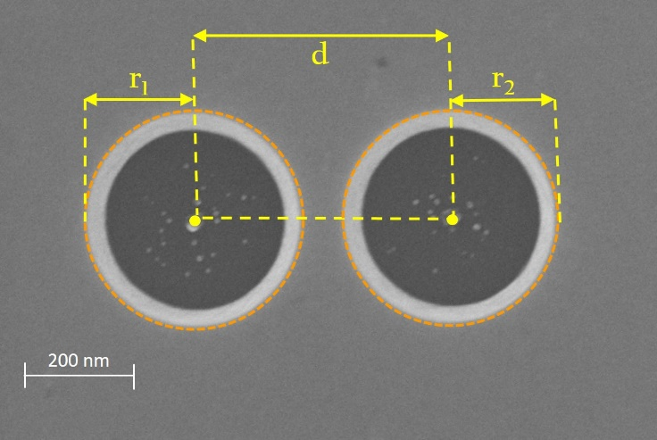
Pore parameters
Using of ImageJ software, which allows to determine a wide range of pore parameters for obtaining of a large amount of statistical information, in analysis of scanning electron microscopy images. Therefore, here we demonstrate the possibility of surface analysis by SEM with ImageJ post-processing for SiO₂/Si ion-track template parameters control.
SEM images of the surfaces
AYSS-2018

Slide 9
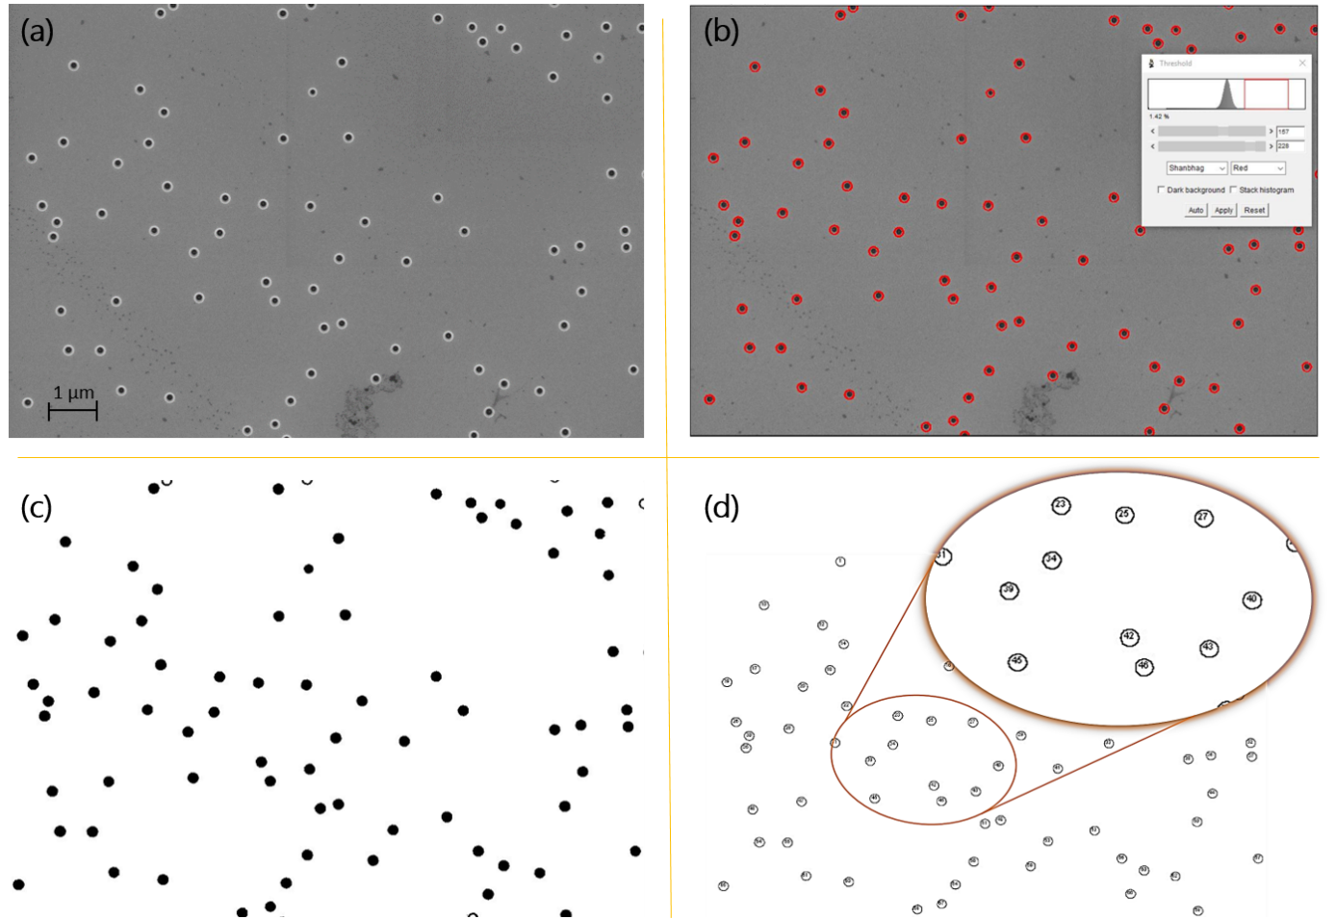
ImageJ
(a) SEM image of porous SiO₂/Si template surface, (b) setting the threshold by using of ImageJ command Threshold, (c) image after binarization and (d) result of command Analyze Particles execution.
AYSS-2018

Slide 10
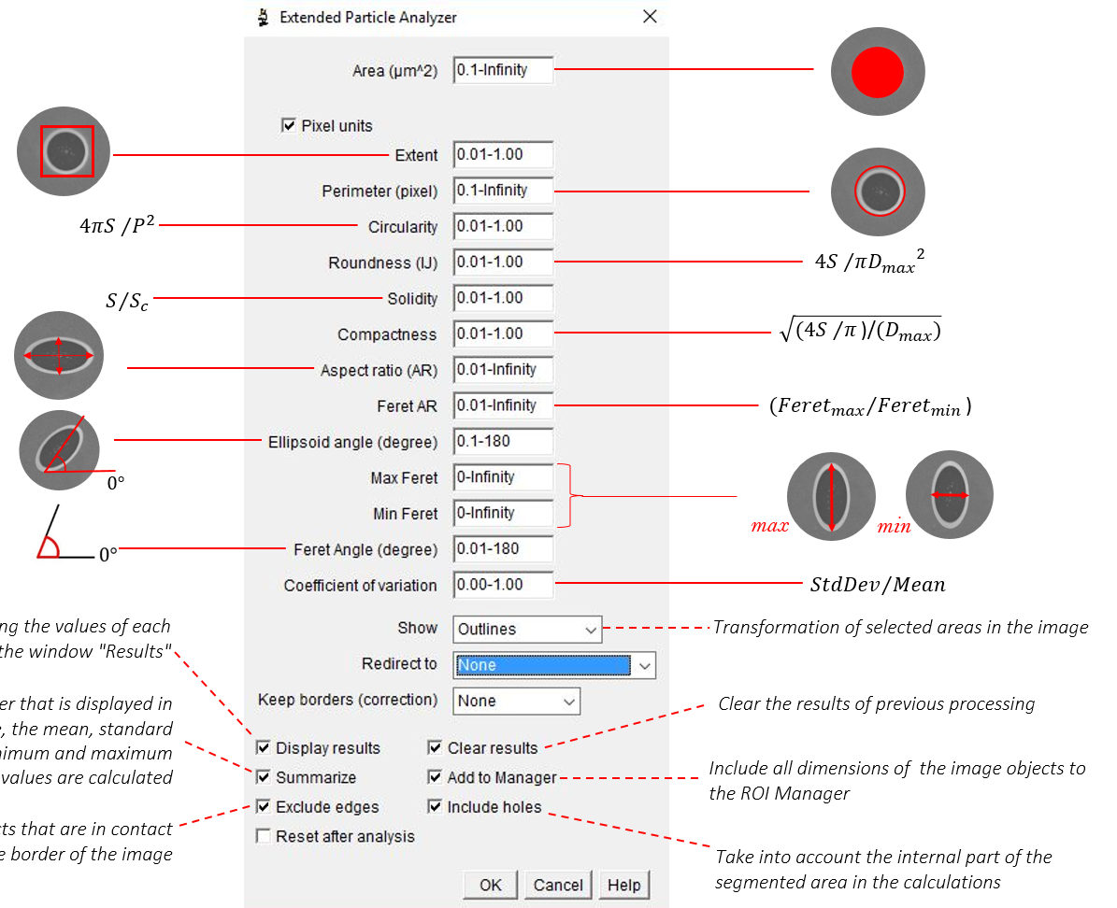
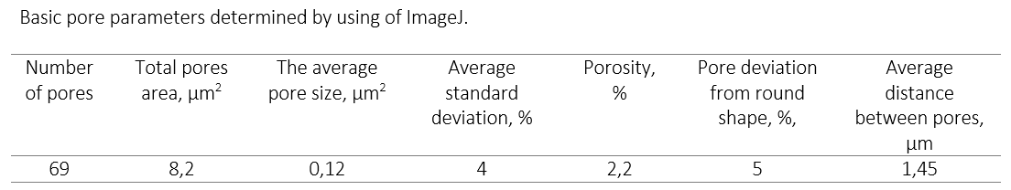
ImageJ
AYSS-2018

Slide 11
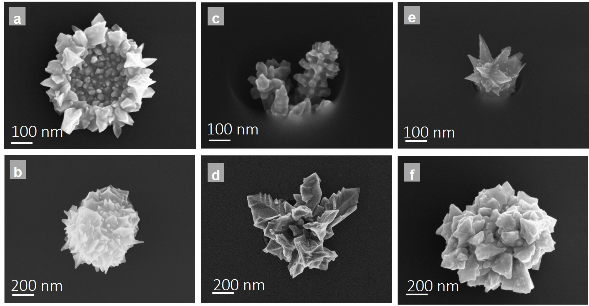
Gold nanostructure
Formation mechanism of nanostructures with different shape has been established and parameters of tailored synthesis of golden nanostructures have been determined. It is shown that the process of self-organization of gold nanostructures in a limited volume depends on the rate of metal reduction, silicon oxidation, and silicon dioxide etching, and can be controlled both by the parameters of chemical deposition (electrolyte composition, temperature and deposition time), and by the parameters of the porous matrix (silicon substrate, geometric characteristics and surface density of pores). This allows to form a wide range of objects, including dendrites and nanostructures with various shapes.
AYSS-2018

Slide 12
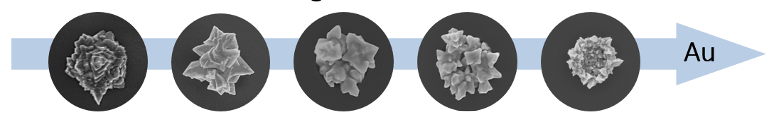
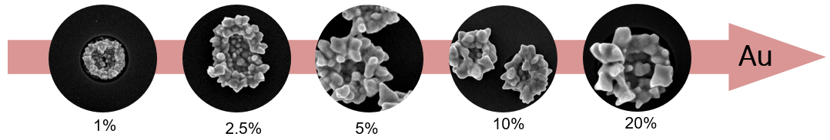
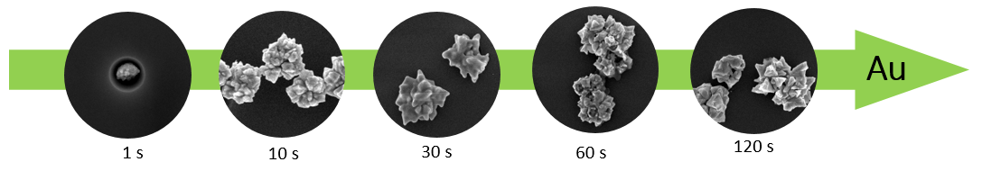
Gold nanostructure
Gold nanostructures with different morphologies have been formed in the pores of a SiO₂ template on single-crystal silicon substrate formed by ion-track technology. Formation mechanism of nanostructures with different shape has been established and parameters of tailored synthesis of golden nanostructures have been determined.
dependence on pore diameter
dependence on solution concentration
dependence on deposition time
AYSS-2018

Slide 13
SERS
SERS spectra of 10⁻⁷ M bilirubin acquired on a coral-like gold nanostructures. There is an indication of a significant Raman signal enhancement due to Au nanostructures pronounced and distinguishable SERS bands.
SERS intensity
Wavenumber, cm⁻¹
AYSS-2018

Slide 14
Conclusions
SiO₂ based porous templates were formed by etching of SHI latent tracks;
2. Characterized by
SEM
ImageJ
Ellipsometry;
3. Application was shown for the example of SERS;
4. Published
Tunable nanoporous silicon oxide templates
by swift heavy ion tracks technology / Nanotechnology
Post-processing of SiO2/Si ion-track template images for pores parameters analysis
/ Materials Today
AYSS-2018

Slide 15
Thank you for y
ur attention!
e-mail: victoria.bundyukova@gmail.com
AYSS-2018

