Slide 1
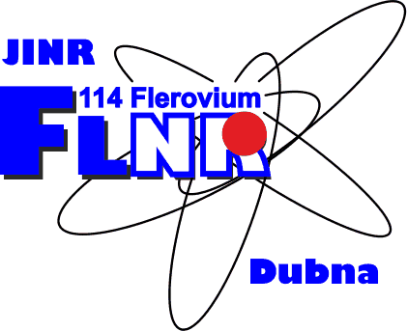
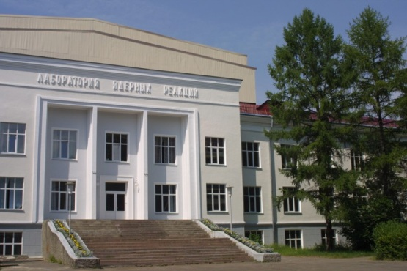
Radioactive ion beam research at JINR and in the world
Leonid Grigorenko
Flerov Laboratory of Nuclear
Reactions, JINR, Dubna, Russia
AYSS-2018, Dubna, April 23-27, 2018

Slide 2
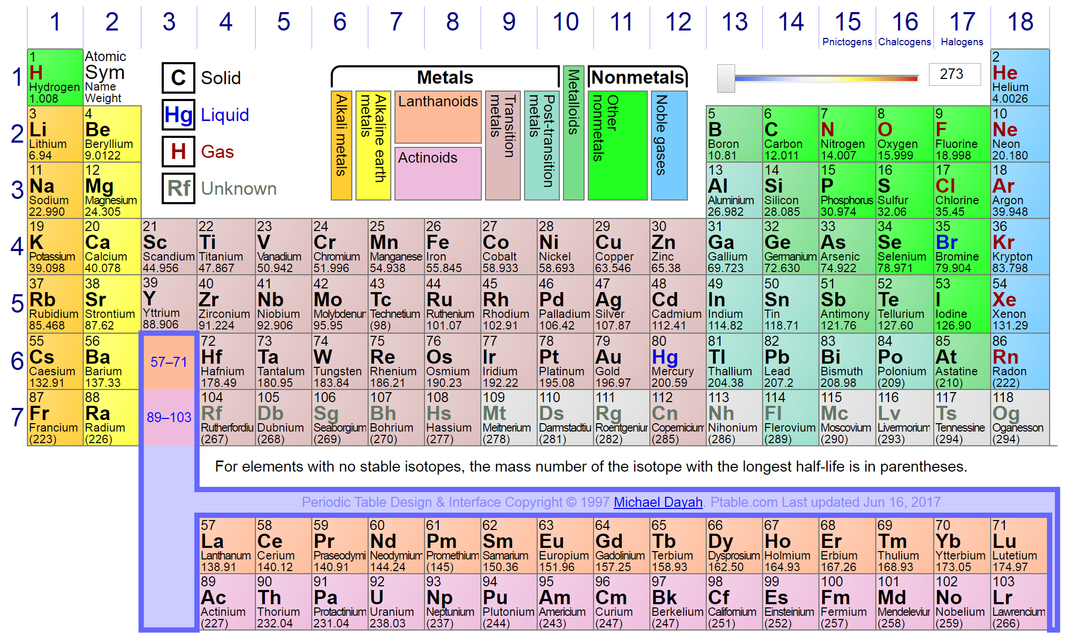
Mendeleev periodic table of elements
ptable.com
Periodic table is base for qualitative understanding of chemistry basic principles
Electron motion in the central Coulomb field of nucleus
Quantum mechanical systematics of shell population
Fight to complete Mendeleev Table: JINR-GNS vs. GSI-SHIP/TASKA. 118 discovered. 119? 120?

Slide 3
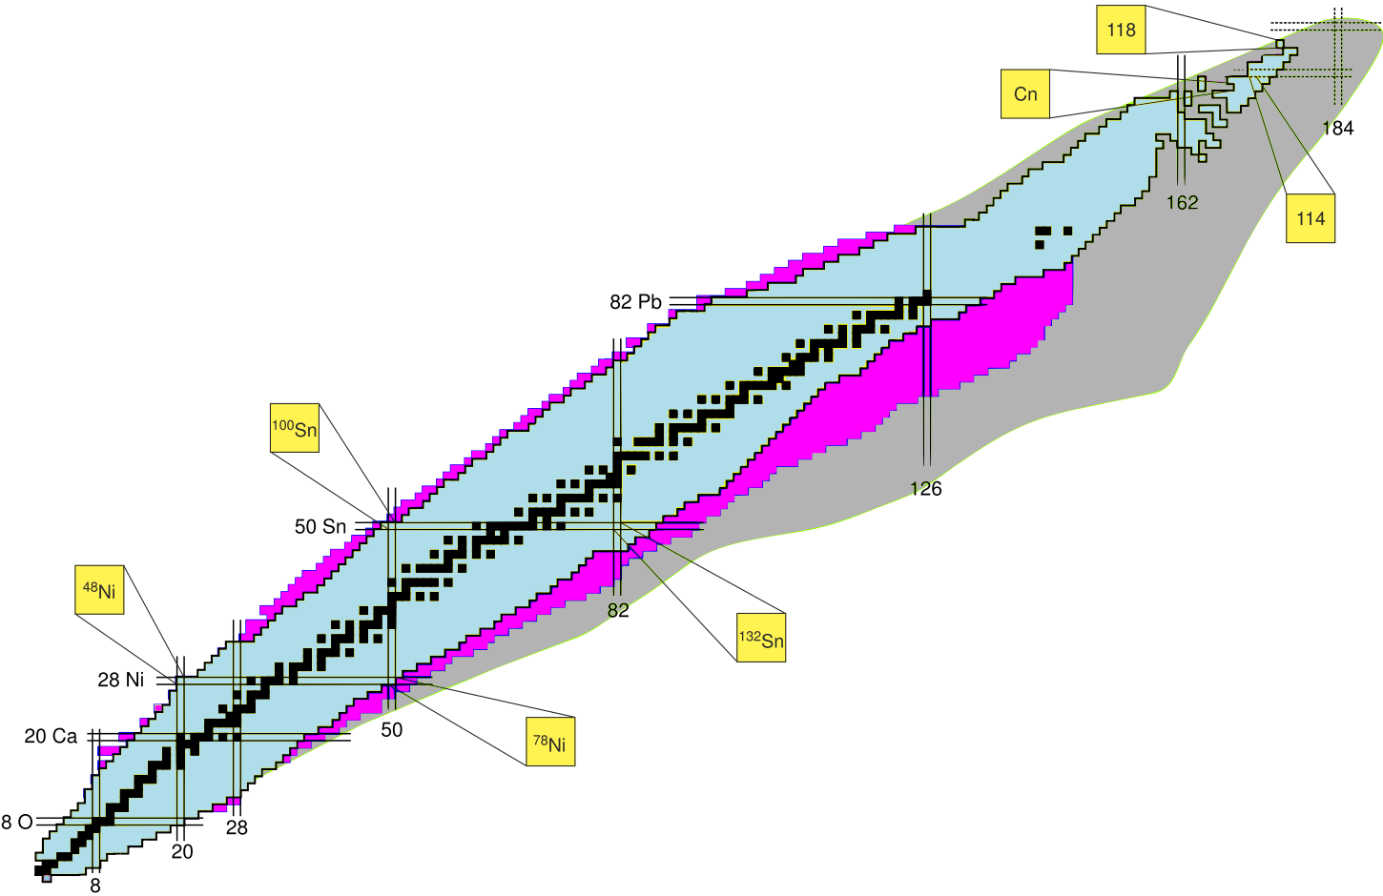
Chart of nuclides is analog of periodic table in the “world of nuclides”
Two types of shells to fill – for neutrons and for protons:
Nuclear “periodic table” is two-dimensional

Slide 4
Radioactive Ion Beam (RIB) physics – “highway” of modern
low-energy nuclear science
The map of nuclides
- 254 stable nuclides,
- 339 can be found in nature
- Around 3100 RI are known
- Around 2500 to be discovered
“Isle of stability” for superheavies:
We just “touched” a bit of its “shore”…
Limits of nuclear structure existence:
Are known only for the lightest nuclei
Proton dripline:
Achieved and studied for Z<32
Exotic structure of exotic nuclides:
- Neutron/proton halo
- Neutron skin
- “Soft” excitation modes
- Breakdown of shell structure
- New “magic numbers”
Neutron dripline:
Achieved and studied for N<20

Slide 5
What is important about RI beyond the nuclear physics?

Slide 6
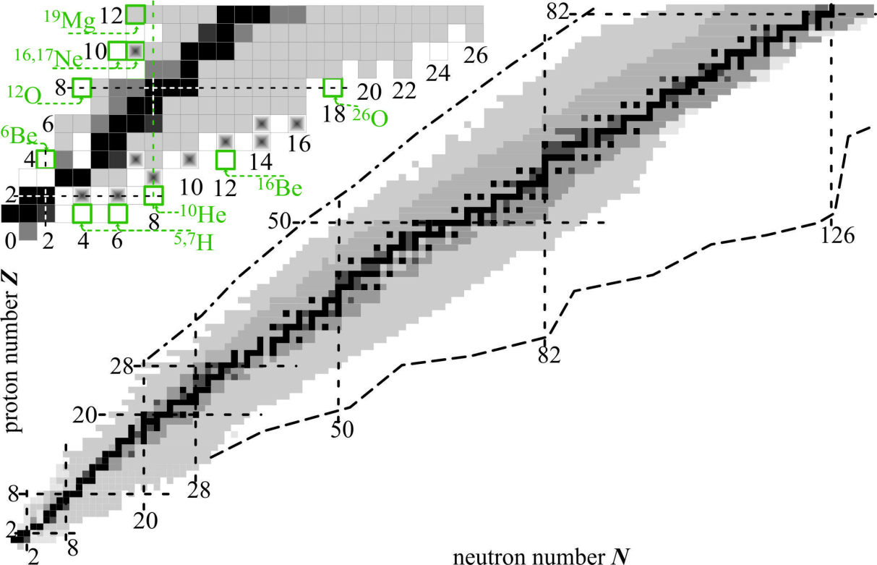
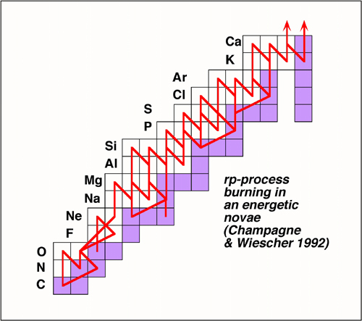
Nucleosynthesys
s-process
rp-process
r-process
rp-process fragment
Hydrostatic burning – slow process
Explosive burning – rapid processes
Where does it take place?
Every day observed violent events in space are produced by rp-processes
Element abundance in space is connected with r-processes
No quantitative understanding until the driplines are studied in details

Slide 7
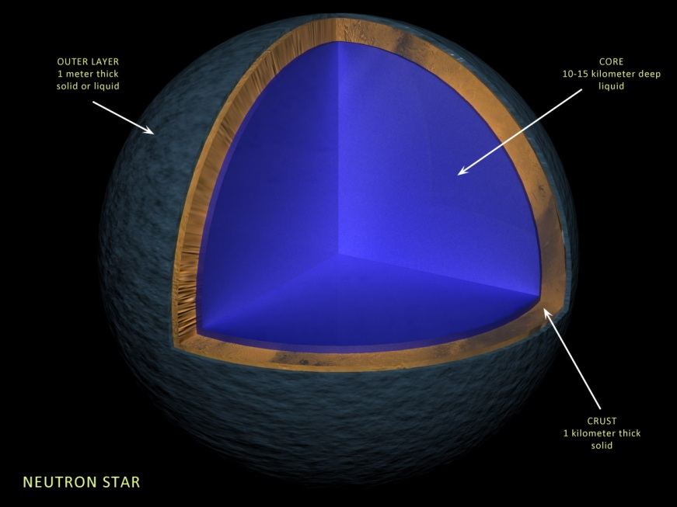
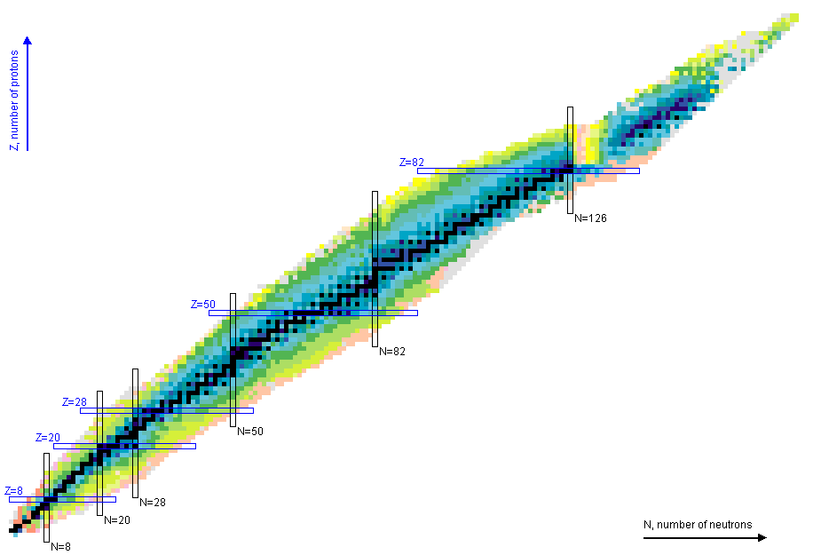
Neutron stars
All the heavy elements in the Universe are produced in explosive nucleosynthesys
PV = (m/μ) RT
Equation of state for ideal gas. What about nuclear matter?
Supernovae explosions. How we get from neutron star to Supernova?
Known nuclei: practically symmetric
nuclear matter
Neutron star: very large nucleus with
absolutely asymmetric nuclear matter
Moving towards the driplines we get experimental knowledge about more and more asymmetric nuclear matter

Slide 8
RIB studies at JINR

Slide 9
Superheavies and superlights at FLNR JINR
Elements 102 - 108 and 113 - 118 synthesized at FLNR JINR
U-400 cyclotron
“Stability island of superheavies” is achieved
New elements in the recent years:
¹¹⁴Fl Flerovium
¹¹⁶Lv Livermorium
¹¹³Nh Nihonium
¹¹⁵Mc Moscovium
¹¹⁷Ts Tennessine
¹¹⁸Og Oganesson
Fragment-separator ACCULINNA:
Studies of the lightest exotic radioactive ion beams
U-400m cyclotron
The only RIB facility in Russia, former Soviet republics and Eastern Europe

Slide 10
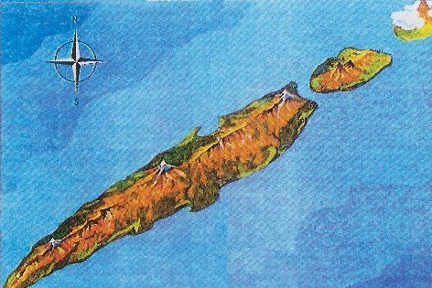
Superheavies and superlights at FLNR JINR
Elements 102 - 108 and 113 - 118 synthesized at FLNR JINR
U-400 cyclotron
“Stability island of superheavies” is achieved
New elements in the recent years:
¹¹⁴Fl Flerovium
¹¹⁶Lv Livermorium
¹¹³Nh Nihonium
¹¹⁵Mc Moscovium
¹¹⁷Ts Tennessine
¹¹⁸Og Oganesson
114
island of Superheavy Elements
peak of U
strait of
instability
82
peak of Pb
Number of protons
strait of
radioactivity
sea of instability
50
peak of Sn
Fragment-separator ACCULINNA:
Studies of the lightest exotic radioactive ion beams
20
sea of instability
peak of Ca
U-400m cyclotron
The only RIB facility in Russia, former Soviet republics and Eastern Europe
20
82
126
184
G.N. Flerov, A.S. Ilyinov (1982)
Number of neutrons

Slide 11
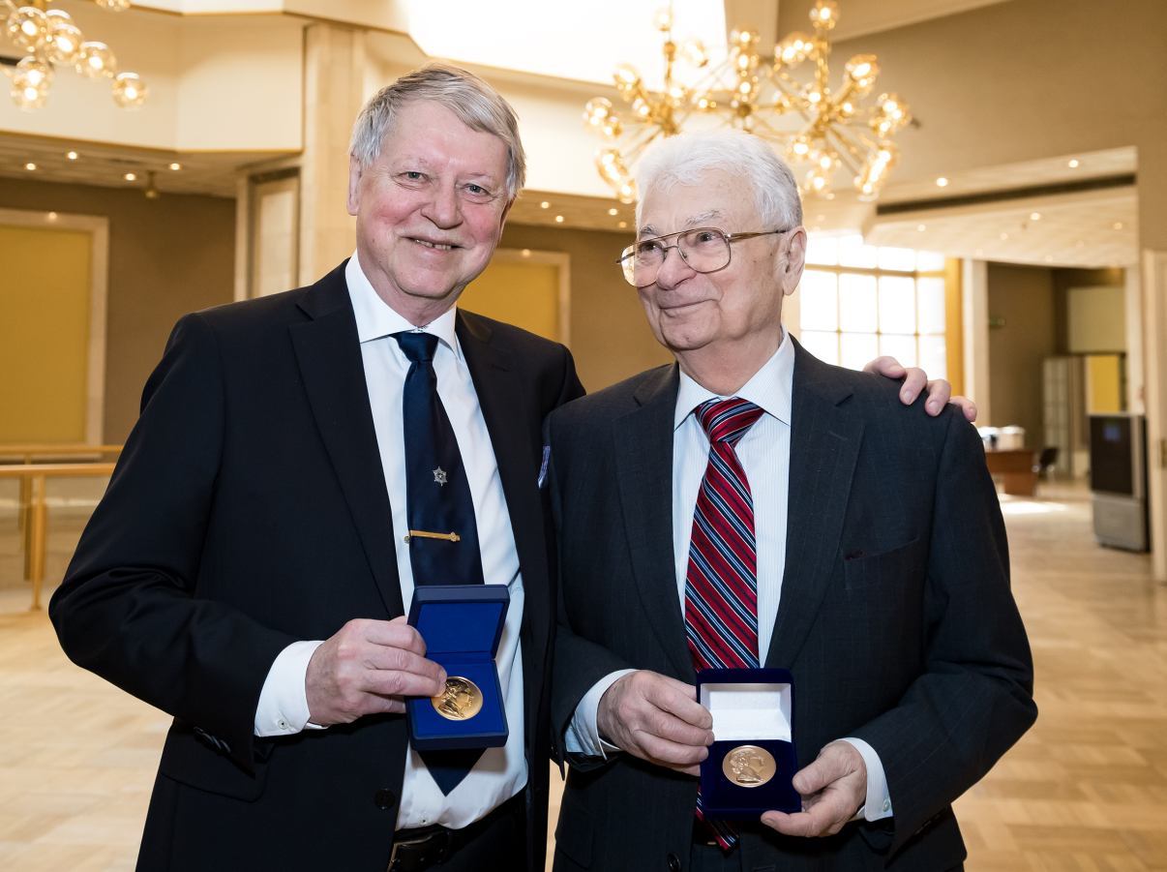
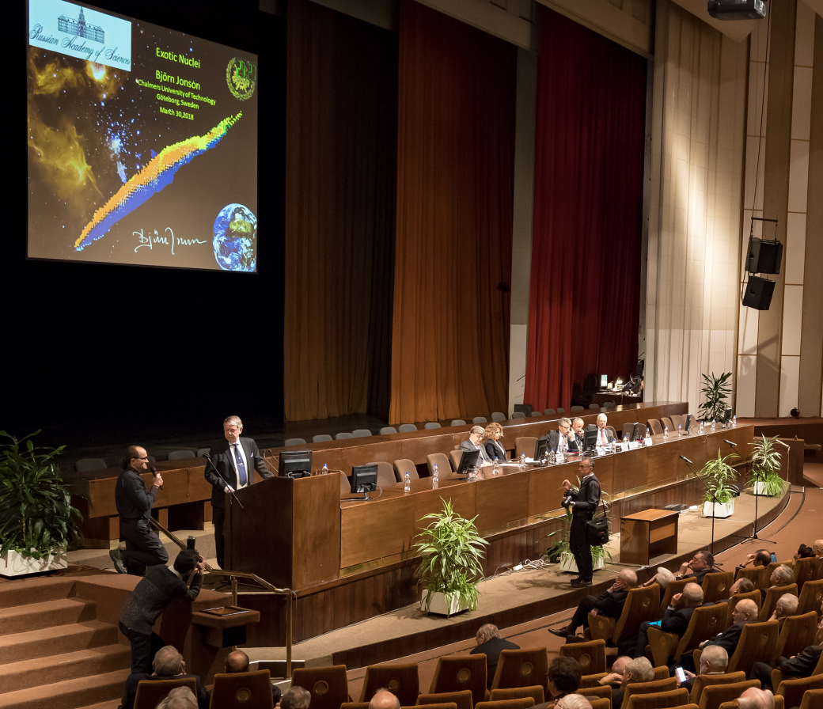
March 30 2018 – The Lomonosov great gold medal is awarded to Yuri Oganessian and Bjorn Jonson
Yu.Ts. Oganessian – synthesis of superheavy elements
B. Jonson – contribution of studies of exotic nuclei (ISOL method and nucleon halo)

Slide 12
7-year planning prospects
“Factory of superheavy elements”
Stage: mounting of equipment
Investment: ~55 M€
Near future
Facility based on
upgraded U-400M + ACCULINNA-2 Stage: first experiments in the fall of 2017
Investment: ~10 M€
Near future

Slide 13
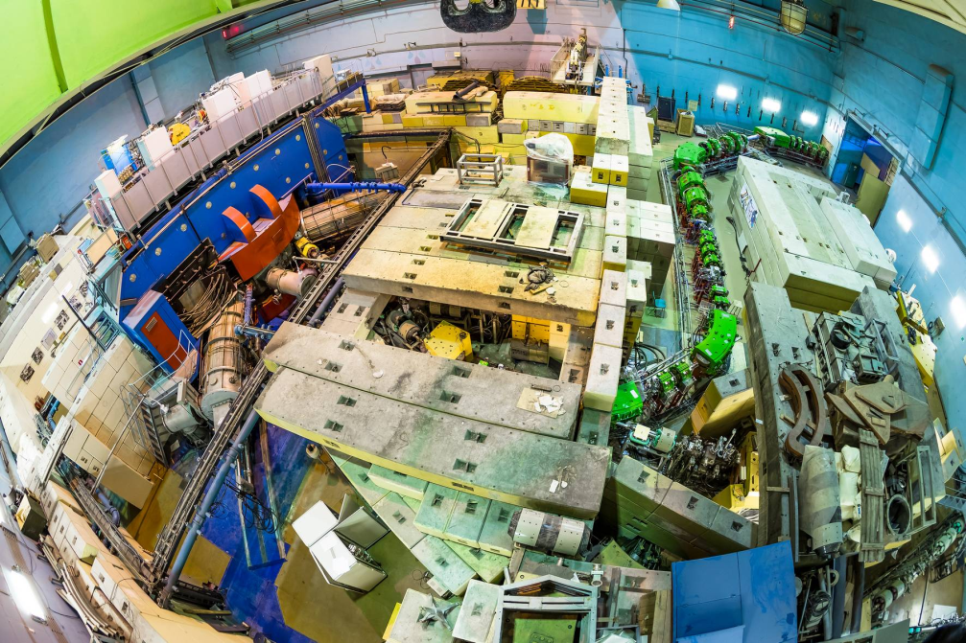
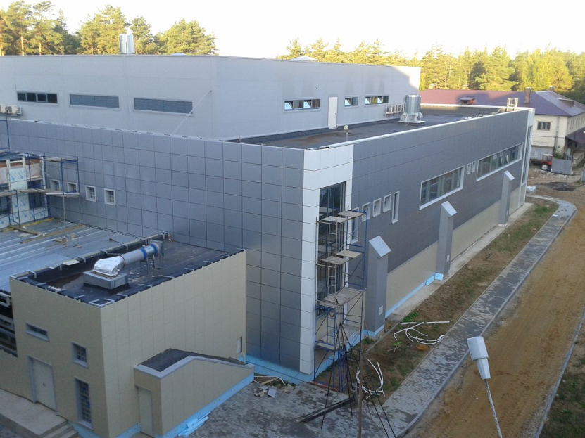
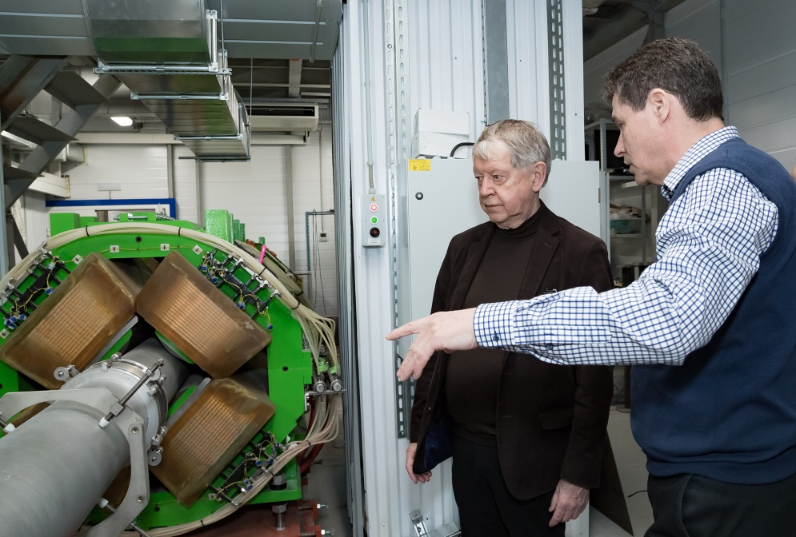
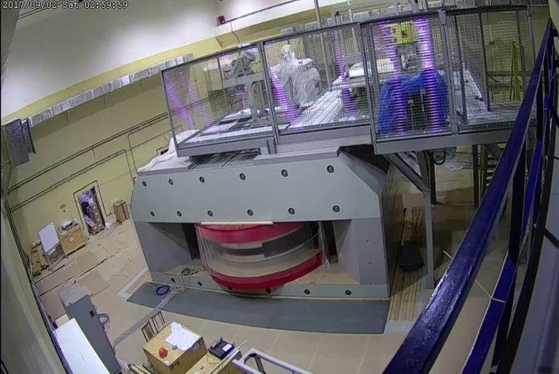
ACCULINNA-2 fragment-separator
New facilities at FLNR
“Factory of superheavy elements”

Slide 14
How to get radioactive ions: Production and identification
“Old school”
1. Reactors. Capture of neutrons is slow.
2. Nuclear Explosions. Extraction is slow.
Modern trend: “factories” of radioactive ions.
3. ISOL.
4. In-flight.

Slide 15
Some relevant reaction mechanisms
Spallation
Typical cross section: 1b
hot
Knockout
Typical cross section: 10 mb
A
A-1
Fragmentation
Dissociation

Slide 16
Why to increase energy or use neutrons
How to make something exotic? Take something heavy (e.g. uranium), accelerate, crash it on the target nucleus, select exotic fragments
10¹⁰ layers
~ 1m
H r ~ 0.8 fm
C r ~ 3 fm
U r ~ 7.5 fm
Complicated to utilize much of the primary beam for nuclear reactions
10⁵ fm
Beam energy loss by ionization
10⁵ fm
G.N. Flerov, A.S. Ilyinov (1982)
Trend to energy increase at modern RIB facilities

Slide 17
RIB production: ISOL (Isotope Separation On-Line)
Possible ISOL layout (SPIRAL2)
Neutron converter
Noble gas
flow
Uranium
foils
Deuteron beam
neutron beam
Selective laser ionization
RIB extraction
Problems:
Extraction selectivity
Extraction time (> 10 ms)

Slide 18
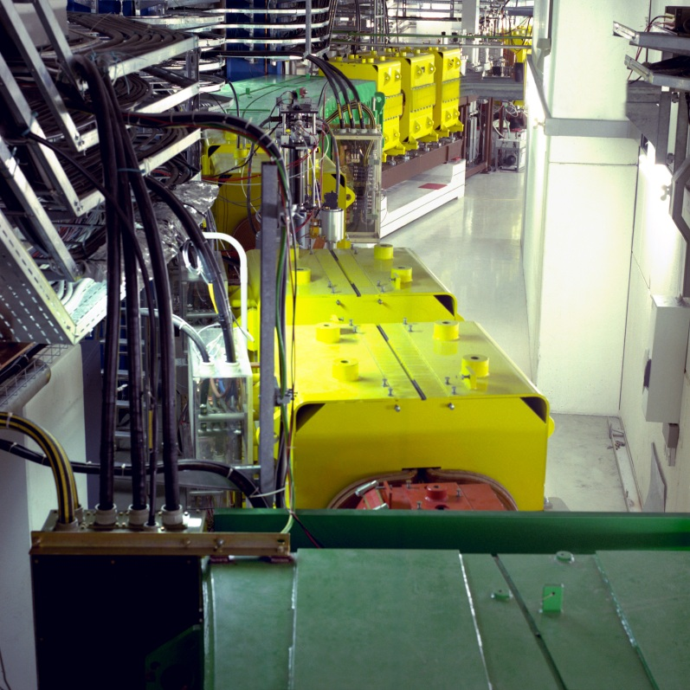
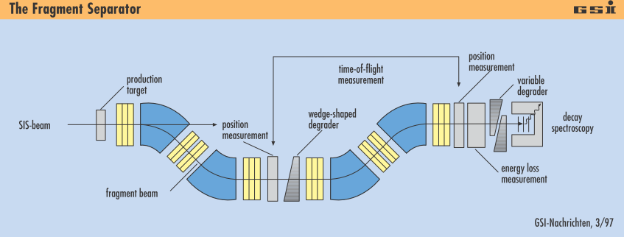
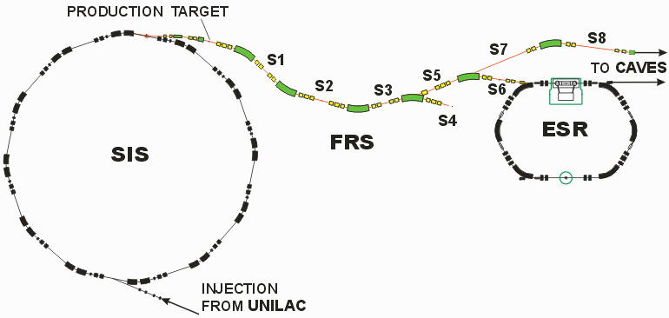
FRS: The Fragment Separator
FRS is an absolutely classic (translation – “giving example”) facility.
FRS defined the landscape of radioactive ion beam research of the last 25 years
Commissioned: end 80-th
Two achromatic stages
Three focal points
150-1000 MeV/Amu operation energies
Relativistic beams – low chromatic aberrations – easy to operate
Muenzenberg: “At this time there was no confidence that it will work in a reasonable way”

Slide 19
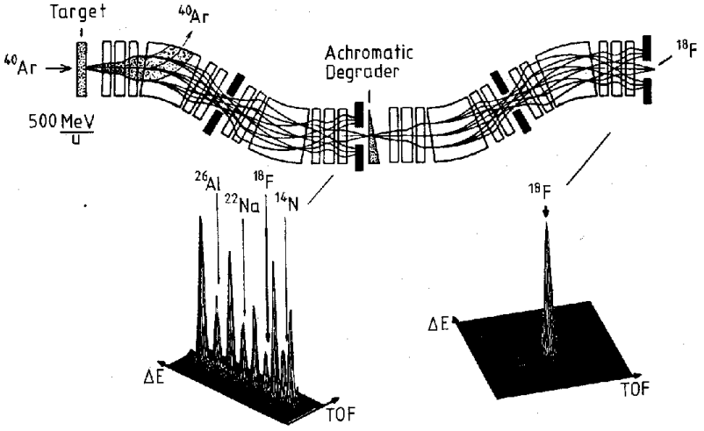
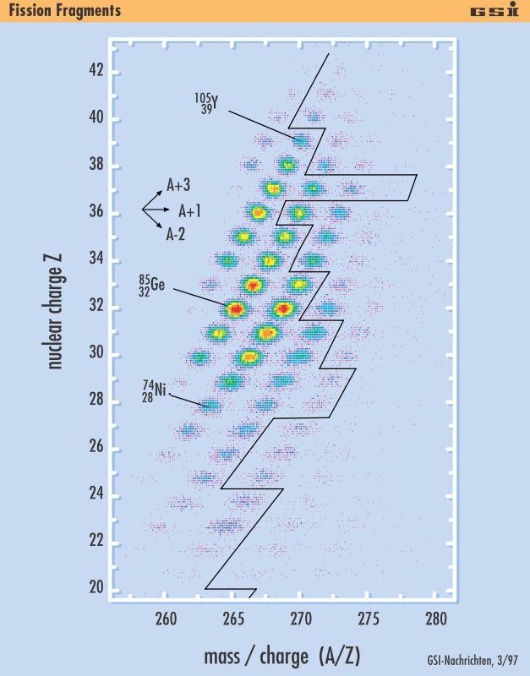
RIB production: In-Flight (Fragment Separators)
Typical FS design: 1-3 achromatic stages
ε = E_{x} / E_{T} cos(q _{k}) = (k_{x},k_{y})/k_{x}k_{y}
FRS@GSI
Wedge degrader changes energy – no direct optical analogue
Qualitatively:
Dipole = prism
Quadrupole = lens
TOF – Δ E particle identification

Slide 20
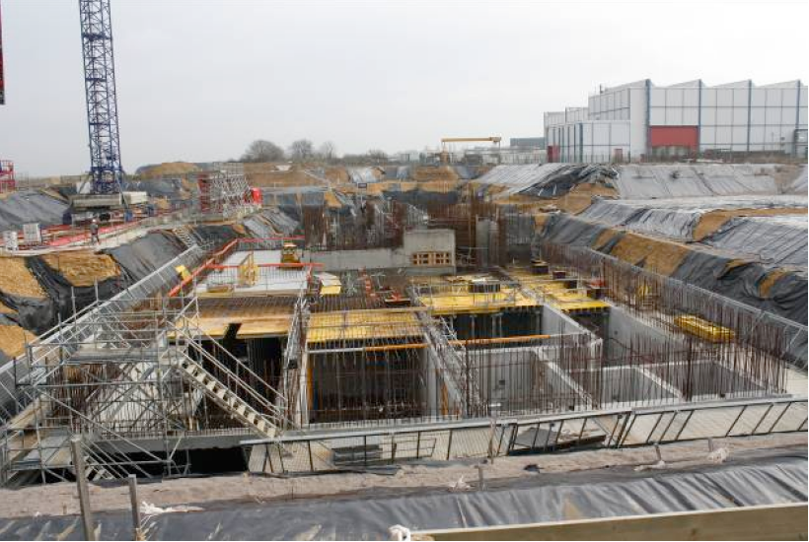
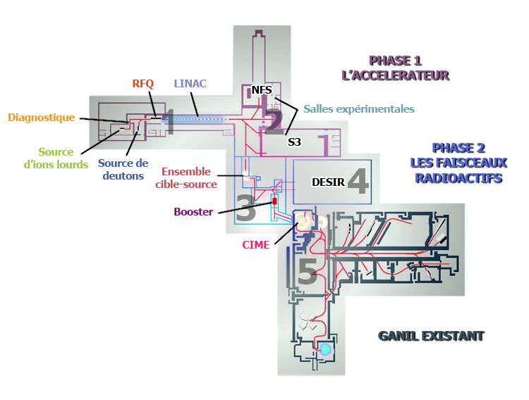
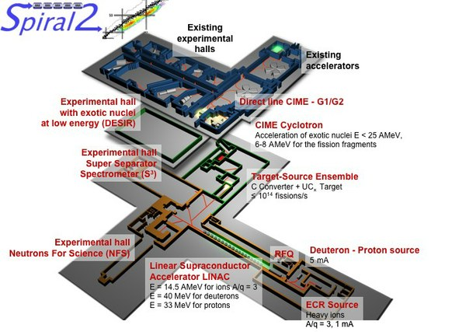
GANIL -> SPIRAL-2
⁶Be
Factory
Location: Caen, France
Production: U target, n beam
Source: linac, deuteron beam
Intensity: 10¹²-10¹³ fissions/s
Separation: ISOL
In operation: 2018
Yellow text
Thick text

Slide 21
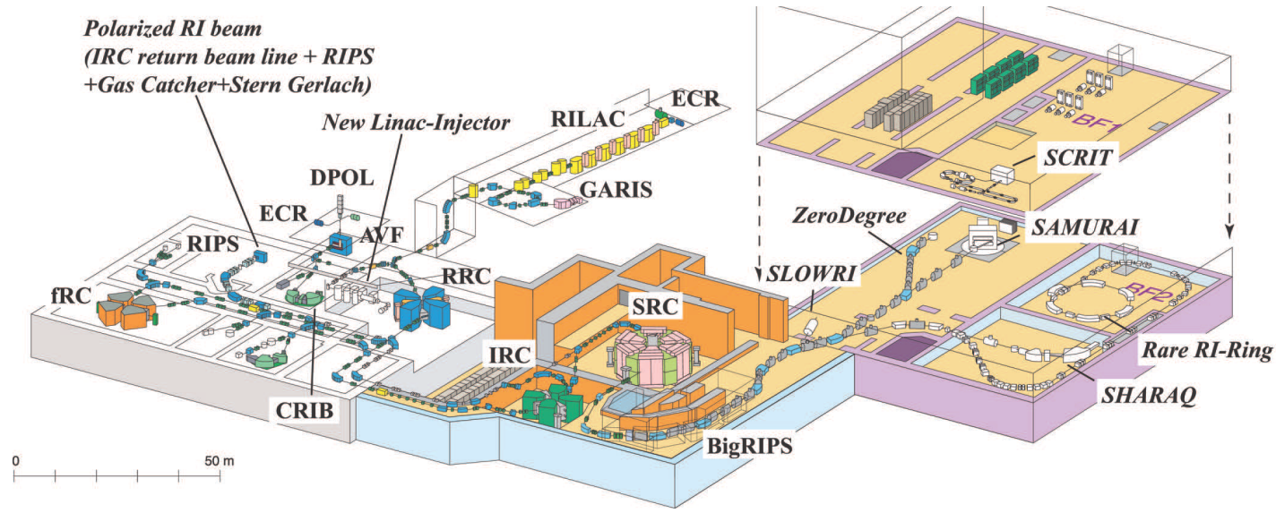
RIKEN -> RIBF (Radioactive Isotope Beam Factory)
⁶Be
¹¹Be
Location: Tokio, Japan
Production: 350-440 MeV/Amu primary beams
Source: cascade of SC cyclotrons
Intensity: 10¹²-10¹³ fissions/s
Separation: BigRIPS fragment separatorS
In operation: since 2010

Slide 22
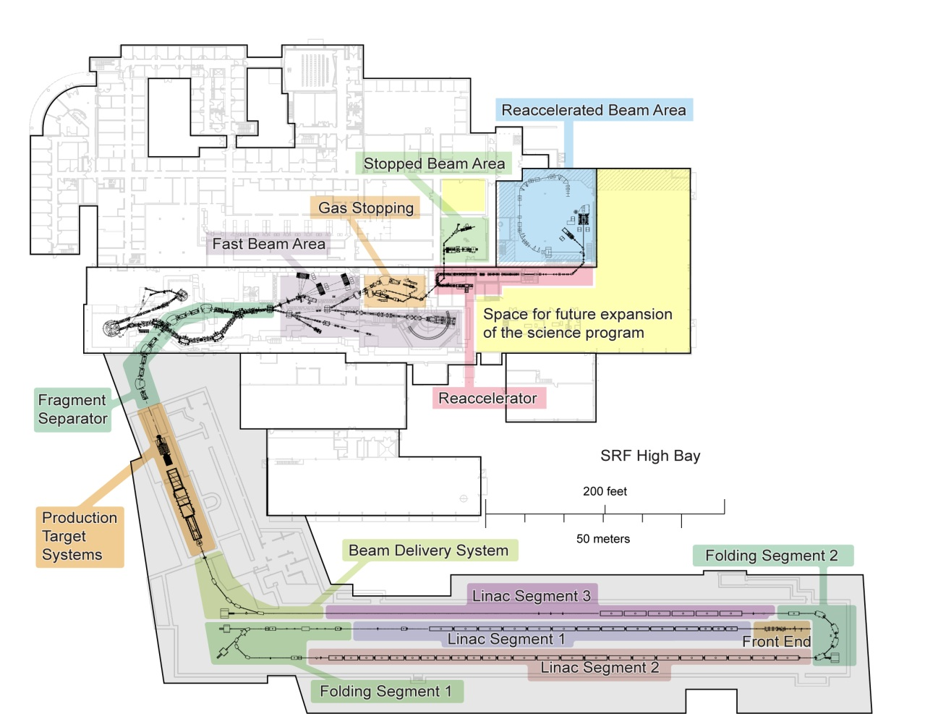
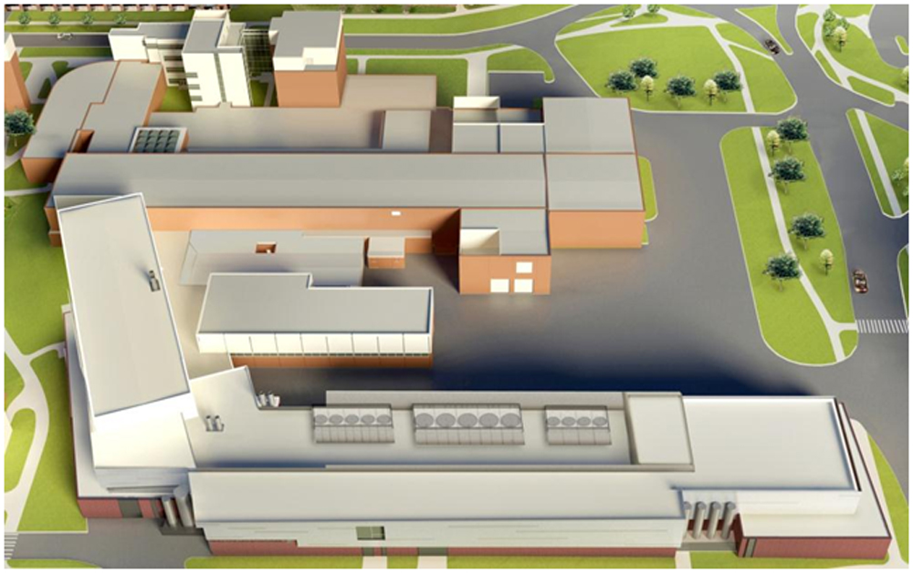
NSCL -> FRIB (Factory Radioactive Isotope Beam)
Location: East Lancing, Michigan, USA
Production: 300 MeV/Amu primary beams
Source: SC linac
Intensity: 10¹²-10¹³ pps
Separation: fragment separator & ISOL
In operation: 2019

Slide 23
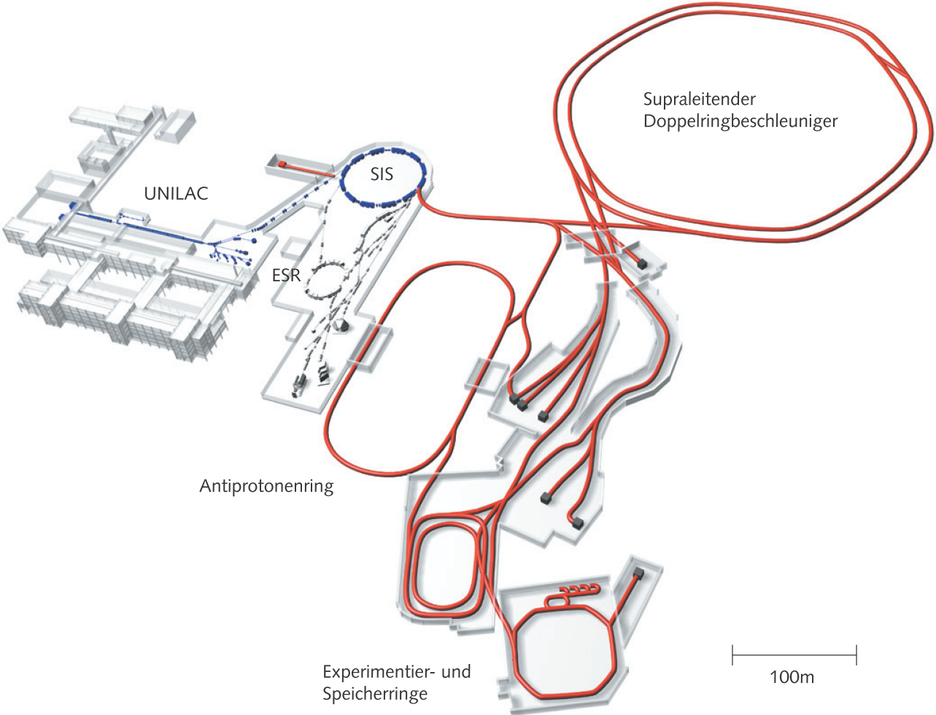
GSI -> FAIR
4 major subprojects:
RIB, relativistic heavy ion, antiproton, applied research
Most complicated and expensive
~1.5 GEuro,
International consortium
Location: Darmstadt, Germany
Production: 2000 MeV/Amu primary beams
Source: cascade of syncrotorons
Intensity: 10¹¹-10¹² pps
Separation: fragment separator SuperFRS
In operation: 2018

Slide 24
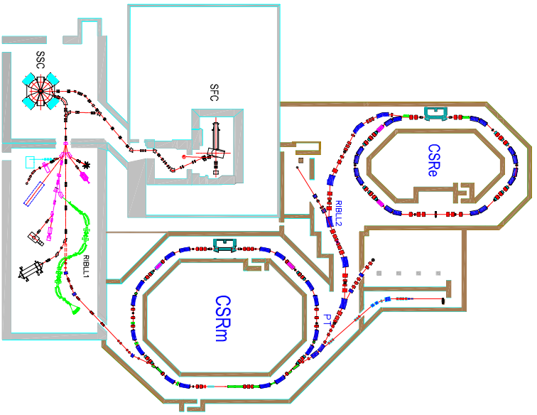
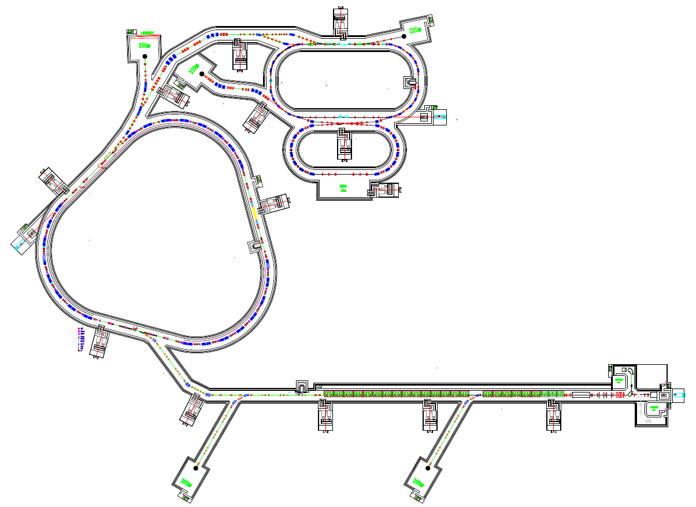
Storage rings. China
Works
HIRFL-CSR@Lanzhou
- Weak “driver”
- Not much space for
driver upgrade
Planned
HIAF:
- 2 storage rings
- 1-st – main function spectrometer
- 2-nd – reactions with “merging beams”

Slide 25




Big, bigger, the biggest
SPIRAL 2
FAIR
FRIB
ACCULINNA
RIBF

Slide 26
How to exist in such conditions:
- To be smart
- To join the club

Slide 27
How to be smart

Slide 28
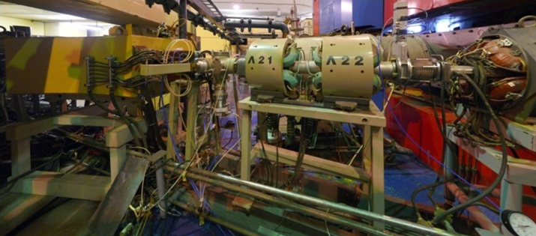
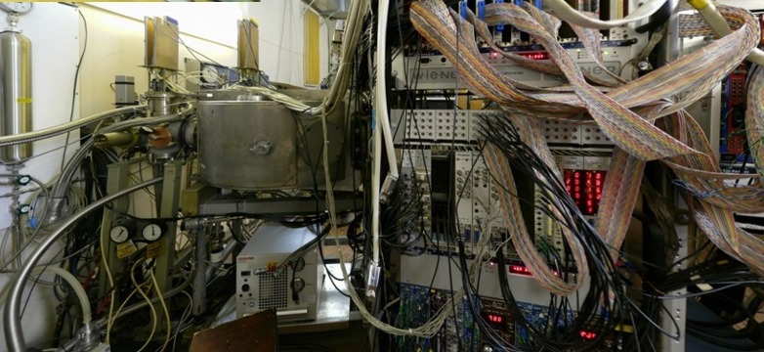
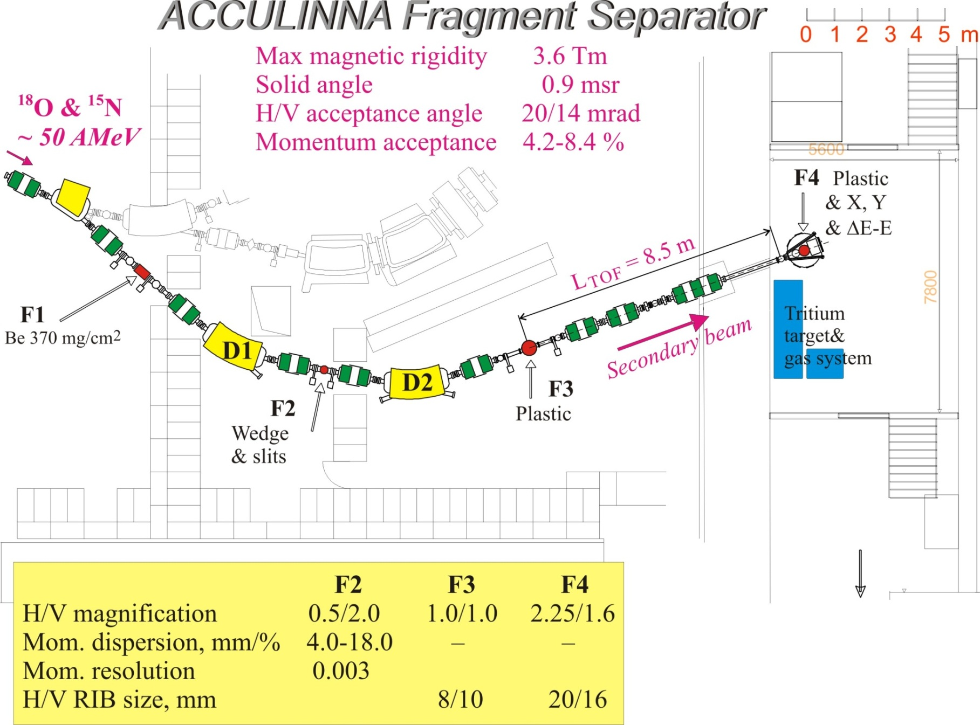
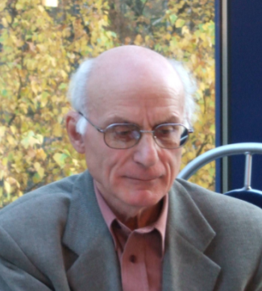

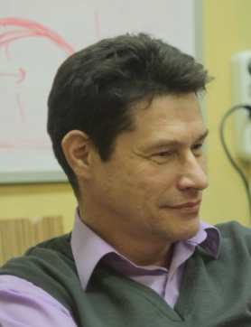
Flerov Lab: Superlights – fragment separator ACCULINNA
U-400M :
⁶Li @ 47 AMeV
I ~ 3×10⁷ 1/s
BS ~ 5 mm
C degrader
¹H(⁶Li,⁶Be)n
E(⁶Li)=33 A MeV
¹¹B @
34 AMeV
I ~ 2×10⁴ 1/s
BS ~ 15 mm
P ~ 90 %
no wedge
Δp/p=0.4%
Be 1.8 mm
Be 1.0 mm
Δp/p=3.6%
³H(⁸He,p)¹⁰He
E(⁸He)=22 A MeV
G.M. Ter-Akopian, A.M. Rodin, A.S. Fomichev, 1996-Now

Slide 29
Flerov Lab: Superlights – fragment separator ACCULINNA
A.A.Korsheninnikov, PRL 82 (1999) 3581.
A.A.Korsheninnikov, PRL 87 (2001) 092501.
S.V. Stepantsov et al., PLB 542 (2002) 35.
M.S. Golovkov et al., PLB 566 (2003) 70.
G.V. Rogachev et al. PRC 67 (2003) 041603(R).
M.S. Golovkov et al., PRL 93 (2004) 262501.
M.S. Golovkov et al., PLB 588 (2004) 163.
M.S. Golovkov et al., PRC 76 (2007) 021605(R).
M.S. Golovkov et al., PLB 672 (2009) 22.
L.V. Grigorenko et. al., PLB 677 (2009) 30.
S.I. Sidorchuk et al., PRL 108 (2012) 202502.
A.S. Fomichev et al., PLB 708 (2012) 6.
I.A. Egorova et al., PRL 109 (2012) 202502.
U-400M :
⁶Li @ 47 AMeV
Historically: injection line for K4-K10 facility
I ~ 3×10⁷ 1/s
BS ~ 5 mm
C degrader
¹H(⁶Li,⁶Be)n
E(⁶Li)=33 A MeV
¹¹B @
34 AMeV
I ~ 2×10⁴ 1/s
BS ~ 15 mm
P ~ 90 %
Transfer, charge-exchange and QFS reaction studies of ^{4,5}H, ^{5,6,8,9,10}He, ⁹Li, ⁶Be, ^{26,27}S, ¹⁷Ne
no wedge
Δp/p=0.4%
Be 1.8 mm
Be 1.0 mm
Δp/p=3.6%
³H(⁸He,p)¹⁰He
E(⁸He)=22 A MeV
G.M. Ter-Akopian, A.M. Rodin, A.S. Fomichev, 1996-Now

Slide 30
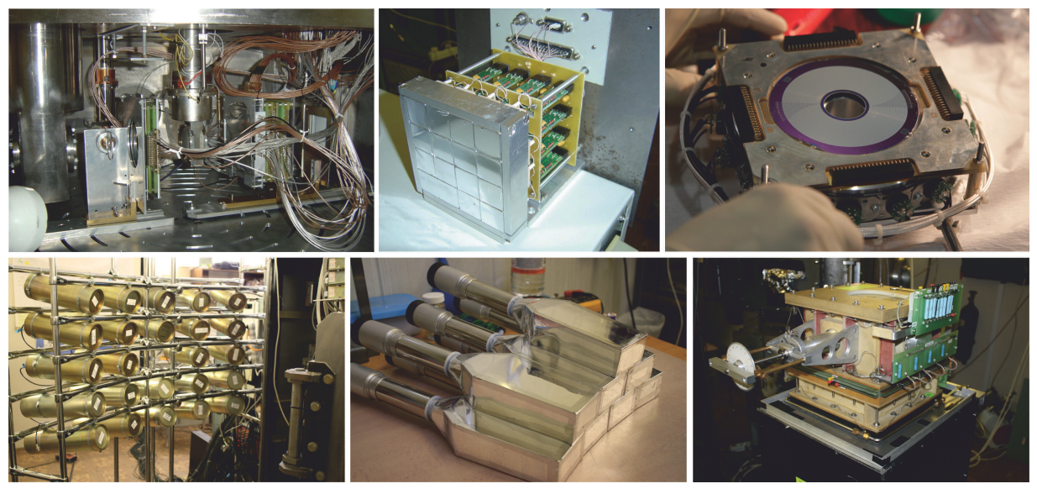
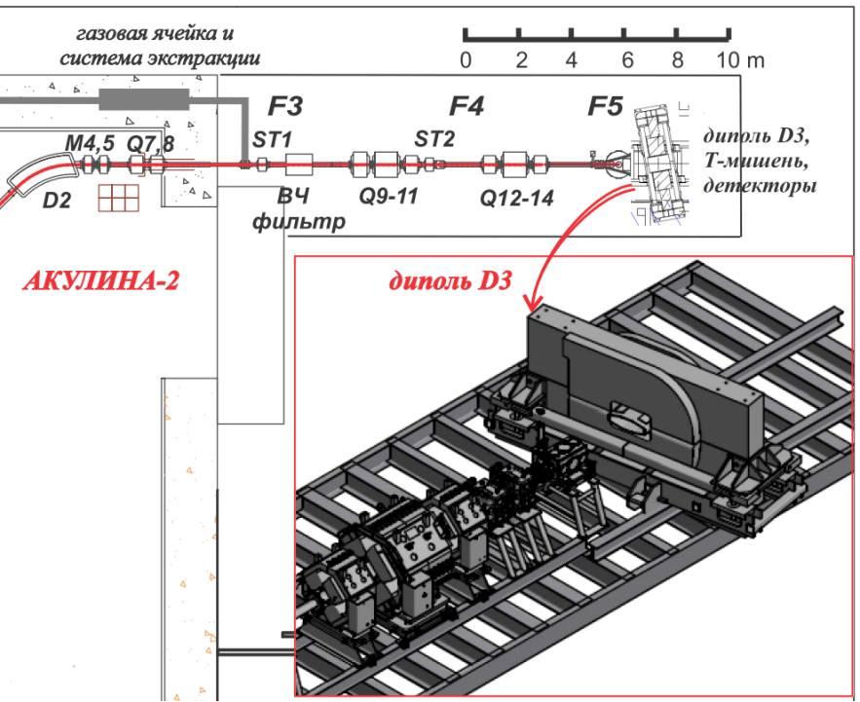
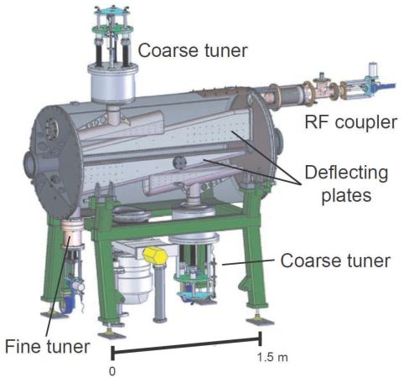
ACCULINNA-2 instrumentation development
Already in production
New OTPC
Zero-angle spectrometer
Velocity filter (RF-kicker)
Stilbene neutron array
γ-array GADAST
“Expensive toys” shopping list
Tritium target system for ACC-2
High-resolution telescope array
U400M upgrade

Slide 31
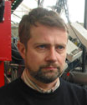
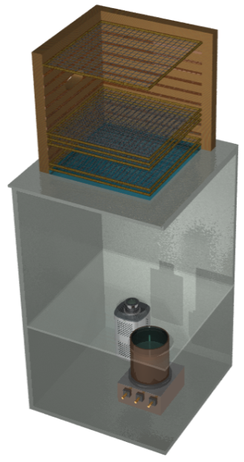
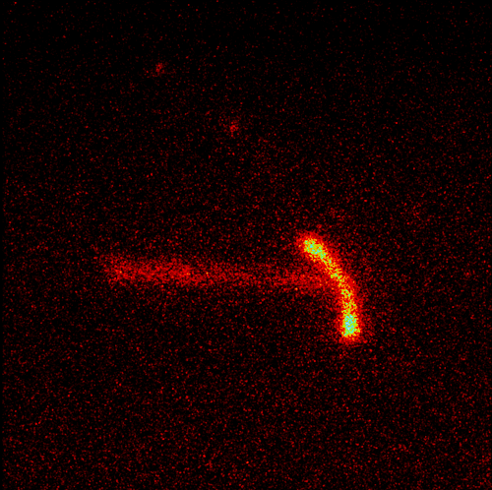
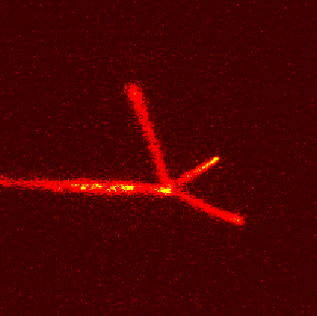
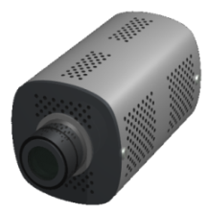
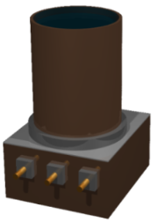
Competitive light nuclei RIB program at FLNR.
Specific equipment development
HI
Warsaw OTPC (optical time-projection chamber)
p
M. Pfutzner, 2007
p
p
⁴⁵Fe
p
³¹Ar
p
MSU 2007: ⁴⁵Fe,
2p-radioactivity
ACCULINNA 2011: ⁸He, β-delayed α-t-n
GSI 2012: S388, ³¹Ar, β-delayed 3p
CCD 2/3’’
1000×1000 pix
12-bits
image ampl. (× 2000)
Truly unique item: cryogenic tritium gas system
Two units move to the neutron-rich region in (t,p) reaction
Background free experiments, easy variation of target thickness
Available only in military laboratories
Nice example of military technology conversion for fundamental science conversion

Slide 32
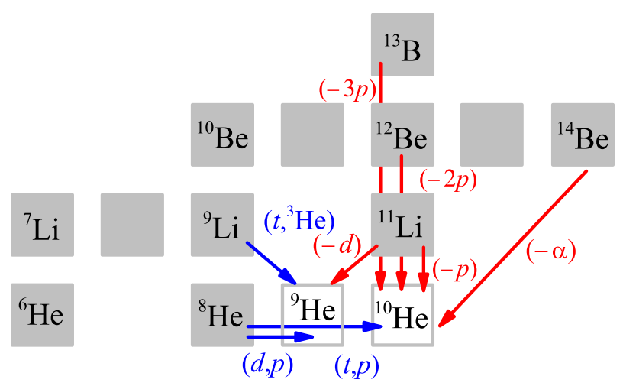
Competitive scientific program at JINR
Intermediate energy reactions (20-70 MeV/nucleon)
High energy reactions
(>70-100 MeV/nucleon)
Transfer reactions
Knockout reactions
Importance of complementary reaction studies

Slide 33
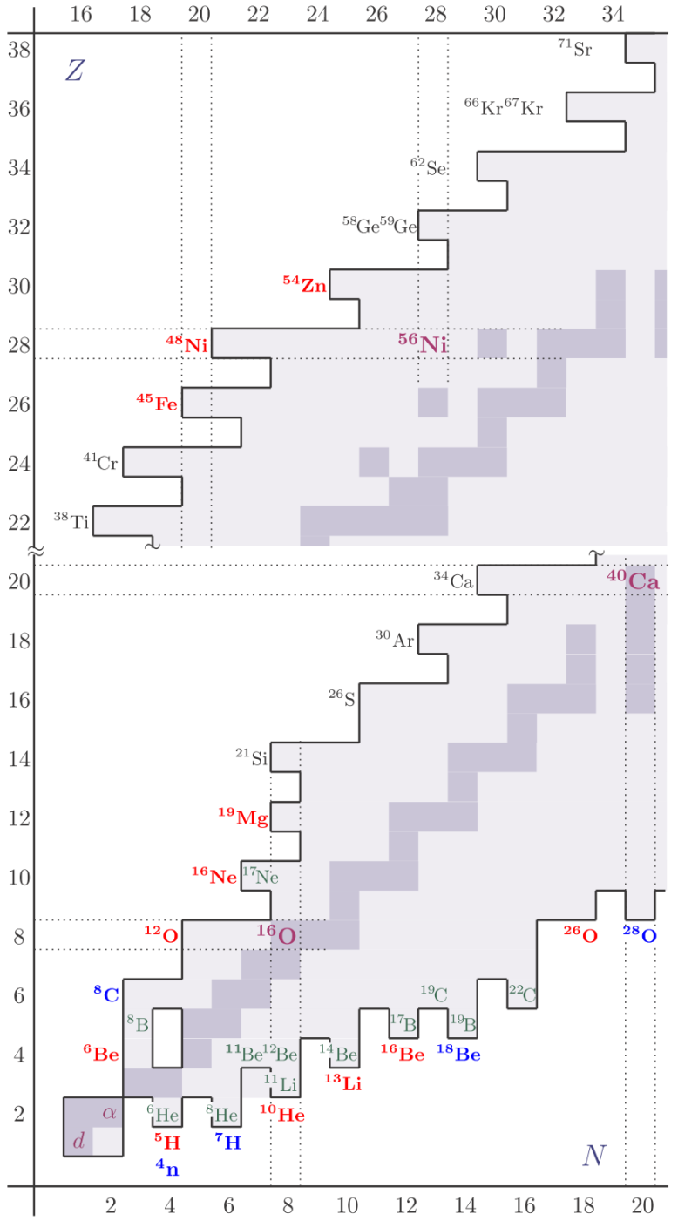
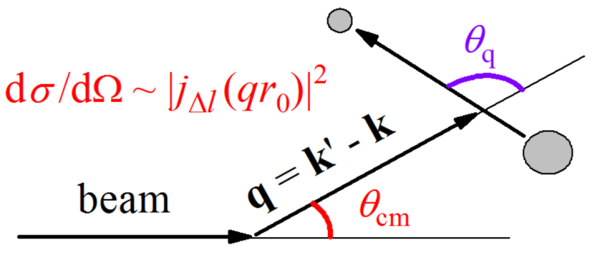
Competitive light nuclei RIB program at FLNR
2. Correlations and few-body dynamics studies
Correlations for aligned states populated in the direct reactions
Few-body dynamics near the driplines
Few-body dynamics at the driplines is consequence of (i) clusterization and (ii) paring
Exotic phenomena near driplines: Haloes (green) True 2p/2n decays (red) 4p/4n emitters (blue) NOT INVESTIGATED (gray)
NOT SO EXOTIC: More or less every second isotope in vicinity of the driplines has features connected to few-body dynamics
Correlations in the three-body decays: two extra degrees of freedom

Slide 34
Exotic things near the driplines

Slide 35
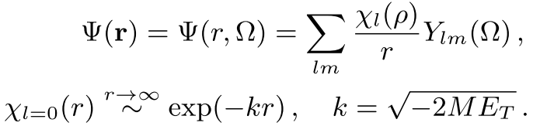
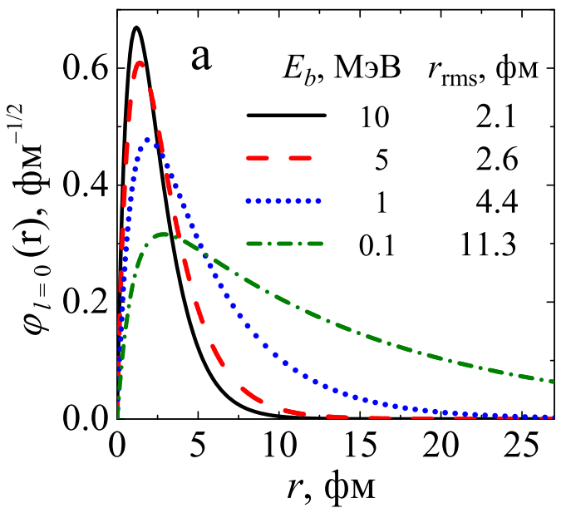
Nucleon halo
G.N. Flerov, A.S. Ilyinov (1982)

Slide 36
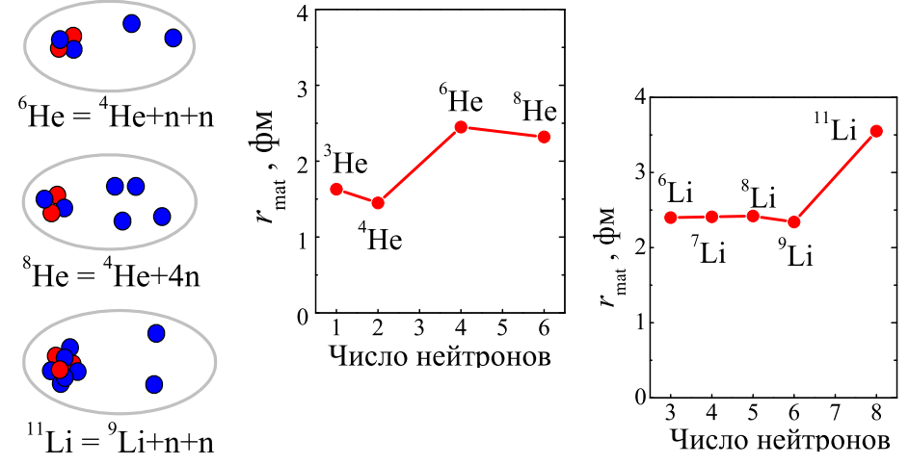
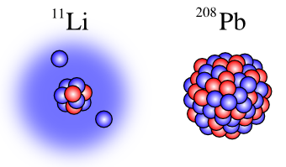


Nucleon halo. Borromean nuclei
Abnormal valence orbital size
Curious spatial correlations
Borromean property
G.N. Flerov, A.S. Ilyinov (1982)

Slide 37



Soft dipole mode
Existance of soft dipole mode strongly influence the nonresonant radiative capture rate in astrophysics
G.N. Flerov, A.S. Ilyinov (1982)

Slide 38


Two-proton radioactivity: a qualitative view
Goldansky and
Zeldovich, 1960
Pfutzner et al and
Giovinazzo et al, 2002
Classical case:
one particle emission is always possible
Quantum mechanical case:
it could be that both particles should
be emitted simultaneously
Exclusive Quantum-Mechanical phenomenon
No deeper bound orbitals.
The common orbital for two protons exists only when both are “inside”.
When one of them goes out, their common orbital do not exist any more and the second HAS to go out instantaneously

Slide 39







Radioactivity “hall of fame”
G.N. Flerov and K.A. Petrzhak
spontaneous fission
F. Jouliot and I. Curie:
β⁺
Henri Becquerel: three classes of radioactivity - negative, positive, and electrically neutral
?
?
V.A. Karnaukhov and G.M. Ter-Akopian
β-delayed p
S. Hofmann:
p
M. Pfutzner:
2p
???
2n radioactivity
???
4n radioactivity

Slide 40
Examples of light exotics studies at FLNR

Slide 41



Example 1: ⁵H studied in the ³H(t,p)⁵H reaction
A.A. Korsheninnikov, 2001, ⁶He(p,2p)⁵H
Discovery of ⁵H at FLNR
M.S. Golovkov, 2004,
Pioneering correlation studies
A.A. Korsheninnikov et al., PRL 87 (2001) 92501.
M.S.Golovkov et al., PLB 566 (2003) 70.
M.S.Golovkov et al., PRL 93 (2004) 262501.
S.V. Stepantsov et al., NPA 738 (2004) 436.
M.S.Golovkov et al., PRC 72 (2005) 064612.
Poor population of ground state. However, correlations provide enough selectivity: quantum amplification
⁵H ground state position is finally established; the excited state is established as 3/2⁺-5/2⁺ degenerate mixture

Slide 42




Example 2: ¹⁰He studied in the ⁸He(t,p)¹⁰He reaction
“Conundrum nucleis” second double magic in nuclide chart
Discovered by Korsheninnikov et al. in 1994 in RIKEN giving E_{T} =1.2 MeV
M.S. Golovkov et al., PLB 672 (2009) 22
S.I. Sidorchuk et al., PRL 108 (2012) 202502
Three-body correlations were studied in ⁵H basing on outstanding statistics. Can be something useful done with really exotic systems and limited statistics?
New ground state energy for ¹⁰He:
E_{T} =2.0-2.5 MeV
Shell structure breakdown in ¹⁰He

Slide 43



Publicity for ¹⁰He work

Slide 44
How to join club?
- Let’s go to GSI/FAIR

Slide 45


Participation in EXPERT@SuperFRS@FAIR
I.G. Mukha, 2007,
Investigation of radioactive decays with particle emission by product tracking
Simultaneously (i) lifetime in the ps range
(ii) spectroscopy of the short-lived states
Extremely thick secondary targets up to ~25 mm
Basic idea is old, technological realization is modern and sophisticated
Efficient work with poor “coctail” beams
Simultaneous results from tracking system (decay spectroscopy) and OTPC (β-delayed decays) – two experiments for the price of one
One of very few experiments at FAIR with dominant Russian contribution

Slide 46
Basic idea
Prof. I. Mukha: opportunity to investigate particle radioactivity in fs-ns lifetime range
Radioactivity studies
HOWEVER. Found to be well suited for spectroscopy
Not an invariant mass measurement: only transverse momentum distributions
Two-body decay
Better than invariant mass method! IF you understand what is happening

Slide 47
EXPERT:
EXotic Particle Emission and Radioactivity by Tracking
VERY THICK secondary
target for one- or two-nucleon knockout
Identification of heavy fragment excitations by target area γ array GADAST
Last achromatic stage of fragment separator is Hi-res spectrometer for heavy decay fragment
Degrade the heavy fragment energy
^{A-1}(Z-2)
4
5
^{A-2}(Z-1)
Beam
Warsaw OTPC
Radioactive particle emission for stopped reaction and decay products
p
^{A}Z
^{A-1}Z
n
^{A}(Z-1)
1
Radiation-
-hard SSDs
for beam diagnostics
2
3
μSi tracking
detector system
for light charged
particles
NeuRad
High-angular resolution neutron detector
6
MC simulation
framework
to interpret the
correlation data with
incomplete kinematics
FRS, SuperFRS
one of the middle focal planes
Particle unstable systems beyond proton or neutron driplines
Hi-res angular measurements both for proton and neutron dripline nuclei populated on secondary target

Slide 48
How to join club?
- Let’s build modern RIB factory of our own

Slide 49
7-year planning prospects
“Factory of superheavy elements”
Stage: mounting of equipment
Investment: ~55 M€
Near future
???
Long-time prospects
Facility based on
upgraded U-400M + ACCULINNA-2 Stage: first experiments in the fall of 2017
Investment: ~10 M€
Near future

Slide 50
Scientific megaprojects in Russia
Комплекс сверхпроводящих колец на встречных пучках тяжёлых ионов NICA («Комплекс NICA»)
Международный центр нейтронных исследований на базе высокопоточного исследовательского реактора ПИК (МЦНИ ПИК)
Токамак с сильным магнитным полем (Игнитор)
Ускорительный комплекс со встречными электрон-позитронными пучками (Супер Чарм-Тау фабрика)
Международный центр исследований экстремальных световых полей (ЦИЭС)
Рентгеновский источник синхротронного излучения четвертого поколения (ИССИ-4).
Форма сбора предложений по проектам создания на территории Российской Федерации инфраструктуры класса «мегасайенс» и/или развития существующей инфраструктуры до уровня класса «мегасайенс»
Наименование проекта: DERICA (Dubna Electron – Radioactive Ion Collider fAcility, Дубненский коллайдер электронов и радиоактивных изотопов)
Инициаторы проекта:
Объединённый институт ядерных исследований, Дубна
Институт ядерной физики им. Г.И. Будкера СО РАН, Новосибирск
G.N. Flerov, A.S. Ilyinov (1982)

Slide 51
To limit universality
To go to underdeveloped fields
Huge increase in the scale of modern and prospective RIB facilities:
Price tag 1-2 G€
Scale increase – (i) RIB production increase and (ii) universality of RIB facility
Is it possible to have world competitive RIB program with modest investment scale?

Slide 52
Empty “ecological niche”
Underdeveloped field: storage ring physics with RIBs
Empty field: studies of RIBs in electron-RIB collider
Studies of electromagnetic formfactors of exotic nuclei in e-RIB collider
Isochronous mass spectromentry
RIB storage ring
Precision reaction studies on internal gas jet target
electron storage ring
Atomic physics studies with striped ions
Etc….
Radioactivity studies with striped ions

Slide 53






Electron scattering
Robert Hofstadter 1915-1990,
1961 Nobel Prize "for his pioneering studies of electron scattering in atomic nuclei and for his consequent discoveries concerning the structure of nucleons.."
After masses, the radial properties are the most important characteristics of nuclei
First Born approximation, fast electrons, relatively light nuclei
электроны, достаточно легкие ядра
Charge formfactor, charge radius
Electromagnetic probe is the most reliably studied
- Electron scattering
- Experiments in traps – “static” EM characteristics -> derivation of r_{ch}
- Electron scattering –
differential characteristics

Slide 54
Status of charge radii studies – broad field for exploration
900 measured for 3100 known nuclear-stable isotopes
Some isotopic chains are well studied – some not at all
Somewhere driplines is nearly achieved – somewhere very far
Systematics demonstrate complicated dynamical effects in the isotopic chains, especially near the driplines

Slide 55


Storage ring and e-RIB collider topic in Russia
Expertize in the field especially at Dubna and Novosibirsk
К4
К10
Yu.Ts. Oganessian et. al.,
Z. Phys. A341 (1992) 217

Slide 56




Status of ring projects in the world
TSR/ISOLDE@CERN
ELISe/NESR@FAIR
ESR/CRYRING@GSI
MUSES@RIKEN
RI-Ring@RIKEN
HIRFL-CSR@Lanzhou
HIAF
– A lot of ring projects – serious interest to the topic
– All the ring projects with e-collider abilities were
cancelled or indefinitely postponed
Не в масштабе

Slide 57


DERICA stages 0 -1
Continuity of scientific program
Minimization of technological risks

Slide 58

DERICA stages 2 - 4
Spacious cite for development
New experimental opportunities on each stage
Good upgrade prospects

Slide 59


Россия – щедрая душа
К концу декабря 2015 г. Прохоров стал единоличным владельцем команды "Бруклин Нетс", поскольку купил долю, которая принадлежала девелоперу Брюсу Ратнеру. В общей сложности российский бизнесмен потратил на команду $825 млн, включая долговые обязательства.
Вклад России в ценах 2005 года – 178.05 M€, что соответствует 17.4% от стоимости проекта ФАИР. Ожидается что ежегодный вклад на эксплуатацию составит порядка 30 M€.
Оценка стоимости проекта DERICA – около 270 M€ - сущие копейки…
http://aculina.jinr.ru/derica.php

Slide 60

Conclusions
There exists broad field of research in the nuclear systems far from stability.
This field would not be “exhausted” in the observable future.
Exotic novel phenomena discovered in the last two decades. Prospects of new discoveries.
There is active research program in this field at FLNR –Superheavy element factory and ACCULINNA-2
Russia is the largest foreign contributor to FAIR project. EXPERT program for SuperFRS@FAIR with large contribution from FLNR
Possible new Russian megaproject DERICA

