Slide 1
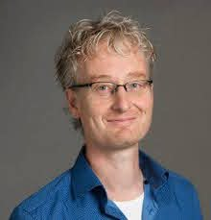
Flow Factorized Representation Learning
Yue Song
T. Andy Keller
Max Welling
CMS ML Seminar
February 6th, 2024
Notes:
Hi name is Andy, I’m finishing up my PhD with Max Welling at the UvA
Super excited to share this work infront of such a diverse community of scientists whose work has really inspired my own work, so I hope you find it as exciting as I do.

Slide 2
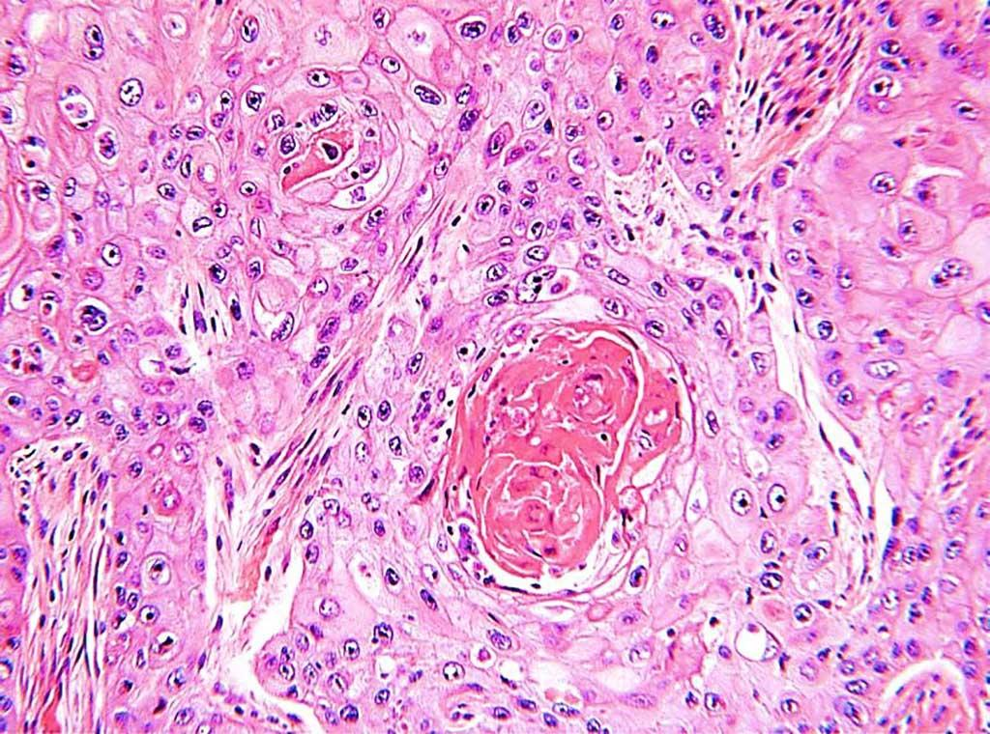
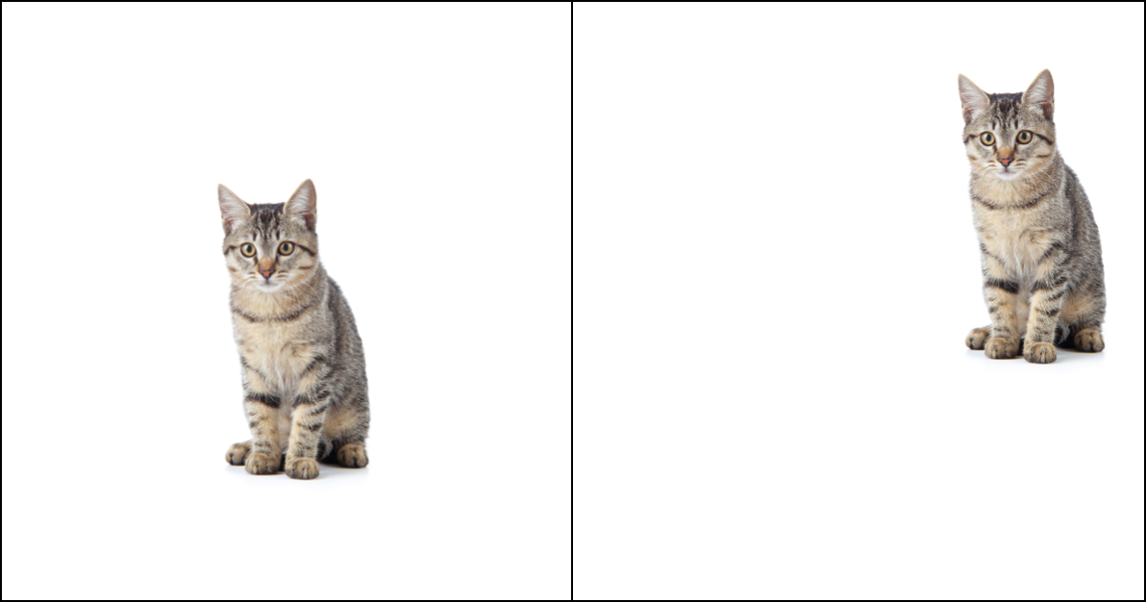
Motivation
Notes:
Equivariance is the mathematical notion of symmetry of functions. At a high level, a representation is said to be equivariant if it transforms in a known, predictable manner for a transformation of the input.

Slide 3
Equivariance
Notes:
Equivariance is the mathematical notion of symmetry of functions. At a high level, a representation is said to be equivariant if it transforms in a known, predictable manner for a transformation of the input.

Slide 4
Equivariance
Notes:
Equivariance is the mathematical notion of symmetry of functions. At a high level, a representation is said to be equivariant if it transforms in a known, predictable manner for a transformation of the input.
The most well known example of an equivariant function is the convolution operation -- which is equivariant to translation.
To demonstrate this, observe that if we first apply a convolutional kernel, and then translate the output, this is equivalent to first translating the input, and then applying the convolution second. -- in otherwords, the function and the transformation commute.

Slide 5
Equivariance
Notes:
Equivariance is the mathematical notion of symmetry of functions. At a high level, a representation is said to be equivariant if it transforms in a known, predictable manner in the output space (phi) for a transformation of the input space (rho).
The most well known example of an equivariant function is the convolution operation -- which is equivariant to translation.
To demonstrate this, observe that if we first apply convolutional kernel, and then translate the output, this is equivalent to first translating the input, and then applying the convolution second. -- in otherwords, the function and the transformation commute.

Slide 6
Equivariance
Notes:
Equivariance is the mathematical notion of symmetry of functions. At a high level, a representation is said to be equivariant if it transforms in a known, predictable manner in the output space (phi) for a transformation of the input space (rho).
The most well known example of an equivariant function is the convolution operation -- which is equivariant to translation.
To demonstrate this, observe that if we first apply convolutional kernel, and then translate the output, this is equivalent to first translating the input, and then applying the convolution second. -- in otherwords, the function and the transformation commute.

Slide 7
Equivariance
Notes:
Equivariance is the mathematical notion of symmetry of functions. At a high level, a representation is said to be equivariant if it transforms in a known, predictable manner in the output space (phi) for a transformation of the input space (rho).
The most well known example of an equivariant function is the convolution operation -- which is equivariant to translation.
To demonstrate this, observe that if we first apply convolutional kernel, and then translate the output, this is equivalent to first translating the input, and then applying the convolution second. -- in otherwords, the function and the transformation commute.

Slide 8
Equivariance
Notes:
Equivariance is the mathematical notion of symmetry of functions. At a high level, a representation is said to be equivariant if it transforms in a known, predictable manner in the output space (phi) for a transformation of the input space (rho).
The most well known example of an equivariant function is the convolution operation -- which is equivariant to translation.
To demonstrate this, observe that if we first apply convolutional kernel, and then translate the output, this is equivalent to first translating the input, and then applying the convolution second. -- in otherwords, the function and the transformation commute.

Slide 9
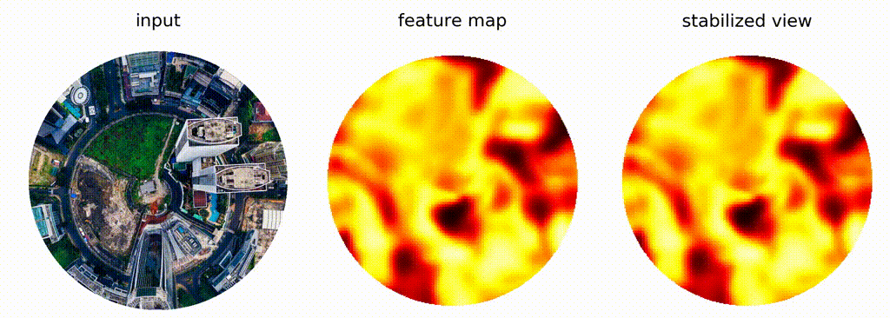
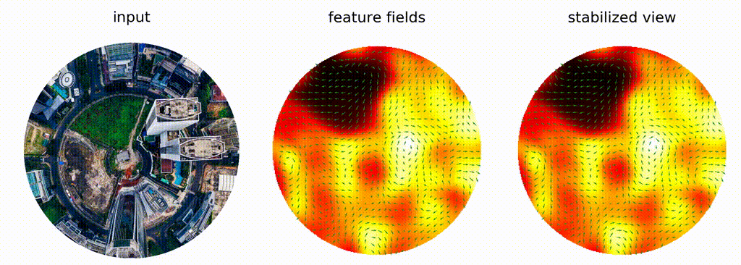
Motivation
A Program to Build E(N)-Equivariant Steerable CNNs. G. Cesa, L. Land, M. Weiler. 2022
https://github.com/QUVA-Lab/escnnx
‹#›
Notes:
Equivariance is the mathematical notion of symmetry of functions. At a high level, a representation is said to be equivariant if it transforms in a known, predictable manner for a transformation of the input.

Slide 10
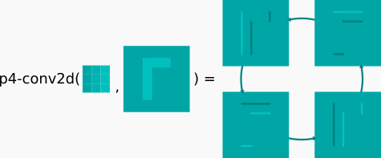
Equivariance
Notes:
Equivariance is the mathematical notion of symmetry of functions. At a high level, a representation is said to be equivariant if it transforms in a known, predictable manner in the output space (phi) for a transformation of the input space (rho).
The most well known example of an equivariant function is the convolution operation -- which is equivariant to translation.
To demonstrate this, observe that if we first apply convolutional kernel, and then translate the output, this is equivalent to first translating the input, and then applying the convolution second. -- in otherwords, the function and the transformation commute.

Slide 11
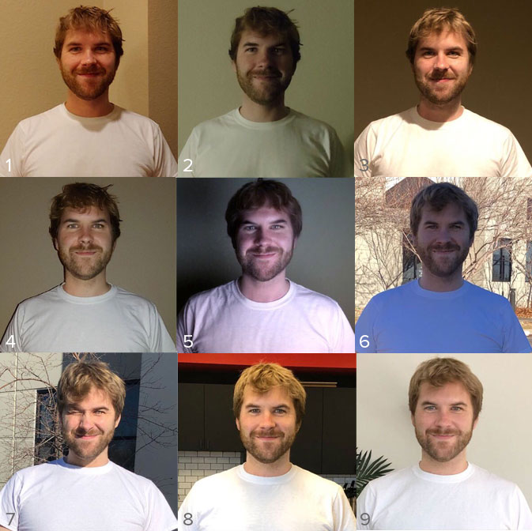
Natural Symmetry Transformations
Can we generalize equivariance?
https://blog.photofeeler.com/lighting/
Notes:
For example, our brain is able to handle changes in lighting or changes in season naturally, but we dont know how to build models which respect these transformations, thus making it hard for us to build systems which handle them in a predictable way.
So is there a way that the mechanisms which allowed us to learn this natural form of organization can also be extended to learn natural transformations, and to be approximately equivariant with respect to those transformations.

Slide 12
Overview
Learning Latent Dynamical Systems
Latent Traversal in Generative Models as Potential Flows. Y. Song, T. A. Keller, N. Sebe, Max Welling. ICML 2023.
Flow Factorized Representation Learning. Y. Song, T. A. Keller, N. Sebe, Max Welling. NeurIPS 2023.
Sparse Transformation Analysis. Y. Song, T. A. Keller, N. Sebe, Max Welling. Under Review, 2024.
Notes:
Specifically I’ll tell you about my work on topographic organization, spatiotemporal dynamics, and then finally how these might apply to self supervised learning.
To begin, I’ll just into my work on topographic organization.

Slide 13
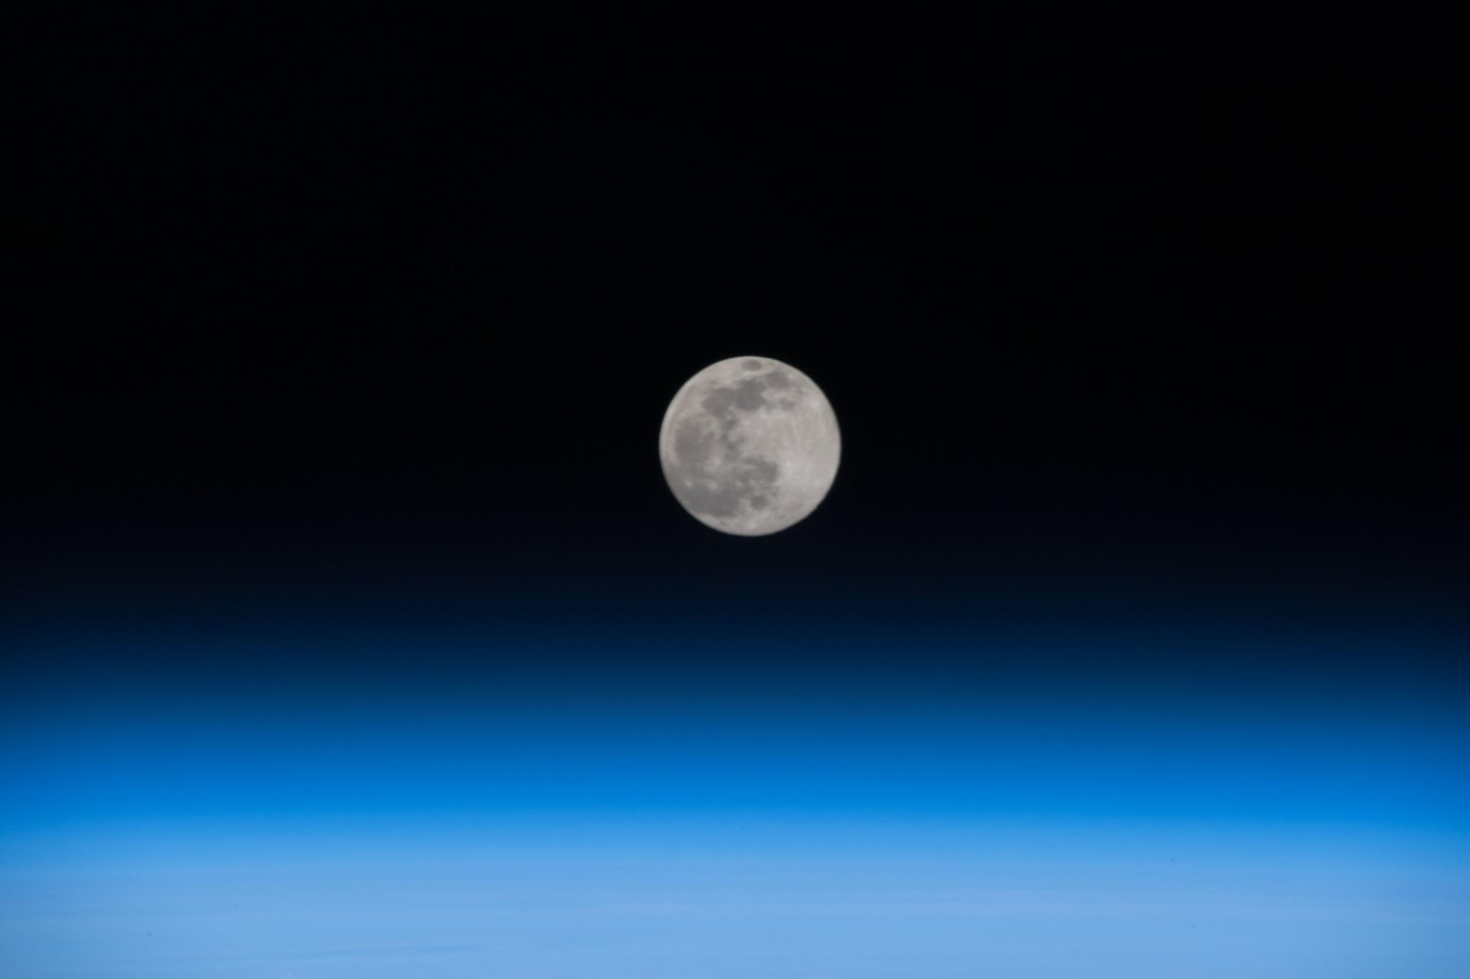
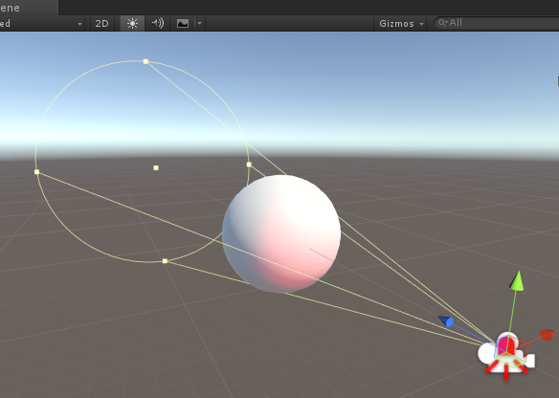
Generative Modeling
Data 𝐗 is generated from unknown ‘latent variables’ 𝐙 through true generator:
Variational Inference: Compute 𝜙 such that is close to
Notes:
Next we’ll get a little more formal with our definition, only to allow us to define and motivate our own model later.
First, in a generative model, we have to assume that the data is generated from some process. In this case, data is generated from unknown latent values, through some true generator function. By introducing prior distribution p(z) on the latents, we can also encode our apriori beliefes into the model.
Like we said before, the unknown ground truth generative model could be a graphics rendering engine which takes in the object position, size, and light position, (all as z) and outputs the image x. One benefit of this formulation is that it is stochastic, so we are specifying a distribution over observations rather than the exact observation, so it gives us some fudge room to be a little wrong and still be right, if that make sense.
Also like we said before, the goal of generative modeling from our point of view is to invert this process, and find the latent variables for a given x. But how do we do that?
If you remember your statistics, this is what is called the posterior distribution P of z given x, and can be computed using bayes rule.
Unfortunately this is intractable due to the integral over all possible latent variables z here. So we have to find an approximate route.
Luckily, some people much smarter than I have figured this out already, and one way to do that is with variational inference, the core idea being that it is instead possible, and tractible, to parameterize and compute an approximate posterior q which is as close to the true posterior as possible using a lower bound on the true likelihood.
p_{\theta^*}(\mathbf{x}) = \int p_{\theta^*}(\mathbf{x}|\mathbf{z})p_{\theta^*}(\mathbf{z})
p_{\theta^*}(\mathbf{z}|\mathbf{x}) = \frac{ p_{\theta^*}(\mathbf{x}|\mathbf{z})p_{\theta^*}(\mathbf{z})}{\int p_{\theta^*}(\mathbf{x}|\mathbf{z})p_{\theta^*}(\mathbf{z})d\mathbf{z}}}

Slide 14
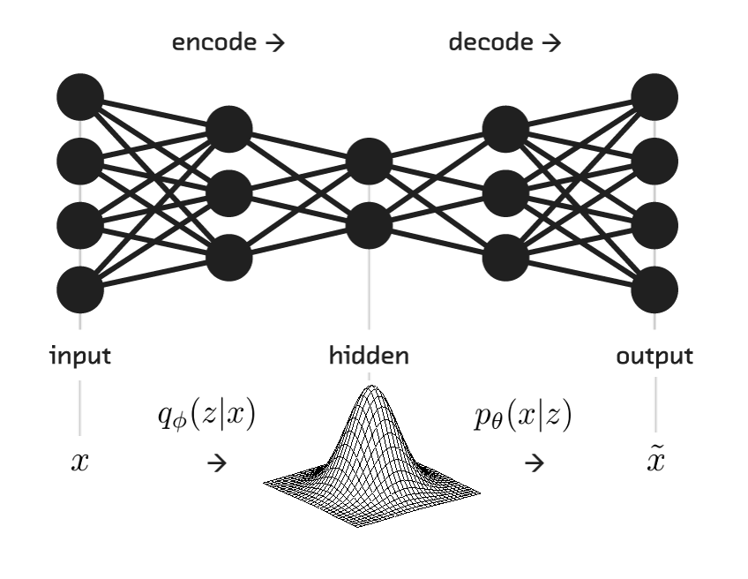
Variational Autoencoders
Notes:
My PhD is focused on integrating modern probabilistic generative models (such as Variational Autoencoders) with what many of us would consider ‘common sense’ – such as simple laws of physics and causation.

Slide 15
Variational Autoencoders
Notes:
My PhD is focused on integrating modern probabilistic generative models (such as Variational Autoencoders) with what many of us would consider ‘common sense’ – such as simple laws of physics and causation.

Slide 16
Variational Autoencoders
Notes:
My PhD is focused on integrating modern probabilistic generative models (such as Variational Autoencoders) with what many of us would consider ‘common sense’ – such as simple laws of physics and causation.

Slide 17
Variational Autoencoders
Notes:
My PhD is focused on integrating modern probabilistic generative models (such as Variational Autoencoders) with what many of us would consider ‘common sense’ – such as simple laws of physics and causation.

Slide 18
Variational Autoencoders
Notes:
\mathbb{E}_{\mathbf{z} \sim q_{\phi}(\mathbf{z} | \mathbf{x})} \Big[ \ln p_{\theta}(\mathbf{x} | \mathbf{z}) + D_{KL}[q_{\phi}(\mathbf{z} | \mathbf{x} ) || p_{\theta}(\mathbf{z})] \Big] \leq \ln p_{\theta}(\mathbf{x})

Slide 19
Standard Equivariance

Slide 20
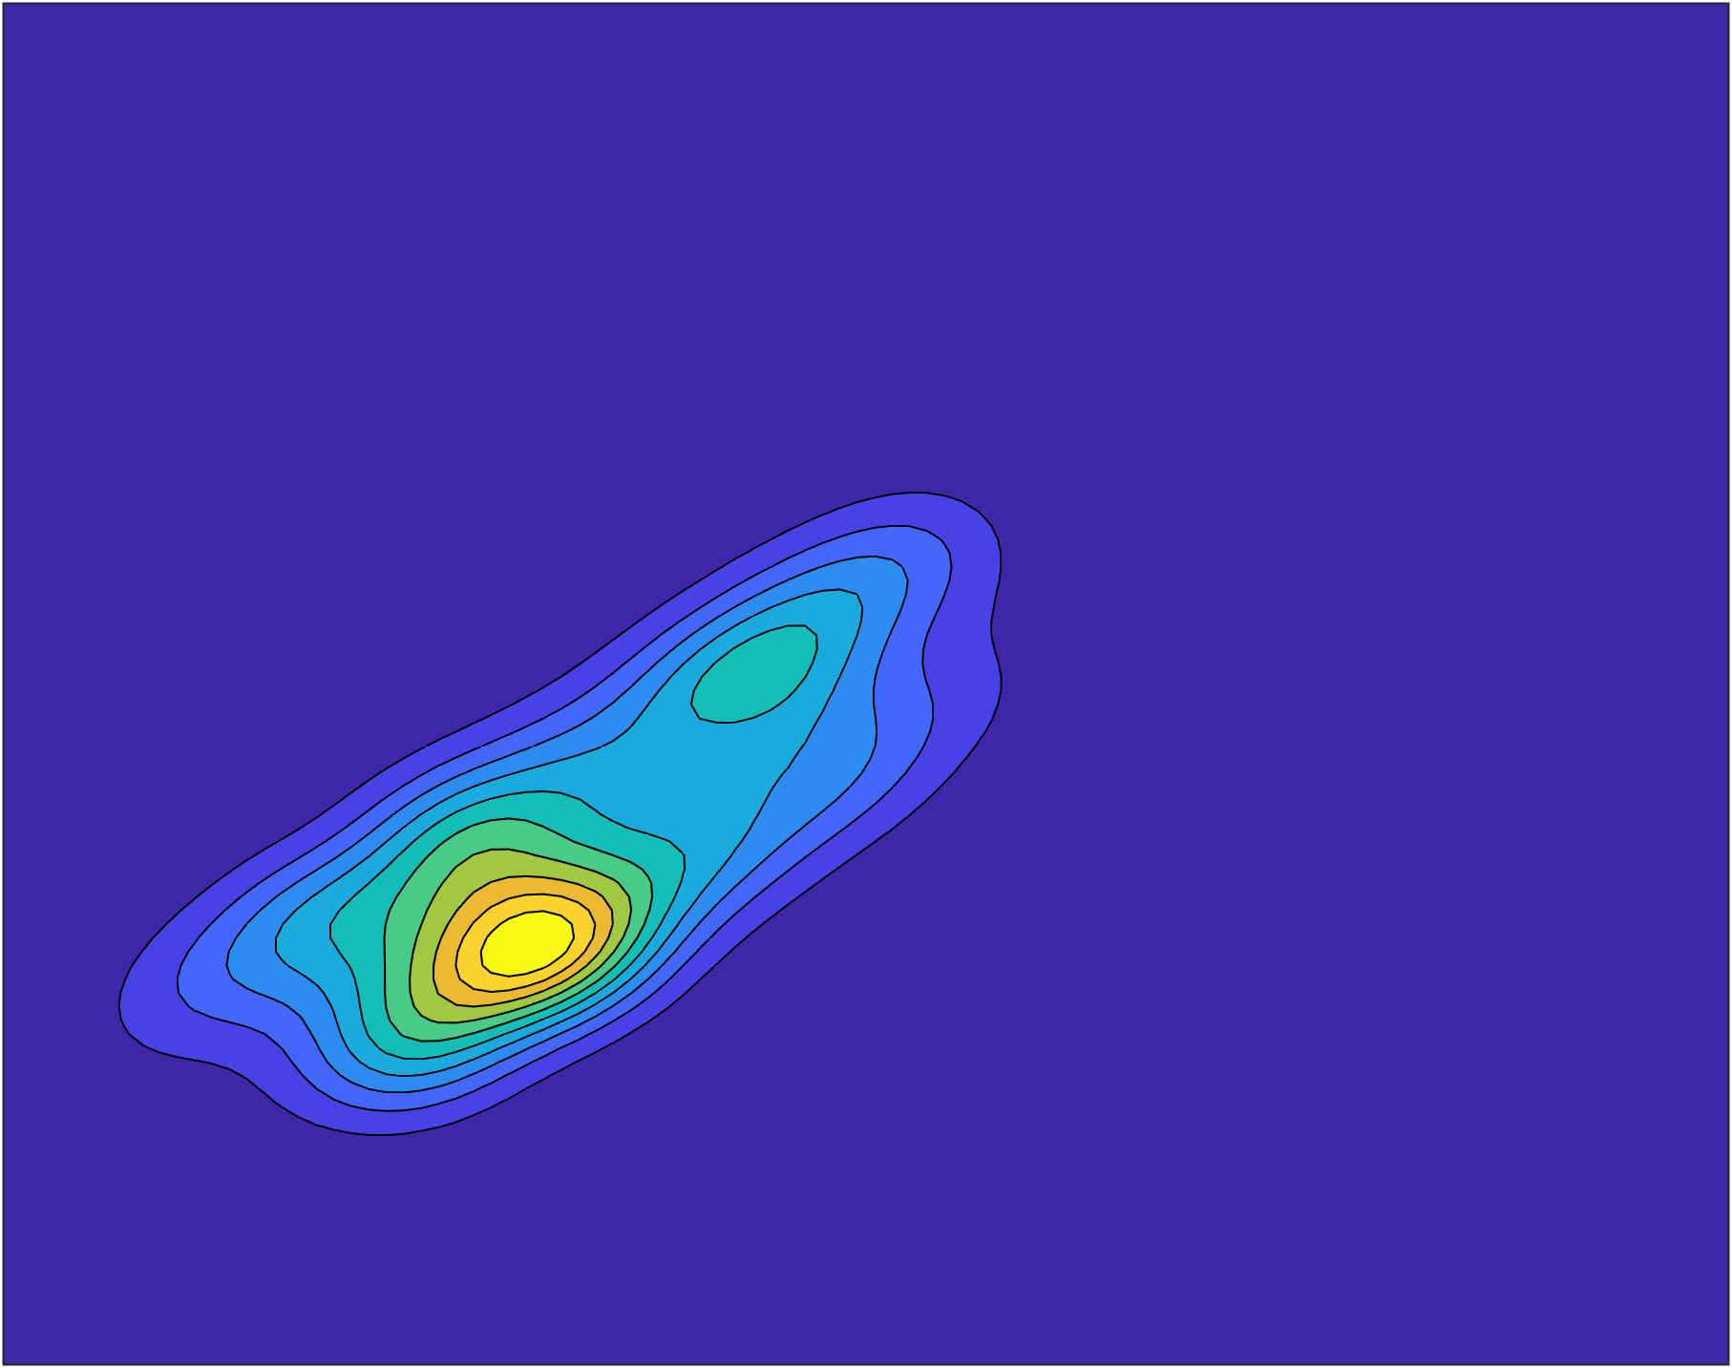
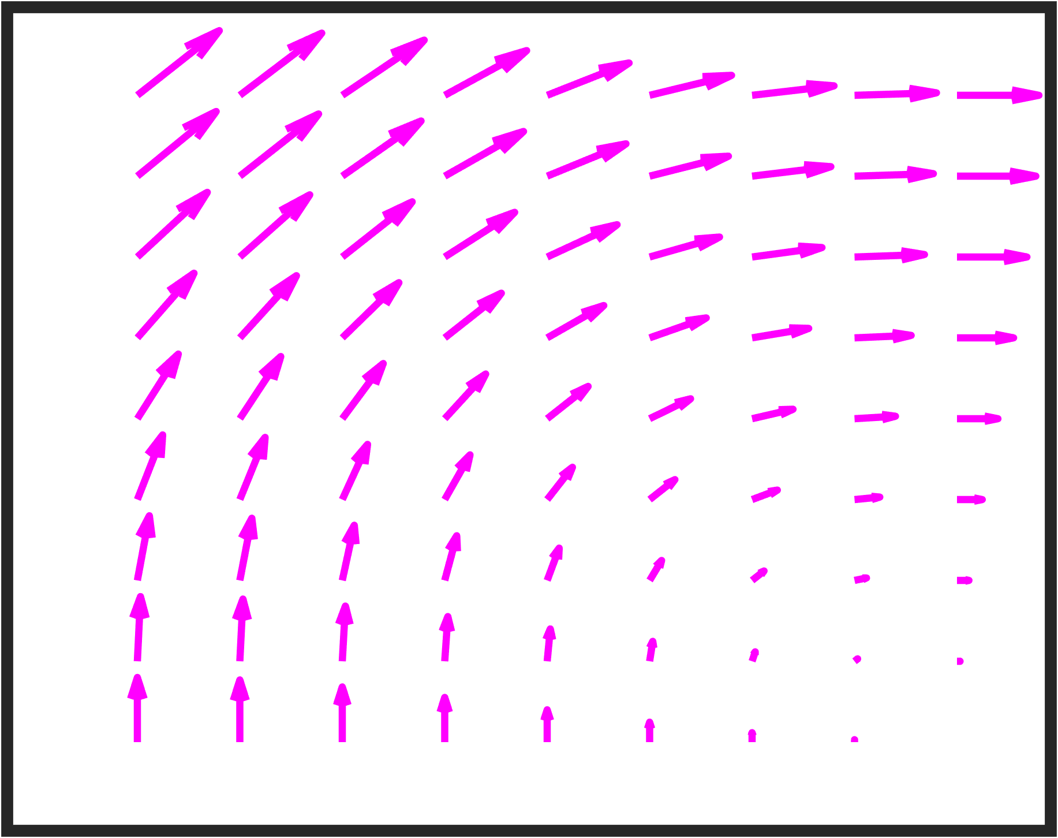
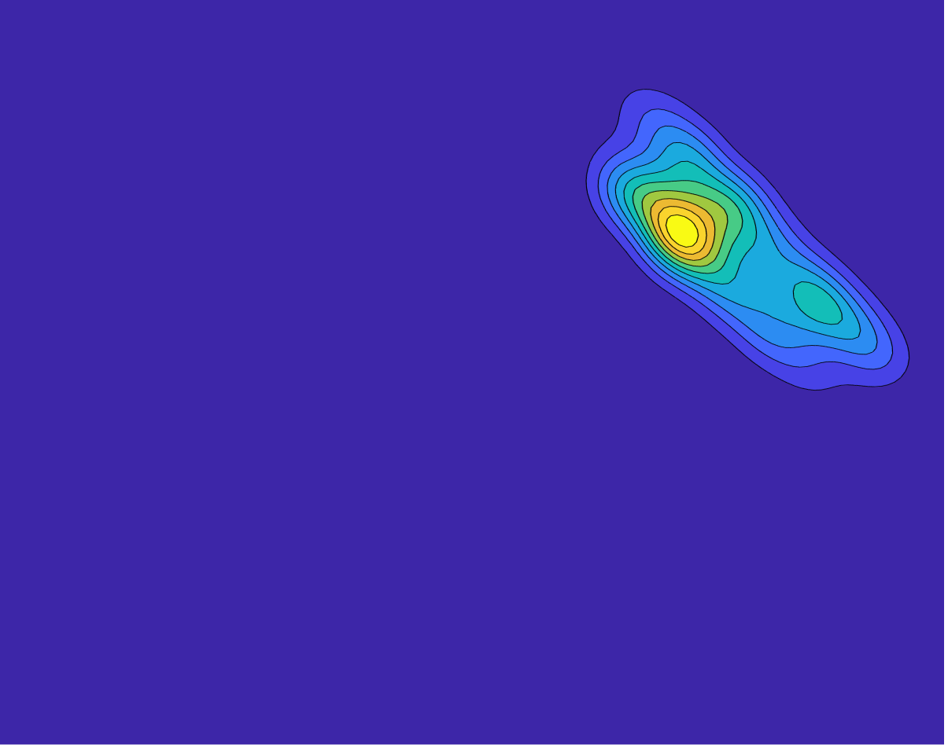
Latent Flows

Slide 21
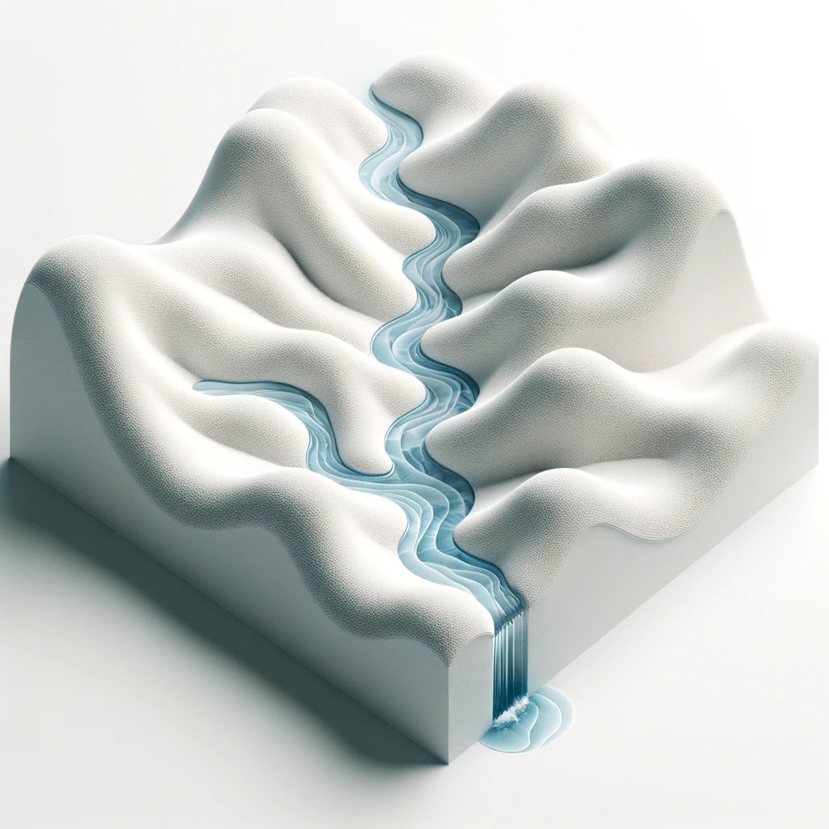
Learning Potential Flows
Latent Traversal in Generative Models as Potential Flows. Y. Song, T. A. Keller, N. Sebe, Max Welling. ICML 2023.
Flow Factorized Representation Learning. Y. Song, T. A. Keller, N. Sebe, Max Welling. NeurIPS 2023.
Notes:
Finally, I think by developing these models I think we may get insights into new mechanisms for inducing organization which we may have never though of before.
As an example, in developing the neural wave machine model, I was using a code base that already had mechanisms for measuring topographic organization implemented by default, and while this wasnt something I was specifically looking at for wave models, the results were just popping up as I ran experiments, and I started to notice that these waves models were indeed learnng topgoraphic organization without us specifiying it explicitly as before.
So then I decided to measure orientation selectivity, and was really blown away when I saw this smoothly varying orientation selectivity of our neurons somewhat reminiscent of the orientation columns of the primary visual cortex. And again this is a very coarse analogy, but I think this is an example of how building these types of models may help us think about the brain in ways that we havent before, and hopefully improve our understanding of the brain as a whole.

Slide 22
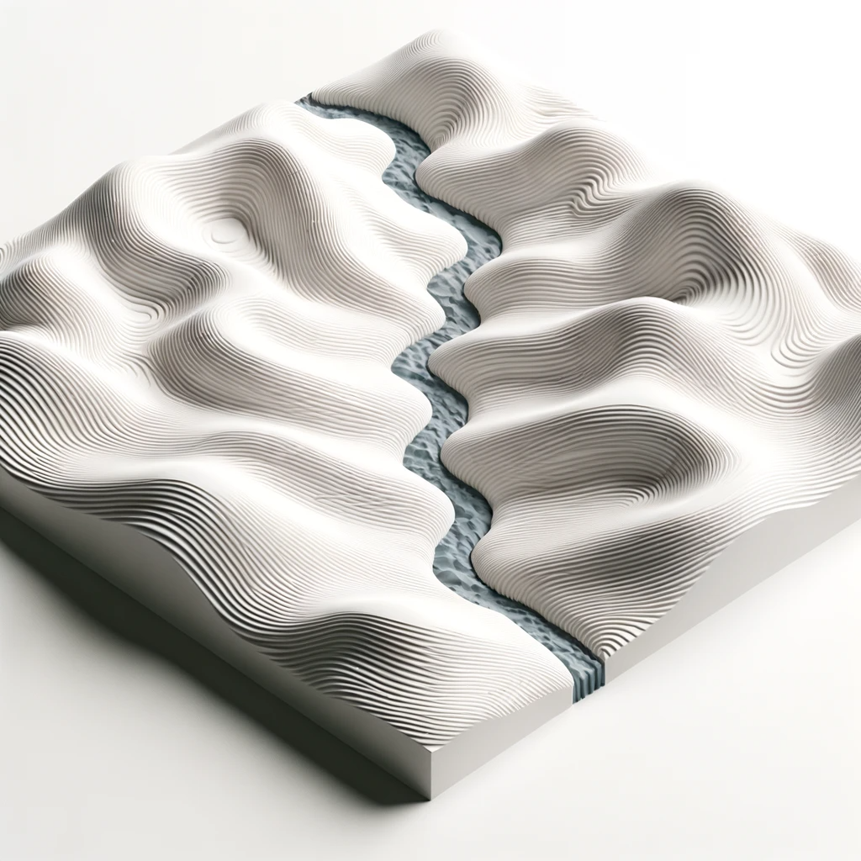
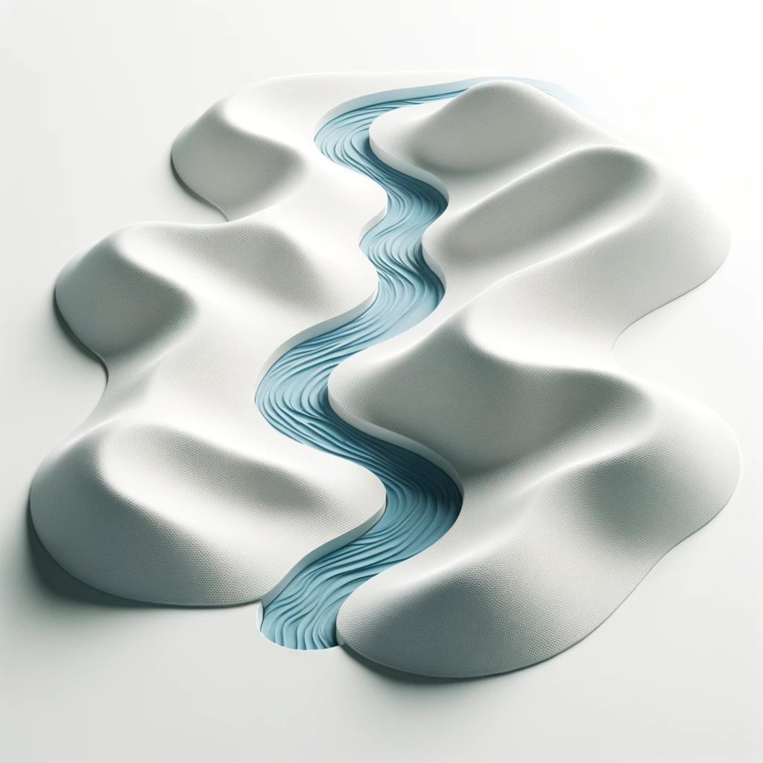
Multiple Transformations
Flow Factorized Representation Learning. Yue Song, T. A. Keller, Nicu Sebe and M. Welling. NeurIPS 2023.
Notes:
Finally, I think by developing these models I think we may get insights into new mechanisms for inducing organization which we may have never though of before.
As an example, in developing the neural wave machine model, I was using a code base that already had mechanisms for measuring topographic organization implemented by default, and while this wasnt something I was specifically looking at for wave models, the results were just popping up as I ran experiments, and I started to notice that these waves models were indeed learnng topgoraphic organization without us specifiying it explicitly as before.
So then I decided to measure orientation selectivity, and was really blown away when I saw this smoothly varying orientation selectivity of our neurons somewhat reminiscent of the orientation columns of the primary visual cortex. And again this is a very coarse analogy, but I think this is an example of how building these types of models may help us think about the brain in ways that we havent before, and hopefully improve our understanding of the brain as a whole.

Slide 23
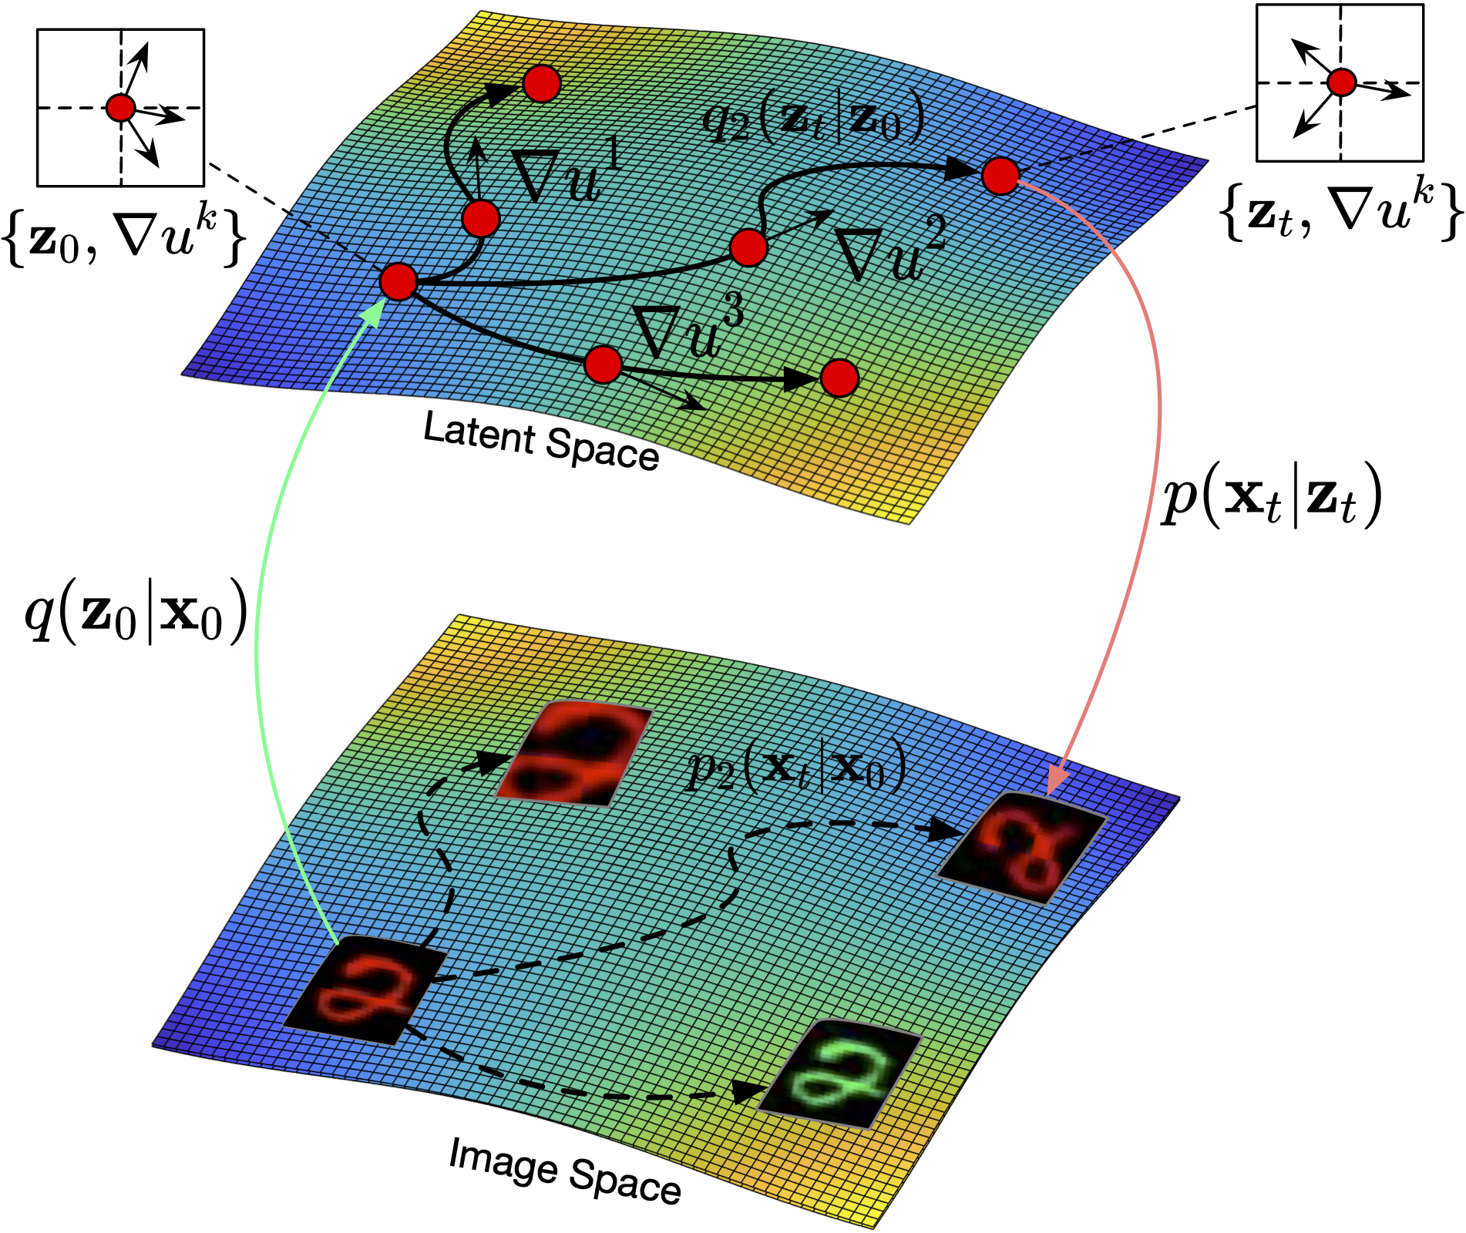
Flow Factorized Representation Learning
Flow Factorized Representation Learning. Yue Song, T. A. Keller, Nicu Sebe and M. Welling. NeurIPS 2023.
Notes:
Finally, I think by developing these models I think we may get insights into new mechanisms for inducing organization which we may have never though of before.
As an example, in developing the neural wave machine model, I was using a code base that already had mechanisms for measuring topographic organization implemented by default, and while this wasnt something I was specifically looking at for wave models, the results were just popping up as I ran experiments, and I started to notice that these waves models were indeed learnng topgoraphic organization without us specifiying it explicitly as before.
So then I decided to measure orientation selectivity, and was really blown away when I saw this smoothly varying orientation selectivity of our neurons somewhat reminiscent of the orientation columns of the primary visual cortex. And again this is a very coarse analogy, but I think this is an example of how building these types of models may help us think about the brain in ways that we havent before, and hopefully improve our understanding of the brain as a whole.

Slide 24
Flow Factorized Representation Learning
Flow Factorized Representation Learning. Yue Song, T. A. Keller, Nicu Sebe and M. Welling. NeurIPS 2023.
Notes:
Finally, I think by developing these models I think we may get insights into new mechanisms for inducing organization which we may have never though of before.
As an example, in developing the neural wave machine model, I was using a code base that already had mechanisms for measuring topographic organization implemented by default, and while this wasnt something I was specifically looking at for wave models, the results were just popping up as I ran experiments, and I started to notice that these waves models were indeed learnng topgoraphic organization without us specifiying it explicitly as before.
So then I decided to measure orientation selectivity, and was really blown away when I saw this smoothly varying orientation selectivity of our neurons somewhat reminiscent of the orientation columns of the primary visual cortex. And again this is a very coarse analogy, but I think this is an example of how building these types of models may help us think about the brain in ways that we havent before, and hopefully improve our understanding of the brain as a whole.

Slide 25
Flow Factorized Representation Learning
Flow Factorized Representation Learning. Yue Song, T. A. Keller, Nicu Sebe and M. Welling. NeurIPS 2023.
Notes:
Finally, I think by developing these models I think we may get insights into new mechanisms for inducing organization which we may have never though of before.
As an example, in developing the neural wave machine model, I was using a code base that already had mechanisms for measuring topographic organization implemented by default, and while this wasnt something I was specifically looking at for wave models, the results were just popping up as I ran experiments, and I started to notice that these waves models were indeed learnng topgoraphic organization without us specifiying it explicitly as before.
So then I decided to measure orientation selectivity, and was really blown away when I saw this smoothly varying orientation selectivity of our neurons somewhat reminiscent of the orientation columns of the primary visual cortex. And again this is a very coarse analogy, but I think this is an example of how building these types of models may help us think about the brain in ways that we havent before, and hopefully improve our understanding of the brain as a whole.

Slide 26
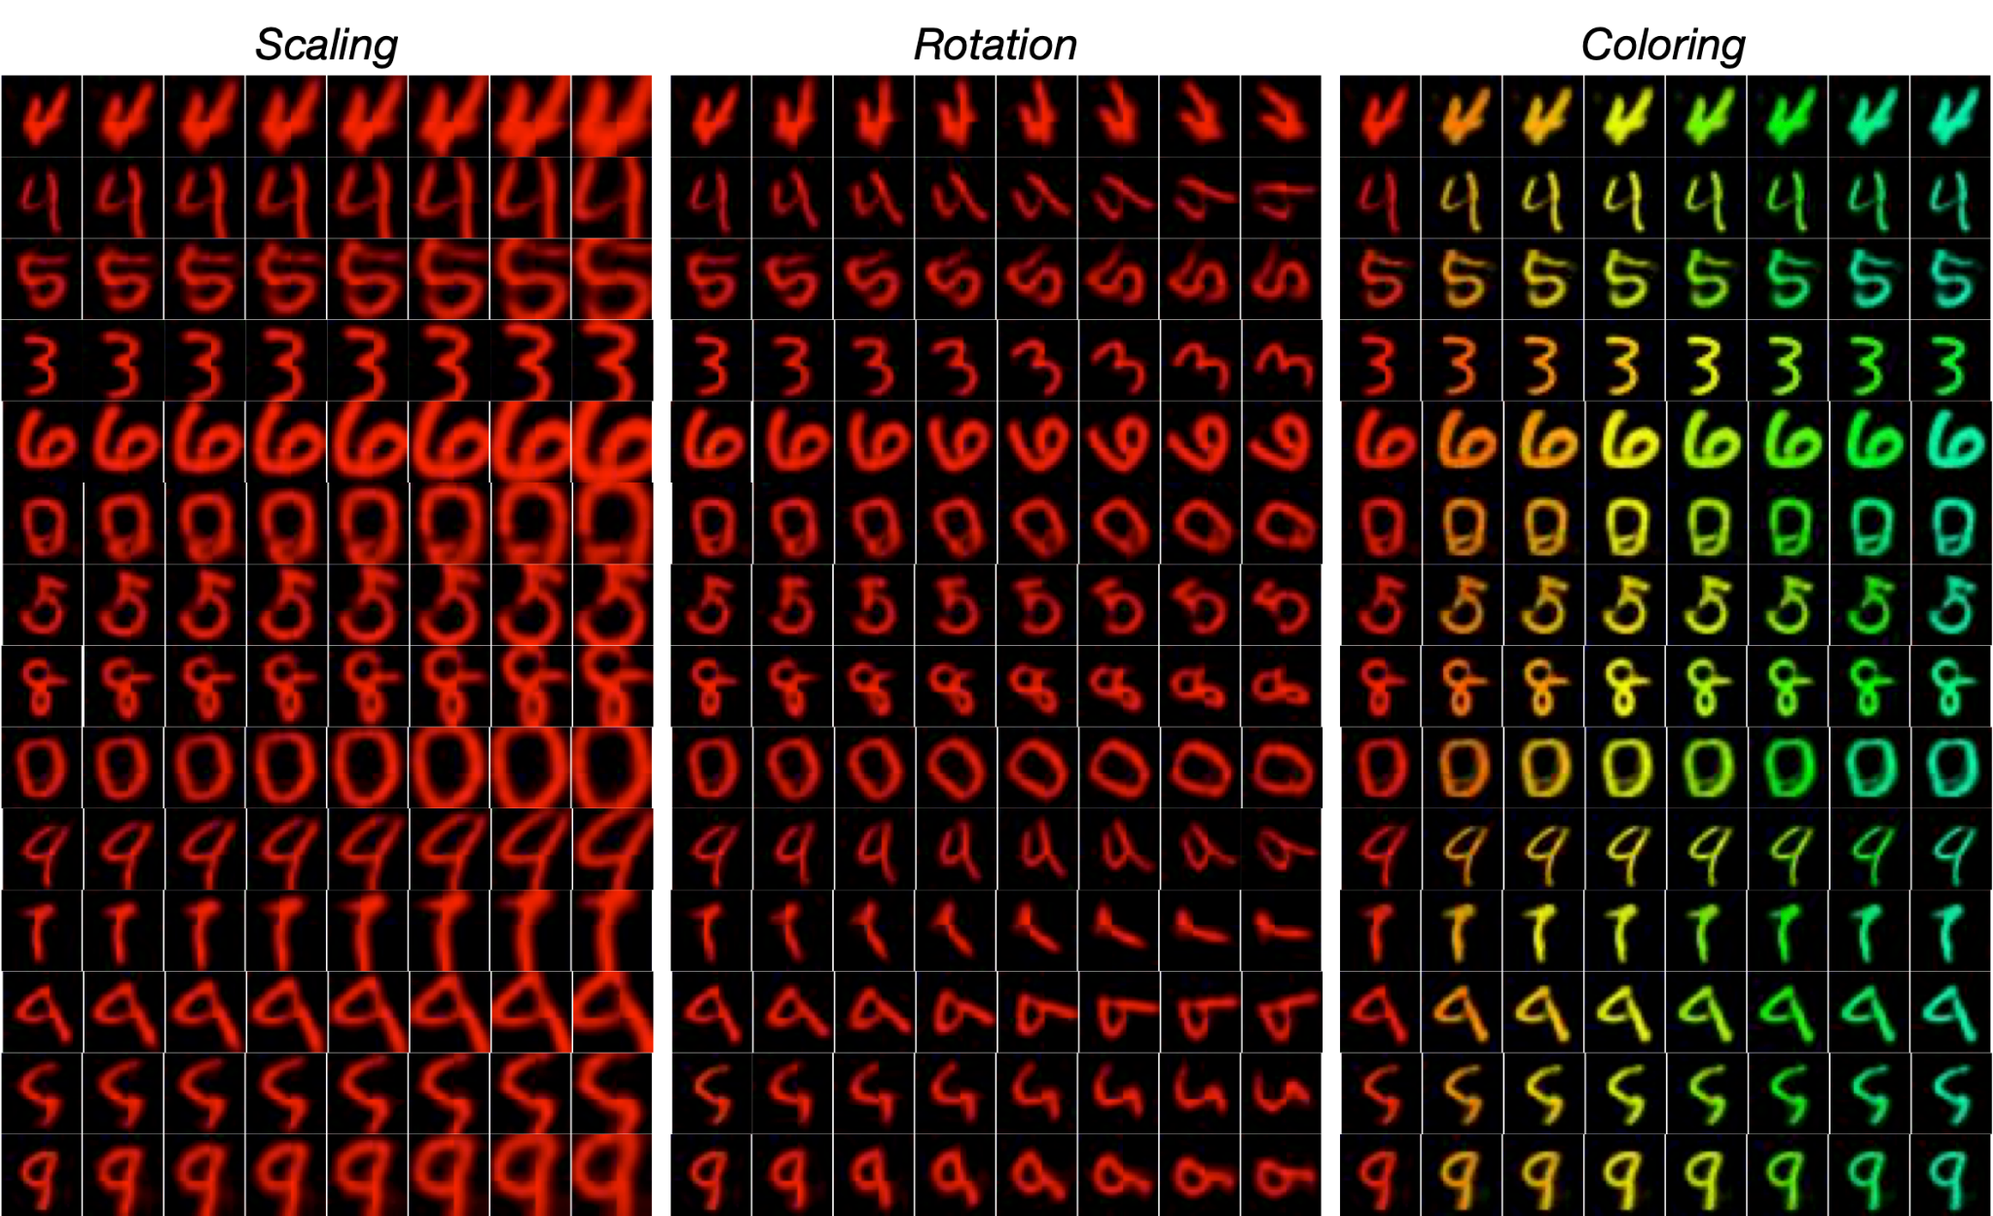
Learned Flows
Flow Factorized Representation Learning. Yue Song, T. A. Keller, Nicu Sebe and M. Welling. NeurIPS 2023.
Notes:
Finally, I think by developing these models I think we may get insights into new mechanisms for inducing organization which we may have never though of before.
As an example, in developing the neural wave machine model, I was using a code base that already had mechanisms for measuring topographic organization implemented by default, and while this wasnt something I was specifically looking at for wave models, the results were just popping up as I ran experiments, and I started to notice that these waves models were indeed learnng topgoraphic organization without us specifiying it explicitly as before.
So then I decided to measure orientation selectivity, and was really blown away when I saw this smoothly varying orientation selectivity of our neurons somewhat reminiscent of the orientation columns of the primary visual cortex. And again this is a very coarse analogy, but I think this is an example of how building these types of models may help us think about the brain in ways that we havent before, and hopefully improve our understanding of the brain as a whole.

Slide 27
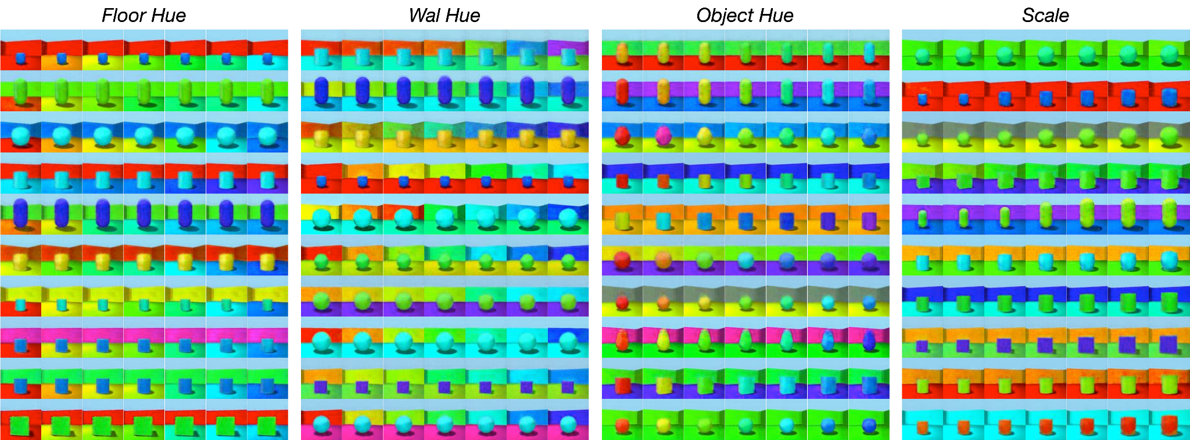
Learned Flows
Flow Factorized Representation Learning. Yue Song, T. A. Keller, Nicu Sebe and M. Welling. NeurIPS 2023.
Notes:
Finally, I think by developing these models I think we may get insights into new mechanisms for inducing organization which we may have never though of before.
As an example, in developing the neural wave machine model, I was using a code base that already had mechanisms for measuring topographic organization implemented by default, and while this wasnt something I was specifically looking at for wave models, the results were just popping up as I ran experiments, and I started to notice that these waves models were indeed learnng topgoraphic organization without us specifiying it explicitly as before.
So then I decided to measure orientation selectivity, and was really blown away when I saw this smoothly varying orientation selectivity of our neurons somewhat reminiscent of the orientation columns of the primary visual cortex. And again this is a very coarse analogy, but I think this is an example of how building these types of models may help us think about the brain in ways that we havent before, and hopefully improve our understanding of the brain as a whole.

Slide 28
Learned Flows
Flow Factorized Representation Learning. Yue Song, T. A. Keller, Nicu Sebe and M. Welling. NeurIPS 2023.
Notes:
Finally, I think by developing these models I think we may get insights into new mechanisms for inducing organization which we may have never though of before.
As an example, in developing the neural wave machine model, I was using a code base that already had mechanisms for measuring topographic organization implemented by default, and while this wasnt something I was specifically looking at for wave models, the results were just popping up as I ran experiments, and I started to notice that these waves models were indeed learnng topgoraphic organization without us specifiying it explicitly as before.
So then I decided to measure orientation selectivity, and was really blown away when I saw this smoothly varying orientation selectivity of our neurons somewhat reminiscent of the orientation columns of the primary visual cortex. And again this is a very coarse analogy, but I think this is an example of how building these types of models may help us think about the brain in ways that we havent before, and hopefully improve our understanding of the brain as a whole.

Slide 29
Switching Mid-Transformation
Flow Factorized Representation Learning. Yue Song, T. A. Keller, Nicu Sebe and M. Welling. NeurIPS 2023.
Notes:
Finally, I think by developing these models I think we may get insights into new mechanisms for inducing organization which we may have never though of before.
As an example, in developing the neural wave machine model, I was using a code base that already had mechanisms for measuring topographic organization implemented by default, and while this wasnt something I was specifically looking at for wave models, the results were just popping up as I ran experiments, and I started to notice that these waves models were indeed learnng topgoraphic organization without us specifiying it explicitly as before.
So then I decided to measure orientation selectivity, and was really blown away when I saw this smoothly varying orientation selectivity of our neurons somewhat reminiscent of the orientation columns of the primary visual cortex. And again this is a very coarse analogy, but I think this is an example of how building these types of models may help us think about the brain in ways that we havent before, and hopefully improve our understanding of the brain as a whole.

Slide 30
Combining Transformations
Flow Factorized Representation Learning. Yue Song, T. A. Keller, Nicu Sebe and M. Welling. NeurIPS 2023.
Notes:
Finally, I think by developing these models I think we may get insights into new mechanisms for inducing organization which we may have never though of before.
As an example, in developing the neural wave machine model, I was using a code base that already had mechanisms for measuring topographic organization implemented by default, and while this wasnt something I was specifically looking at for wave models, the results were just popping up as I ran experiments, and I started to notice that these waves models were indeed learnng topgoraphic organization without us specifiying it explicitly as before.
So then I decided to measure orientation selectivity, and was really blown away when I saw this smoothly varying orientation selectivity of our neurons somewhat reminiscent of the orientation columns of the primary visual cortex. And again this is a very coarse analogy, but I think this is an example of how building these types of models may help us think about the brain in ways that we havent before, and hopefully improve our understanding of the brain as a whole.

Slide 31
Flow Factorized Representation Learning
Flow Factorized Representation Learning. Yue Song, T. A. Keller, Nicu Sebe and M. Welling. NeurIPS 2023.
Notes:
Finally, I think by developing these models I think we may get insights into new mechanisms for inducing organization which we may have never though of before.
As an example, in developing the neural wave machine model, I was using a code base that already had mechanisms for measuring topographic organization implemented by default, and while this wasnt something I was specifically looking at for wave models, the results were just popping up as I ran experiments, and I started to notice that these waves models were indeed learnng topgoraphic organization without us specifiying it explicitly as before.
So then I decided to measure orientation selectivity, and was really blown away when I saw this smoothly varying orientation selectivity of our neurons somewhat reminiscent of the orientation columns of the primary visual cortex. And again this is a very coarse analogy, but I think this is an example of how building these types of models may help us think about the brain in ways that we havent before, and hopefully improve our understanding of the brain as a whole.

Slide 32
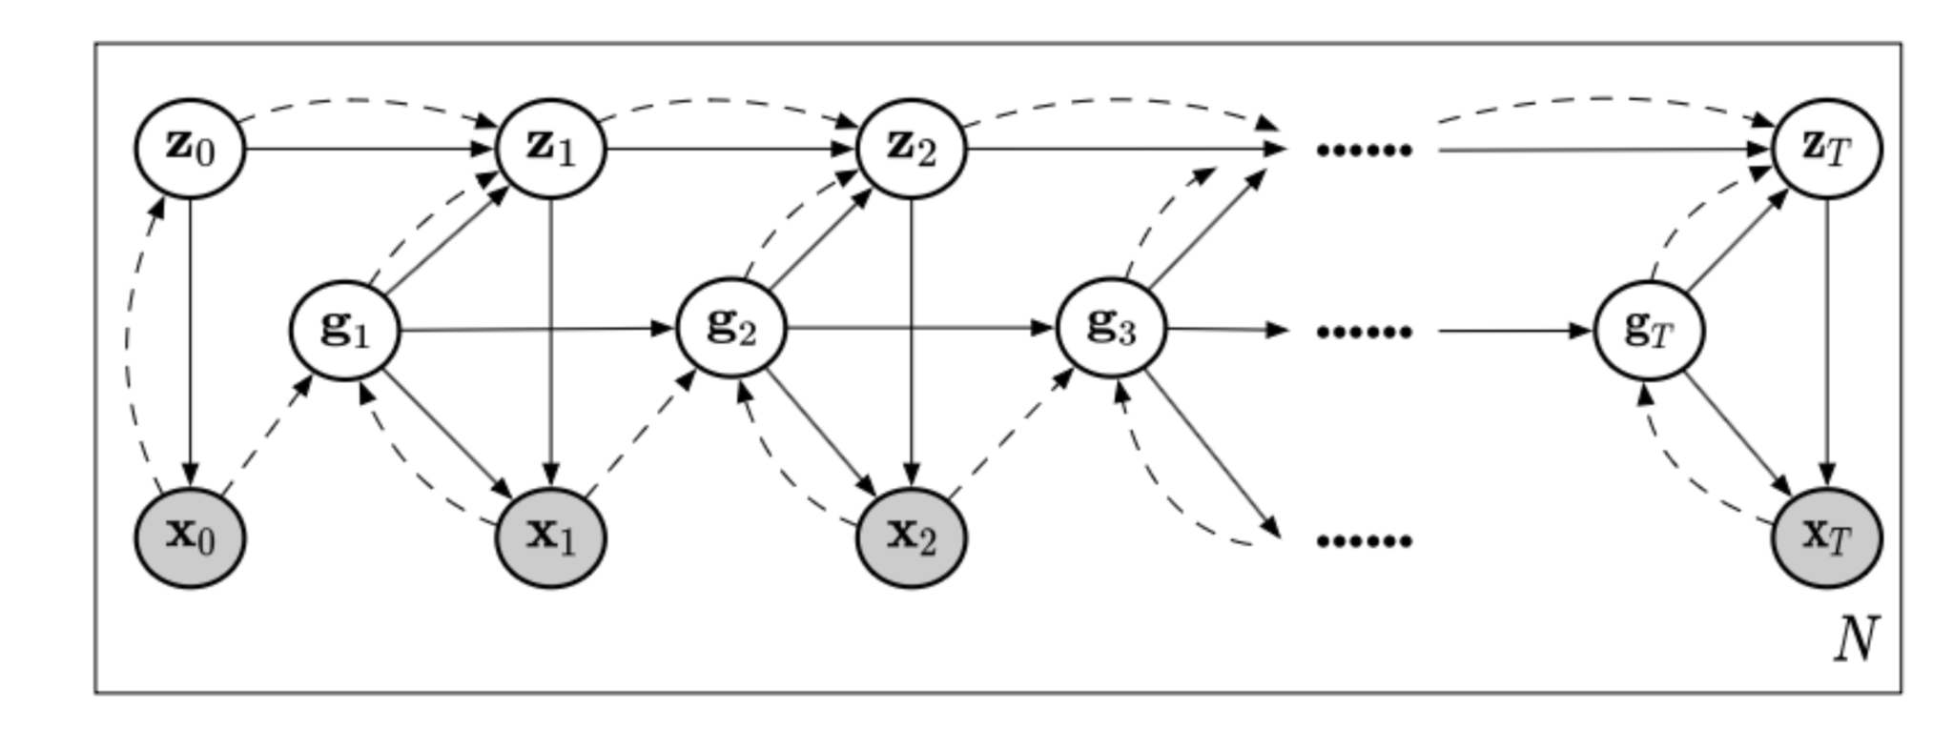
Sparse Transformation Analysis
Sparse Transformation Analysis. Yue Song, T. A. Keller, Nicu Sebe and M. Welling. Under Review, 2024.
Notes:
Finally, I think by developing these models I think we may get insights into new mechanisms for inducing organization which we may have never though of before.
As an example, in developing the neural wave machine model, I was using a code base that already had mechanisms for measuring topographic organization implemented by default, and while this wasnt something I was specifically looking at for wave models, the results were just popping up as I ran experiments, and I started to notice that these waves models were indeed learnng topgoraphic organization without us specifiying it explicitly as before.
So then I decided to measure orientation selectivity, and was really blown away when I saw this smoothly varying orientation selectivity of our neurons somewhat reminiscent of the orientation columns of the primary visual cortex. And again this is a very coarse analogy, but I think this is an example of how building these types of models may help us think about the brain in ways that we havent before, and hopefully improve our understanding of the brain as a whole.

Slide 33
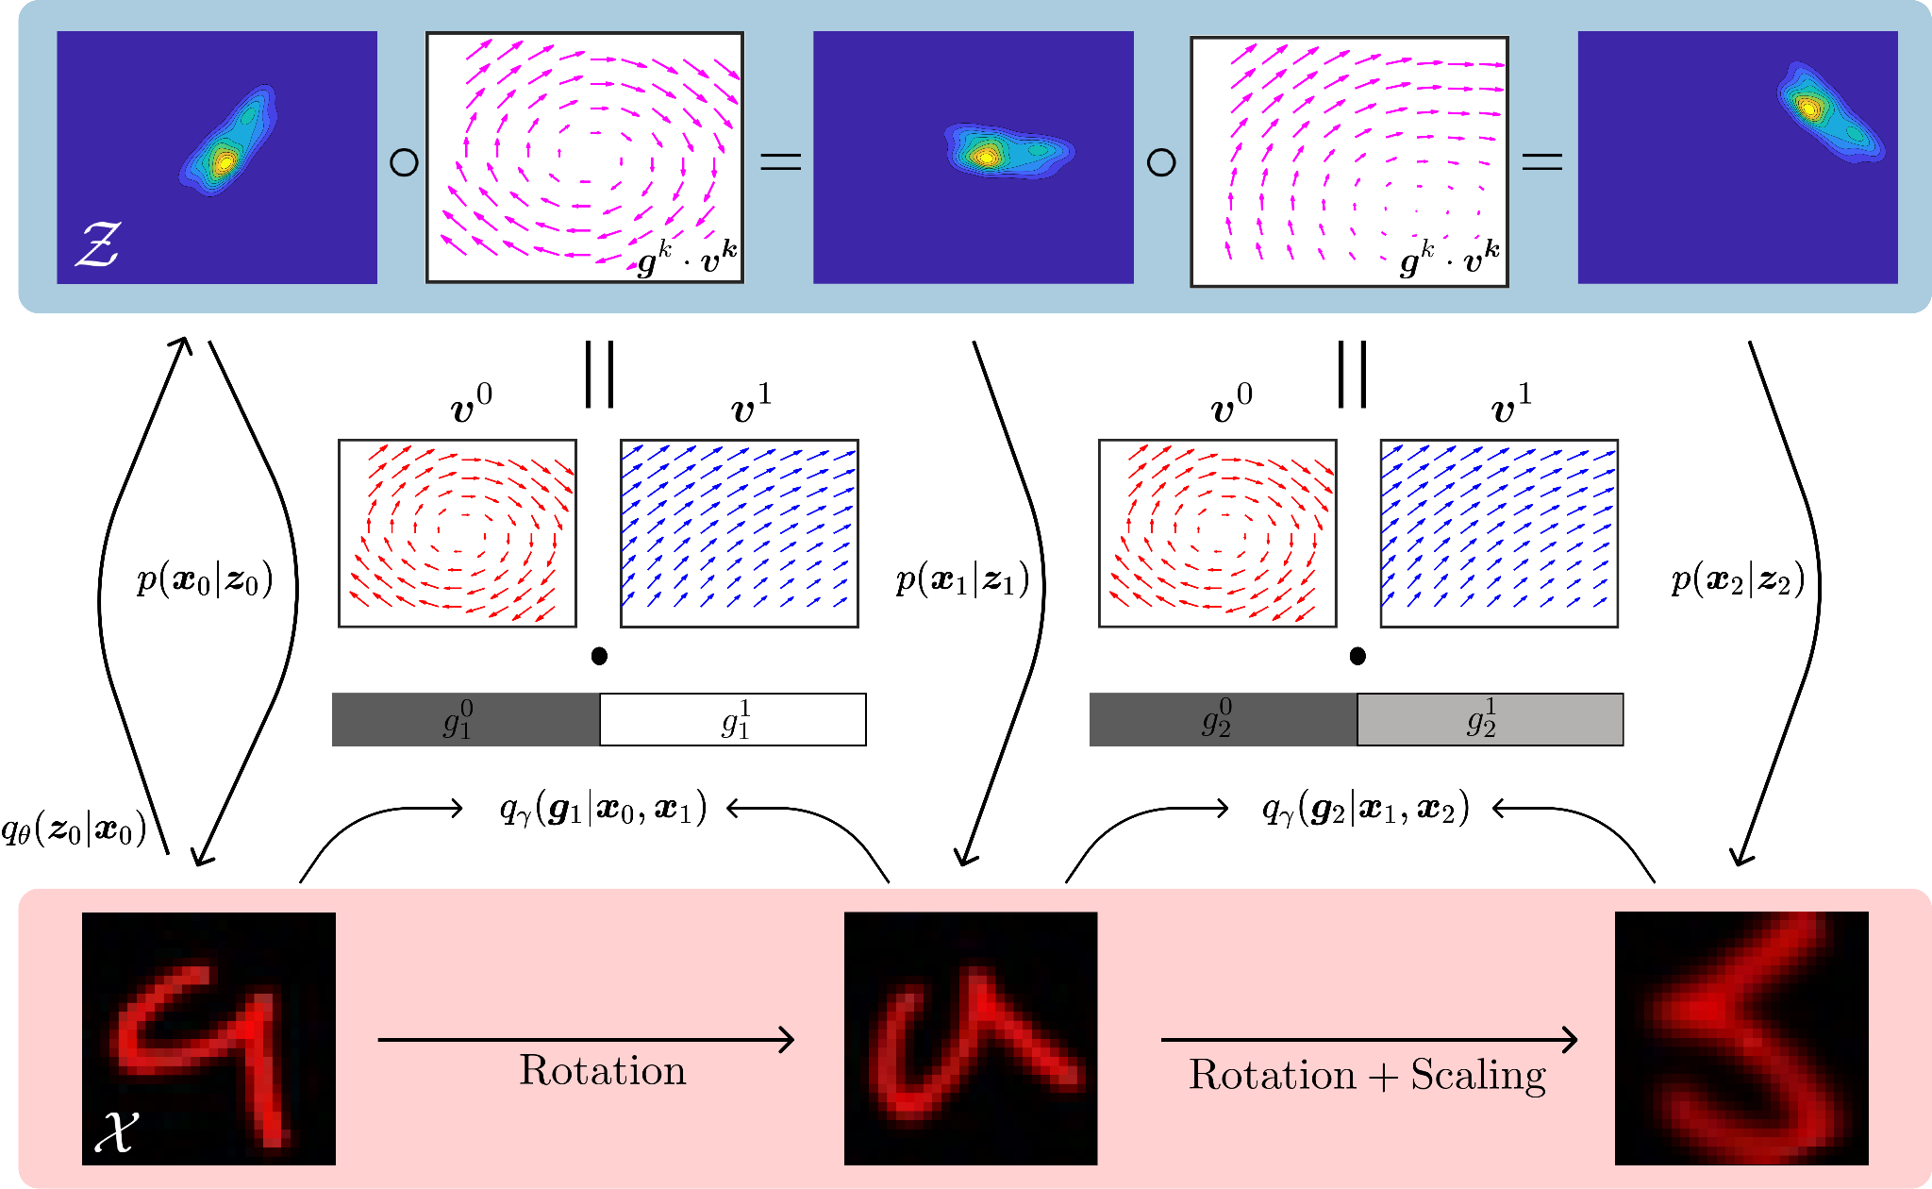
Sparse Transformation Analysis
Sparse Transformation Analysis. Yue Song, T. A. Keller, Nicu Sebe and M. Welling. Under Review, 2024.
Notes:
Finally, I think by developing these models I think we may get insights into new mechanisms for inducing organization which we may have never though of before.
As an example, in developing the neural wave machine model, I was using a code base that already had mechanisms for measuring topographic organization implemented by default, and while this wasnt something I was specifically looking at for wave models, the results were just popping up as I ran experiments, and I started to notice that these waves models were indeed learnng topgoraphic organization without us specifiying it explicitly as before.
So then I decided to measure orientation selectivity, and was really blown away when I saw this smoothly varying orientation selectivity of our neurons somewhat reminiscent of the orientation columns of the primary visual cortex. And again this is a very coarse analogy, but I think this is an example of how building these types of models may help us think about the brain in ways that we havent before, and hopefully improve our understanding of the brain as a whole.

Slide 34
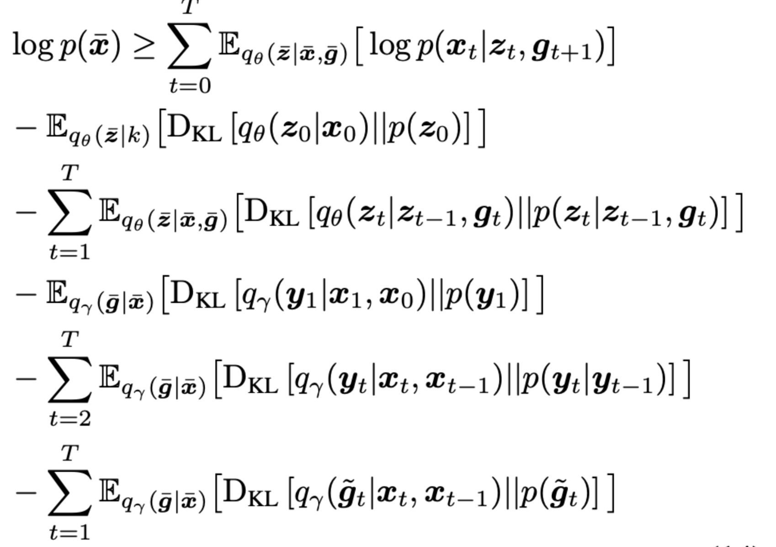
Sparse Transformation Analysis
Sparse Transformation Analysis. Yue Song, T. A. Keller, Nicu Sebe and M. Welling. Under Review, 2024.
Notes:
Finally, I think by developing these models I think we may get insights into new mechanisms for inducing organization which we may have never though of before.
As an example, in developing the neural wave machine model, I was using a code base that already had mechanisms for measuring topographic organization implemented by default, and while this wasnt something I was specifically looking at for wave models, the results were just popping up as I ran experiments, and I started to notice that these waves models were indeed learnng topgoraphic organization without us specifiying it explicitly as before.
So then I decided to measure orientation selectivity, and was really blown away when I saw this smoothly varying orientation selectivity of our neurons somewhat reminiscent of the orientation columns of the primary visual cortex. And again this is a very coarse analogy, but I think this is an example of how building these types of models may help us think about the brain in ways that we havent before, and hopefully improve our understanding of the brain as a whole.

Slide 35
Sparse Transformation Analysis
Sparse Transformation Analysis. Yue Song, T. A. Keller, Nicu Sebe and M. Welling. Under Review, 2024.
Notes:
Finally, I think by developing these models I think we may get insights into new mechanisms for inducing organization which we may have never though of before.
As an example, in developing the neural wave machine model, I was using a code base that already had mechanisms for measuring topographic organization implemented by default, and while this wasnt something I was specifically looking at for wave models, the results were just popping up as I ran experiments, and I started to notice that these waves models were indeed learnng topgoraphic organization without us specifiying it explicitly as before.
So then I decided to measure orientation selectivity, and was really blown away when I saw this smoothly varying orientation selectivity of our neurons somewhat reminiscent of the orientation columns of the primary visual cortex. And again this is a very coarse analogy, but I think this is an example of how building these types of models may help us think about the brain in ways that we havent before, and hopefully improve our understanding of the brain as a whole.

Slide 36
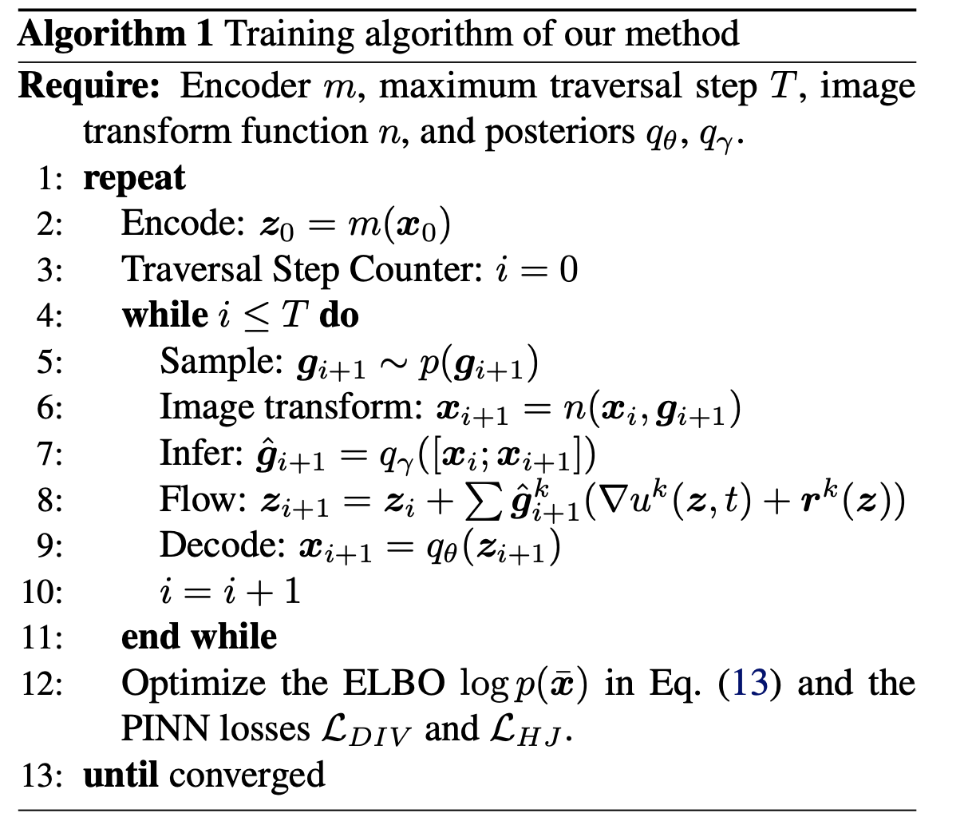
Sparse Transformation Analysis
Sparse Transformation Analysis. Yue Song, T. A. Keller, Nicu Sebe and M. Welling. Under Review, 2024.
Notes:
Finally, I think by developing these models I think we may get insights into new mechanisms for inducing organization which we may have never though of before.
As an example, in developing the neural wave machine model, I was using a code base that already had mechanisms for measuring topographic organization implemented by default, and while this wasnt something I was specifically looking at for wave models, the results were just popping up as I ran experiments, and I started to notice that these waves models were indeed learnng topgoraphic organization without us specifiying it explicitly as before.
So then I decided to measure orientation selectivity, and was really blown away when I saw this smoothly varying orientation selectivity of our neurons somewhat reminiscent of the orientation columns of the primary visual cortex. And again this is a very coarse analogy, but I think this is an example of how building these types of models may help us think about the brain in ways that we havent before, and hopefully improve our understanding of the brain as a whole.

Slide 37
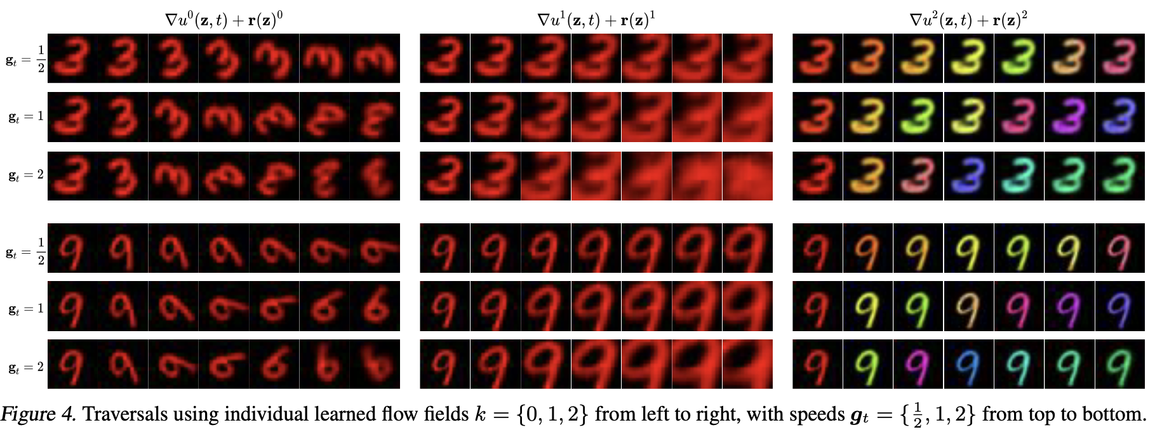
Flows Separate Transformations Unsupervised
Sparse Transformation Analysis. Yue Song, T. A. Keller, Nicu Sebe and M. Welling. Under Review, 2024.
Notes:
Finally, I think by developing these models I think we may get insights into new mechanisms for inducing organization which we may have never though of before.
As an example, in developing the neural wave machine model, I was using a code base that already had mechanisms for measuring topographic organization implemented by default, and while this wasnt something I was specifically looking at for wave models, the results were just popping up as I ran experiments, and I started to notice that these waves models were indeed learnng topgoraphic organization without us specifiying it explicitly as before.
So then I decided to measure orientation selectivity, and was really blown away when I saw this smoothly varying orientation selectivity of our neurons somewhat reminiscent of the orientation columns of the primary visual cortex. And again this is a very coarse analogy, but I think this is an example of how building these types of models may help us think about the brain in ways that we havent before, and hopefully improve our understanding of the brain as a whole.

Slide 38
Flows can be switched during traversal
Sparse Transformation Analysis. Yue Song, T. A. Keller, Nicu Sebe and M. Welling. Under Review, 2024.
Notes:
Finally, I think by developing these models I think we may get insights into new mechanisms for inducing organization which we may have never though of before.
As an example, in developing the neural wave machine model, I was using a code base that already had mechanisms for measuring topographic organization implemented by default, and while this wasnt something I was specifically looking at for wave models, the results were just popping up as I ran experiments, and I started to notice that these waves models were indeed learnng topgoraphic organization without us specifiying it explicitly as before.
So then I decided to measure orientation selectivity, and was really blown away when I saw this smoothly varying orientation selectivity of our neurons somewhat reminiscent of the orientation columns of the primary visual cortex. And again this is a very coarse analogy, but I think this is an example of how building these types of models may help us think about the brain in ways that we havent before, and hopefully improve our understanding of the brain as a whole.

Slide 39
Flows can be combined linearly

Slide 40
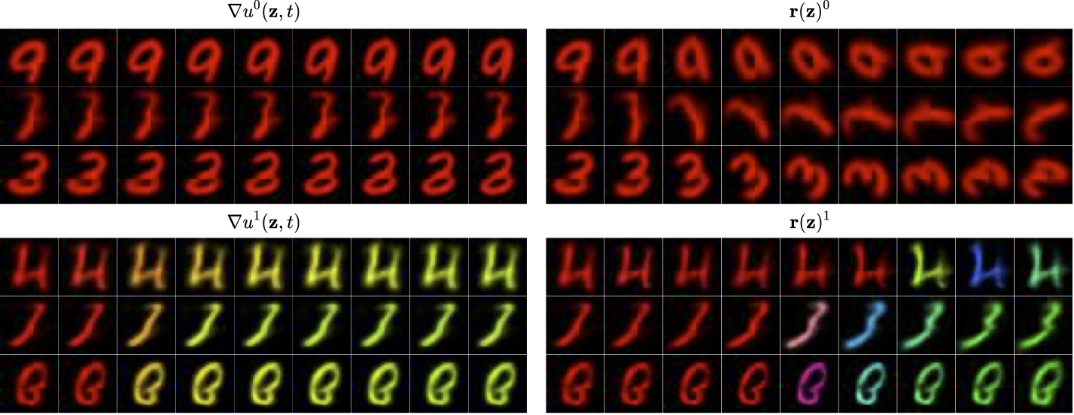
Curl-free and Div-free parts learn different things
Sparse Transformation Analysis. Yue Song, T. A. Keller, Nicu Sebe and M. Welling. Under Review, 2024.
Notes:
Finally, I think by developing these models I think we may get insights into new mechanisms for inducing organization which we may have never though of before.
As an example, in developing the neural wave machine model, I was using a code base that already had mechanisms for measuring topographic organization implemented by default, and while this wasnt something I was specifically looking at for wave models, the results were just popping up as I ran experiments, and I started to notice that these waves models were indeed learnng topgoraphic organization without us specifiying it explicitly as before.
So then I decided to measure orientation selectivity, and was really blown away when I saw this smoothly varying orientation selectivity of our neurons somewhat reminiscent of the orientation columns of the primary visual cortex. And again this is a very coarse analogy, but I think this is an example of how building these types of models may help us think about the brain in ways that we havent before, and hopefully improve our understanding of the brain as a whole.

Slide 41
Unsupervised Approximate Equivariance
Sparse Transformation Analysis. Yue Song, T. A. Keller, Nicu Sebe and M. Welling. Under Review, 2024.
Notes:
Finally, I think by developing these models I think we may get insights into new mechanisms for inducing organization which we may have never though of before.
As an example, in developing the neural wave machine model, I was using a code base that already had mechanisms for measuring topographic organization implemented by default, and while this wasnt something I was specifically looking at for wave models, the results were just popping up as I ran experiments, and I started to notice that these waves models were indeed learnng topgoraphic organization without us specifiying it explicitly as before.
So then I decided to measure orientation selectivity, and was really blown away when I saw this smoothly varying orientation selectivity of our neurons somewhat reminiscent of the orientation columns of the primary visual cortex. And again this is a very coarse analogy, but I think this is an example of how building these types of models may help us think about the brain in ways that we havent before, and hopefully improve our understanding of the brain as a whole.

Slide 42
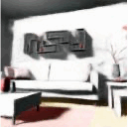
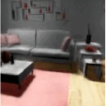
Visualizations of Latent Flows

Slide 43
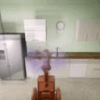
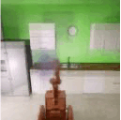
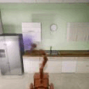
Visualizations of Latent Flows

Slide 44
Visualizations of Latent Flows

Slide 45
Thank you!!
Yue Song
Max Welling
akandykeller.github.io
t.anderson.keller@gmail.com
@t_andy_keller

