Slide 1
FlashSim
an end-to-end ML based simulation framework
CMS Week, February 2024
F. Cattafesta, F. Vaselli ― INFN & Scuola Normale Superiore, Pisa
A. Rizzi, P. Asenov ― INFN & Università di Pisa
M. Galli, M. Donega ― ETH
T. Sookpinij, P. Srimanobhas, V. Wachirapusitanand, P. Sriling ― Chulalongkorn University

Slide 2
The goal of FlashSim
FlashSim ― Universal very fast ML-based end-to-end simulation
analysis and sample independent
simulation speed ~kHz
using state-of-the-art generative models
directly from a subset of NANOGEN to NANOAODSIM
It should be easily re-trainable
new simulation campaign
different CMS Run scenarios
Accuracy between FullSim and FastSim

Slide 3
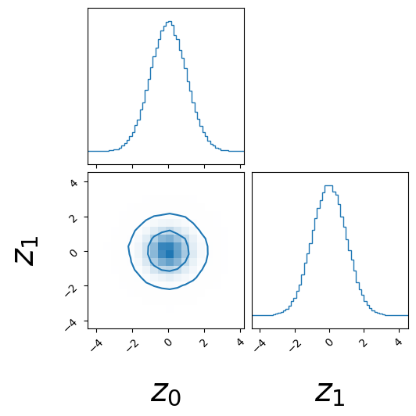
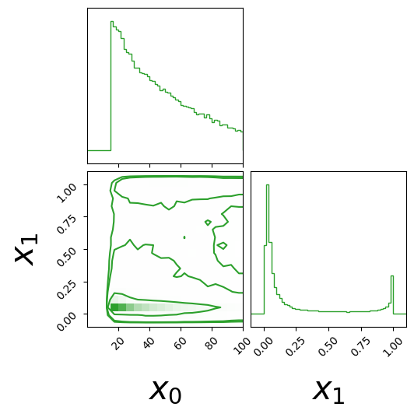
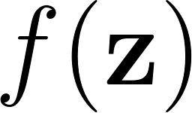
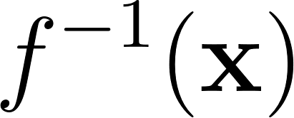
Normalizing Flows generative models
sampling
training
We can generate new samples from an unknown pdf by applying an invertible transformation to random noise
We learn the inverse transform during the training phase

Slide 4
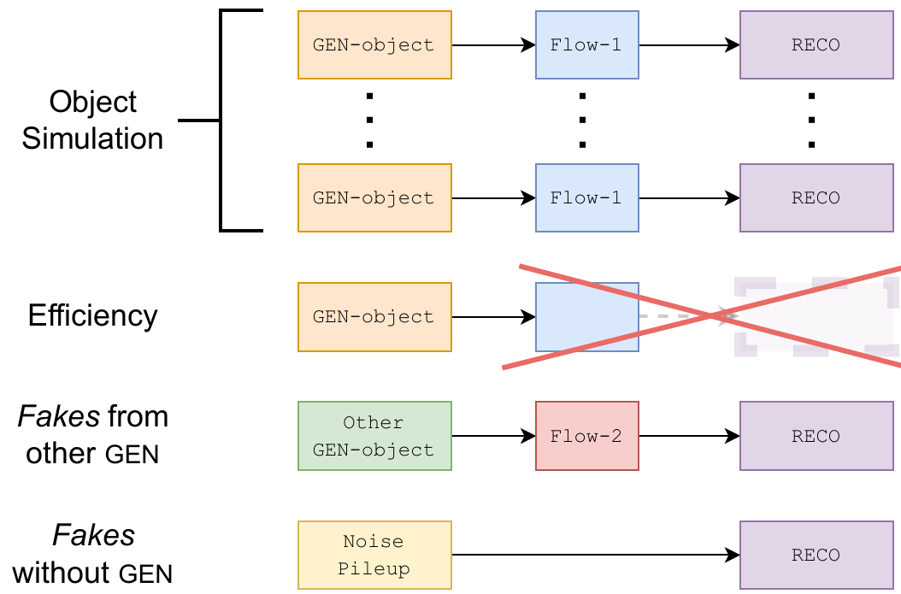
The FlashSim framework
One model for each GEN object
proper simulation of the GEN object
reconstruction efficiency
RECO from other GEN object (e.g. electrons from GEN Jets)
True fakes with no GEN information
🠆 Smaller models and control on the physical inputs

Slide 5
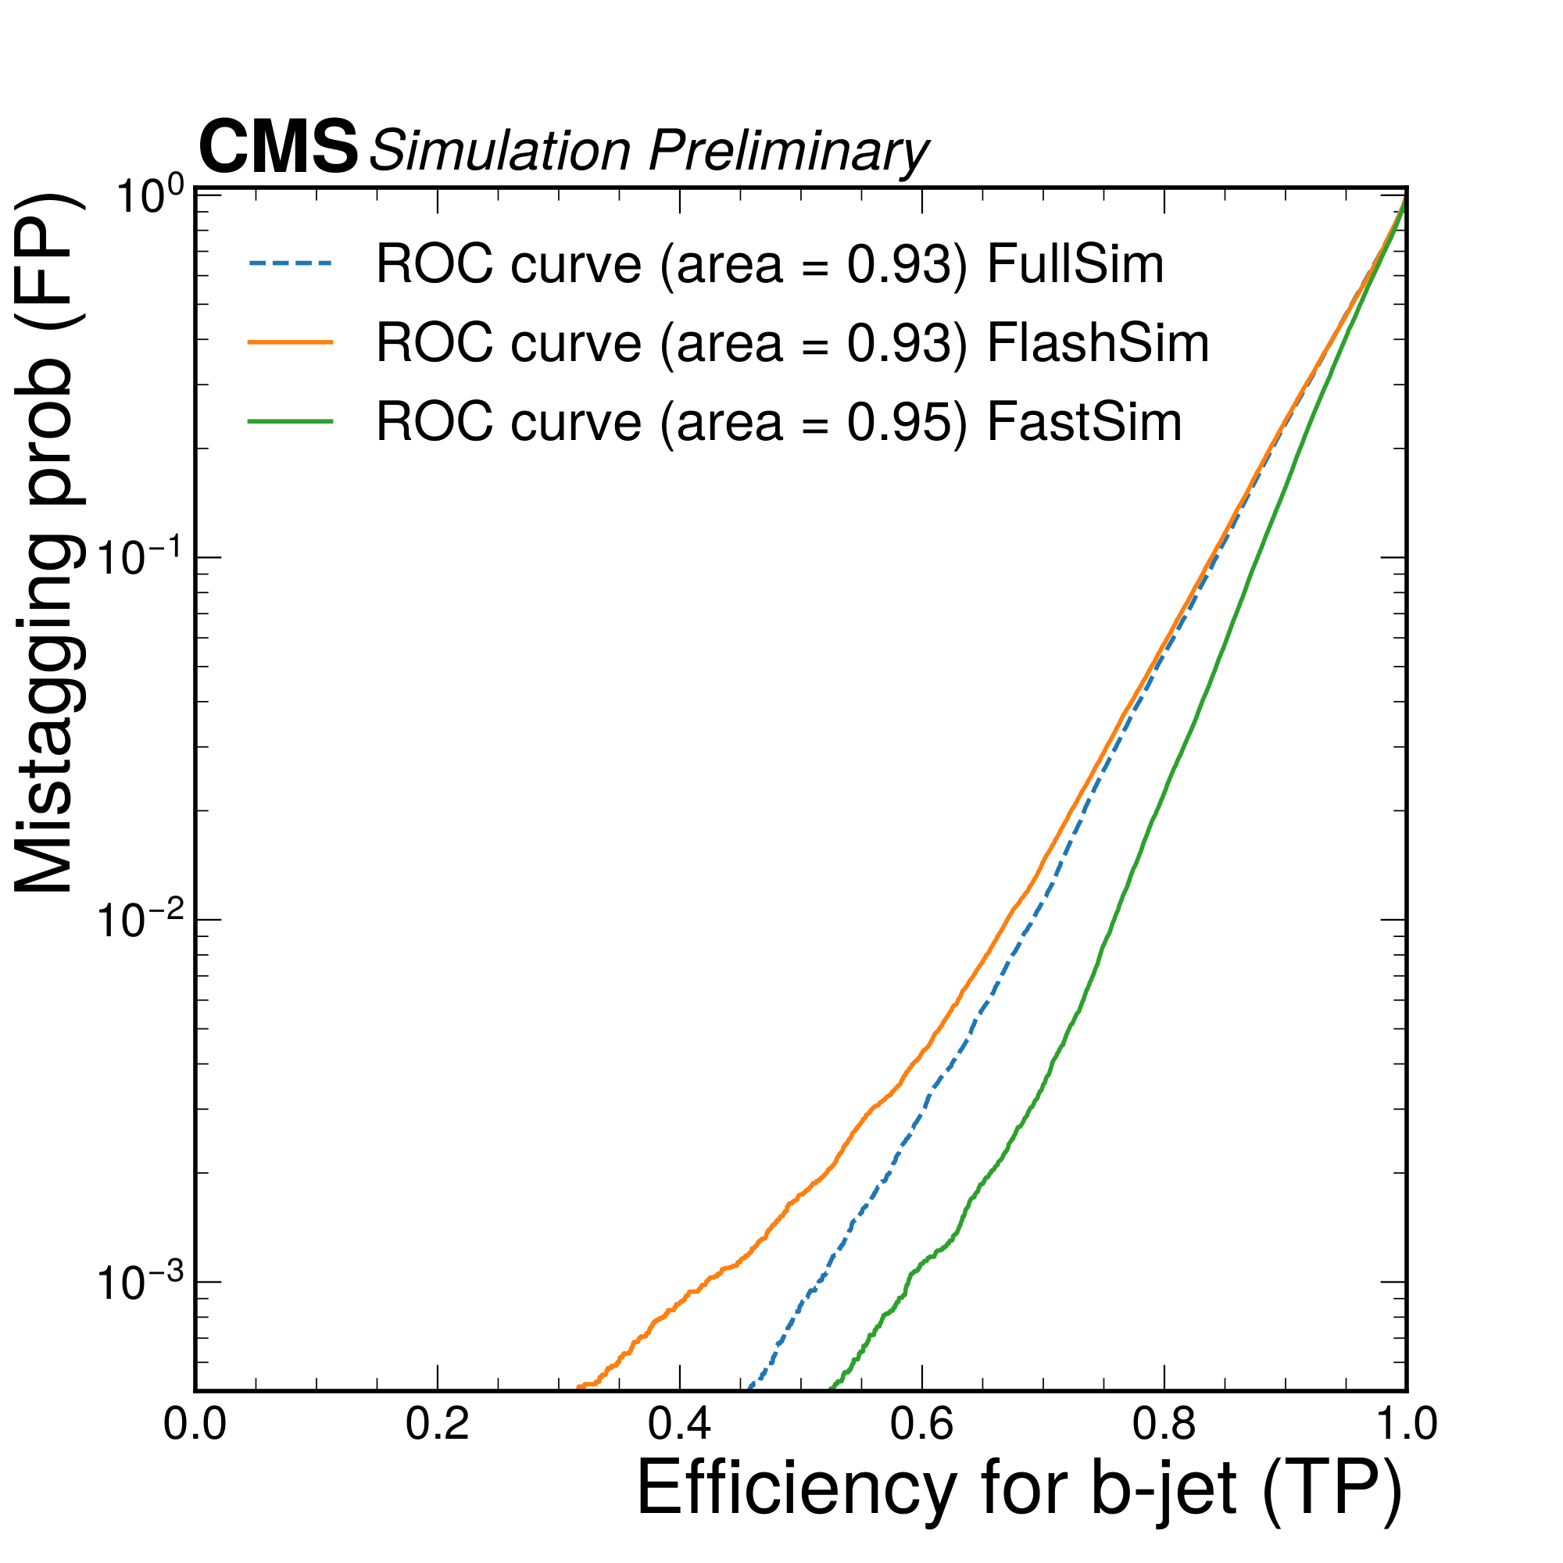
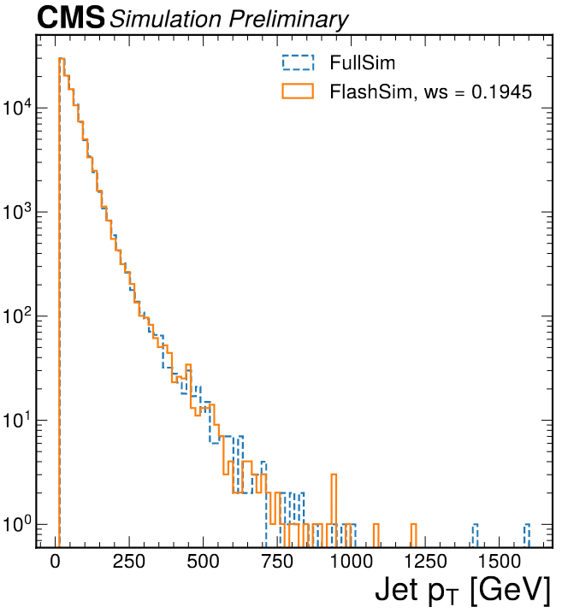
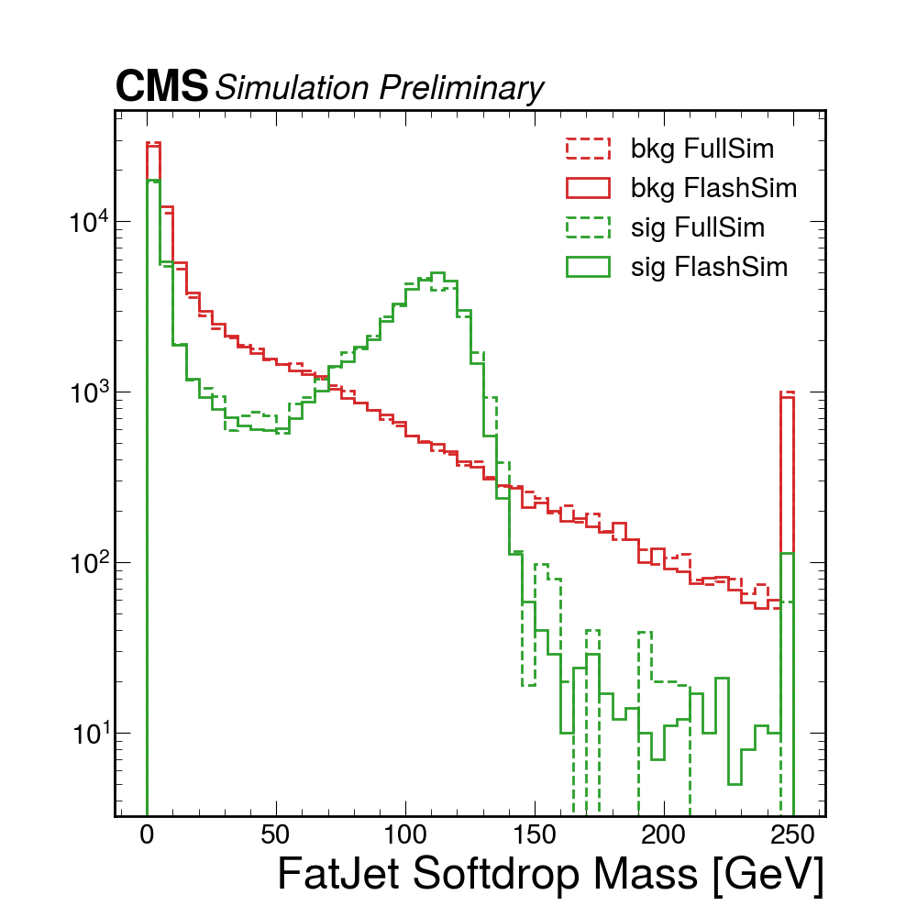
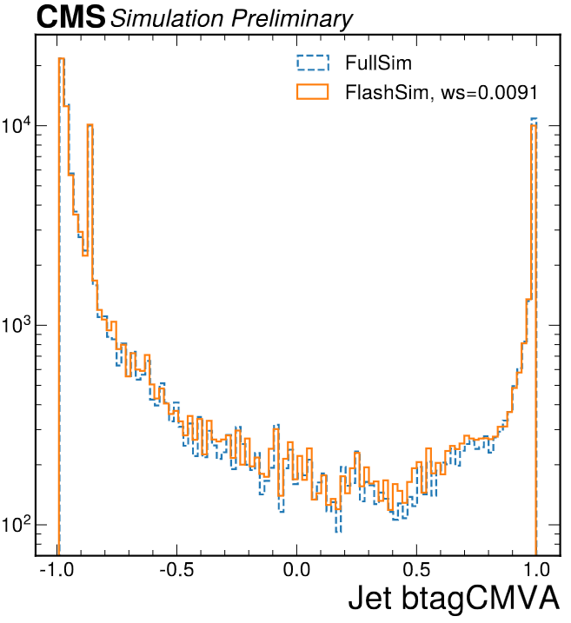
Results on jets …
Jets, FatJets, Muons, Electrons models already implemented
O(10) kHz per object!
Details can be found in the CMS Note
Remarkable results on 1D distributions, correlations and conditioning

Slide 6
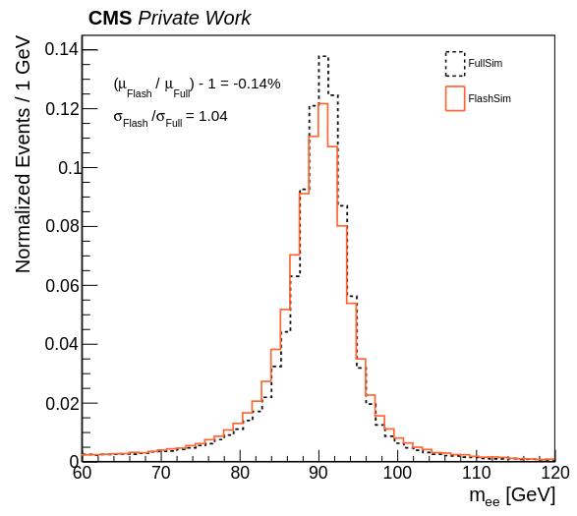
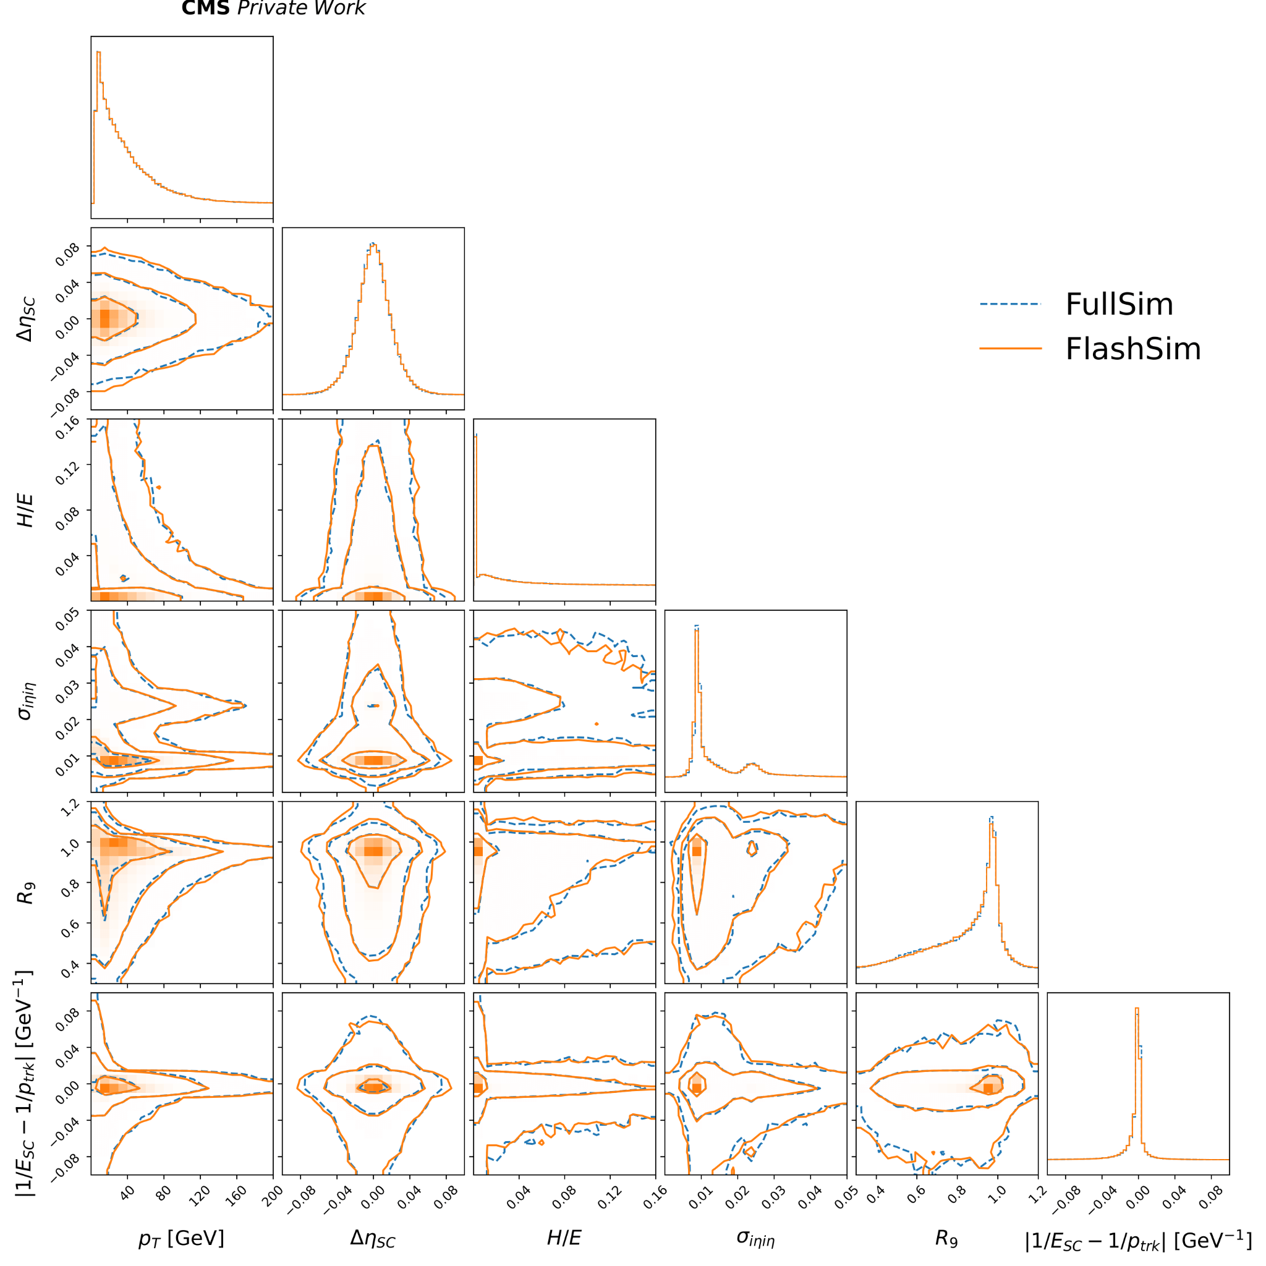
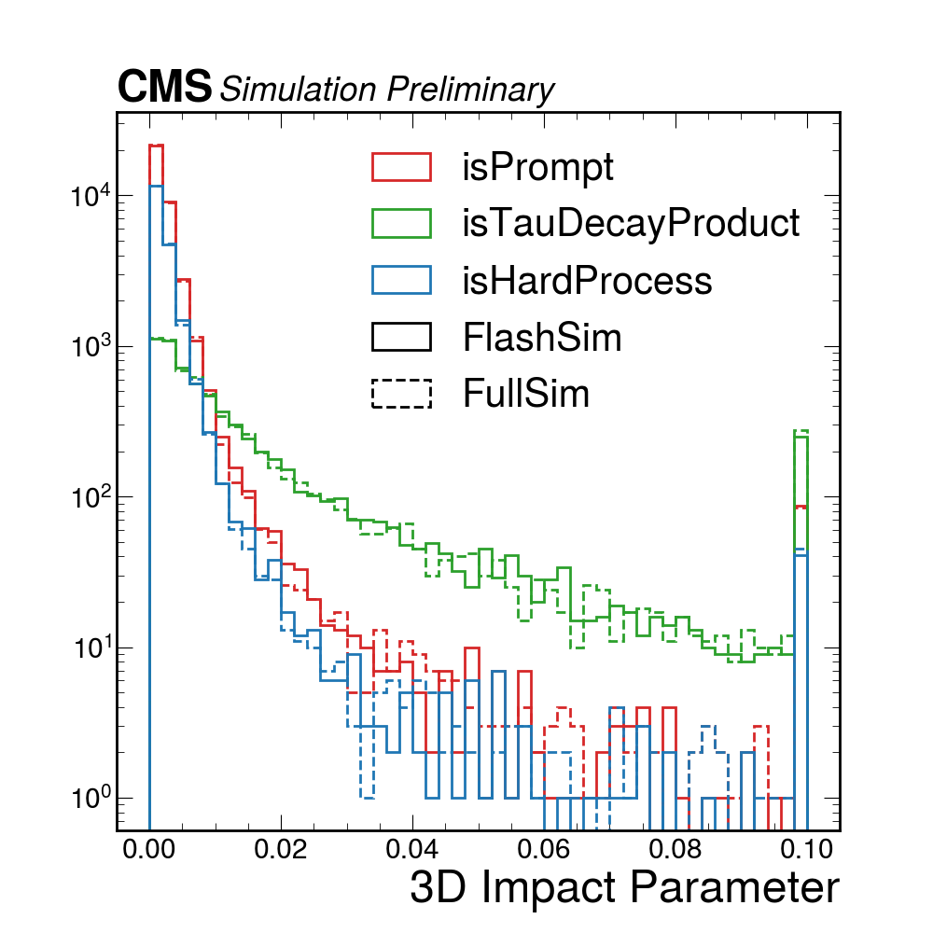
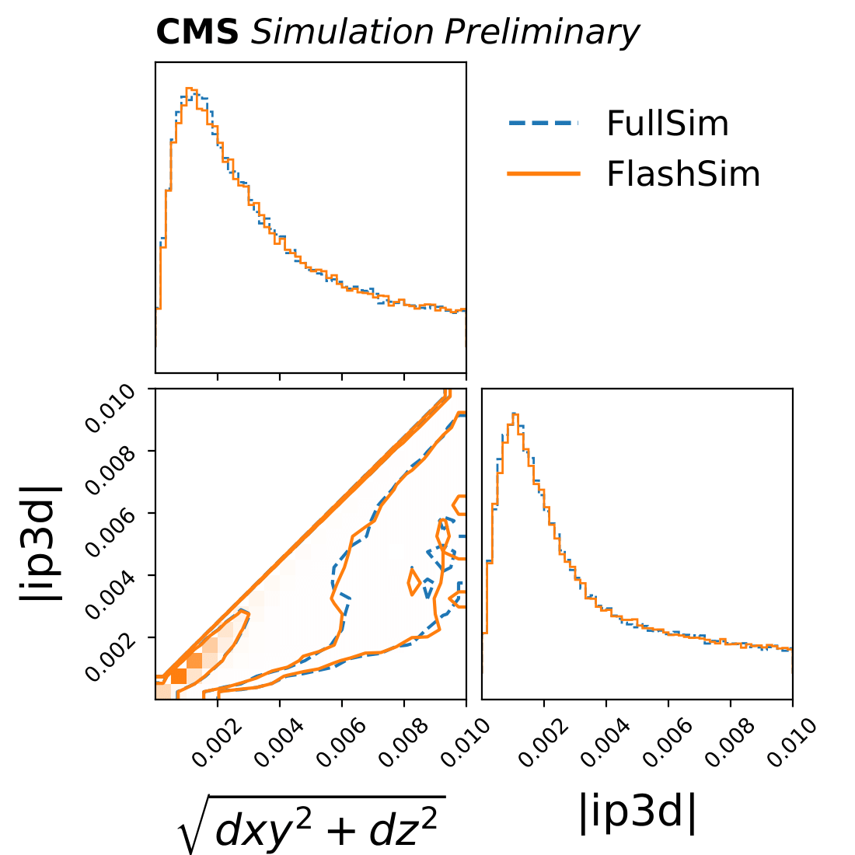
… and leptons
Master Thesis
Electrons from GEN-Electrons
Muons

Slide 7
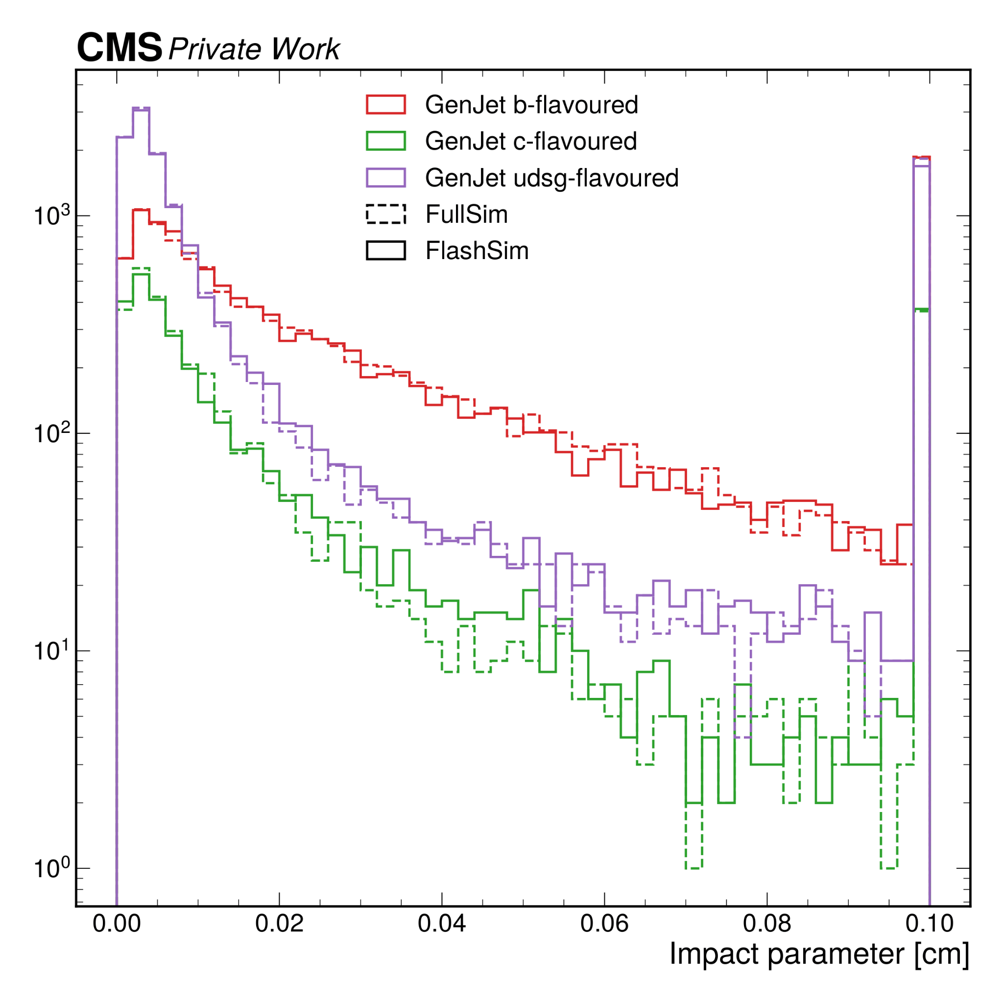
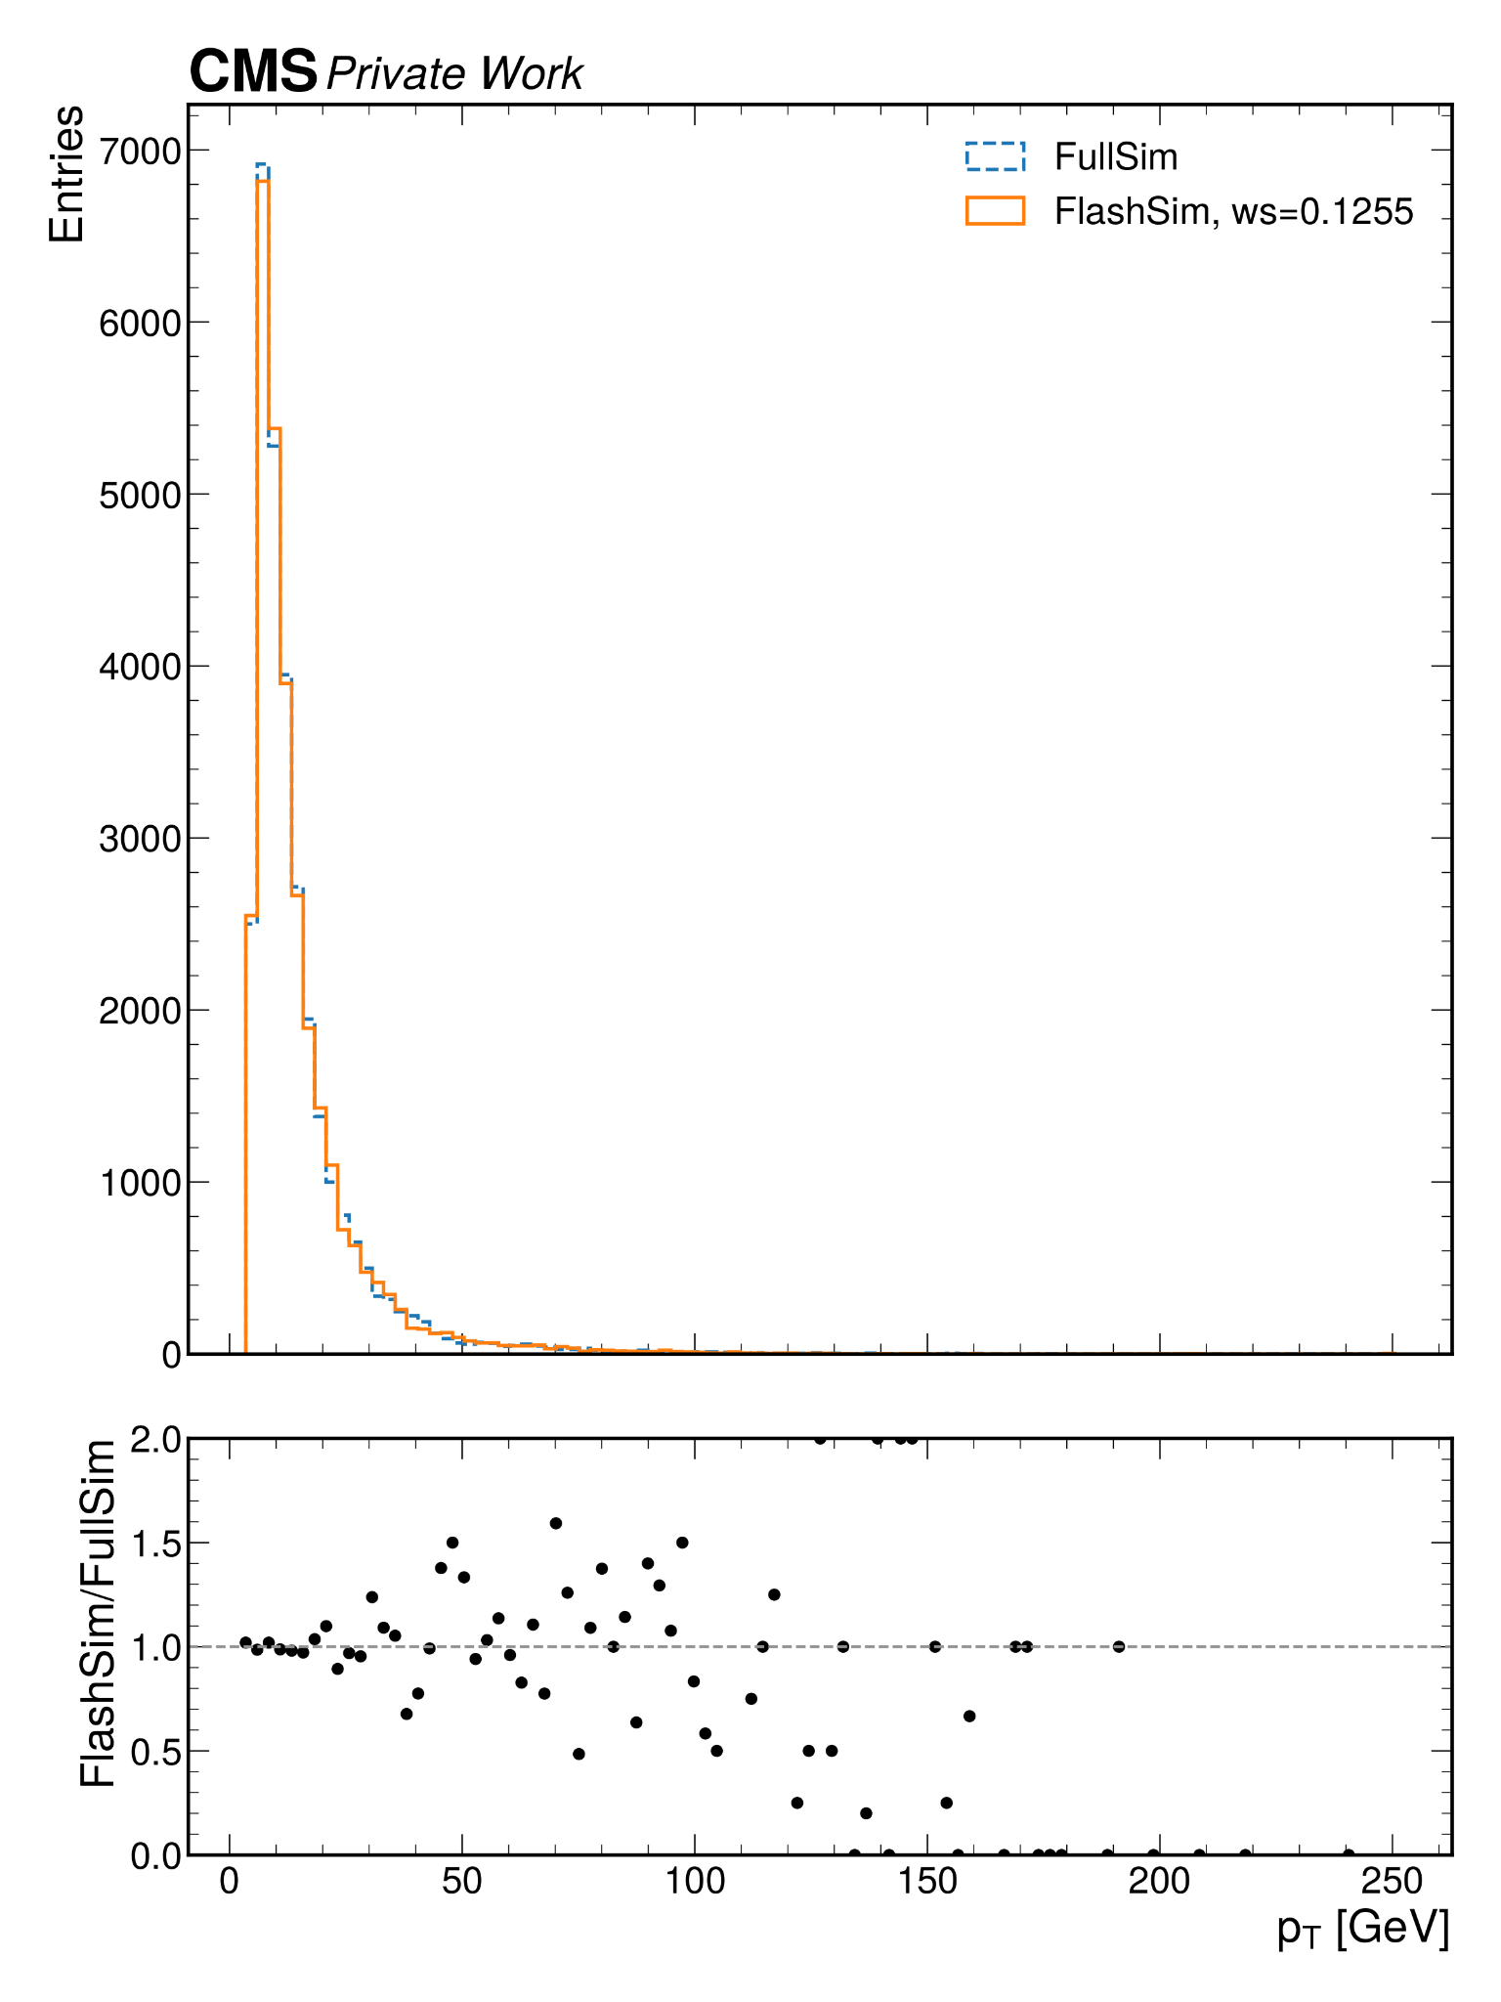
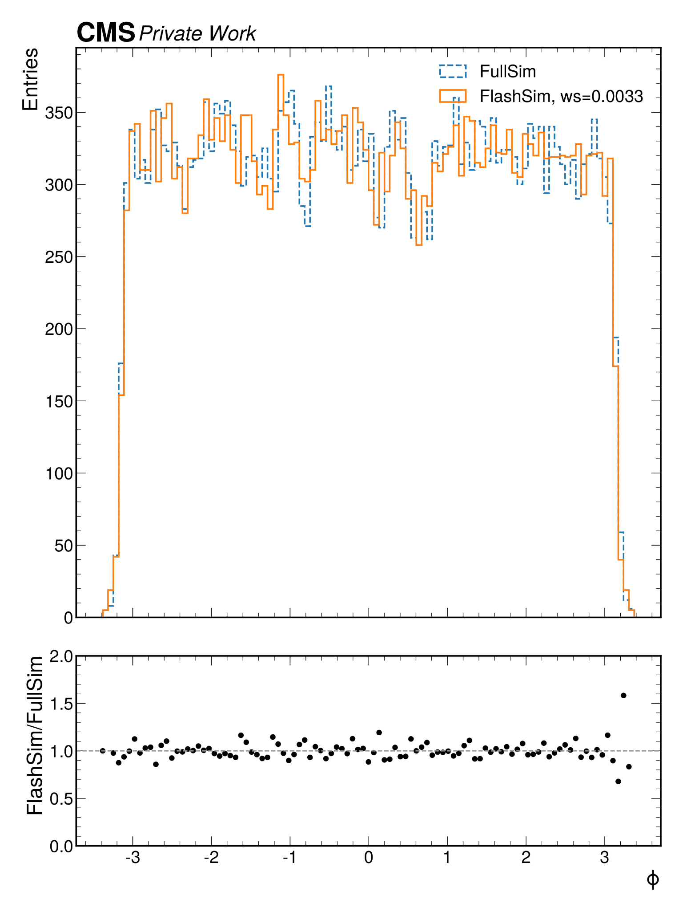
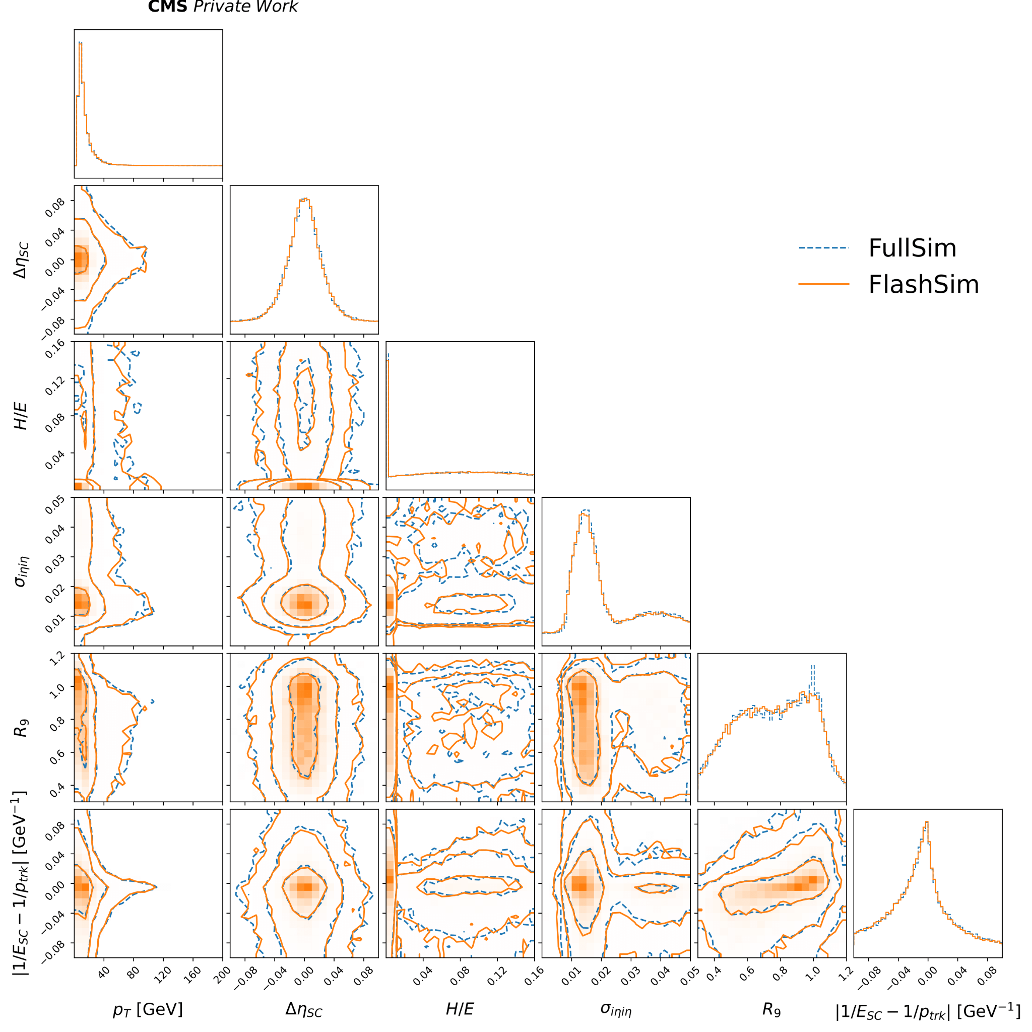
Electrons from GEN Jets
GEN Jet variables used to condition the simulation of RECO Electrons

Slide 8
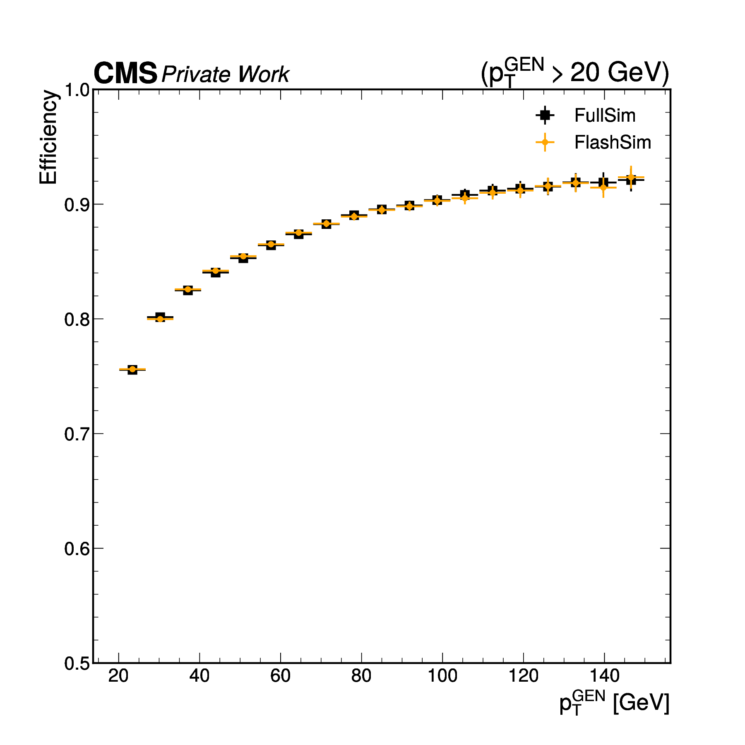
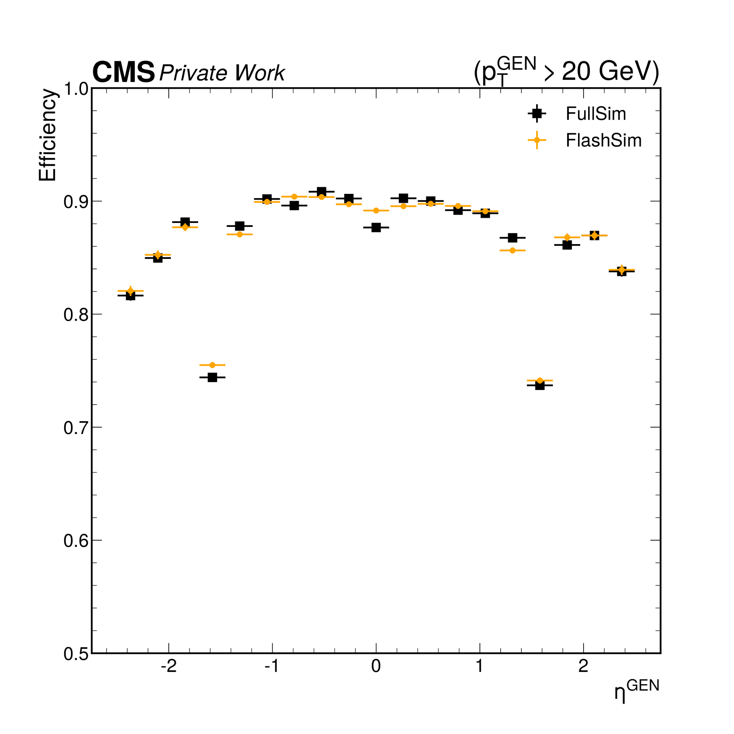
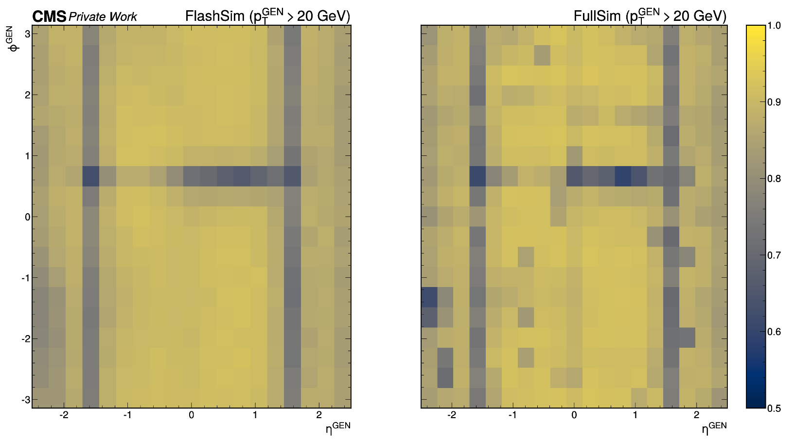
Modeling the efficiencies
Efficiency = P_{RECO} (p_{T},η,ϕ,...)
We must decide whether to simulate a given object
Feedforward Deep Neural Network to learn FullSim reconstruction probability (efficiency) as a function of the GEN inputs
y ~ unif([0,1))
isReco = DNN(inputs) > y

Slide 9
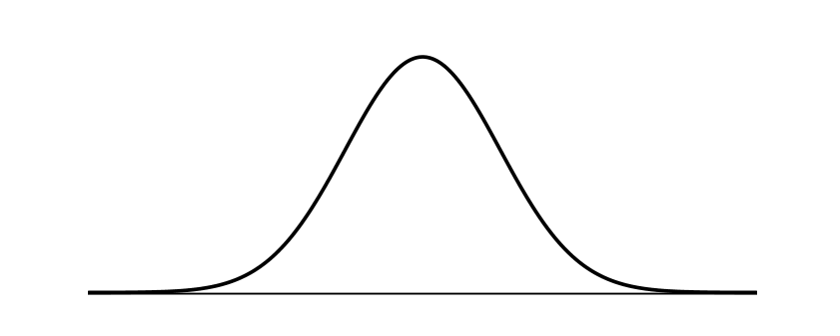
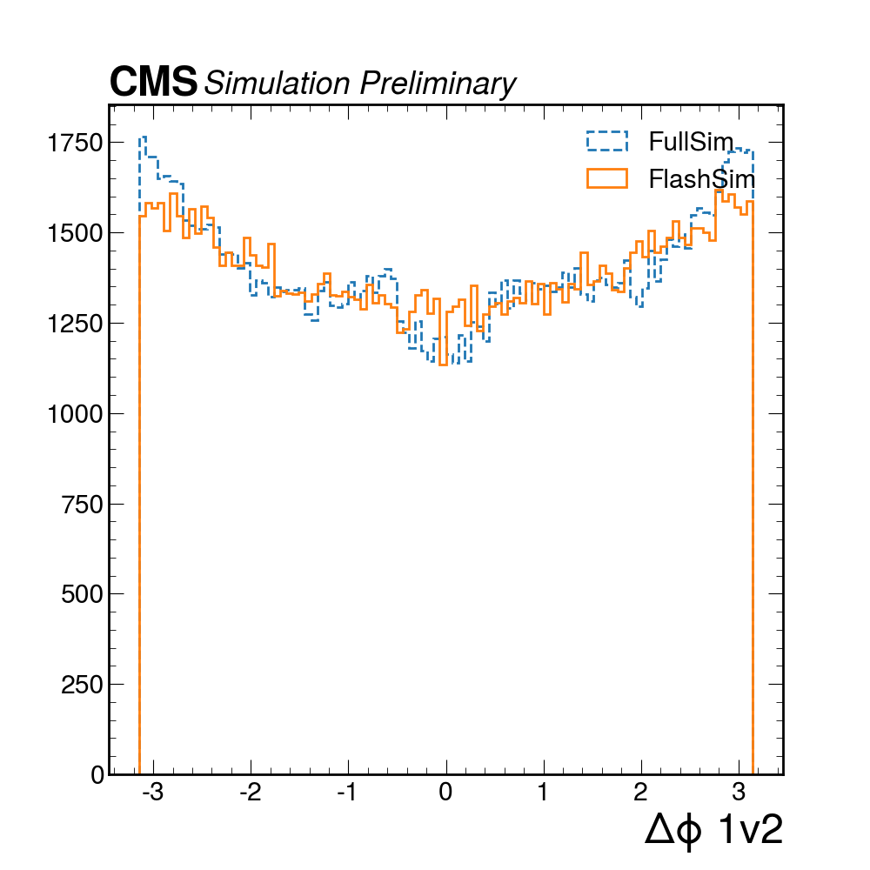
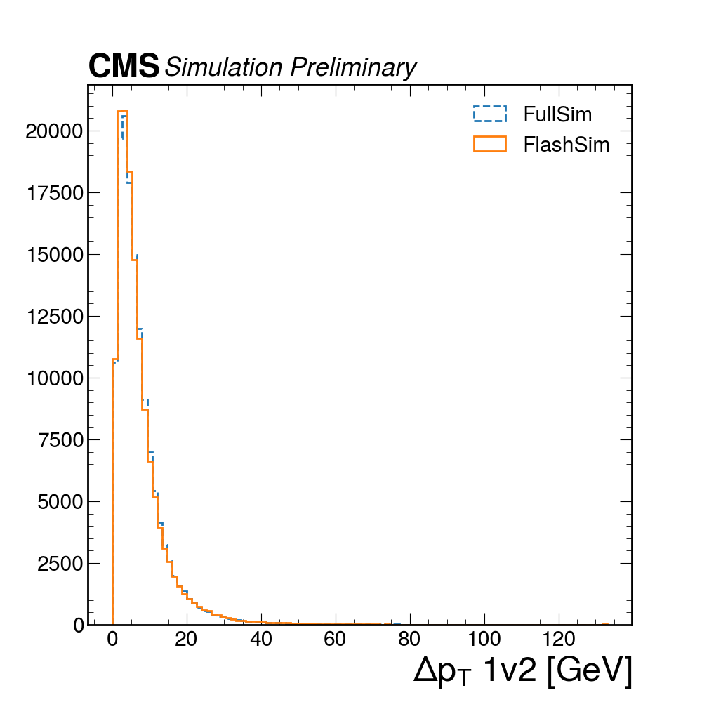
Fake Jets
The problem is that there is no GEN object to start from
🠆 Autoregressive chain on a variable number of fake jets in the event
Pt
Pt
Pt
Eta
Eta
…
Eta
Phi
Phi
Phi
Jet-0
Jet-1
Jet-9
We learn the (kinematic) distributions conditioned on the previous jet (p_{T} ordered)
This is a way to exploit the correlation between fakes
🠆 Input to regular jets model

Slide 10
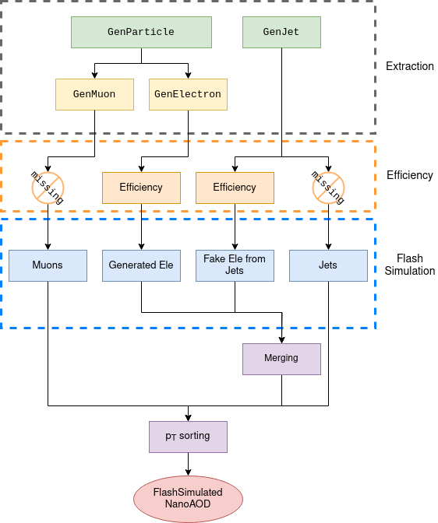
The FlashSim framework: event simulation
To be used in analysis, the object simulation must be converted into an event simulation
NanoBuilder:
extraction of the GEN features
decide whether the object can be simulated (efficiency)
simulation through the associated FlashSim model
other manipulations
We need efficient event-wise operations to exploit the true speed of the object-simulation

Slide 11
Applications
In which way FlashSim can be applied to a real analysis?

Slide 12
Increasing the size of a MC sample
Method 1 ― ONE-TO-ONE EVENT SIMULATION
Generate more GEN events to pass to FlashSim
the generation uses a fraction of the CPU resources compared to FullSim
given O(10) kHz per object, the generator could be a bottleneck
Method 2 ― OVERSAMPLING*
Simulate multiple RECO events using the same GEN event as input
do not need to produce more GEN events
RECO events sharing the same GEN information are correlated → proper statistical treatment non-trivial
GEN
RECO
RECO
GEN
RECO
RECO
GEN
…
…
…
GEN
RECO
RECO
GEN
RECO
RECO
*see https://etd.adm.unipi.it/t/etd-08062022-170936/

Slide 13
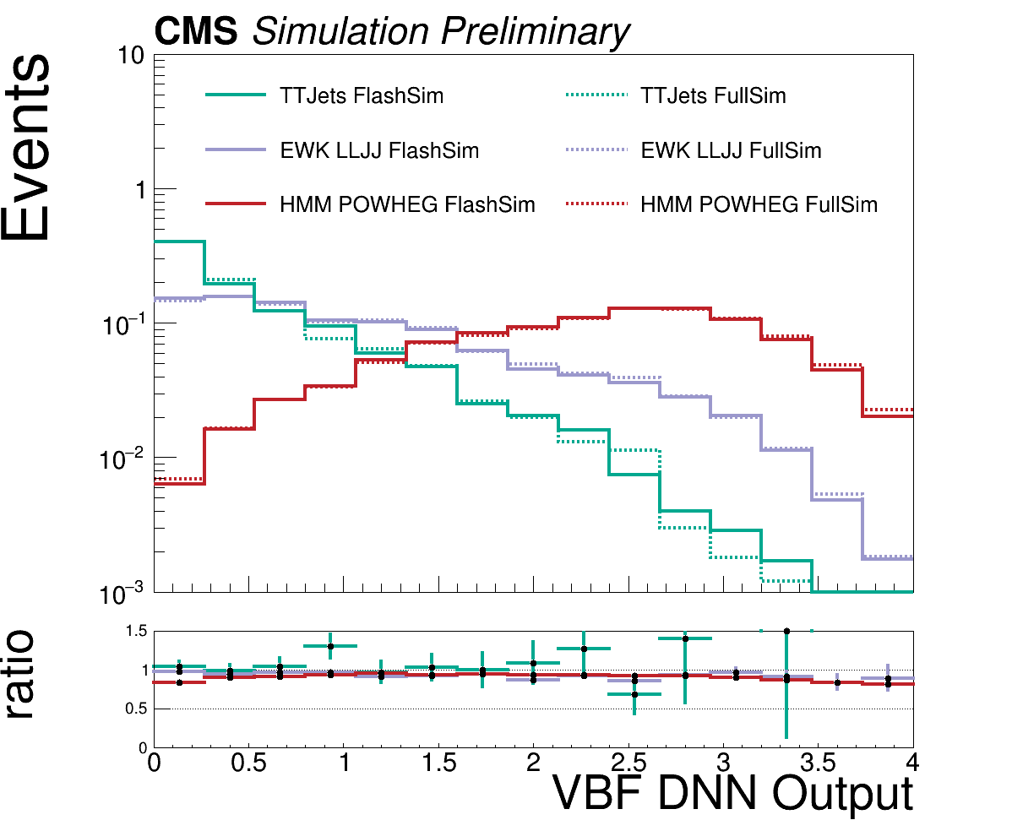
VBF H → μ⁺μ⁻ analysis
Crucial to test the accuracy on a real analysis!
Derived quantities exploit the dependencies and correlations between the simulated variables (e.g. same DNN discriminator as CMS evidence paper HIG-19-006)
one-to-one event simulation of muons and jets of tt+jets, DY+jets, EW ℓℓjj, Hμμ

Slide 14
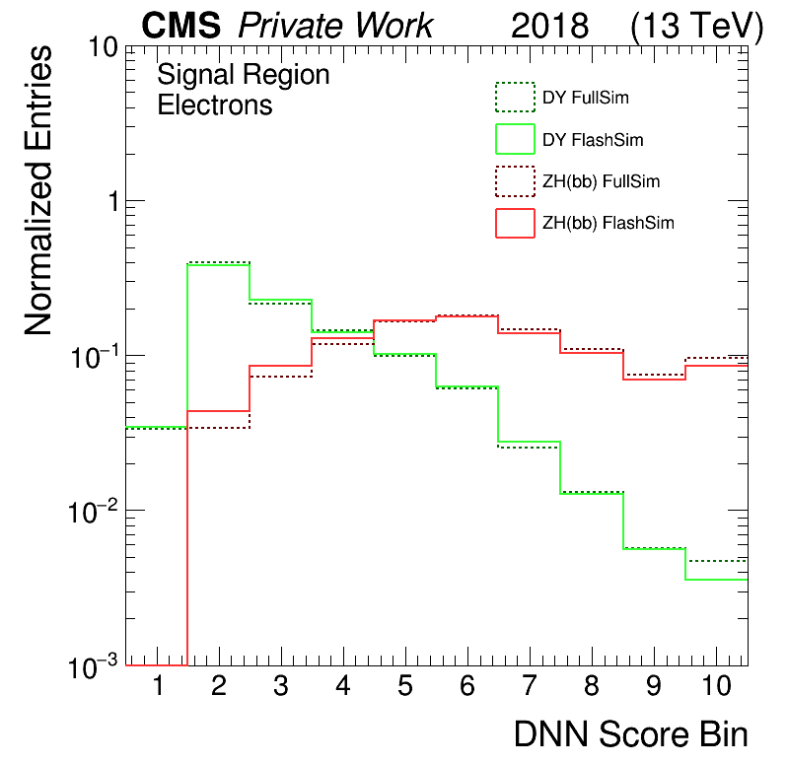
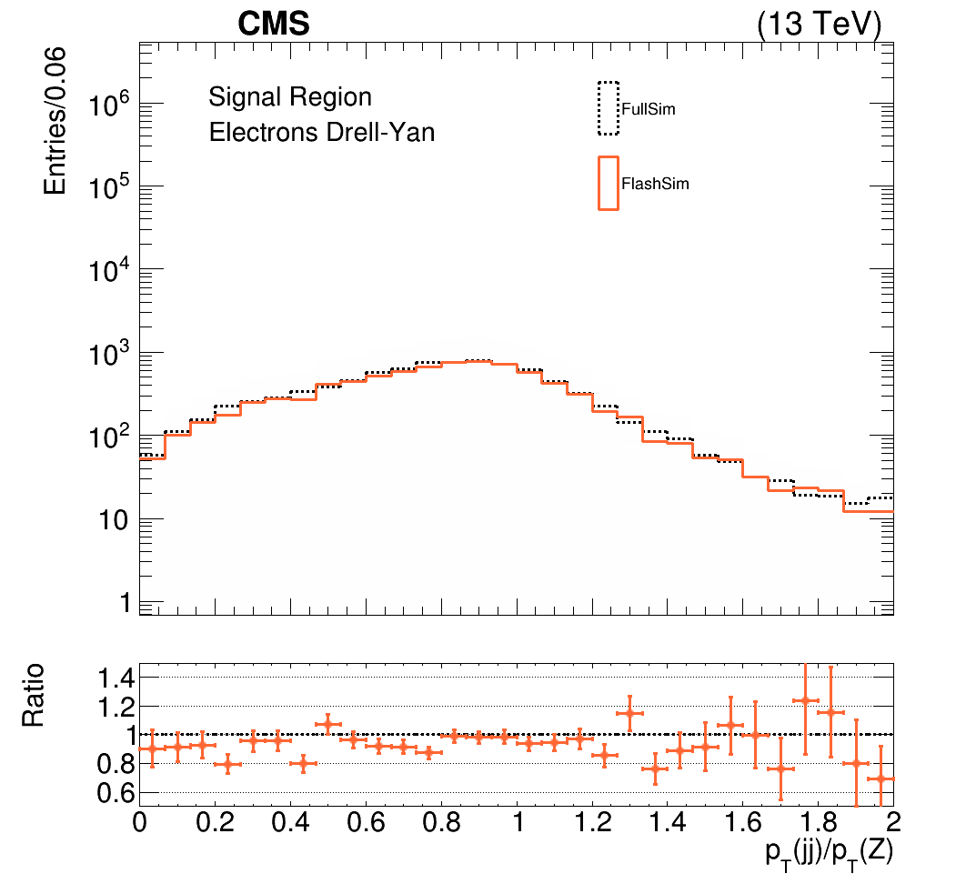
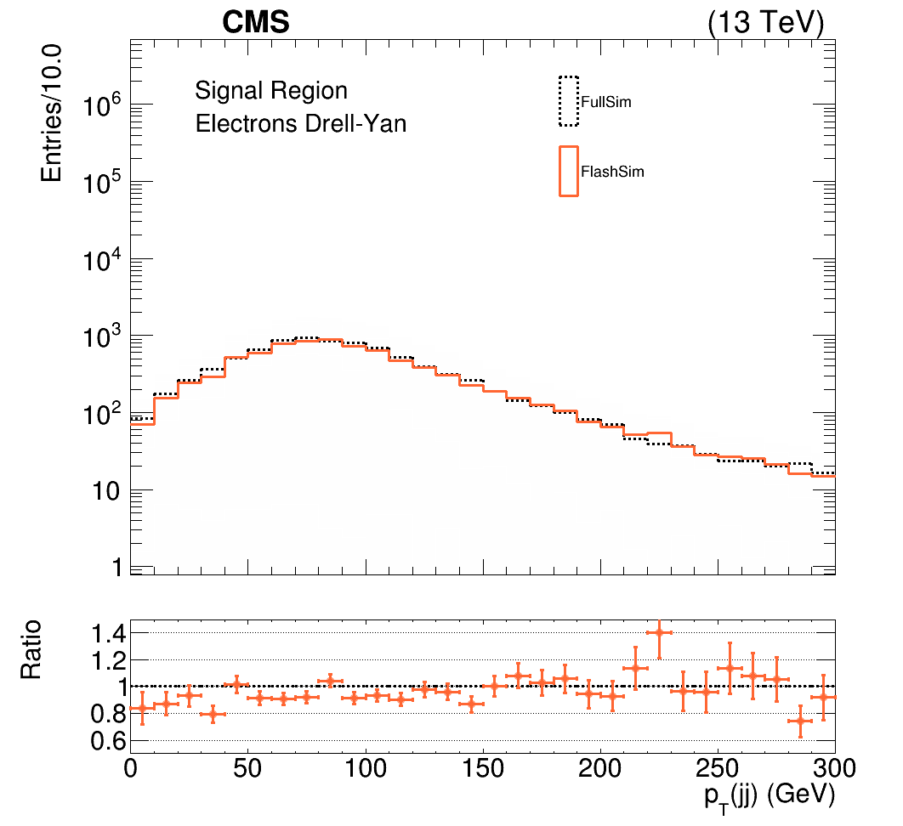
Simplified ZH H → bb analysis
Most recent results – with electrons!
one-to-one event simulation of DY+jets and ZHbb processes
Simplified Run 2 Z(ℓ⁺ℓ⁻)H(bb) analysis → DNN signal-background discriminator (not from HIG-20-001)

Slide 15
Oversampling: statistical treatment
EVENT-1
EVENT-2
EVENT-3
+
+ … +
Usually, a histogram is filled with events (and their weights)
N = oversampling factor
Oversampling → the final histogram is given by the weighted sum of sub-histograms filled with the distributions of events sharing the same GEN
Note: the final uncertainty is larger than just calling TH1::Fill()
EVENT-1
EVENT-2
EVENT-3
1/N ✕
+
1/N ✕
+ … +
1/N ✕
Final Histogram

Slide 16
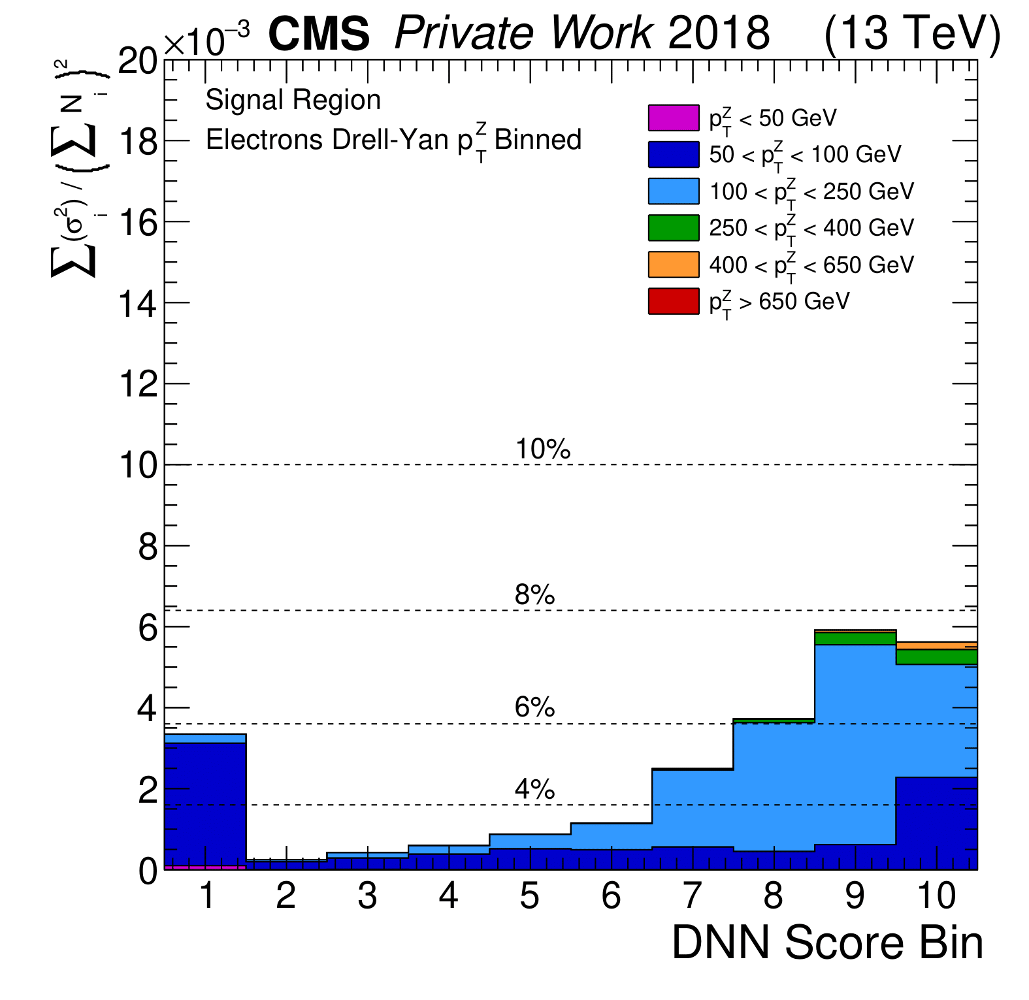
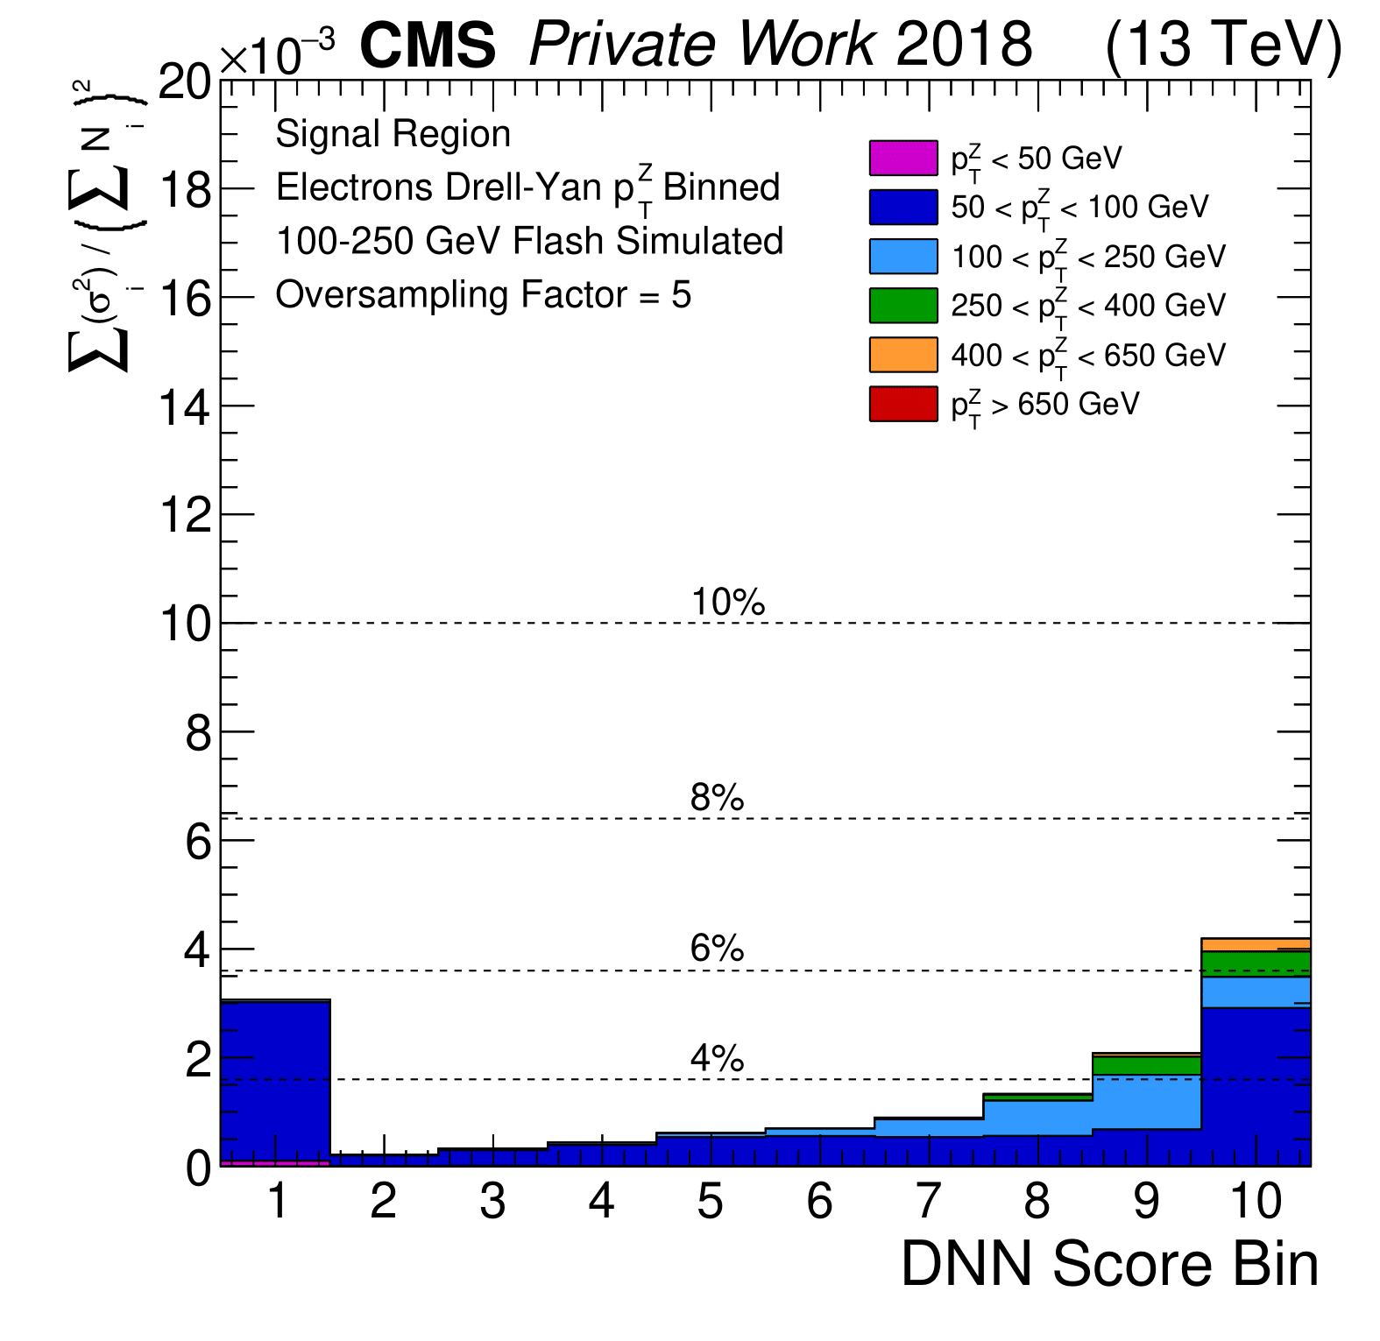
Statistical uncertainty reduction Z(ℓ⁺ℓ⁻)H(bb)
DY+jets with 100 < p_{T}(Z) < 250 GeV oversampled by a factor 5
~80M ×5 simulated events
🠚 Statistical uncertainty is reduced by a factor 2-3 in the signal-enriched region
without oversampling
oversampling ×5

Slide 17
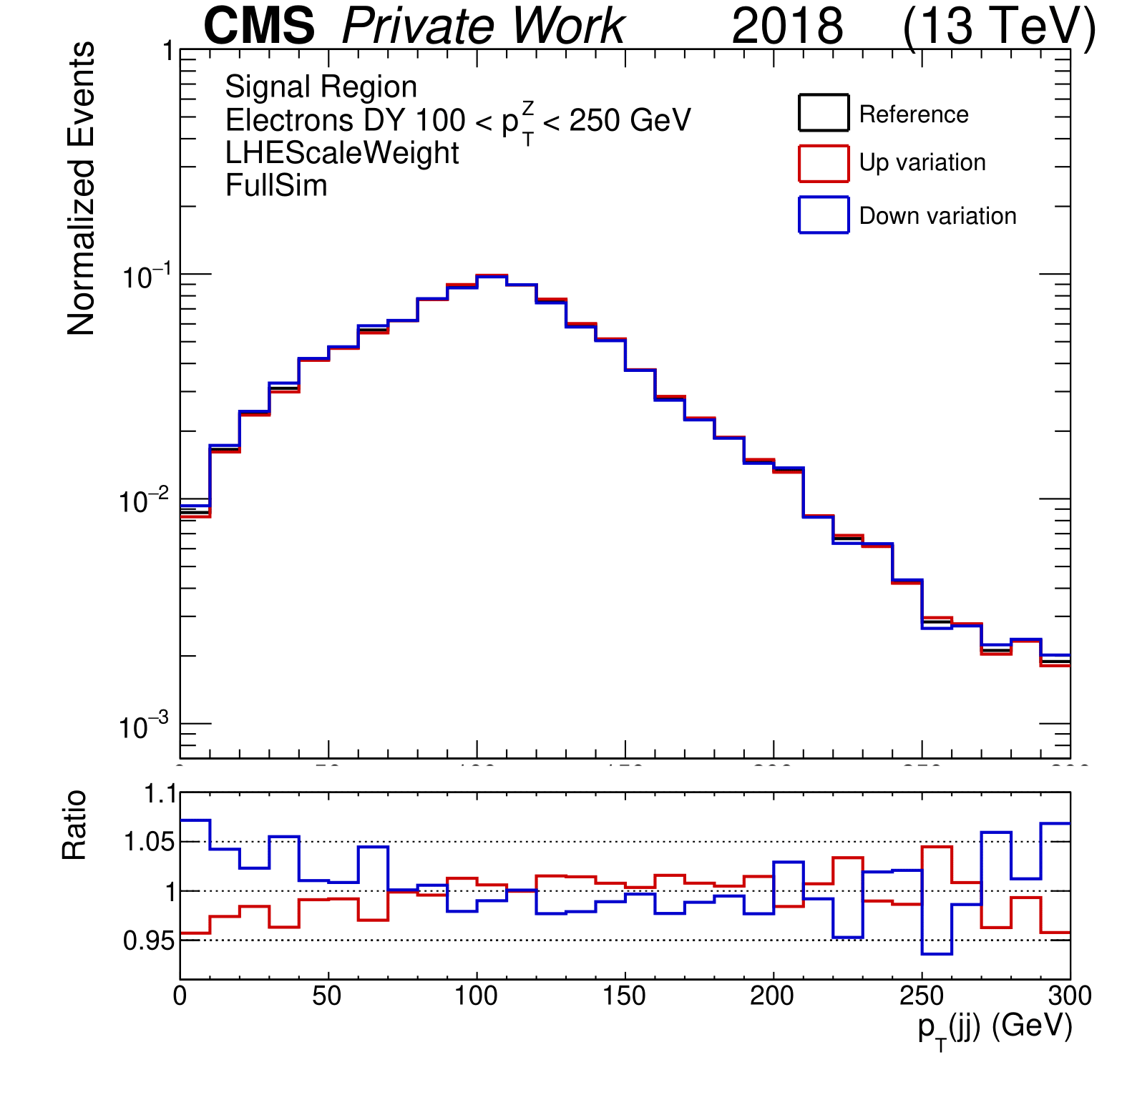
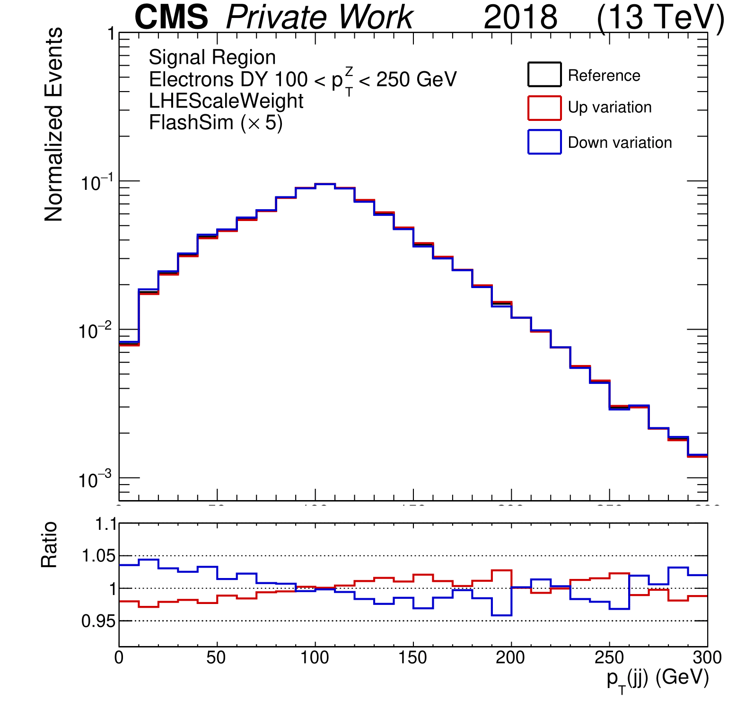
Differential Scale Factors for systematic variations
Fluctuations due to the limited number of events appear when evaluating alternative samples for systematic uncertainties
FlashSim allows computing smoother variations in a fraction of time
without oversampling
oversampling ×5
(LHE renormalization scale variation)

Slide 18
Differential Scale Factors for systematic variations
VAR.(FullSim) = REF.(FullSim) ✕ RATIO(FlashSim)
Variation at FullSim accuracy
FlashSim to FullSim differences cancel out
Given a (FullSim) sample made from a generator (e.g. POWHEG)
we can get a sample from another generator (e.g. aMC@NLO)
with FullSim accuracy
in very short time!
aMC@NLO(FullSim) = POWHEG(FullSim) ✕
aMC@NLO(FlashSim)
POWHEG(FlashSim)
True FullSim aMC@NLO sample for the comparison

Slide 19
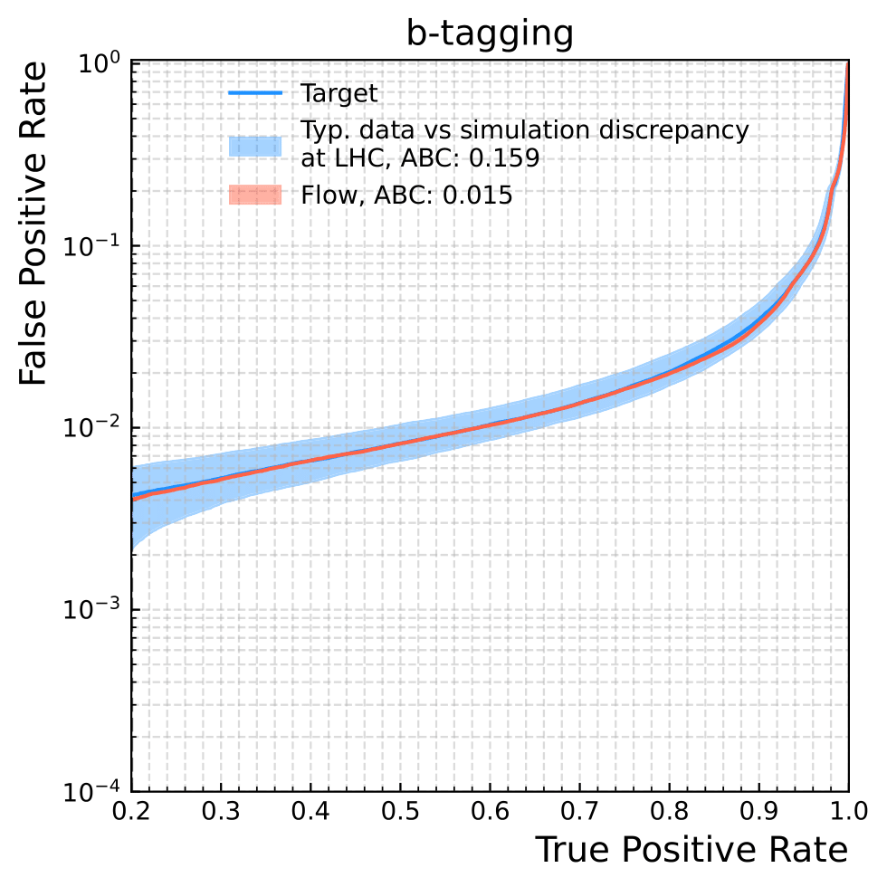
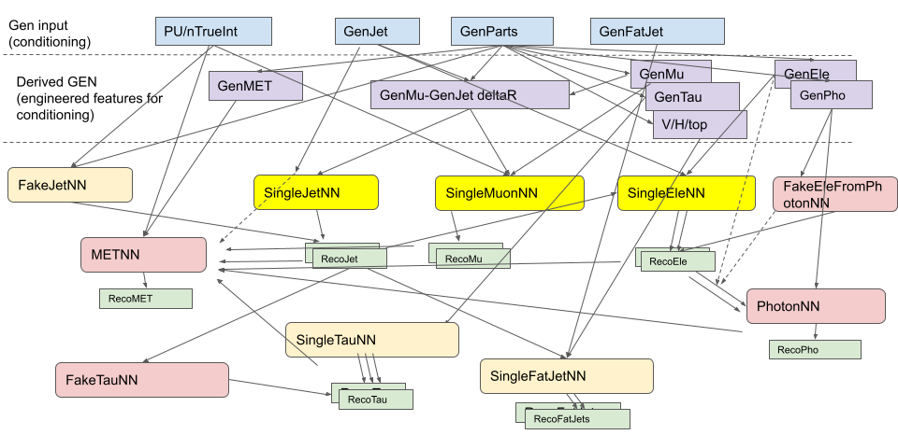
Current and future developments
limited authorship paper on toy-dataset in preparation
At the moment
photons (ETH), taus (Chula), MET (CERN)
efficiencies for existing models
Continuous Flow Matching under investigation (limited authorship paper on toy-dataset in preparation)
For the (near!) future
NanoBuilder improvements
evaluate the performances on other analyses
more objects / complete NANOAOD

Slide 20
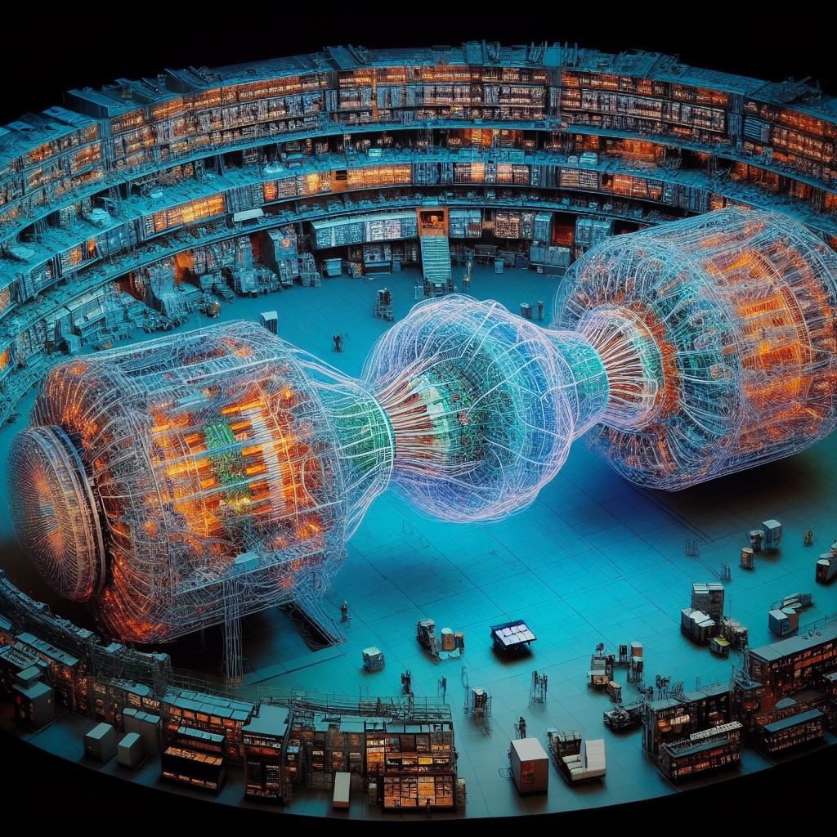
Conclusions
Using Generative AI techniques to simulate CMS events seem possible (but not using GPT4)
Trying our best to build a working framework soon!
Of course any help is welcomed!
➞ Join the effort!
➞ More benchmark analyses needed!
Mattermost https://mattermost.web.cern.ch/cms-exp/channels/flashsim
Documentation coming soon …
Draw an event display of the CMS experiment at CERN produced by a Higgs boson decaying to two muons

Slide 21
Backup

Slide 22
History & Recent developments
First attempts with analysis specific flashsim / idea to aim at NANOAOD https://indico.cern.ch/event/1024708/#8-analysis-specific-fast-sim-f
First prototype of universal flashsim with Normalizing Flow, test case of Jets https://indico.cern.ch/event/1131678/#3-prototype-of-flashsim-using
Prototype with Jets and Muons https://indico.cern.ch/event/1191657/timetable/#14-flashsim
Addition of Electrons and first tests of fat jets and fake jets https://indico.cern.ch/event/1275985/#63-new-objects-added-to-flashs
DPS approval of early prototype https://indico.cern.ch/event/1276734/#49-dps-flashsim-prototype-an-e
Talk at Deep Dive https://indico.cern.ch/event/1289007/#10-end-to-end-simulation-flash
Talk at Sim meeting https://indico.cern.ch/event/1365460/#82-flashsim-progress
Talk at ML meeting https://indico.cern.ch/event/1372228/#20-recent-progress-on-flash-si
Talk at Deep Dive https://indico.cern.ch/event/1355548/#62-flash-sim

Slide 23
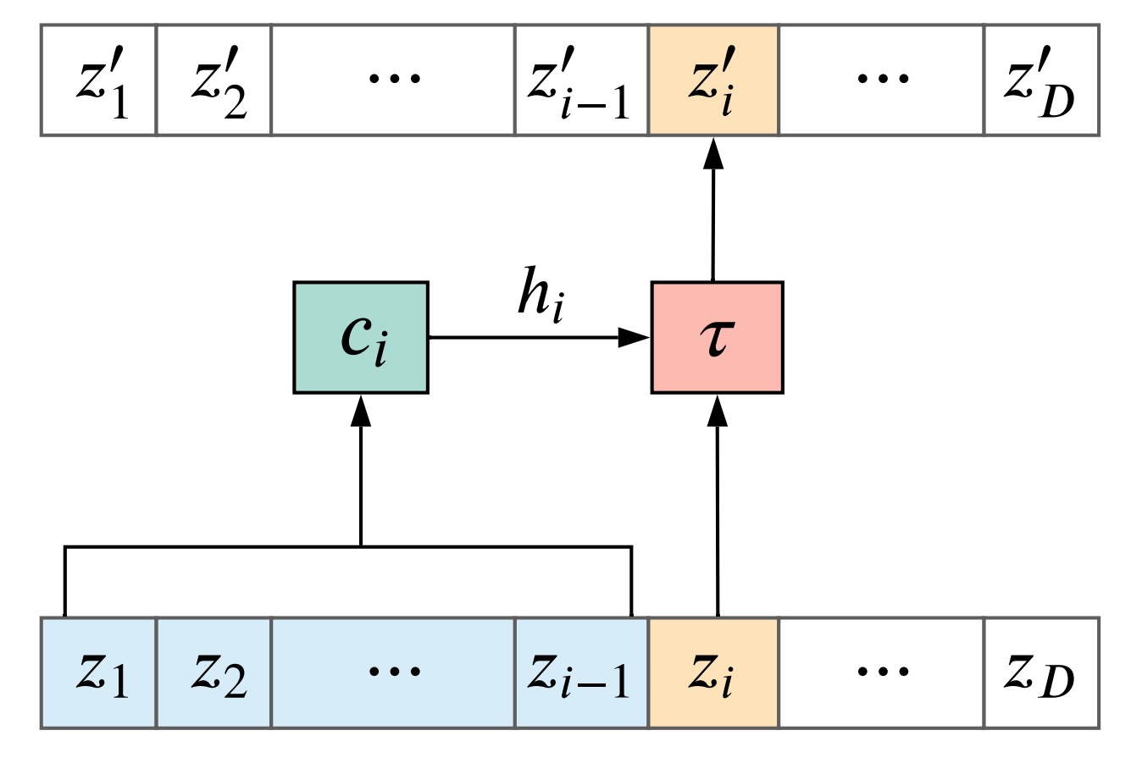
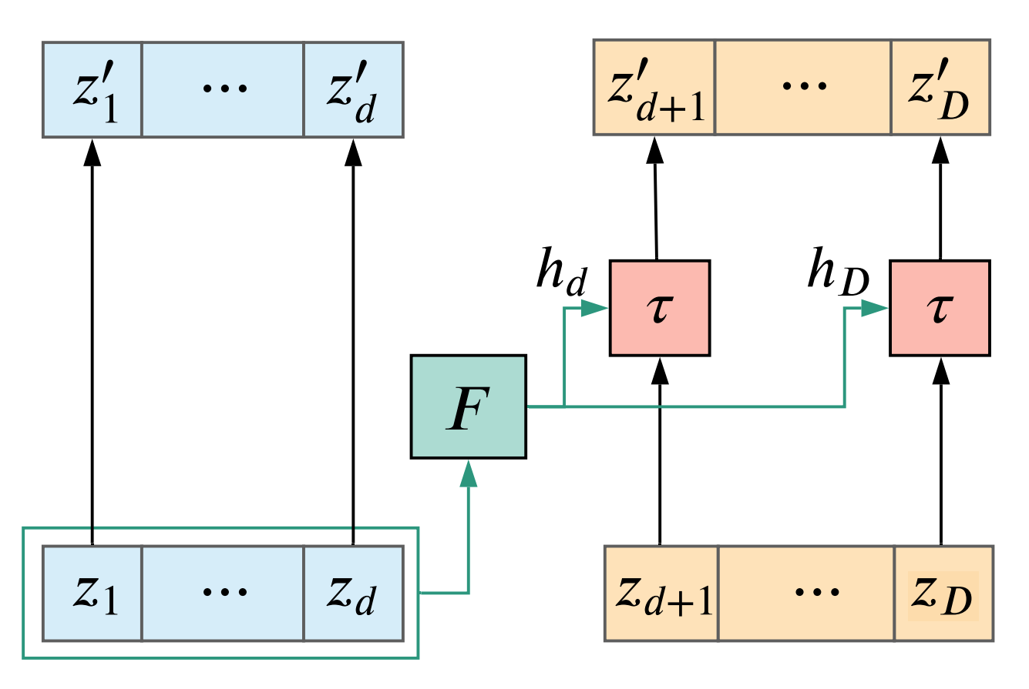
Flows building blocks: conditioners
Autoregressive:
How do we treat the input variables?
Want to correctly model correlations
How do we use the other target variables while transforming another?
Various way to do it!
Coupling:
Notes:
slide troppo densa. dire che combiniamo piu’ flow. separare nelle due trasformazioni?

Slide 24
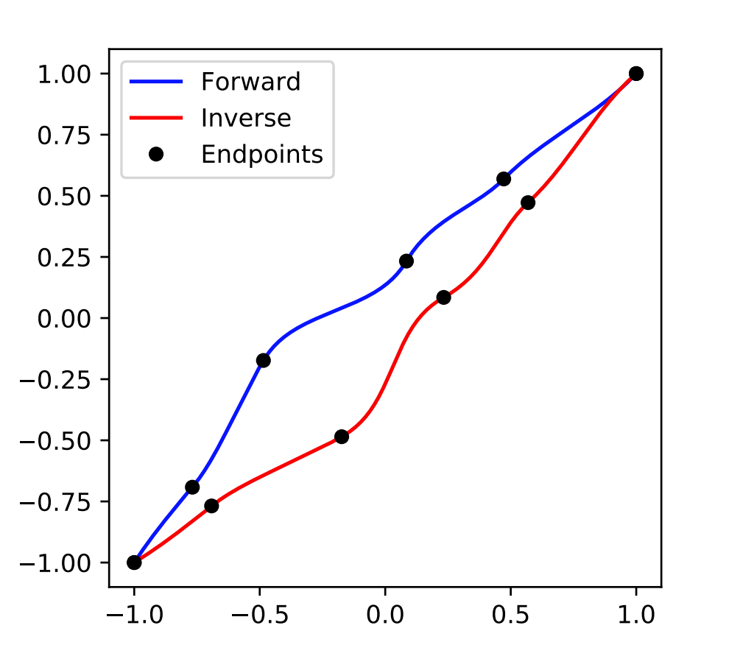
Flows building blocks: transforms
Affine:
How do we transform the variables?
Various ways to do it (as long as the transformation is invertible!)
Each model is made up of multiple
coupling+transformation blocks
This gives us an expressive final transformation with good correlations
between variables
(Most models are trained on 5 million TTbar objects)
Splines:
Notes:
slide troppo densa. dire che combiniamo piu’ flow. separare nelle due trasformazioni?

Slide 25
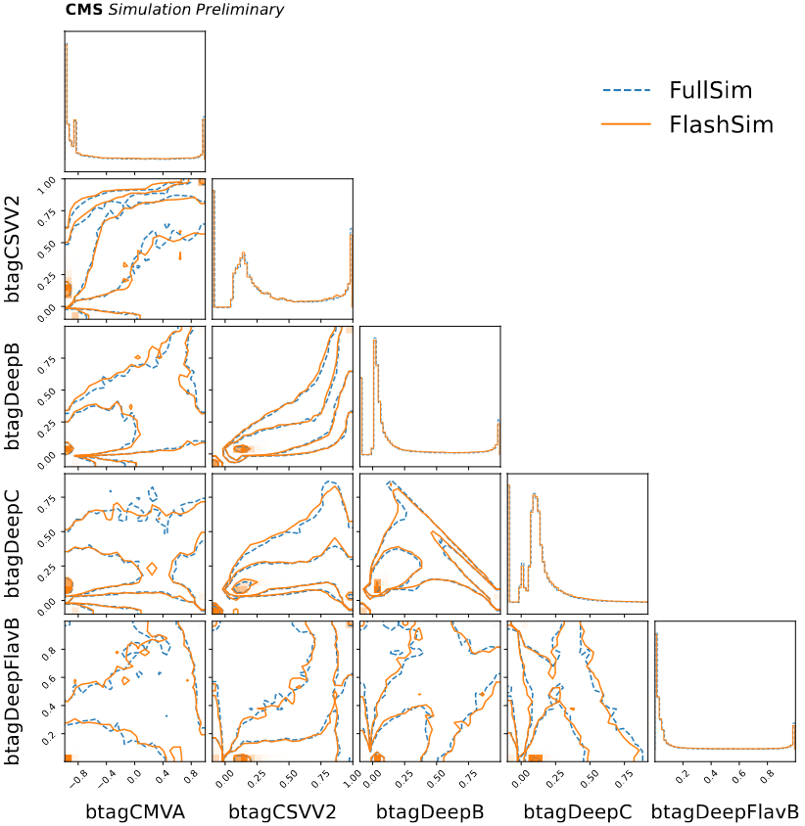
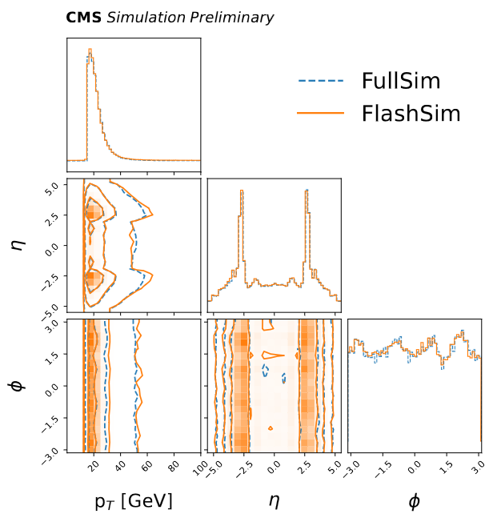
Jets (AK4) results

Slide 26
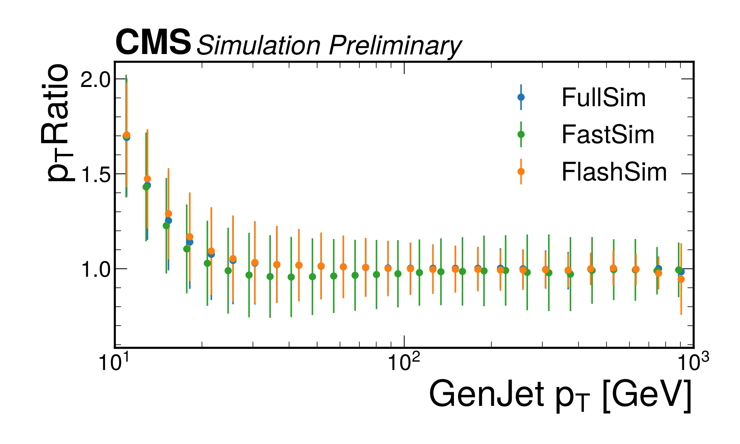
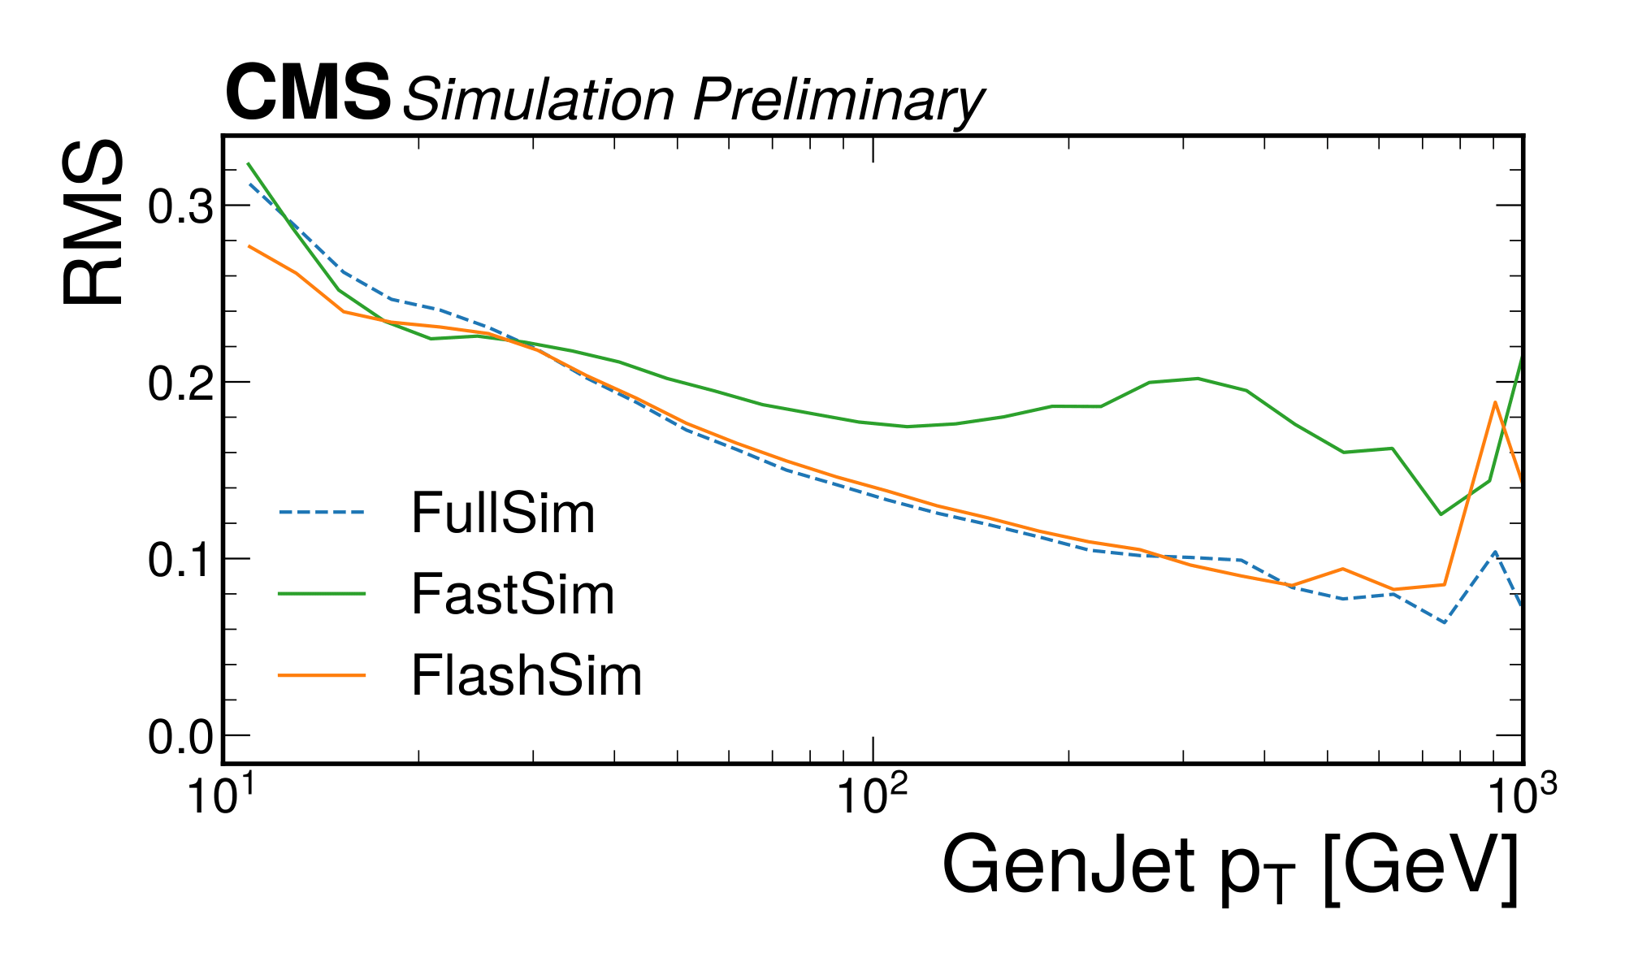
AK4 Generator-matched Jets
conditioning
comparison with
FullSim sample:
/TTToSemiLeptonic_TuneCP5_13TeV-powheg-pythia8/RunIISummer20UL18NanoAODv9-106X_upgrade2018_realistic_v16_L1v1-v1/NANOAODSIM
FastSim sample:
/TTToSemileptonic_TuneCP5_13TeV-powheg-pythia8/RunIISummer20UL18NanoAODv9-FSUL18_FSUL18_106X_upgrade2018_realistic_v16_L1v1_ext1-v3/NANOAODSIM

Slide 27
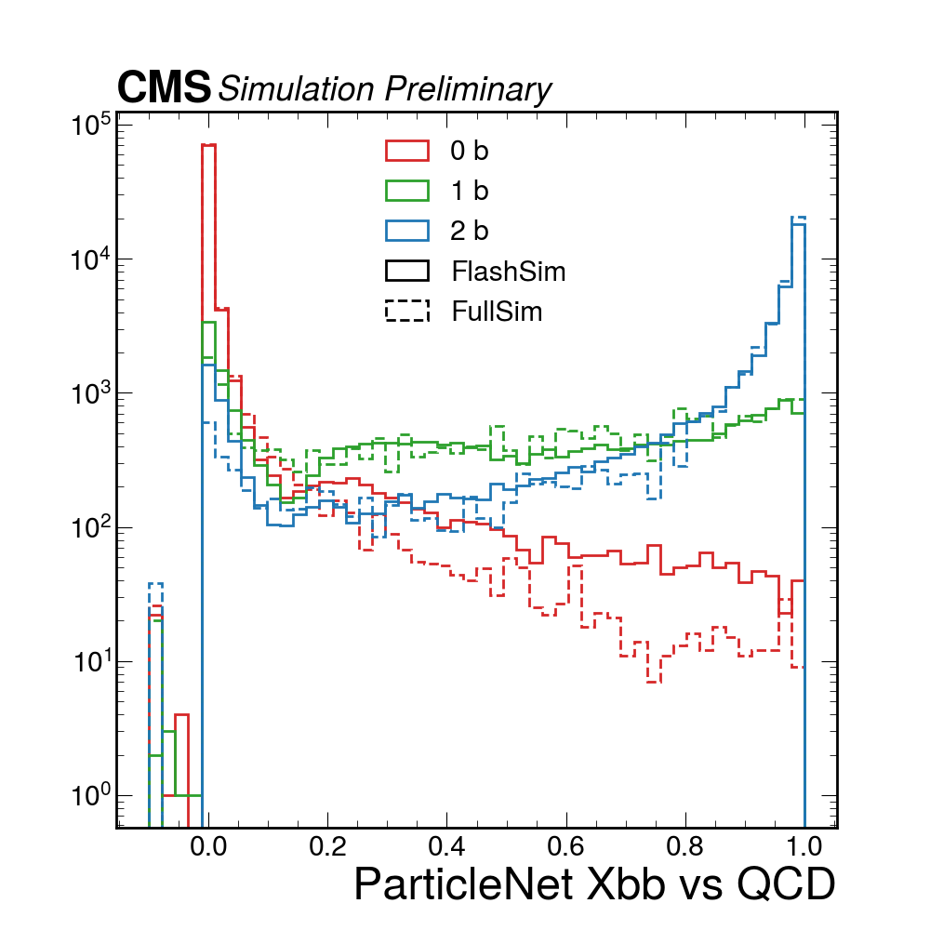
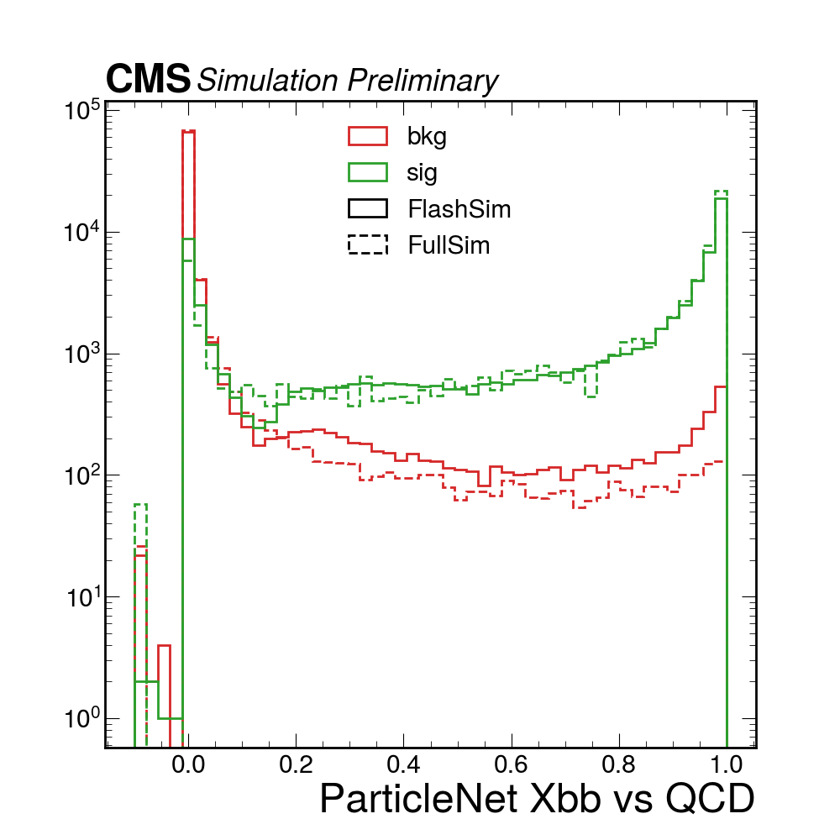
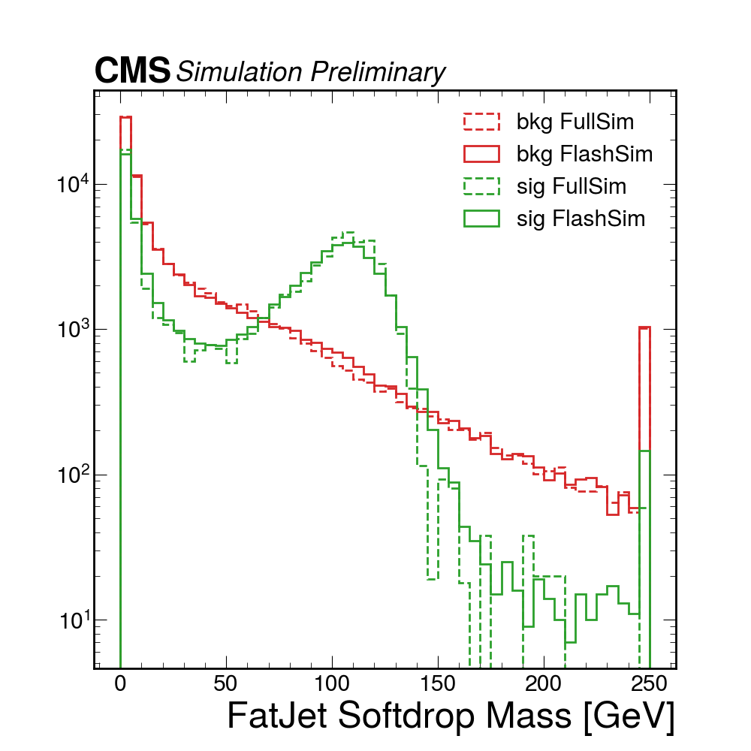
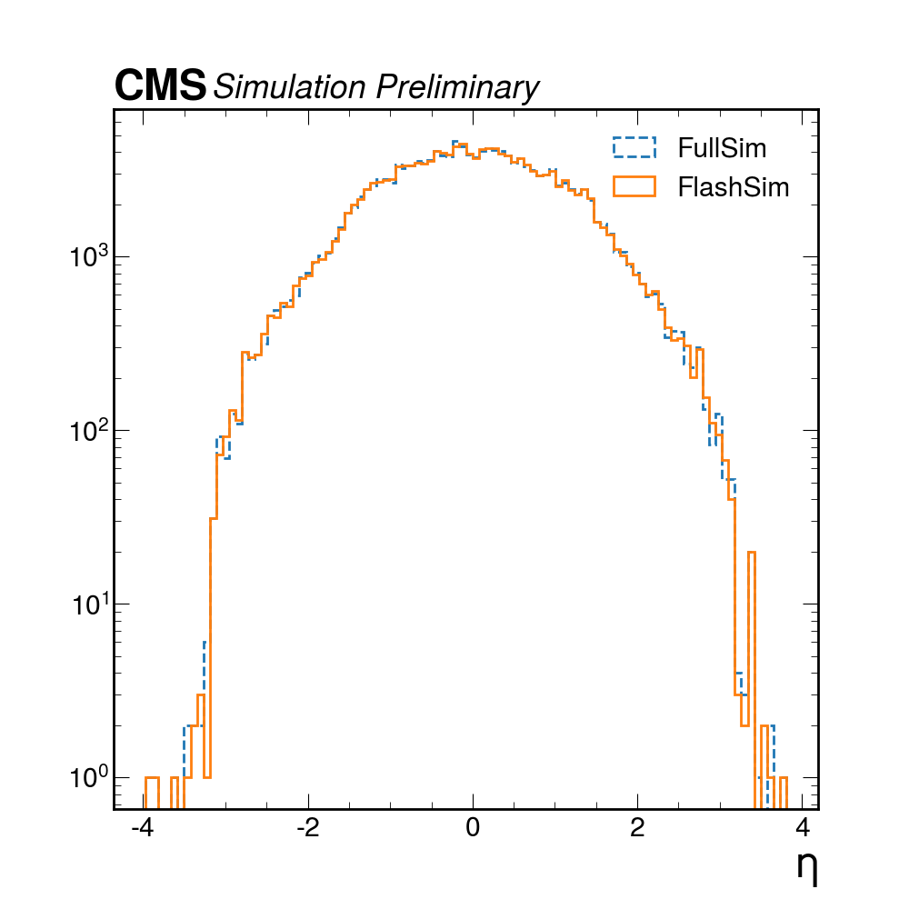
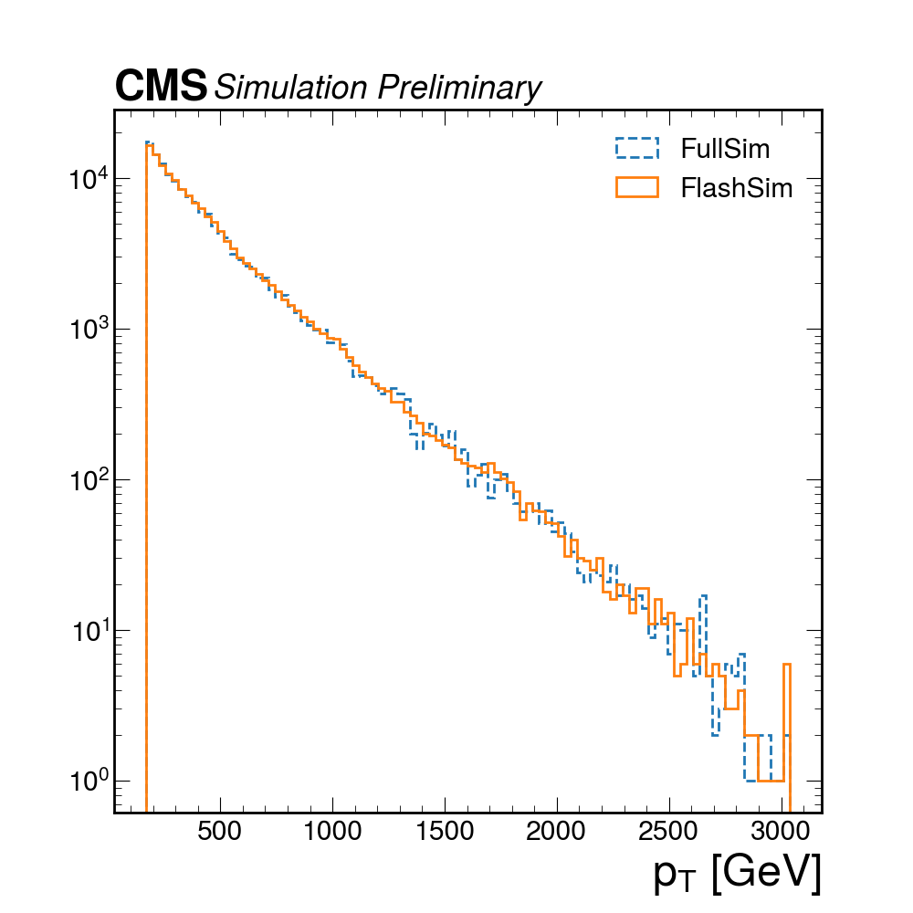
Phase2 AK8Jets tests
Limited by training statistic (few 100k)
Extrapolating from Run2 results, a few millions of events should be all we need!

Slide 28
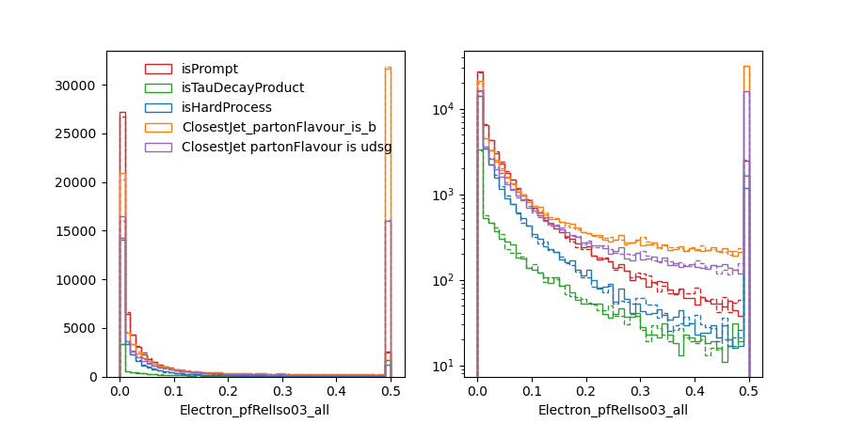
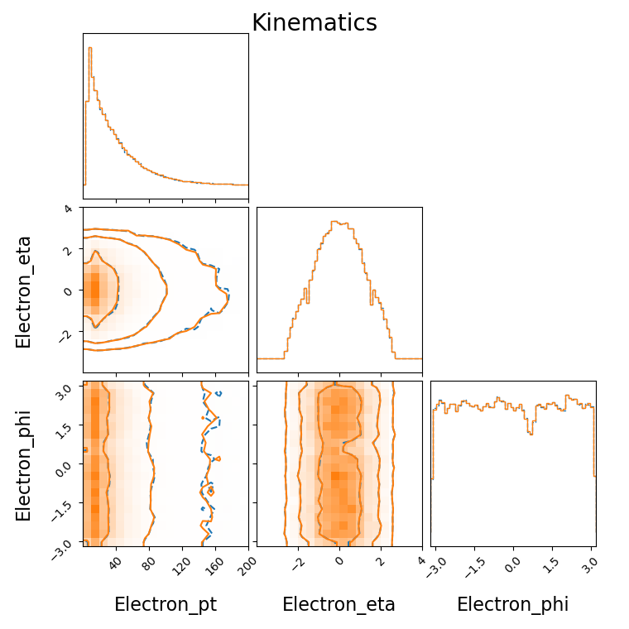
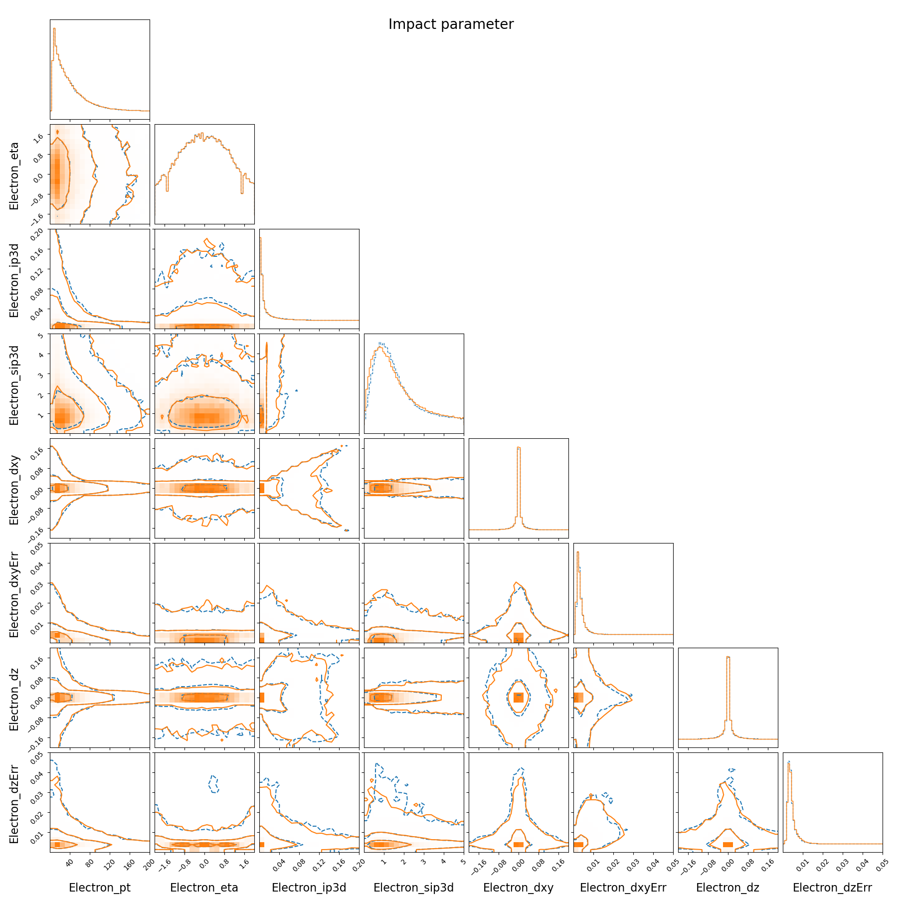
Electrons results

Slide 29
Electrons from GEN Jets results

Slide 30
FlashSim: Elettroni da Jets

Slide 31
Efficiency model
Feedforward DNN
Simple architecture (~100k parameter)
Using the Binary Cross Entropy as loss function ensures that the network output is a probability

Slide 32
Fake Jets
Sample number of fake jets from Pileup_nTrueInt vs. nFakeJets distributions
Autoregressive chain of the kinematic triplet (p_{T},η,ϕ)
p( i | i - 1) i ≥ 1
i = 0 : no conditioning
Triplets used as input to the jets model to get the other RECO variables

Slide 33
Fake jets results

Slide 34
Drell-Yan electrons

Slide 35
Drell-Yan muons

Slide 36
ZH(bb) electrons

Slide 37
ZH(bb) muons

Slide 38
Oversampling
Prototype OversampledTH within ROOT RDataFrame (to be improved!) (https://github.com/cms-flashsim/OversampledTH)
Non-oversampled case
𝑤 statistical weight associated with the MC event
For the i-th bin of an histogram, the probability of being in this bin and the associated uncertainty are
Oversampled case
A fold is the set of RECO events sharing the same GEN
limited authorship paper on toy-dataset in preparation

Slide 39
Limits and resolution
The distribution of the events in a fold has a characteristic spread
This depends on the experimental resolution of the considered variable
The impact of oversampling is more important for variables whose resolution is detector-dependent
The effect is milder if the resolution is GEN-dependent

Slide 40
Resolution of detector

Slide 41
Effect on uncertainty

Slide 42
DY 100-250 GeV

Slide 43
DNN Score electrons

Slide 44
DNN Score muons

Slide 45
LHEScale variations

