Slide 1
SPD ECAL Status Report February 2024 Oleg Gavrishuk, Laboratory of High Energy Physics, Dubna, Russia
ECAL position inside of Cryostat – Sizes Fixed
ECAL New Sizes corrected in 2024 – is READY
SPD Barrel design:
TZ for LHEP & DLNP - under preparation
Matrix Form for new scintillator production (40x40x1.5 mm³) - READY
Stamp Form for Lead – proceed an Agreement preparation
Scintillate production: Vladimir, Uniplast: DLNP take participation
Technical task and Agreement – in preparation
End Cup part via 256 cells planning produce during 2024
Technical task, Agreement - in preparation
Oleg Gavrishuk, JINR, Dubna , Russia

Slide 2
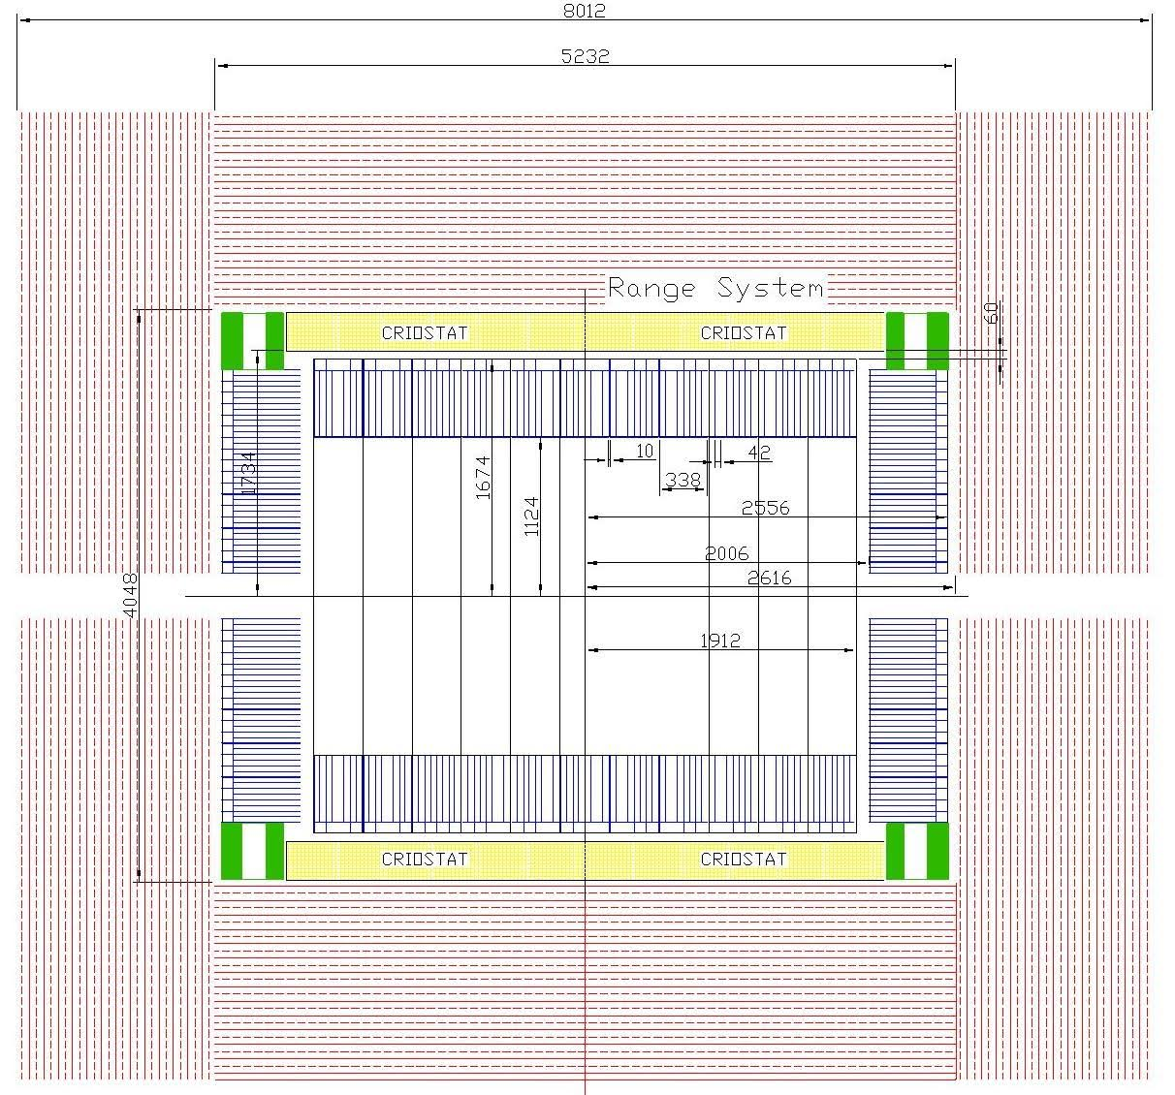
ECAL with New Sizes in 2024
Oleg Gavrishuk, JINR, Dubna , Russia

Slide 3
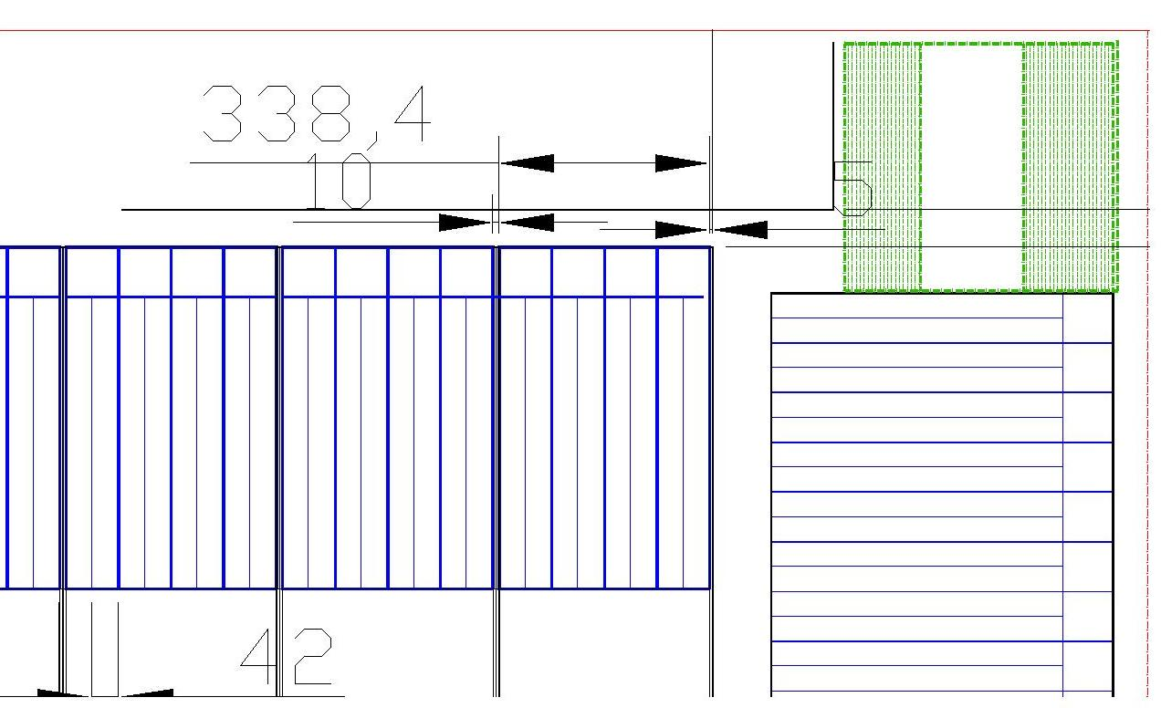
ECAL barrel Gap sizes along beam
Oleg Gavrishuk, JINR, Dubna , Russia

Slide 4
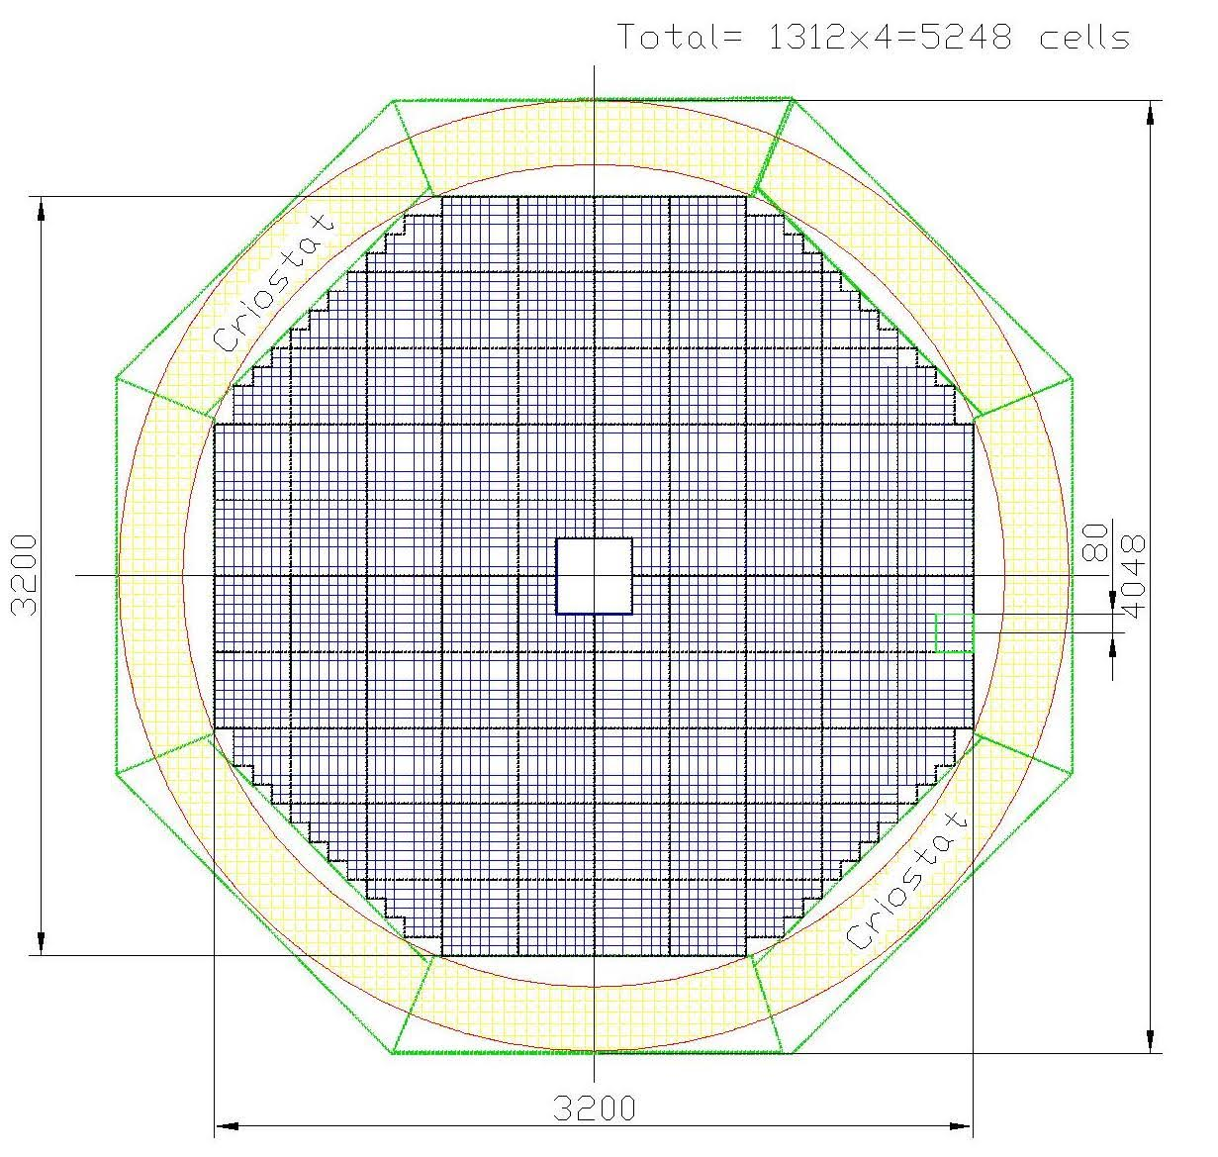
ECAL composition with New Sizes in 2024
ENDCUP:
Cells per One = 5136
2 End Cups Cells = 10272
ADC64 – 160
16ch Amplifiers – 642
Power units – 20
Weight – 2x12.8 = 25.6 ton
NOT take in account
The Cells Wall Thickness (4 mm)
Oleg Gavrishuk, JINR, Dubna , Russia

Slide 5
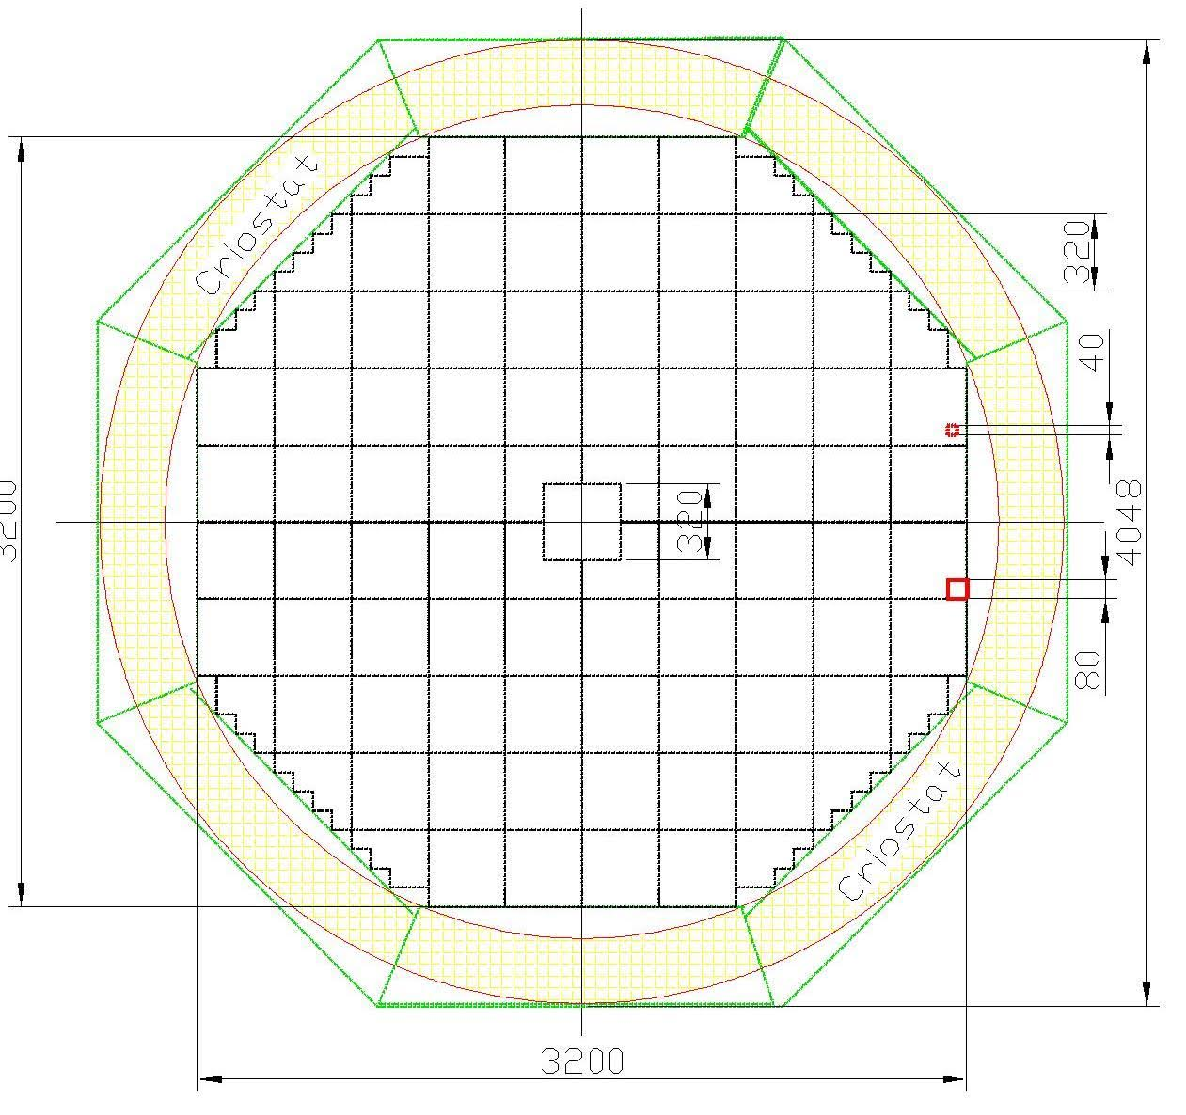
ECAL End Cup Frame New Sizes in 2024
ENDCUP Frame design
Load – 12.8 ton
Cells for 16 Modules (64 cells)
Cells - Stainless Steel , d=4 mm
Frame from Left & Right part
Frame has Support (green)
Support stay on RS Iron
This picture NOT take in account
The Cells Wall Thickness (4 mm)
Oleg Gavrishuk, JINR, Dubna , Russia

Slide 6
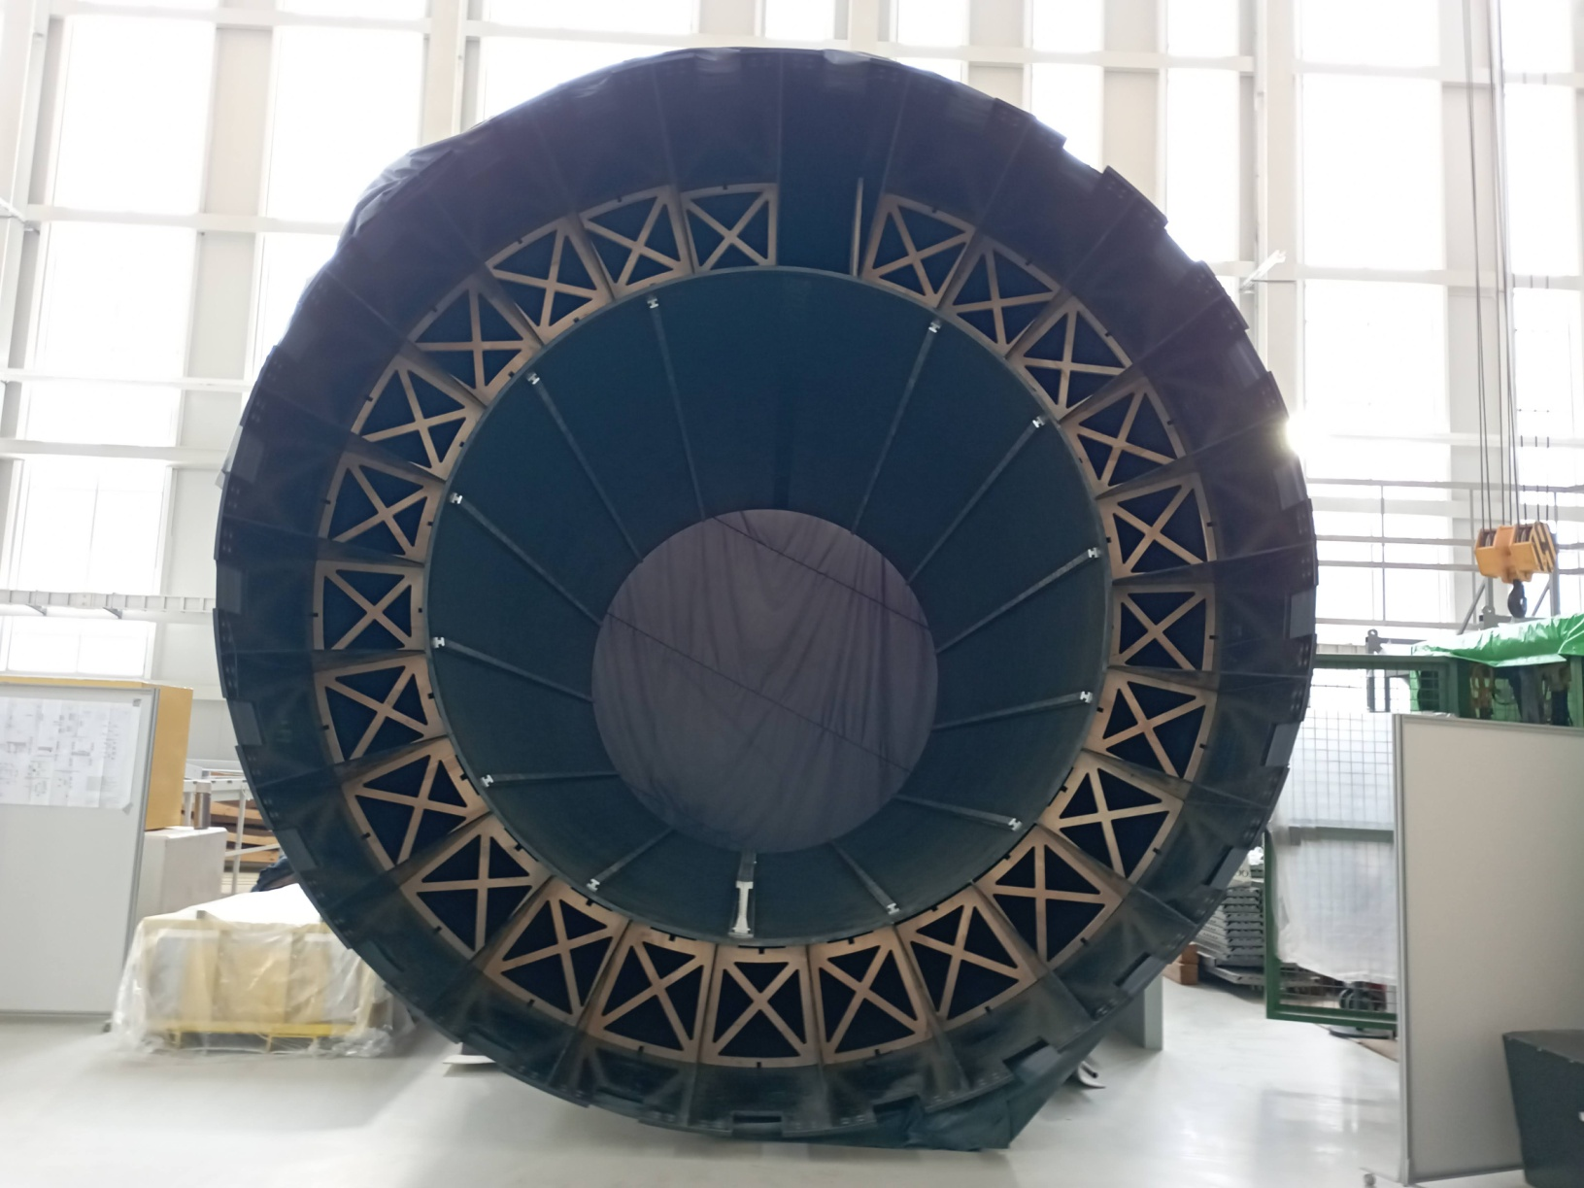
MPD Support for ECAL 2024
Oleg Gavrishuk, JINR, Dubna , Russia

Slide 7
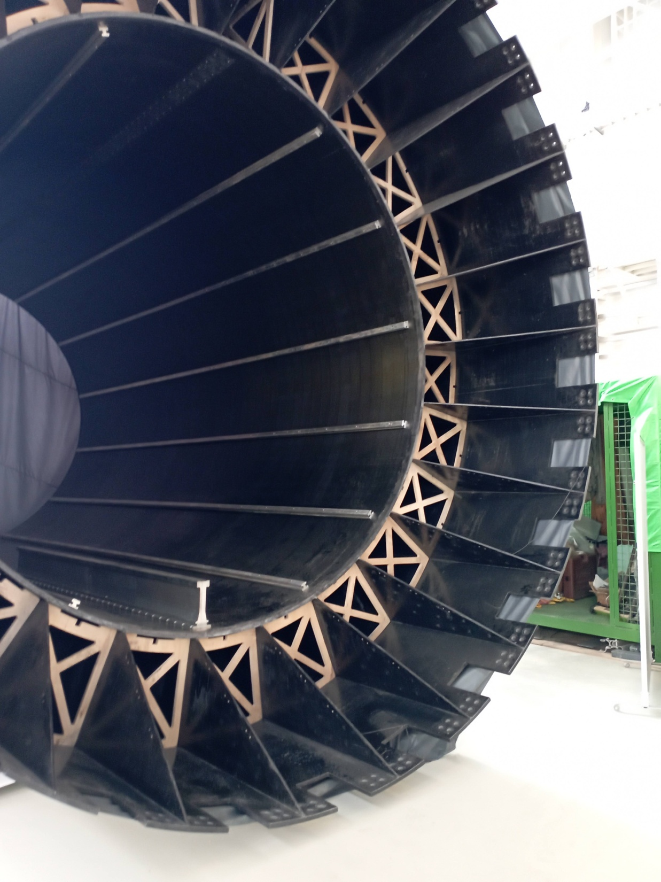
MPD 2024
Oleg Gavrishuk, JINR, Dubna , Russia

Slide 8
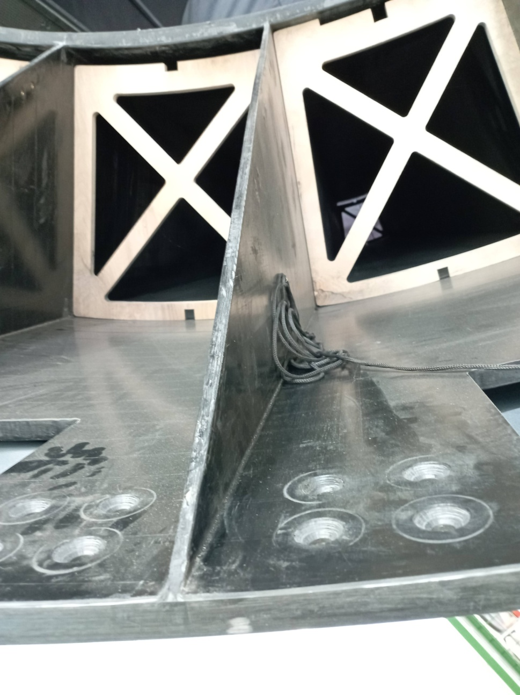
MPD 2024
Oleg Gavrishuk, JINR, Dubna , Russia

Slide 9
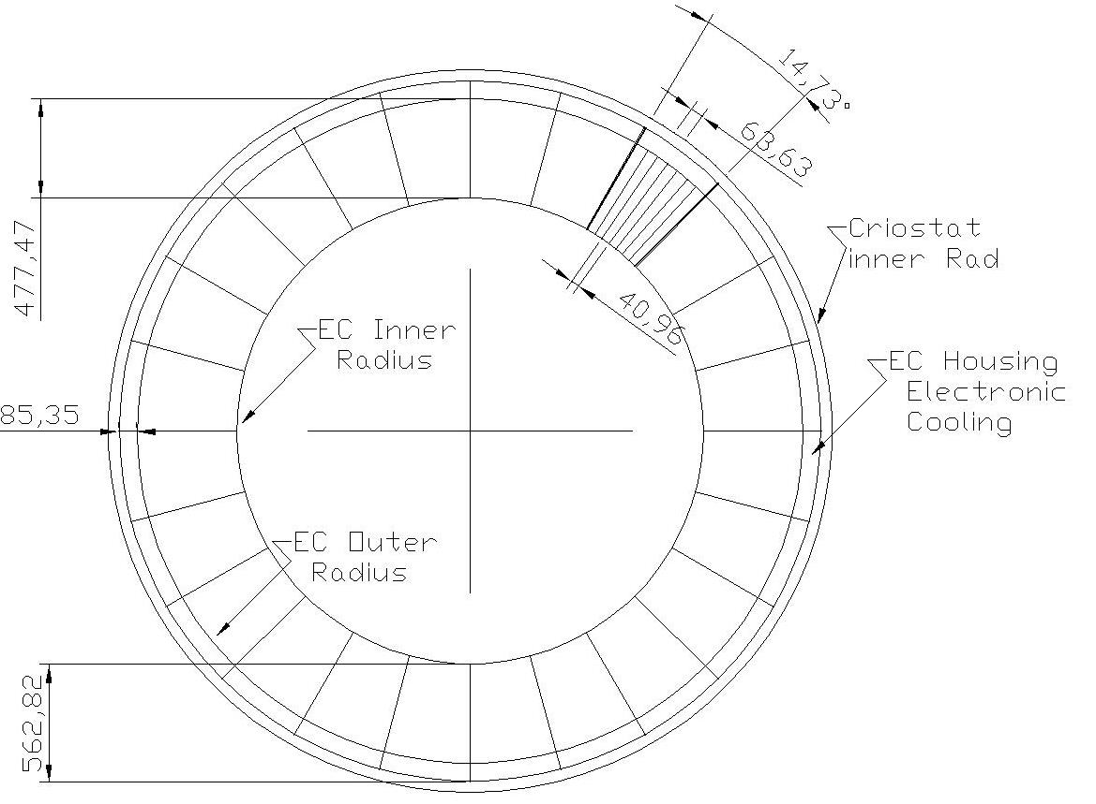
ECAL Barrel MPD option, 24 sectors
Oleg Gavrishuk, JINR, Dubna , Russia

Slide 10
TZ Barrel support. Design look like MPD
MPD documents are ready in LHEP
Scaling for sizes factor ~ 1.4
Take in account ECAL SPD Barrel Weight - facrot ~2
Preferences in Design:
Documentation exist in LHEP
Experience exist during manufacturing
Production was done
Preferences in Setup:
Support for all inner detectors:
RPC planes
STRAW tubes
Independent ECAL Sectors assembling

Slide 11
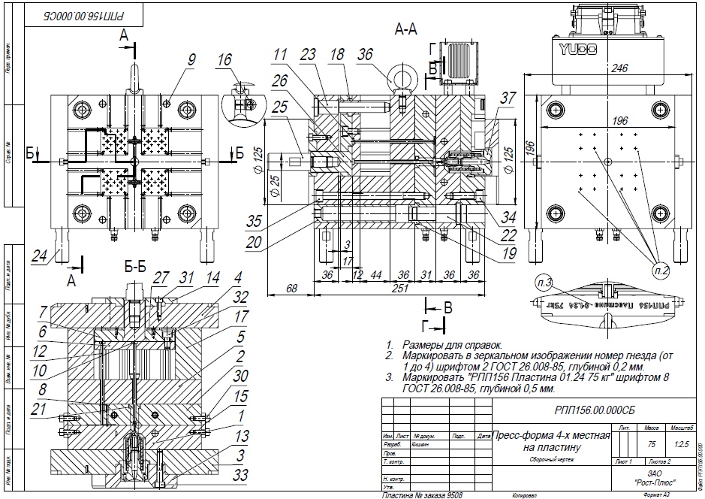
Matrix form for new scintillator production (40x40x1.5 mm³)
Matrix firm is special setup for molding by pressure technology
It allow produce scintillator from granulated polystyrene with doppands
4 set form produce 4 scintillator plate per 1 minute

Slide 12
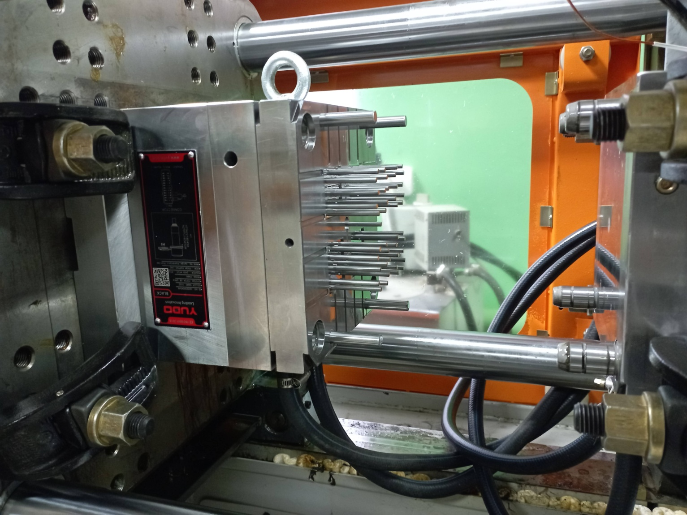
Matrix form for new scintillator production (40x40x1.5 mm³)
Matrix firm is ready and tested in Uniplast, Vladimir in February 2024

Slide 13
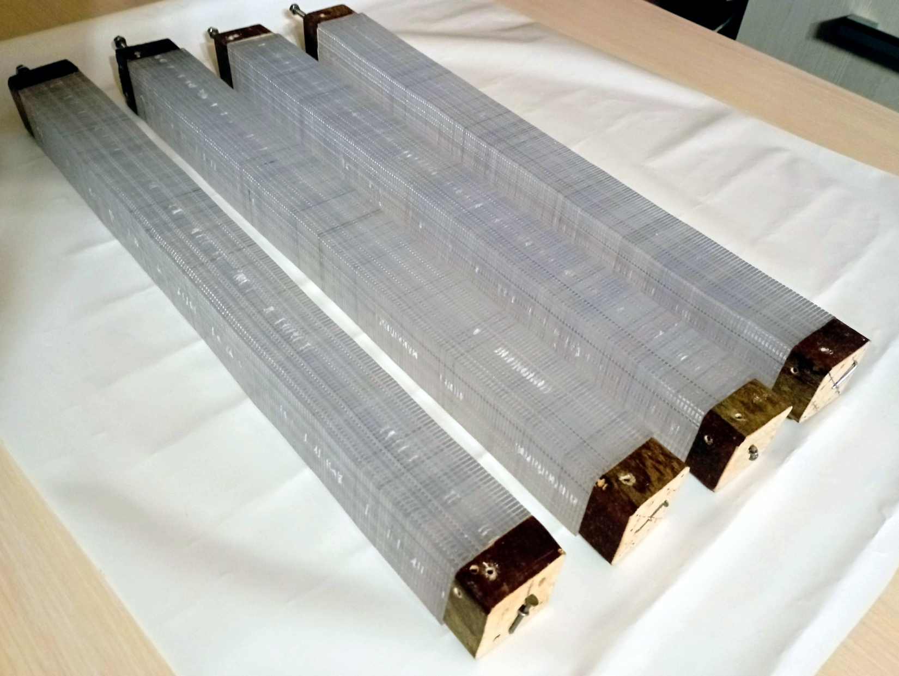
New Cells 40x40 – 200 layers
produced I Vladimir at February 2024
Scintillator plate:
40x40 mm
t=1.5+0.010
Gap – 0.055
---------------
100 plates – L=104 mm
200 plates – L= 416 mm

Slide 14
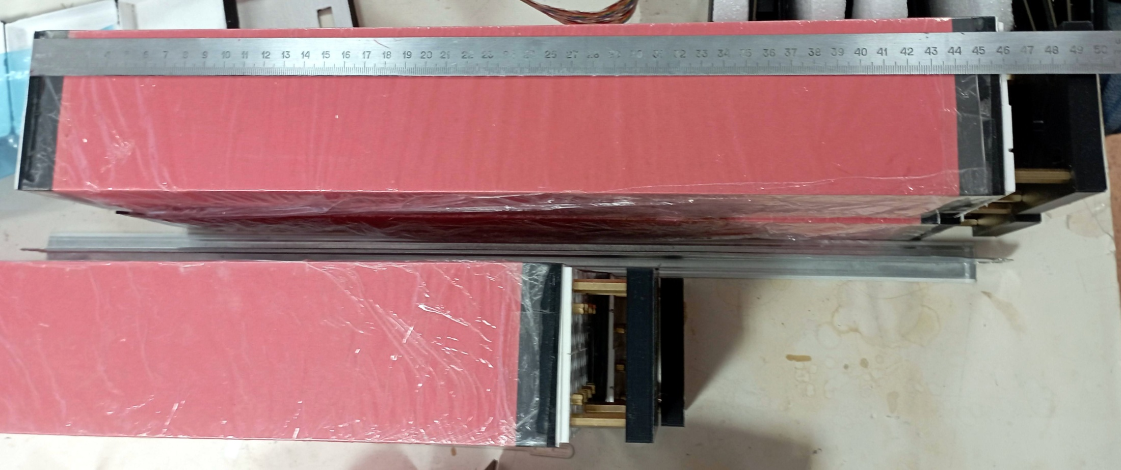
New 2 cells modules – 200 layers
produced in Protvino 2023 – MPD technologu
Total=500 mm without Readout Card & ADC
ECAL =460 mm , Absorber=420 mm

Slide 15
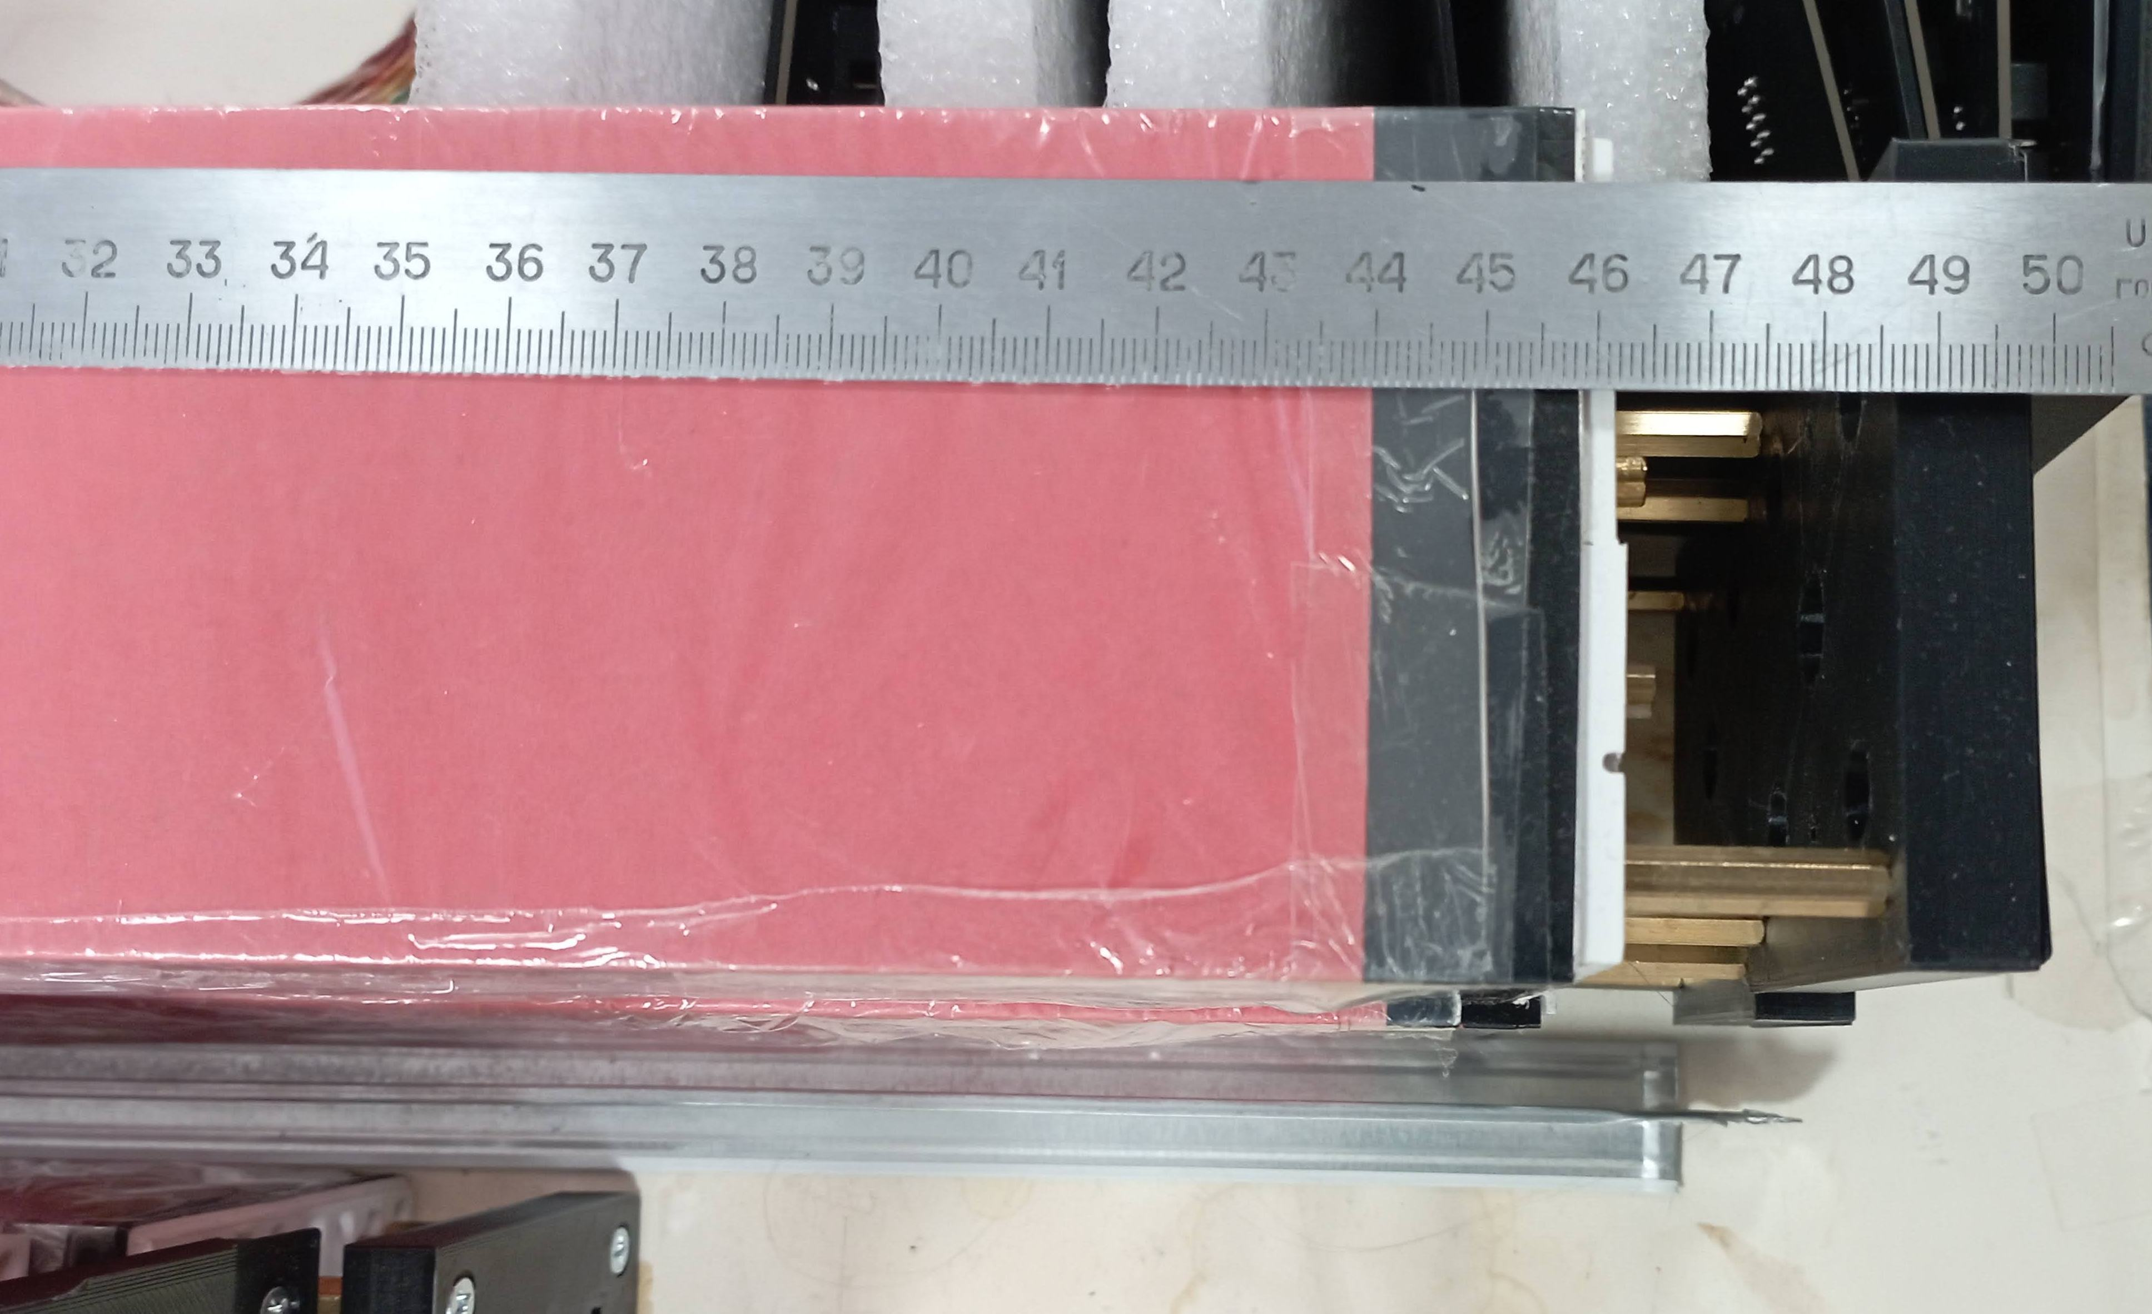
New 2 cells modules – 200 layers
produced in Protvino 2023 – MPD technology
Body=200 Layesr, L=460-20=440 mm

Slide 16
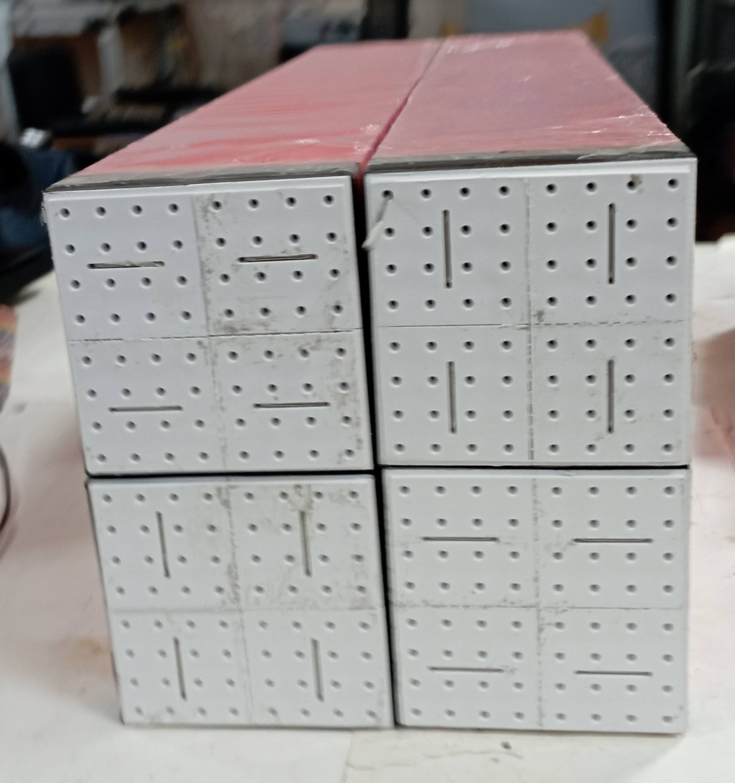
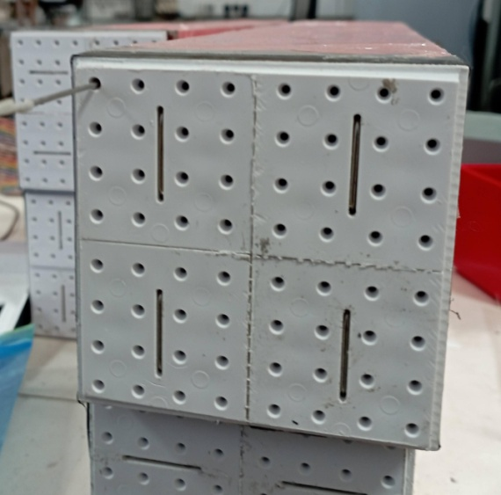
New 4 modules:
Single mod=80.2
Total 4 = 320.6
Single mod=80.2
4 cells 40x40

Slide 17
New 4 modules:
Single mod=80.2
Total 4 = 320.6
Single mod=80.2
4 cells 40x40

Slide 18
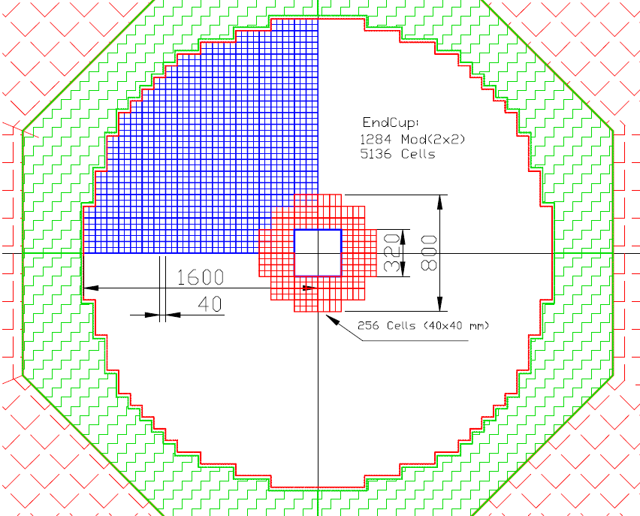
End Cup for SPD with new scintillator to be produced in 2024 via 256 cells of 40x40 mm²
This Figure shows in red 64 modules, consisting of 4 cells each (256 cells). The weight of this assembly is 597 kg. This will require 130 kg of polystyrene, 465 kg of lead, as well as additives: 1.95 kg of P-terphenyl and 65 g. POPOP, and 2000 meters WLS fiber type Y-11.
It is 1/20 part of End Cup and
taken time of 36 Days to prepared 51200 Stint. plates.
To read this setup, we need four ADC64 - 64-channel amplitude encoders, as well as 16 boards of 16-channel amplifiers and bias voltage regulators.

Slide 19
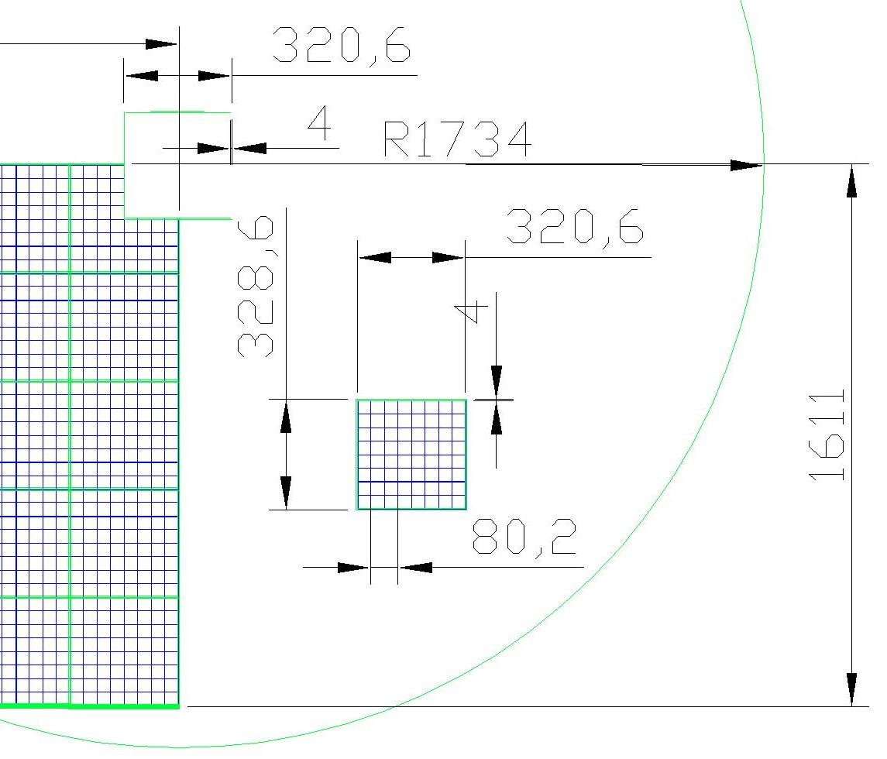
End Cup for SPD in Frame. Cells for 16=4x4 modules Border thick=4 mm Stainless steel

Slide 20
End Cup for SPD with new scintillator to be produced in 2024 via 256 cells of 40x40 mm²
Проверить влияние мертвых зон - перегородок на End Cup ? на энергетическое разрешение - константный член ? Расстояние от центра - 2010 мм от точки взаимодействия - до начала калориметра Перегородки - стенки коробов сталь 4 мм - образуют короба размером примерно 320х320 - рисунок в отдельном письме Энергии - 50 МэВ - 8 ГэВ Модуль - 4 ячейки - 80.2х80.2 мм (обернутый в 2 слоя бумаге). в короб вставляется 4 модуля - 16 ячеек 9каналов) Короб стальной - 4 мм стенка - нерж. сталь.

Slide 21
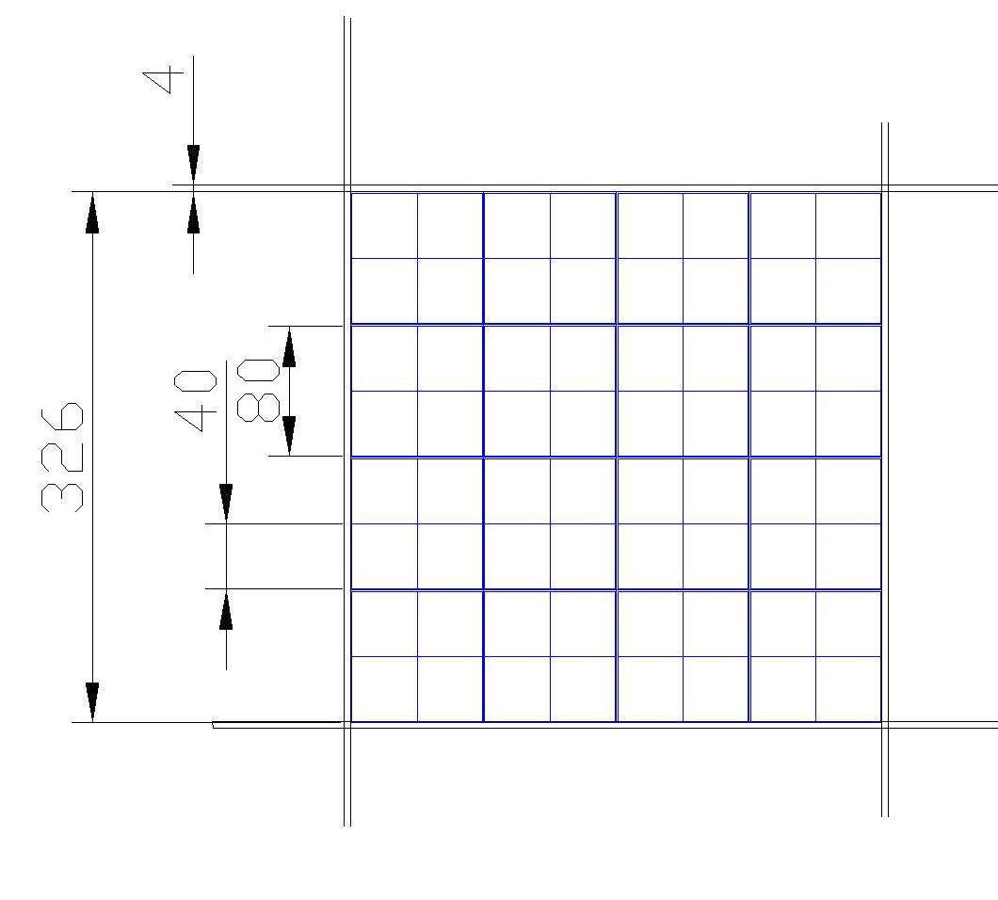
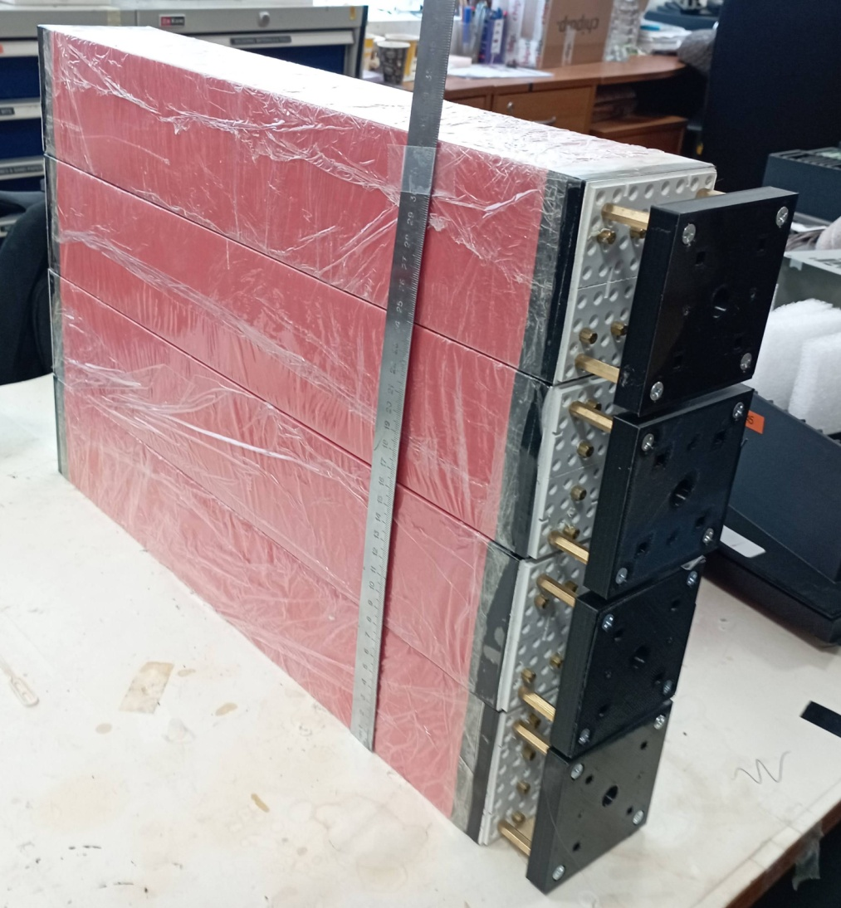
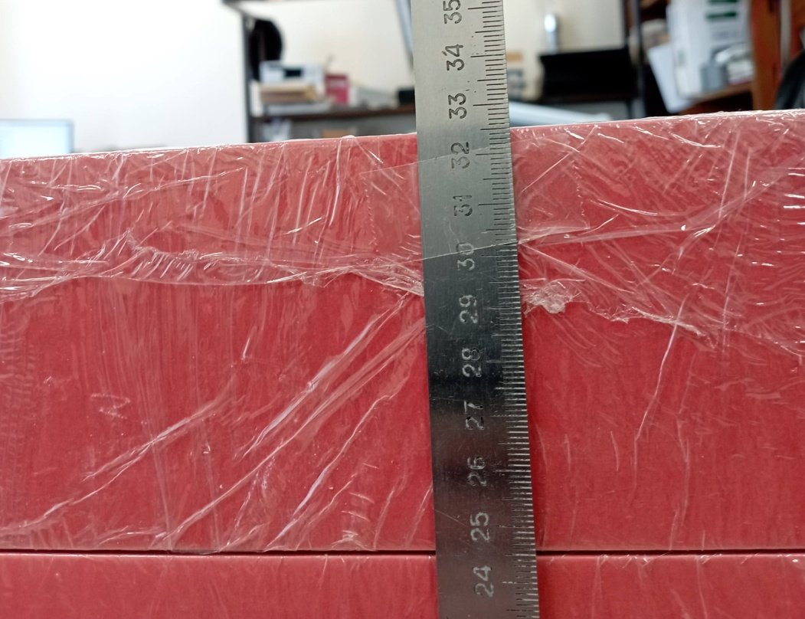
End Cup in frame/ Box 4x4 modules – 64 ch
Высота Короба из 4-х модулей 326 мм
Это – 8 границ , ширина которыз равнв 6/8 = 0.75 mm
Стенка короба – 4 мм , нерж.ст.

Slide 22
Conclusions
New ECAL geometry - corrected in 2024
Technical task for LHEP – preparation in progress
SiPm EQR 20-60 (20 mk pich) were studied soon
WLS Russian production 200 m has be studied soon
New ECAL setup with cell size 4x4 cm² assembled – 16 cells (4 modules)
ECAL test in cosmic rays was done with SiPm EQR15
Matrix form for new scintillator production should was ready in February 2924
New scintillator production for End Cup part - start soon: March 2024
Lead plates production – start in 2024 July
256 ECAL cells for End Cup (1/20 part) – should assembled in end of 2024
Oleg Gavrishuk, JINR, Dubna , Russia

