Slide 1
Forward Silicon Tracker (FSD) status
Oleg Tarasov on behalf of Forward Silicon Tracker team
12th Collaboration Meeting of the BM@N Experiment at the NICA Facility
May 13 – 17, 2024

Slide 2
Content of the report:
Diagnostics and elimination of defects in FSD-planes.
Coordinates of modules (Si-detectors) after disassembly-assembly of FSD-planes.
Refinment of FSD-planes positioning device in the BM@N experemental hall.
Conclusion.

Slide 3
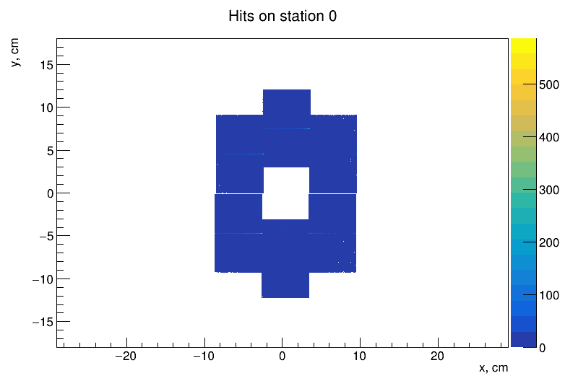
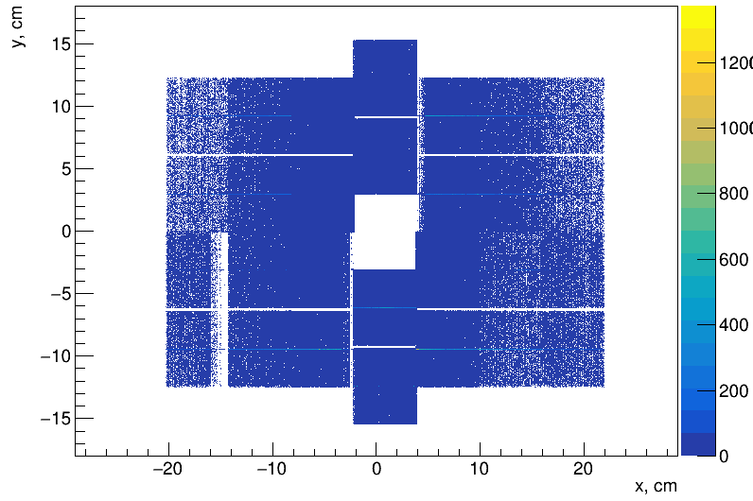
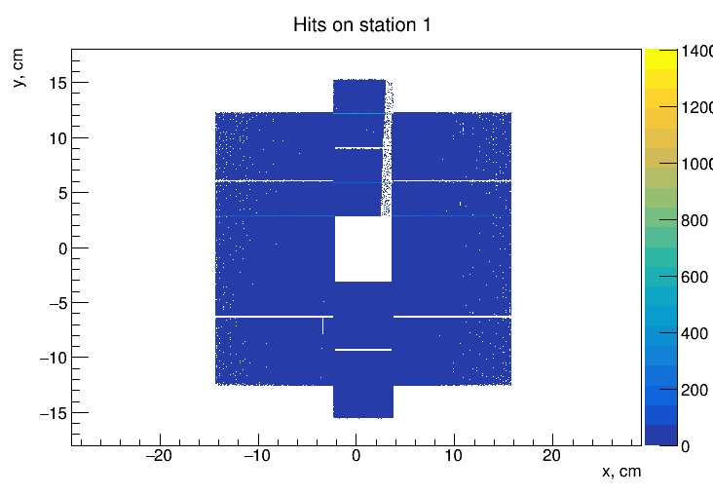
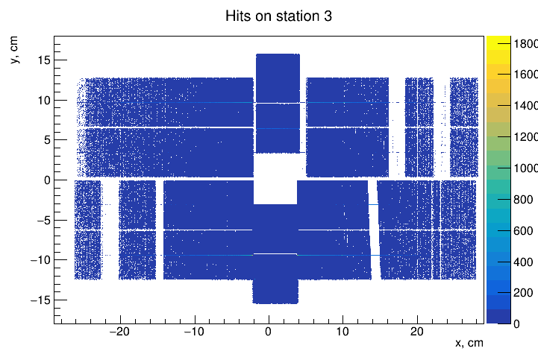
FSD: before replacing (Run 8305, 30.01.2023)
Hits on station 1
6 modules, DSSD 63×93 mm²
Hits on station 3
14 modules, DSSD 63×63 mm²
Run | 8305
Beam | Xe
Energy | 3.8 Gev/n
Target | Csl (2%)
Summary:
10 dead zones, 3 were discovered before the run and 7 occurred during the run
#14
#9
Module | Chip
#41 | 5Y
#14 | 5X
#9 | 5X
#39 | 1X
#19 | 5X
#13 | 4X, 5X
#17 | 4X, 5X
#12 | 4X, 5X
#5-21 | 5X
#23 | 4Y
Hits on station 2
10 modules, DSSD 63×63 mm²
Hits on station 4
18 modules, DSSD 63×63 mm²
#13
#17
#41
#39
#19
D.D. Chemezov
#12
#5-21
#23

Slide 4
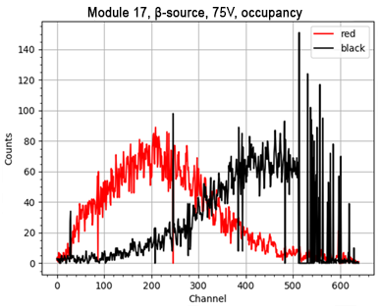
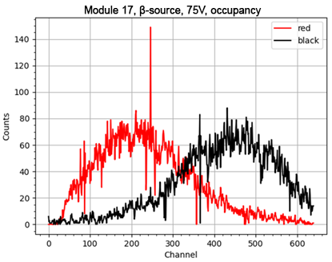
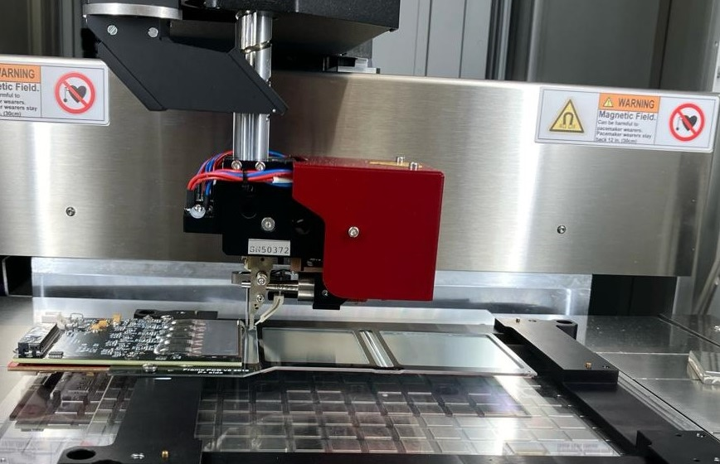
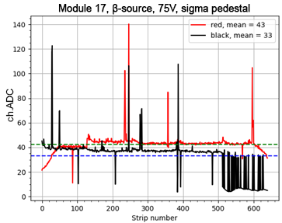
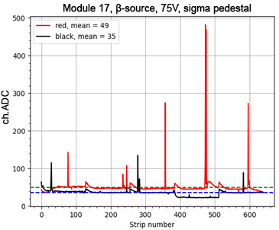
FEE board replacing
Mod #17
Mod #17
Bad zone Chip #5
To eliminate the dead zones it was necessary to assemble a new FEE board completely, 5 ASICs were spent to eliminate each of defects. The old boards were disconnected from the modules and replaced with a new ones. Total: 9 new black boards (p+ strips) were built, 45 VATAGP 7.2 ASICs were used (30 spare ASICs available).
Before replacement
After replacement
Yu.A. Kopylov; O.G. Tarasov

Slide 5
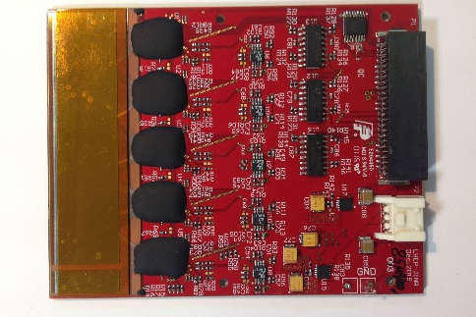
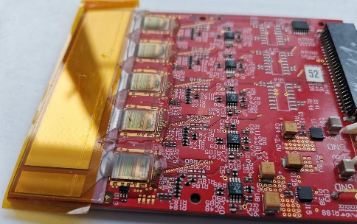
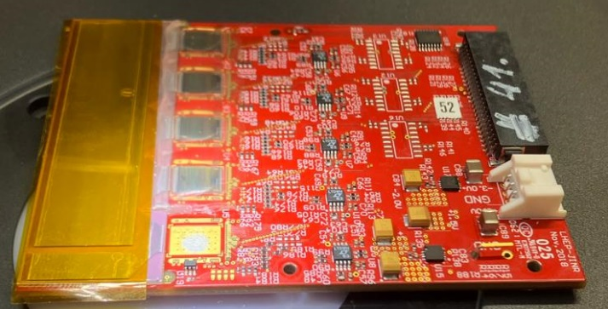
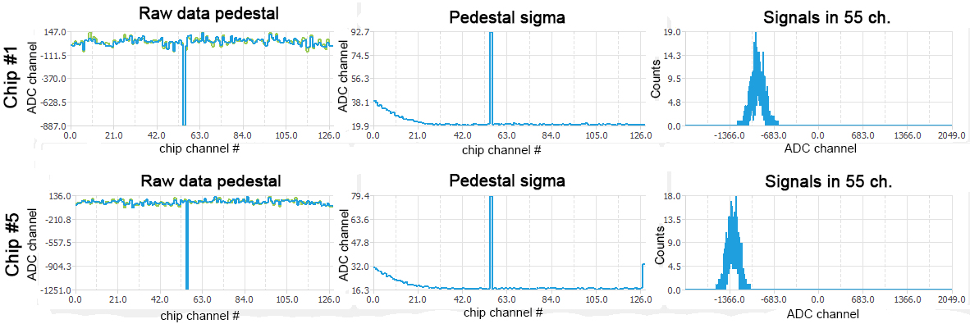
Repairable FEE boards with new compound
Black BE-08 encapsulant (polarization temperature 100℃)
an additional optical shield for chips
Not removable mechanically or with chemical solvents (dimethyl sulfoxide, dimethylformamide, CH₂O₂)
Ultra Light-Weld 9008 Flexible, UV-Curable Encapsulant
Does not create an additional optical shield
Can be mechanically removed so FEE boards are repairable
Replacement of one chip:
Before replacement
After replacement
removed chip
E.A. Streletskaia, Yu.A. Kopylov; O.G. Tarasov

Slide 6
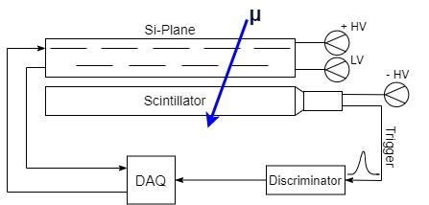
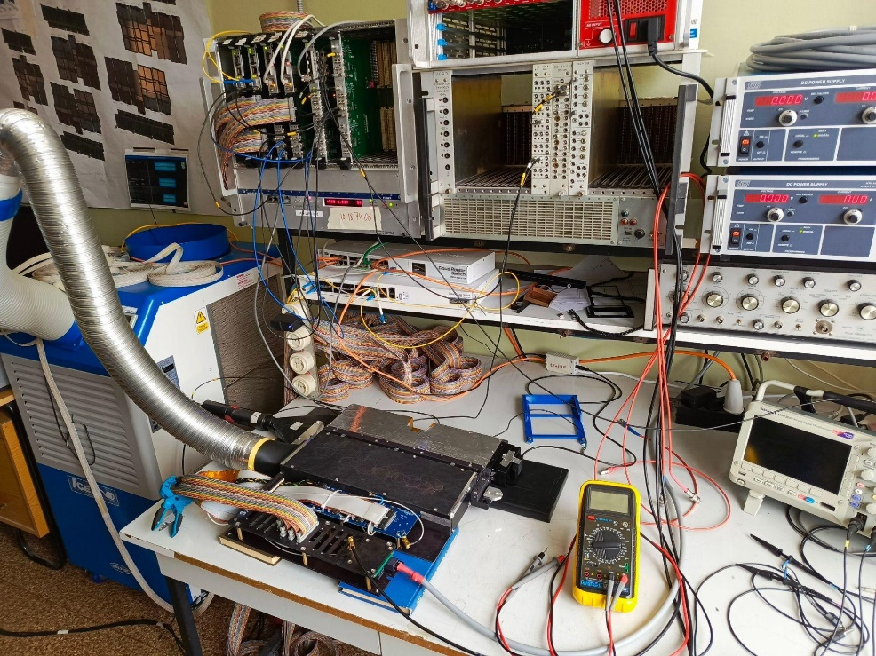
Cosmic tests of FSD
DAQ
Trigger signal discriminator
FUG (LV)
Caen (HV)
Dimensions:
Scintillator: 150x600 mm²
Station-1, half-plane: 93x180 mm²
Station-2, half-plane: 126x300 mm²
Station-3, half-plane: 126x420 mm²
Station-4, half-plane: 126x540mm²
Cooling system
Si-Plane
Scintillator
E.V. Martovitsky; S.V. Khabarov

Slide 7
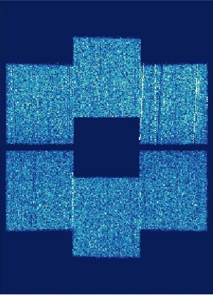
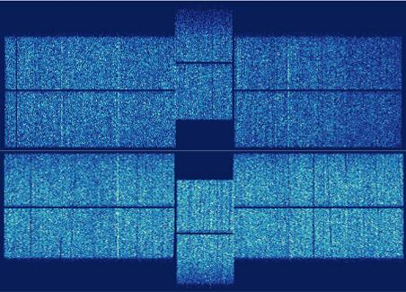
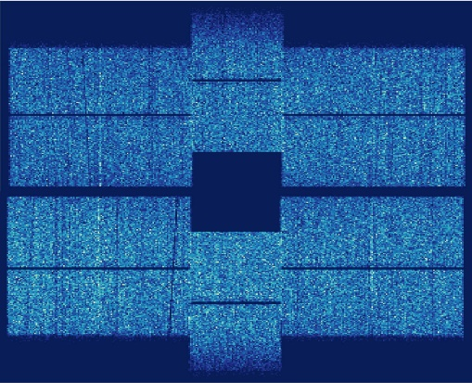
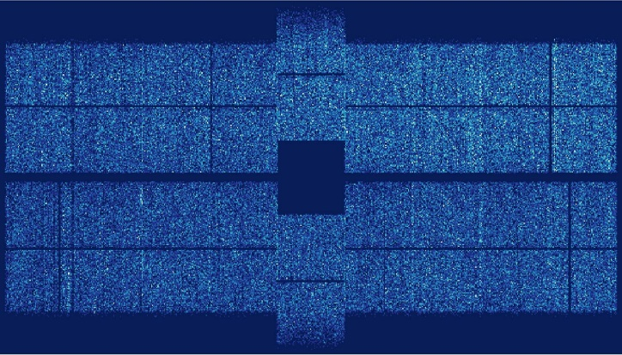
FSD: after replacing
Cosmic tests station 1
Cosmic tests station 3
Beam hole
93643 hit entries
165513 hit entries
111664 hit entries
All dead zones have been eliminated!
319725 hit entries
Cosmic tests station 2
Cosmic tests station 4
201548 hit entries
124789 hit entries
198035 hit entries
138624 hit entries
E.V. Martovitsky; D.D. Chemezov

Slide 8
#9/2
#7/2
#17
#13
#5/2
#1-20
#10-2017
#3/2
#37
#4-21
#19
#10
#21
#6-21
#20
#4-0/22
#24
#41
#2-21
#28
#6-0/22
#16
#22
#9-2017
#5-0/22
#34
#7
#39
0
1
0
2
3
1
2
4
0
3
5
6
1
2
4
5
7
0
1
3
6
8
2
4
beam
7
5
8
9
10
6
9
10
11
12
3
7
8
11
13
Repaired modules (10 pcs)
4
9
12
13
14
15
5
16
17
#11
#26
#29
#15
#23
#40
#32
#30
#31
#18
#27
#33
#9
#25
#1-0/22
#42
#38
#36
#9/1
#5-21
#2-0/22
#35
#7/1
#14
#12
#3-0/22
#5/1
#3/1
E.V. Zubarev
Station 1
Station 2
Station 3
Station 4

Slide 9
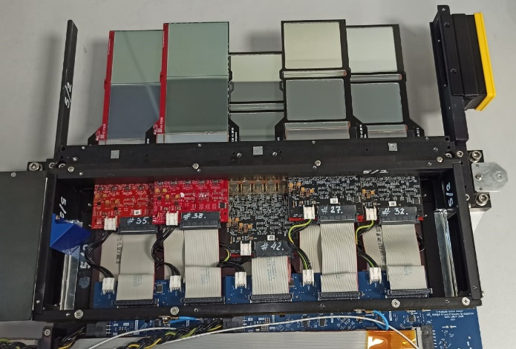
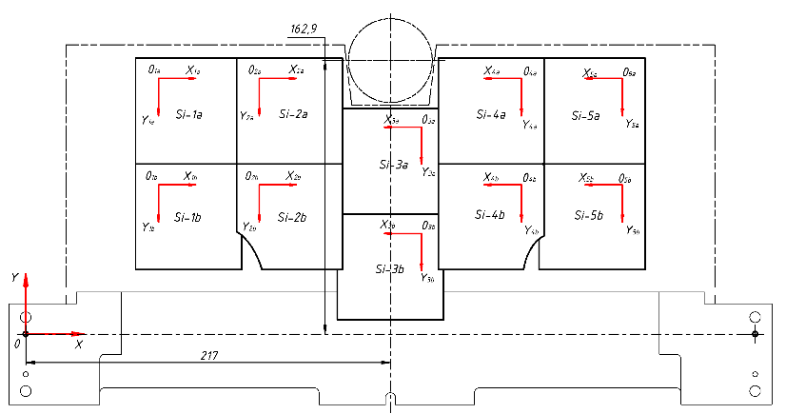
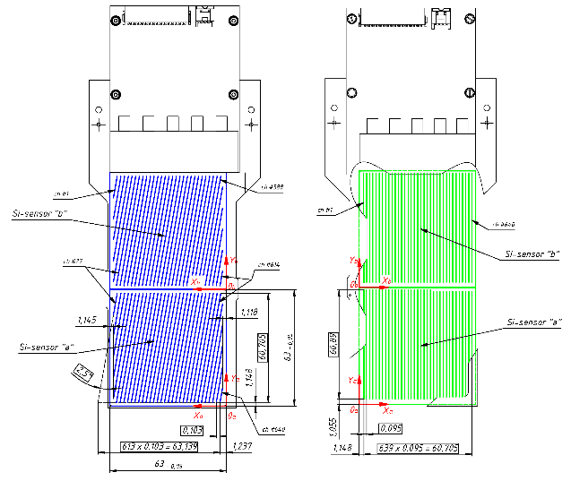
Coordinates of modules (Si-sensors) after disassembly-assembly FSD-planes.
Si-detectors
base bar
reference pin
reference pin
base surface
Position of Si-sensors in half-plane
# 5/2 (25.03.24) after repair
Difference in Si-sensors position data in half-plane # 5/2 (25.03.24 compared to 06.07.22)
Changing of Si-sensors positions after disassembly and reassembly does not exceed:
- 100 μ‎m for X-coordinate
- 50 μ‎m for Y-coordinate
Inclined strips side (N+)
Straight strip side (P+)
Sensor position | X±0.02* (mm) | Y±0.02* (mm) | Turn in 0XY plane (deg.)** | Z±0.2*** (mm) | Module serial number
Si-1a | 65.55 | 164.23 | -0.03 | 16.0 | #34
Si-1b | 65.59 | 101.25 | 0.01 | 15.7
Si-2a | 125.45 | 164.21 | 0.04 | 27.6 | #16
Si-2b | 125.55 | 101.26 | -0.01 | 27.6
Si-3a | 248.63 | 134.21 | -0.04 | 14.0 | #41 repair
Si-3b | 248.57 | 71.22 | -0.03 | 13.9
Si-4a | 308.42 | 164.24 | -0.01 | 25.8 | #24
Si-4b | 308.46 | 101.26 | 0.0 | 25.9
Si-5a | 368.64 | 164.25 | -0.06 | 14.2 | #21
Si-5b | 368.56 | 101.26 | -0.03 | 14.0
Sensor position | ΔX (mm) | ΔY (mm) | Changin of turn (deg.)** | ΔZ (mm) | Module serial number
Si-1a | -0.08 | -0.02 | 0.0 | 0.1 | #34
Si-1b | -0.05 | -0.01 | 0.0 | 0.0
Si-2a | -0.09 | -0.02 | 0.0 | 0.1 | #16
Si-2b | -0.06 | 0.0 | 0.0 | 0.1
Si-3a | -0.06 | -0.02 | -0.02 | -0.5 | #41 repair
Si-3b | -0.03 | -0.01 | 0.0 | -0.3
Si-4a | -0.08 | -0.01 | 0.0 | -0.3 | #24
Si-4b | -0.05 | 0.0 | 0.0 | -0.1
Si-5a | -0.07 | -0.02 | 0.01 | -0.2 | #21
Si-5b | -0.05 | -0.01 | 0.0 | -0.2
*-position of the origin point of the Si-sensors in the coordinate plane 0XY (tied to the outer reference pins).
**-the distance from the base surface of the base bar to the middle of the Si-sensors surface farthest from it.
E.V. Zubarev

Slide 10
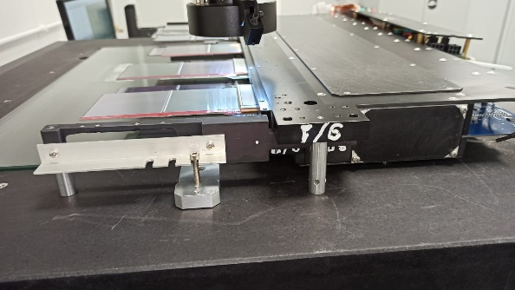
FSD: New coordinates of Si-sensors in the plane
Position of Si-sensors in plane
# 5/2 (25.03.24) after repair
Position of Si-sensors in plane
# 7/1 (27.03.24) after repair
Position of Si-sensors in plane
# 9/1 (10.04.24) after repair
Position of Si-sensors in plane
# 9/2 (17.04.24) after repair
Sensor position | X±0.02* (mm) | Y±0.02* (mm) | Turn in 0XY plane (deg.)** | Z±0.2*** (mm) | Module serial number
Si-1a | 65.55 | 164.23 | -0.03 | 16.0 | #34
Si-1b | 65.59 | 101.25 | 0.01 | 15.7
Si-2a | 125.45 | 164.21 | 0.04 | 27.6 | #16
Si-2b | 125.55 | 101.26 | -0.01 | 27.6
Si-3a | 248.63 | 134.21 | -0.04 | 14.0 | #41 repair
Si-3b | 248.57 | 71.22 | -0.03 | 13.9
Si-4a | 308.42 | 164.24 | -0.01 | 25.8 | #24
Si-4b | 308.46 | 101.26 | 0.0 | 25.9
Si-5a | 368.64 | 164.25 | -0.06 | 14.2 | #21
Si-5b | 368.56 | 101.26 | -0.03 | 14.0
Sensor position | X±0.02* (mm) | Y±0.02* (mm) | Turn in 0XY plane (deg.)** | Z±0.2*** (mm) | Module serial number
Si-1a | 65.47 | 164.14 | 0.03 | 28.6 | #14 repair
Si-1b | 65.48 | 101.11 | 0.04 | 28.0
Si-2a | 125.39 | 164.27 | 0.06 | 16.2 | #36
Si-2b | 125.48 | 101.29 | 0.05 | 15.8
Si-3a | 185.42 | 164.13 | 0.05 | 28.0 | #9 repair
Si-3b | 185.47 | 101.12 | 0.04 | 27.8
Si-4a | 308.46 | 134.28 | -0.04 | 14.2 | #33
Si-4b | 308.41 | 71.31 | 0.03 | 14.0
Si-5a | 368.43 | 164.21 | 0 | 25.8 | #30
Si-5b | 368.41 | 101.21 | 0.02 | 26.1
Si-6a | 428.48 | 164.27 | -0.02 | 14.5 | #15
Si-6b | 428.46 | 101.27 | -0.01 | 14.2
Si-7a | 488.57 | 164.18 | -0.06 | 25.7 | #29
Si-7b | 488.50 | 101.18 | -0.06 | 26.0
Sensor position | X±0.03* (mm) | Y±0.05* (mm) | Turn in 0XY plane (deg.)** | Z±0.2*** (mm) | Module serial number
Si-1a | 65.46 | 164.28 | 0.03 | 15.0 | #12 repair
Si-1b | 65.59 | 101.21 | 0.05 | 15.3
Si-2a | 125.48 | 164.31 | 0.04 | 26.4 | #5-21 repair
Si-2b | 125.56 | 101.18 | 0.02 | 27.2
Si-3a | 185.54 | 164.36 | 0.01 | 15.2 | #25
Si-3b | 185.60 | 101.35 | 0.00 | 15.3
Si-4a | 245.39 | 164.34 | 0.06 | 26.7 | #18
Si-4b | 245.50 | 101.13 | 0.06 | 27.2
Si-5a | 368.46 | 134.37 | -0.02 | 14.4 | #31
Si-5b | 368.48 | 71.37 | 0.01 | 14.0
Si-6a | 428.42 | 164.35 | 0.00 | 25.8 | #40
Si-6b | 428.48 | 101.35 | 0.01 | 25.9
Si-7a | 488.61 | 164.35 | -0.03 | 13.7 | #23 repair
Si-7b | 488.59 | 101.34 | -0.05 | 13.7
Si-8a | 548.45 | 164.37 | 0.01 | 25.7 | #26
Si-8b | 548.49 | 101.38 | 0.01 | 25.8
Si-9a | 608.60 | 164.32 | -0.04 | 14.7 | #11
Si-9b | 608.60 | 101.29 | -0.02 | 14.3
Sensor position | X±0.03* (mm) | Y±0.05* (mm) | Turn in 0XY plane (deg.)** | Z±0.2*** (mm) | Module serial number
Si-1a | 65.58 | 164.27 | 0.01 | 16.2 | #39 repair
Si-1b | 65.59 | 101.28 | 0 | 15.8
Si-2a | 125.45 | 164.23 | 0.05 | 27.2 | #9-2017
Si-2b | 125.49 | 101.11 | 0.04 | 27.4
Si-3a | 185.41 | 164.22 | 0.07 | 16.2 | #28
Si-3b | 185.49 | 101.22 | 0.06 | 15.9
Si-4a | 245.51 | 164.29 | 0.03 | 27.8 | #20
Si-4b | 245.53 | 101.28 | 0.01 | 27.7
Si-5a | 368.44 | 134.32 | 0.01 | 14.1 | #10
Si-5b | 368.43 | 71.32 | 0.02 | 13.9
Si-6a | 429.39 | 164.32 | 0.01 | 26.5 | #19 repair
Si-6b | 428.39 | 101.33 | 0.02 | 26.2
Si-7a | 488.58 | 164.31 | -0.06 | 14.5 | #10-2017
Si-7b | 488.51 | 101.30 | -0.04 | 14.2
Si-8a | 548.50 | 164.31 | -0.01 | 25.9 | #13 repair
Si-8b | 548.47 | 101.29 | -0.01 | 25.9
Si-9a | 608.62 | 164.29 | -0.07 | 14.2 | #17 repair
Si-9b | 608.54 | 101.28 | -0.04 | 14.0
Measurement of Si-detectors position coordinates in 2024y were carried out on a new tooling for plane fixation on the table of video-measuring microscope "NORGAU" NVM II-5040D (3 points of support).
- New coordinates were entered into the data table for positions of detectors in FSD-planes
E.V. Zubarev

Slide 11
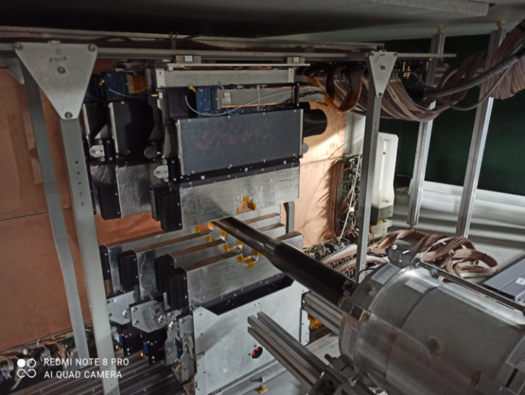
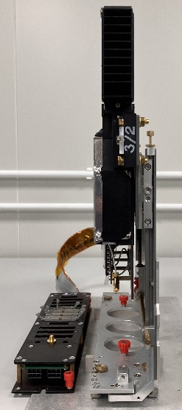
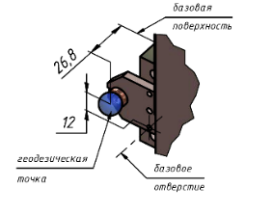
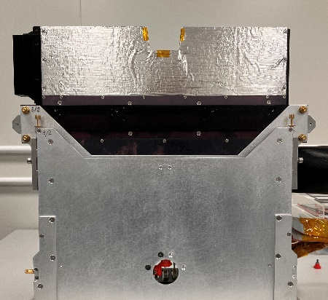
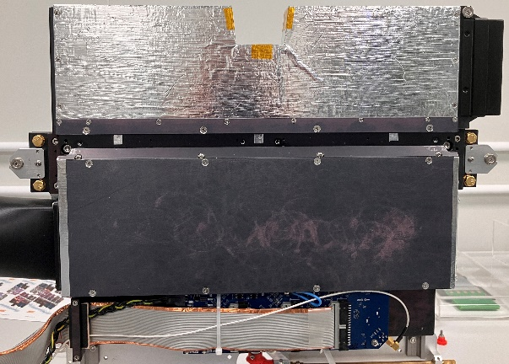
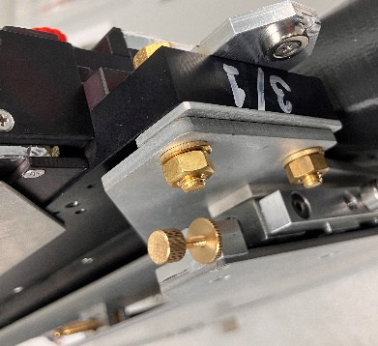
Refinement of FSD-planes positioning device in the BM@N experemental hall.
Y
Z
Y
X
Adjustment shims to eliminate plane rotation around the Y axis.
(2022 Xe-run:
∠= 0,11° ÷ 0,74°)
Added a 3rd geodetic marker to control the inclination of the plane around the X axis
Z
Z
Y
X
Screws to eliminate rotation of the plane around the Z-axis
(2022 Xe-run:
∠= 0,11° ÷ 0,22°)
X
E.V. Zubarev

Slide 12
Conclusion
Eliminated defects in FSD-planes, all defects were related to FEE-chips failures. At the end of Xe-run (February 2023) number of problematic chips were 2,7% (from 480 pC.), at the moment - 0%.
FSD-planes are ready to installation and alignment in BM@N experimental hall .
True coodrinates of Si-detectors in FSD half-planes after disassembly-assembly during defects repair were measured with accuracy ± 50μ‎m.
Refined FSD-planes positioning devices for alignment in BM@N experimental hall (added a 3-rd geodetic marker).

Slide 13
Thank you for your attention!

Slide 14
Additional slides

Slide 15
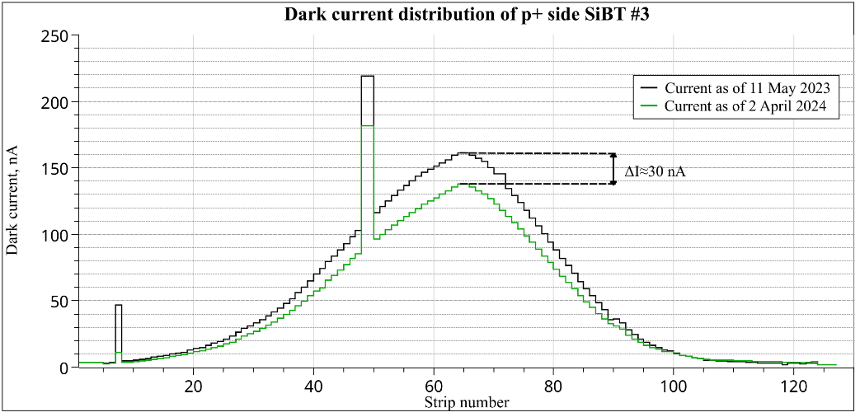
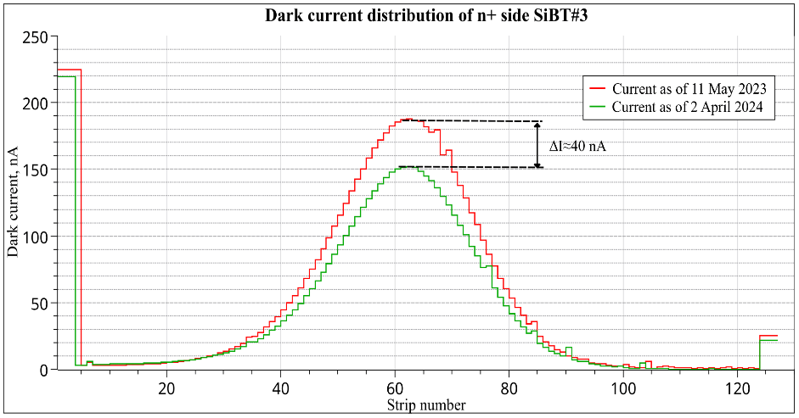
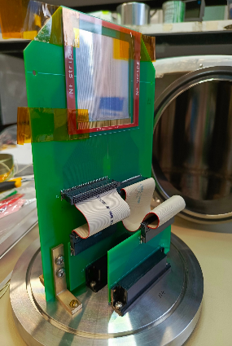
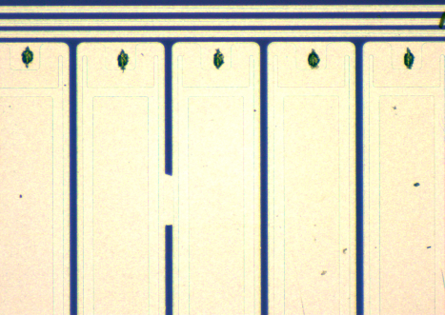
SiBT station #3 status
49 and 50th strips are shorted out on the detector. Irreparable defect
 | I_{max}, nA | I_{Σ}, μA
May 2023 | 182 | 7.1
April 2024 | 219 | 5.9
Delta | ≈40 | 1.2
There was no contact on the connector. The defect was eliminated by cleaning the connectors
#49
#50

Slide 16
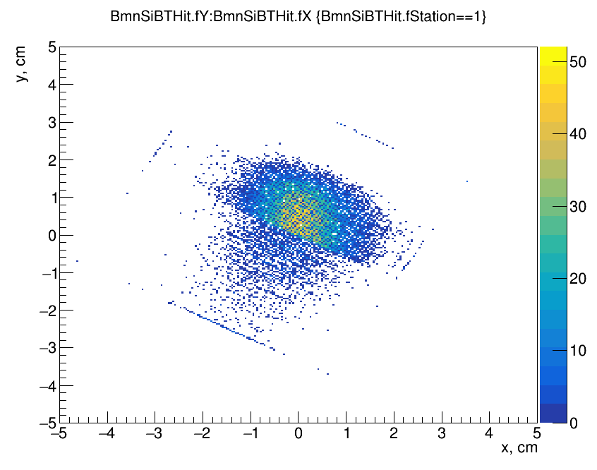
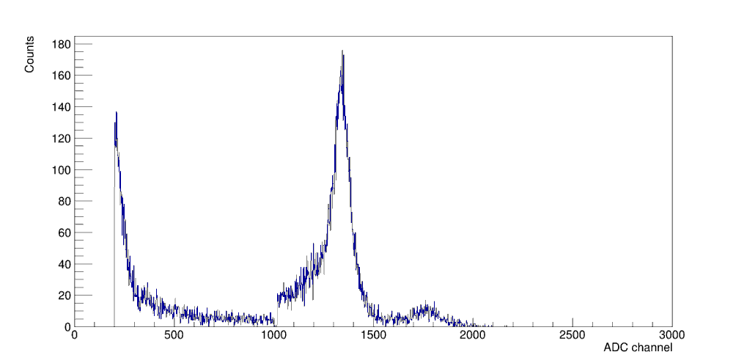
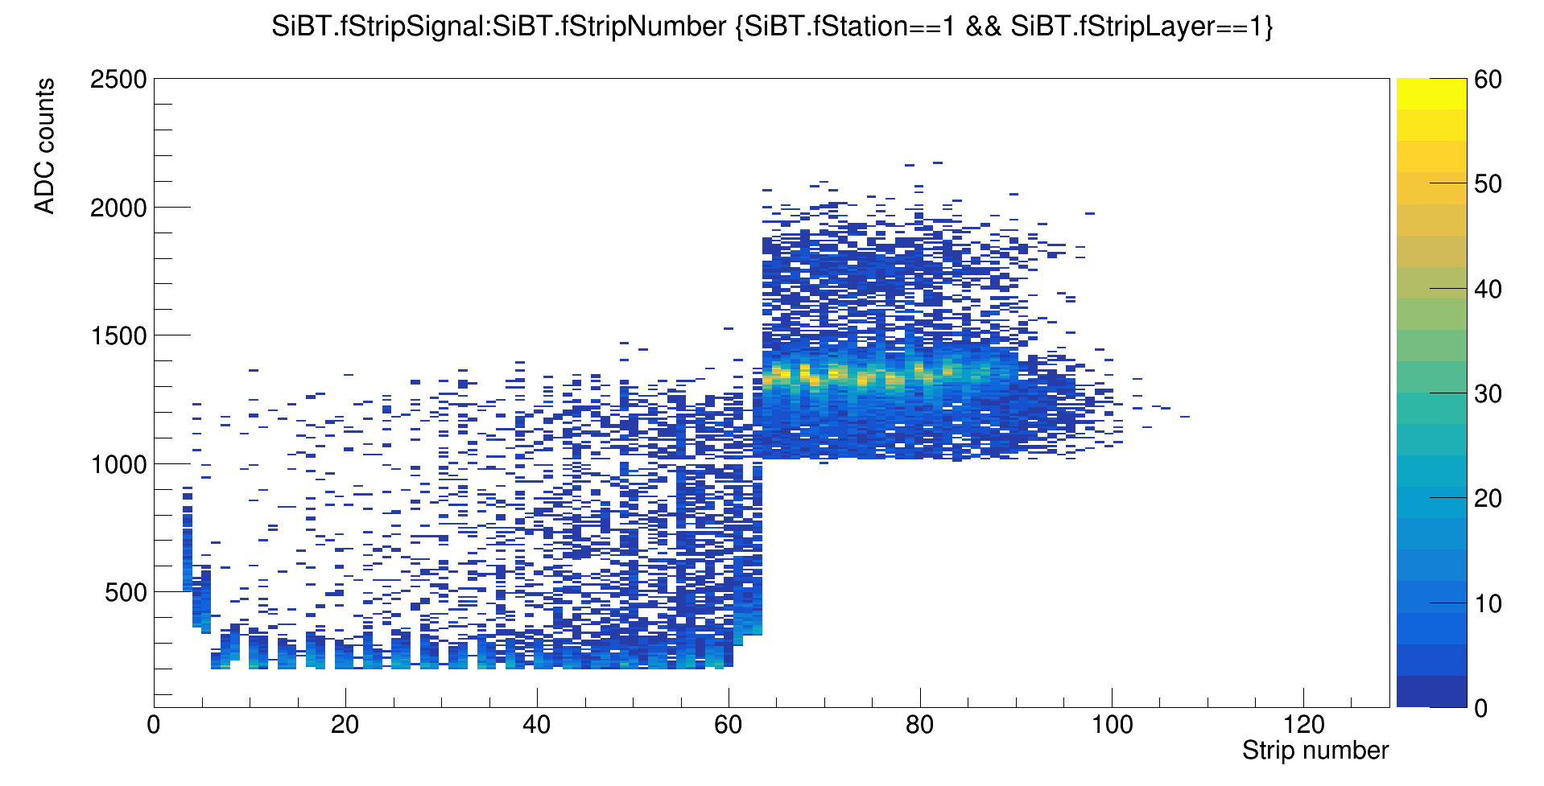
SiBT FEE during Xe-run
Hit plot SiBT #2
This slide shows SiBT FEE operation in XE-run on example of SiBT #2 (run 8387, 1.02.2023). The gains of FEE-chips on n+ side were not tuned for signals on the order of 10.9 pC (energy losses of Xe with energy 3.8 GeV/n are 245.5 MeV). Because of this signals from one of FEE-chips were below th threshold and were not written (in this case – chip 1 (channels 0 – 63)
Chip 1
Chip 2
Chip 1 (0-63 ch.)
pileups
Chip 2 (64-127 ch.)
Amplitude distribution (SiBT #2 n+ side)
Channel distribution of amplitudes (SiBT #2 n+ side)
Notes:
На этом слайде показано почему в течение сеанса на бим трекерах «отваливались» чипы. Правая верхняя картинка – распределение сигналов с каждого из стрипов. Можно видеть, что первые 64 канала (первый чип) почти полностью обрезан порогом. Те полосы, которые остались на графике – временные наложения разных событий. Основная часть сигнала должна была бы быть в области ниже 300 отсчётов АЦП, но это значение «попало за порог».
Нижняя правая картинка – амплитудный спектр для того же трекера. Можно видеть в начале правый хвост Ландау-распределения сигналов с первого чипа (который обрезан), по центру – Ландау для второго чипа. Маленький пик справа обусловлен временными наложениями.
На левой нижней картинке показано распределение координат попадания ксенона в бим трекер. Половина «отвалилась» - загрузка значительно меньше, чем у другой половины

Slide 17
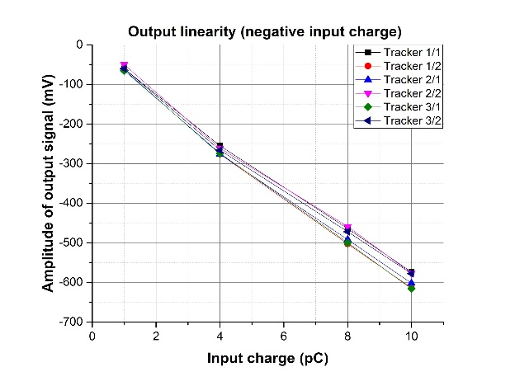
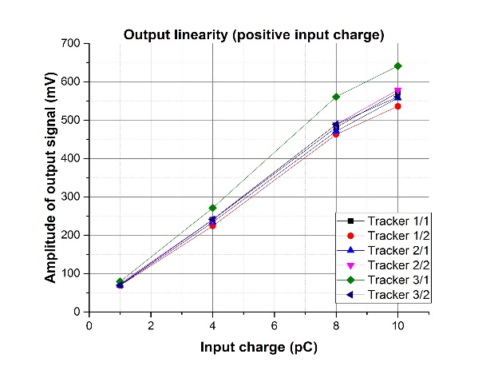
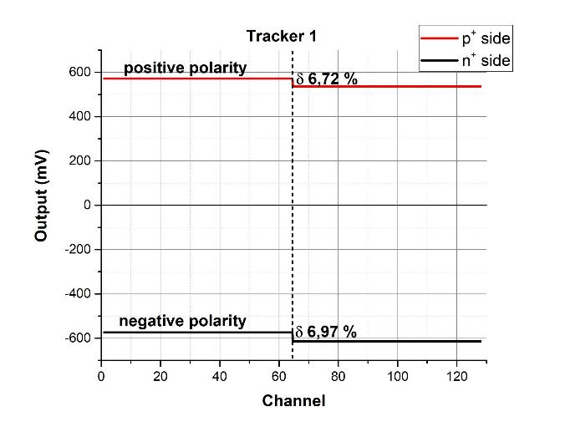
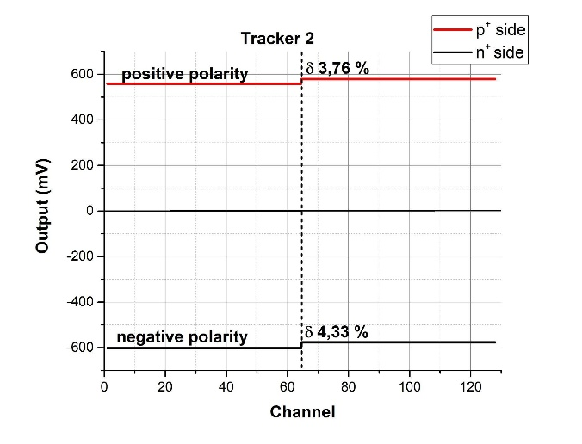
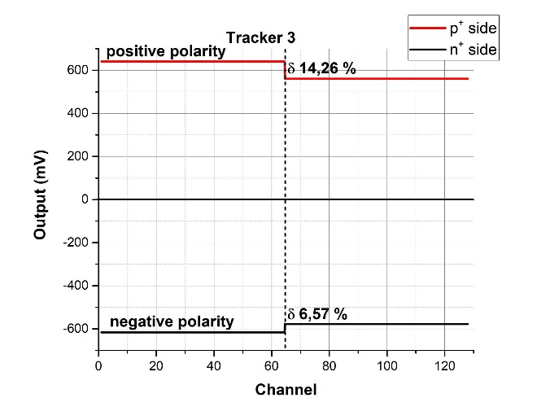
SiBT FEE status
Linearity of ASICs after PCB tuning (t_{s}=240 nS)
The gain spread of ASICs (input 10 pC, t_{s}=240 ns+120 ns)

Slide 18
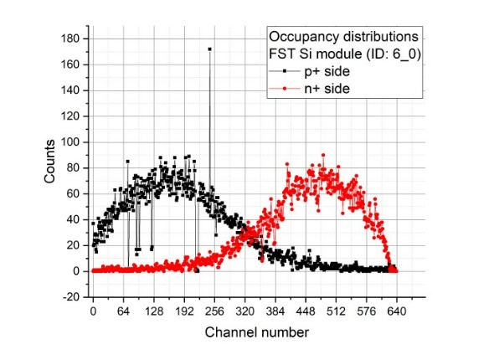
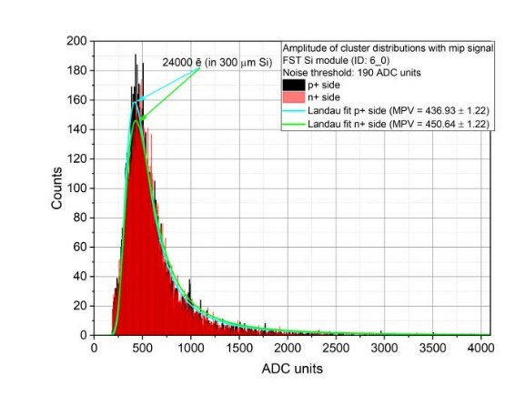
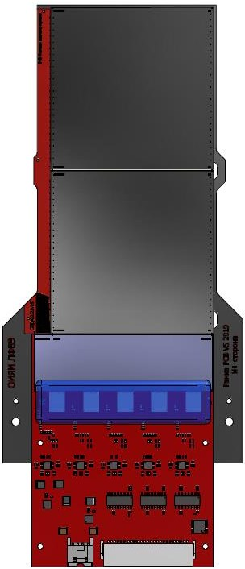
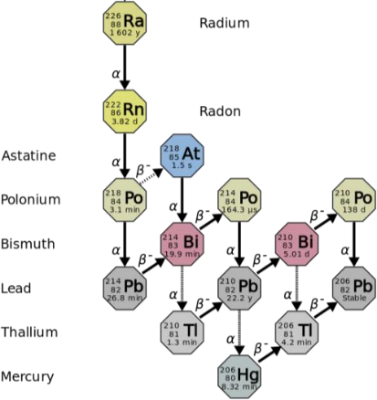
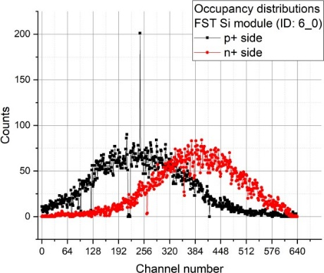
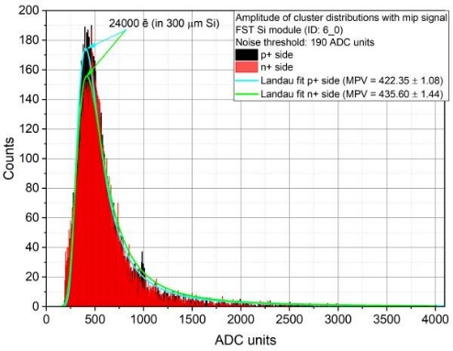
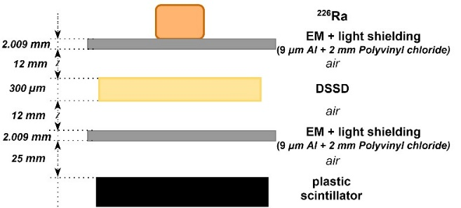
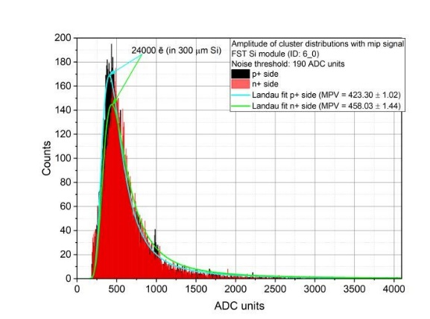
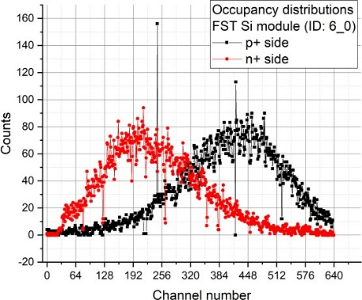
FST Si module test results
1
1
RA source positions
1 2 3
HV = 75 V; T = 17 ⁰C
639
0
n+ side p+ side
0
639
2
2
Electron end-point energy up to 3.27 MeV (²¹⁴𝐵𝑖)
HV = 75 V; T = 17 ⁰C
83
3
Measurement with RA source cross-section
(trigger rate: 150 Hz)
3
Ufd = 30 V
Module ID | <ENCp+> ē RMS | <ENCn+> ē RMS | SNR p+ side | SNR n+ side | Bad channels ratio, %
6_0 | 1963.60 | 2 237.88 | 12.22 | 10.72 | 1.25
HV = 75 V; T = 17 ⁰C
17

Slide 19
Измерения положения Si-детекторов в модулях и плоскостях проводились на бесконтактном видеоизмерительном микроскопе «NORGAU» NVM II-5040D.
видеоизмерительный микроскоп
«NORGAU» NVM II-5040D
Диапазон перемещений по осям X и Y (мм) | 500 х 400
Диапазон перемещений по оси Z (мм) | 250
Допускаемая абсолютная погрешность линейных измерений по осям X и Y (мкм)* | ±(2.5+L/200)
Допускаемая абсолютная погрешность линейных измерений по оси Z (мкм)* | ±(2.5+L/100)
* L –измеряемая длина в мм
стол оператора
измеряемый объект
объектив
Si #1
предметный стол
измеряемый объект
(плоскость из 5 модулей)
Si #2
Топологические знаки на детекторе можно использовать в качестве реперов
реперный крест детектора
отсутствие сварки

Slide 20
Beam profilometer is necessary for beam tuning (alignment of the center beam with the center of the target)
Beam profilometer upgrade
working position
detector: DSSD, (128p⁺×128n⁺), strips pitch = 475 μm, thickness (Si) -175 μm, active area (61 × 61) mm². Strips are combined in pairs on detector board. Total have (64p⁺×64n⁺), pitch = 950 μm
mechanical design: the plane of the profilometer is automatically removed from the beam zone to the parking position
FEE based on two VA32HDR11 ASICs. Total number of channels are 64 for X and 64 for Y coordinate. Dynamic range
-35pC - +25pC. Peaking time 800ns. Self trigger
mode based on TA32cg2 ASICs
current status:
FEE have been designed, manufactured and tested.
Next step is testing FEE with Si detector placed in
flanges with alpha-source (5.5 MeV) and
standalone DAQ subsystem.
Beam tracker Cross-board
Beam profilometer
standalone DAQ
New readout electronics for beam profilometer

