Slide 1
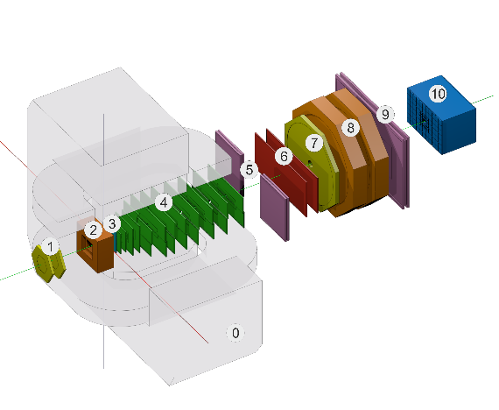
Production of the Configuration Information system for the BM@N experiment
E. Alexandrov¹, I. Alexandrov¹, A. Chebotov¹, I.Filozova¹, K.Gertsenberger¹, D.Priakhina¹, I.Romanov¹, G.Shestakova¹, A. Yakovlev¹
¹JINR, Dubna
12th Collaboration Meeting of the BM@N Experiment at the NICA Facility, Almaty, 12-18 May, 2024
Joint Institute for Nuclear Research

Slide 2
Possibilities
keeps in databases all setup data
can start, stop and monitor setup tasks during experiment runs
can use web interface to supports data bases and operations with setup tasks
Notes:
set of various configuration hardware parameters
required for setting the detectors into operation modes (like working voltage)

Slide 3
BM@N Information System and online processes diagram

Slide 4
BM@N Configuration Information System and online processes diagram
bmn-config-he.jinr
bmn-config-w1-he.jinr
bmn-config-he.jinr
bmn-config-he.jinr

Slide 5
Online Event Display

Slide 6
Online histograming

Slide 7
Online GEM Silicon statistics

Slide 8
WEB: BM@N Configuration Manager panel.
Online processes to be controlled by Configuration manager

Slide 9
Example of task view

Slide 10
Example of task view (zoomed)

Slide 11
Web-interface. Configuration Manager and Task Monitor panels

Slide 12
Upgrades of the Configuration Information System
Configuration manager
conversion from DB data to DDS topology fixes
error handling improvements
significant log service improvements
DB upgrades (2 new tables in use)
Web Configuration manager
added Configuration manager panel (not in production, to be finished)

Slide 13
Configuration manager log states

Slide 14
Configuration manager log in DB

Slide 15
Configuration manager log view

Slide 16
WEB: Configuration manager log

Slide 17
WEB: Configuration manager log

Slide 18
Next steps
to have in WEB
session log that is still running
agent log
Configuration manager log panel
to be finished
add messages status filter
add Grafana monitoring in order to set alarms in case of problem
moving to use REST API in all public communications

