Slide 1
Review of methods for measuring collective flow and global polarization of Λ hyperons
Troshin V.^{1,2},Parfenov P.^{1,2}, Taranenko A.^{1,2}
(1- JINR, 2 - MEPhI)
12th Collaboration Meeting of the BM@N Experiment at the NICA Facility

Slide 2
Outline
Introduction
Anisotropic flow and global polarization measurements
Track crossing
Reconstructed efficiency
Radial distance asymmetry
Detector occupancy
Summary

Slide 3
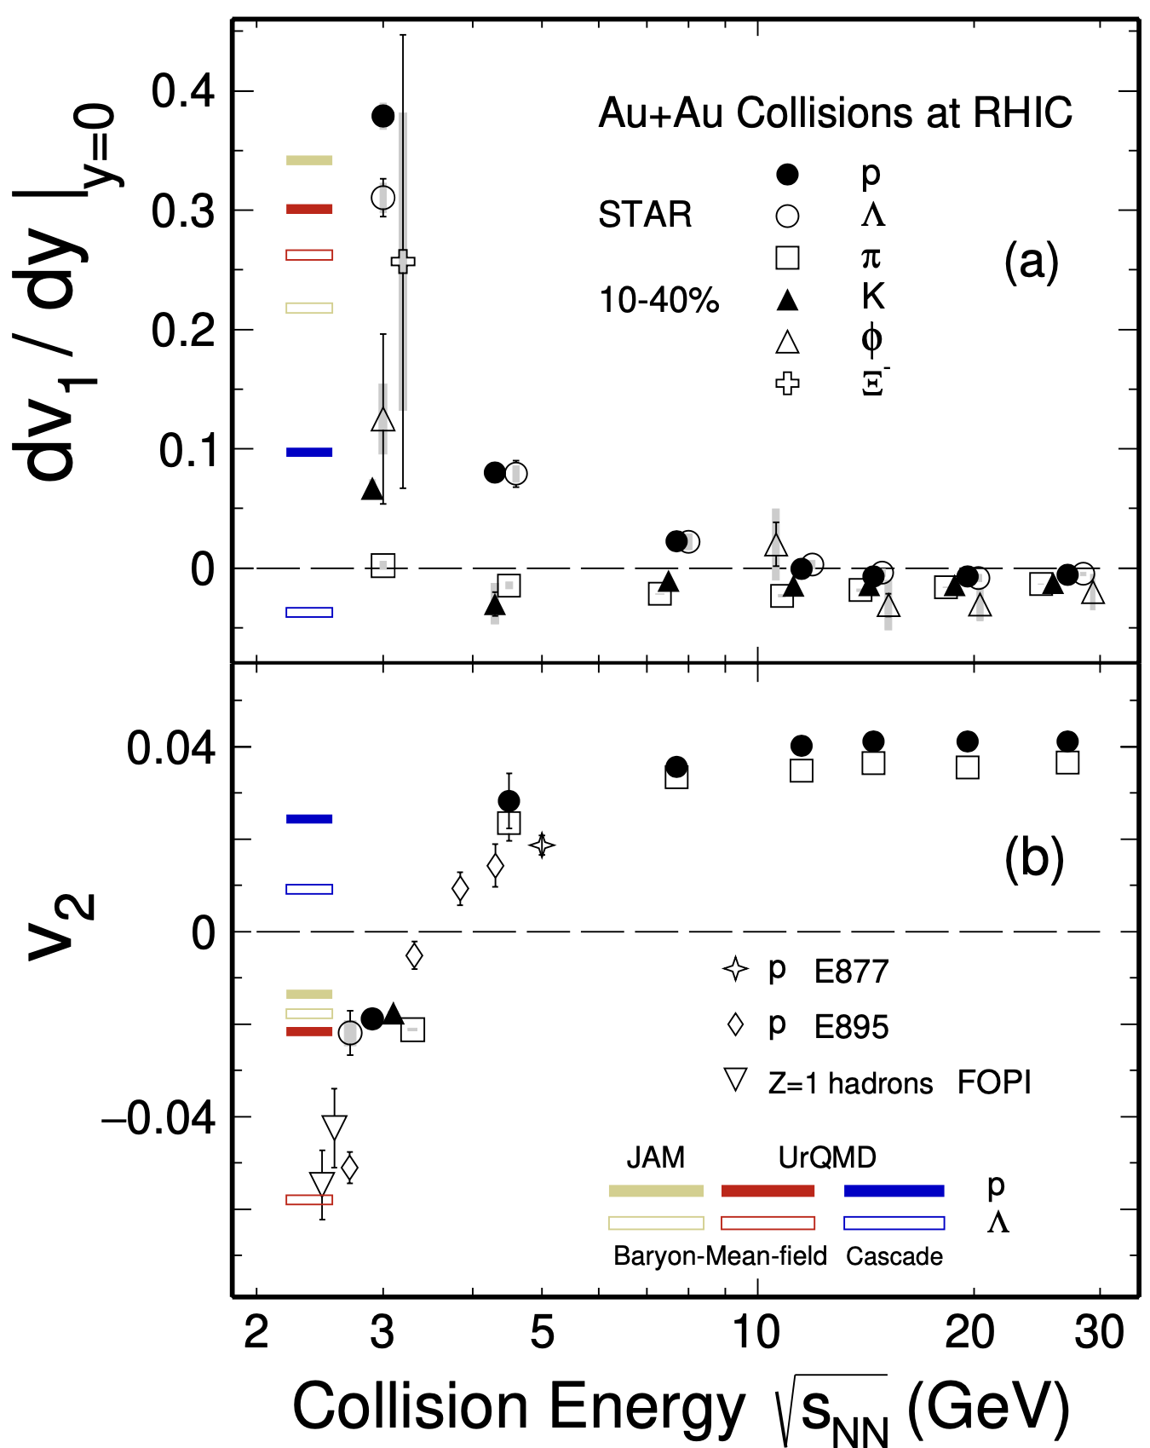
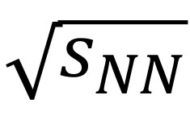
Anisotropic transverse flow in heavy-ion collisions at Nuclotron-NICA energies
Strong energy dependence of dv₁/dy and v₂ at SNN =4-11 GeV.
Anisotropic flow at FAIR/NICA energies is a delicate balance between:
The ability of pressure developed early in the reaction zone
Long passage time (strong shadowing by spectators).
Differential flow measurements v_{n}( SNN , centrality, pid, p_{T}, y) will help to study:
effects of collective (radial) expansion on anisotropic flow
interaction between collision spectators and produced matter
baryon number transport
Several experiments (MPD, BM@N, STAR FXT, CBM, HADES, NA61/SHINE) aim to study properties of the strongly-interacted matter in this energy region.
BM@N
CBM
MPD
M. Abdallah et al. [STAR Collaboration] 2108.00908 [nucl-ex]

Slide 4
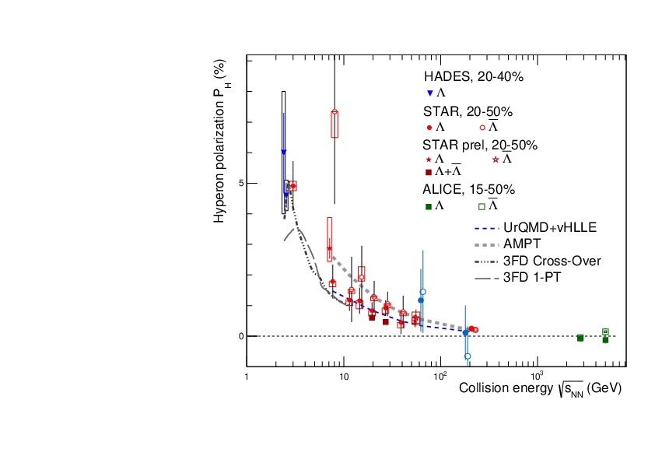
Global Polarization at Nuclotron-NICA energies
Predicted and observed global polarization signals rise as the collision energy is reduced:
NICA energy range will provide new insight
- splitting of global polarization
Comparison of models, detailed study of energy and kinematical dependences, improving precision
Probing the vortical structure using various observables
BM@N
MPD
S. Singha, EPJ Web Conf. 276 (2023) 06012
J. Adam et al. (STAR Collaboration), Phys. Rev. C 98, 014910 (2018)
O. Teryaev and R. Usubov, Phys. Rev. C 92, 014906 (2015)

Slide 5
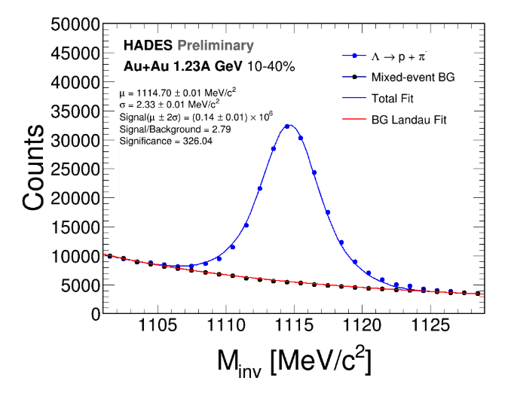
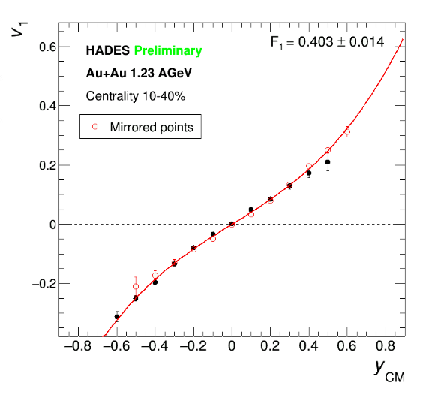
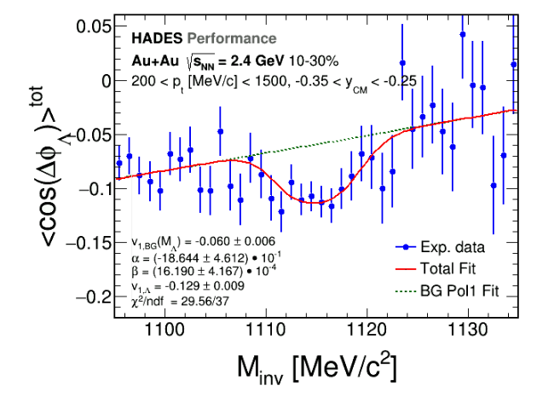
v_{n} of V0 particles: invariant mass fit method
Reasonable directed flow measurements for reconstructed Λ
Frédéric Julian Kornas Thesis: PhD Dortmund U. (2021)

Slide 6
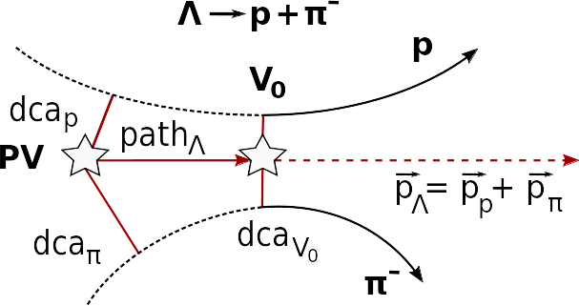
Measurements of global hyperon polarization
Polarization can be measured using the azimuthal angle of proton in Lambda rest frame φ*
PV — primary vertex
V₀ — vertex of hyperon decay
dca — distance of closest approach
path — decay length
Determine centrality
Determine event plane ( , )
Reconstruct Lambda
Measure global polarization

Slide 7
Δφ-method
Obtain invariant mass distribution in bins of
Net amount of Λ in each bin
Distribution of
Fit of the distribution to get → P_{Λ}
dN/dΔφ_{P}*
_{θ} *
-φ*
p
beam direction (z)
x
impact parameter
b
y

Slide 8
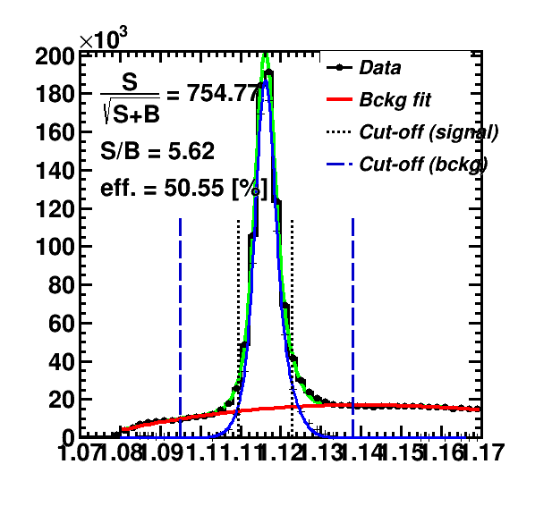
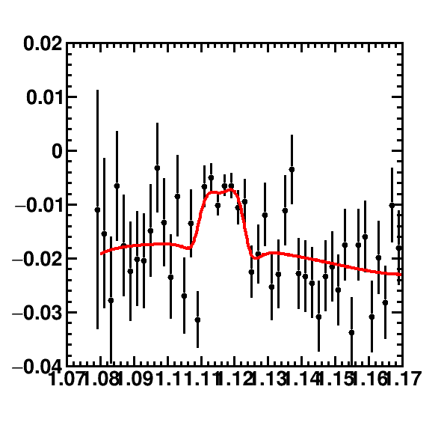
Inv. mass fit method
Use invariant mass distribution
Calculate Sig/All, Bg/All ratios
Fit <sin(𝚿_{EP} - φ_{p}*)> as a function of inv. mass:
Use P^{S}(p_{T}) = <sin(𝚿_{RP} - φ_{p}*)>^{S} to find P_{H}:

Slide 9
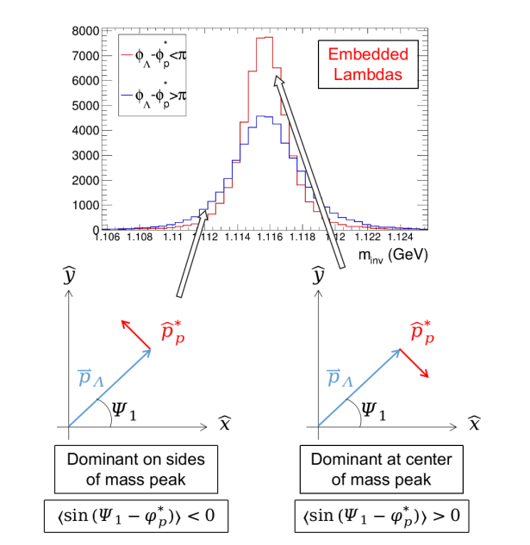
Track crossing and v₁ contribution
Problem: daughter particles tracks with opposite charges are bended in the opposite directions in the magnetic field, and these tracks may cross each other that leads 2 peaks distribution. Solution: fit signal with 2 gausses
Warning: with detector asymmetry it would provide the effect of v₁ on the polarization measurements and odd pseudorapidity dependence
M.S. Abdallah et al. (STAR Collaboration), Phys. Rev. C 104, L061901 (2021)

Slide 10
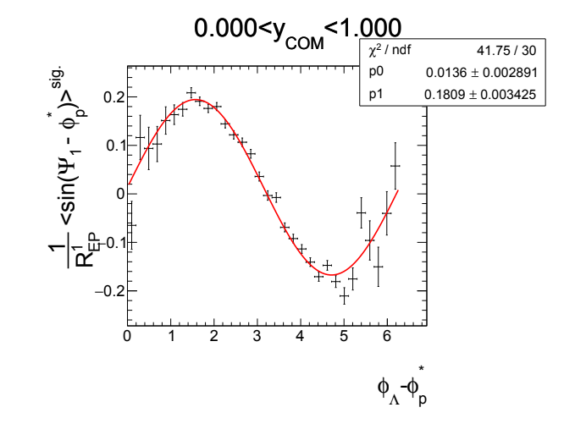
Generalized inv. mass fit method
Fit P^{S} = <sin(𝚿_{RP} - φ_{p}*)>^{S}
in bins of φ_{Λ} - φ_{p}* for η>0, η<0 using formula:
This fit corrects effects of directed flow and acceptance contributions to P_{H}
M.S. Abdallah et al. (STAR Collaboration), Phys. Rev. C 104, L061901 (2021)

Slide 11
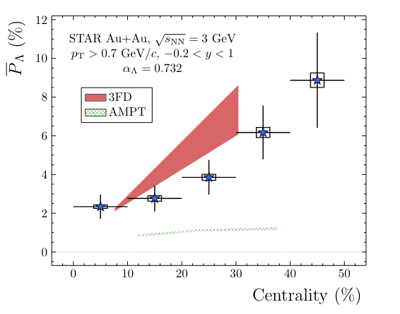
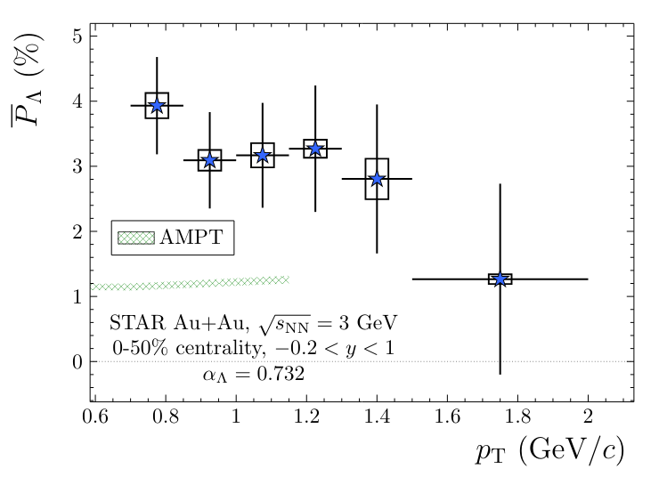
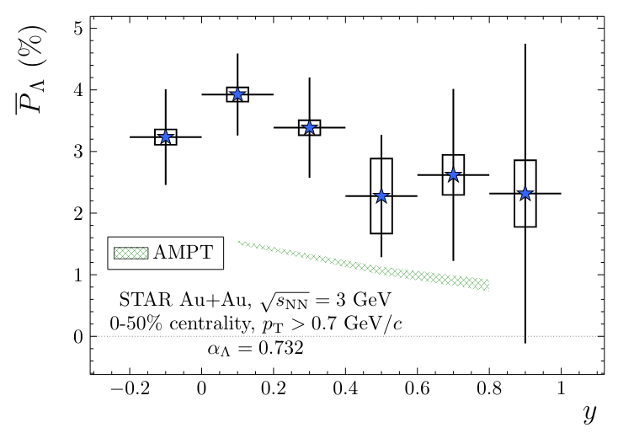
Global polarization: STAR results
M.S. Abdallah et al. (STAR Collaboration), Phys. Rev. C 104, L061901 (2021)
No dependence within uncertainties

Slide 12
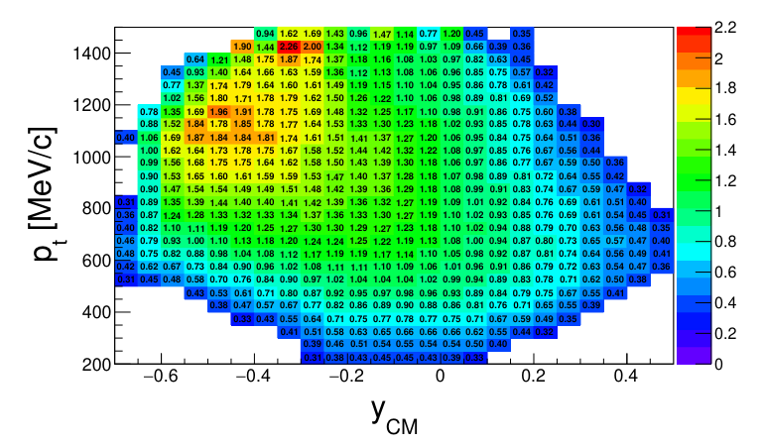
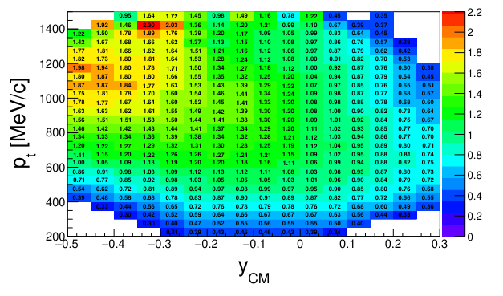
Corrections for reconstruction efficiency
Problem: collective flow and global polarization are the observables with amplitude ~ 10⁻¹-10⁻² and 10⁻³ correspondingly
Very limited acceptance leads to increasing the fluctuations of the mean due to low efficiency
Solution: weighting with relative reconstruction efficiency
Avoiding the shift of the mean
Do not facing with the increasing of fluctuations
Frédéric Julian Kornas Thesis: PhD Dortmund U. (2021)

Slide 13
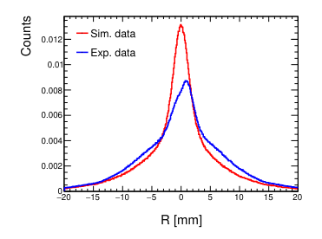
Corrections for the radial distance asymmetry
Radial distance R - is the minimum distance of the reconstructed track to the beam axis
Problem: asymmetry of the radial distance wrt. vertex.
Solution: take the R distribution in the inv. mass range under the peak of Λ and calculate the weights that do this distribution flat after the correction
Frédéric Julian Kornas Thesis: PhD Dortmund U. (2021)

Slide 14
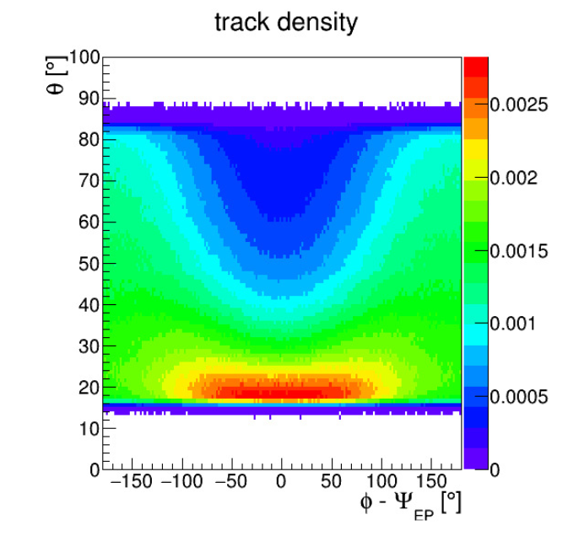
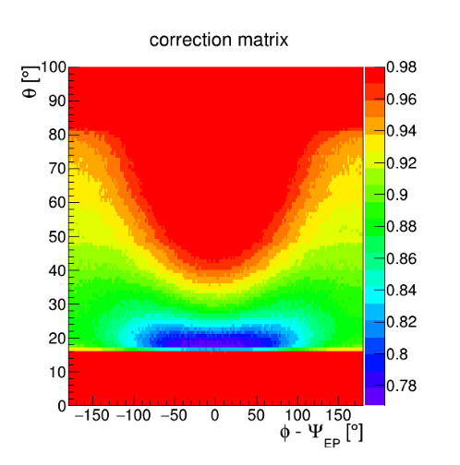
Corrections for detector occupancy
Problem: efficiency loss due to strong varying track densities
Result: effect on v₁ pseudorapidity dependence
Solution:
centrality bins for occupancy
To obtain corrections due to occupancy for Λ the multiplication of proton and pion occupancy is used:
Very high effect on v₁ slope that cannot be explained with systematics
Occupancy corrections for Λ is not working correctly
Frédéric Julian Kornas Thesis: PhD Dortmund U. (2021)

Slide 15
Summary
Inv. mass fit method is a standard method for v_{n} measurements of V0 particles
Δφ-method and inv. mass fit method gives reasonable result for global polarization measurements
Generalized inv. mass fit method is possible to correct acceptance effects and directed flow contribution
Corrections reconstructed efficiency and radial distance asymmetry provides a reasonable effects
Corrections for detector occupancy are still important to be studied
Thank you for your attention!

Slide 16
BACKUP

Slide 17
Corrections for reconstruction efficiency
cut efficiency <0.3
Provide a relative efficiency
Smooth it by Savitzky-Golay filter
Frédéric Julian Kornas Thesis: PhD Dortmund U. (2021)

