Slide 1
Analysis of geometrical cuts efficiency for Λ and К-short reconstruction in the Xe run
Ramin Barak
12th Collaboration Meeting of the BM@N Experiment at the NICA Facility, 12–18 May 2024

Slide 2
Goals
Derivation of values for geometric cuts for different cases of the signal value (70, 80, 90 and 100 % of the maximal signal).
Approximation of the number of Λ and $K_{S}^{0}$ created during the experiment depending on rapidity and Pt.
Verification of the stability of the geometric cuts for different cases of the signal value.

Slide 3
Data
Experimental data obtained in the physical session at the beginning of 2023 with a beam energy of 3.8 GeV per nucleon, a CsI target and Xe beam.
Dubna Cascade Model - Statistical Multifragmentation Model (DCM-SMM) Monte Carlo generator was used to model the data.
1 million experimental and Monte Carlo events were analyzed.

Slide 4
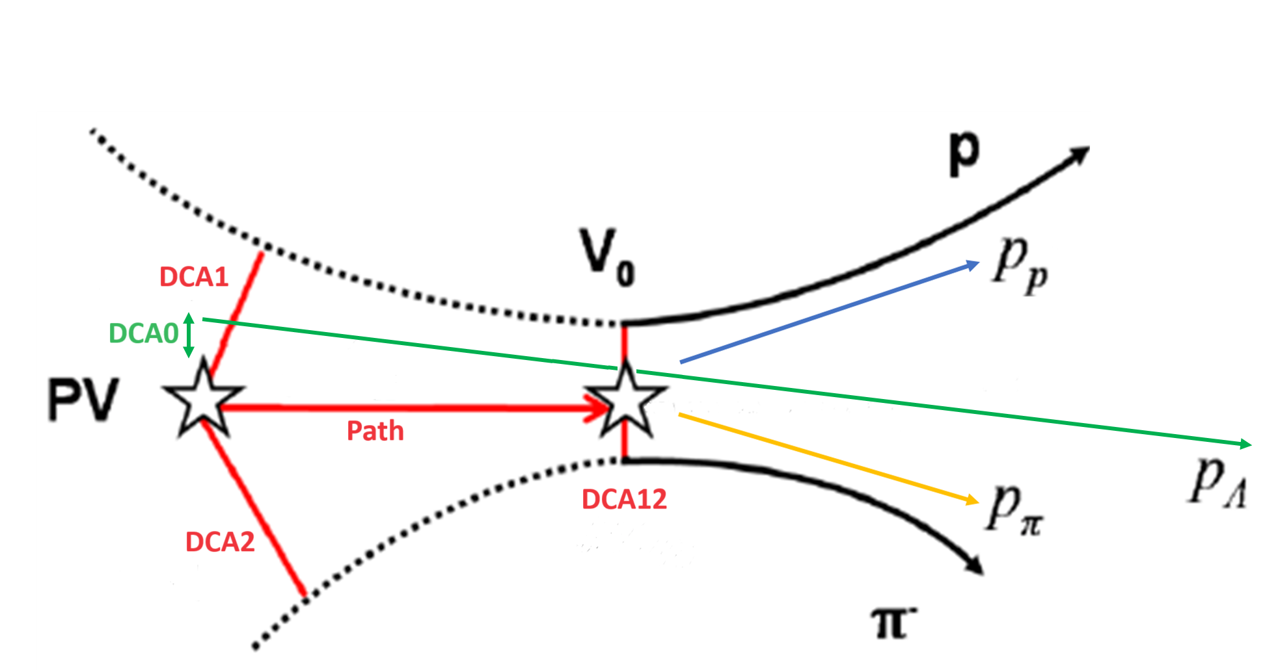
Data processing procedure
Reconstruction of particle tracks was carried out.
Mathematical algorithms were developed and implemented to search for the Λ p + π⁻ and $K_{S}^{0}$ π⁺ + π⁻decays:
shuffling pairs of particles with different signs
calculation of invariant mass
imposing a number of geometric restrictions (4) on the parameters of each pair
PV – primary vertex.
Path – the distance traveled by Λ from the primary vertex to the point of its decay.
DCA0 – the distance between the primary vertex and the projection of momentum of Λ.
DCA1 – the shortest distance from the proton to the vertex.
DCA2 – the shortest distance from the negative π-meson to the vertex.
DCA12 – the distance between the proton and the negative π-meson at the decay point of Λ.
Event topology

Slide 5
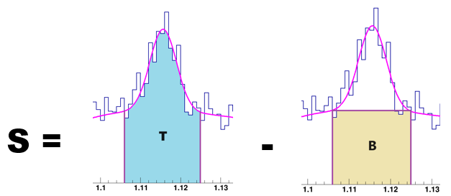
Fit parameters for signal selection
$BG=A∗\sqrt{\left(m − m_{threshold}\right)}∗e^{−B(m −m_{threshold})}$
Significance: $\frac{S}{\sqrt{T}}$
Efficiency: $\frac{N_{signal}}{N_{generated}}$* 100 %
chosen as a measure of the optimal value

Slide 6
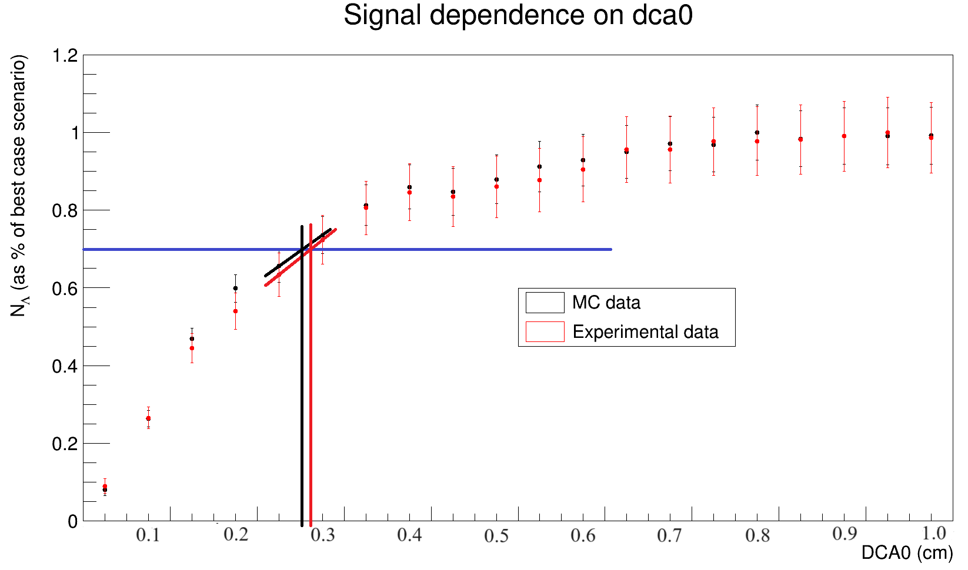
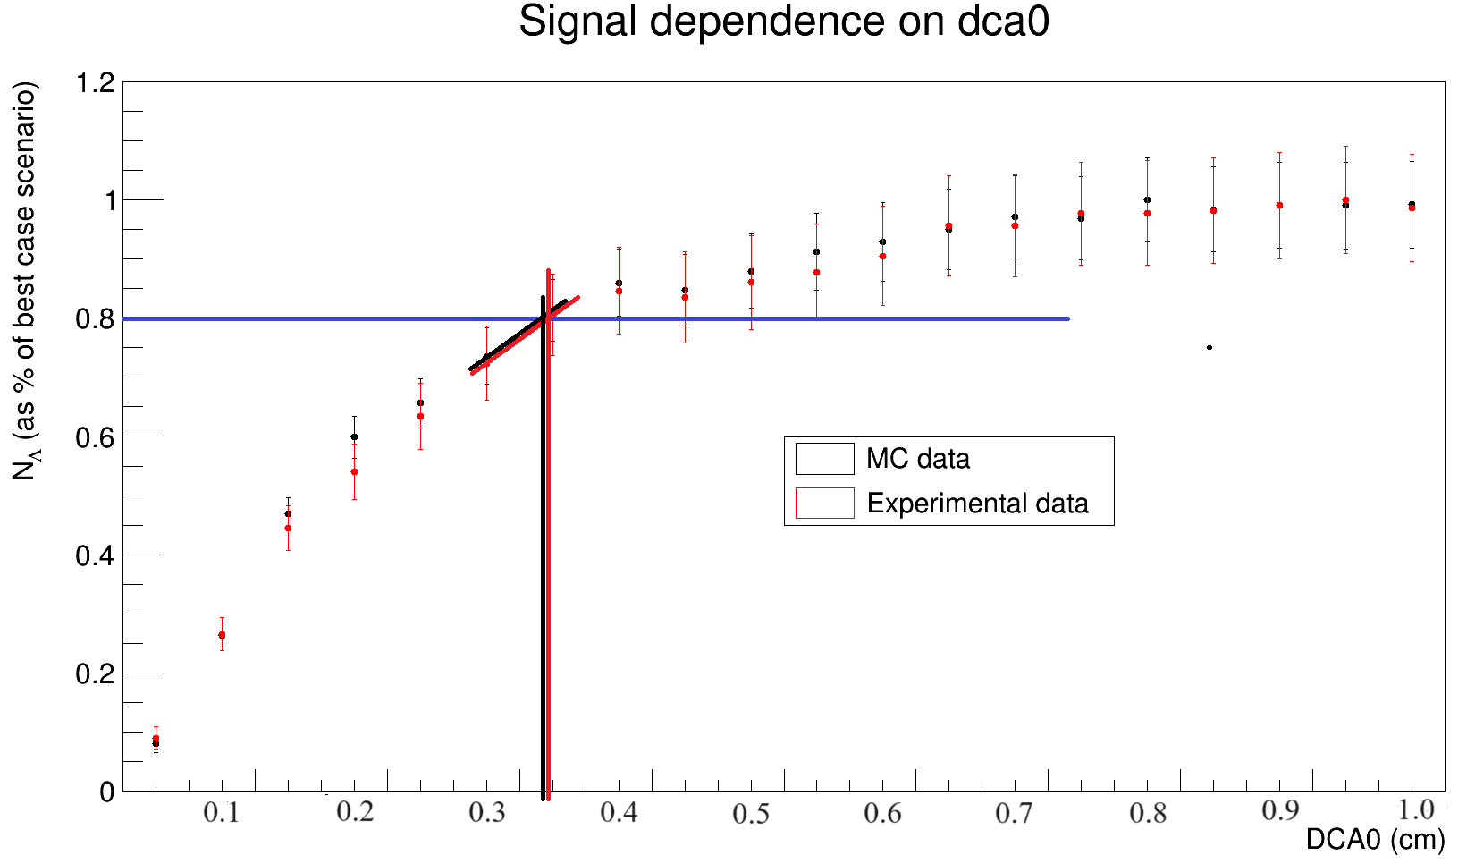
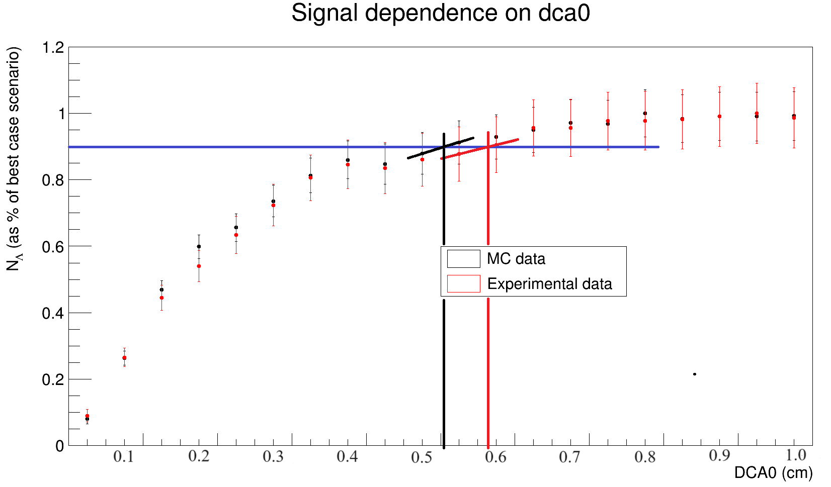
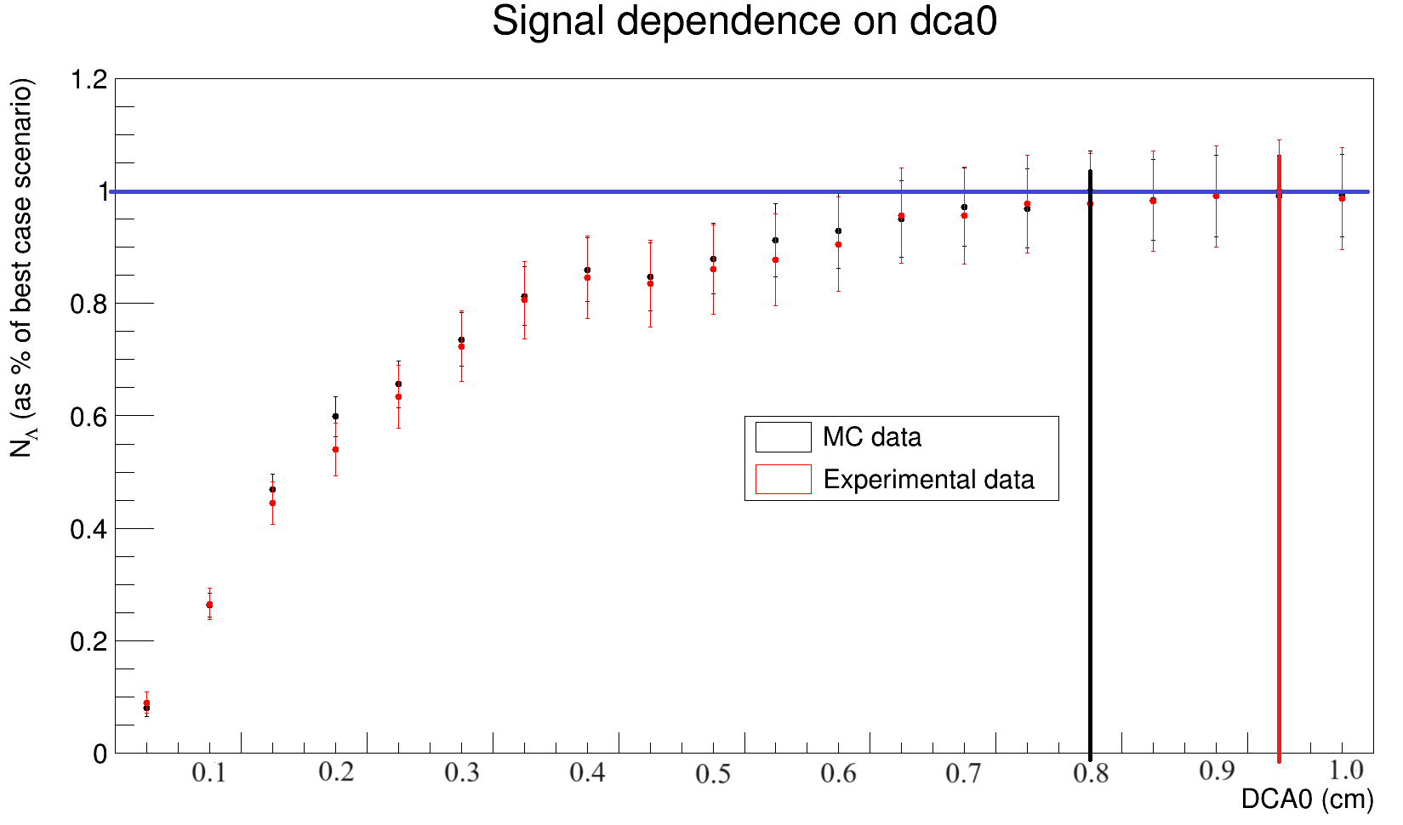
Results
Signal dependence on difference values of geometric restrictions for Λ

Slide 7
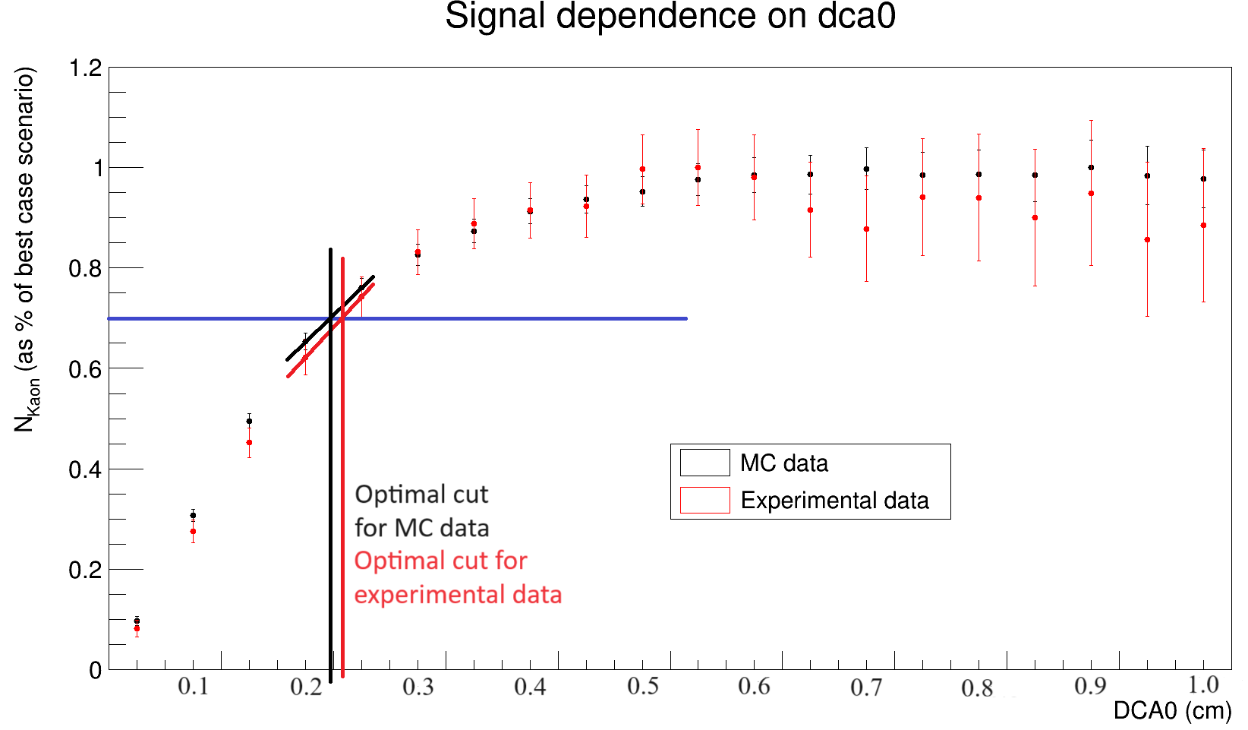
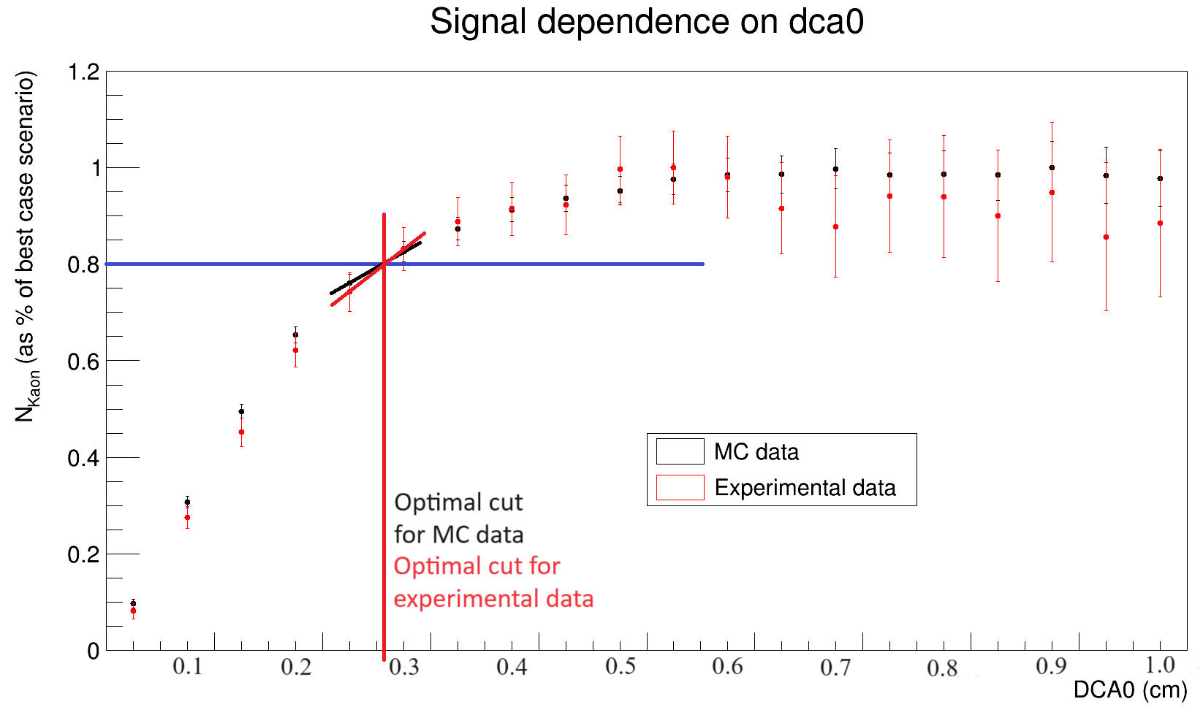
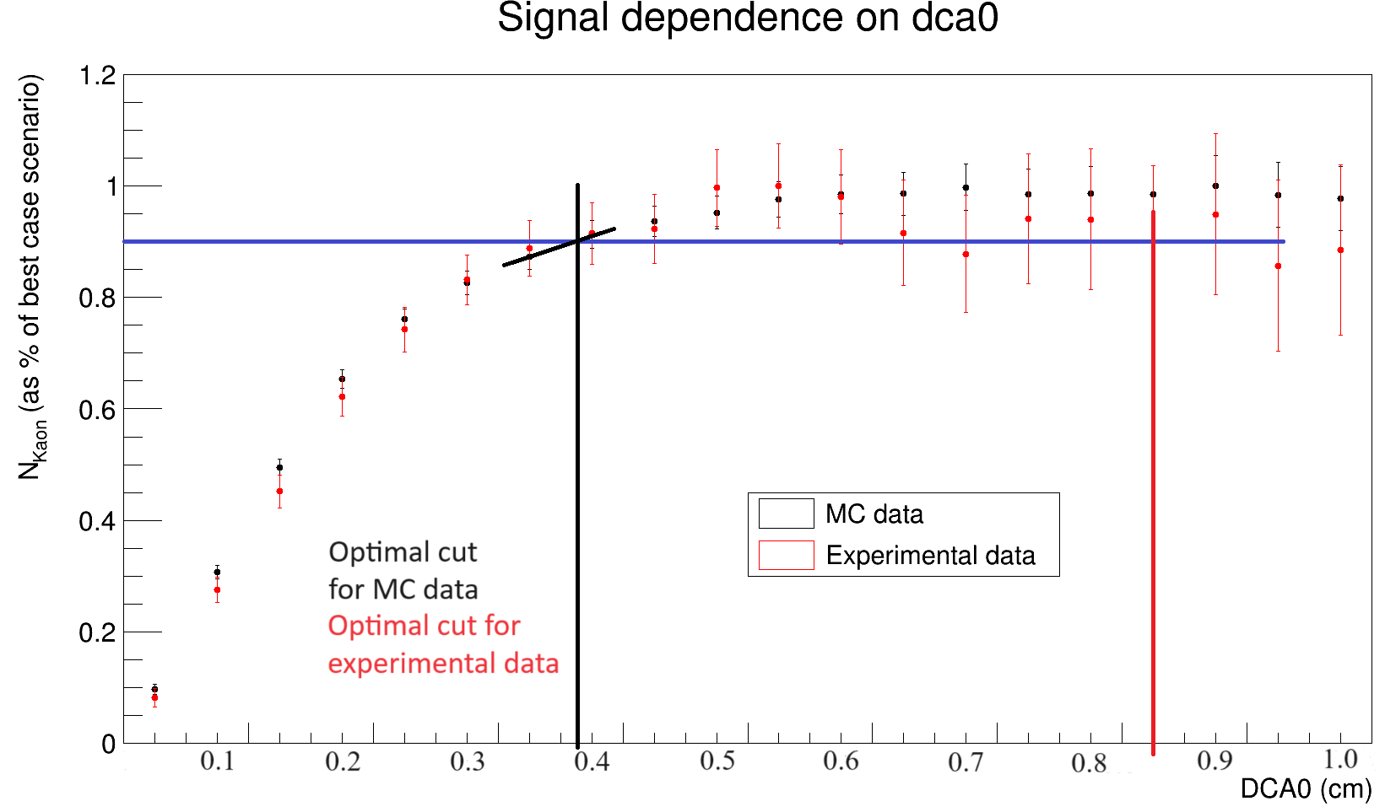
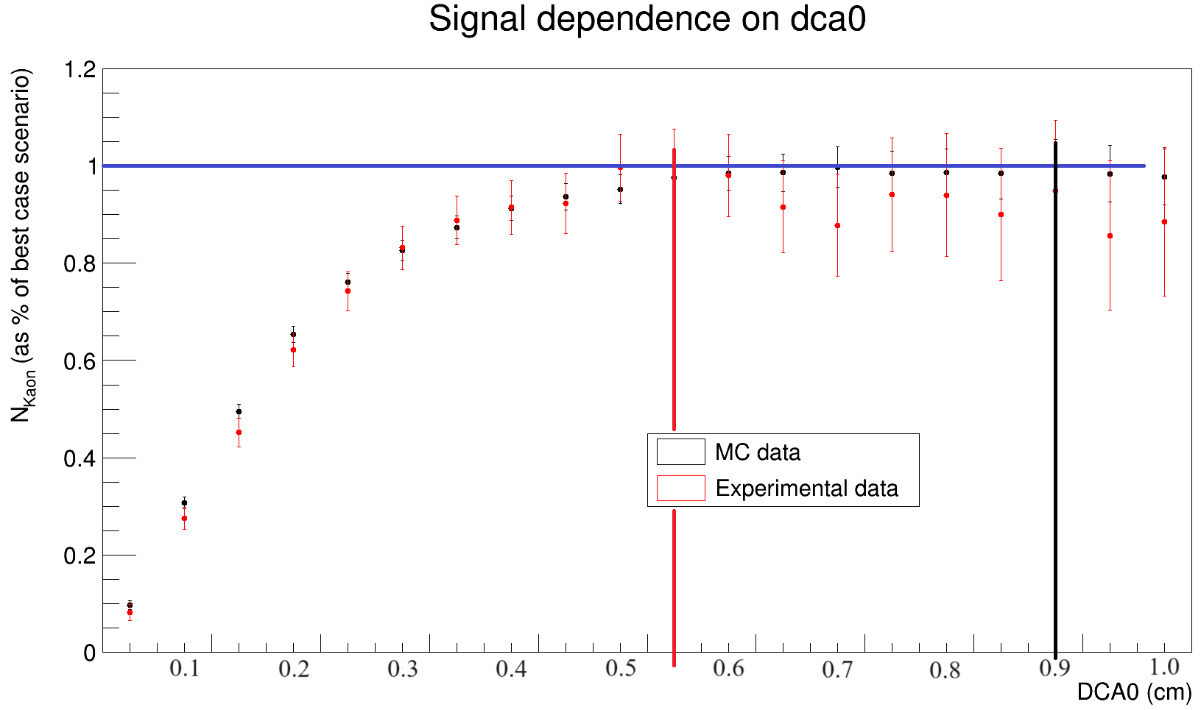
Signal dependence on difference values of geometric restrictions for $K_{S}^{0}$

Slide 8
Efficiency values
Λ depending on rapidity
Interval rapidity | 0.4 - 0.6 | 0.6 – 0.8 | 0.8 – 1.0 | 1.0 – 1.2 | 1.2 – 1.4
Signal of 100% | 0 $±$ 0 | 0.795 $±$ 0.026 | 2.22 $±$ 0.040 | 3.27 $±$ 0.046 | 0 $±$ 0
Signal of 90 % | 0 $±$ 0 | 0.168 $±$0.012 | 0.728 $±$ 0.023 | 1.38 $±$ 0.030 | 0.635 $±$ 0.021
Signal of 80 % | 0 $±$ 0 | 0.134 $±$ 0.011 | 0.592 $±$ 0.021 | 0.963 $±$ 0.025 | 0.315 $±$ 0.015
Signal of 70% | 0 $±$ 0 | 0.108 $±$ 0.010 | 0.448 $±$ 0.018 | 0.678 $±$ 0.021 | 0.273 $±$ 0.014
Zero’s in the table are caused by an absence of the signal in the interval of interest for the signal value at hand.
Λ depending on Pt
Interval Pt | 0 - 0.23 | 0.23 – 0.46 | 0.46 – 0.69 | 0.69 – 0.92 | 0.92 – 1.15
Signal of 100% | 0 $±$ 0 | 0 $±$ 0 | 0 $±$ 0 | 0 $±$ 0 | 0 $±$ 0
Signal of 90 % | 0 $±$ 0 | 0.566 $±$0.012 | 0.573 $±$ 0.014 | 0.330 $±$ 0.014 | 0 $±$ 0
Signal of 80 % | 0.117 $±$ 0.006 | 0.362 $±$ 0.010 | 0.359 $±$ 0.011 | 0.214 $±$ 0.011 | 0 $±$ 0
Signal of 70% | 0.0954 $±$ 0.006 | 0.241 $±$ 0.008 | 0.251 $±$ 0.009 | 0.165 $±$ 0.010 | 0 $±$ 0

Slide 9
Efficiency values
$K_{S}^{0}$ depending on rapidity
Interval rapidity | 0.4 - 0.6 | 0.6 – 0.8 | 0.8 – 1.0 | 1.0 – 1.2 | 1.2 – 1.4
Signal of 100% | 2.09 $±$ 0.063 | 0 $±$ 0 | 0 $±$ 0 | 0 $±$ 0 | 0 $±$ 0
Signal of 90 % | 1.64 $±$ 0.056 | 0.551 $±$0.032 | 0 $±$ 0 | 0 $±$ 0 | 0 $±$ 0
Signal of 80 % | 0.861 $±$ 0.041 | 0.632 $±$ 0.034 | 0 $±$ 0 | 0 $±$ 0 | 0 $±$ 0
Signal of 70% | 0.539 $±$ 0.032 | 0.451 $±$ 0.029 | 0 $±$ 0 | 0 $±$ 0 | 0 $±$ 0
$K_{S}^{0}$ depending on Pt
Interval Pt | 0 - 0.23 | 0.23 – 0.46 | 0.46 – 0.69 | 0.69 – 0.92 | 0.92 – 1.15
Signal of 100% | 0 $±$ 0 | 0 $±$ 0 | 0 $±$ 0 | 0 $±$ 0 | 0 $±$ 0
Signal of 90 % | 0.296 $±$ 0.016 | 0.284 $±$0.015 | 0 $±$ 0 | 0.415 $±$ 0.024 | 0 $±$ 0
Signal of 80 % | 0.113 $±$ 0.010 | 0.216 $±$ 0.013 | 0.188 $±$ 0.014 | 0.201 $±$ 0.017 | 0 $±$ 0
Signal of 70% | 0.144 $±$ 0.011 | 0.140 $±$ 0.011 | 0 $±$ 0 | 0 $±$ 0 | 0 $±$ 0

Slide 10
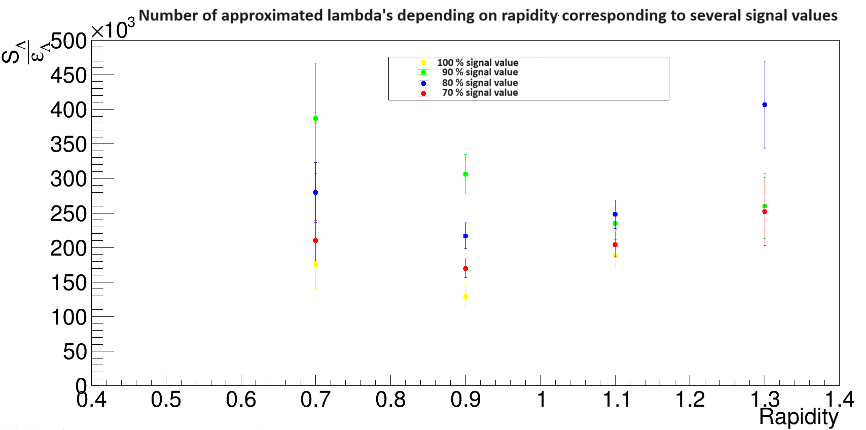
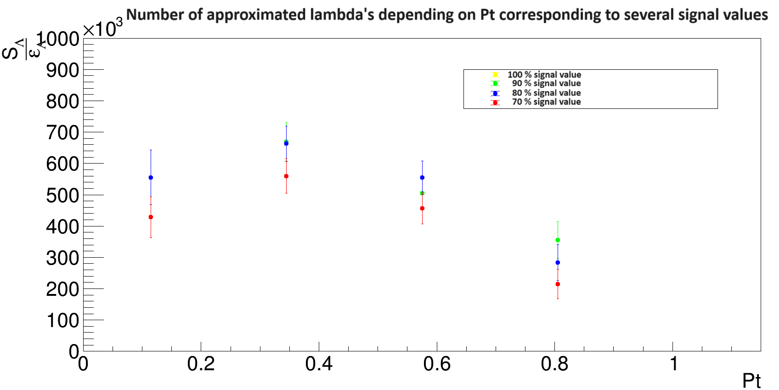
Number of approximated Λ

Slide 11
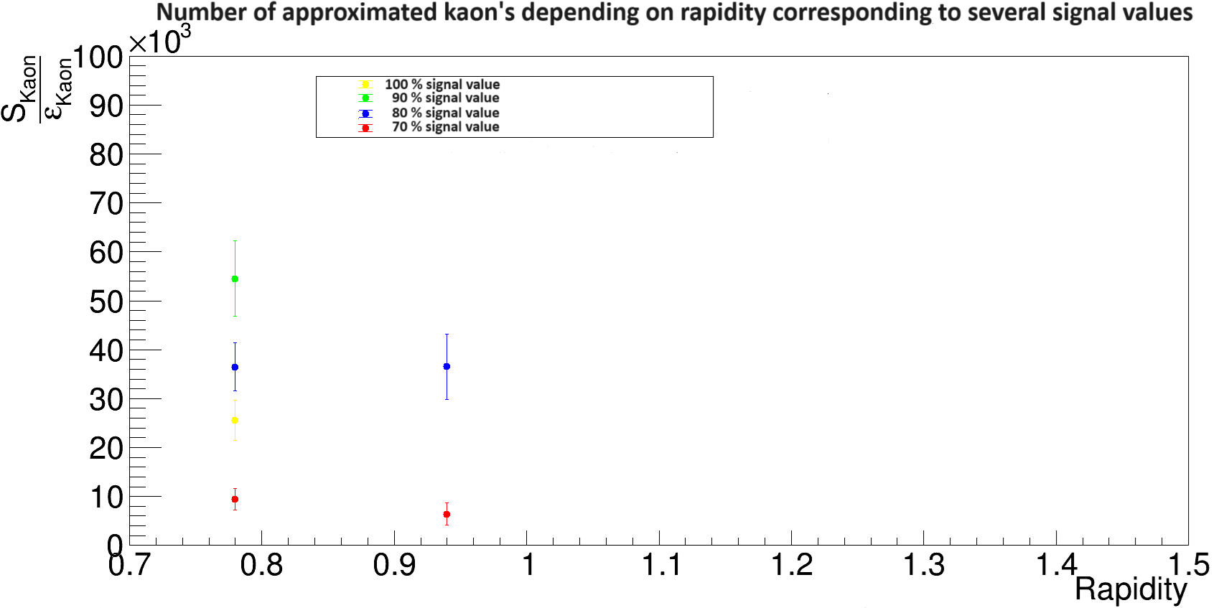
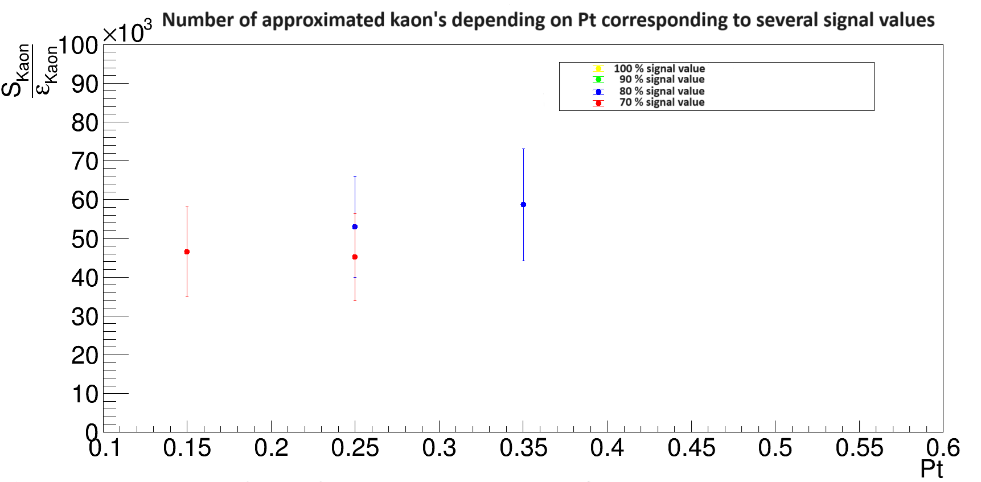
Number of approximated $K_{S}^{0}$

Slide 12
Conclusions
Values for geometric cuts for different cases of the signal value were derived.
The number of Λ and $K_{S}^{0}$ created during the experiment depending on rapidity and Pt were approximated.
The geometric cuts seem to be unstable which probably has to do with disagreement between the MC and experimental data.

Slide 13
Backup

Slide 14
Cuts Λ
Signal of 70 %
Signal of 80 %
MC:
6.48 cm <= path <= 50.0 cm
0.0 cm <= dca12 <= 0.255 cm
0.0 cm <= dca0 <= 0.275 cm
1.00 cm <= dca2 <= 10.0 cm
Experimental:
5.95 cm <= path <= 50.0 cm
0.0 cm <= dca12 <= 0.230 cm
0.0 cm <= dca0 <= 0.287 cm
1.02 cm <= dca2 <= 10.0 cm
MC:
5.62 cm <= path <= 50.0 cm
0.0 cm <= dca12 <= 0.278 cm
0.0 cm <= dca0 <= 0.344 cm
0.814 cm <= dca2 <= 10.0 cm
Experimental:
4.85 cm <= path <= 50.0 cm
0.0 cm <= dca12 <= 0.287 cm
0.0 cm <= dca0 <= 0.348 cm
0.835 cm <= dca2 <= 10.0 cm
Signal of 90 %
Signal of 100 %
MC:
4.51 cm <= path <= 50.0 cm
0.0 cm <= dca12 <= 0.402 cm
0.0 cm <= dca0 <= 0.528 cm
0.645 cm <= dca2 <= 10.0 cm
Experimental:
4.08 cm <= path <= 50.0 cm
0.0 cm <= dca12 <= 0.393 cm
0.0 cm <= dca0 <= 0.590 cm
0.651 cm <= dca2 <= 10.0 cm
MC:
0.625 cm <= path <= 50.0 cm
0.0 cm <= dca12 <= 0.867 cm
0.0 cm <= dca0 <= 0.800 cm
0.465 cm <= dca2 <= 10.0 cm
Experimental:
2.50 cm <= path <= 50.0 cm
0.0 cm <= dca12 <= 1.02 cm
0.0 cm <= dca0 <= 0.950 cm
0.465 cm <= dca2 <= 10.0 cm

Slide 15
Cuts $K_{S}^{0}$
Signal of 70 %
Signal of 80 %
MC:
0.820 cm <= dca1 <= 10.0 cm
0.0 cm <= dca12 <= 0.275 cm
0.0 cm <= dca0 <= 0.223 cm
0.952 cm <= dca2 <= 10.0 cm
Experimental:
0.800 cm <= dca1 <= 10.0 cm
0.0 cm <= dca12 <= 0.375 cm
0.0 cm <= dca0 <= 0.233 cm
0.968 cm <= dca2 <= 10.0 cm
MC:
0.680 cm <= dca1 <= 10.0 cm
0.0 cm <= dca12 <= 0.363 cm
0.0 cm <= dca0 <= 0.281 cm
0.768 cm <= dca2 <= 10.0 cm
Experimental:
0.650 cm <= dca1 <= 10.0 cm
0.0 cm <= dca12 <= 0.550 cm
0.0 cm <= dca0 <= 0.281 cm
0.800 cm <= dca2 <= 10.0 cm
Signal of 90 %
Signal of 100 %
MC:
0.504 cm <= dca1 <= 10.0 cm
0.0 cm <= dca12 <= 0.550 cm
0.0 cm <= dca0 <= 0.390 cm
0.584 cm <= dca2 <= 10.0 cm
Experimental:
0.504 cm <= dca1 <= 10.0 cm
0.0 cm <= dca12 <= 0.660 cm
0.0 cm <= dca0 <= 0.850 cm
0.600 cm <= dca2 <= 10.0 cm
MC:
0.400 cm <= dca1 <= 10.0 cm
0.0 cm <= dca12 <= 0.900 cm
0.0 cm <= dca0 <= 0.900 cm
0.400 cm <= dca2 <= 10.0 cm
Experimental:
0.400 cm <= dca1 <= 10.0 cm
0.0 cm <= dca12 <= 1.00 cm
0.0 cm <= dca0 <= 0.550 cm
0.400 cm <= dca2 <= 10.0 cm

Slide 16
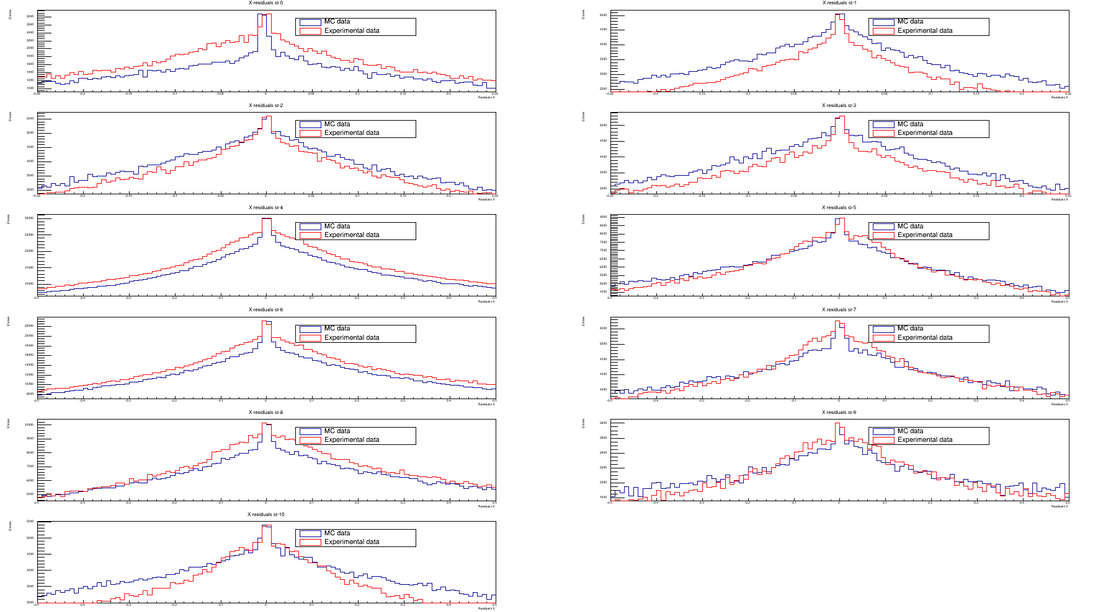
Residuals
X-residuals

Slide 17
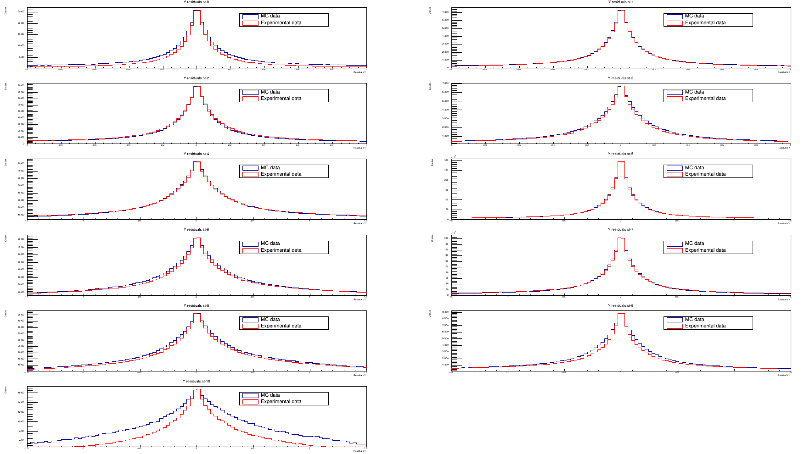
Residuals
Y-residuals

Slide 18
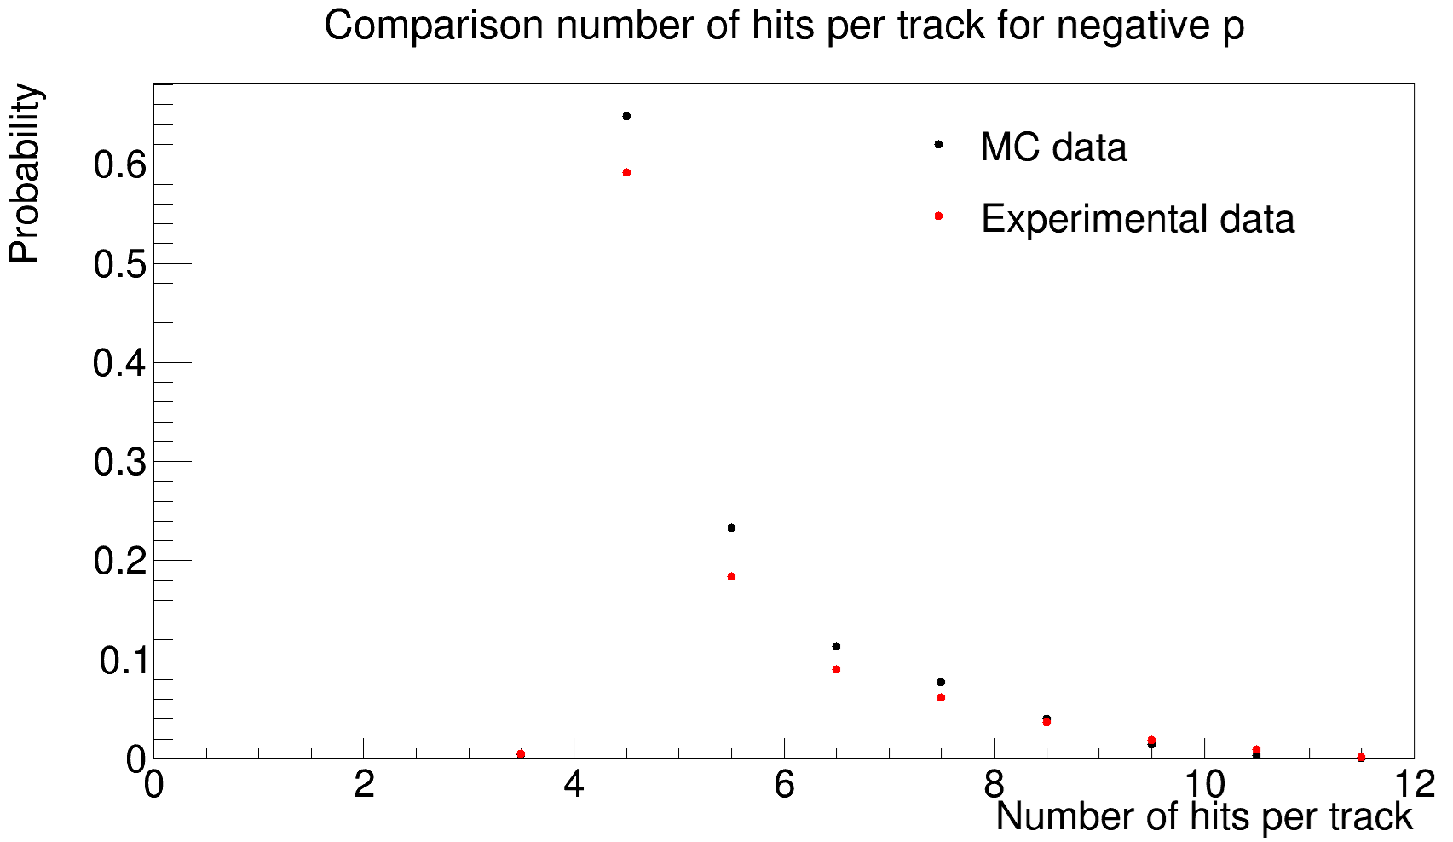
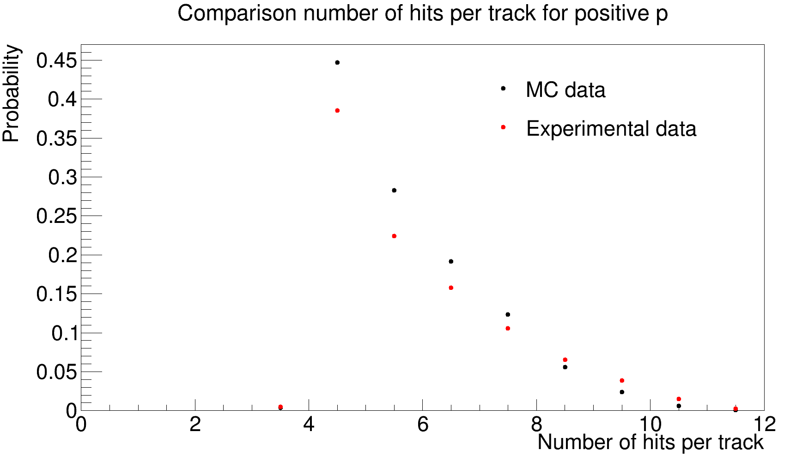
Comparison MC and experimental data

Slide 19
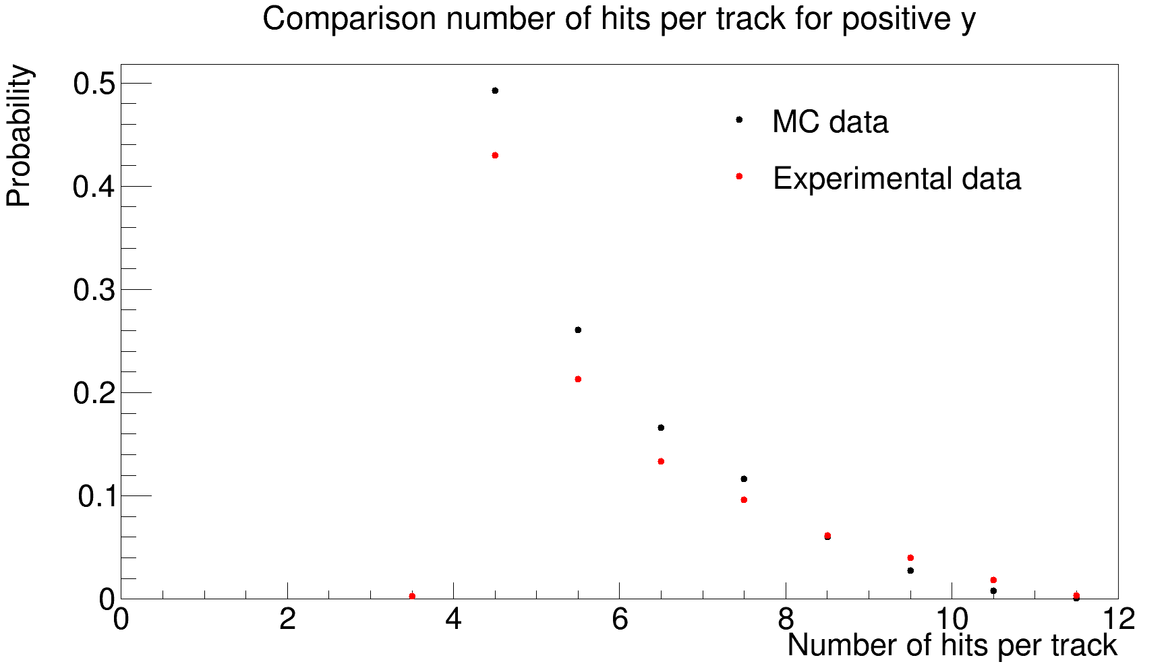
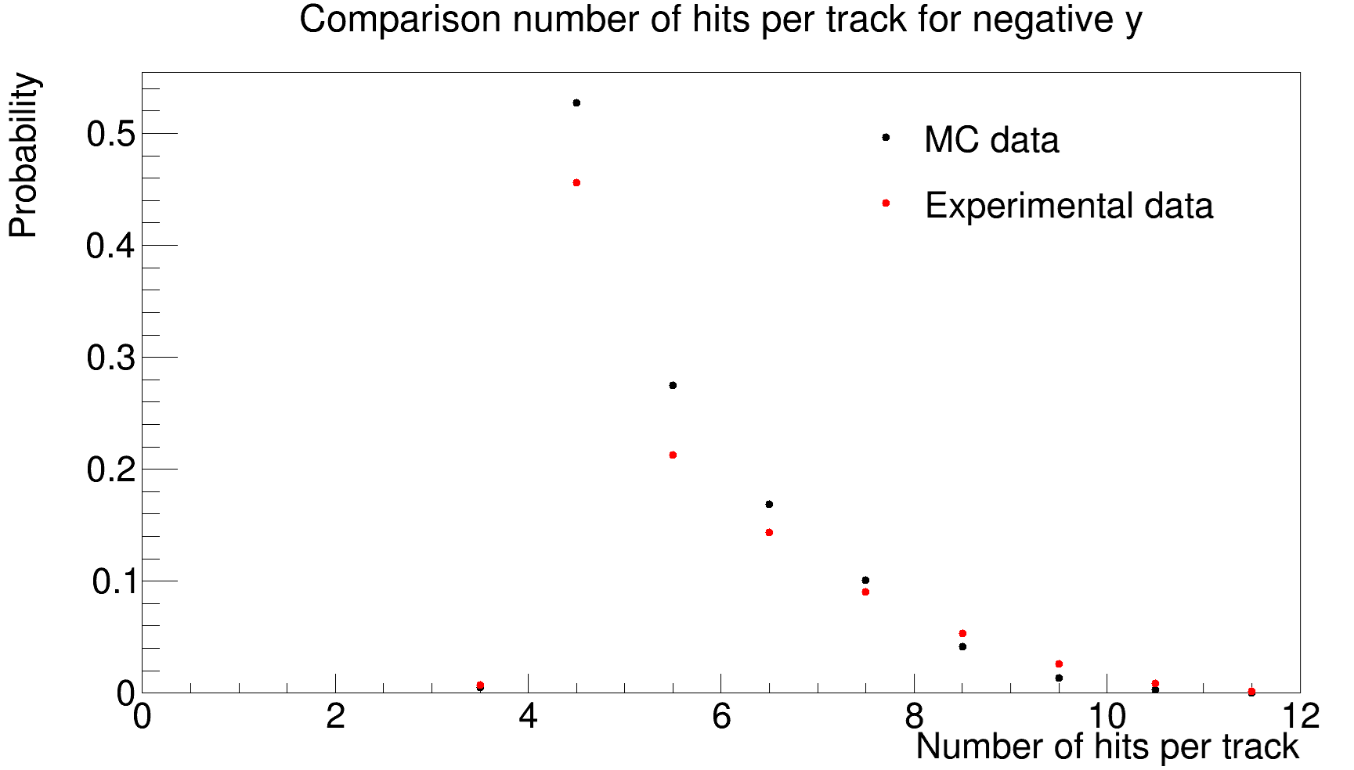
Comparison MC and experimental data

Slide 20
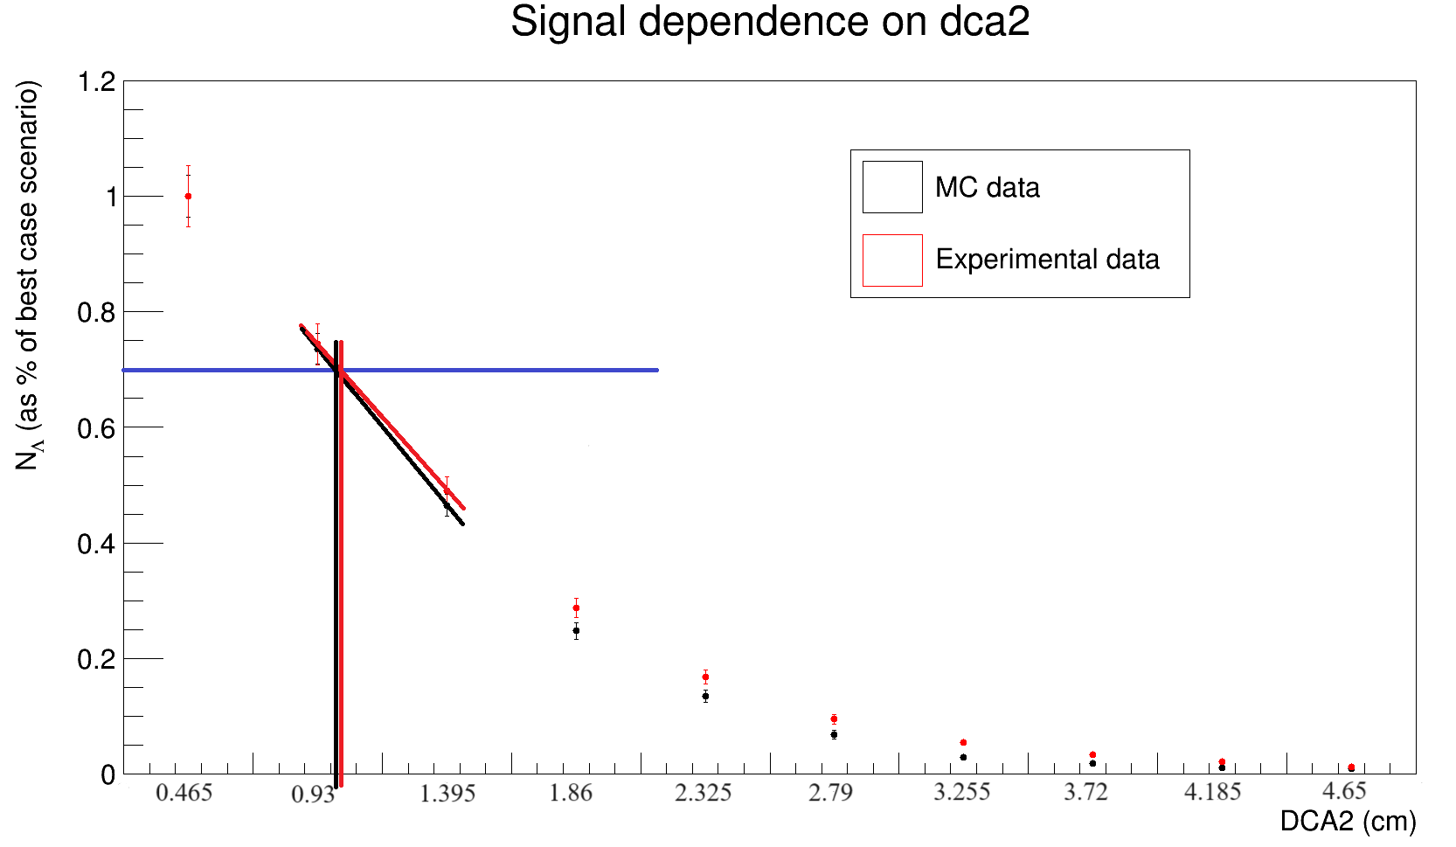
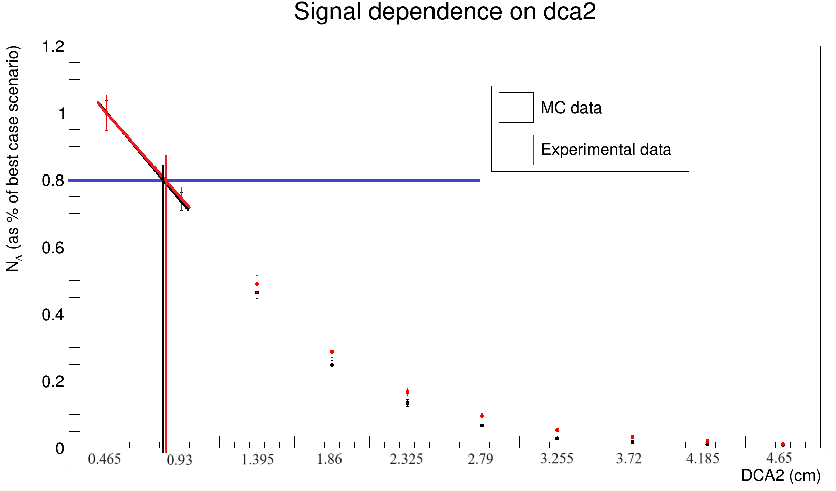
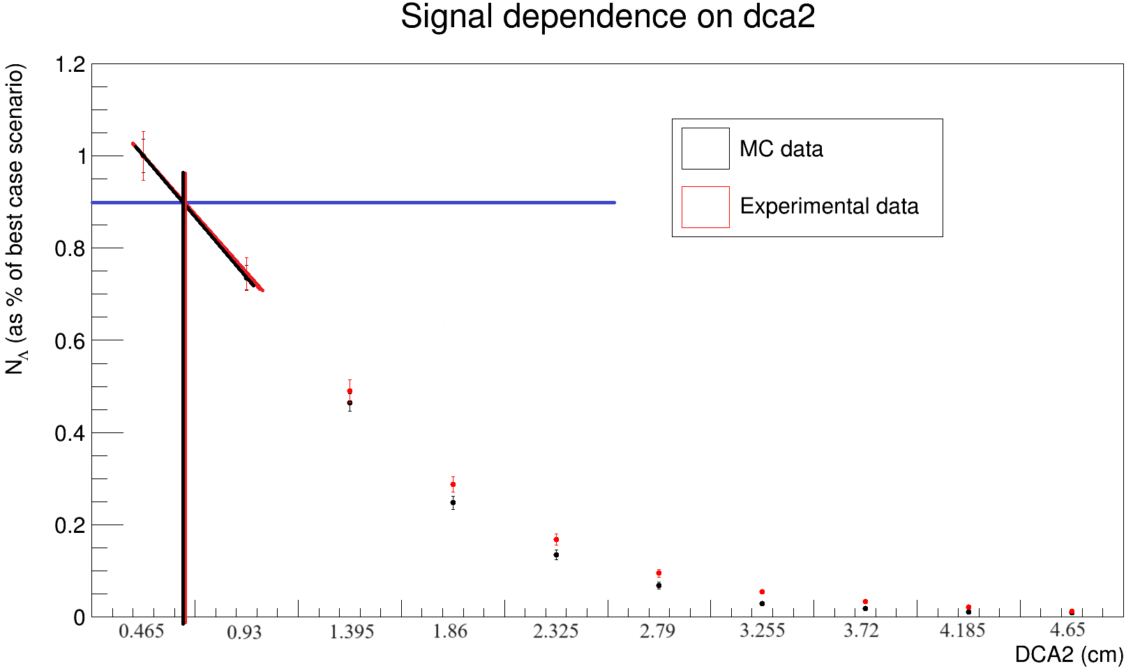
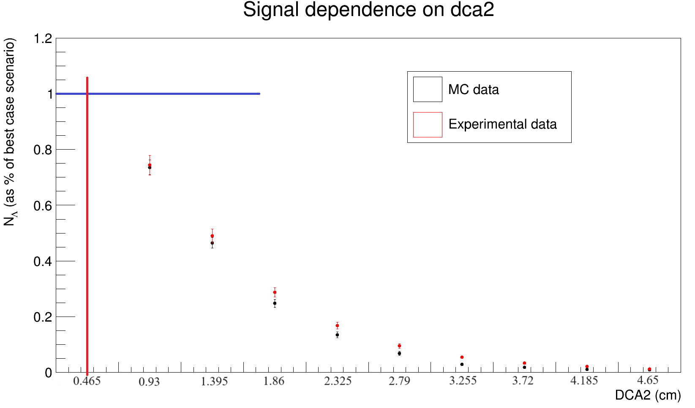
Signal analysis
Signal dependence on difference values of geometric restrictions for Λ

Slide 21
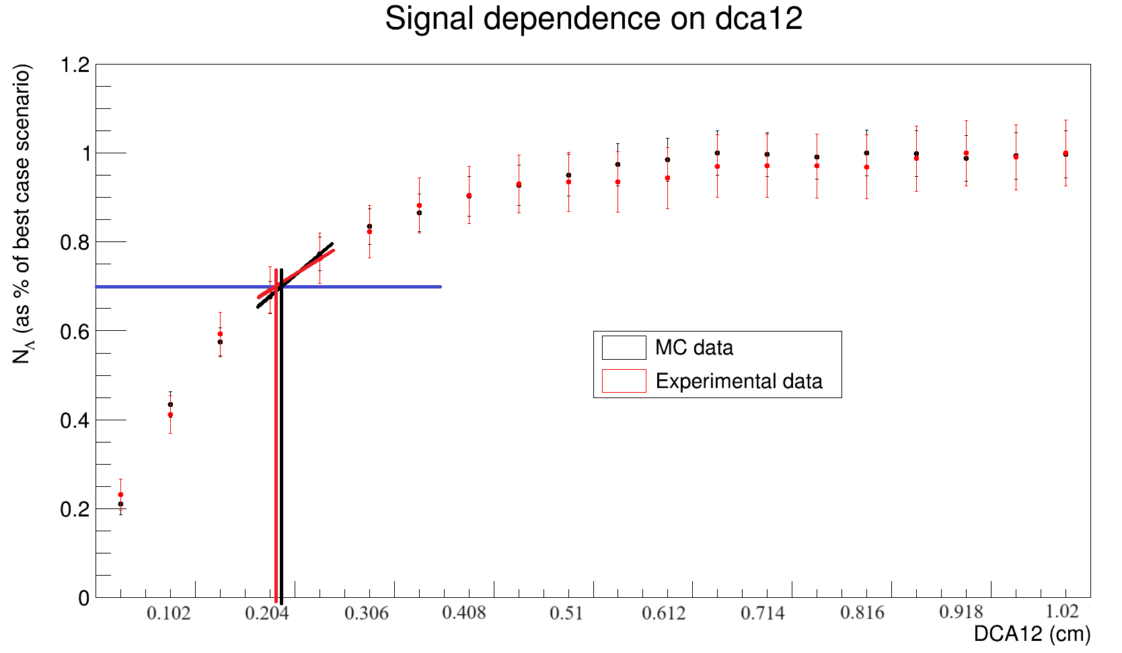
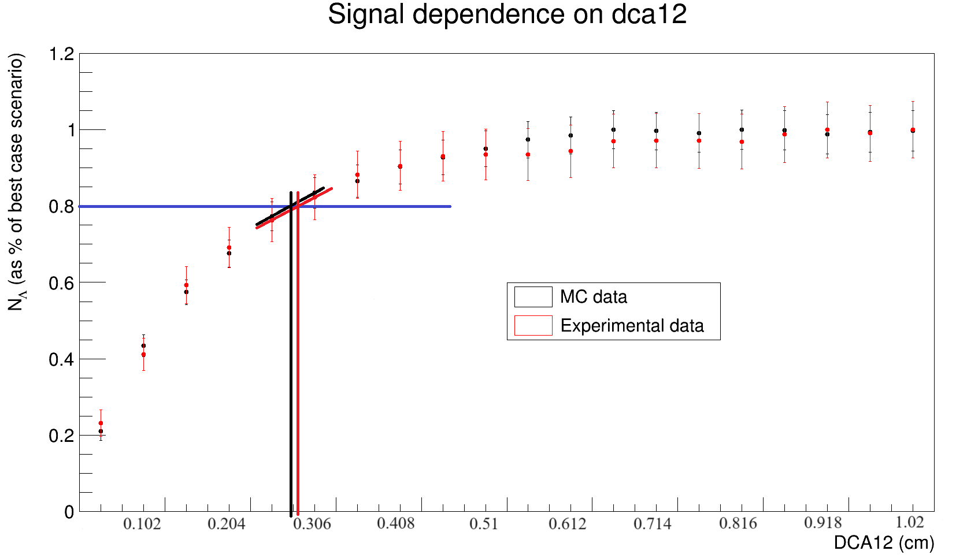
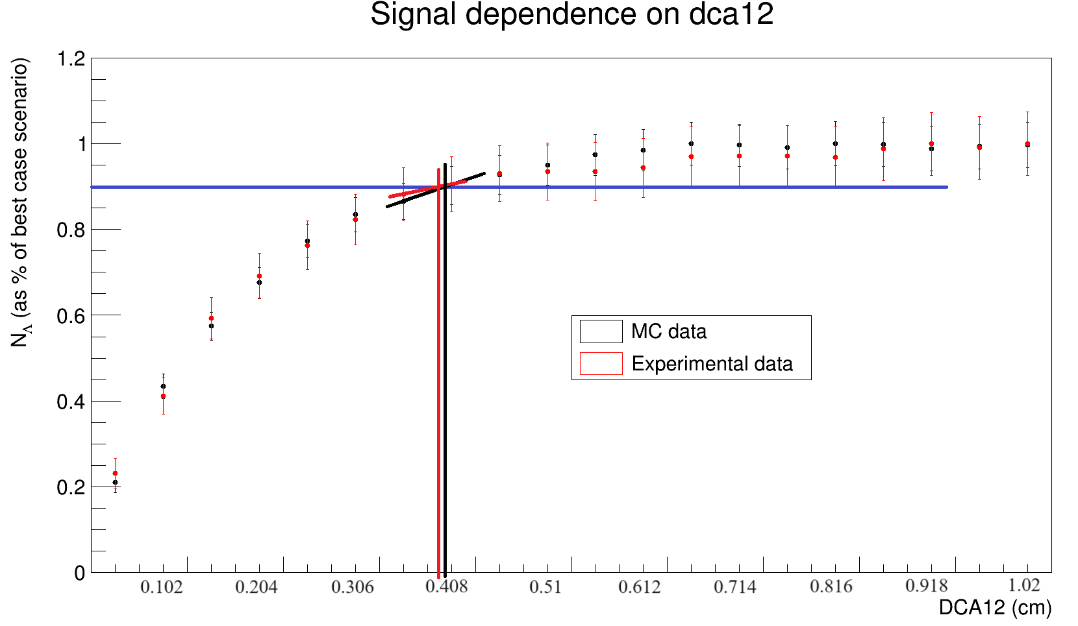
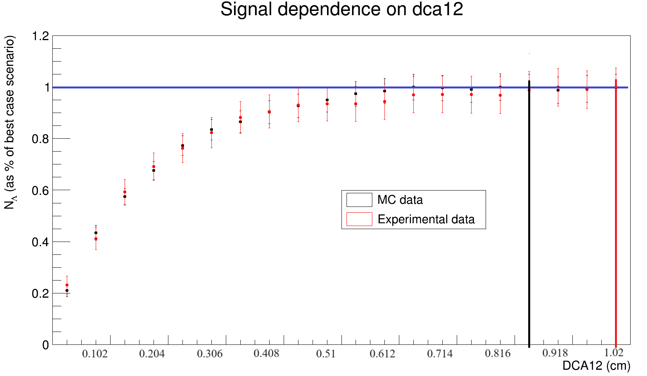
Signal analysis
Signal dependence on difference values of geometric restrictions for Λ

Slide 22
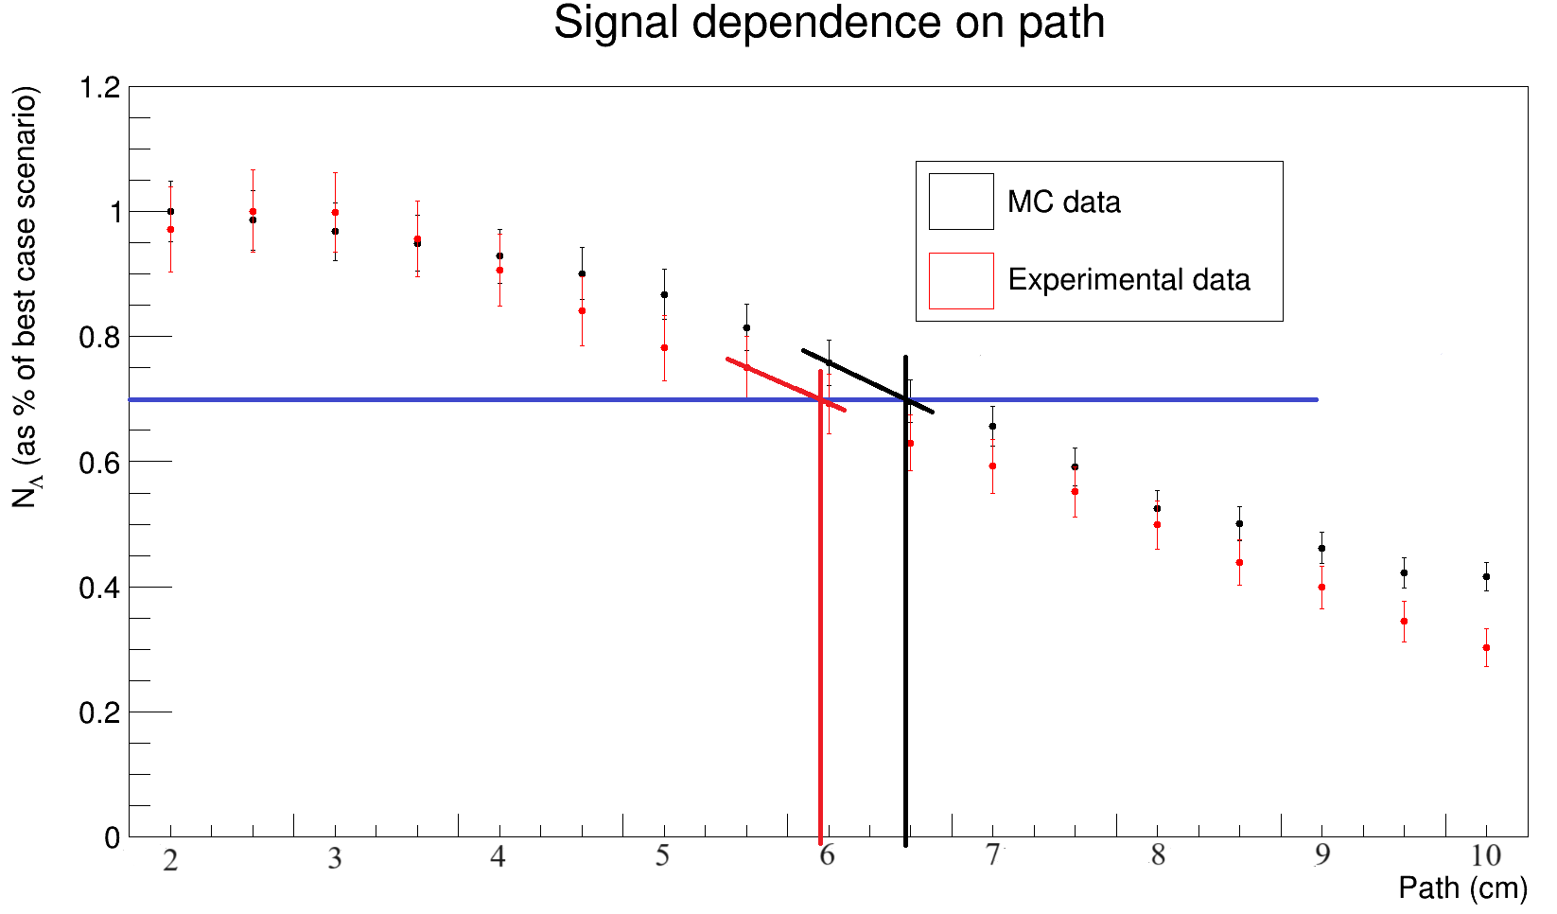
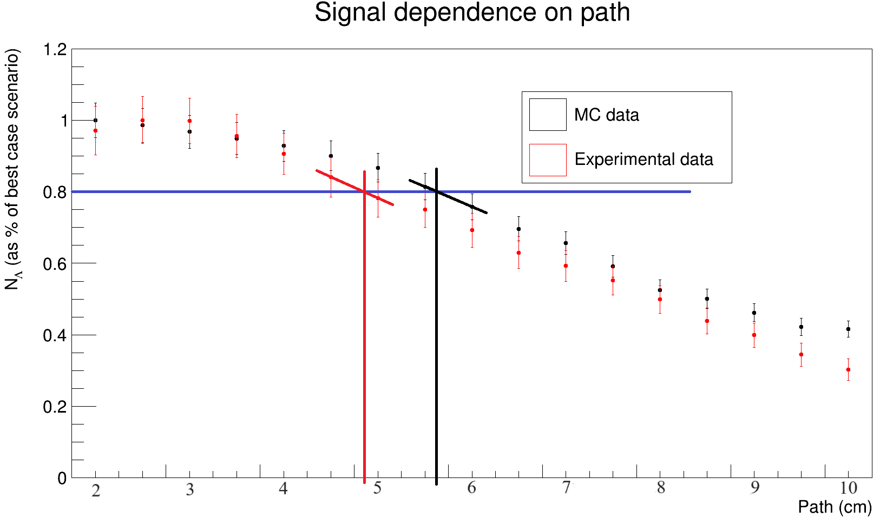
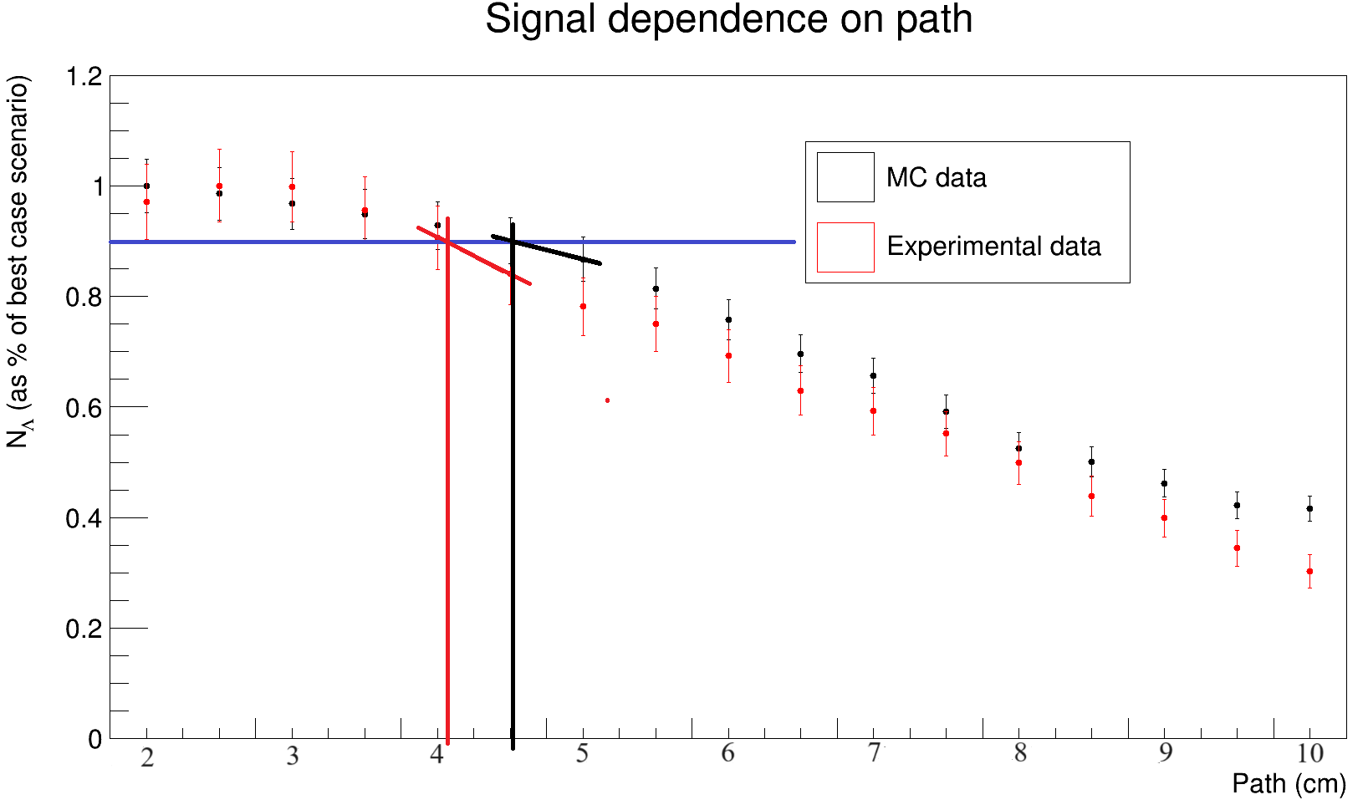
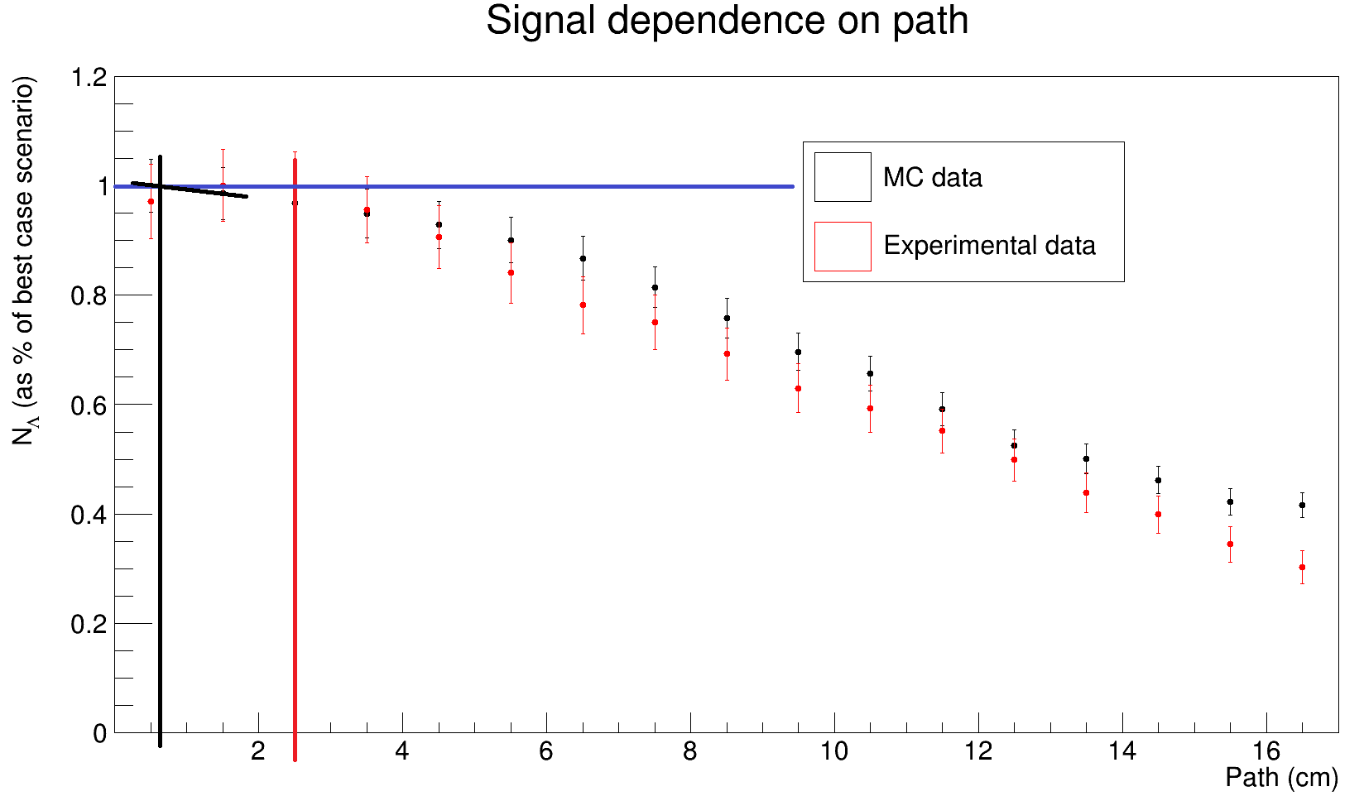
Signal analysis
Signal dependence on difference values of geometric restrictions for Λ

Slide 23
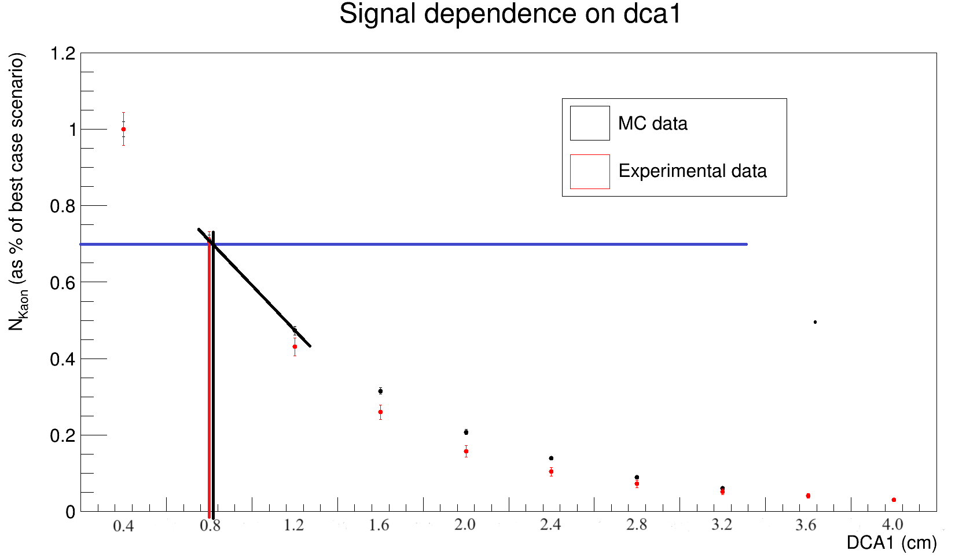
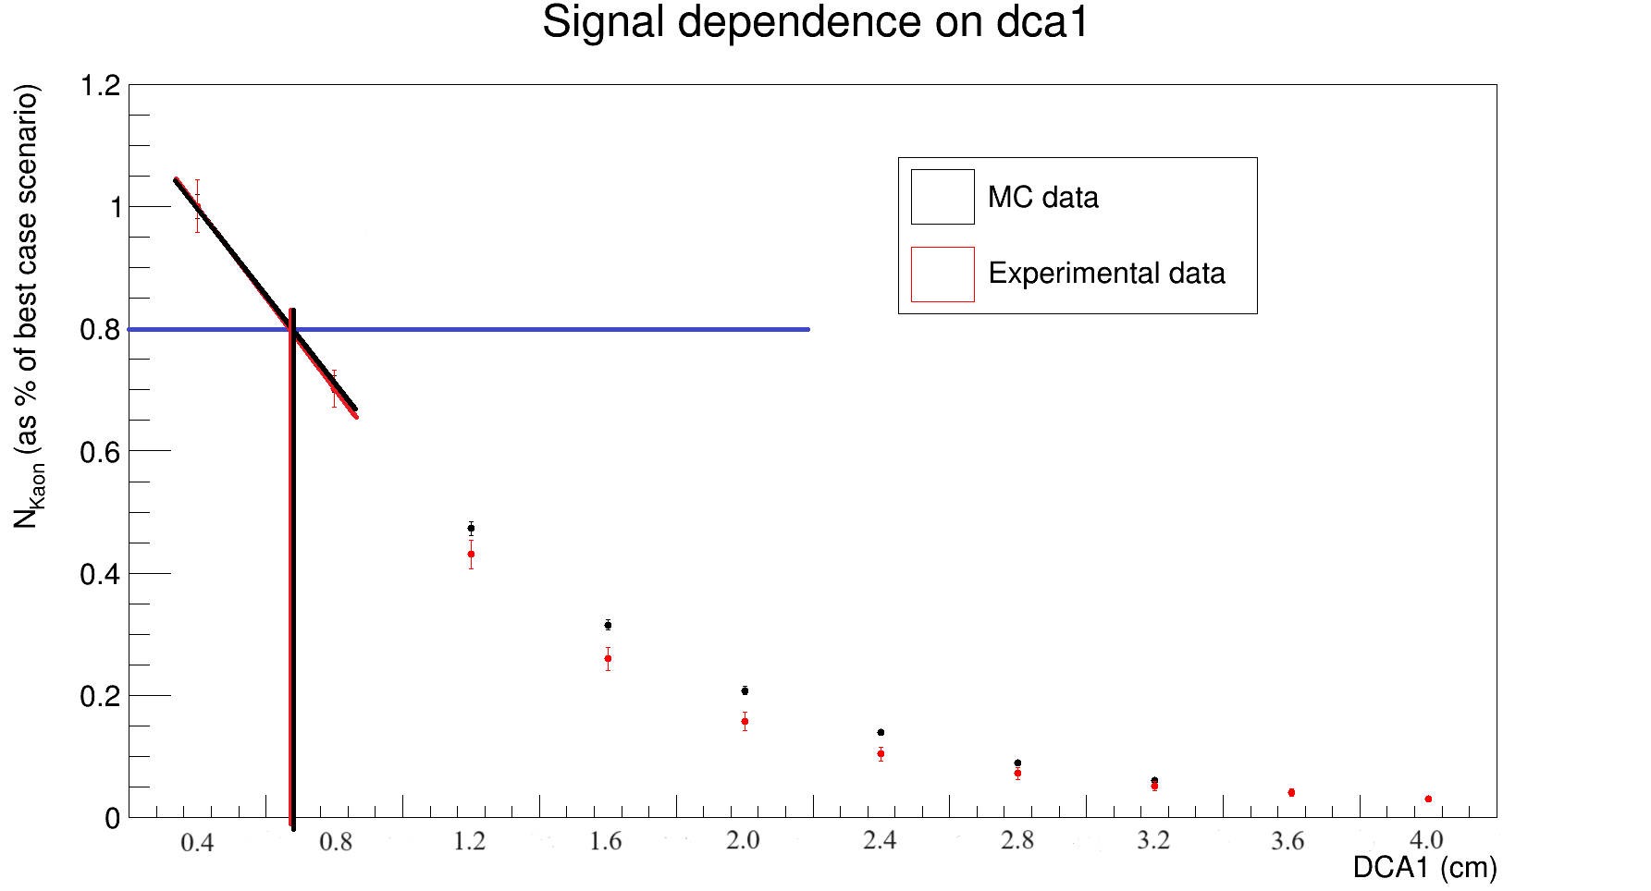
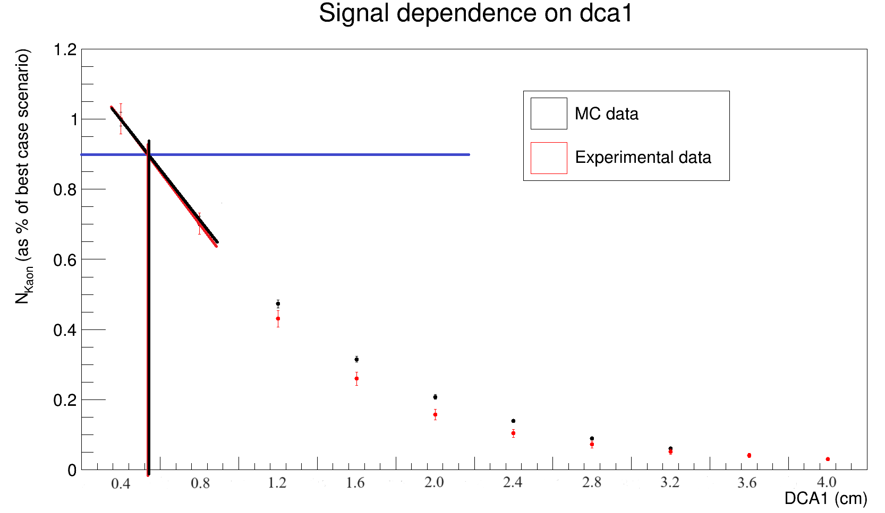
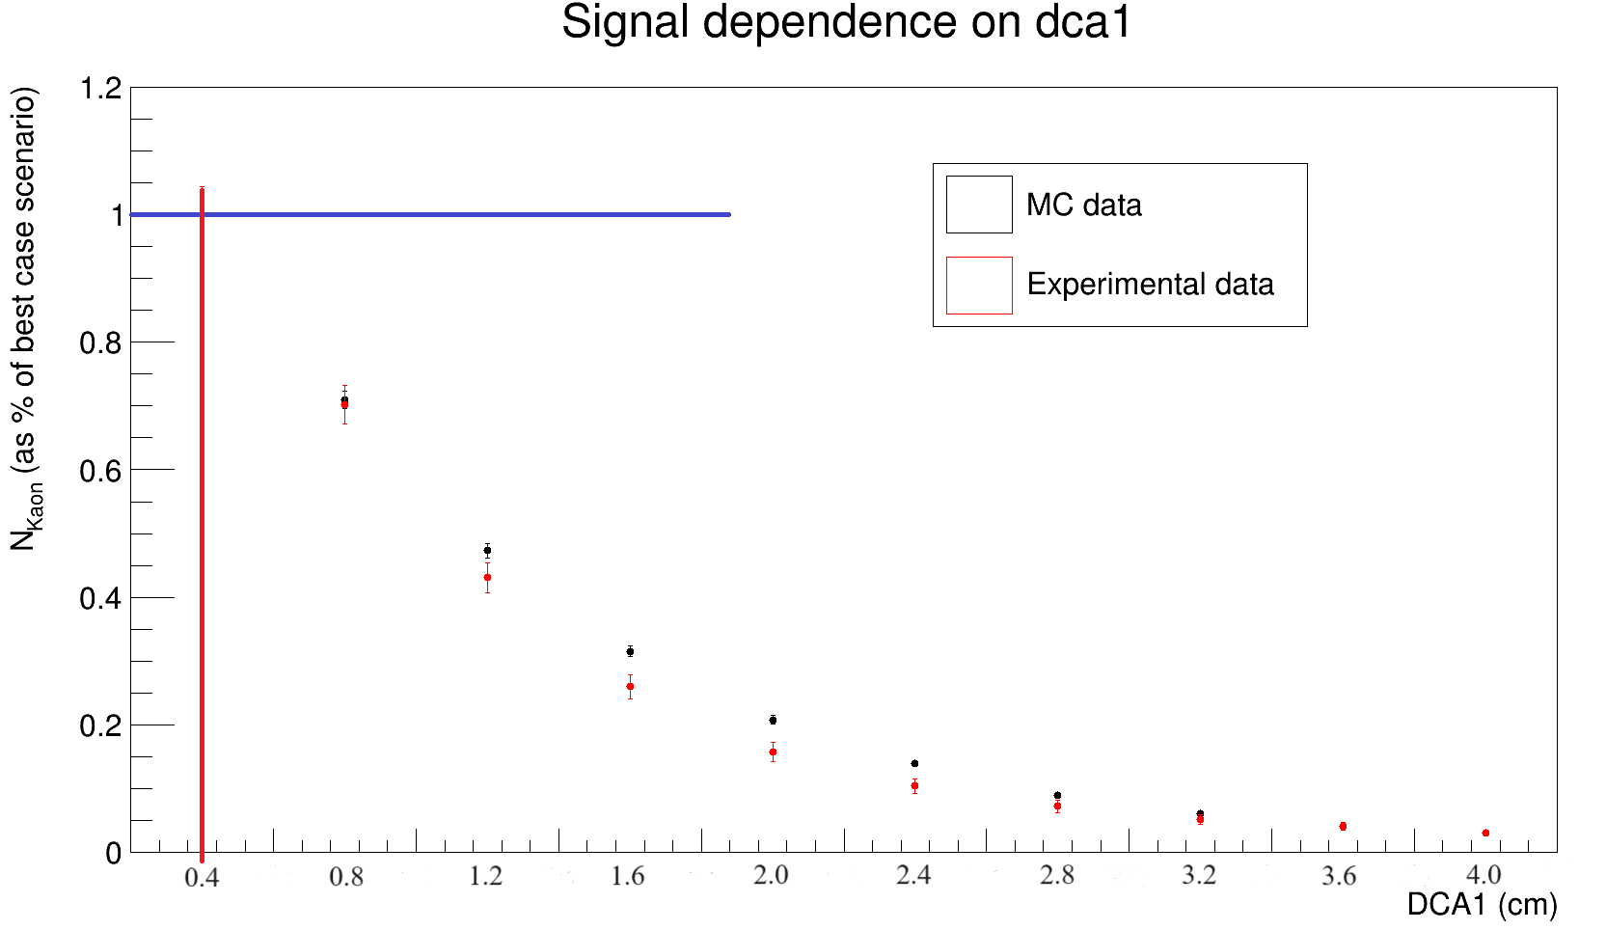
Signal analysis
Signal dependence on difference values of geometric restrictions for $K_{S}^{0}$

Slide 24
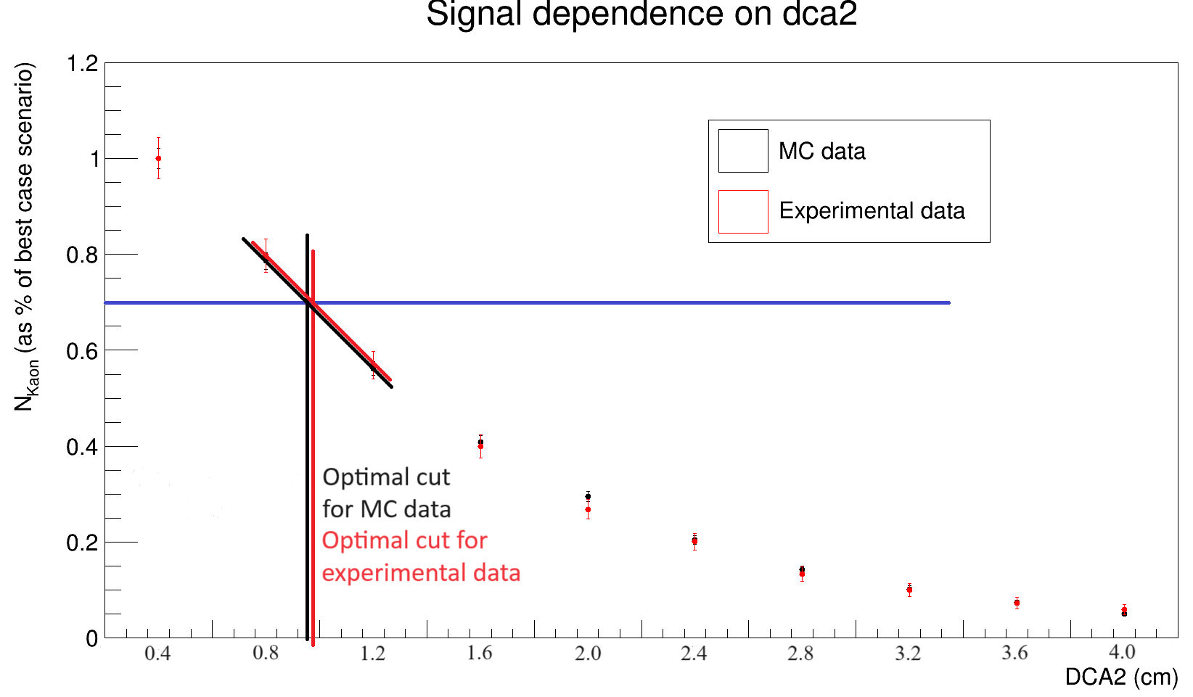
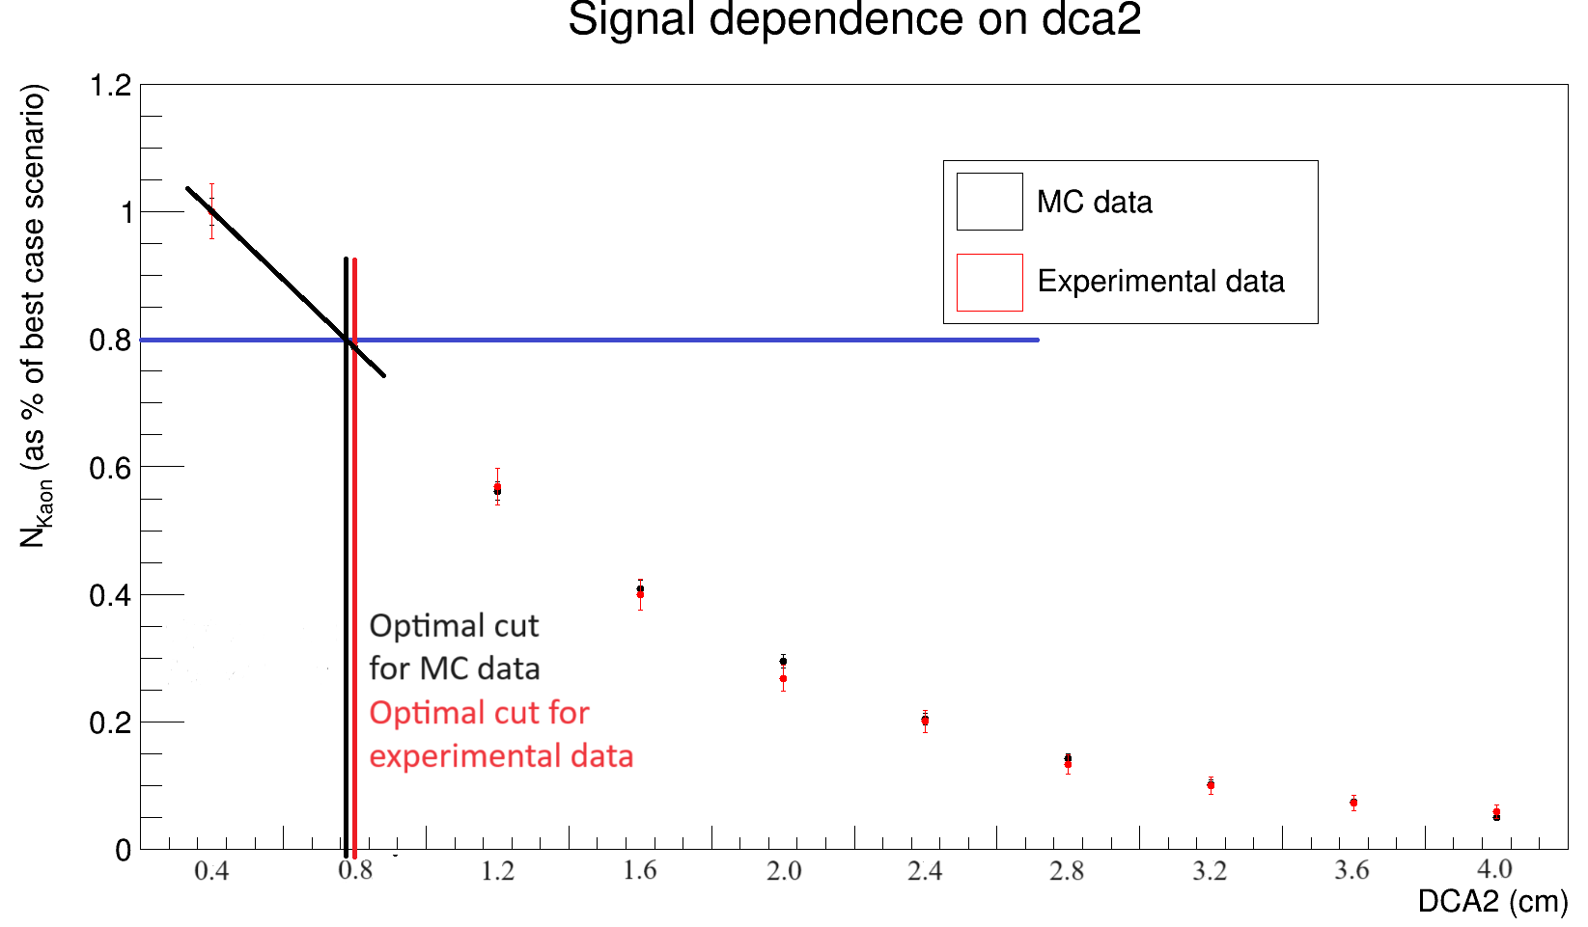
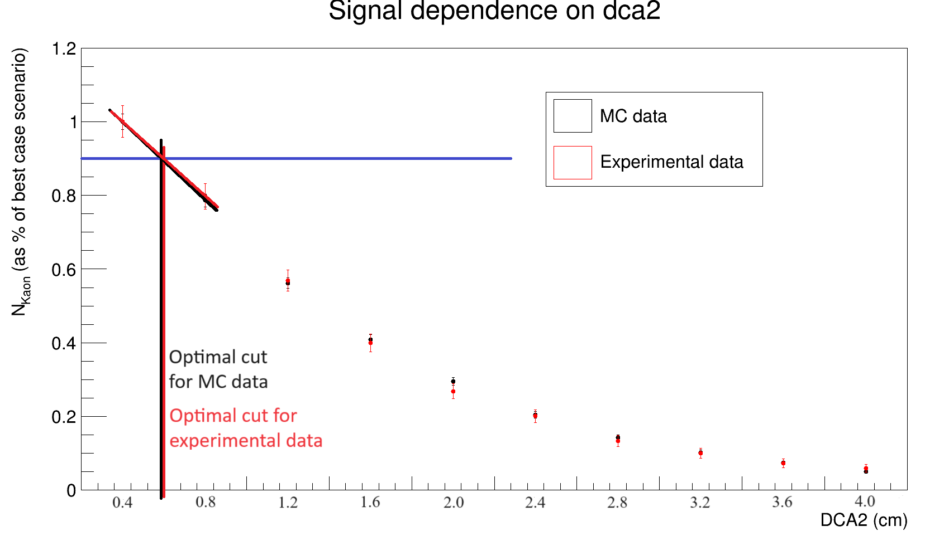
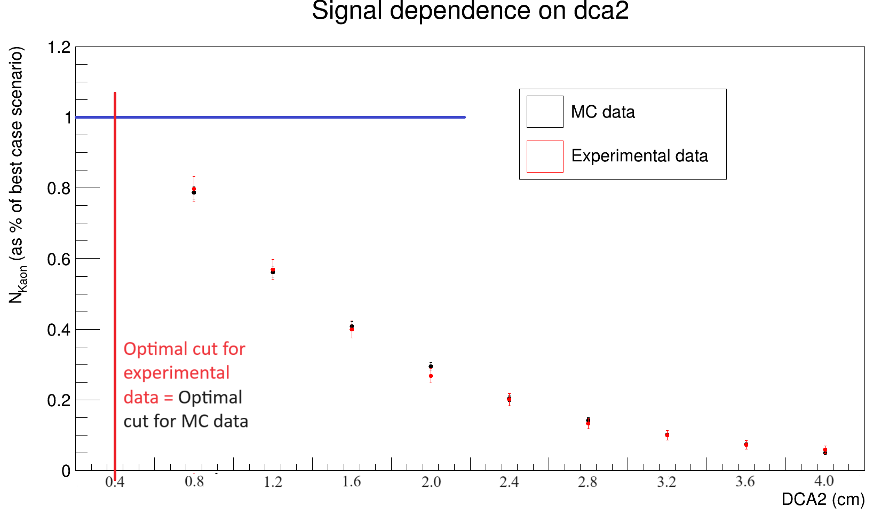
Signal analysis
Signal dependence on difference values of geometric restrictions for $K_{S}^{0}$

Slide 25
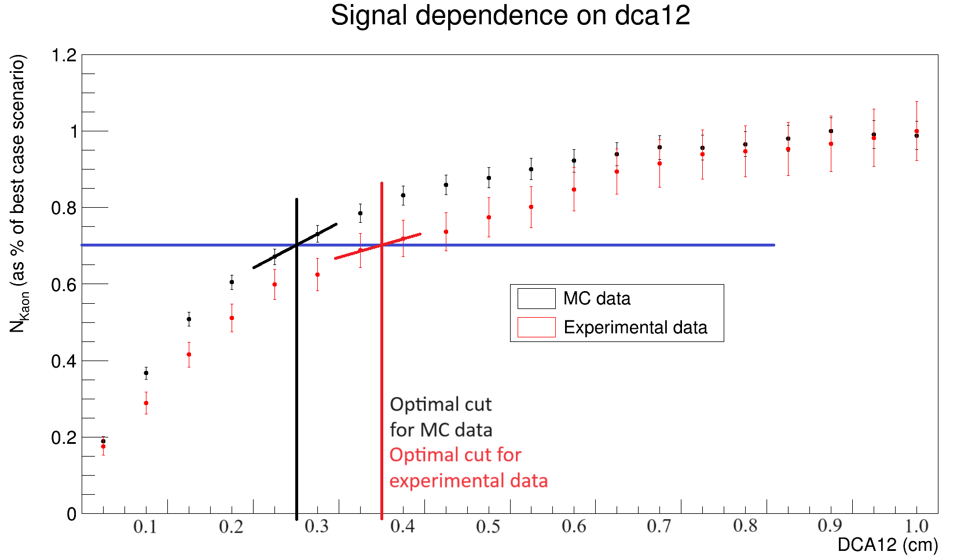
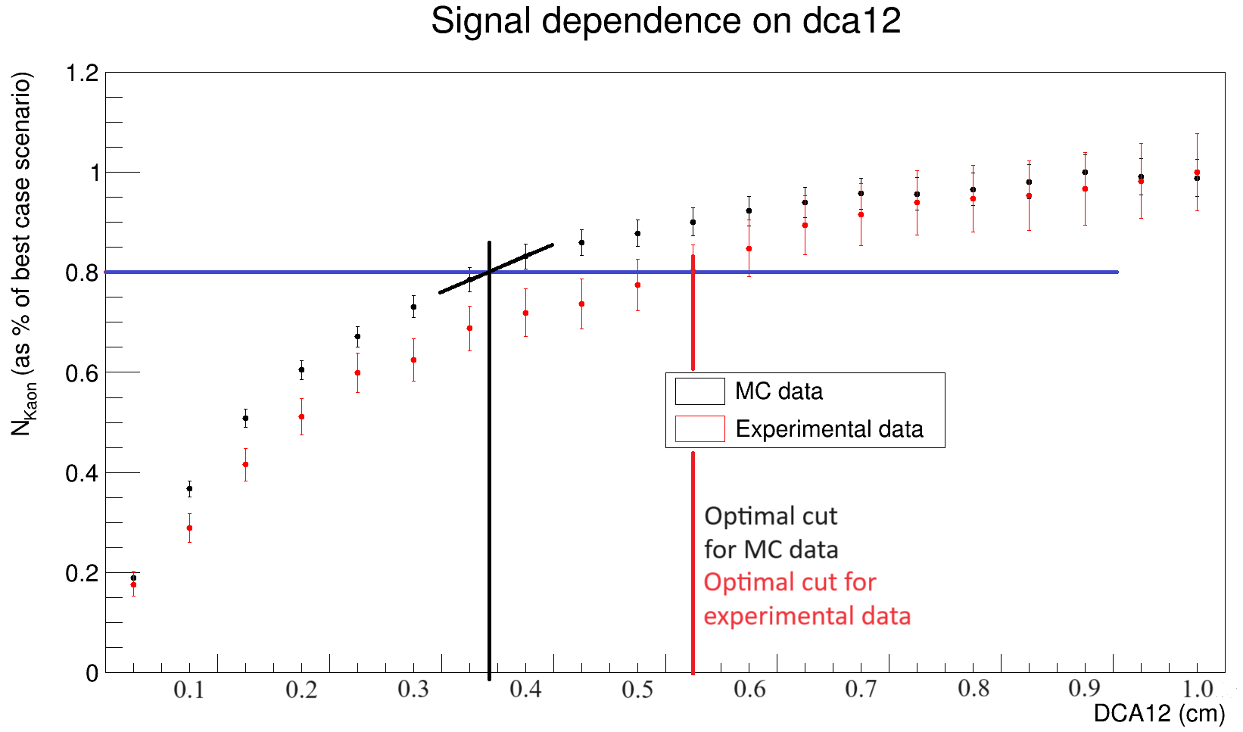
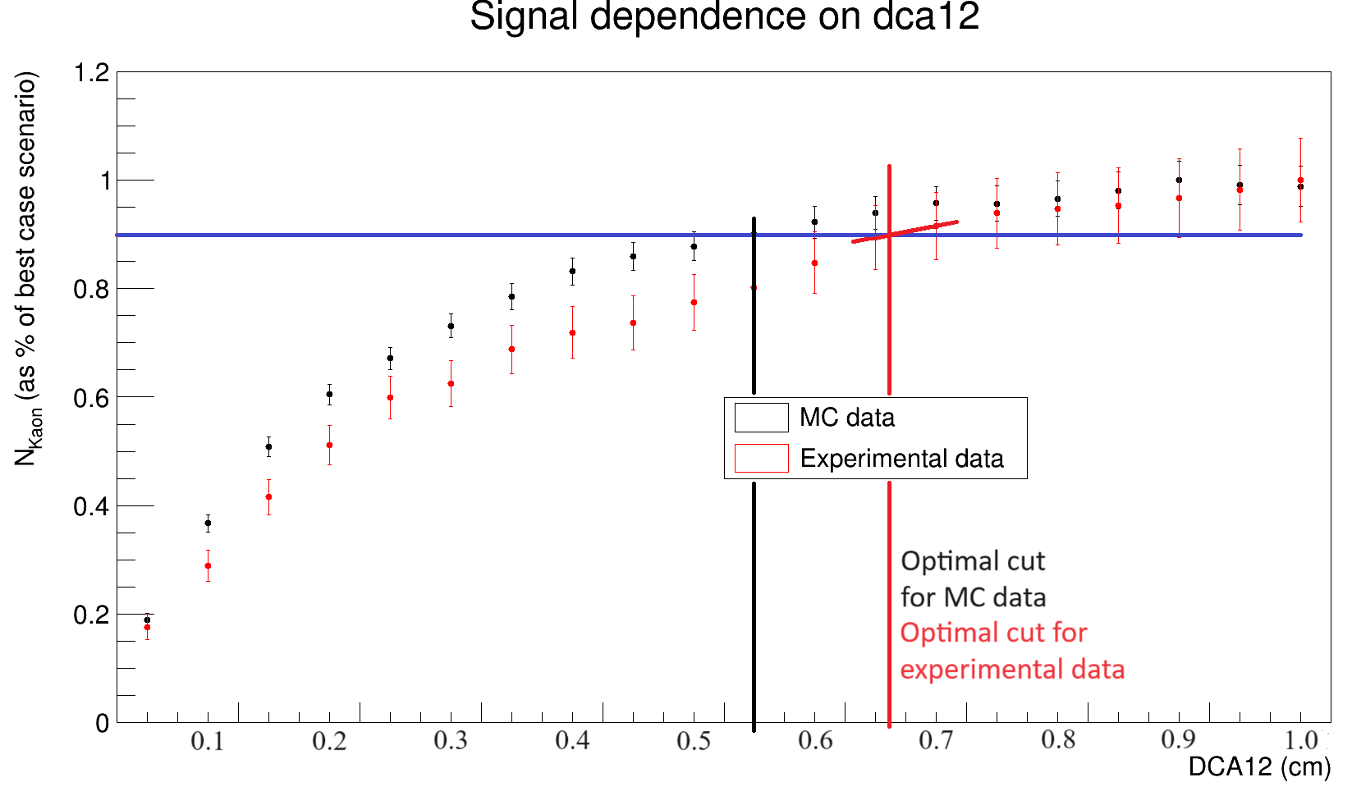
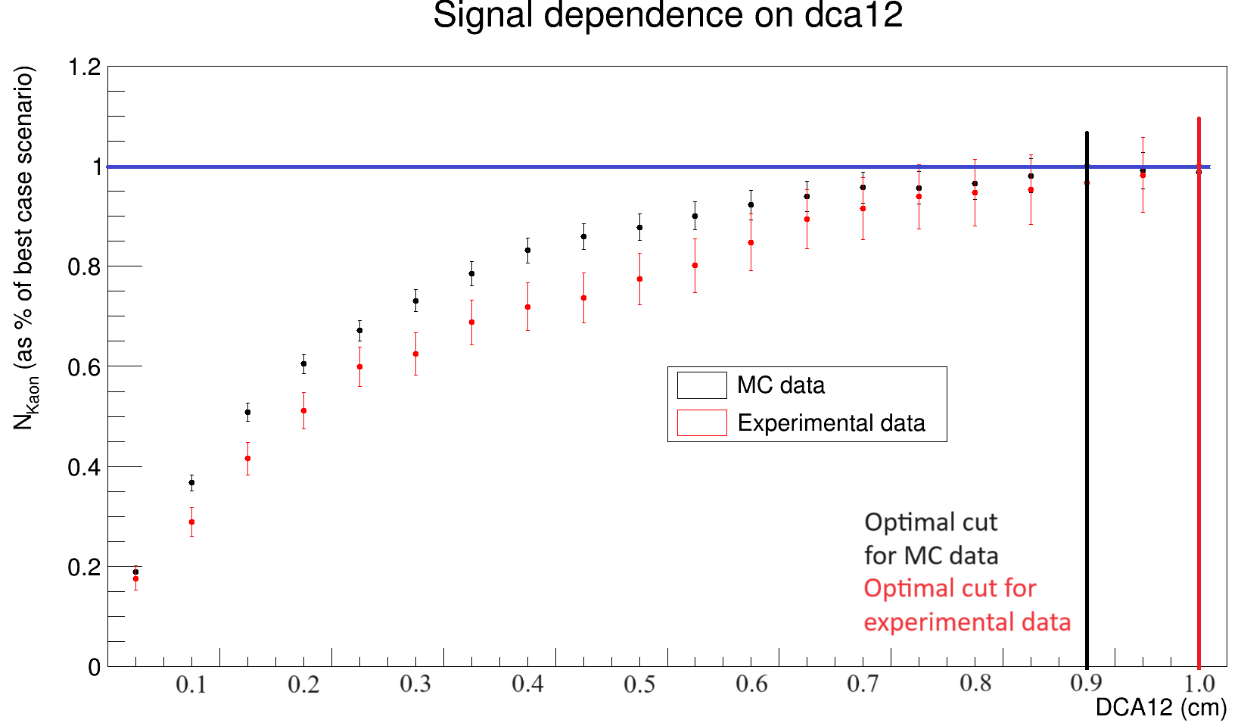
Signal analysis
Signal dependence on difference values of geometric restrictions for $K_{S}^{0}$

