Slide 1
Report of the PubCom chair
End EL Cone
SPD collaboration meeting
Samara University,Samara, Russia
October 23, 2023
Energy-Momentum Tensor and Light Cone
Oleg Teryaev
JINR, Dubna
Notes:
<number>
<number>

Slide 2
Temporary Publication Committee http://spd.jinr.ru/publication-committee/ spd_pubcom@jinr.ru
O. Teryaev JINR chair
Guskov JINR
P. Jones iThemba LABS
V. Kim PNPI
A. Korzenev JINR
A. Kulikov JINR
V. Ladygin JINR
E. Tomasi-Gustaffson IRFU Saclay
M. Kozhin JINR secretary (special thanks)

Slide 3
NEW document of publication policy (available)
Increase of the number of the papers
Necessity of differentiated approach
Procedure
Working group chaired by Egle Tomasi-Gustaffson: many thanks!

Slide 4
SPD Publication Policy 20.07.2023 (appr 09.10.23)http://spd.jinr.ru/wp-content/uploads/2023/10/SPD_Publication_Policy.pdf
General publications in referenced journals should be submitted to the Publication Committee for an approval of principle at least one month before the foreseen date of submission. The Publication Committee may appoint a dedicated Review Committee to follow up the paper till publication. The draft should be made available to the whole collaboration at least one week before the foreseen date of submission.
Approval for plenary talks and general presentations (title and abstract) to Conferences should be requested to the Publication Committee as much in advance as possible, preferably one month before submission and registration. A presentation is defined as ‘general’ if it represents an overview of the SPD project and its physics program or the SPD setup as a whole, including contributions from more than one working group.

Slide 5
SPD Publication Policy-2 http://spd.jinr.ru/wp-content/uploads/2023/10/SPD_Publication_Policy.pdf
Journal papers, devoted to some particular subdetector, a particular experimental technique or a Monte Carlo simulation for a given physics problem are signed by the subgroup of people having directly contributed. The Coordinator of the corresponding working group is responsible for preparation of the paper draft and the author list.
The Spokespersons act as mediators and judges for disputes that may arise and are the ultimate responsible for the publication of the SPD results. Any SPD member may require to remove his name in the author list, if he feels his contribution not sufficient or if he does not agree with statements of the paper. A motivated request should be sent to the authors, the relevant Coordinator and the Chairperson of the Publication Committee.

Slide 6
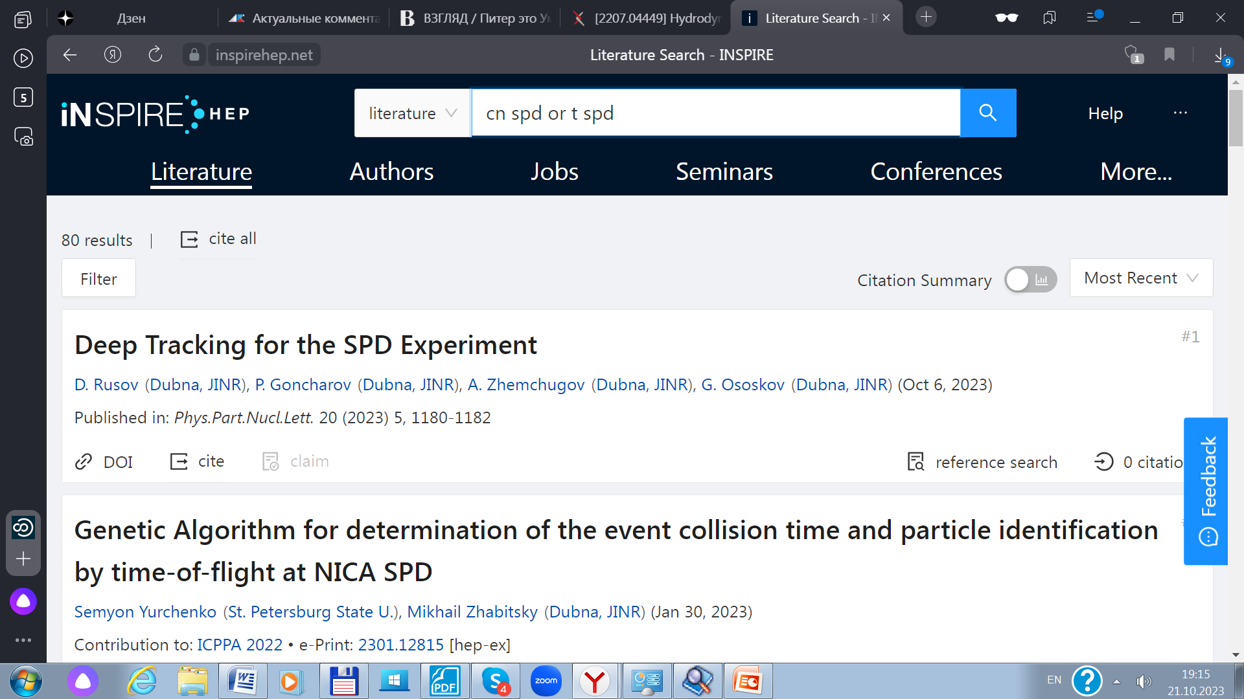
“SPD+” papers

Slide 7
SPD related papers http://spd.jinr.ru/spd-publications/
On the physics potential to study the gluon content of proton and deuteron at NICA SPD
A. Arbuzov (Dubna, JINR), A. Bacchetta (Pavia U. and INFN, Pavia), M. Butenschoen (Hamburg U., Inst. Theor. Phys. II), F.G. Celiberto (Pavia U. and INFN, Pavia and ECT, Trento and Fond. Bruno Kessler, Povo), U. D'Alesio (Cagliari U. and INFN, Cagliari) et al.
e-Print: 2011.15005 [hep-ex]
DOI: 10.1016/j.ppnp.2021.103858
Published in: Prog.Part.Nucl.Phys. 119 (2021), 103858
70 (2022-50) citations
Possible Studies at the First Stage of the NICA Collider Operation with Polarized and Unpolarized Proton and Deuteron Beams
V.V. Abramov (Serpukhov, IHEP), A. Aleshko (SINP, Moscow), V.A. Baskov (Lebedev Inst.), E. Boos (SINP, Moscow), V. Bunichev (SINP, Moscow) et al.
DOI: 10.1134/S1063779621060022
Published in: Phys.Part.Nucl. 52 (2021) 6, 1044-1119
14 (2022-9) citations

Slide 8
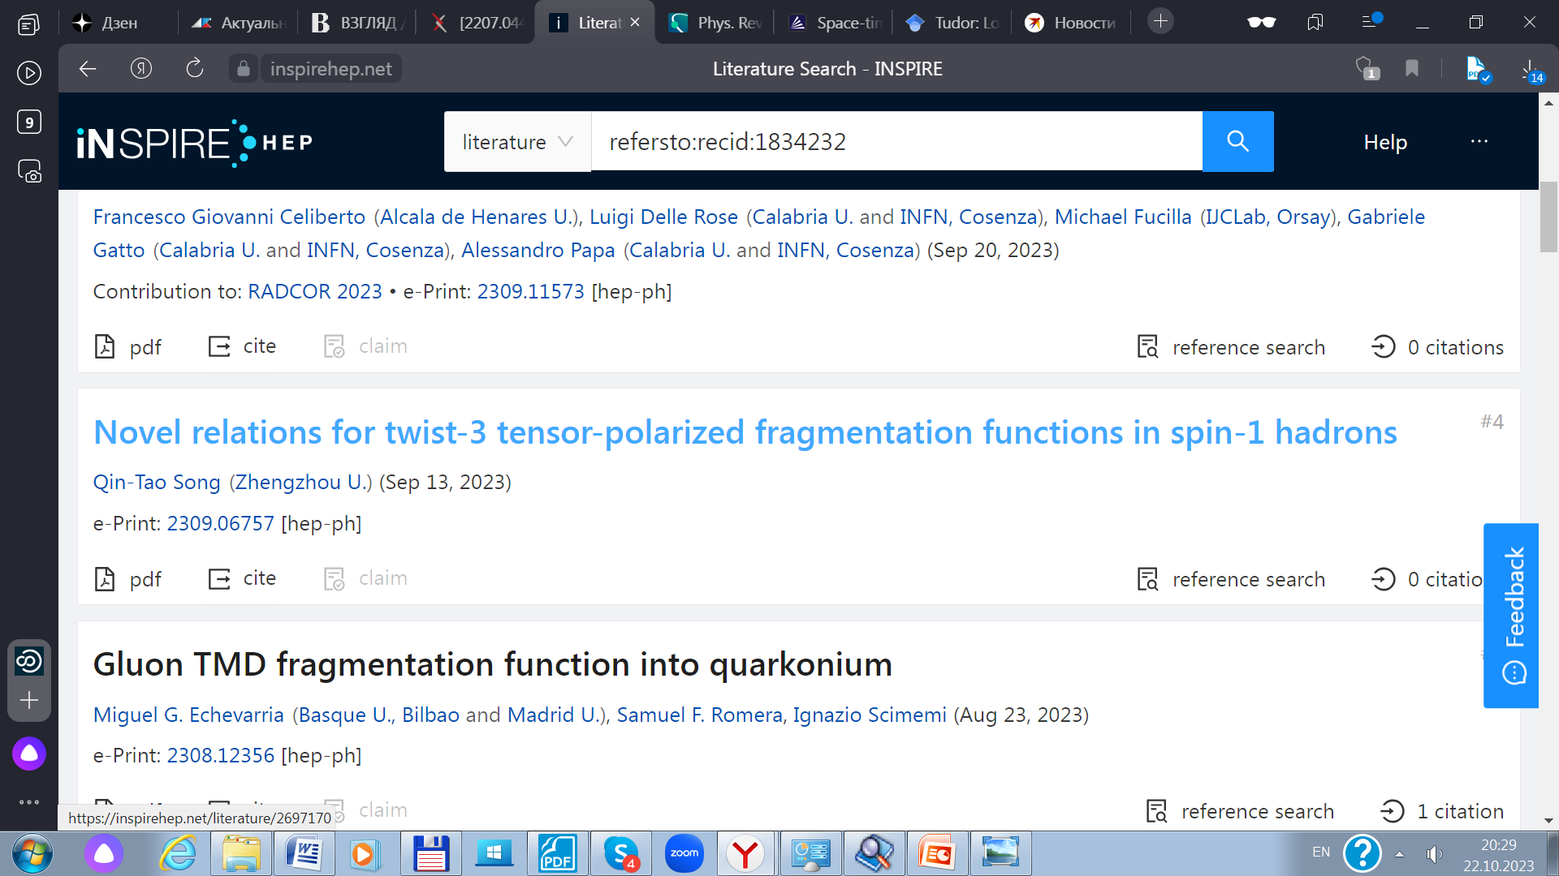
Citations

Slide 9
Conferences http://spd.jinr.ru/conferences/
2021: 13 talks at 11 conferences
24-th International Spin Symposium, SPIN2021, 18-22 October 2021, Matsue, Japan
Spin Physics Detector at NICA, PLENARY talk by V. Ladygin (for SPD Collaboration)
XXVIII International Workshop on Deep-Inelastic Scattering and Related Subjects, Stony Brook, 12-16 April 2021
The SPD (Spin Physics Detector) experiment at NICA, talk by A. Korzenev (for SPD Collaboration)
22-nd PANIC21 Conference, 5-10 September 2021, Lisbon, Portugal
Spin Physics Detector project at JINR, talk by A. Guskov (for SPD Collaboration)
Quarkonia as Tools 2021, 22-26 March 2021
Physics with charmonia at the SPD experiment, talk by I. Denisenko (for SPD Collaboration) 19-th International Conference on Hadron Spectroscopy and Structure in memoriam Simon Eidelman (HADRON2021), 26-31 July 2021, Mexico City, Mexico
The NICA-SPD project: a new tool to investigate the hadron structure, talk by E. Tomasi - Gustaffson(for SPD Collaboration)

Slide 10
2022:12 talks at 12 conferences
Quarkonia as Tools 2022, 9-15 January 2022, Aussois, France.
Quarkonium Physics at SPD NICA, talk by Amaresh Datta
Correlations in Partonic and Hadronic Interactions (CPHI2020), 07-10 March 2022, Duke University, Durham, NC.
Gluon physics at SPD (JINR), talk by Alexey Guskov
First Pan-African Astro-Particle and Collider Physics Workshop, 21-23 March 2022
The Spin Physics Detector at NICA, talk by Reham El-Kholy
nformation and Telecommunication Technologies and Mathematical Modeling of High-Tech Systems 2022 (ITTMM 2022), Moscow, Russia, April 18-22, 2022
Применение метода максимального правдоподобия для оценки параметров траекторий
элементарных частиц в задаче реконструкции внутреннего детектора эксперимента
SPD NICA, talk by Alexey Zhemchugov
15th Pisa Meeting on Advanced Detectors, 22-28 May 2022. La Biodola, Isola d’Elba, Italy
VMM3a ASIC as a potential front-end electronics solution for future Straw Trackers, talk by Vitalii Bautin

Slide 11
2023:25 talks at 10 conferences
India-JINR workshop on elementary particle and nuclear physics, and condensed matter research 16–19 Oct 2023
The Spin Physics Detector project at NICA, talk by A. Guskov
XXVII International Scientific Conference of Young Scientists and Specialists (AYSS-2023), 29 октября 2023 г. to 3 ноября 2023 г.DLNP, JINR
Transverse single-spin asymmetry for inclusive pi0 and eta mesonsat forward rapidity in SPD-NICA, talk by Mayvi Pedraza Monzon ; Time slice simulation in the SPD straw tracker, talk by Morozova Svetlana
42nd 42nd International Symposium on Physics in Collision (PIC 2023), 10-13 Oktober, Arica, Chile
SPD experiment at JINR, talk by Igor Denisenko

Slide 12
Conferences-23
The XXVth International Baldin Seminar on High Energy Physics Problems “Relativistic Nuclear Physics and Quantum Chromodynamics”, September 18 to 23, 2023 in Dubna, Russia.
MATERIALS SELECTION OF THE SPD BEAM-BEAM COUNTER SCINTILLATION DETECTOR PROTOTYPE, talk by A Zakharov
Resolution of Spd Detector in the Search of Dibarions with small energy exitations, talk by V. Kurbatov
Simulation of silicon detectors of the MiniSPD setup, talk by Nurlan Barlykov
Local polarimetry with inclusive neutral pions in SPD at NICA, falk by K. Shtejer
On the possibility of observing weakly excited 6-quark states in d-d → 6q+d processes at the NICA SPD, talk by B. Kostenko

Slide 13
Conferences-23
CONFERENCE ON HIGH ENERGY PHYSICS 11-14 September 2023, YEREVAN, ARMENIA
SPD Experiment, A Guskov
Сluster particle production @ SPD experiment, D. Budkouski

Slide 14
Conferences-23
XIXth Workshop on High Energy Spin Physics dedicated to 90th anniversary of A.V. Efremov birth, 4–8 сент. 2023 г.JINR (Efremov-90, DSPIN23)
Physics with SPD experiment at NICA, talk by Victor Kim
Prospects of Open-Charm Asymmetry Measurements at the SPD, talk by Amaresh Datta
Simulation of the pp – scattering for the Beam-Beam Counter at SPD at NICA, talk by A Terekhin
Resolution of SPD Detector in the Search of Dibarions with small energy excitations, takl by V. Kurbatov
Fast simhulation of nucleon momenta in deuteron for experiments at NICA SPD, talk by B. Kostenko
Exclusive reactions and Spin problems at SPD, talk by S. Shimanskiy

Slide 15
Conferences-23
Technology and Instrumentation in Particle Physics (TIPP 2023) conference will be held in Cape Town, South Africa 04th to 08th September 2023.
Spin Physics Detector at the NICA accelerator complex, talk by Alexander Korzenev
The Actual Problems of Microworld Physics, Minsk, Belarus, 27 August – 3 September, 2023
Exploring the possibility of studying the Drell-Yan process in the SPD (NICA) experiment, talk by A. Skachkova
TWENTY-FIRST LOMONOSOV CONFERENCE ON ELEMENTARY PARTICLE PHYSICS 24-30 August, Moscow, Russia
SPD experiment at JINR, talk by Igor Denisenko

Slide 16
Conferences-23
XXX Anniversary International Seminar Nonlinear Phenomena in Complex Systems, 19-23 June 2023, Minsk, Belarus
The SPD (Spin Physics Detector) experiment at NICA, talk by Alexander Korzenev
Particle Identification in SPD, talk by Artem Ivanov
Study of inclusive π0 production at SPD, talk by Ruslan Akhunzyanov
Ks0 reconstruction study in SPD, talk by Natalia Rogacheva

Slide 17
Plans for 2024
Session Nuclear Physics Session of RAS at JINR (spring)
In-person participation
Section on 3D/spin structure, SPD-related talks

Slide 18
SUMMARY
SPD is visible in publications and conference talks
DSPIN23, BALDIN23 provided good possibility
SPD physics is extensively studied and presented
More is required: RAS Session,…

