Slide 1
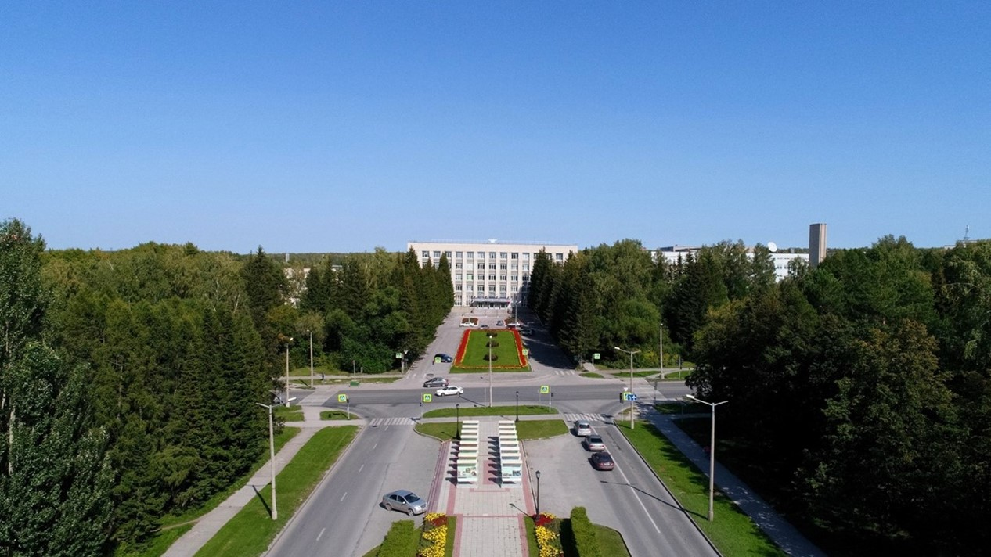
The Budker Institute of Nuclear Physics

Slide 2
SPD magnet
Status of the SPD superconductive solenoid development

Slide 3
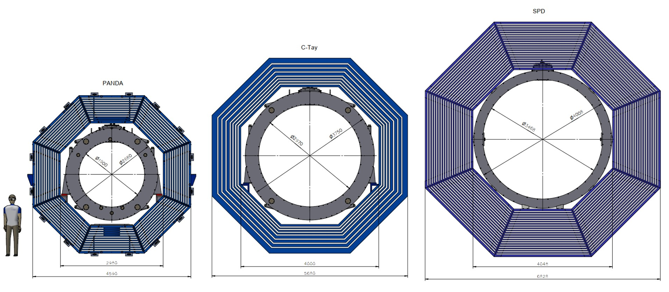
PANDA & C-tay & SPD Magnet.
This slide shows 3 magnet projects for detectors: PANDA (FAIR), D=2680 mm, L=3090 mm; C-tay factory (BINP), D=3750 mm, L=3700 mm; and SPD (JINR), D=4008 mm, L=4220 mm.

Slide 4
SPD Магнит with Control Dewar
Control Dewar box
and TL
Power supply and energy
extraction system
The magnetic field along the solenoid axis should be 1.0 T.
BINP presents our participation in SPD project with the following items:
Magnetic and engineering design of the magnet including tools and support;
Production and delivery of the magnet (consisting of the cryostat with cold mass, alignment components, proximity cryogenics, supports);
Power converter, energy extraction system, quench protection and instrumentation.
Instrumentation Frame
Responsibility of the BINP
Magnet

Slide 5
SPD development
• Magnetic analysis of the magnet including of calculations of the magnetic forces is done. Using the Maxwell tensor method, the magnetic forces acting on the elements of the solenoid (barrel part of the yoke, endcaps) and coils were calculated. The results of the calculations were presented at a workshop at JINR on December 17, 2023. Magnetic field map of the SPD solenoid is ready. This topic will be presented in more detail in the report by E.I. Antokhin.
• Design of the proximity cryogenics with flow scheme and all instrumentation for cryogenics and insulation vacuum for the cryostat and control Dewar, current leads is in progress. Selection of equipment and instruments for the SPD solenoid cryogenic system is carried out. 3D model of the distribution box with cryogenic piping was developed. Thermal loads on 4.5K cryogenic systems and 60K heat shields are estimated. This topic will be presented in more detail in the report by T.V. Bedareva.
• Design of the power supply system and energy extraction system is in progress. Selection of equipment and instruments for the SPD solenoid cryogenic system is carried out. This topic will be presented in more detail in the report by A.I. Erokhin.

Slide 6
SPD yoke and solenoid
The cryostat of the magnet with the coils, cold mass and thermal shields is located inside the yoke.
Outside diameter of the cryostat is 4008 mm and a gap between the yoke and the cryostat about 20 mm. Radially a free diameter of 3468 mm is left for the SPD detectors. The length of the magnet is 4220 mm and the magnet should be installed symmetrically inside the yoke.

Slide 7
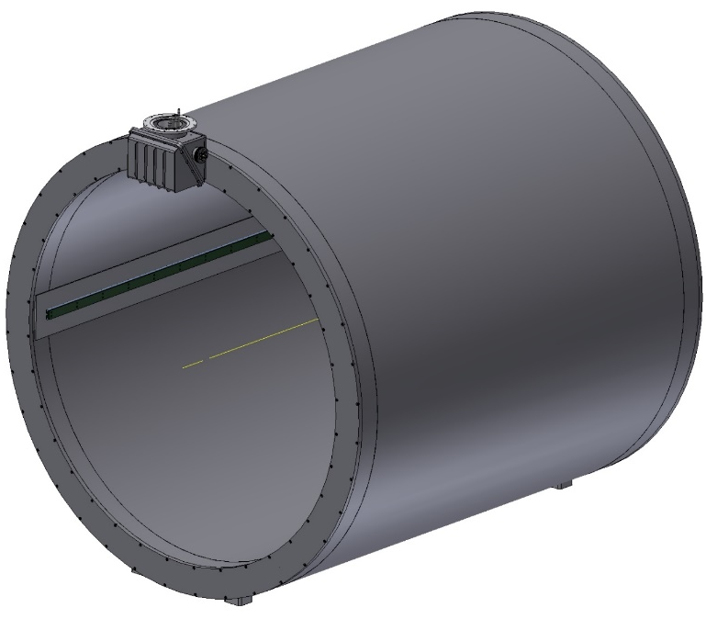
SPD Magnet
Cryostat: Outer diameter -4008 mm;
Inner diameter - 3468 mm;
Length 4220 mm;
Thickness - 270 mm;
Cold mass: Outer diameter -3756 mm;
Inner diameter - 3662 mm;
Length 3416 mm;
Coils: (2 pieces): Number of layers - 2; Number of turns 2x156=312.
(1 piece): Number of layers - 2; Number of turns 2x78=156
Total number of turns - 780
Weight: - cryostat - 16700 kg
- shield - 1000 kg
- cold mass - 5390 kg
Total: ~23 t
Switching box
The main characteristics of the magnet:
Magnetic field along the axis - 1.0T with uniformity ± 2%;
The superconductive solenoid consists of three coils, the current is 5200 A.
Conductor type: Rutherford type cable consists of 8 strands with a diameter of 1.4 mm and a Cu / NbTi ratio of one, extruded into a matrix of high purity aluminum A996, the conductor cross-section at a temperature of 4.5K is 7.90mm in width and 10.90mm in height;
Guides for placing the calorimeter

Slide 8
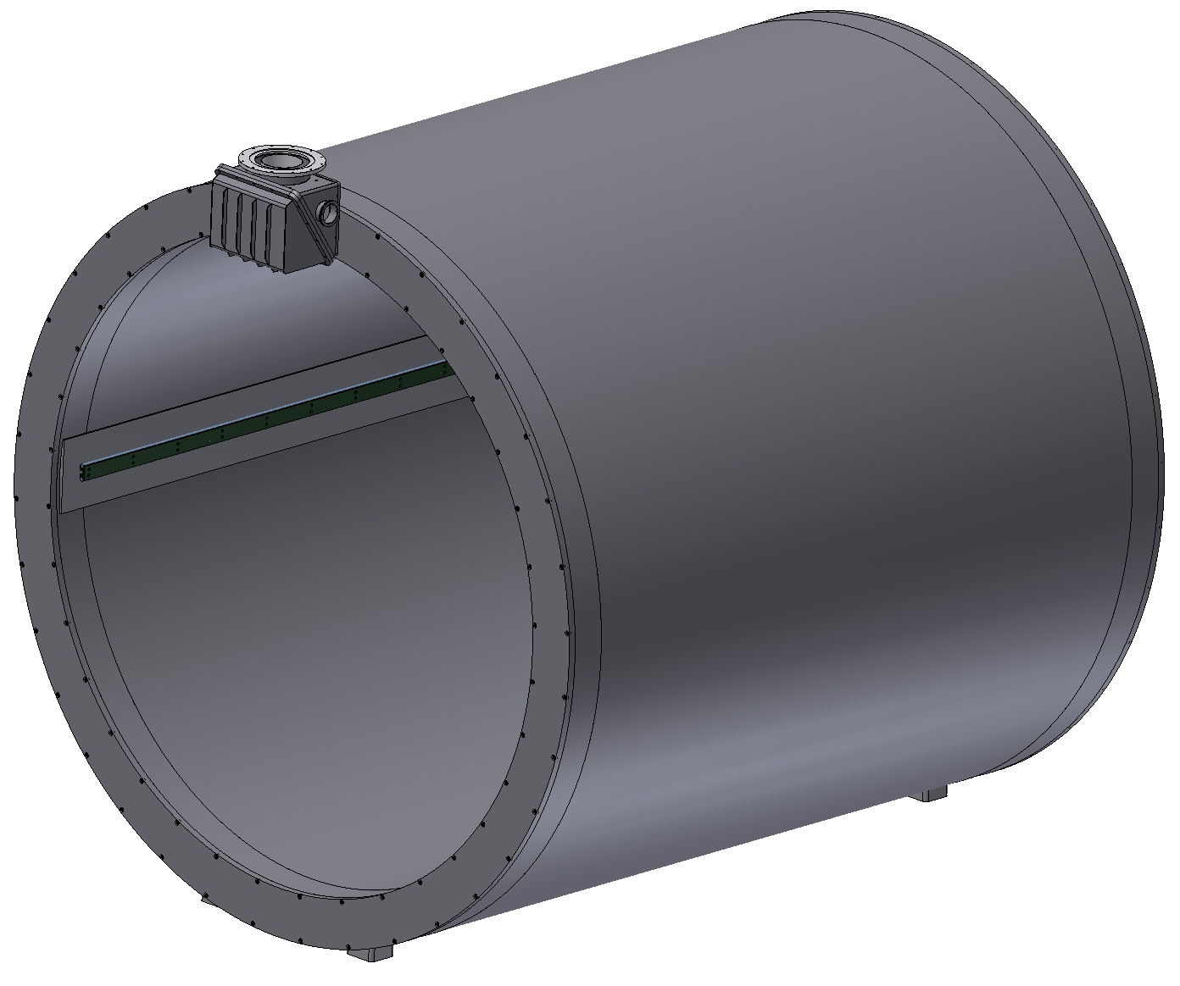
Inner diameter is 4008 mm, Outer diameter is 3468 mm, length is 4220 mm. The thickness of the outer shell is 12 mm, the inner shell is 20 mm, the thickness of the flanges is 45 mm. The thickness at the ends of the shells is 40 mm. Material: St. Steel. The weight of Cryostat is ~16.7 t
Cryostat

Slide 9
The maximum equivalent stress is 65 MPa. The maximum deformation is 1 mm.
Cryostat (calculation)
Operation condition (p=0.05 MPa) + weight.

Slide 10
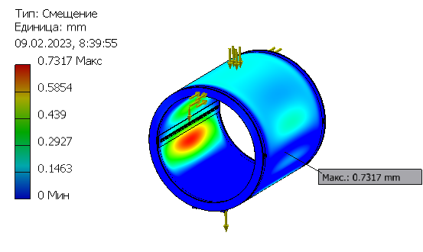
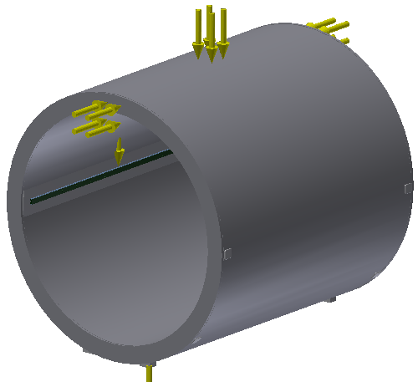
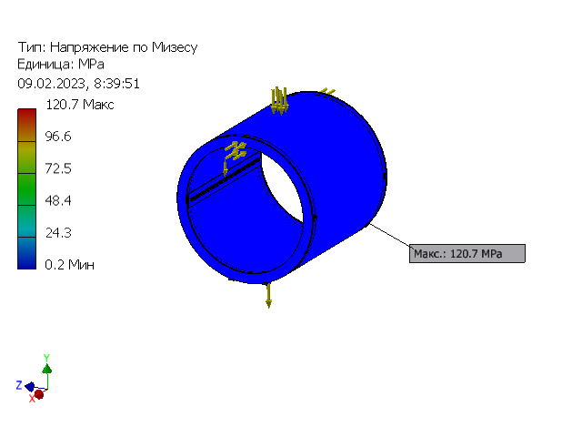
It is suppose that the calorimeter will be based on guides located along the magnet in the middle plane. The maximum equivalent stress is 120 MPa. The maximum deformation is 0,7 mm.
Cryostat (calculation)
Operation condition (p=0.1 MPa), weight + weight of calorimeter (60t )

Slide 11
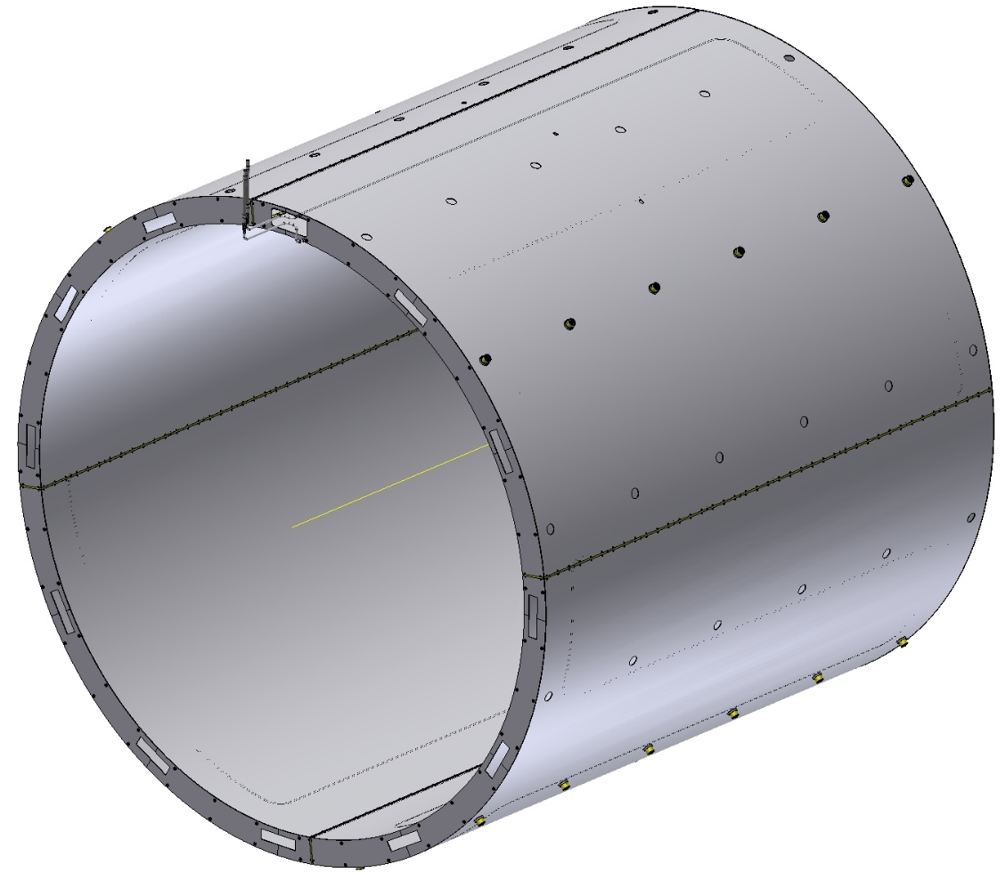
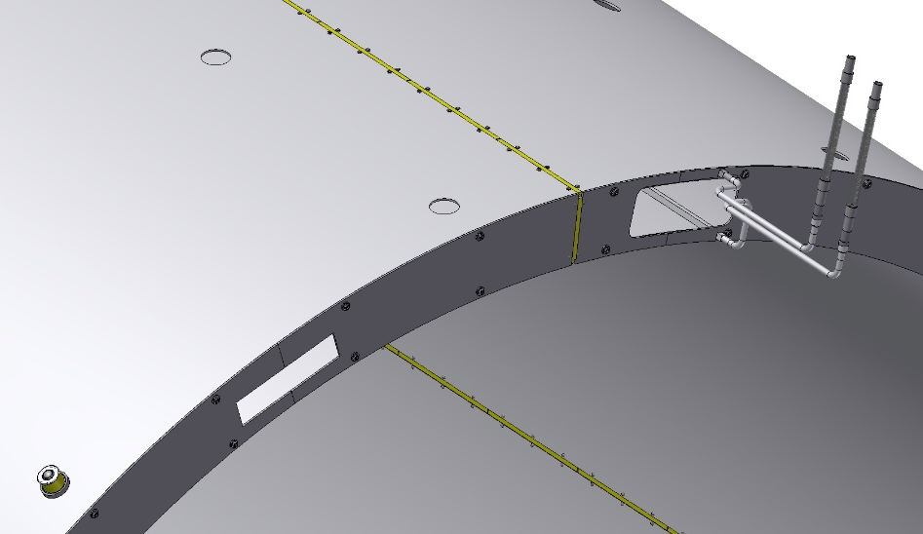
Material - aluminum alloy AMg-5. Outer diameter - 3898 mm, inner diameter - 3568 mm, length - 3720 mm. Wall thickness - 4 mm, Shield weight ~1 t
Thermal shield 80K
Gap
Insulator G10
Collector
For the collector, a 12x12 with 8 mm hole Al profile welded to the shell of the shields is used. The shield is divided around the perimeter into 4 parts using G10 insulators. Outside the shield is covered with 30 layers of MLI and inside surface of the shield is covered with 10 layers of MLI .

Slide 12
Shield
Ring (G10)
Support
Balls transfer units
Bush(G10)
The shield is positioned in the cryostat using ball bearings with an insulating ring (4 rows at the bottom and 2 rows at the top).
In the axial direction, the shield is fixed in the central part with help of bolts through the insulating bush - 4 point at the top and 4 point at the bottom.

Slide 13
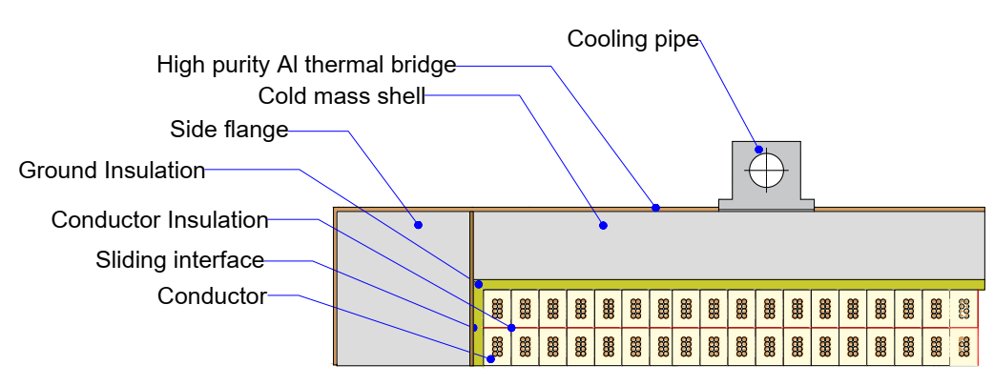
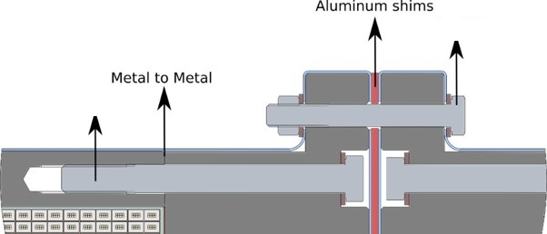
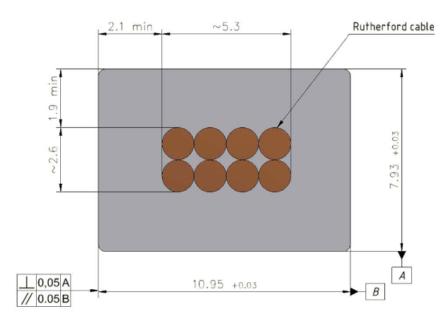
Cold Mass (design)
2 coils x 2 layers - 312 turns
1 coil x 2 layers - 156 turns
Magnetic field - 1 T
Current - 5.2 kA
Conductor mechanical and electrical parameters.
Thickness (after cold work) at 300 K | mm | 7.93 | ± 0.03
Width (after cold work) at 300 K | mm | 10.95 | ± 0.03
Critical current (at 4.2 K, 5 T) | A | > 14690
Critical current (at 4.5 K, 3 T) | A | > 16750
Overall Al/Cu/sc ratio |  | 10.5/1.0/1.0
Aluminum RRR (at 4.2 K, 0 T) |  | > 600
Al 0.2% yield strength at 300 K | MPa | > 30
36 x M12
Rutherford cable, 8 strands, extruded in Al matrix
64 x M12
10.95 мм x 7.93 мм,
NbTi / Cu d=1.4 мм
Rutherford cable is used to wind the coils. The cold mass consists of three coils, The coils are fixed together using bolts. If necessary, we will use special shims between the sections of the coils.

Slide 14
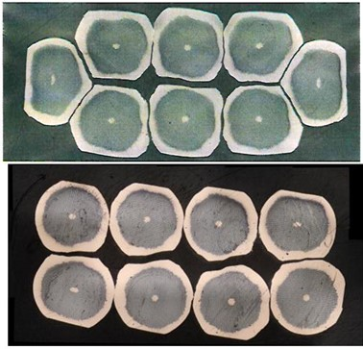
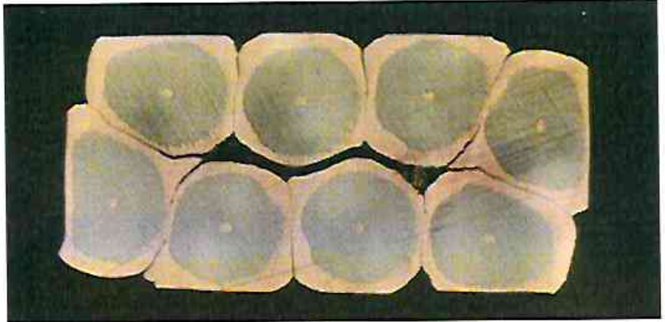
SPD superconductive conductor
SPD Rutherford cable parameters were selected and a 100 meter long sample was produced for further development. Cryogenic tests were performed on individual strands after cable fabrication. The parameters correspond to the technical specification. These works were carried out jointly with VNIIRP.
Results of cable geometric dimensions control
Parameter | Unit | Value | Tolerance | Test
Diameter filament | µm | < 20 | - | 18
Diameter strand | mm | 1.400 | ± 0.005 | 1.4 ± 0.05
Cu/SC ratio | - | 1.00 | ± 0.05 | 0,95
Surface coating | - | none | - | -
NbTi Jc (at 4.2 K, 4.05 T) | A/mm2 | > 2800 | - | -
Critical current (at 4.2 K, 4.05 T) | A | > 2600 | - | > 2660
n-value (at 4.2 K, 4.05 T) | - | > 30 | - | 34 for 8T
Conductor RRR | - | > 100 | - | 165
Twist direction | - | left | - | left
Twist pitch | mm | 25 | ± 5 | 49
Number of strands | - | 8 | - | 8
Cable width | mm | 5.3 | ± 0.1 | 6,1 ± 0.05
Cable thickness | mm | 2.60 | ± 0.05 | 2,6 ± 0.05
Transposition angle | degree | 20.0 | ± 0.5 | 14
Twist direction | - | right | - | right
Critical current degradation of extracted strand (at 4.2 K, 4.05 T) | % | < 5 | - | 1,5
RRR of extracted strands | - | > 60 | - | 72
Cable 6,1 × 2,6 mm², angle 14°, twist pitch 49 mm
Cable 5,3 × 2,6 mm², angle 20°, twist pitch 25 mm

Slide 15
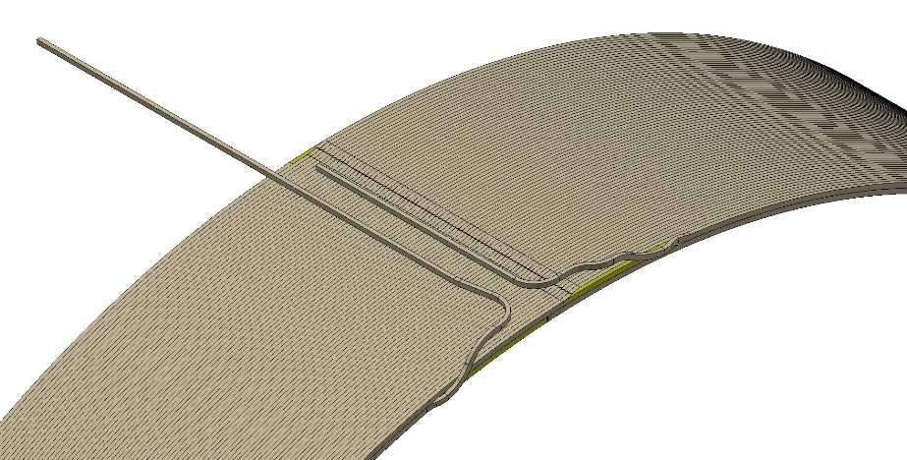
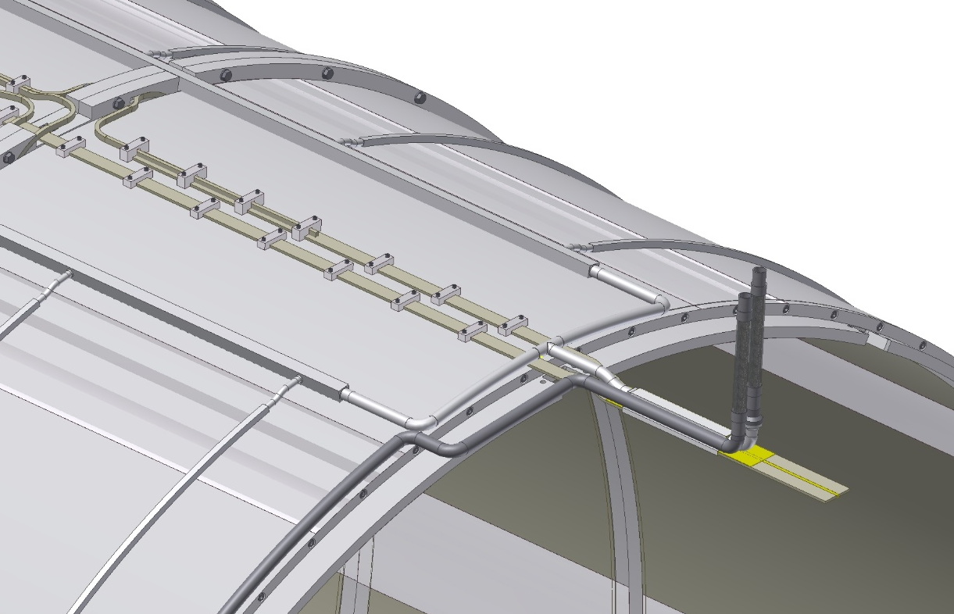
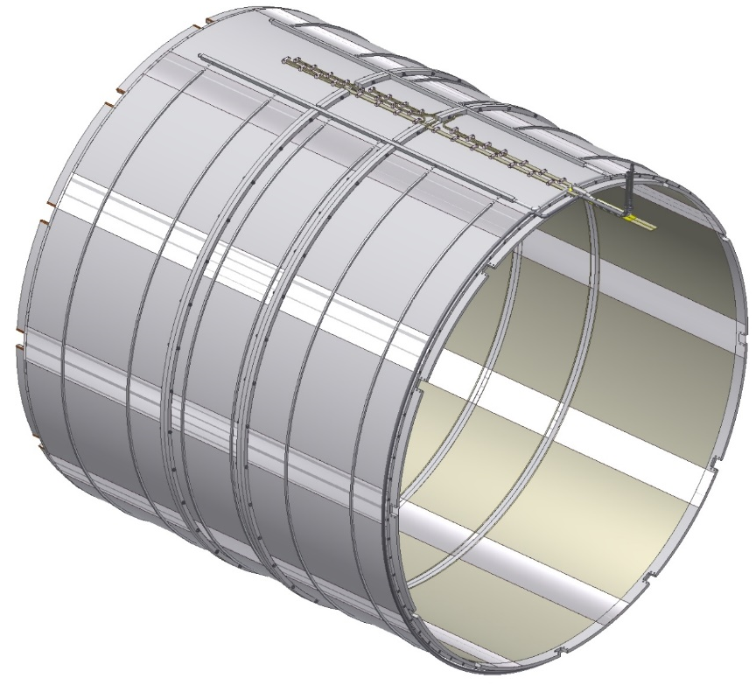
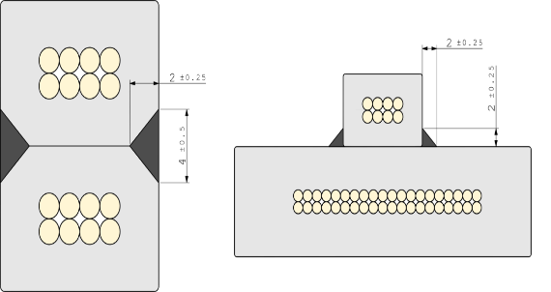
Inner diameter is 3662 mm, Outer diameter is 3756 mm, The length is 3416 mm, The weight of cold mass is ~5,4 t. The connection of the coils to the current leads is made through bas-bars with a cross section of 32 by 5.6 mm Thermal bridges made of high purity aluminum are used for temperature equalization.
Cold Mass
Support brackets
Bus-bars
Manifold
Coil winding
coil-to-coil and layer-to-layer joints
Thermobriges

Slide 16
The magnet consists of 3 coils: front and back have 2 layers of 312 turns, cable length ~ 3600 meters; the central coil has 2 layers of 156 turns, the cable length is ~1800 meters. For cooling, a tube with a cross section of 14x14 mm and a hole of 10 mm is used, welded to the shell of the cold mass. Bimetallic adapters are used to connect aluminum profiles to stainless steel pipes.
Cold Mass
Collector
Out
Bimetal Al-St.Steel.
In

Slide 17
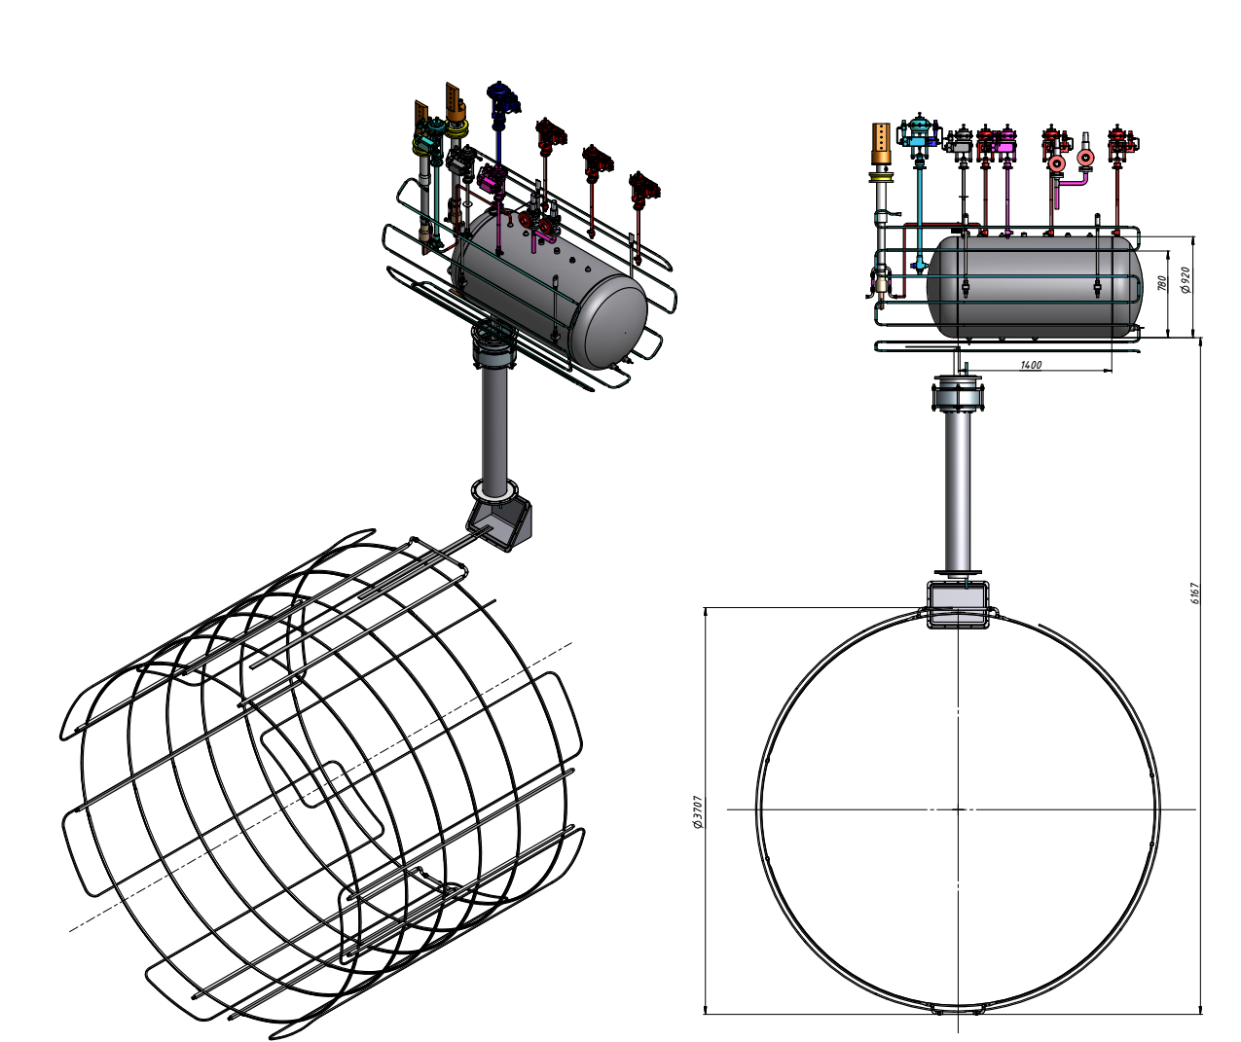
SPD solenoid. Cold mass cooling design.
It is planned to use the thermosiphon method of cooling the superconducting coil due to the natural convection of two-phase helium.
The volume of liquid helium is 10 - 20 liters
Helium mass flow SPD - 9-10 g/sec.

Slide 18
Fixed support
SPD Magnet (Suspension system)
Sliding support
Spherical bearing
Fixation of the cold mass is made with help of triangular suspensions made of STEF-1, 12 pieces on each side. On one side the supports are fixed, on the other side its are sliding to compensate for temperature changes in the length of the coil. The Suspensions have spherical bearings to avoid bending during thermal changes in the dimensions of the cold mass.

Slide 19
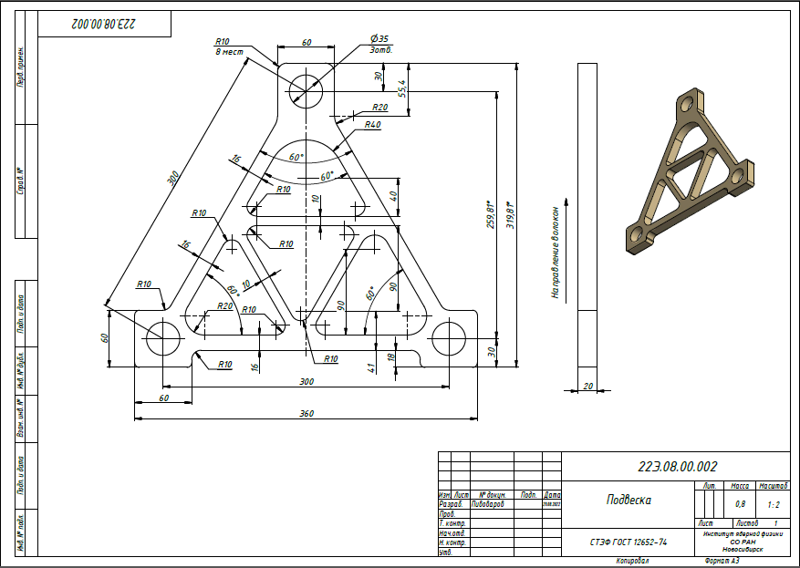
Suspension Calculation for cross force P = 1,5 t.
Material – СТЭФ-1
Material – Сarbon
Material | Max. equivalent stress | Max. deformation | Permissible stress
СТЭФ-1 | 100 MPa | 1,4 mm | 132 Мпа
Сarbon | 135 MPa | 0,53 mm | 1075 МPа
Calculations were made for suspensions of СТЭФ and Carbon. The results are presented in the table.
We have made and tested the СТЭФ suspension at 300K and 100K. Destruction of the suspension 300К - 3920 kg and 100К - 4250 kg. Deformation at 1,5 t was 5 mm (300K).

Slide 20
SPD Магнит with Control Dewar
Switching box
Connection of current leads with Bas-bars coils.
The connection of the coil with the current leads is carried out in a special box located outside the cryostat.

Slide 21
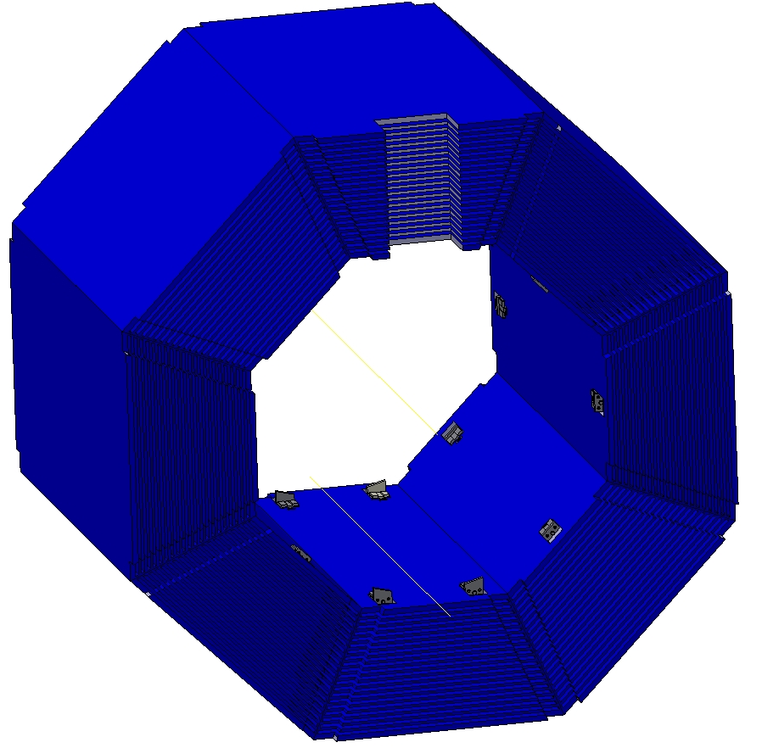
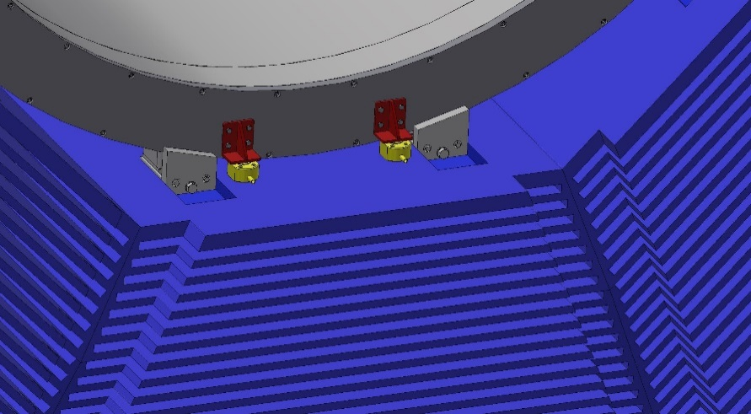
SPD Magnet (positioning and fixation)
Removable
Support
Hydraulic jack
The magnet is positioned inside the iron yoke using hydraulic jacks.

Slide 22
SPD Magnet (fixation)
Adjustable support
The cryostat is fixed in an iron yoke by means of special adjustable supports fixed on octants .
The wedge surface of the support allows you to fix the cryostat after positioning the magnet using hydraulic jacks.

Slide 23
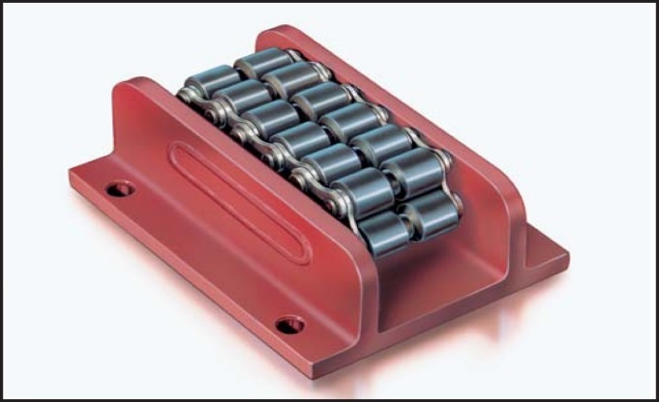
Magnet Assembly Procedure
Cryostat flange support
Roller skate Boerkey
Cryostat Inner Shell Support
Inner Shield support
Cold mass support
Outer Shield support
Assembly stand
To assemble the magnet, a special stand with an I-beam - 700 GOST 26020-83, 9 meters long, with a guide rail and a roller system (Roller skate Boerkey model AM-H) for rolling up the magnet elements, is used.
Such a scenario was used to assemble the PANDA magnet, which was successfully assembled, disassembled and reassembled.

Slide 24
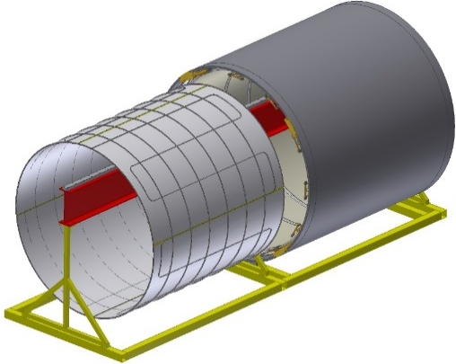
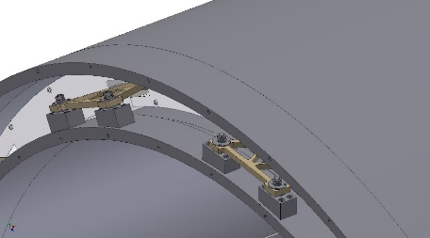
Magnet Assembly Procedure
Removable support
Installing the outer shell
Installing the outer shield
Position the outer shield
Installing the Cold Mass
segment
Shield flange segments
Position the Cold Mass.
fixing on temporary segments
The Inner shield position. Partial installation of the shield flange segments
Installing the inner shell
Installing the inner shield
Fixing of the cold mass on the inner shell. Removal of the temporary segments after fixing the cold mass. Installation all shield flange segments.
The Inner shell position.
Installation of cryostat flanges

Slide 25
Thank you for your attention!

