Slide 1

SPD ECAL status 2024
ECAL position inside of Cryostat
Test results with new SiPm EQR15 11-6060D-S
Matrix form for new scintillator production (40x40x1.5 mm³)
Scintillator production in Vladimir
16.05.2024
Oleg Gavrishchuk
1
Notes:
1
1

Slide 2
SPD ECAL Requirement
The high multiplicity of secondary particles leads to the requirements
of high segmentation and high density of the absorber’s medium with a small Moliere radius.
It is required in order to have a sufficient spatial resolution and a capability to resolve overlapping showers. The transverse size of the calorimeter cell should be of the order of the Moliere radius. A reliable reconstruction of photons and neutral pions is possible only for small a overlap of showers.
Occupancy should not exceed 5%, to make possible an efficient photons reconstruction with high precision. The SPD experiment imposes the following requirements on the calorimeter characteristics:
– reconstruction of photons and electrons in the energy range from 50 MeV to 10 GeV;
– energy resolution for the above-mentioned particles: ∼ 5%/√E[GeV];
– good separation of two-particle showers;
– operation in the magnetic field;
– long-term stability: 2÷3% in a six-month period of data taking.
16.05.2024
Oleg Gavrishchuk
2
Notes:
2
2

Slide 3
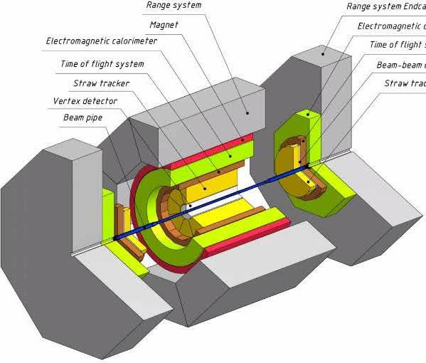
Overview of the SPD ECAL
The SPD electromagnetic calorimeter is placed between the cryostat with magnet coils and the PID.
The calorimeter consists of a barrel and two end-caps, covering a 4π solid angle.
The thickness of the calorimeter is dictated by the required thickness of the active part and the size of the readout block consisting of a photodiode and the amplifier boards, as well as by the size of the flexible part of the fibers.
16.05.2024
Oleg Gavrishchuk
3
Notes:
3
3

Slide 4
Overview of the SPD ECAL
For an efficient absorption of electrons and photons with energies up to 10 GeV, the calorimeter thickness, which is defined by the number of sampling layers, should be at least 17÷20 X0 in terms of radiation lengths X0.
For the sampling structure of 190 layers of 1.5-mm polystyrene scintillator and 0.5-mm lead, the length of the active part is 380 mm, which corresponds to 17.6 X0.
The transverse size of the calorimeter cell should be on the order of the effective Moliere radius of the calorimeter medium. The selected structure has a Moliere radius of 58 mm.
The separation efficiency of two photons with energies from 200 MeV to 500 MeV depends on the cell size and reaches a plateau at a cell size of 40 mm, as it was determined in the MC simulation.
The cells in the barrel part of the calorimeter have a trapezoidal shape in the azimuthal direction to minimize the gaps between the modules. The vertex angle of the trapezoid equals 1.87◦.
16.05.2024
Oleg Gavrishchuk
4
Notes:
4
4

Slide 5
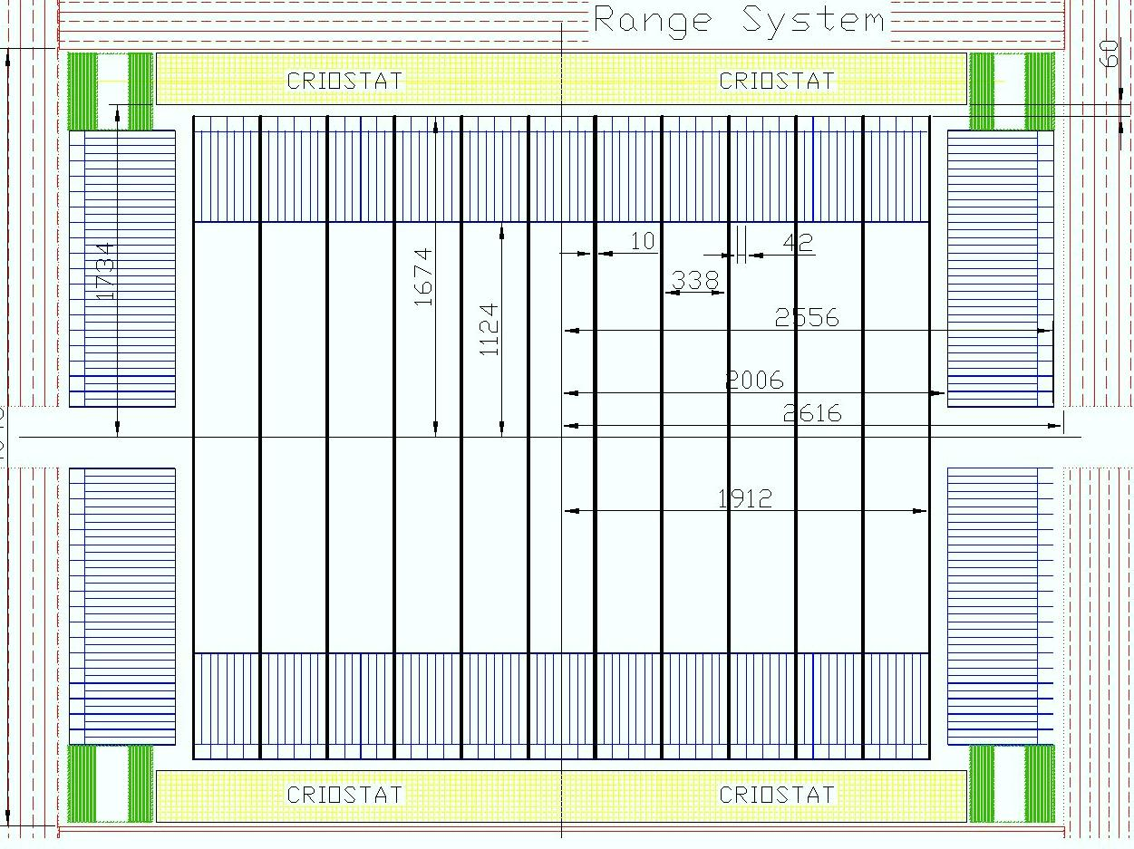
SPD ECAL Barrel – side view
16896 cells
52.9 tons
In the direction along the beam axis the cell size is equal to ~42 mm
The barrel consists of 11 annular rings, located one after another along the beam axis.
One Ring containing 384 modules weighing ~4.8 ton.
The ring is made to facilitate moving and ECAL installation using Rails inside of Cryostat.
The calorimeter ring is divided into 24 sectors by the angle φ , thus forming a cluster of 64 cells which are read by one ADC
In total, there are 16896 cells with a weight of 52.9 tons.
16.05.2024
Oleg Gavrishchuk
5
Notes:
5
5

Slide 6
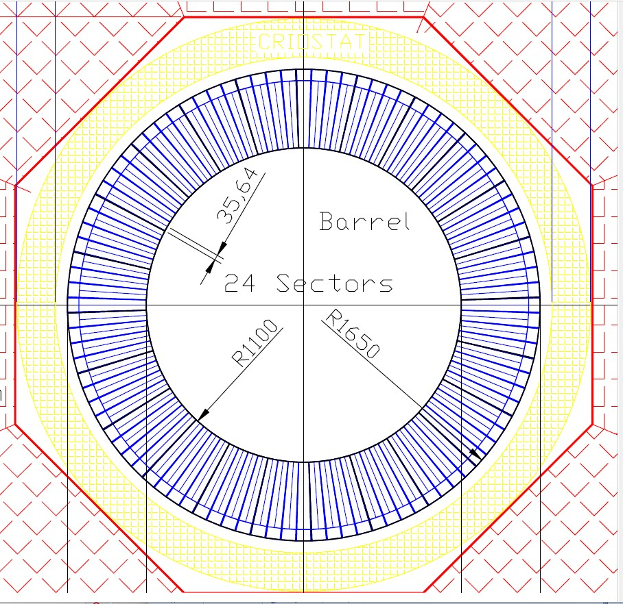
SPD ECAL Barrel – front view
cell φ =1.87◦.
There are 16896 cells
Weight is 52.9 tons
The barrel part is composed of the cells of trapezoidal shape in the azimuthal direction with a vertex angle of 1.87◦.
The front sizes of one cell is equal to ~35 mm (in φ ), and ~42 – in the direction along the beam axis .
Each layer of the calorimeter’s barrel is composed along the φ angle of 96 modules (4 cells per module).
Calorimeter ring is divided into 24 sectors by the angle φ , thus forming a cluster of 64 cells which are read by one ADC.
The calorimeter barrel is composed of 11 rings, as shown in previous slide
There are 16896 cells with a weight of 52.9 tons.
16.05.2024
Oleg Gavrishchuk
6
Notes:
6
6

Slide 7
SPD ECAL Barrel – side view
16896 cells
52.9 tons
In the direction along the beam axis the cell size is equal to ~42 mm
The barrel consists of 11 annular rings, located one after another along the beam axis.
One Ring containing 384 modules weighing ~4.8 ton.
The ring is made to facilitate moving and ECAL installation using Rails inside of Cryostat.
The calorimeter ring is divided into 24 sectors by the angle φ , thus forming a cluster of 64 cells which are read by one ADC
In total, there are 16896 cells with a weight of 52.9 tons.
16.05.2024
Oleg Gavrishchuk
7
Notes:
7
7

Slide 8
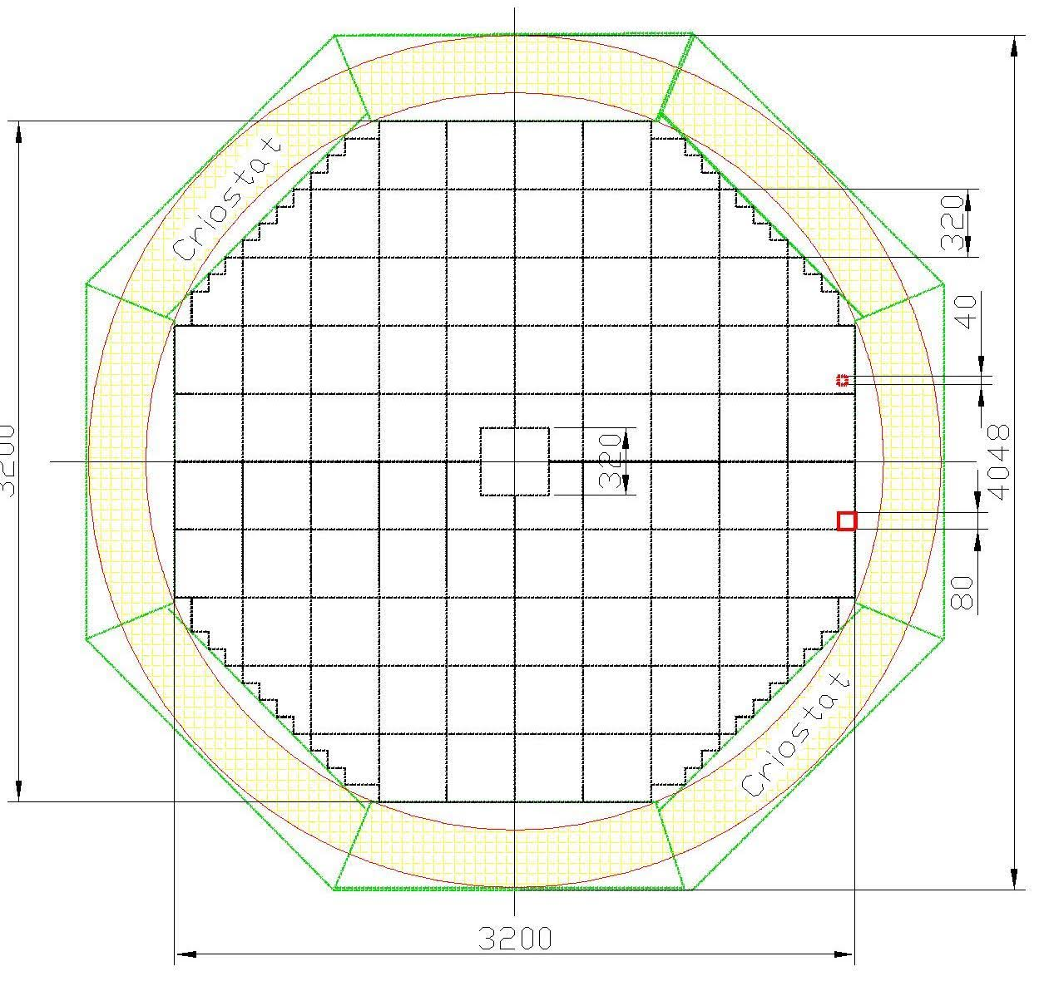
SPD ECAL End Cup via 80 clusters
Each end-cap consists of 5.136 cells, grouped by 64 cells, forming 80 clusters – big squire:
All 64 cells of each cluster are connected to 4 pcs. of 16-channel FE-boards for MPPC’s bias voltage control and their readout is provided by one ADC. A complete list of ECal’s main components – ADC, FE, HV, MPPC, etc.
The cell cross-section is 40×40 mm2 and the length is 500 mm along the beam.
The end-cap has the absorber length equal to 17.6 X0
The weight of one end-cap is 14.4 tons and for two parts 28.8 tons, respectively.
In total, there are10.272 cells in both end-caps.
There is a hole for the beam pipe in the center of each end-cap. The hole has a size of 320×320 mm2, which is equivalent to 64 cells.
The end-cap is mounted in the Frame that supports it and shapes its geometry. The Frame
is installed on the barrel RS.
There is a gap about 6 cm between the end-cap of the RS and the calorimeter’s end-cap for the ADC’s placement and cable routes. This gap is also necessary for air circulation of the ADC cooling (visible in side view)
5/16/2024
Oleg Gavrishuk, JINR, Dubna , Russia
8

Slide 9
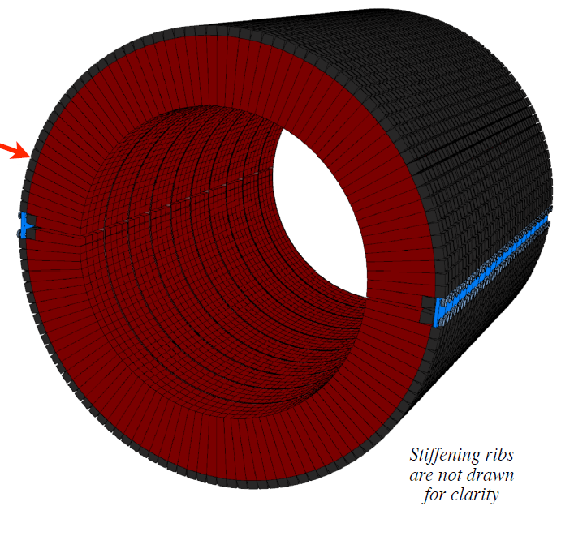
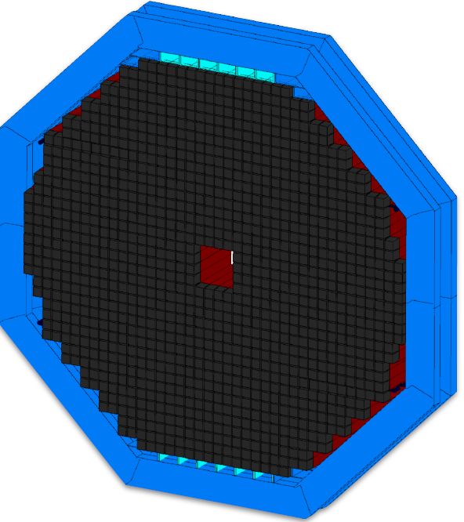
ECAL 3D View Barrel and Cup parts
5/16/2024
Oleg Gavrishuk, JINR, Dubna , Russia
9

Slide 10
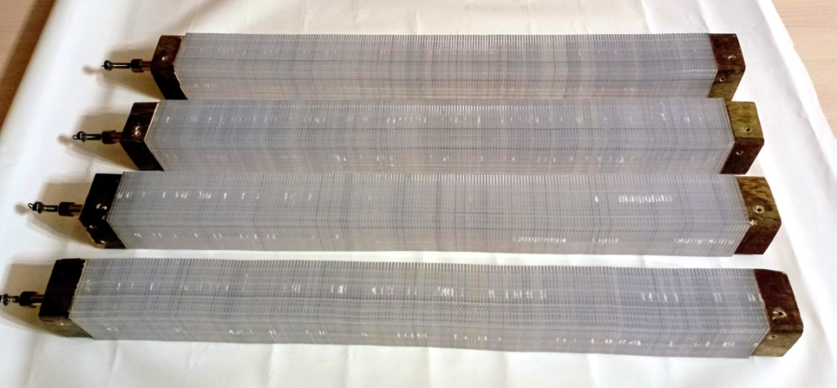
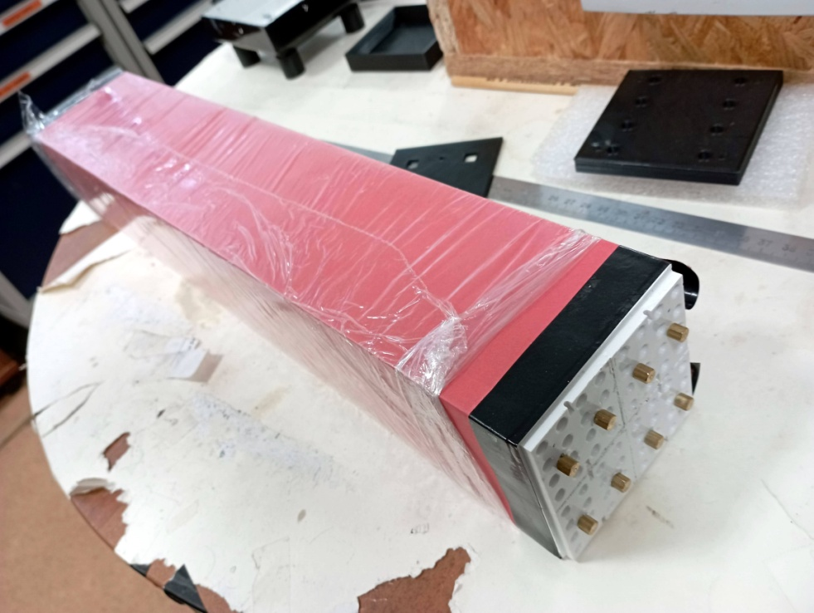
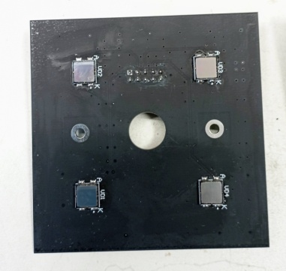
SPD ECAL cells design
The module consisted of 190 alternating layers of scintillator and lead with a thickness of 1.5 mm and 0.5 mm, respectively.
Absorption length is equal to 17.6X0 and a Moliere radius is anout 5.8 cm.
The energy resolution for 1 GeV photons is assumed to to be ∼5% .
The scintillator plates are made of polystyrene with an 1.5% p-Terphenyl and 0.05% POPOP.
Scintillation time of about 2.5 ns and a light output of 60% of anthracene.
The scintillator emission light (~420 nm) is absorbed by the WLS of Y-11 (1 mm diameter) and reemitted at 480 nm.
SipM type EQR-11-6060 detect the emitted from WLS light with PDE ~40%.
Cells 40x40 mm²
Module from 4 Cells without WLS
Printed Board wit 4 SiPms
16.05.2024
Oleg Gavrishchuk
10
Notes:
10
10

Slide 11
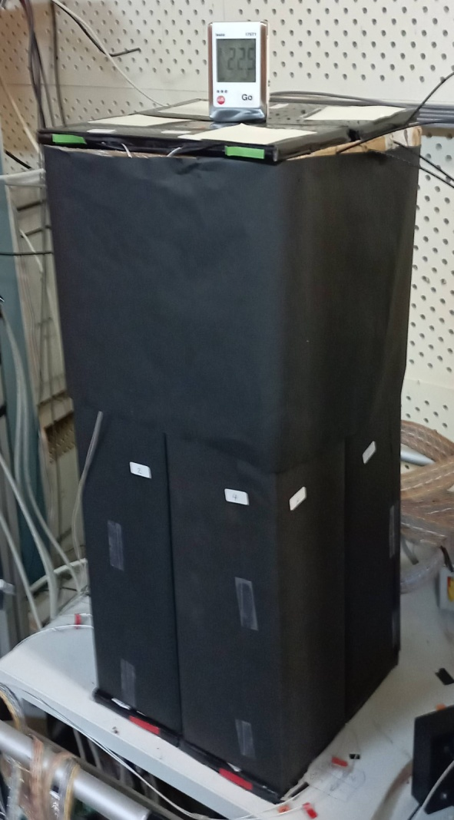
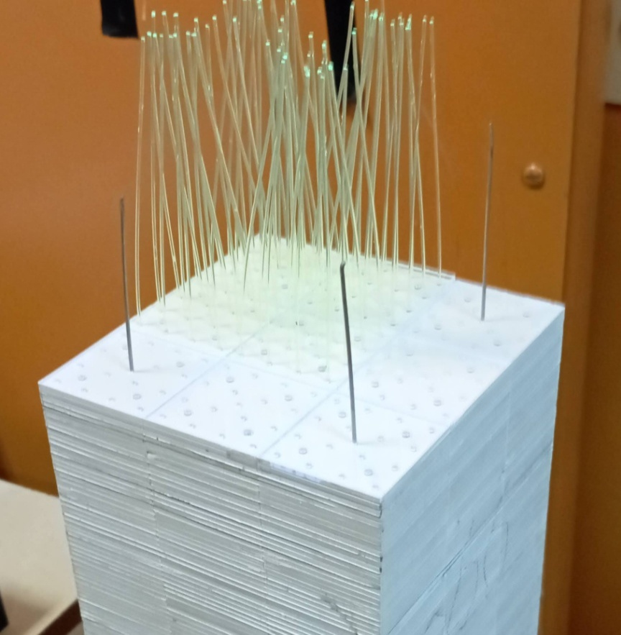
Test results with cosmic particles
Cosmic Rays
Setup of 4 modules. Each module consist from 9 cells of 4x4 cm². Totally tested 36 cells.
Sampling:
1.5 mm Scintillator
0.3 mm Lead
200 layers
Scintillator composition:
Polysterene
1.5% Paterphenyle
0.04% POPOP
Single Ecal module shown in assembling stage.
It is visible 9 cells as 3x3 matrix with WLS fibers (16 per cell). Y11(200) diameter 1.0 mm was used.
5/16/2024
Oleg Gavrishuk, JINR, Dubna , Russia
11

Slide 12
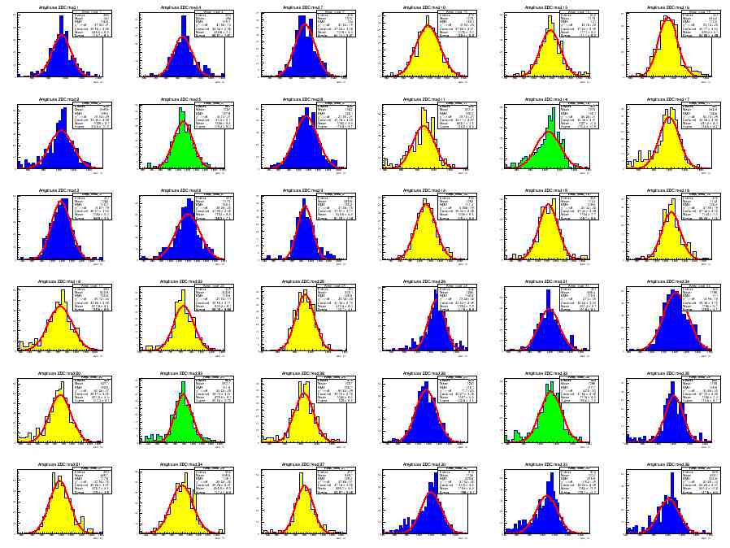
MIP spectra from 36 Cells. Top view shown on picture Above. One hit/event – applied selection criteria during analysis.
Calibration coefficients were found and normalized to 240 MeV.
5/16/2024
Oleg Gavrishuk, JINR, Dubna , Russia
12

Slide 13
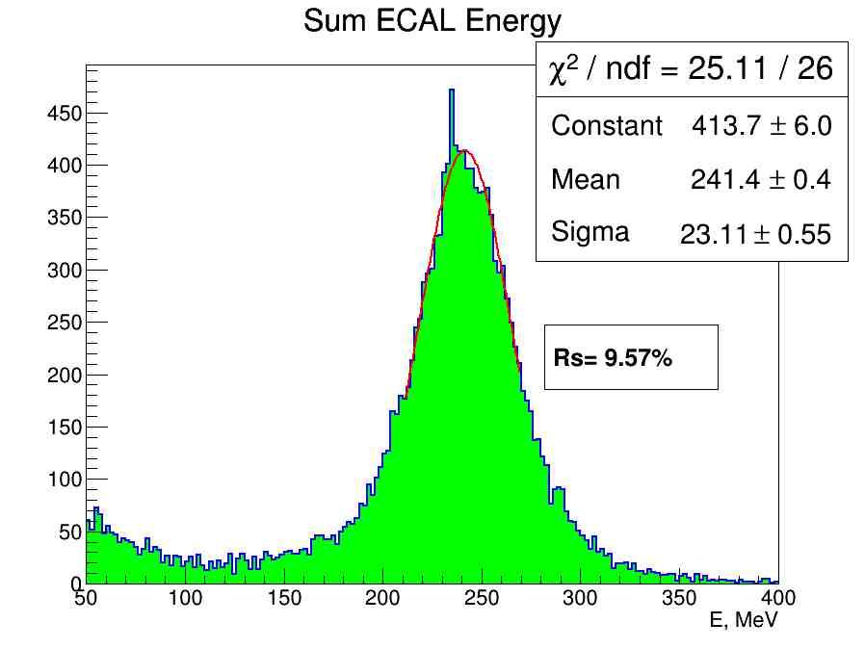
MIP spectra from 36 Cells as Total Sum take in account the Calibration coefficients normalized to 240 MeV. These Energy resolution corresponded to MC
5/16/2024
Oleg Gavrishuk, JINR, Dubna , Russia
13

Slide 14
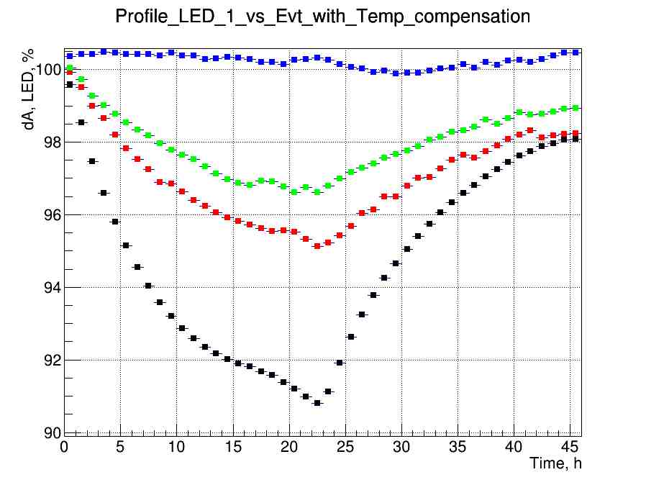
Kt=50 mV/⁰C
Kt=40 mV/⁰C
Kt=30 mV/⁰C
Kt=20 mV/⁰C
Test of long time Stability was done with different Kt for individual module.
The temperature variation from 20 to 30 ⁰C per day was applied.
5/16/2024
Oleg Gavrishuk, JINR, Dubna , Russia
14

Slide 15
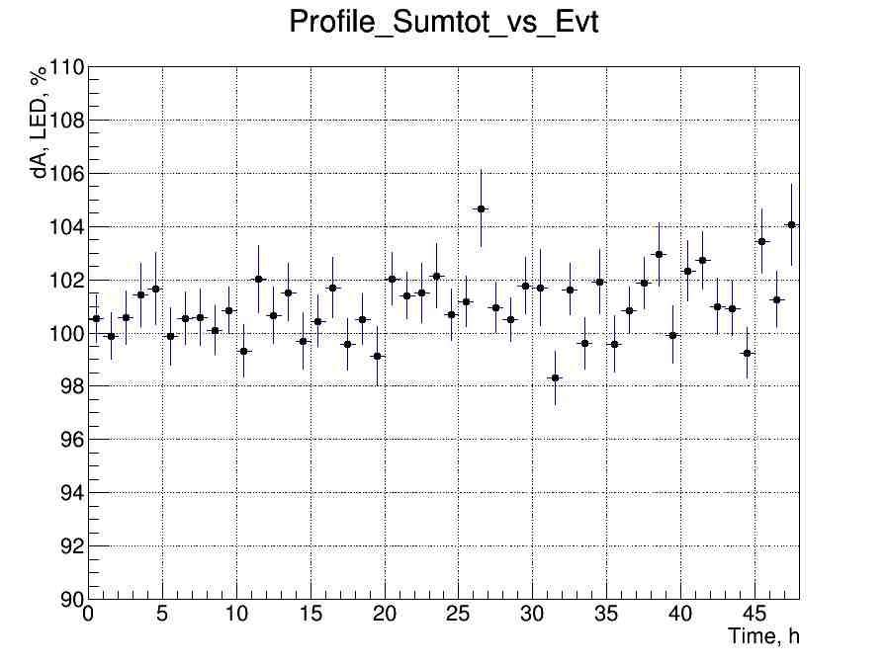
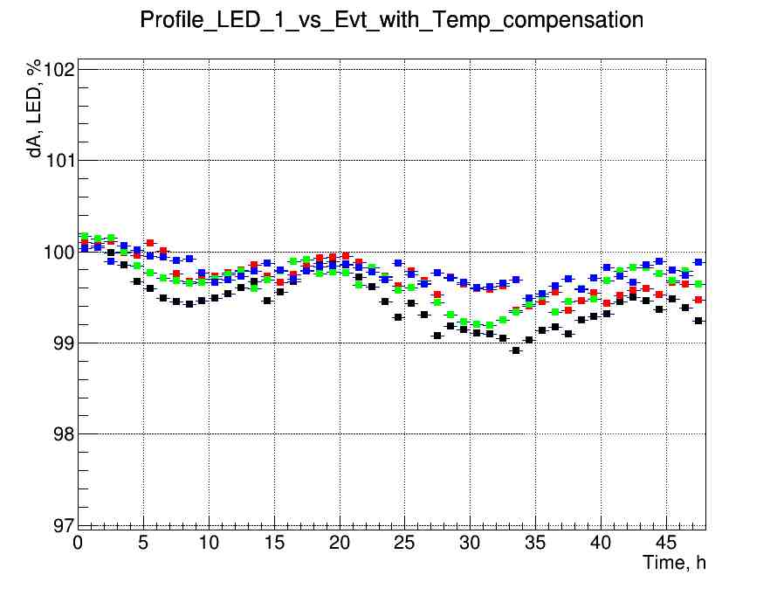
Kt=50 mV/⁰C
Long time stability for 4 modules shown +/-0.5% LED signal variation during 45 hours at Kt=50 mv/⁰C.
Profile Sum total of MIP signal shown ~1% variation during 45 hours.
This variation is not sensitive for MIP spectra with 9% resolution.
5/16/2024
Oleg Gavrishuk, JINR, Dubna , Russia
15

Slide 16
NDL SiPm Series EQR15 11-6060D-S
www.ndl-sipm.net/PDF/Datasheet-EQR15.pdf
NDL (Novel Device Laboratory, Beijing) http://www.ndl-sipm.net/indexeng.html
For a conventional SiPM, the quenching resistors are usually fabricated on the surface, and used to connect all APD cells to trace metal lines. In contrast, NDL SiPM employs intrinsic epitaxial layer as the quenching resistors (EQR), and uses a continuous silicon cap layer as an anode to connect all the APD cells. As a result, the device has more compact structure and simpler fabrication technology, allows larger micro cell density (larger dynamic range) while retaining high photon detection efficiency (PDE).
5/16/2024
Oleg Gavrishuk, JINR, Dubna , Russia
16

Slide 17

Type | EQR15-11-6060D-S | EQR20-11-6060D-S | Remarks
Effective Pitch | 15 µm | 20 µm
Active Area | 6.0x6.0 mm² | 6.24x6.24 mm²
Micro-cell Number | 160 000 | ~90 000
Typical Breakdown Voltage , Va | 30 V | 27.5 V
Temperature coefficient | 28 mV/⁰C |  | Not given
Recommended Oper. Voltage | Va+8V | Va+5V
Peak PDE at 420 nm | 45% | 45%
Gain | 4.0x10⁵ | 8.0x10⁵
Dark Current Rate | 250 kHz/mm² | 120 kHz/mm² | ~1000 kHz/mm²
Terminal Capacitance | 5.6 pF/mm² |  | Not given
5/16/2024
Oleg Gavrishuk, JINR, Dubna , Russia
17

Slide 18
Dark Current for EQR SiPm of 6x6mm² with 15 and 20 micron pitch sizes
15 micron pitch

Slide 19

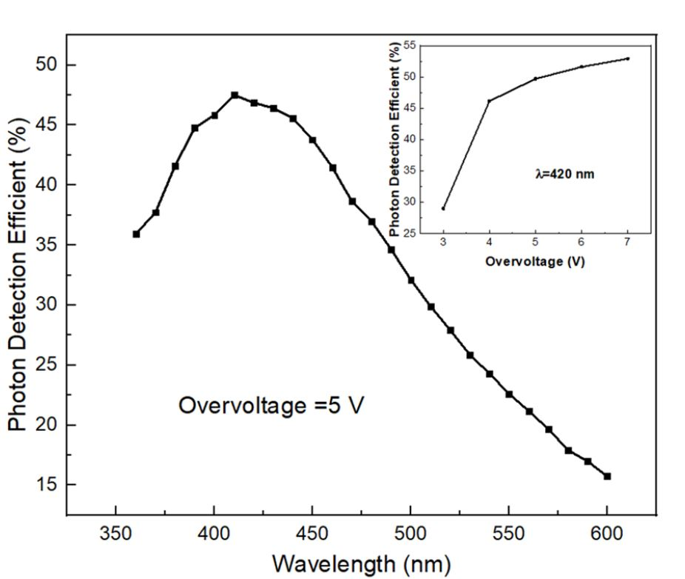
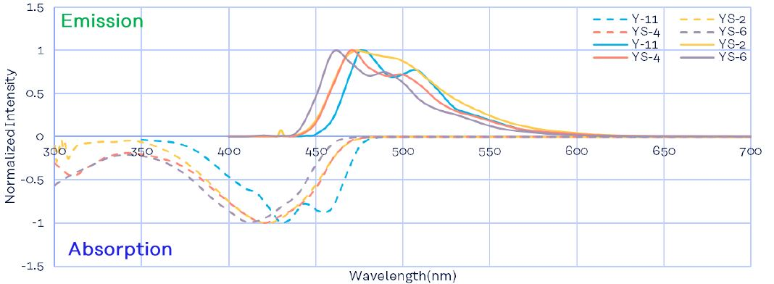
Photon Detection Efficient (PDE) correspond to WLS Emission spectra of Y11.
PDE close to flat maximum about 45% at 6-7 Overvoltage.
Notes:
19

Slide 20
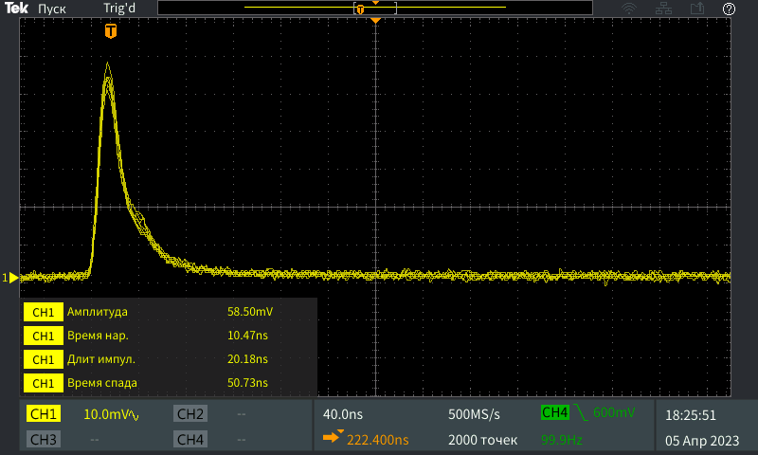
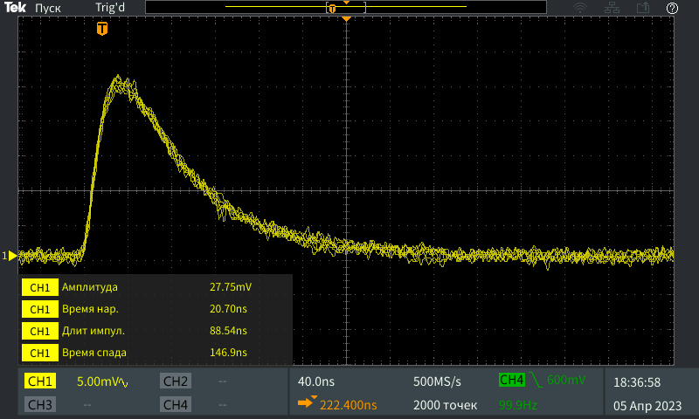
Pulse shape of SiPm with 15 µm pitch and 6x6 mm² size
EQR-15-60
Front – 10 ns
Length – 20 ns
HAMAMATSU S14160-6015
Front – 21 ns
Length – 89 ns
5/16/2024
Oleg Gavrishuk, JINR, Dubna , Russia
20

Slide 21
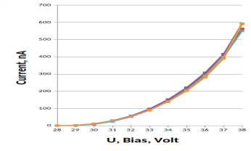
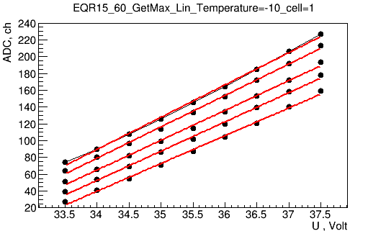
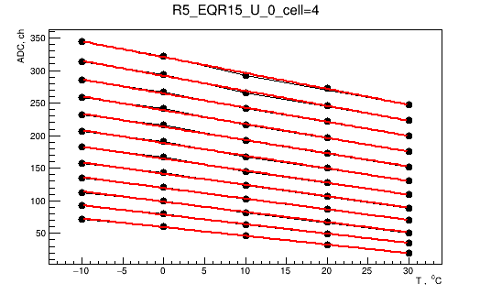
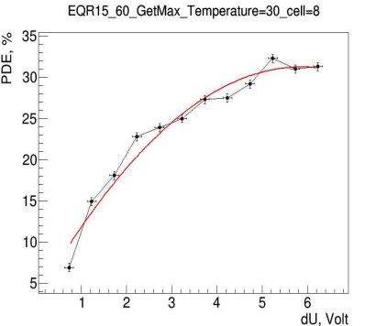
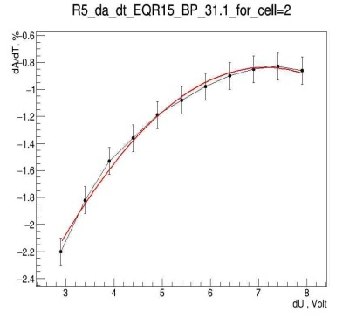
SiPm test Results
Dark Current measurements
Gain vs Overvoltage: dA/dU
Gain vs Temperature: dA/dt
PDE vs Overvoltage
Operation Volt. how to select it ?
Temperature stability studies
5/16/2024
Oleg Gavrishuk, JINR, Dubna , Russia
21

Slide 22
Gain vs Overvoltage allow obtain:
slope=dA/dU vs U
Gain vs Temperature allow obtain:
slope=dA/dT vs T
U=38V
T=-10 ⁰C
dA/dT
dA/dU
T=+30 ⁰C
U=32V
K_{t}=dU/dT=dA/dT/dA/dU
The thermal stabilization coefficient (K_{t}) was defined as the ratio of the slope dA/dT to the slope dA/dU depending on the applied bias.
5/16/2024
Oleg Gavrishuk, JINR, Dubna , Russia
22

Slide 23
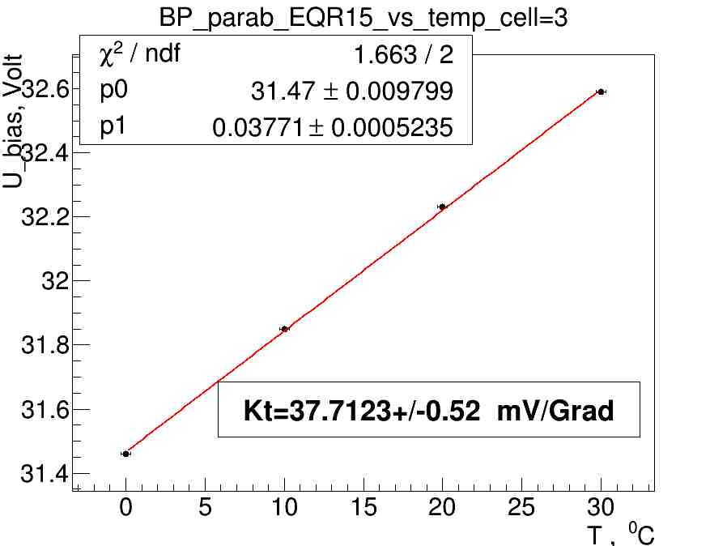
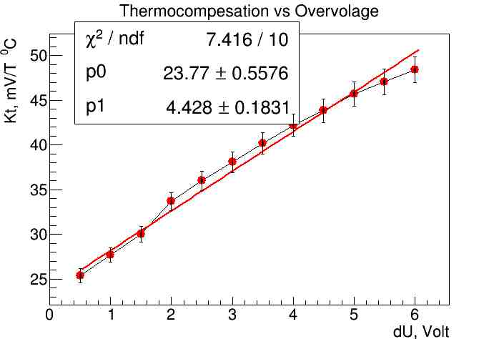
Break Point (Bp) was defined as extrapolation point of dA/dU to zero.
Take assumption his linear behavior from Temperature we find that Bp=32 V at 20 ⁰C.
Kt=dU/dT=dA/dt/dA/dU fom previous slides we find that dependence from Overvoltage has linear behavior and equal to ~50 mv/⁰C at Operation point 5.5 V.
Operate point
5/16/2024
Oleg Gavrishuk, JINR, Dubna , Russia
23

Slide 24


Temperature sensitivity vs dU
Photon Detection Efficient vs dU
dA/dT vs dU
PDE vs dU
Operation point
Operation point
Operation point was found at dU=6.5 V take in account that:
dA/dT and PDE – has Plato in dU.
dA/dT has minimal value ~ 1%/⁰C , PDE close to maximal value ~ 32%.
5/16/2024
Oleg Gavrishuk, JINR, Dubna , Russia
24

Slide 25
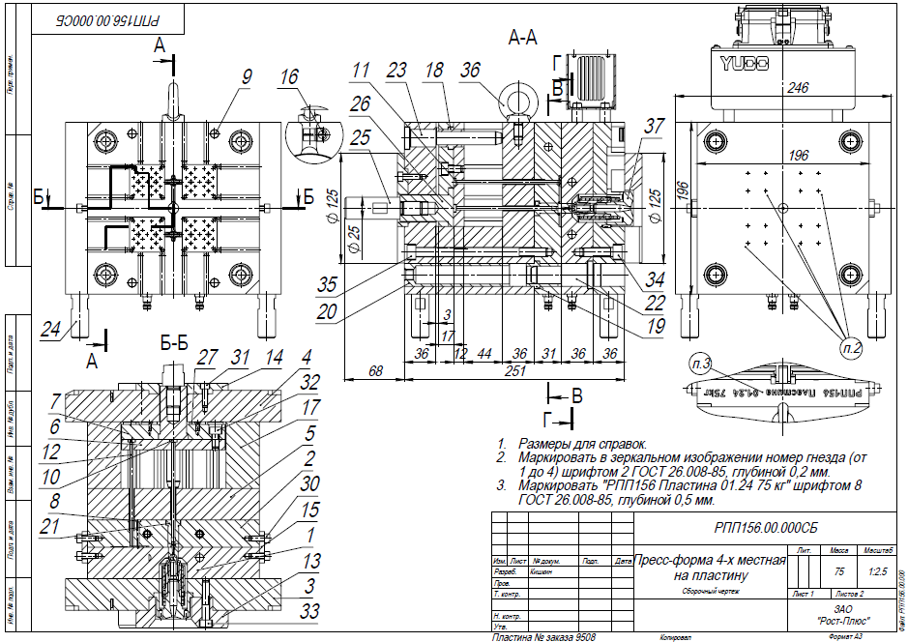
Matrix Form drawing 2023 for scintillator production (40x40x1.5 mm³)
Shown t drawing of 4 sets Form to produce 4 scintillator plates per one cycle.
Matrix Form it is a special setup for molding by pressure technology.

Slide 26
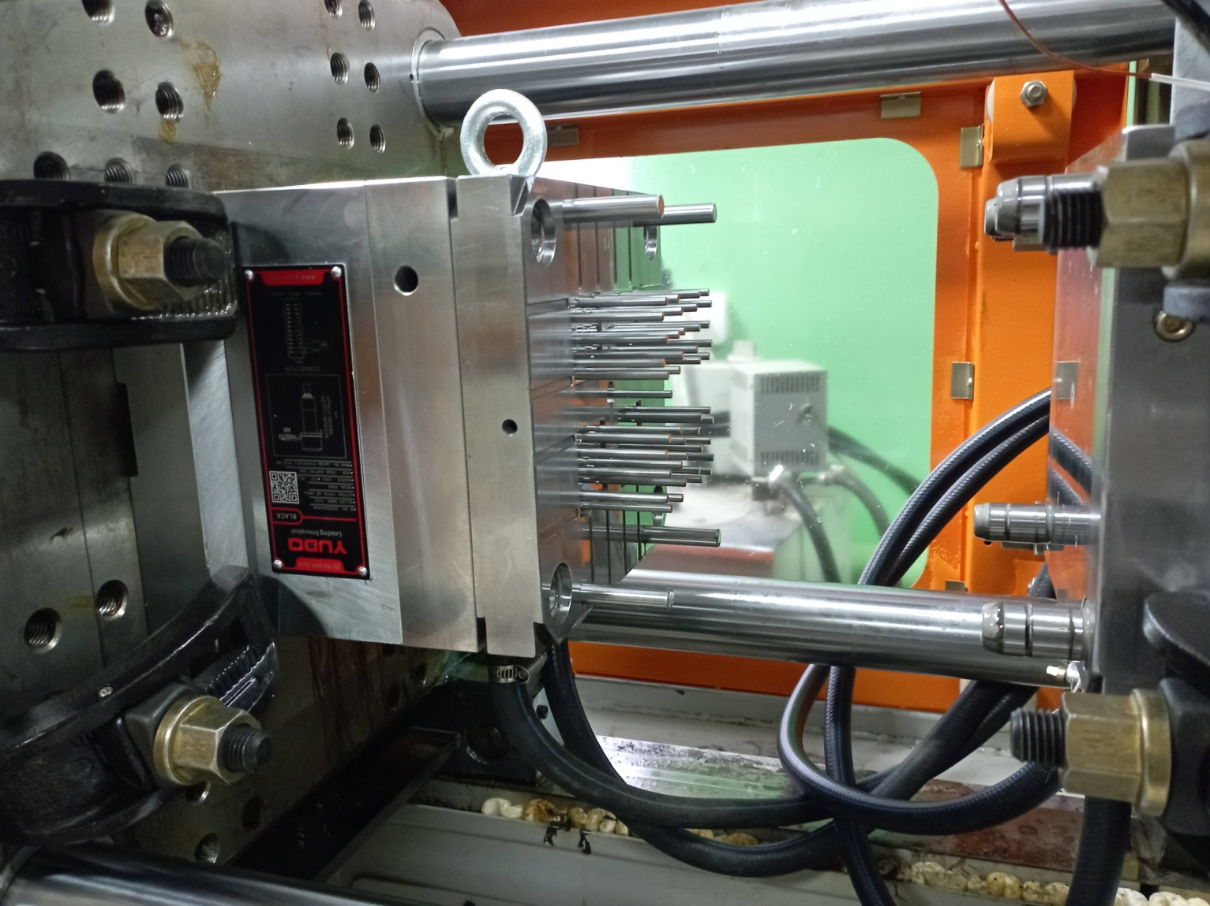
New Matrix Form for scintillators of 40x40x1.5 mm³ is ready.
This Form was tested in Vladimir in March of 2024.

Slide 27
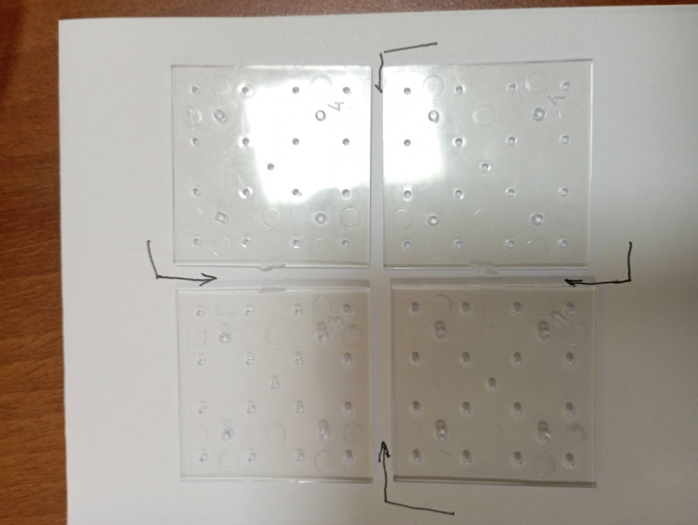
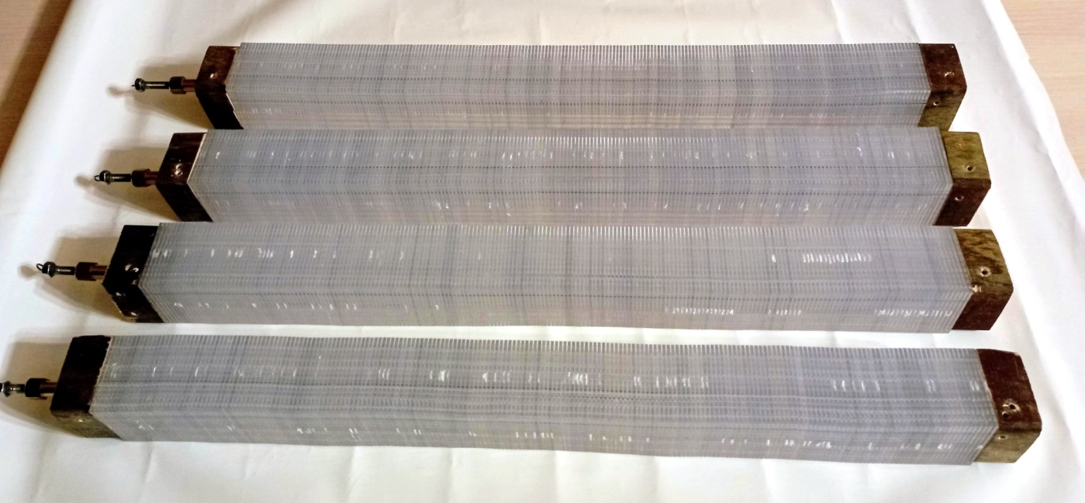
New scintillator tiles produced in Vladimir in April of 2024
4 tiles from one production cicle
4 cells , assembled in stack to check sizes and tolerance limits.

Slide 28
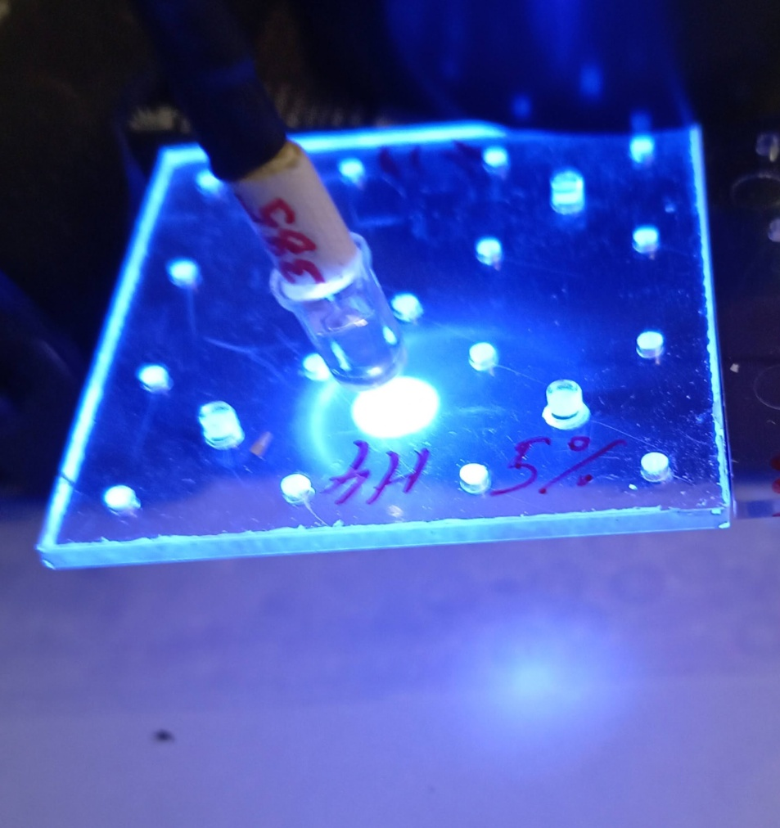
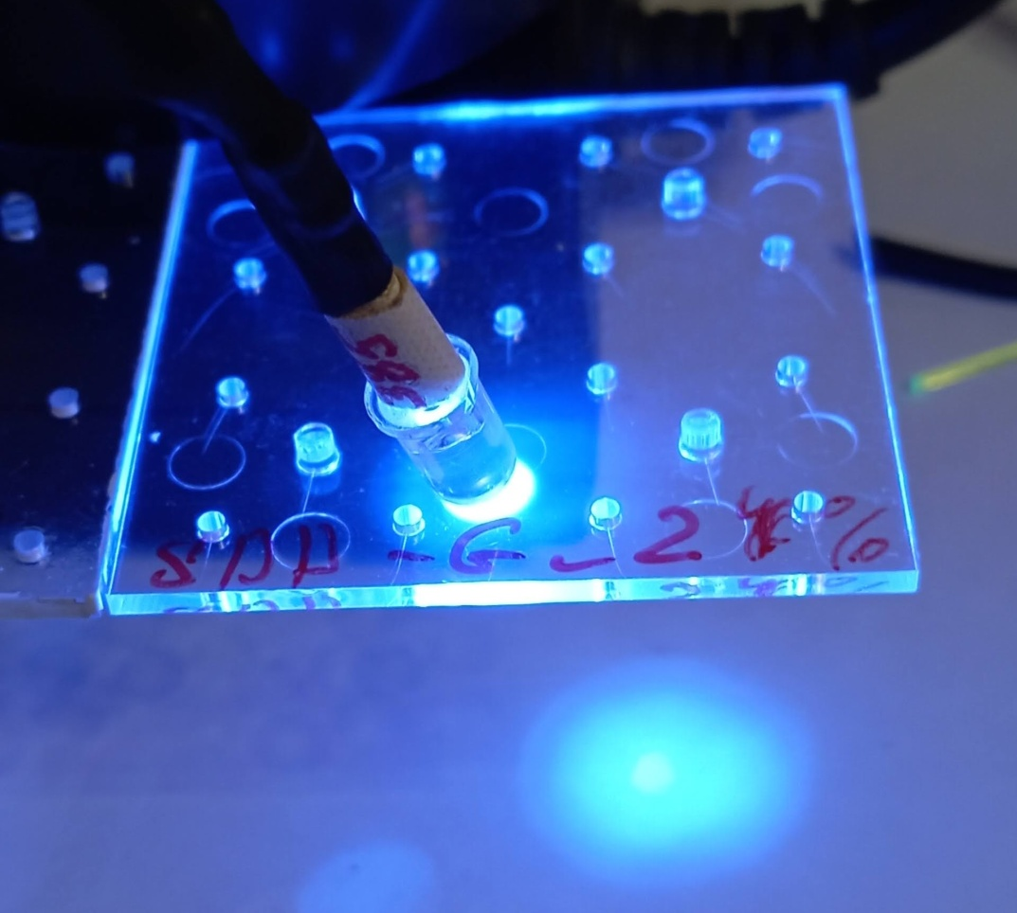
Test with LED 380 nm shown absorption efficiency at POPOP 0.04% and 0.05%
Transparent – not enough light absorption – is bad option
Good enough – 0.05% POPOP

Slide 29
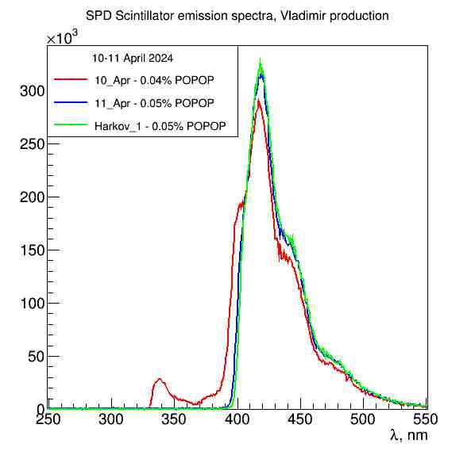
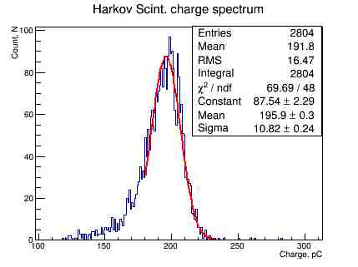
Scintillator Emission spectra depending on the POPOP concentration
Scintillator Charge spectrum from
α-source ²⁴¹Am
Emission spectra – read illustrate low POPOP concentration
Signal from α-source – illustrate light output from scintillator

Slide 30
Taking into account the difference in the light output of the plates, it is possible to arrange them in a module in the opposite phase of the attenuation of light into the spectrum of the bias fiber. This will reduce signal scatter and therefore improve measurement accuracy.
Normalization is made to a scintillator produced in Kharkov in 2013. Compound: 2.0% PTP 0.05% POPOP
100 % 2.0% PtP + 0.05% POPOP
85% 1.5% PtP + 0.05% POPOP
56% 1.5% PtP + 0.04% POPOP

Slide 31
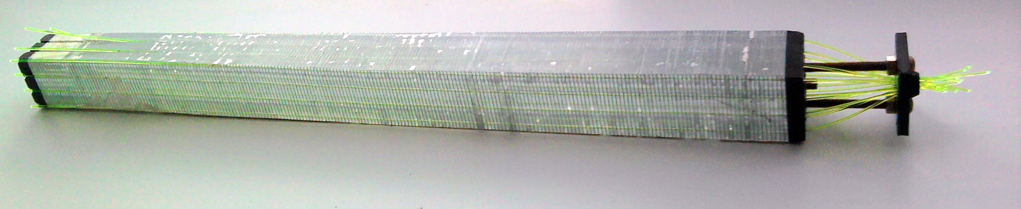
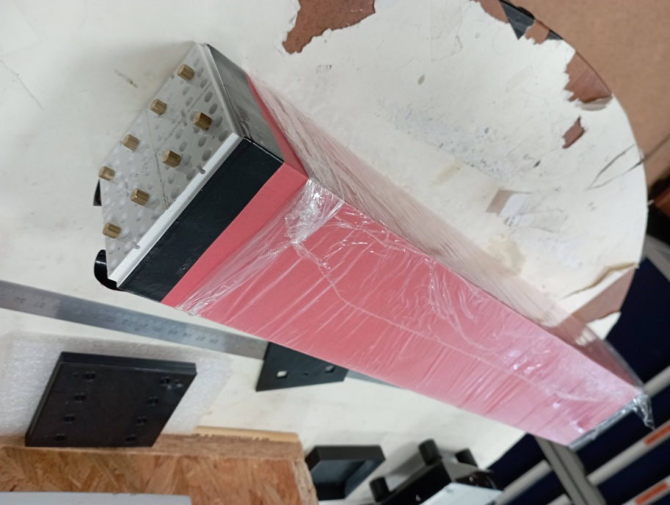
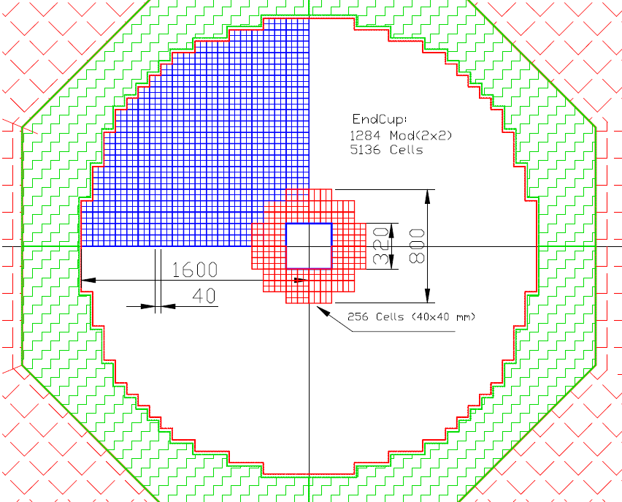
End Cup for SPD with new scintillator to be produced in 2024
via 256 cells of 40x40 mm²
Single Cell 40x40 mm2
One Module setup consist from 4 cells of 2x2
In red is shown 64 Modules, consisting from 4 cells each of 2x2.

Slide 32
End Cup part (read) for with new scintillator to be produced in 2024 via 256 cells of 40x40 mm²
This Figure shows in red 64 modules, consisting of 4 cells each. The weight of this assembly is 597 kg. This will require 130 kg of polystyrene, 465 kg of lead, as well as additives: 1.95 kg of P-terphenyl and 65 g. POPOP, and 2000 meters WLS fiber type Y-11.
It is 1/20 part of End Cup and
taken time of 36 Days to prepared 51200 Stint. plates.
To read this setup, we need four ADC64 - 64-channel amplitude encoders, as well as 16 boards of 16-channel amplifiers and bias voltage regulators.

Slide 33
Conclusions
New ECAL geometry was designed in 2023-2024
SiPm EQR15-60 – pitch 15 μm was studied
SiPm EQR20-60 – pitch 20 μm will be studied soon
New ECAL setup (16 cells) with cell size 4x4 cm² was assembled
ECAL test in cosmic rays was done
Matrix form for new scintillators of 40x40x1.5 mm³ is ready
New scintillator production started in April of 2024
Planned produced 160.000 plates – it is 6.4% from one End Cup
5/16/2024
Oleg Gavrishuk, JINR, Dubna , Russia
33

Slide 34
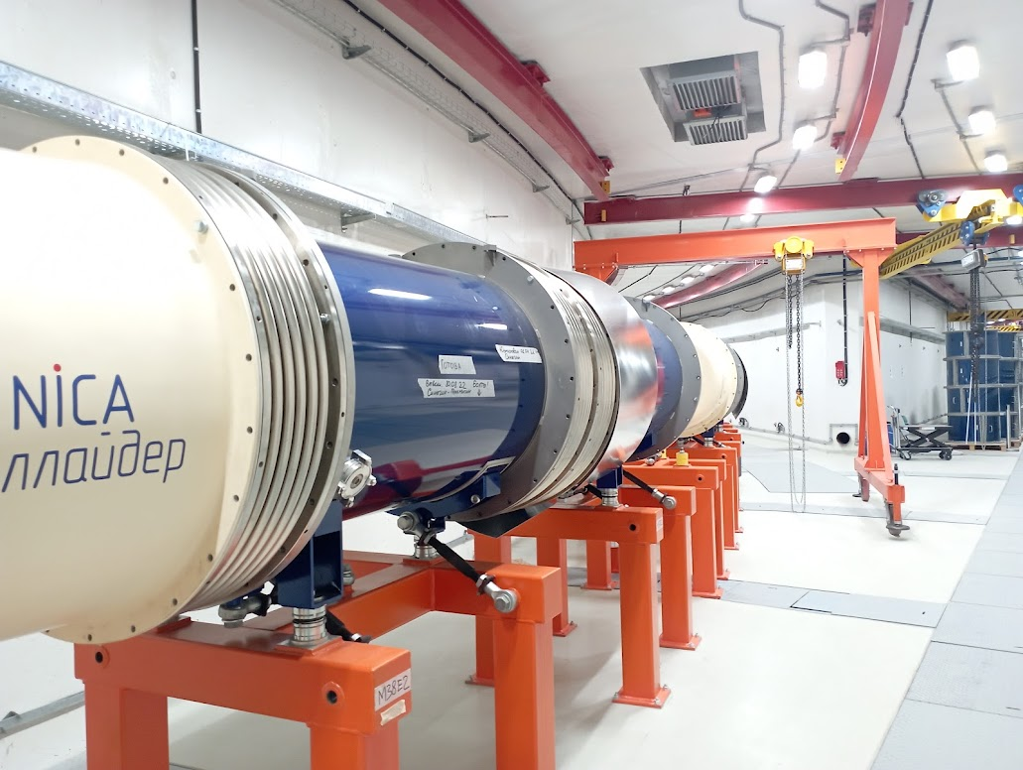
End of Report
Thanks for attention to All
VII SPD collaboration meeting
20-24 May 2024

