Slide 1
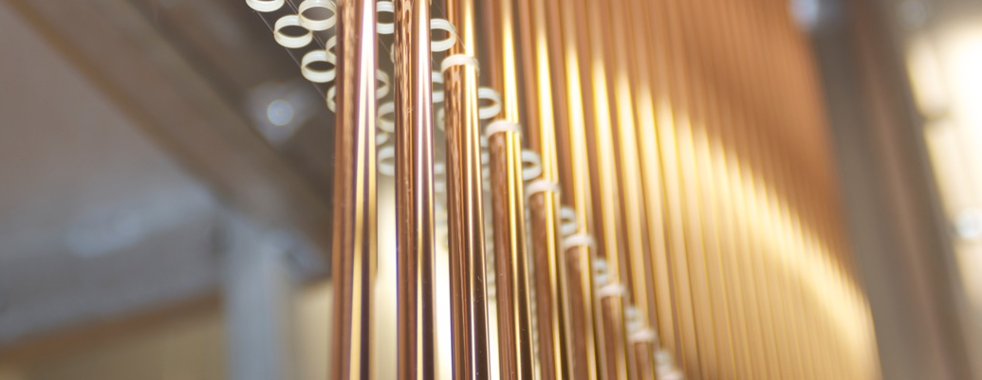
Straw-Barrel status report

Slide 2
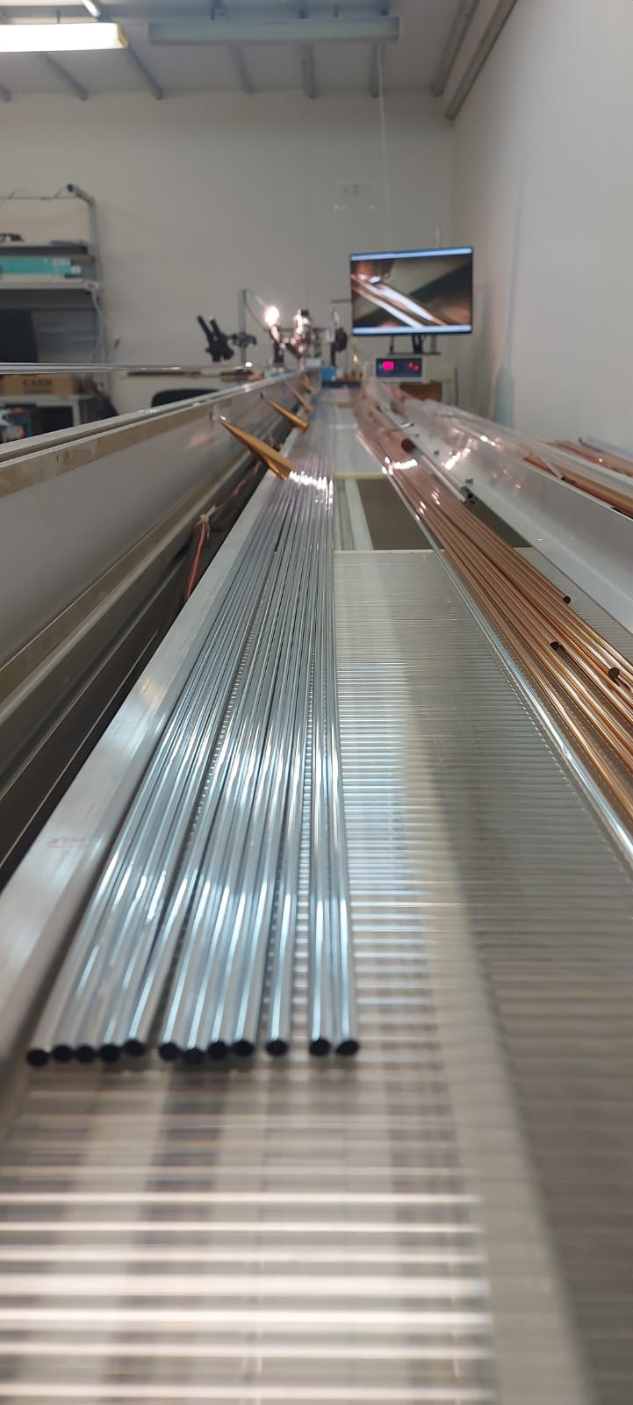
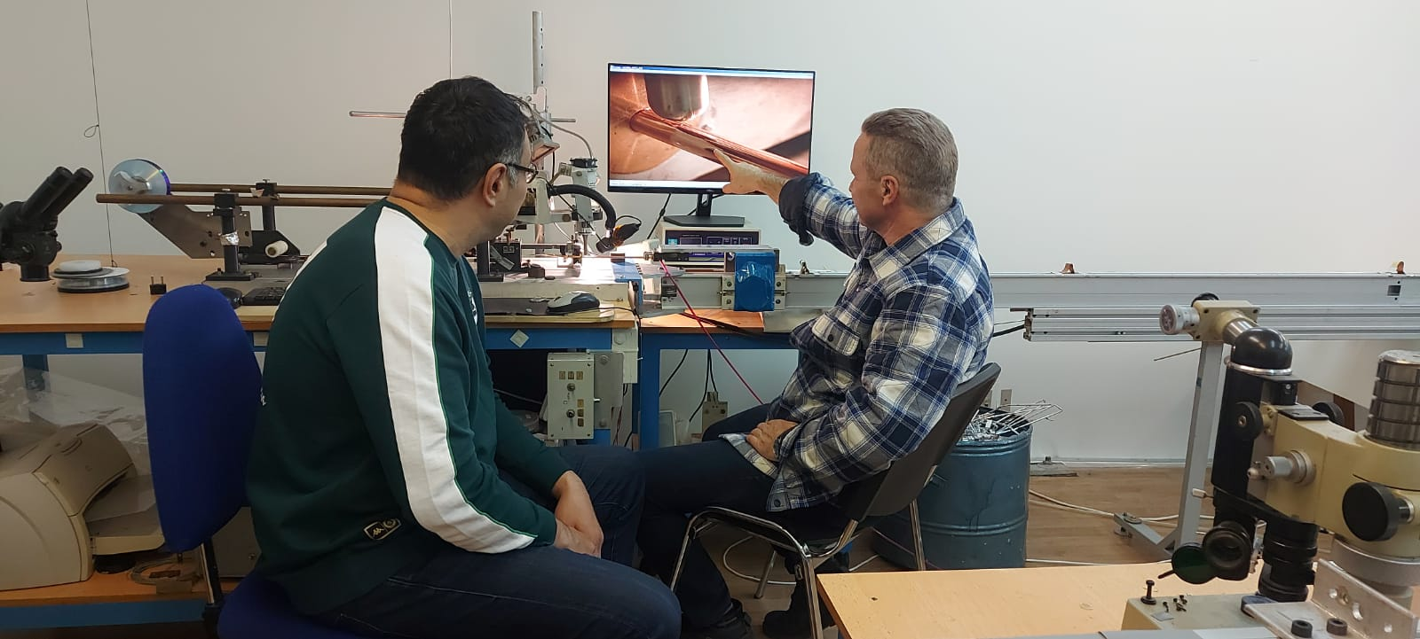
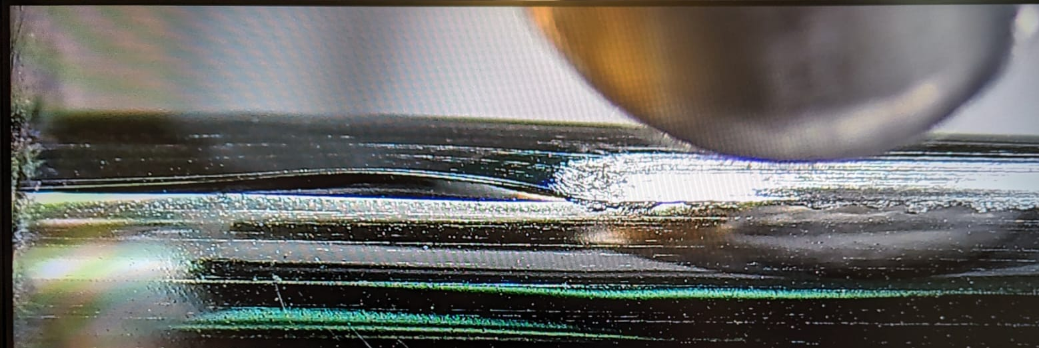
STRAW production line
• Productivity- 1m/min • Produced ~20km straw
• Length- 5.5m • Installed ~8000 straw
• Diameter-from 10 mm • After 10 years of operation non- working- 3 straw
• Film thickness-36 microns • Film is available in Russia •Number of employees-10FTE • Number of employees-10FTE
• Coating thickness 50-100nm
• Coating is carried out in the RF

Slide 3
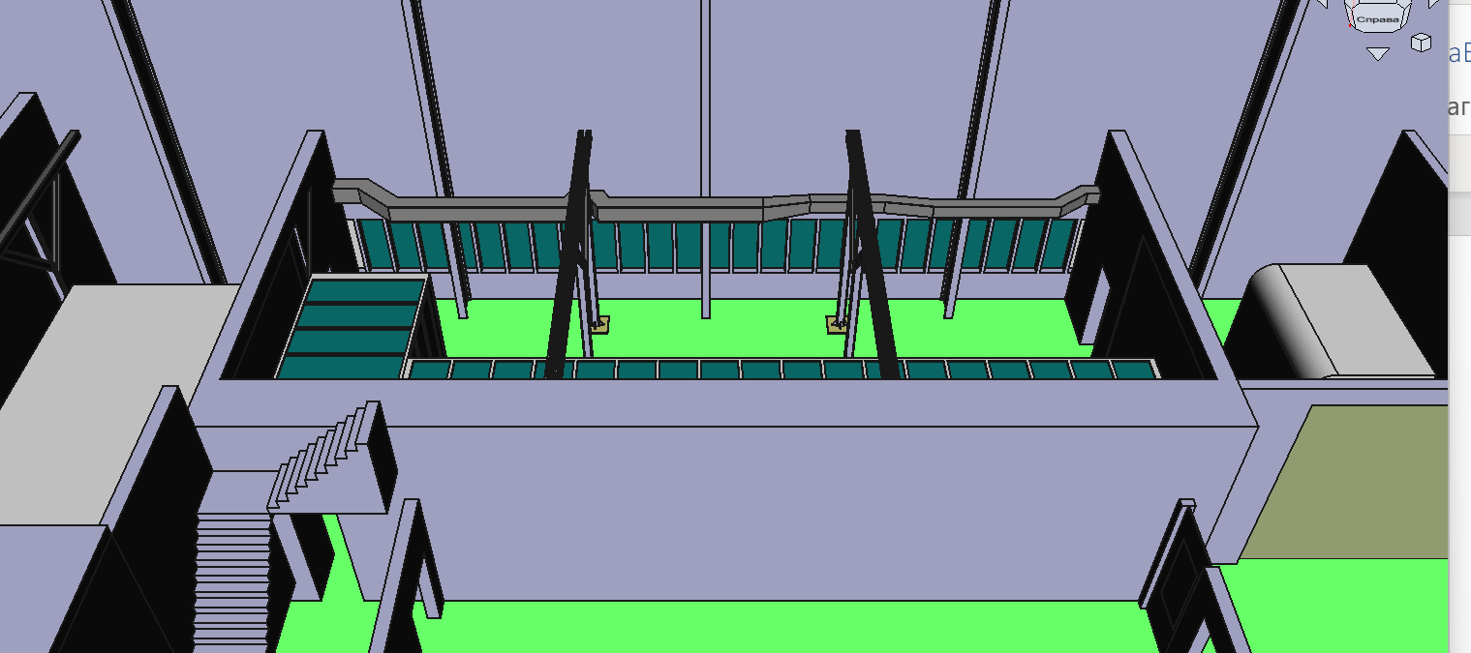
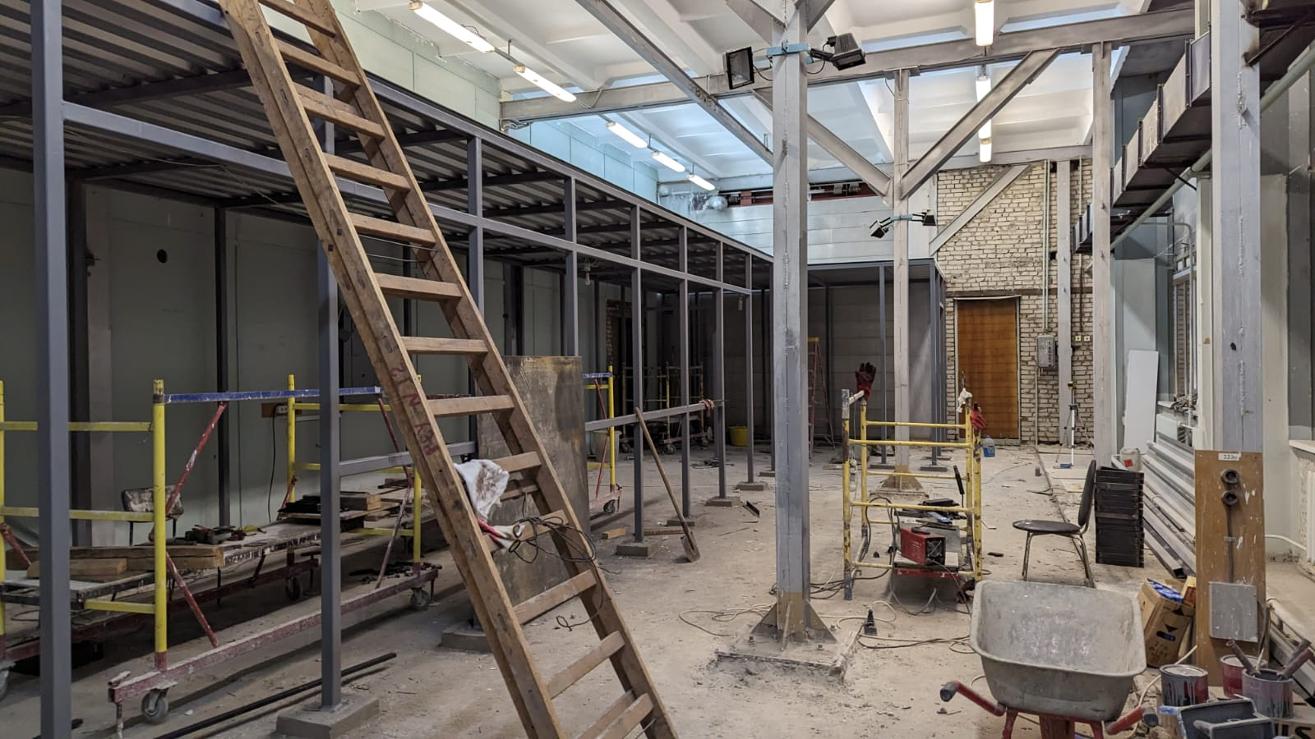
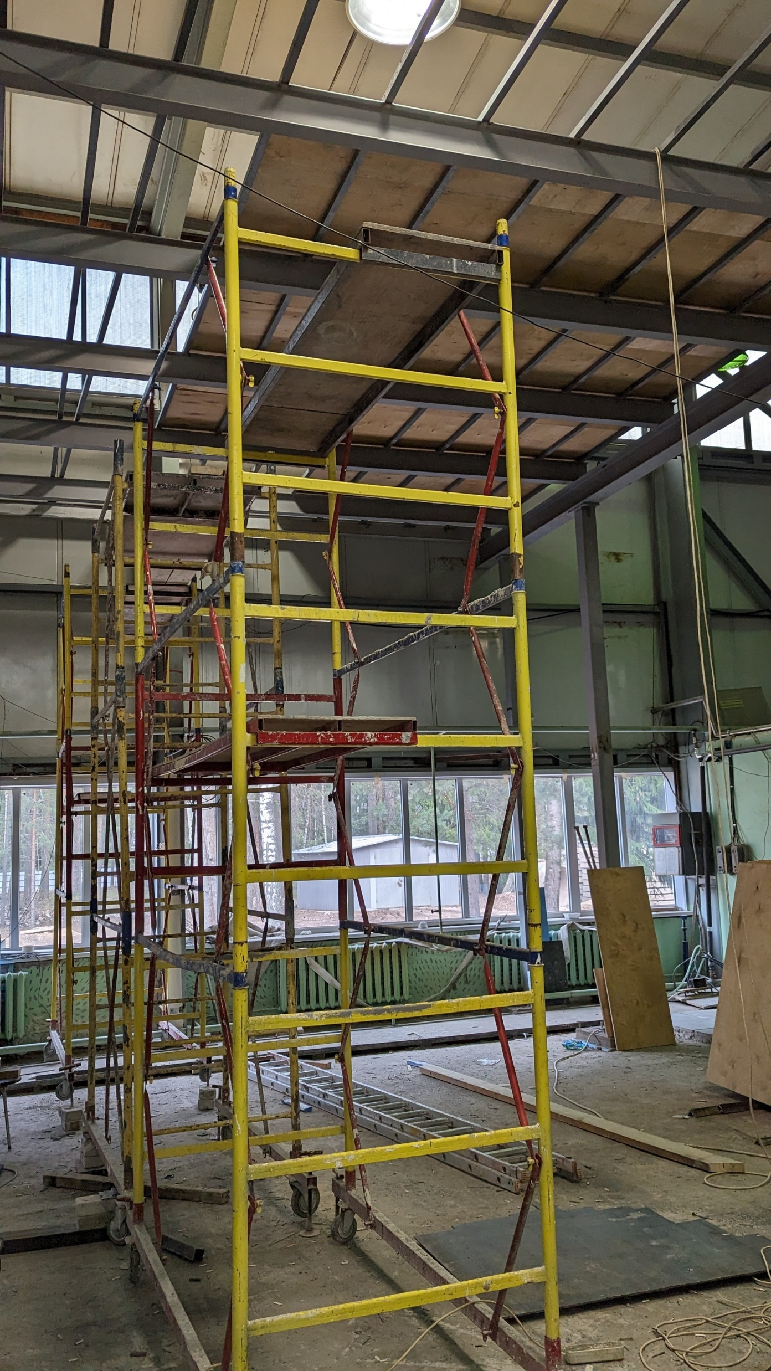
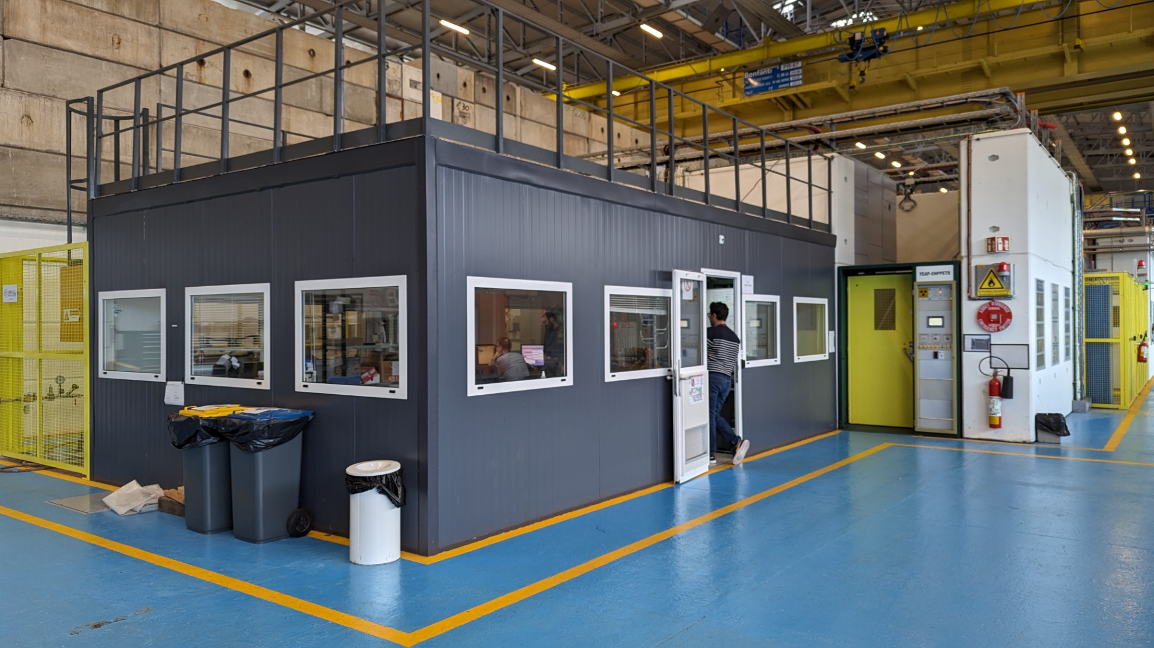
New Straw production line and assembling place
Area ~200 sq.m., clean room~100 sq.m, machine shop and assembling hall~50 sq.m and 8,5 m high
Double Production line length~12m
The deadline is the beginning of the 3rd quarter of 2024
Commissioning works-the beginning of the 4th quarter of 2024
Necessary materials and equipment have been purchased
Planned volume ~60km straw
This is what we want to get

Slide 4
Measurements of the straw performance and choice of the readout electronics parameters
- Spatial resolution (SPS)
– influence of the readout parameters
- electronics noise, threshold
- influence of the wire displacement
- different operation conditions (gas gain, pressure dependence)
- measurements in the magnetic field (H4)
- Charge measurements (PS, low momentum pi, mu, e)
- charge distribution for different particle momenta
- multiple scattering probability
- electronics dynamic range for PID (protons are required, under discussion)
- measurements at PNPI under discussion

Slide 5
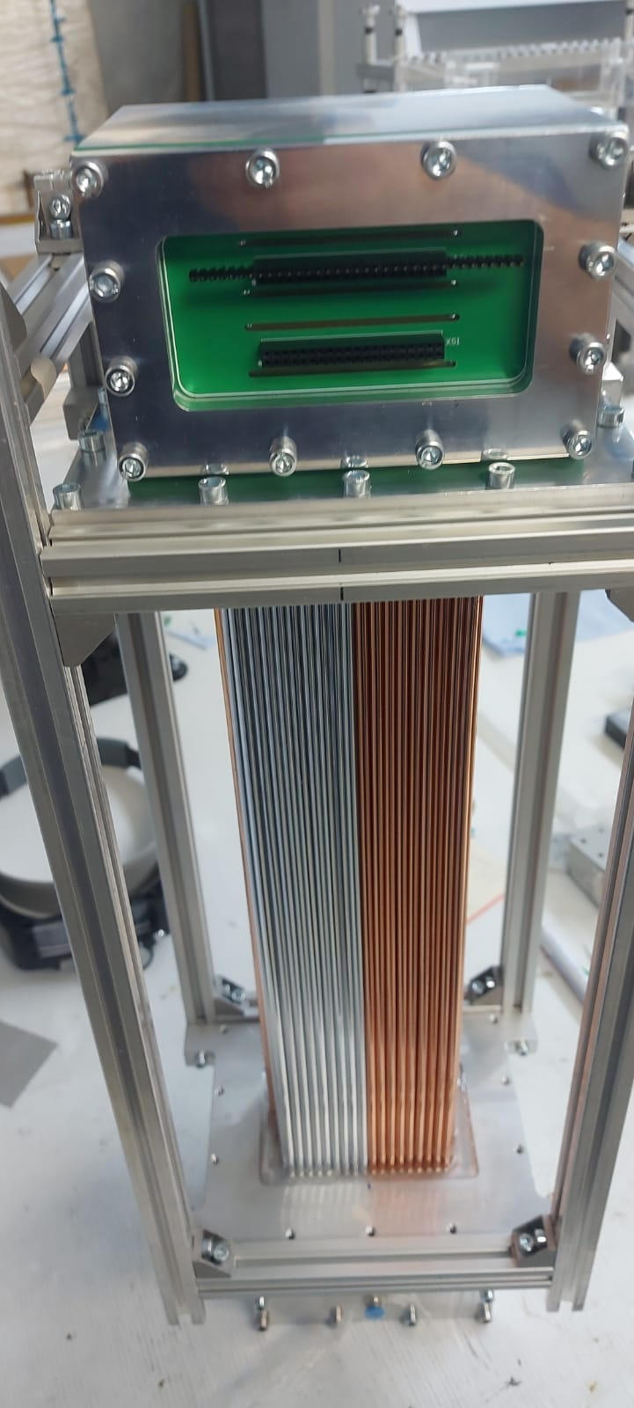
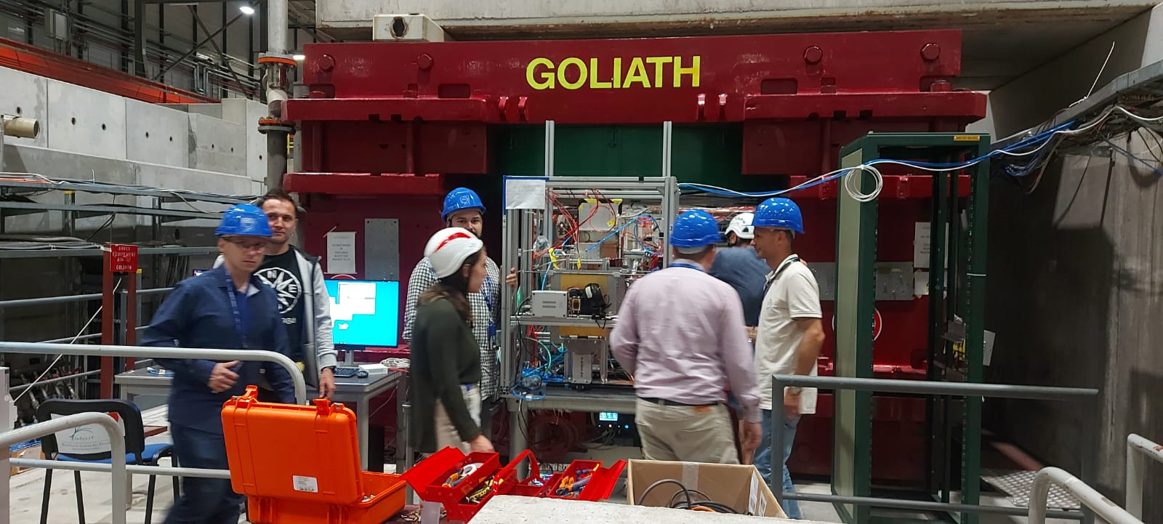
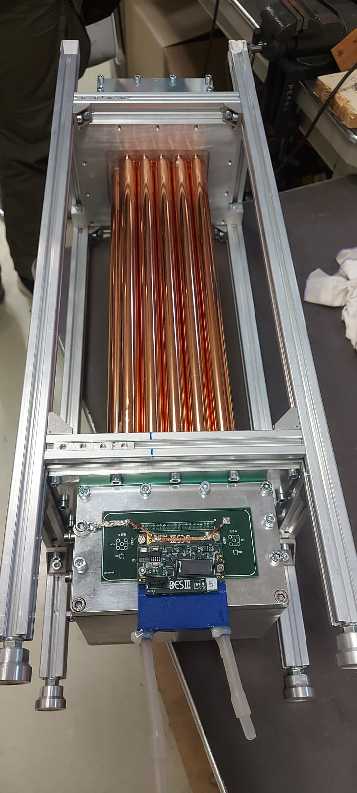
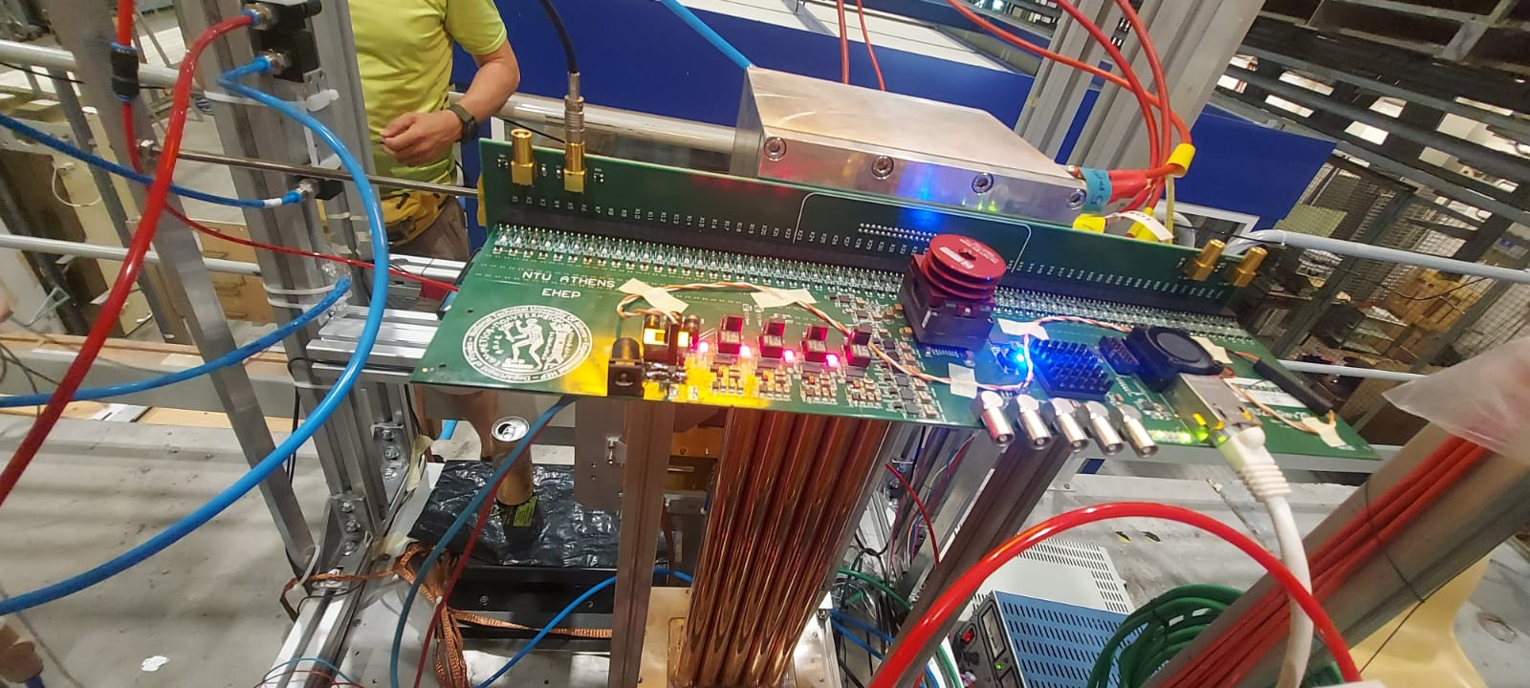
Beam Test activity

Slide 6
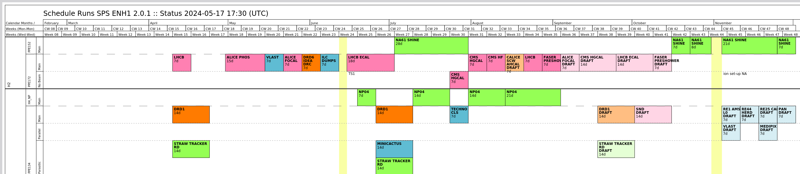
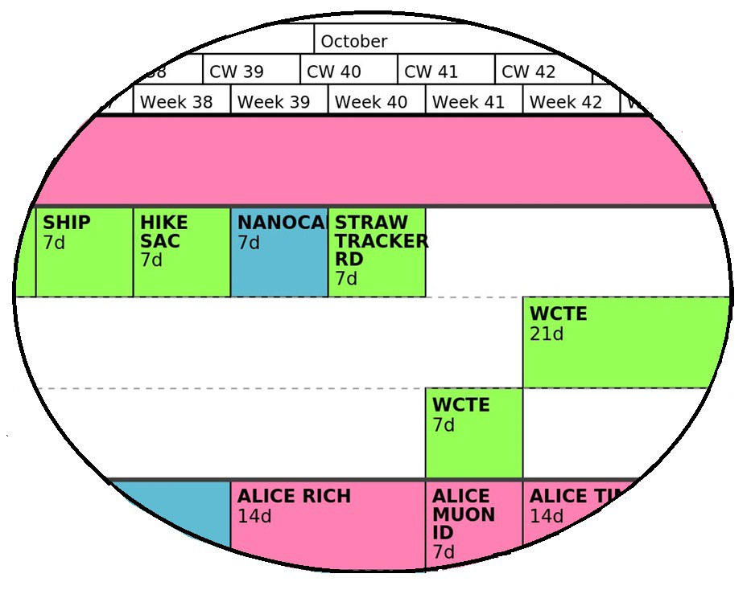
Test beam periods 2024 at SPS and PS
Three different tasks:
- setup development, readout electronics test and debugging :
SPS H8 beam dump (low intensity muons)
- spatial resolution: SPS H4
- charge measurements for low momentum particles: PS T09

Slide 7
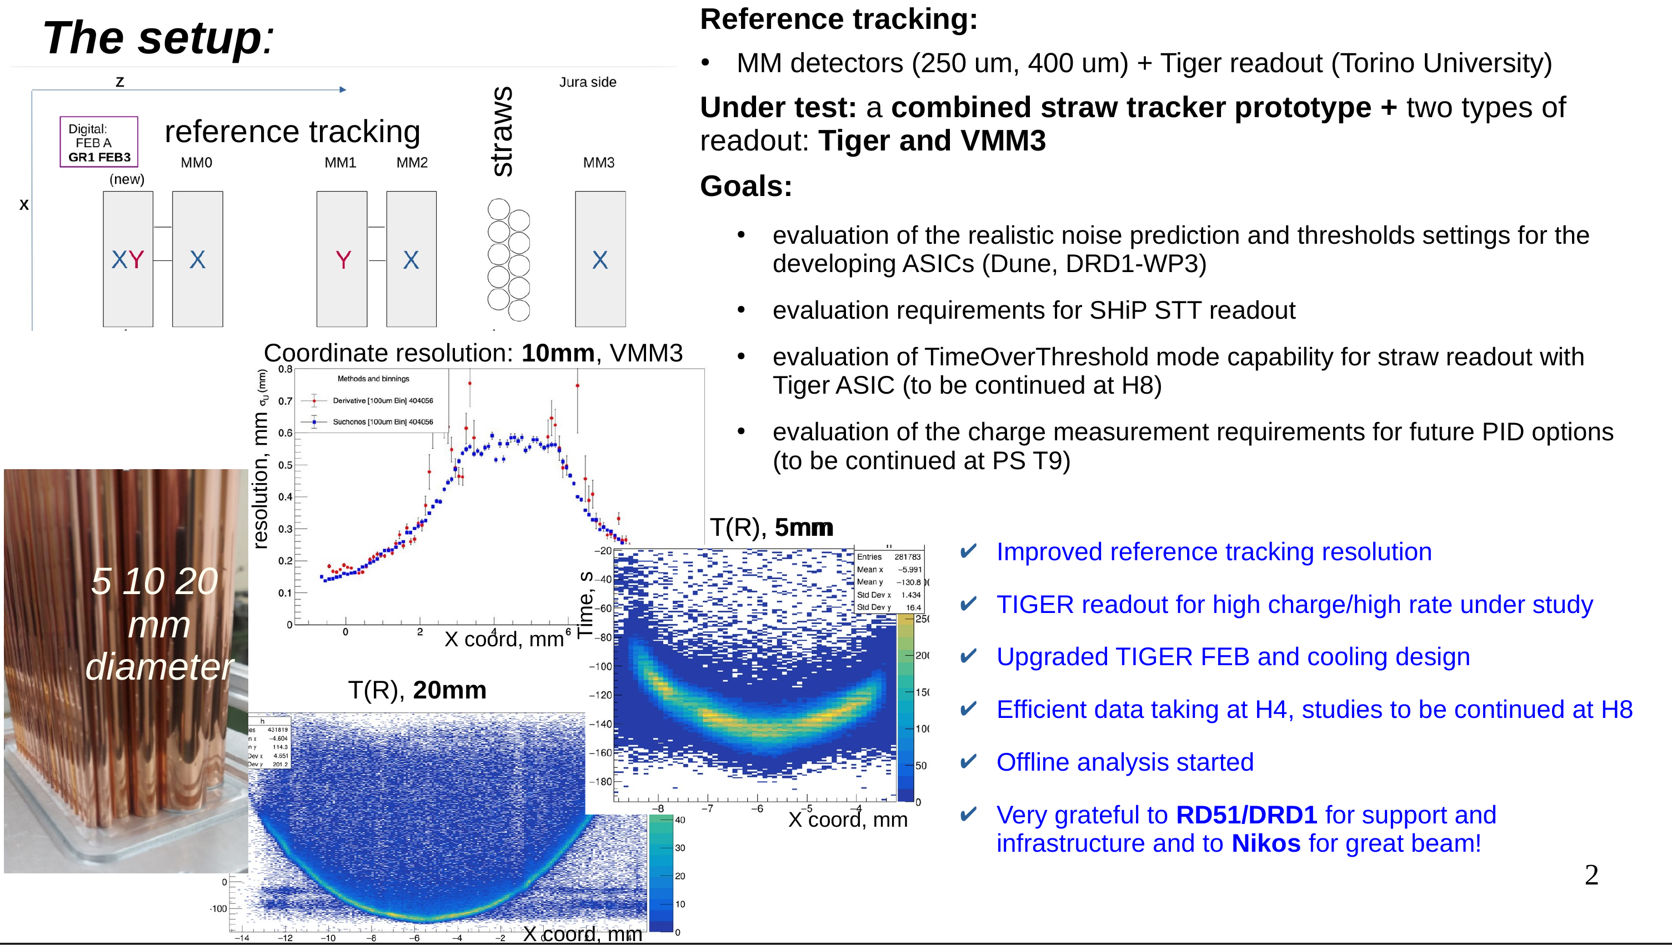
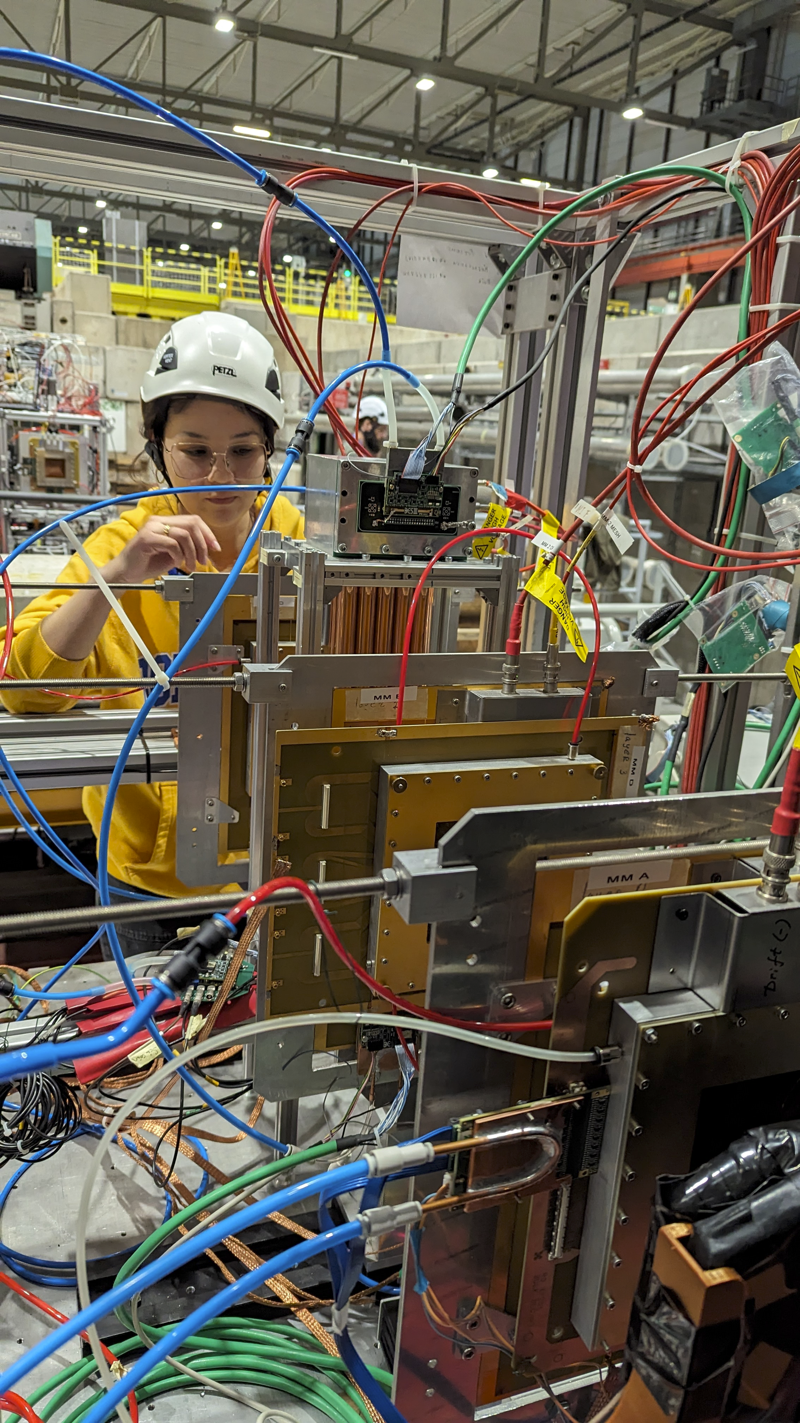
The SPS setup

Slide 8
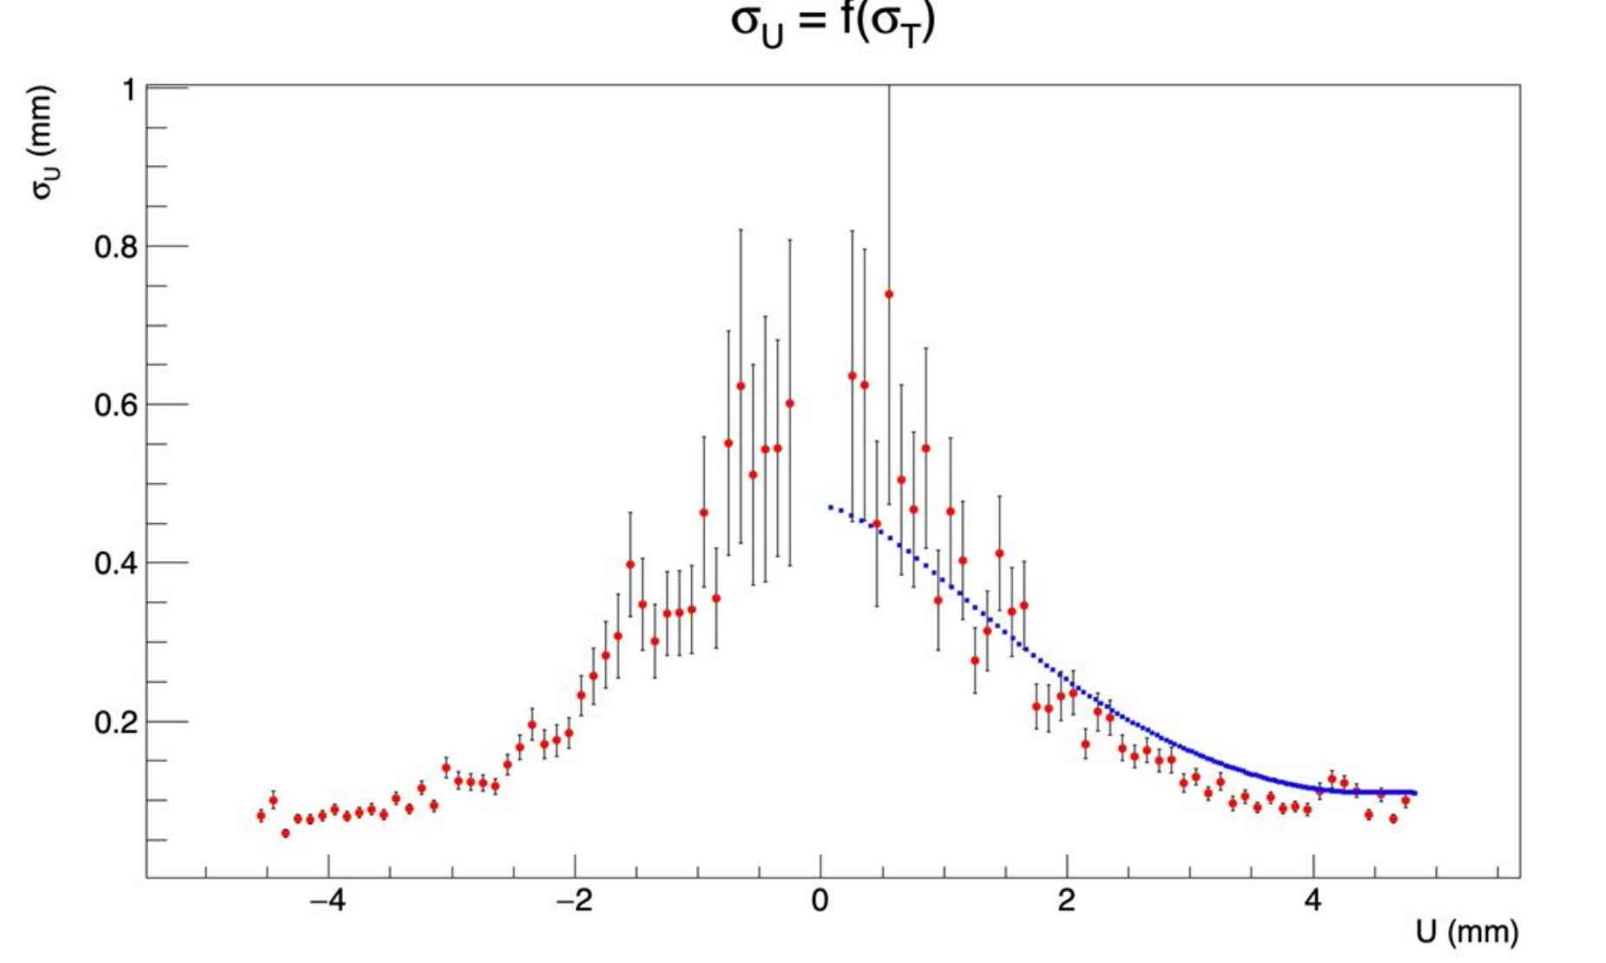
Validation with NA62 data
- good agreement between two independent analysis methods
- results similar to the resolution obtained with straw prototype and VMM3/TIGER
- see A.Chukanov’s talk
Notes:
8

Slide 9
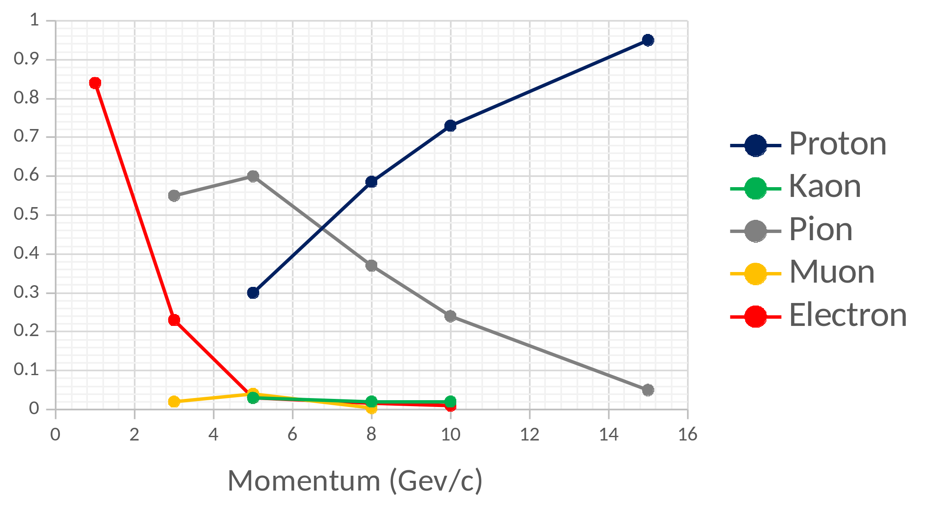
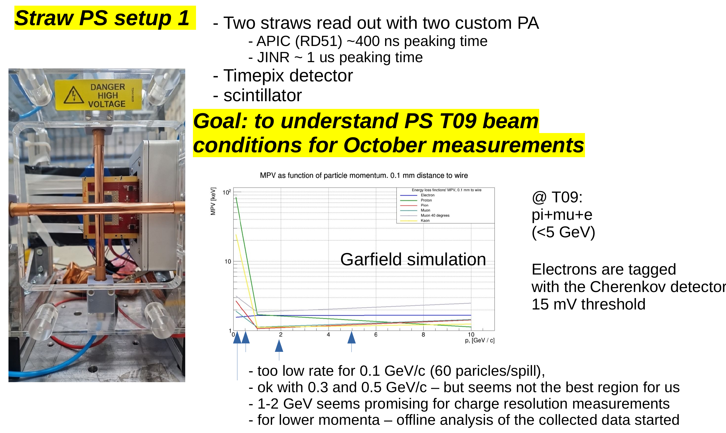
The PS setup
hadron beam
+ electron beam ( reference )
see S.Bulanova talk

Slide 10
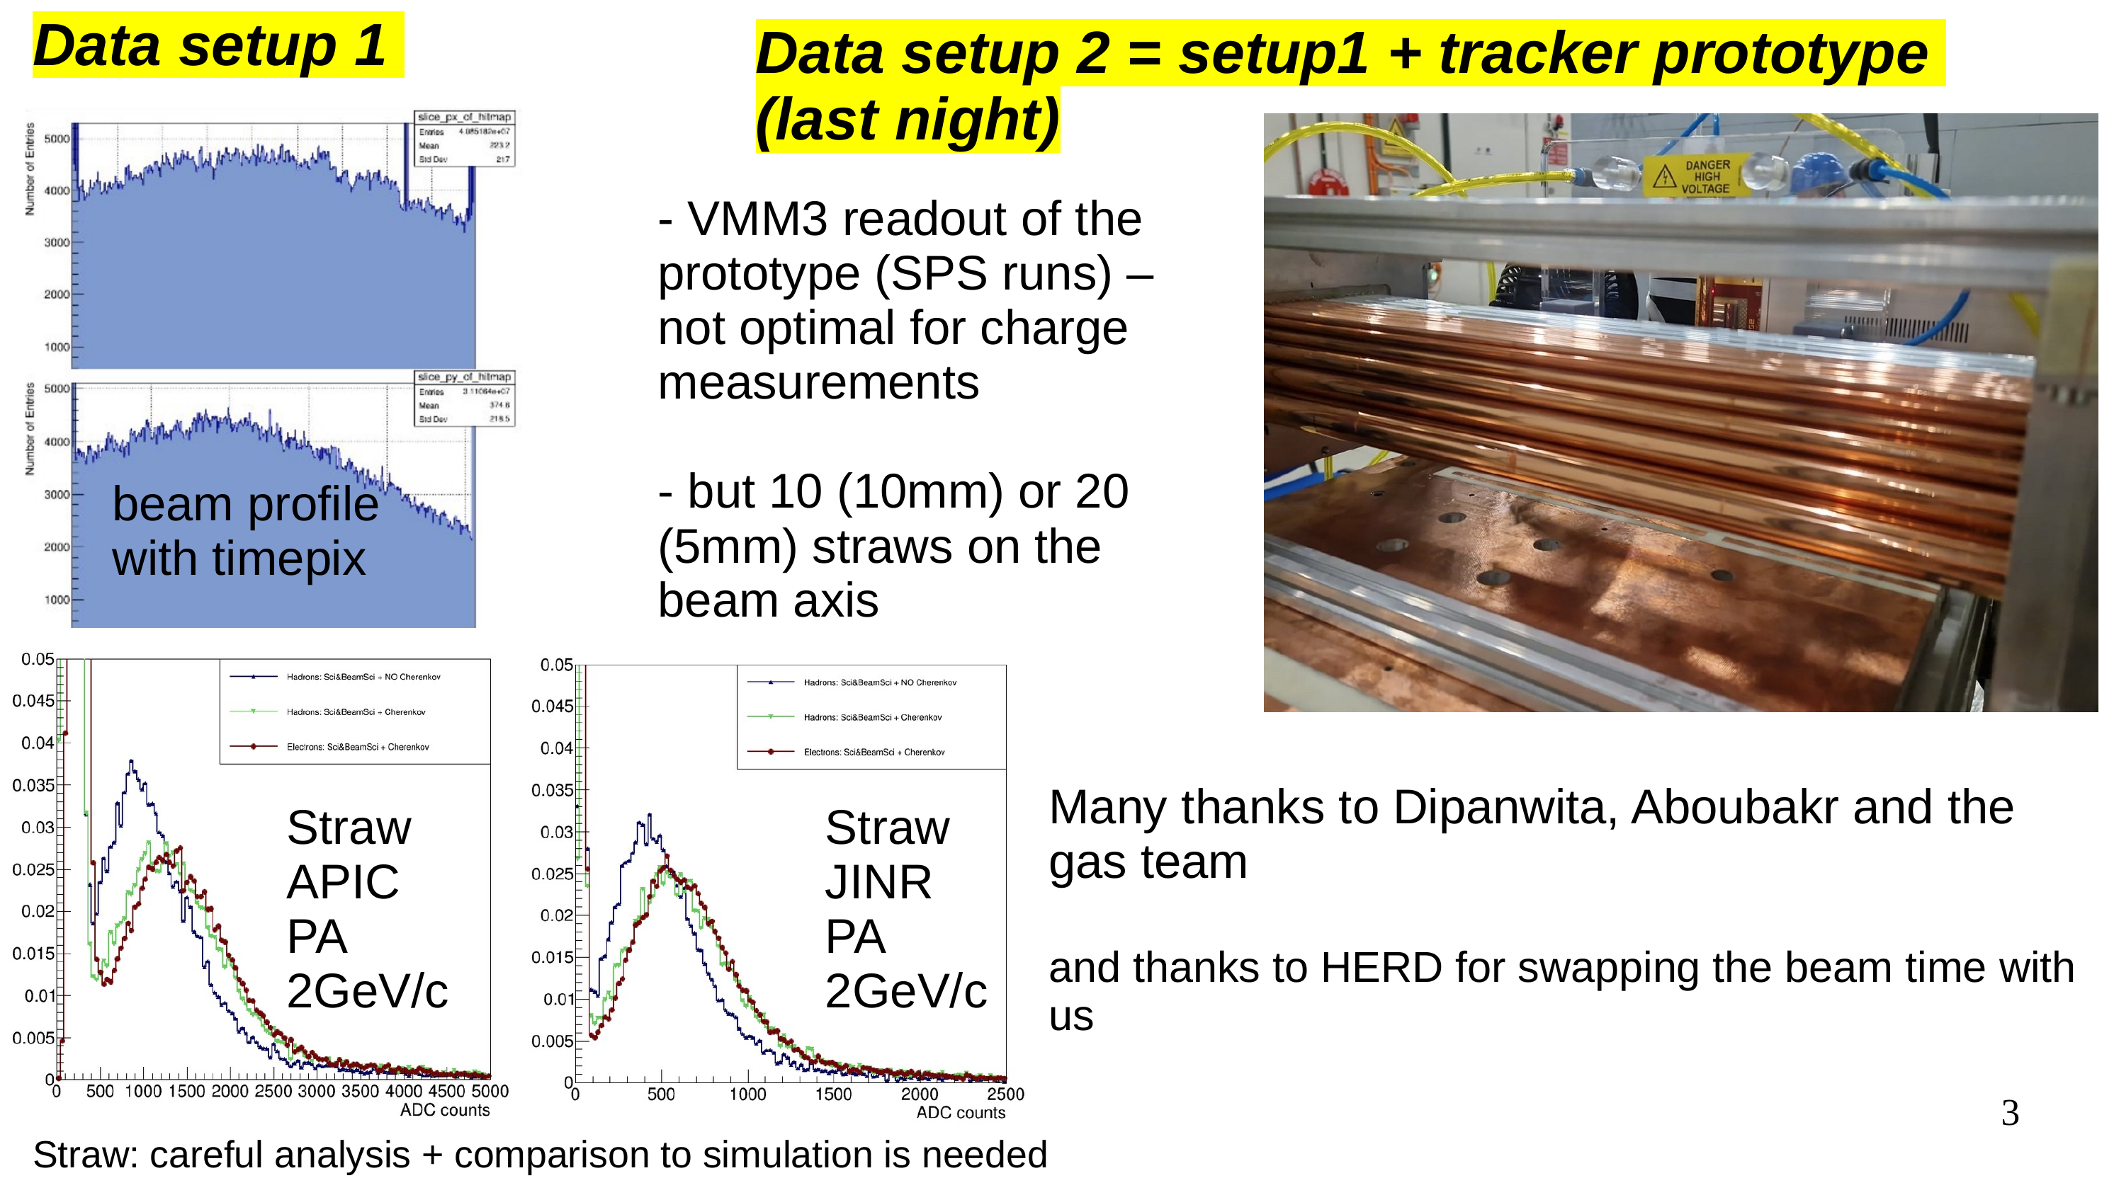
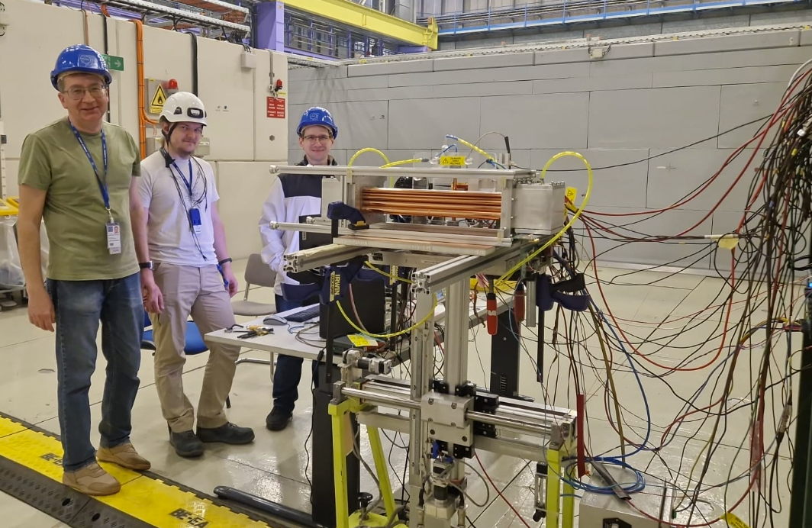
The PS setup
Feedback from PS:
- will investigate possibility for low momenta protons
- for October TB it is possible to increase intensity

Slide 11
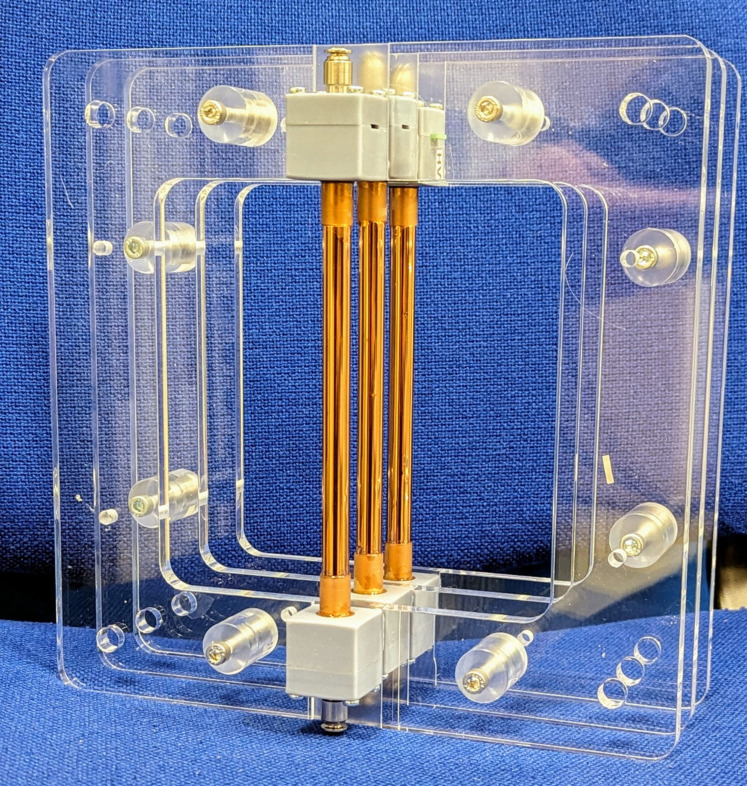
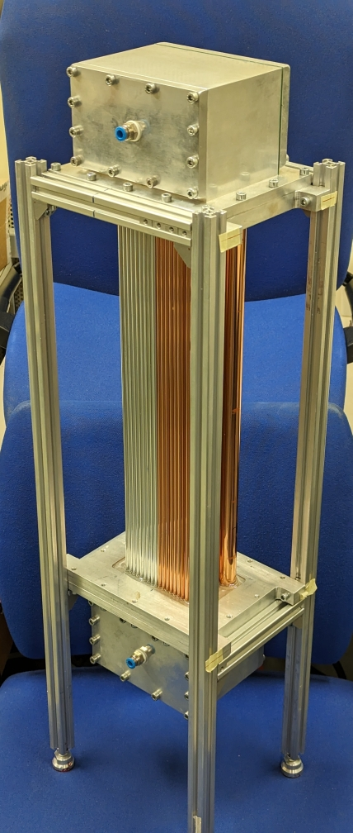
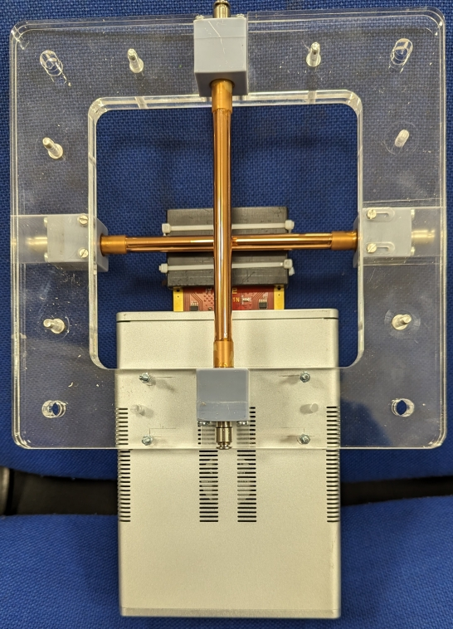
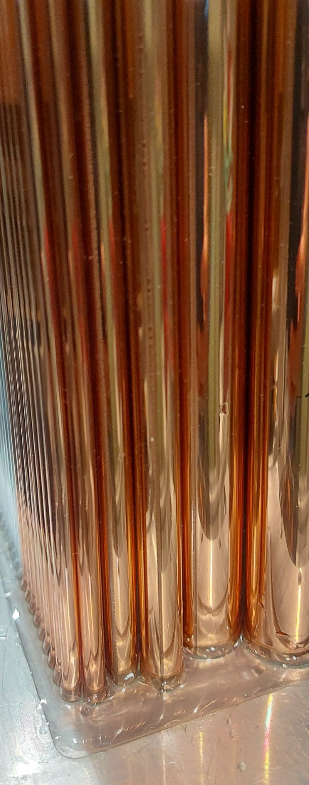
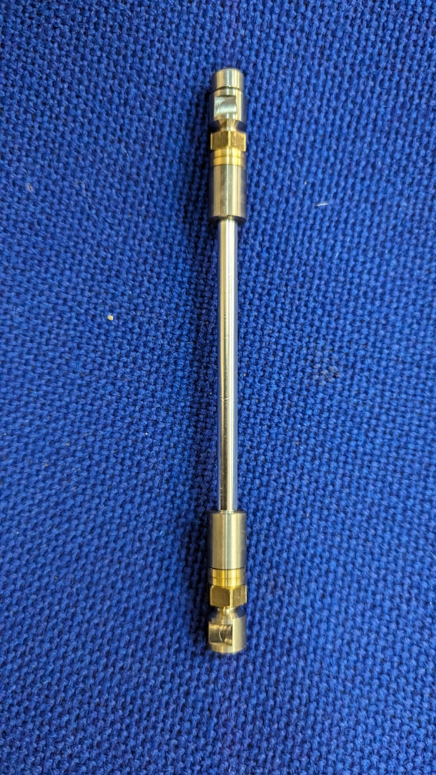
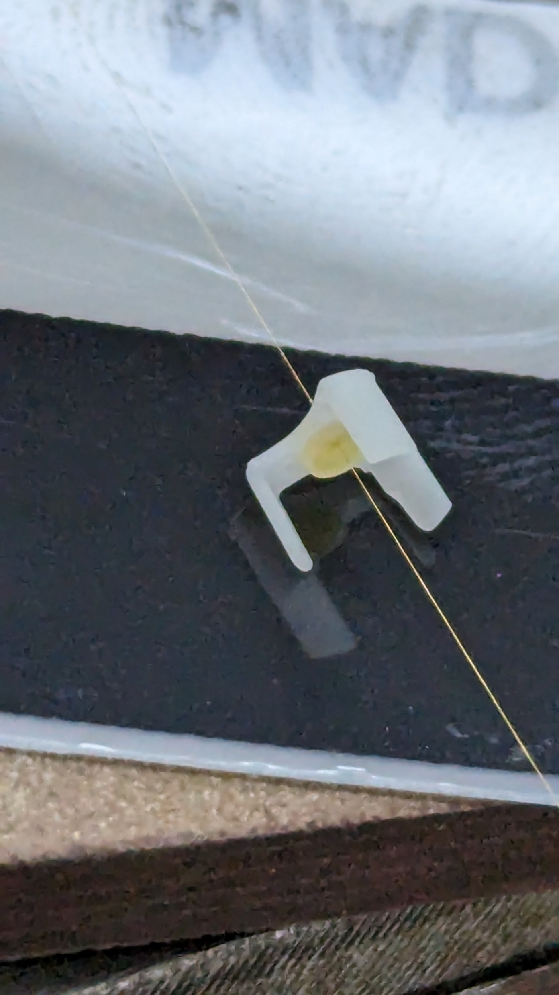
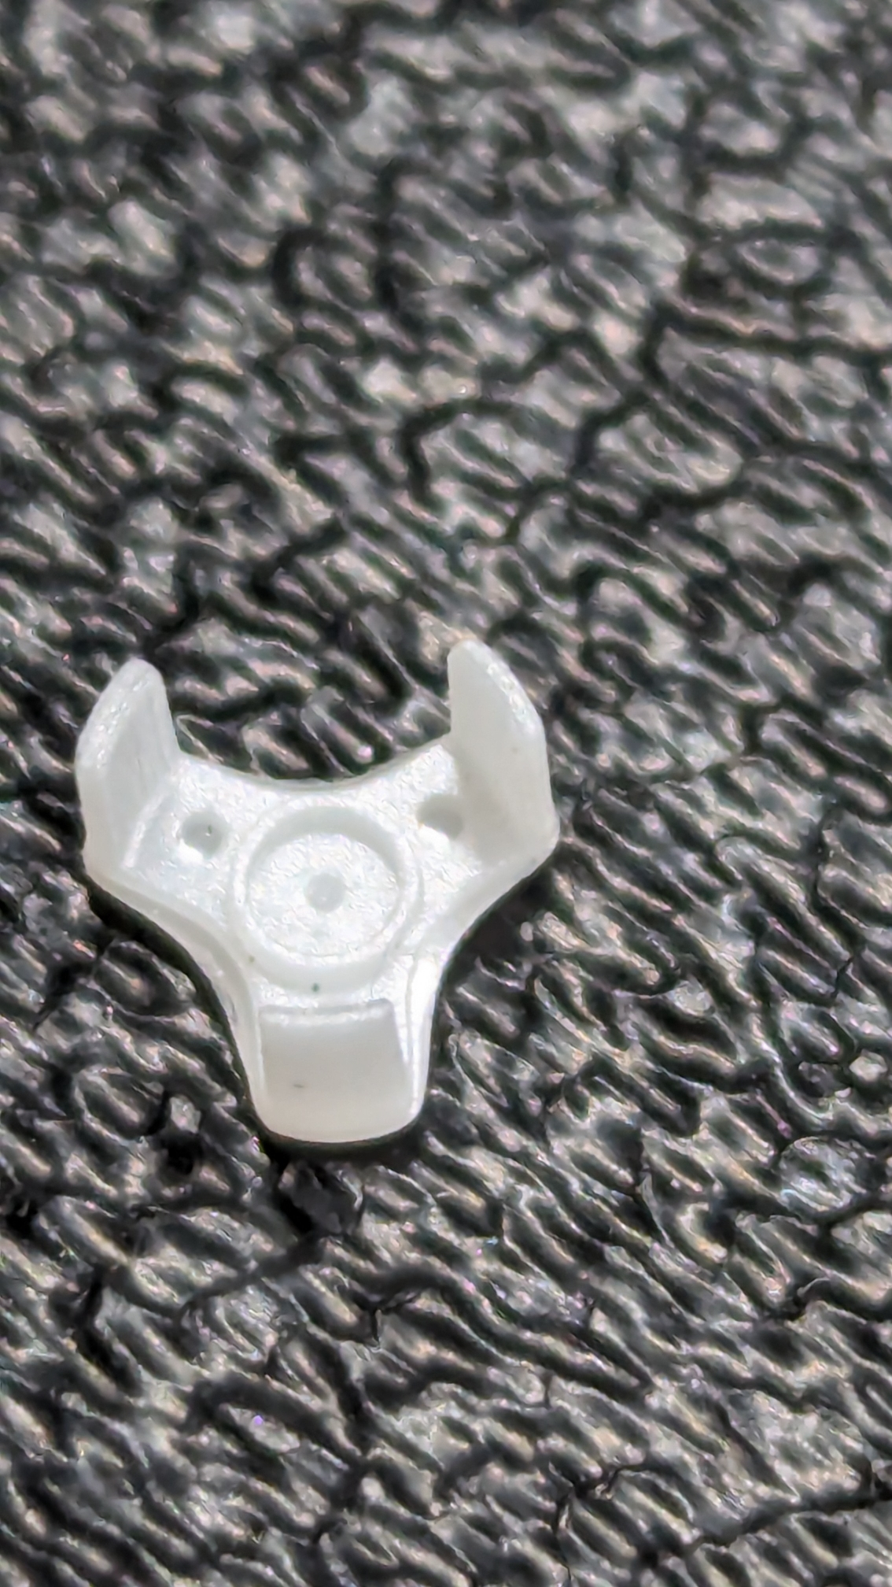
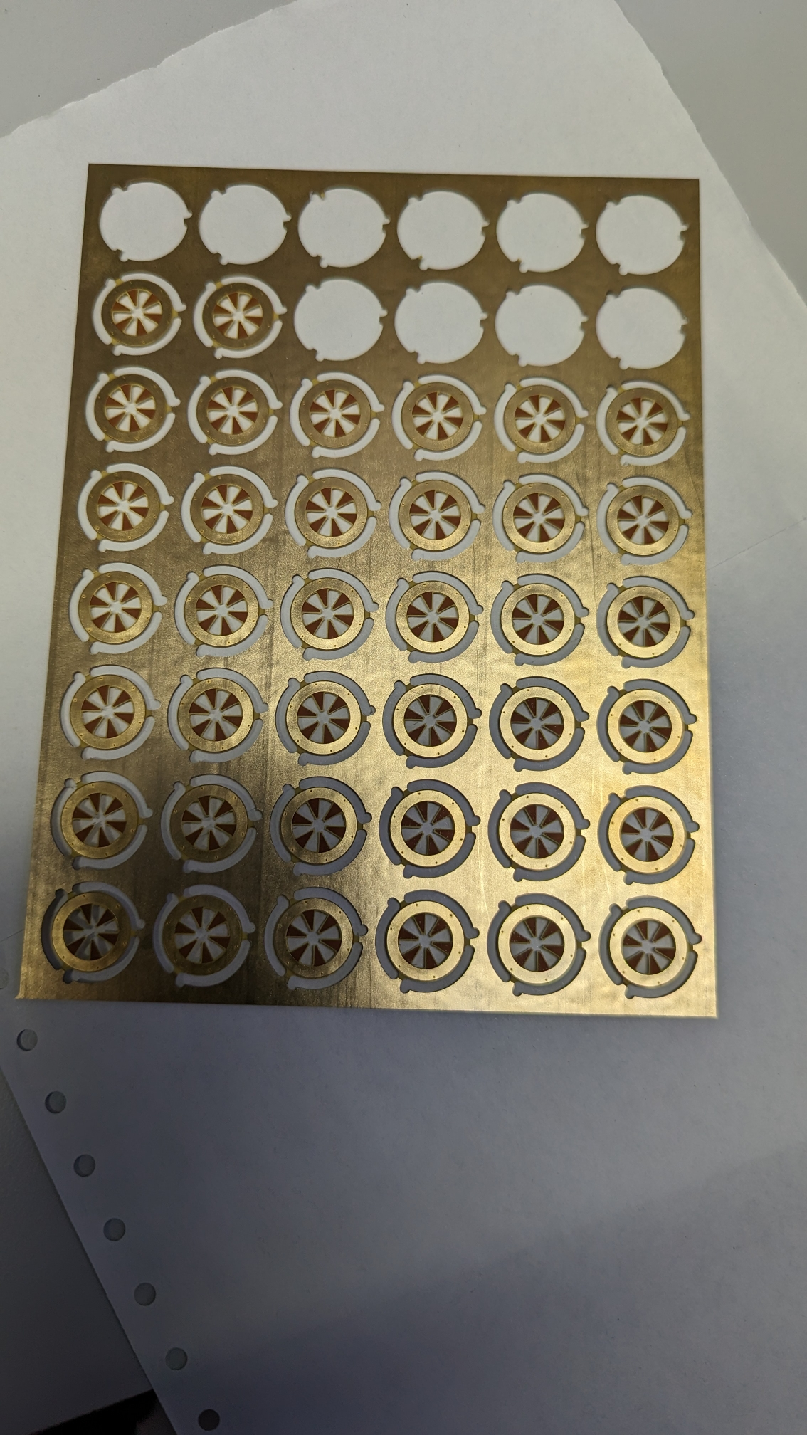
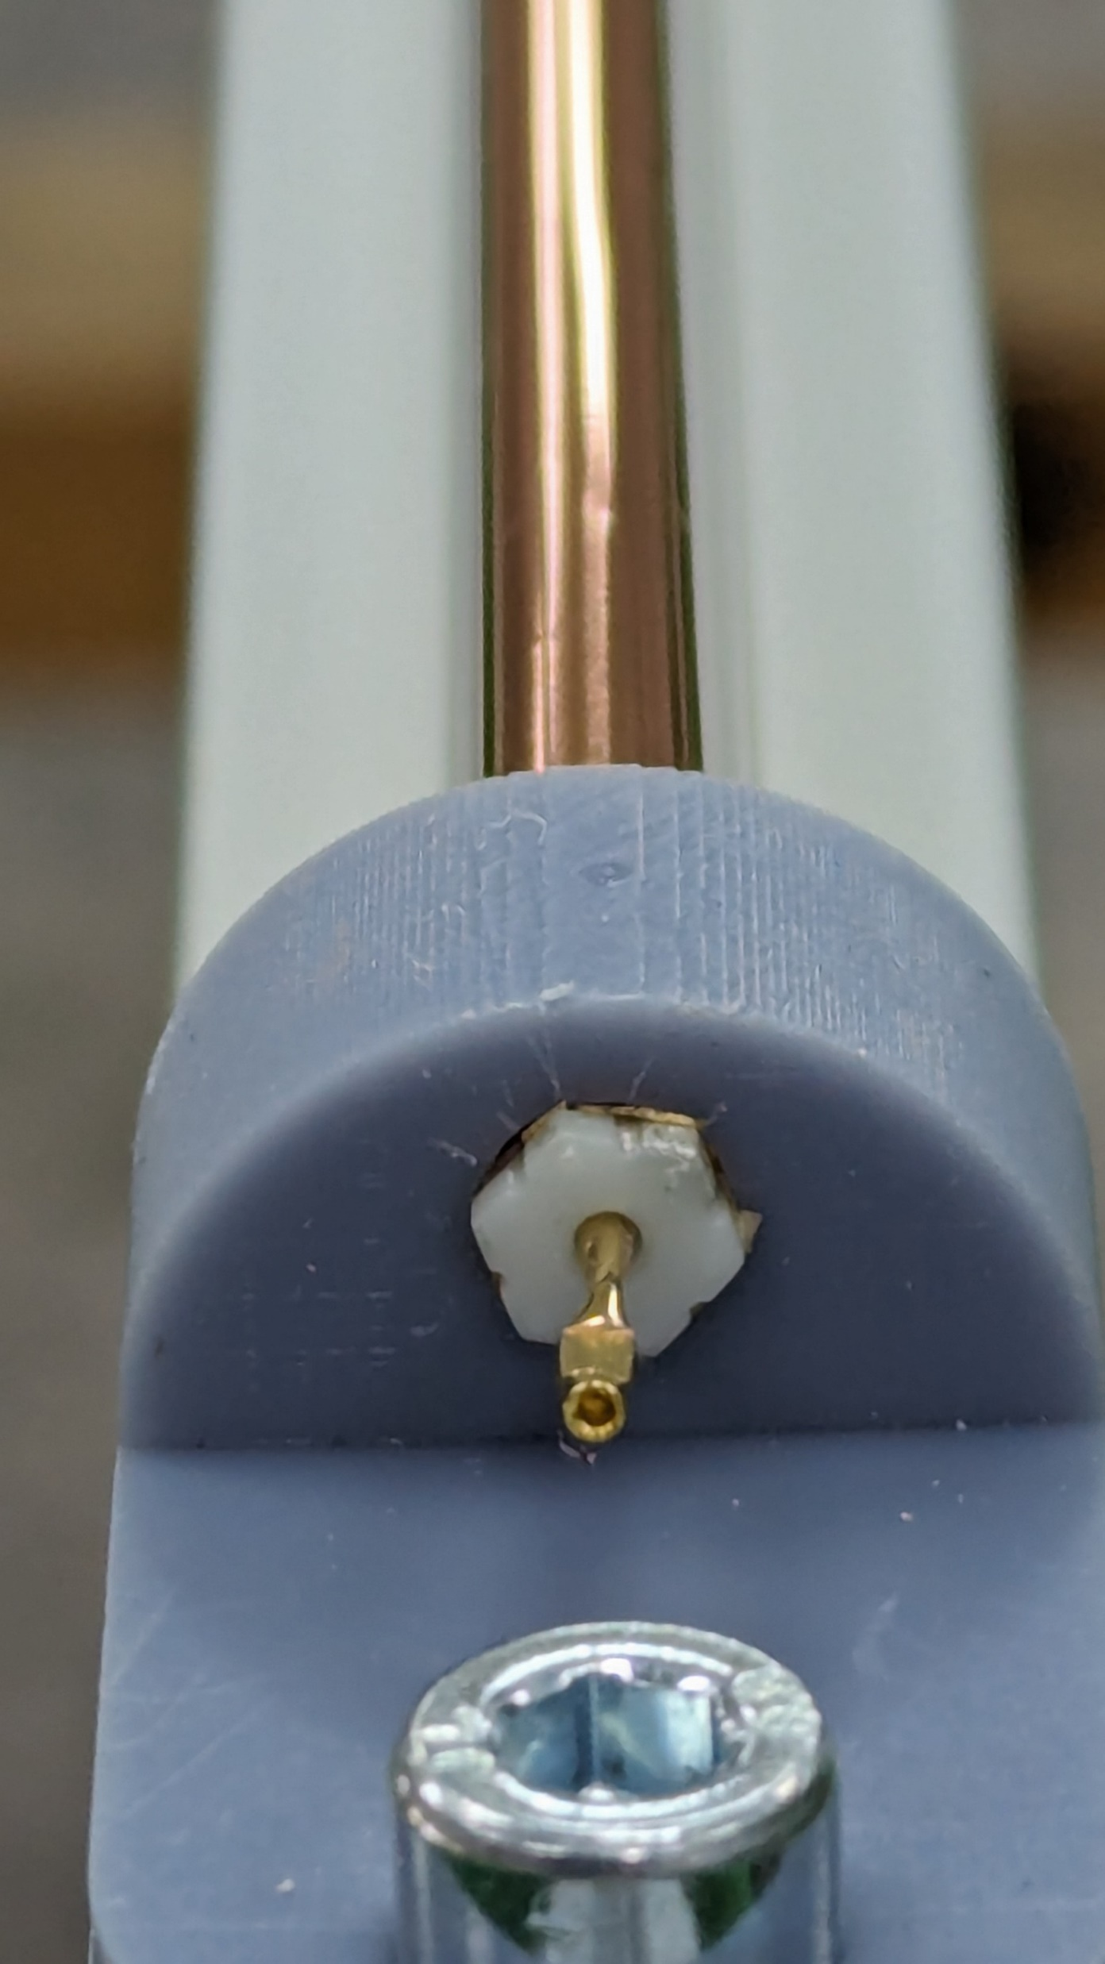
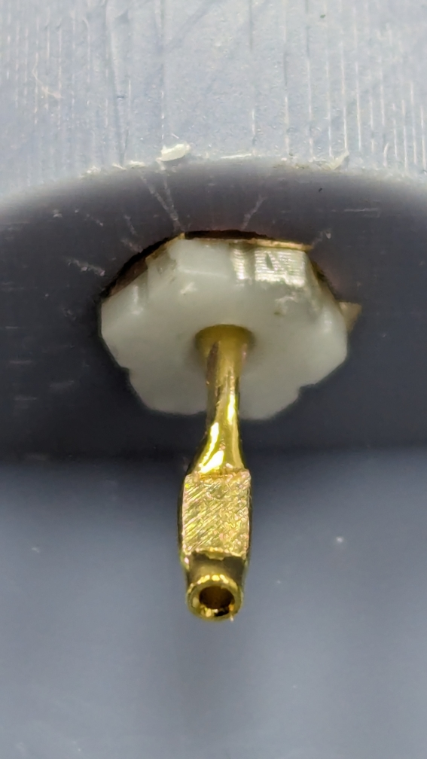
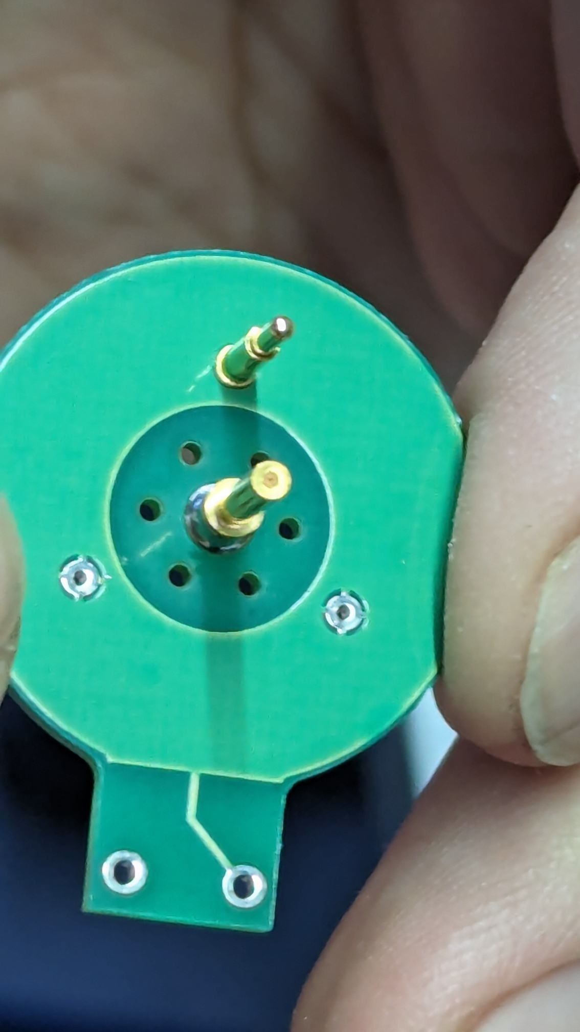
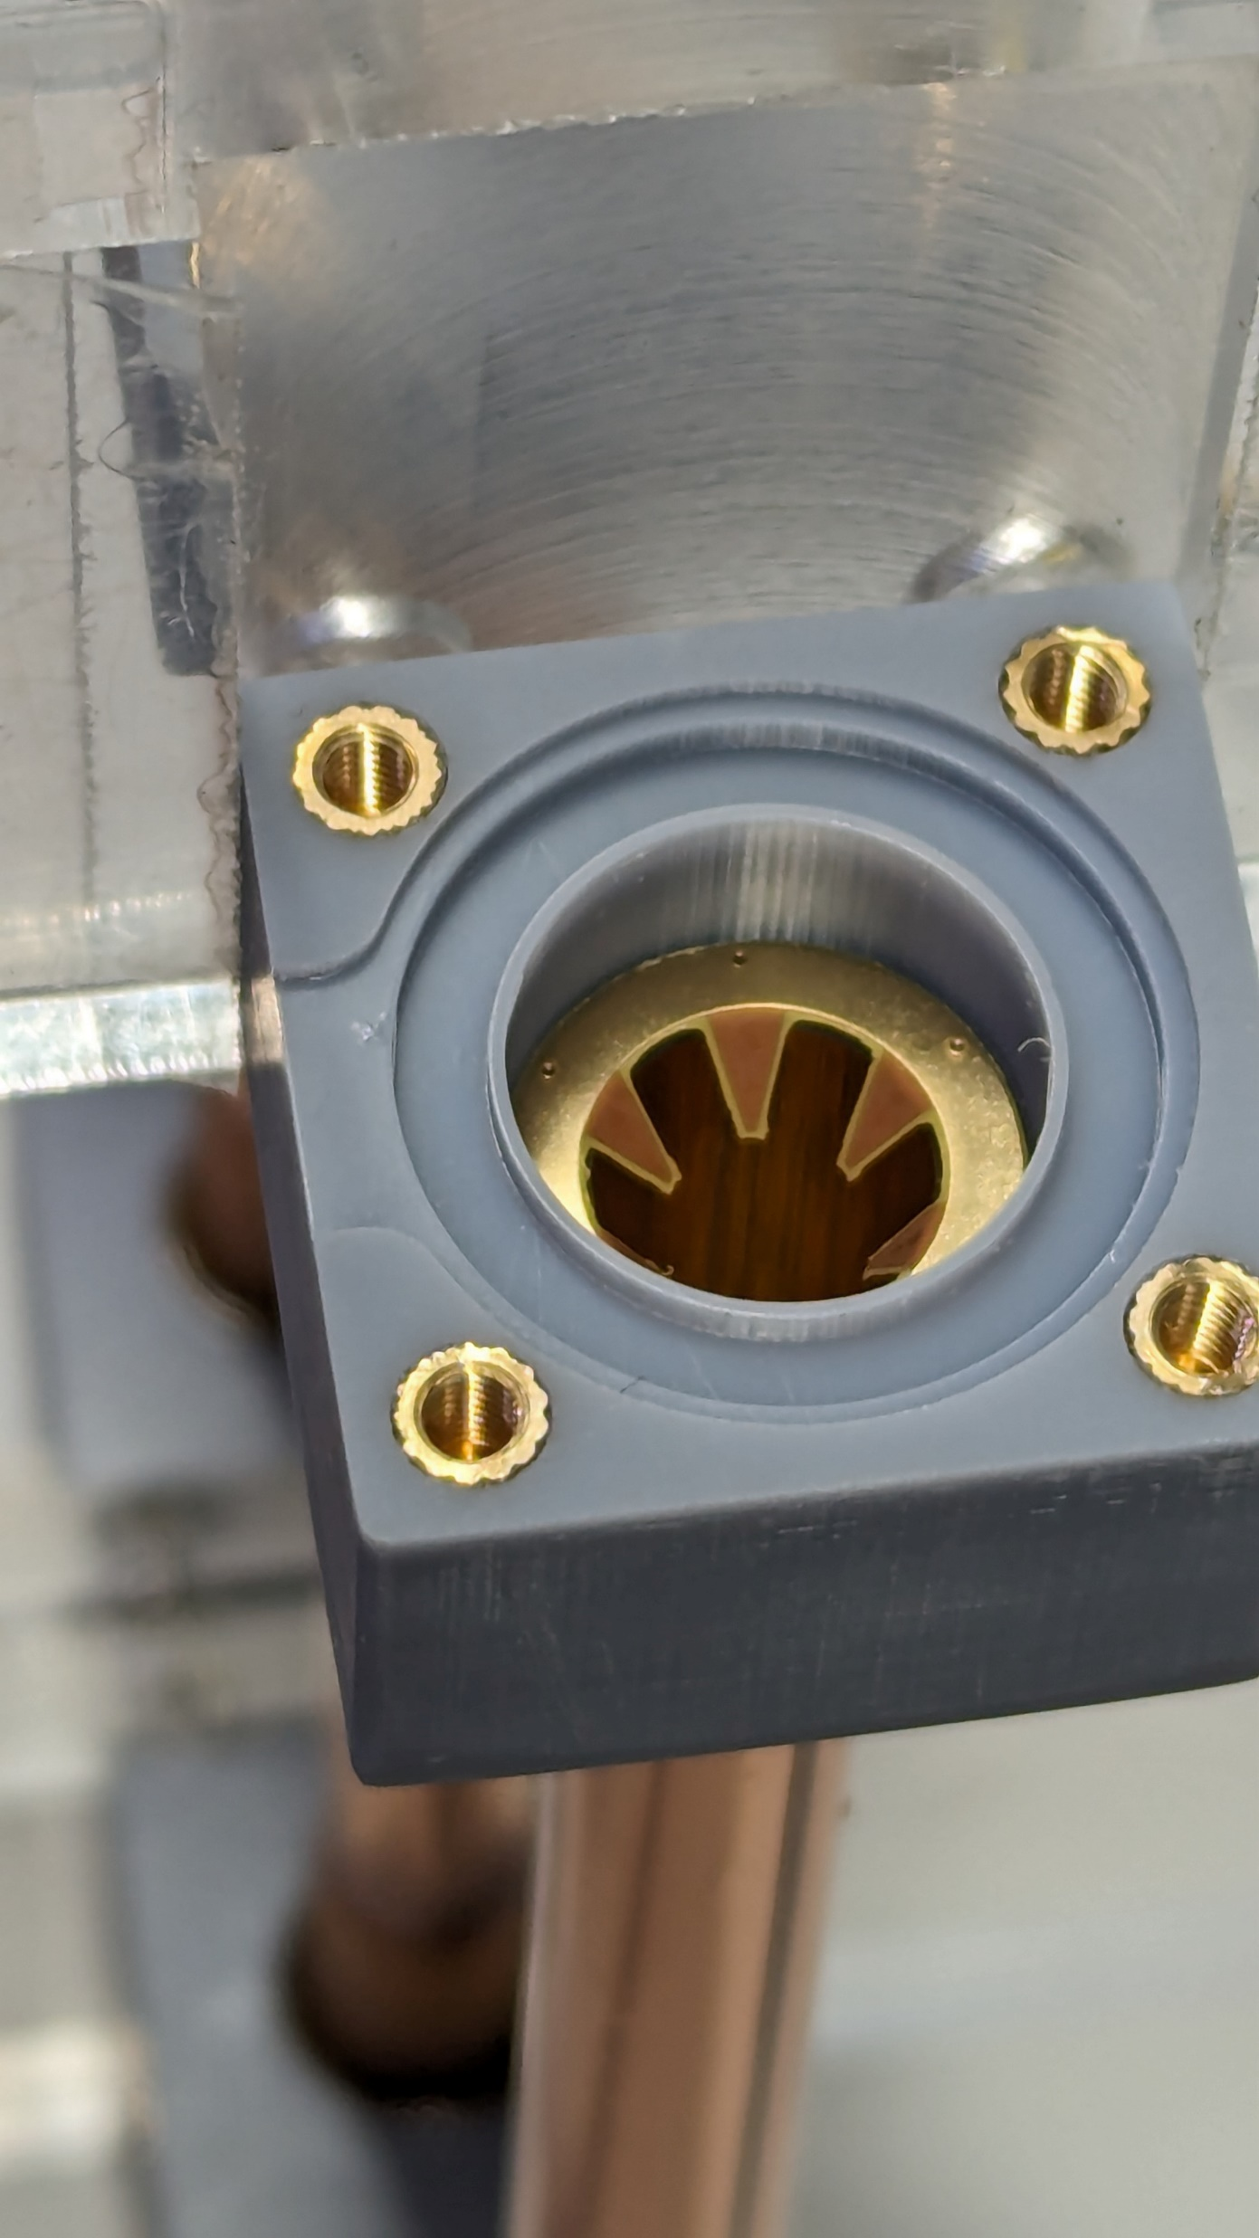
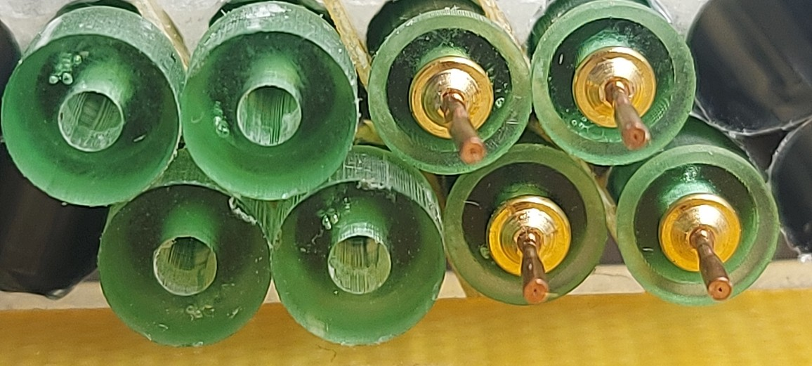
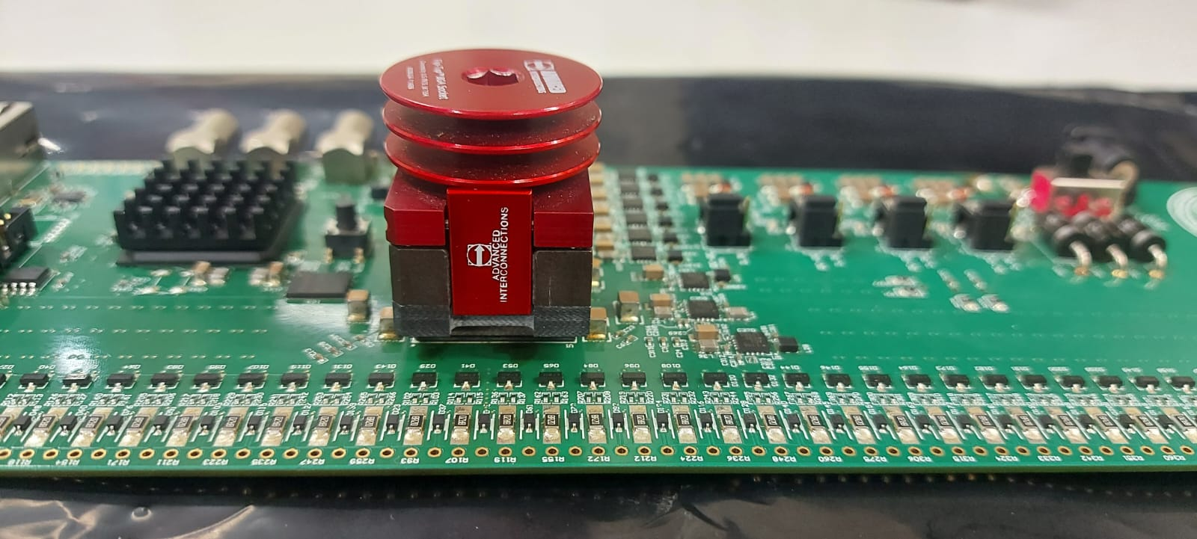
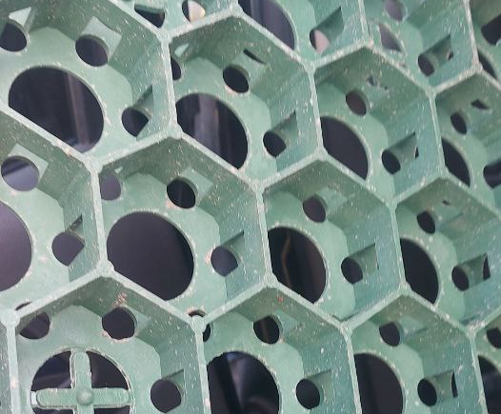
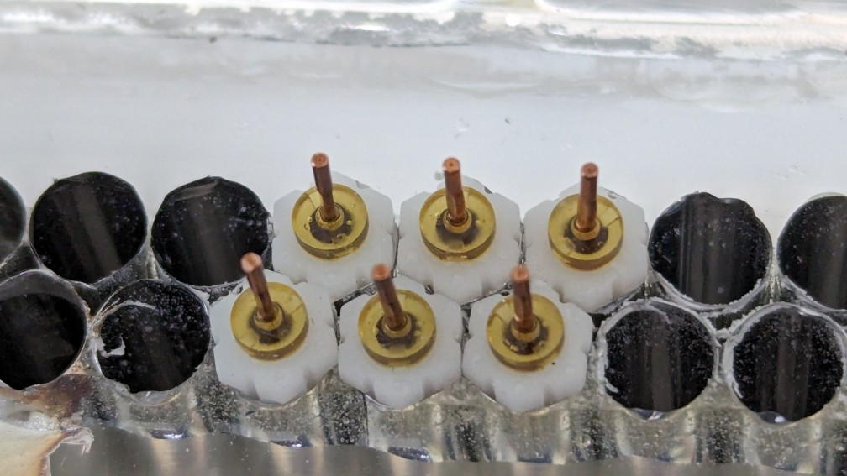
Prototyping
- Small prototype production (lab and test beam straw and readout performance studies)
- development and prototyping of the construction elements (gas supply, sealing)
- development and optimization of the electrical connections (noise and x-talk reduction

Slide 12
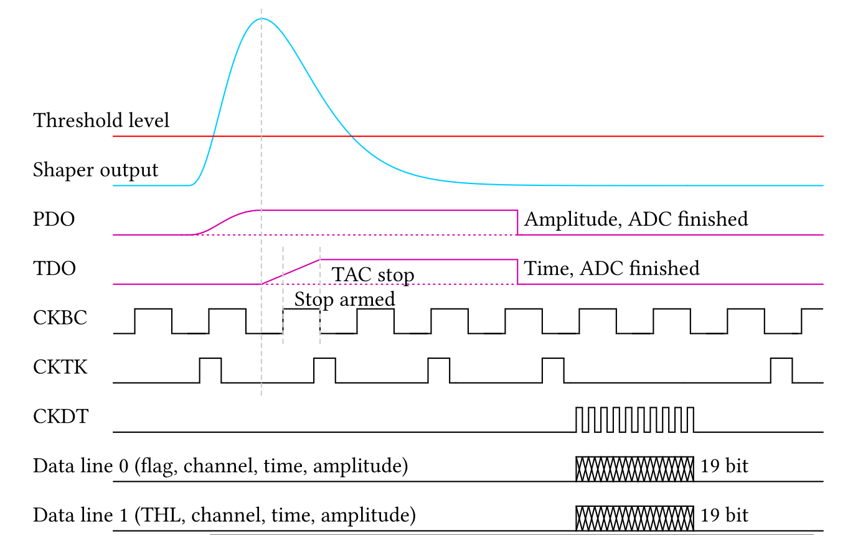
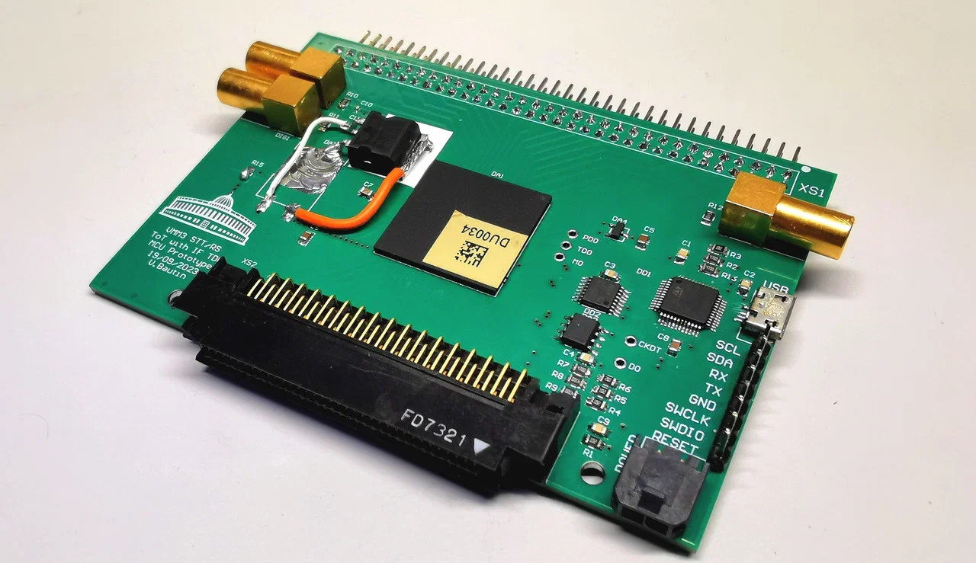
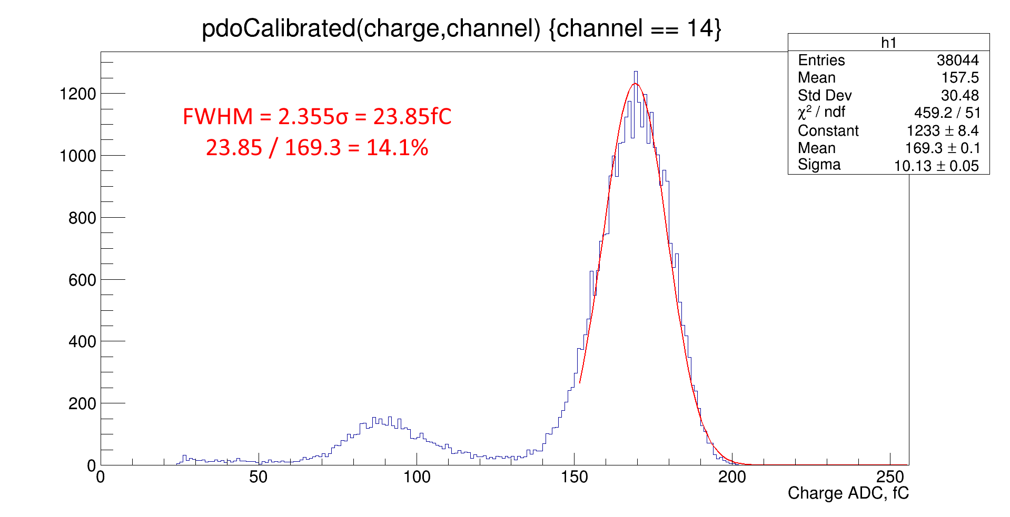
Electronic R&D
VMM3a PCB with microcontroller.

Slide 13
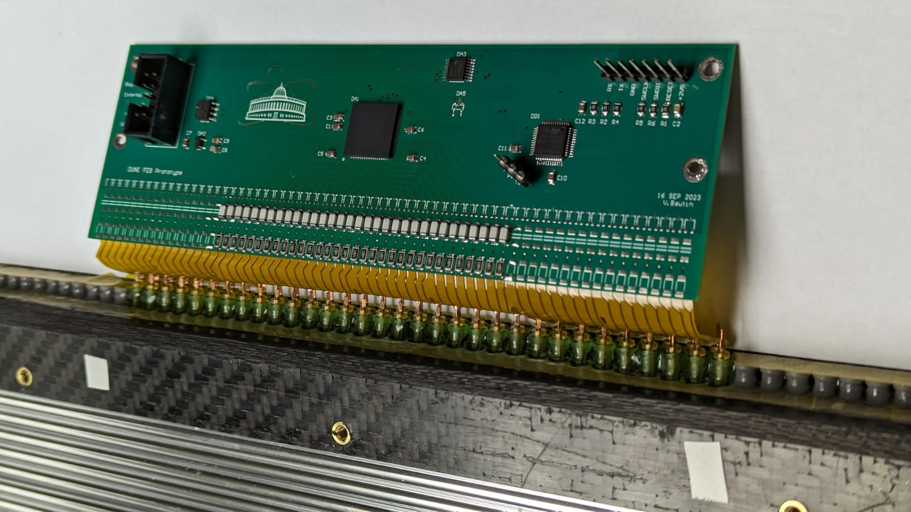
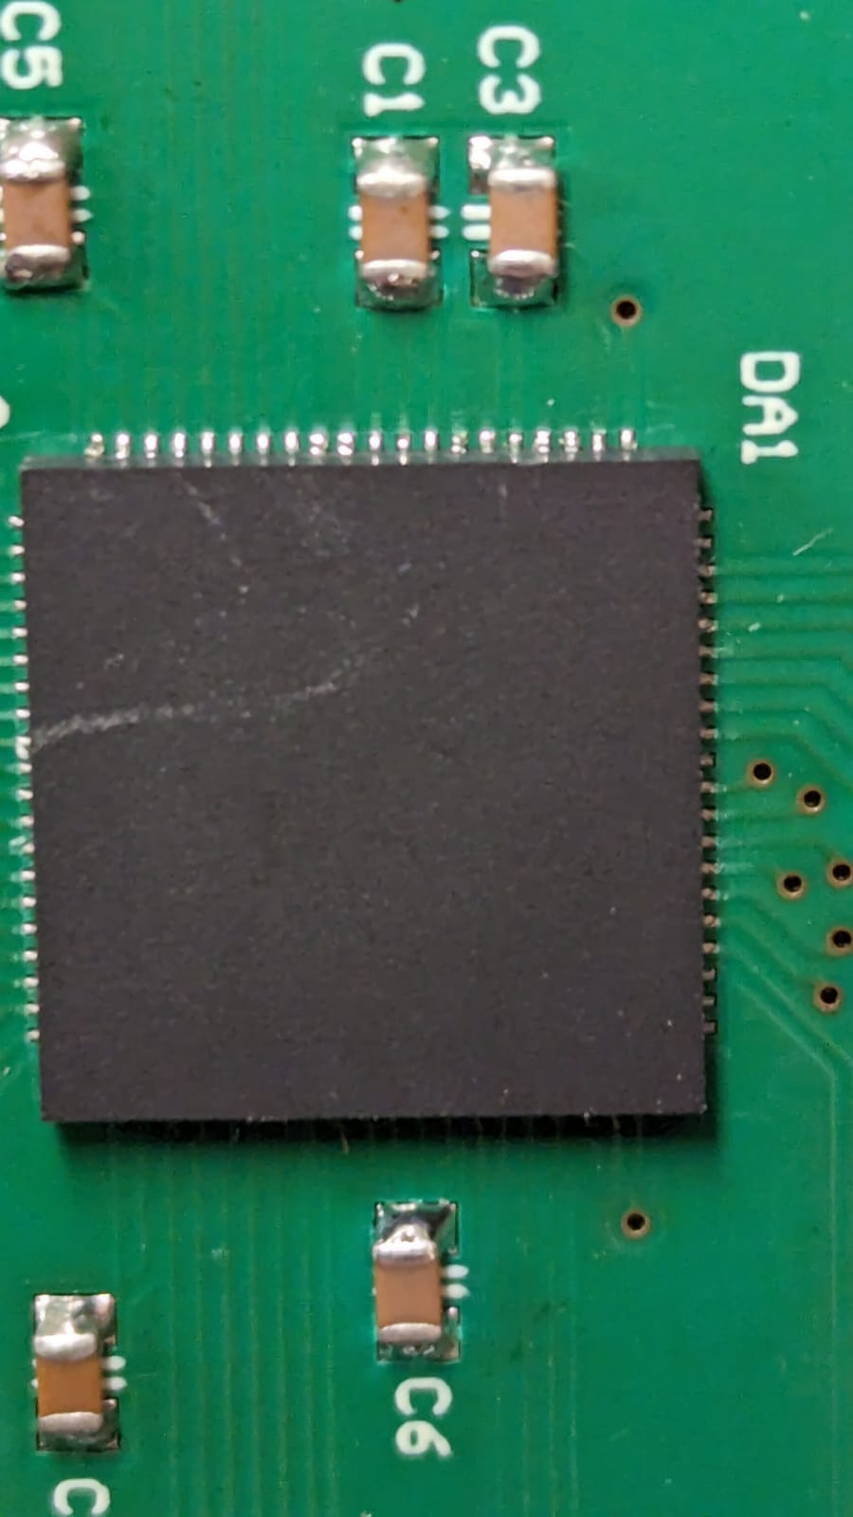
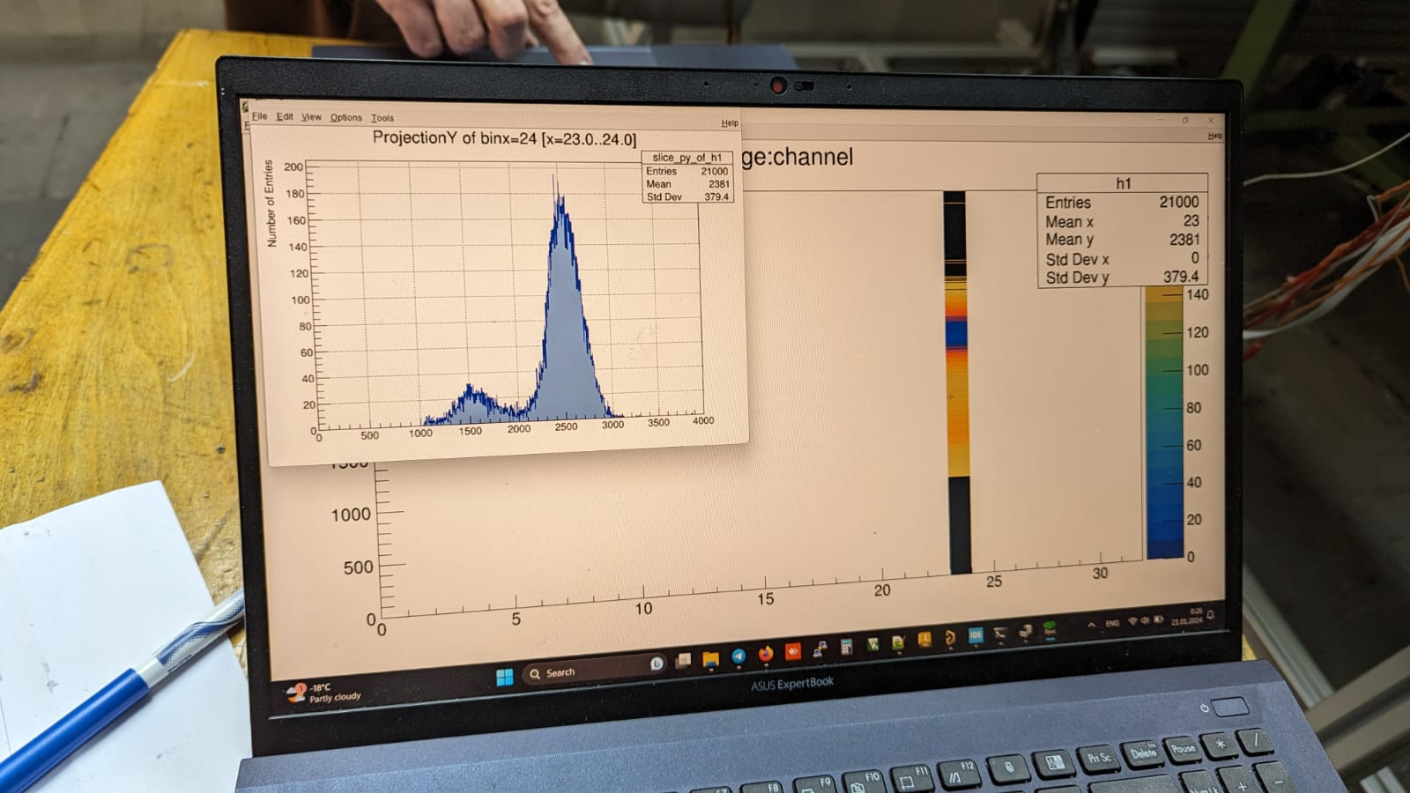
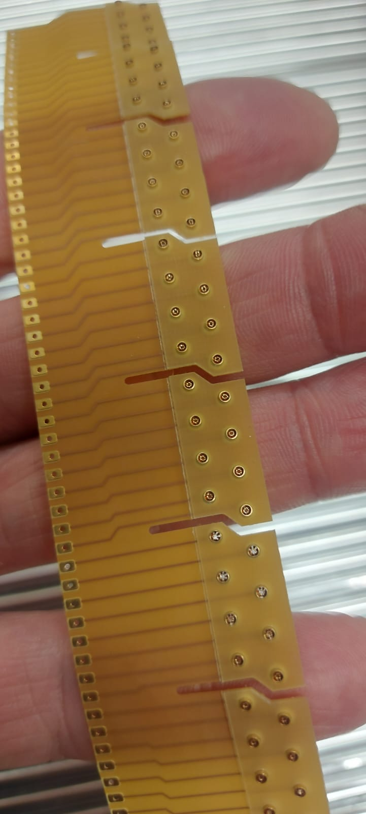
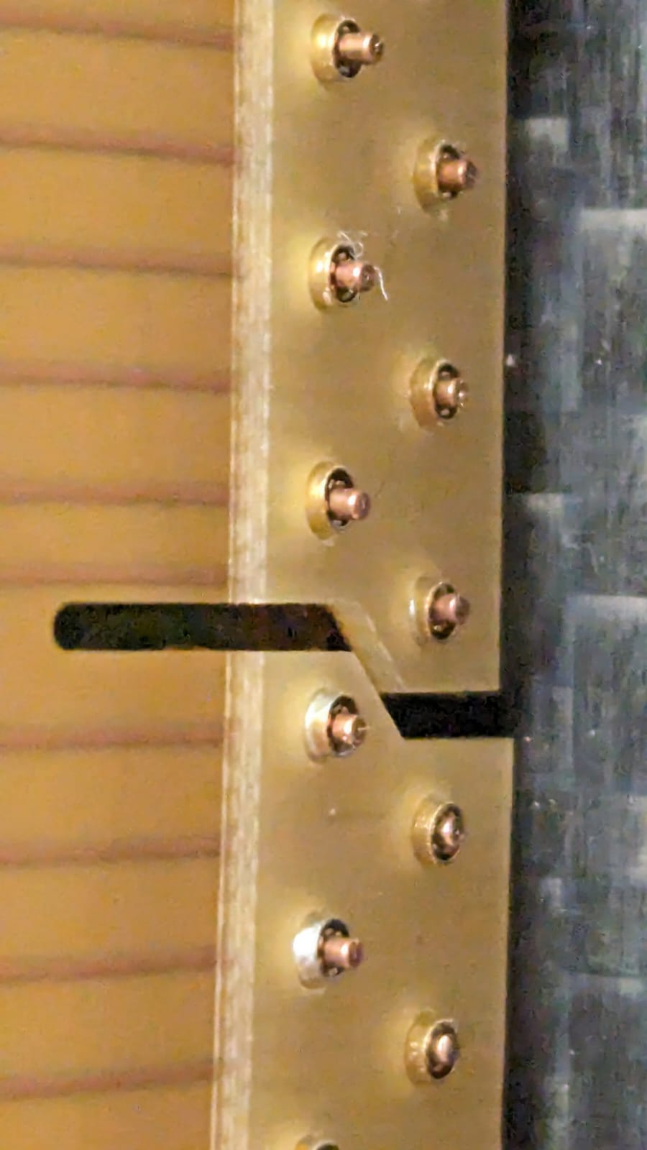
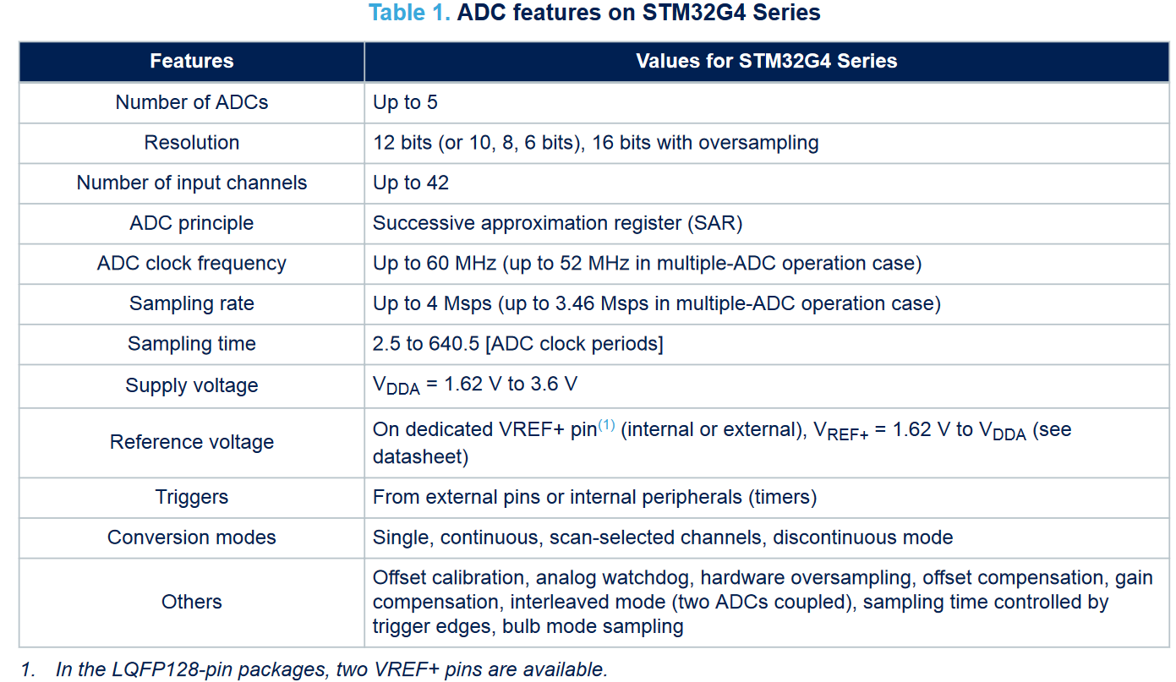
FEE на noname ASIC from De Geronimo

Slide 14
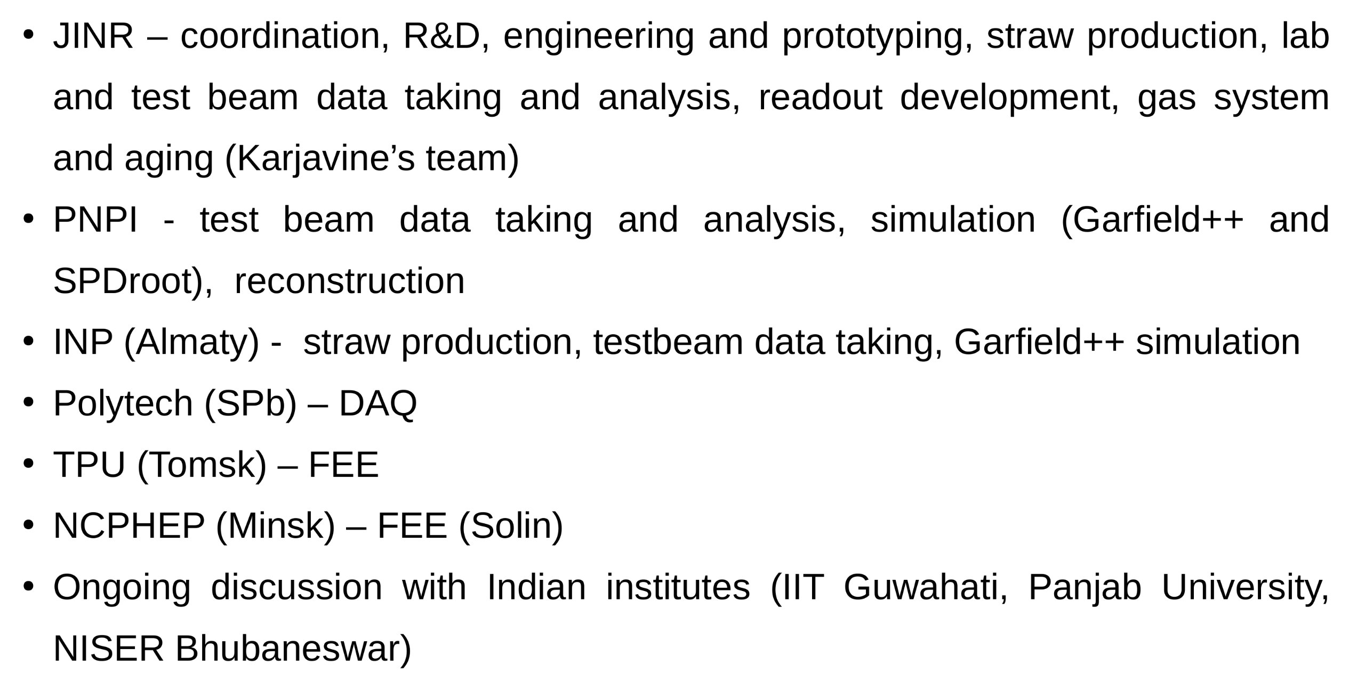
Contributions

Slide 15
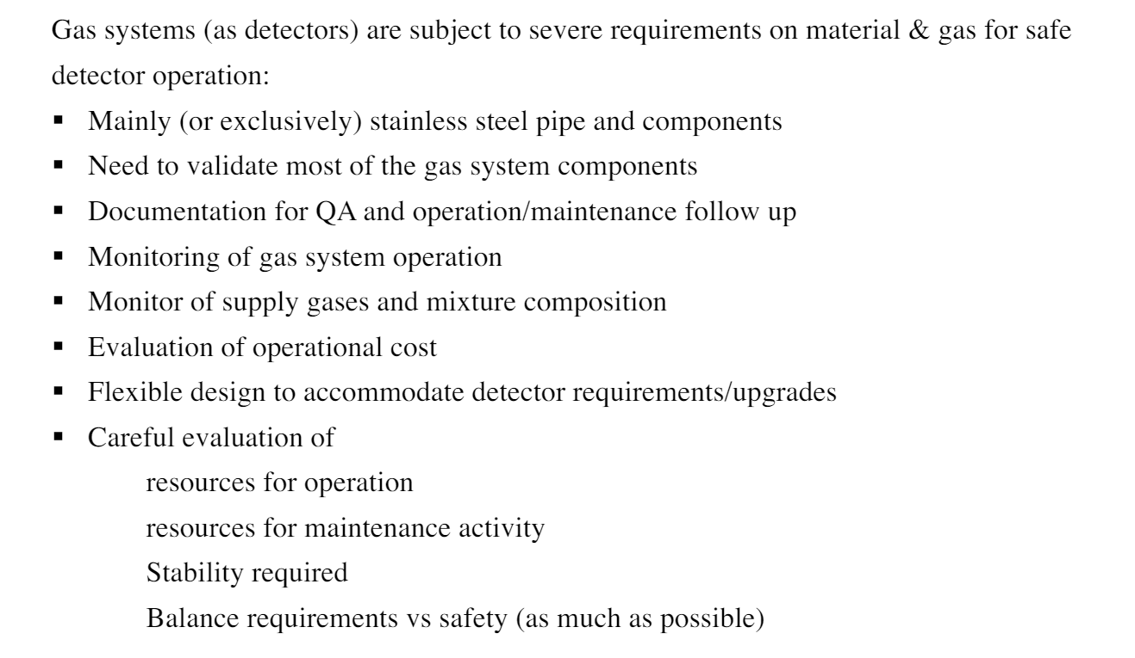
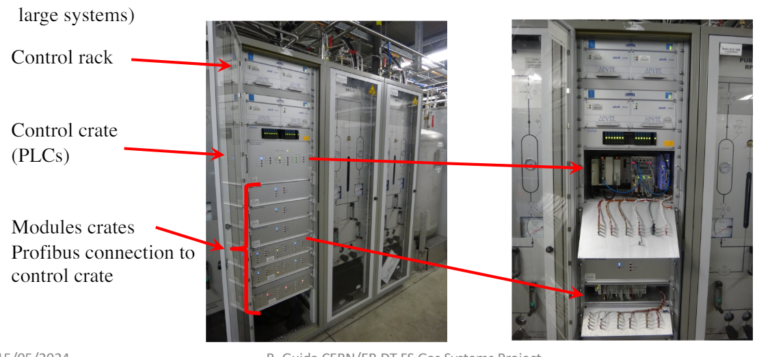
Gas System: design requirement

Slide 16
Publications for 2023
Testbeam Measurements and Realistic Simulation for the SPD Straw Drift Tubes
November 2023
Physics of Atomic Nuclei 86(5):832-837
Straw signal modeling using Garfield++ interface to LTSPICE
November 2023
Journal of Physics Conference Series 2642(1):012005
Online Gas Gain Monitoring System
October 2023
Physics of Particles and Nuclei Letters 20(5):1240-1242
VMM3 ASIC as a potential front end electronics solution for future Straw Trackers,
NIM,Volume 1047,2023,

Slide 17
Plans
- straw tracker prototyping
- new assembling and production lab spaces
- recovery of the miniSPD setup
- readout electronics prototyping
- test beam measurements at SPS and PS, the corresponding data analysis and feedback to FEE developers
- evaluating possibilities for the testbeam measurements at PNPI (Gatchina), INP (Almaty) and AANL(ErPhI,Erevan)
- concept development of the gas supply system
- longevity study for straw and supporting element material

Slide 18
Backup

Slide 19
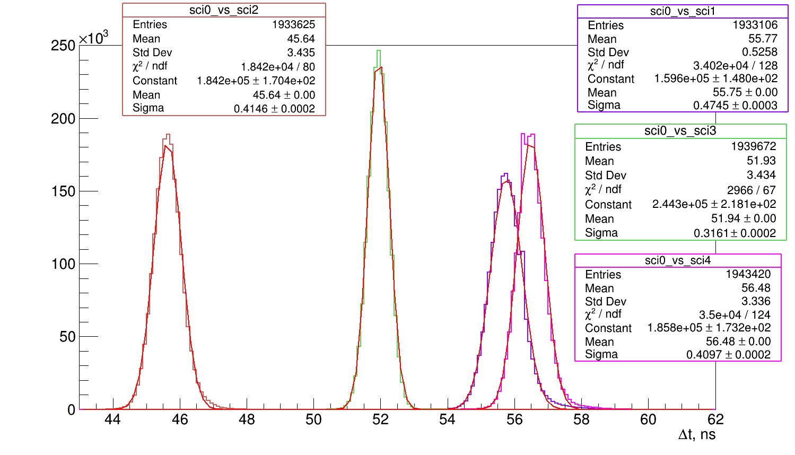

Reference tracking and timing
Time resolution -- T0
Reference tracking -- residuals
Better than 500ps
Work ongoing:
- accounting for the reference system uncertainty in the TB analysis
- improvement of the reference tracking resolution

Slide 20


10mm Straw Resolution
PRELIMINARY
The weighted mean of Coordinate resolution distribution better than 200 μm
The best time ‘resolution’ is about 4-5 ns
Analysis ongoing

