Slide 1
Development of FARICH detector for the SPD experiment: status and prospects
A.Yu.Barnyakov on behalf of PID group
SPD Collaboration Meeting
20-24 May 2024, KBTU, Almaty, Kazkhstan

Slide 2
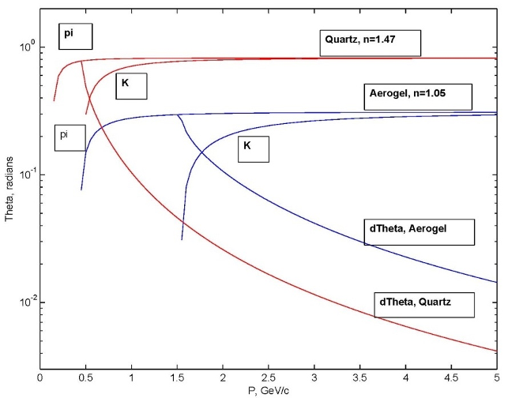
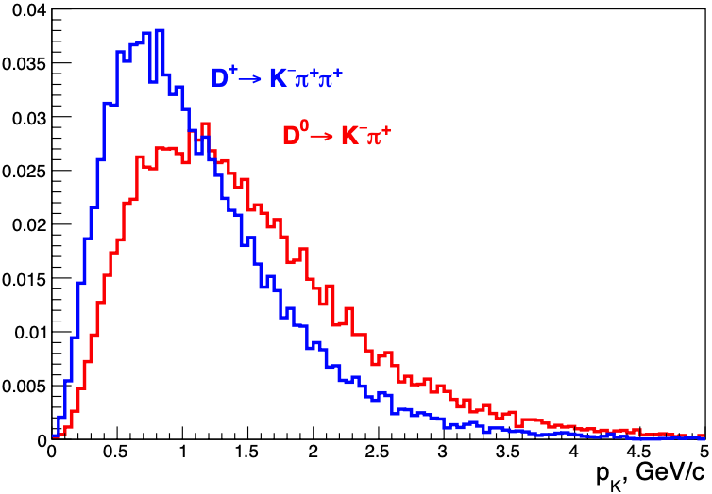
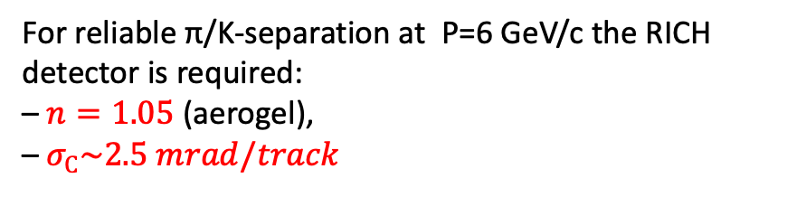
PID system: requirements
The main task of SPD PID system is
π/K-separation up to P=5÷6 GeV/c
For reliable π/K-separation at P=6 GeV/c the RICH detector is required:
– $n=1.05$ (aerogel),
– $σ_{С}\sim 2.5 mrad/track$

Slide 3
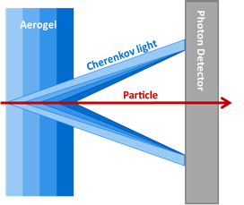
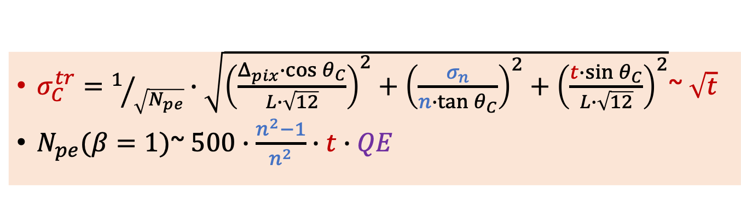
FARICH motivation
$σ_{C}^{tr}=1/{\sqrt{N_{pe}}}∙\sqrt{{\left(\frac{Δ_{pix}∙\cos{θ_{C}}}{L∙\sqrt{12}}\right)}^{2}+{\left(\frac{σ_{n}}{n∙\tan{θ_{C}}}\right)}^{2}+{\left(\frac{t∙\sin{θ_{C}}}{L∙\sqrt{12}}\right)}^{2}}$~ $\sqrt{t}$
$N_{pe}(β=1)$~ $500∙\frac{n^{2}−1}{n^{2}}∙t∙QE$
To get $\left\langle N_{pe}\right\rangle ≫5$ from aerogel with n=1.05 & thickness 1 cm is too hard practice task!!!
Thicknesses and refractive indexes in each layer are adjusted in such way that Cherenkov rings from each layer overlap in the same region of the position-sensitive photon detector.
The number of detected Cherenkov photons increases due to increase of the thickness without degradation of Cherenkov angle resolution due to uncertainties of photon emission point.
T.Iijima et al., NIM A548 (2005) 383 and A.Yu.Barnyakov et al., NIM A553 (2005) 70

Slide 4
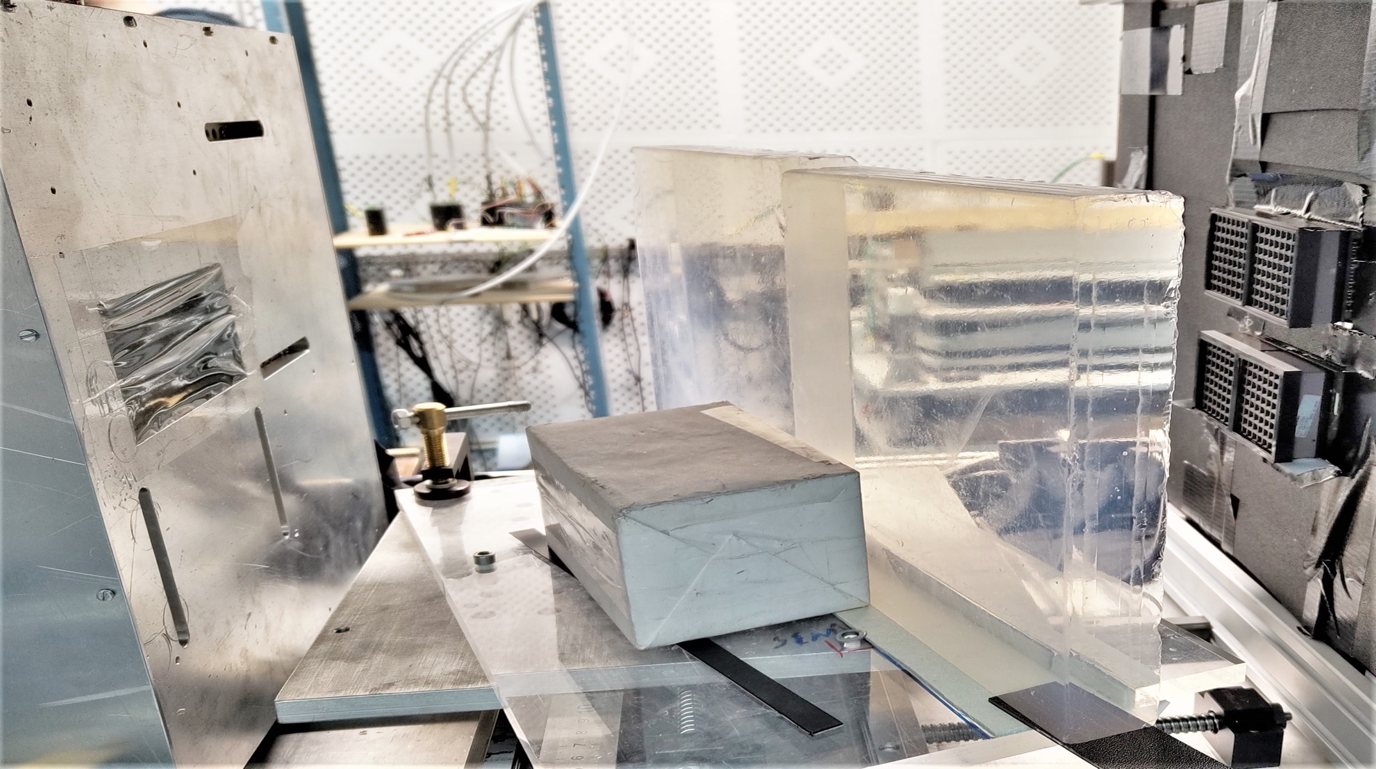
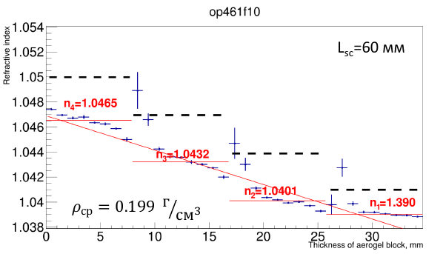
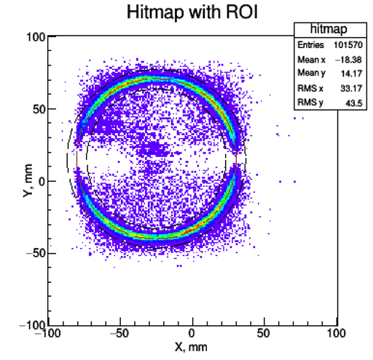
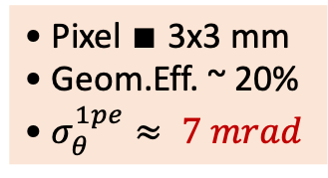

The largest 4-layer focusing aerogel samples were produced in Novosibirsk and tested at BINP in 2022-2023
2 aerogel pcs
230x230x35 mm
Refractive index profile is measured with help of digital X-ray setup at the BINP.
MaPMT H12700 (Hamamatsu)
with mask 3х3 mm²
GEM
$$e^{−}$$
Single photon Cherenkov angle resolution is investigated with relativistic electrons at BINP beam test facilities ”Extracted beams of VEPP-4M complex”.
• Pixel $∎$3x3 mm
• Geom.Eff. ~ 20%
• $σ_{θ}^{1pe}≈ 7 mrad$

Slide 5
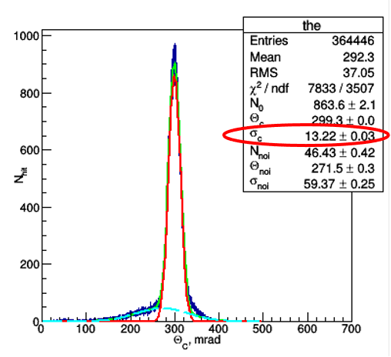
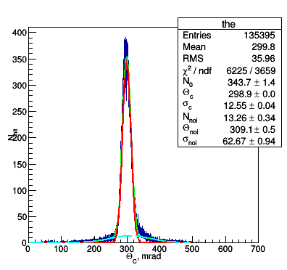
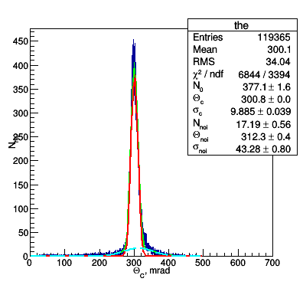
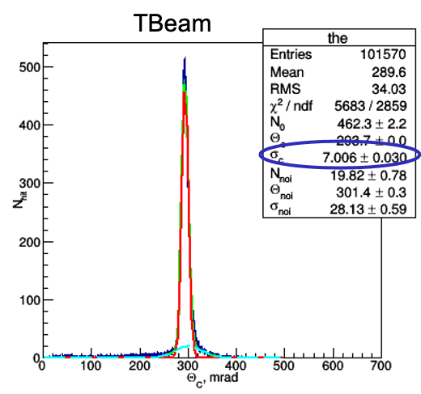
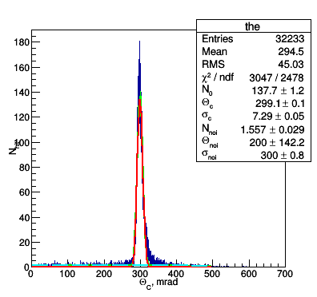
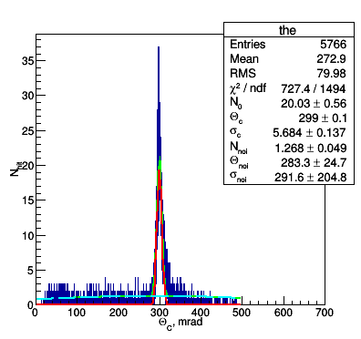
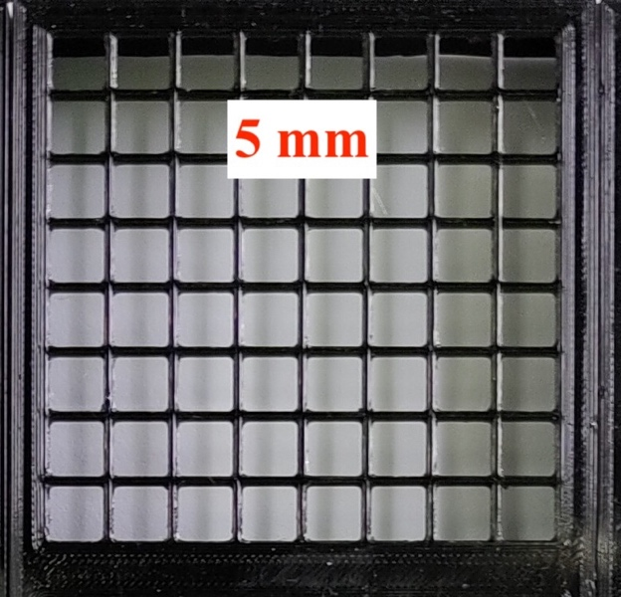
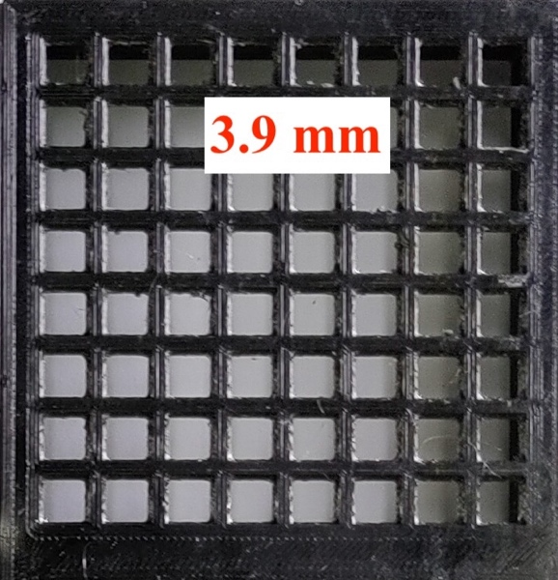
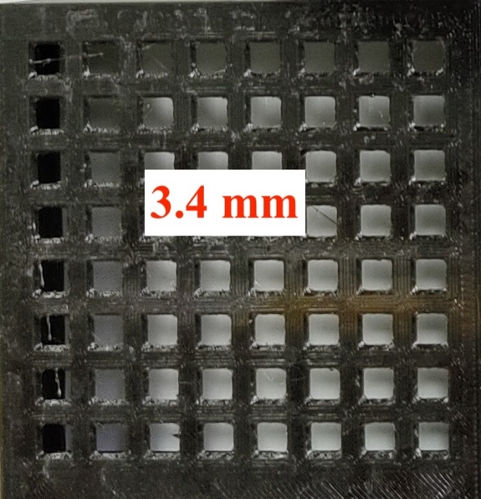
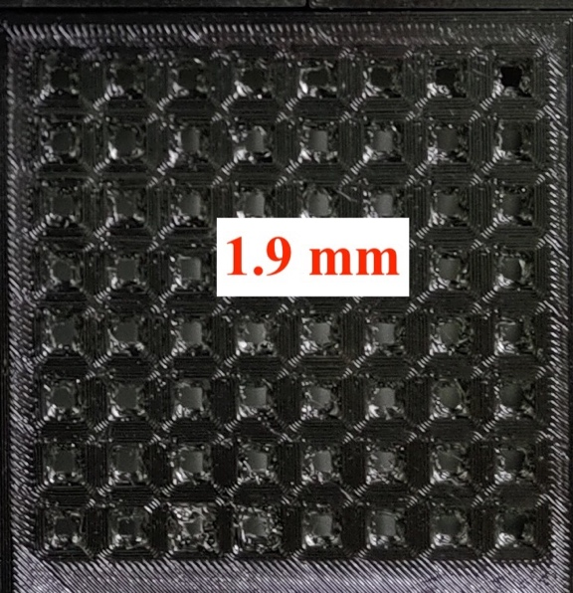
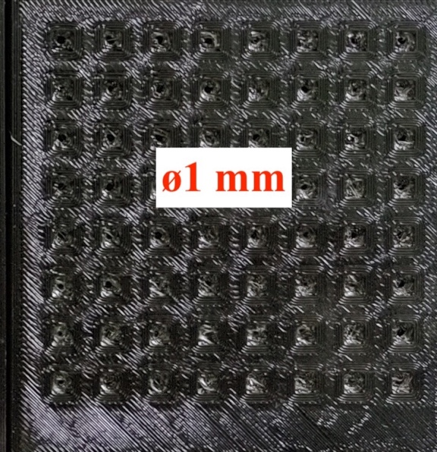
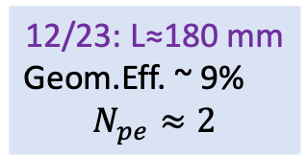
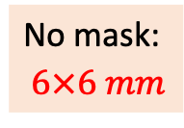
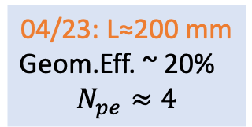
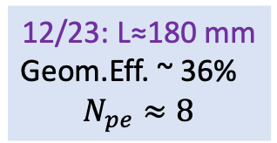

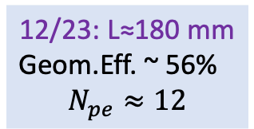
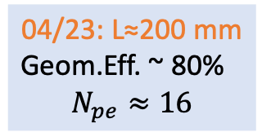
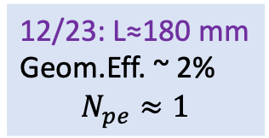

TBeam 2023 res.: $σ_{θ_{C}}^{1pe}=\sqrt{\frac{∆_{pix}^{2}}{{\left(\sqrt{12}∙L∙n\right)}^{2}}+σ_{aer}^{2}+σ_{trk}^{2}}$
$σ_{aer}≈5.7$ mrad
No mask:
$6×6 mm$
3 mm
04/23: L≈200 mm
Geom.Eff. ~ 80%
$$N_{pe}≈16$$
12/23: L≈180 mm
Geom.Eff. ~ 56%
$$N_{pe}≈12$$
12/23: L≈180 mm
Geom.Eff. ~ 36%
$$N_{pe}≈8$$
04/23: L≈200 mm
Geom.Eff. ~ 20%
$$N_{pe}≈4$$
12/23: L≈180 mm
Geom.Eff. ~ 9%
$$N_{pe}≈2$$
12/23: L≈180 mm
Geom.Eff. ~ 2%
$$N_{pe}≈1$$
$π/K$: – 5.5 GeV/c 6 GeV/c 6.5 GeV/c 8.0 GeV/c
µ$/π$: – 1.2 GeV/c 1.4 GeV/c 1.5 GeV/c 1.6 GeV/c

Slide 6
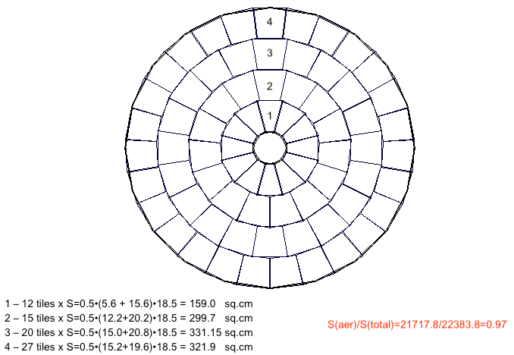
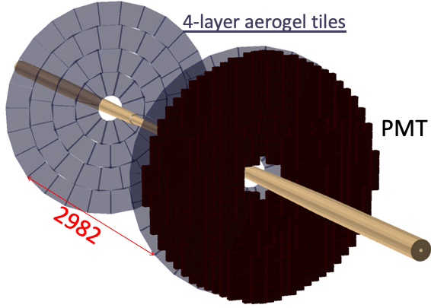
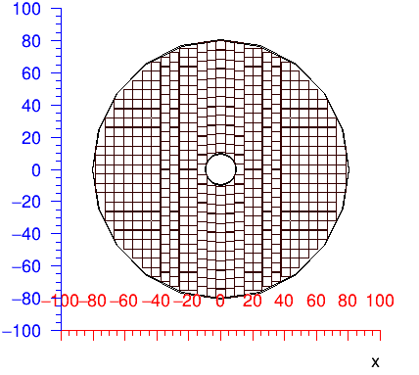
FARICH system conceptual design
Aerogel:
74 tiles
Photon detector: 548 PMT 51х51 mm
FARICH system:
• 4-layer aerogel with n_{max}=1.05 (or less)
• Focus distance – 20 cm
• PS PD – MCP-PMT or SiPM arrays with pixel 3÷6 mm
550 PMTs per endcap if lateral sizes ~51x51 mm
2200 PMTs per endcap if lateral sizes ~27х27 mm

Slide 7
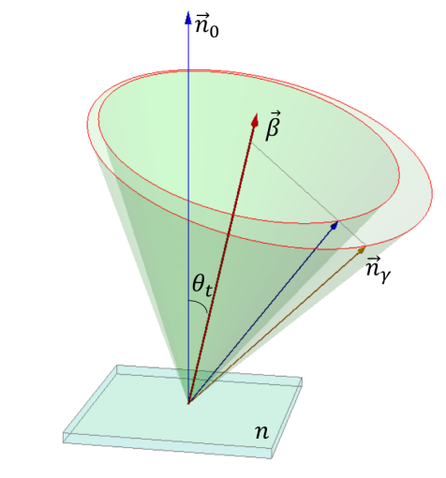
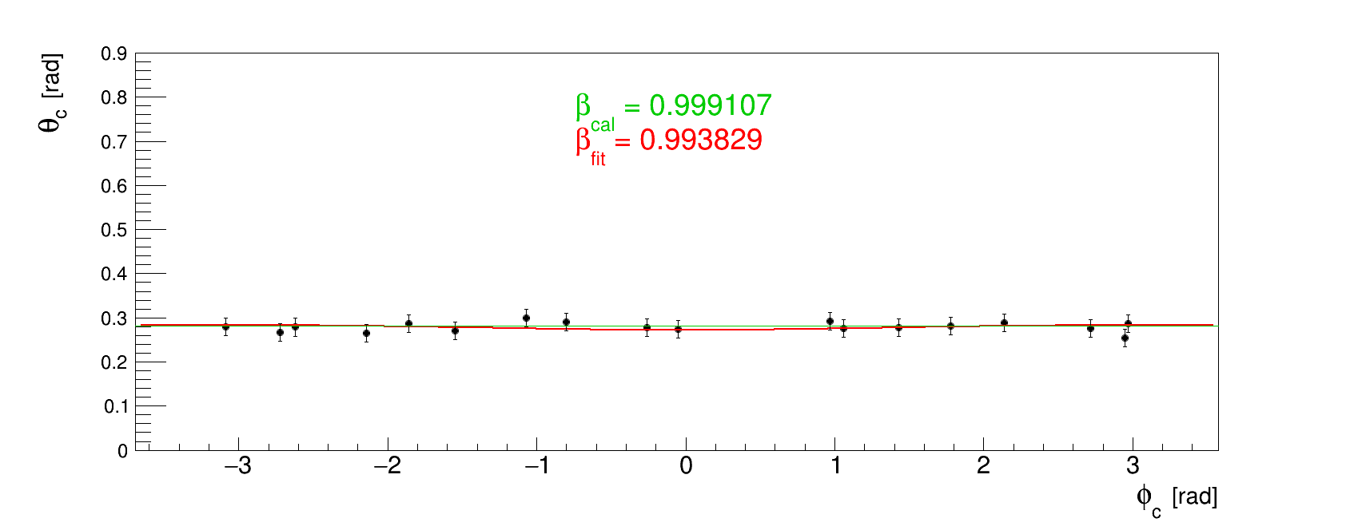
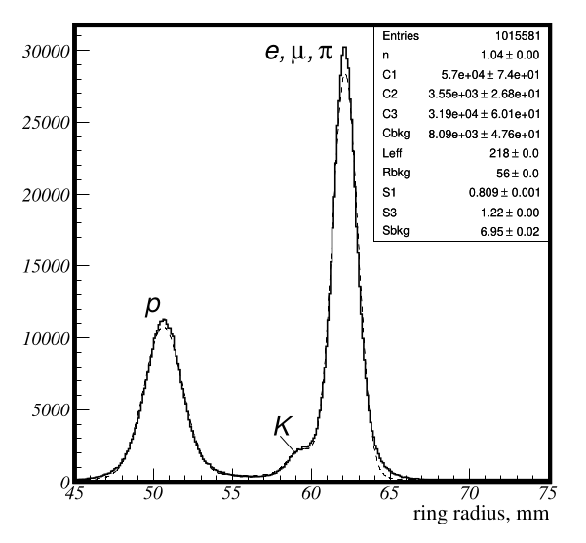
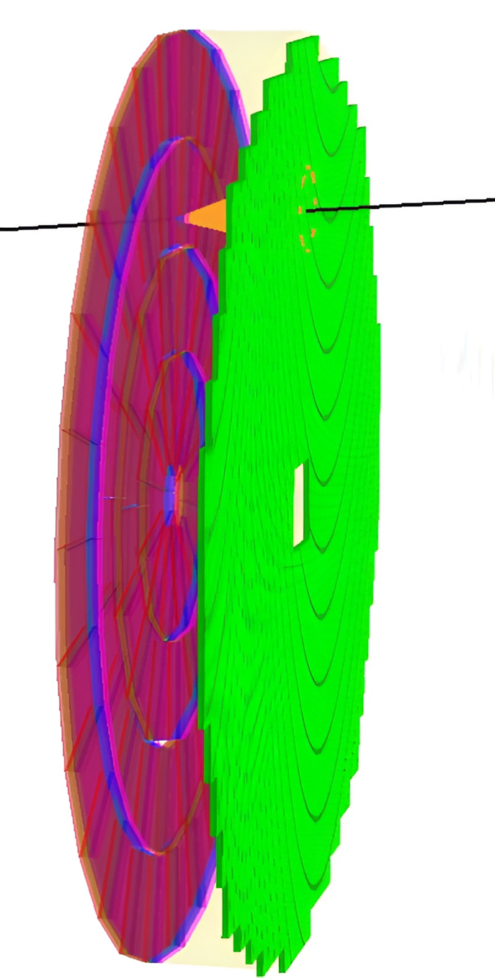
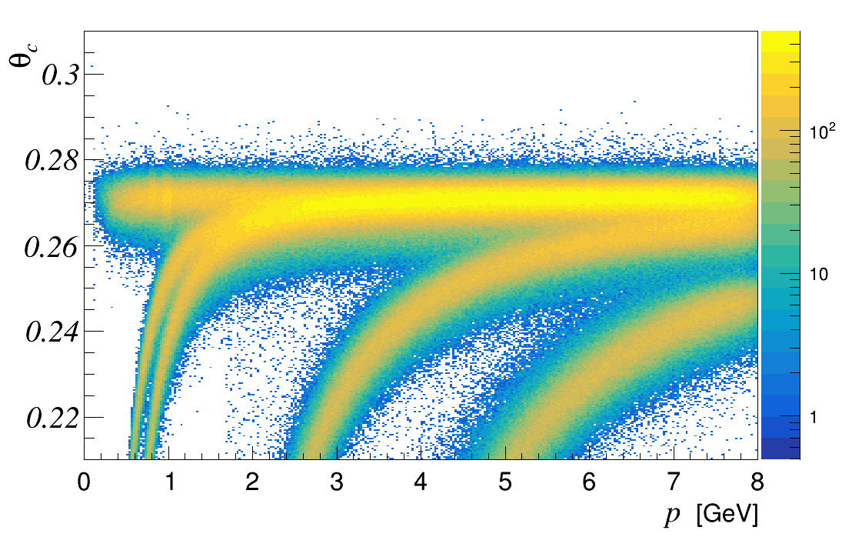
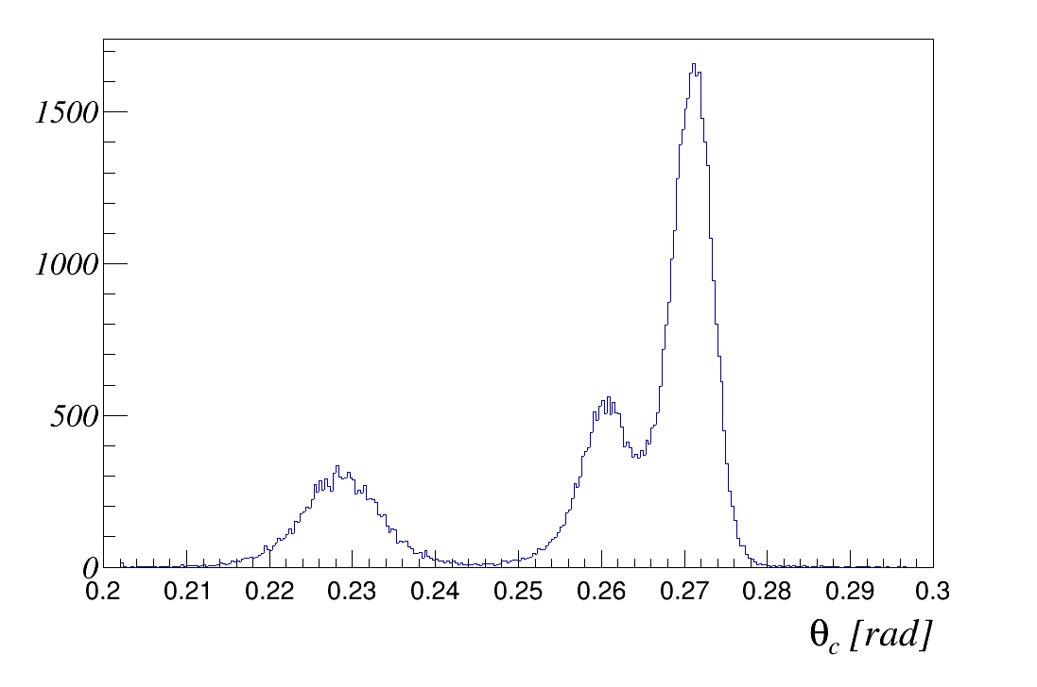










Simulation FARICH in SPD
Reconstruction: fit analytical formula to (θ_{c,}φ_{c}) distribution to obtain β
Nucl. Instrum. Meth. A, 732:352–356, 2013
RD
particles momentum 6 GeV/c
$$e$$
MC
$$e$$
$$μ$$
$$π$$
$$μ$$
$$π$$
$$K$$
$$p$$
$$p$$
$$K$$

Slide 8
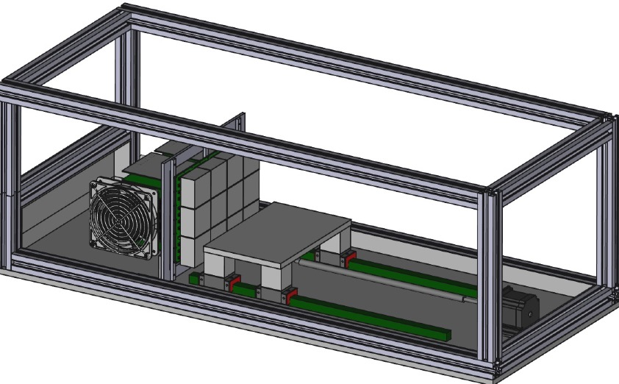
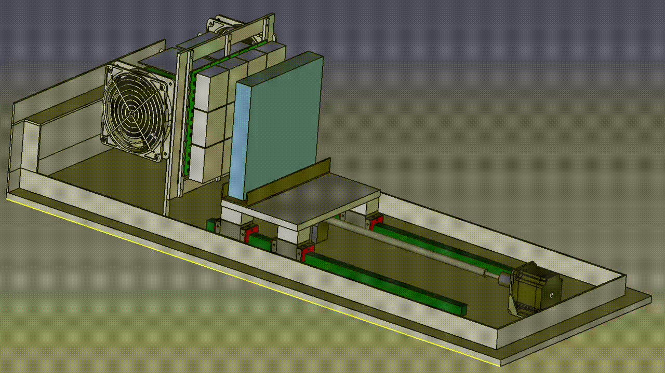
FARICH prototype with full ring detection
970 мм
420 мм
340 мм
• Tunable focal distance from 5 to 60 cm
• Aerogel tiles with lateral dimensions up to 200x200 mm²
• 2 DiRICH boards (GSI) to readout up to 12 multi-anode PMTS with 768 pixels _{in total} – option #1
• 6 DiRICH boards (GSI) to readout up to 36 multi-anode PMTS with 2304 pixels _{in total} –option #2

Slide 9
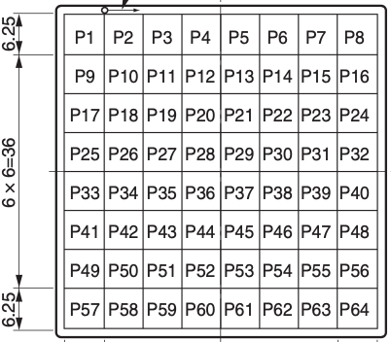
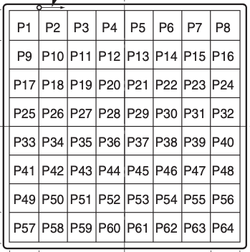
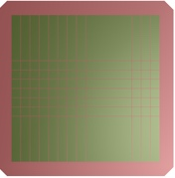
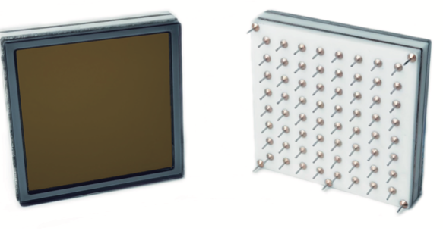
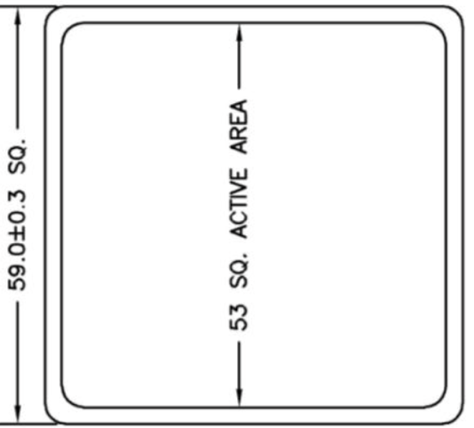
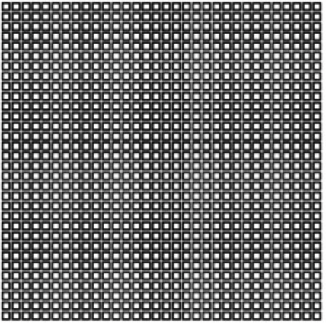
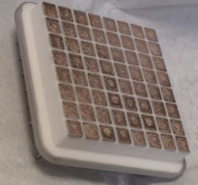
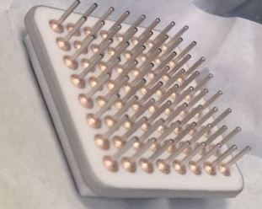
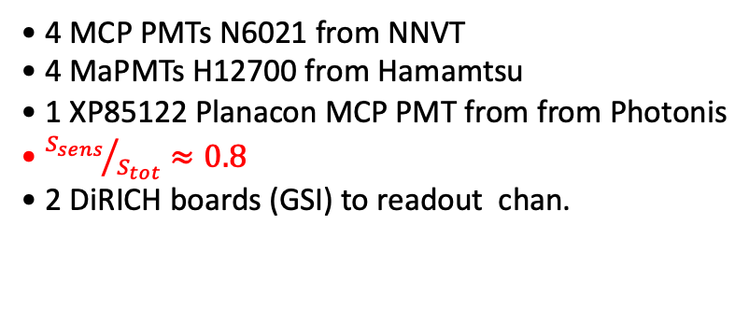
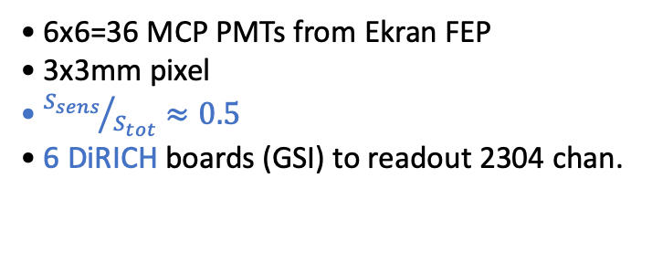
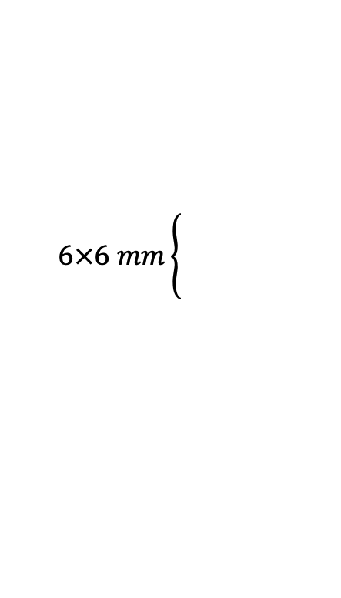
FARICH prototypes
Step #1 (2024/25): 6x6mm
Step #2 (2025/26): 3x3mm
51 mm
46 mm
H12700
(Hamamatsu)
51 mm
N6021 (NNVT)
N6021 (NNVT)
XP8122
Planacon
53 mm
154 mm
Ekran FEP
$$6×6 mm\left\{\begin{aligned} \\ \\ \end{aligned}\right.$$
• 4 MCP PMTs N6021 from NNVT
• 4 MaPMTs H12700 from Hamamtsu
• 1 XP85122 Planacon MCP PMT from from Photonis
• ${S_{sens}}/{S_{tot}}≈0.8$
• 2 DiRICH boards (GSI) to readout chan.
• 6x6=36 MCP PMTs from Ekran FEP
• 3x3mm pixel
• ${S_{sens}}/{S_{tot}}≈0.5$
• 6 DiRICH boards (GSI) to readout 2304 chan.

Slide 10
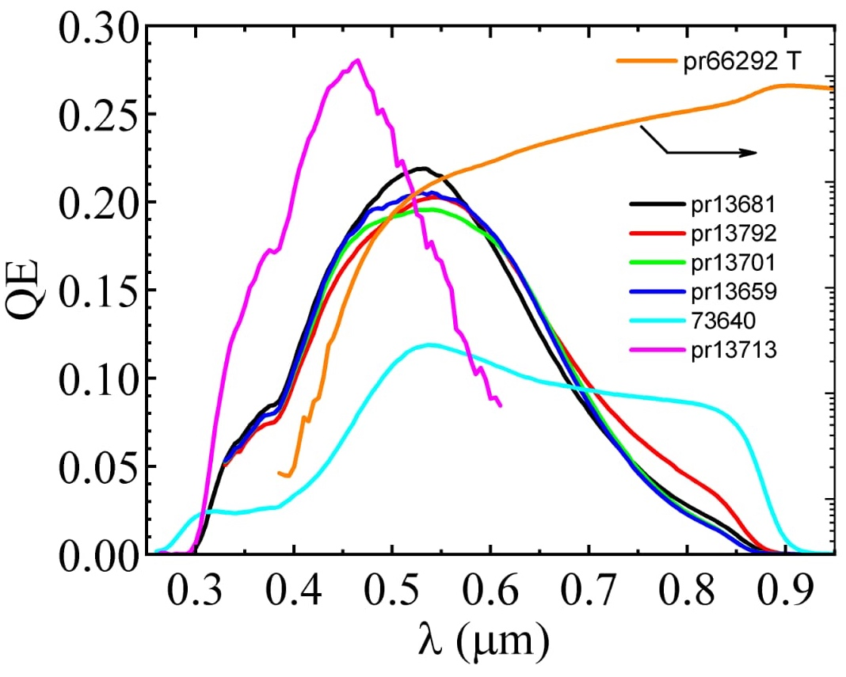

MCP PMT rectangular shape from Ekran FEP
Multi-alkali PCs sputtered on ordinary glass
Ekran FEP design of MCP PMT with 8x8 3x3 mm pixels
It is planed to use UV-glass to enhence PDE in blue region
• Until the Autumn the first Russian rectangular-shape multi-anode MCP PMTs partially based on Chinese components are expected
• Until the end of year MCP PMTs totally based on Russian components are expected
Ceramic components from China (NNVT) deliverd to Ekran FEP
MCPs:
• For the first rectangular PMTs usage of MCPs made by Ekran FEP is planed
• For the first serial batch implementation of MCPs from VTC Baspik is planed
Ekran FEP also works with vendors from Saratov to produce ceramic components inside the Russia

Slide 11

On aerogel optimization for the SPD project
4-layer aerogel with $nmax=1.05$ and thickness $35 mm$ was optimized for SCTF to provide reliable $µ/π–$separation at $1 GeV/c$
For SPD aerogel lower index looks more suitable to provide $π/K–$ and $µ/π–$separation at higher momenta. Lower $n$ means:
  Larger difference in π– and K–mesons Cherenkov angles;
  lower impact from dispersion;
  but lower number of Cherenkov photons which could be compensted by increase of aerogel thickness especially if the pixel size is about $6 mm$.
More optimal aerogel for SPD looks like:
> Maximal refractive index $\sim 1.04$
> Aerogel thikness is about $40 mm$
> 3 or 4 number of layers with 15 or 10 mm thick each
There is a room for optimization with help of simulation or even ML approaches
There is a room for optimization with help of simulation or even ML approaches
R&Ds on production of optimal SPD aerogel and test its performances are required.

Slide 12

Summary & Plans for 2024/2025
We are going (and almost ready) to prepare and carry out tests with FARICH prototype based on available components at hadron beams to demonstrate its current PID capabilities:
  • 4-layer aerogel tiles with n_{max}=1.05 and t=35mm (optimized for SCTF project)
  • Multi-anode PMTs (from Hamamatsu, NNVT, Photonis) with $6×6 mm$ pixels
  • DiRICH (GSI) based readout system
Optimize (with help of simulation) and produce first aerogel tiles for the SPD experiment requirements (n_{max}=1.04 and t=40mm)
Test and compare performances of position-sensetive MCP PMTs with rectangular shapes:
  • N6021 from NNVT (China) – $6×6 mm$ pixels
  • For the first time produced in Russia from Ekran FEP – $3×3 mm$ pixels
Start developmant of FARICH prototype based on Russian position-sensetive MCP PMTs

Slide 13
BACK UP SLIDES

Slide 14




FARICH technique milestones
2004÷2005
The Belle II (ARICH) is the first application of the method
The first 4-layer monolithic sample
n=1.030 6.0mm
n=1.027 6.3mm
n=1.024 6.7mm
n=1.022 7.0mm
Increase N_{pe} due thickness increase without σ_{Θc} degradation
T.Iijima et al., NIM A548 (2005) 383 and A.Yu.Barnyakov et al., NIM A553 (2005) 70
2017
Excellent PID capability were shown at CERN beam test in 2012
Two 4-layer focusing aerogel blocks
230x230x35 mm
A.Yu. Barnyakov, et al., NIM A 732 (2013) 352
2022÷2023
Notes:
Идея ФАРИЧ появилась в 2004 г.
Точность измерения черенковского угла связана с точностью измерения скорости, а значит с качеством разделения частиц.

Slide 15



Recent beam test results
Pixel 6x6 mm
Geom.Eff. ~ 80%
Pixel 3x3 mm
Geom.Eff. ~ 20%
Main results:
• N_{pe} $≈$ 16 (~ 0.8 of Ring)
• $σ_{θ}^{1pe}≈13.5 mrad$($∎$ 6mm)
• $σ_{θ}^{1pe}≈ 7.5 mrad$ ($∎$ 3mm)

Slide 16





Cherenkov angle Single Photo-Electron (SPE) resolution
Belle II
PTEP 2016, 033H01
TBeam
Simulation
Aerogel: 20+20 mm (Chiba Univ.)
n(400nm): 1.045 +1.055
Pixel: 5x5 mm
4-layers (Novosibirsk) –>
1.039 ÷ 1.046
6x6 mm
–
–
3x3 mm
4-layers (ideal profile)
1.041 ÷ 1.050
3x3 mm
Geom.Eff. ~ 90%
$$N_{pe}≈10.5$$
Geom.Eff. ~ 80%
$$N_{pe}≈16$$
Geom.Eff. ~ 20%
$$N_{pe}≈4$$
Dimensions of focusing aerogels 23x23x3.5 cm allow us to design the full-scale FARICH systems for the future particle physics experiments.
Beam test results are in good agreement with MC simulation and corresponds to:
π/K–separation at level of $3σ$ up to P=4.5 GeV/c for 6x6 mm pixel
π/K–separation at level of $3σ$ up to P=8.5 GeV/c for 3x3 mm pixel

Slide 17



FARICH based on existing solutions
MCP PMT available from vendors:
Expected performance:
59 mm
51 mm
Planacon XP85112 (USA)
8x8 pixels with 6x6 mm
NNVT N6021 (China)
8x8 pixels with 5.9x5.9 mm
2x548 PMTs:
• 2x35kPixels
• Pixel ~6x6 mm
Existing FEE aka DiRICH (GSI):
• 1 DiRICH board per each 6 PMTs
• 2x100 DiRICHs per 2 end-caps
• 2x100 optical links to DAQ sys.
• 10÷20 TRB3 interfaces
• π/K–separation up to 5 GeV/c
• µ/π–separation up to 1.1 GeV/c
• K/p–separation from 3 to 9 GeV/c

Slide 18




FARICH based on 3x3mm pixels
Suitable PDs with 3x3mm pixels
Expected performance:
27 mm
MCP PMT, Ekran FEP (RU)
64 2.5x2.5mm pixels
Still under R&D
SiPM arrays, Joinbon (China)
64 3x3mm pixels, PDE~40%
DCR ~1÷2•10⁶cps/ch.@300°K
2x2600 PMTs:
• 2x166.4kPixels
• Pixel 3x3 mm
Specialazed FEE is required!!!
• FaRICH-Auslese-System (GSI) – design inspired by DiRICH approach to readout of SiPM arrays or MCP PMTs with 3x3mm pixels?!
• ASICs developed at BINP for SR detector to readout Hybrid Photo Detectors?!
• π/K–separation up to 8.5 GeV/c
• µ/π–separation up to 1.7 GeV/c
• K/p–separation from 3 to 14 GeV/c

Slide 19


Momentum measurements with FARICH
$$\frac{σ_{p}}{p}=γ^{2}∙\frac{σ_{β}}{β}$$
$$\frac{σ_{p}}{p}=γ^{2}∙\tan{θ}∙σ_{θ}^{tr}$$
$$σ_{θ}^{tr}=\frac{σ_{θ}^{1pe}}{\sqrt{N_{pe}(p)}}=\frac{σ_{θ}^{1pe}}{\sqrt{N_{pe}^{β=1}}}∙\frac{p\sqrt{n^{2}−1}}{\sqrt{p^{2}\left(n^{2}−1\right)−m^{2}}}$$
$$\frac{σ_{p}}{p}=\frac{p\sqrt{p^{2}+m^{2}}}{m^{2}}\sqrt{n^{2}−1}∙\frac{σ_{θ}^{1pe}}{\sqrt{N_{pe}^{β=1}}},$$
where $m$ – particle mass, $p$ – particle momentum, $n=1.05$ – refractive index of aerogel, $σ_{θ}^{1pe}$ and $N_{pe}^{β=1}$ are single photon Cherenkov angle resolution and number of detected photons per track correspondingly measured with relativistic electron beams.

