Slide 1


JINR
“Active Role of Gluons in hadron interactions”
E.Kokoulina (JINR, и GSTU, Gomel, Belarus)
(kokoulina@jinr.ru,
Samara University. 23–27 Oct 2023)
VI SPD Collaboration Meeting and Workshop on Information Technology in Natural Sciences

Slide 2
To structure of the proton:
13th Conference, ”Confinement & hadron spectrum”. Ireland (2018):
“Gluons are carriers of the strong force, bind quarks together inside nucleons and nuclei and generate nearly all of the visible mass in the Universe. Despite their importance, fundamental questions remain about the role of gluons in nucleon and nuclei.” Xiangdong Jin
VI SPD Collaboration Meeting and Workshop on Information Technology in Natural Sciences

Slide 3
Multiparticle processes studying in HEP
Electron-positron annihilation (е⁺е⁻).
Proton & proton-antiproton interactions. Three-gluon decay of bottomonium.
“Thermalization” project (high multiplicity). Collective phenomena.
Relativistic nuclear physics (АА).
VI SPD Collaboration Meeting and Workshop on Information Technology in Natural Sciences

Slide 4
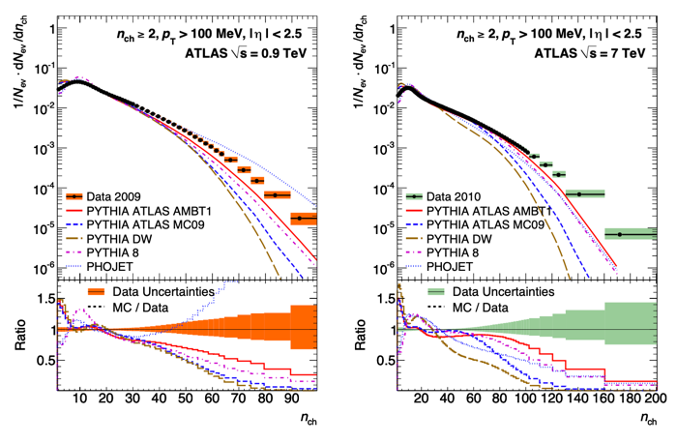
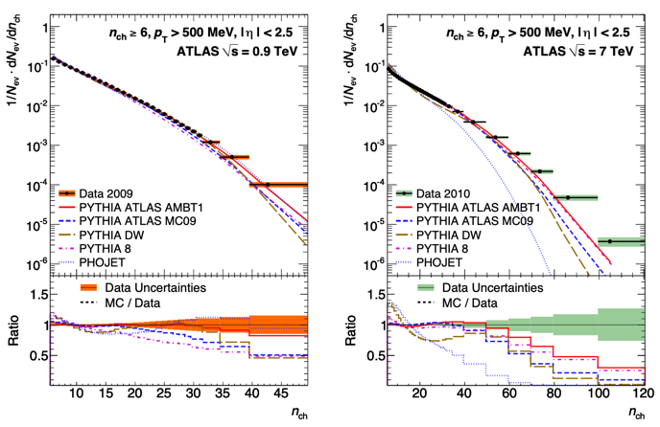
Experiments at LHC (ATLAS)
АTLAS’s data [2010] for MD in pp interactions at 0.9 and 7 TeV
Comparisons with Monte Carlo generators (PYTHIA, PHOJET).
VI SPD Collaboration Meeting and Workshop on Information Technology in Natural Sciences

Slide 5
e⁺e⁻ anihilation. I stage
Konishi et al. & Giovannini [NP, 1979] describe the qg-cascade in pQCD as Markov branching process of elementary events:
quark emission of gluon – , (A)
gluon fission – , (A)
quark-antiquark pair creation from gluon – (B).
~
System of diff. eq. describing branching processes, leads to Polia (NBD) for q-jet and Farry MD for g-jet:
Evolutinary parameter:
~
~
А и А – probabilities of 1) и 2) events, k_{p} = A/A.
VI SPD Collaboration Meeting and Workshop on Information Technology in Natural Sciences

Slide 6
e⁺e⁻ - annihilation
O.Biebel.
Phys.Rep. 2001
Multiplicity Distribution (MD)
Generation function (GF):
I stage
qg-cascade
GF ←> MD
Correlative moments, F_{k}:
II stage
(hadronization)
VI SPD Collaboration Meeting and Workshop on Information Technology in Natural Sciences

Slide 7
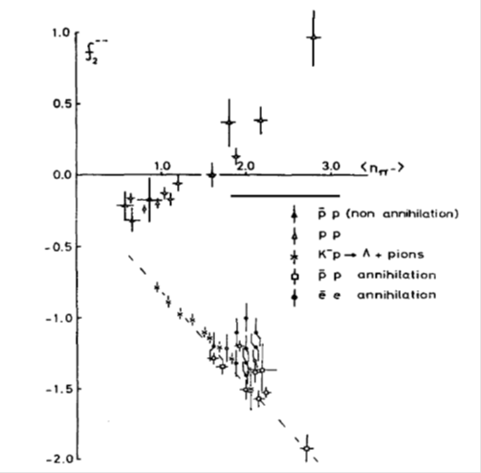
e⁺e⁻ annihilation - II stage
pQCD is unable to describe hadronization. The choice of MD at this stage is based on experimental behavior of the second correlative moment f₂ =<n(n-1)>-<n>² =D₂ - <n> (D₂ - variance).
The independent formation of particles is described by Poisson distribution with f₂ = 0. Polya MD at the first stage corresponds to negative binomial distribution (NBD):
We chose binomial MD (Bernoulli) for II-stage:
VI SPD Collaboration Meeting and Workshop on Information Technology in Natural Sciences

Slide 8
Convolution of two stages
(soft decoloration).
p = q, g,
Model parameters: $k_{p}, \overline{m}{ , N}_{q}=N,{ \overline{n}}_{q}^{h}, N_{g}=αN, { \overline{n}}_{g}^{h}=α{\overline{n}}_{q}^{h} .$
VI SPD Collaboration Meeting and Workshop on Information Technology in Natural Sciences

Slide 9
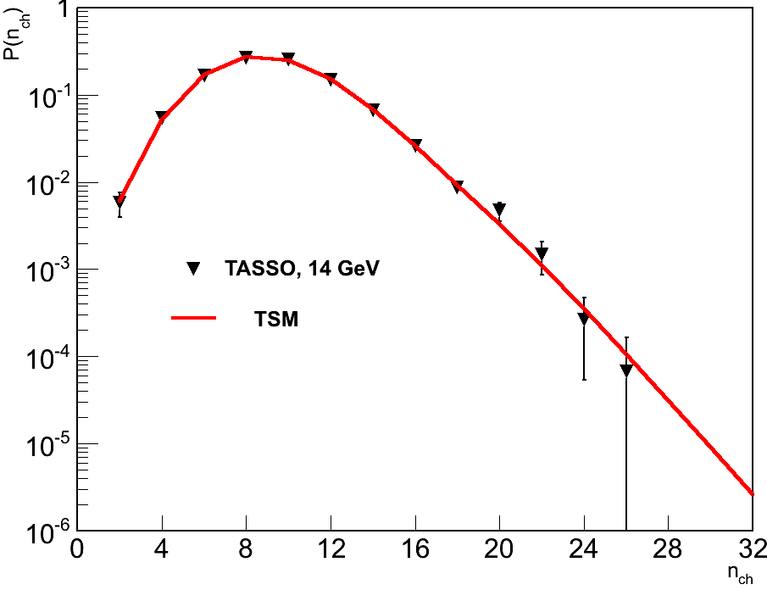
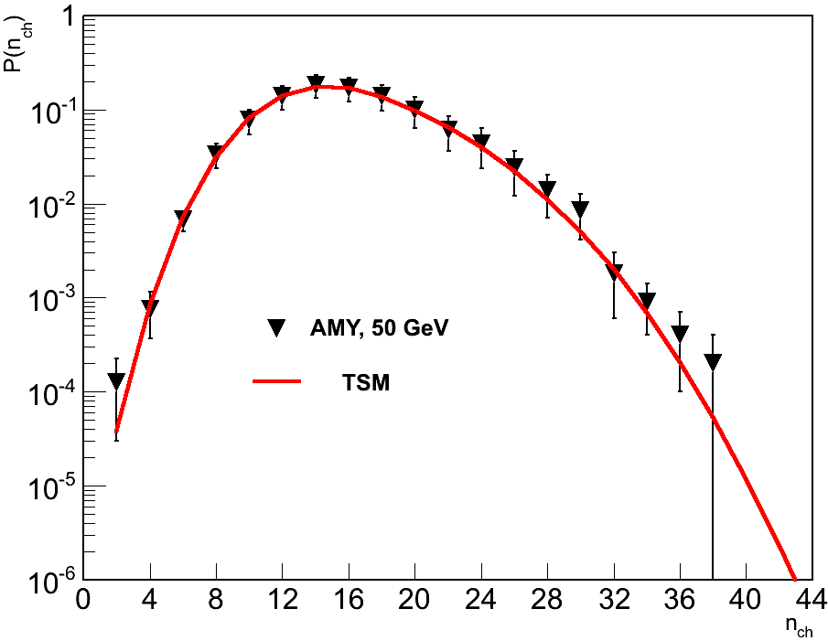
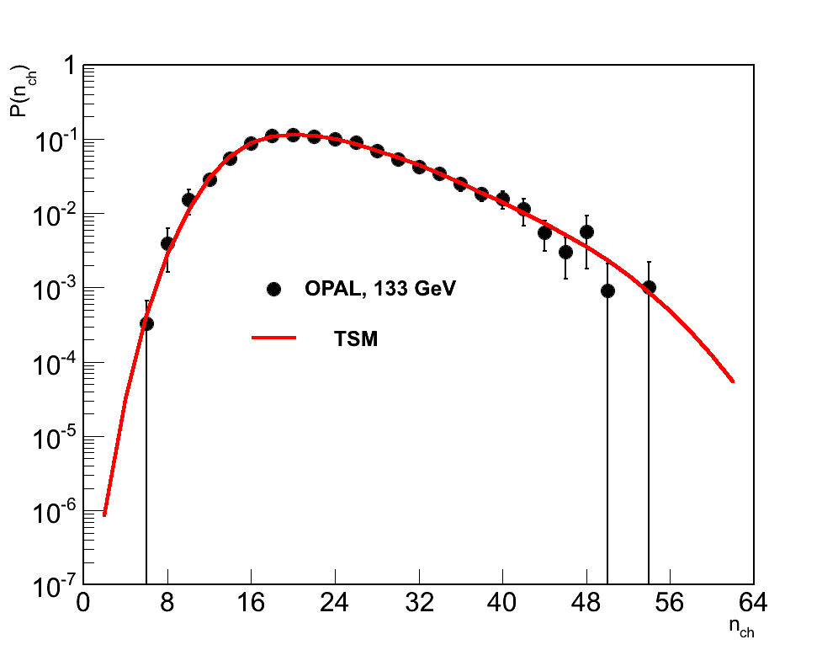
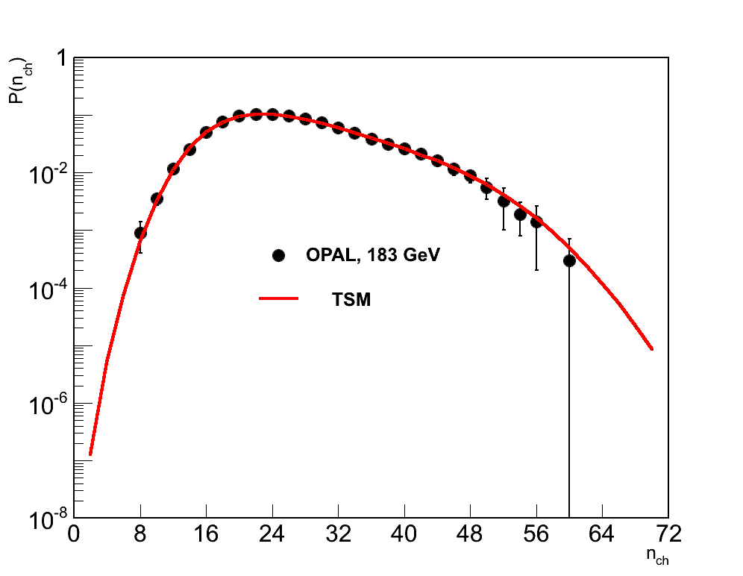
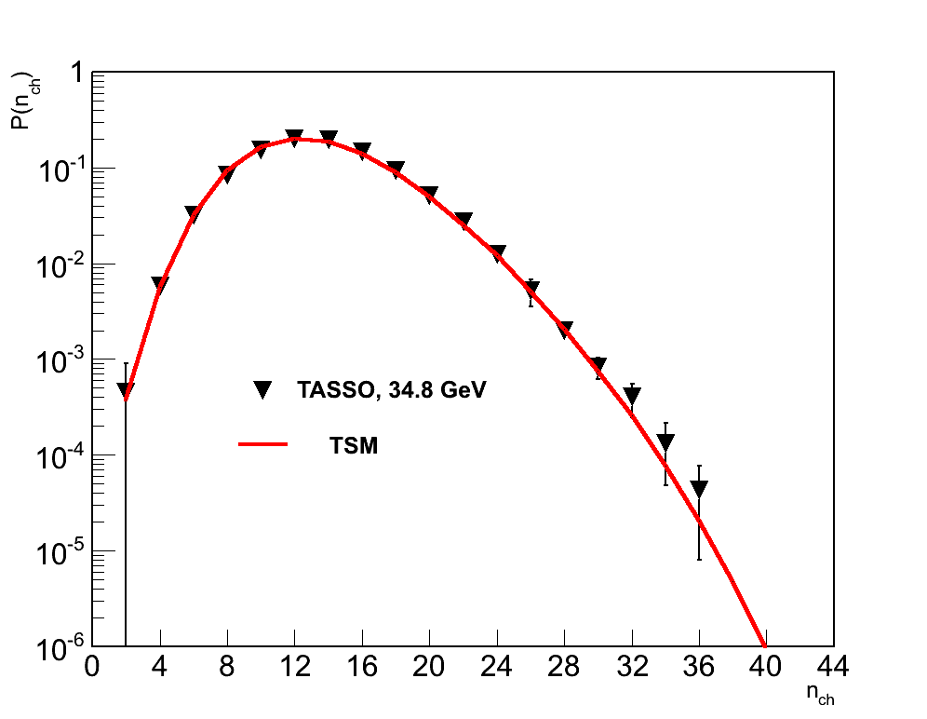
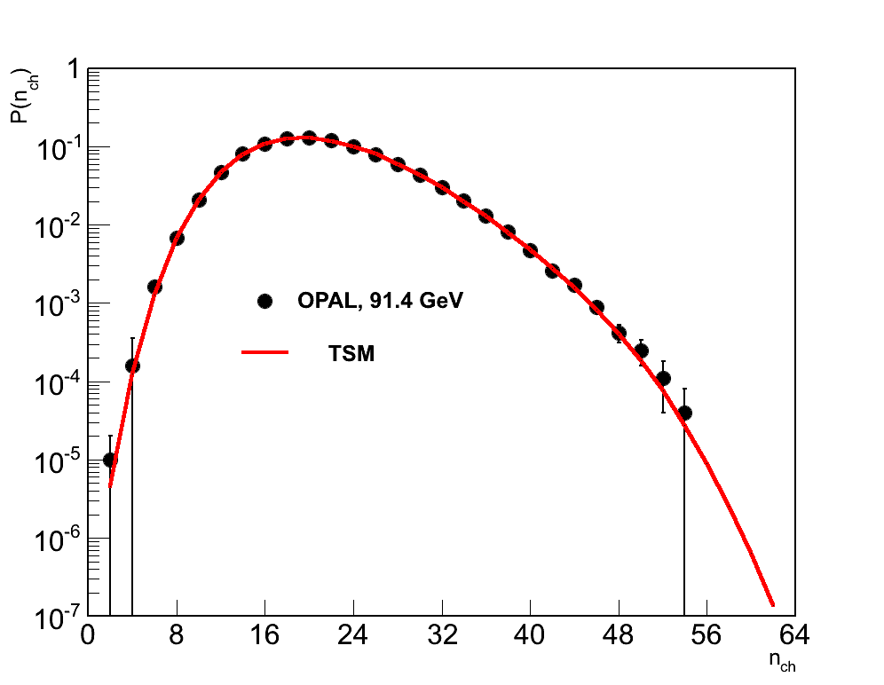
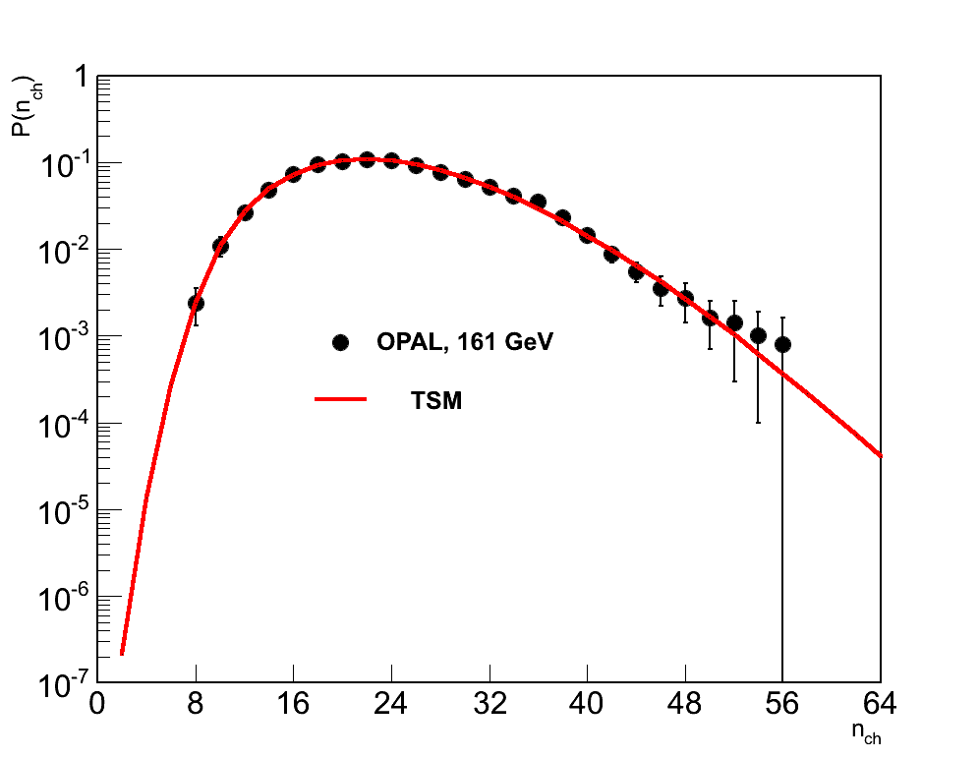
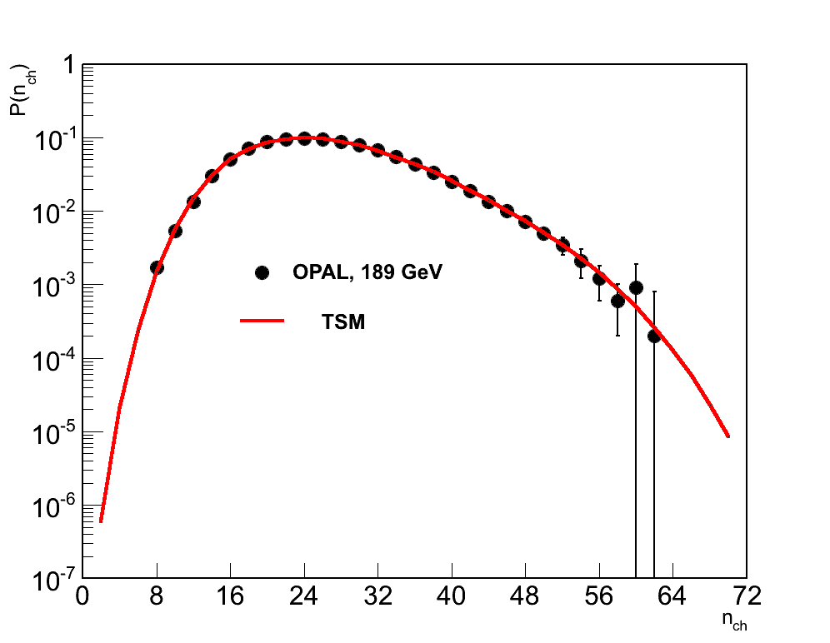
MD in е+е- annihilation (14 -189 GeV)
VI SPD Collaboration Meeting and Workshop on Information Technology in Natural Sciences

Slide 10

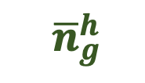

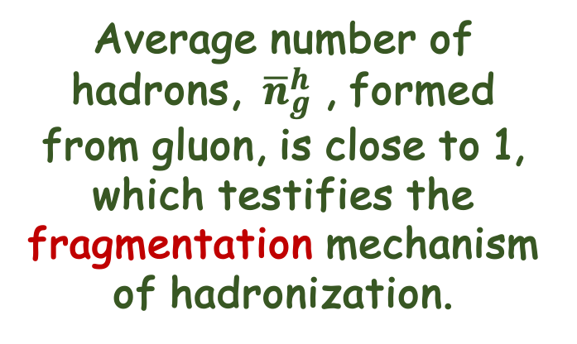

Parameters of Model
$$\overline{m}$$
$${ \overline{n}}_{g}^{h}$$
Average number of hadrons, ${ \overline{n}}_{g}^{h}$ , formed from gluon, is close to 1, which testifies the fragmentation mechanism of hadronization.
$$\overline{m}$$
~ log s .
Hypothesis of parton-hadronic duality (LoPHD)
<m> = 𝞀 < n>, 𝞀 ~ 1.
Recombination mechanism
(in qg-medium)
Fragmentation mechanism (in vacuum)
[ B. Muller. 2004]
VI SPD Collaboration Meeting and Workshop on Information Technology in Natural Sciences

Slide 11
Parameter of model k_{p}
k_{p} is determined by the ratio of the bremsstrahlung contributions of active gluons (q -> q + g) to their division (g -> g + g), A/A, at the cascade stage. It takes on values ​​more than 1, which indicates the predominance of bremsstrahlung over fission. It tends to decrease with increasing energy. Withing the statistical bootstrap model, it was shown, k_{p}⁻¹ can be interpreted as the “temperature” at that stage
,
it rises with energy.
~
VI SPD Collaboration Meeting and Workshop on Information Technology in Natural Sciences

Slide 12


f₂ changes sign with energy from “-” to “+”
$$\overline{m}$$
Parameters: α ∼ 1, N ∼ 6. At √s < 5 << 1 and f₂ < 0. At √s > ≿ 10, > 10 and the sign of the second correlative moment is changed : f₂ > 0.
$$\overline{m}$$
VI SPD Collaboration Meeting and Workshop on Information Technology in Natural Sciences

Slide 13

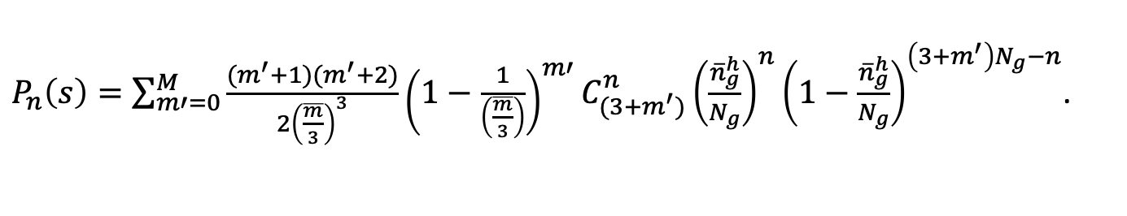
Three-gluon decay of quarkoniums ϒ(9.46), ϒ (10.02)
Z
$P_{n}\left(s\right)=\sum_{m′=0}^{M}{\frac{(m^{′}+1)(m^{′}+2)}{2{\left(\frac{\overline{m}}{3}\right)}^{3}}{\left(1−\frac{1}{\left(\frac{\overline{m}}{3}\right)}\right)}^{m′}}C_{(3+m^{′})}^{n}{\left(\frac{{\overline{n}}_{g}^{h}}{N_{g}}\right)}^{n}{\left(1−\frac{{\overline{n}}_{g}^{h}}{N_{g}}\right)}^{\left(3+m^{′}\right)N_{g}−n}$.
$$\overline{m}=\overline{m′}+ 3.$$
VI SPD Collaboration Meeting and Workshop on Information Technology in Natural Sciences

Slide 14
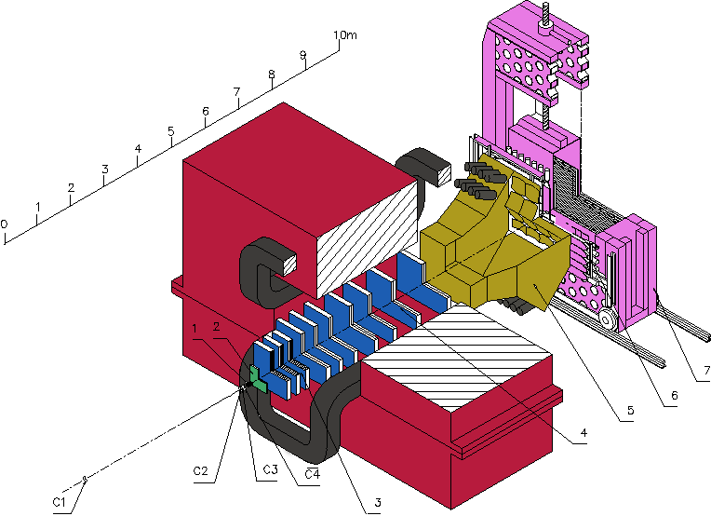
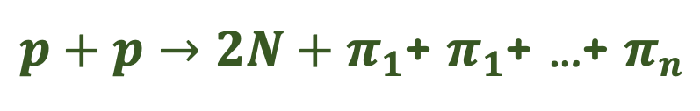
Hadron Interactions with High Multiplicity (HM). “Thermalization” project (IHEP+SINP MSU+JINR)
$p+p→2N+π_{1}$+ $π_{1}$+ …+ $π_{n}$
Project started in 2005, SVD-2 setup at U-70 accelerator, 50-GeV р-beam, Н₂ target, high multiplicity trigger. Kinematical limit (total energy spent on secondary particle production at rest) is close to 59 pions.
Spectrometer with Vertex Detector (SVD-2)
VI SPD Collaboration Meeting and Workshop on Information Technology in Natural Sciences

Slide 15
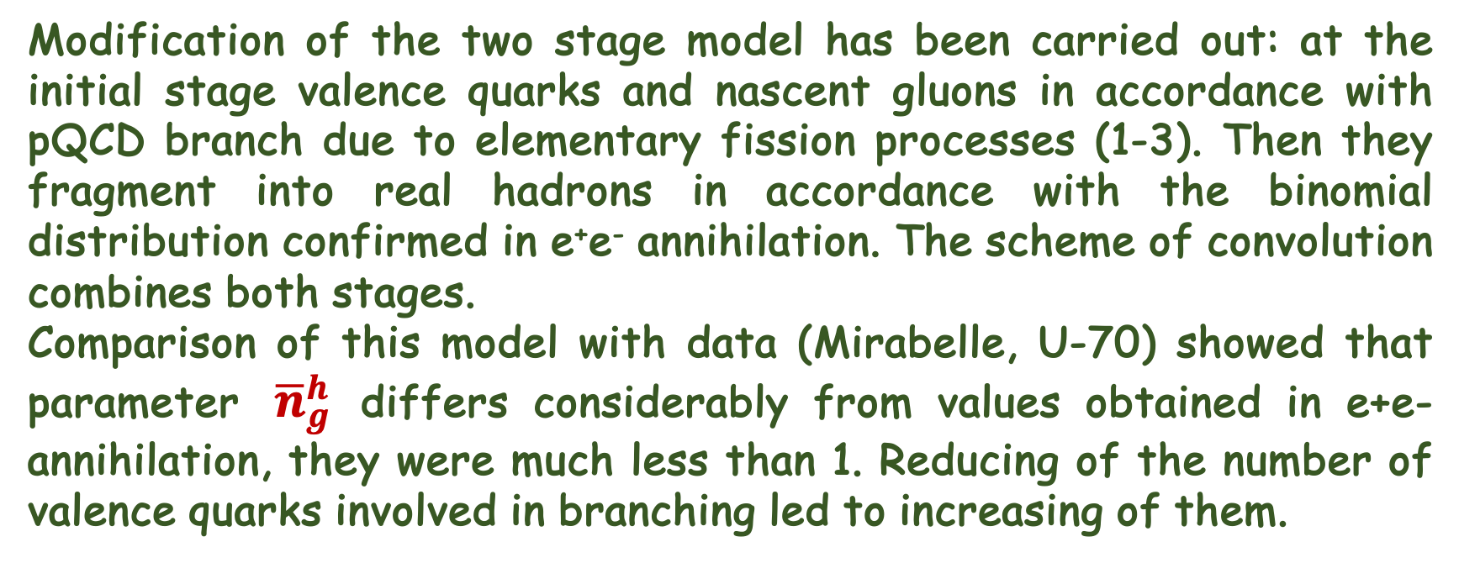
Gluon Dominance Model (GDM)
Modification of the two stage model has been carried out: at the initial stage valence quarks and nascent gluons in accordance with pQCD branch due to elementary fission processes (1-3). Then they fragment into real hadrons in accordance with the binomial distribution confirmed in e⁺e⁻ annihilation. The scheme of convolution combines both stages.
Comparison of this model with data (Mirabelle, U-70) showed that parameter ${ \overline{n}}_{g}^{h}$ differs considerably from values obtained in e+e- annihilation, they were much less than 1. Reducing of the number of valence quarks involved in branching led to increasing of them.
VI SPD Collaboration Meeting and Workshop on Information Technology in Natural Sciences

Slide 16
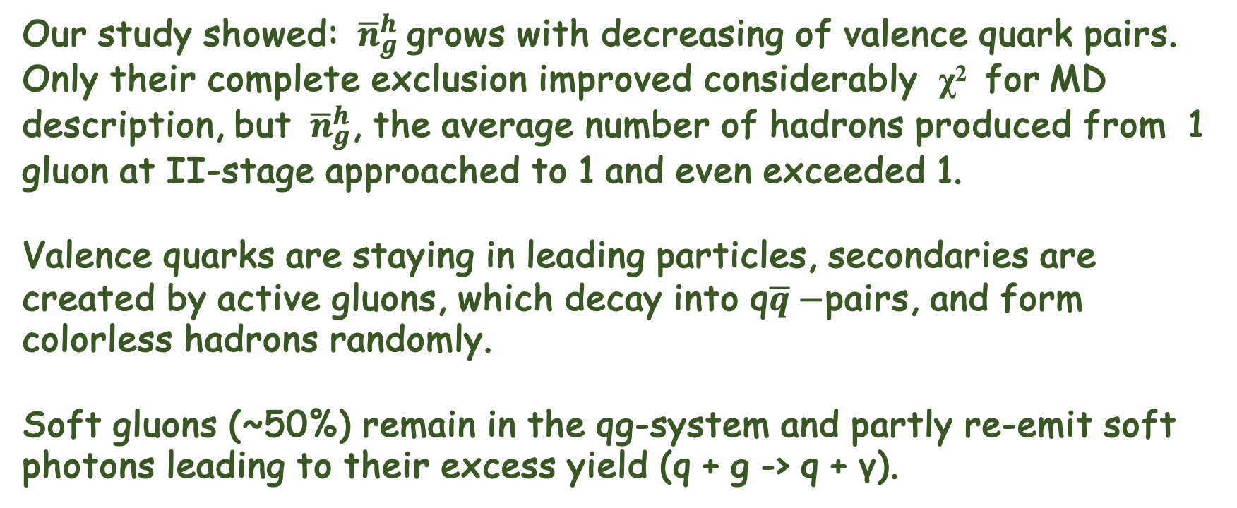
Gluon Dominance Model (GDM)
Our study showed: ${ \overline{n}}_{g}^{h}$grows with decreasing of valence quark pairs. Only their complete exclusion improved considerably χ² for MD description, but ${ \overline{n}}_{g}^{h}$, the average number of hadrons produced from 1 gluon at II-stage approached to 1 and even exceeded 1.
Valence quarks are staying in leading particles, secondaries are created by active gluons, which decay into q$\overline{q}−$pairs, and form colorless hadrons randomly.
Soft gluons (~50%) remain in the qg-system and partly re-emit soft photons leading to their excess yield (q + g -> q + γ).
VI SPD Collaboration Meeting and Workshop on Information Technology in Natural Sciences

Slide 17
GDM, g-fission:
appearance of active gluons
gluon fission
hadronization
Almost a half of gluons (~ 47 %) remain in qg-system, without being fragmented into hadrons (A.H. Mueller has the same result, 2003).
VI SPD Collaboration Meeting and Workshop on Information Technology in Natural Sciences

Slide 18
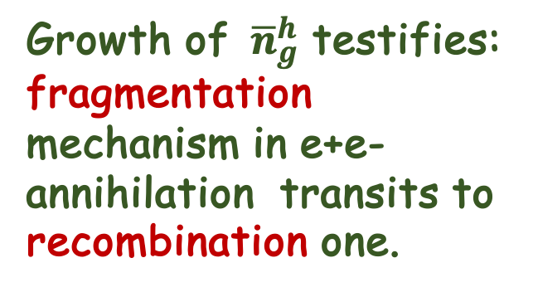
GDM, scheme without gluon fission
Parameters:
р ГэВ/с |  | M_{g} | N |  | Ω | χ²/ndf
102 | 2.75±0.08 | 8 | 3.13±0.56 | 1.64±0.04 | 1.92±0.08 | 2.2/5
205 | 2.82±0.20 | 8 | 4.50±0.10 | 2.02±0.12 | 2.00±0.07 | 2.0/8
300 | 2.94±0.34 | 10 | 4.07±0.86 | 2.22±0.23 | 1.97±0.05 | 9.8/9
405 | 2.70±0.30 | 9 | 4.60±0.24 | 2.66±0.22 | 1.98±0.07 | 16.4/12
800 | 3.41±2.55 | 10 | 20.30±10.40 | 2.41±1.69 | 2.01±0.08 | 10.8/12
Growth of ${ \overline{n}}_{g}^{h}$ testifies:
fragmentation mechanism in e+e- annihilation transits to recombination one.
ISR energy 60 GeV:
VI SPD Collaboration Meeting and Workshop on Information Technology in Natural Sciences

Slide 19
GDM describes MD in pp at 100-800 GeV/c
102 GeV/c
300 GeV/c
205 GeV/c
405 GeV/c
GDM
NBD
GDM
КNО-IHEP
800 GeV/c
800 GeV/c
VI SPD Collaboration Meeting and Workshop on Information Technology in Natural Sciences

Slide 20
GDM with gluon fission
Data [Mirabelle & SVD-2] рр at 50 GeV/с has been stitched along topolog. cross sections, σ_{n}. GDM takes into account two types of hadronization: gluon c without their fission (blue line) and with fission (green line). Superposition of those contributions is shown by red line. HM stipulates namely by gluon fission. Their ratio: bremsstrahlung to gluon fission is equal to ~ 1/10.
VI SPD Collaboration Meeting and Workshop on Information Technology in Natural Sciences

Slide 21
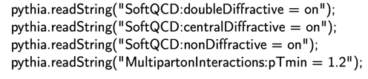
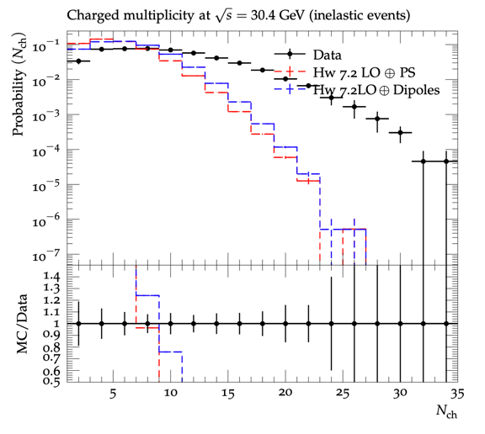
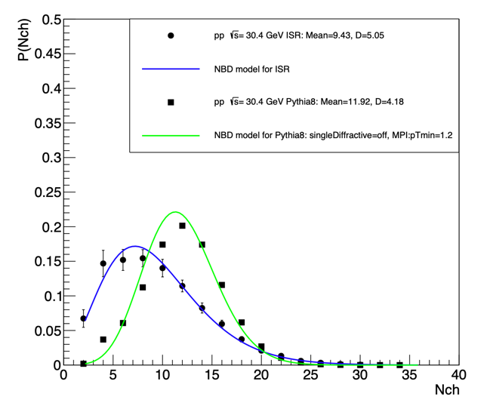
GDM with gluon fission
Data [ISR] рр at 30.4 GeV/с & MC Pythia8
Herwig++ 7.2 для √s = 30.4 ГэВ
VI SPD Collaboration Meeting and Workshop on Information Technology in Natural Sciences

Slide 22
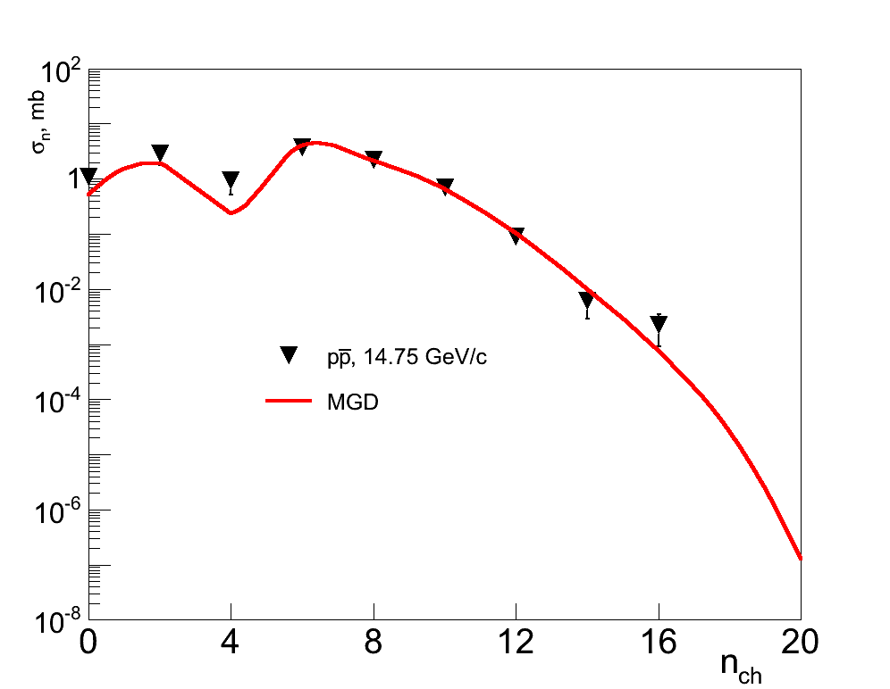
Proton-antiproton annihilation in GDM
<n₋>
J.G. Rushbrooke, B.R. Webber. Phys.Rep. 44 (1978) 1
VI SPD Collaboration Meeting and Workshop on Information Technology in Natural Sciences

Slide 23
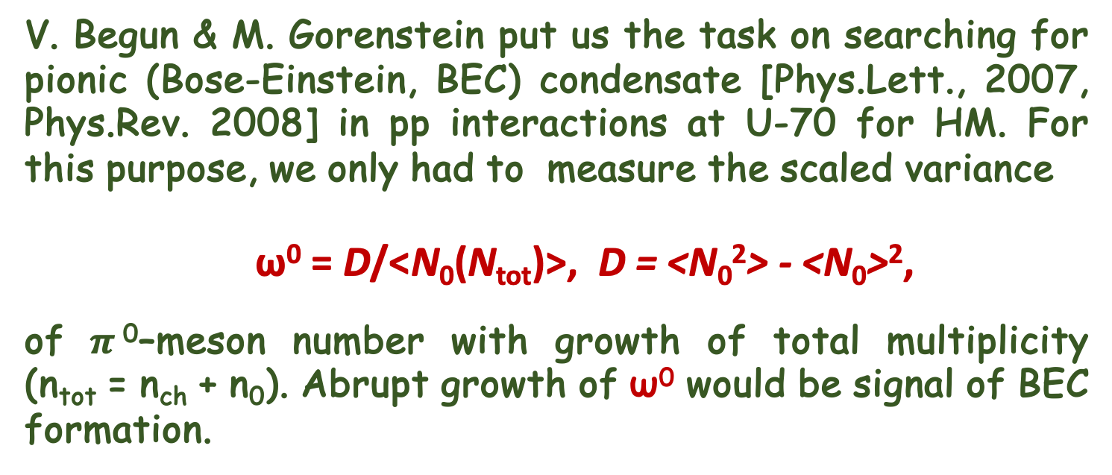
Neutral pion fluctuations at high total multiplicity
V. Begun & M. Gorenstein put us the task on searching for pionic (Bose-Einstein, BEC) condensate [Phys.Lett., 2007, Phys.Rev. 2008] in рр interactions at U-70 for HM. For this purpose, we only had to measure the scaled variance
ω⁰ = D/<N₀(N_{tot})>, D = <N₀²> - <N₀>²,
of $π$⁰–meson number with growth of total multiplicity (n_{tot} = n_{ch} + n₀). Abrupt growth of ω⁰ would be signal of BEC formation.
VI SPD Collaboration Meeting and Workshop on Information Technology in Natural Sciences

Slide 24
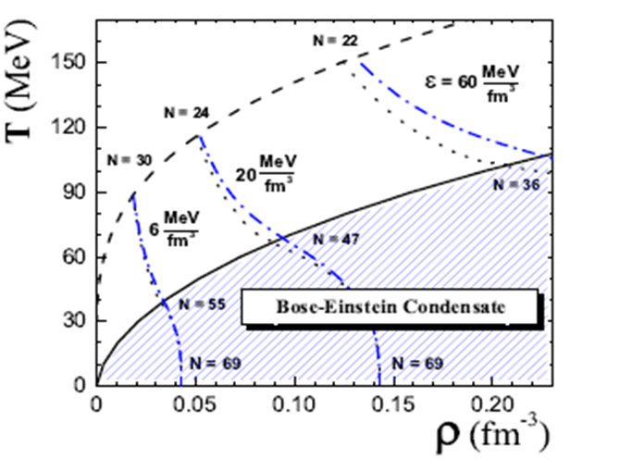
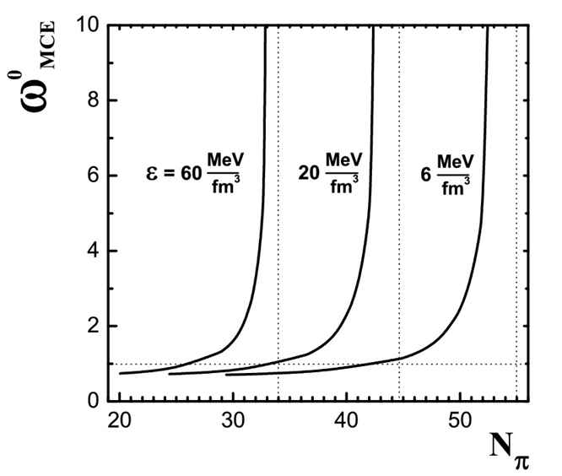
Fluctuiations of $π$⁰–mesons at High multiplicity
Phase diagram of pionic gas at μ_{Q} = 0. Dash line corresponds to ρ_{π}(T, μ_{π} = 0), solid – BEC. Energy densities 6, 20 и 60 Мev/fm³.
→ T_{C}(π) >> T_{C}(A).
VI SPD Collaboration Meeting and Workshop on Information Technology in Natural Sciences

Slide 25
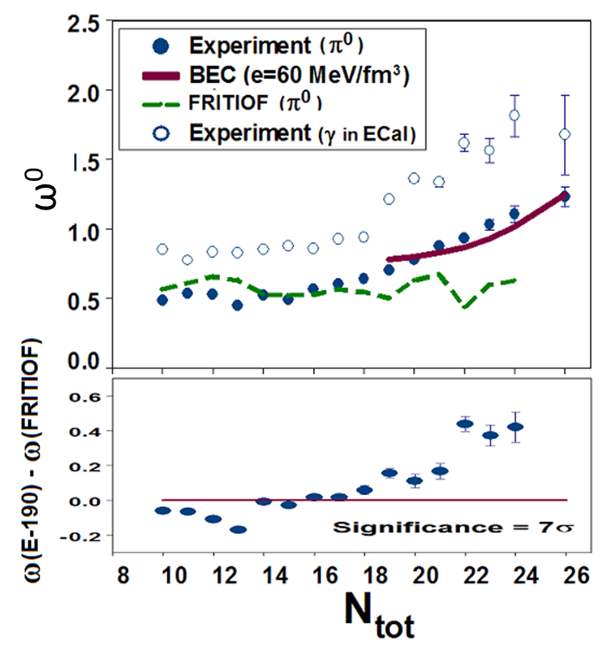
Fluctuiations of $π$⁰–mesons at High multiplicity
The deviation of the scaled variance, ω⁰ measured on the SVD-2 from the Monte Carlo predictions in the HM region is 7𝜎 at N_{tot} ∼ 25 [EPJ, 2012, ICHEP 2012].
VI SPD Collaboration Meeting and Workshop on Information Technology in Natural Sciences

Slide 26
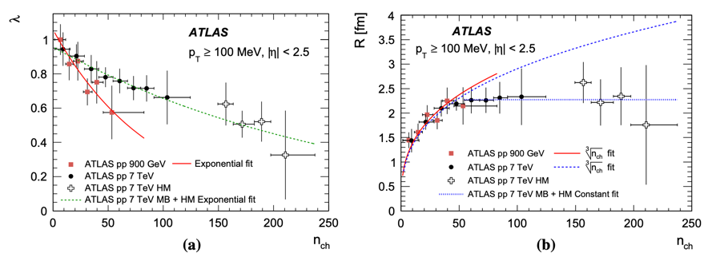
Bose-Einstein correlations in pp at HM (ATLAS)
Two-particle Bose-Einstein correlations in pp at 0.9 и 7 ТeV. ATLAS Collab. EPJ, 75 (2015). C₂(Q) = ρ(Q)/ρ₀(Q) = C₀ [1 + Ω (λ, QR)](1 + εQ), Q² = (p₁-p₂)² .
𝜆 close to 1 characterizes chaotic emission of particles, 𝜆 close to 0 – coherent emission (is characteristic for BEC), R defines the size of emission region, for BEC it’s hard time [hep-ph 1501.04530 ]. Their wave functions entangle . LHCb confirms 1709.01769 [hep-ex].
VI SPD Collaboration Meeting and Workshop on Information Technology in Natural Sciences

Slide 27
Polar angle (𝛳) distributions: small mult. and HM
Angle distributions on the polar angle Θ. In HM region we observe two-humped structure, which it’s interpreted as Cherenkov radiation gluon by quark. Θ_{Cher} = 0.05377 ± 0.00273 rad with CL3.1 𝜎. For gluon rings cos Θ = 1/𝛽n_{r}, where n_{r} refraction coefficient n_{r} = 1.0016 ± 0.0001(4), close to 1. It testifies about rarity of qg-medium.
VI SPD Collaboration Meeting and Workshop on Information Technology in Natural Sciences

Slide 28
Longitudinal & transversal components of p at HM
<p _{T} > and <p || > components of charged particles.
Left: M.C.-simulation, right: experimental data.
BEC formation starts to form from n_{ch} ∼ 16 (inflection point). At n_{tot} > 18 ω⁰ rises, leading particles disappear, hadron system becomes isotropic in all directions.
VI SPD Collaboration Meeting and Workshop on Information Technology in Natural Sciences

Slide 29
KNO scaling
The world KNO distribution with addition of the SVD-2 four points (√s = 9.8 GeV).
VI SPD Collaboration Meeting and Workshop on Information Technology in Natural Sciences

Slide 30
RESULTS
The study of events with HM allowed us to develop and supplement the mechanism of multiple production with a description of the hadronization stage by the Bernoulli distribution for various processes: e+e- annihilation, bottomonium decays, pp interactions, and proton and antiproton annihilation.
In the HM region, the collective behaviour of secondary particles has been discovered and confirmed, which gives us new ideas about the mechanism of multiple production, in particular, the active role of the gluon component in this process.
VI SPD Collaboration Meeting and Workshop on Information Technology in Natural Sciences

Slide 31
Afterwords
“Perhaps there are no discoveries in elementary or higher mathematics, or even, perhaps, in any other field that could be made ... without analogy.” George Poiya.
VI SPD Collaboration Meeting and Workshop on Information Technology in Natural Sciences

Slide 32
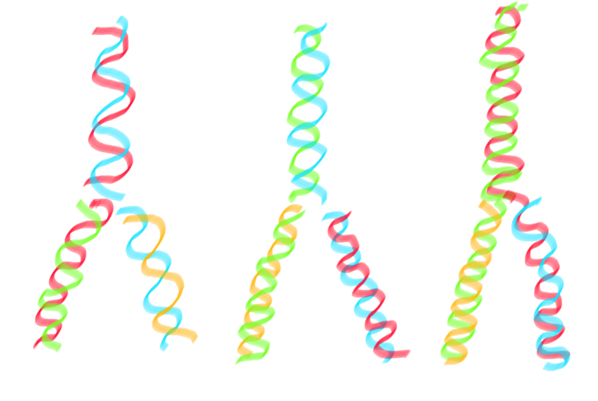
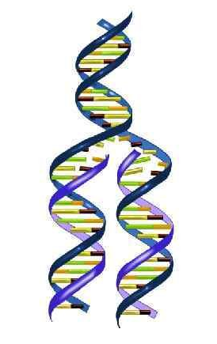
DNA Replication ~ gluons -> hadrons
VI SPD Collaboration Meeting and Workshop on Information Technology in Natural Sciences

