Slide 1
The Cryogenic Distribution Box of the SPD Superconductive Solenoid
Budker Institute
of Nuclear Physics
Novosibirsk
T.Bedareva, E.Pyata, S.Pivovarov, M.Kholopov, A.Orlova

Slide 2
General information
Budker Institute
of Nuclear Physics
Novosibirsk
Transfer Line to Refregerator
Platform
Refregerator
The magnet cryostat with coils, cold mass and thermal shields is located inside the yoke. A distribution box called Control Dewar is located on the top octant of the yoke.
The overall dimensions are determined by the space planned to accommodate the SPD detectors and the magnet field parameters.
The total weight of the cryostat, transfer line and Control Dewar is ~17 t.
The magnetic field along the solenoid axis should be 1.0 T.
Control Dewar
Transfer Line
Yoke
Cryostat

Slide 3
Budker Institute
of Nuclear Physics
Novosibirsk
Current Source and Energy Extraction System
Control Dewar
Vessel
The SPD control Dewar is designed to ensure helium supply to the cryogenic system in accordance with the flow scheme.
The transfer line connects vacuum vessels of cryostat and the control Dewar.
The length of the transfer line depends on the size and configuration of the frame for sliding endcap halves, as well as the type of platform.
The platform is used for preparation, installation and, subsequently, for repair. The platform must have good access for transportation of equipment and personnel to the place of work.
Platform
Transfer Line
Cryostat

Slide 4
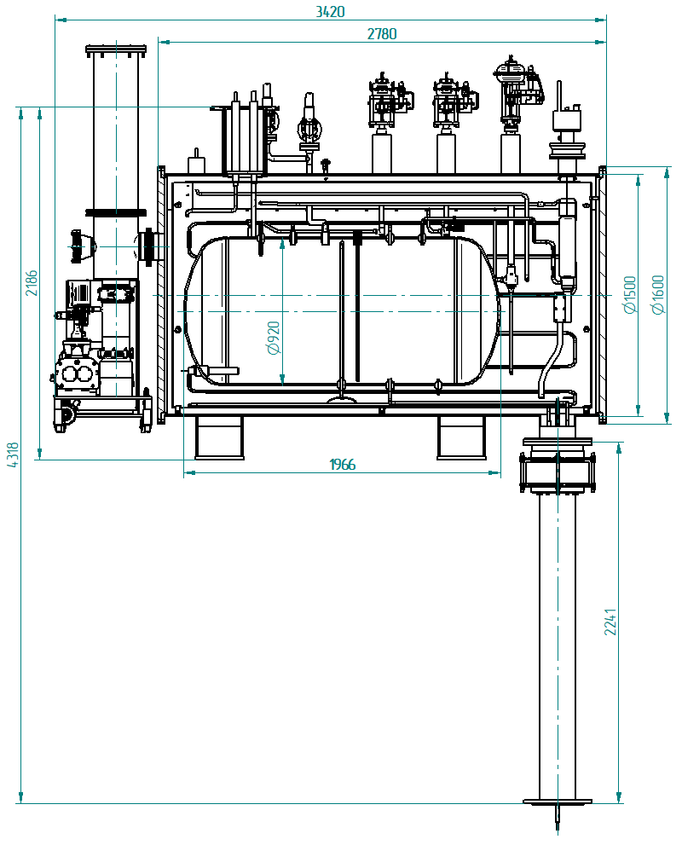
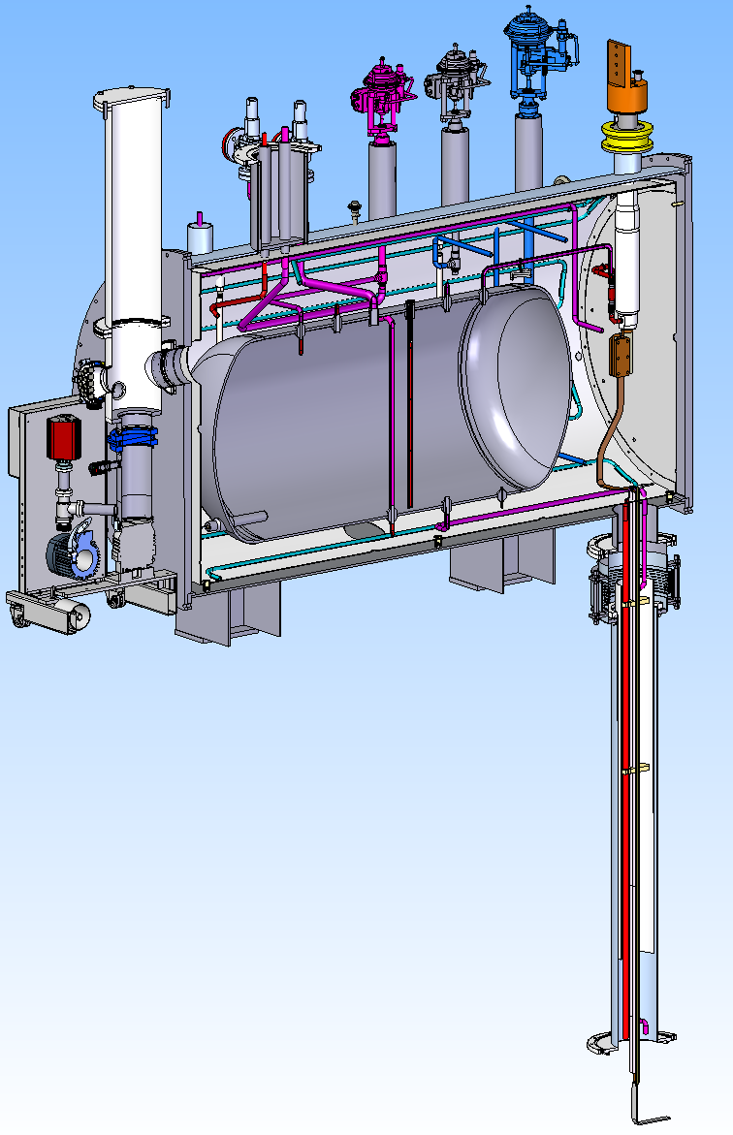
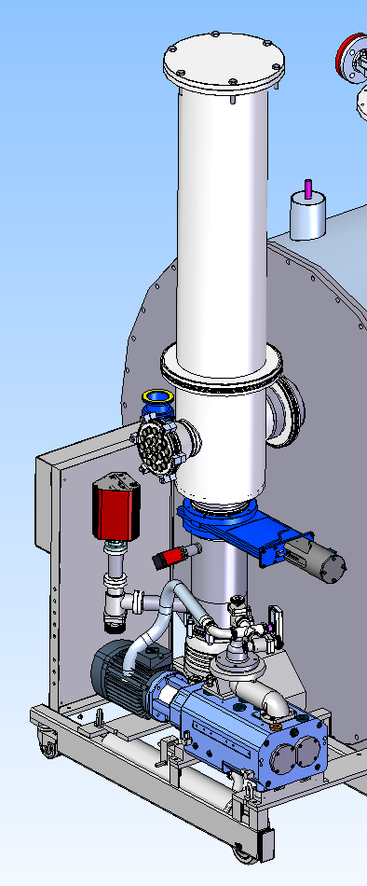
Distribution Box Design
Budker Institute
of Nuclear Physics
Novosibirsk
The distribution box includes cryogenic valves, safety relief valves, the 800 liter liquid helium vessel, instrumentation and current leads for solenoid operation.
The pump station with technological volume.

Slide 5
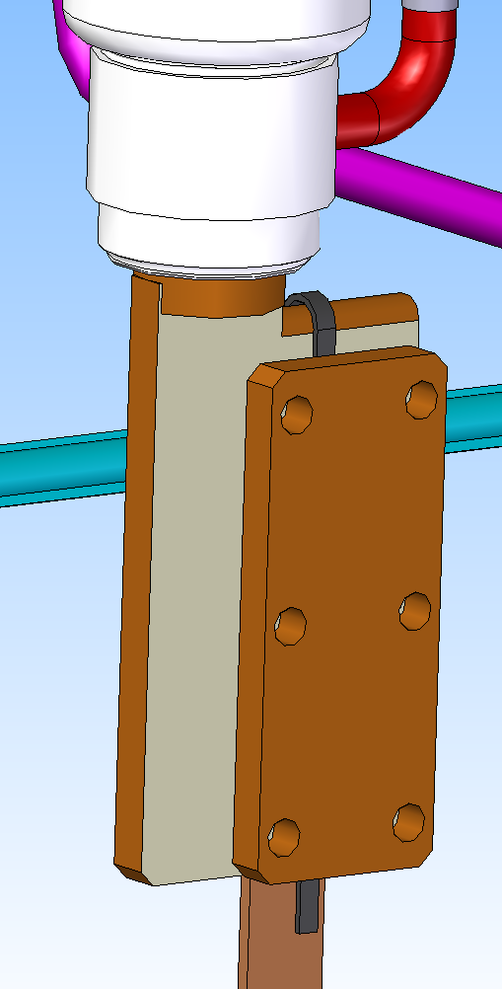
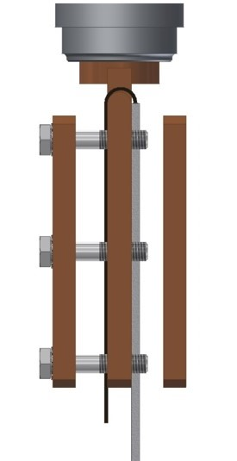
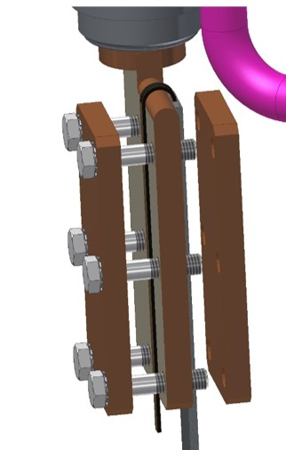
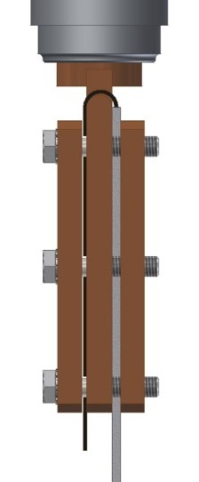
Budker Institute
of Nuclear Physics
Novosibirsk
Connection of the SC conductor to the current lead terminal. The surface of the terminal is tin plated with tin solder to avoid potential between copper and aluminum. Spring washers are used. Rutherford cable is soldered with a minimum length of 150 mm.

Slide 6
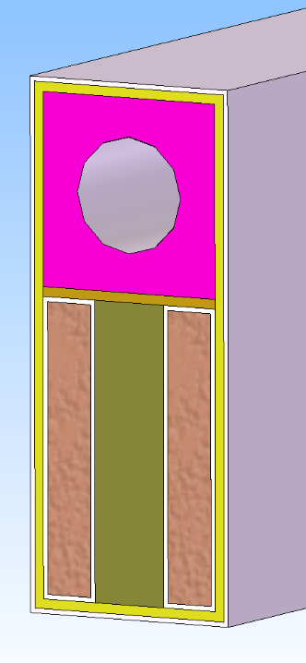
Transfer Line Design
Budker Institute
of Nuclear Physics
Novosibirsk
Reverse Flow
The busbars going to the magnet are not cooled and this is a high risk of quench or even too high temperature for the SC.
The proposed by BINP design provides the temperature regime of the conductor. In order to validate this design, several tests need to be performed.
The transfer line connects the vacuum volumes of the cryostat and the control Dewar. The transfer line has an outer diameter of 219.1 mm and the wall thickness of 2 mm. It contains the superconducting busbars, direct and return pipes for gaseous and liquid helium flows and measurement wiring. All components are surrounded by a thermal shield.
G10
AL Tape
Fiber Glass with Epoxy
Conductive Busbars

Slide 7
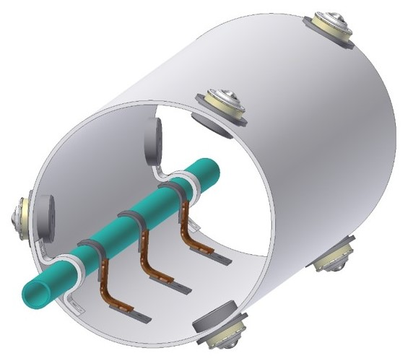
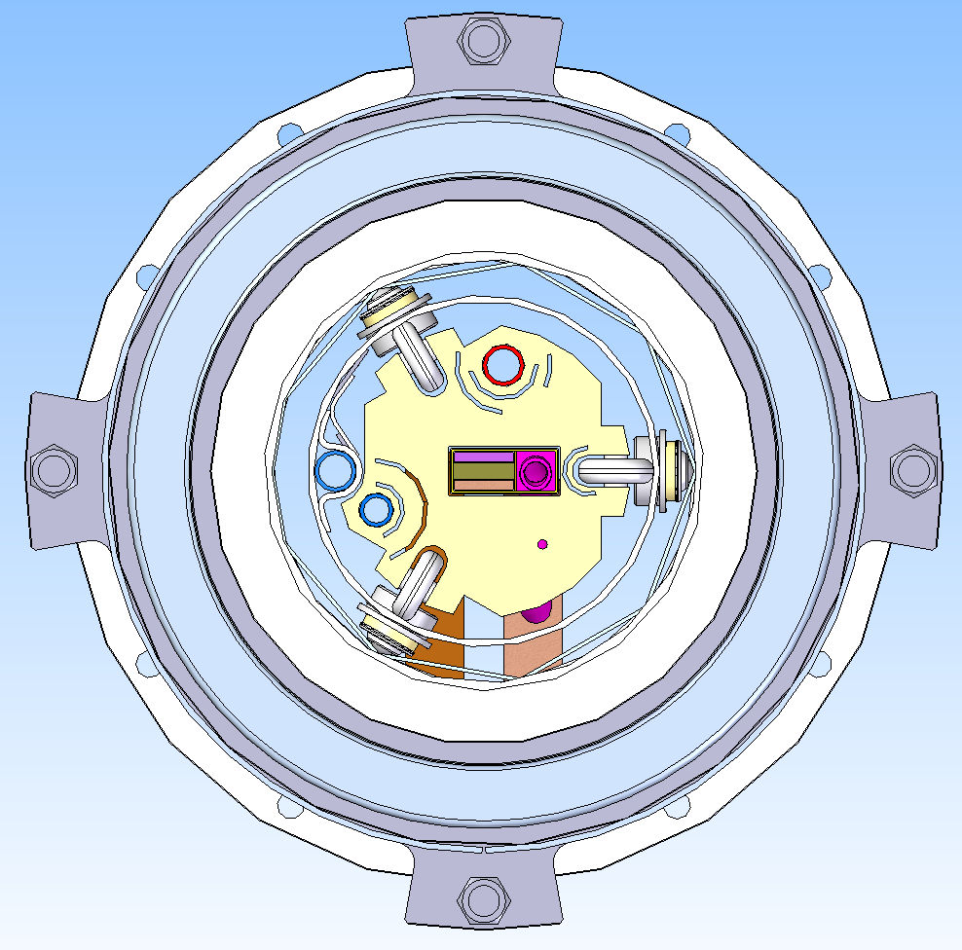
Budker Institute
of Nuclear Physics
Novosibirsk
The 80K pipe should be fixed to the transfer line thermal shield and for this thermal bridges are installed every 350-400mm.
The figures show of the transfer line’s thermal shield with thermal bridges and transfer line cross section.

Slide 8
Heat Loads of SPD
Budker Institute
of Nuclear Physics
Novosibirsk
T=4.5K | Heat loads, W
 | Normal condition | Without magnetic field | Current ramping
Cryostat
radiation | 7,80 | 7,80 | 7,80
supports | 3,60 | 3,60 | 3,60
eddy current loss in cold mass* | - | - | 11,50
eddy current loss in conductor* | - | - | 0,09
current leads, 4.5kA B=1* | 10,00 | 8,00 | 8,00
Control Dewar
radiation | 0,50 | 0,50 | 0,50
supports | 0,26 | 0,26 | 0,26
cold valves | 0,93 | 0,93 | 0,93
safety relief valves | 4,30 | 4,30 | 4,30
vacuum barrier | 0,35 | 0,35 | 0,35
Transfer line
radiation | 0,12 | 0,12 | 0,12
supports | 0,32 | 0,32 | 0,32
Total | 28,18 | 26,18 | 37,77

Slide 9
Heat Loads of SPD
Budker Institute
of Nuclear Physics
Novosibirsk
T=60K | Heat loads, W
 | Normal condition | Without magnetic field | Current ramping
Cryostat
radiation | 160,00 | 160,00 | 160,00
supports thermal shields | 12,00 | 12,00 | 12,00
eddy current loss in thermal shields | - | - | 47,00
Control Dewar
radiation | 11,60 | 11,60 | 11,60
supports thermal shields | 6,50 | 6,50 | 6,50
supports Helium vessel | 9,12 | 9,12 | 9,12
cold valves | 9,50 | 9,50 | 9,50
safety relief valves | 1,10 | 1,10 | 1,10
vacuum barrier | 1,18 | 1,18 | 1,18
Transfer line
radiation | 1,05 | 1,05 | 1,05
supports | 2,35 | 2,35 | 2,35
Total | 214,40 | 214,40 | 261,40

Slide 10
Flow Scheme
Budker Institute
of Nuclear Physics
Novosibirsk
The cryogenic system of the cryostat and the control Dewar shall be designed according to the loads resulting in all operating scenarios. The design pressure for all pipelines and the helium vessel is 19 bar absolute pressure (bar-a).
Liquid helium used to cool the cold mass is supplied from the liquefier at a temperature of 4.5 K. Solenoid thermal shields surround the cold internal parts and are cooled by gaseous helium, which flows through serpentine heat exchanger pipes.
The helium stream exits the liquefier at a temperature level of 40 or 50 K and returns to the liquefier after passing the thermal shields at a temperature level about 80 K.
The Process Flow Diagram (PFD) of the SPD cryogenic system has the same principle as for the CMS solenoid (CERN) and PANDA (FAIR).

Slide 11
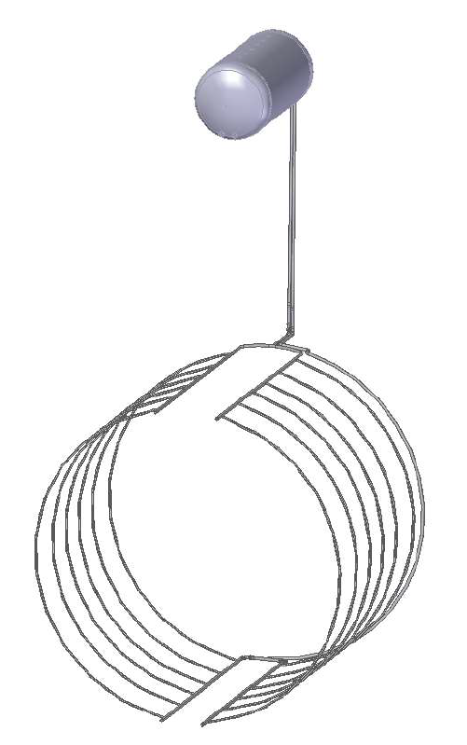
Cold Mass Cooling
Budker Institute
of Nuclear Physics
Novosibirsk
The cold mass of the SPD solenoid is indirectly cooled by circulating two-phase helium by natural convection.
The thermo-syphon circuit consists of a bottom and top manifolds connected by 12 parallel syphon tubes attached to the outer surface of the support cylinder of the cold mass.
The cryogenic scheme relies on indirect cooling of the cold mass by circulating saturated helium at 4.5 K by natural convection.
Natural circulation loop works on the principle that a heat load on the channels of the heat exchanger produces a two-phase flow that is on average less dense than the liquid phase.
Mass Helium flow SPD - 9-10 g/sec.
Thermo-syphon circuit

Slide 12
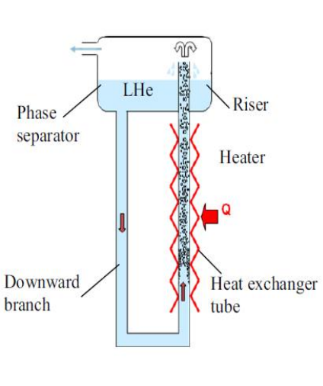
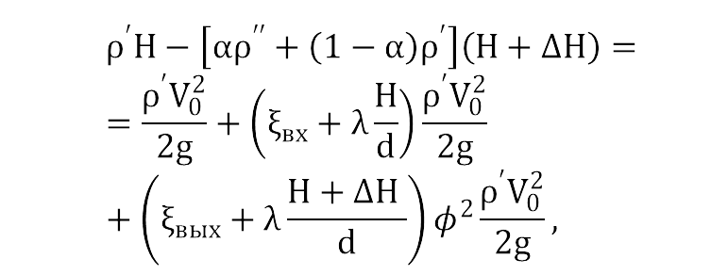
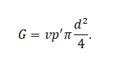
Thermo-Syphon Cooling Method
Budker Institute
of Nuclear Physics
Novosibirsk
The Bernoulli equation
The mass flow rate
The liquid helium circulation speed in the system
Operating principle of the thermo-syphon cooling method

Slide 13
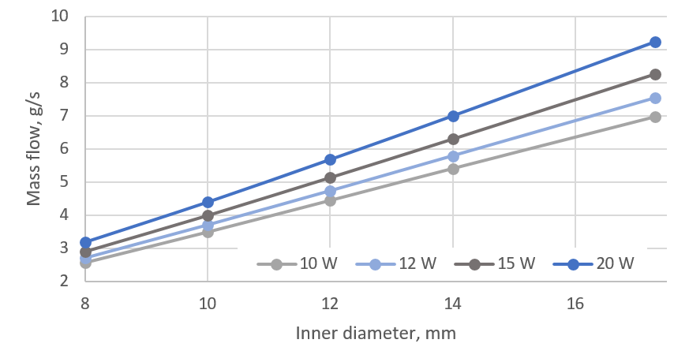
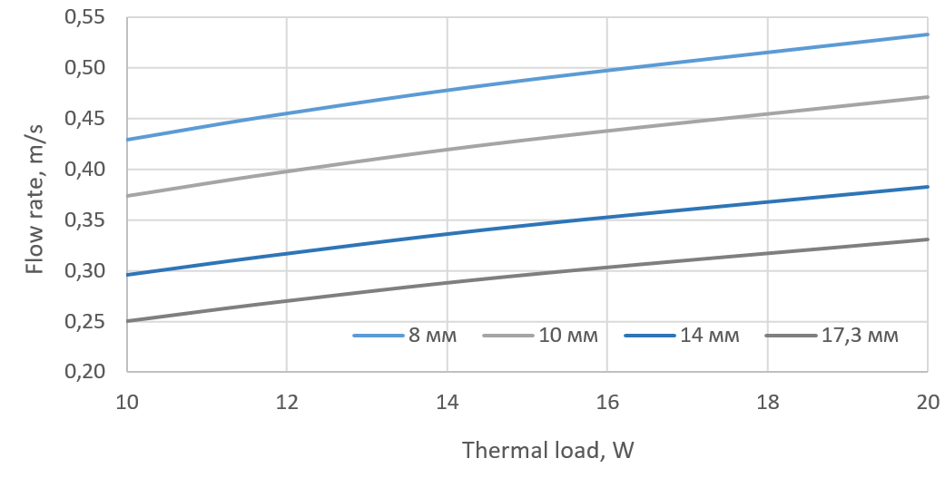
Thermo-Syphon Cooling
Budker Institute
of Nuclear Physics
Novosibirsk
The dependence of the flow rate on the thermal load for different types of tubes
The dependence of the mass flow rate on the diameter of the tube for different thermal loads

Slide 14
Budker Institute
of Nuclear Physics
Novosibirsk
Thank you for your attention!

