Slide 1
Study of Spin Effects in the SPASCHARM Experiment
V. Mochalov
(on behalf of the SPASCHARM collaboration)

Slide 2
Outline
SPASCHARM Project
  Physics Program
  Polarized proton and antiproton beams
SPASCHARM stage 1 (current)
  Physics
  Experimental Setup
  Current activity
SPASCHARM perspectives

Slide 3
Motivation
The project is aimed at studying the spin structure of the nucleon and the spin dependence of the strong interaction at energies up to 50 GeV. The fixed target SPASCHARM experiment will systematically study polarization phenomena in exclusive and inclusive hadronic reactions.
The universal setup will detect dozens of particles, produced on a polarized proton and nuclear targets. In parallel with single-spin asymmetries, the polarization of hyperons and the elements of the density spin matrix of vector mesons will be measured.
The ultimate goal of the experiment is to study spin structure of the proton, primarily the determination of the contribution of gluons to the spin of the proton through the investigation of spin effects in the formation of various charmonium states

Slide 4
Motivation 2
The presence of polarized both protons and antiprotons in the CP neutral system potentially opens up opportunities for studying and comparing CP conjugate reactions with one another. This allows us to look at CP invariance in a new perspective, inaccessible to collisions of unpolarized particles.
Finally, the presence of eight types of unpolarized beams (π±, K±, p, p͂, d, C), in combination with a polarized and nuclear targets, extends the range of studies of polarization phenomena by an order of magnitude and enhances the uniqueness of the project. The study of energy dependence of spin effects reveals the dynamics of interaction. The measurements might be conducted at several energies in order to estimate the model parameters.

Slide 5
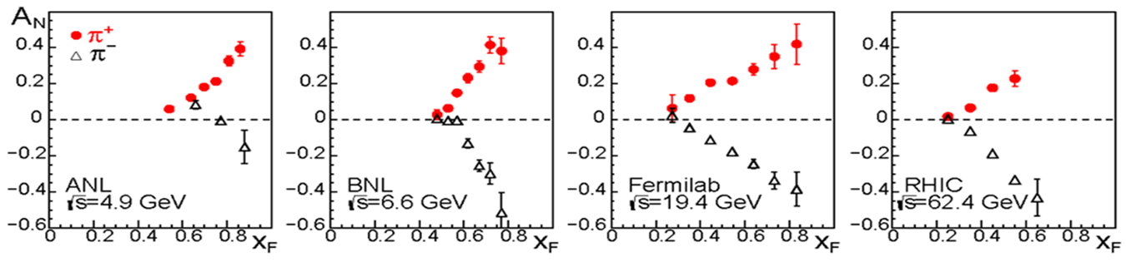
Single-spin asymmetry measurements (motivation)
Single–spin asymmetries and hyperon polarization almost do not depend on beam energy – accuracy is more important:
inclusive and exclusive reactions, including elastic, of the light (u, d, s – quarks) hadrons in the beam fragmentation region with polarized beam or target. The hyperon and vector mesons polarization (elements of the density spin matrix)

Slide 6
SPASCHARM-2 physics program
Stage 2 with polarized and un-polarized beams and without polarized target:
  Single-spin asymmetry А_{N} in J/ψ and χ₁/χ₂ inclusive production polarized proton beam. Expected statistics (conservative) for 40 days of data taking is:.
    p (40 GeV) beam (5⋅10⁷ р/cycle): 20000 J/ψ and 2500 χ₁/χ₂ states.
  Statistic error of J/Ψ asymmetry measurements is 7% for
  The cross-section ratio for χ₁/χ₂ production will be measured to determine the mechanism of charmonium production using pion and proton beams.
Stage 2 with longitudinally polarized beam and target:
  Double-spin asymmetry А_{LL} measurements to study ΔG/G(x).
  А_{NN} measurements for Drell-Yan pairs to study transversity h(x). Simultaneously А_{NN} and A_{N} in J/ψ, χ₁/χ₂. production will be studied.
  Double spin asymmetry measurements at different channels

Slide 7
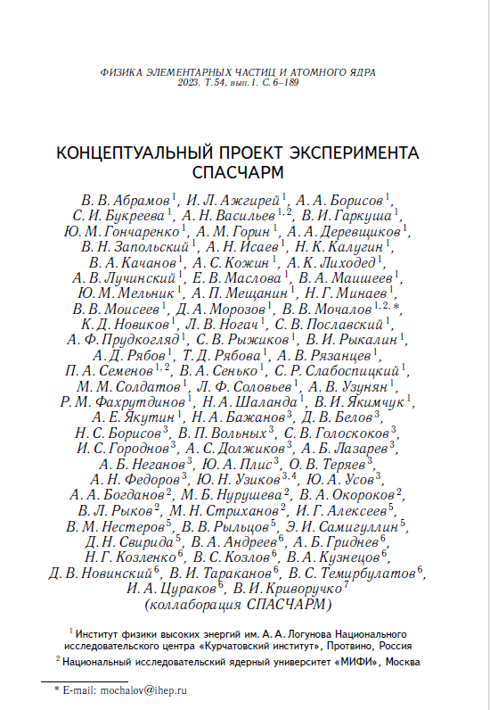
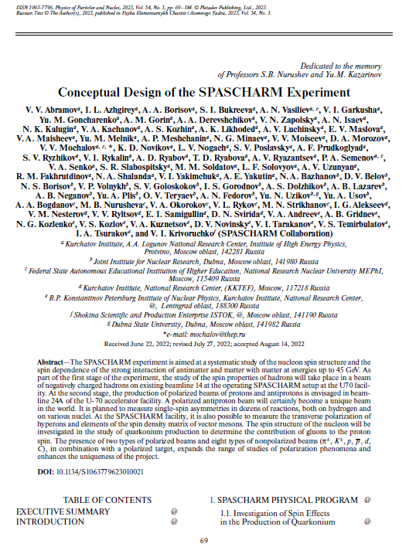
Conceptual Design Report

Slide 8
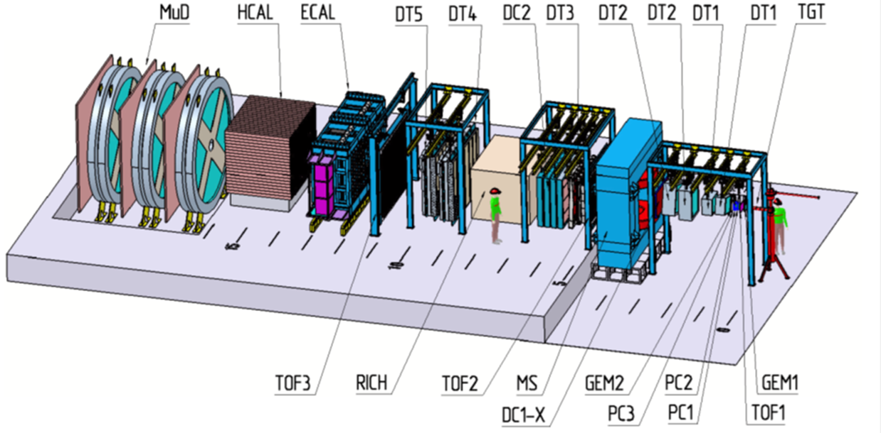
SPASCHARM Setup at beamline 24

Slide 9
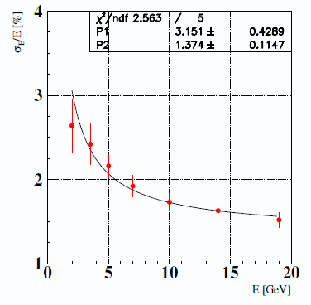
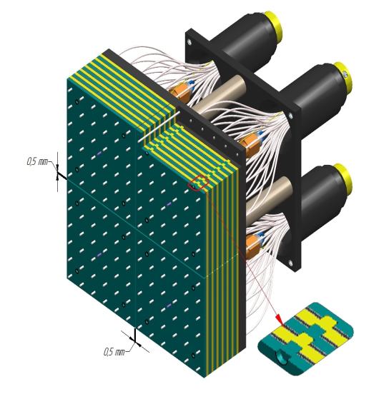
Electromagnetic Calorimeter
Fine-segmented “shashlyk”-type calorimeter,
Cell structure: Scintillator: 1.5 mm, Lead: 0.3 mm (380 layers)
2400 cells of the size 55×55×700 mm³, depth ~20X₀ About 11-12 m from target
Photodetectors: Hamamatsu R7899

Slide 10
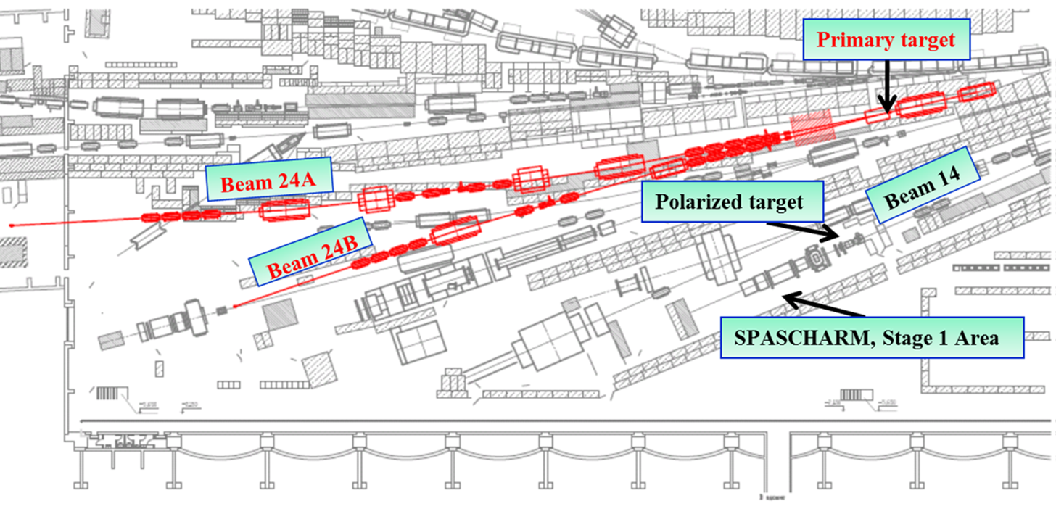
SPASCHARM beam-line 24A

Slide 11
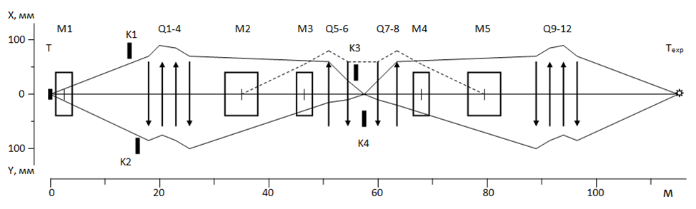
Optical scheme channel 24A
Main optic scheme for polarized beam p≤45 GeV/c from hyperon-decay.
Q – quads, М – dipoles К – collimators, Т , Т_{exp} – targets (channel and experiment), green – spin flipper (BINP, Novosibirsk)

Slide 12
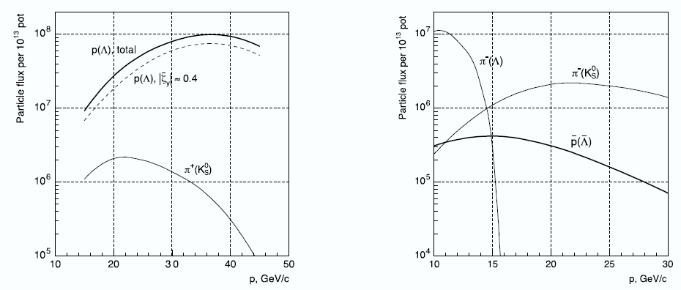
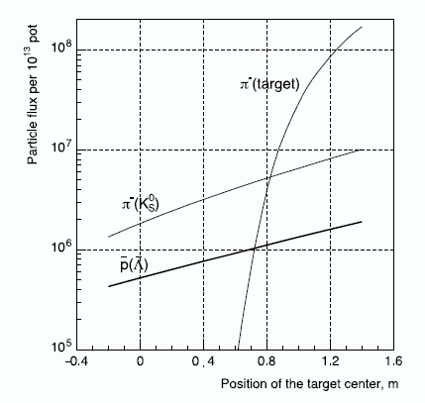
Beam intensity
V.Abramov et al, The polarized proton and antiproton beam project at U-70 accelerator Nuclear Inst. and Methods in Physics Research, A 901 (2018) 62–68

Slide 13
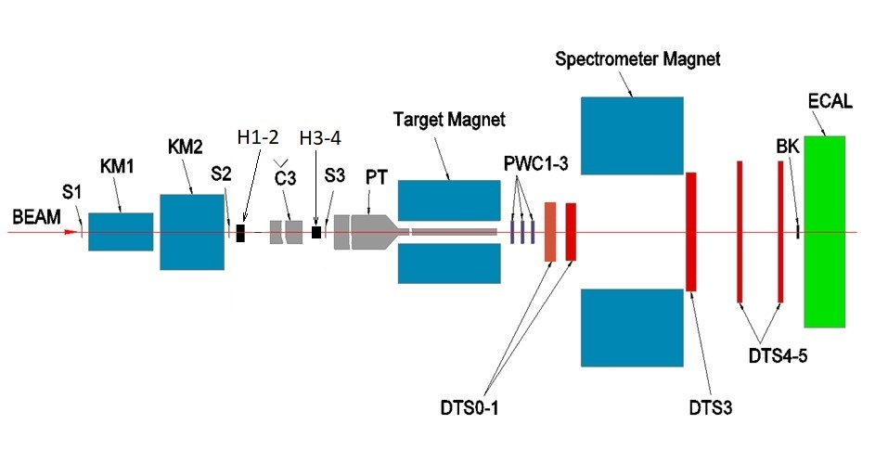
SPASCHARM at beamline 14
Energy 26,5 GeV, Particles pi/K/pbar=98%, 1.75%,0.15%, Intensity: up to 10⁶
Charged: Δθ_{x} > ±180 mrad, Δθ_{y} ≈ ±120 mrad, 0 < x_{F} < 1, p_{T} < ~2.5 GeV/c
γ and π⁰: Δθ_{x} ≈ ±50 mrad, Δθ_{y} ≈ ±40 mrad, 0 < x_{F} < 1, p_{T} < ~1 GeV/c
Field in spectrometer magnet 0,7 T (BxL)

Slide 14


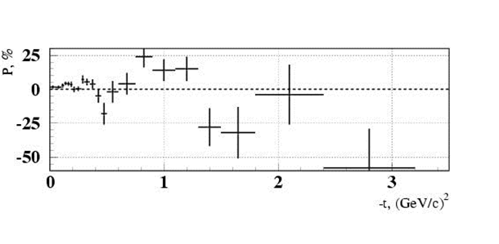
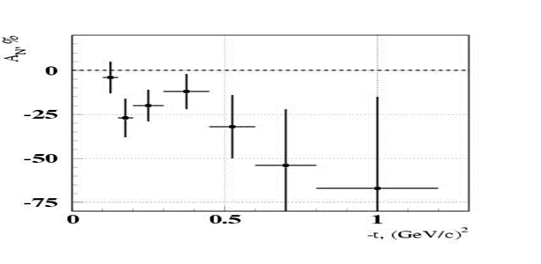
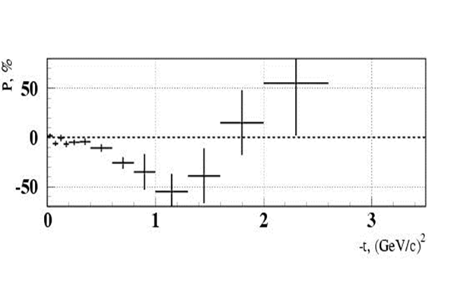
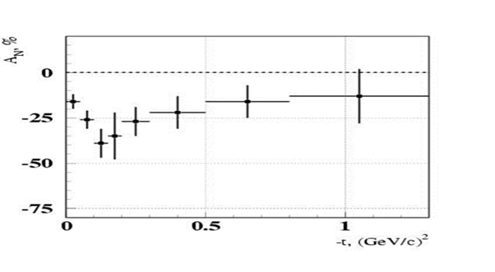


Beamline 14 motivation (exclusive)

Slide 15
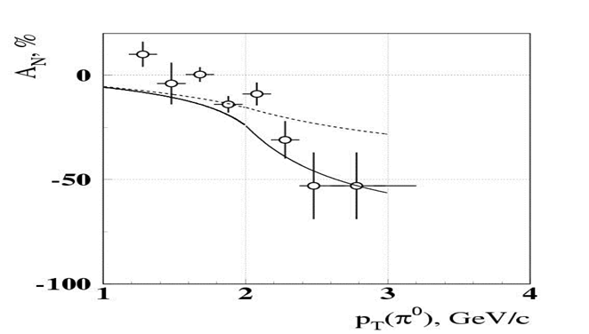
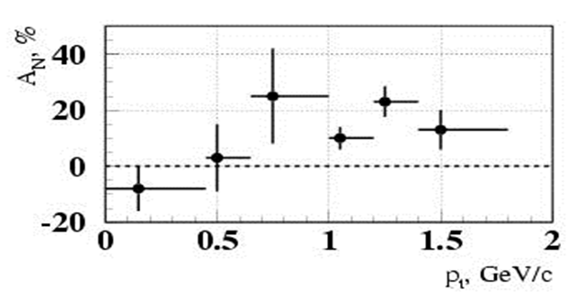
SPASCHARM at Beam-line 14
(motivation inclusive)
pp↑→π⁰X at x_{F}=0
pd↑→π⁰X at x_{F}>0.7
Phys.Lett. B243 (1990) 461-464, Sov.J.Nucl.Phys. 50 (1989) 432-437, Yad.Fiz. 50 (1989) 695-704
Phys.Atom.Nucl. 73 (2010) 2017-2021, Yad.Fiz. 73 (2010) 2072-2076
A_{N} = (16±5)% at p_{T} =(0.7-1.8) GeV/c and at x_{F} > 0.7.
A quite sizeable asymmetry showed up at p_{T} ~ 1 GeV/с and above even in the unpolarized beam fragmentation region.

Slide 16
SPASCHARM physics program at beamline 14
A_{N} measurements in charged pion, K⁰ and ω(782) production with polarized target and negative charge particle (and proton) beam
  π⁻ + p↑ → π⁻ X, π⁻ + p↑ → π⁺ X (data are collected),
  π⁻(K⁻)+p↑ → π⁰ (K⁰)X, π⁻(K⁻) + p↑ → ω(π⁻ π⁺ π⁰) X
  New Polarized target is under construction
Spin density matrix of vector mesons and hyperon polarization with negative charge particle (and proton) beam on Nuclei targets

Slide 17
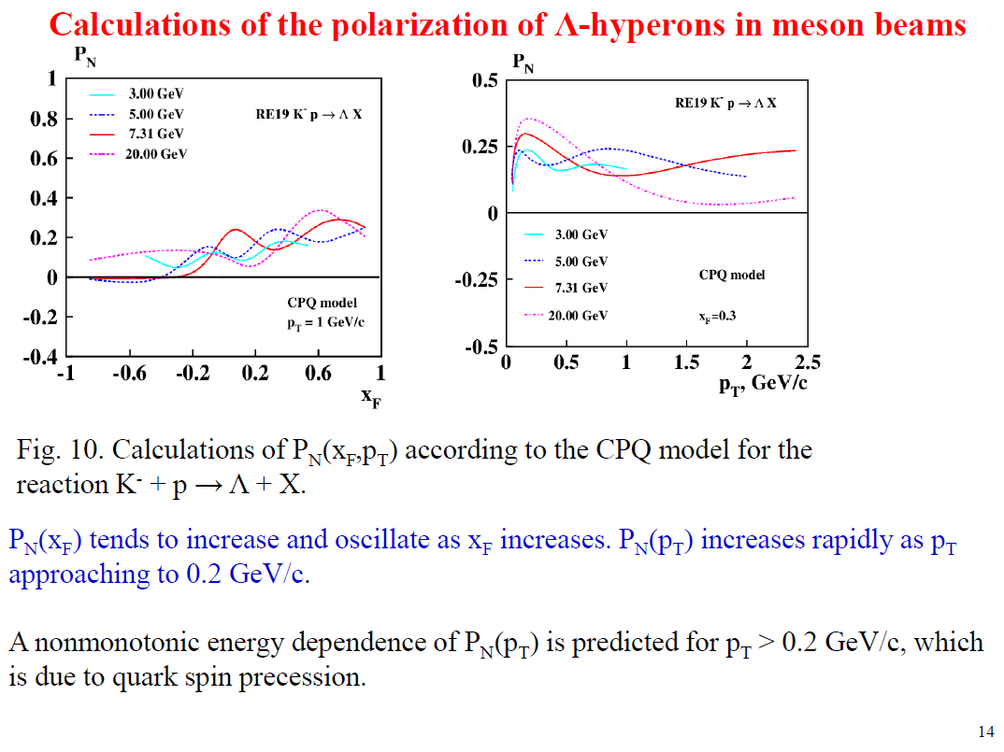

Slide 18
Current activity
SPASCHARM setup upgrade
  Beam profilometer (required for proton beam and asymmetry measurements)
  New fiber hodoscope
  Large drift chambers (PINP and KI)
Analysis:
  A-dependence of K_{s} and K* inclusive production (reported on Nucleus 2023 and RAS session-2024)
  Charged pion asymmetry - first result this Fall (?)
  Λ (Λbar) – polarization, ρ and K* spin alignment (2021-2023 data) - first result this Fall (?)

Slide 19
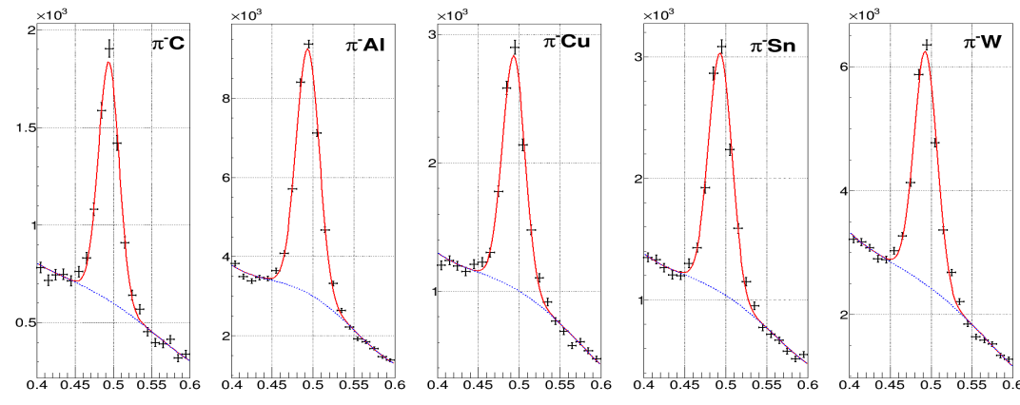
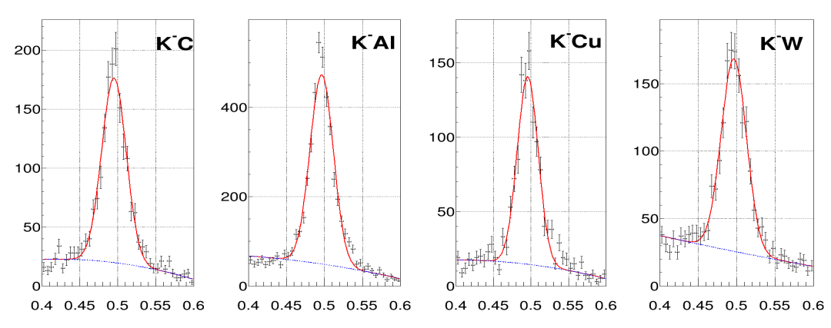
K_{s} reconstruction

Slide 20
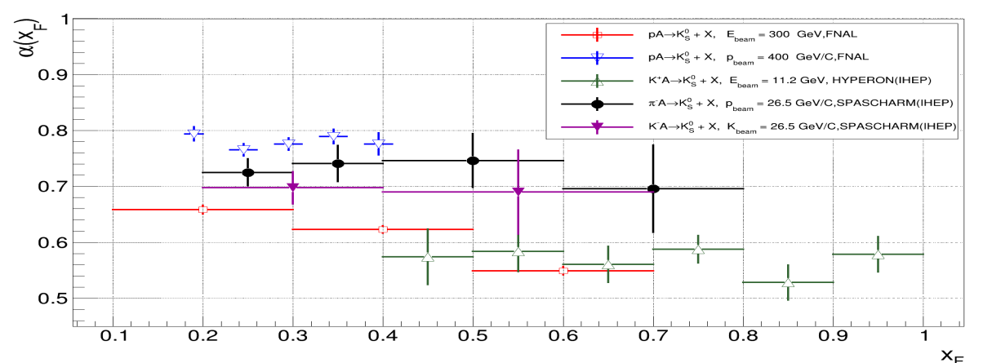
A-dependence

Slide 21
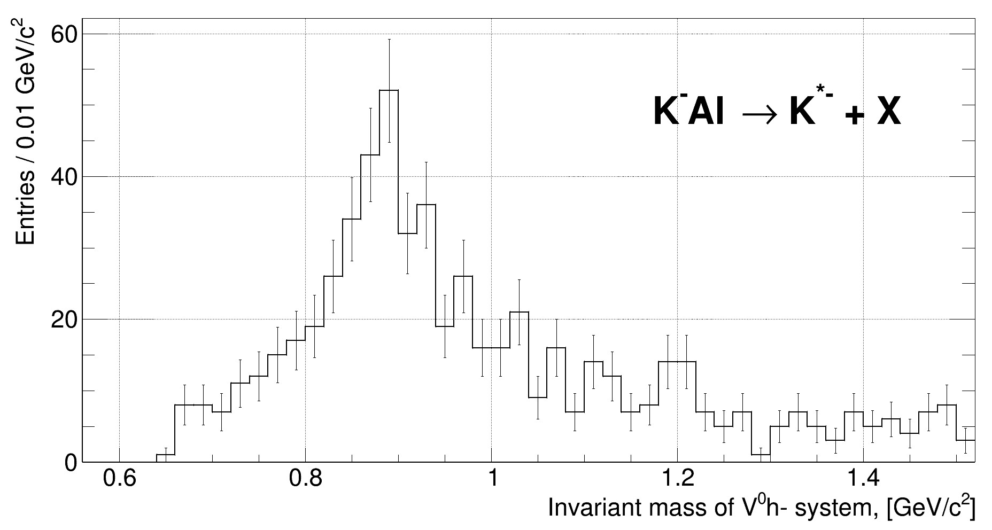
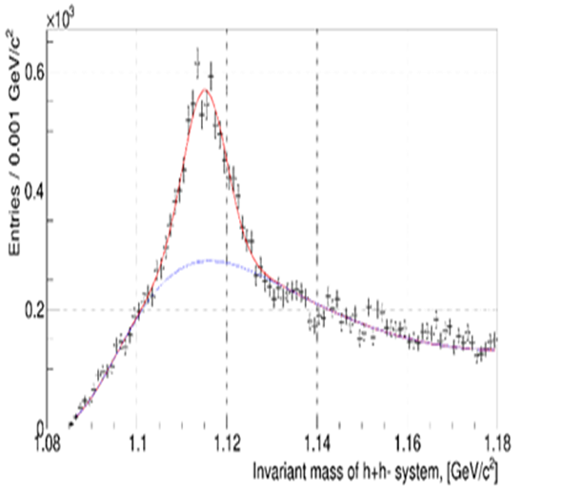
K* and Λ studies
First indication on significant Λ polarization on K⁻ beam (zero on π⁻)

Slide 22
U70 accelerator facility modernization Plans 2024-2030
2024-2027 Current Facility Modernization to achieve stable data taking runs with high statistics (two data taking runs each year are expected):
  Modernization of Cooling and Vacuum systems of U70-ring
  Modernization of beam control system (including HF)
  Modernization of booster power supply
2028-2033 New perspective modernization of U70
  Increase of U70 Intensity (up to 3х10¹³)
  Development new beamline 24 for spin and spectroscopy studies (polarized beam for SPASCHARM experiment and meson beams for VES experiment)

Slide 23
SPASCHARM strategy
2024-2026 Study spin alignment of vector mesons and hyperon polarization with p, K⁻ and π⁻ beams and nuclei targets (including dependence on nucleus number)
  New polarized target (Contract with JINR signed on April,2024) – new target to be ready before Fall 2026)
  Production new EM calorimeter (SPD prototype?)
2027-2032 Study SSA with p, K⁻ and π⁻ beams and polarized target on beamline 14
  Development beamline 24 (polarized beam, including spin flipper)
  SPASCHARM setup modernization (FARICH?, Full scale EM calorimeter, beam tagging, setup for elastic scattering)
2032->Study spin effects with polarized beams

Slide 24
Conclusion
SPASCHARM physics program is rich and complementary to SPD program
The first stage of the SPASCHARM experiment has started and first spin data were accumulated
Collaboration of IHEP, JINR, PNPI, KI (TEP) and MEPHI and Experimental Setup is ready to take new data and study spin effects on p, K⁻ and π⁻ beams with different nuclei. First spin results are on the way (this Fall?)
Contract to produce new polarized target has been signed
We will be glad new Institutes to join SPASCHARM experiment
The Talk was supported by RSF grant 22-12-00164

Slide 25
Backup slides

Slide 26
Преимущества СПАСЧАРМ
Широкая физическая программа и систематические исследования явления поляризации
Разнообразие пучков: поляризованные пучки протонов и антипротонов, неполяризованные π±, K±, p, анти-p, d, C.
Исследование десятков реакций одновременно.
Поперечно и продольно поляризованные и ядерные мишени.
Множество изучаемых поляризационных величин: A_{N}, P_{N}, A_{NN}, A_{LL}, D_{NN}, ρik, …
Полное покрытие азимутальных углов для снижения систематических ошибок, большой кинематический диапазон
Идентификация вторичных частиц, и заряженных, и нейтральных, например γ, π0, π±, K±, p, анти-p, d.
Использование спин-ротатора для получения поперечно- и продольно поляризованные пучки и уменьшения систематики.
Система сбора данных, быстро собирающая большой объем информации.

Slide 27
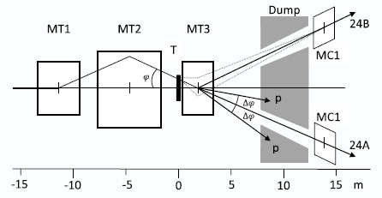
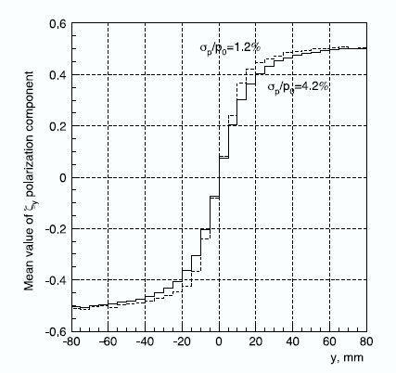
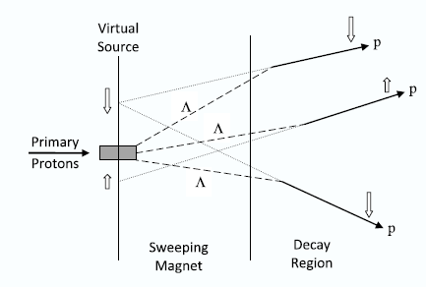
Beam target
(beam extracted from U70)
MT3 parameters have been chosen as a compromise between contradictory requirements to its length : 𝐿 = 2.6 m, aperture 𝐻 × 𝑉 = 140 × 56 mm², 𝐵𝑚𝑎𝑥 = 1.9 T. Target: Aluminum plate, 400 mm long, 3 mm high, and 100 mm wide

Slide 28
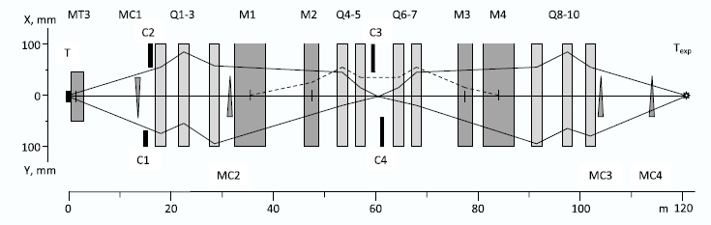
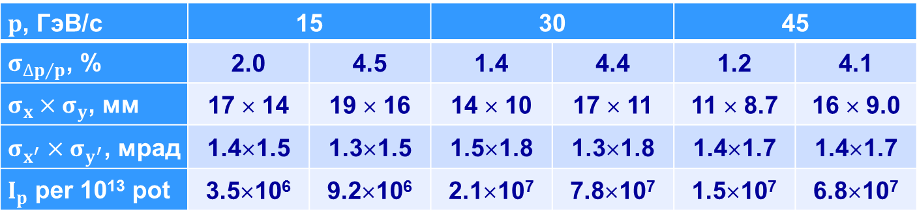
Optical scheme and properties
$p$, ГэВ/с | 15 |  | 30 |  | 45
$σ_{{∆p}/p}$, % | 2.0 | 4.5 | 1.4 | 4.4 | 1.2 | 4.1
$σ_{x}×σ_{y}$, мм | 17 × 14 | 19 × 16 | 14 × 10 | 17 × 11 | 11 × 8.7 | 16 × 9.0
$σ_{x^{′}}×σ_{y^{′}}$, мрад | 1.4×1.5 | 1.3×1.5 | 1.5×1.8 | 1.3×1.8 | 1.4×1.7 | 1.4×1.7
$I_{p}$ per 10¹³ pot | 3.5×10⁶ | 9.2×10⁶ | 2.1×10⁷ | 7.8×10⁷ | 1.5×10⁷ | 6.8×10⁷

Slide 29
Polarized antiproton beam (14 GeV/c)
Momentum collimator position | Min | Max
Momentum interval Δp/p, % | ±5.5 (σ=2.3) | 12.0 (σ=5.6)
Beam size, σ_{X} × σ_{Y} , mm | 18 × 19 | 20 × 19
Beam divergence σ_{X} × σ_{Y} , mrad | 1.6 × 1.9 | 1.5 × 2.0
Full intensity for 10¹³ protons | 1.4×10⁵ | 3.9×10⁵
Anti-proton P, GeV/c | Full anti-proton beam intensity for 10¹³ p/cyc. @ ext. target
10 | 1.9×10⁵
14 | 3.9×10⁵
20 | 3.4×10⁵
30 | 9.3×10⁴
40 | 1.6×10⁴

Slide 30
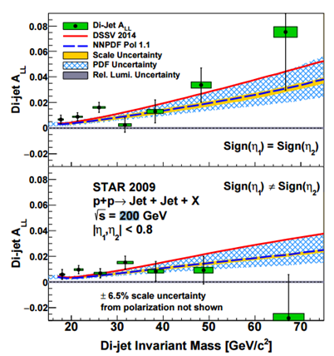
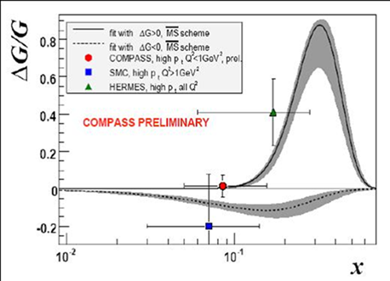
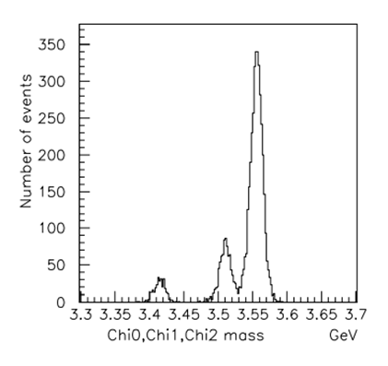
Исследования вклада глюонов в спин протона

Slide 31
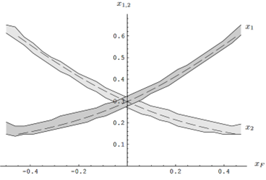
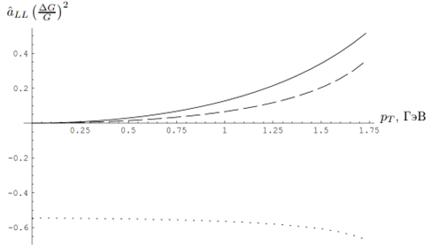

Кинематика и асимметрия «СПАСЧАРМ 24»
Зависимость партонных спиновых асимметрий $gg→ψg$ (сплошная линия), $gg→χ_{c1}g$ (пунктирная линия) и $gg→χ_{c2}g$ (точечная линия) от поперечного импульса чармония

Slide 32
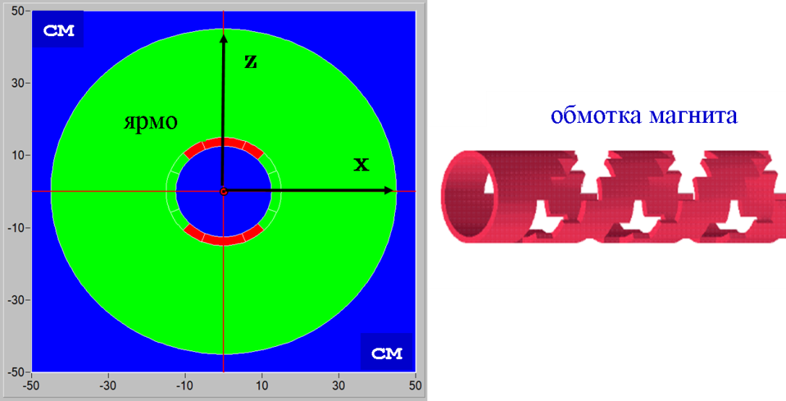

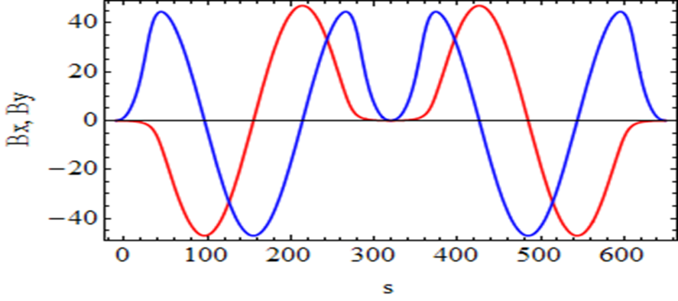
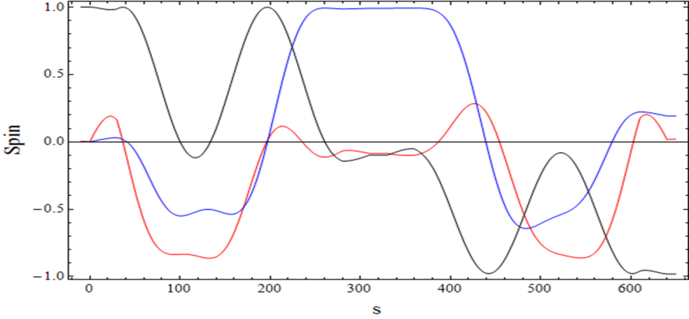
SPIN flipper
2 Helical magnets:
B_{max} = 47 kGs; λ= 2.5 m
Correctors:L=30 cm; B= 23 kGs; tilt = ± 0.1 rad;
Total length 6.5 m
Flipper optics: practically is equal to empty straight 6.5 m;
Spin transparency ≈ 97%

Slide 33
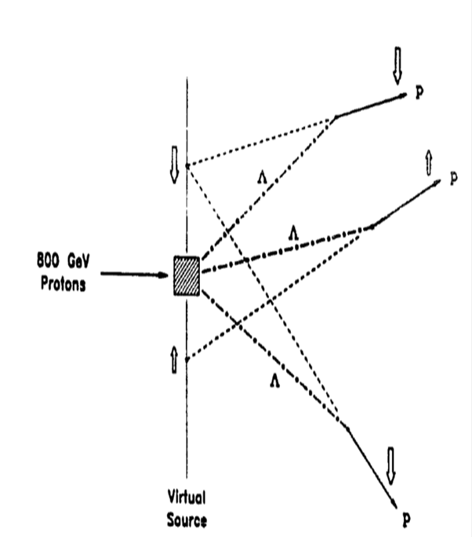
Получение поляризованного пучка от распада гиперонов
Λ - hyperon creates the longitudinally polarized proton aligned with proton momentum (in Λ rest frame)
Protons will have transverse spin component in lab. frame depending on proton emission angle. Therefore the spin states of protons are separated in space
Base for building the polarized particle tagging system (PPTS).

Slide 34
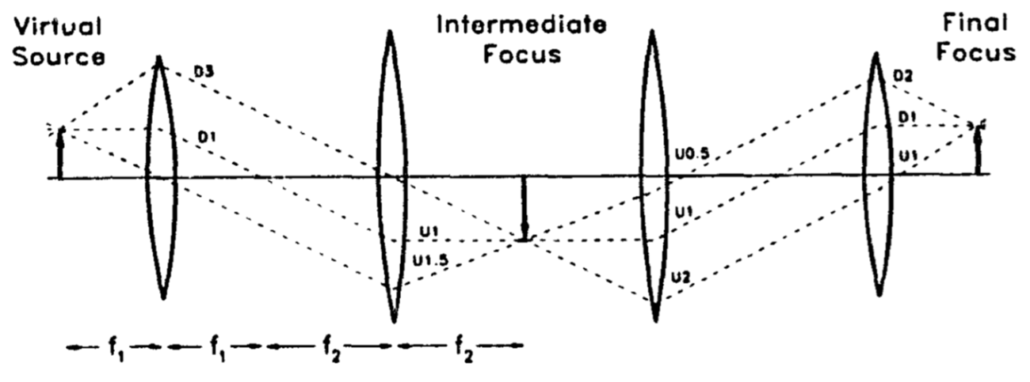
Доставка поляризованного пучка на мишень

Slide 35
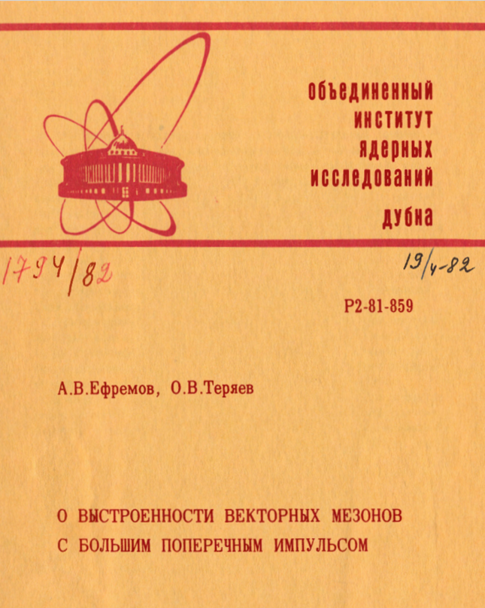
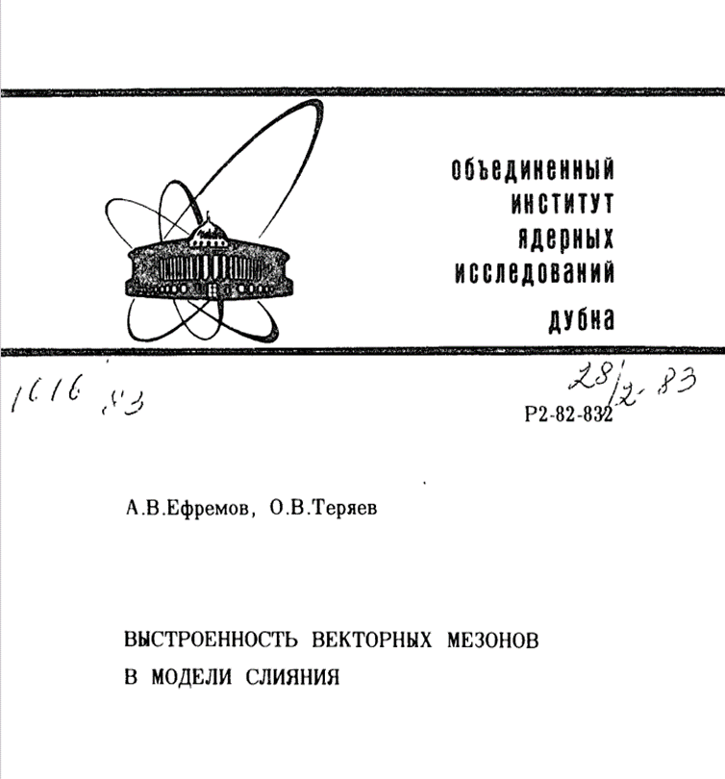
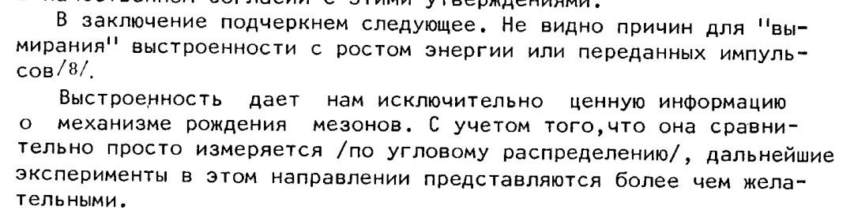
SPIN alignment

Slide 36
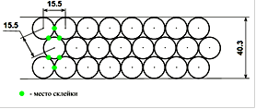
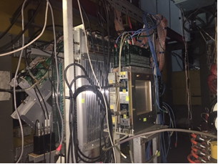
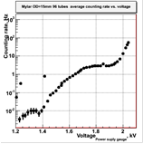
New 15 mm drift chamber
4 planes (X,Y, U,V).
Placed together with prop. chambers
Additional chamber is required for vertex reconstruction (K0, Λ)
Increase efficiency and accuracy of track reconstruction

Slide 37
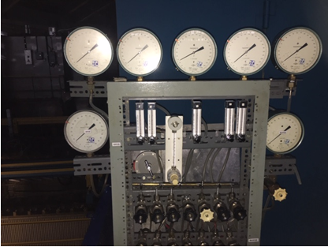
Track system
New gas system
Study of dependence of efficiency and stability on gas mixture on cosmics and beam.
It was found at least 1 (better 1.5) volume blowing through the chamber
TDC was reconfigured to decrease redout time twice

Slide 38
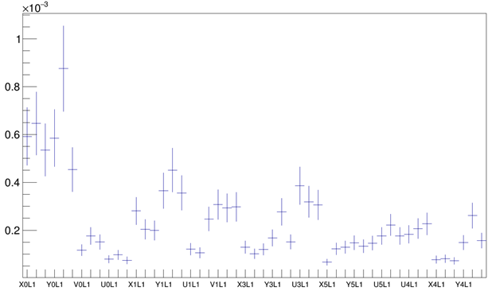
Achieved stability in 2021

Slide 39
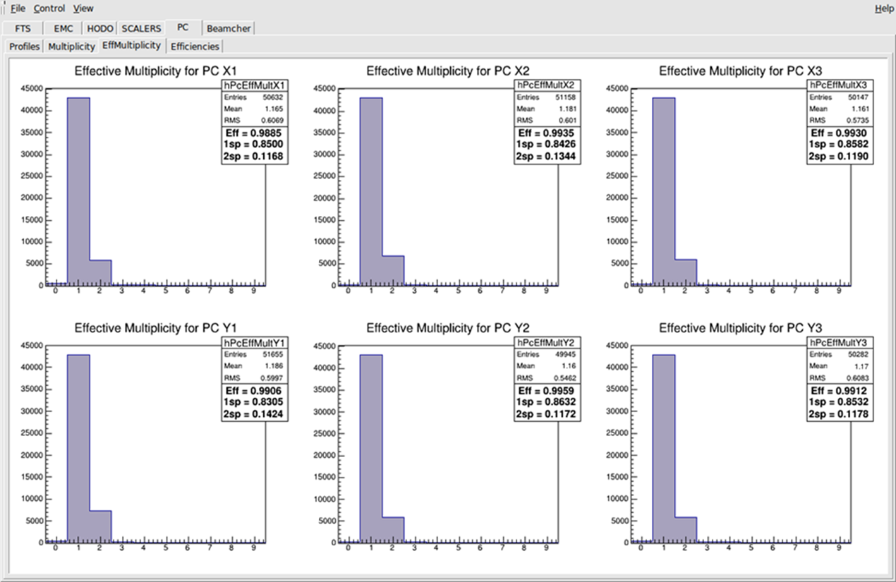
Proportional chambers efficiency

Slide 40
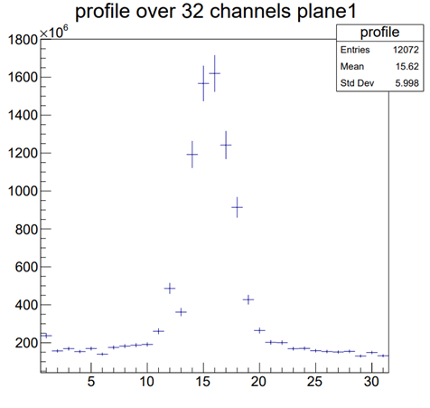
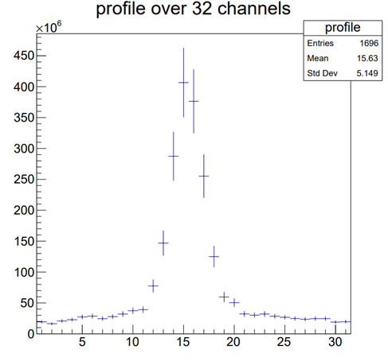
New profilometer to prove beam position

Slide 41
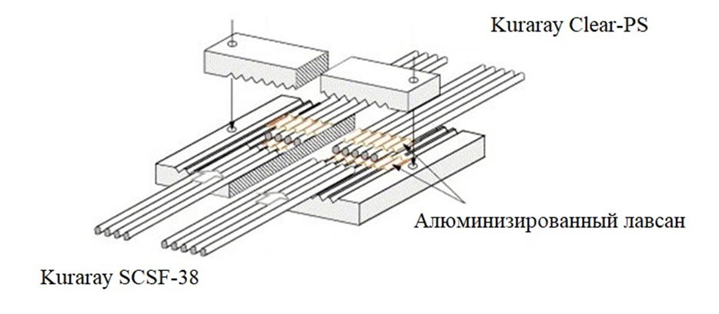
Fiber Hodoscope

Slide 42

Study of ρ0 – meson spin alignment.

