Slide 1
SPD ECAL Status Report February 2024 Oleg Gavrishuk, Laboratory of High Energy Physics, Dubna, Russia
29.02.2024
ECAL position inside of Cryostat – Sizes Fixed
ECAL New Sizes corrected in 2024 – is READY
SPD Barrel design:
TZ for LHEP & DLNP - under preparation
Matrix Form for new scintillator production (40x40x1.5 mm³) - READY
Stamp Form for Lead – proceed an Agreement preparation
Scintillate production: Vladimir, Uniplast: DLNP take participation
Technical task and Agreement – in preparation
End Cup part via 256 cells planning produce during 2024
Technical task, Agreement - in preparation
2/28/2024
Oleg Gavrishuk, JINR, Dubna , Russia
1

Slide 2
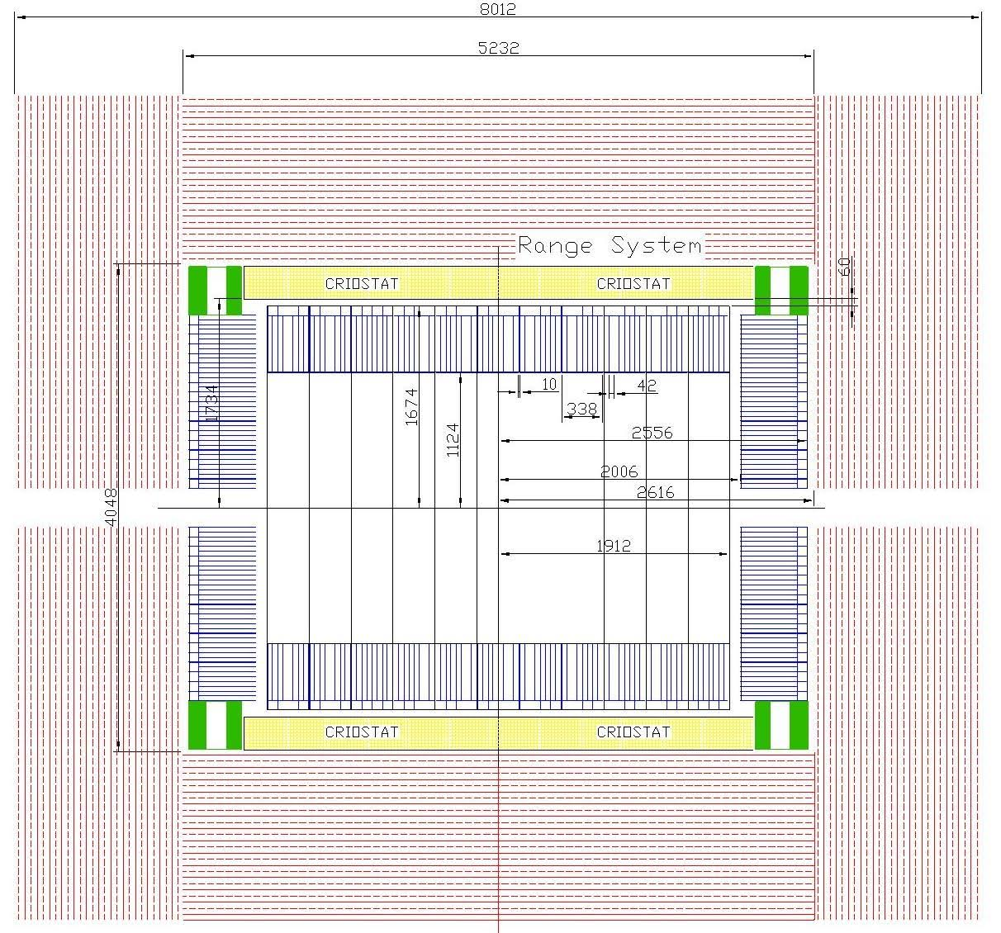
ECAL with New Sizes in 2024
2/28/2024
Oleg Gavrishuk, JINR, Dubna , Russia
2

Slide 3
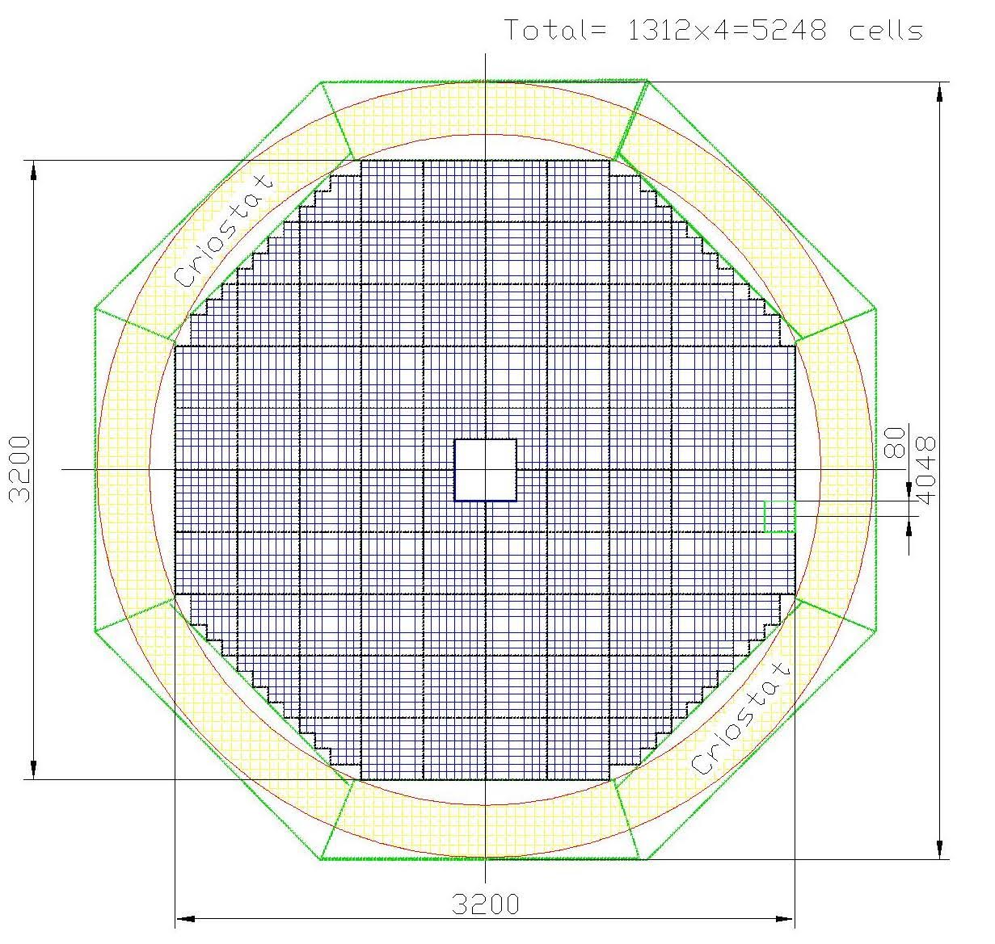
ECAL composition with New Sizes in 2024
ENDCUP:
Cells – 5136 / per EndCup
Total cells – 10272
ADC64 – 160
16ch Amplifiers – 642
Power units – 20
Total Weight – 256 tonn
2/28/2024
Oleg Gavrishuk, JINR, Dubna , Russia
3

Slide 4
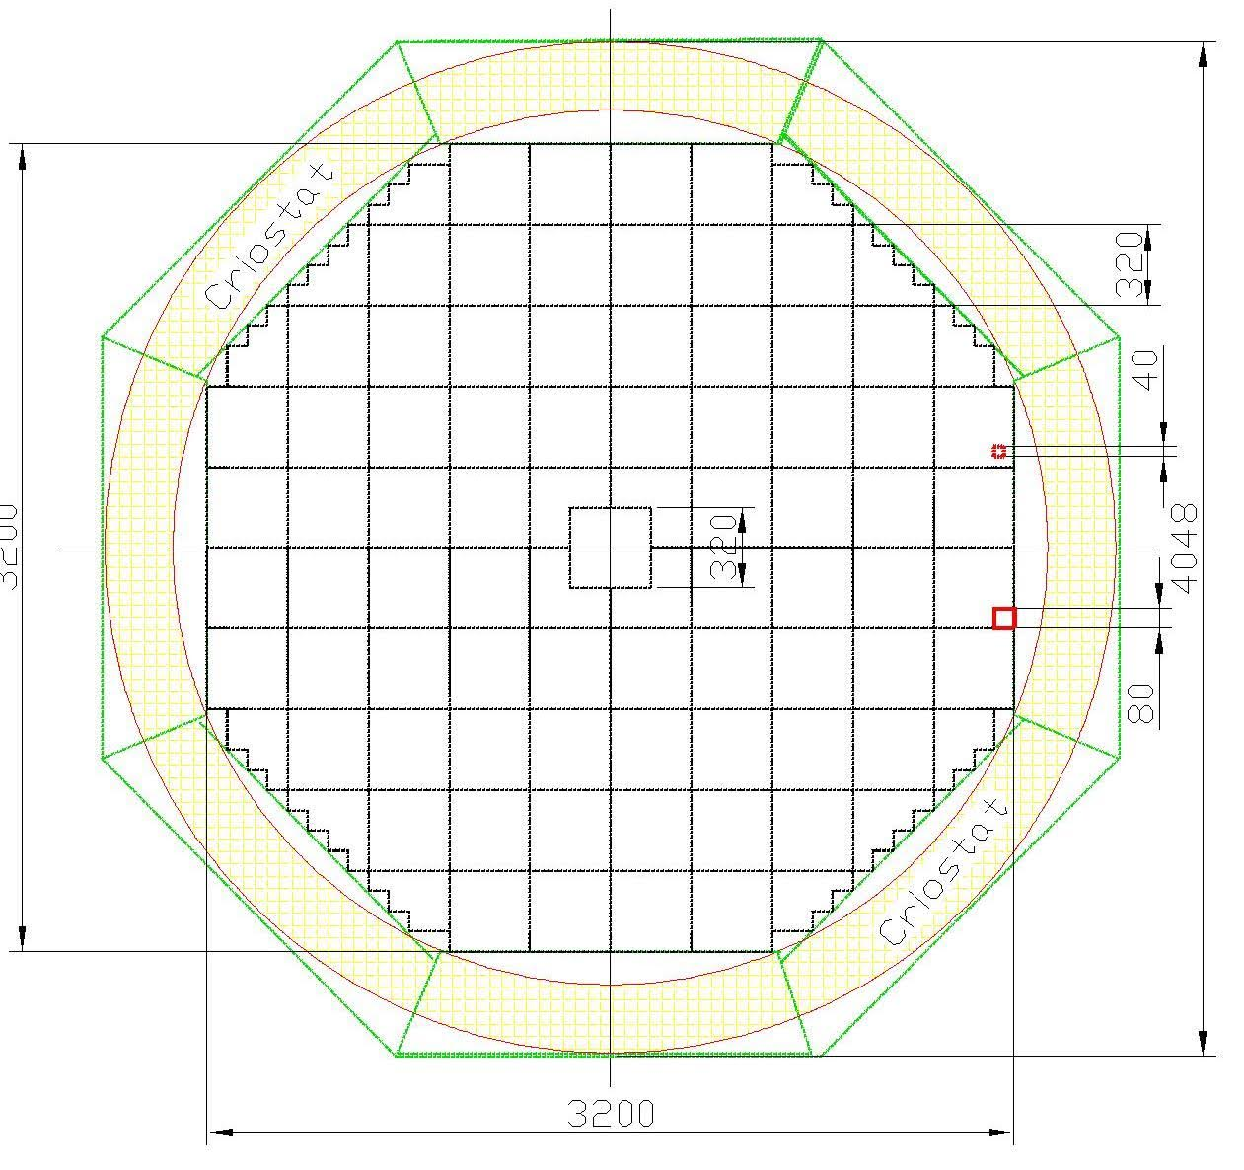

Slide 5
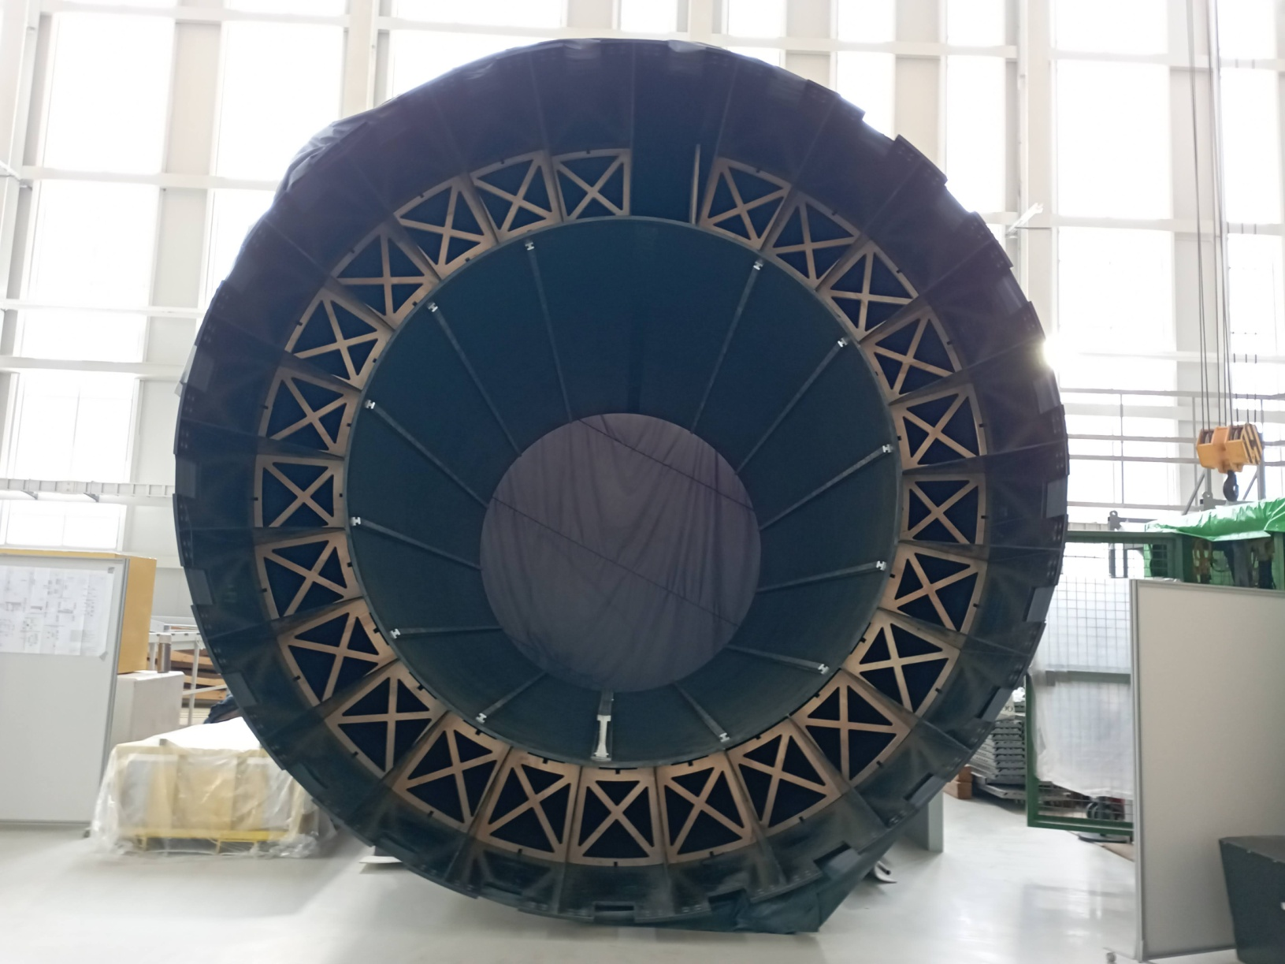

Slide 6
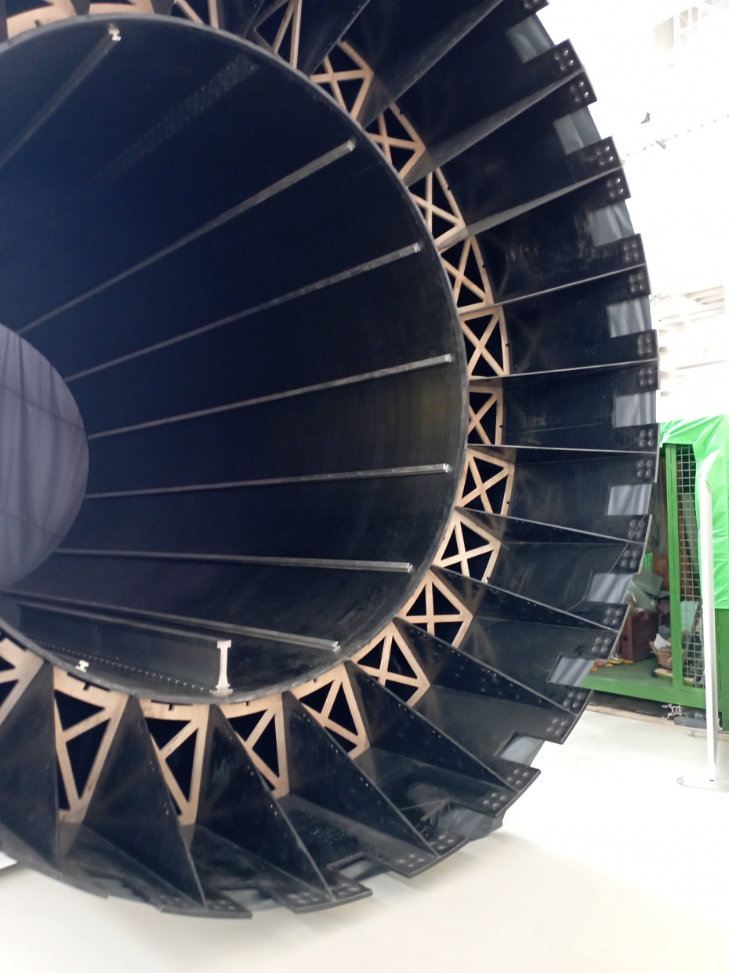
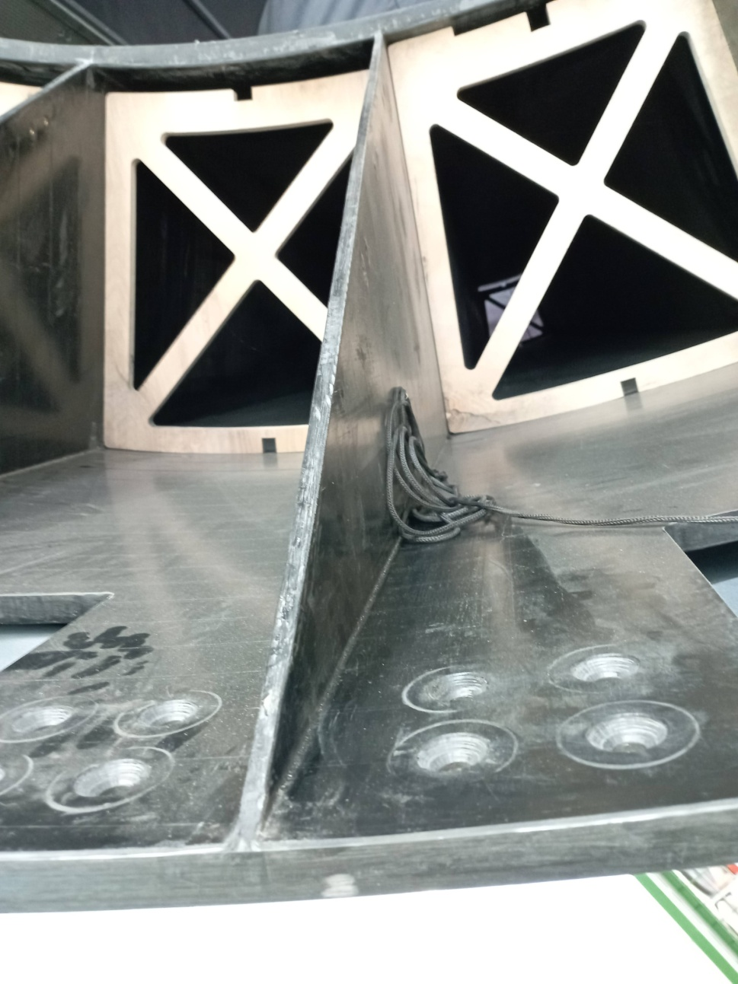

Slide 7
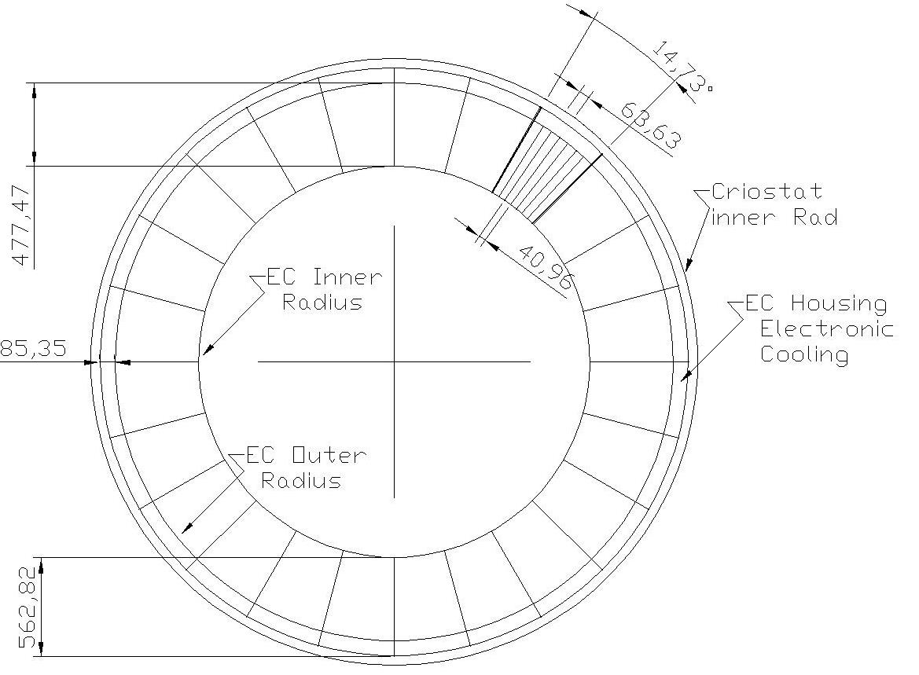

Slide 8
TZ Barrel support. Design look like MPD
MPD documents are ready in LHEP
Scaling for sizes factor ~ 1.4
Take in account ECAL SPD Barrel Weight - facrot ~2
Preferences in Design:
Documentation exist in LHEP
Experience exist during manufacturing
Production was done
Preferences in Setup:
Support for all inner detectors:
RPC planes
STRAW tubes
Independent ECAL Sectors assembling

Slide 9
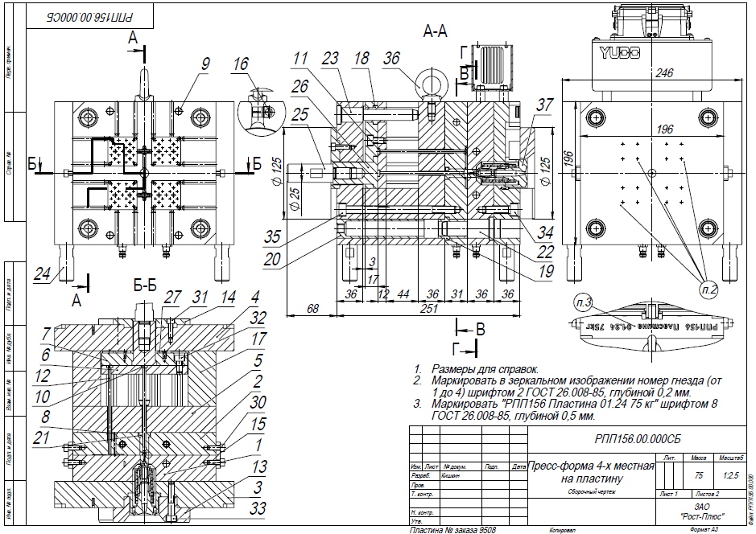
Matrix form for new scintillator production (40x40x1.5 mm³)
Matrix firm is special setup for molding by pressure technology
It allow produce scintillator from granulated polystyrene with doppands
4 set form produce 4 scintillator plate per 1 minute

Slide 10
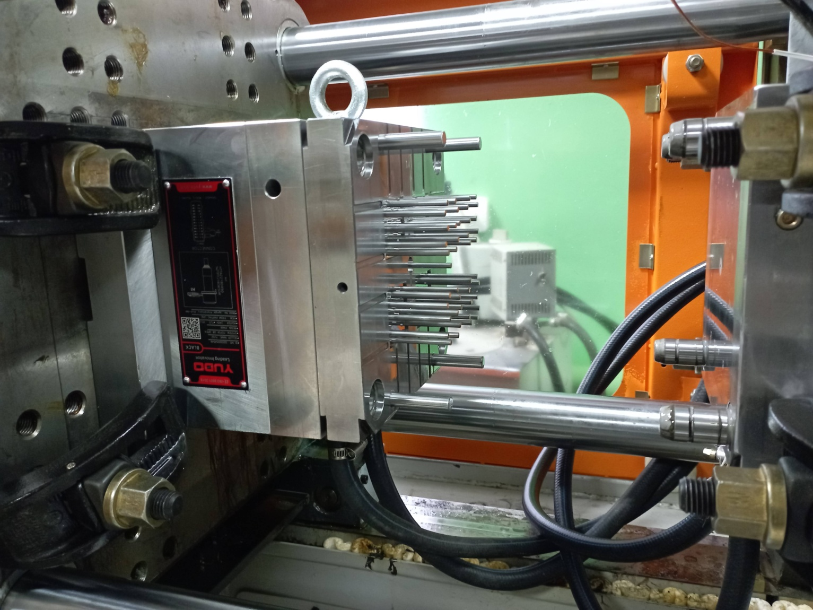
Matrix form for new scintillator production (40x40x1.5 mm³)
Matrix firm is ready and tested in Uniplast, Vladimir in February 2024

Slide 11
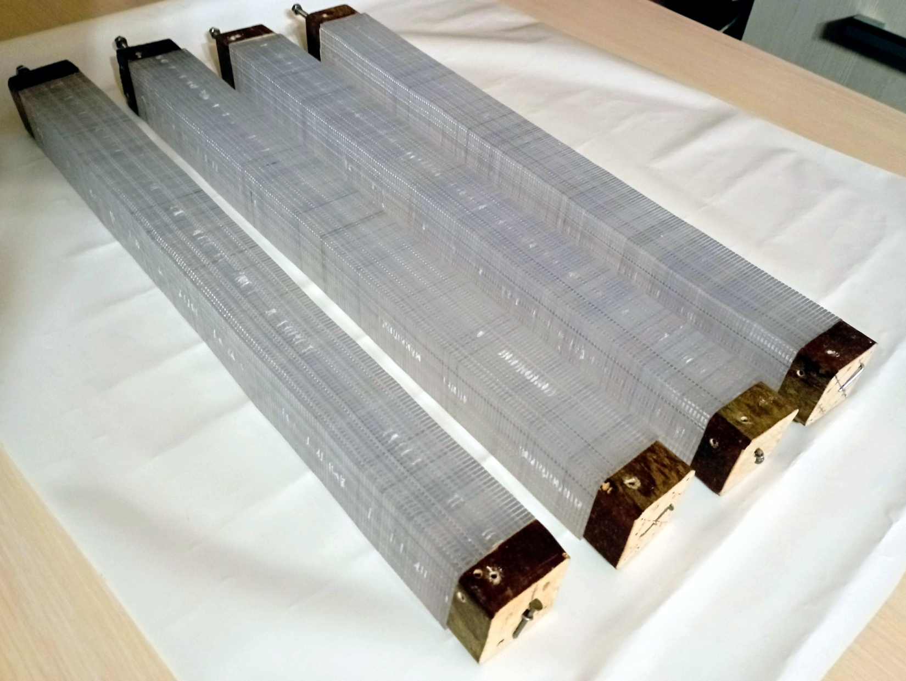

Slide 12
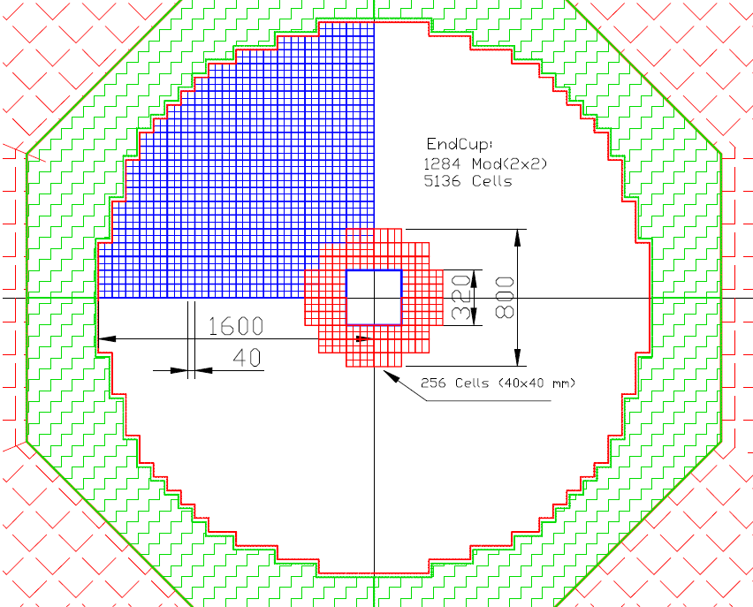
End Cup for SPD with new scintillator to be produced in 2024 via 256 cells of 40x40 mm²
This Figure shows in red 64 modules, consisting of 4 cells each (256 cells). The weight of this assembly is 597 kg. This will require 130 kg of polystyrene, 465 kg of lead, as well as additives: 1.95 kg of P-terphenyl and 65 g. POPOP, and 2000 meters WLS fiber type Y-11.
It is 1/20 part of End Cup and
taken time of 36 Days to prepared 51200 Stint. plates.
To read this setup, we need four ADC64 - 64-channel amplitude encoders, as well as 16 boards of 16-channel amplifiers and bias voltage regulators.

Slide 13
Time table for ECAL production
1 | 2 | 3 | 4 | 5 | 6
Items | Num. | Scint. | Lead | Assemb. | Year
Barrel | 16896 | 2347 | 2347 | 2347 | 10,2
End Cup-2 | 5136 | 1427 | 1427 | 1427 | 6,2
End Cup-2 | 5136 | 1427 | 1427 | 1427 | 6,2

Slide 14
Conclusions
New ECAL geometry - corrected in 2024
Technical task for LHEP – preparation in progress
SiPm EQR 20-60 (20 mk pich) were studied soon
New ECAL setup with cell size 4x4 cm² assembled – 16 cells (4 modules)
ECAL test in cosmic rays was done with SiPm EQR15
Matrix form for new scintillator production should was ready in February 2924
New scintillator production for End Cup part - start soon: March 2024
Lead plates production – start in 2024 July
256 ECAL cells for End Cup (1/20 part) – should assembled in end of 2024
2/28/2024
Oleg Gavrishuk, JINR, Dubna , Russia
14

Slide 15
End of Report
Thanks for attention to All
2/28/2024
Oleg Gavrishuk, JINR, Dubna , Russia
15

