Slide 1
PWG3 Summary:
Anisotropic collective flow and development of the corresponding measurement techniques for the MPD experiment
Arkadiy Taranenko^{1,2}
¹National Research Nuclear University MEPhI, Moscow
²VBLHEP JINR, Dubna
XIII MPD Collaboration Meeting, Dubna, Russia, 23-25 April 2024

Slide 2
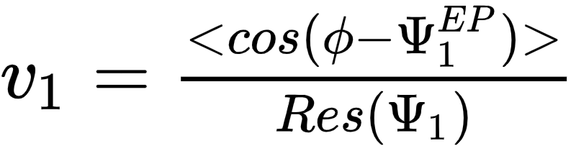
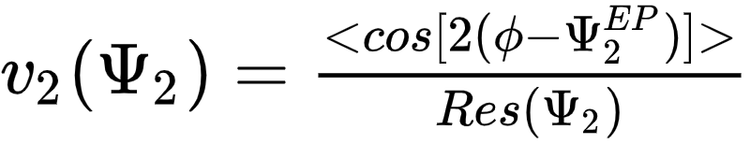
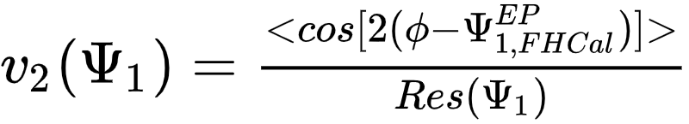
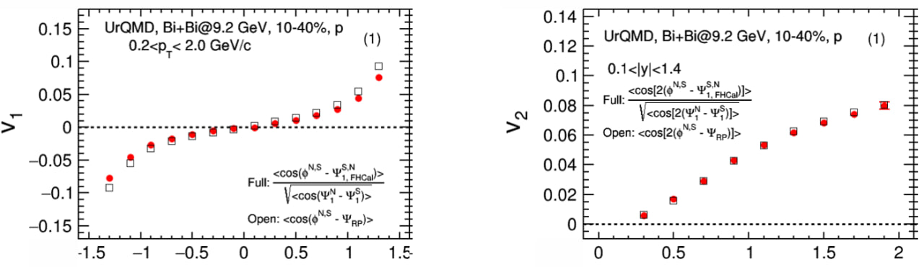


evFlowEP wagon for flow measurements in MPD
Wagon #1
Wagon #2
Wagon #3
AnalysisManager
evCentrality
evPlane
evFlowEP
Results
Get event plane angles from FHCal/TPC
MpdAnalysisEvent event
event.getCentrTPC()
Directed flow:
Elliptic flow:
FHCal F
FHCal N
TPC N
TPC S
FHCal S
$$η$$
$η$-gap
See details in A.Demanov’s talk on Cross-PWG 05.03.2024

Slide 3
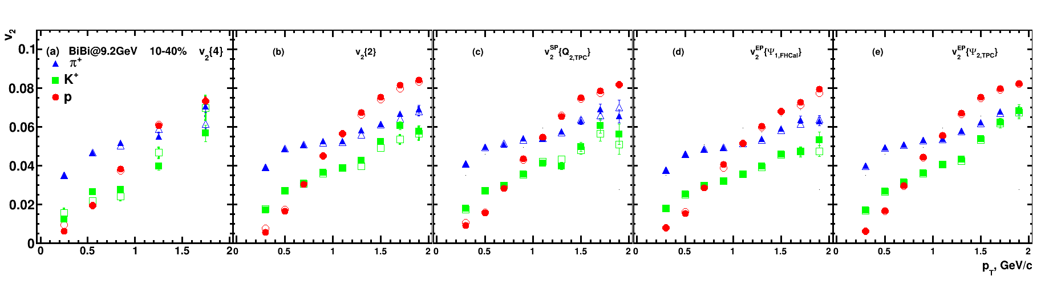

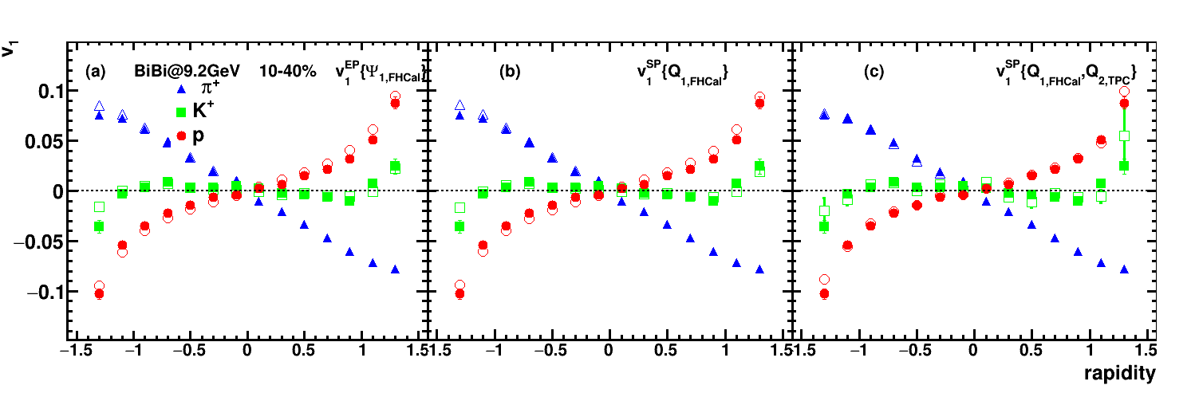
Performance of v_{1,2} of identified hadrons in MPD
Good performance for v₁, v₂ using several methods for flow measurements
(EP, SP, Q-Cumulants)
Good performance for flow measurements for all methods used (EP, SP, Q-cumulants)

Slide 4
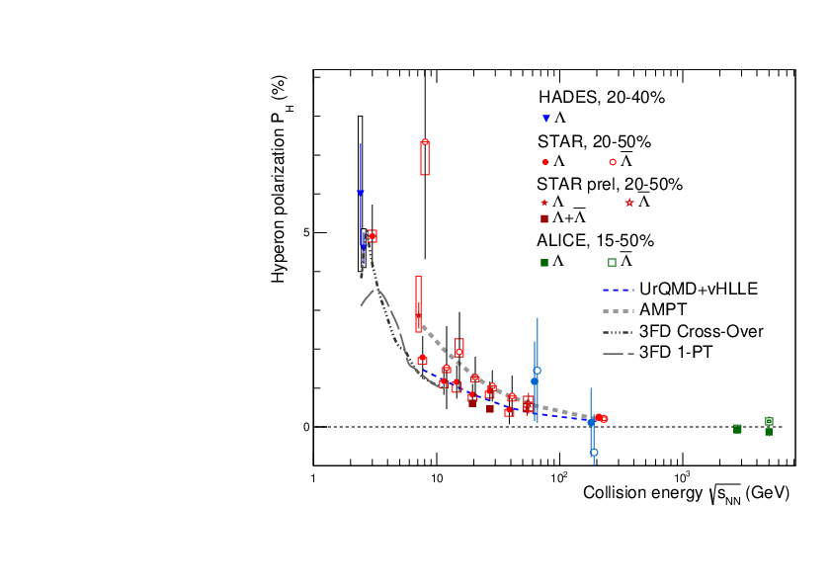
Global Polarization at Nuclotron-NICA energies
Predicted and observed global polarization signals rise as the collision energy is reduced:
NICA energy range will provide new insight
- splitting of global polarization
Comparison of models, detailed study of energy and kinematical dependences, improving precision
Probing the vortical structure using various observables
9.2 GeV
MPD
FXT-MPD
S. Singha, EPJ Web Conf. 276 (2023) 06012
J. Adam et al. (STAR Collaboration), Phys. Rev. C 98, 014910 (2018)
O. Teryaev and R. Usubov, Phys. Rev. C 92, 014906 (2015)

Slide 5
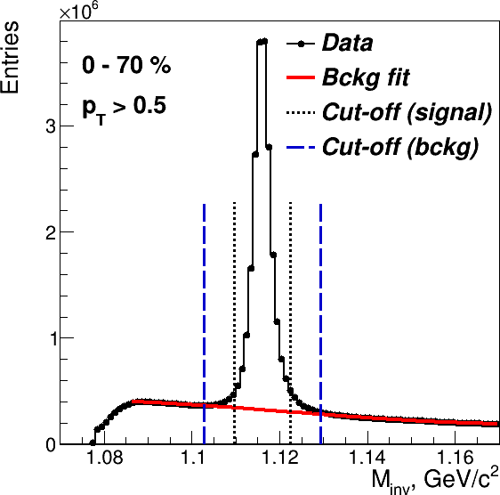
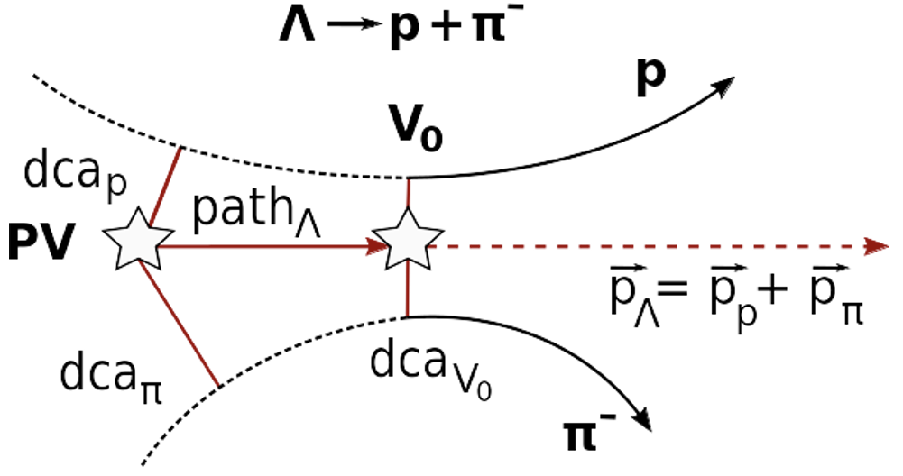
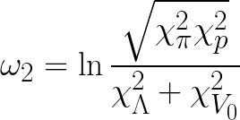
Λ selection: MpdRoot
Fitting procedure (sideband method):
Global fit (Gauss + Legendre polynomials)
Background fit in sidebands (± 7σ)
Signal Cut-off: <M>± 3σ
Λ selection criteria:
  «ω»-selection (1 parameter)
  «χ»-selection (5 parameters)

Slide 6
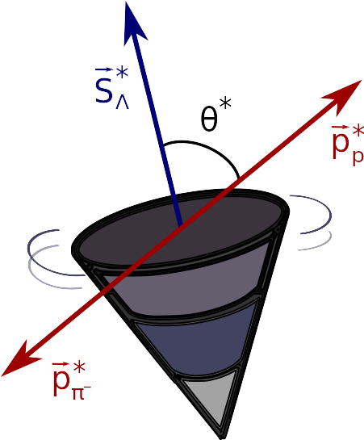
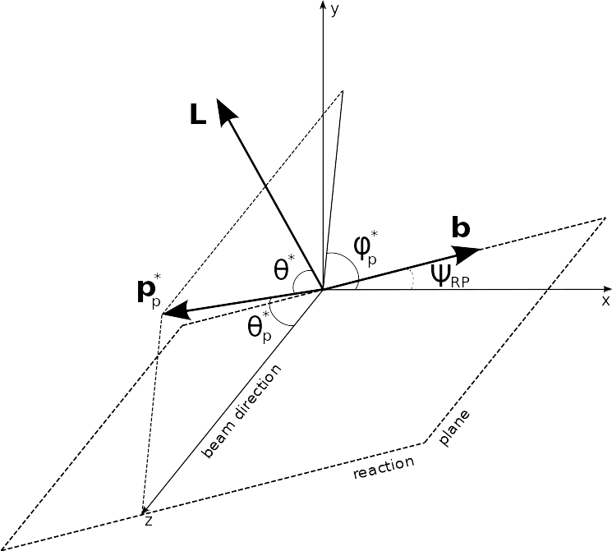
Global hyperon polarization
w.r.t. reaction plane (RP)
Emerges in HIC due to the system angular momentum
Measured through the weak decay:
P
* — denotes hyperon rest frame
θ* — angle between the decay particle(proton) and polarization direction
hyperon decay constant

Slide 7
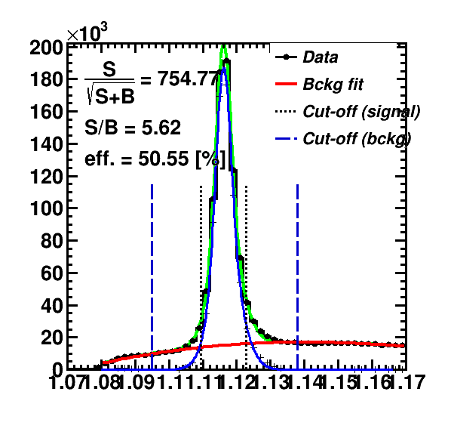
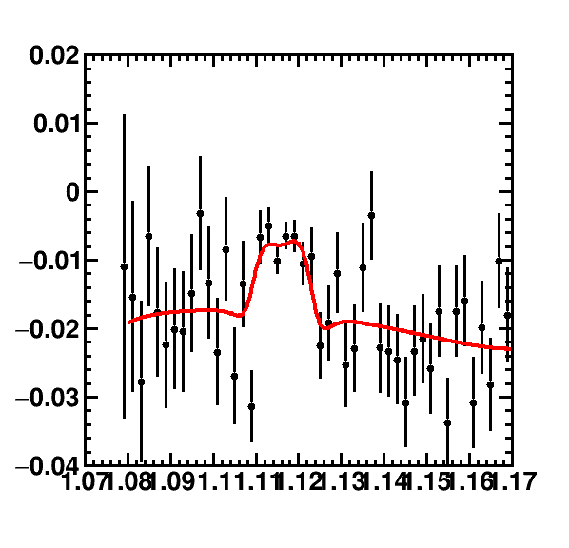
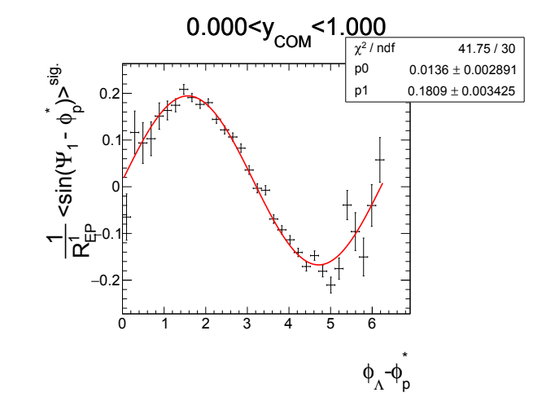
P_{H} measurements: inv. mass fit method
Use invariant mass distribution
Calculate Sig/All, Bg/All ratios
Fit <sin(𝚿_{EP} - φ_{p}*)> as a function of inv. mass:
Use P^{S}(p_{T}) = <sin(𝚿_{RP} - φ_{p}*)>^{sig} to find P_{H}^{true} using fit:
Last fit corrects effects of directed flow and acceptance contributions to P_{H}

Slide 8
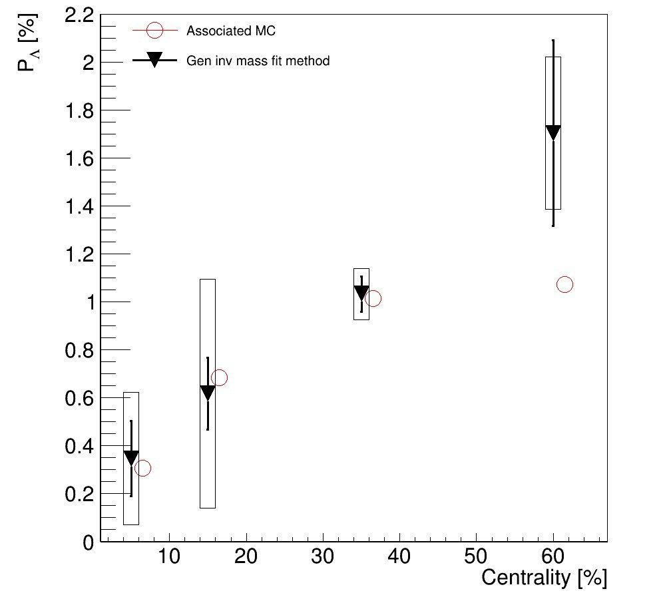
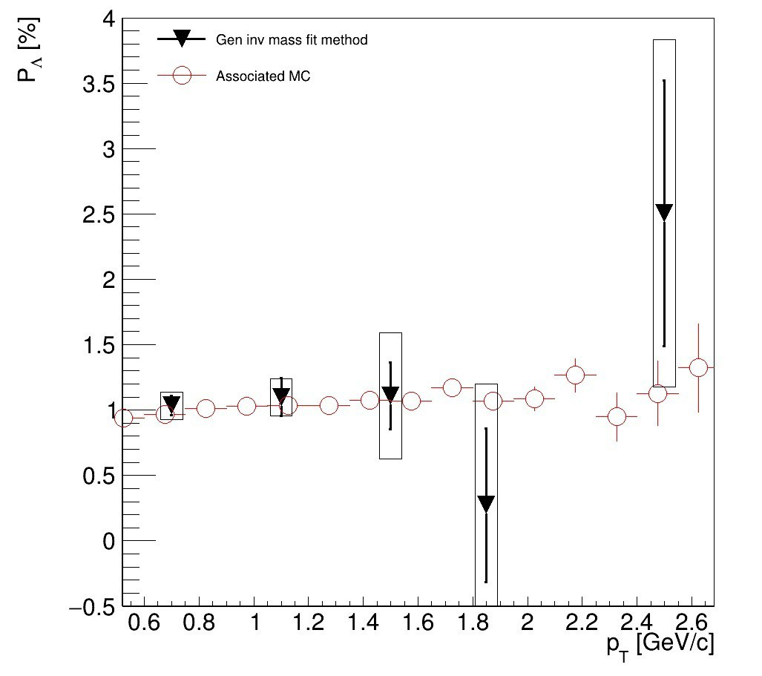
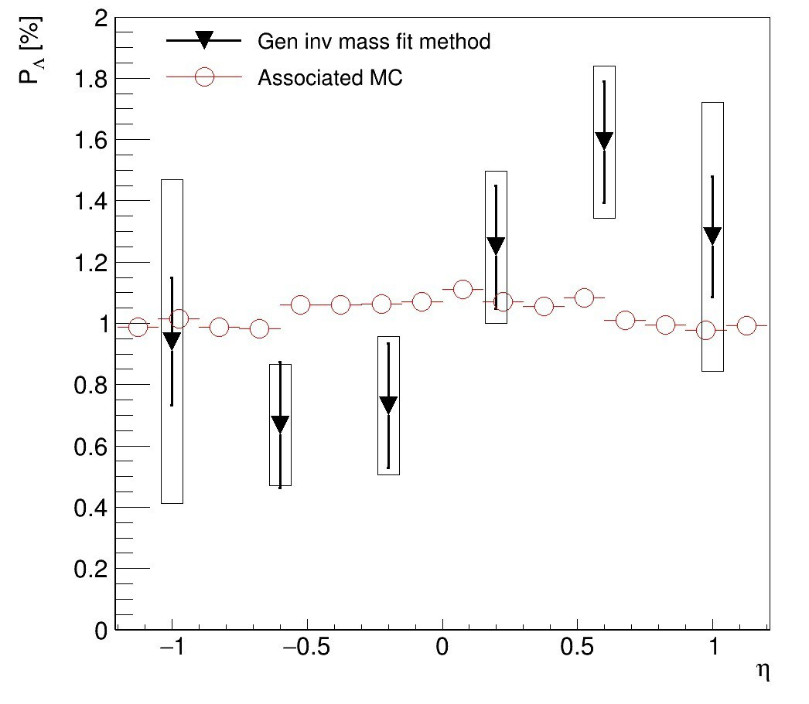
Centrality dependence of P_{Λ}
p_{T}>0.5 GeV/c
|𝛈|<1.5
|𝛈|<1.5
p_{T}>0.5 GeV/c
Good agreement with Associated MC
More statistics needed for differential (pT,𝛈) measurements

Slide 9
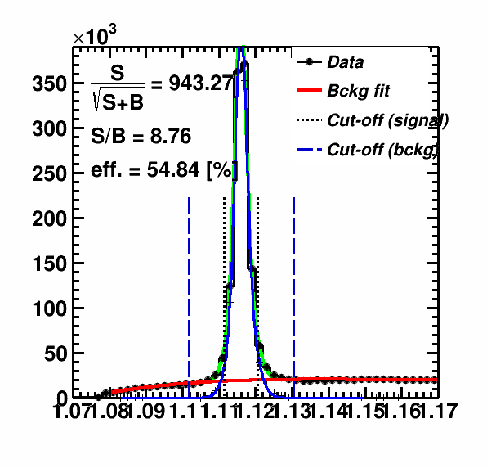
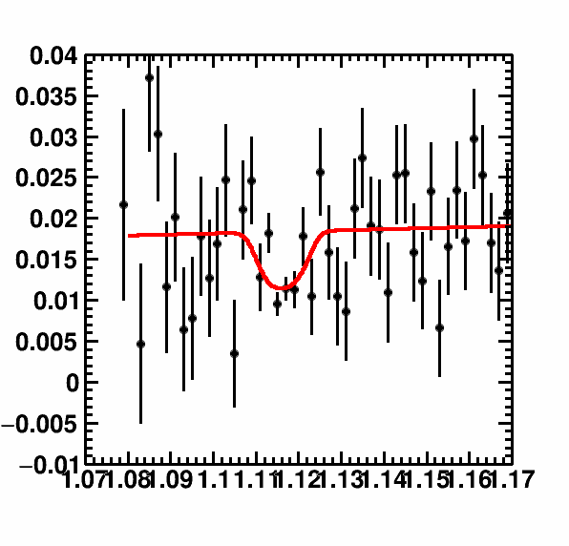
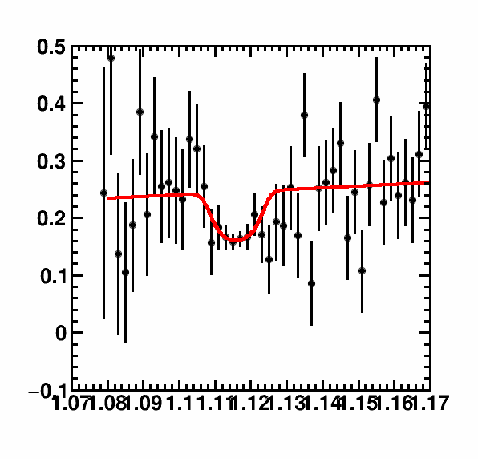
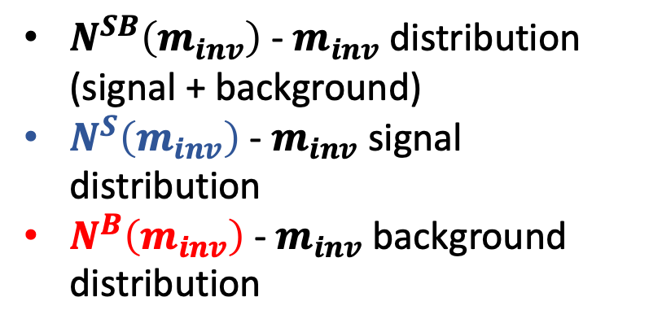
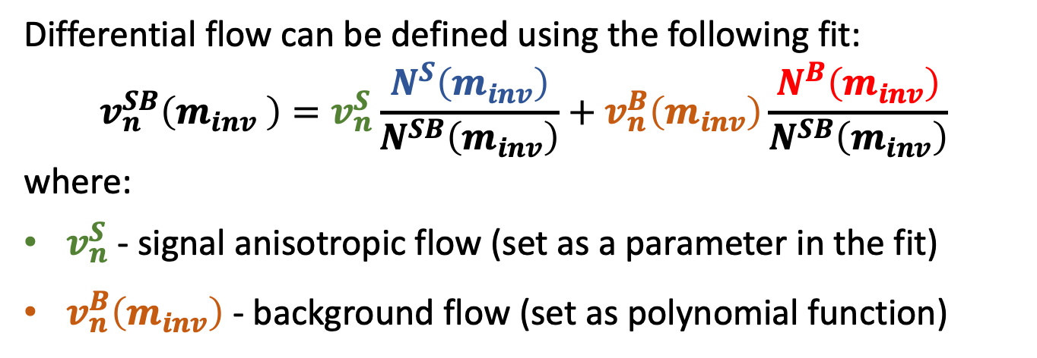
Anisotropic flow of V0 particles
Differential flow can be defined using the following fit:
$$v_{n}^{SB}\left(m_{inv} \right)=v_{n}^{S}\frac{N^{S}\left(m_{inv}\right)}{N^{SB}\left(m_{inv}\right)}+v_{n}^{B}\left(m_{inv}\right)\frac{N^{B}\left(m_{inv}\right)}{N^{SB}\left(m_{inv}\right)}$$
where:
$v_{n}^{S}$ - signal anisotropic flow (set as a parameter in the fit)
$v_{n}^{B}\left(m_{inv}\right)$ - background flow (set as polynomial function)
m_{p𝛑}
v₁
v₂
$N^{SB}\left(m_{inv}\right)$ - $m_{inv}$ distribution (signal + background)
$N^{S}\left(m_{inv}\right)$ - $m_{inv}$ signal distribution
$N^{B}\left(m_{inv}\right)$ - $m_{inv}$ background distribution
v₂
m_{p𝛑}
m_{p𝛑}

Slide 10
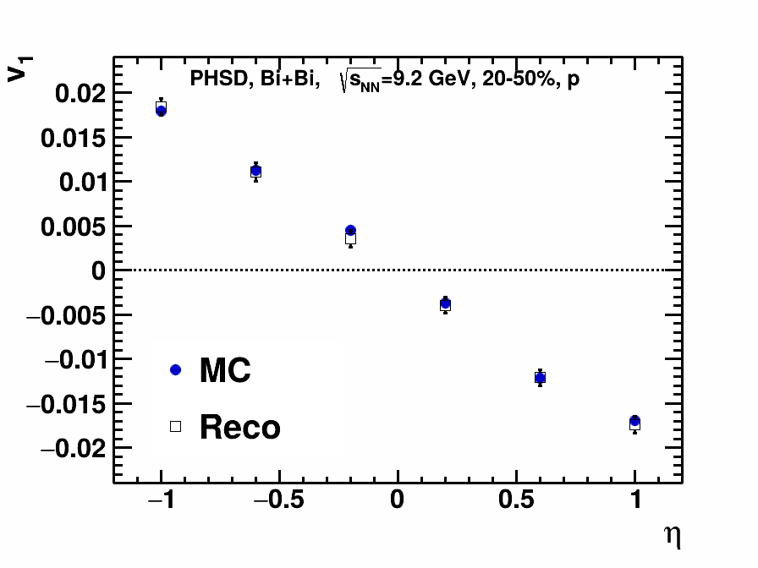
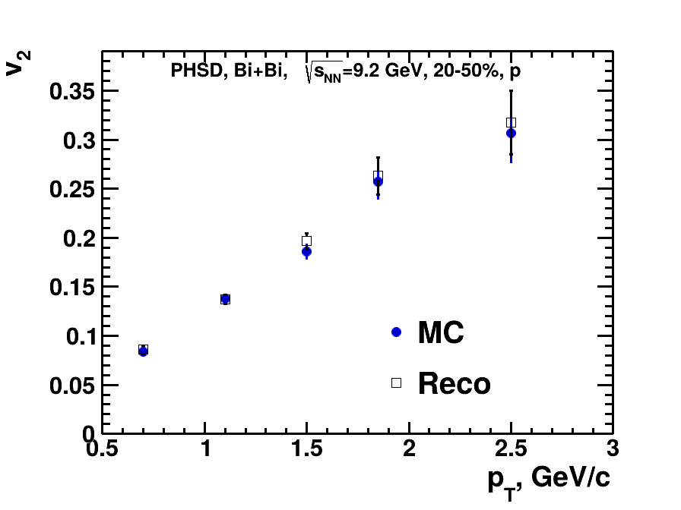
Performance of v_{1,2} of 𝚲 hyperons in MPD
V. Troshin
Good performance for v₁, v₂ using invariant mass fit and event plane methods

Slide 11
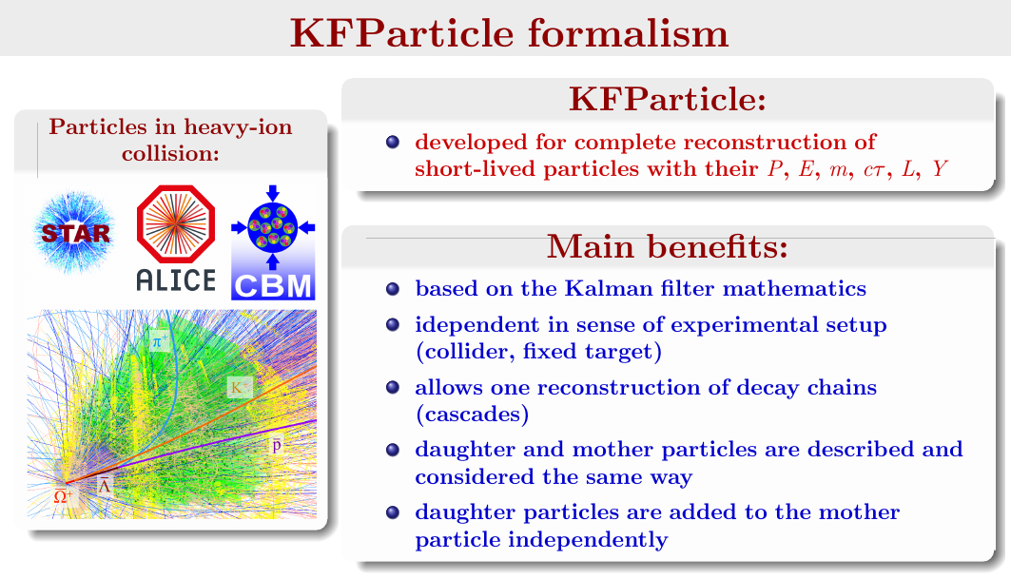
t = 0 fm
t = 2.5 fm
t = 5 fm
11

Slide 12
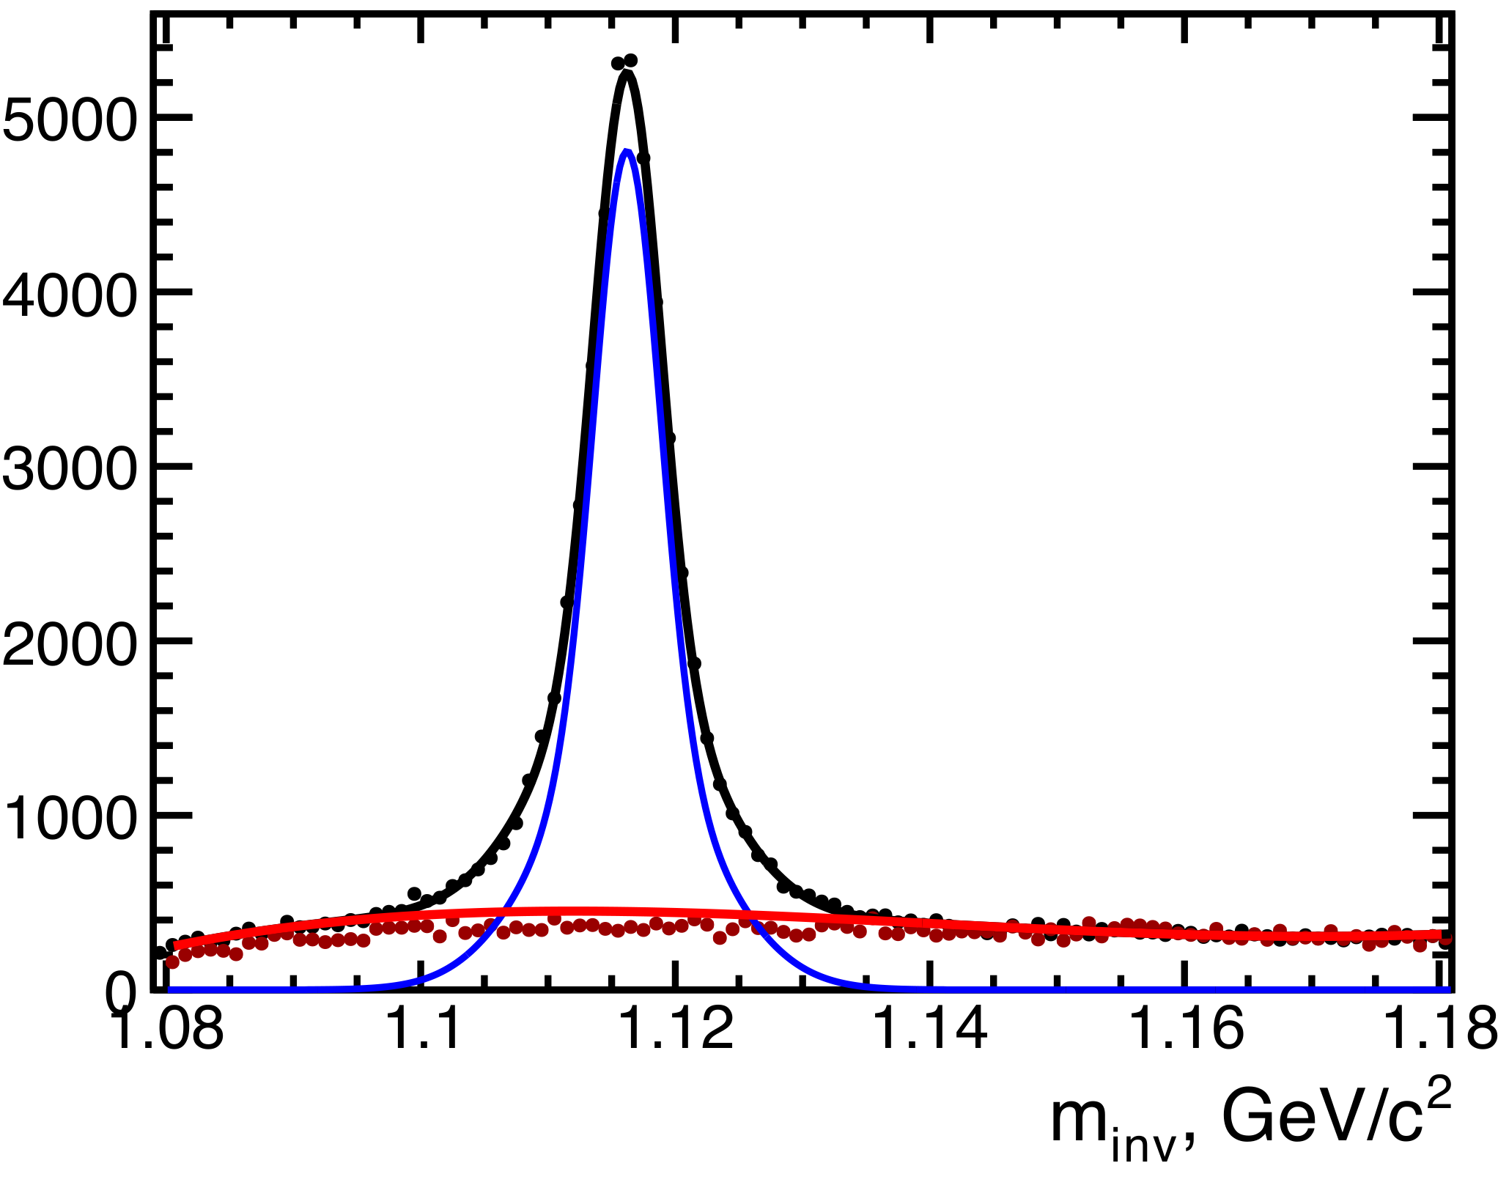
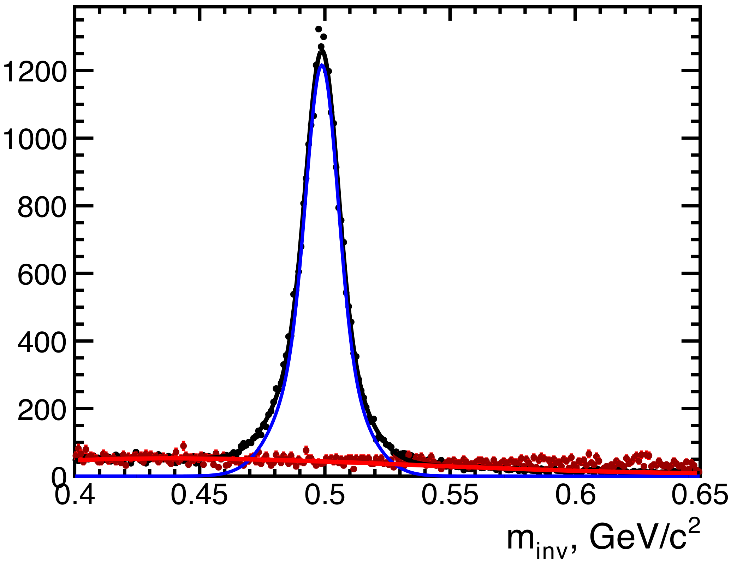
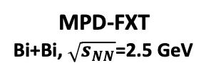

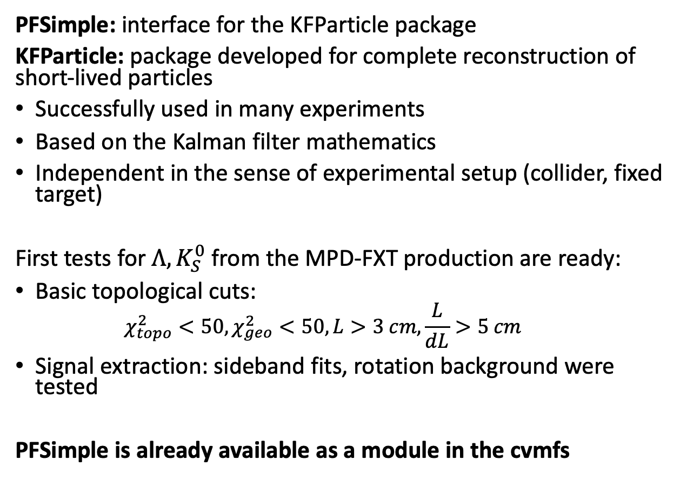
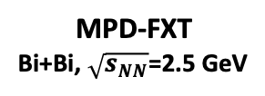

V0 selection: PFSimple
MPD-FXT
Bi+Bi, $\sqrt{s_{NN}}$=2.5 GeV
PFSimple: interface for the KFParticle package
KFParticle: package developed for complete reconstruction of short-lived particles
Successfully used in many experiments
Based on the Kalman filter mathematics
Independent in the sense of experimental setup (collider, fixed target)
First tests for $Λ, K_{S}^{0}$ from the MPD-FXT production are ready:
Basic topological cuts:
  $$χ_{topo}^{2}<50,χ_{geo}^{2}<50, L>3 cm,\frac{L}{dL}>5 cm$$
Signal extraction: sideband fits, rotation background were tested
PFSimple is already available as a module in the cvmfs
$$Λ→p+π^{−}$$
motherId cut applied
MPD-FXT
Bi+Bi, $\sqrt{s_{NN}}$=2.5 GeV
$$K_{S}^{0}→π^{+}+π^{−}$$
motherId cut applied

Slide 13
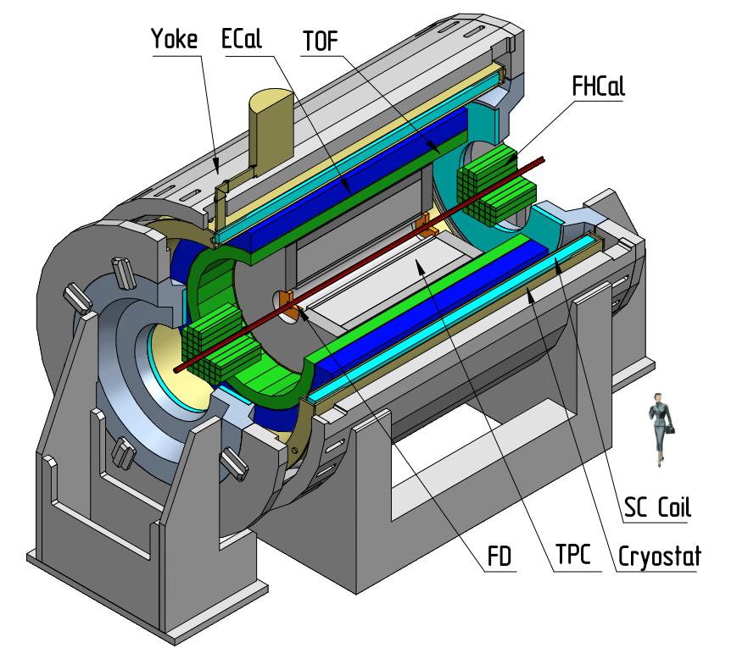
MPD in Fixed-Target Mode (MPD-FXT)
Model used: UrQMD mean-field
  Bi+Bi, E_{kin}=1.45 AGeV (√s_{NN} =2.5 GeV)
  Bi+Bi, E_{kin}=2.92 AGeV (√s_{NN} =3.0 GeV)
  Bi+Bi, E_{kin}=4.65 AGeV (√s_{NN}=3.5 GeV)
Point-like target
GEANT4 transport
Multiplicity-based centrality determination
Particle species selection via dE/dx (TPC) and m² (TOF+TPC)
Primary track selection: |DCA|<1 cm
Track quality selection:
  N_{hits}>27 (proton), N_{hits}>22 (pion)
Beam
Target (z=-115 cm)

Slide 14
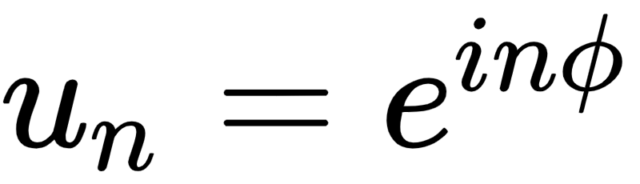
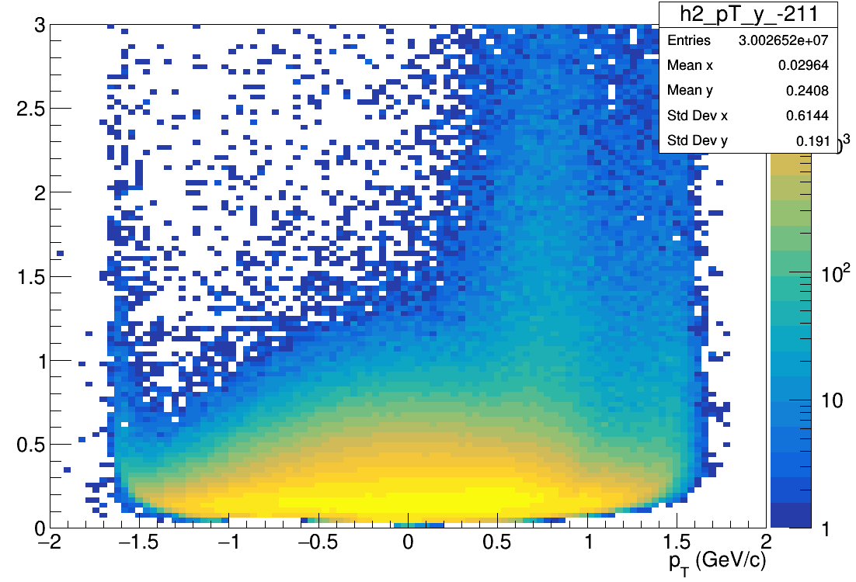
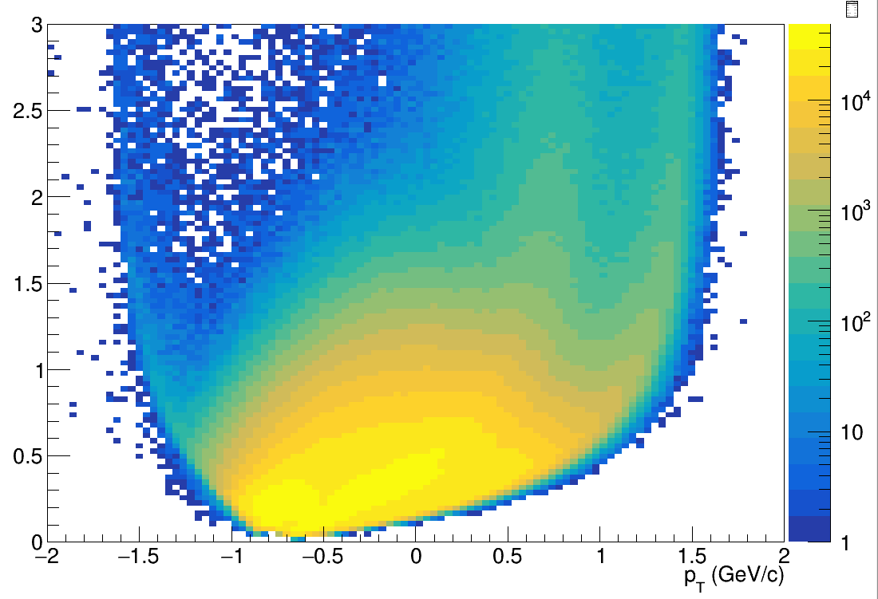
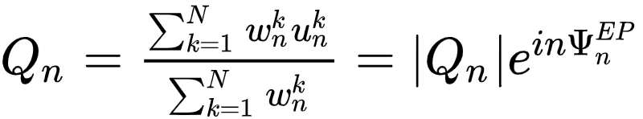
Flow vectors
F3
Q{F2}
F2
Modules of FHCal divided into 3 groups
F1
From momentum of each measured particle
define a u_{n}-vector in transverse plane:
Q{F1}
Q{F3}
π-
p
where φ is the azimuthal angle
Sum over a group of u_{n}-vectors in
one event forms Q_{n}-vector:
Additional subevents from tracks not pointing at FHCal:
Tp: p; -1.0<y<-0.6;
Tπ: π-; -1.5<y<-0.2;
Ψ_{n}^{EP} is the event plane angle
Notes:
Let’s introduce flow vectors. Every particle in event represent as un vector in transverse plane, where phi is azimuthal angle of particle’s momentum. Summation over this un-vectors results with Qn vector, which is directed to symmetry plane of the event. This plane is called Event plane, and the transverse angle of this plane is called event plane angle relatively.

Slide 15
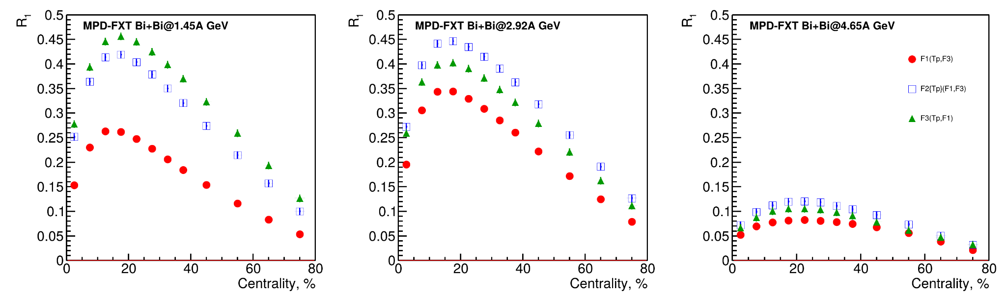
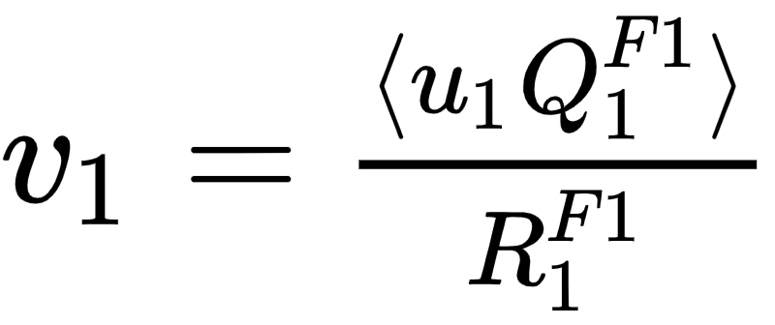
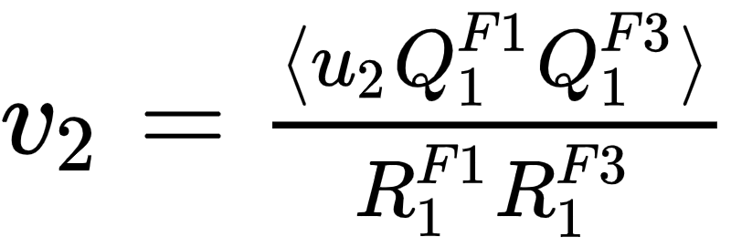

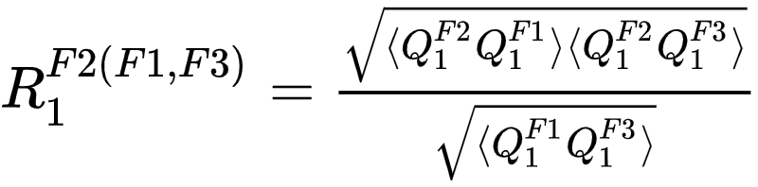
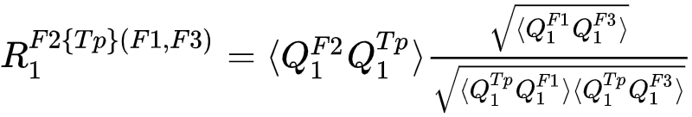
Flow methods for v_{n} calculation
Tested in HADES:
M Mamaev et al 2020 PPNuclei 53, 277–281
M Mamaev et al 2020 J. Phys.: Conf. Ser. 1690 012122
Scalar product (SP) method:
Where R₁ is the resolution correction factor
Symbol “F2(F1,F3)” means R₁ calculated via (3S resolution):
Symbol “F2{Tp}(F1,F3)” means R₁ calculated via (4S resolution):
Notes:
In this work two methods of flow calculation are used: Event plane for cross-checks and scalar product for the analysis. In the first method, one estimates event plane angle and measures mean cosine of particles azimuthal angle. Then, resolution of event plane estimation is applied. Resolution is calculated with random sub event method.
In the scalar product the correlation between flow vectors are calculated and then, the resolution correction is applied estimated with 3-sub event method.

Slide 16
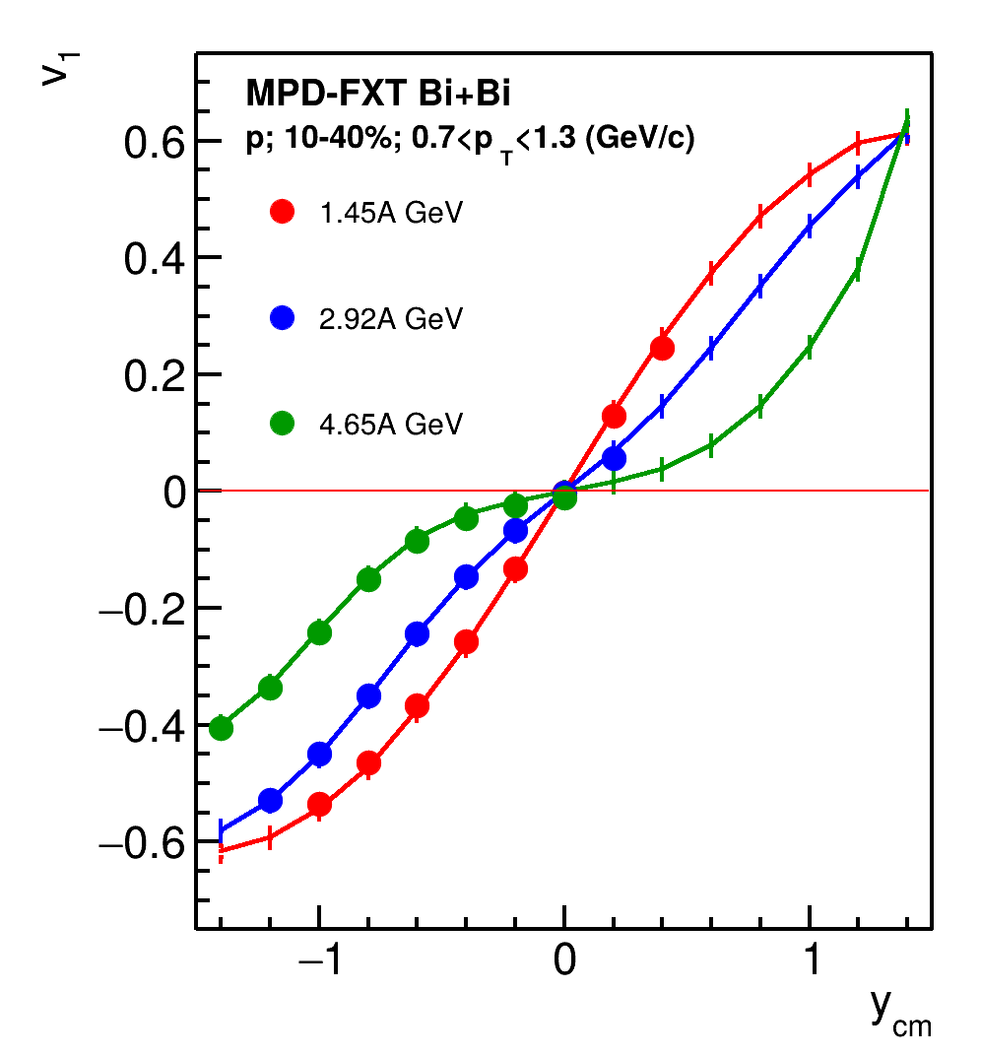
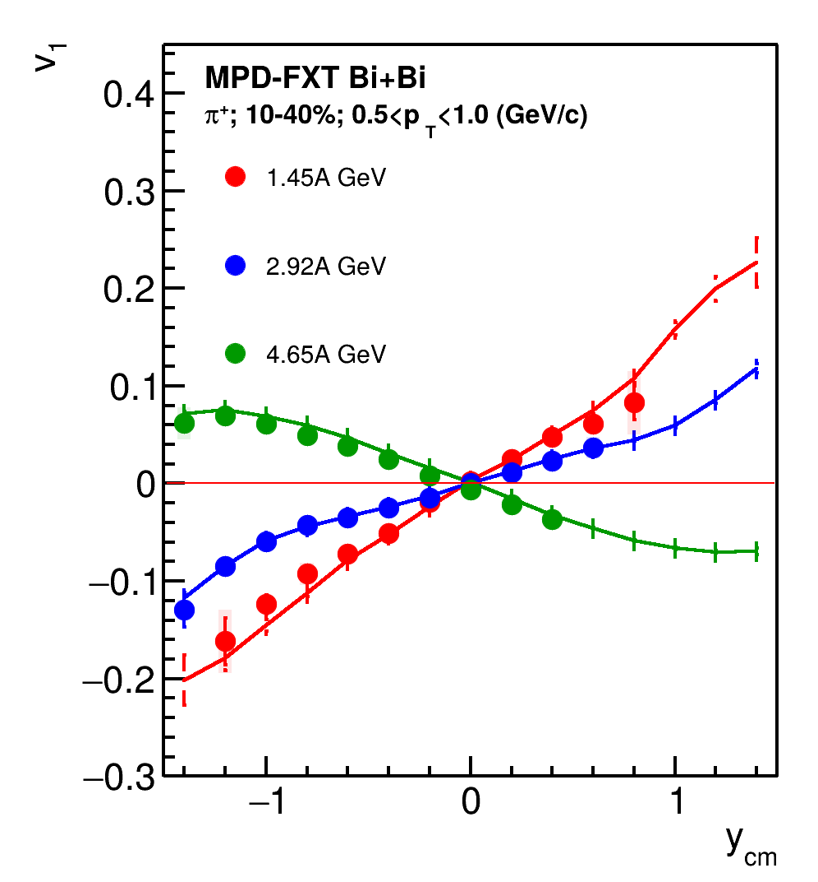
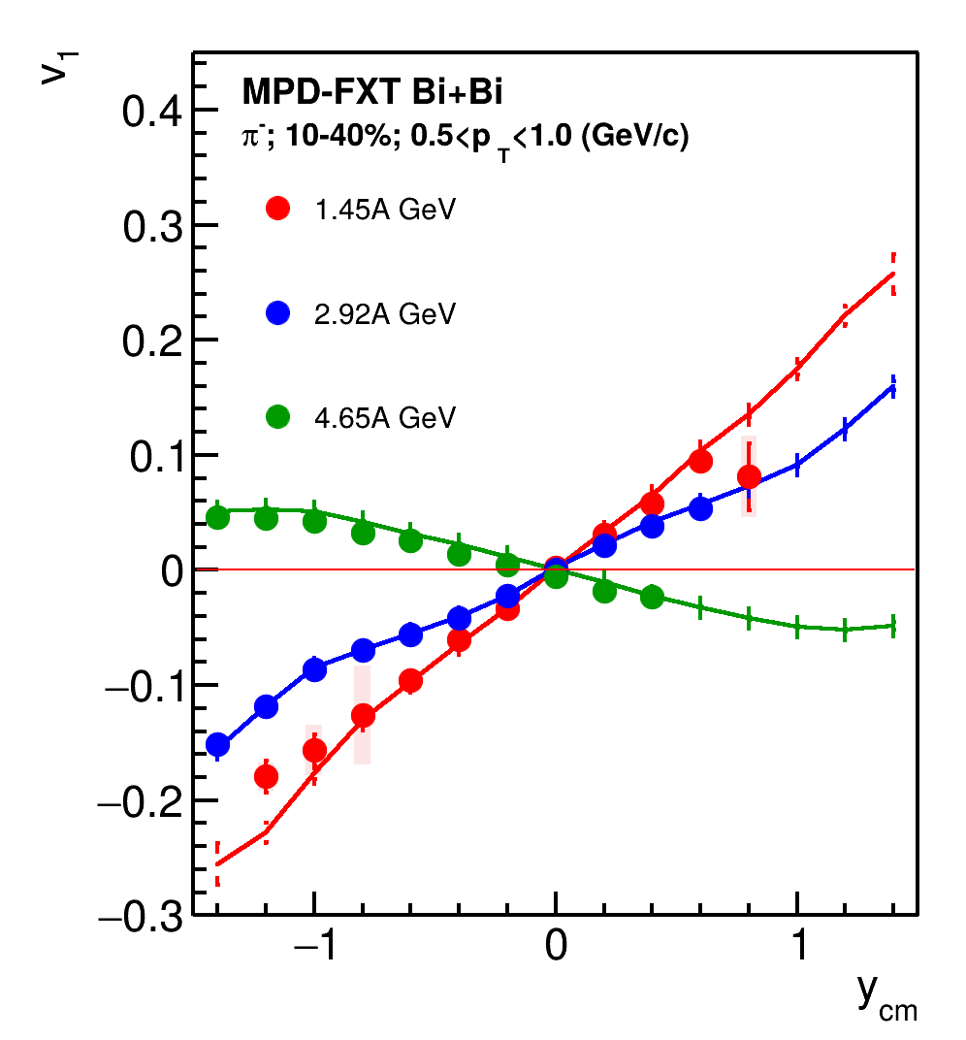
Results: v₁(y)
p
𝝿⁺
𝝿⁻
Good agreement with MC data

Slide 17
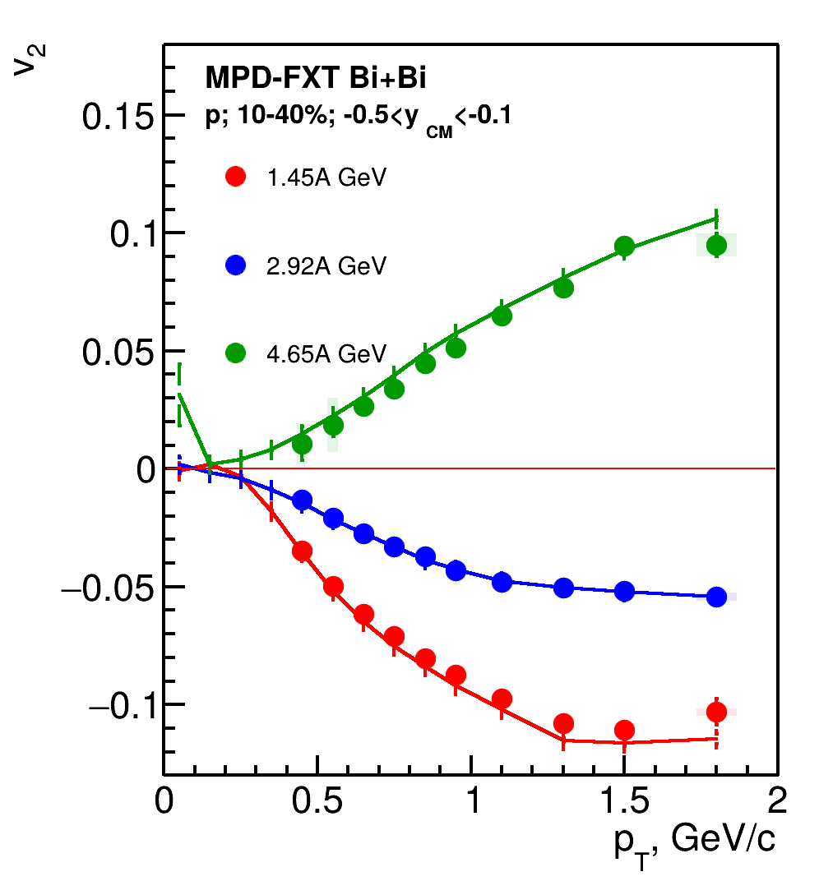
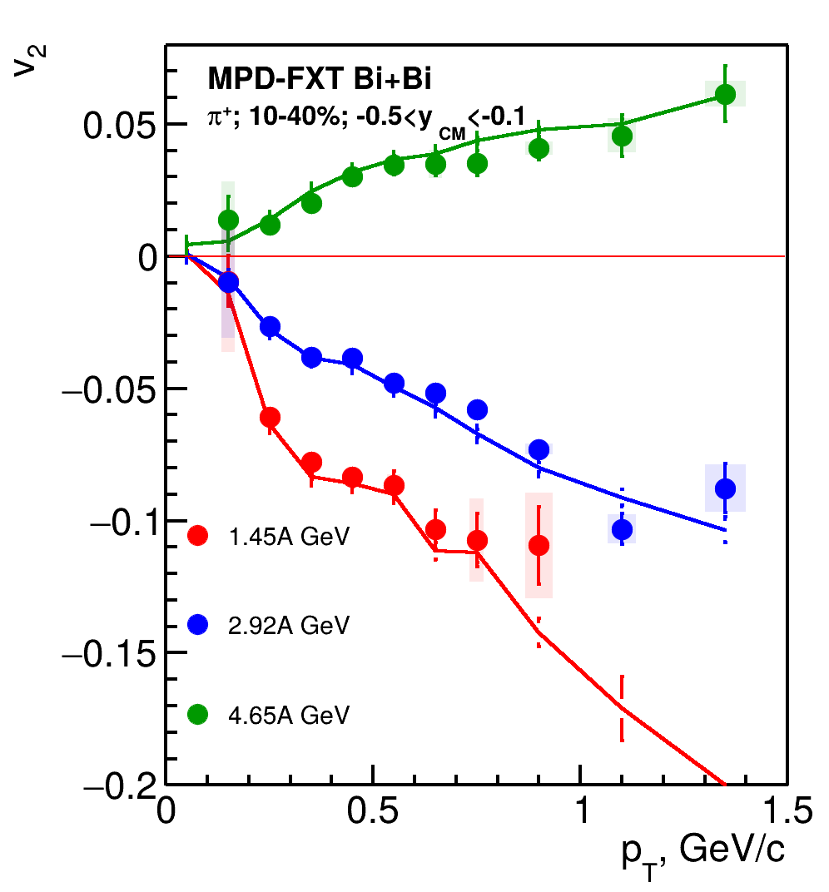
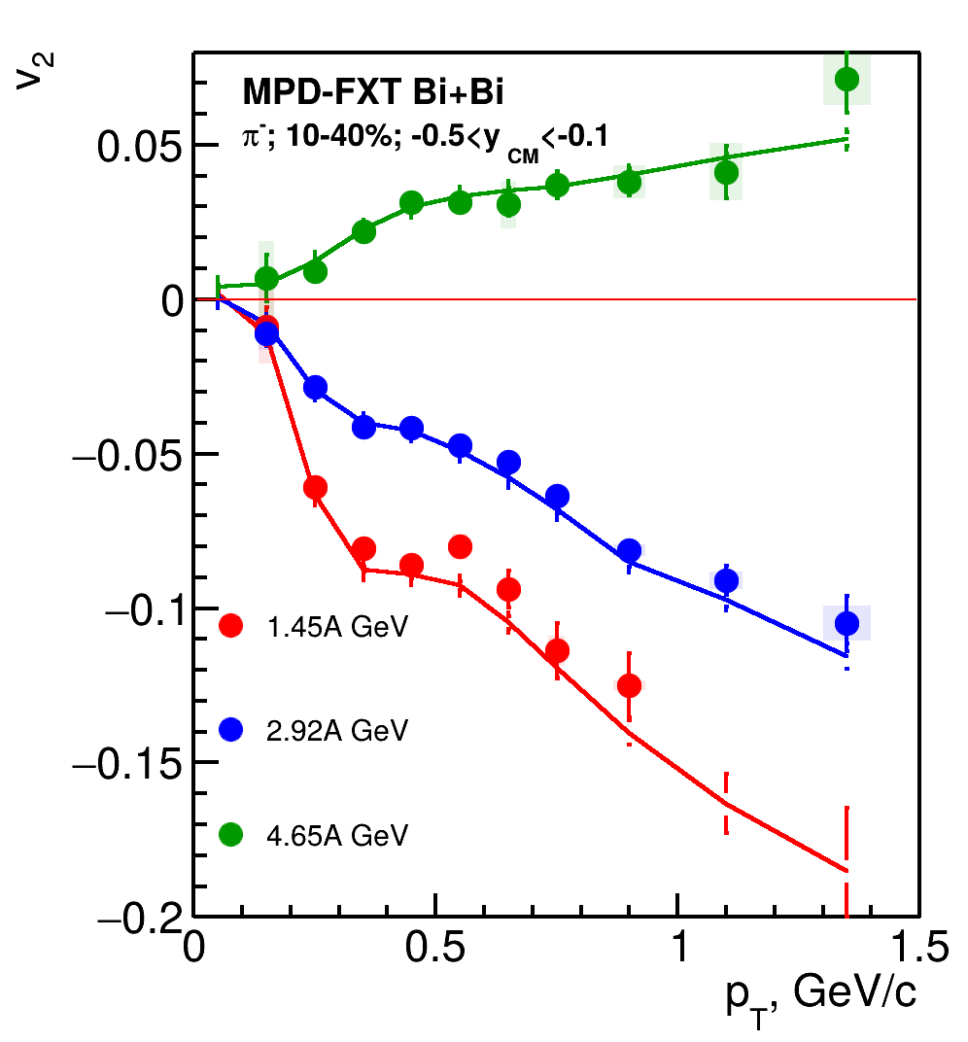
Results: v₂(p_{T})
p
𝝿⁺
𝝿⁻
Good agreement with MC data

Slide 18
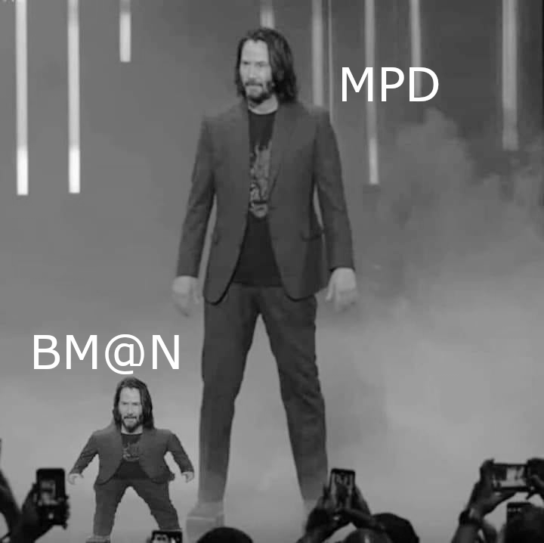
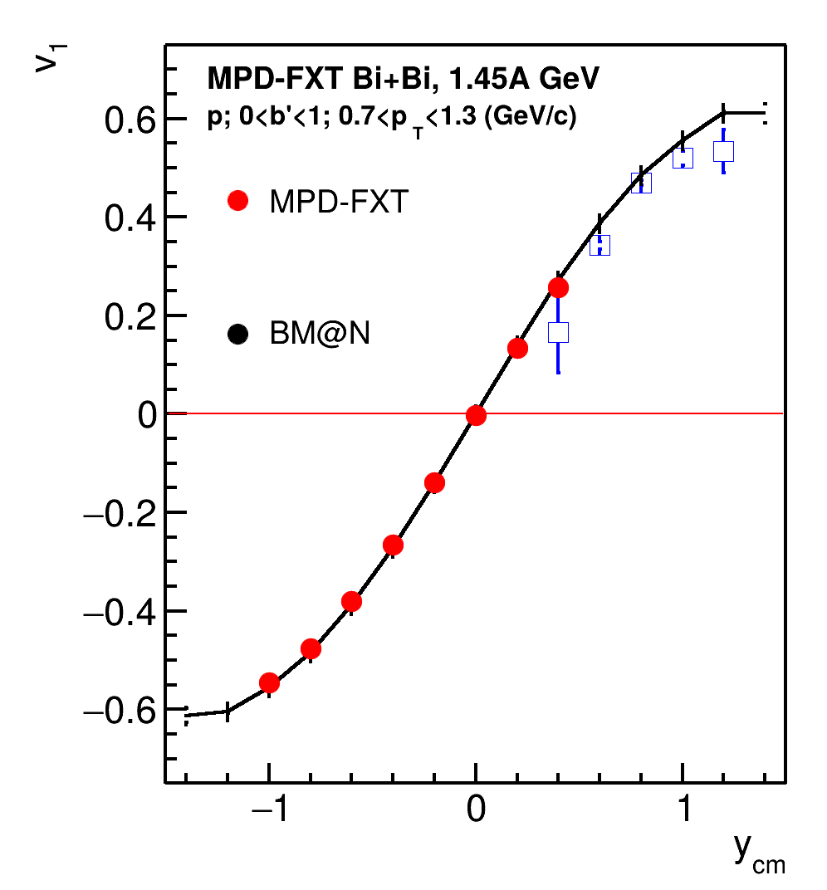
Comparison with BM@N performance
BM@N TOF system (TOF-400 and TOF-700) has poor midrapidity coverage at √s_{NN} = 2.5 GeV
One needs to check higher energies (√s_{NN} = 3, 3.5 GeV)
More statistics are required due to the effects of magnetic field in BM@N:
  Only “yy” component of <uQ> and <QQ> correlation can be used
Despite the challenges, both MPD-FXT and BM@N can be used in v_{n} measurements:
To widen rapidity coverage
To perform a cross-check in the future

Slide 19
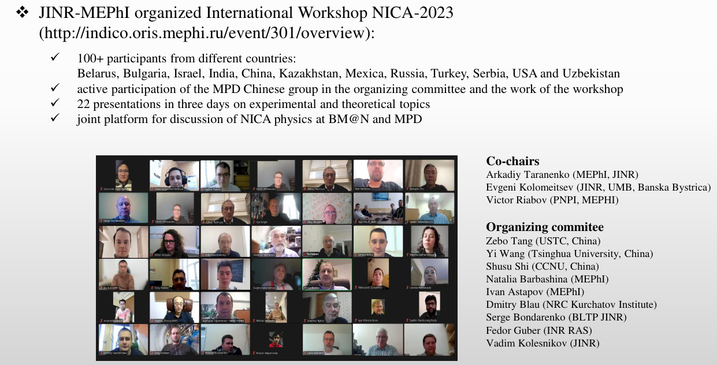
Conferences and workshops

Slide 20

Summary and Outlook
Feasibility study for anisotropic flow:
  evFlowEP wagon for $v_{n}$ measurements is implemented in the MpdRoot and already tested
  Results from reconstructed and generated data are in a good agreement for all methods
  New PFSimple interface available and tested on MPD-FXT production
  Flow performance for MPD-FXT: good agreement between reconstructed and generated data in backward rapidity and midrapidity regions
  MPD-FXT and BM@N can be complementary to each other in terms of flow measurements and noticeably widen available rapidity region
Performance of the global $Λ$ polarisation $P_{Λ}$:
  Results were recently published in EPJA
  Invariant mass fit method for $P_{Λ}$ measurements was implemented and tested
  Good agreement between “reco” and “associated MC” results
  More statistics needed for differential $P_{Λ}\left(p_{T},y\right)$ measurements

Slide 21
Thank you for your attention!

Slide 22
Backup slides

Slide 23











Methods for v_{n} measurements
Sub-event 2-particle Q-cumulants v2{2}:
Δη=0.1 is applied between 2 sub-events A, B to suppress non-flow
4-particle Q-cumulants v2{4}
Event plane method: Δη=0.1
Here: 𝜔_{i} - p_{T,i} transverse momentum of the i-th track in the TPC
𝜑_{i} - azimuthal angle of the i-th track in the TPC
Ψ_{n}- event plane angles
Method’s details described in PRC 83 (2011), 044913 , EP method: Phys.Rev.C 77 (2008) 034904

Slide 24



Motivation of elliptic flow fluctuation study
Indicate a dominated initial state driven uctuations σ_{ε2}
Provide constraints for IS models and shear viscosity η(T/s)
v₂ fluctuations at $\sqrt{s_{NN}}$=11.5-39 GeV
observed in STAR:
Weak dependence on collision energy
How about v2 fluctuations at NICA energies?

Slide 25

Relative v₂ fluctuations of identified hadrons
For more details see A.Demanov’s talk on ISHEP-2023
Weak dependence between v₂{4}/v₂{2} of protons and pions at 11.5 GeV
The difference between v₂{4}/v₂{2} of protons and pions increases with decreasing energy

Slide 26


Event plane Resolution
2 sub event: Δη=0.1
Anisotropic flow is measured as follows:
TPC
West
Δη
East
We do not measure the Ψ₃ resolution after to 60% centrality
Ψ₃ resolution are smaller than Ψ₂
Good agreement between R_{MC}(Ψ_{n}) and R_{reco}(Ψ_{n})
-1.5 0 1.5
η

Slide 27

Comparison of Reco and MC: v₂ eta-sub EP
Cuts:
Charged particles only
Primary
|η|<1.5
Δ η = 0,1
p_{T} >0.2 GeV/c
|DCA|<3σ
nTPC hits ≥ 16
PID: PDG code
good agreement of the v_{2,mc} with v_{2,reco} data
The difference at large p_{T} between v_{2,mc} and v_{2,reco} (non-flow)

Slide 28



Comparison of Reco and MC: v₃ eta-sub EP
Cuts:
Charged particles only
Primary
|η|<1.5
Δ η = 0,1
p_{T} >0.2 GeV/c
|DCA|<3σ
nTPC hits ≥ 16
PID: PDG code
Good performance for $v_{3}$ measurements
Further research is required (need more statistics)

Slide 29


Flow performance study for MPD in fixed-target mode
MPD FXT
MPD FXT
BM@N
MPD
BM@N
MPD
P. DANIELEWICZ, R. LACEY, W. LYNCH 10.1126/science.1078070
The flow data from E895 experiment have ambiguous interpretation:
  v₁ suggests soft EOS while v₂ corresponds to hard EOS
Additional measurements are essential to clarify the previous measurements
Notes:
There were measurements of collective flow in the past and the results are ambiguous to interpret
On this slide a comparison between theoretical calculations on directed and elliptic flow on energy and actual experimental data is presented. As you can see, data points are on better agreement with hard EOS in the case of v1 and for v2 the situation is opposite.
Thus we need more precise measurements to clarify the previous data

Slide 30








The Bayesian inversion method (Γ-fit): main assumptions
Relation between multiplicity N_{ch} and impact parameter b is defined by the fluctuation kernel:
2 main steps of the method:
Fit experimental (model) distribution with P(N)
– centrality based on impact parameter
Mean multiplicity as a function of c_{b} can be defined as follows:
Construct P(b|E) using Bayes’ theorem:
P(b|N) = P(b)P(N|b)/P(N)
- 5 parameters
Fit function for N_{ch} distribution:
b-distribution for a given N_{ch} range:
Notes:
the ratio of the fluctuation to the average value is equal to a constant
In the ehd

Slide 31



Centrality determination: multiplicity fit
Good agreement between fit and data
Cuts on tracks:
Nhits>16
0 < η < 2
Multiplicity-based centrality determination using inverse Bayes was used

Slide 32





PID procedure
W. Blum, W. Riegler, L. Rolandi, Particle Detection with Drift Chambers (2nd ed.), Springer, Verlag (2008)
Fit dE/dx distributions with Bethe-Bloch parametrization:
p_{i} - fit parameters
Fit (dE/dx - f(βɣ))/f(βɣ) with gaus in the slices of p/q and get σ_{p}(dE/dx)
p
𝝿⁺
Fit m² with gaus in the slices of p/q and get σ_{p}(m²)
p
(dE/dx,m)→(x,y) coordinates for PID:
𝝿⁺

Slide 33








PID procedure: Results
Protons:
Pions (𝛑⁺):
Pions (𝛑⁻):
charge<0

Slide 34

Measurements of global hyperon polarization
Polarization can be measured using the azimuthal angle of proton in Lambda rest frame φ*
PV — primary vertex
V₀ — vertex of hyperon decay
dca — distance of closest approach
path — decay length
Determine centrality
Determine event plane ( , )
Reconstruct Lambda
Measure global polarization

Slide 35















P_{H} measurements: Δφ-method
Obtain invariant mass distribution in bins of
  Net amount of Λ in each bin
  Distribution of
Fit of the distribution to get → P_{Λ}
  dN/dΔφ_{P}*
_{θ} *
-φ*
p
beam direction (z)
x
impact parameter
b
y

Slide 36


Centrality dependence of P_{Λ}
p_{T}>0.5 GeV/c
p_{T}>0.5 GeV/c
«ω»-selection
«χ»-selection
Both methods have a good agreement with Associated MC

Slide 37


p_{T} - dependence of P_{Λ} for centrality 20-50%
«ω»-selection
«χ»-selection
Both methods have a good agreement with Associated MC
Need more statistics to study high p_{T} region

Slide 38



η-dependence of P_{Λ} for centrality 20-50%
p_{T}>0.5 GeV/c
p_{T}>0.5 GeV/c
«ω»-selection
«χ»-selection
Both methods have an agreement with Associated MC
Need more statistics to study η-dependence

Slide 39




Correlation between P_{y} and v₁
See O. Terayev’s talk at INFINUM-2023 and
V. Voronyuk’s talk at XI MPD CM
$P_{y}vs v_{1}$ correlation is not optimal for a differential analysis
Pearson correlation coefficient represent linear correlation between two sets of data from -1 to 1

Slide 40



Pearson correlation coefficient between P_{y}, v₁ and N
N - multiplicity of Primary Λ
$ρ\left(P_{Λ},v_{1}\right)$ is insensitive to multiplicity fluctuations of primary $Λ$

Slide 41


Pearson correlation coefficient between P_{y} and v₁
Bi-Bi 9.2GeV PHSD
Non-zero linear correlation between P_{y} and v₁
increasing with p_{T}
highest for 0.5<y<1

Slide 42



The BM@N experiment (GEANT4 simulation for RUN8)
FHCal
Silicon + GEM
TOF-700
TOF-400
neutron
x=0
ion
proton
Square-like tracking system within the magnetic field deflecting particles along X-axis
Charge splitting on the surface of the FHCal is observed due to magnetic field
Notes:
Схема эксперимента хадес на слайде.
Траектории рожденных частиц регистристрируются трекинговой системой, состоящей из …
Импульс восстанавливается по отклонению частиц в магнитном поле
Идентификация производится при помощи детекторов времени пролета … которые регистрируют время пролета. Зная длину траектории можно вычислить массу частицы.
Спектаторы регистрируются детектором FW. Поскольку они отклоняются в плоскости реакции материей в области перекрытия, спектаторы используются для оценки угла плоскости реакции.
Всего столько статистики ...

Slide 43


BM@N vs MPD: p_{T}-y acceptance
π-
p
MPD has greater coverage of backward area (even covers projectile spectators)
and MPD covers midrapidity region
BM@N has greater coverage of forward area
y_{cm}=0
y_{cm}=0

Slide 44


BM@N vs MPD: η-φ acceptance
MPD
BM@N
MPD has more uniform acceptance along φ-axis
BM@N has non-uniform acceptance due to square-like shape of the tracking system

Slide 45
Summary for main topic 1
Software implementation of MC Glauber and Г-fit with multiplicity based fitting procedure is used for MPD
Relation between impact parameter and centrality classes is extracted
Centrality determination procedures based on MC sampling of spectators energy are developed
and tested based on NA61/SHINE data for both MC-Glauber and inverse Bayes approaches
Results are tuned on the spectator production implemented in the DCM-QGSM-SMM model
Simplified procedure for hadron calorimeters based on Gauss distribution is also proposed for MC-Glauber approach
Work in progress
Investigate the effect on centrality determination due to the fragment loss
in beam hole of the MPD FHCal
Introduce detailed parametrization for steps of centrality determination procedure
and improve current parametrization
Apply this procedure for MPD FHCal simulations

Slide 46
Summary for main topic 2
Flow measurements for UrQMD model (req. 25):
  Directed and elliptic flow measurements were done using several methods: event plane, scalar product and Q-Cumulant.
  Results are ready for the second collaboration paper
Flow measurements for vHLLE+UrQMD model (req. 32):
  Observed outlier events in the distribution Mult vs b - typical for this model
  Centrality classes have been determined using the Inverse Bayes method. For this model, flow measurements (without cut on Mult vs b) are possible up to 50-60%
  There is a good agreement between v_{2,mc} and v_{2,reco}. But there are differences at large p_{T} region - contribution from non-flow.
  Current statistics are not enough for v₃ measurements.

Slide 47
Summary for the main topic 3
Performance study for v_{n} measurements using FFD detector:
  Event plane Resolution of FFD is much more smaller than FHCal resolution;
  Good agreement for 2 and 3 sub event methods
  FFD has extremely small Resolution for 2-nd harmonic
  FFD can be used for directed flow measurements
  FFD needs more statistics than FHCal for elliptic flow measurements due to low resolution
Performance study for v_{n} measurements in MPD-FXT:
  For each particle species v₁ and v₂ are consistent with the model signal mostly in backward rapidities
  Official production for different beam energies (√s_{NN}=2.5, 3.0, 3.5 GeV 10-11 M min bias events each) has been requested for the further studies

Slide 48


Comparison of Reco and MC: v₂{4}
Cuts:
Charged particles only
Primary
|η|<1.5
Δ η= 0,1
p_{T} >0.2 GeV/c
|DCA|<3σ
nTPC hits ≥ 16
PID: PDG code
good agreement of the v_{2,mc} with v_{2,reco} data
The difference at large p_{T} betwin v_{2,mc} and v_{2,reco} is less than for other methods -> Not affected by the non-flow effects

Slide 49


v₂ fluctuations at = 5 - 11.5 GeV
For more details see A.Demanov’s talk on ISHEP-2023
v₂ fluctuations decrease with decreasing energy more strongly than at = 11.5-39 GeV
The energy dependence of the v₂{4}/v₂{2} is stronger for protons than for pions

Slide 50


FHCal and FFD detectors
The FFD consists of two sets of Cherenkov counters located at ±140 cm from the nominal interaction point. Each set has 20 physical detectors with 4 read-out channels each. As a result, the total number of read-out channels is 2 sides 80 channels = 160 channels.
FHCal consists of two sets of hadron calorimeters in pseudorapidity region 2<|η|<5
Each set has 44 modules form azimuthal symmetry. Total number of modules 88.

Slide 51




Directed flow of charged hadrons with FHCal and FFD
FHCal and FFD have consistent results; both can be used for directed flow measurements.

Slide 52




Elliptic flow of charged hadrons with FHCal and FFD
Due to low Resolution FFD need more statistics than FHCal for elliptic flow measurements.

Slide 53


MPD-FXT: v₁ for $π^{+}$
v₁ is consistent with model signal for y < 1
No efficiency corrections were applied yet

Slide 54


MPD-FXT: v₂ for $π^{+}$
v₂ is consistent with model signal for y < 0.5
No efficiency corrections were applied yet

