Slide 1
NICA-MPD-Platform
23 APRIL 2024
XIII MPD COLLABORATION MEETING
SPEAKER: ALEXANDER FEDUNIN
HEAD OF SECTION ENGINEERING SUPPORT GROUP

Slide 2
1
2
3
What is the NMP?
Main Components
of the NMP
Advantages
of the NMP

Slide 3
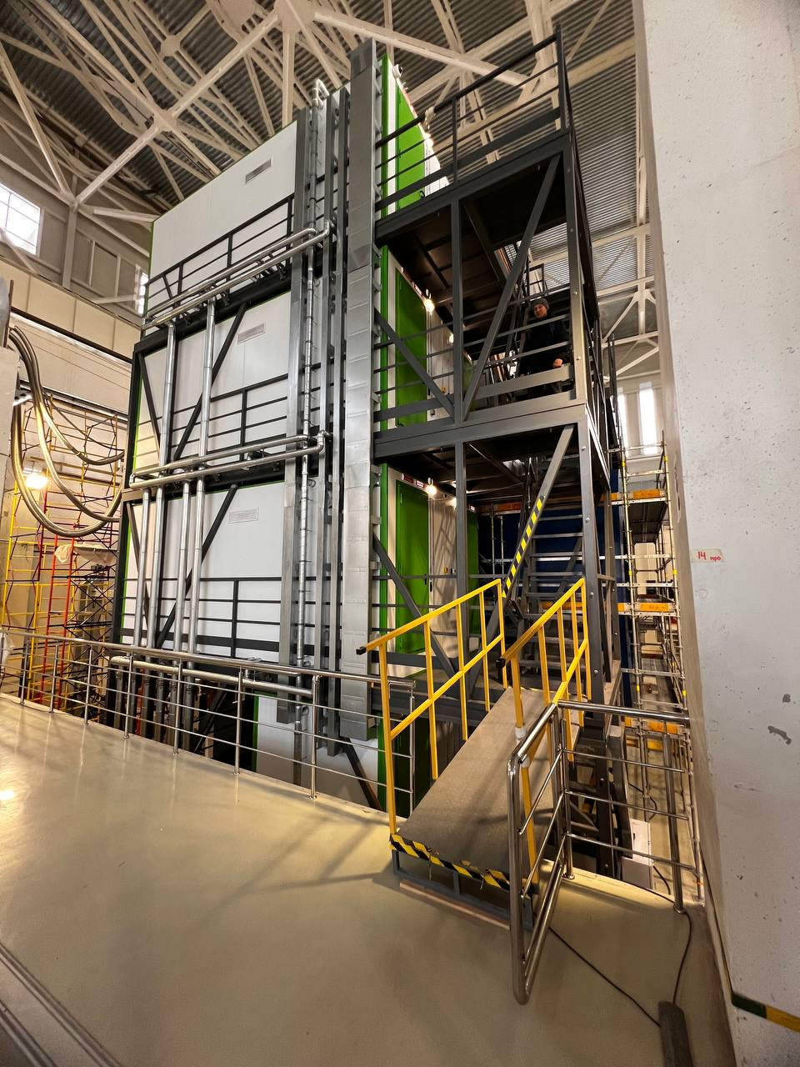
NMP (NICA-MPD-Platform)
Is the part of data center and a main element of IT infrastructure.
This is a high-tech facility where critical data will be processed and information will be transmitted.
The NMP contains the electronics for collecting and processing data from the MPD, power supply and gas distributors sub detectors.

Slide 4
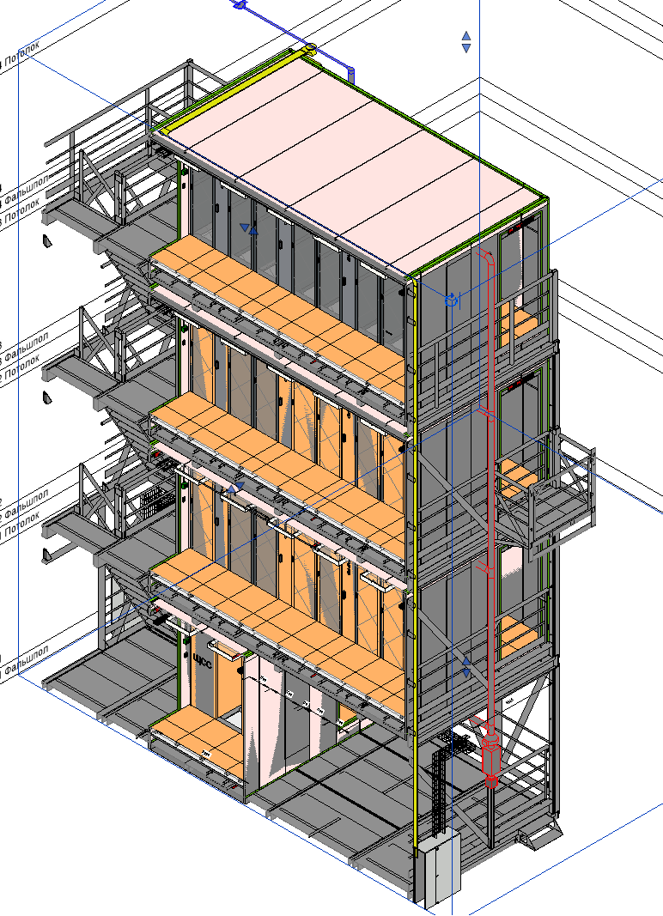
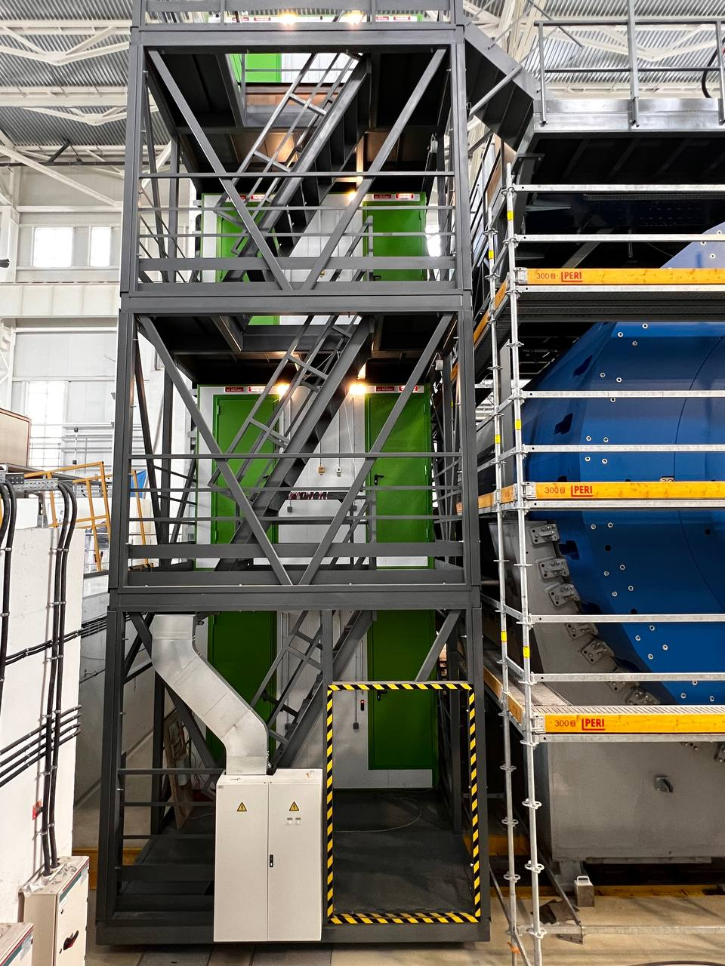
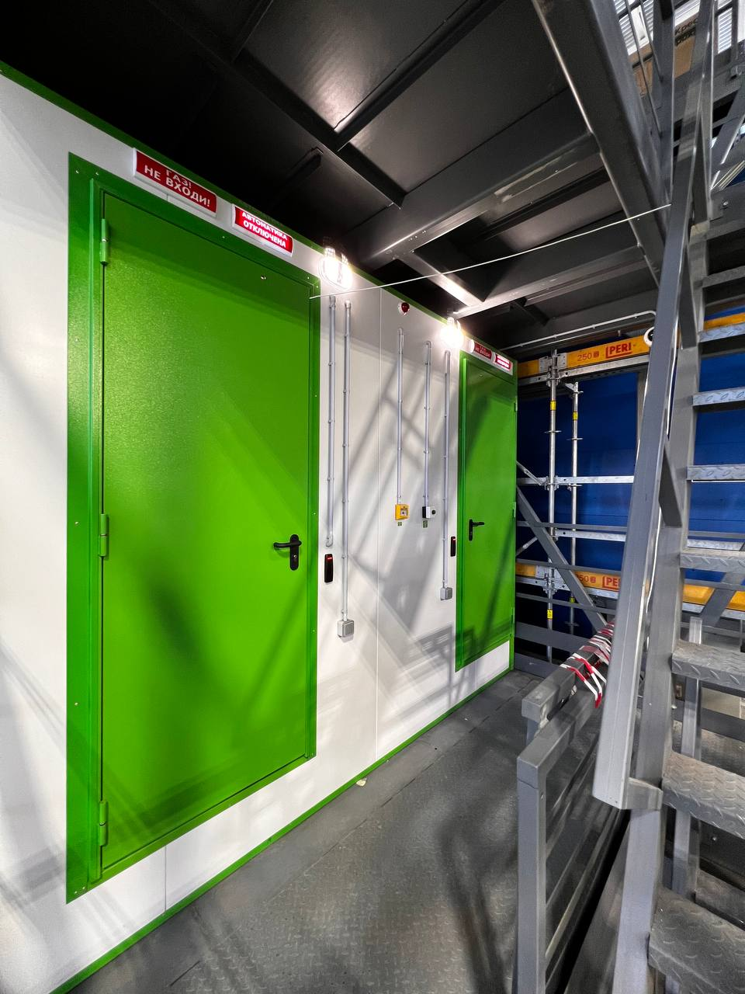
Construction of the NMP

Slide 5
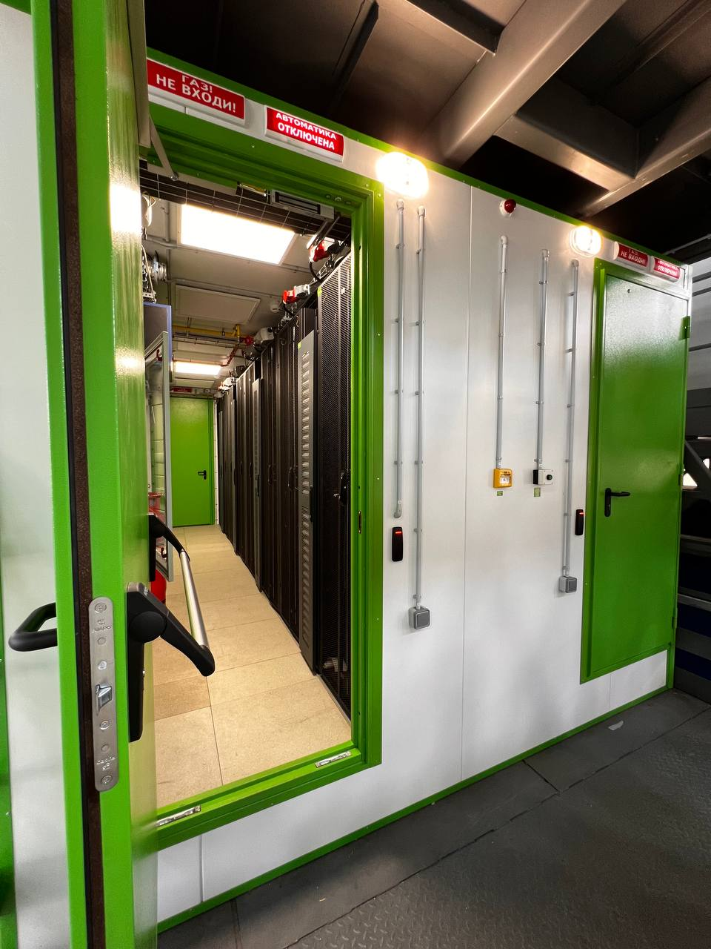
Construction of the NMP
Inside module there are racks with
- electronics,
- cooling
- power supply equipment
- other engineering systems

Slide 6
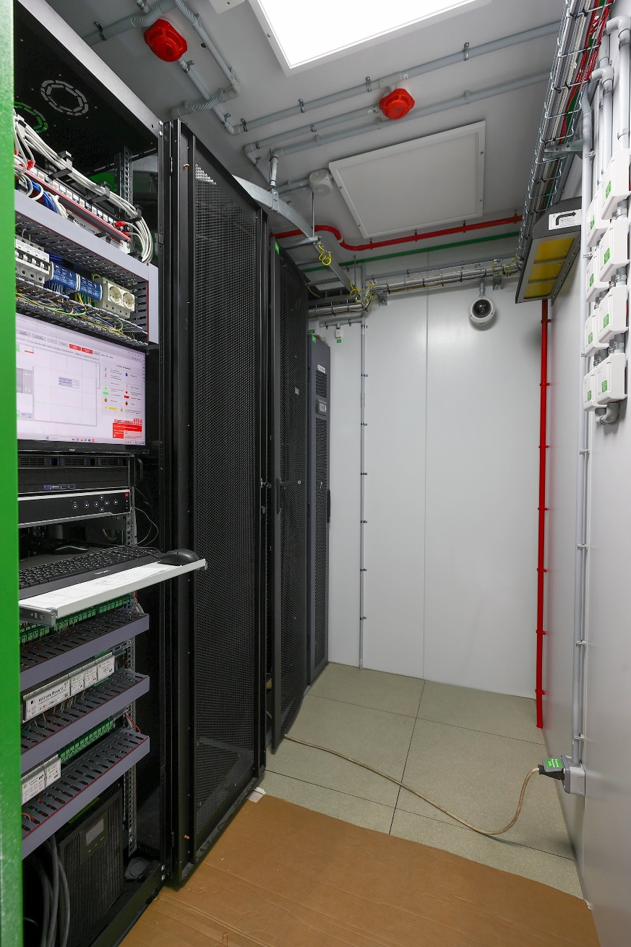
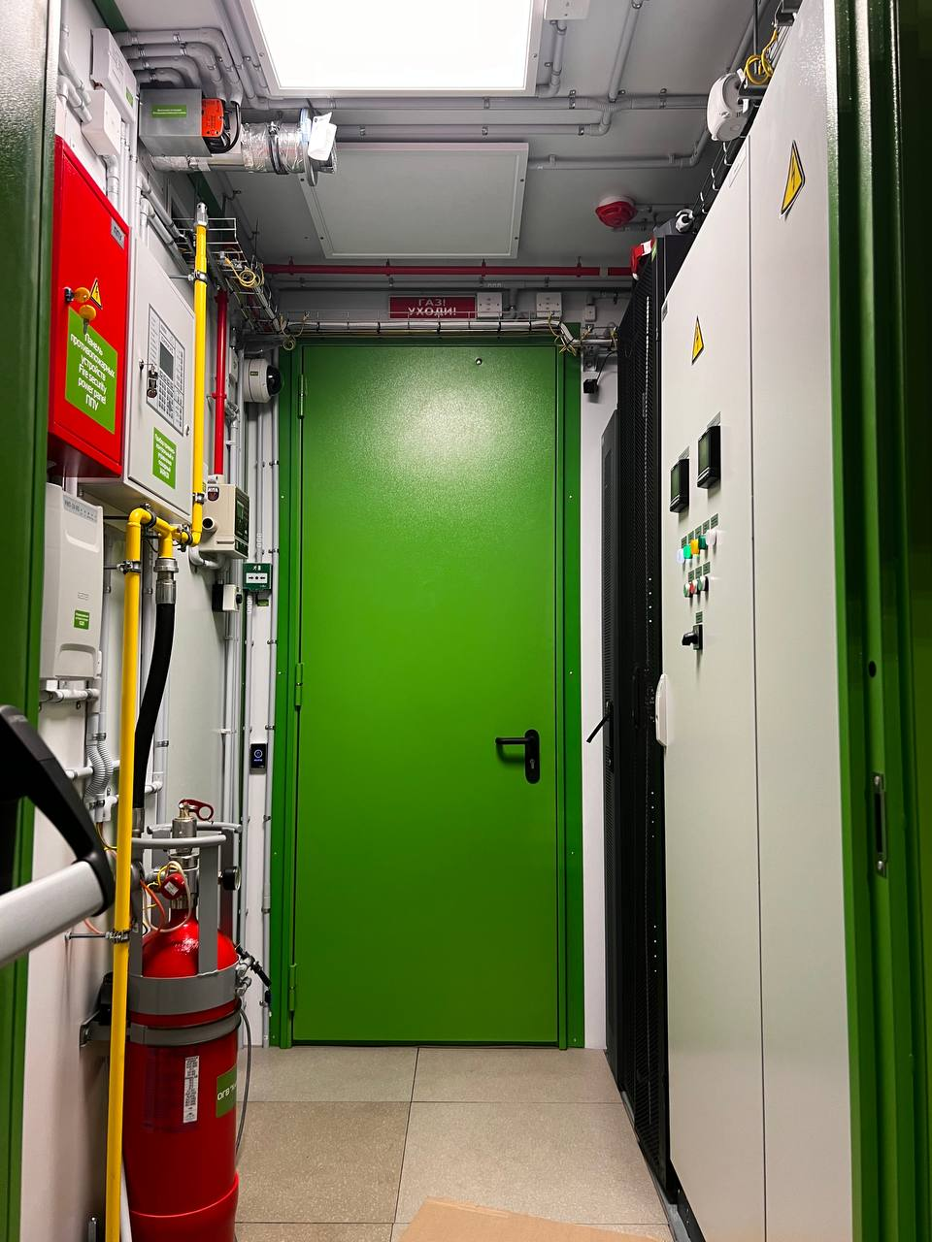
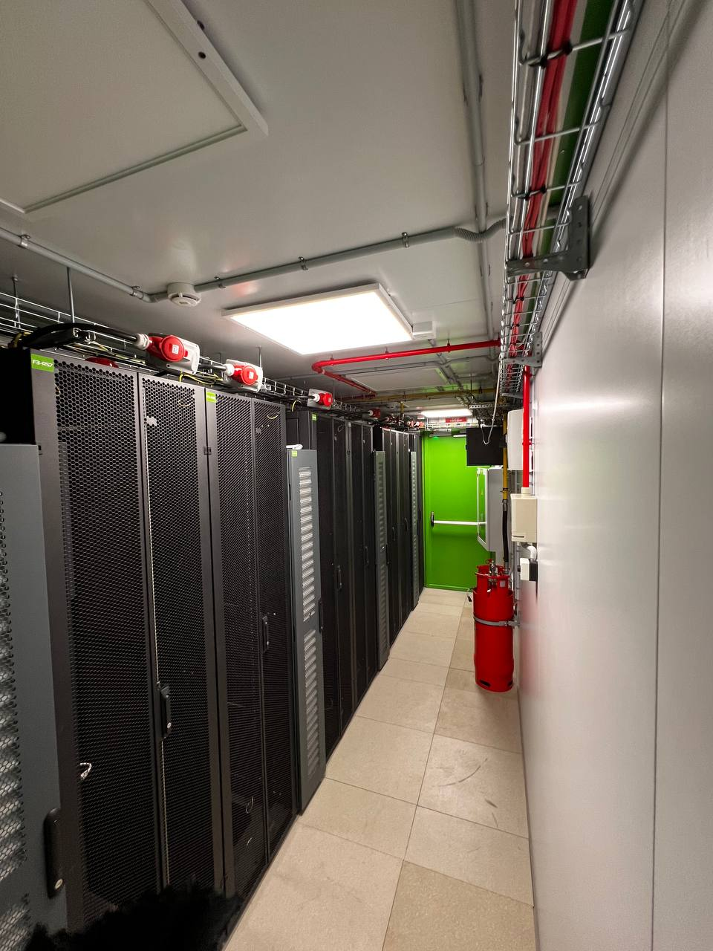
MAIN COMPONENTS OF THE NMP
1
FLOOR
2 3 4
FLOORS
IT RACKS on the NMP

Slide 7
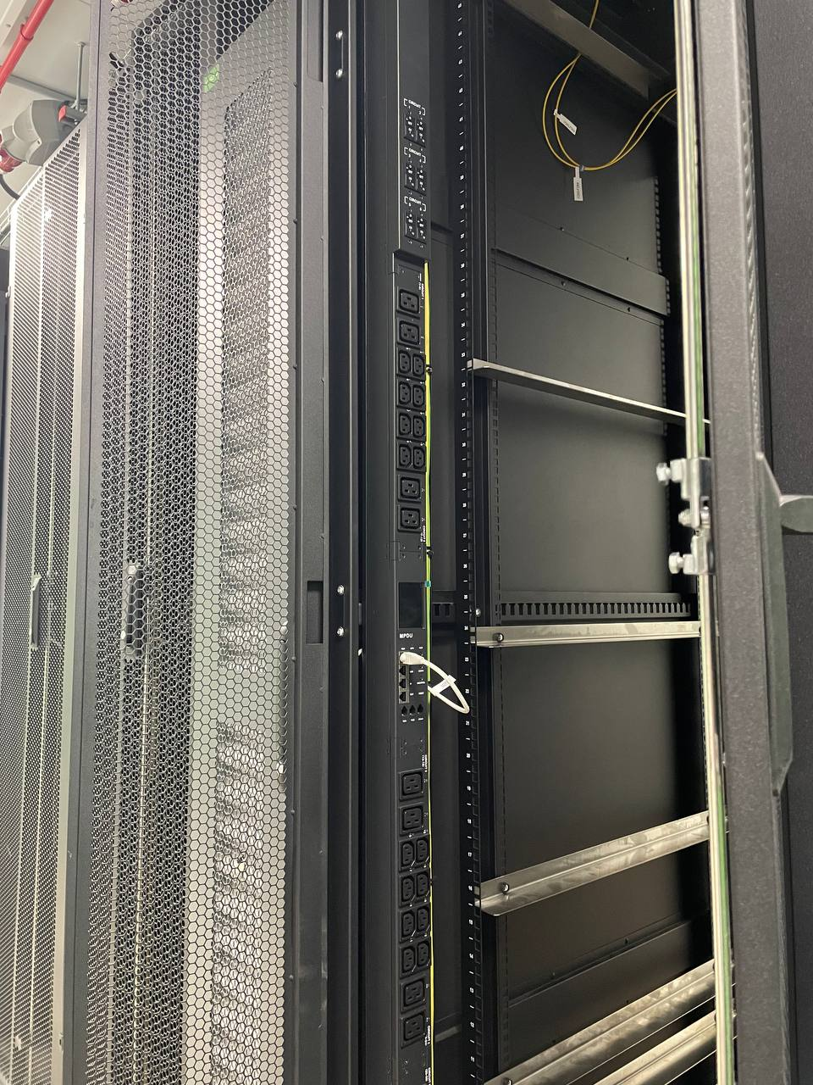
MAIN COMPONENTS OF THE NMP
IT RACKS on the NMP
Each rack has PDU controlled and ventilation panel

Slide 8
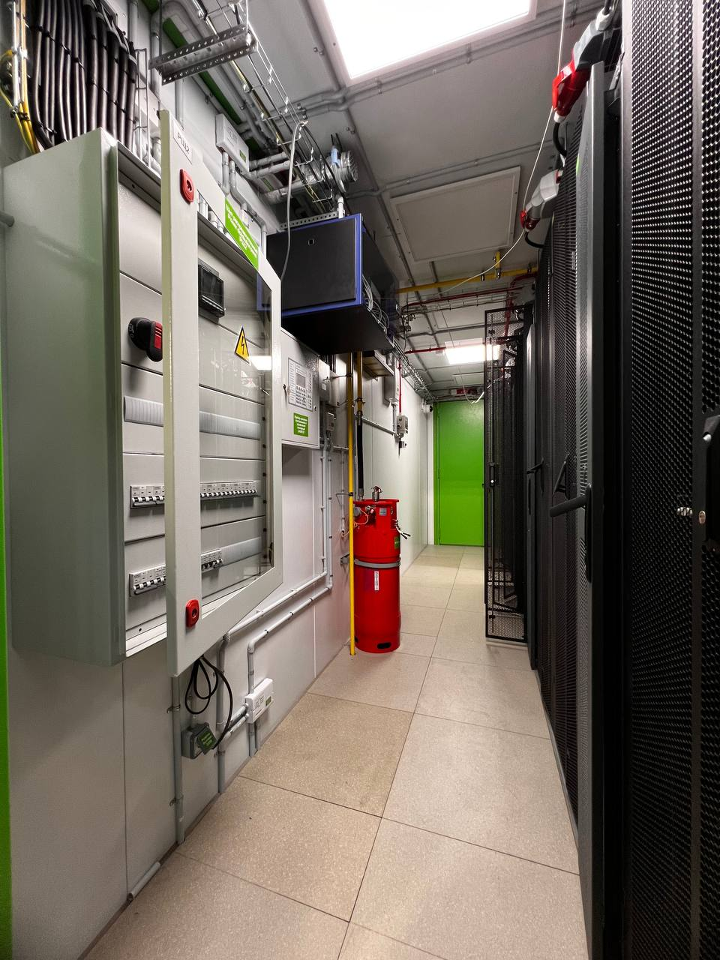
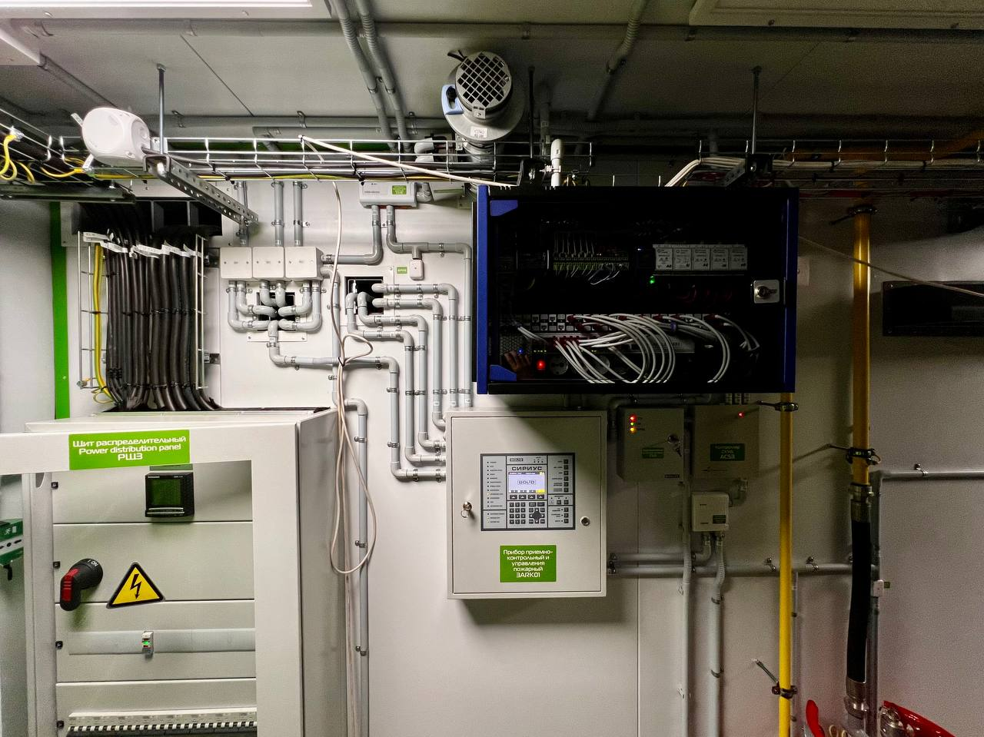
MAIN COMPONENTS OF THE NMP
• Power Supply

Slide 9
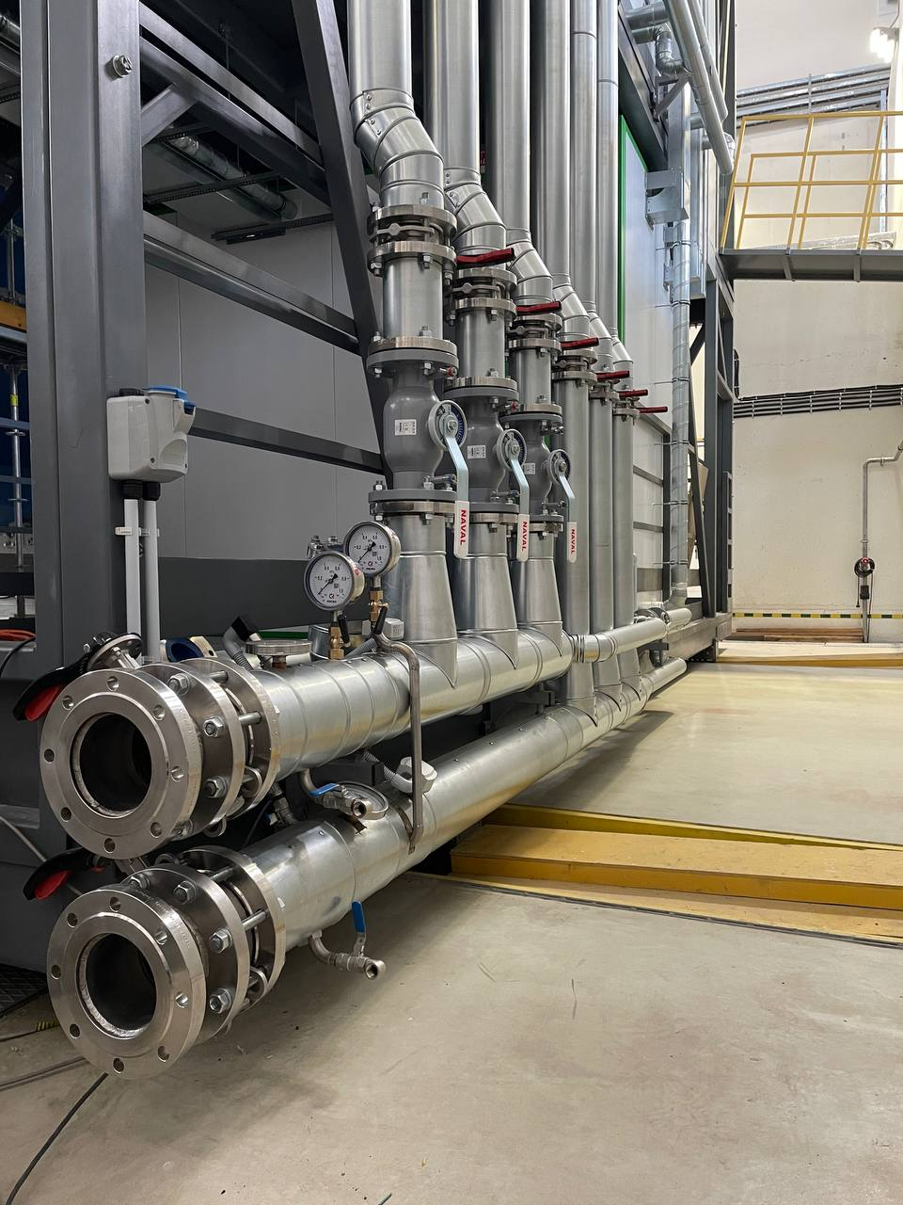
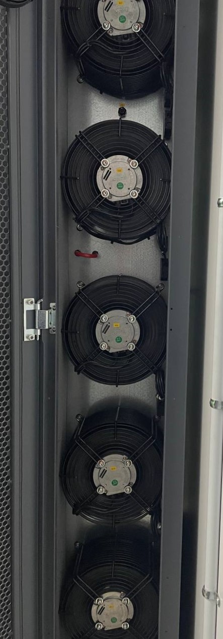
MAIN COMPONENTS OF THE NMP
The cooling system protects the equipment from overheating, maintains and regulates the set air temperature
• Cooling System

Slide 10
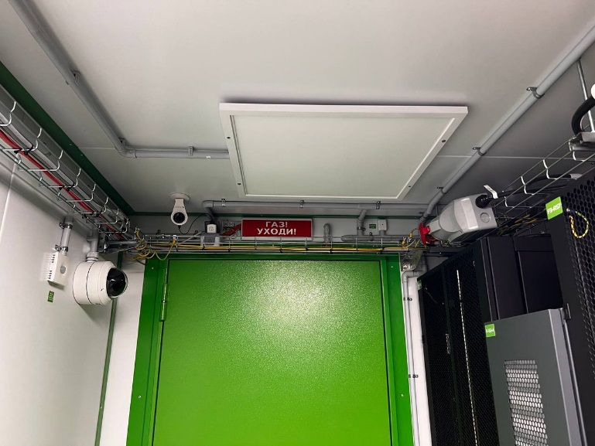
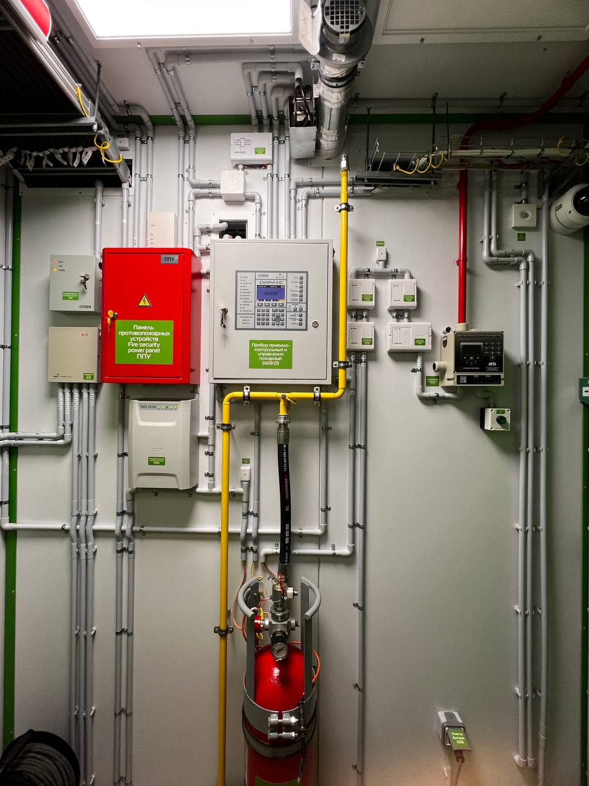
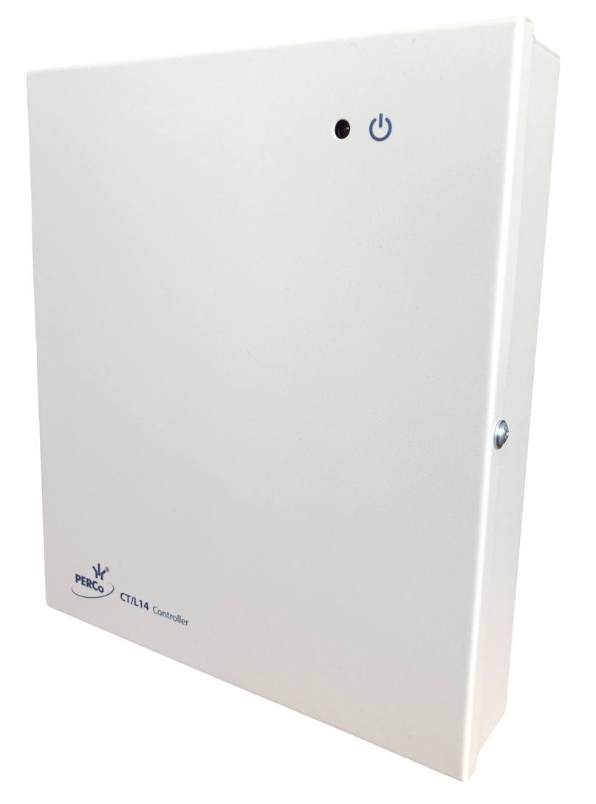
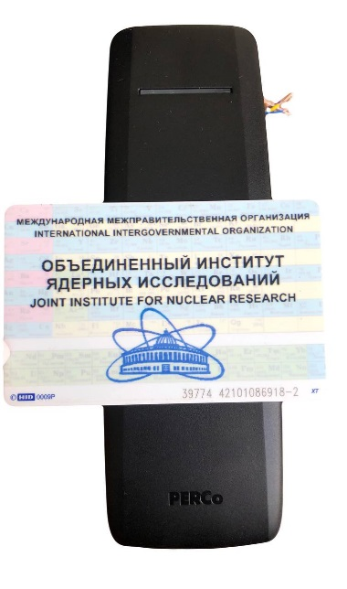
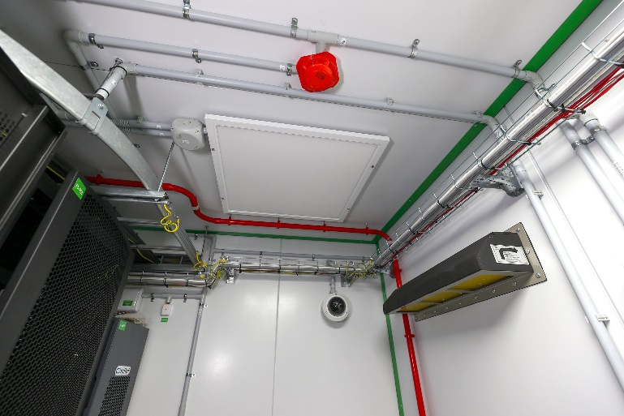
MAIN COMPONENTS OF THE NMP
Access control and
management system
CCTV video surveillance system
Fire automation of extinguishing system

Slide 11
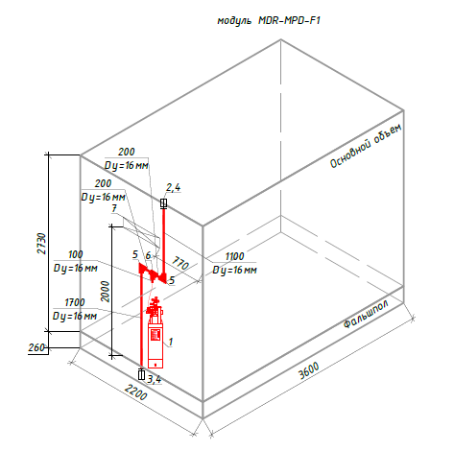
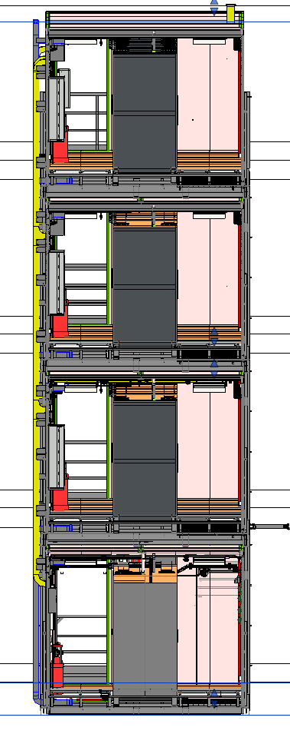
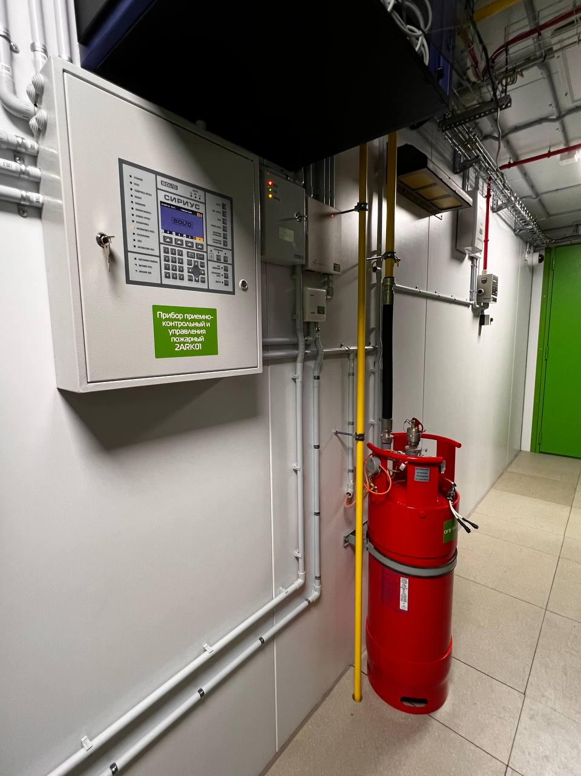
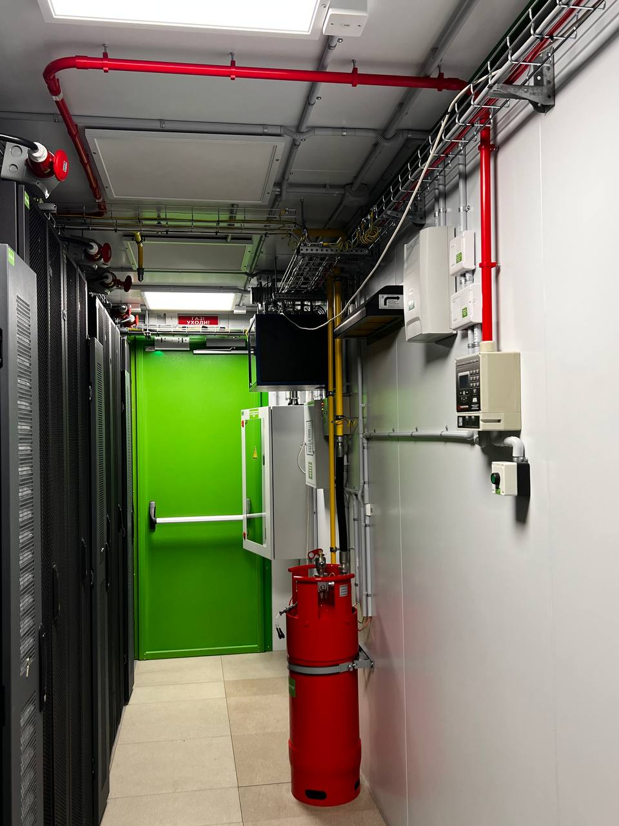
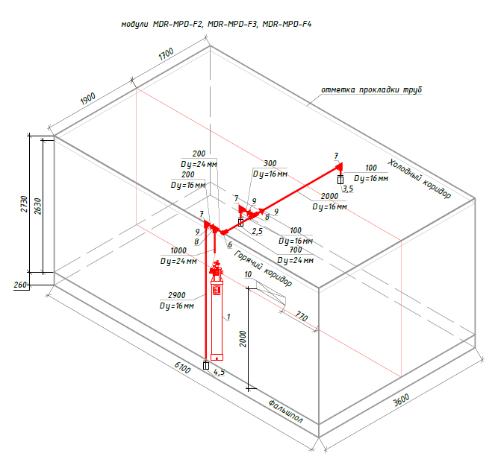
Fire automation of extinguishing system
XIII MPD Collaboration meeting

Slide 12
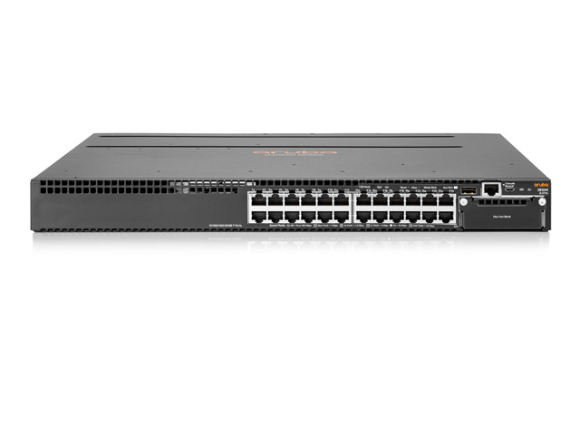
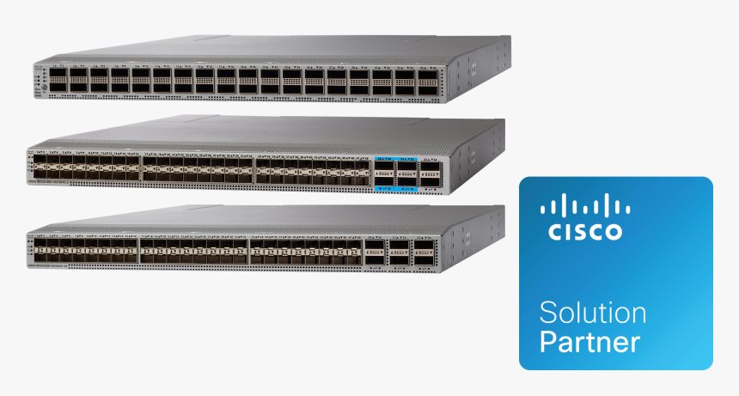
Коммутатор HPE Aruba 3810M 24G 4SFP+ (JL071A)
Network Equipment
Switches, routers, and
other devices that provide high-speed communications
Коммутатор Cisco Nexus 93180YC-EX

Slide 13
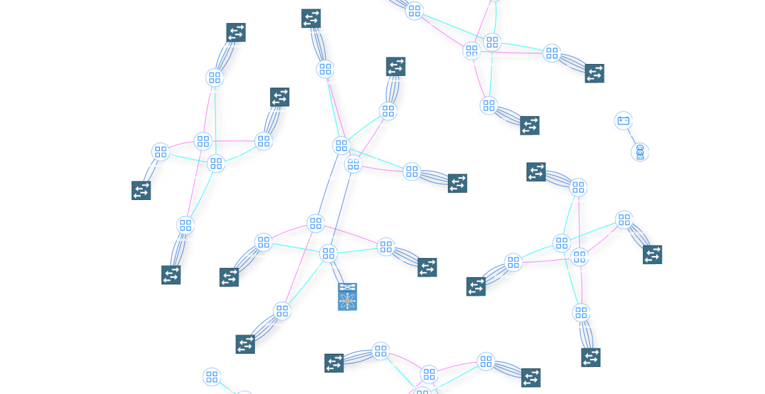
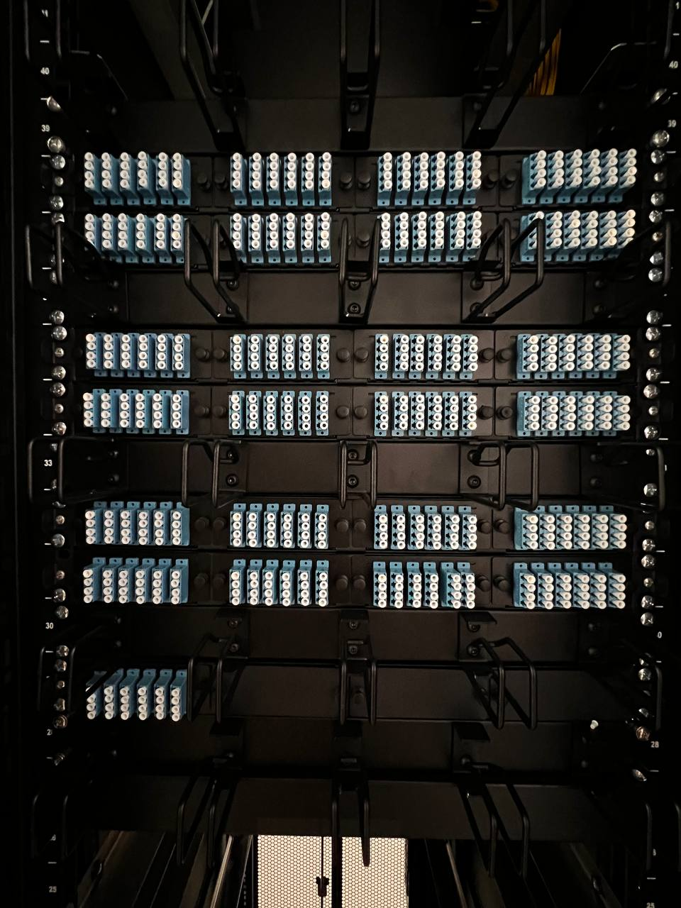
STRUCTURED CABLING SYSTEM

Slide 14
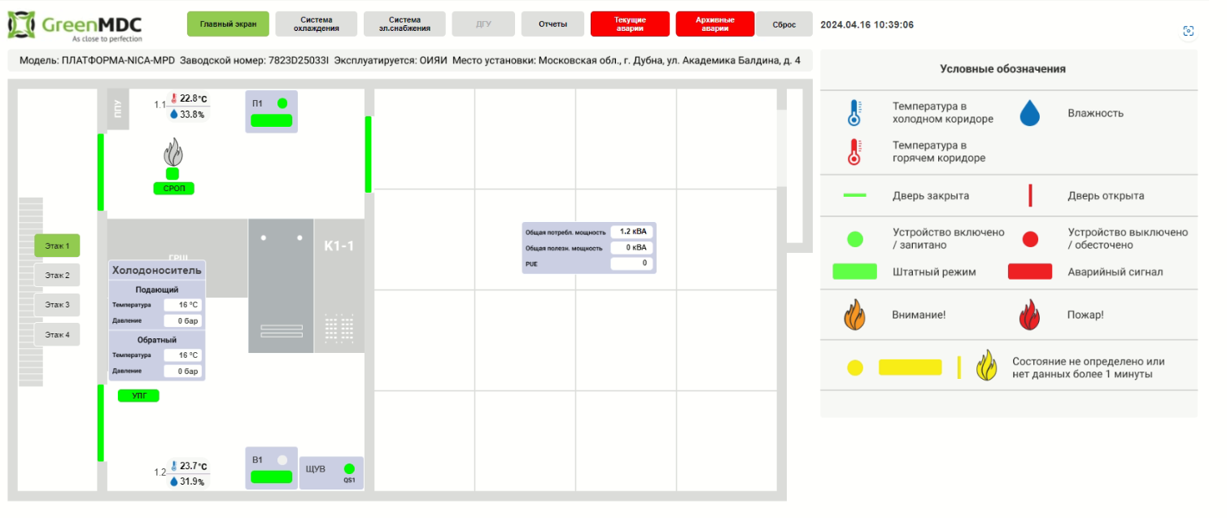
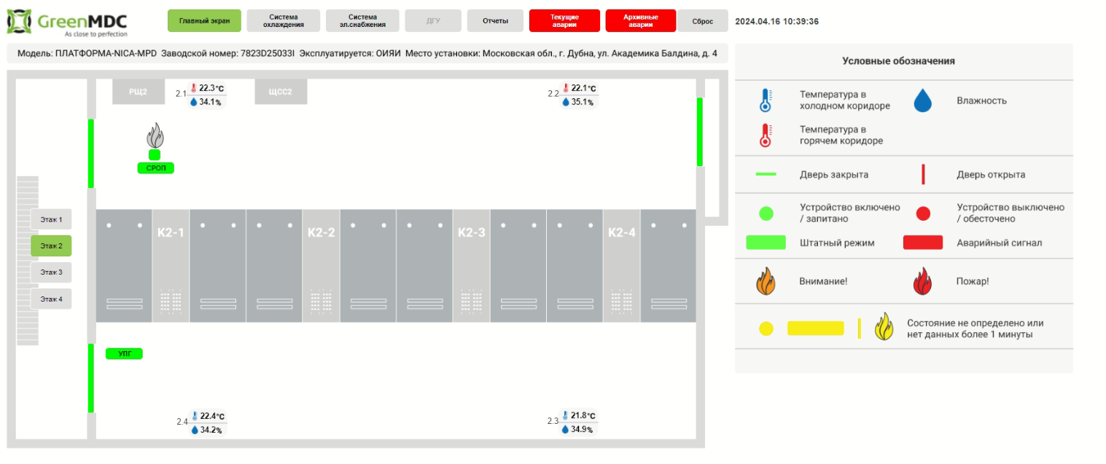
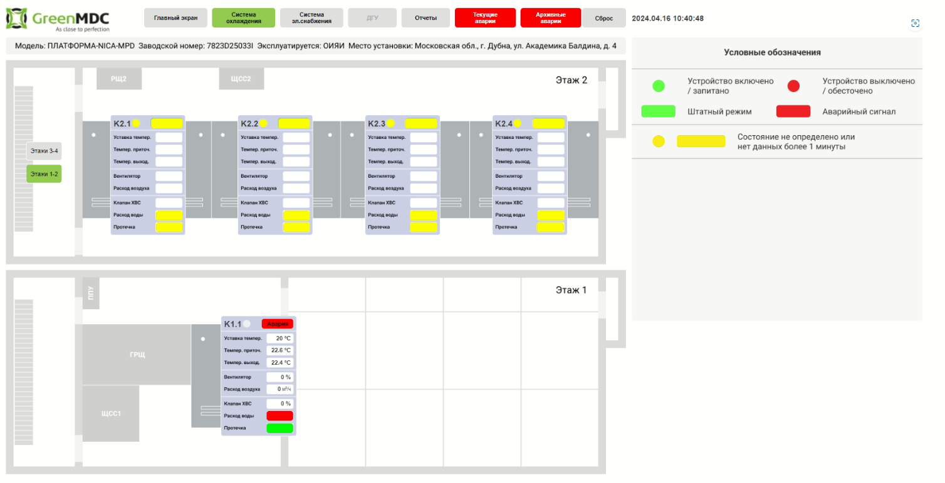
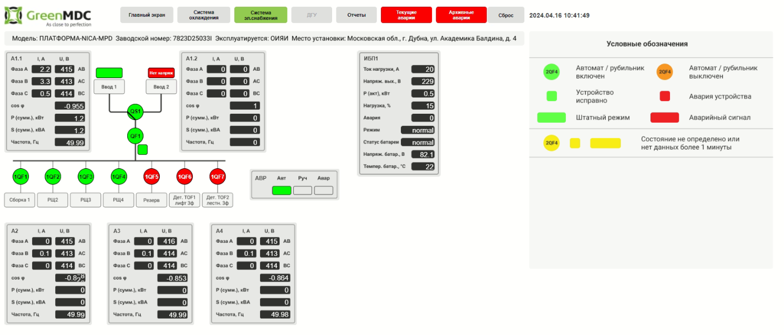
Monitoring system

Slide 15
DEVELOPED AND TESTED SOFTWARE FOR THE CABLE SYSTEM

Slide 16
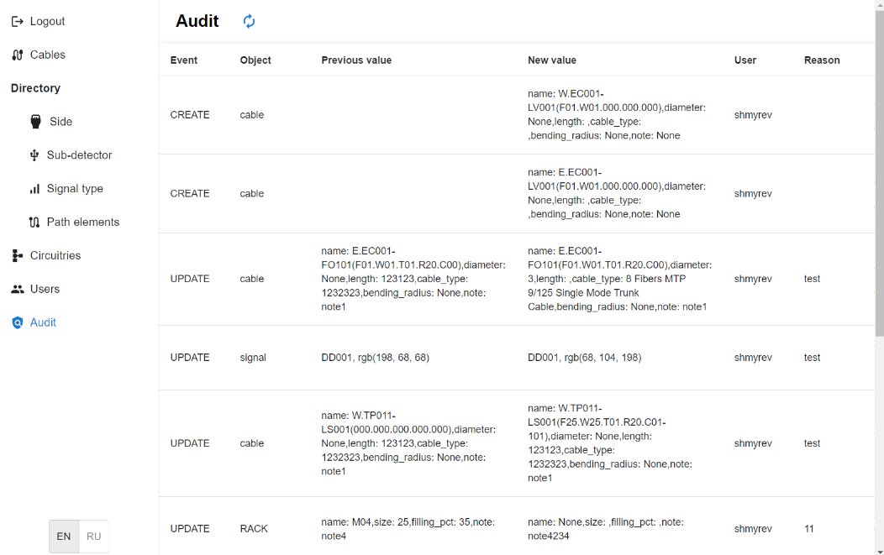
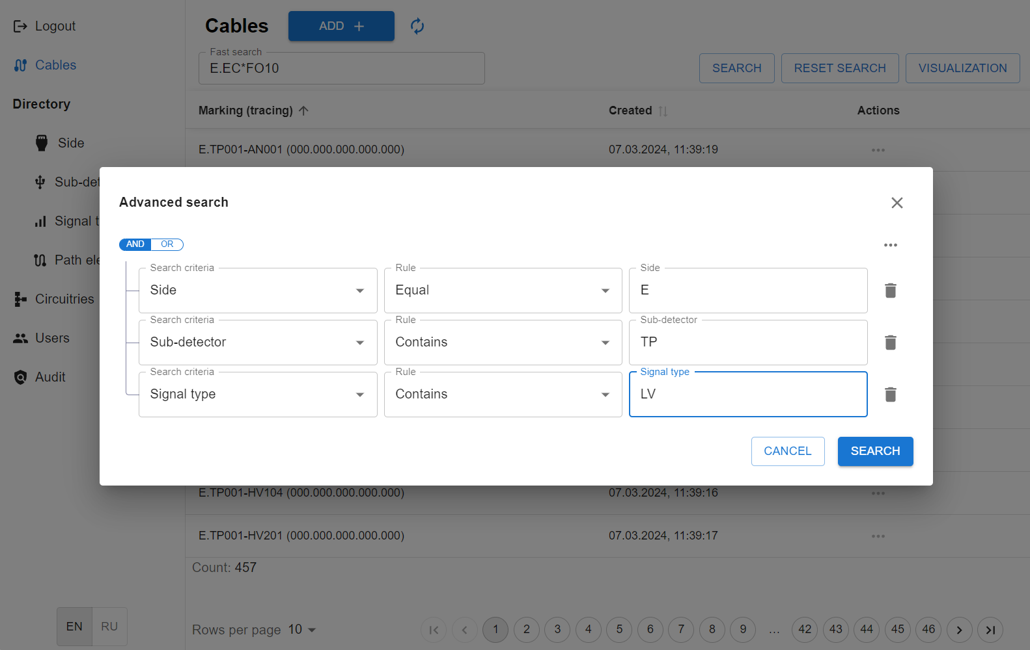
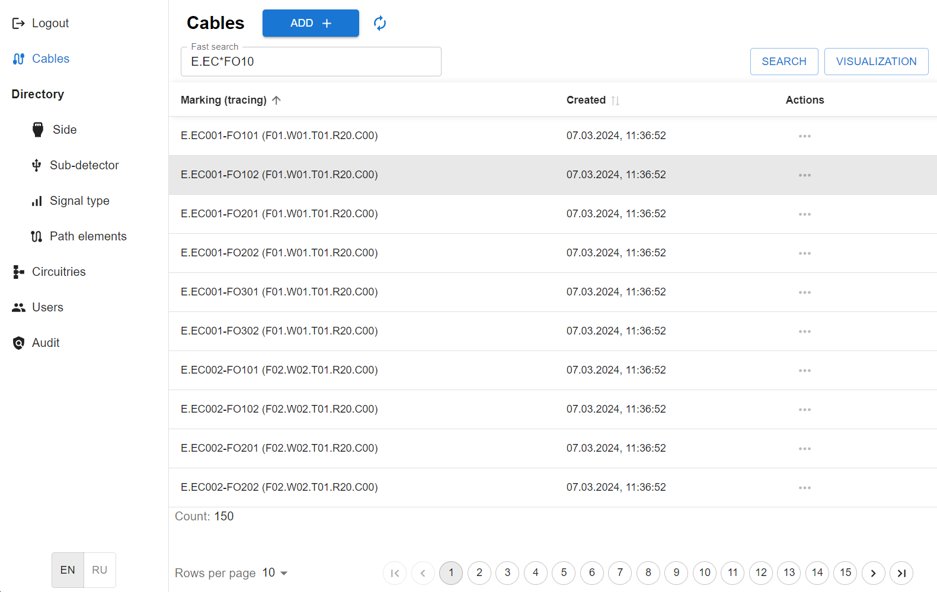
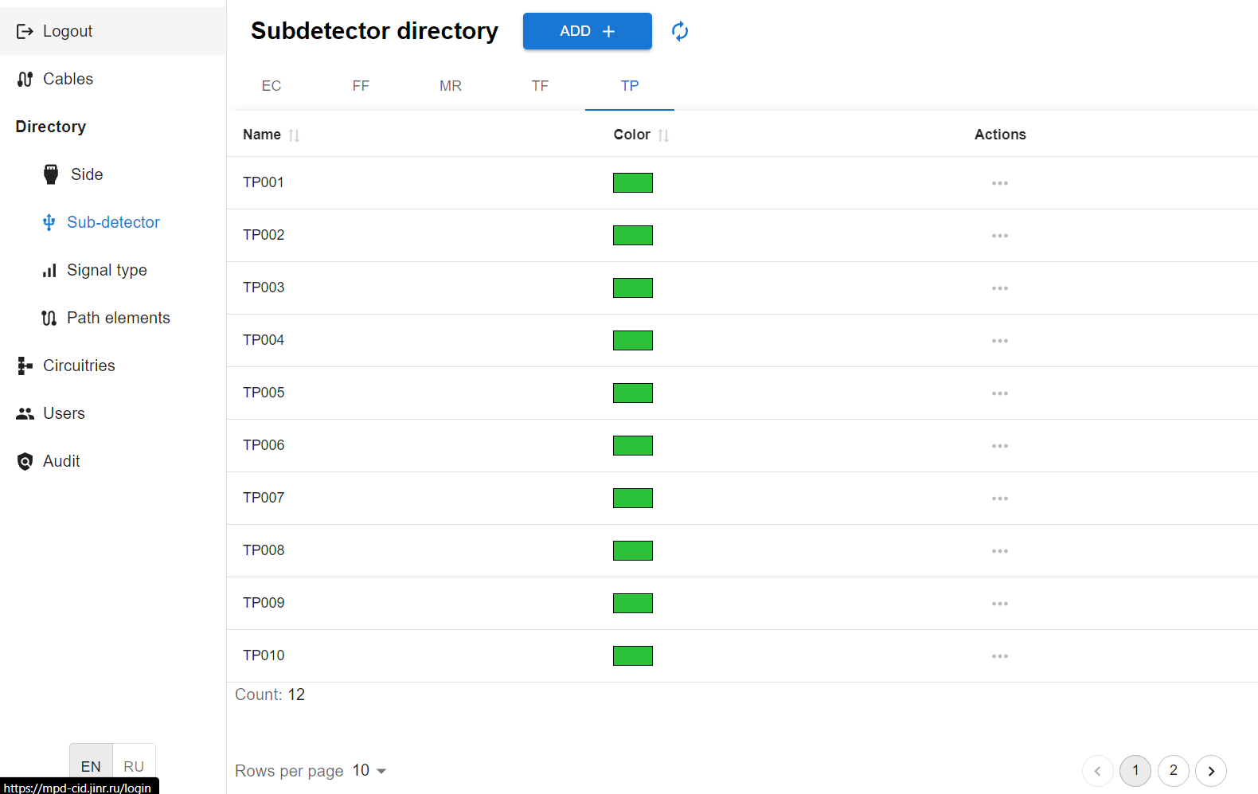
Software features

Slide 17
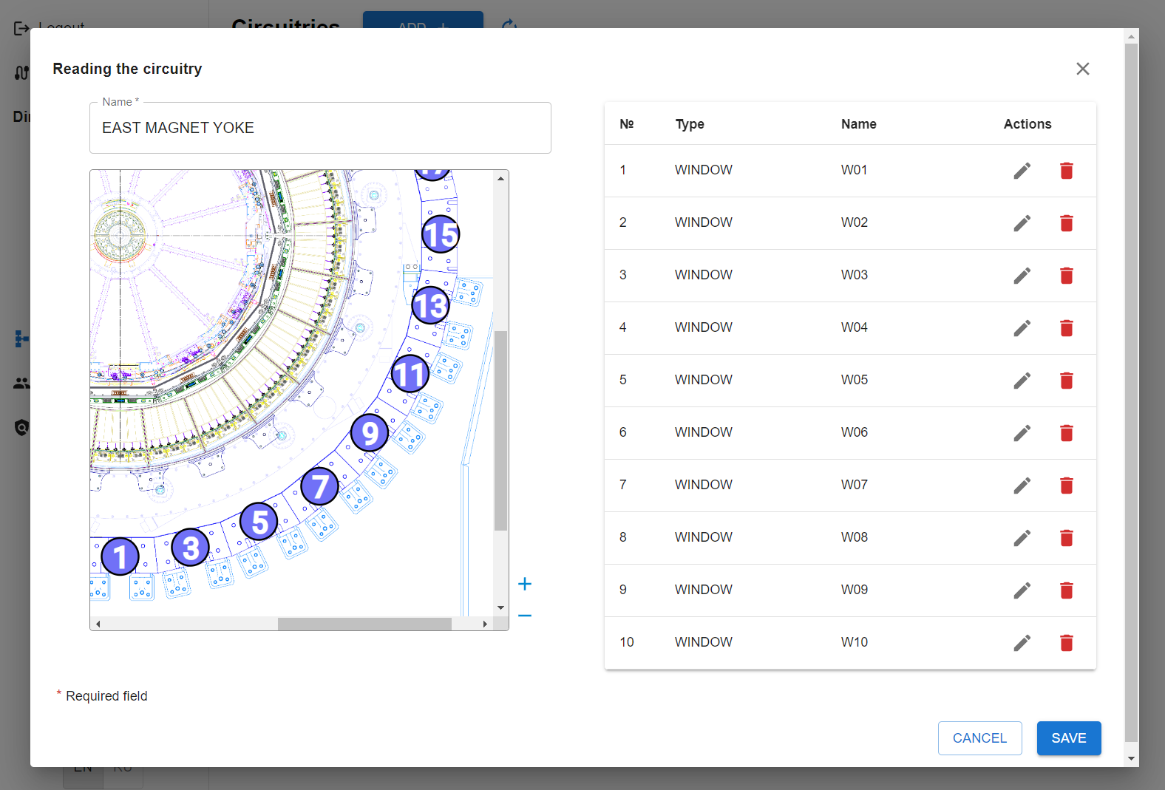
Software features

Slide 18
Advantages of the NMP
1
2
Reliability
Efficiency
High fault tolerance and redundancy of critical components.
Optimized energy consumption and control automation.

Slide 19
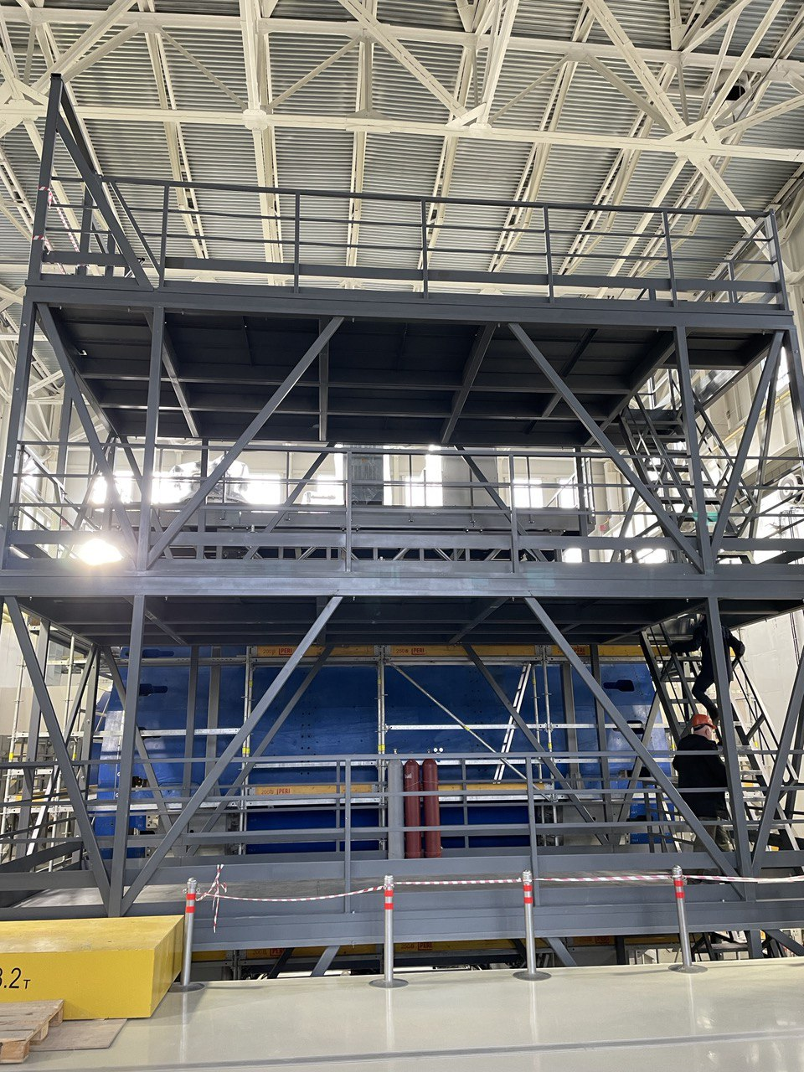
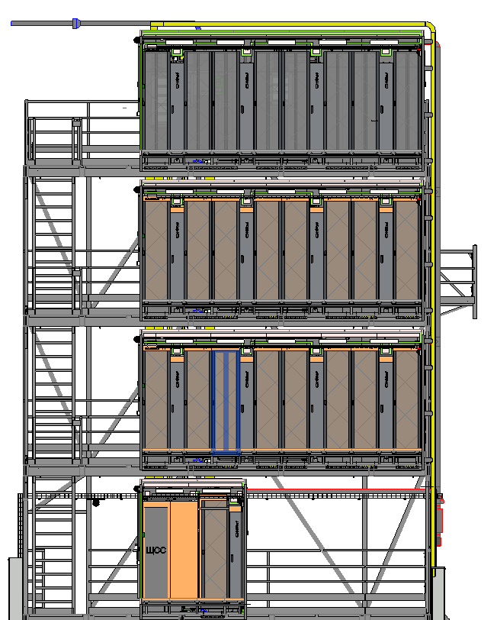
End 2022
2023
2024

Slide 20
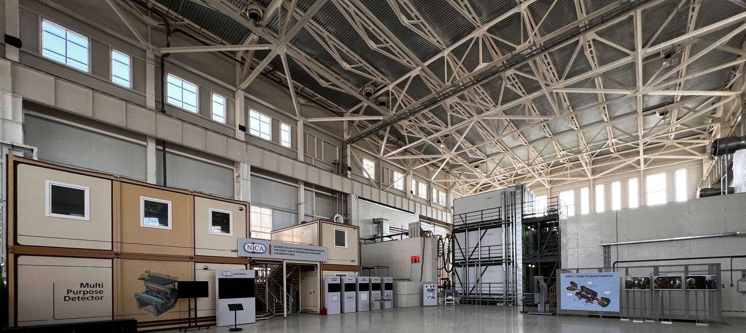
Thank you for your attention
23 APRIL 2024
XIII MPD COLLABORATION MEETING
SPEAKER: ALEXANDER FEDUNIN
e-mail: fediunin@lhep.ru

