Slide 1
Status of Forward Hadron Calorimeter (FHCal)
A.Ivashkin
Institute for Nuclear Research RAS, Moscow
on behalf of the FHCal group
FHCal overview;
Progress in integration;
FHCal readout;
FHCal in trigger;
Open questions.
13th MPD collaboration meeting, Apr., 2024.

Slide 2
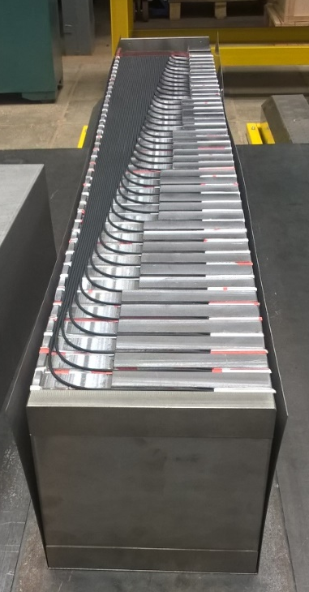
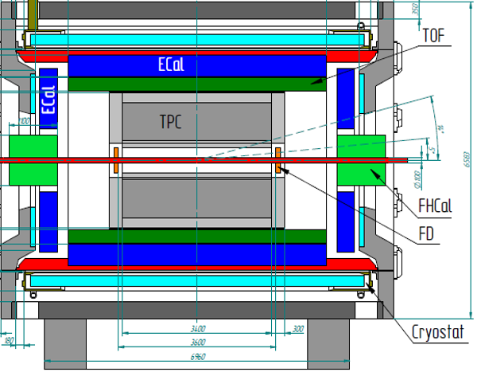
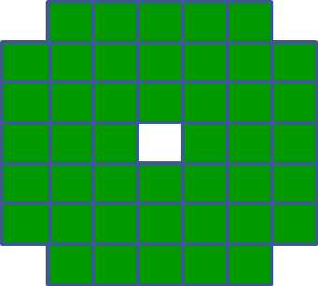
FHCal in MPD
FHCal modules
FHCal
FHCAL consists of 2x44 modules.
~1x1 m² each part.
Beam hole 15x15 cm².
Lead/scintillator sampling calorimeter.
Longitudinal segmentation;
Light readout- WLS-fibers;
7 sections/photodetectors in each module.
Two arms of hadron calorimeter at opposite sides in forward regions.
At the distance 3.2 meters from the interaction point.
Available acceptance corresponds to pseudorapidity 2.0<η <5.0

Slide 3
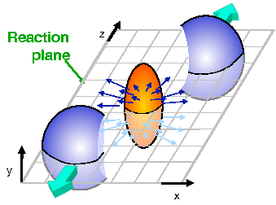

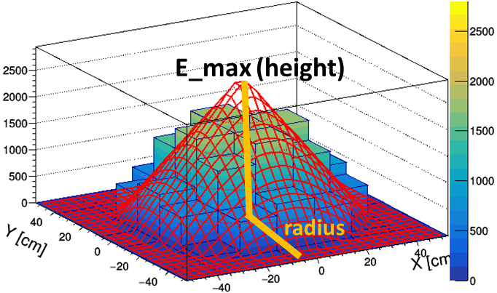
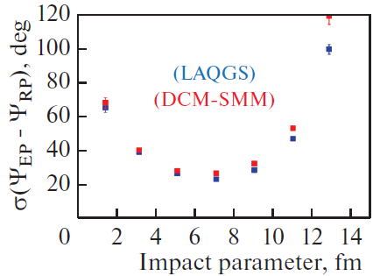
Tasks of FHCal :
The centrality of the collision;
The reaction plane orientation;
Minimum bias trigger;
Physics in forward rapidity?
Centrality:
2D-Fit of energy distributions in FHCal modules
X

Slide 4
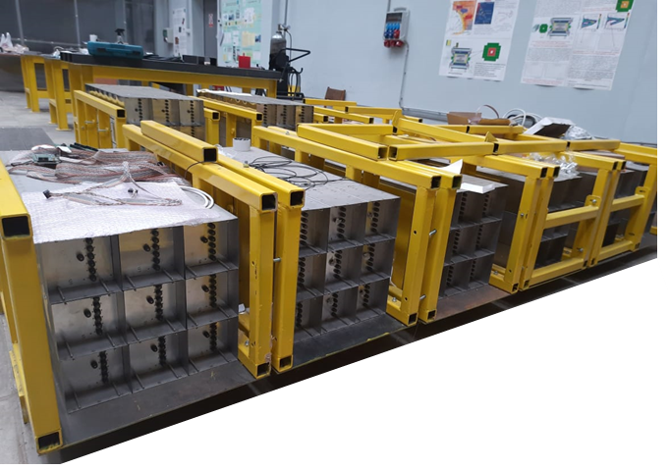
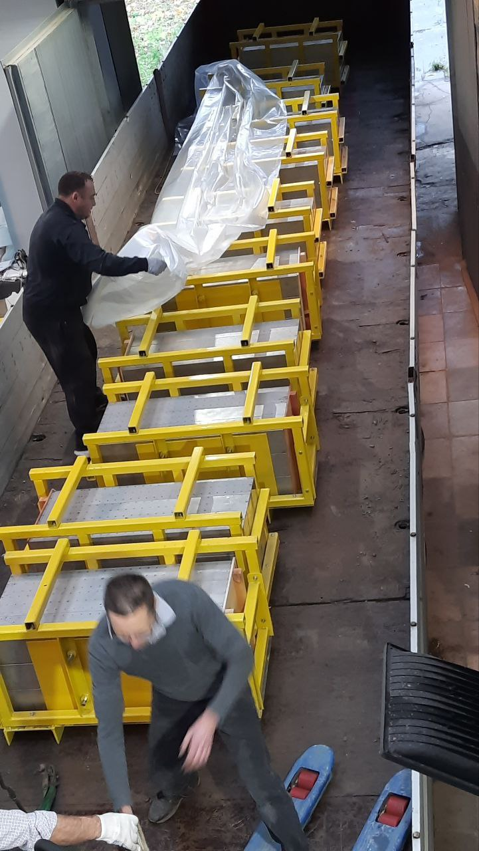
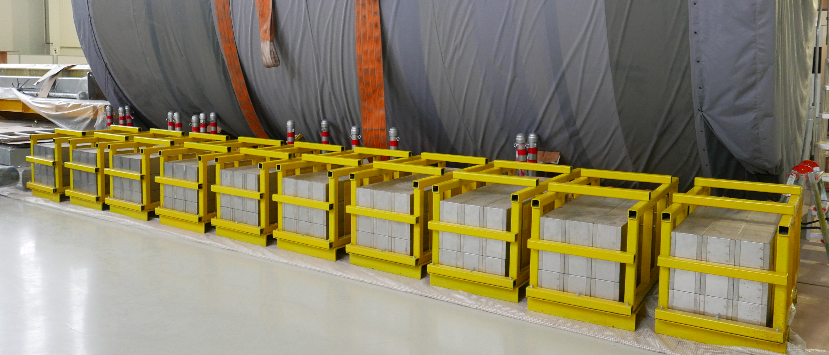
FHCal modules are at MPD hall now!
Modules in stockroom at INR
Transportation
In Nov’23
90 modules were delivered form INR to MPD hall
Modules at MPD hall

Slide 5
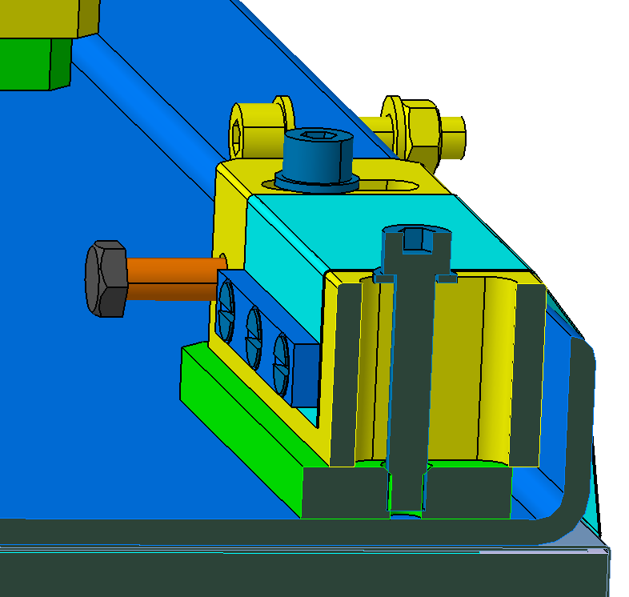
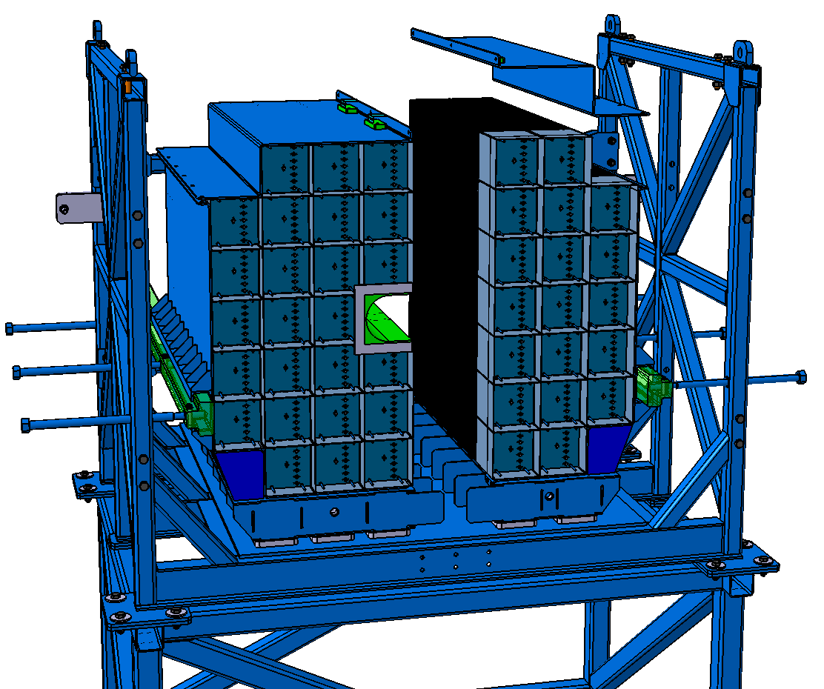
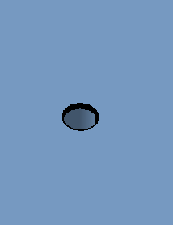
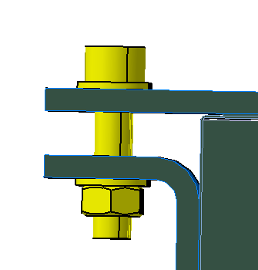
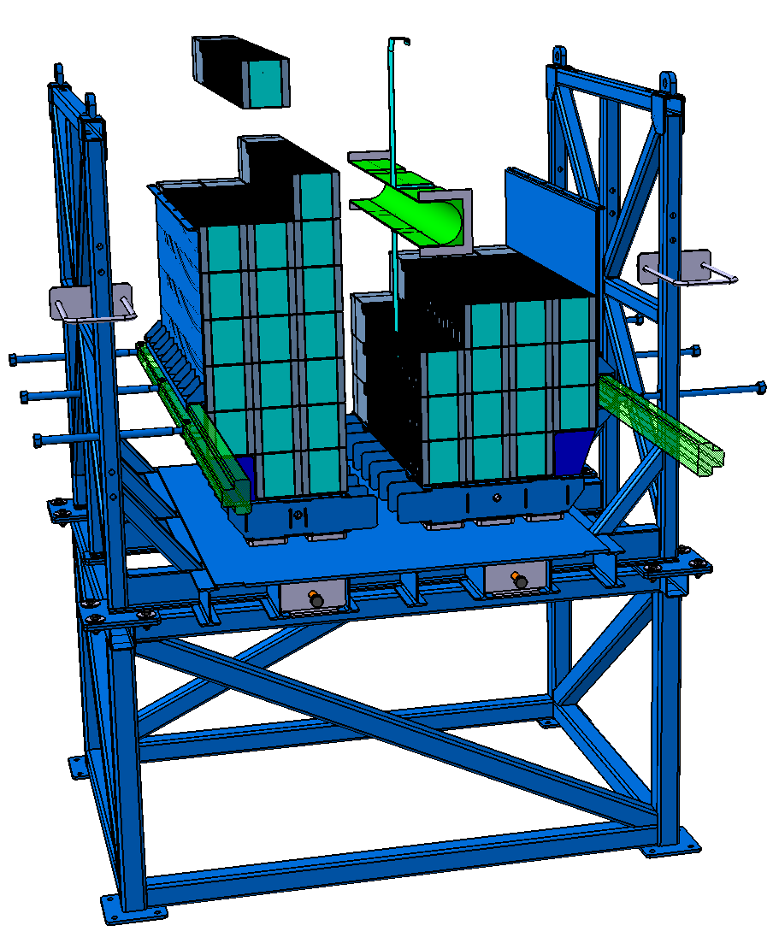
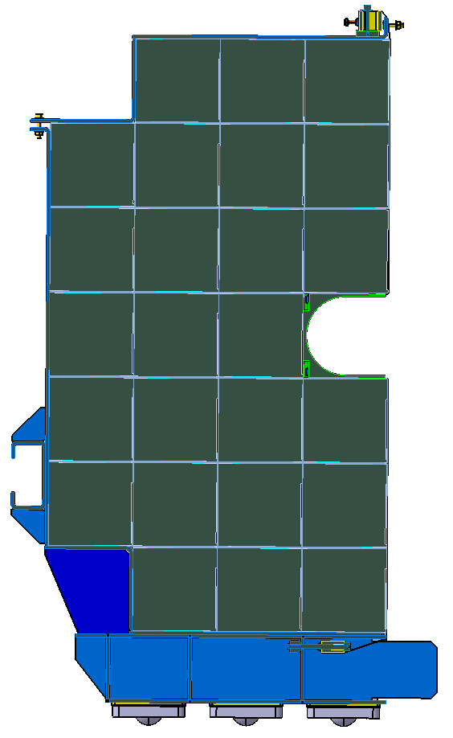
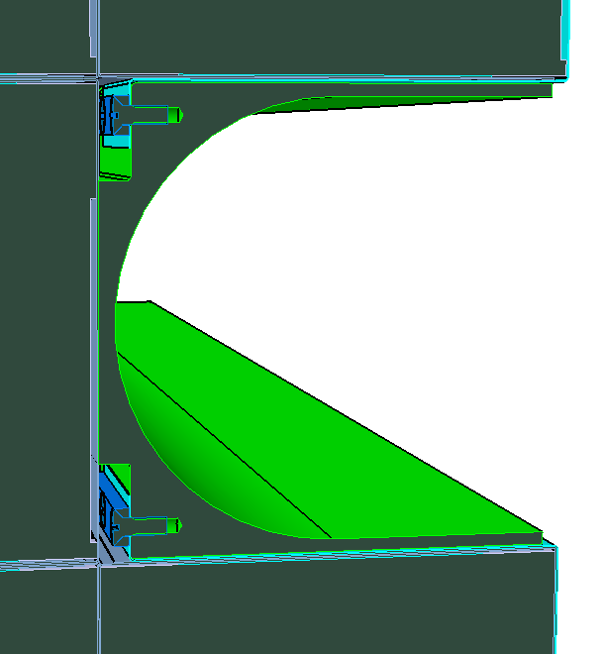
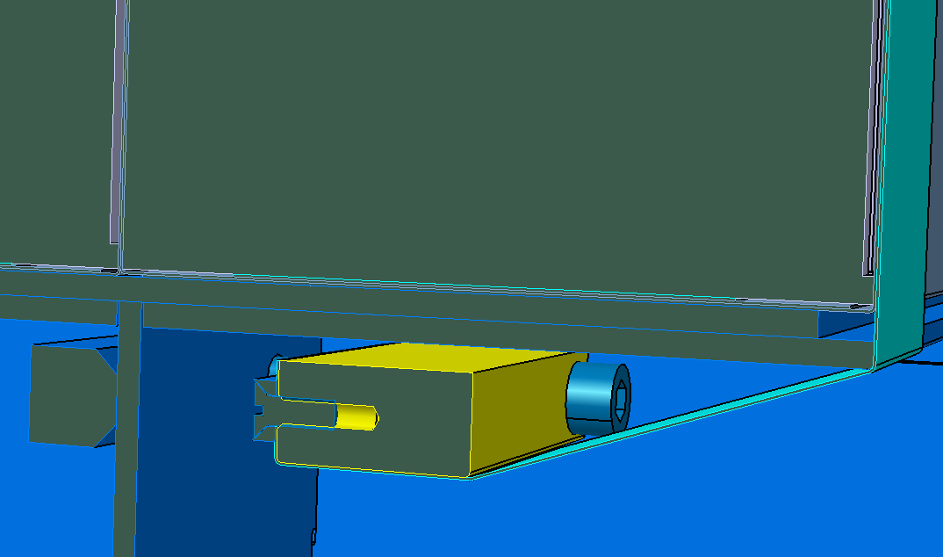
Step 1: Assembling of FHCal modules in basket
Drawings
М10 х30
M8
M6

Slide 6
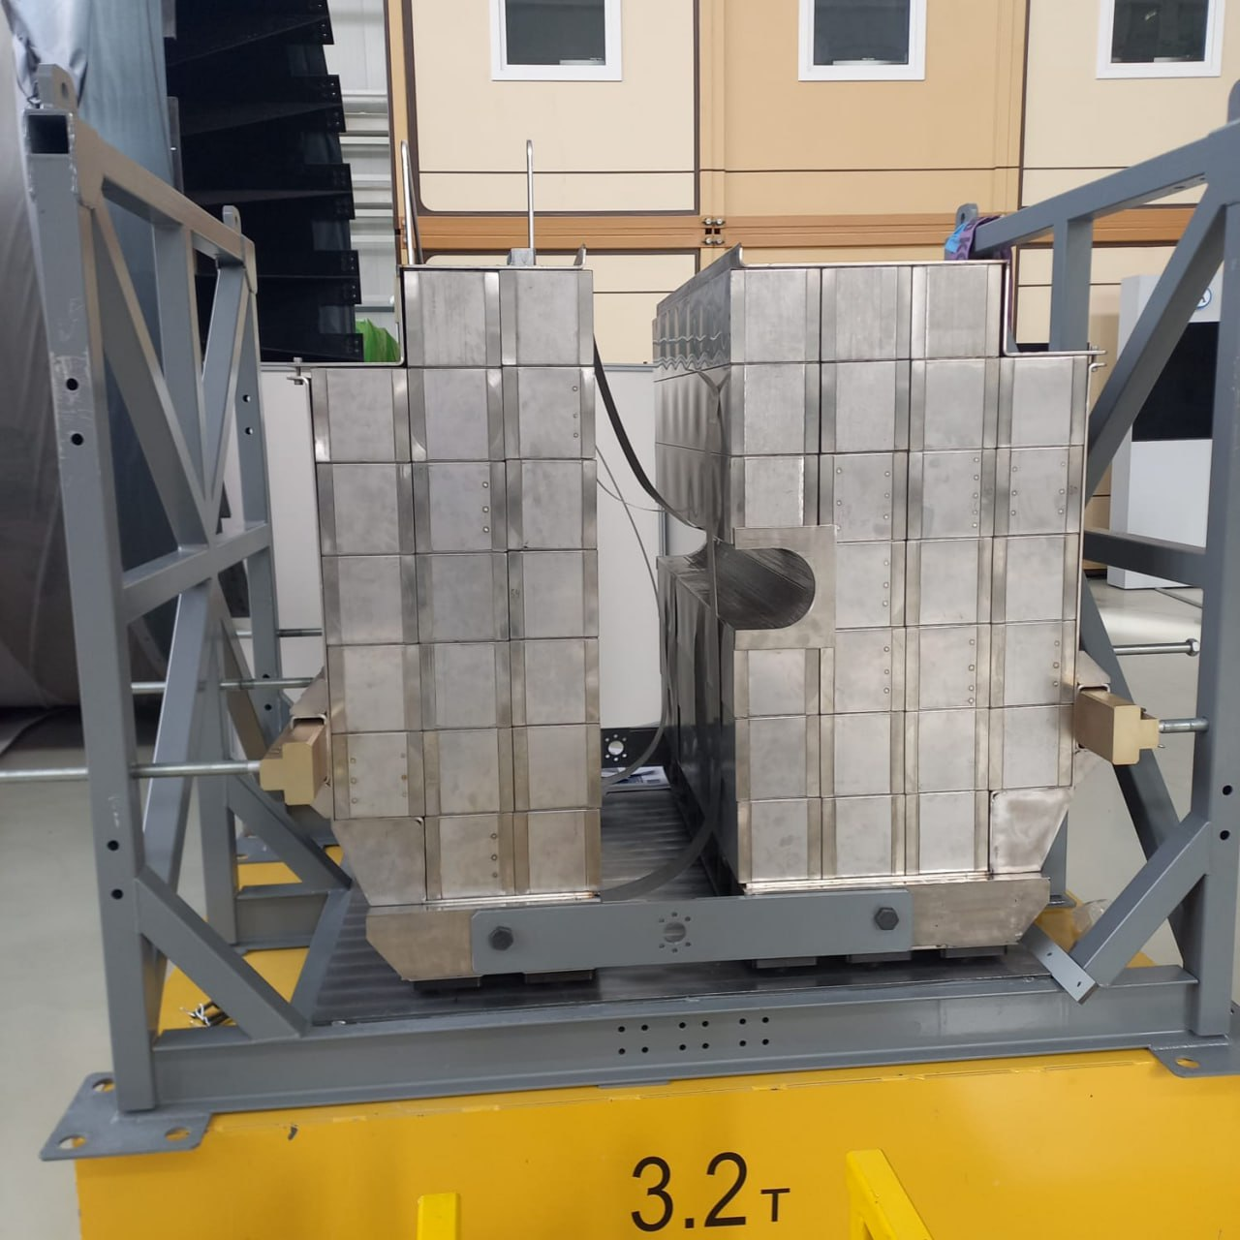
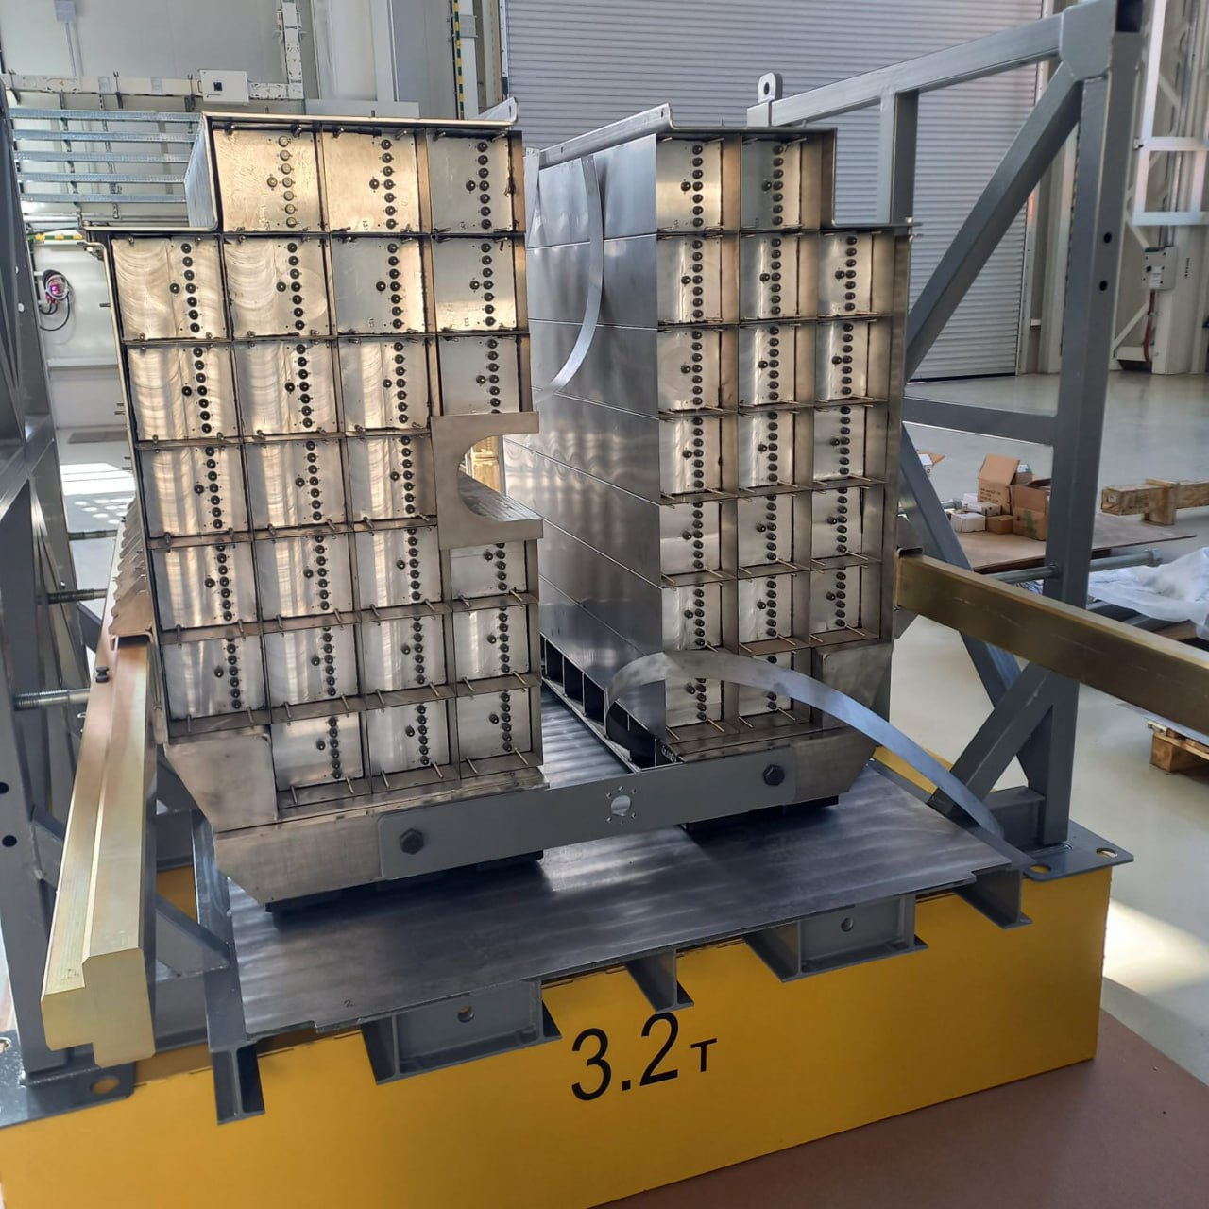
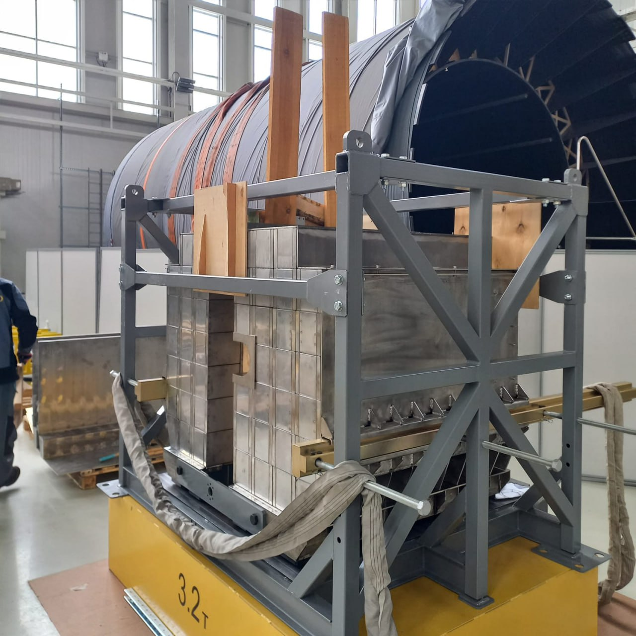
Step 1: Assembling of FHCal modules in basket
Photos from MPD hall
One FHCal arm already assembled in basket !

Slide 7
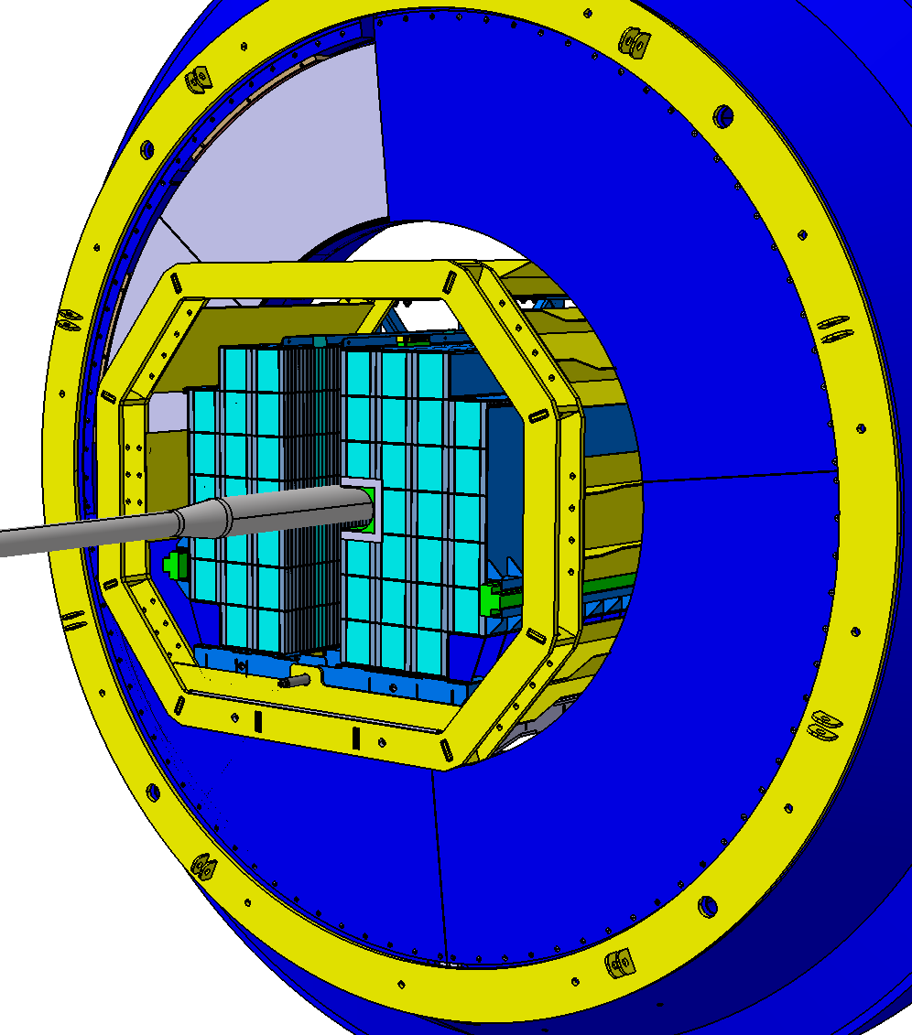
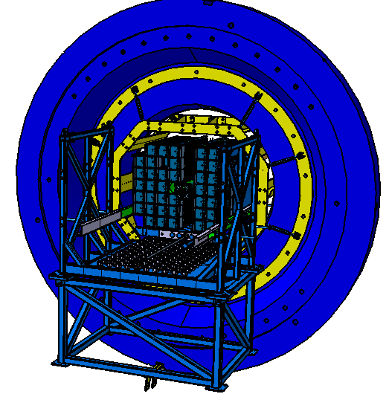
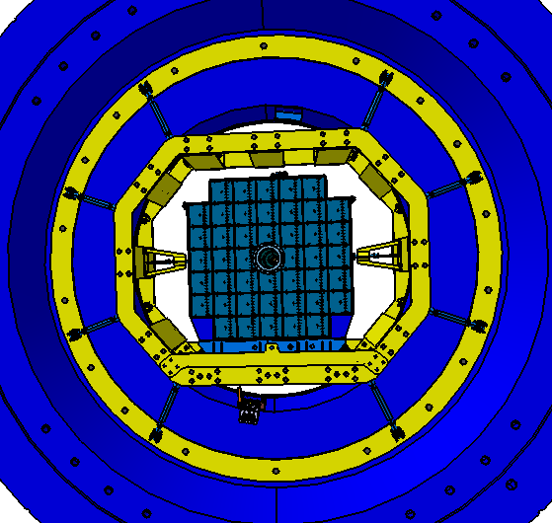
Step 2: FHCal installation into support frame (in pole)
Drawings
FHCal inserted into pole from inner side
Main problem: beam pipe between two FHCal halves
Two FHCal halves pressed together

Slide 8
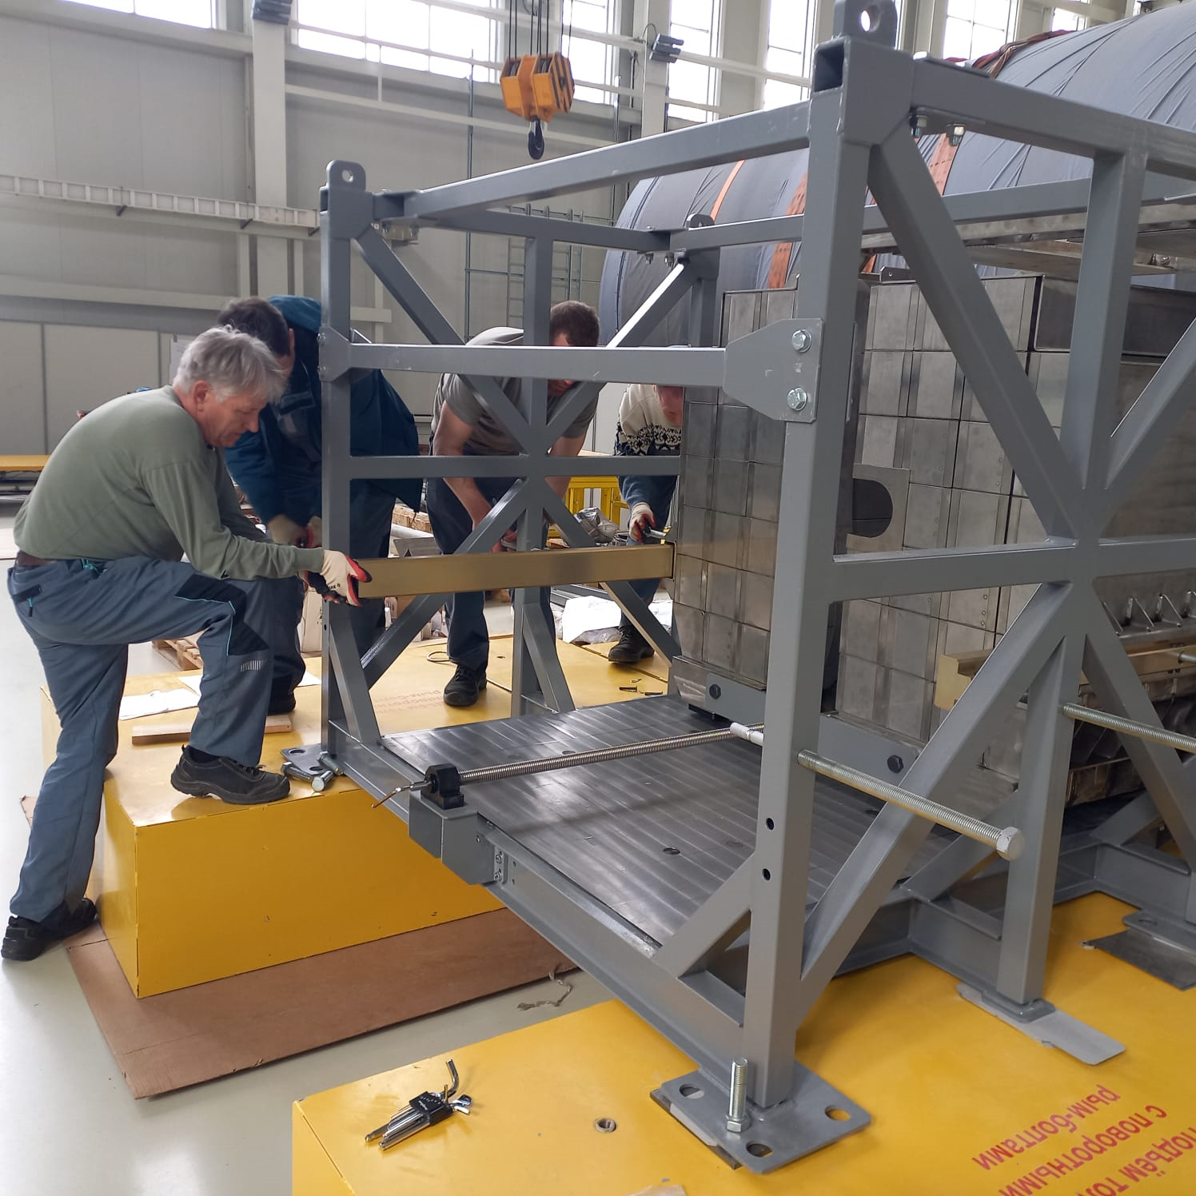
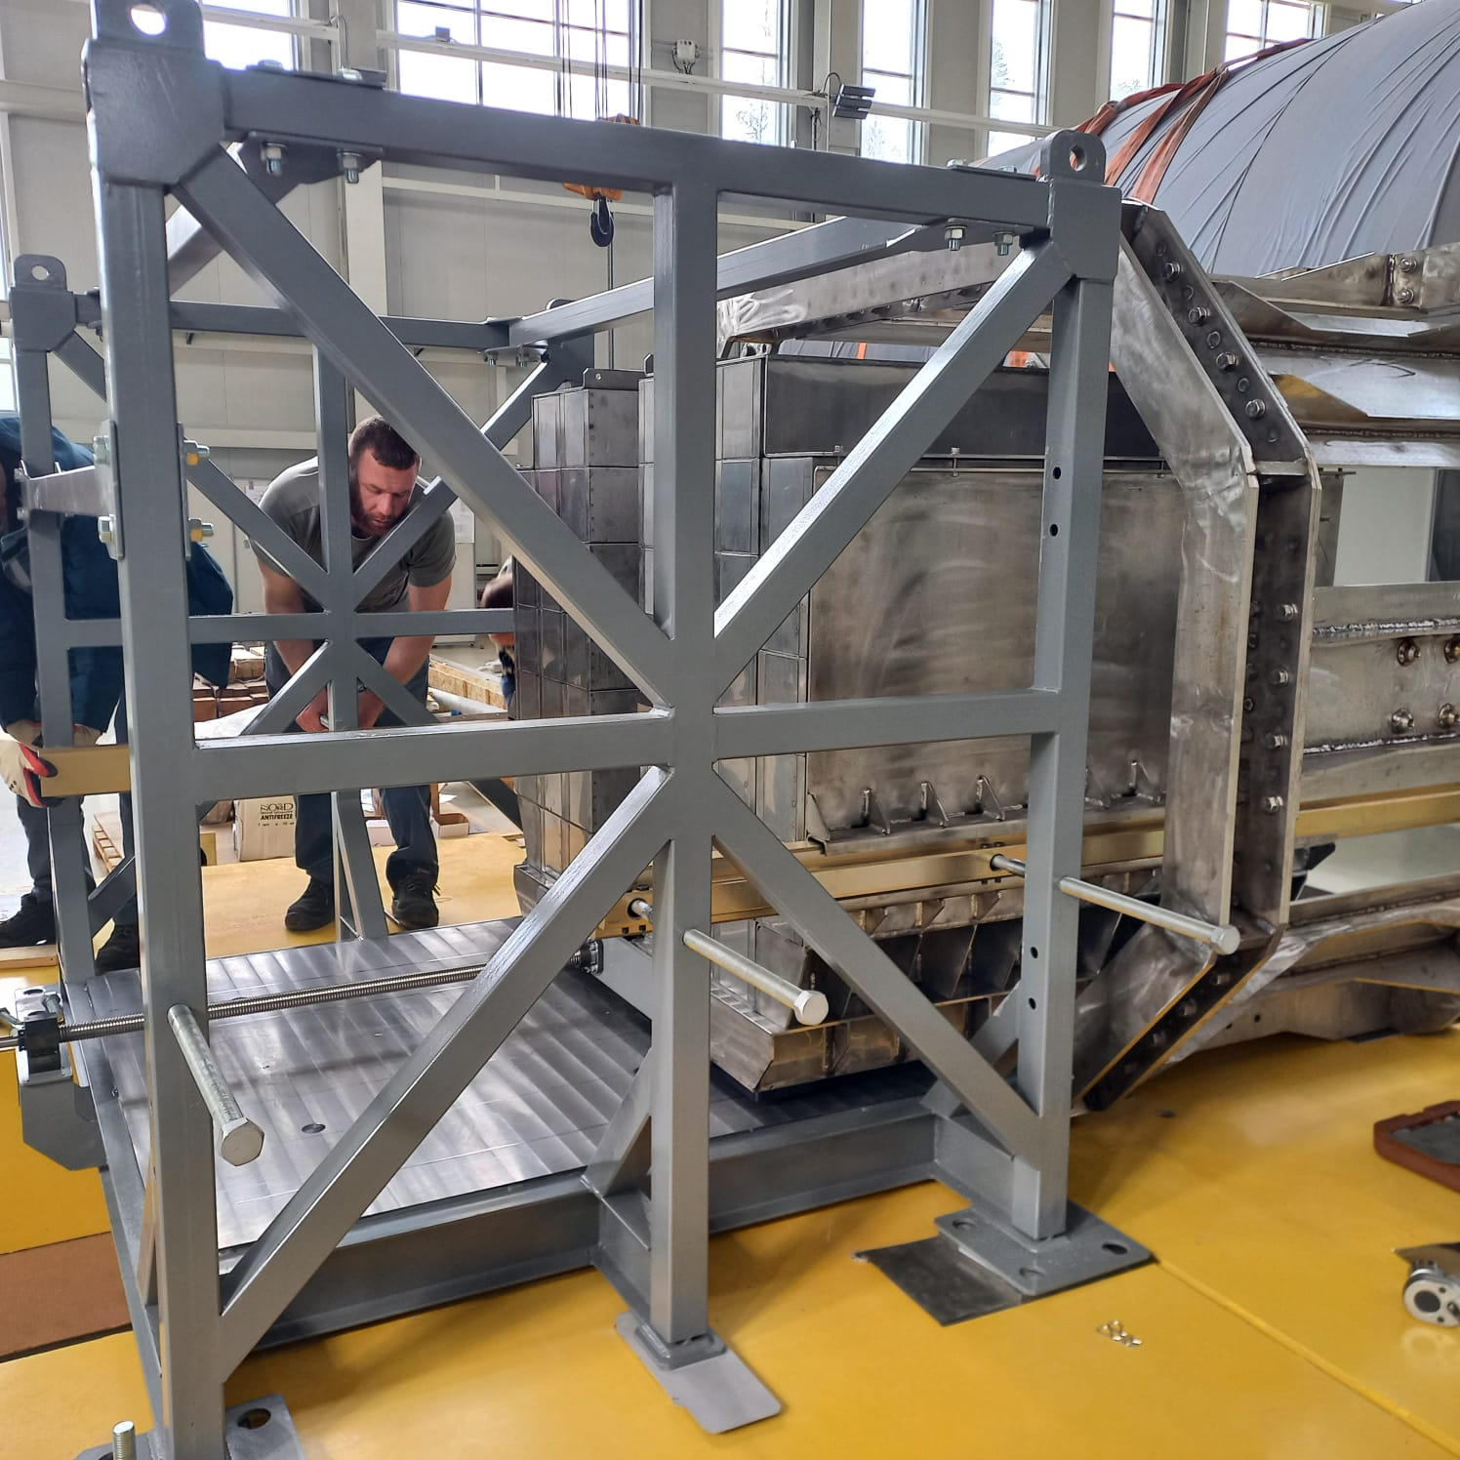
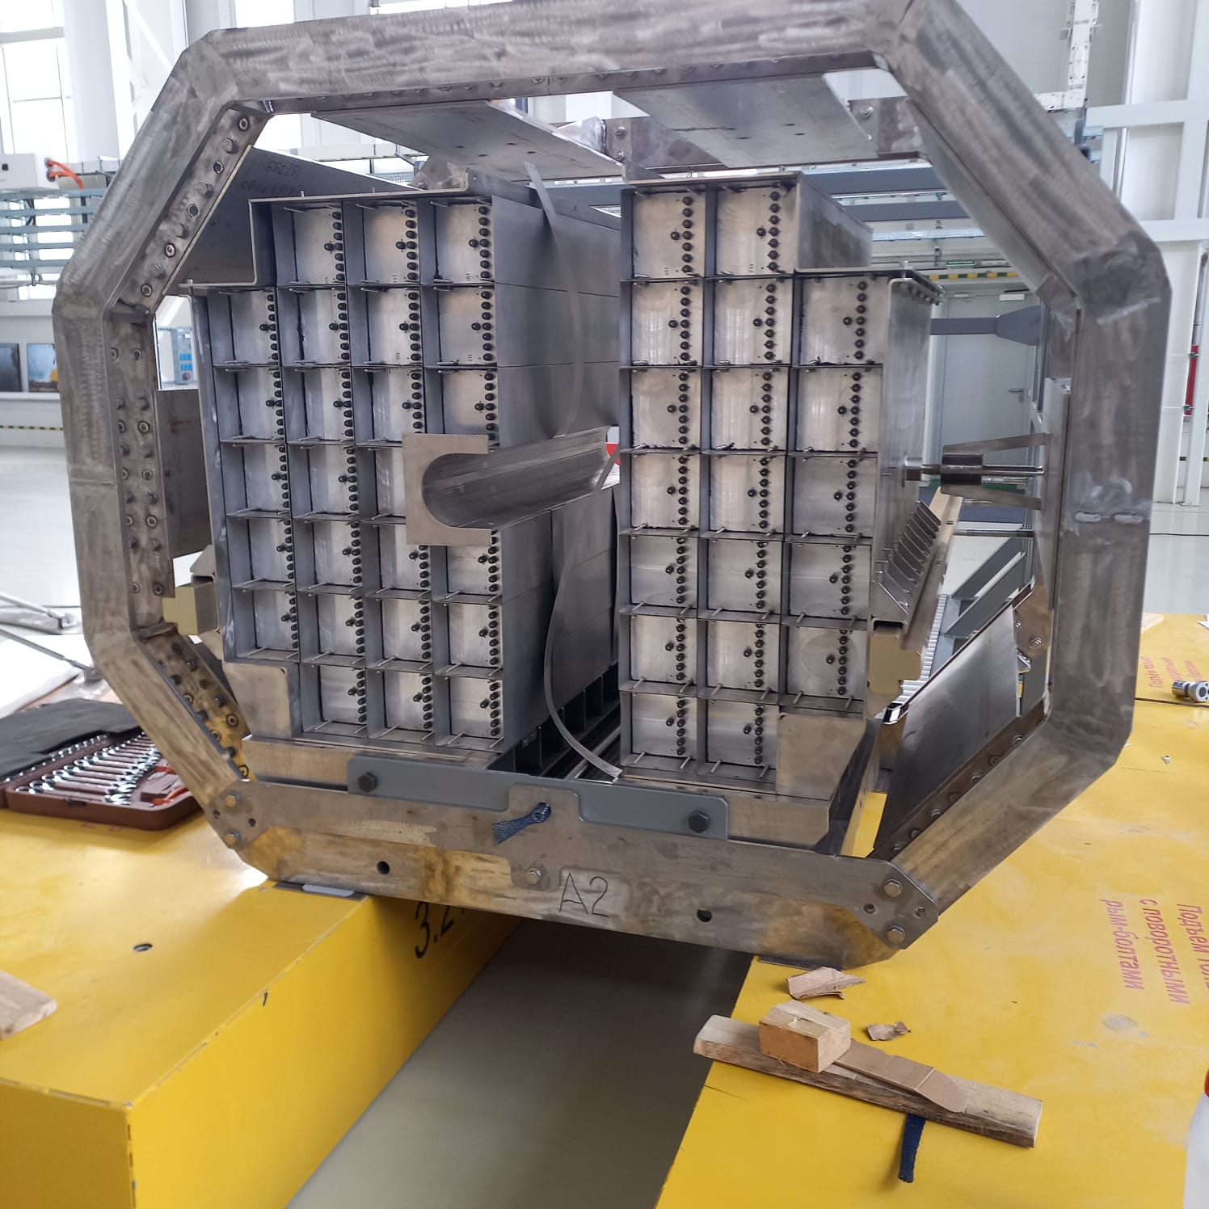
Step 2: FHCal installation into support frame (at floor)
Photos from MPD hall
FHCal arm already moved into support frame!

Slide 9
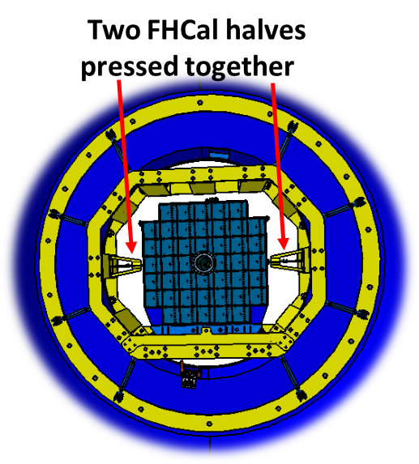
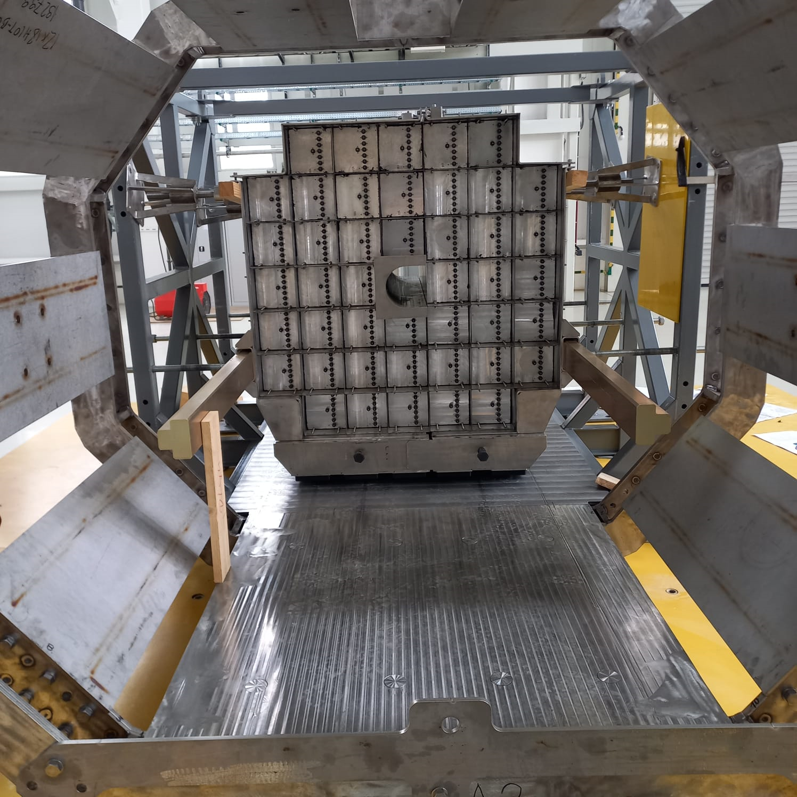
Step 3: Put FHCal parts together
Drawing
Photo from MPD hall
Can we add additional metal in central hole to symmetrize interactions around beam pipe?
Can it help in centrality reconstruction?
FHCal parts pressed together!
Up to now all manipulations with FHCal were performed at floor successfully!
Many thanks to S. Gerasimov and JINR technical group!

Slide 10
Next steps in development of FHCal
Installation of Front-End-Electronics;
Installation of Detector Control System (DCS);
Installation of readout;
Calibration with cosmic muons;
Development of FHCal trigger.

Slide 11
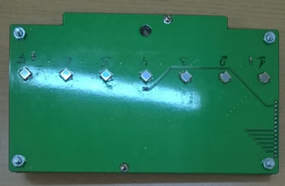
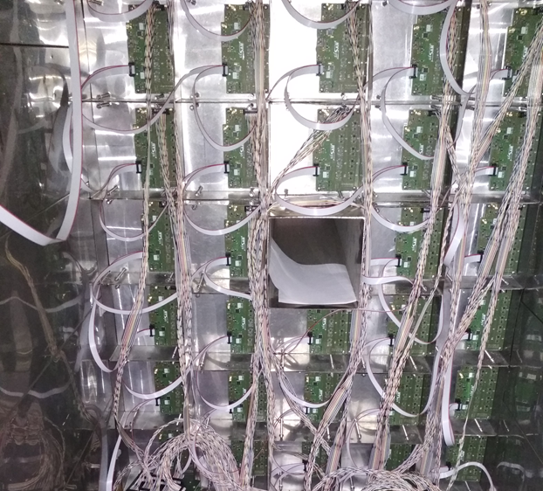
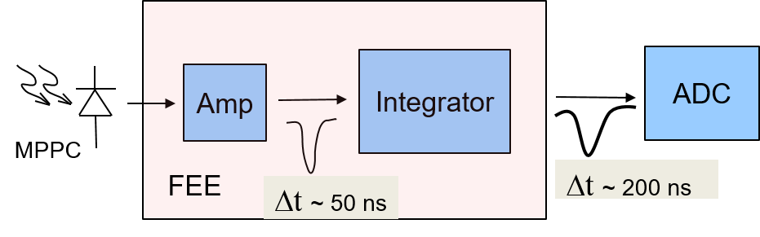
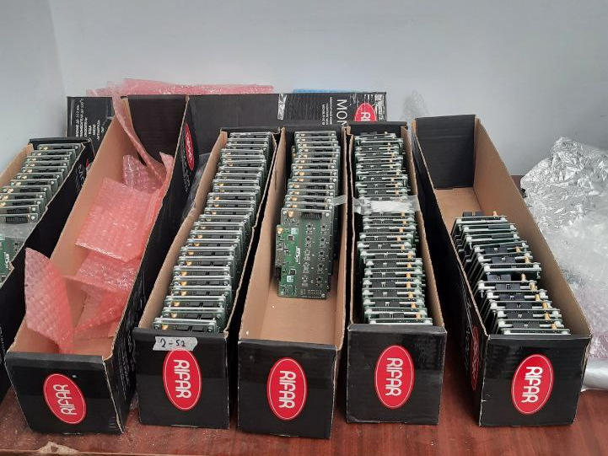
Front-End-Electronics
Two PCBs in each module with:
7 photodetectors ;
Photodetectors – MPPCs;
two-stage amplifiers;
HV channels;
LED calibration source.
MPPC: S14160-3010PS
size – 3x3 mm²;
pixel -10x10 µm²;
PDE~18%.
FHCal modules are currently equipped with FEE in the MPD hall.

Slide 12
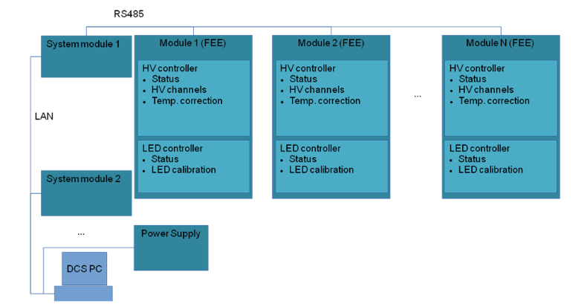
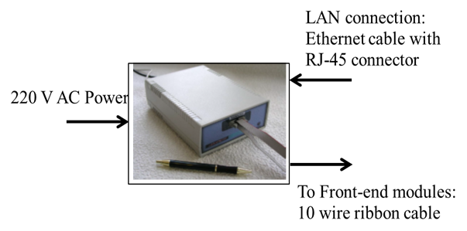
Detector Control System (DCS)
DCS Tasks:
Control of HV at photodetectors (MPPC’s);
Temperature control of photodetectors;
Compensation of temperature drift of MPPC gain;
Monitoring of MPPC gain with stabilized light source.
DCS open question:
Cabling for RS485 bus (now flat cables)?
Pick up noises in real environment ?
Place for System Module: near calorimeter or in Control Room?
LAN
RS485
General
Slow Control
FHCal New Slow
Control (proxy)
System Module
FEE
FEE
FEE
System Module
FEE
Database
FEE
FEE
Connection diagram
Hardware:
System Module (HV sys. Co.)

Slide 13
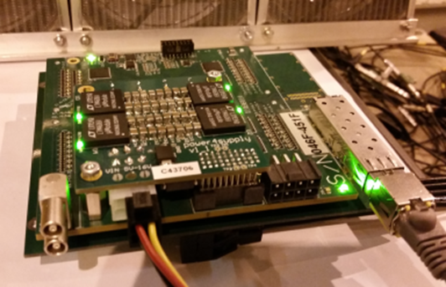
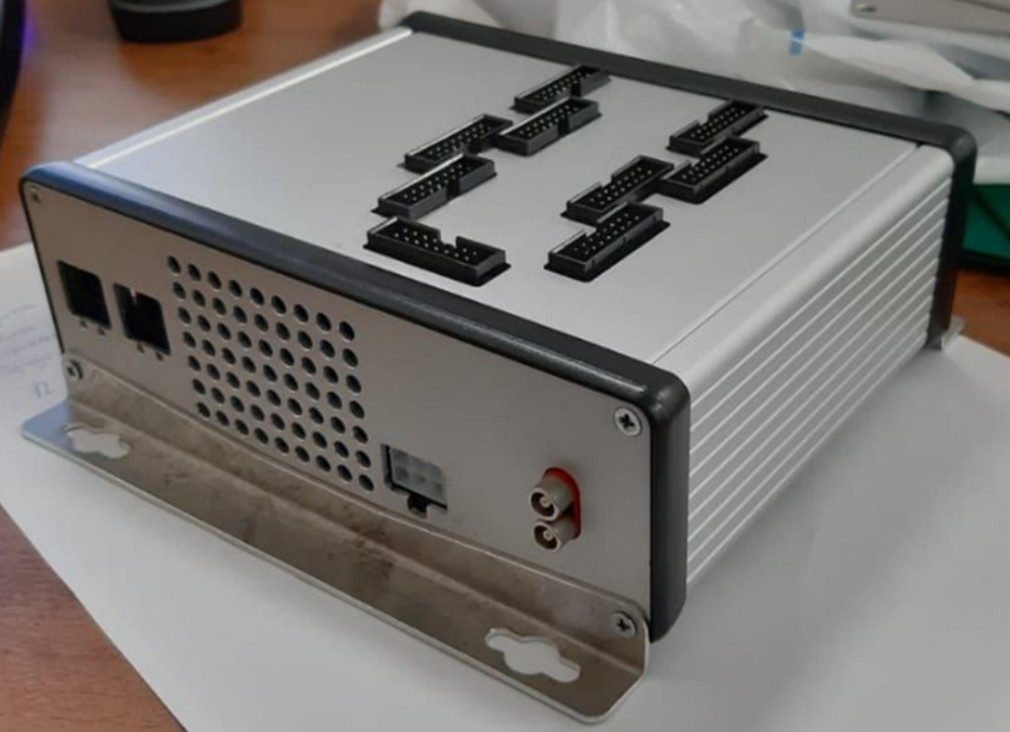
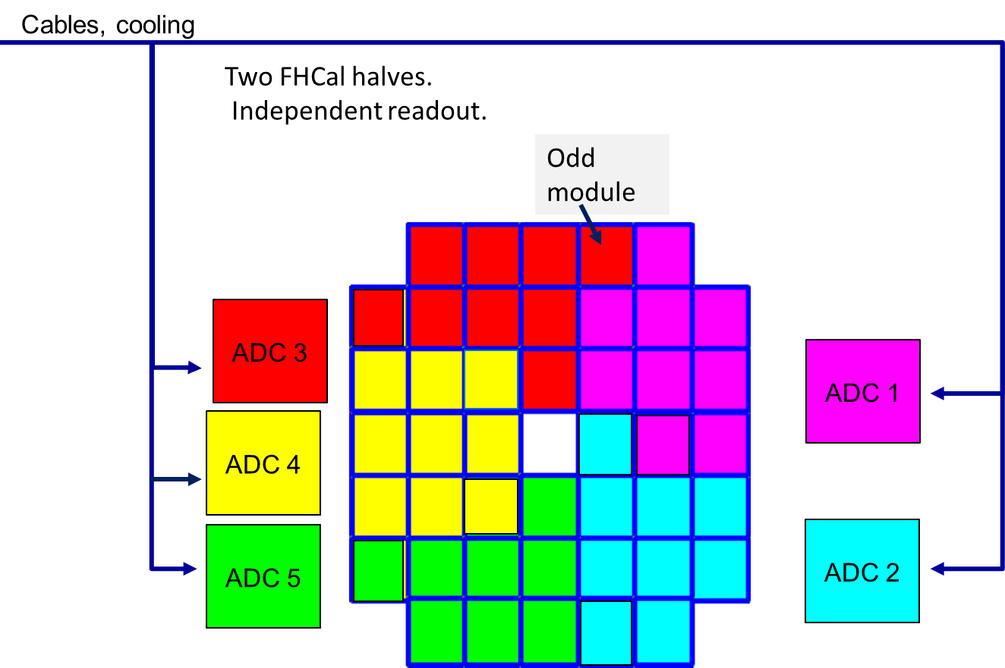
ADC signal readout
FPGA based 64 channel ADC64 board, 62.5MS/s (AFI Electronics, JINR, Dubna).
5 ADCs for each arm of FHCal
All 10 ADC boxes are tested and ready for installation.
Open questions for readout:
Would ADC be replaced by new ECAL-type modules? (Fast ADC for FHCal trigger)?
ADC cooling? Pipes for air?
Two halves of FHCal.

Slide 14
FHCal readout and control
FHCal arm
on detector
signal cables
1
FEE
near detector
~20m cables
DAQ
2
FEE
ADC64 (1)
(9 modules)
…
ADC64 (2)
(9 modules)
44
FEE
power supply
…
ADC64 (5)
(8 modules)
DCS Control box
HVsys
- Ethernet
General Control System
Both FHCal arms have the same readout scheme.

Slide 15
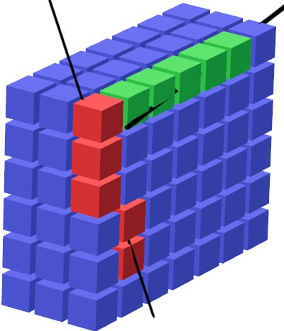
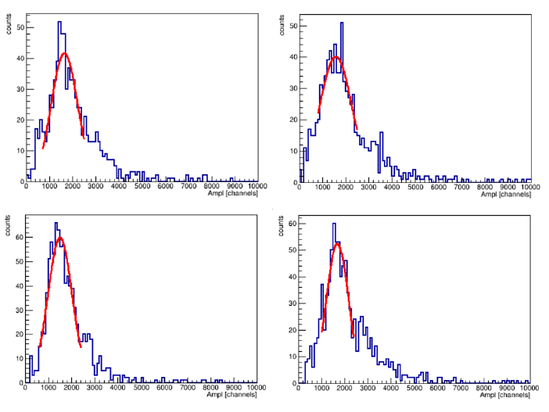
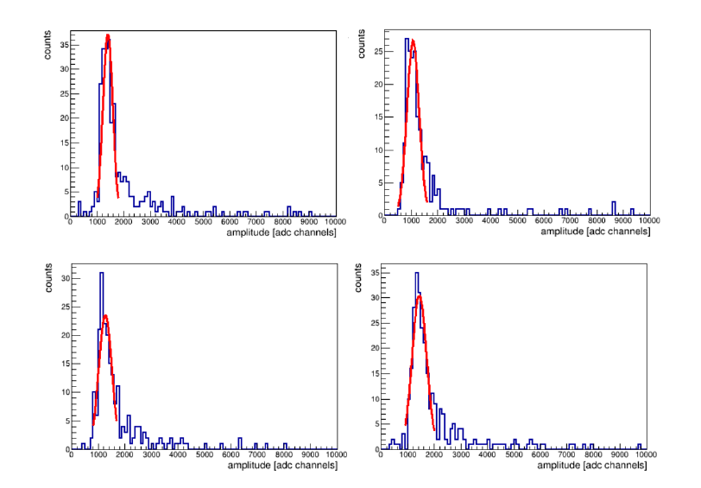
Energy calibration with cosmic nuons
Response of FHCal modules to cosmic muons with different track geometries.
Vertical muons
Wide peaks;
Short time for collection;
(one day data acquisition);
Energy deposition should be normalized for horizontal muons;
Horizontal muons
Energy deposition 5 MeV;
Narrow peak;
But long time for collection;
(one week data acquisition);
Required at least one time.
Tests done for FHCal prototype.
Must be done for full FHCal.

Slide 16
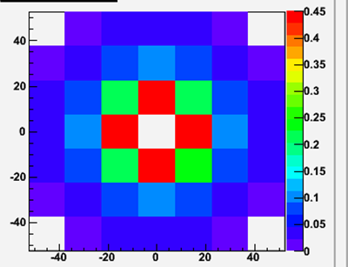
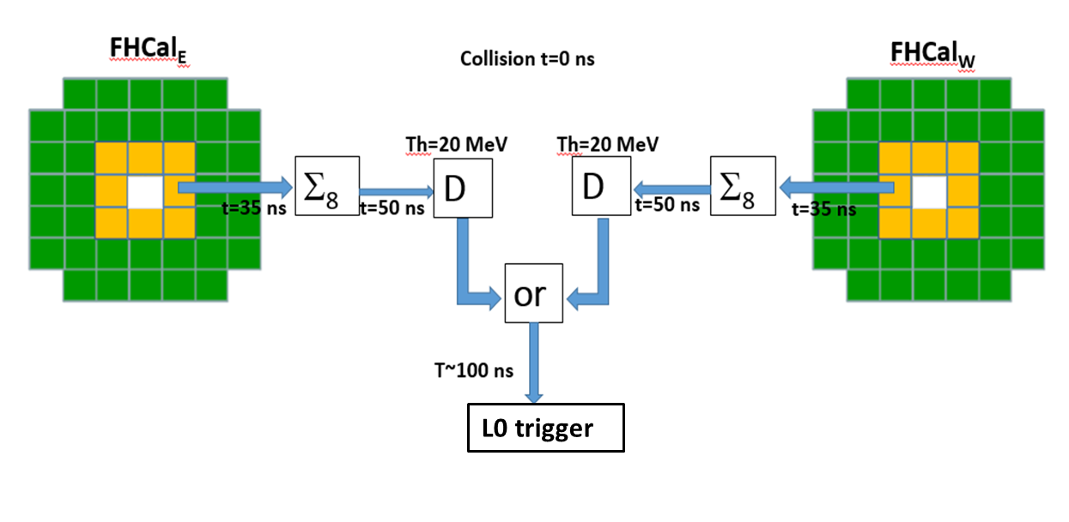
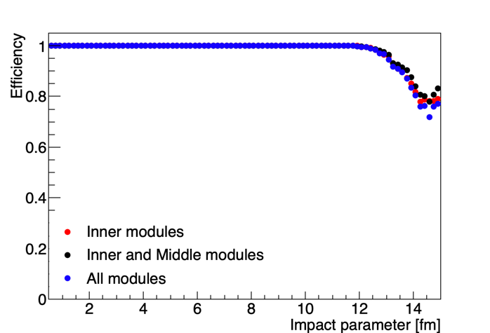
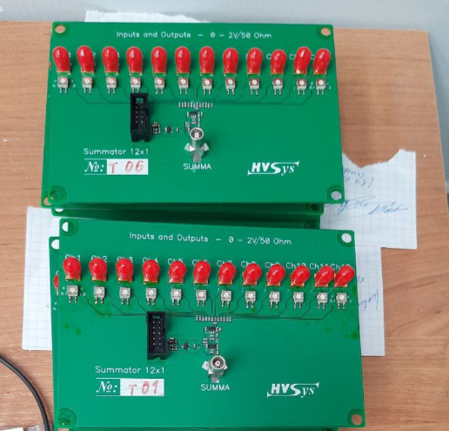
FHCal trigger (analog version)
Scheme of FHCal trigger
12-channels signal adders
Threshold 2 MeV/module
Trigger efficiency ~98%
Adders of analog signals from individual modules were produces for full FHCal.
The configuration of modules in trigger would depend on FEE and correlation noises. Flexible configuration is to be developed.
Dependence of trigger efficiency on the configuration of modules (Au-Au 11 GeV).

Slide 17
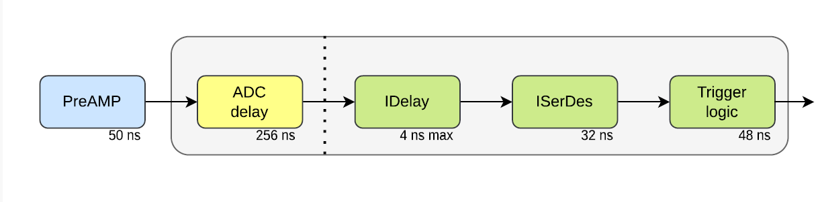
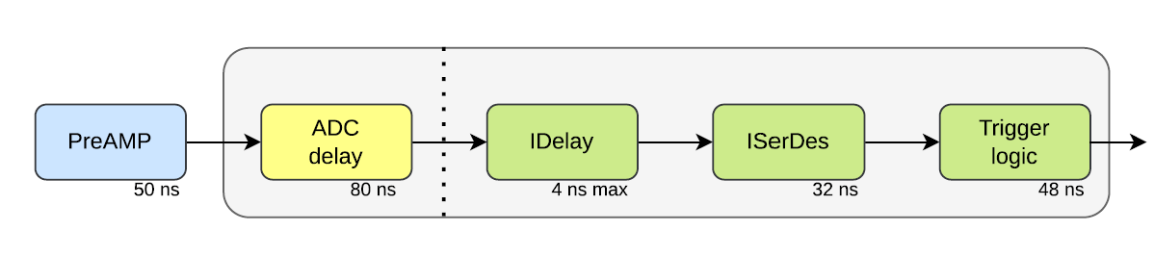
Digital FHCal trigger ? (Data from MPD trigger group)
Version ADC64s2 V5.0 prepared for FHCal
Total delay time 387 ns
New version ADC64ECAL prepared for ECal
Total delay time 237 ns (150 ns shorter)
New ADC modules allow arrangement of FHCal trigger logic with digitized signals instead of analog adders!?

Slide 18
Summary (open questions)
Timetable for FHCal installation?
One or two FHCal arms at the beginning?
Cabling for ADC and DCS?
Place for DCS System Module?
What ADCs (previous or new Ecal type)?
What FHCal trigger (analog or digital)?
Pipes with cooling air for ADCs?

Slide 19
Thank you!

Slide 20
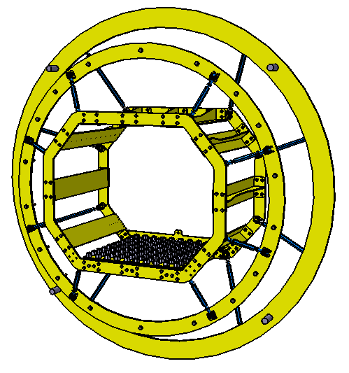
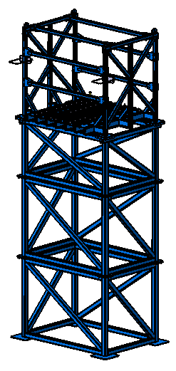
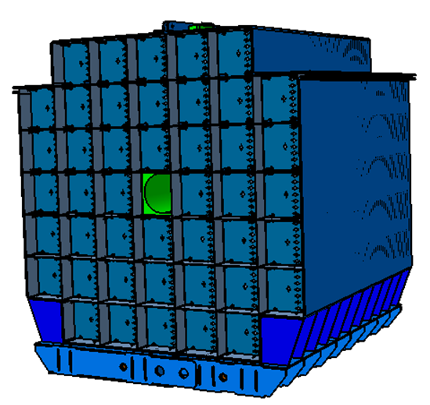
Mechanical support (main elements)
Support frame in magnet pole
Outer table
Basket of FHCal modules
Пластина
Design of all elements was finished!
The production starts now!

Slide 21
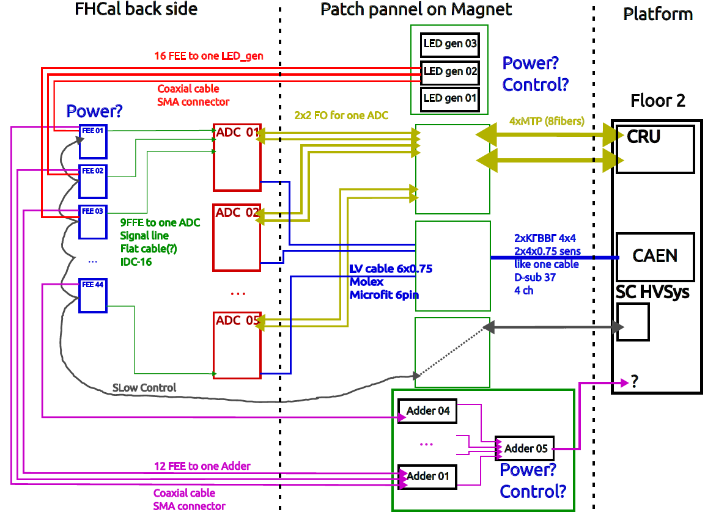

FHCal cabling
Prepared by
M. Rumyantsev
Patch panel is not ready.
Must be constructed in nearest time

