Slide 1
Anisotropic flow measurements at Nuclotron-NICA and Equation of State
Petr Parfenov^{1,2,3}, Mikhail Mamaev^{1,2,3}, Valery Troshin^{1,2}, Arkadiy Taranenko^{1,2}
With big help from Andrey Moshkin (VBLHEP JINR) and Dmitry Podgainy (LIT JINR)
¹VBLHEP JINR, Dubna
²National Research Nuclear University MEPhI, Moscow
³INR RAS, Moscow
For the MPD Collaboration
XIII MPD Collaboration Meeting, Dubna, Russia, 23-25 April 2024
This work is supported by: the NRNU program Priority 2030, grant RSF no. 22-12-00132

Slide 2
Outline
Introduction:
EoS for high badyon density matter
Anisotropic flow at Nuclotron-NICA
Extracting EoS information using $v_{n}$
Comparison of $v_{n}$ results from models and experiments
Comparison with HADES, STAR results
Scaling with system size
Summary and Outlook

Slide 3
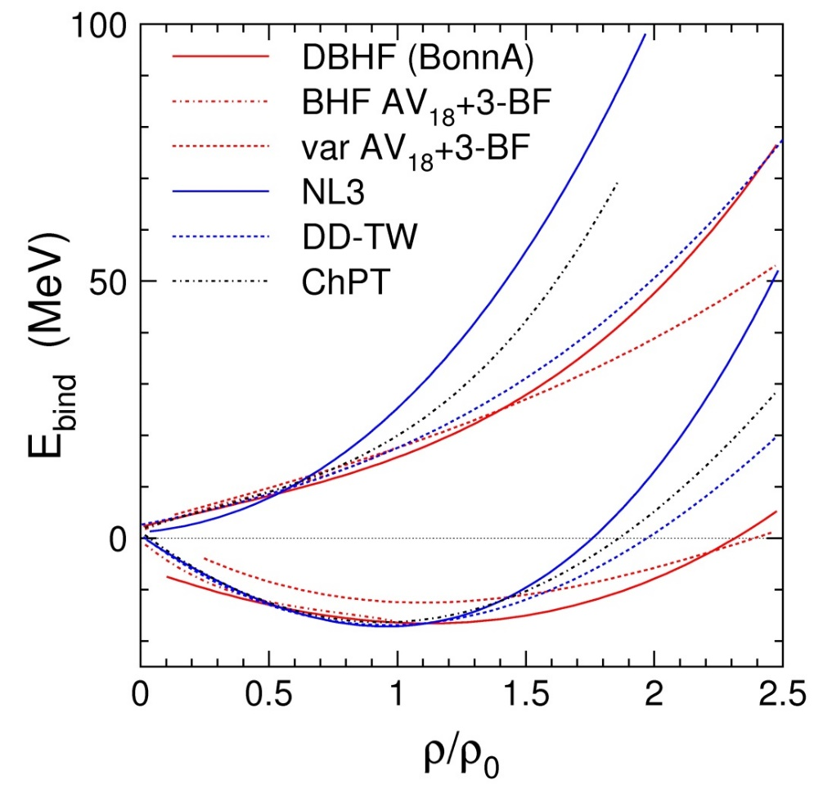
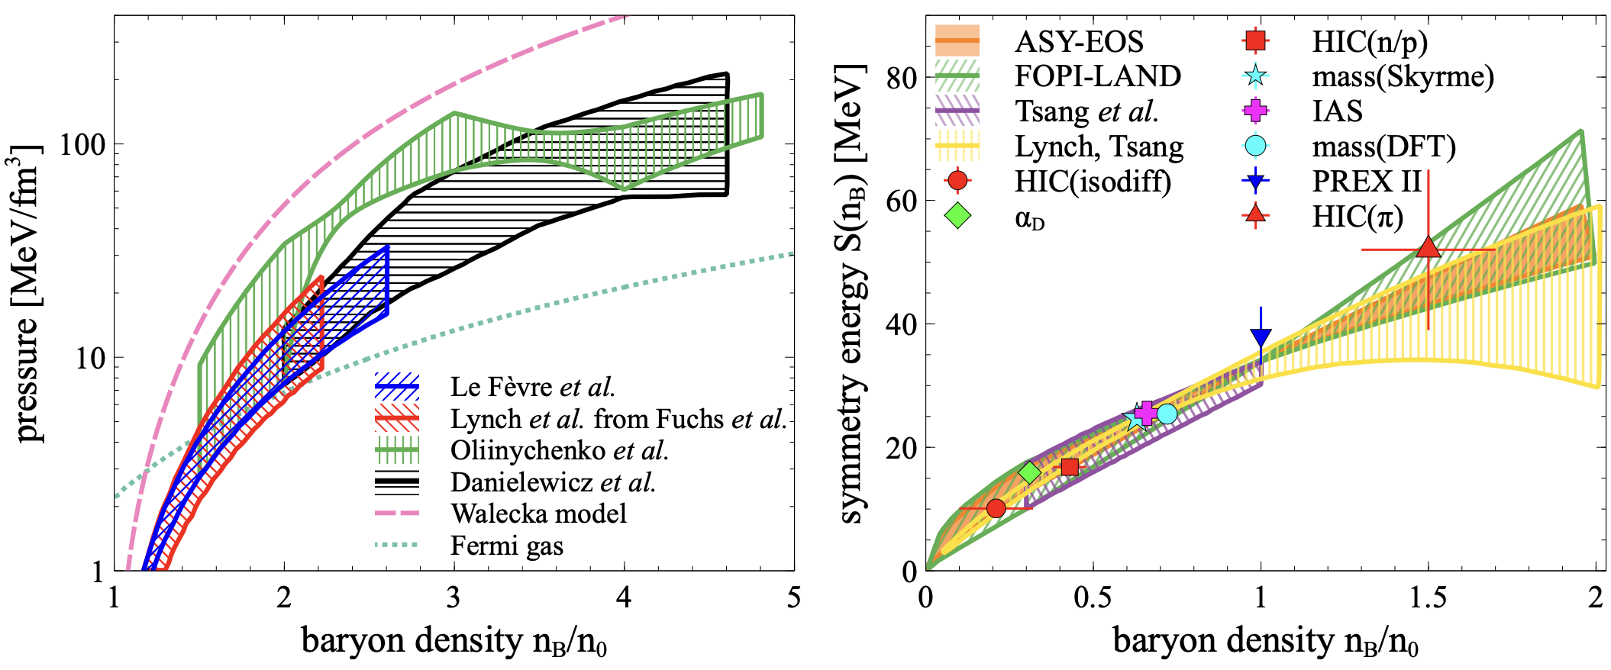
EOS for high baryon density matter
The binding energy per nucleon:
Isospin asymmetry:
Symmetric matter
Symmetry energy
Neutron matter
E/A
E_{sym}
Symmetric matter
Ch. Fuchs and H.H. Wolter, EPJA 30 (2006) 5
A. Sorensen et. al., Prog.Part.Nucl.Phys. 134 (2024) 104080
New data is needed to further constrain transport models with hadronic d.o.f.

Slide 4
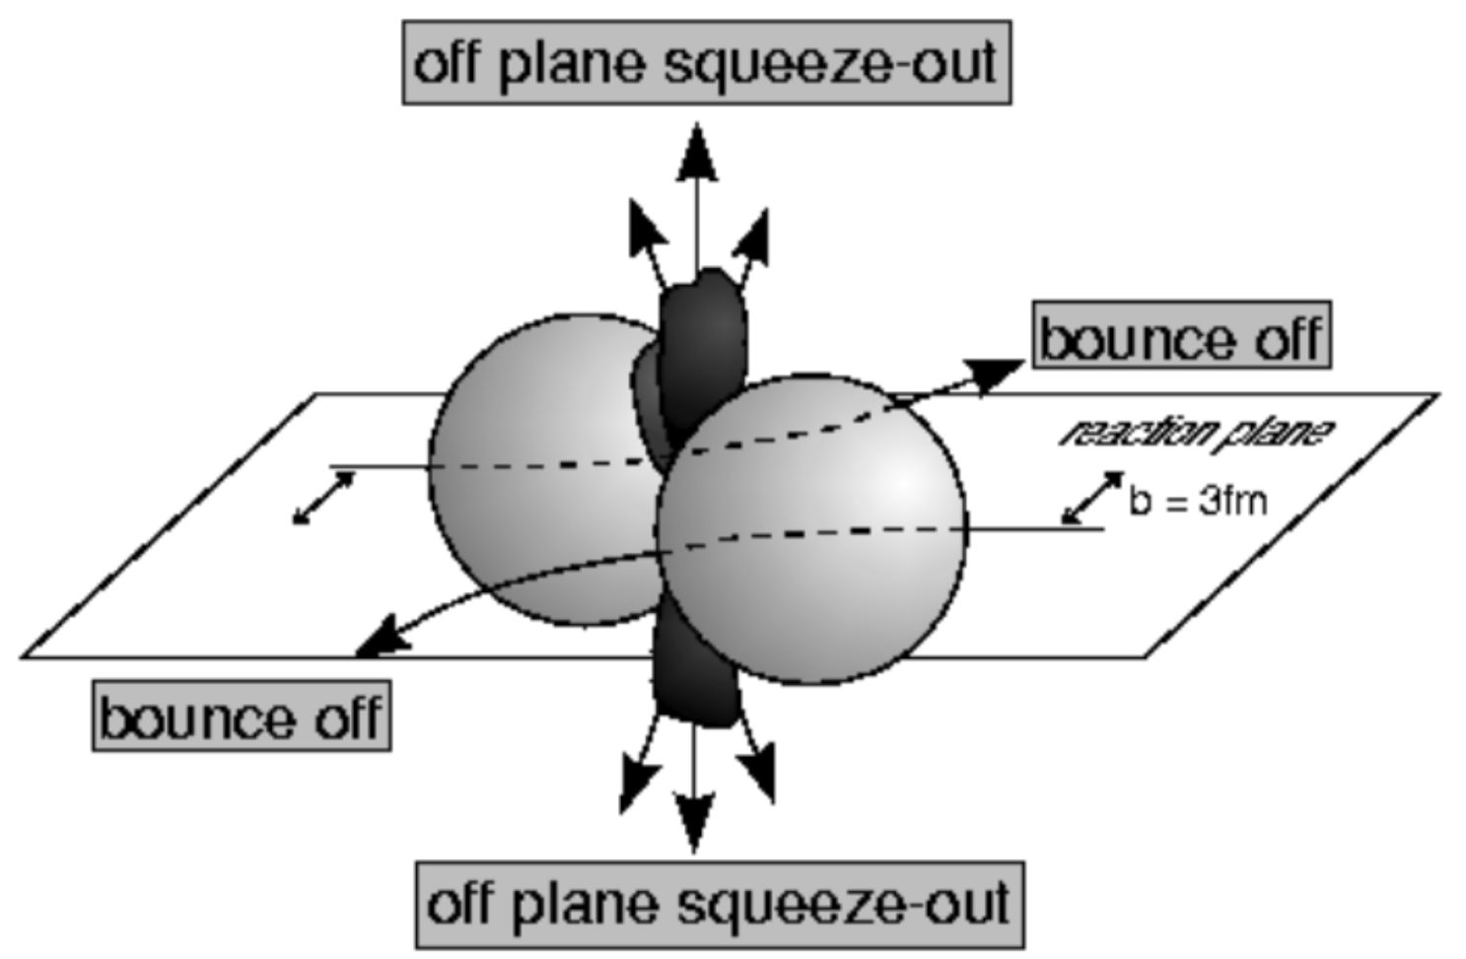
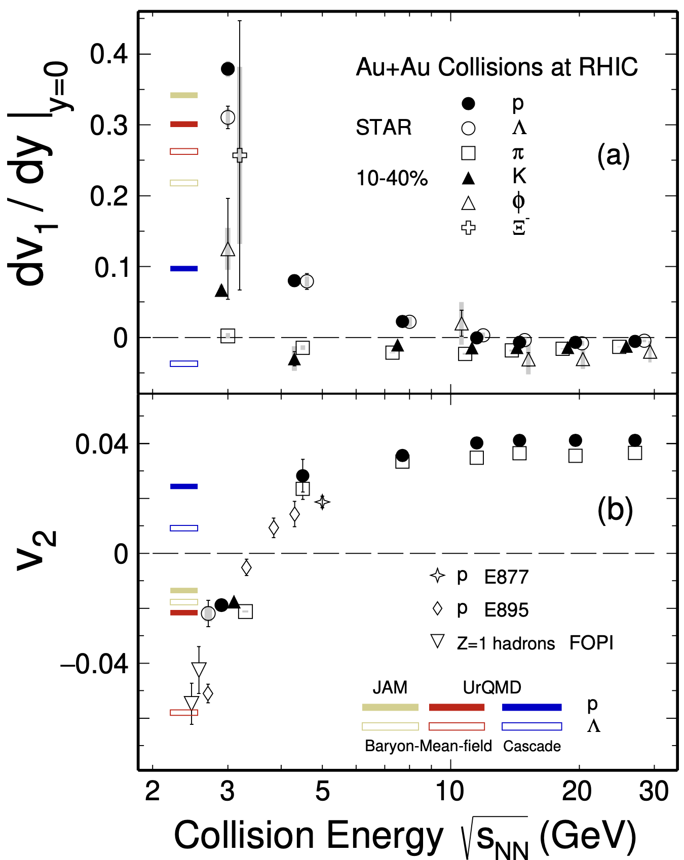
Anisotropic flow at Nuclotron-NICA energies
STAR, Phys.Lett.B 827 (2022) 137003
$$\frac{dN}{dφ}∝1+2\sum_{n=1}{v_{n}\cos\left[n\left(φ−Ψ_{RP}\right)\right]}$$
$$v_{n}=\left\langle \cos\left[n\left(φ−Ψ_{RP}\right)\right]\right\rangle$$
v₁ – directed flow, v₂ – elliptic flow
BM@N
MPD
MPD-FXT
Strong energy dependence of $dv_{1}/dy$ and $v_{2}$ at $\sqrt{s_{NN}}$=2-11 GeV
Anisotropic flow at FAIR/NICA energies is a delicate balance between:
The ability of pressure developed early in the reaction zone ($t_{exp}=R/{c_{s}}$)
The passage time for removal of the shadowing by spectators ($t_{pass}={2R}/{γ_{CM}β_{CM}}$)
16.05.2023
XIII MPD CM
Notes:
One more way to study the properties of the matter created in the collision is through the lens of collective motion of created in the collision particles.
We can decompose the azimuthal distribution of produced particles with respect to RP in a FS
Coefficients …
The main mechanisms driving the direced and elliptic flow are
Bounce off for directed flow — when two nuclei collide, the remnants are deflected out from the overlap region and pull the matter created in the collision apart
Squeeze out for elliptic flow — when the remnants of colliding nuclei are pushing the matter within the overlap region and squeeze the produced particles out of reaction plane
Collective flow is sensitive to …

Slide 5
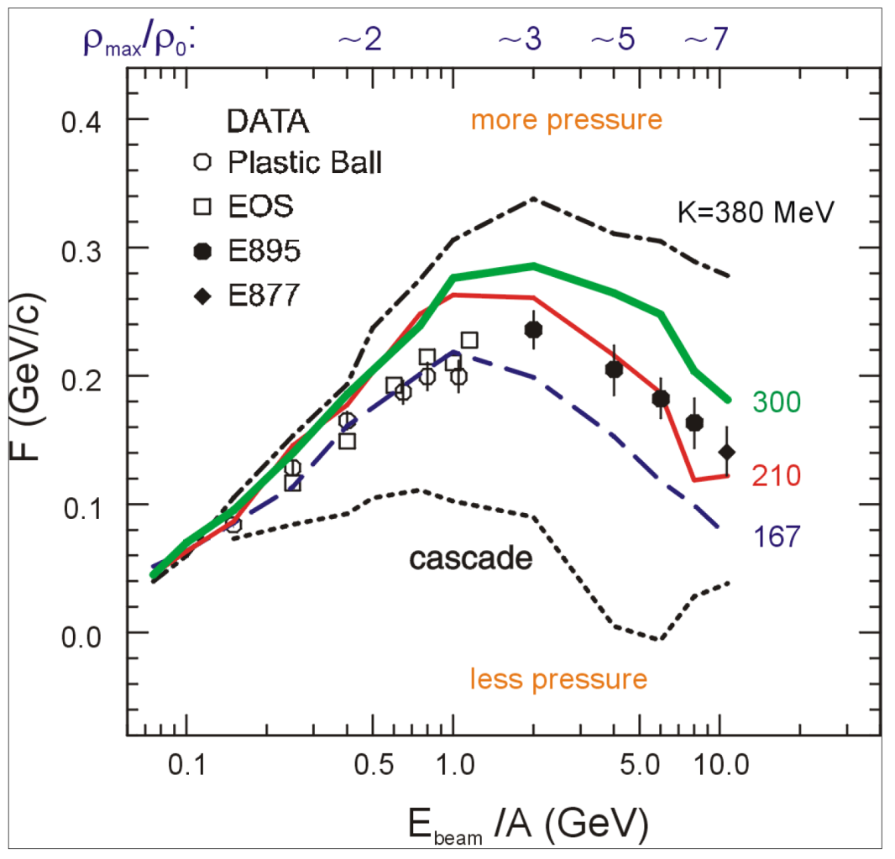
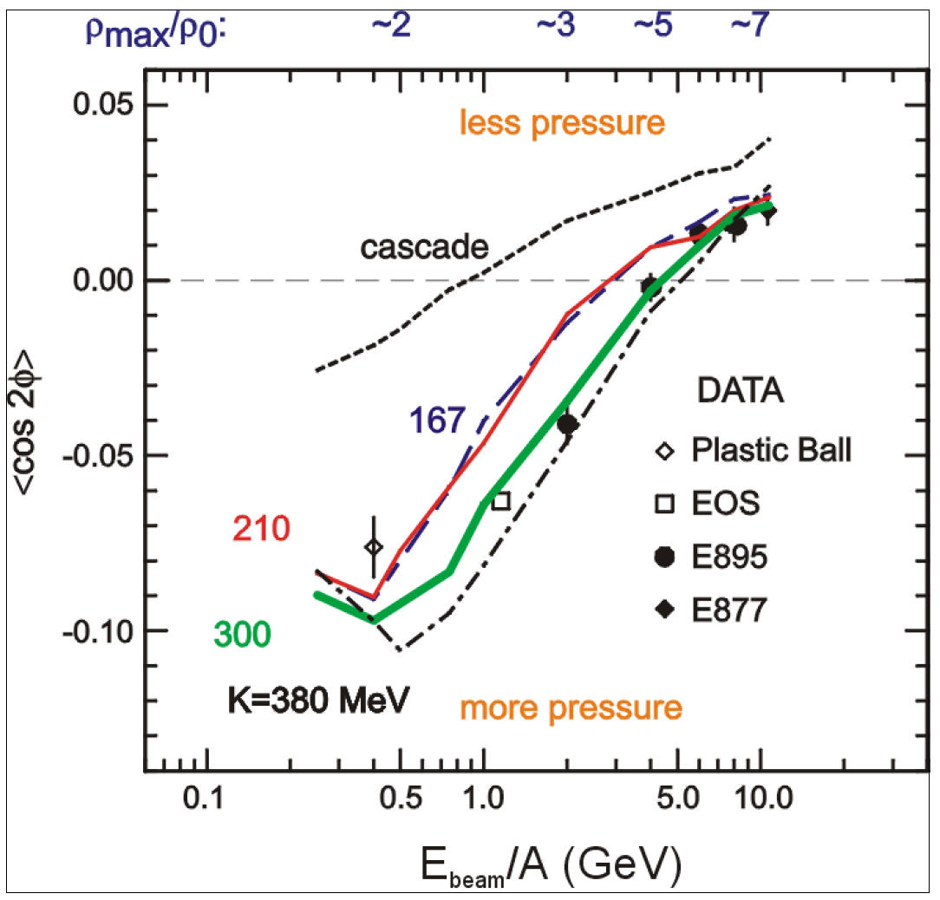
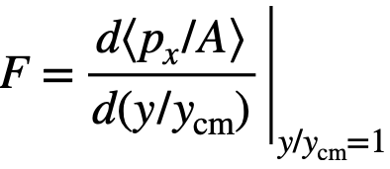
Sensitivity of the collective flow to the EOS
P. Danielewicz, R. Lacey, W.G. Lynch, Science 298 (2002) 1592
EoS extraction: define incompressibility
$$K_{0}=9ρ^{2}\frac{∂^{2}\left(E_{A}\right)}{∂ρ^{2}}$$
Discrepancy in the interpretation:
$v_{1}$ suggests soft EoS ($K_{0}$≈210 MeV)
$v_{2}$ suggests hard EoS ($K_{0}$≈380 MeV)
New measurements using new data and modern analysis techniques might address this discrepancy
MPD-FXT
BM@N
MPD
MPD-FXT
BM@N
MPD
Soft EOS
Hard EOS
$$v_{2}≡\left\langle \cos\left(2\left(φ−Ψ_{RP}\right)\right)\right\rangle$$
Additional measurements are essential to clarify the previous results
16.05.2023
XIII MPD CM

Slide 6
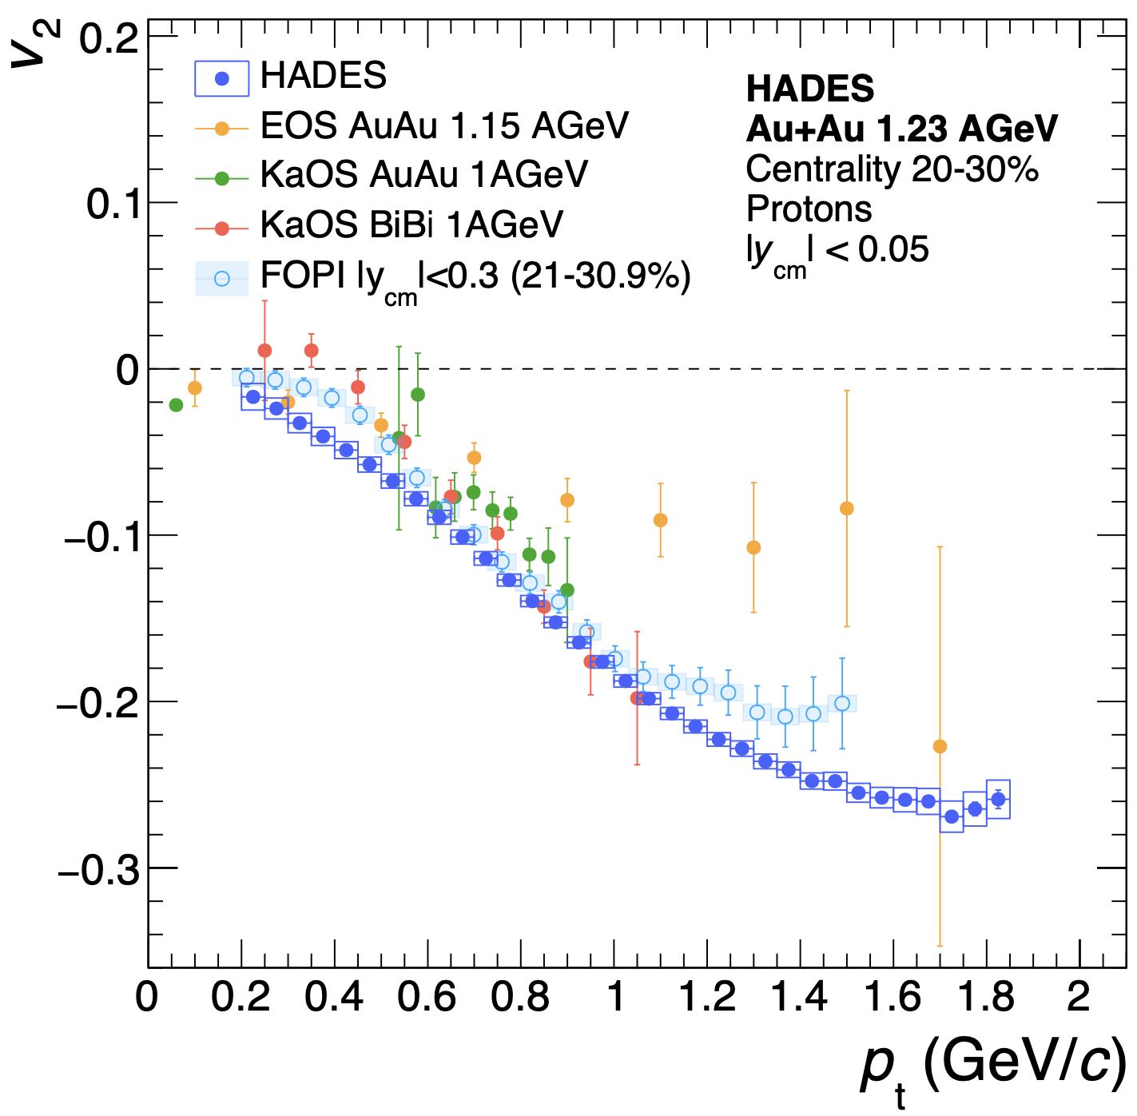
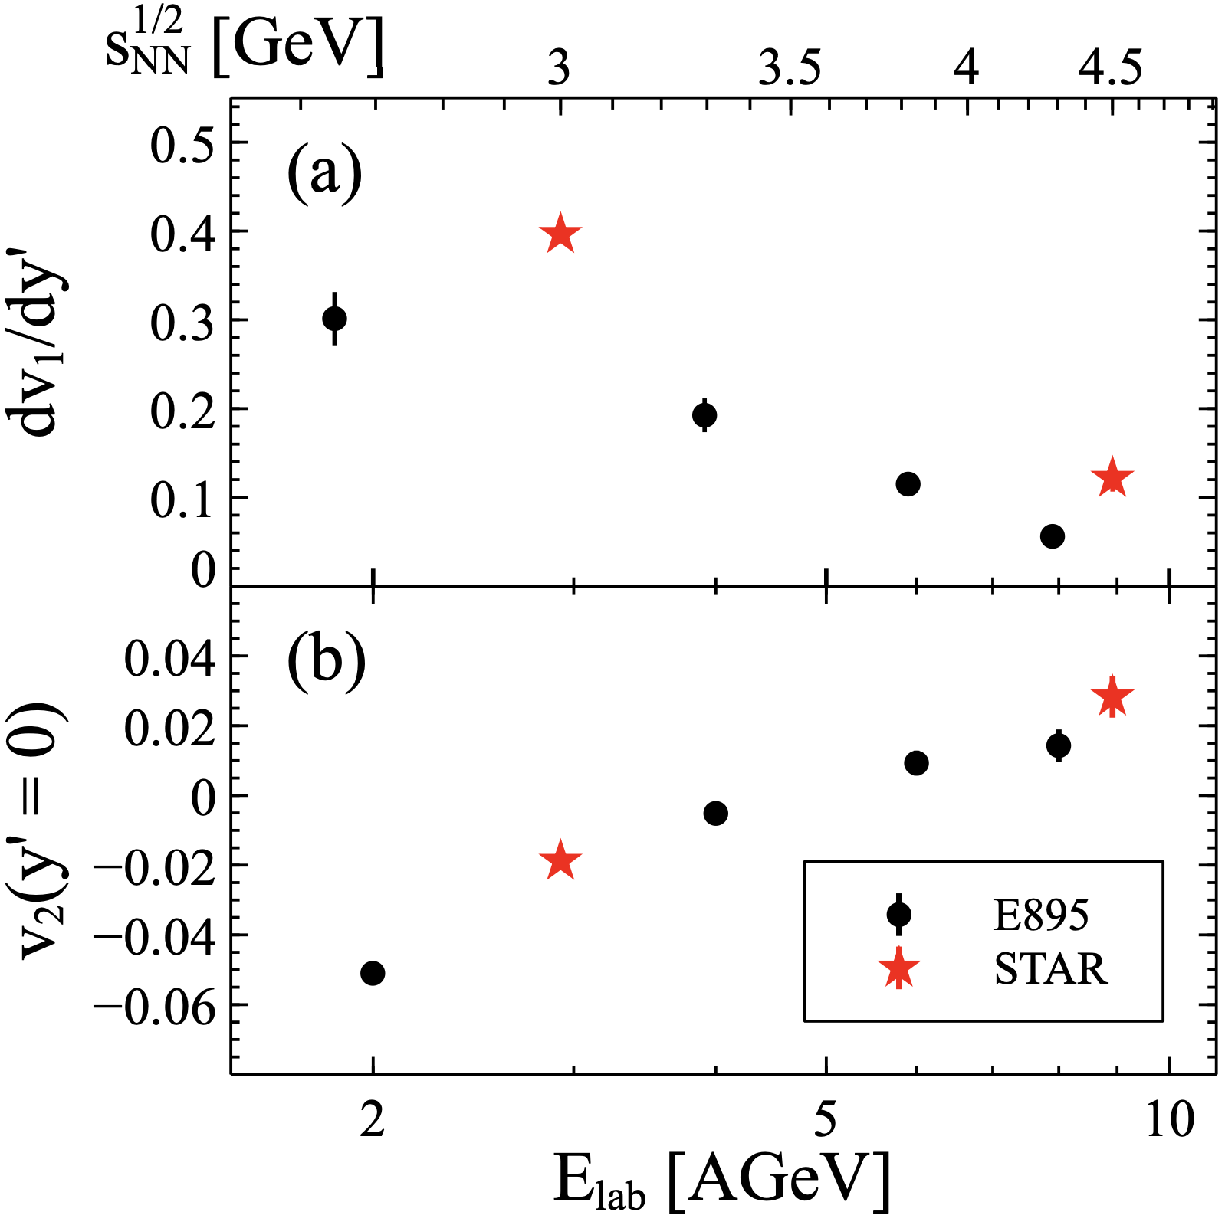
Why do we need new measurements at BM@N and MPD?
The main source of existing systematic errors in $v_{n}$ measurements is the difference between results from different experiments (for example, FOPI and HADES, E895 and STAR)
New data from the future BM@N ($\sqrt{s_{NN}}$=2.3-3.3 GeV) and MPD ($\sqrt{s_{NN}}$=4-11 GeV) experiments will provide more detailed and robust $v_{n}$ measurements

Slide 7
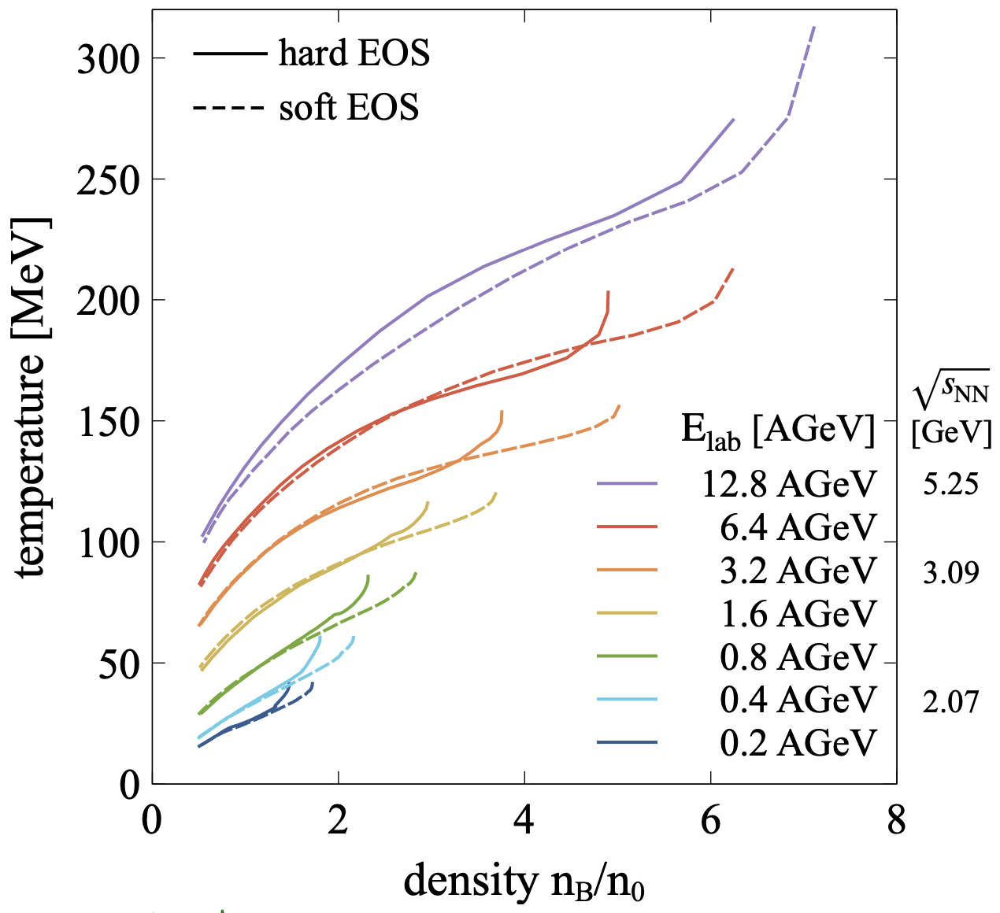
Sensitivity of the collective flow to the EOS
A. Sorensen et. al., Prog.Part.Nucl.Phys. 134 (2024) 104080
A. Sorensen et. al., Prog.Part.Nucl.Phys. 134 (2024) 104080
MPD
MPD-FXT
BM@N
Incompressibility $K_{0}$:
parameter which specifies the behavior of EOS in the given baryon densities $K_{0}=K_{0}\left(n_{B}\right)$
Models with flexible EOS for different ($K_{0},n_{B}$) are required
Nuclotron-NICA coverage in terms of density: $2≲{n_{B}}/{n_{0}≲8}$
16.05.2023
XIII MPD CM
Notes:
One more way to study the properties of the matter created in the collision is through the lens of collective motion of created in the collision particles.
We can decompose the azimuthal distribution of produced particles with respect to RP in a FS
Coefficients …
The main mechanisms driving the direced and elliptic flow are
Bounce off for directed flow — when two nuclei collide, the remnants are deflected out from the overlap region and pull the matter created in the collision apart
Squeeze out for elliptic flow — when the remnants of colliding nuclei are pushing the matter within the overlap region and squeeze the produced particles out of reaction plane
Collective flow is sensitive to …

Slide 8
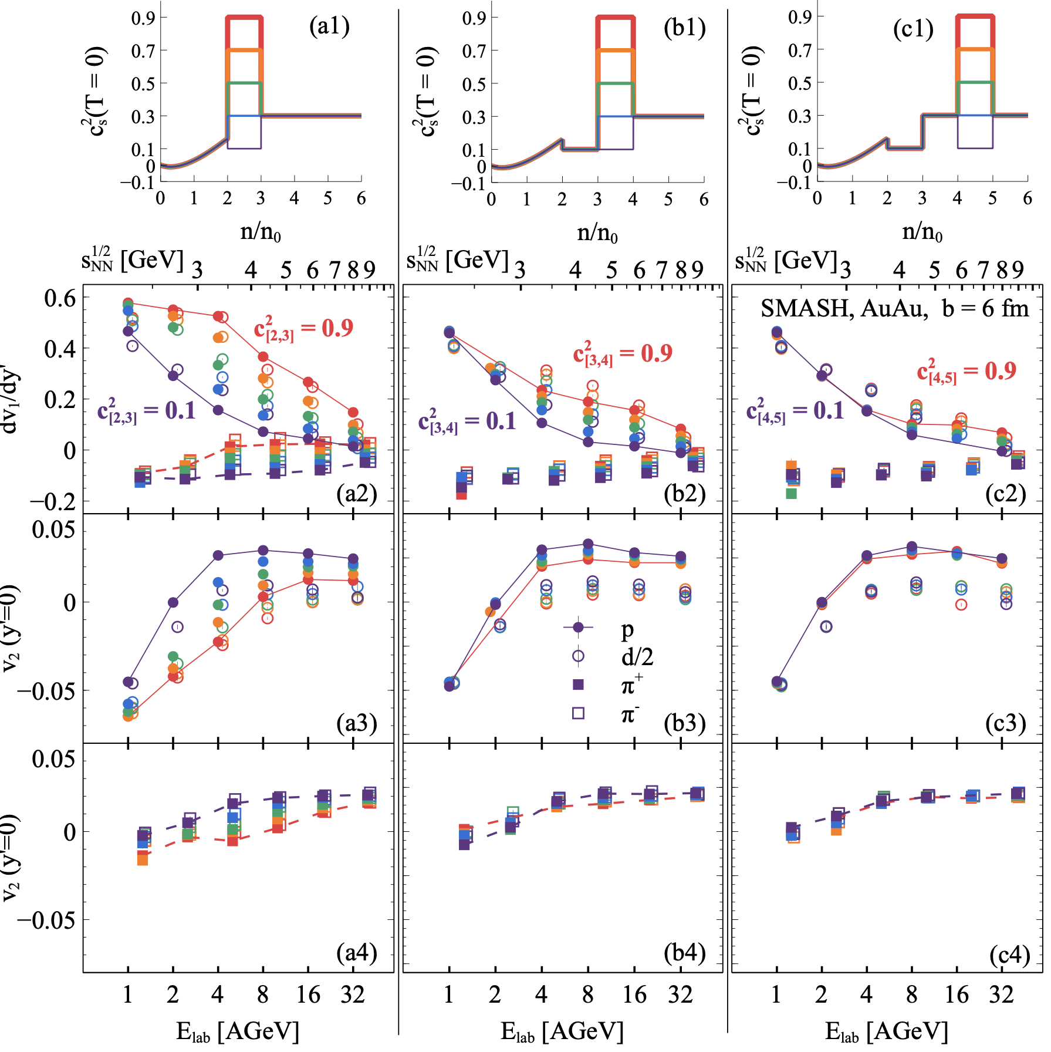
Sensitivity of the collective flow to the EOS
A. Sorensen et. al., Prog.Part.Nucl.Phys. 134 (2024) 104080
SMASH model with flexible EOS was used to test the sensitivity of the $v_{n}$ to changes of EOS in a specific density range $n/n_{0}$:
$2<n_{B}/n_{0}<3$: ${dv}_{1}/dy′$ and $v_{2}$ of pions, protons and deuterons are very sensitive to the EOS
$3<n_{B}/n_{0}<4$: ${dv}_{1}/dy′$ and $v_{2}$ of protons and deuterons are sensitive to the EOS
$3<n_{B}/n_{0}<4$: weak sensitivity to the EOS
The most precise constraints can be achieved from the flow of identified hadrons (𝛑±,K±,p,…) and light nuclei (d,t,…)

Slide 9
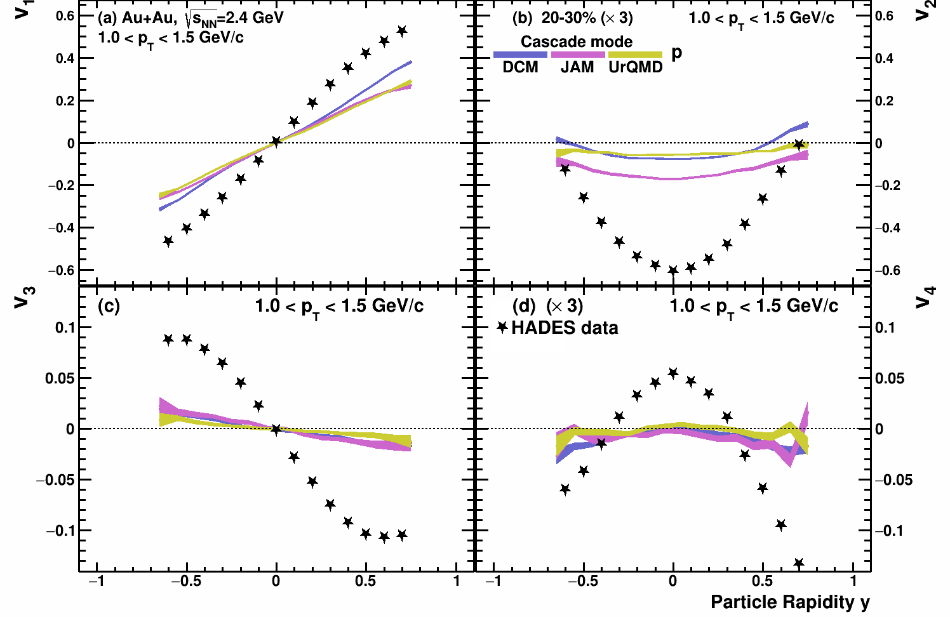
$v_{n}\left(y\right)$in Au+Au $\sqrt{s_{NN}}$=2.4 GeV: cascade models
P. Parfenov, Particles 5, no.4, 561-579 (2022)
Kinematic cuts:
V_{1,3}(y): 1.0 < pT < 1.5 GeV/c
V_{2,4}(y): 1.0 < pT < 1.5 GeV/c
Cascade models fail to reproduce HADES experimental data

Slide 10
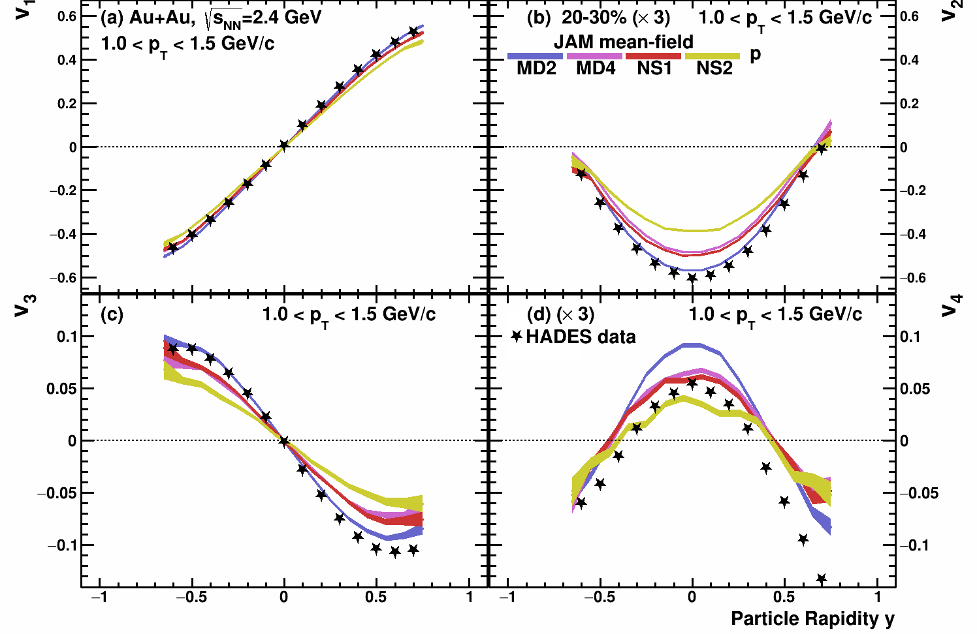
$v_{n}\left(y\right)$in Au+Au $\sqrt{s_{NN}}$=2.4 GeV: models vs. HADES data
P. Parfenov, Particles 5, no.4, 561-579 (2022)
Kinematic cuts:
V_{1,3}(y): 1.0 < pT < 1.5 GeV/c
V_{2,4}(y): 1.0 < pT < 1.5 GeV/c
Good agreement for $v_{n}\left(y\right)$
Higher harmonics are more sensitive to different EOS than $v_{1}$

Slide 11
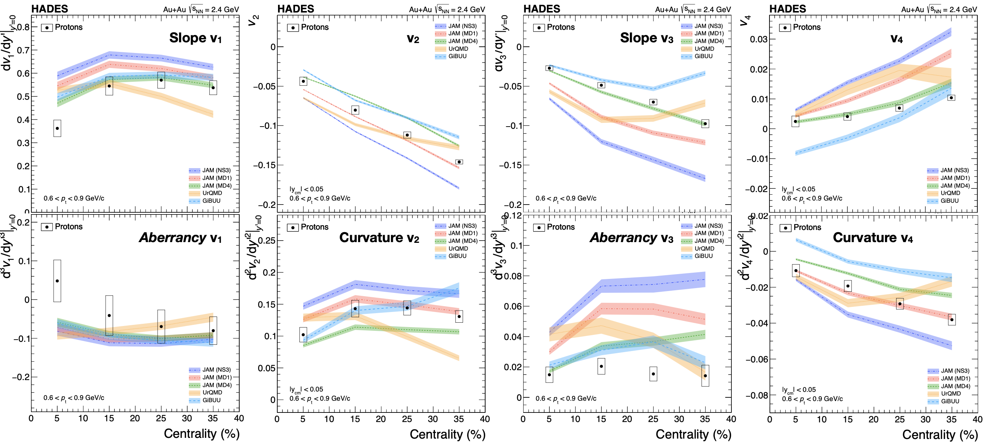
$v_{n}\left(y\right)$in Au+Au $\sqrt{s_{NN}}$=2.4 GeV: models vs. HADES data
HADES, Eur. Phys. J. A 59 (2023) 4, 80
Overall trend reasonably well described, but no model works everywhere

Slide 12
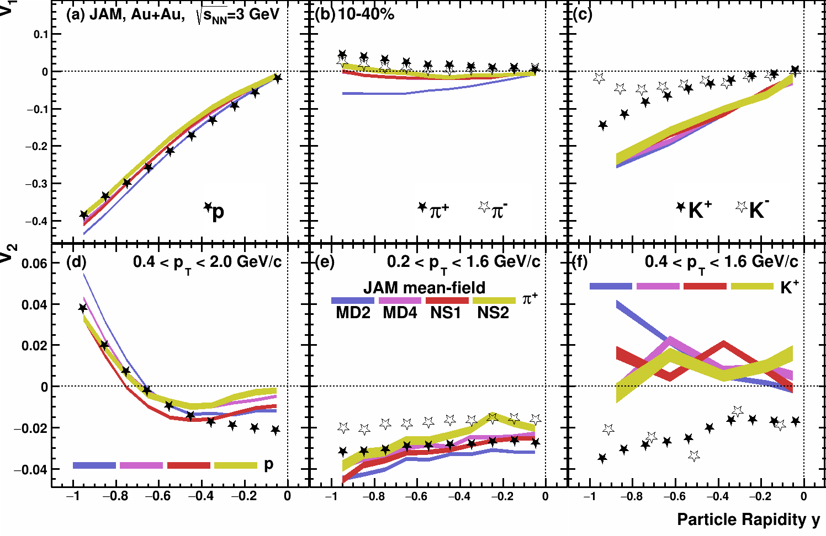
$v_{1,2}\left(y\right)$in Au+Au $\sqrt{s_{NN}}$=3 GeV: model vs. STAR data
P. Parfenov, Particles 5, no.4, 561-579 (2022)
Models do not describe all particle species equally well
$v_{1}$, $v_{2}$ of protons are described by JAM, UrQMD (hard EOS) and SMASH (hard EOS with softening at higher densities)

Slide 13
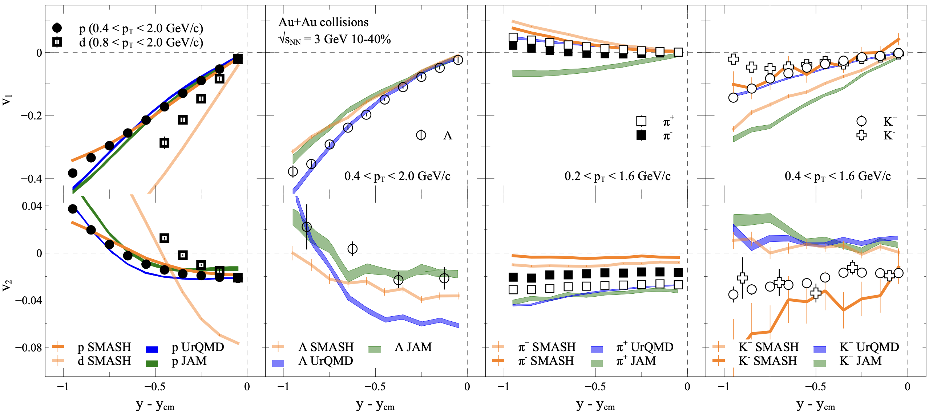
$v_{1,2}\left(y\right)$in Au+Au $\sqrt{s_{NN}}$=3 GeV: model vs. STAR data
A. Sorensen et. al., Prog.Part.Nucl.Phys. 134 (2024) 104080
Model description of $v_{n}$:
Good overall agreement for $v_{n}$ of protons
$v_{n}$ of light nuclei is not described
$v_{n}$ of 𝛬 is not well described
nucleon-hyperon and hyperon-hyperon interactions
Light mesons (𝜋,K) are not described
No mean-field for mesons
Models have a huge room for improvement in terms of describing $v_{n}$

Slide 14
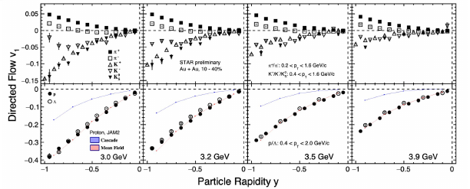
New STAR results from BES-II
Results from QM 2023
New preliminary results from STAR BES-II were presented at QM-2023 for Au+Au at $\sqrt{s_{NN}}$=3, 3.2, 3.5, 3.9 GeV

Slide 15
$v_{2}$ transition from out-of-plane to in-plane
P. Parfenov, Particles 5, no.4, 561-579 (2022)
v₂
Results from QM 2023
Transition of $v_{2}$ from out-of-plane to in-plane can be a good tool to constrain models and extract information about EOS
$v_{2}≈0$ in midrapirity at $\sqrt{s_{NN}}$=3.3 GeV for central and mid-central collisions for protons
$v_{2}<0$ for peripheral collisions
Models can not reproduce $v_{2}$ of 𝜋±, K±, K⁰_{S}, 𝛬
Transition from out-of-plane to in-plane depends on centrality, rapidity and particle species

Slide 16
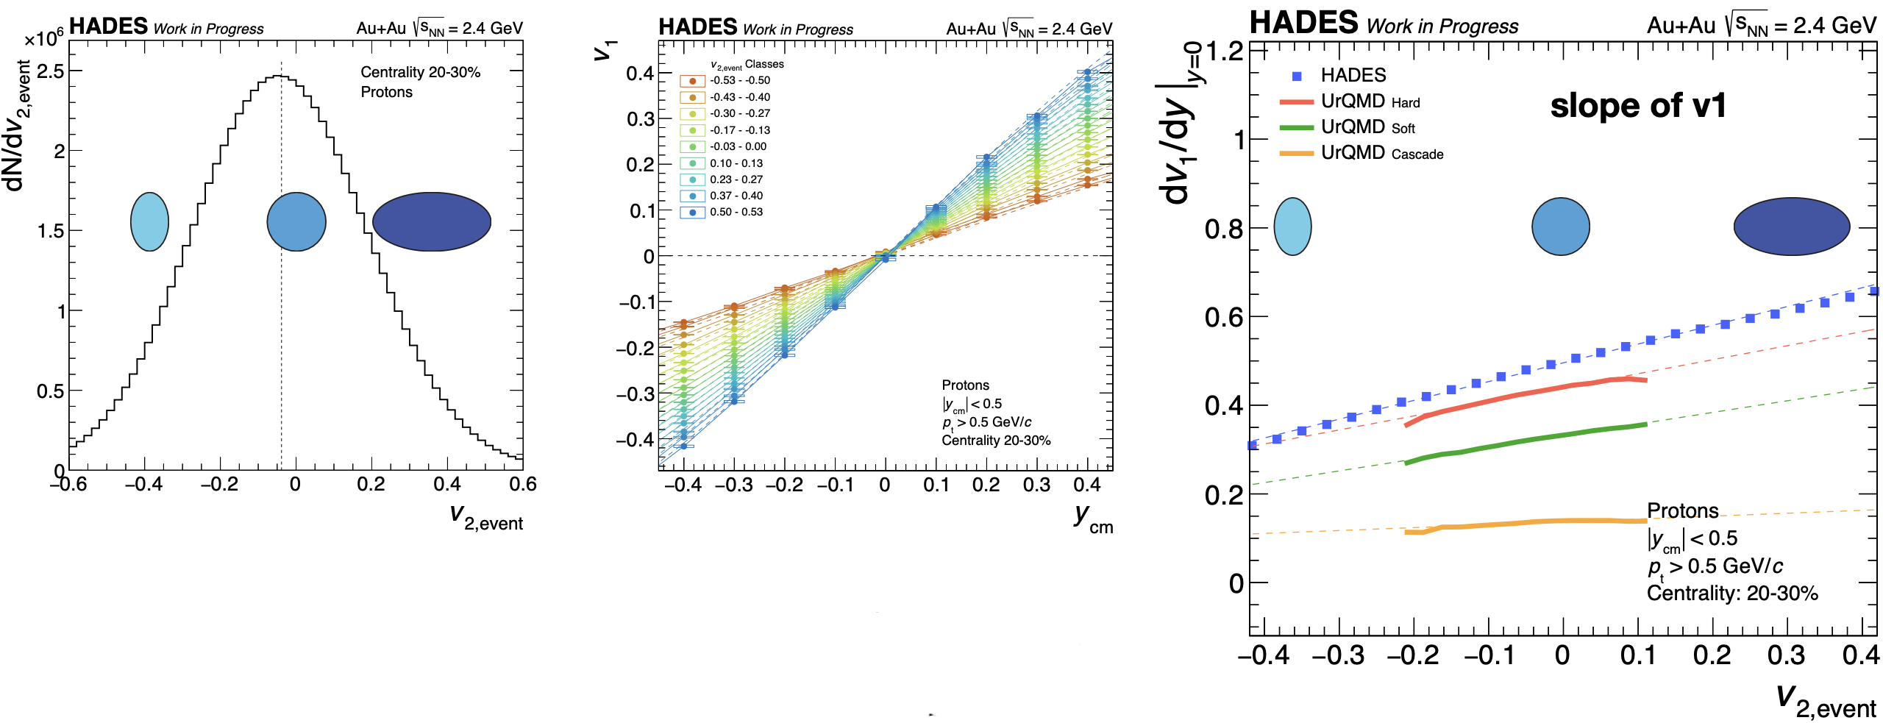
Event-wise flow correlations
B. Kardan, EMMI Workshop 2024
Events can be characterized based on the event-wise magnitude of the elliptic flow $v_{2,event}$
UrQMD can not discribe ${dv_{1}}/{dy{\left.​\right|}_{y=0}}$ of protons as a function of $v_{2,event}$
Strong sensitivity to the EOS

Slide 17
Event-wise flow correlations
B. Kardan, EMMI Workshop 2024
${dv_{3}}/{dy{\left.​\right|}_{y=0}}$ of protons as a function of $v_{2,event}$ shows strong sensitivity to EoS
Models overestimate $v_{4}$ of protons as a function of $v_{2,event}$ compared to the HADES data
Mean-field models do not reproduce experimental data on the event-wise flow correlations of protons

Slide 18
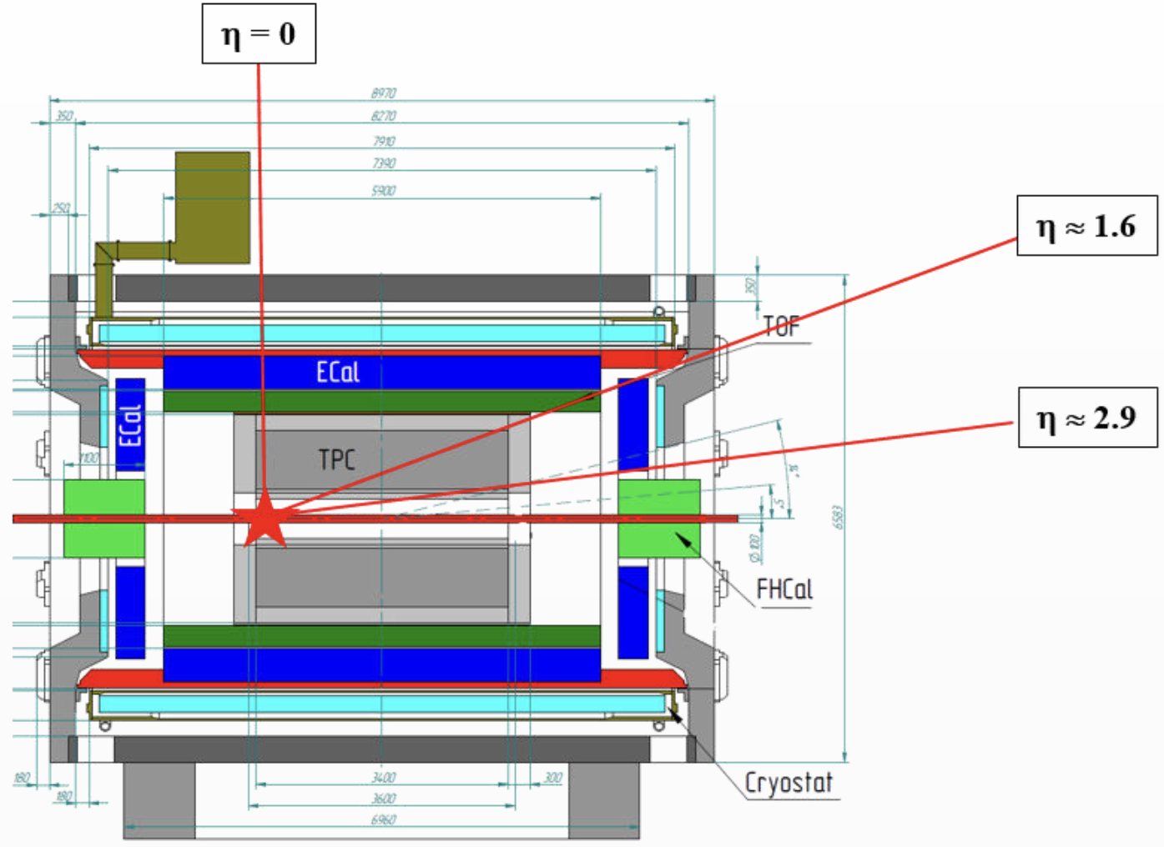
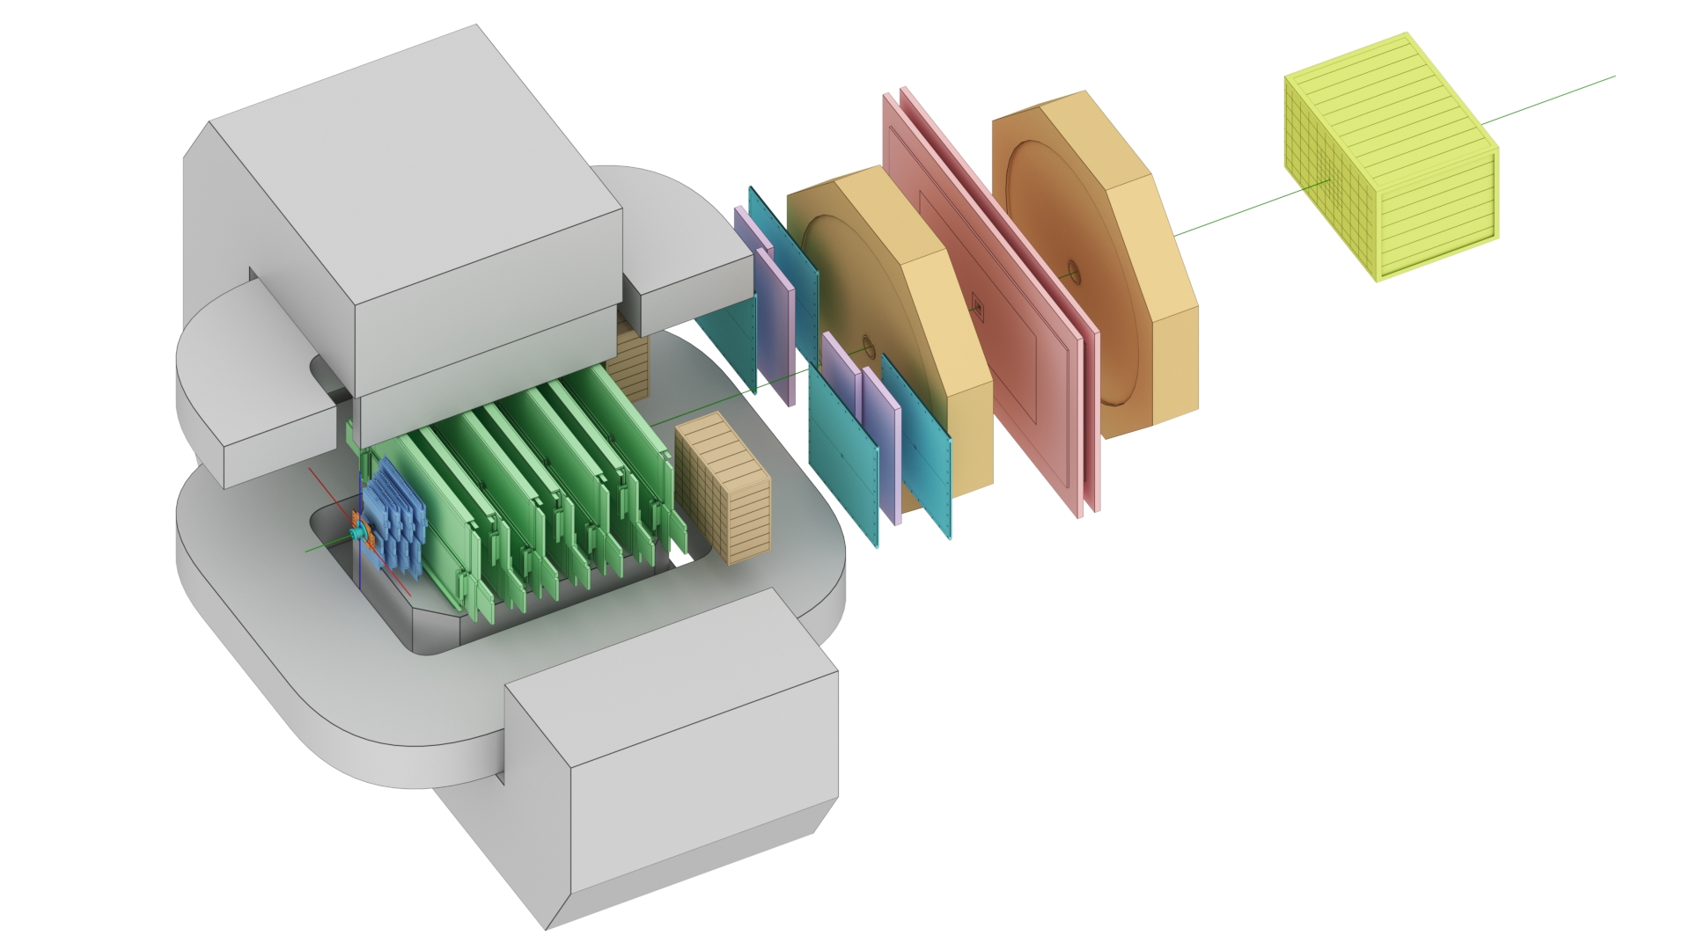
The MPD-FXT and BM@N experiments
BM@N
MPD-FXT
FHCal
Silicon + GEM
TOF-700
TOF-400
Detectors used for anisotropic flow measurements:
Tracking system: FwdSi+GEM (BM@N); TPC (MPD-FXT)
PID: TOF-400, TOF-700 (BM@N); TPC, TOF (MPD-FXT)
EP measurements: FHCal (BM@N), FHCal (MPD-FXT)
16.05.2023
XIII MPD CM
Notes:
Схема эксперимента хадес на слайде.
Траектории рожденных частиц регистристрируются трекинговой системой, состоящей из …
Импульс восстанавливается по отклонению частиц в магнитном поле
Идентификация производится при помощи детекторов времени пролета … которые регистрируют время пролета. Зная длину траектории можно вычислить массу частицы.
Спектаторы регистрируются детектором FW. Поскольку они отклоняются в плоскости реакции материей в области перекрытия, спектаторы используются для оценки угла плоскости реакции.
Всего столько статистики ...

Slide 19
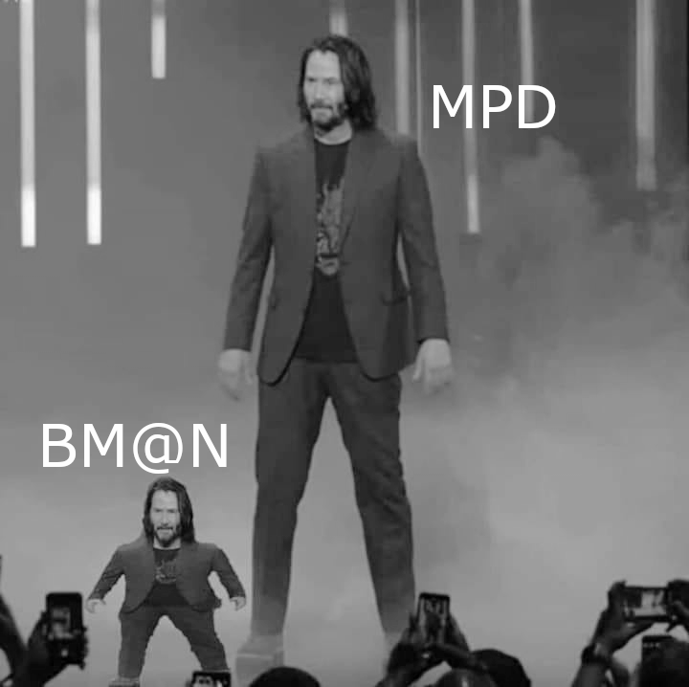
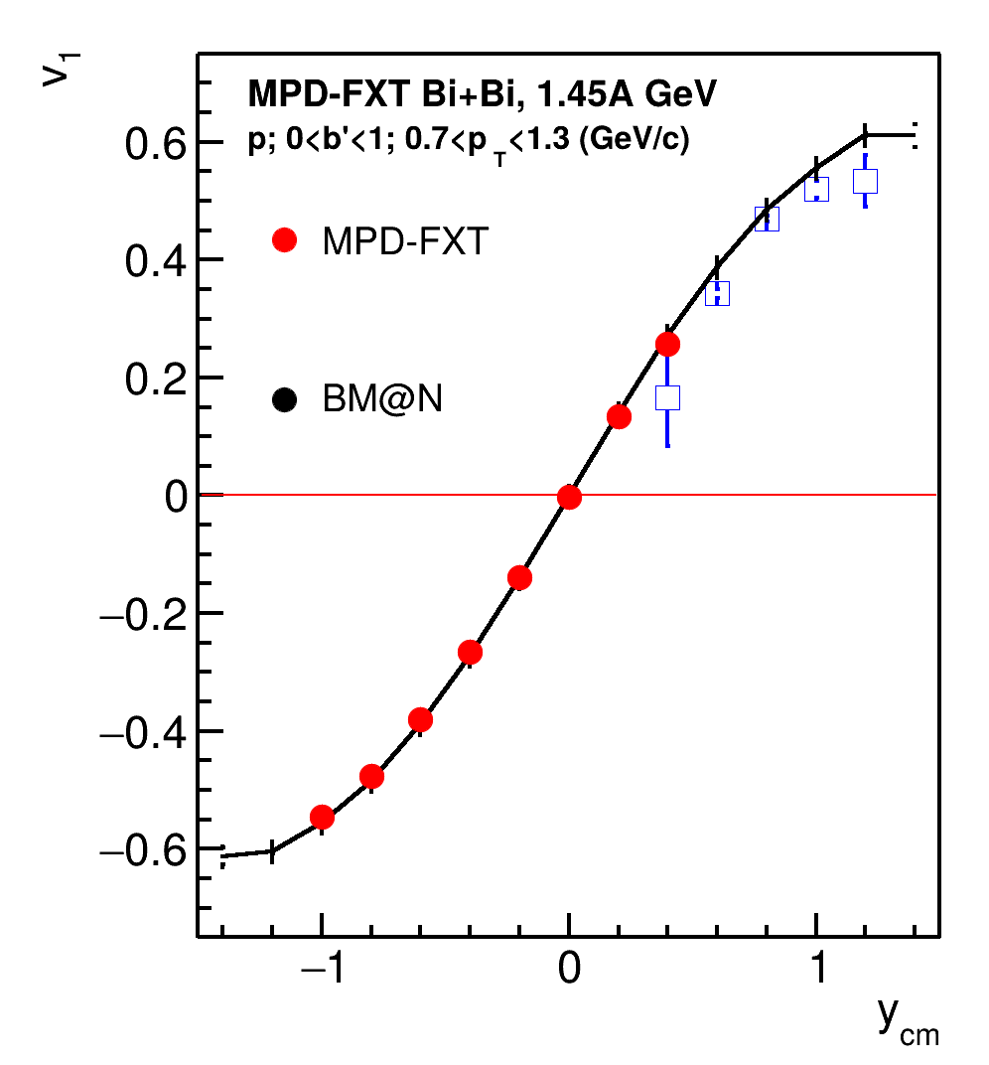
Comparison with BM@N performance
BM@N TOF system (TOF-400 and TOF-700) has poor midrapidity coverage at √s_{NN} = 2.5 GeV
One needs to check higher energies (√s_{NN} = 3, 3.5 GeV)
More statistics are required due to the effects of magnetic field in BM@N:
Only “yy” component of <uQ> and <QQ> correlation can be used
Despite the challenges, both MPD-FXT and BM@N can be used in v_{n} measurements:
To widen rapidity coverage
To perform a cross-check in the future

Slide 20
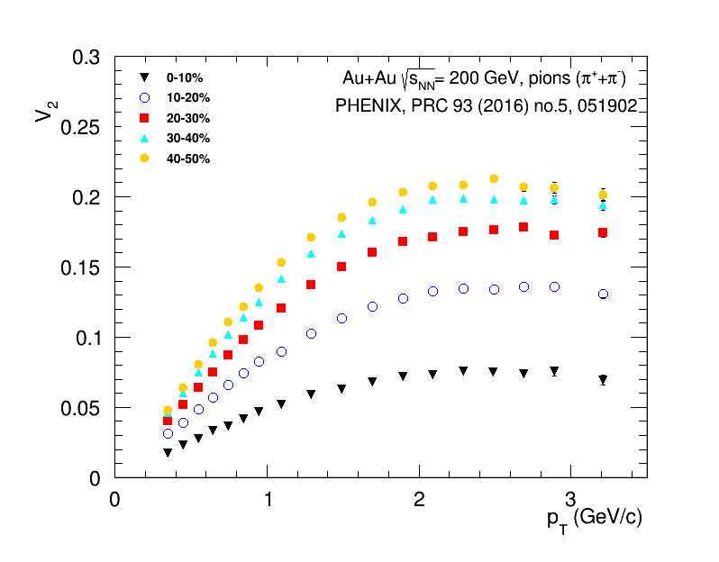
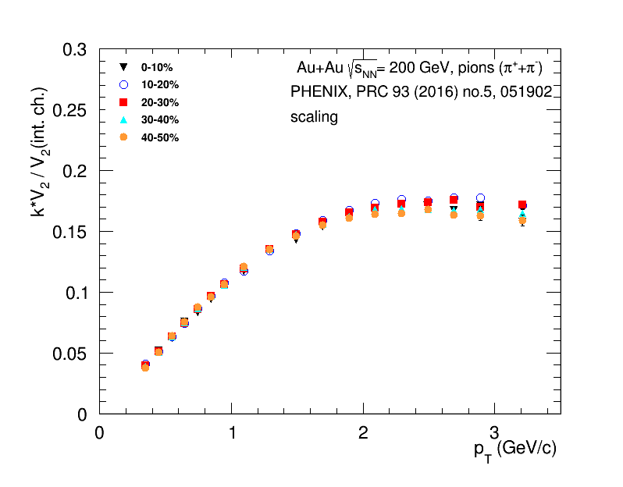
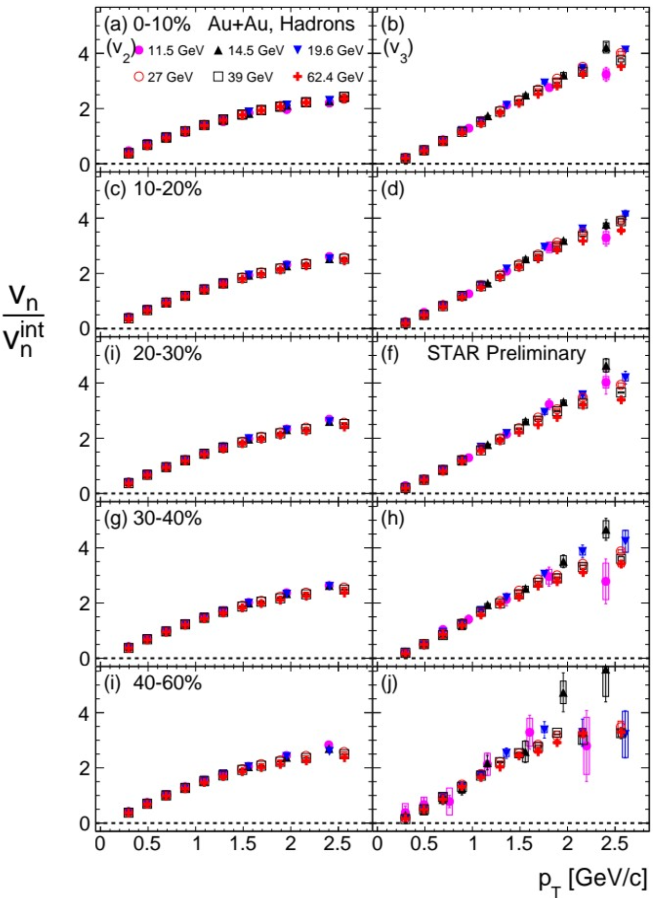
Scaling with integral anisotropic flow
J.Phys.Conf.Ser. 1690 (2020) 1, 012128
$$v_{n}\left(int.\right)≡\left|v_{n}^{int}\right|=\left|{\left\langle v_{n}\left(p_{T},y,centrality,PID\right)\right\rangle }_{p_{T},y}\right|$$
Scaling works at top RHIC and BES energy range
Similar trend for pions, kaons and protons

Slide 21
$\left|v_{n}^{int}\right|$ scaling: JAM MD2 model – Nuclotron energies
$$\left|v_{n}^{int}\right|=\left|{\left\langle v_{n}\left(p_{T},y,centrality,PID\right)\right\rangle }_{p_{T},y}\right|$$
Scaling works for JAM model at $\sqrt{s_{NN}}=2.4$ GeV for Au+Au, Xe+Cs and Ag+Ag collisions
Provides a useful tool to make comparison of $v_{n}$ results from different colliding systems

Slide 22
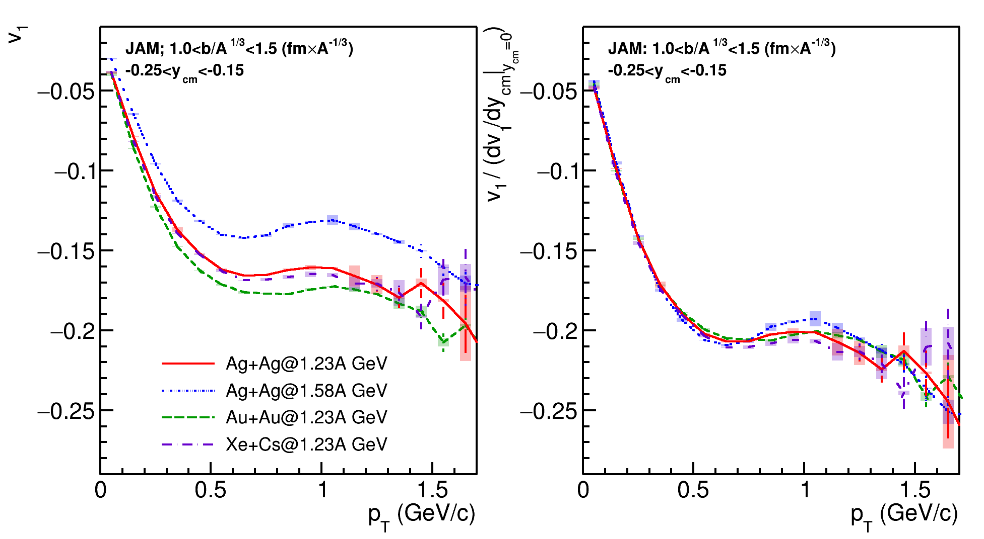
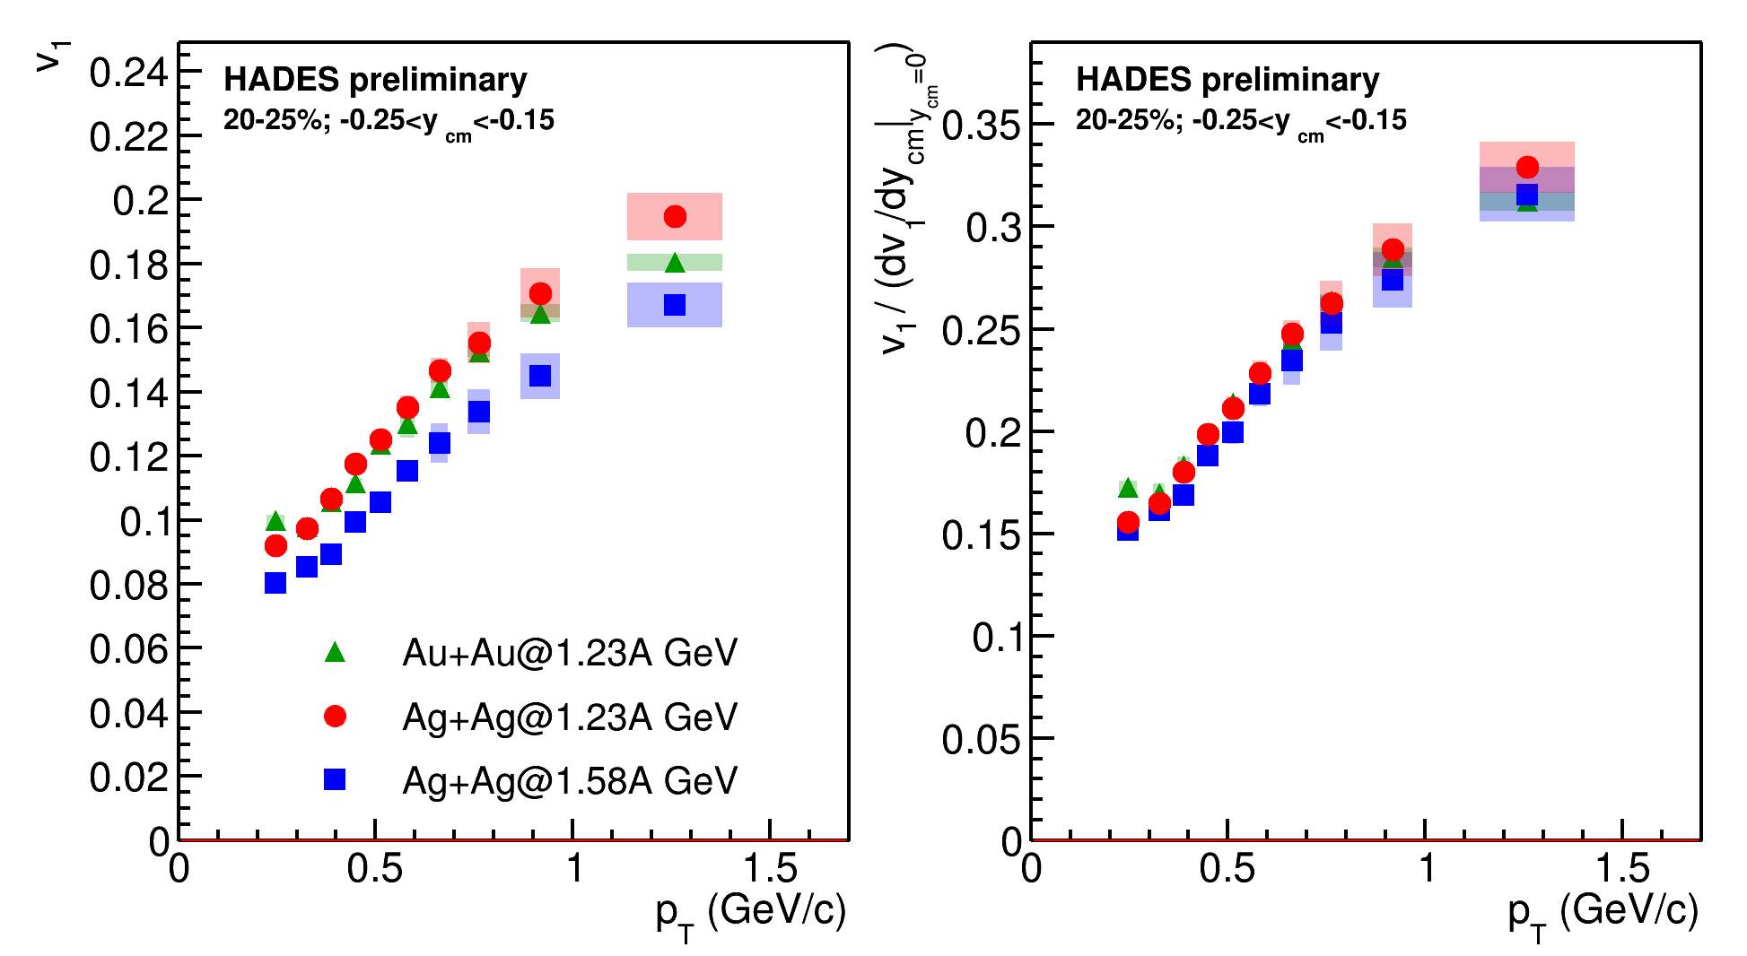
Scaling with $v_{1}$ slope
Scalings with ${{dv}_{1}}/{dy}{\left.​\right|}_{y=0}$ slope can be useful for comparison of the $v_{n}\left(y,p_{T}\right)$ results for different colliding systems

Slide 23
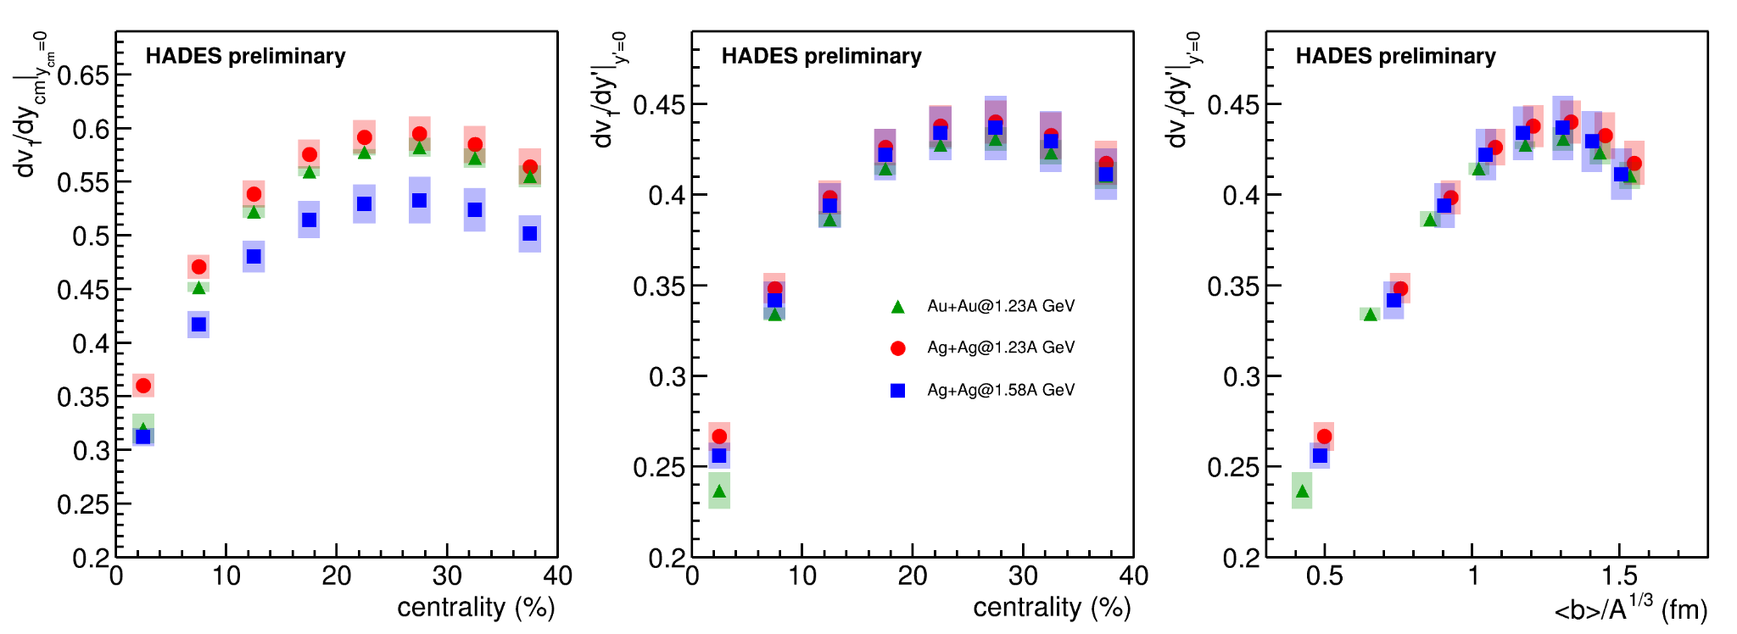
Scaling with system size
Scalings with $b_{0}$ works for model data
Scaling with ${y′(t}_{pass})=y/y_{beam}$ and ${\left\langle b\right\rangle }/{A^{1/3}}$ can be applied on the experimental data
$$b_{0}=b/{1.15\left(A_{targ}^{1/3}+A_{proj}^{1/3}\right)}$$
b, fm
b₀, fm

Slide 24
Summary
Extracting EOS information from the measurements:
One should consider baryon dependency for the incompressibility $K=K\left(n_{B}\right)$
Observables can be sensitive to the EOS in different ${n_{B}}/{n_{0}}$ regions
Comparison with STAR BES at $\sqrt{s_{NN}}$=3 GeV and HADES at $\sqrt{s_{NN}}$=2.4 GeV:
Good overall agreement with experimental data for $v_{n}$ of protons using mean-field models with hard EOS
Models do not describe all particle species equally well (mesons, $Λ$, light nuclei)
Event-wise flow correlations of protons can not be described by current models
Out-of-plane to in-plane transition of $v_{2}$:
This transition depends on beam energy, centrality, rapidity range, and particle species
Both MPD-FXT and BM@N can complement each other in terms of $v_{n}$:
Cross-checks can be performed to test the implemented flow measurement techniques
Using results from both experiments can widen the rapidity coverage - no single fixed target experiment can achieve that!
Scaling relations can be used to compare results from MPD, MPD-FXT and BM@N with the existing experimental data for $\sqrt{s_{NN}}≤$3 GeV and further constrain models:
Scaling with system size provides a useful tool to make comparison of $v_{n}$ results from different colliding systems
New data from the BM@N and MPD (MPD-FXT) is required to address the discrepancies in the existing data and provide further constraints for the EoS in the models

Slide 25
Thank you for your attention!

