Slide 1
XIII Collaboration Meeting of the MPD Experiment at the NICA Facility
The progress of ECal production in China

Slide 2
CONTENTS
1
  MPD-ECAL introduction
2
  ECal module and PCB production
3
  Batch test of ECal PCBs
4
  Summary

Slide 3
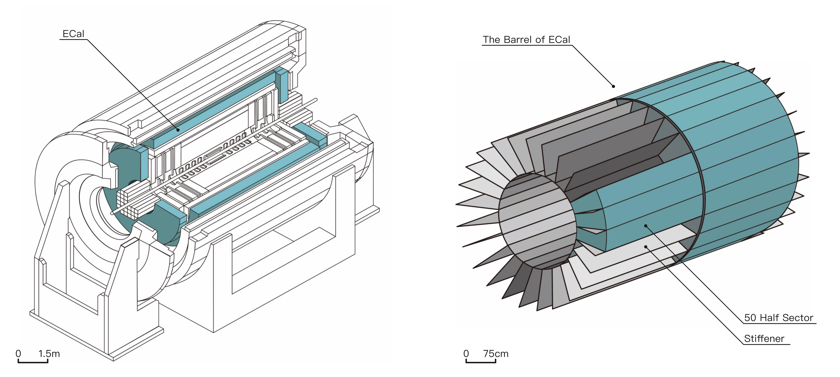
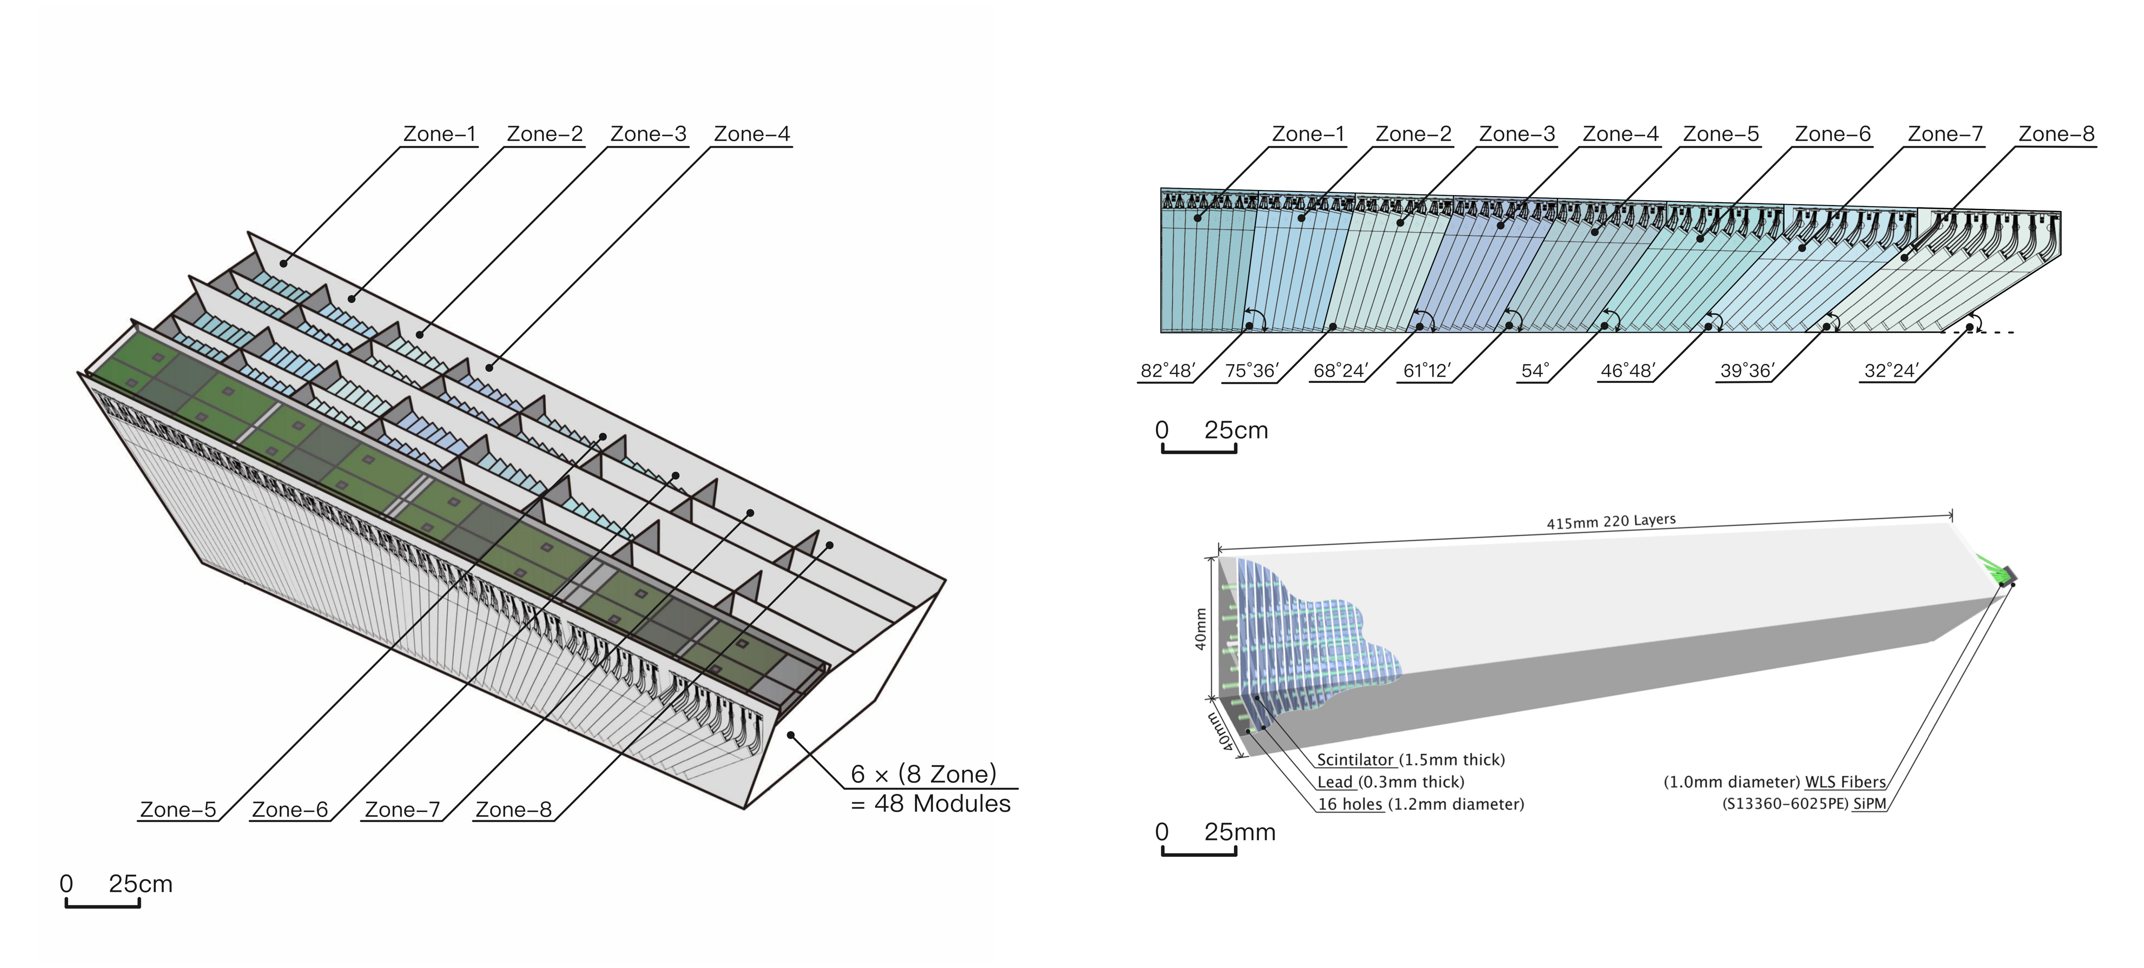
MPD-ECal production
MPD-ECal requirements:
particle occupancy : < 5%
Time resolution : <1ns
Energy resolution : < 5% @1GeV
Operate in the magnetic FIELD : ~ 0.5T
Adequate space resolution.
MPD-ECal
The Barrel of ECal
ECal Half-Sector
ECal 8-Zone
The ECal-MPD
1 Barrel
50 Half-sector
300 8-Zone module
2400 Module
38400 Tower
ECal Module
ECal Tower

Slide 4
ECal module and PCB production in China
ECal module:
Construction of 8 sectors. 768 modules in total.
Institutes: Tsinghua University 60%
Shandong University 20%
Fudan University 10%
University of South China 10%
ECal PCB:
Production and 1200 PCBs (without SiPMs).

Slide 5
Modules production in China
In the first stage, 8 sectors have been produced in China
8 sectors=16 half sectors=768 modules=12288 towers
1
2
3
4
5
6
7
8
Modules produced in each institutes
 | 1 | 2 | 3 | 4 | 5 | 6 | 7 | 8 | Total | Progress
THU | 19 | 19 |  | 38 | 96 | 96 | 96 | 96 | 460 | Finished
SDU |  |  | 96 | 58 |  |  |  |  | 154 | Finished
FDU |  | 77 |  |  |  |  |  |  | 77 | Finished
USC | 77 |  |  |  |  |  |  |  | 77 | Finished

Slide 6
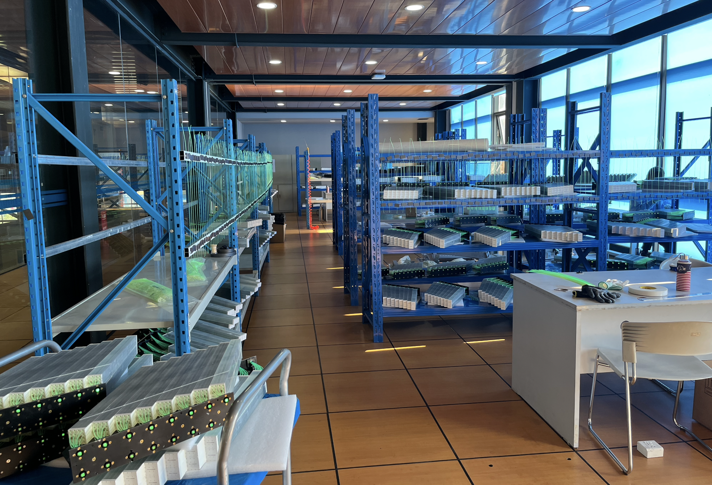
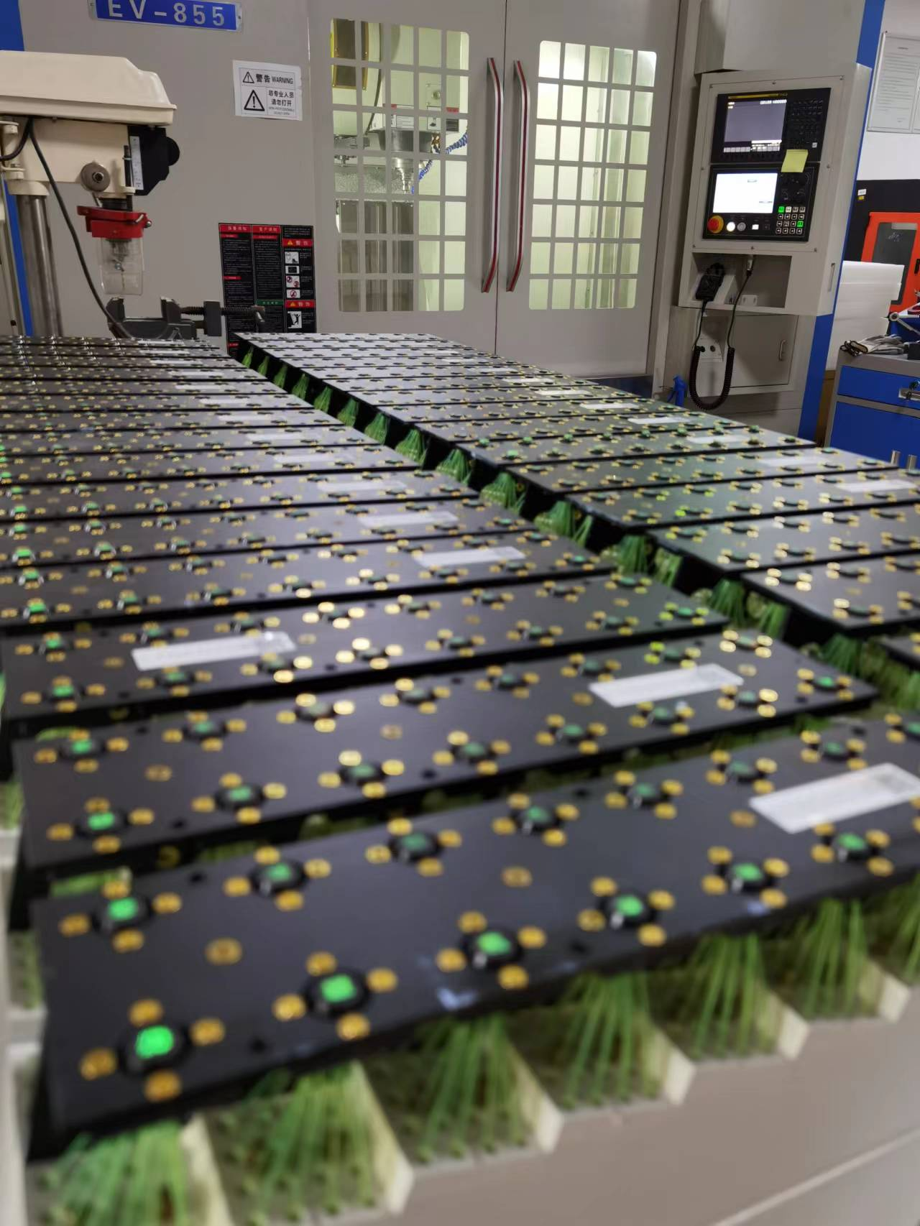
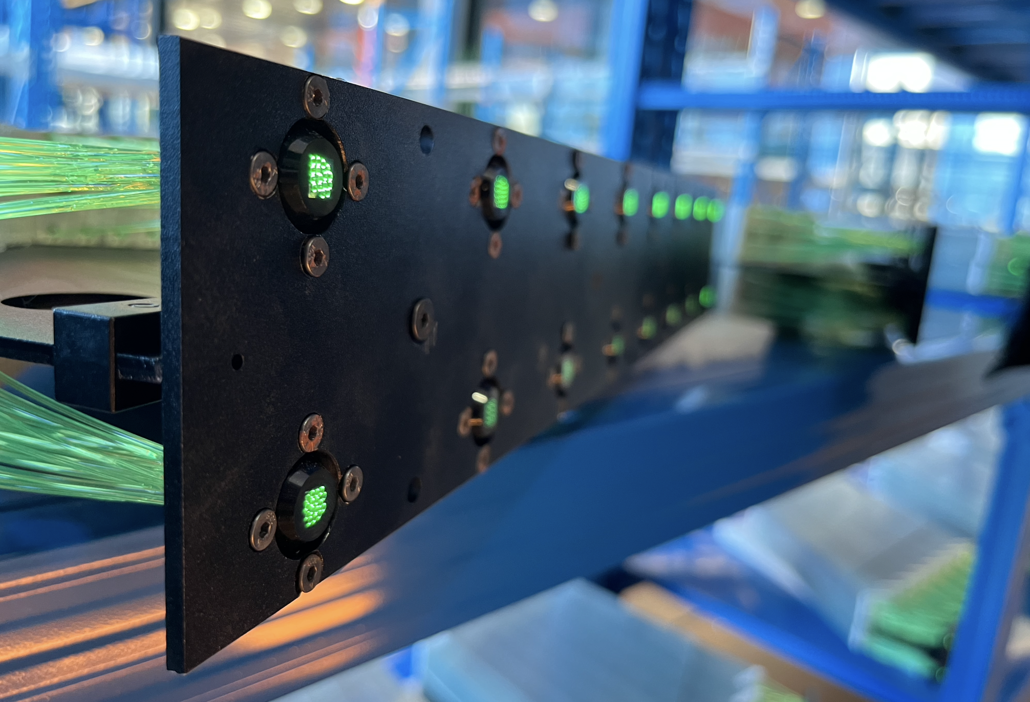
Modules production in China
Module production in THU
Module production in THU
Module production in SDU

Slide 7
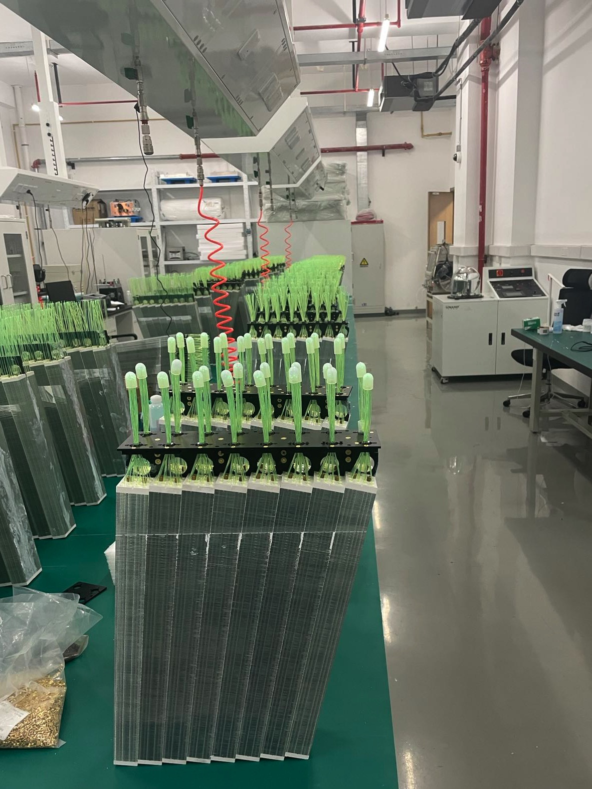
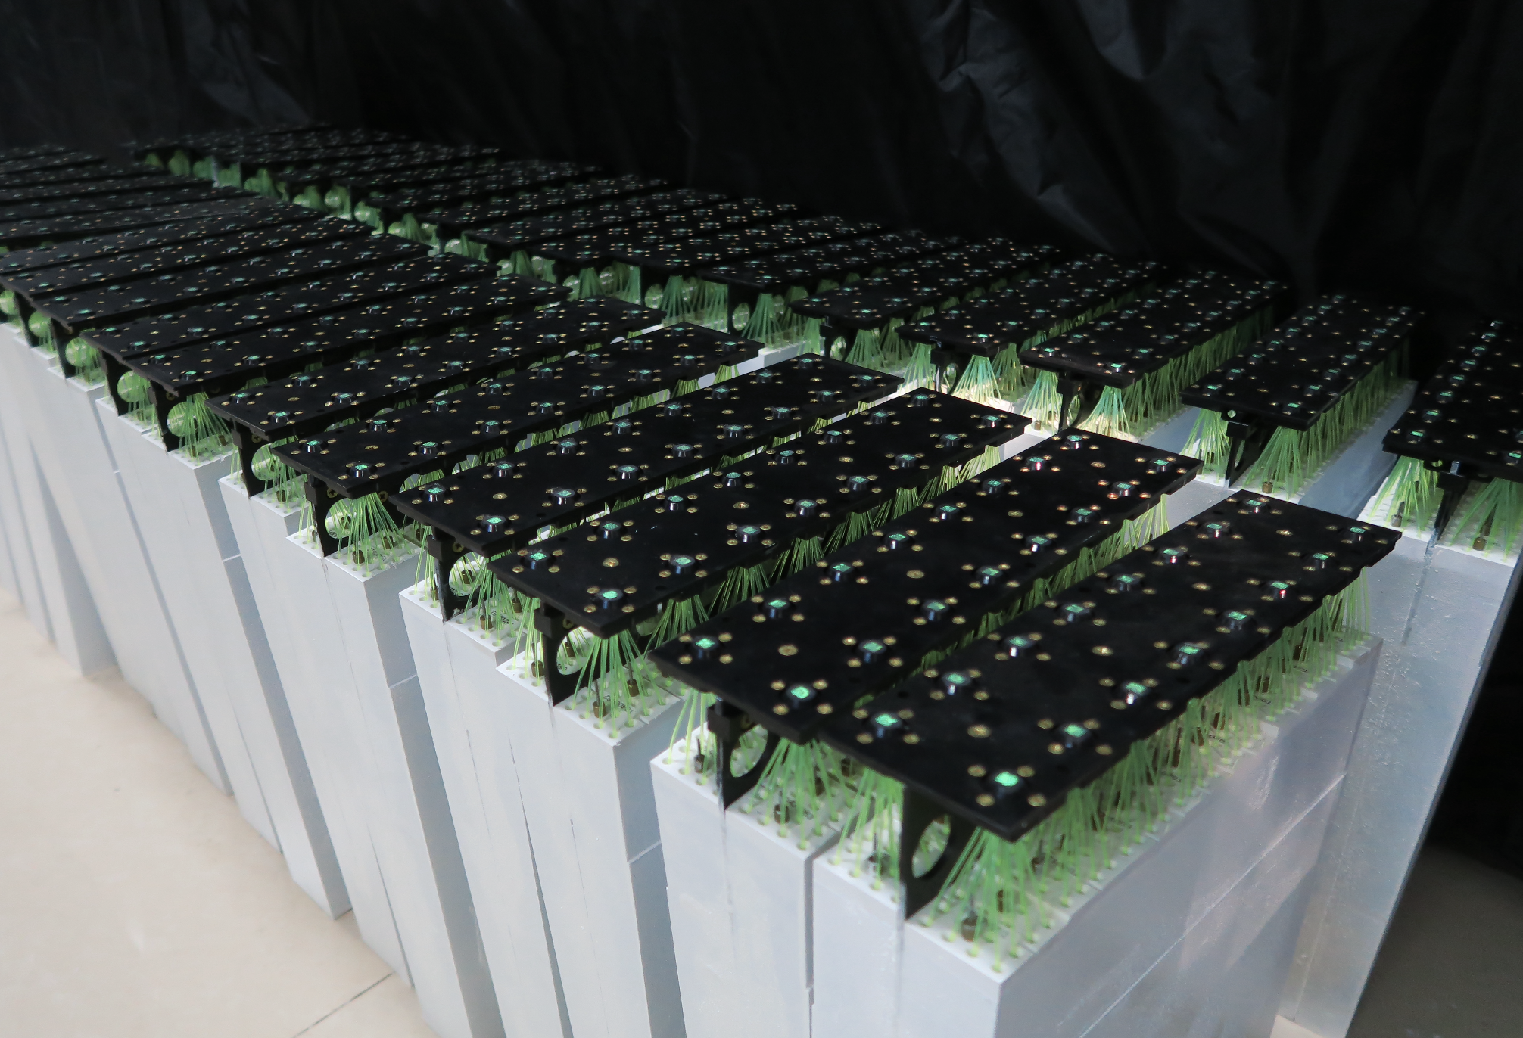
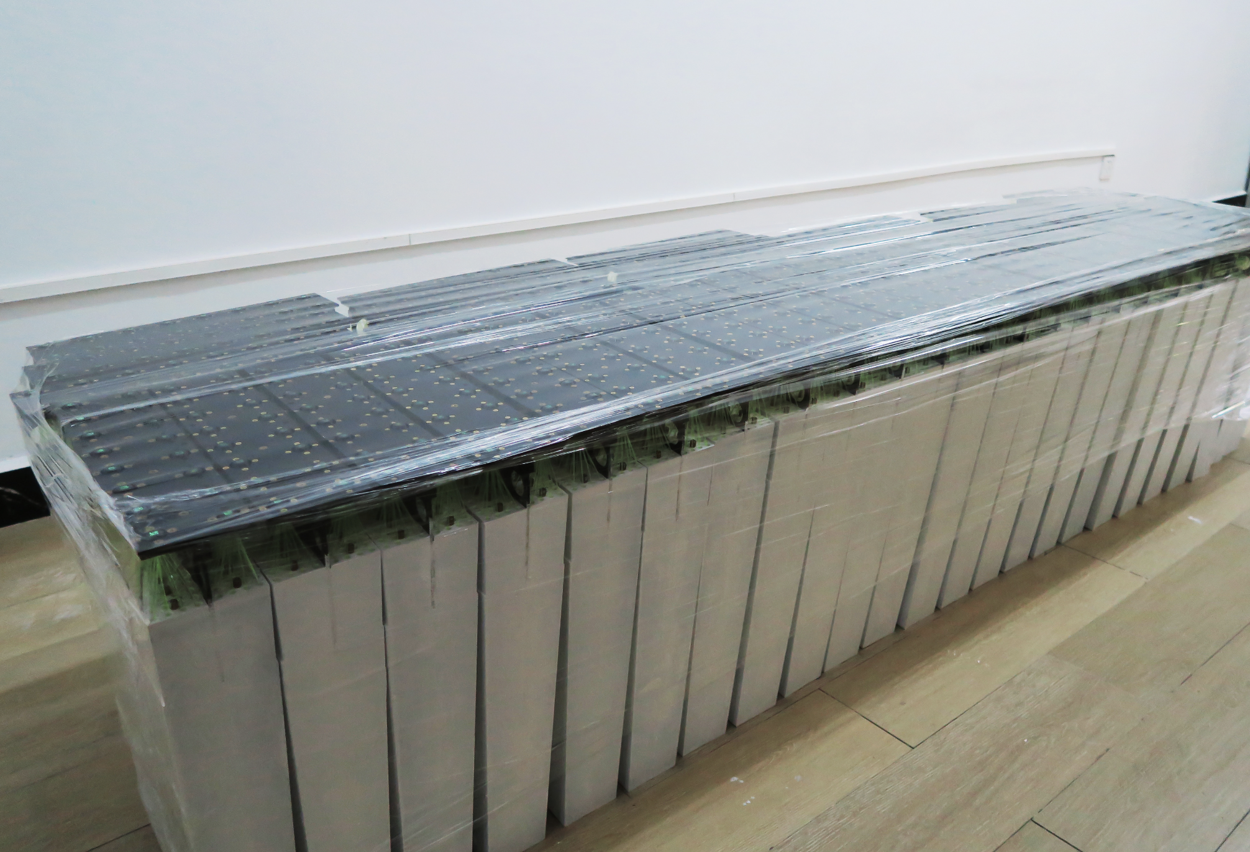
Modules production in China
Module production in USC
Module production in FDU
Module production in USC

Slide 8
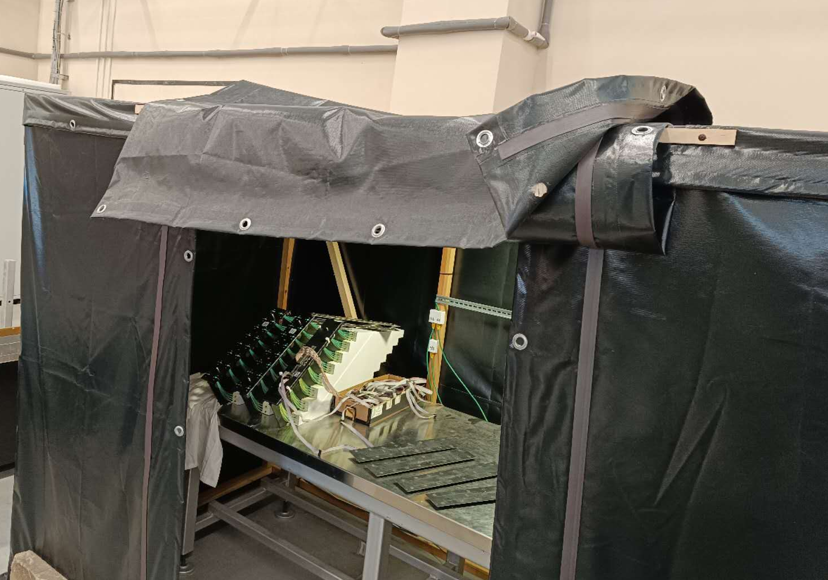
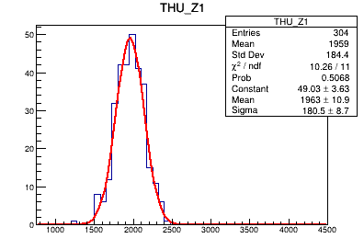
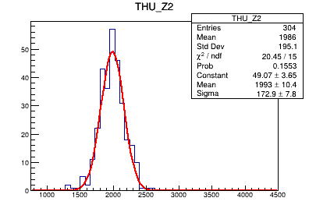
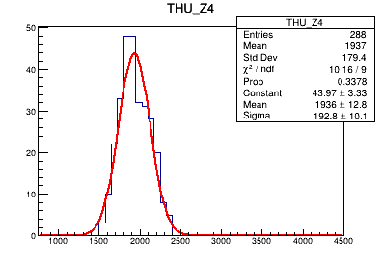
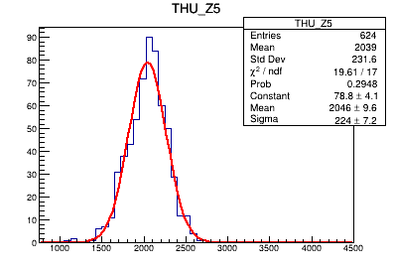
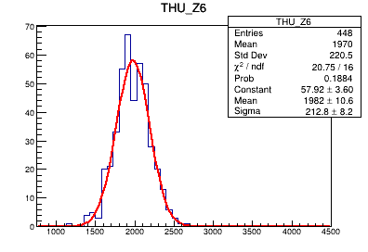
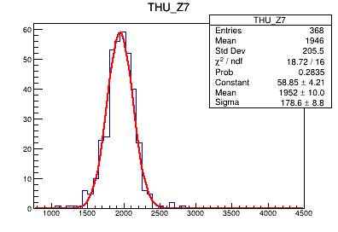
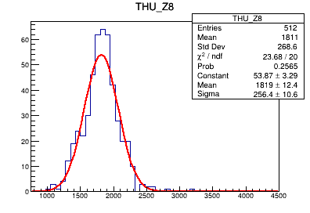
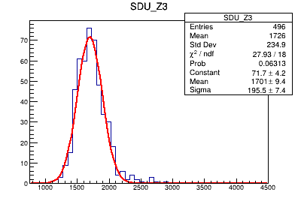
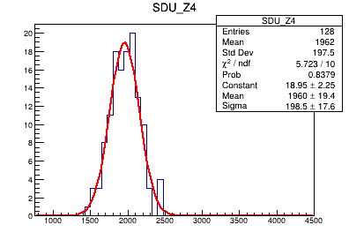
Cosmic Test of 217 Modules from China
Cosmic test in JINR

Slide 9
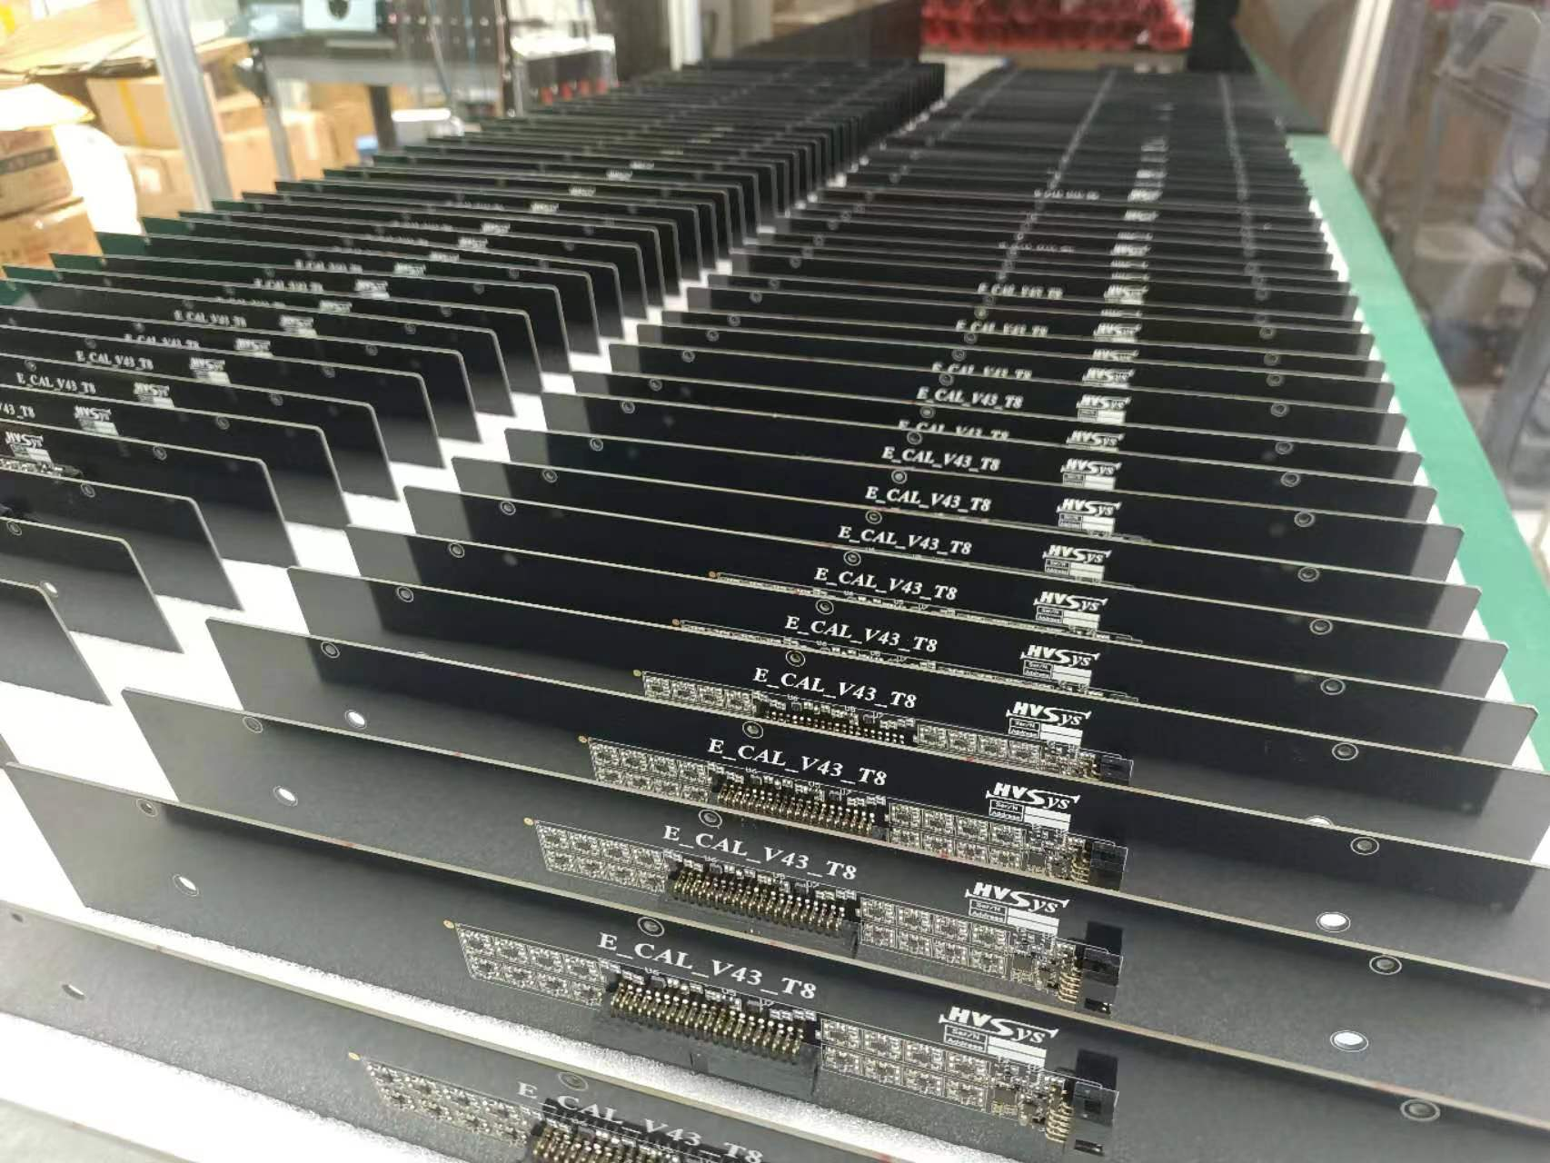
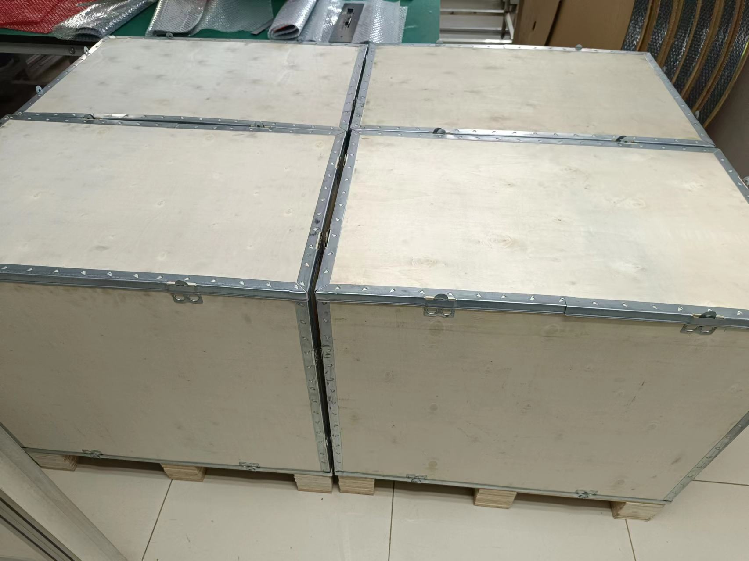
PCBs production in China
 | T123 | T4 | T5 | T6 | T7 | T8 | Total | Production | Test | Shipment
THU | 450 | 150 | 150 | 150 | 150 | 150 | 1200 | Finished | Finished | Finished

Slide 10
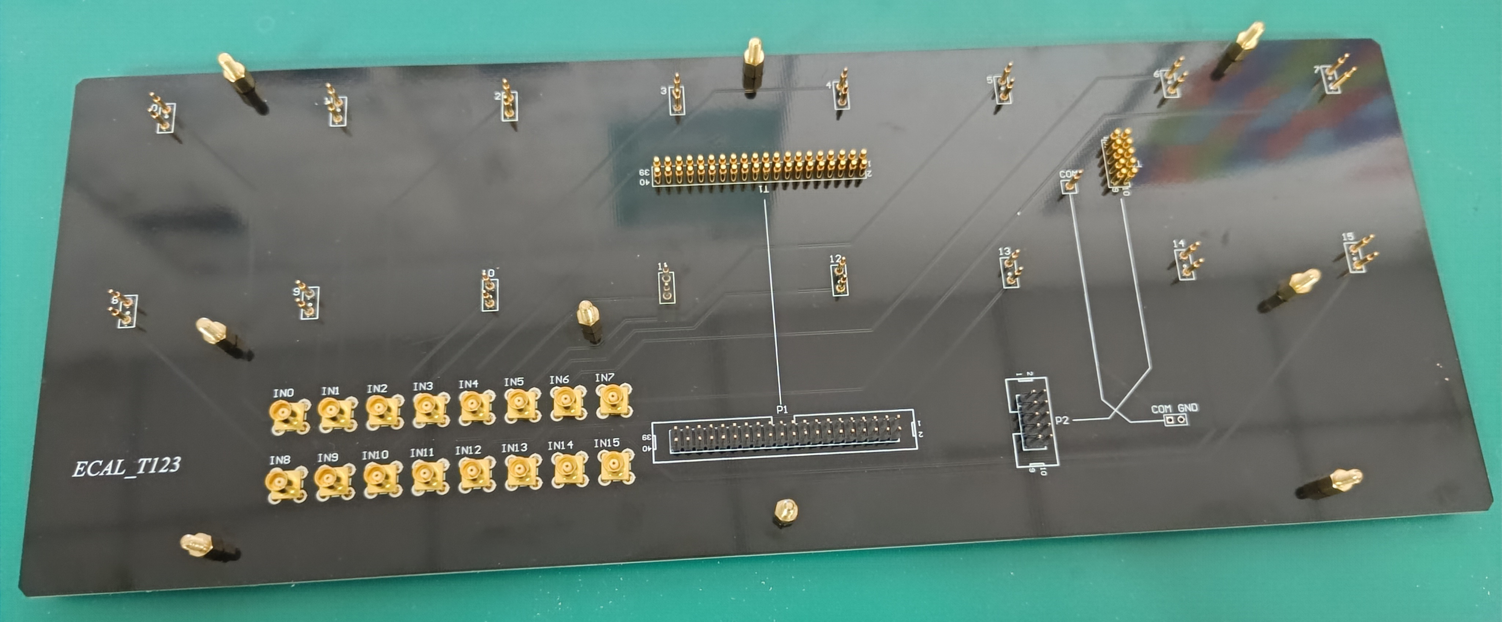
Batch test of ECal PCBs
The pads for SiPM
40P Header
10P Header
POGO PIN
Input Signal
Adaptor

Slide 11
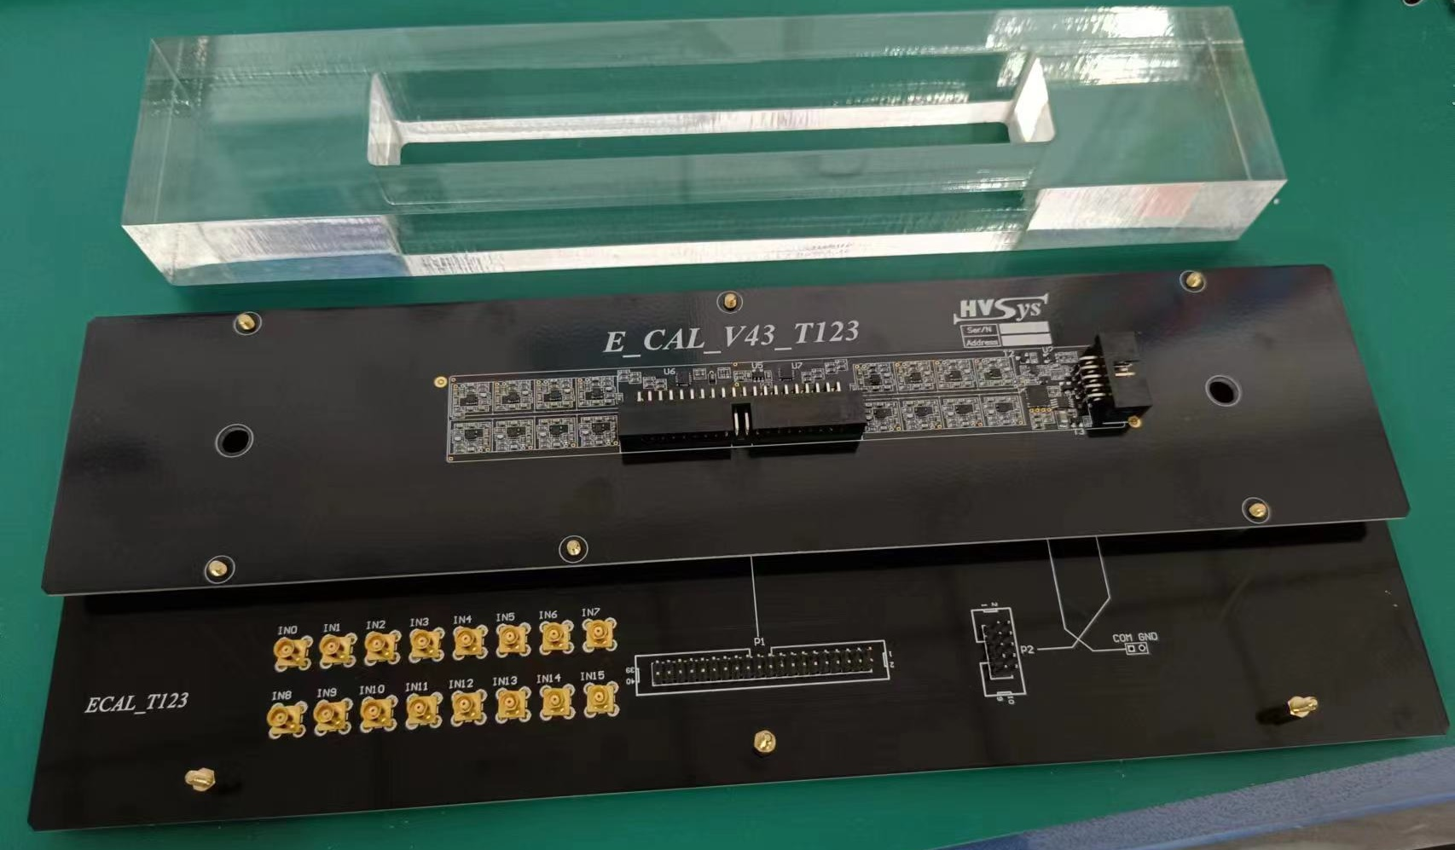
Batch test of ECal PCBs

Slide 12
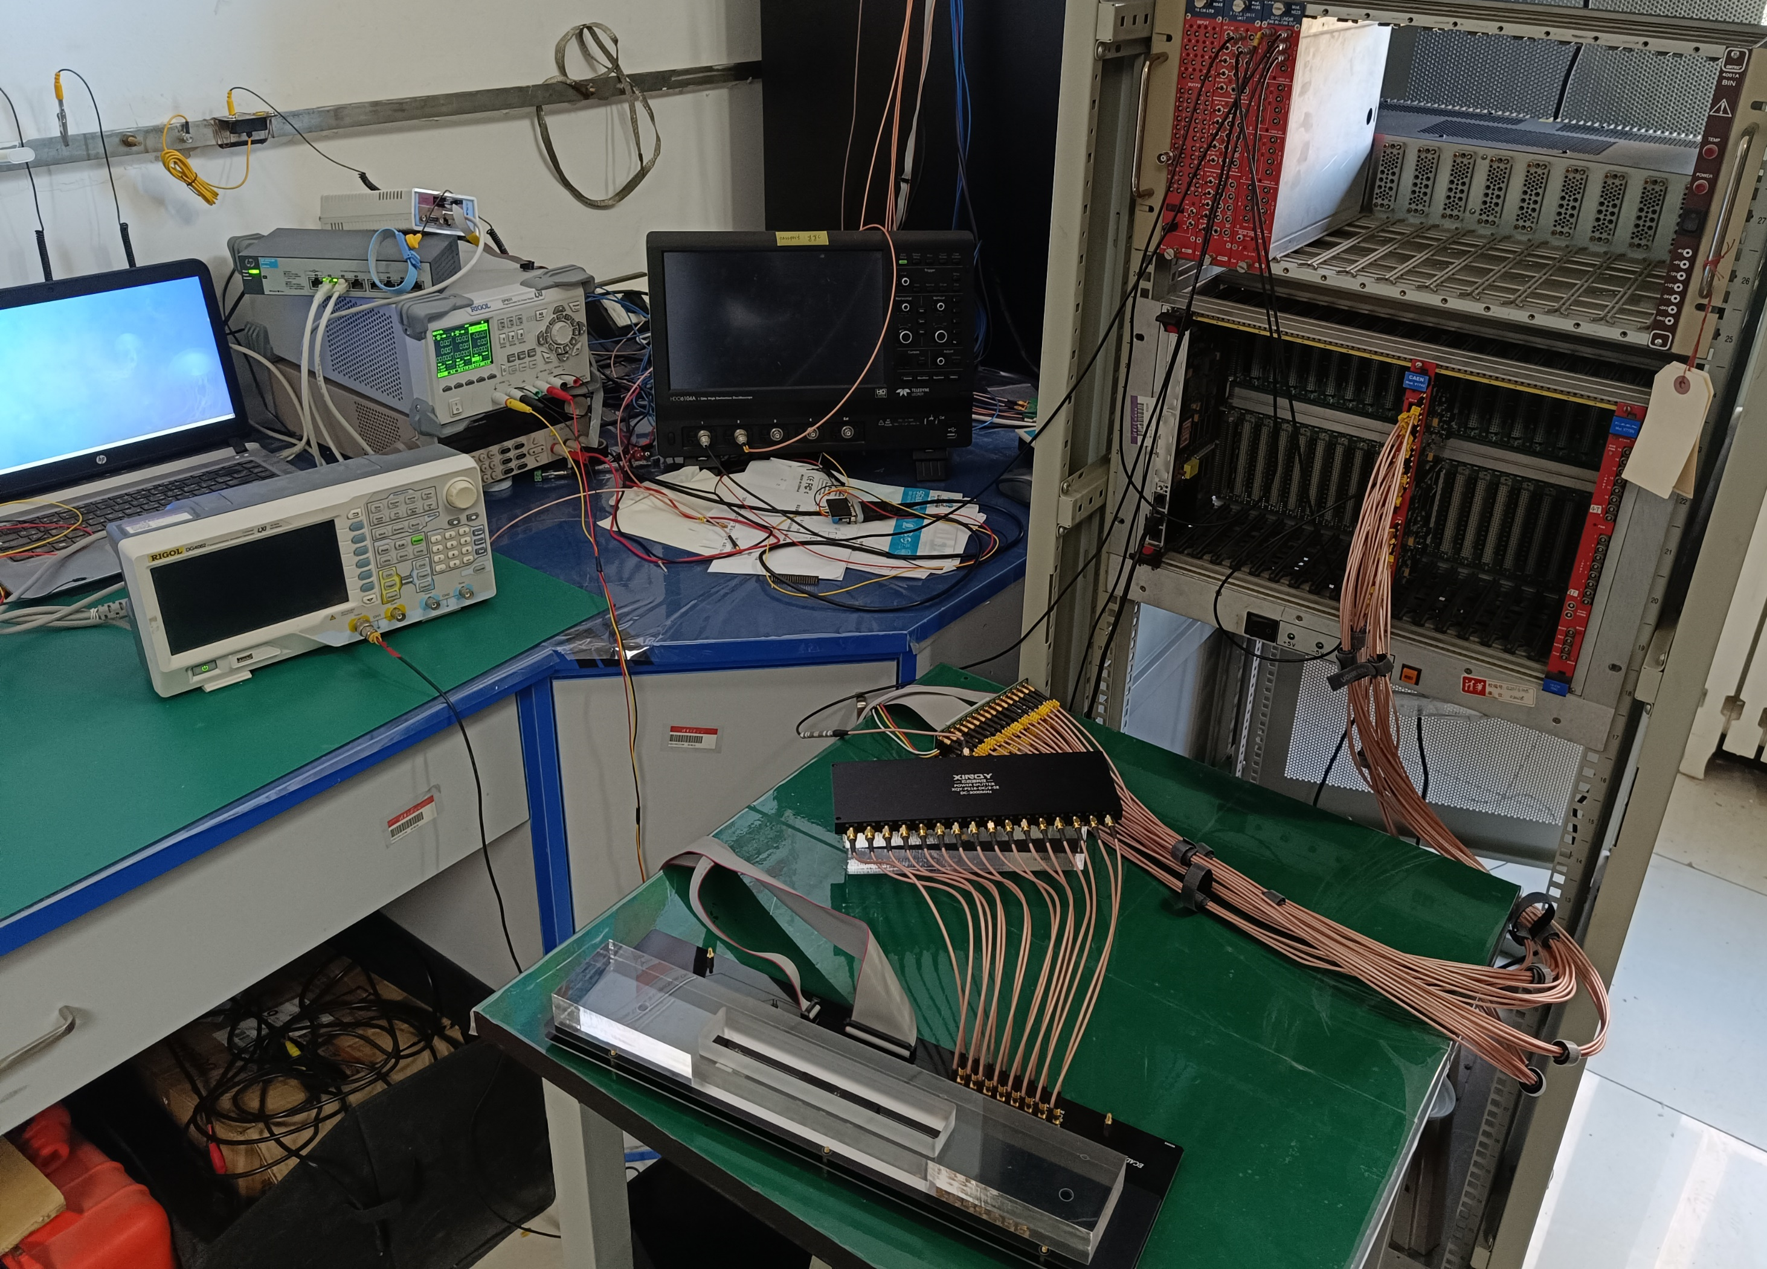
Batch test of ECal PCBs
NIM Crate
Power Supply
PC
VME Crate
Adapter
Waveform Generator
Power Splitter
Backplane & PCB

Slide 13

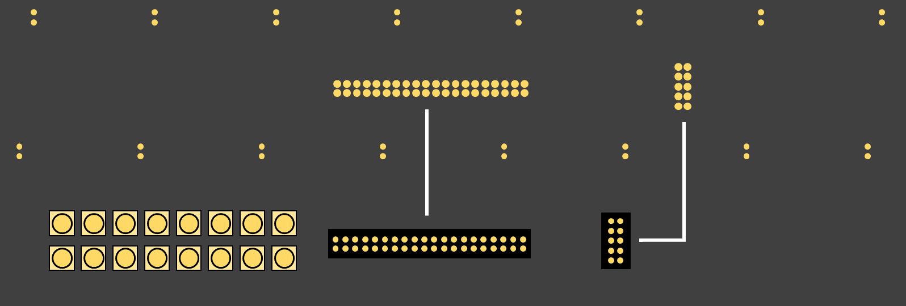
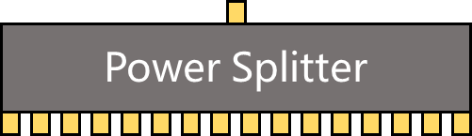
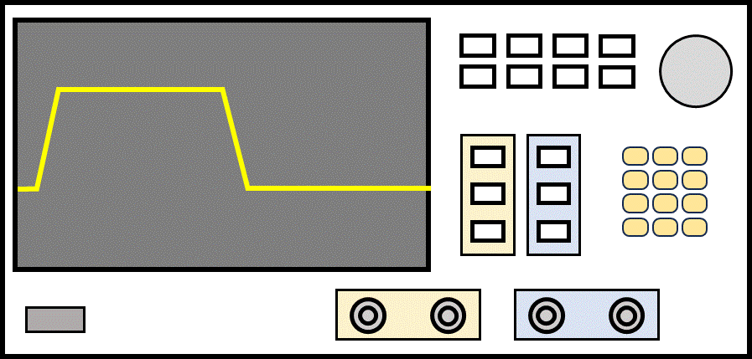
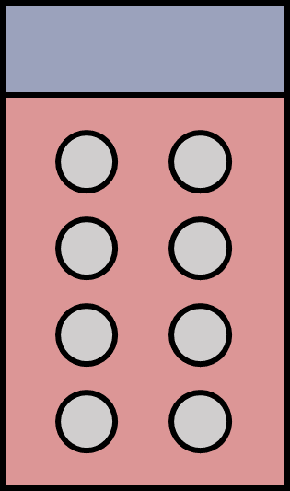
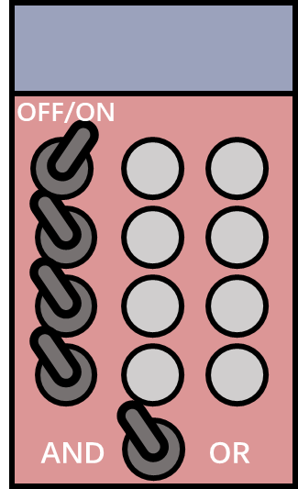
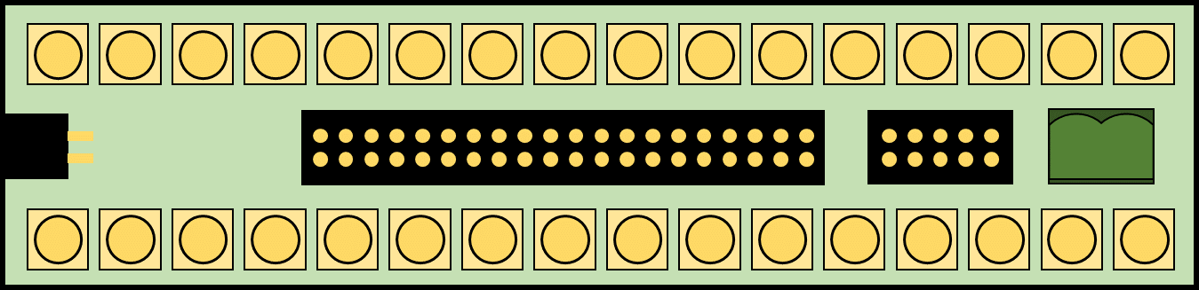
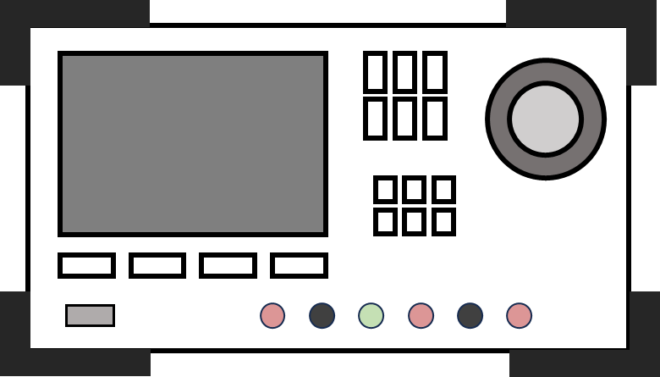

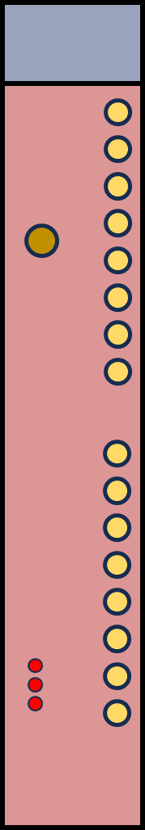

Batch test of ECal PCBs
Waveform Generator
Fan in-Fan out
Logic Unit
Adapter
Negative Signals
Power Supply
PC
NIM Crate
Positive Signals
TRG
VME Crate
V1742
VME Bridge

Slide 14
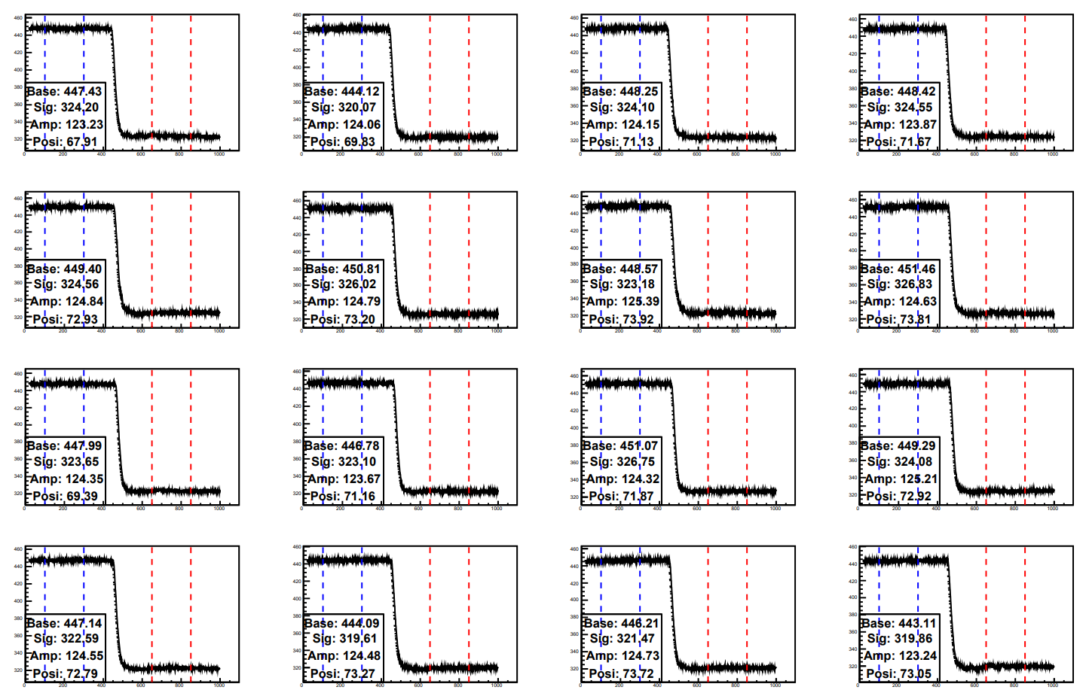
Batch test of ECal PCBs
Example of waveforms of 16 channels

Slide 15
Batch test of ECal PCBs
The response of PCBs is related to the temperature slightly
R
01
02
15
R
16
17
30
R
Less than 30 minutes

Slide 16
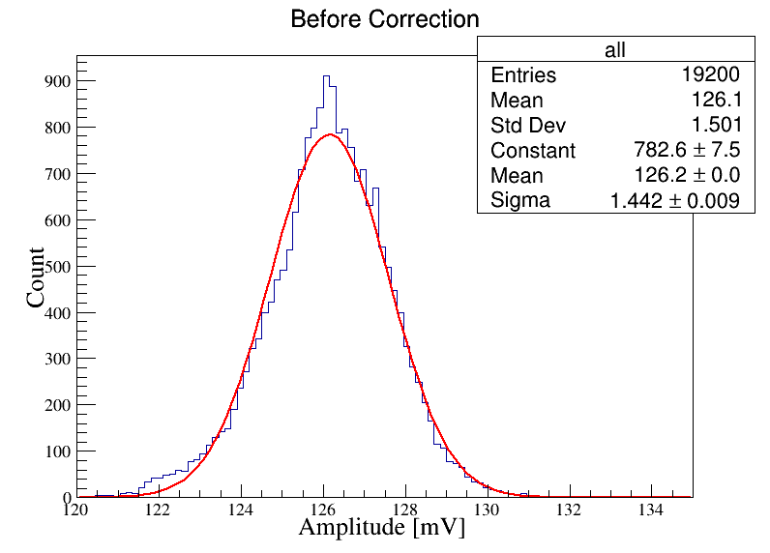
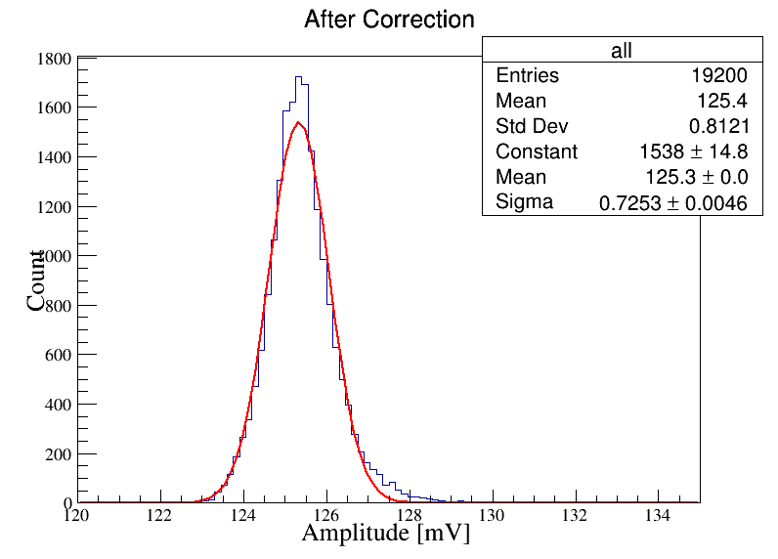
Batch test of ECal PCBs
The response of PCBs is related to the temperature slightly
1200 boards, 19200 channels

Slide 17
Summary
The China Group has established a complete QA & QC system. QA & QC of Material, Tower and Module have reached the requirements.
768 modules have been shipped to JINR.
The cosmic test results show that the light yield of different tower is very consistent.
1200 PCBs have been produced in China and shipped to JINR.
Each PCB has been tested before the shipment.

