Slide 1
Central DCS / Run Control Concept
Sergey SERGEEV
XIII MPD Collaboration meeting
Apr. 23-25, 2024

Slide 2
Concepts
Modular, used defined interface (DIM + defined message format).
Extendable
Modules could be replaced/modified
As simple as possible (KISS – Keep It Stupidly Simple) and transparent
For MPD experiment only (not generic)
Based on DB to be used by MPD (PostgreSQL ?)

Slide 3
Experiment DCS structure
Run type DB
Diagnostics tools
Predefined set of RUN types
State
Client
RC/CDCS
Shift leader
Client
Command
FFD DCS
…………
TPC DCS
TOF DCS
ECAL DCS
DAQ
LV
HV
Laser
Cooling
…………
Command –> set run type
State – actual subdetector state
Off, StdBy, NotRdy,
Rdy, Wrng, Error,…
Client
Server
Client
Config DB
Client
HW

Slide 4
CDCS interface I
RC/CDCS subscribes to published by subdetectors state InfoItems with names
MPD_DCS_State/<subdetector name>
Run configuration contains subdetectors list used in a run
RC/CDCS sends run type name (text) to all CommandItems of subdetectors being in a list. CommandItems should have a name like
MPD_DCS_IniCmd /<Subdetector name>

Slide 5
CDCS interface II
Each subdetector DCS root node could (should?) have a CommandItem with name
MPD_DCS_DisplayCmd/<subdetector node name>
A command received by this CommandItem should start diagnostic tool (see below)
DAQ should have additional Info/Command items to provide vital information to/from the RC/CDCS (to be discussed with DAQ team)

Slide 6
CDCS interface III
RC/CDCS has a CommandItem MPD_DCS_Messages to receive messages from subsystems/subdetectors
Format of message should be like (to be discussed)
<subdetector name>_<severity level>_<message text>
<severity level> defines a way to process the message
0 -> just to show in a window. Could be scrolled by messages arriving later
1 -> stays at the screen until confirmed
2 -> stays at the screen until confirmed + sound alarm if not confirmed during defined time (1 min as an example)
3 -> stays at the screen until confirmed + instant sound alarm
All messages have a text content

Slide 7
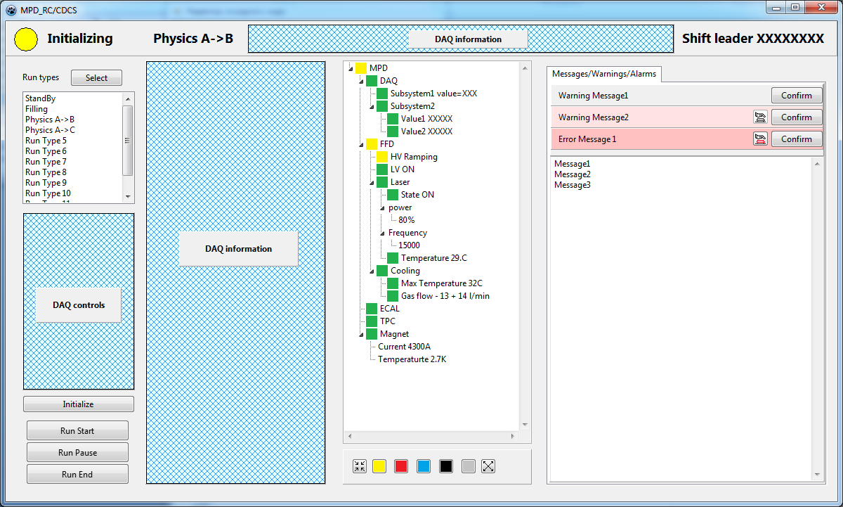
How it could look like

Slide 8
States and colors
State=-1, Item does not have a state, no color to be displayed
State=0, OFF - any of sub-elements does not respond
State=1, StdBy – any of sub-elements is in stand-by mode
State=2, NotRdy – any of element is in transition state (Time-out should be implemented)
State=3, Ready – all elements are OK
State=4, Wrng – any of elements is in Warning state
State=5, Error – any of elements is in Error state
State=6, Ignrd – node in Partitioned state

Slide 9
Extended display (to be discussed)
A subdetector should provide a set of diagnostics tools started by a CommandItem
MPD_DCS_DisplayCmd/<subdetector name>
This should be an application running at the CDCS PC(?) or a web-page running AJAX script (?). The web server could be provided by a CDCS. Page content should be developed by the subdetector team and could be located at a common disk space
Start parameters are defined in the CommandItem command content

Slide 10
Subdetector DCS (obligatory)
Run type name
Subdetector State
FSM:
If any subsystem in Off -> Off
If any subsystem in StdBy-> StdBy
If any subsystem in Error-> Error
…………………………………………………
If all subsystems in Rdy -> Rdy
Subdetector
DCS
DB
Run type name to
HW configs
FSM
HW Config name
Partitioning:
Remove part of a system from the common tree.
Works at level of a subdetector DCS and at level of a server
Actual state
Server
…………
Server

Slide 11
Subdetector DCS (optional)
Additional DISPLAY commands
Extra info to CDCS
Subdetector
DCS
Server
…………
Server

Slide 12
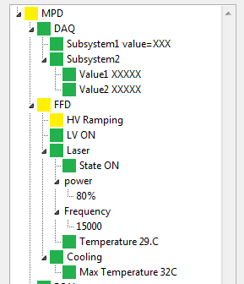
Extra parameters interface
MPD state is built using 1-st level nodes
“MPD_DCS_State/DAQ”, content=“3”
“MPD_DCS_State/DAQ/Subsystem1”,
content=“3_value=XXX”
“MPD_DCS_State/DAQ/Subsystem1/Value1”,
content=“3_XXXXX”
“MPD_DCS_State/FFD/Laser_power”,
content=“-1”
“MPD_DCS_State/FFD/Laser_power/”,
content=“-1_80%”
Obligatory
Extra info to display in the tree, defined by subsystem/subdetector

Slide 13
Thank you for attention

Slide 14
Based on TCP/IP sockets
Developed in 80-s at DELPHI experiment
Main feature – converts hardware address space (IP + port) to logical name address space -> components could migrate on computers
Event-driven (real-time)
Could have multiple name domains
Open source
Works on Windows, VMS, several Unix flavors (Linux, Solaris, HP-UX, Darwin, etc.) and the real time OSs: OS9, LynxOs and VxWorks
Libraries for C, C++, Jawa, Delphi (Lazarus), Python
A lot of debugging tools
See https://dim.web.cern.ch/

Slide 15
How it works
At startup every Server registers its services at DNS (DIM name server)
Any Client could request a connection to a service, after that the client receives actual IP and port number for requested service (performed inside the DIM library)
DIM establishes a TCP/IP connection Server-Client
Further communication is done directly via TCP/IP sockets (Server-Client only)
Pleasant bonus: If a Service contains a “description” then debugging tools could interpret TCP/IP buffer content to display in a human-readable way

Slide 16
Source code C++
Create 2 Info items
DimService servint("TEST/INTVAL",ival);
DimService new_servint("new_TEST/INTVAL",boolval);
DimServer::start(newDns, "new_TEST");
if(!boolval) boolval=1; else boolval=0;
ival++;
servint.updateService();
new_servint.updateService();
New data ready
…………………………………………………………………………..
…………………………………………………………………………..
Publish New data

