Slide 1
Current status of the MPD Event Display
Alexander Krylov akrylov@jinr.ru

Slide 2
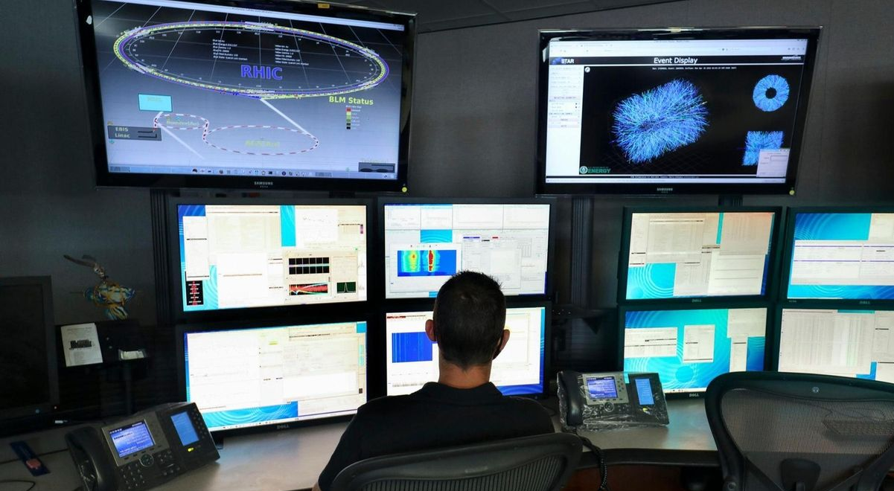
The Event Display
STAR experiment control room
ATLAS experiment control room

Slide 3
The Event Display components

Slide 4
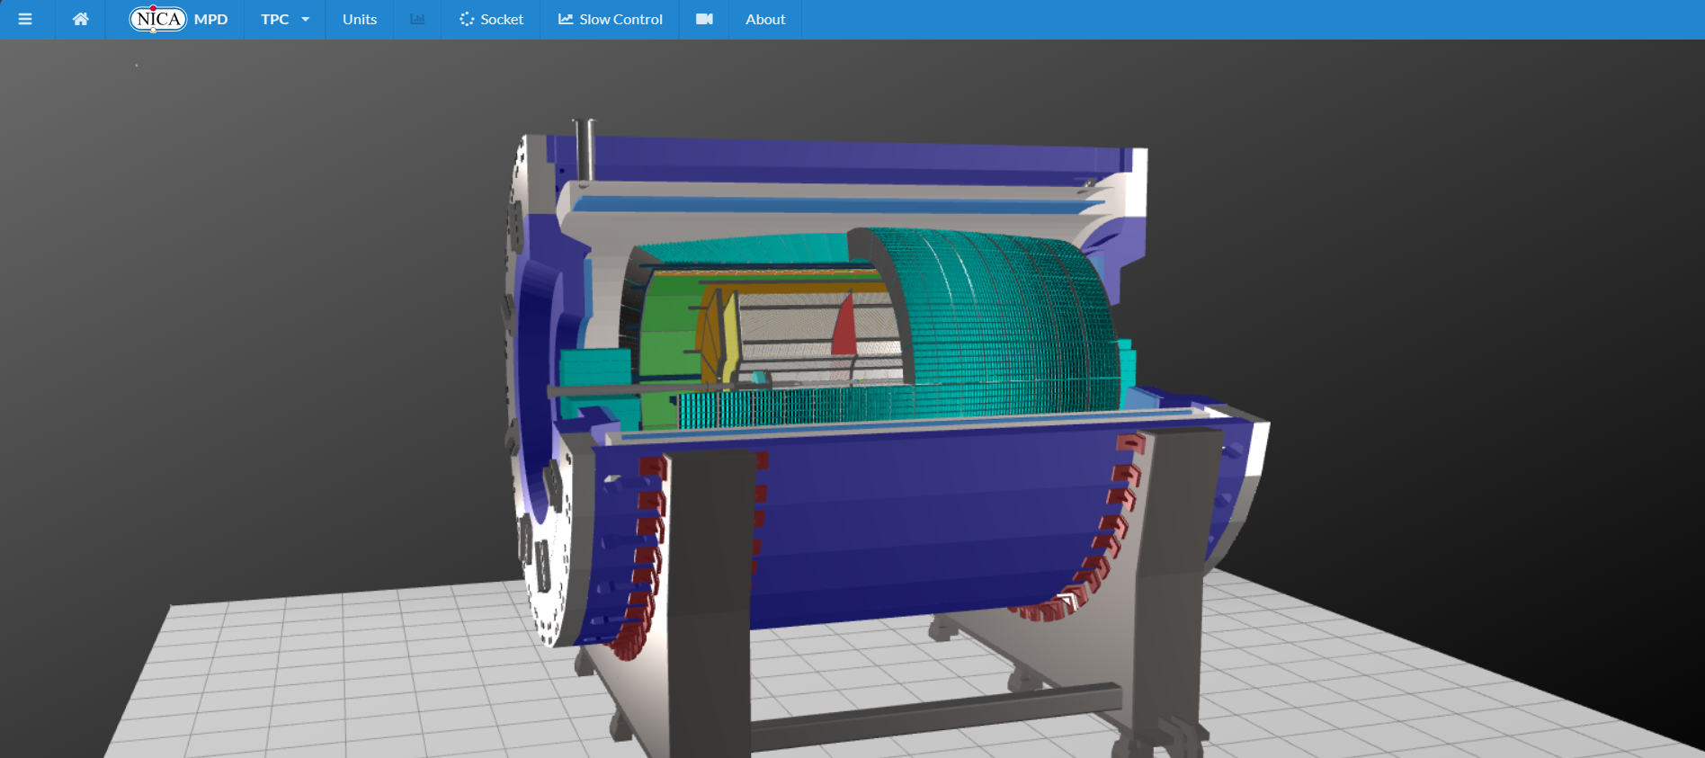
Event Display prototype
Stable version of the Event Display are available by address:
https://mpd-edsrv.jinr.ru
Git project was created for developers:
https://git.jinr.ru/nica/mpd-event-display.git
MPD geometry in Event Display

Slide 5
Real time mode of the Event Display

Slide 6
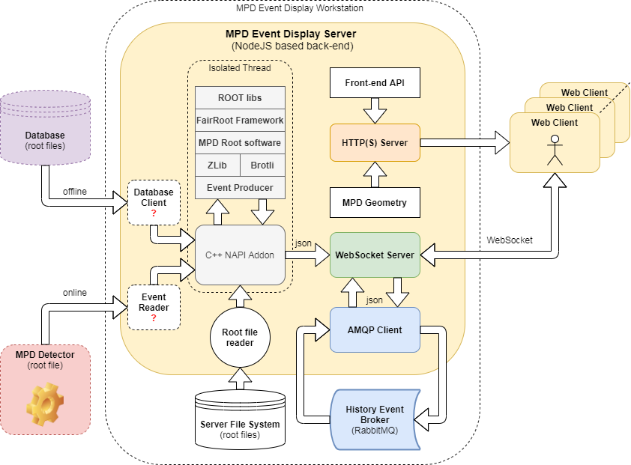
Event Display scheme

Slide 7
JavaScript engines
V8 is an open-source JavaScript engine developed by The Chromium Project for Google Chrome and Chromium web browsers.
SpiderMonkey currently maintained by the Mozilla Foundation and it is written in C/C++ and contains an interpreter, the IonMonkey JIT compiler, and a garbage collector. It is still used in the Firefox web browser.
JavaScriptCore (Nitro) is Apple's engine for its Safari browser based on optimizing just-in-time (JIT) compiler named FTL was announced on May 2014. As of February 2016, the backend of FTL JIT is replaced by “Bare Bones Backend” (or B3 for short).

Slide 8
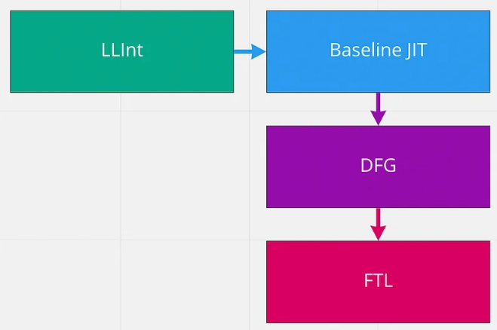
Engine choice
V8 engine developed by the Chromium Project
JavaScriptCore (Nitro) used in Safary browser (Apple)
Notes:
V8’s Interpreter called Ignition and Optimization Compiler called TurboFan
Start-up interpreter (LLInt), baseline JIT, a low-latency optimizing JIT (DFG), and a high-throughput optimizing JIT (FTL)

Slide 9
New features (geometries transfer)
Current path
New path
(Investigated by Petr Doroshev)

Slide 10
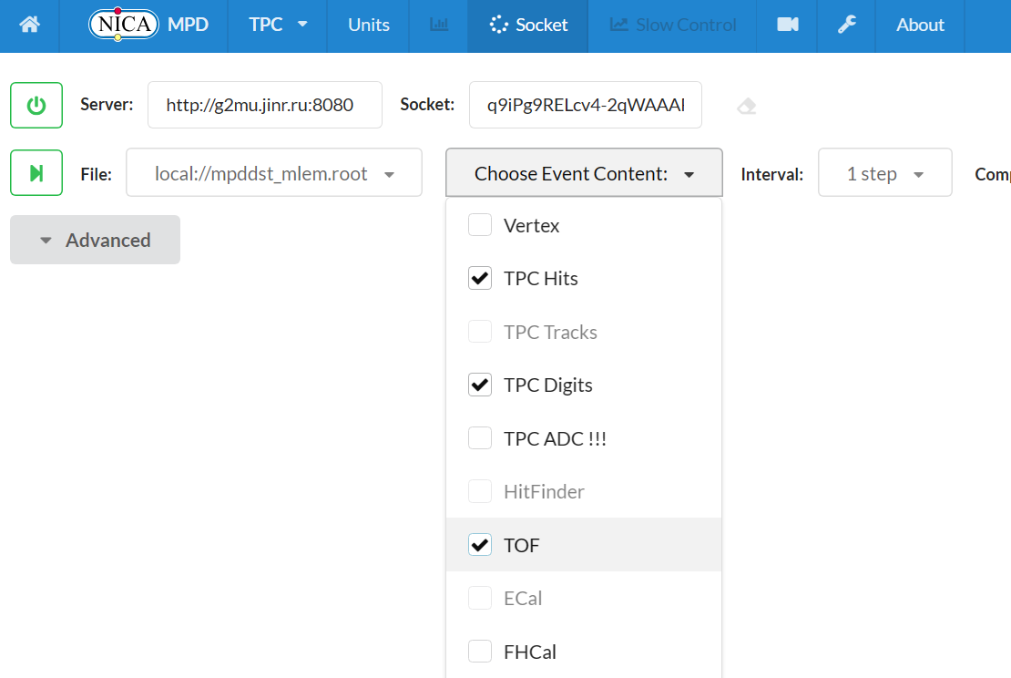
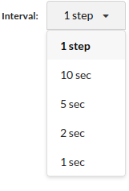
New features (simple start)
1
2
3

Slide 11
Implemented features (detectors geometry)

Slide 12
Implemented features (event visualization)

Slide 13
Implemented features (tracks visualization)

Slide 14
Summary
The event display is now prepearing for real-time use in the control room;
Started work on testing various modern solutions to speed up the event display by changing the JavaScript engine, as well as updating the server-side runtime environment;

Slide 15
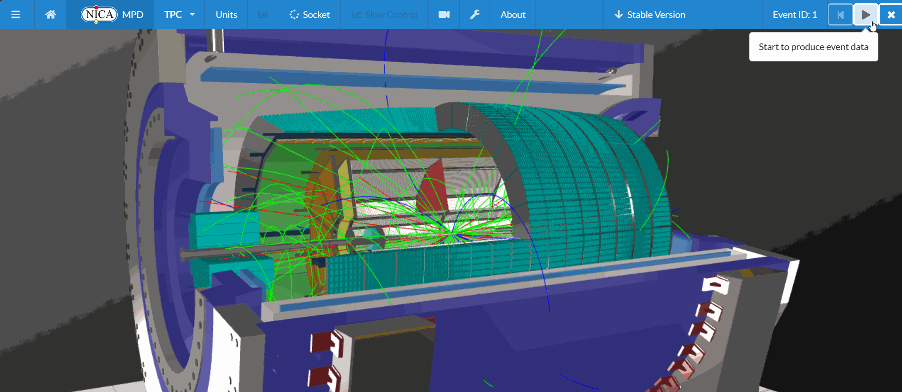
Thank you for your attention!

Slide 16
Implemented features (detectors geometry)

Slide 17
Implemented features (event visualization)

Slide 18
Implemented features (tracks visualization)

Slide 19
New features (simple start)
Old
New

Slide 20
New feature (simple start)

Slide 21
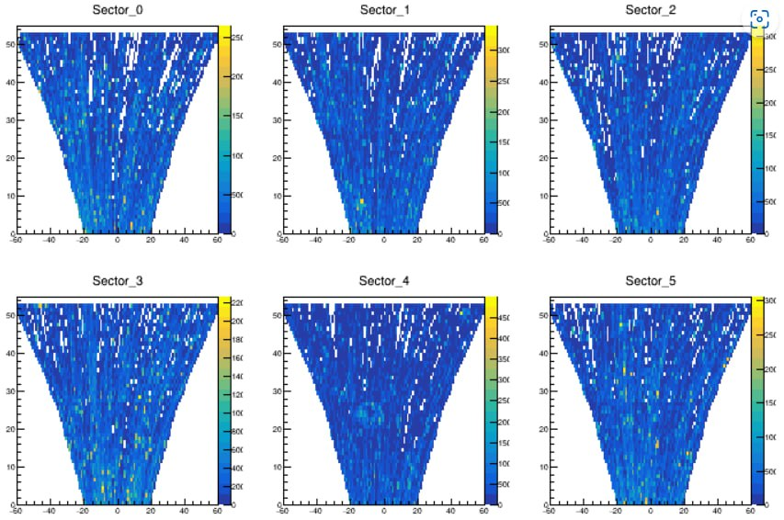
Quality assurance (QA)
TPC QA for Star
TPC QA for MPD

Slide 22
MPD Software Development & Computing Team
Rogachevsky O. Coordinator
Krylov V., Krylov A. Online MPD Event Display
Moshkin A., Pelevanyuk I. Mass Production
Bychkov A. Detector Simulation
Kuzmin V. Detector Alignment
Podgainy D., Zuev M. Supercomputing
Alexandrov E., Alexandrov I. Databases
Balashov N. Gitlab Support
Belyakov D. Network Infrastructure
Belecky P., Kamkin A. Acts Tracker
Busa J. Build System
Hnatic S. Architecture

