Slide 1
Design of Automation Systems for Experimental Facilities
Task 1

Slide 2
Farah Mahmoud
3rd year student
Nuclear Engineering
department, Alexandria University, Egypt

Slide 3
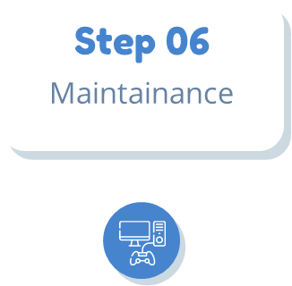
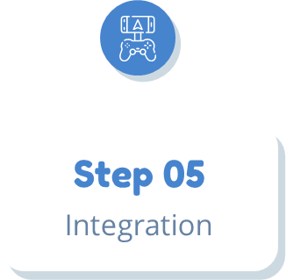
Life Cycles of Automated Systems (DCS)
Step 02
Step 04
Design
Testing
Step 01
Step 03
Specification
Implementation

Slide 4
Design of Automation Systems
The objective of this task is to search for the design parts of automation systems for different experimental facilities through TDR &CDR then find ways to develop them
In the design phase, distributed control system (DCS) is designed and engineered based on the project requirements
This includes selecting appropriate hardware and software, designing the control strategy, and creating the wiring and network diagrams

Slide 5
Some Standards for designing of Automation Systems
Control System Frameworks Engineers working on control systems have access to control system toolkits, they provide essential functionalities for designing, building, and modifying control systems
Hardware and networking the control system architecture involves a mix of hardware, networking, and application software. The control system ensures remote control and monitoring of all devices and subsystems
Collaboration, standardization, and adaptability are critical for designing effective automation systems for accelerators

Slide 6
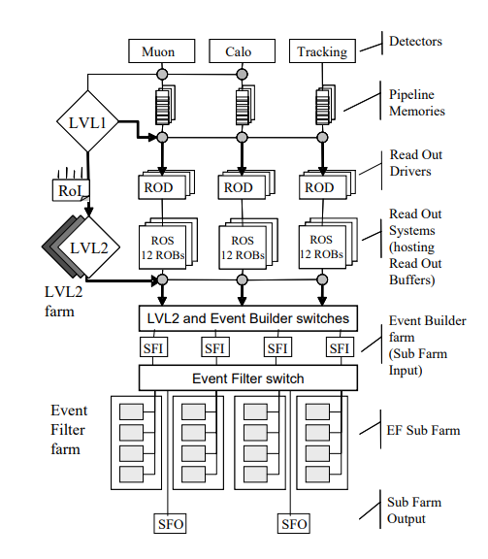
Example.1 ATLAS
HLT( High Level Trigger)
Uses calorimeter and muon detector information to select events at 75 KHz
LVL-2
Provides additional rejection factor of 20-30 bringing the rate to 3 KHz
EF (Event Filter Farm)
Analyzes the entirety of each event data to achieve a further rate reduction to 200Hz

Slide 7
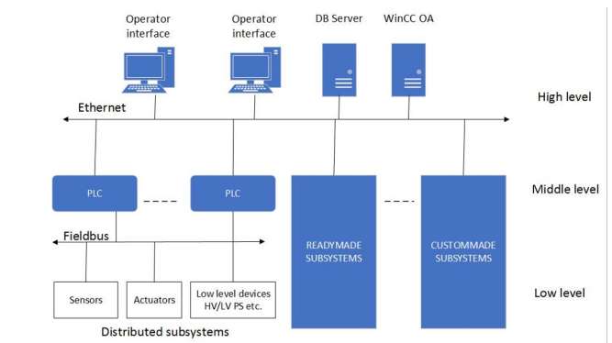
Example.2 SPD
High Level
To provide human-machine interface for operators, communicate with the external world(accelerators)
Middle Level
Represented by programmable logic controllers and integrated ready-made and custom-made subsystems
Low Level
Includes measurement channels built into the front end electronics and DAQ of the detector part, I/O devices, and low and high voltage power supplies

Slide 8
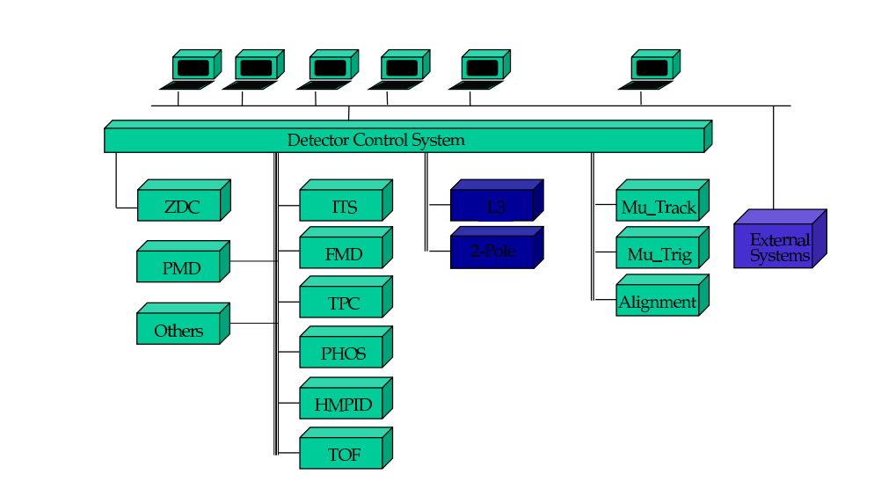
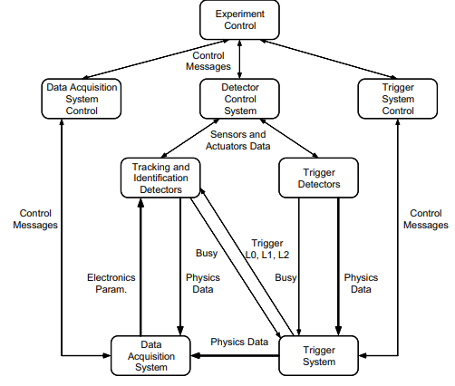
Example.2 ALICE

Slide 9
Suggestions and planning for Improving
1
2
3
Energy efficiency and power management
Use of artificial intelligence to optimize accelerator operations
and improve machine performance
High-Level Synthesis

Slide 10
References
https://cds.cern.ch/record/1035150/files/daq-conf-2007-022.pdf

