Slide 1
My vision of the design process
Culicov Alexandru

Slide 2
Who am i?
My name is Alexandru Culicov, I am a second-year student at the University of Timisoara, Romania. I am 19 years old, I was born and raised in Russia and applied to Romania to specialize in computer science.

Slide 3
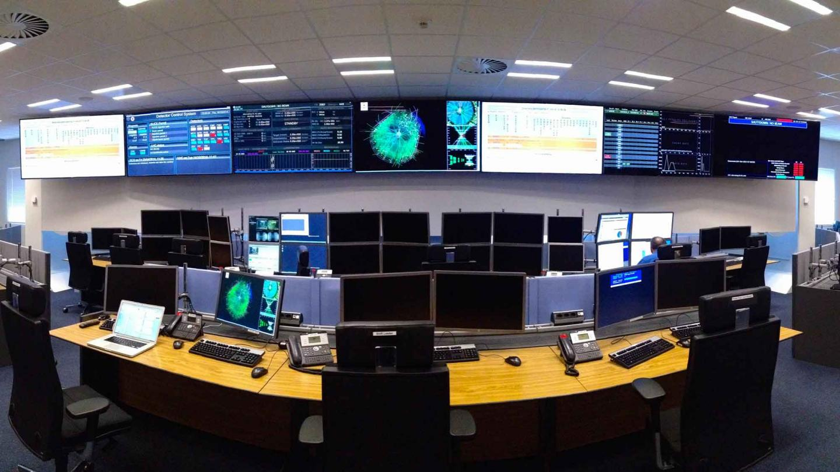
My vision of the task:
As I understand it, our main task is to borrow the basic concepts from the ALICE control system, and create a base on the basis of which developers could create a unified system that is not fragmented into pieces.

Slide 4
How we can do it?
We need to use the following tools and approaches to create a unified system based on the ALICE control system:
Design Methodology: Using Unified Modeling Language (UML) for modeling.
Integrated Development Environments (IDEs): Using IDEs such as Eclipse with plugins for modeling and development.
Version Control Systems: Using Git for code management and version control.
Project Management Systems: Using JIRA or Trello for planning and tracking tasks.
Documentation: Creating technical documentation using tools like Microsoft Visio or Confluence.
Quality Control: Using automation testing tools like JUnit and Selenium, as well as continuous integration and deployment tools like Jenkins or GitLab CI.

Slide 5
Planning:
We need to thoroughly gather the requirements of the ALICE system.
We should analyze the components and interfaces of the ALICE system.
We must identify common concepts for unifying the ALICE system.
We need to develop a flexible, scalable architecture.
We should develop reusable core modules.
We need to define clear APIs and integration points.
We must provide detailed guidelines for developers.
We should thoroughly test the system for stability and compatibility.
We need to gather and incorporate feedback for system improvement.
We should deploy and facilitate the adoption of the system through training and support.

Slide 6
Splitting tasks:
Requirements Gathering (Person 1):
Thoroughly gather the requirements of the ALICE system.
Component and Interface Analysis (Person 2):
Analyze the components and interfaces of the ALICE system.
Identification of Common Concepts (Person 3):
Identify common concepts for unifying the ALICE system.
Architecture Development (Person 4):
Develop a flexible, scalable architecture.
Core Module Development (Person 1):
Develop reusable core modules.
API and Integration Definition (Person 2):
Define clear APIs and integration points.
Guidelines Provision (Person 3):
Provide detailed guidelines for developers.

