Slide 1
Docker, HSF and LFSPD
Valeriy Onuchin
JINR/DNLP/SPD

Slide 2
Why Docker?
To run thousands or even hundreds of thousands of SPD jobs
Consider Docker as a very light virtual machine
Docker provides the ability to package and run an application in a loosely isolated environment called a container
Application running in Docker can run on any OS system, any OS flavor, can run in distributed environment
Read about Docker https://habr.com/ru/search/?q=docker&target_type=posts
I created a Docker with HSF software

Slide 3
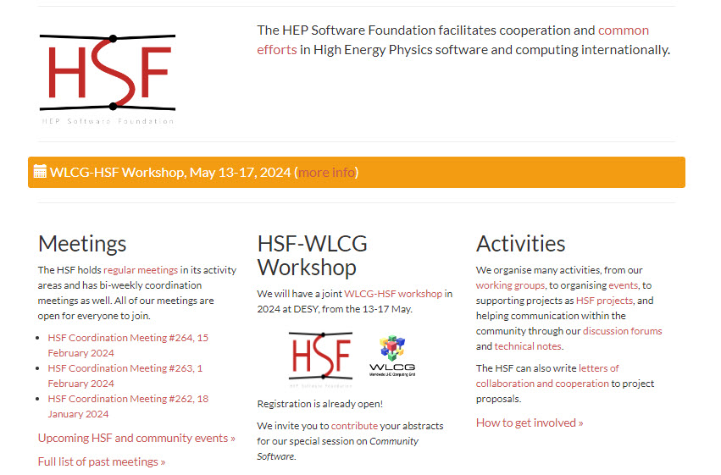
Why HSF?
HSF stands for “HEP Software Foundation” https://hepsoftwarefoundation.org/

Slide 4
What from HSF we can steal?
Here Gaudi based https://git.jinr.ru/x2v0/hsf packages which can be base of future SPD software
I wrote scripts to build them under Linux For SPD and create a Docker

Slide 5
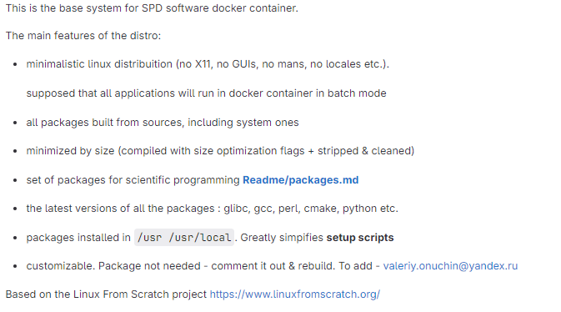
What is LFSPD?
LFSPD – Linux For SPD https://git.jinr.ru/x2v0/lfspd

Slide 6
Why LFSPD?
Don’t ask me why. I just did it!
To prove to myself that I'm not a camel
It was not easy. Hundreds of recompilations of hundreds packages.
Struggling with stupid mistakes. Patching … and it’s all over and over again resulting in:
Desperation & hopelessness
Overburning & depression
Endless “why I’m doing it?” & alcoholic breakdown
If I’m really fired this is the last amazing & outstanding thing what I’ve done in my life

