Slide 1
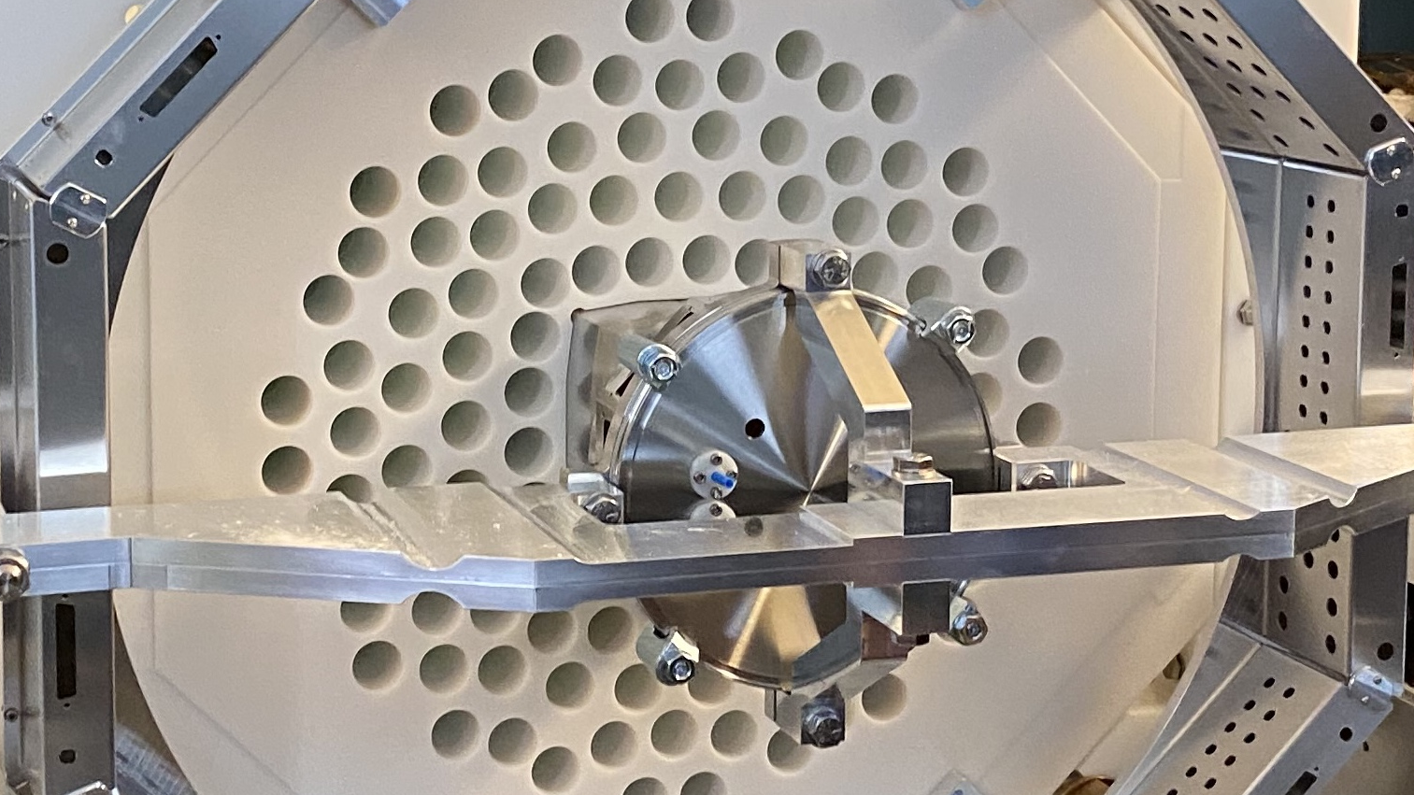
Характеристики спонтанного деления сверхтяжёлых ядер. Массы осколков и нейтроны
Лаборатория ядерных реакций им. Г.Н. Флёрова, ОИЯИ
Андрей Исаев
к.ф.-м.н., нач.группы
сепаратор SHELS
Совещание по физике тяжёлых ионов, 13 – 17 мая, 2024
Нижний Новгород, Россия

Slide 2
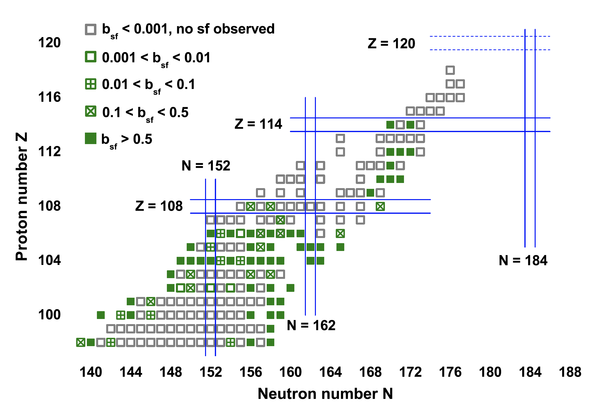
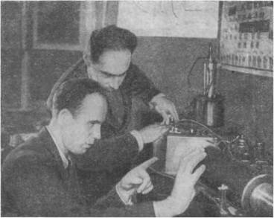
Spontaneous Fission
Flerov G. N. and Petrjak K. A.
Spontaneous Fission of Uranium
Phys. Rev. (1940) 58: 89
Heßberger F. P.
Spontaneous fission properties of superheavy elements
Eur. Phys. J. A (2017) 53: 75

Slide 3
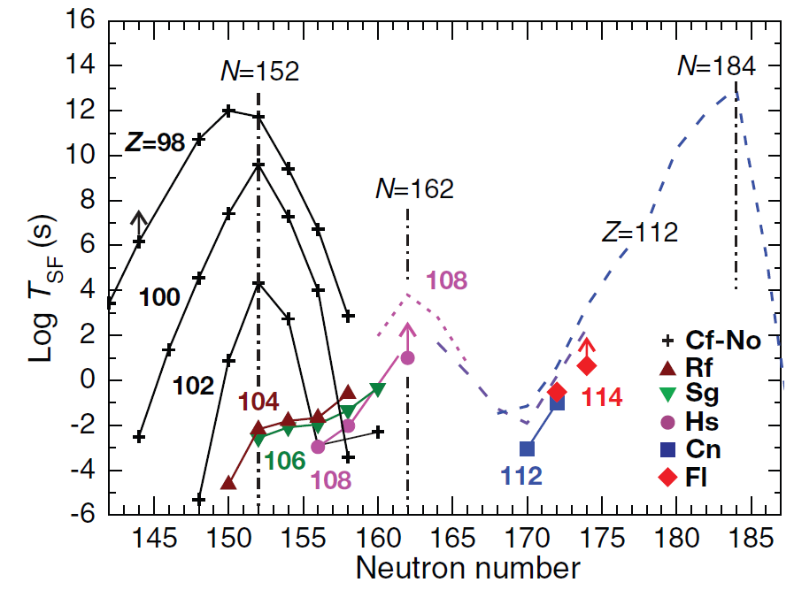
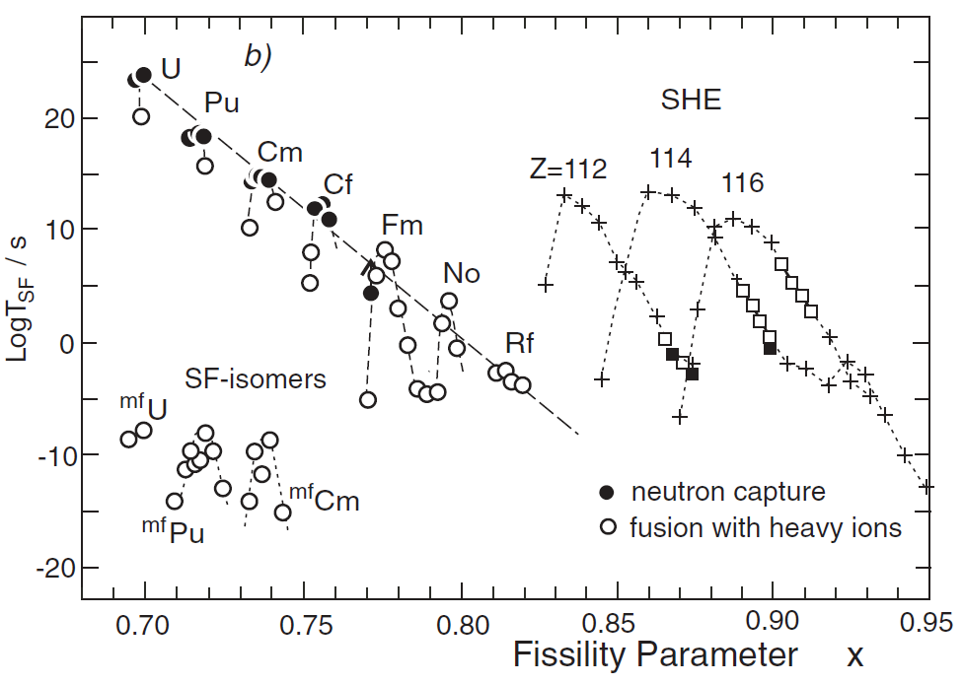
Spontaneous Fission
Oganessian Yu.Ts. and Utyonkov V.K.
Super-heavy element research
Rep. Prog. Phys. 78 (2015) 036301 (22pp)

Slide 4
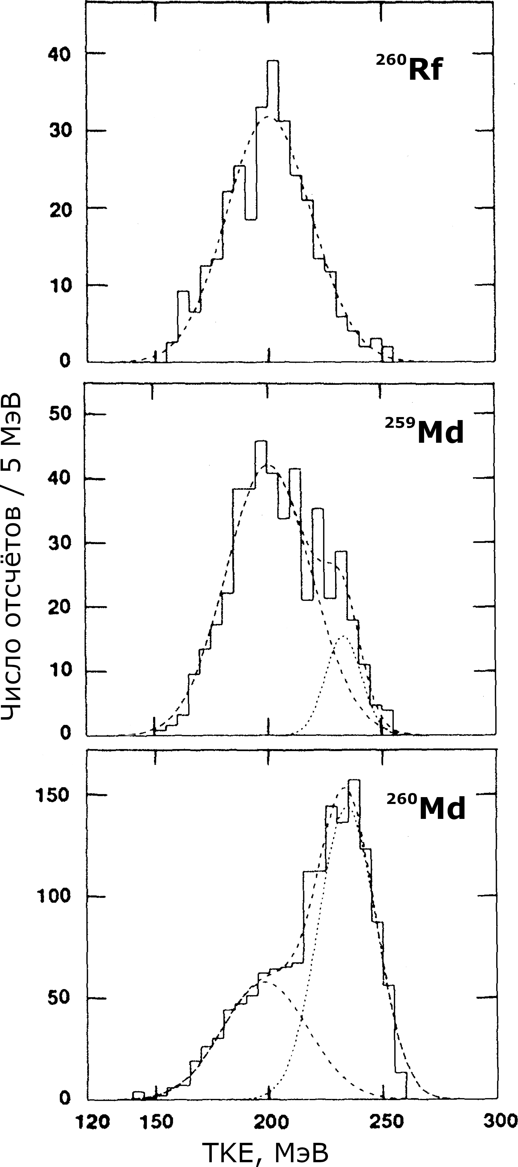
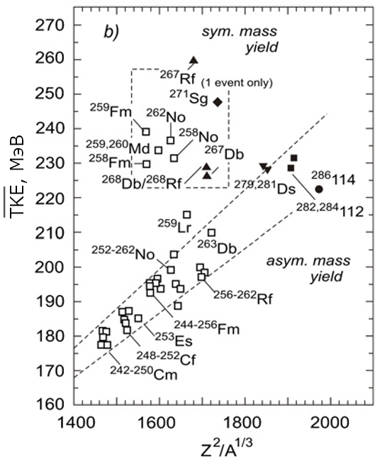
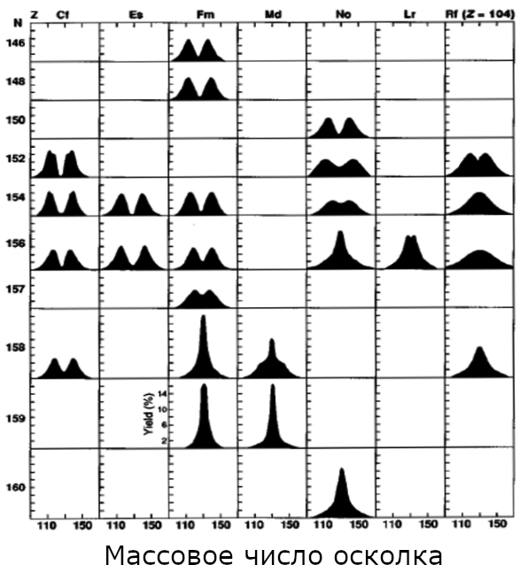
Fission Modes
TKE [MeV]
Count / 5 MeV
Fragment mass number
Oganessian Yu. Ts.
Heaviest nuclei from ⁴⁸Ca-induced reactions
J. Phys. G: Nucl. Part. Phys. 34 (2007) R165–R242
Hoffman D. C., Lane M. R.
Spontaneous fission
RCA 70/71 (1995) P. 135–146
TKE [MeV]
Hulet E. K. et al.
Spontaneous fission properties of ²⁵⁸Fm, ²⁵⁹Md, ²⁶⁰Md, ²⁵⁸No, and ²⁶⁰104: Bimodal fission
PRC 40/2 (1989) P. 770–784

Slide 5
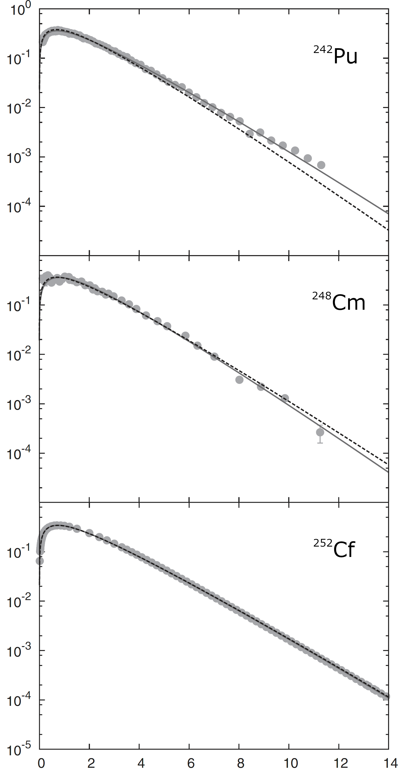
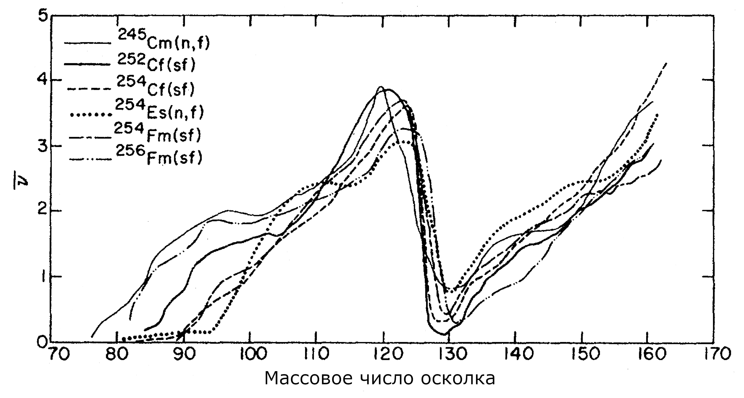
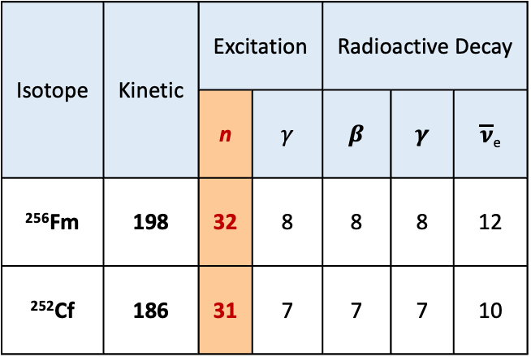
Prompt Neutrons
Fission fragments can remove their excitation by emitting a certain number of neutrons
The number of emitted neutrons depends on the fragment excitation
The multiplicity of prompt neutrons provides valuable information about the dynamics of the fission process
Different forms of energy (in MeV), released during SF of nuclei
Isotope | Kinetic | Excitation |  | Radioactive Decay
 |  | n | 𝛾 | 𝜷 | 𝜸 | $\overline{\text{ν}}$_{e}
²⁵⁶Fm | 198 | 32 | 8 | 8 | 8 | 12
²⁵²Cf | 186 | 31 | 7 | 7 | 7 | 10
¹³²Sn
Z = 50, N = 82
Spectrum [1/MeV]
Fragment mass number
Gangrskii Yu. P., Markov B. N., Perelygin V. P.
Registration and spectrometry of fission fragments.
Moscow: Energoatomizdat (1992), 312 p
Gindler J.
Dependence of neutron yield on
fragment mass for several low-energy fissioning systems
PRC 19/5 (1979) P. 1806–1819
Energy [MeV]
Iwamoto O.
Systematics of prompt fission
neutron spectra
JNST 45/9 (2008) P. 910–919

Slide 6
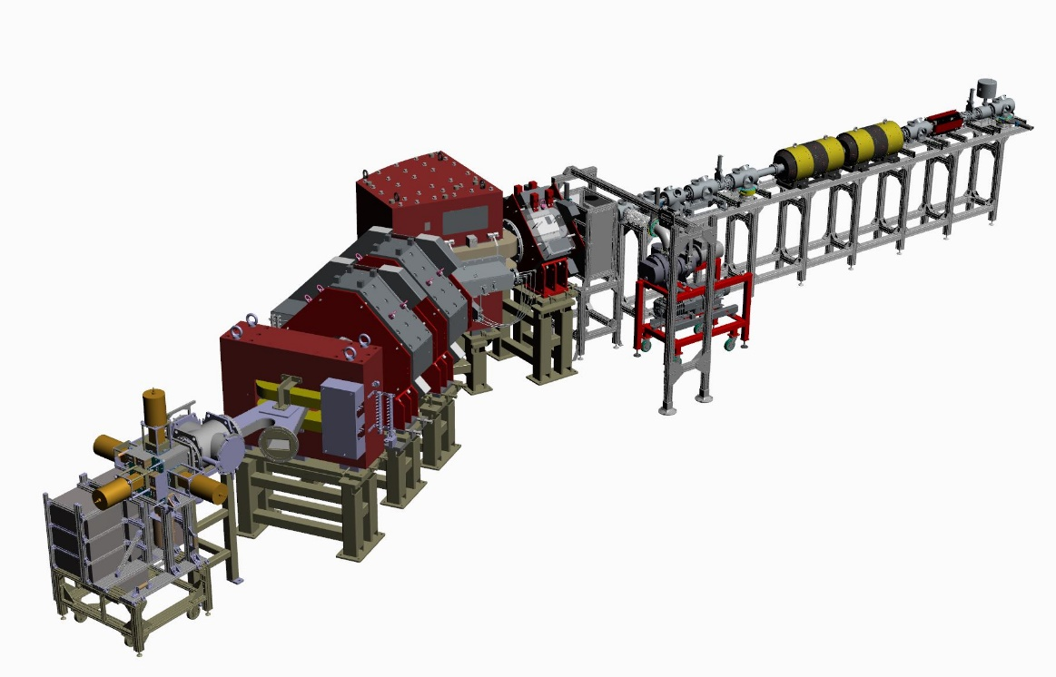
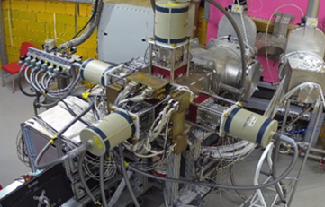
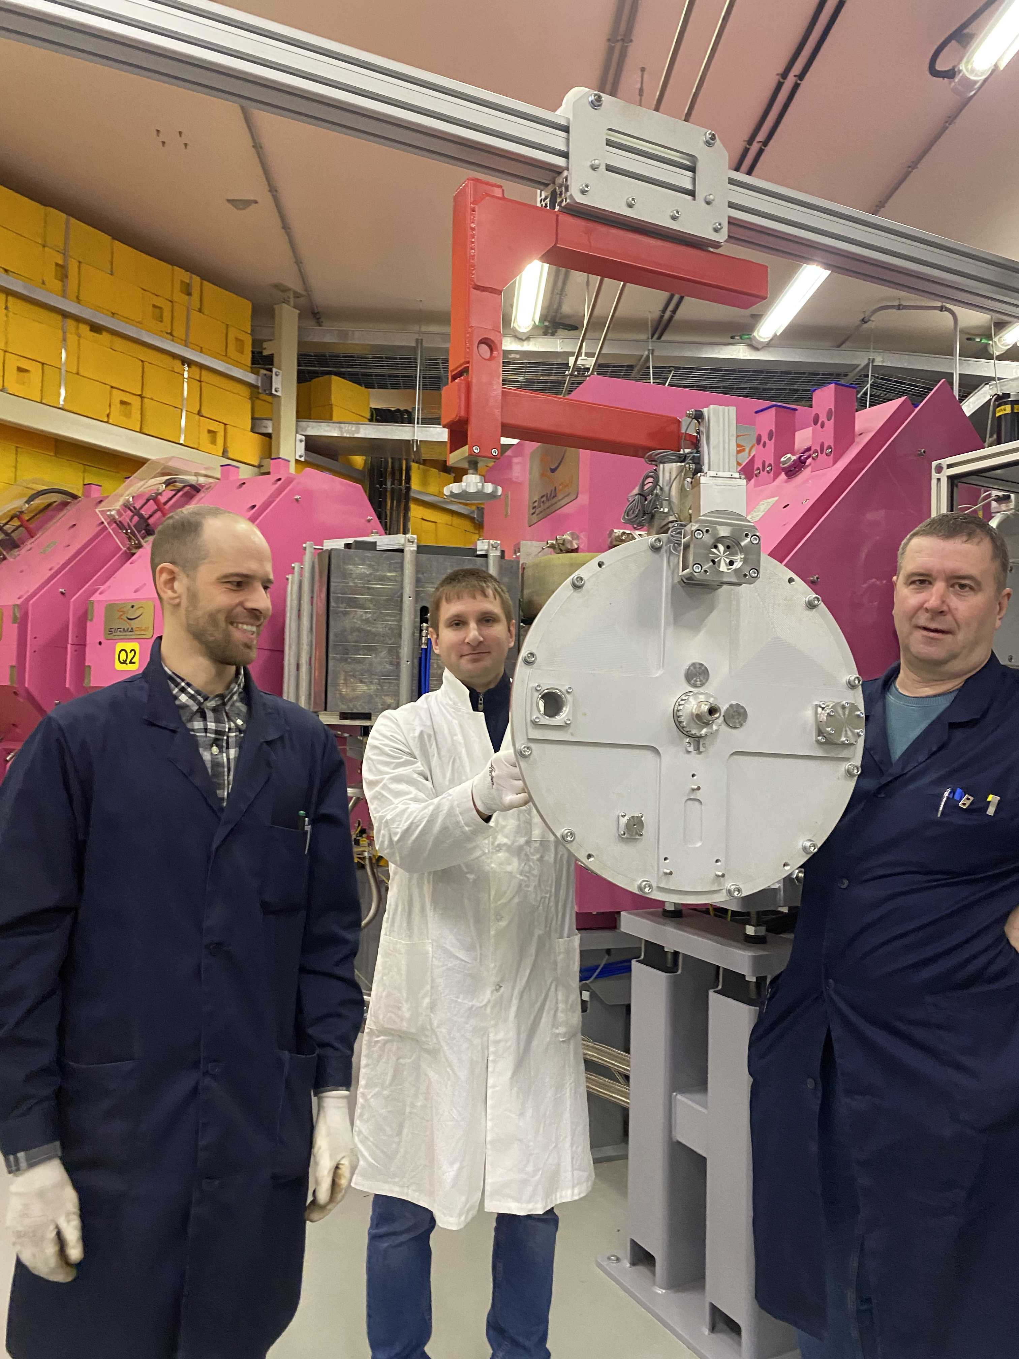
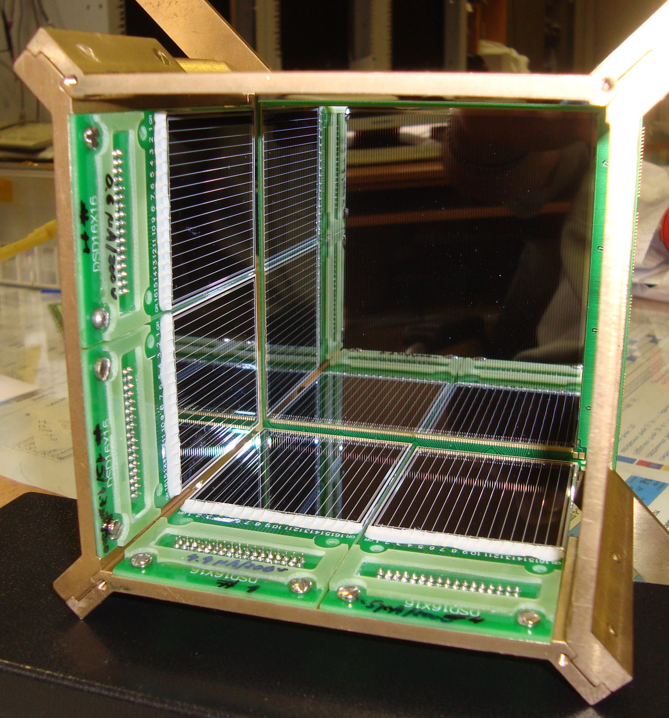
Tests of new rotating target at SHE factory
GRAND separator
GABRIELA system
New target
April 2024:
⁴⁸Ca + ²⁰⁶Pb -> ²⁵²No + 2n (𝜎~200 nb, b_{sf}~0.33)
Target: 690 µg/cm² PbS (480 mm in diameter)
Beam: 6 pμA of ⁴⁸Ca (!)
Result: 1 SF/s of ²⁵²No implanted to focal DSSD
DSSD array

Slide 7
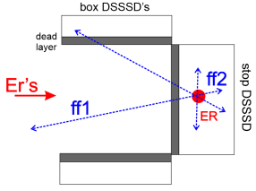
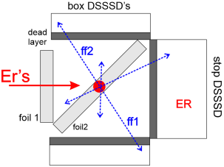
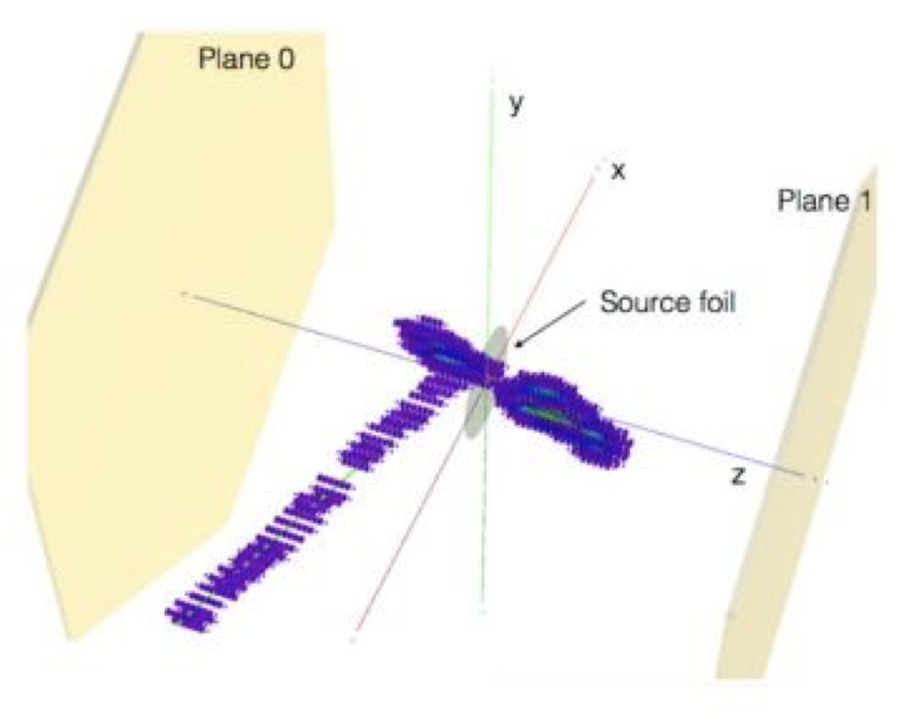
Spontaneous fission of ²⁵²No
The implantation “box” detector
 | F1+F2 ε_{det} ~ 40 % 35 000 F1+F2 events per 24h | TKE + prompt neutrons Mass measurements not supported
 | F1+F2 ε_{det} ~ 3 % 2 600 events per 24h | 2E + prompt neutrons ΔM > 10 amu
 | F1+F2 ε_{det} ~ 90 % 78 000 F1+F2 events per 24h | 2E + Bragg curves (Z) + prompt neutrons? ΔM ~ 7 amu
The “box” + inclined film
TPC inside neutron detector?

Slide 8
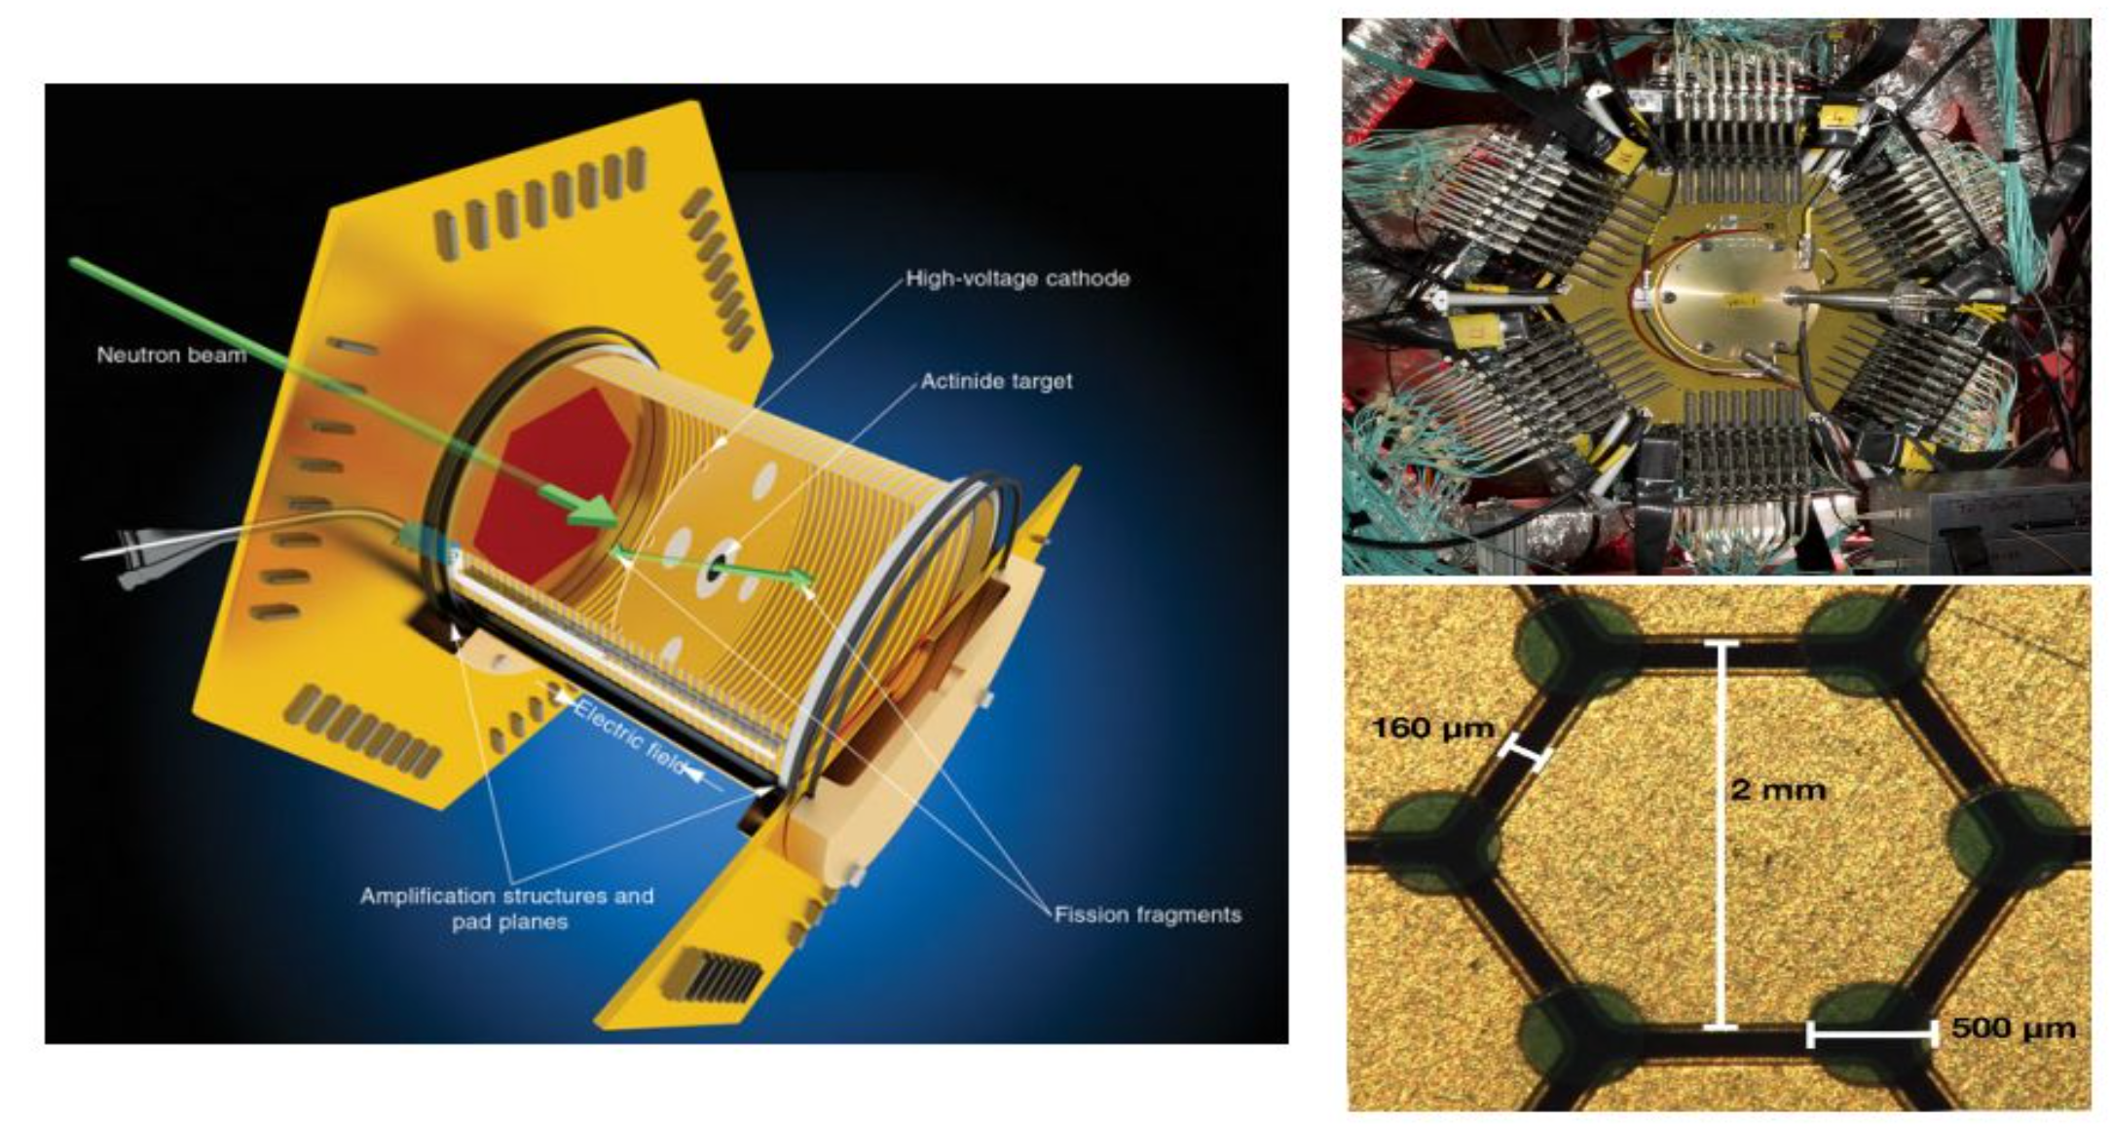
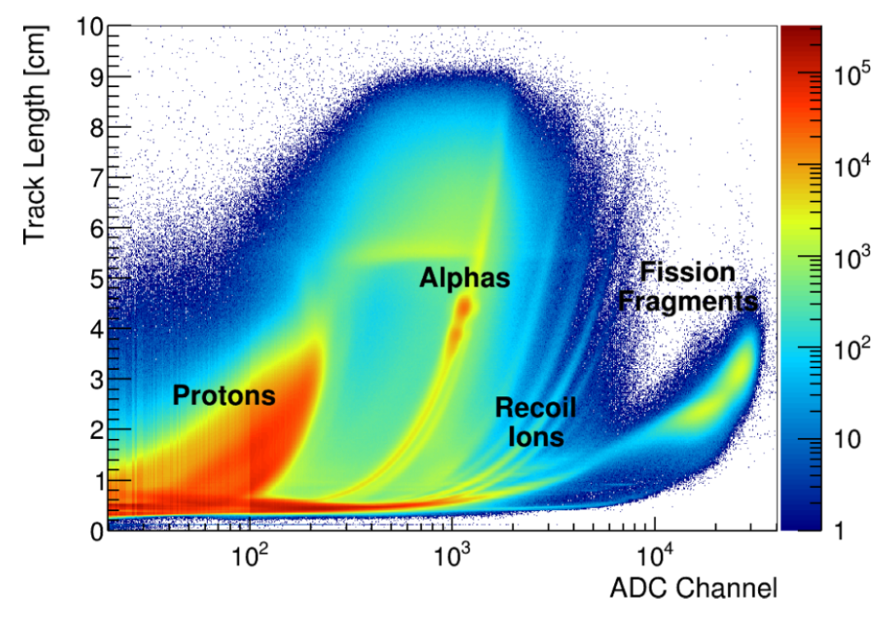
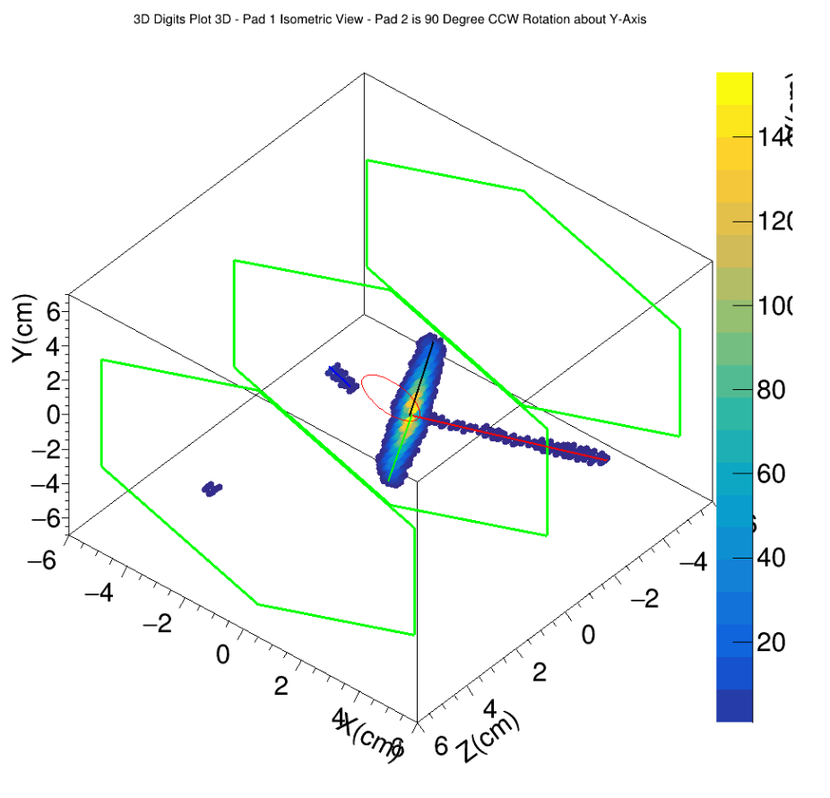
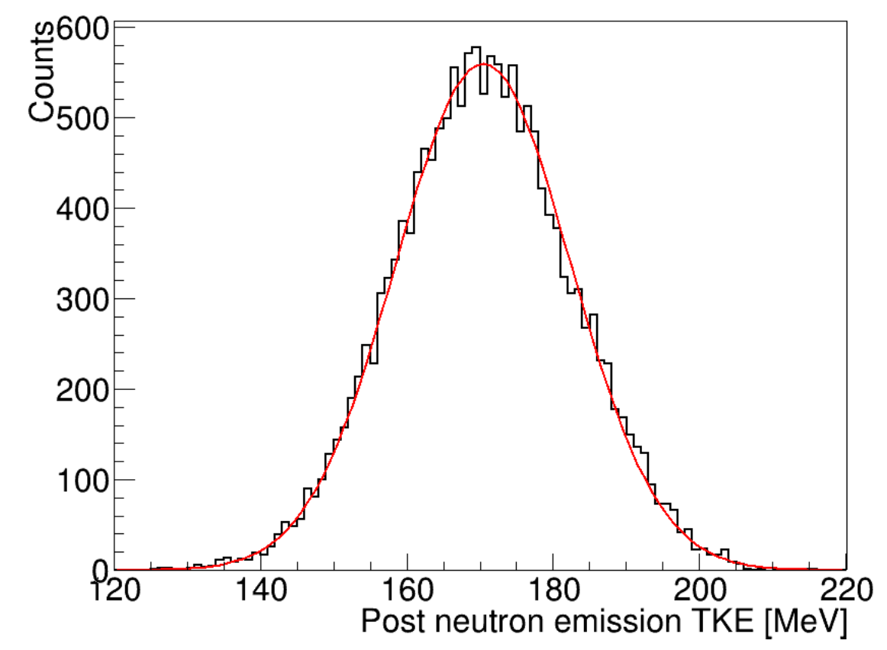
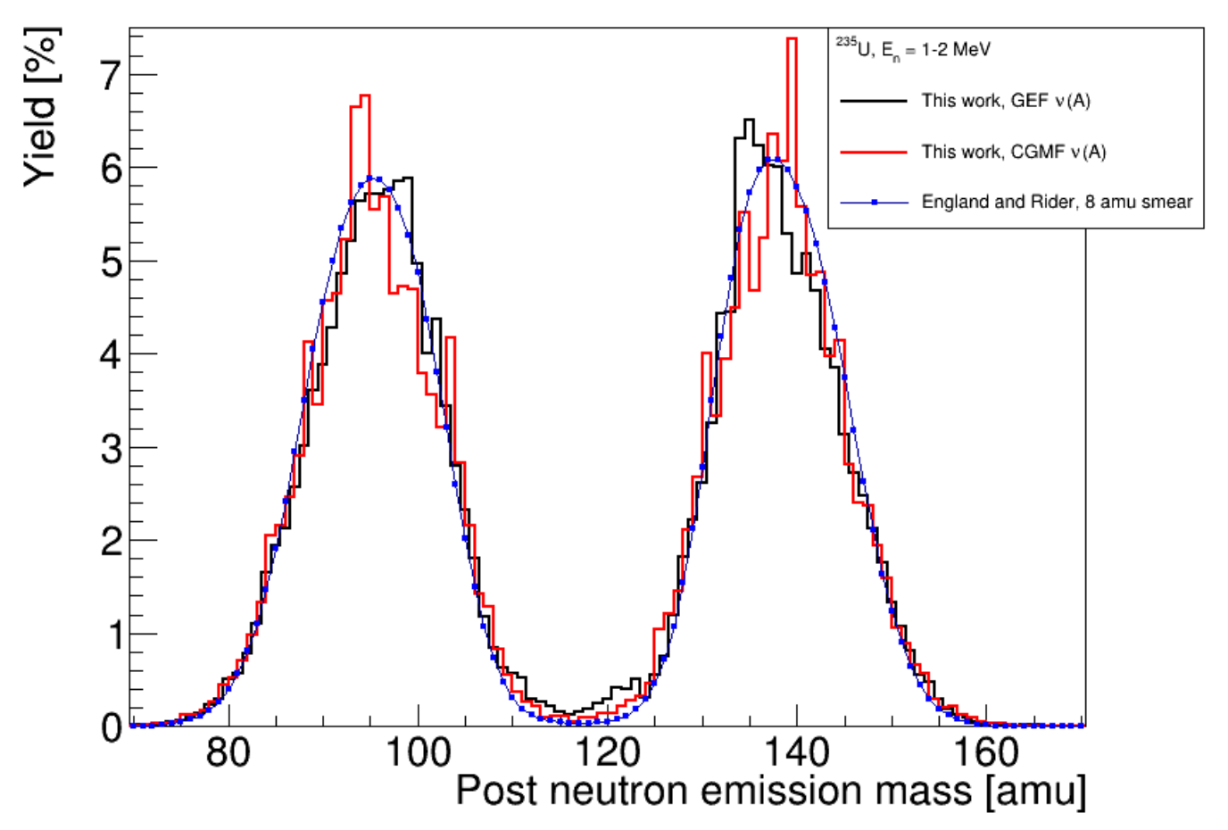
Time projection chamber (TPC) inside neutron detector?
FissionTPC design. The experiment directs a neutron beam at a foil target, at the center of the chamber between the two volumes, inducing fission. The fissionTPC is filled with a mixture of argon and isobutane used as a drift gas, serving as the medium for charged particles to deposit energy, through ionization. The uniform axial electric field allows the ionization electrons to drift to the pad plane, where their signal is amplified by the MICROMEGAS and their signal is read out on the hexagonal pads.
²³⁵U(n,f)
²³⁵U(n,f)
Ruz J. et al.
The NIFFTE project.
Journal of Instrumentation 8/12 (2013) P. C12018

Slide 9
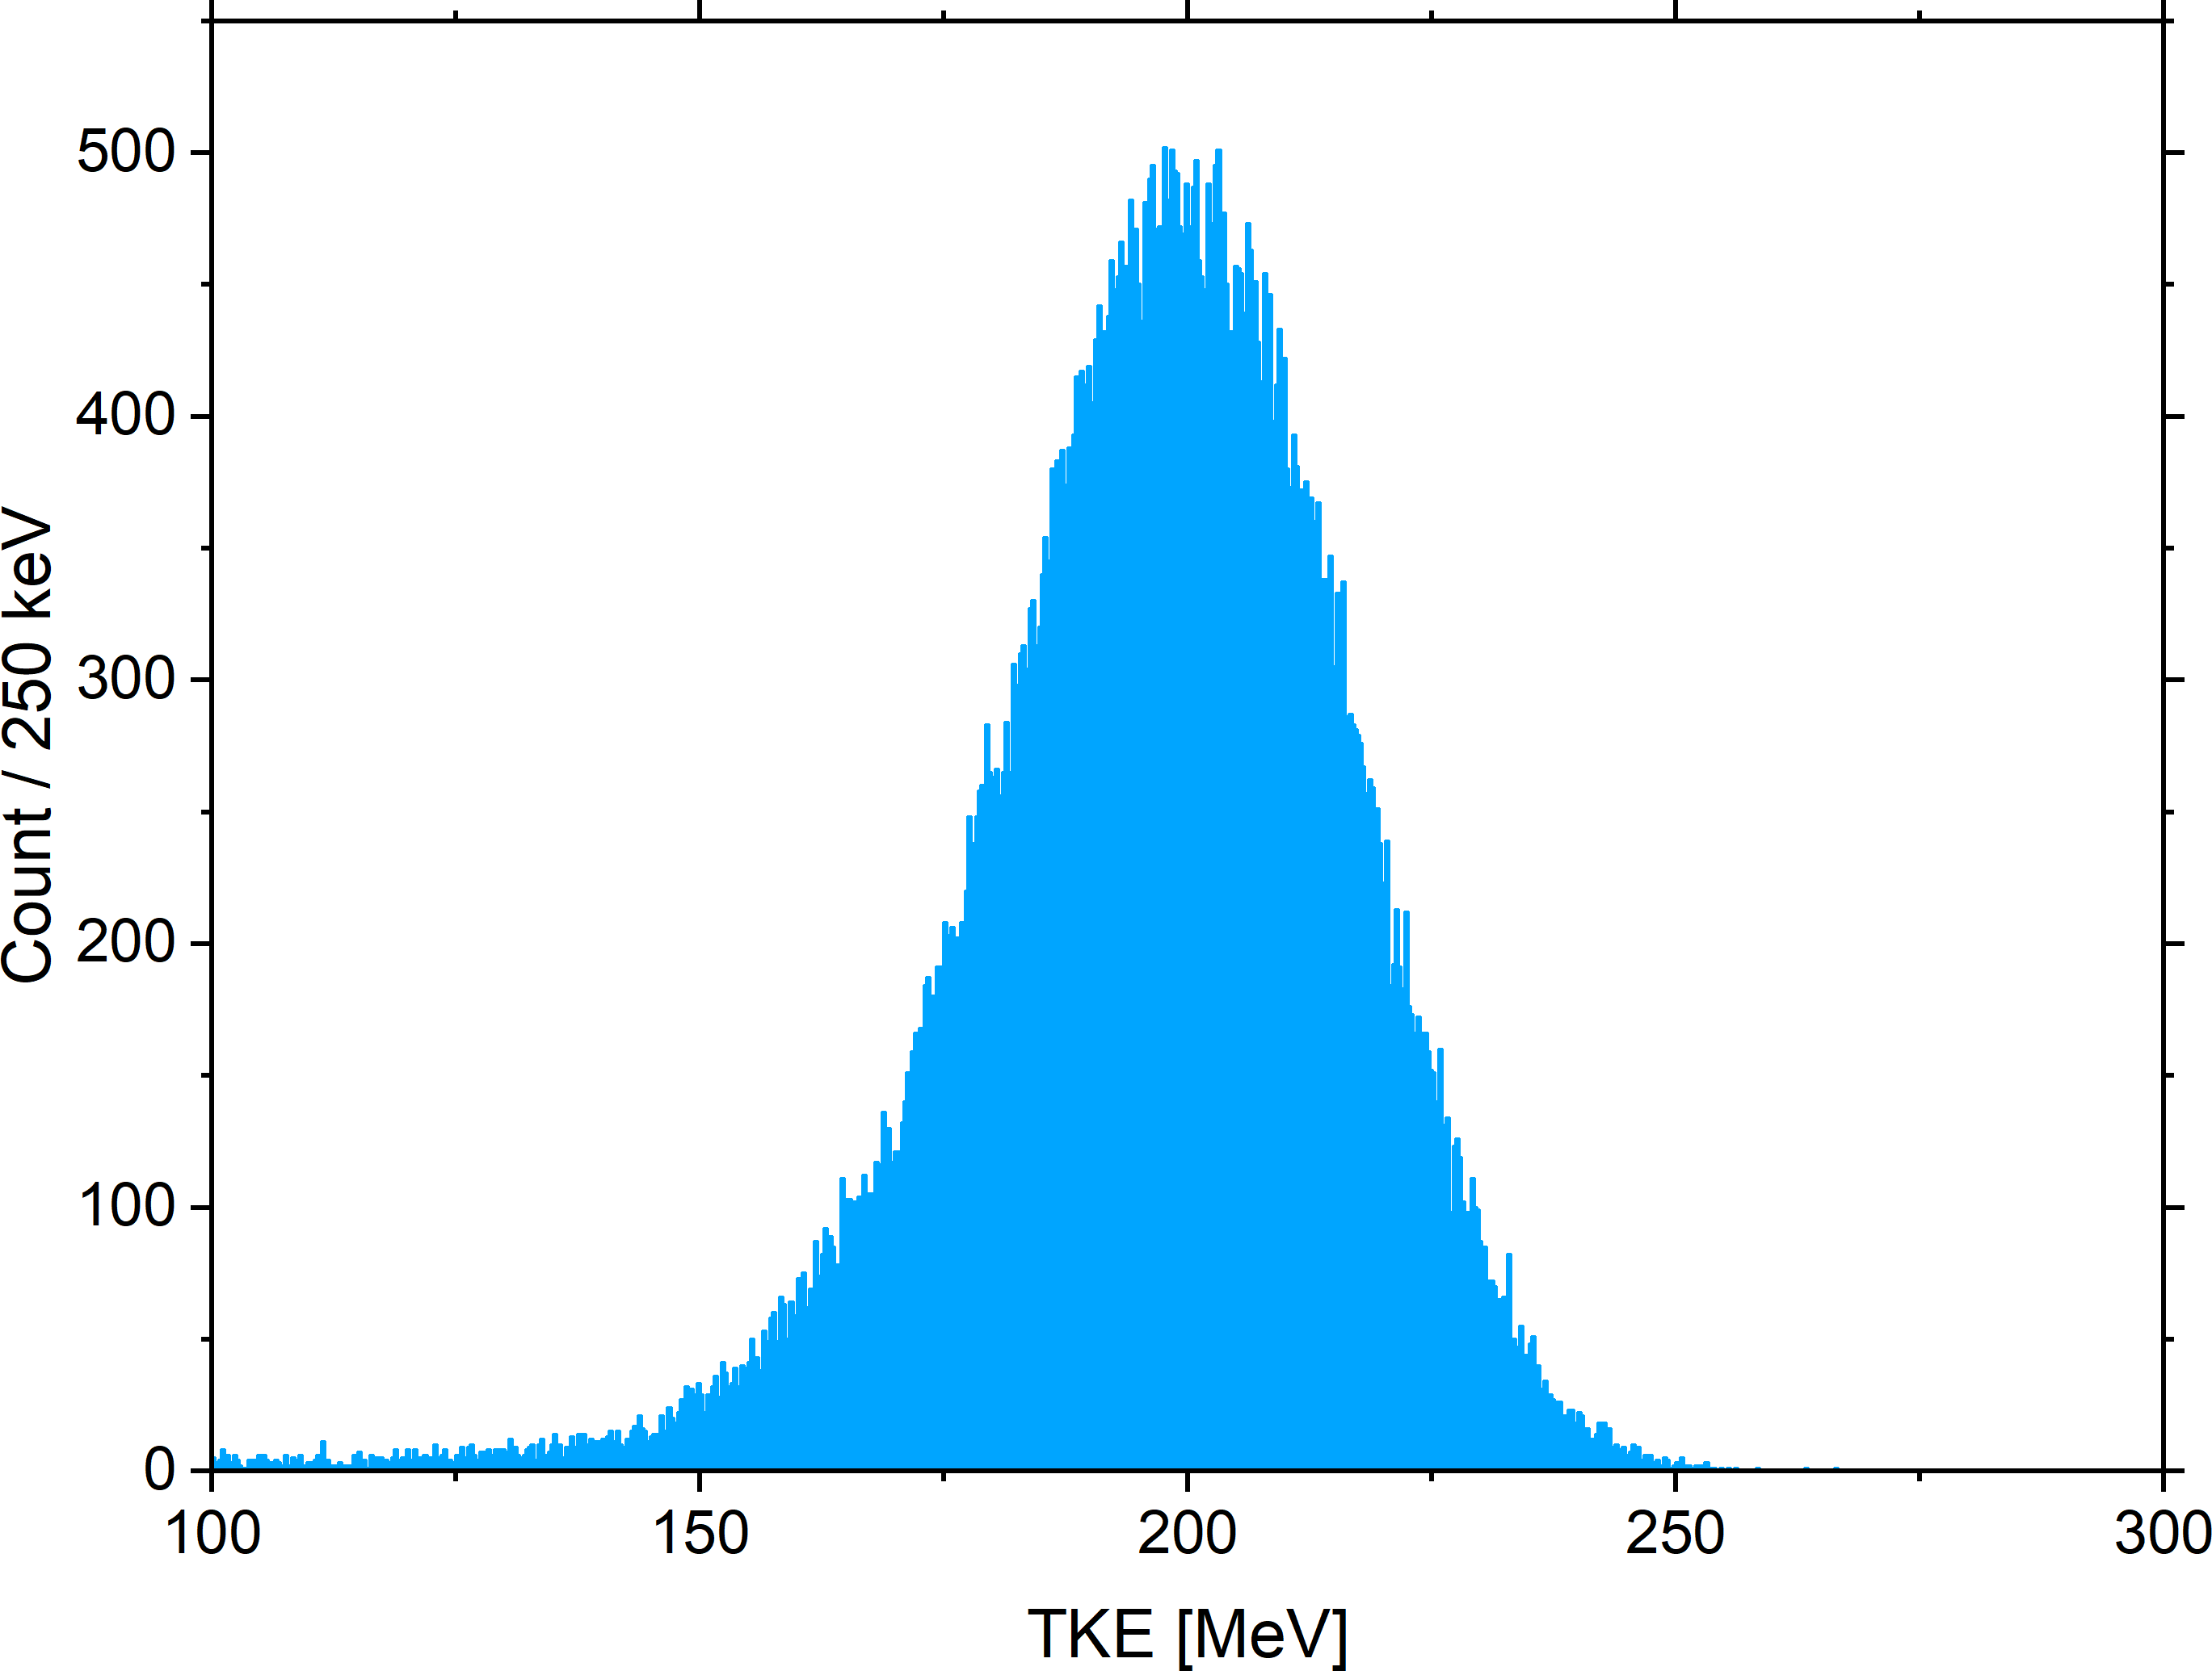
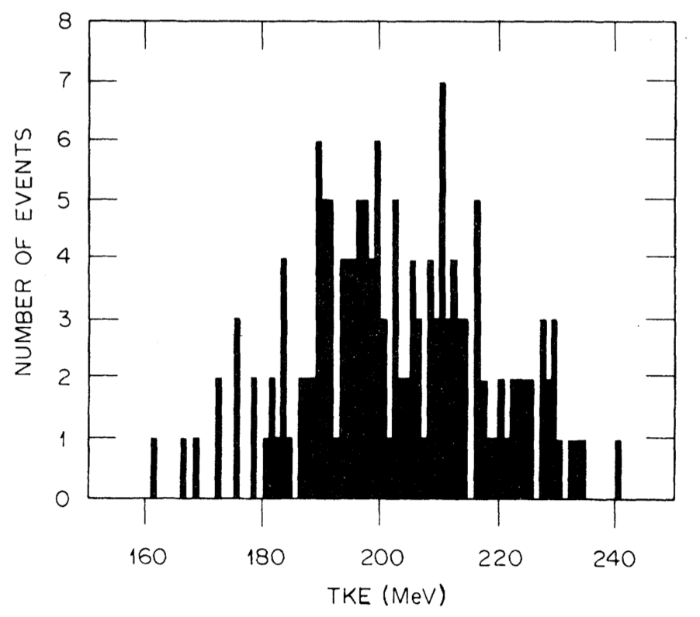
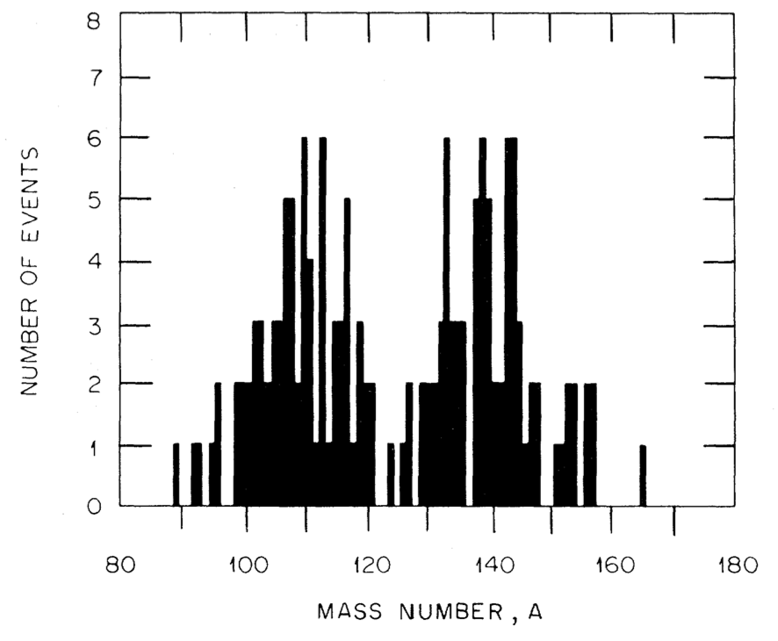
Spontaneous fission of ²⁵²No
Bemis 1977, 176 SF
GRAND 2024
~85k SF of ²⁵²No
<TKE> ~ 199 MeV
“Super-asymmetric fission exists at low excitation energy of the compound system, however, not at the yield level expected from recent studies applying the 2E method of measuring only the fission fragment kinetic energy”
F.-J. HAMBSCH. SUPER-ASYMMETRIC FISSION: FACT OR FICTION?
Seminar on Fission Pont d'Oye IV, World Scientific (1999) P. 23–31.
Bemis C.E. et al.
Fragment-mass and kinetic-energy distributions from the spontaneous fission of ²⁵²No.
Phys. Rev. C 15/2 (1977) P. 705-712.

Slide 10
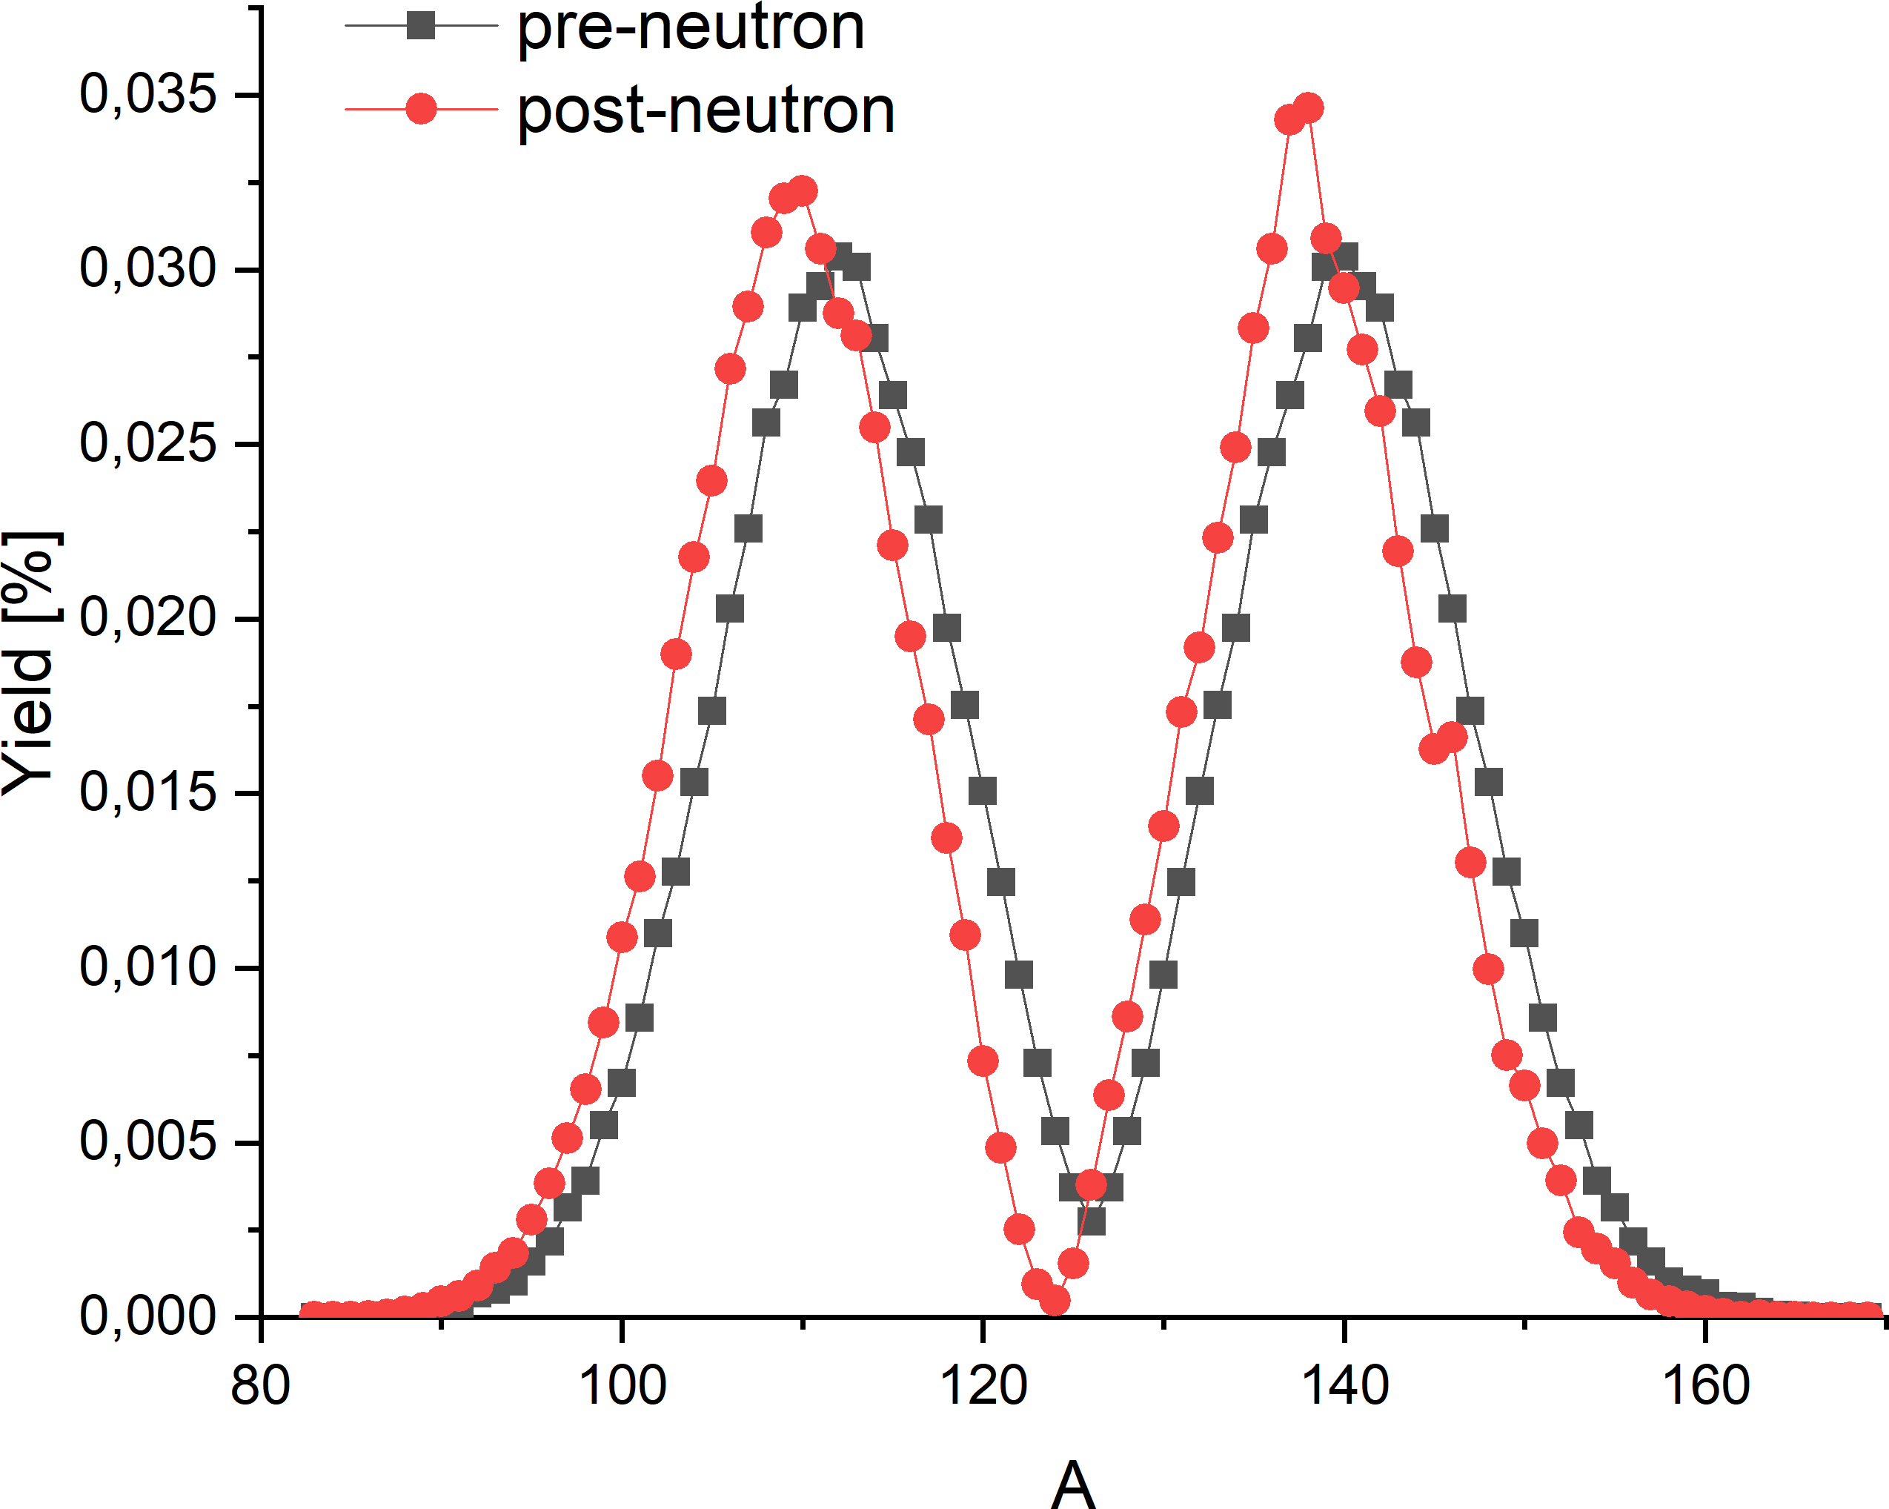
Spontaneous fission of ²⁵²No
Bemis C.E. et al.
Fragment-mass and kinetic-energy distributions from the spontaneous fission of ²⁵²No.
Phys. Rev. C 15/2 (1977) P. 705-712.
GEF model

Slide 11
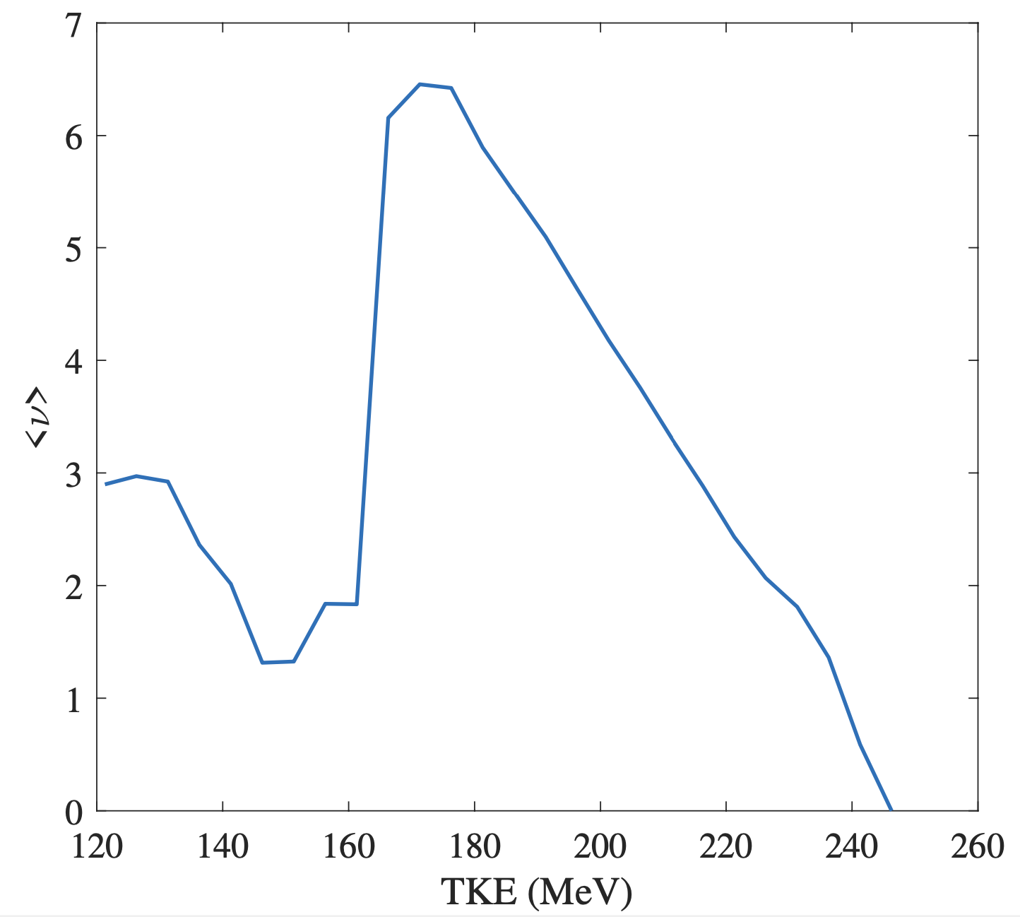
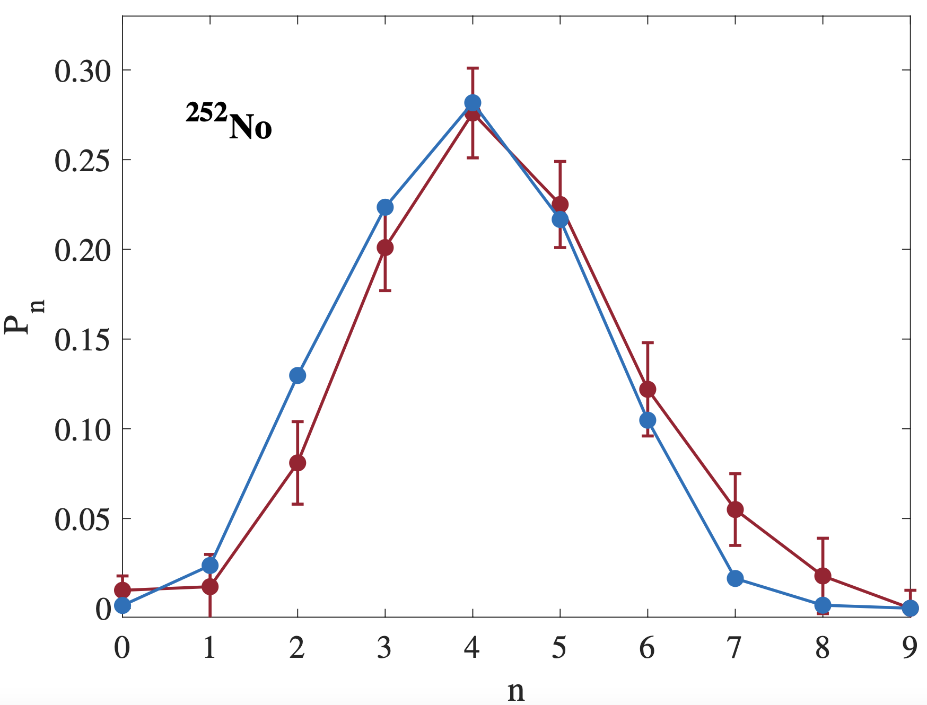
Spontaneous fission of ²⁵²No
ISP model
SFiNx experiment
ISP model
Calculations with additional version of ISP model made by BLTP JINR: A. V. Andreev, T. M. Shneidman and A. Rahmatinejad

Slide 12
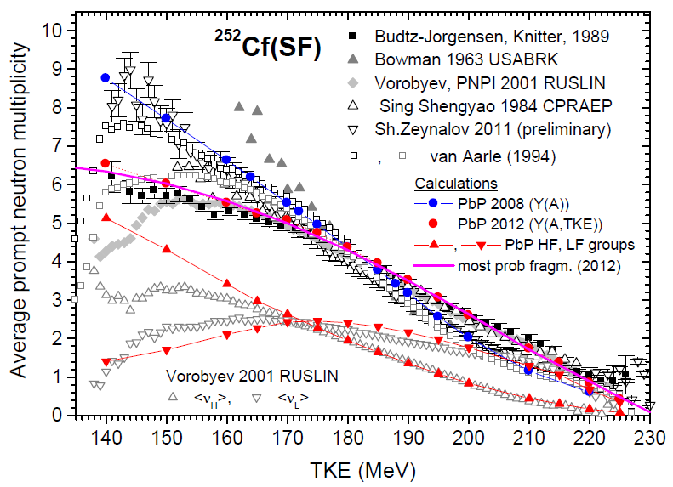
Spontaneous fission of ²⁵²No
²⁵²No
ISP model
Visan I. et al.
Prompt emission modelling in the fission process.
Rom. J. Phys. 59 (2014) P.272

Slide 13
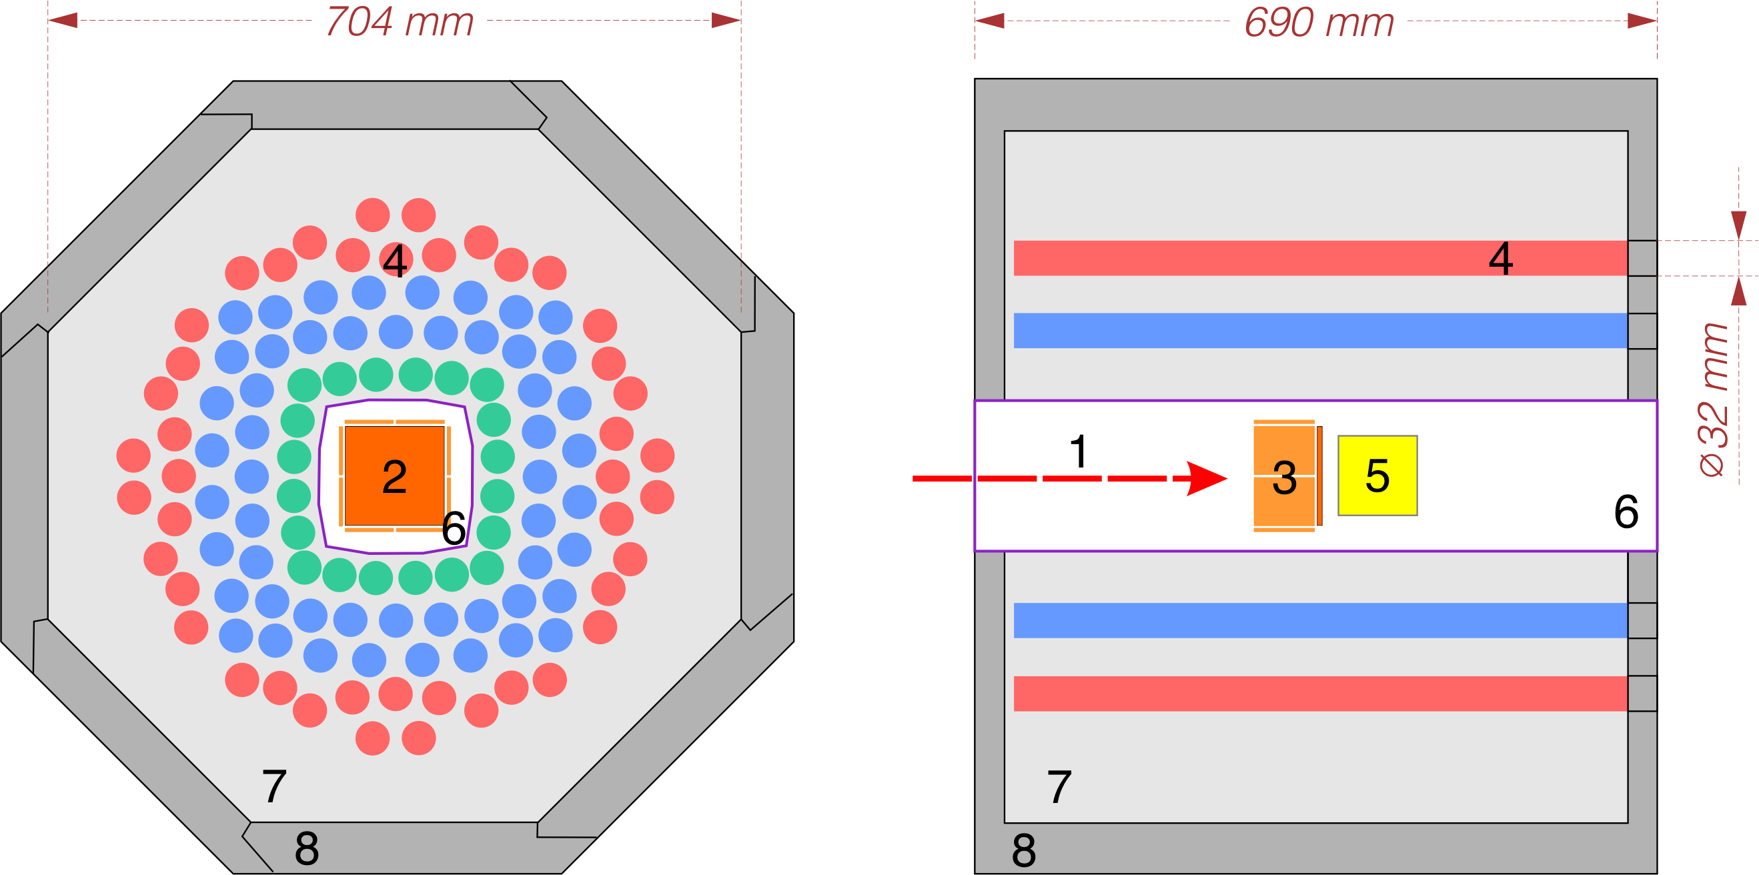
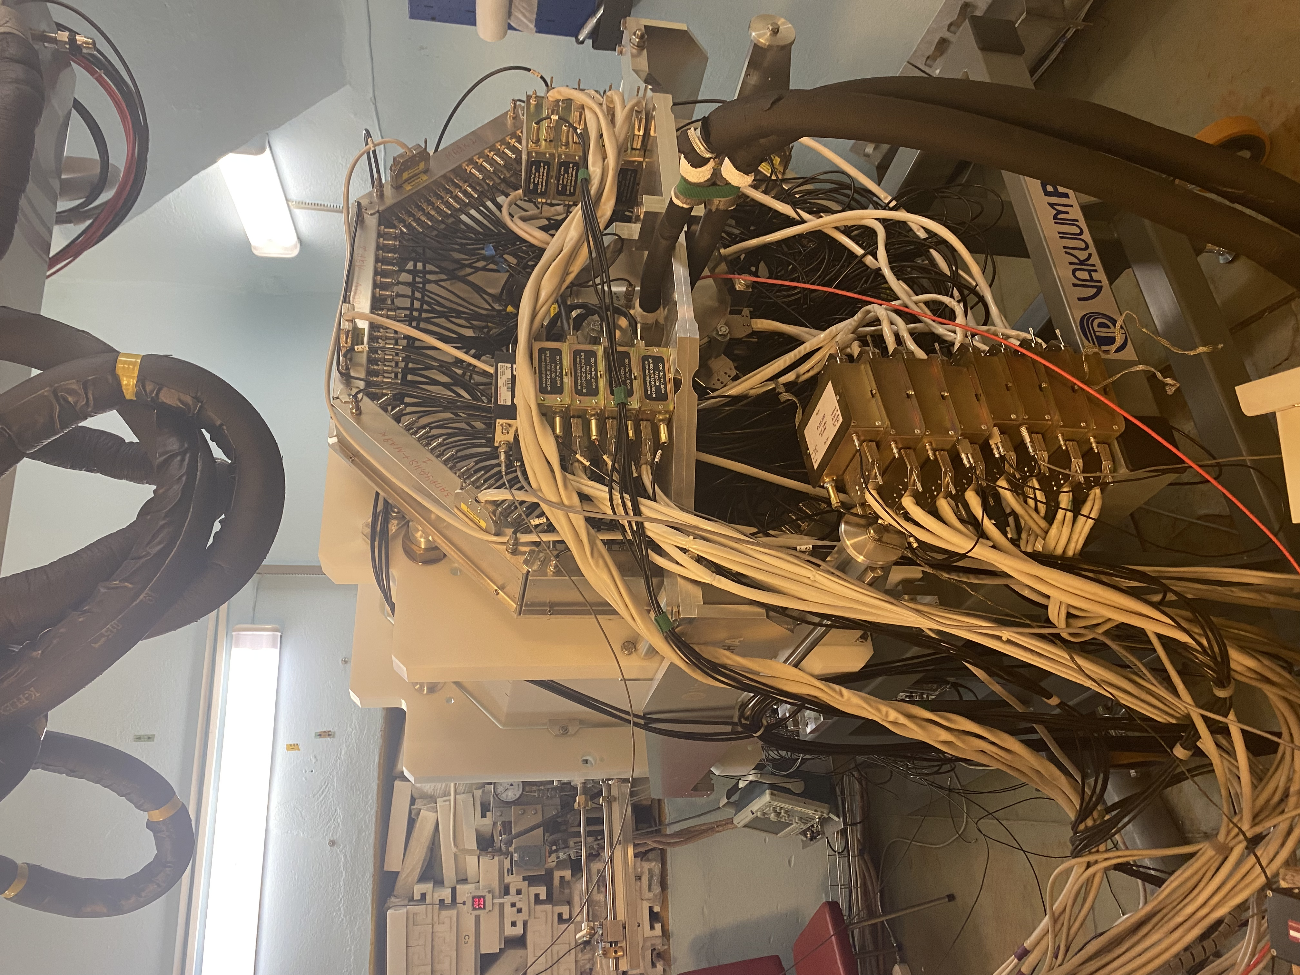
SFiNx – Spontaneous Fission, Neutrons and x-rays
The legend:
1 – evaporation residues
2 – focal-plane Si-detector
3 – side Si-detectors
4 – ³He-counters
5 – scintillator
6 – vacuum chamber
7 – moderator
8 – shield
Isaev A. V. et al.
The SFiNx detector system
PEPAN Letters 19 (2022) P. 37–45
Isaev A. V. et al.
Study of spontaneous fission using the SFiNx system
APP B Proc. Suppl. 14 (2021) P. 835–839
DSSD 100×100 mm
128×128-strips

Slide 14
SFiNx – Spontaneous Fission, Neutrons and x-rays
 | SFiNx
³He-counters | 116
Single neutron registration efficiency with ²⁴⁸Cm, % | 55±1
Focal DSSD | 128×128-strips 100×100 mm (x2-3 ERs capture in comparison with old detector) Resolution: 15 keV (for 8 MeV 𝛼-particles, with cooling)
Side DSSD | 8 32×16-strips detectors
Scintillator | 9 CLLBC for prompt 𝛾-quanta
Neutron average lifetime in detector, 𝜇s | 18±1

Slide 15
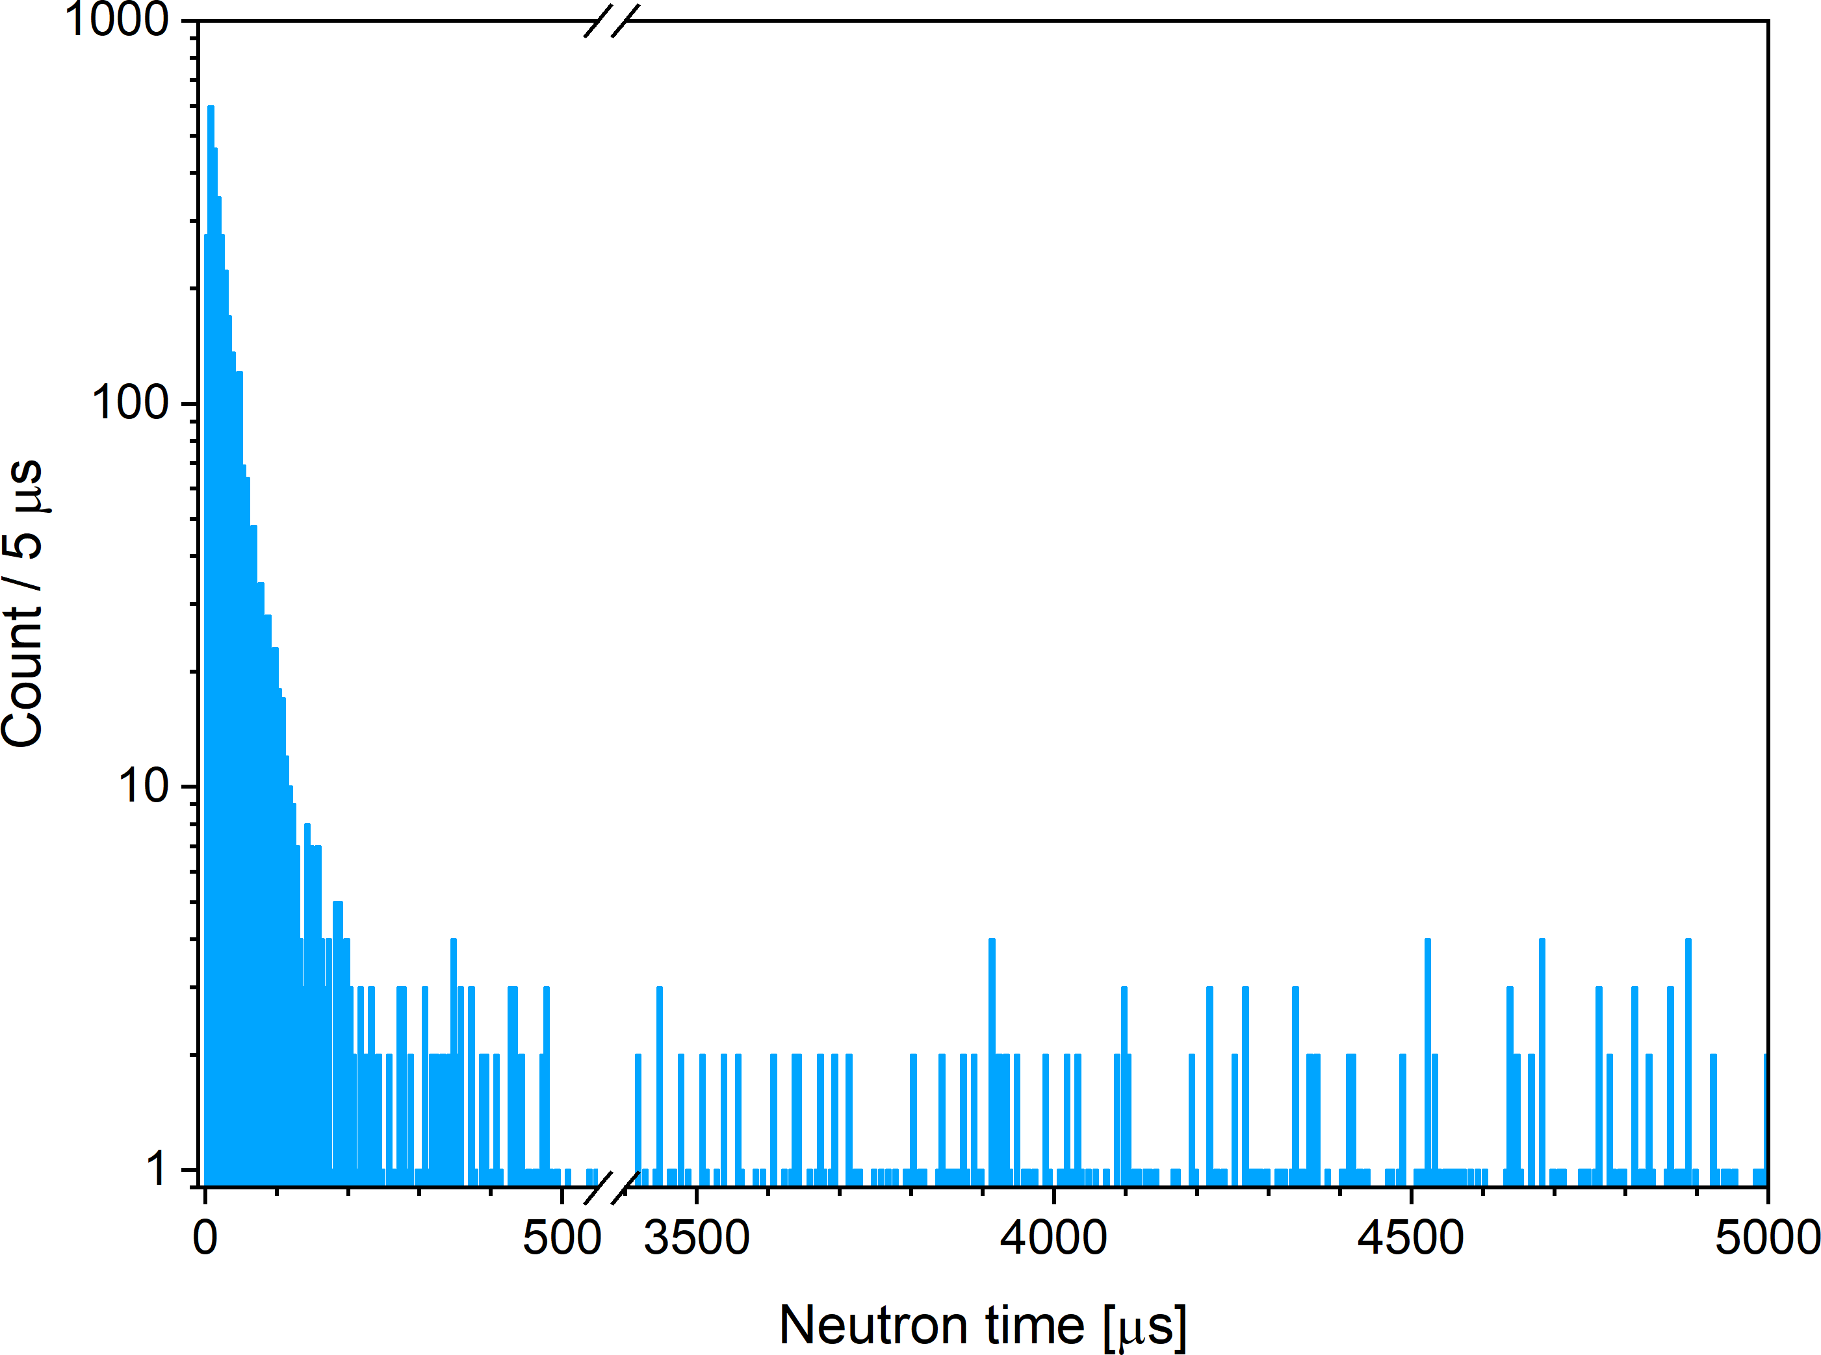
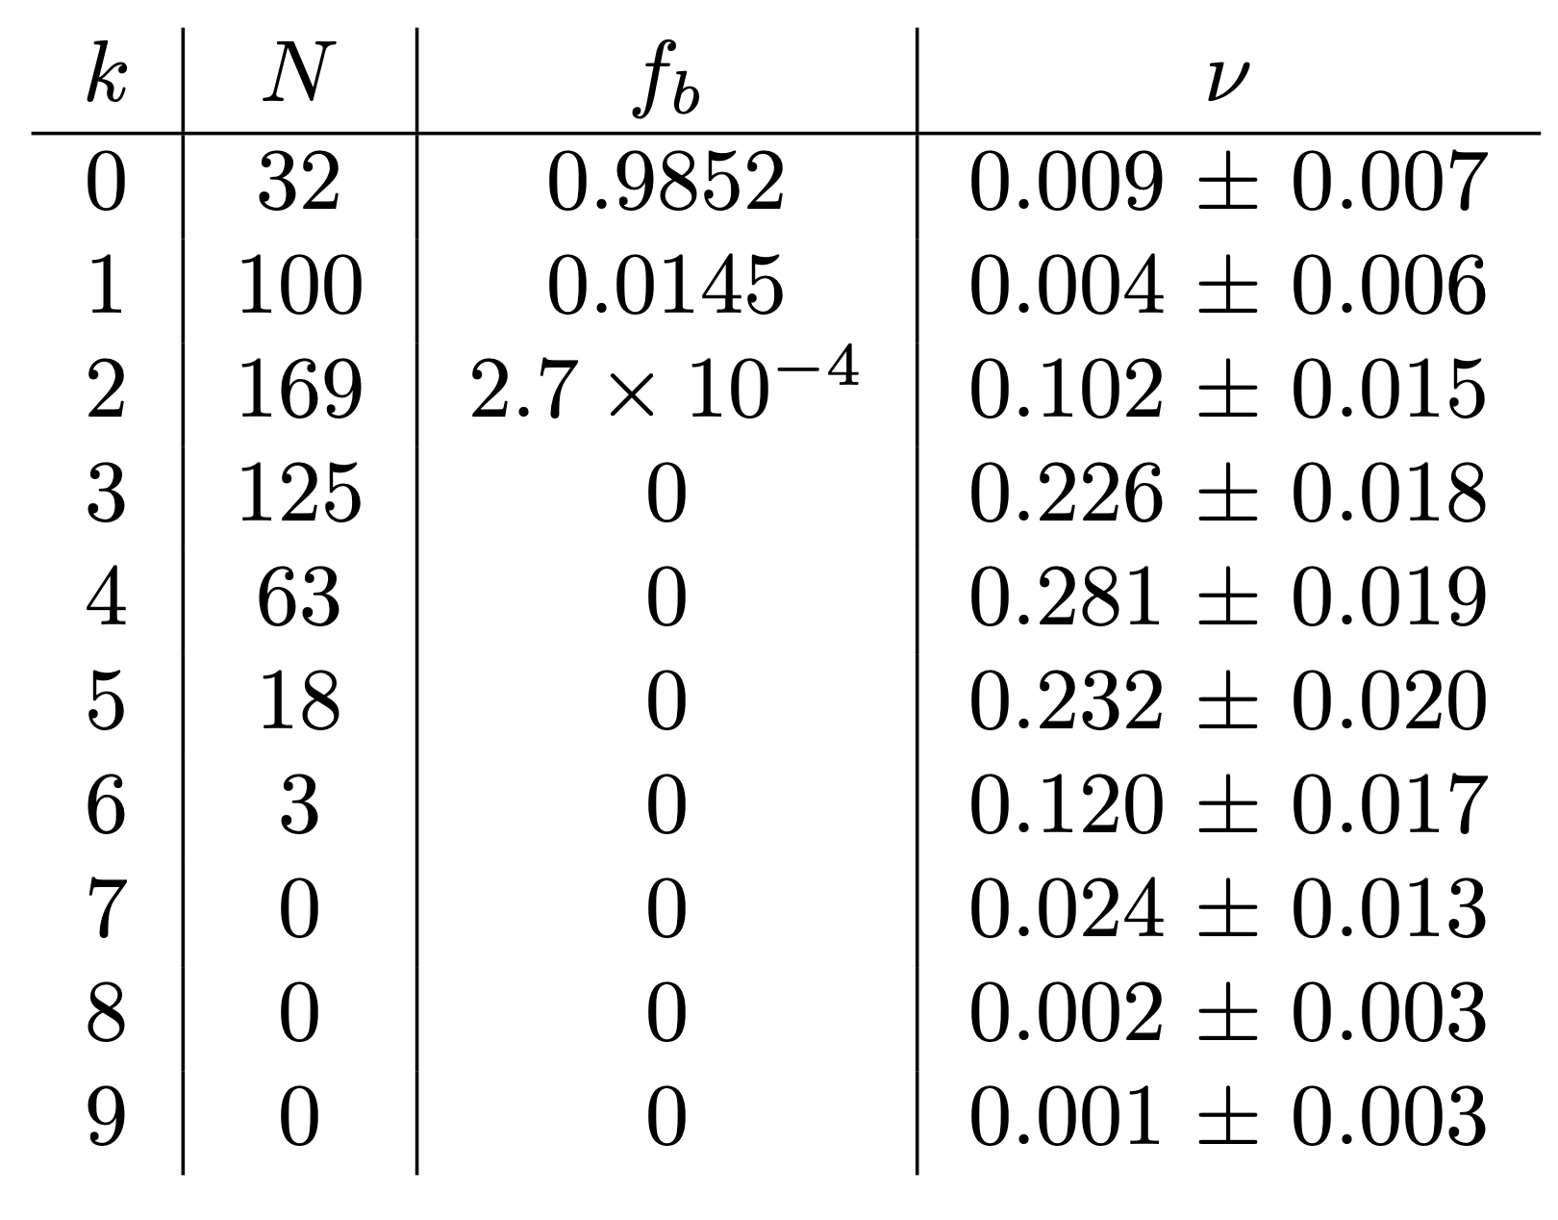
The Background Influence
The background neutron multiplicity distribution was taken to perform the background correction.
SFiNx is always waiting for neutron events!
The average load of the detector: ~100 n/s (or 0.0128 n/window).
The average background neutron multiplicity with 27140 windows is 0.015 n/window.
Time window for prompt neutrons (effect) is 0 – 128 μs from SF act. The average lifetime of the neutron in the setup is ~ 20 μs.
The observed of detecting background neutrons of the given multiplicity f_{b}, and the restored emission probability ν for the prompt neutrons multiplicity k for ²⁵⁰No.
Analysis of 20 time windows of 128 μs for 1357 SF acts for background in the range 2440 – 5000 μs (far enough in time to not include effect neutrons).
Distribution of time differences between neutron detection and the SF of ²⁵⁰No.
Mukhin R. S. et al.
Accepted: Chinese Physics C, 0091, 2024

Slide 16
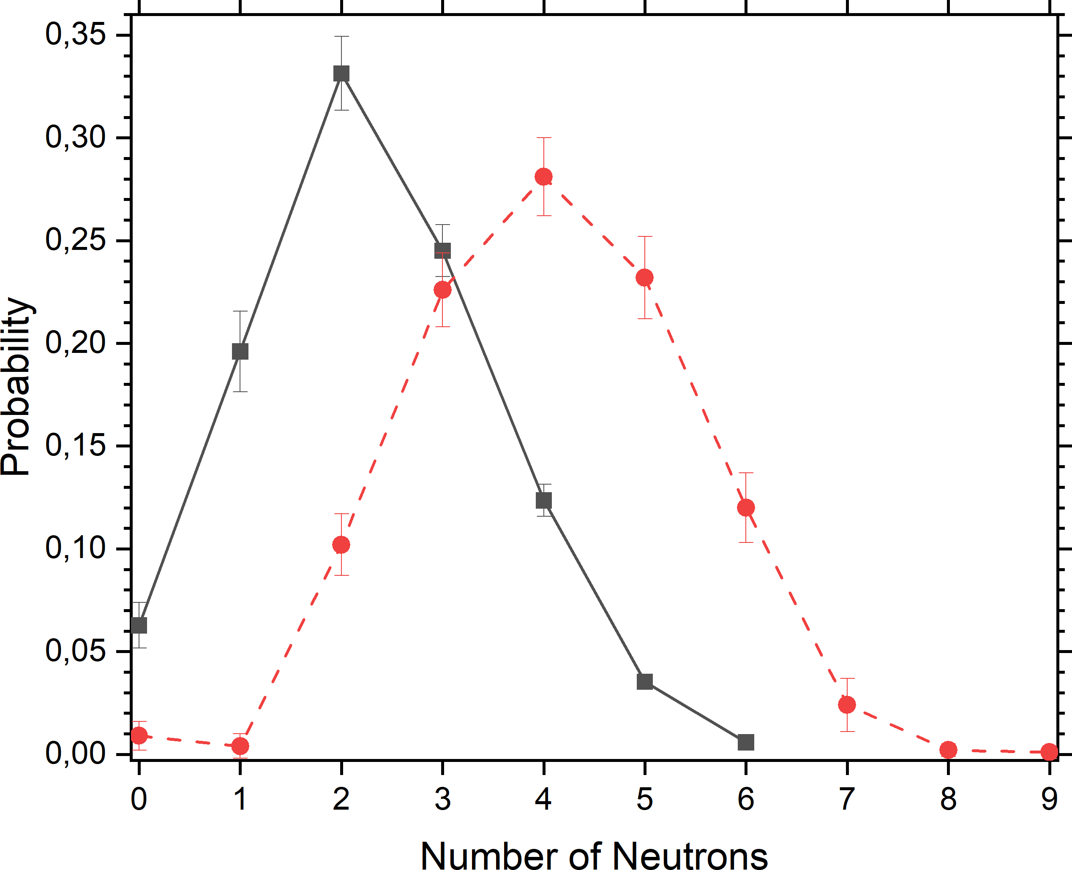
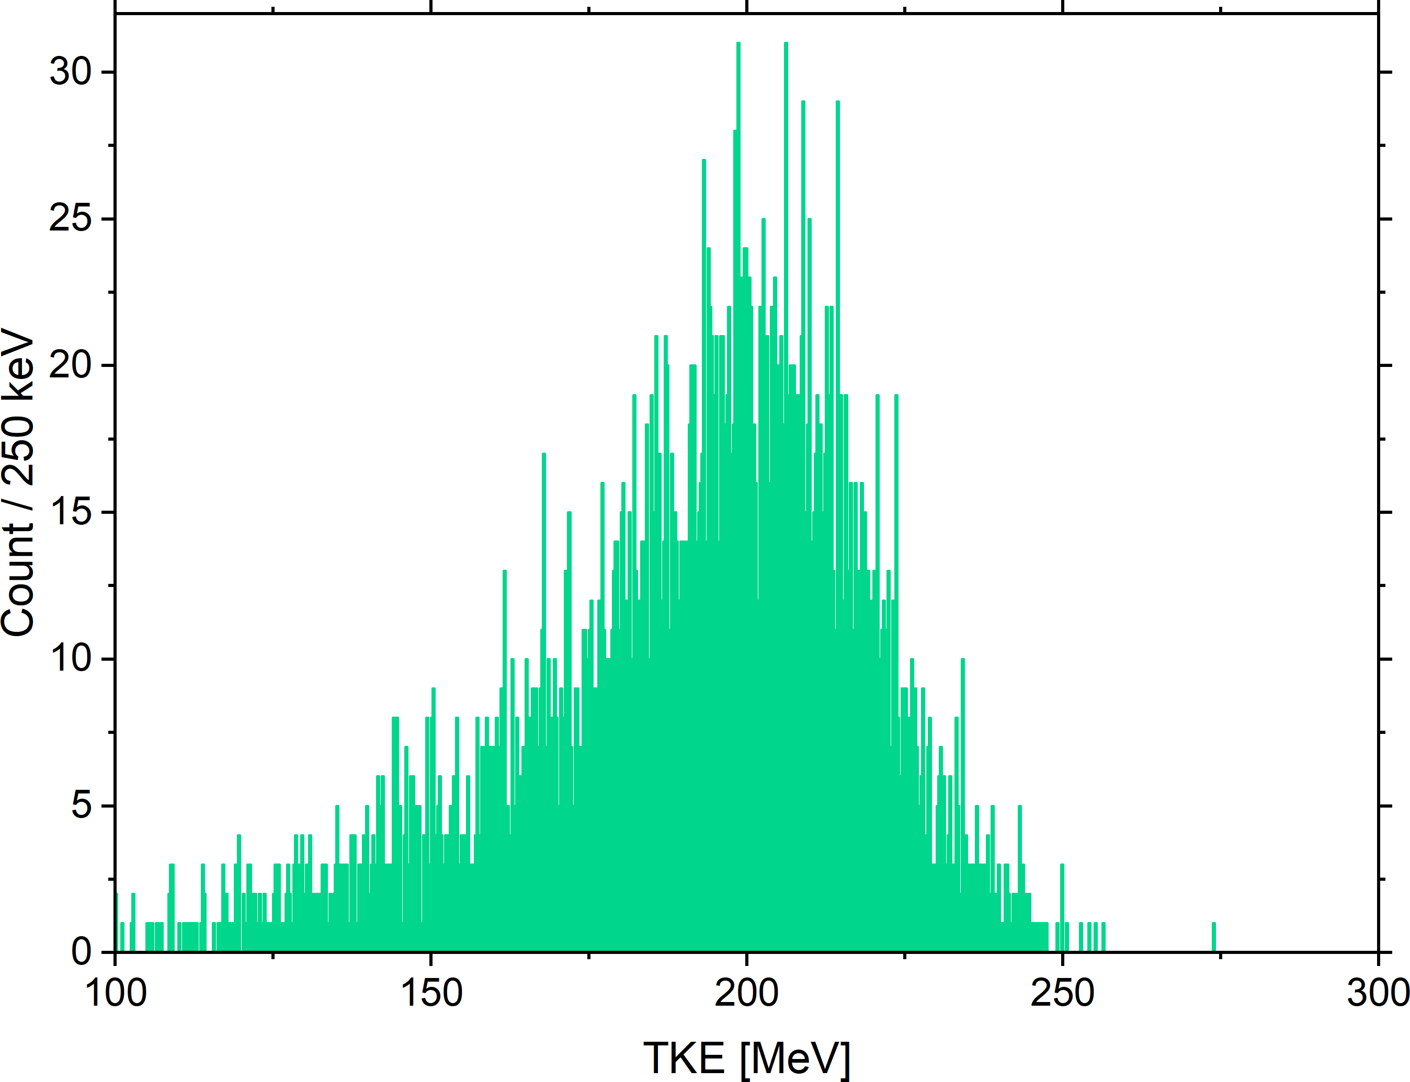
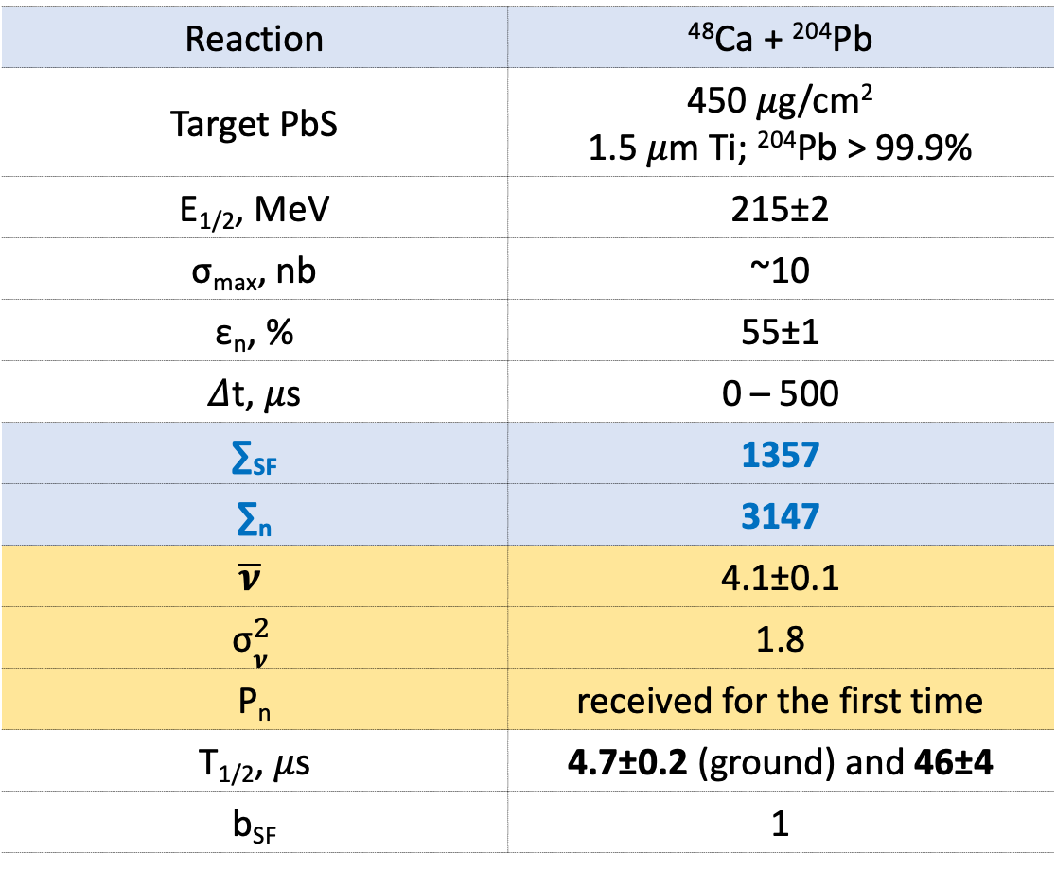
Isotope ²⁵⁰No
Reaction | ⁴⁸Ca + ²⁰⁴Pb
Target PbS | 450 𝜇g/cm² 1.5 𝜇m Ti; ²⁰⁴Pb > 99.9%
E_{1/2}, MeV | 215±2
σ_{max}, nb | ~10
ε_{n}, % | 55±1
𝛥t, 𝜇s | 0 – 500
∑_{SF} | 1357
∑_{n} | 3147
$$\overline{\text{ν}}$$ | 4.1±0.1
$${\text{σ}}_{\text{ν}}^{2}$$ | 1.8
P_{n} | received for the first time
T_{1/2}, 𝜇s | 4.7±0.2 (ground) and 46±4
b_{SF} | 1
2022 SFiNx ◼︎ Measured ● Restored
2019
GABRIELA
4279 SF
Mukhin R. S. et al. Chinese Physics C, Vol. 48, No. 6 (2024) 064002

Slide 17
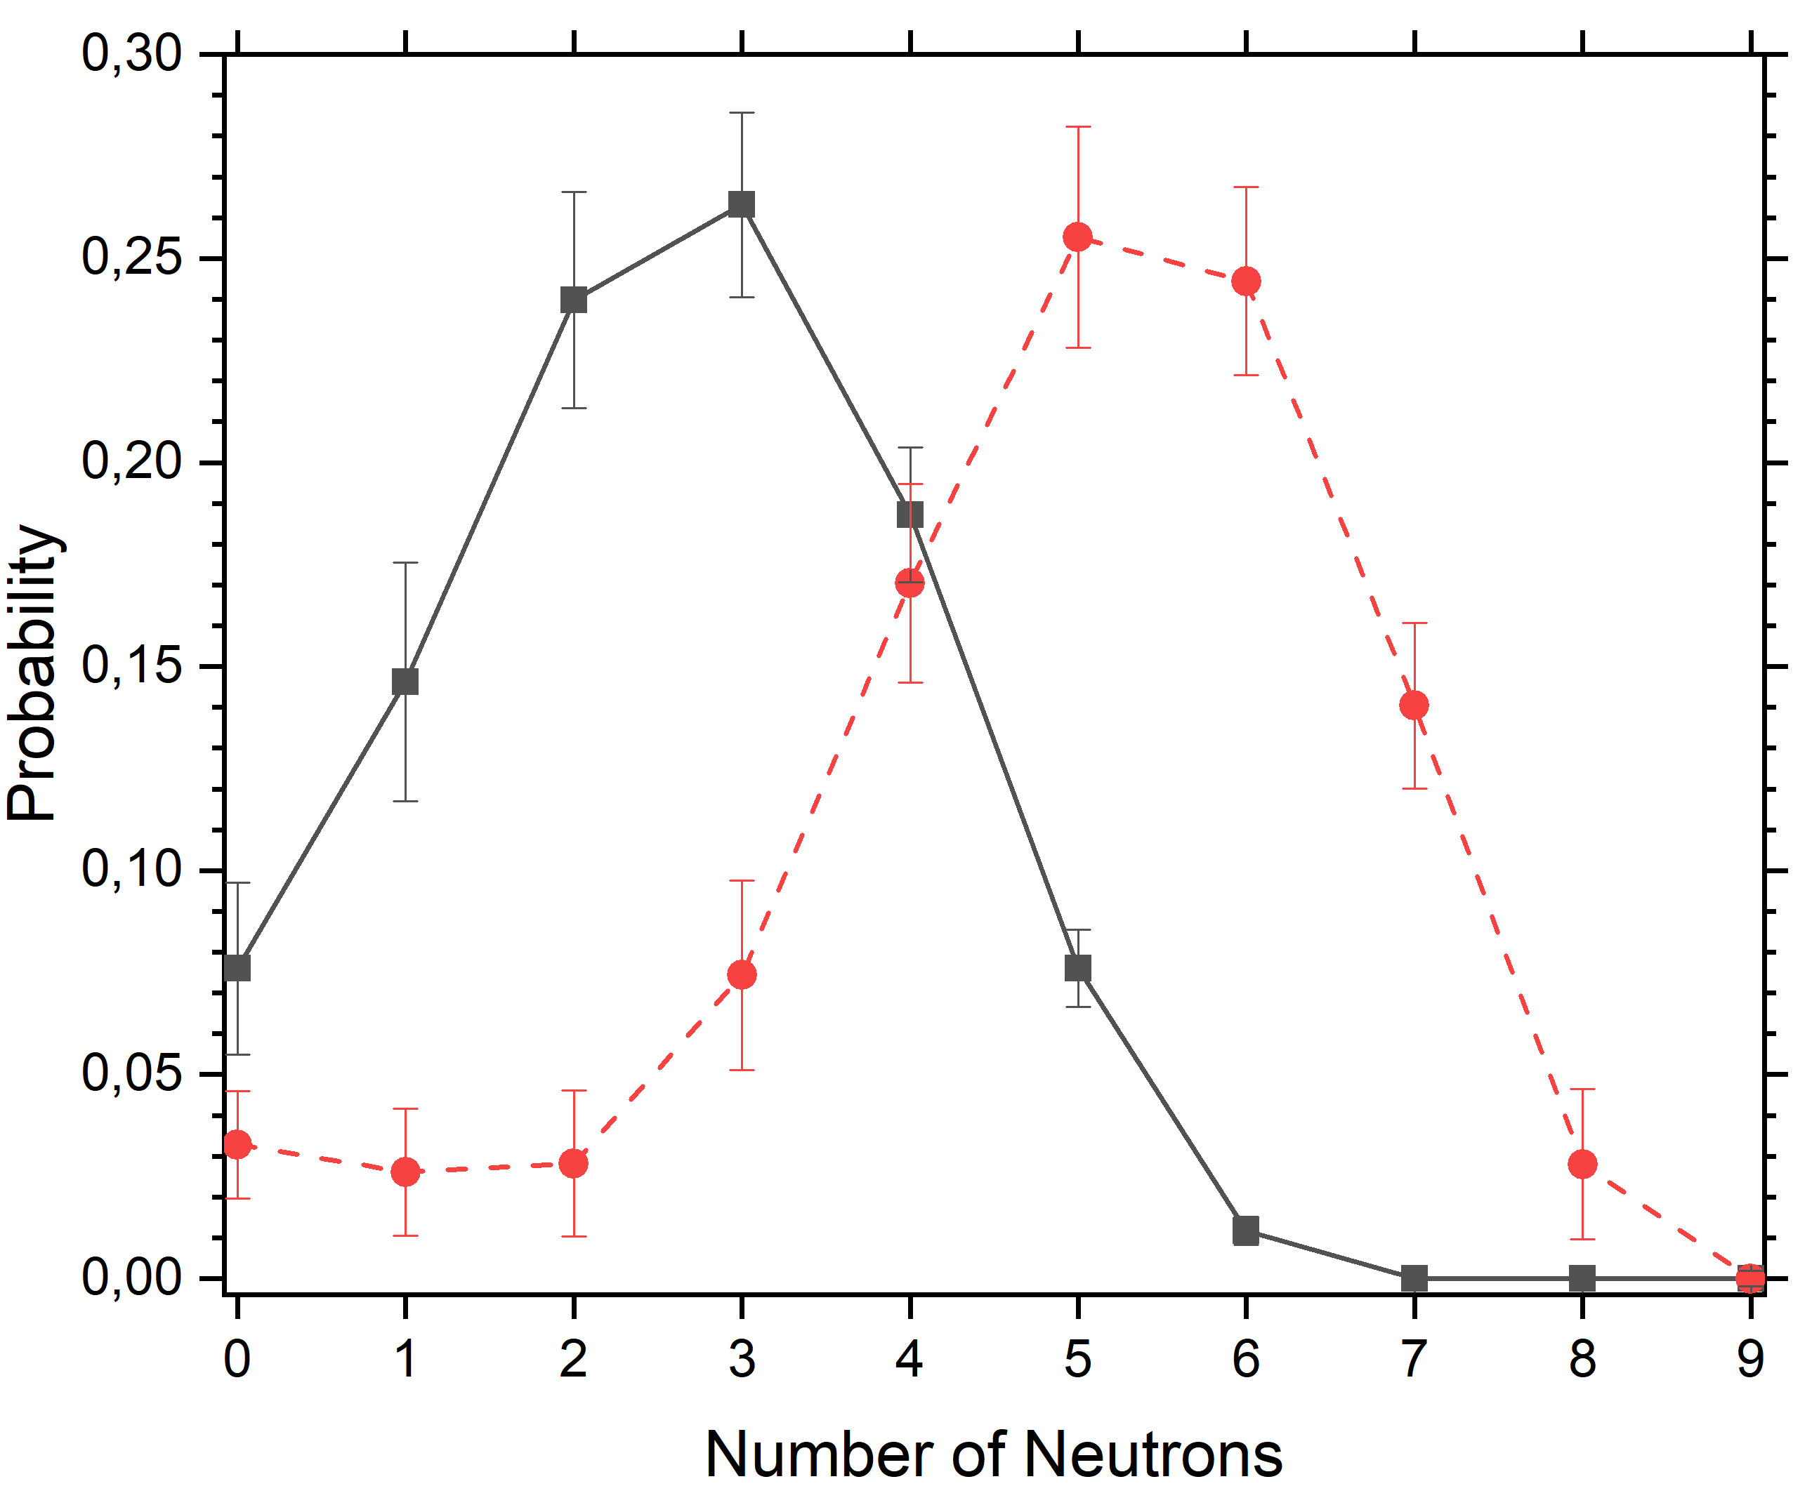
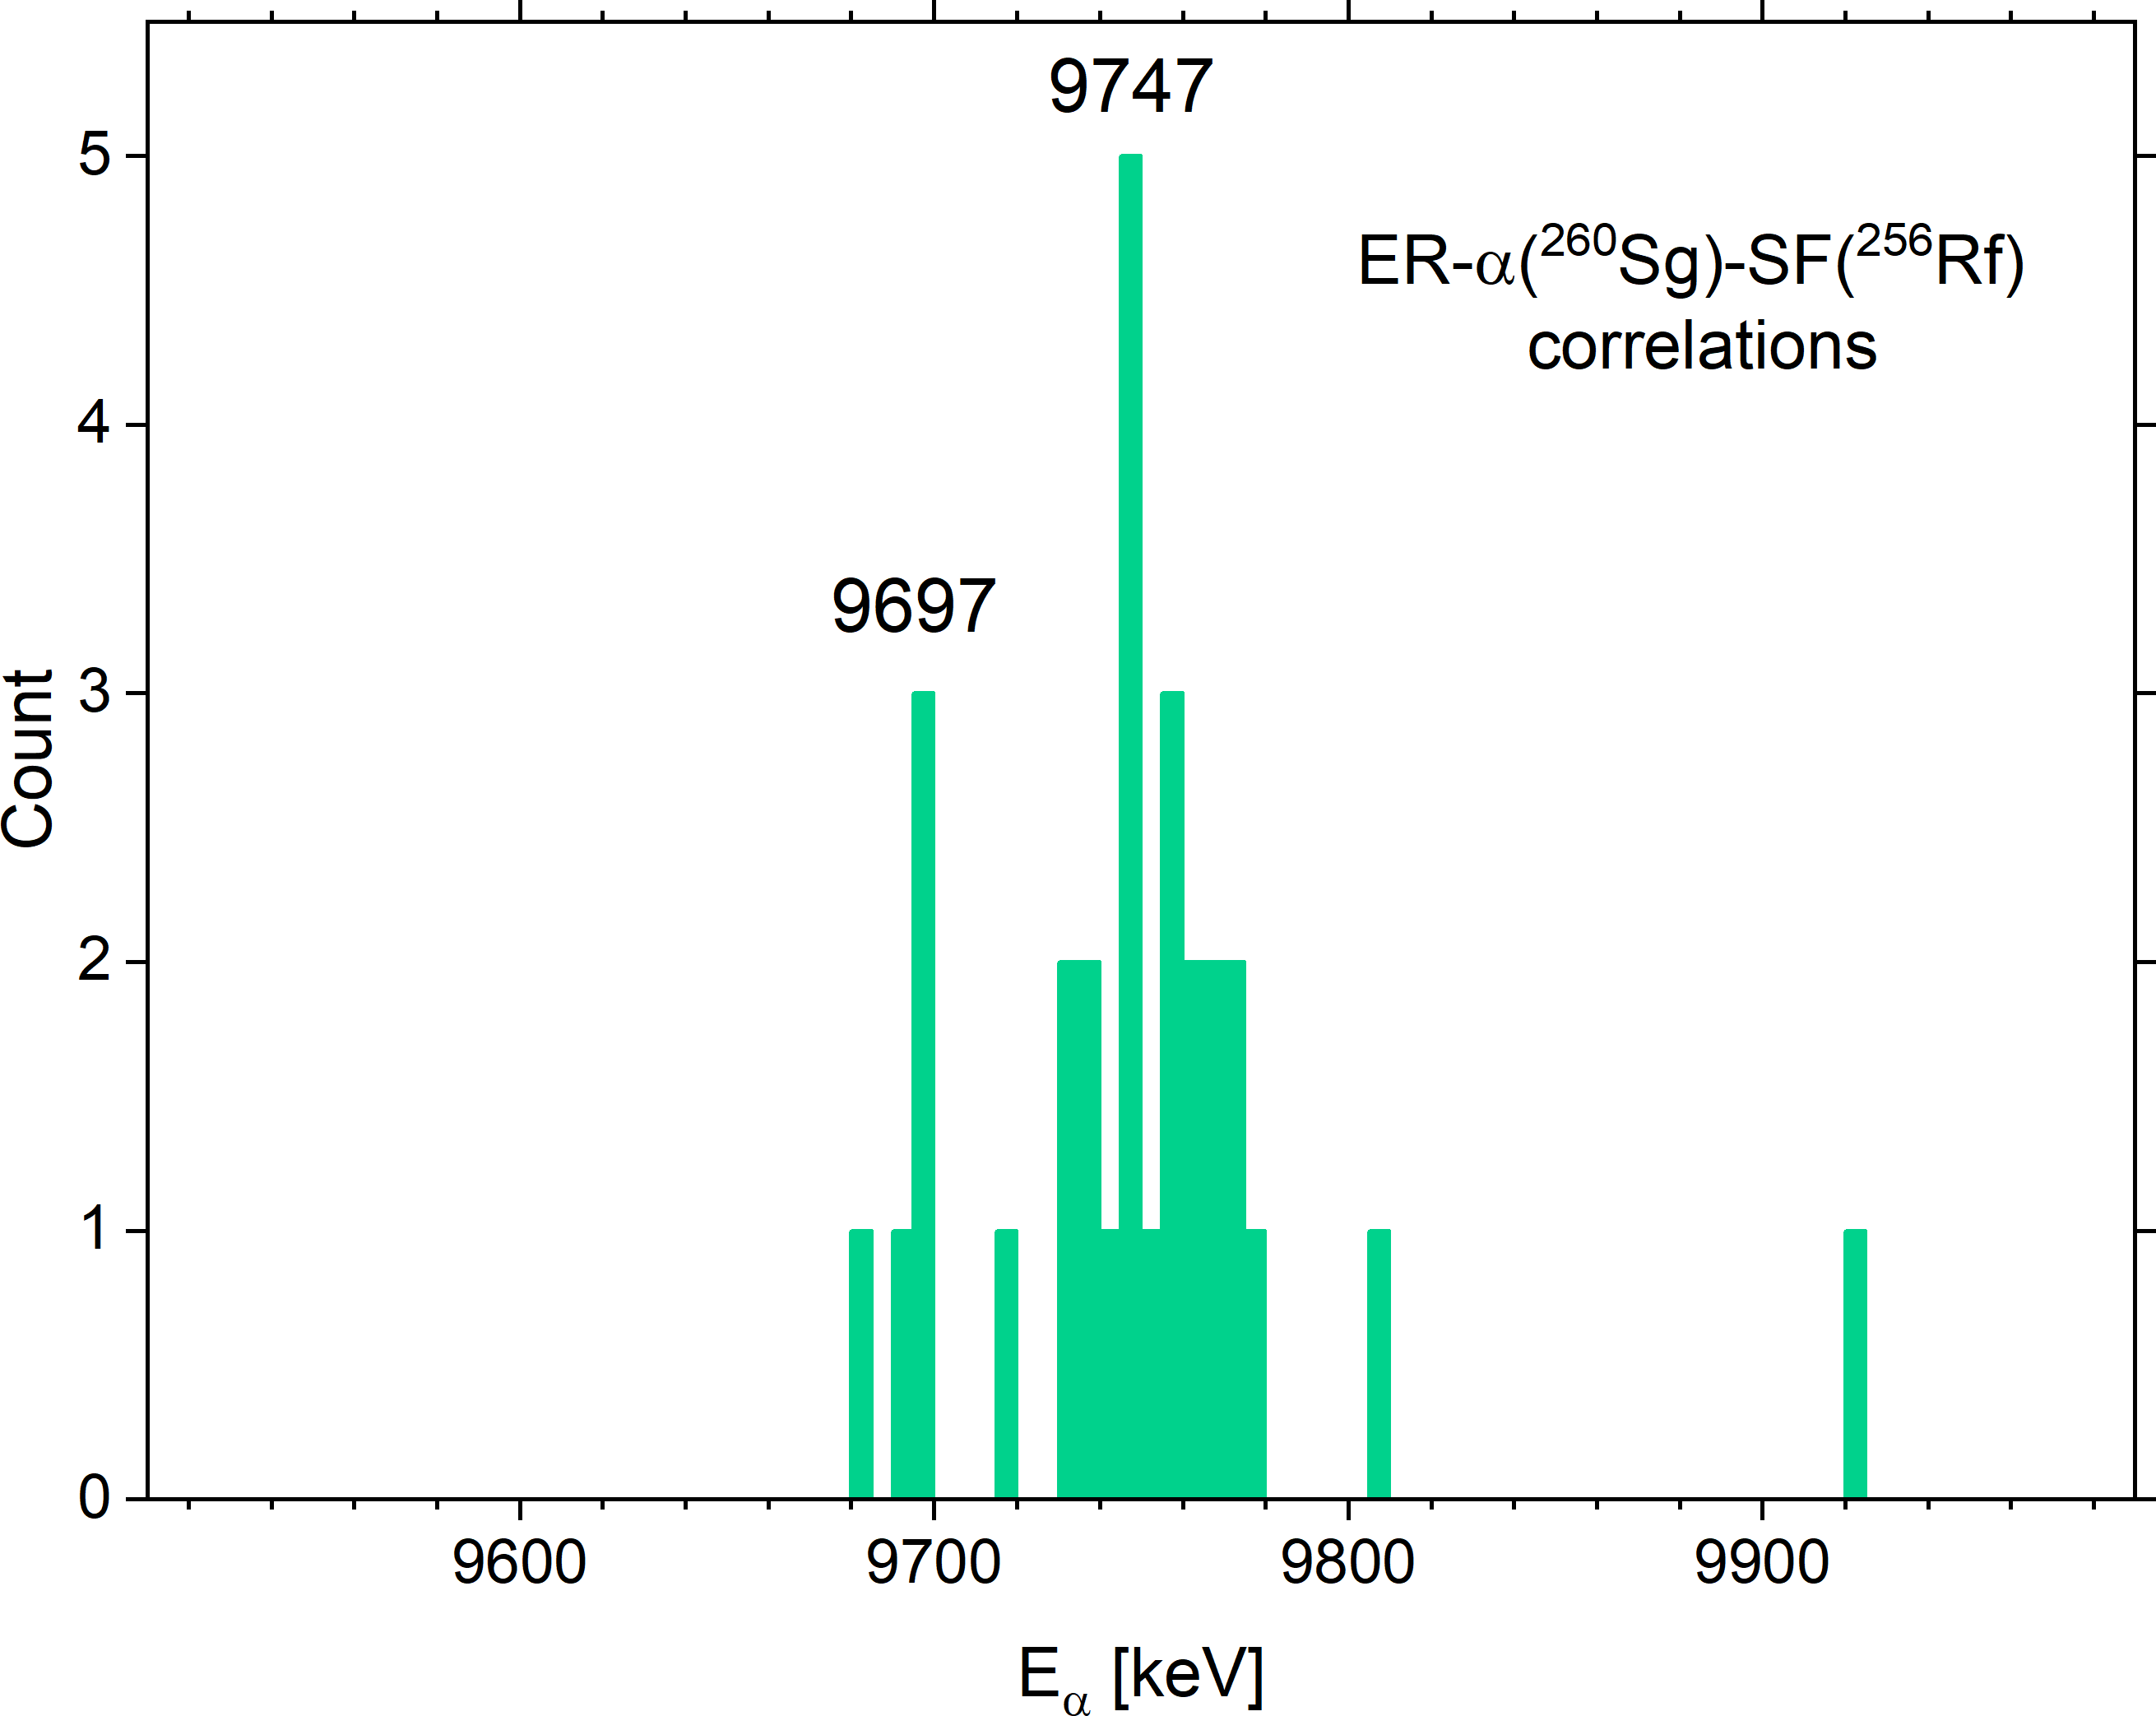
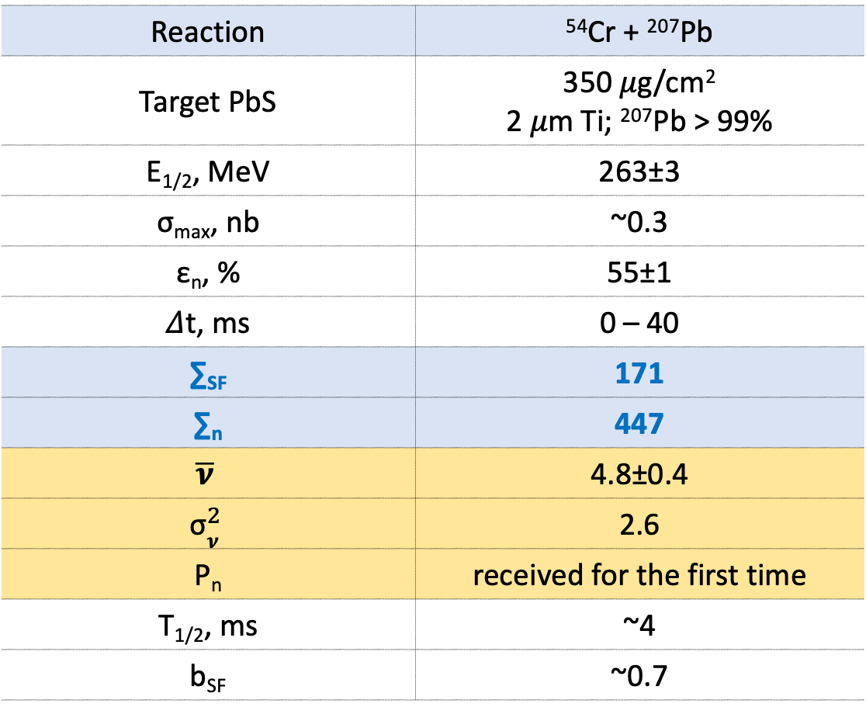
Isotope ²⁶⁰Sg
Reaction | ⁵⁴Cr + ²⁰⁷Pb
Target PbS | 350 𝜇g/cm² 2 𝜇m Ti; ²⁰⁷Pb > 99%
E_{1/2}, MeV | 263±3
σ_{max}, nb | ~0.3
ε_{n}, % | 55±1
𝛥t, ms | 0 – 40
∑_{SF} | 171
∑_{n} | 447
$$\overline{\text{ν}}$$ | 4.8±0.4
$${\text{σ}}_{\text{ν}}^{2}$$ | 2.6
P_{n} | received for the first time
T_{1/2}, ms | ~4
b_{SF} | ~0.7
◼︎ Measured ● Restored
Preliminary results
2nd experiment is planned for May 2024

Slide 18
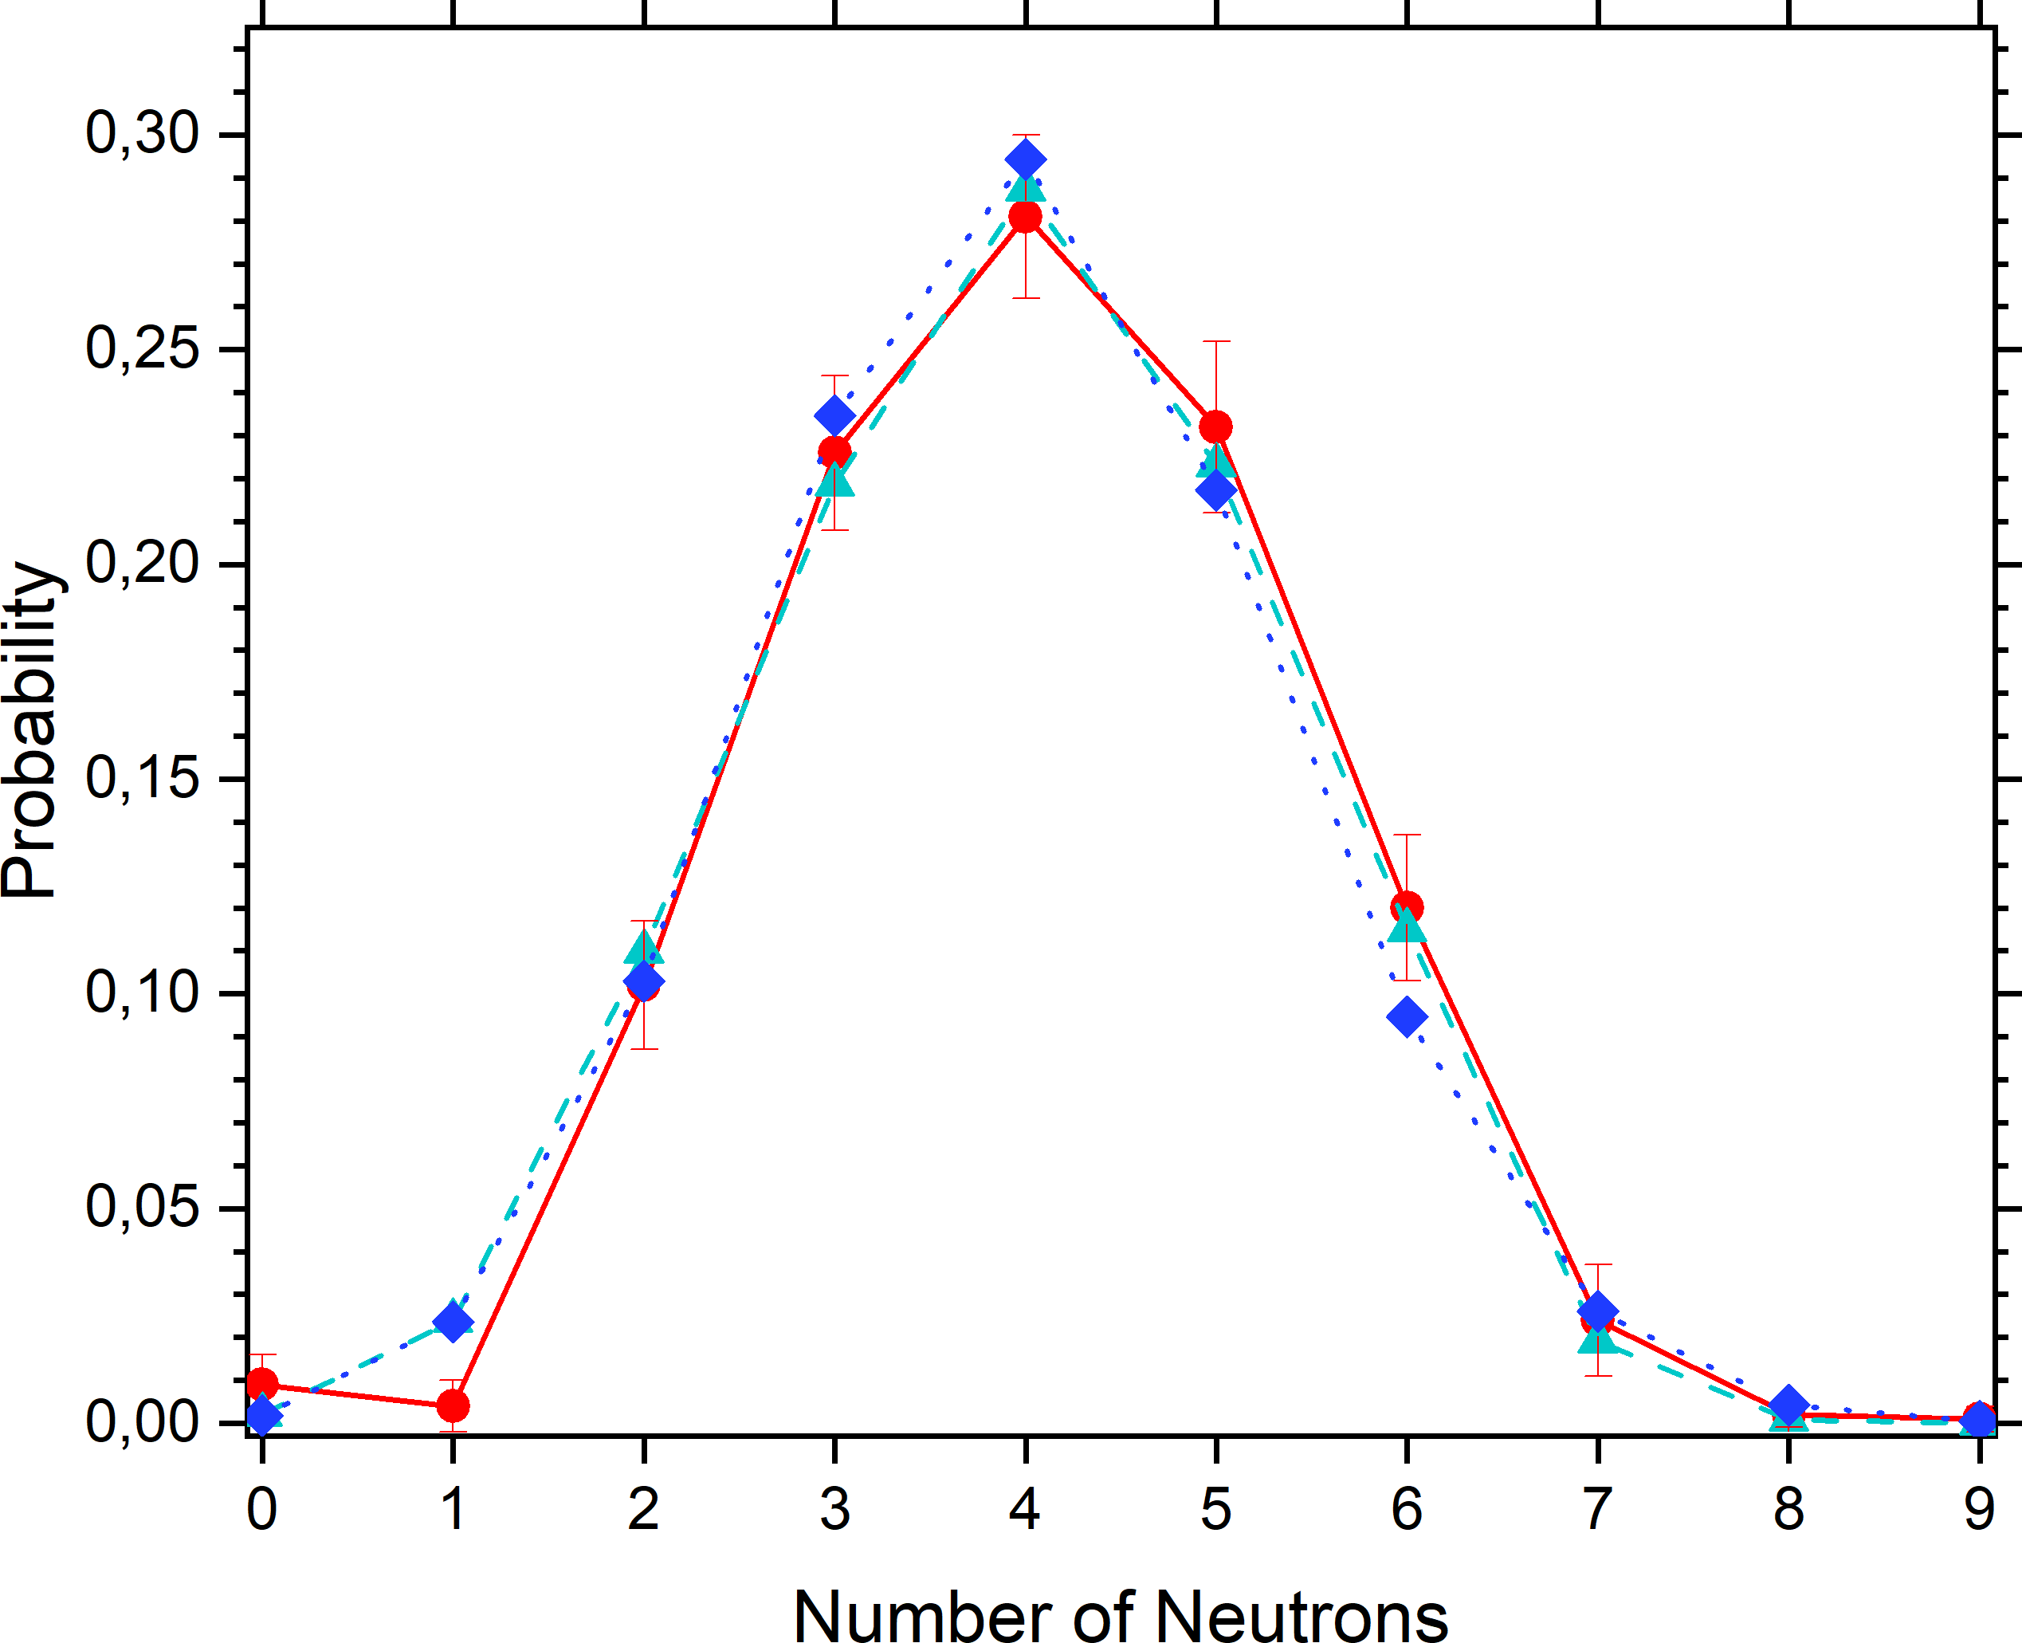
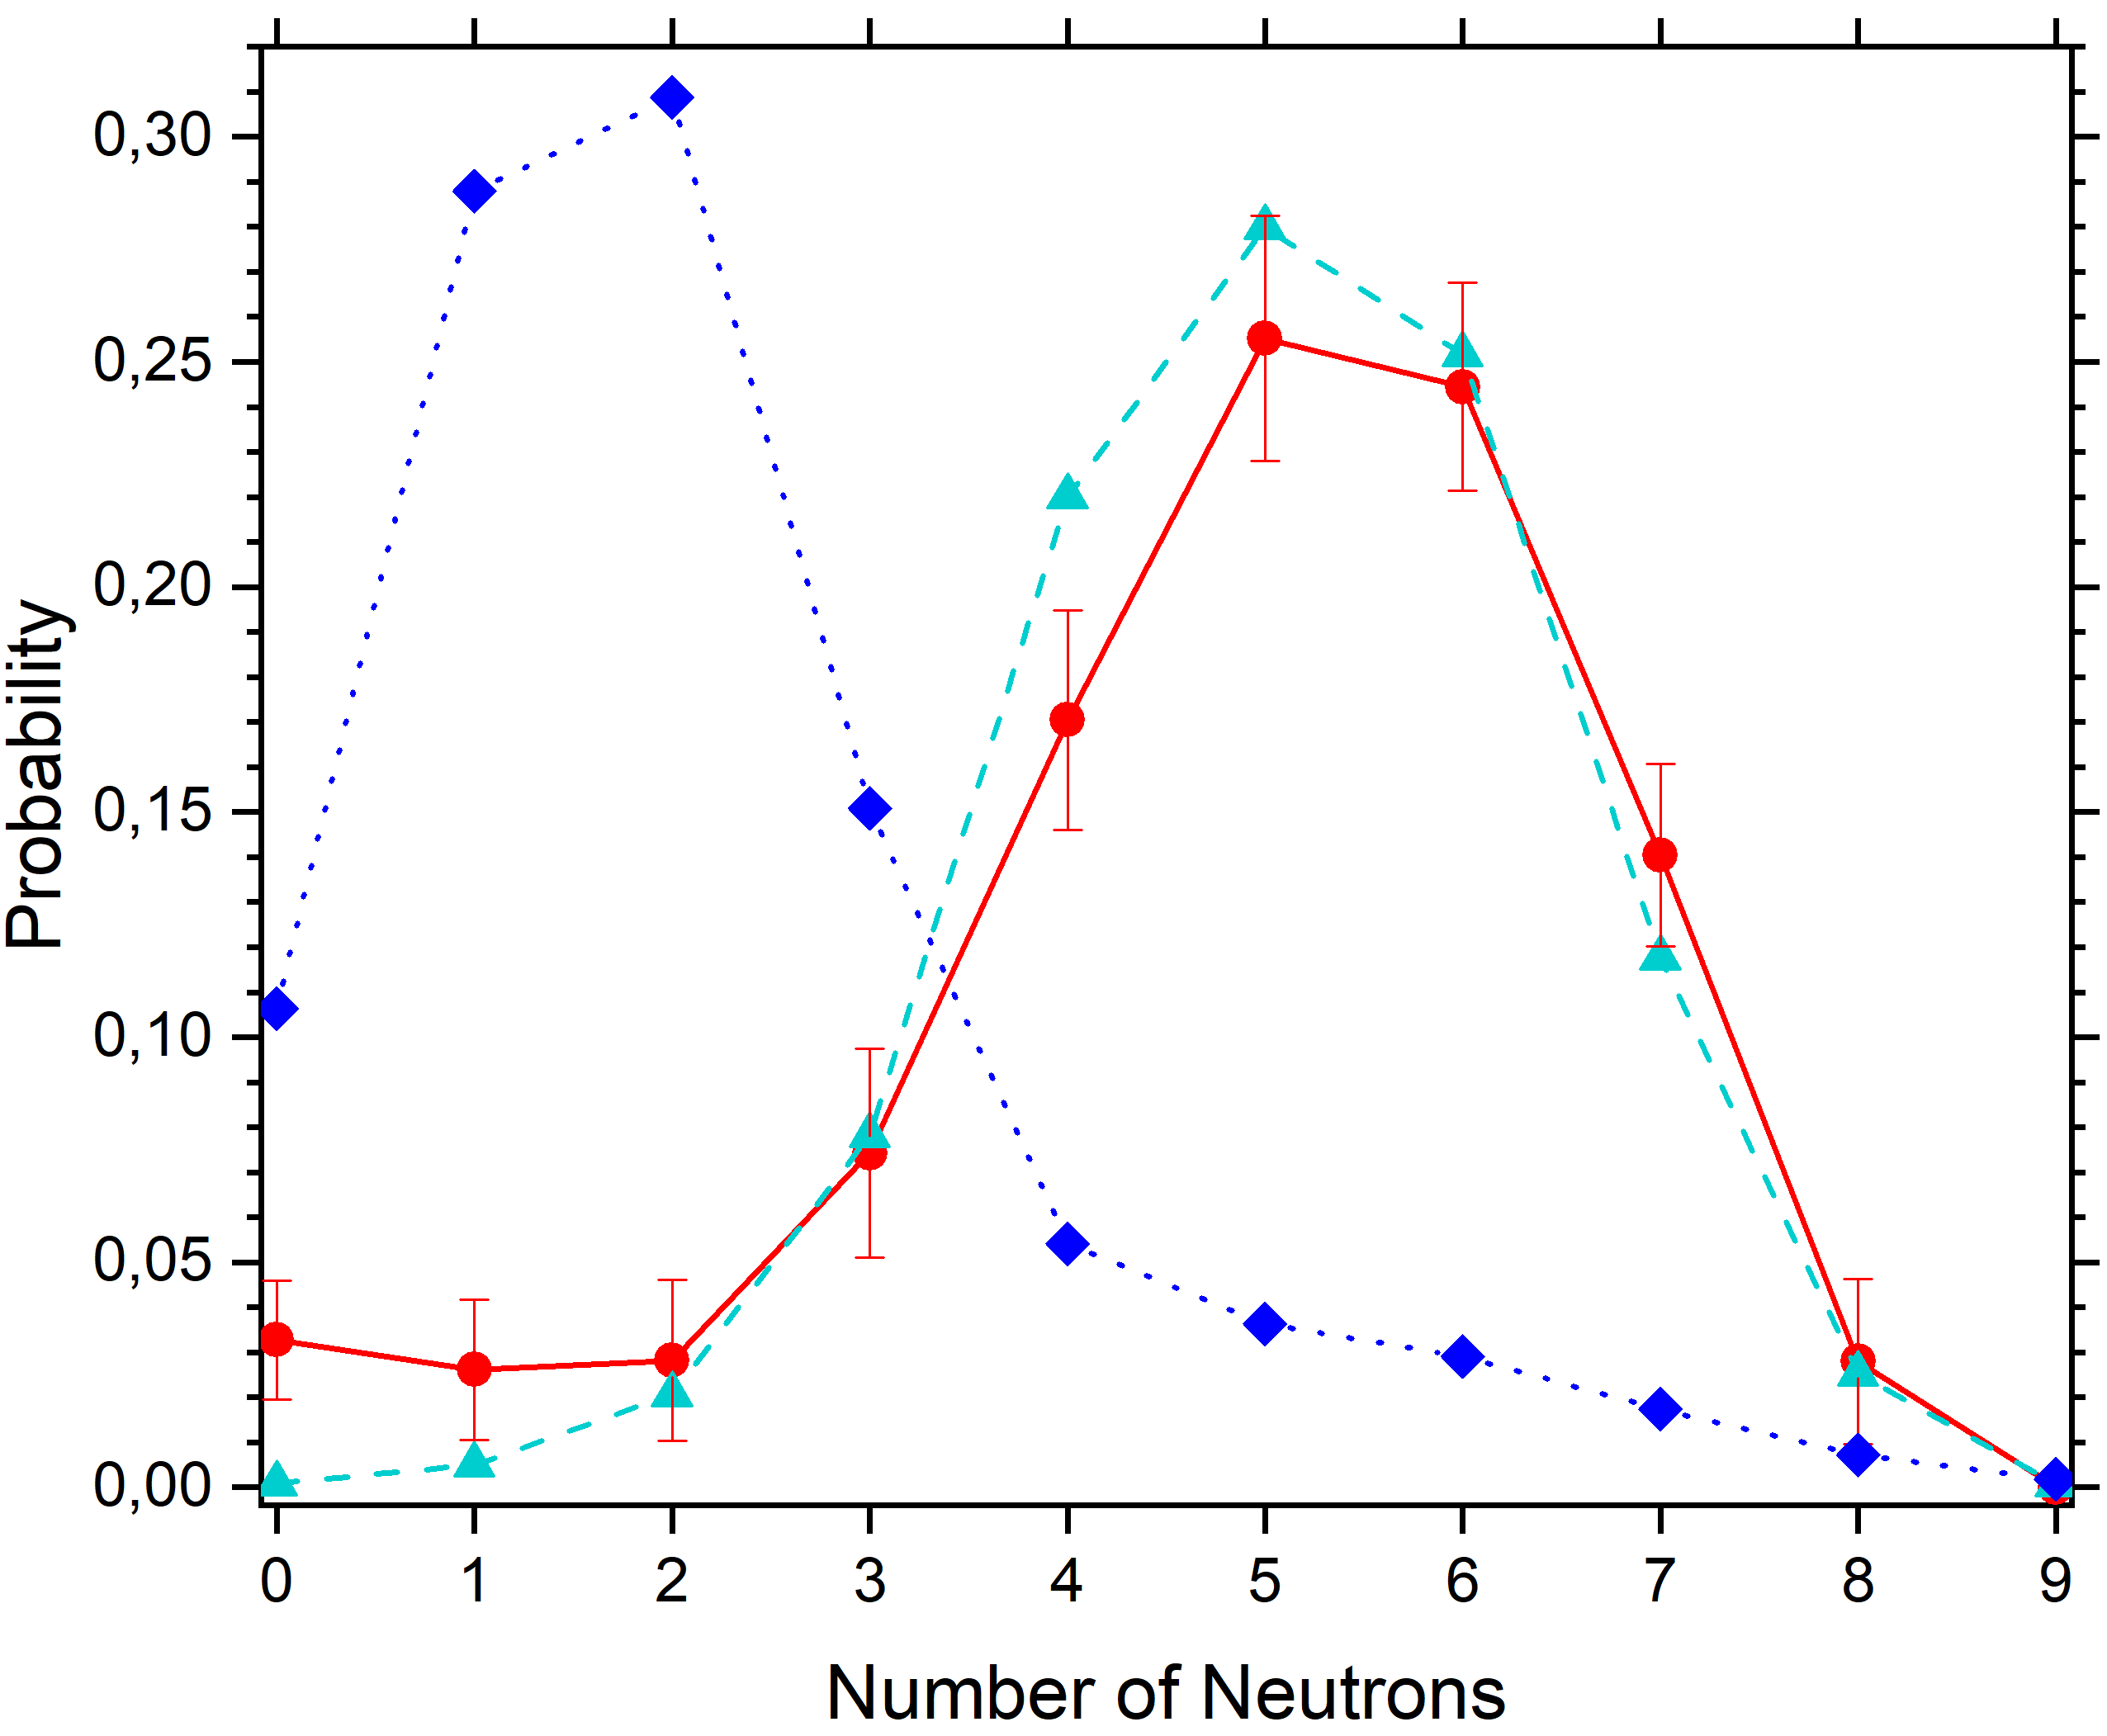
Agreement Between Theory and Experiment
²⁵⁰No
²⁶⁰Sg
● SFiNx (4.1±0.1) / CPC-0091 (2024) | ● SFiNx (4.9±0.2) / Preliminary results
Theory:▲ ISP (4.0), ◆ GEF (4.0) | Theory: ▲ ISP (5.1), ◆ GEF (2.1)
Calculations with additional version of ISP model made by BLTP JINR: A. V. Andreev, T. M. Shneidman and A. Rahmatinejad

Slide 19
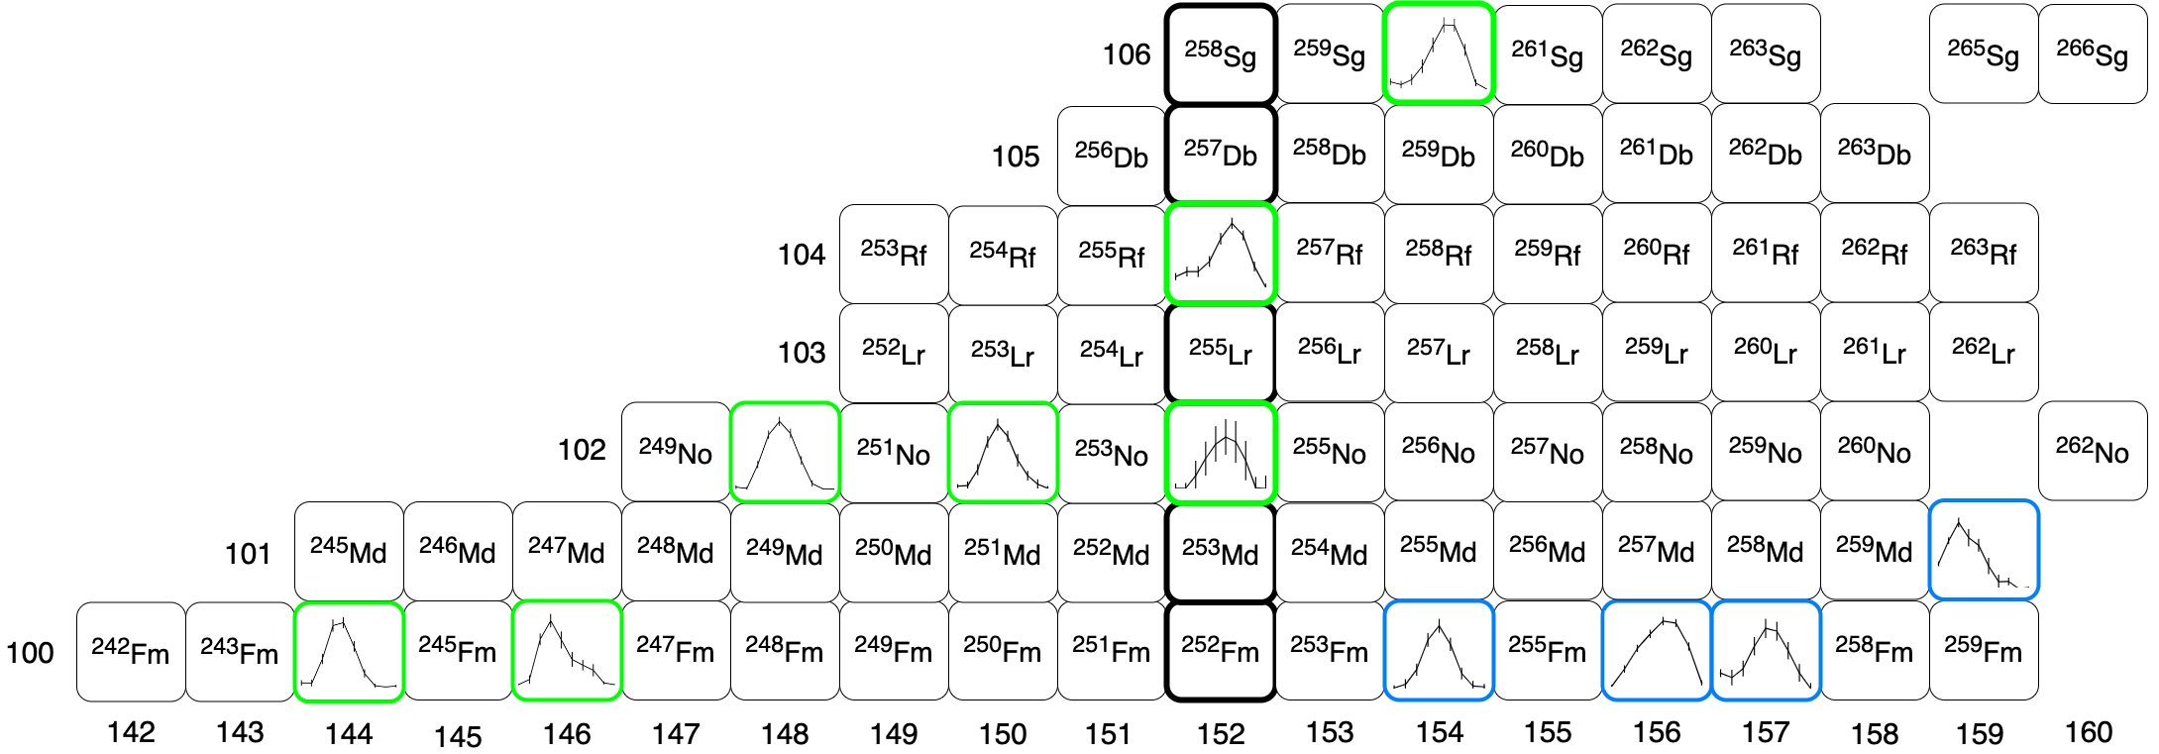
Features of the Prompt Neutron Multiplicity
SHELS separator (FLNR)

Slide 20
Features of the Prompt Neutron Multiplicity
SHELS separator (FLNR)

Slide 21
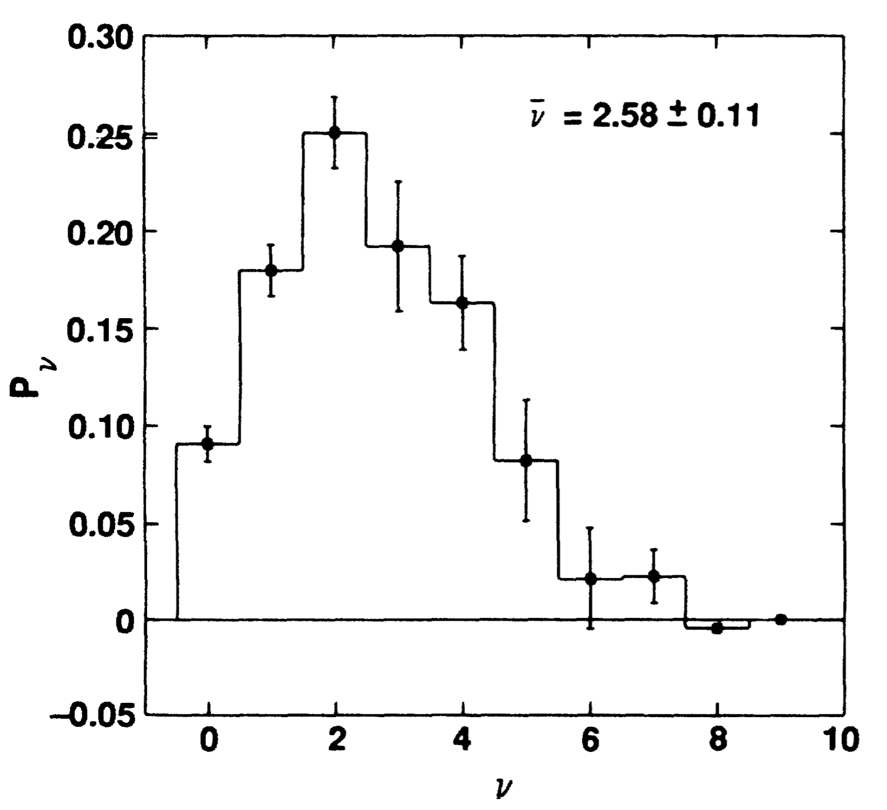
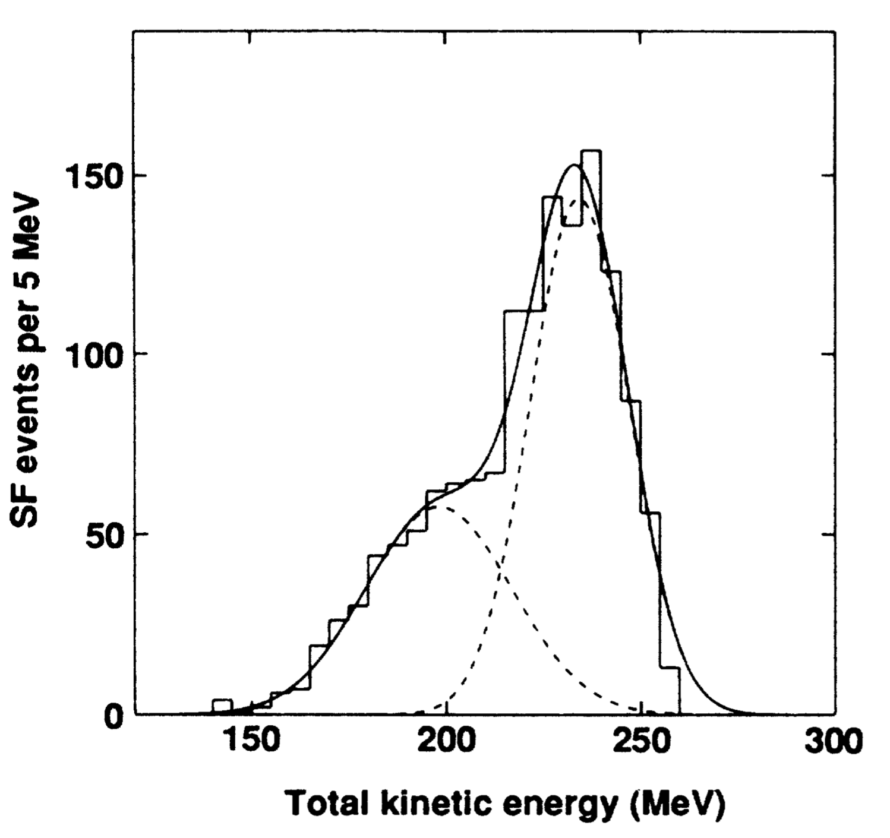
Features of the Prompt Neutron Multiplicity
²⁶⁰Md
²⁶⁰Md
Fragment mass number
Wild J. F. et al.
Prompt neutron emission from the spontaneous fission of ²⁶⁰Md
Phys. Rev. C 41/2 (1990) P. 640-646
Hoffman D. C., Lane M. R.
Spontaneous fission
RCA 70/71 (1995) P. 135–146

Slide 22
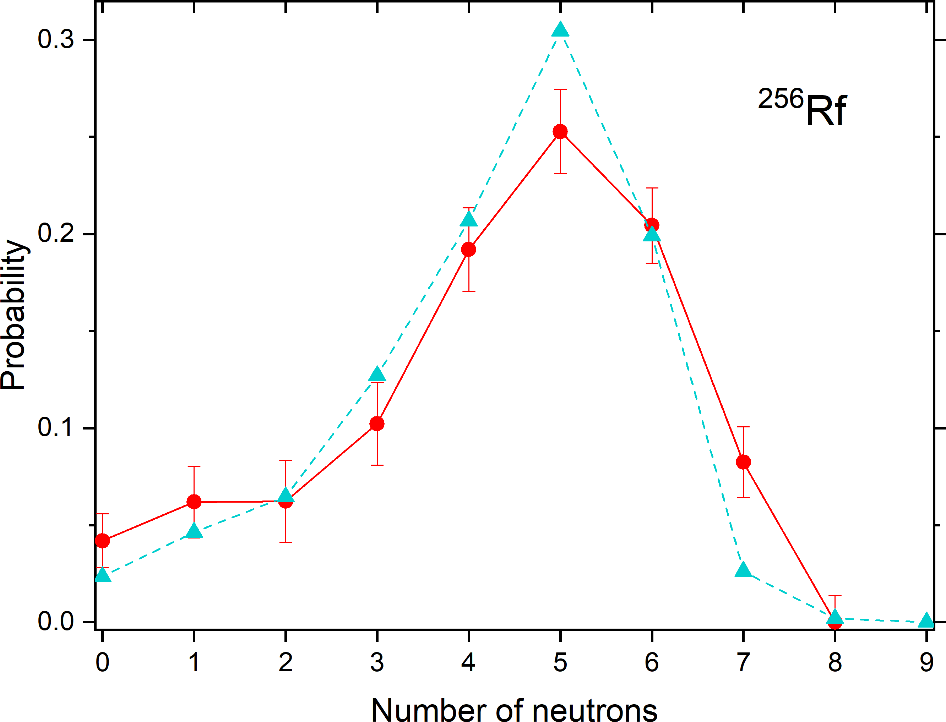
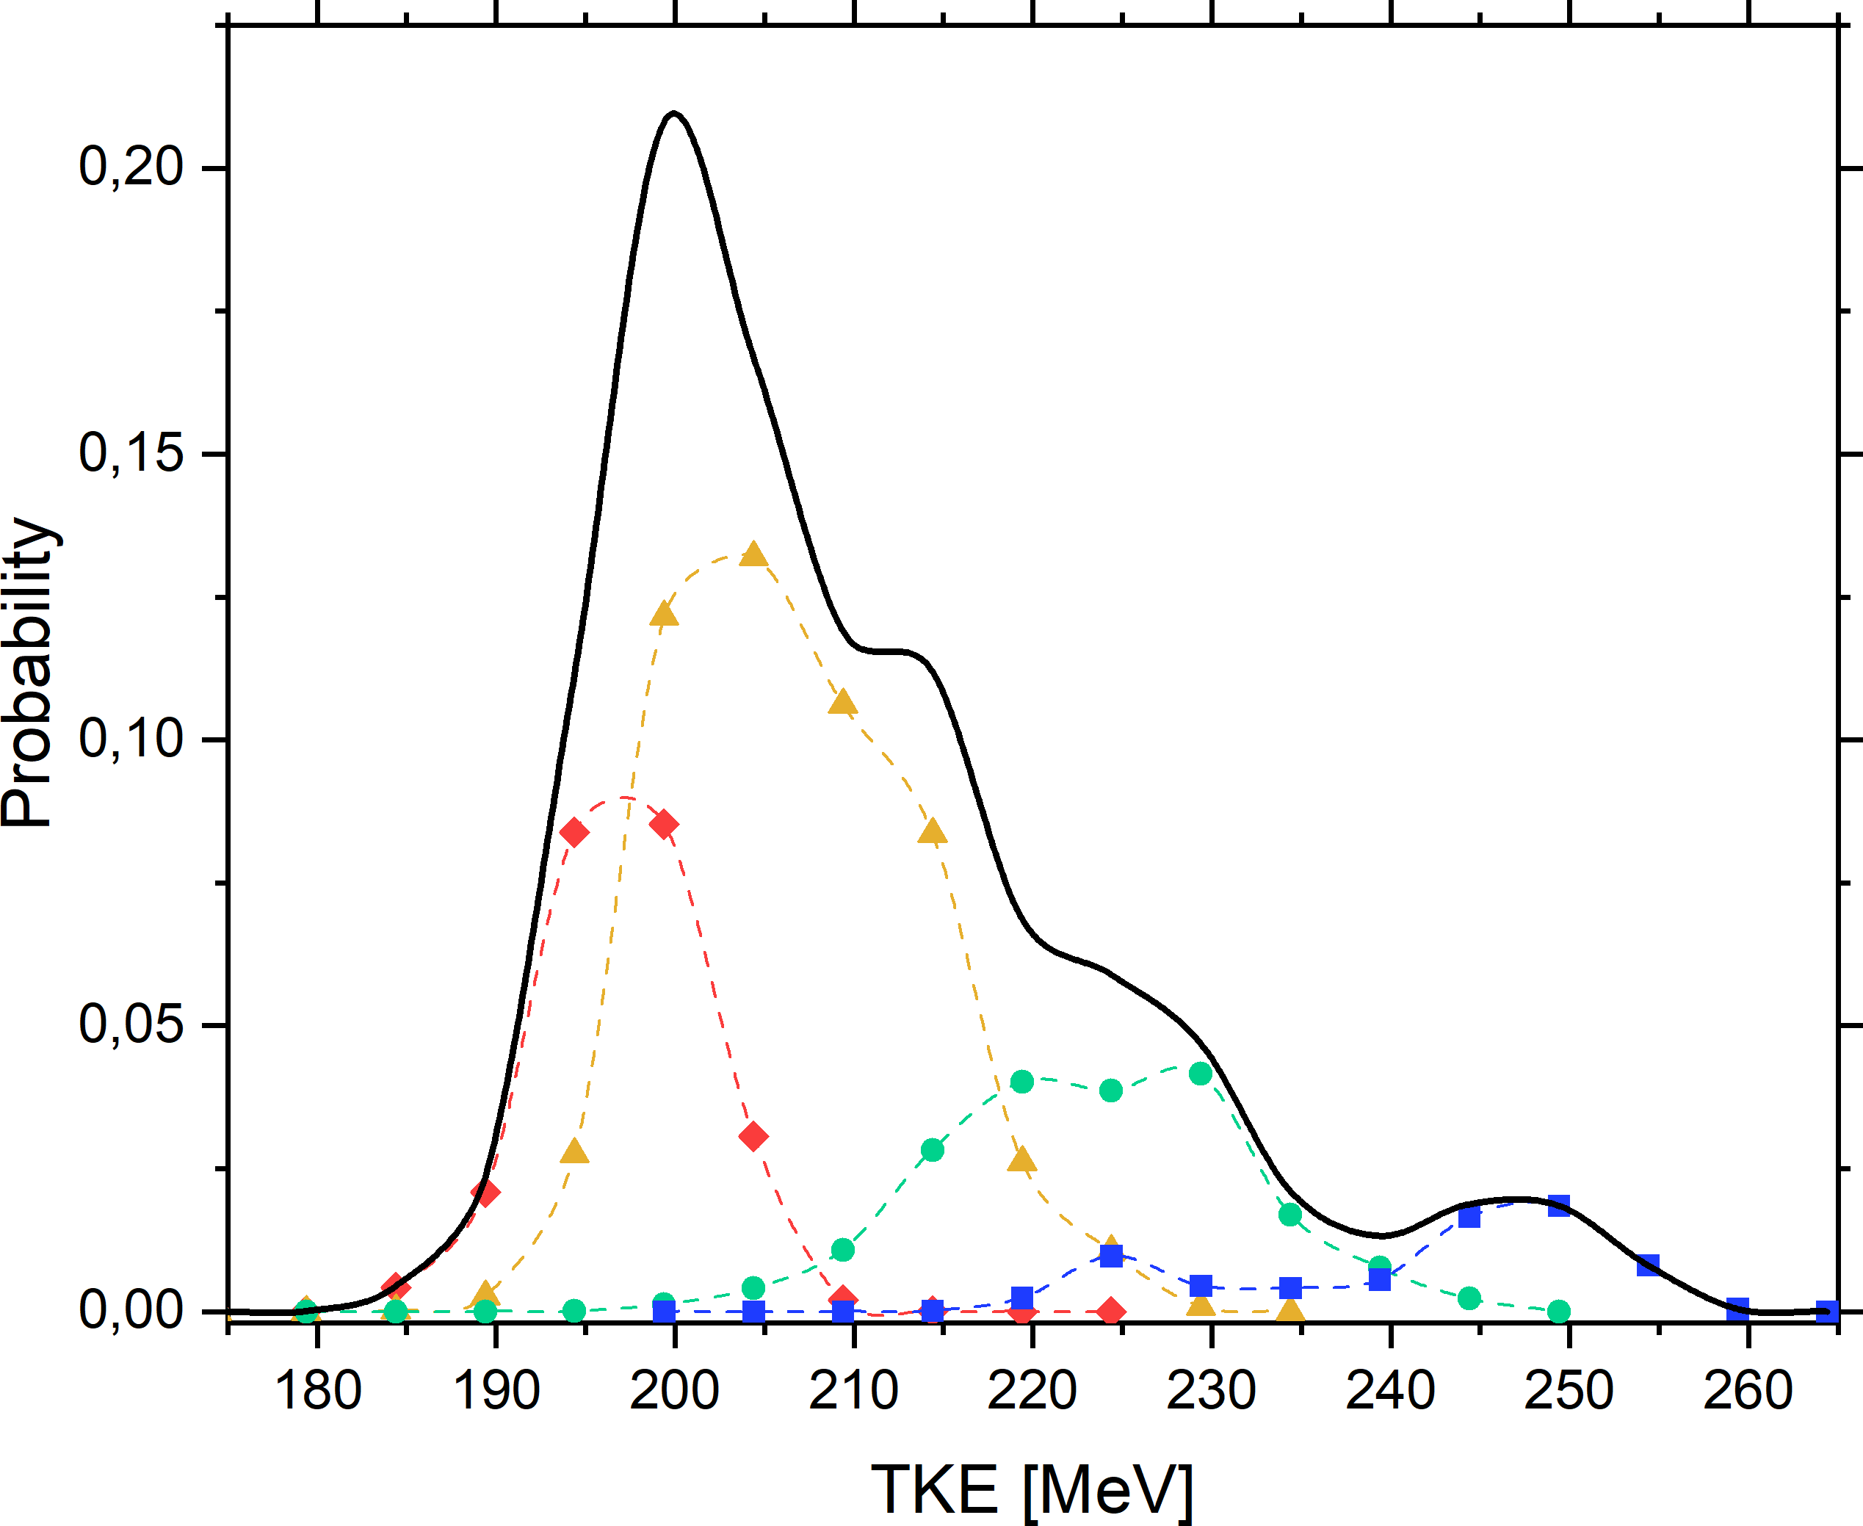
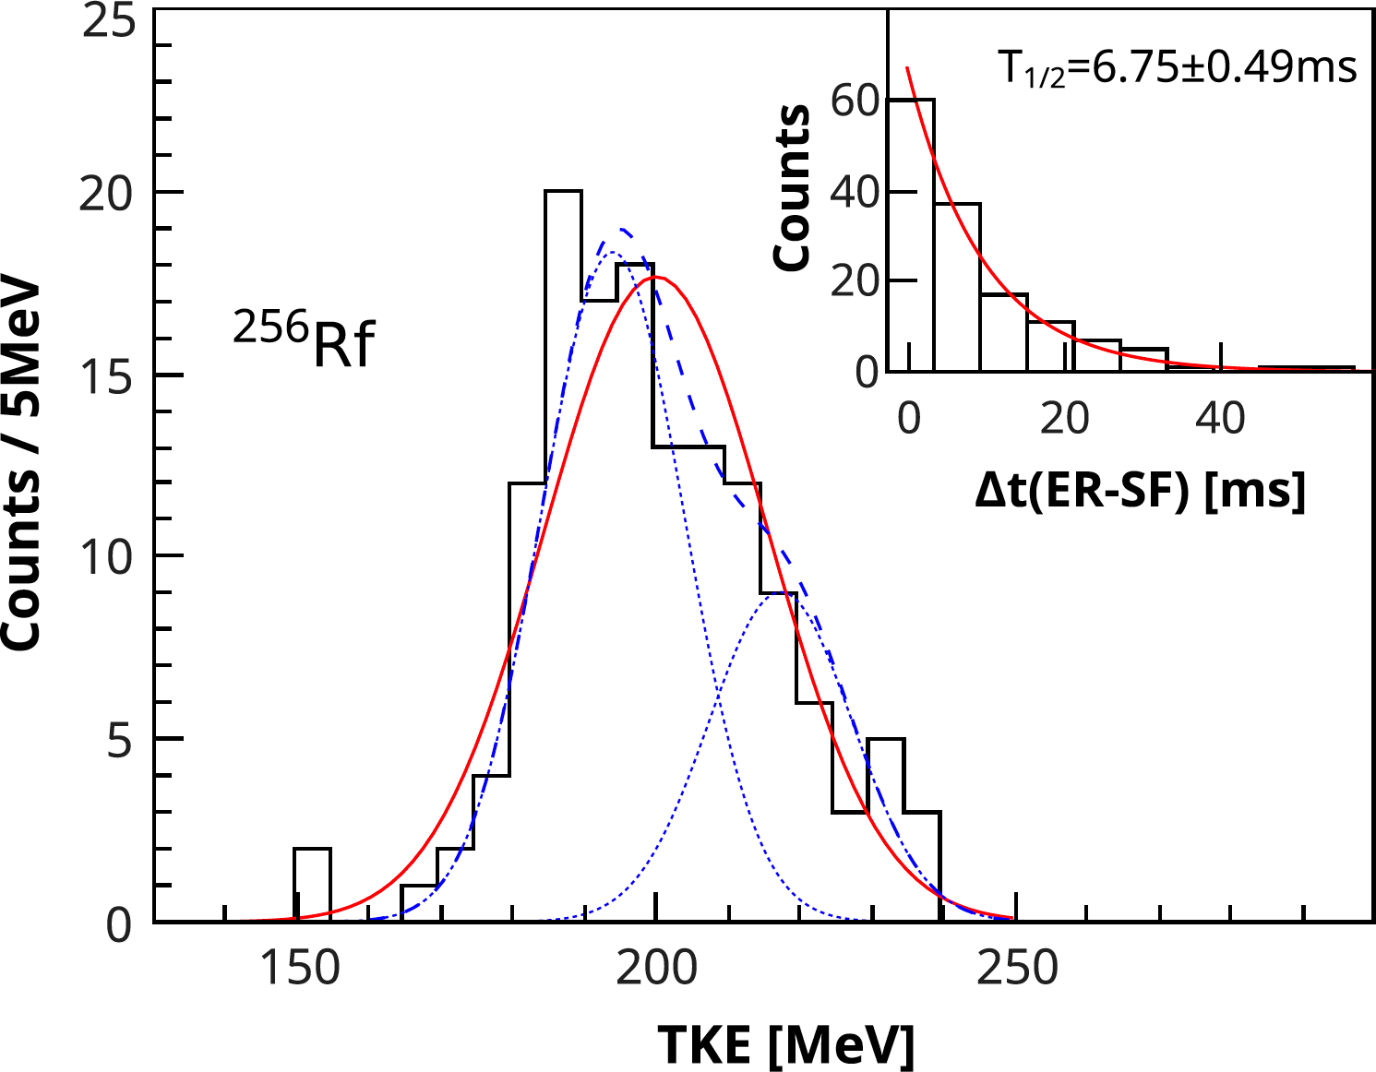
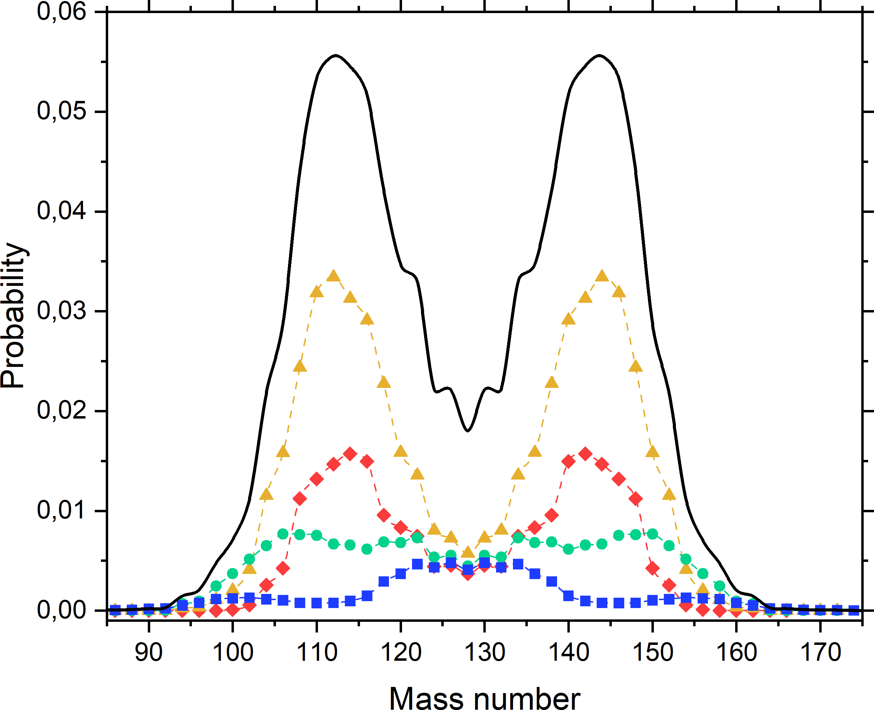
Features of the Prompt Neutron Multiplicity
ISP model
Experiment
Multiplicity:
0n-1n
2n-3n
4n-5n
6n-9n
● FLNR, experiment (4.30±0.09)
▲ BLTP, ISP model (4.3)
Mosat P. et al.
K isomerism in ²⁵⁵Rf and total kinetic energy measurements for spontaneous
fission of ^{255,256,258}Rf
Phys. Rev. C 101 (2020) 034310
Isaev, A. V. et al.,
Structure of the prompt neutron multiplicity distribution
in the spontaneous fission of ²⁵⁶Rf.
Physics Letters B 843 (2023) 138008

Slide 23
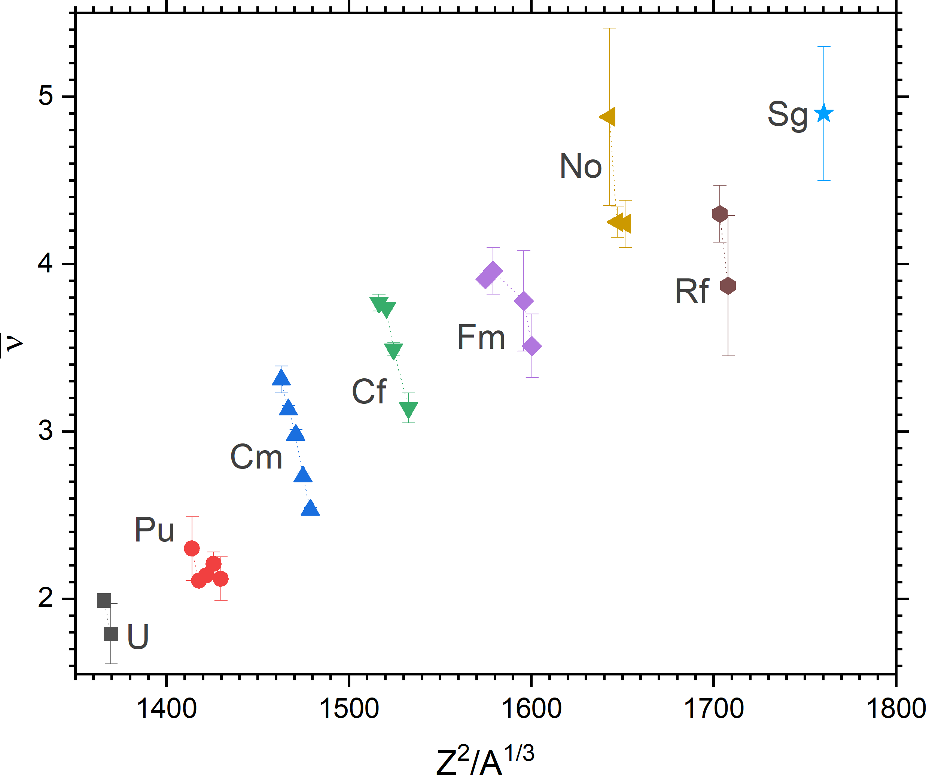
Nu-bar Value Systematic
FLNR JINR
Db

Slide 24


Nu-bar Value Systematic
Experimental data
?
FLNR JINR
²⁶⁰Sg
²⁶⁸Db
Theoretical calculations (●)
Rubchenya V. A.
Prompt neutron characteristics in the spontaneous fission of heavy and superheavy nuclei.
LXV International Conference "Nucleus 2015" June 29-July 3, 2015, St. Petersburg

Slide 25



Spontaneous Fission in the SHE region
Map taken from A.V. Karpov presentation (FLNR)
SFiNx detector
GRAND separator

Slide 26

Spontaneous Fission in the SHE region
⁴⁸Ca + ²⁴²Pu
4n 3n
Key idea:
beam off by Recoil-Alpha correlation to reduce neutron background.
Cross section [pb]
GRAND+GABRIELA
Dec. 2022, 1.5 p𝝁A of ⁴⁸Ca
Achieved: 2 Flerovium decays per day!
E_{1/2} [MeV]
What statistics are needed?
100+ SF for neutron multiplicity
10+ SF for average number of neutrons
Several isotopes in the one experiment
First tests of new rotating target
D = 480 mm and 6 p𝝁A of ⁴⁸Ca
SHE Factory, April 2024
Plans: 8 Flerovium decays per day!

Slide 27





Spontaneous Fission in the SHE region
ISP global fitting
ISP increased decay rate
²⁸²Cn
?
Calculations with additional version of ISP model made by BLTP JINR: A. V. Andreev, T. M. Shneidman and A. Rahmatinejad

Slide 28
Заключение
На сепараторе ГРАНД Фабрики СТЭ получен ток в 6 pμA пучка ⁴⁸Ca на 480 мм вращающейся мишени;
Создана высокоэффективная детектирующая система SFiNx для изучения спонтанного деления короткоживущих ядер;
Получены новые данные по выходам мгновенных нейтронов короткоживущих изотопов вплоть до ²⁶⁰Sg;
²⁸²Cn
?
4. С применением SFiNx на Фабрике СТЭ можно впервые измерить зависимость среднего числа нейтронов от TKE для ²⁵²No и исследовать множественность мгновенных нейтронов ²⁷⁹Ds и ²⁸²Cn. Это позволит дать моделям деления опорные данные в области самых тяжёлых ядер!
(для ²⁸²Cn потребуется эксперимент длительностью 2 месяца).

Slide 29












Thank you for your attention!

Slide 30


Super-Short Fission Mode
“The super-short fission mode in which the scission configurations are very compact, consisting of two nearly spherical protofragments near ¹³²Sn, thus leading to high fragment kinetic energies and low neutron multiplicities. We have shown in detail how this mode dominates in spontaneous fission of ^{258–268}Fm, while it gradually subsides with increasing excitation energy.”
M. Albertsson, et al. Super-short fission mode in fermium isotopes.
PRC 104/6 (2021) P. 064616
Average TKE (a) and nu-bar value (b) for fission of fermium isotopes, vs the neutron number of the initial nucleus. The calculated results for the even isotopes are shown as open blue diamonds for sf, open green squares for thermal fission, and open red circles for E0∗ = 15 MeV. The experimental data on TKE are taken for sf (black diamonds) and for thermal fission (black squares). Also shown are data for fission of ^{259,260}Md(sf) (black stars). Data points are connected by dashed lines. The solid line in panel (a) shows the Viola systematics for sf.
Contour plots (on a logarithmic scale) of the number of fission events for ²⁶⁰Fm in the A-TKE plane based on 10⁵ spontaneous or thermal fission events. Also shown are Q* (filled diamonds) and average TKE(A) (filled circles). Typical scission shapes are shown for the compact, symmetric super-short and the elongated, asymmetric standard modes.

Slide 31



Super-Asymmetric Fission Mode
The improved statistics and the possibility of selecting off-line the angular cone in the fragment mass determination revealed that the enhanced far asymmetric yield in the spontaneous fission of ²⁵²Cf as observed earlier and most probably for other nuclides too, is artificial and due to energy degradation. Reducing the angular cone to only those events where cos 𝜽 > 0.9, revealed that the enhancement disappeared. Hence, careful data analysis, especially in the far asymmetric region, is essential. For a definite conclusion, about whether the double-energy method employing high resolution ionization chambers is adequate to answer the question if far asymmetric events really exist, at least 100 times more counting statistics is needed.

Slide 32

Unfolding of Multiplicity Distribution
• Since the detector efficiency is far from 100%, the measured neutron distribution is highly distorted
• Let's assume that the number of neutrons registered is a random variable that obeys the binomial distribution
  $n$ – maximum neutron multiplicity
  $x∈ℝ^{1, n}$ – true neutron multiplicities
  $K∈ℝ^{n,n}$ – detector response matrix:
  $$K_{i,j}=\frac{j!}{i!\left(j−i\right)!}ε^{i}{\left(1−ε\right)}^{j−i}$$
  where i – is the number of emitted neutrons, j – is the number of measured neutrons, $ε$ – single neutron registration efficiency.
  $y∈ℝ^{1, n}$ – measured neutron multiplicities:
    $$y=Kx$$
  $x_{d}={\left(K^{T}K\right)}^{−1}Ky$ – direct solution of the problem
  A direct solution often doesn't make sense, when the noise level is high (including statistical uncertainties)!

Slide 33


Tikhonov Statistical Regularization
• The essence of the method is to find an approximate solution using a priori information about the distribution:
  Smooth
  Flat on the "tails"
  Has no negative values
• The regularization matrix R has the form:
• Regularized solution:
$$x_{r}={\left(L^{T}L+αs^{2}R^{T}R\right)}^{−1}L^{T}g$$
  - $L\sim K, g\sim y,$
  - $s=\sqrt[n]{\prod_{0}^{n}{s_{i}}};where s_{i} are the uncertainties of the measured distribution$
  $α$ – regularization parameter (smoothing degree)
  $σ^{2}=s^{2}diag({\left(L^{T}L+αs^{2}R^{T}R\right)}^{−1})$ – uncertainties of the regularized solution
Mukhin R. S. et al. PEPAN Letters 18 (2021) P. 439–444
Turchin V.F., Kozlov V.P., and Malkevich M.S. Soviet Physics Uspekhi 13.6 (1971) P. 681–703
Turchin V.F. USSR Computational Mathematics and Mathematical Physics 7.6 (1967) P. 79–96

Slide 34






Direct Solution vs Tikhonov Regularization
$$ε \sim 55\%$$
850k ²⁴⁸Cm SF
1357 ²⁵⁰No SF
Direct Solution
Regularization
($α=89$)

