Slide 1
National Research Nuclear University MEPhI
Institute of Nuclear Physics and Engineering
Department of "Elementary Particle Physics" №40
Application of artificial intelligence methods for particle identification in the FARICH SPD detector
Supervisor: Zhemchugov A.S.
Student: Massalov K.Yu.
Moscow 2024

Slide 2
Introduction
inclusive production of charmonia
open charm
prompt photons
Decay modes of D-meson:

Slide 3
Goal
Creation of neural network methods for reconstructing signals from the FARICH detector
Studying their characteristics and comparing them with classical approaches
The primary tasks are a review of existing methods for reconstructing signals from FARICH and the creation of a Cherenkov ring simulation program for training neural networks.

Slide 4
Reconstruction methods
Method name | Pros | Cons
Separation of particles by second moments | Simplicity Speed | Requires preliminary clustering Low noise resistance
Iterative method | Automatic matching of track with ring | Requires additional information Speed
Mask method |  | Requires preliminary clustering Low noise resistance Speed

Slide 5
Reconstruction methods
Method name | Pros | Cons
Fuzzy clustering | Simplicity Speed | Requires additional information Low noise resistance Speed
Gradient methods for minimizing the loss function | Resistance to initial estimates | Requires preliminary clustering Speed

Slide 6
Appropriate architectures of NN
Convolution NN (with image as input)
Convolution NN (with point clouds as input)
Graph NN

Slide 7
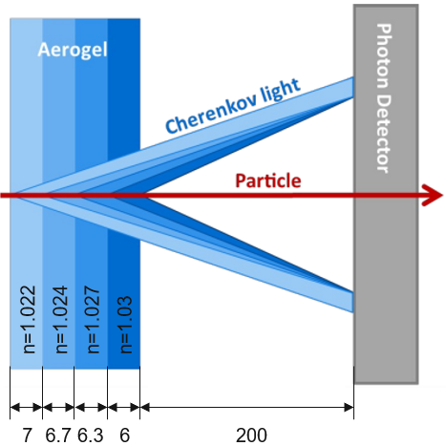
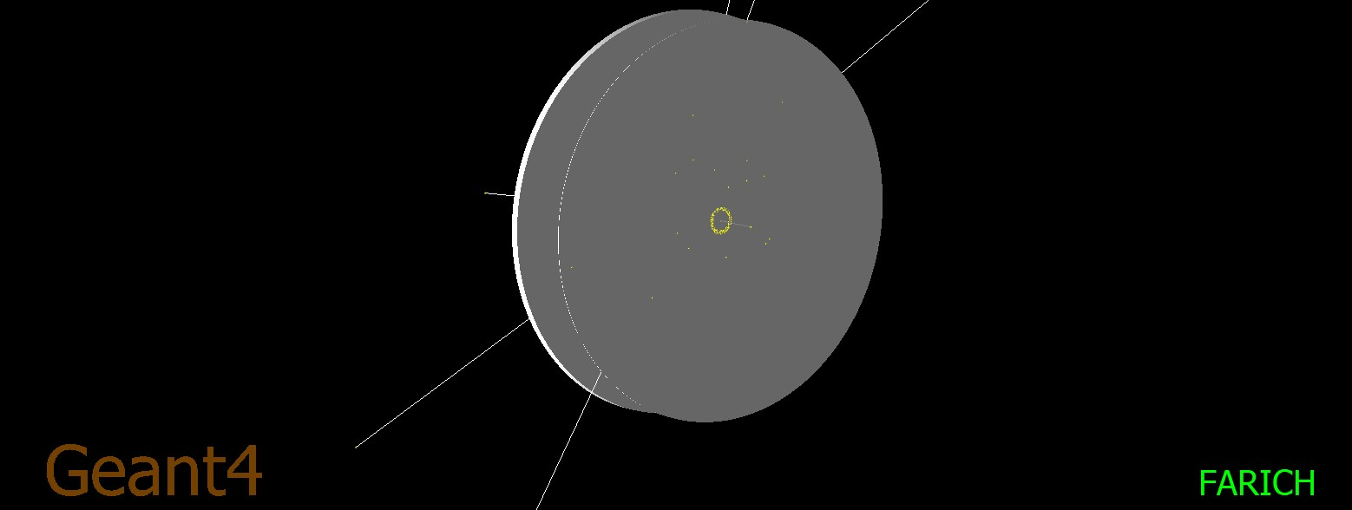
Modeling of the FARICH detector

Slide 8
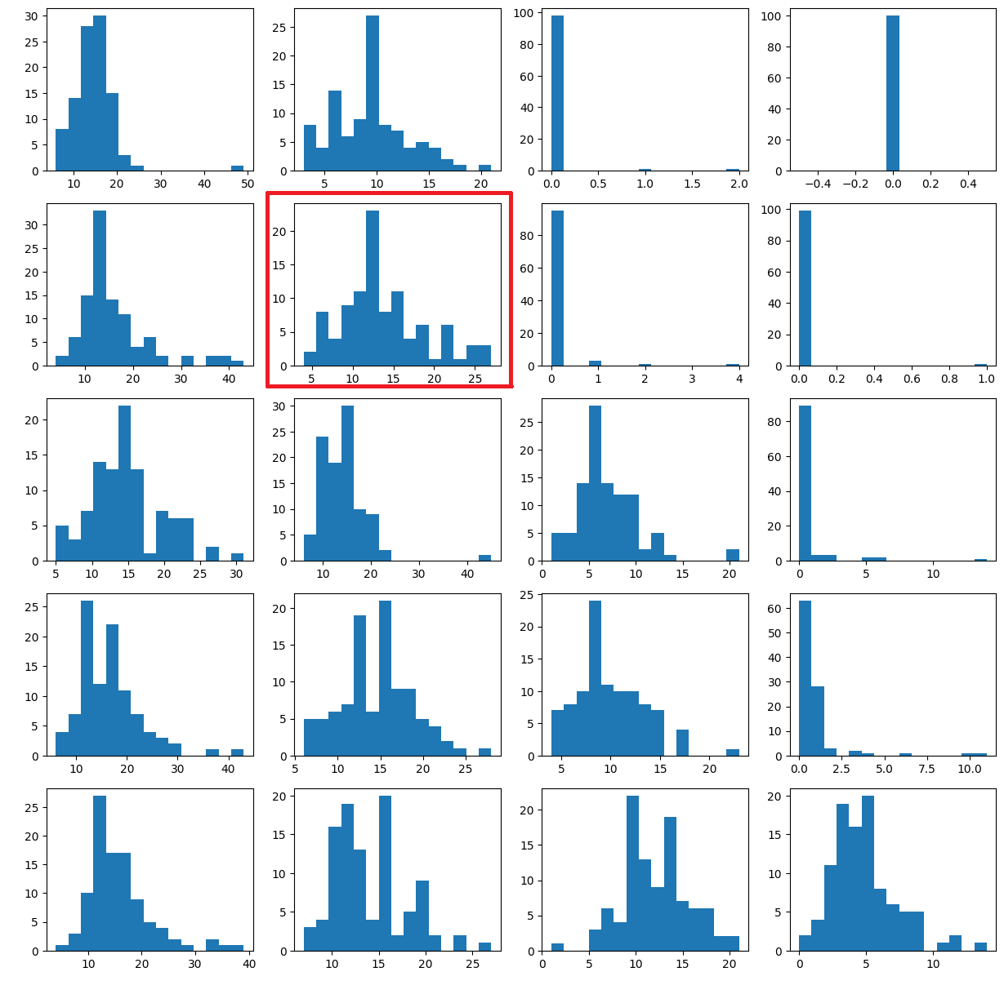
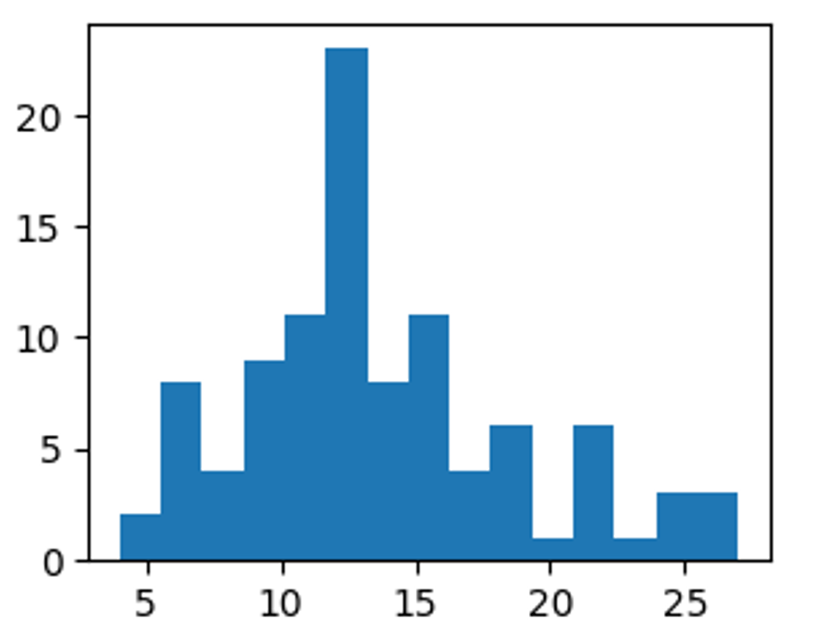
Event simulations
Photons spektrum for π⁺ at 2 GeV momentum
p=1 GeV
p=2 GeV
p=3 GeV
p=4 GeV
p=5 GeV
Number of photons

Slide 9
Event simulations
Second moments
(angle of incidence 0 deg )
p=1 GeV
p=2 GeV
p=3 GeV
p=4 GeV
p=5 GeV

Slide 10
Event simulations
Second moments
angle of incidence 30 deg (top) and 60 deg (bottom)
p=1 GeV
p=2 GeV
p=3 GeV
p=4 GeV
p=5 GeV

Slide 11
Conclusion
Using the GEANT4 software package, the events of the passage of different particles at different momentums through the FARICH detector were simulated. Histograms were constructed for second moments of the resulting rings. From the resulting histograms we can conclude that it is possible to separate π +, K+, p+, but the efficiency of this method is low.
In future work, it is planned to refine the detector model with a more accurate account of the detection efficiency of Cherenkov photons, study the effectiveness of classical reconstruction algorithms taking into account different angles of particle incidence on the FARICH radiator, as well as develop and train a neural network for particle identification.

Slide 12
Thank you for
your attention

