Slide 1
Quantum fields in a finite volume and possible quark-hadron scaling duality
A.S. Parvan
DFT, IFIN-HH, Bucharest
BLTP, JINR, Dubna

Slide 2
QCD phase diagram
In the modern paradigm the fundamental
theory of the strong interactions is considered
to be the non-abelian gauge field theory –
Quantum Chromodynamics (QCD)
This theory is based on the unobservable
quantities such as the color charge and the
fractional elementary electric charge.
The QCD postulate of quark confinement
is the postulate of the color nonobservability :
All hadron states and physical observables are
color-singlets (T. Muta, Foundations of QCD).
The quarks are confined to the inside of hadrons and their mean free path cannot exceed 1fm. The deconfinement of the quarks (QGP) from hadrons may be possible only in a spatial region smaller than the summary volume of these hadrons.
Until now, we have only one reliable point on the QCD phase diagram obtained from the fundamental theory of QCD (by the lattice calculations) : HotQCD Coll., A.Bazavov et. al.,
Phys. Rev. D 90, 094503 (2014)
All another points on the entire QCD phase diagram are only phenomenological models predictions.
What does this LQCD point mean?

Slide 3
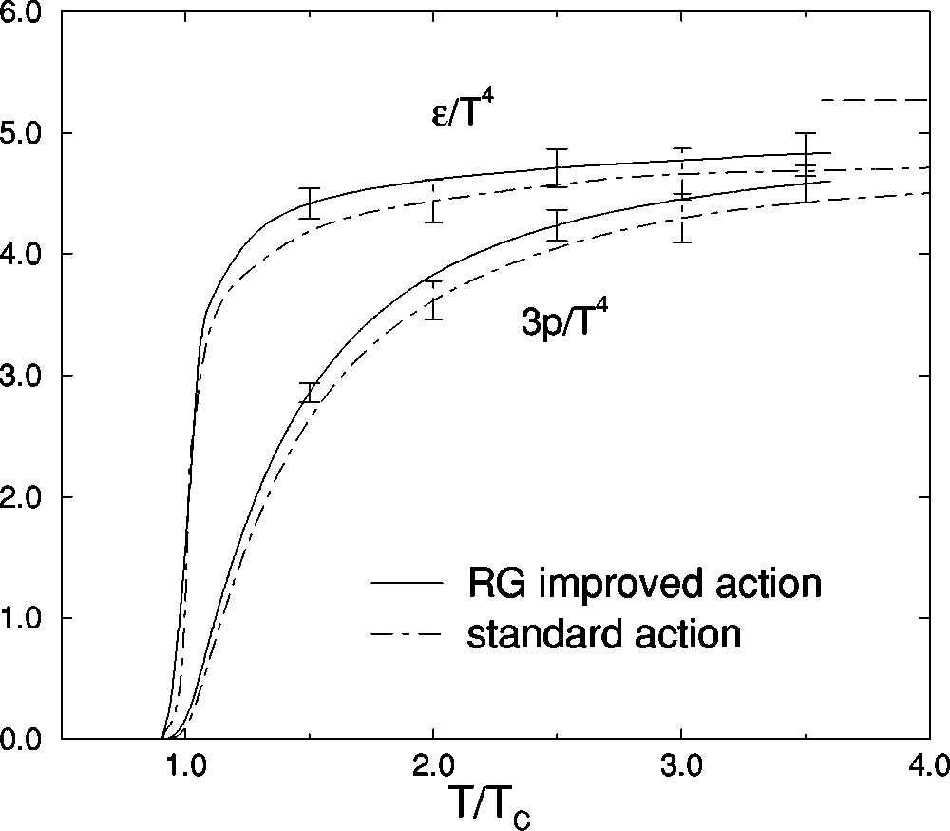
Equation of state and caloric curve in the lattice QCD: Phase transition
Pure SU(3) gauge theory
Two flavor QCD
CP-PACS Collab., M. Okamoto et al.,
Phys. Rev. D 60, 094510 (1999)
Frank Wilczek, Physics Today 53, 8, 22 (2000)

Slide 4
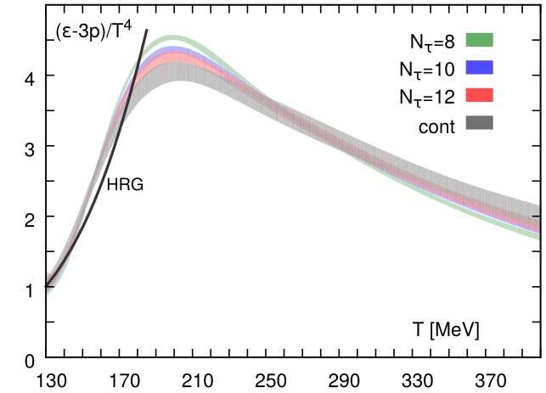
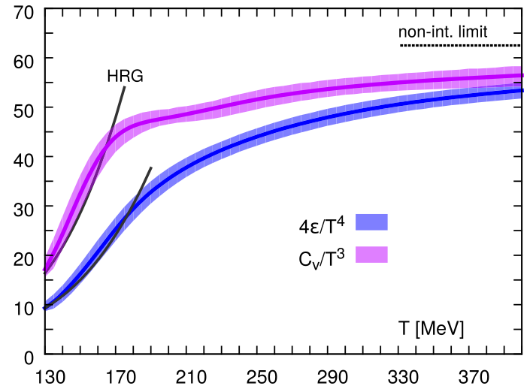
Quark-hadron duality in QCD: (2+1)-flavor QCD
EoS and Caloric curve
Trace anomaly
Heat capacity
Comparison of caloric curve, EoS, trace anomaly and
heat capacity of (2+1)-flavor lattice QCD with Hadron
resonance gas (HRG) model predictions (solid lines)
HotQCD Coll., A.Bazavov et. al., Phys. Rev. D 90, 094503 (2014)
(See also the talk of T. Steinert given at this Workshop)
HRG model: Relativistic ideal gas of mixture of hadrons from the total
PDG list in the grand canonical ensemble

Slide 5
The free real scalar field in a finite volume

Slide 6
Free real scalar field: Definitions
Lagrangian density:
Partition function:
Hamiltonian operator in the
Schrodinger representation:
Eigenfunctions and eigenvalues
of the field operator and its conjugate field operator in the Schrodinger representation :

Slide 7
The path integral method
Discretization of inverse temperature and spatial volume:
4-dimensional lattice:
One spatial dimension
Partition function in one spatial dimension:

Slide 8
Partition function in the one spatial dimension configuration space
Using the orthogonality and completeness relations, we obtain the partition function:
Matrix element:
Hamiltonian:
Chemical potential for the real scalar field:

Slide 9
Partition function in the one spatial dimension configuration space
Partition function:
Boundary conditions:
Partition function after integration over

Slide 10
Partition function in the one spatial dimension configuration space
Partition function in the bilinear form:
A.S.P., Physica A 496 (2018) 410
Symmetric square matrix A of size in the explicit form for real scalar field:

Slide 11
Momentum lattice space
4-dimensional momentum lattice space:
Some relations in the 4-dimensional momentum lattice space:

Slide 12
Partition function in the one spatial dimension momentum space
Using the discrete Fourier transform in one spatial dimension, we obtain the partition function in the momentum space:
A.S.P., Physica A 496 (2018) 410
Matrix of the bilinear form for the real scalar field:

Slide 13
Partition function in the one spatial dimension momentum space
Matrix of the bilinear form for the real scalar field:
A.S.P., Physica A 496 (2018) 410
- Matsubara
frequency
Partition function in the momentum space in 1-spatial dimension:

Slide 14
Lattice thermodynamic quantities in the momentum space
3-spatial dimensions
Generalization of the partition function to 3-spatial dimensions:
A.S.P., Physica A 496 (2018) 410
Relativistic lattice dispersion
relation
Density of thermodynamic potential, energy density and pressure in 3-spatial dimensions:
J.Engels, F.Karsch, H.Satz,
Nucl. Phys. B 205, 239 (1982),
A.S.P., Physica A 496 (2018) 410

Slide 15
One-Side Limit: 3-spatial dimensions
A.S.P., Physica A 496 (2018) 410
Energy density, vacuum term and physical term:
The lattice quantities in the one-side limit are divided
analytically into the sum of two terms: vacuum
and physical
The physical terms are the ideal gas of bosons
The vacuum terms are finite
Pressure, vacuum term and physical term:
Density of thermodynamic potential, vacuum term and physical term:

Slide 16
Continuum Limit: 3-spatial dimensions
Energy density, vacuum term and physical term:
A.S.P., Physica A 496 (2018) 410
The lattice quantities in the continuum limit are
the sum of two terms: vacuum and physical
The physical terms are the ideal gas of bosons in
a finite volume V
The vacuum terms are infinite
Pressure, vacuum term and physical term:
Density of thermodynamic potential, vacuum term and physical term:

Slide 17
Finite lattice: Vacuum and physical quantities
Vacuum terms on a finite lattice (summation over is changed to integration at T=0):
J.Engels, F.Karsch, H.Satz,
Nucl. Phys. B 205, 239 (1982)
Physical terms on a finite lattice:
A.S.P., Physica A 496 (2018) 410
Mean occupation
numbers on the lattice
The continuum limit is recovered!

Slide 18
Potential inhomogeneity and zeroth law of thermodynamics
I. Thermodynamic potential is a homogeneous function of the first order with respect to V (a linear function):
A.S.P., Physica A 496 (2018) 410
Zeroth law of
thermodynamics:
-condition
-additive
II. Thermodynamic potential is an inhomogeneous function with respect to V (not a linear function):
Zeroth law of
thermodynamics:
-condition
-nonadditive
If the thermodynamic potential is an inhomogeneous function with respect to V (not a linear function) then it is non-additive, potential inhomogeneity is not equal to zero and the zeroth law of thermodynamics is violated!

Slide 19
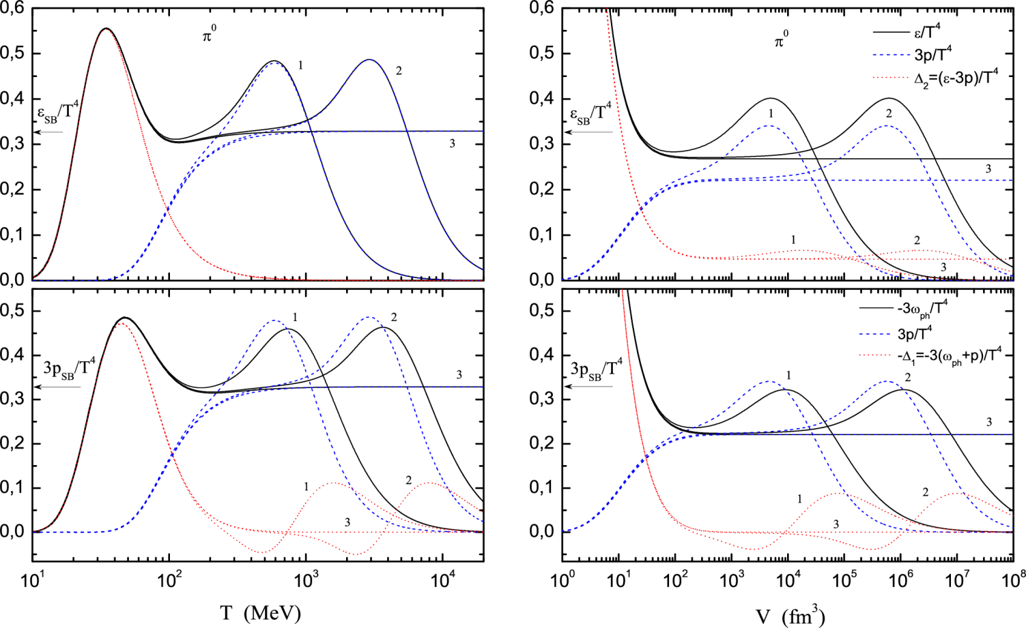
The exact lattice results for the massive scalar field
A.S.P., Physica A
496 (2018) 410
on the finite lattice. Thus, the real scalar field on the finite lattice is thermodynamically inconsistent.
The first maximum in energy density is due to the
zero-mode term. The second maximum is due to the finite lattice and disappears in the continuum limit.

Slide 20
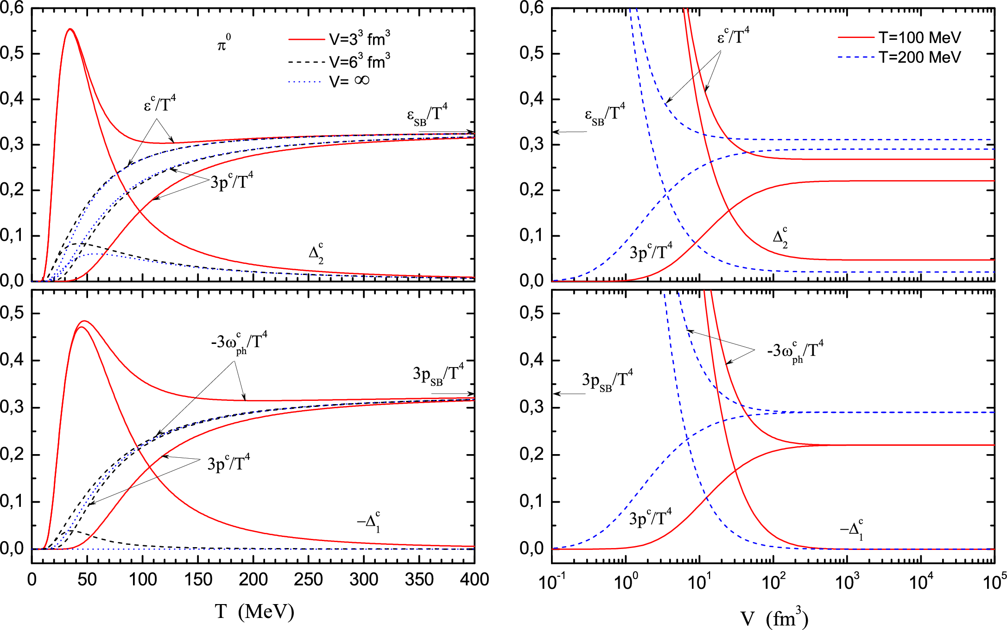
Continuum limit: Massive free real scalar field in a finite volume
A.S.P., Physica A
496 (2018) 410
The behavior of the caloric curve and EoS of the scalar real field (ideal gas) in a continuum limit in a finite volume V is qualitatively the same as in the lattice QCD!
The potential inhomogeneity decreases with increasing V. But it is not zero at small values of V. Thus, the real scalar field in the continuum limit at small values of V is thermodynamically inconsistent.

Slide 21
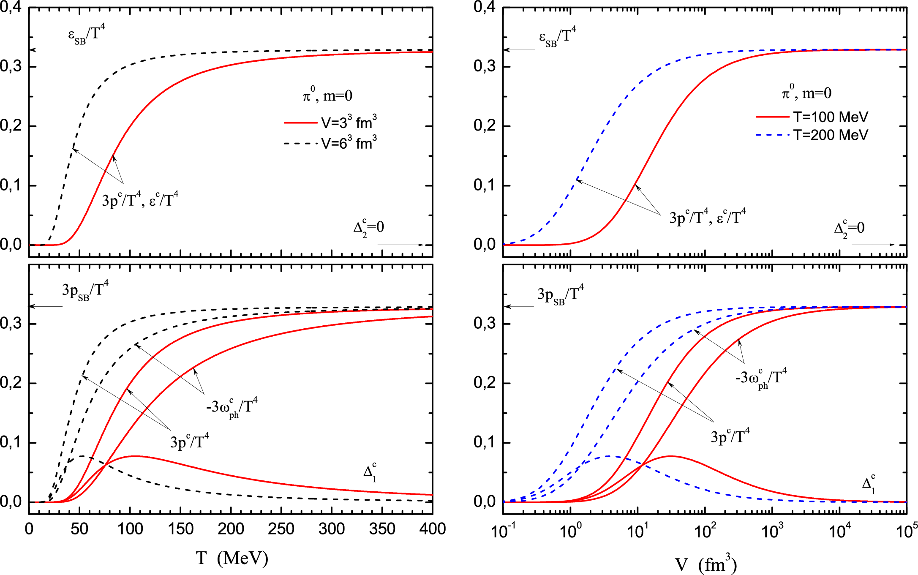
Continuum limit: Massless free real scalar field in a finite volume
(without zero-mode term)
A.S.P., Physica A
496 (2018) 410
The behavior of the energy density and pressure of the scalar real massless field (ideal gas) in a continuum limit in a finite volume V is qualitatively the same as in the lattice QCD. But for the massless ideal gas the pressure and energy density coinside.

Slide 22
The possible quark-hadron scaling duality (Preliminary results)

Slide 23
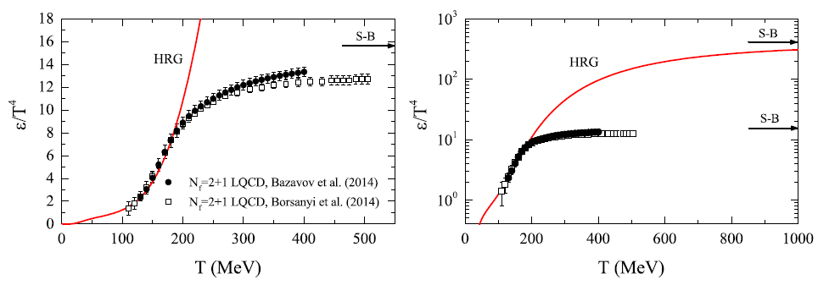
The (known) quark-hadron duality on the different scales
Small scale
Large scale
Preliminary
Preliminary
Comparison of the results of the Hadron Resonance Gas (HRG) model (solid line) and the (2+1)-flavor lattice QCD
Here, for HRG model: (PDG)
The region of the overlapping of the curves for for the
HRG model and LQCD at T<170 MeV is considered to describe the quark-hadron duality:
Let us see to this quark-hadron duality on a larger
scale. We see that the curves for for HRG model
and LQCD have the same behavior but on the different scales.
Each of them recover its Stefan-Boltzmann limit at very high temperatures
The difference between their Stefan-Boltzmann limit lies in the different number of types of particles and different degeneracy factors.
Therefore, to correctly compare them the curves should be scaled properly!
HotQCD Coll., A.Bazavov et. al., Phys. Rev. D 90, 094503 (2014),
A. Andronic, P. Braun-Munzinger, J. Stachelf, M. Winn, Phys. Lett. B 718 (2012) 80

Slide 24
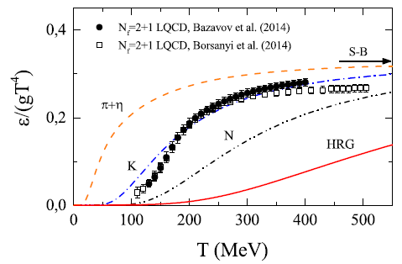
The scaled energy density: The quark-hadron scaling duality
Preliminary
The effective degeneracy factor of the
quarks and gluons:
where the factor 7/8 appears from the difference
of the Bose-Einstein and Fermi-Dirac statistics
The effective degeneracy factor of the
hadrons:
Let us divide the energy density of the HRG model and of
the lattice QCD to their effective degeneracy factors
In the scaled energy density the quark-hadron duality of the
HRG model totally disappear!
The scaled ideal gas of pions and the ideal gas of nucleons also do not describe the scaled results of LQCD.
But the scaled ideal gas of kaons agrees with the scaled results of LQCD! Namely, kaons and antikaons contain all the three quarks u,d,s and their antiquarks!
where is the spin-isospin
degeneracy factor of the (anti)mesons (i=M) and (anti)baryons (i=B)

Slide 25
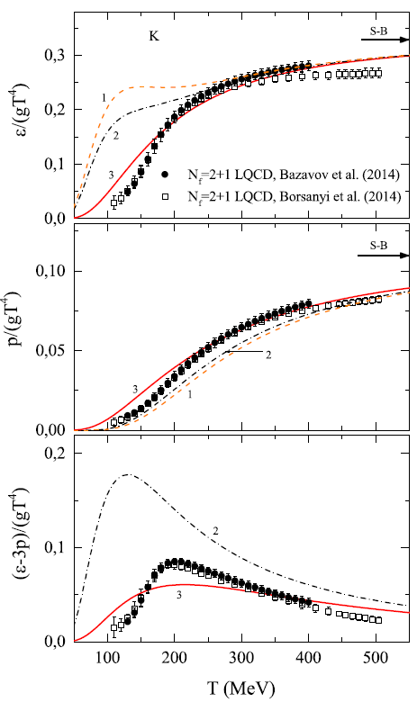
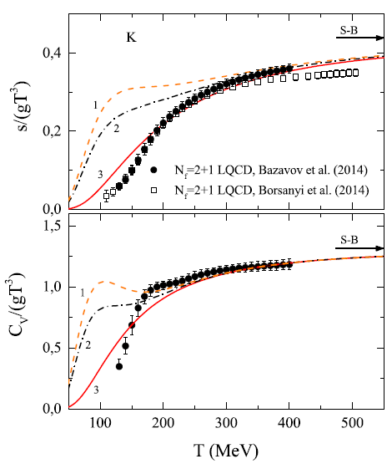
The quark-hadron scaling duality: Ideal gas of kaons vs (2+1)-flavor LQCD
Preliminary
Preliminary
Preliminary
Preliminary
Preliminary
Comparison of scaled quantities (energy density, pressure, trace anomaly, entropy density and heat capacity) of (2+1)-flavor lattice QCD with the ideal gas of kaons and antikaons predictions (lines)
In a finite volume V

Slide 26
Conclusions
The exact analytical lattice results for the partition function of the free neutral scalar field in one spatial dimension in both the configuration and the momentum space were obtained in the framework of the path integral method.
The symmetric square matrices of the bilinear forms on the vector space of fields in both configuration space and momentum space were found explicitly.
The thermodynamic properties and the finite volume corrections to the thermodynamic quantities of the free real scalar field were studied.
The possible manifestation of the quark-hadron scaling duality was found.
The scaled results of the ideal gas of kaons and antikaons describe very well the scaled data of (2+1)-flavor LQCD.

Slide 27
Thank you for your attention!

