Slide 1
Magnetohydrodynamics simulations,
flow, flow fluctuations, and vortices
Ajit M. Srivastava
Institute of Physics
Bhubaneswar, India
Collaborators:
Arpan Das, Shreyansh S. Dave (IOP, India)
Saumia P.S. (JINR, Dubna)

Slide 2
Outline:
Magnetic field in relativistic heavy-ion collision experiments.
Interdependence of magnetic field evolution and flow fluctuations
2 Enhancement of elliptic flow due to magnetic field, but
very complex interdependence. (different results in literature ?)
Possibility of larger η/s (not sQGP ?)
3. Relativistic Ideal Magnetohydrodynamics (RMHD) simulations:
Complex effects on v₂ , Transient increase of magnetic field
Power spectrum of flow fluctuations:
Qualitative patterns with magnetic field and with vortices
5. Deformed nuclei: Anomalous elliptic flow,
quadrupole magnetic field (beam focusing effects?)
6. New possibilities at FAIR,NICA? Vortex (superfluid phase,..)
Dynamo effect for magnetic field?
7. QCD transitions and Pulsars as sources and detectors of
Gravitational waves

Slide 3
Magnetic field in heavy-ion collisions:
Important physics to look for: Chiral magnetic effect, chiral
Vortical effect,……..
Magnetic field affects every aspect of flow: enhancement of v₂
Most important: Must find clean signal for the presence of
initial magnetic field. Qualitative patterns important due to
incomplete understanding of magnetic field evolution during
very early stages of evolution.
We start with discussion of effect of Magnetic Field on v₂ :
We earlier pointed out that initial magnetic field can enhance
elliptic flow (Mohapatra, Saumia, AMS, MPLA 26, 2477 (2011)).
Similar enhancement confirmed by Tuchin: J.Phys.G39, 025010(2012)
Later simulations: no effect found: Inghirami et al: arXiv:1609.03042
Important to understand these discrepancies
Will show results of our present simulations

Slide 4
Complex factors affect elliptic flow (in fact, every aspect of flow)
in the presence of magnetic field:
Briefly recall basic physics of our original argument:
In presence of magnetic field, there are different types of waves in the plasma. Fast magnetosonic waves: Generalized sound waves with significant contributions from the magnetic pressure.
Basically, distortions of magnetic field in transverse direction
costs energy, equation of state stiffer in that direction
Expect larger sound speed in transverse direction.
Flow velocity proportional to c_{s}²
So we argued: Flow in x direction
will be enhanced, while in y direction will not change:
Conclusion was: B increases v₂ .

Slide 5
However, the physics of this is not that simple.
Other factors can be present.
For example, it is known that under certain situations, expansion of a conducting plasma into regions of magnetic field gets hindered.
One can expect it from Lenz’s law: expanding conductor squeezes magnetic flux, which should oppose expansion of plasma (cause of squeezing). Such an argument will imply suppression of v₂ due to B. This will be expected when magnetic field extends well beyond
plasma region.
However, this is also not correct, as this completely misses the
factor of distortion of magnetic field costing energy (which was
the argument we used in our paper arguing for increase of v₂ .)
We can expect that to hold true when magnetic field is entirely
contained inside plasma region.
In general, all such factors are present. As we will see later, in some situation one factor will dominate, while in another, the other factor. Along with these two factors, fluctuations also play important role. Final effect is a combination of all these factors.

Slide 6
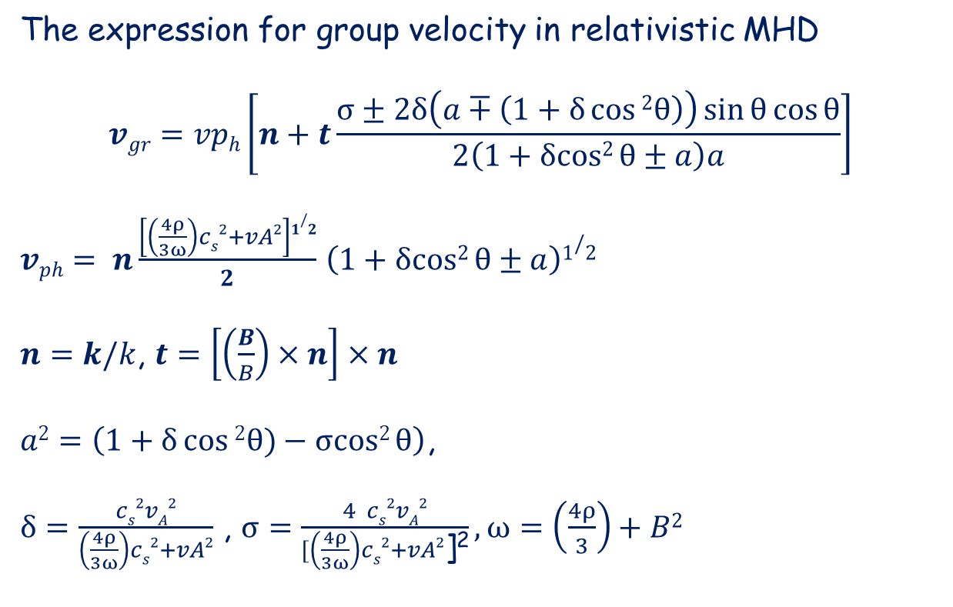
First we note: very complex flow patterns can develop due to
magnetic field when fluctuations are also present.
B
n
v_{gr}
θ
x
t
Note: Direction of group velocity depends on the coefficient of t above, which depends on local pressure (for a given B). Thus: with pressure variations, direction keeps changing: Very complex flow pattern
(May lead to generation of vortices due to strong fluctuations).

Slide 7
Relativistic Magneto-Hydrodynamics Simulations:
Arpan Das, Shreyansh S. Dave, Saumia P.S., AMS, PRC 96, 034902 (2017)
We do not discuss the issue of survival of magnetic field in the
plasma. Due to conductivity (Tuchin) magnetic field does not
decay very rapidly in the plasma, field diffusion time at least
several fm.
We take an initial value of the field, at a given time after the collision, calculated by taking uniformly charged nuclei (spherical
or ellipsoidal for deformed case), and Lorentz transforming for oppositely moving nuclei with required impact parameter.
We carry out 3+1 dimensional simulation using Glauber-like initial
conditions for QGP, with profile in z-direction being Woods-Saxon
with appropriate size. We work in the limit of infinite conductivity:
so use equations of Ideal Relativistic MHD:
We follow formalism from:
Mignone and Bodo, Mon. Not. R. Astron. Soc. (2005)
We first give a brief summary of the formalism:

Slide 8
Conservation of total energy-momentum tensor (perfect fluid
QGP + magnetic field):
Maxwell’s equations:
Where:
and:

Slide 9
For simulation, these equations are cast in the following form
Where different quantities are defined as:
(F^{y,z} are similarly defined by appropriate change of indices)
Note: From U at each stage, independent variables
have to be extracted.

Slide 10
Are extracted by defining:
And writing
These equations are written eventually as a single equation for one unknown W (by rewriting equation for |m|² :
This equation is solved using Newton-Raphson method to get
W, from which other independent variables are obtained using above equations.

Slide 11
Limitations of the simulation:
Due to computer limitations, we use small lattice (200x200x200)
so small nuclei used (copper), also for small times only
up to maximum of 3 fm time, sometime much shorter time.
We use smaller energy CMS energy of 20 GeV, for very large
energies magnetic field becomes very large near receding
nuclei (it is 3+1 dimensional simulation), causing problem
With fluctuations difficult to run for long times.
General problem when magnetic field energy density becomes
much larger than the plasma density.
Same problem was found in other simulation also (Inghrami et al.
where no effect on v₂ was found)
For elliptic flow, we have studied details of the dependence of
elliptic flow on magnetic field, and it seems to crucially depend
on the relative profiles of B and plasma density.
We first present these results

Slide 12
Result-1: Elliptic flow in the presence of magnetic field:
We see that magnetic field enhances v₂ , but only up to impact parameter of about 6 fm, after that B suppresses it. Also
Enhancement increases for small impact parameter. Why?

Slide 13
Note: Magnetic field almost monotonically increases with
impact parameter.

Slide 14
Elliptic flow with and without magnetic field:
We see that magnetic field enhances v₂ for small impact
Parameters, then enhancement decrease. Eventually, magnetic field suppresses elliptic flow.

Slide 15
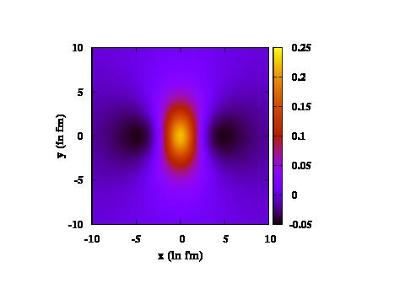
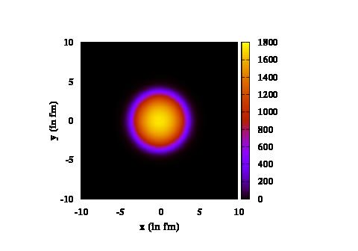
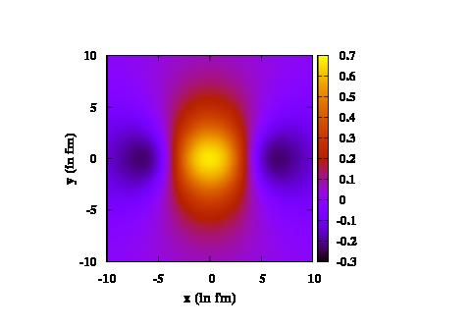
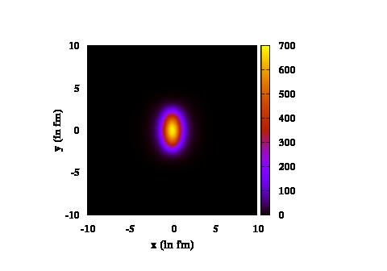
Magnetic field plots (top) and plasma density plots (bottom)
for small 1 fm (left) and large 7 fm (right) impact parameter
Left: B contained entirely within
plasma region, expect enhanced v₂
from anisotropic sound speed
Right: B extends well outside plasma region, expect v₂ suppression from flux squeezing (Lenz’s law)

Slide 16
Summary of results for effect of magnetic field on elliptic flow:
If magnetic field is contained almost entirely within the plasma region,
then elliptic flow is enhanced with increasing magnetic field. This
happens for small values of the impact parameter.
This is in accordance with the original argument of having a stiffer equation of state transverse to magnetic field direction.
However, if the magnetic field extends well beyond the plasma region,
then elliptic flow is suppressed by the magnetic field. This will be in
accordance with the Lenz’s law. This happens when impact parameter is large.
Note: The simulations of Inghirami et al. (arXiv:1609.03042 ) was
for large impact parameter, hence may have been affected by this
Lenz’s law suppression.
Important to check that simulation for small values of impact parameters.

Slide 17
Result-2: Temporary increase of magnetic field due to
flux-rearrangement by evolving plasma density fluctuations
Evolving fluctuations can push around flux lines, leading to
temporary, localized concentration of flux.
Important for chiral magnetic effect which is sensitive to local
magnetic field (instanton size regions). We could only study
small fluctuations, for large fluctuations effect can be stronger

Slide 18
Power spectrum of flow fluctuations:
First: brief review
Mishra, Mohapatra, Saumia, AMS, PRC77, 064902 (2008); 81, 034903(2009)
Inhomogeneities of all scales present, even in central collisions: Arising from initial state fluctuations
These anisotropies were known earlier, however, they were only
discussed in the context of determination of the eccentricity for elliptic flow calculations. Early discussions only for V₂, V₄, V₆
We argued that due to these initial state fluctuations all flow
coefficients will be non-zero in general:
All Fourier coefficients V_{n} are of interest (say, n=1 to 30 -40,
including Odd harmonics, these were never discussed earlier.
We emphasized: Learn from CMBR power spectrum analysis: Calculate root-mean-square values of V_{n} ,
and NOT their average values.

Slide 19
For central events average values of flow coefficients will be zero
(same is true even for non-central events if a coordinate frame with fixed orientation in laboratory system is used).
Following CMBR analysis,we proposed to calculate root-mean-square values of these flow coefficients using a lab fixed coordinate system,
And plot it for a large range of values of n = 1, 30-40
These values will be generally non-zero for even very large n
and will carry important information .
Conclusion: Plot power spectrum for V_{n} for entire range of
values of n. The whole plot will have information about
Early stages of fluctuations and plasma evolution.

Slide 20
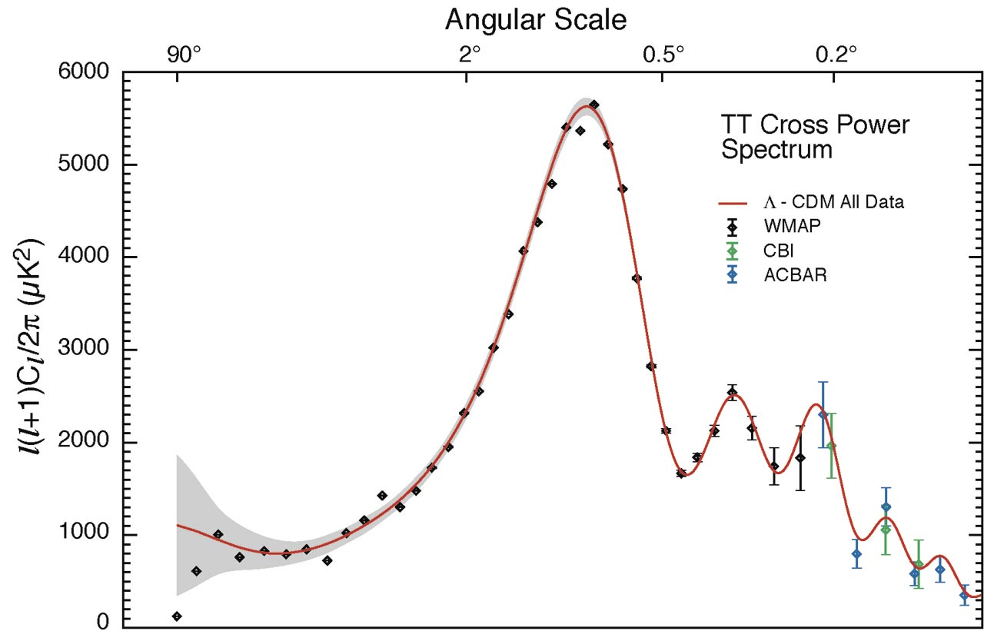
Recall: Acoustic peaks in CMBR anisotropy power spectrum
Solid curve:
Prediction from
inflation
Can such a power spectrum be expected for heavy-ion collisions ?
So far we discussed: Plot of for large values of n
will give important information about initial density fluctuations.
We now discuss: Such a plot may also reveal non-trivial structure
like acoustic peaks for CMBR as above.

Slide 21
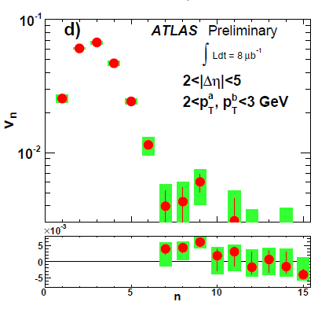
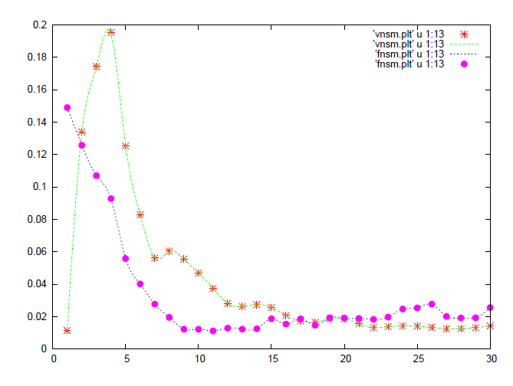
Focus on dip
for low n below
First peak
Relativistic Hydrodynamics
Simulations: (Saumia P.S.,
AMS, Mod. Phys. Lett. A31,
1650197 (2016))
Power spectrum of
momentum anisotropies
Power spectrum of
spatial anisotropies
Very important to understand
suppression of low n
Harmonics. It contains
information about freezeout
horizon size

Slide 22
Result-3: Effect of
Magnetic field on
power spectrum
Top: small magnetic field: 0.1 – 0.4 m_{π}² .
Very tiny effect
Strong magnetic field 5 m_{π}² .
Significant effect, note first
few flow coefficients show some
even-odd power difference.
Here magnetic field put in by hand (also taken constant along
Y direction for stable simulation,
for Gauss’ law)

Slide 23
Much stronger magnetic field:
15 m_{π}² . Very clear even-odd power difference. Qualitative
in nature. Arises from reflection
symmetry about the axis of
magnetic field, so clear effect only when B dominates over random fluctuations.
(important implications for low l
modes of CMBR power spectrum)
To show that fluctuations mask this signal we show power
spectrum in the presence of small magnetic field (1 m_{π}² ),
but in the absence of any initial
state fluctuations. Note: even-odd effect still very strong.

Slide 24
Result-4: New possibilities with deformed nucleus
different collision geometries will lead to anomalous elliptic flow:
At present: we represent these situations by producing QGP region and magnetic field independently using suitable impact parameters,
and then combine the two profiles as per our choice.
First consider: Elliptical plasma region, but magnetic field induces larger flow along semi-minor axis of the ellipse,
This should suppress v₂ .(for B contained within plasma region)
Expect: larger flow along x axis from pressure gradient. Usual Elliptic flow.
But B along x axis gives stiffer eqn. of state along y axis: This should give larger flow along y axis.
Result: suppression of elliptic flow along x axis. For strong magnetic field case, it can lead to negative elliptic flow.

Slide 25
Simulation result:
Suppression of v₂ due to magnetic field
pointing along x axis (semi-minor axis).
Full simulation for deformed nuclei:
In progress

Slide 26
Another interesting possibility:
Isotropic QGP region but B gives rise to significant
non-zero elliptic flow, even without any fluctuations.
May provide a good signal for presence of initial
magnetic field
Note: non-zero magnetic field arising from spectators, even when QGP region is roughly isotropic.
This magnetic field induces non-zero elliptic flow

Slide 27
Isotropic QGP region, but non-zero v₂ due
B, which increases monotonically with B.

Slide 28
A very interesting possibility: Crossed-configuration for
deformed (Uranium) nuclei. Produced magnetic field is
quadrupolar.
Expect phenomena arising from beam focusing (along
longitudinal direction), along with very large v₄ .
Deviations from Bjorken scaling?
Under investigation at present.

Slide 29
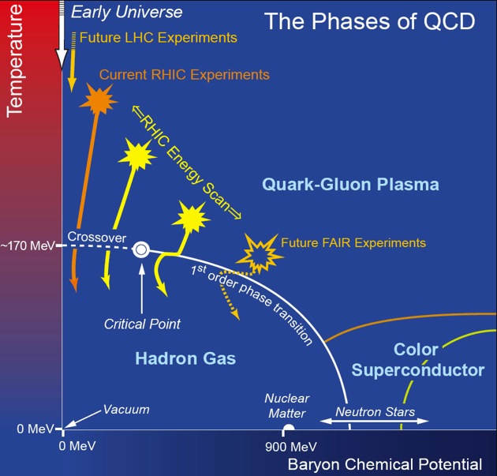
High baryon density phases and vorticity
Recall: QCD
Phase diagram
High density transition to exotic phases: superfluidity: Vortices
Note: Possibility of Nucleon superfluidity for low energy collisions ?
Qualitative effects on the power spectrum, clean signal of vorticities.

Slide 30
Nucleon superfluid vortices play crucial role in understanding
of pulsar glitches. Only theoretically investigated so far
Proposal: Very low energy collisions of neutron rich nuclei
(possibly superheavy, near neutron dripline) may create
bulk phase of nucleon superfluidity.
Possible at FAIR and NICA
Then our signals can establish nucleon superfluid vortices and
investigate their properties under direct experimental control.
Very important for understanding of neutron star properties.
We have carried out UrQMD simulations: Possible to get temperatures of few MeV for nucleonic system for 1 GeV beam energy collision (U-U).
Smaller temperature will be better
Nucleon superfluid transition temperautre: 0.2 MeV to 5 Mev
Arpan Das, Shreyansh Dave, Somnath De, AMS, MPLA 32, 1750170 (2017)

Slide 31
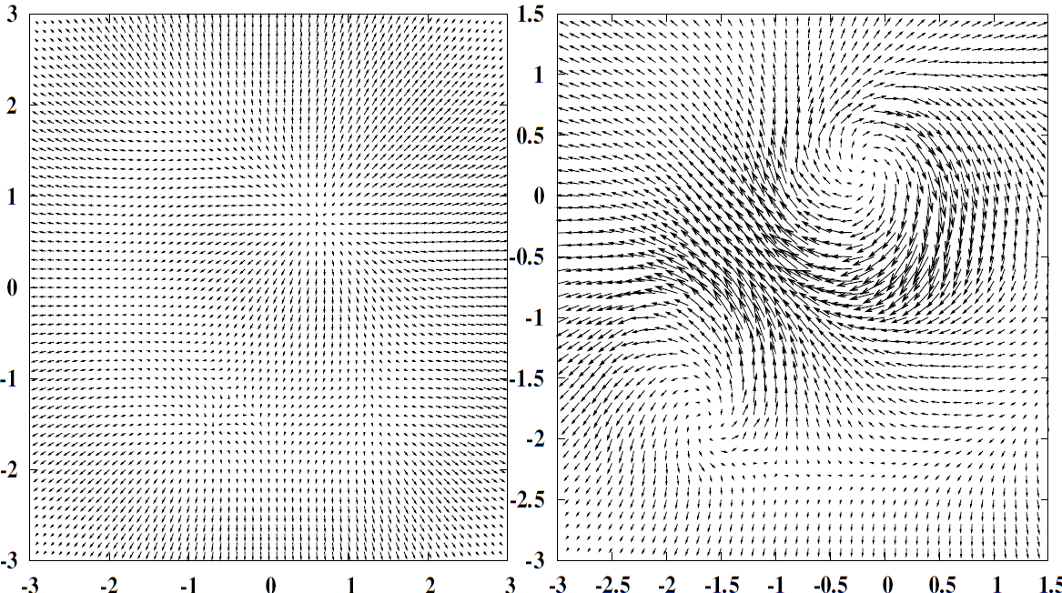
Results of relativistic hydrodynamics simulations with two-fluid
picture of superfluid (normal component and superfluid component)
Qualitatively different features of flow pattern and power spectrum
Signalling superfluid transition
Velocity profile at central rapidity without (left) and
With (right) vortices: τ–τ₀ = 0.84 fm/c

Slide 32
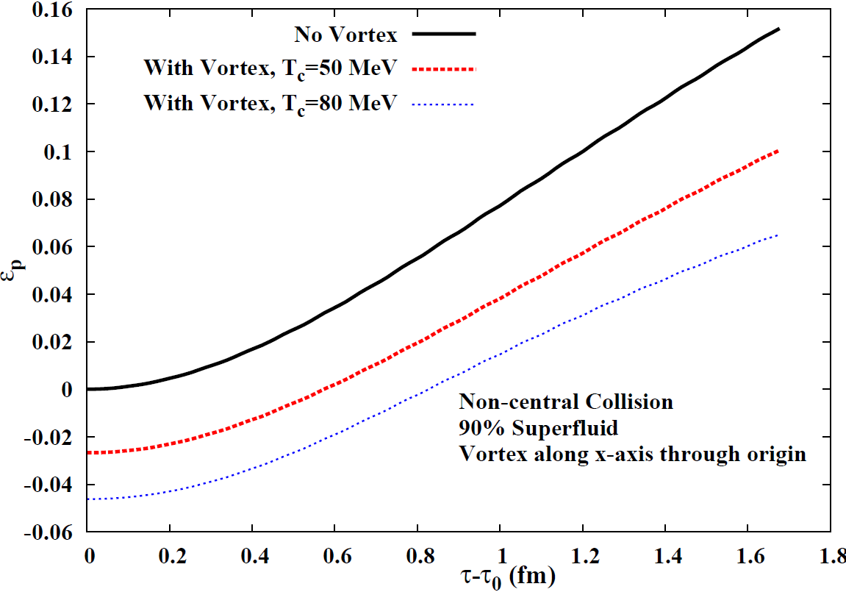
Strong negative elliptic flow due to vortices
T=25 MeV
ξ = 0.7 fm,v₀=0.3
ξ = 0.4 fm,v₀=0.5

Slide 33
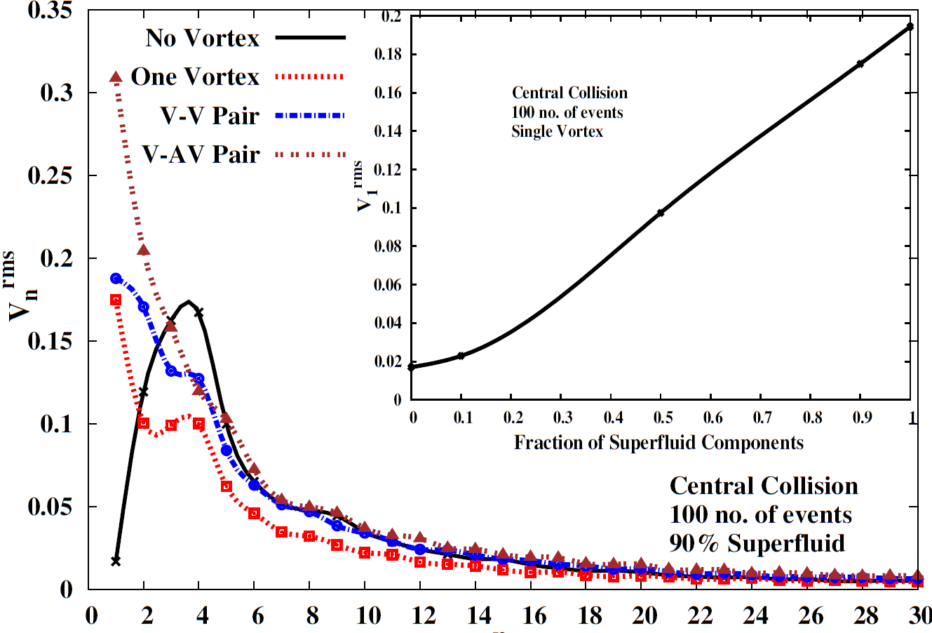
Strong directed flow in the presence of vortices

Slide 34
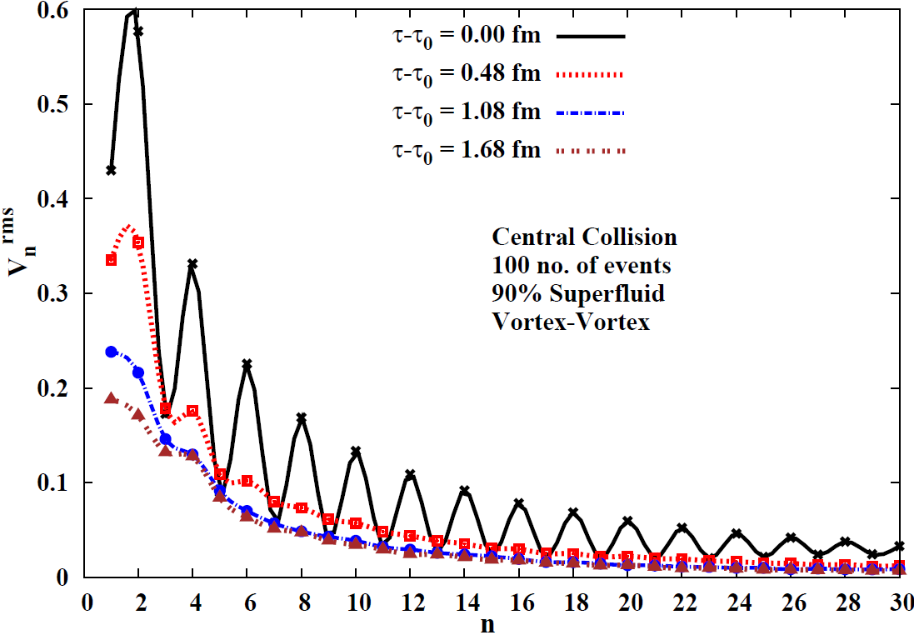
In certain cases: different powers in even-odd harmonics in
The presence of vortices during initial stages: Could be probed by
Thermal photon elliptic flow, or peripheral collisions

Slide 35
Dynamo effect ?
With Superfluid vortices at FAIR and NICA:
(Arpan Das, Shreyansh S. Dave, AMS: arXiv: 1607.00480)
This can lead to remarkable possibilities:
Vortices (turbulence) are known to strongly increase magnetic field, the so-called Dynamo effect.
We studied evolution of magnetic field in the presence of
vortex configuration (as per our above paper).
We see strong increase in the magnetic field in the presence of
vortices.
Note: Dynamo effect for ideal MHD may be possible in strong
flux-folding regime as expected in the presence of vortices.

Slide 36
Central magnetic field evolution in presence of vortices
(Cu-Cu, impact parameter 2 fm).

Slide 37
Signals from Neutron stars (Partha Bagchi, Arpan Das,
Biswanath Layek, AMS, PLB, 747, 120 (2015))
Phase transitions and density fluctuations:
Density fluctuations inevitably arise during phase transitions:
First order transition: random bubble nucleations lead to density
fluctuations, with typical distance scales of inter-bubble separation
Second order transition, or smooth cross-over:
Density fluctuations with size scale of correlation domains, scale invariant density fluctuations in critical regime
In any transition/cross-over: large scale density fluctuations
inevitably arise if topological defects are produced
If density fluctuations arise in the core of a pulsar, it will affect
its moment of inertia (MI) and quadrupole moment Q:
Can be detected by precision measurements of pulse shape/timing
Implications of phase transition in the pulsar core:
Rapid changes in Pulsar timings and Gravitational waves

Slide 38
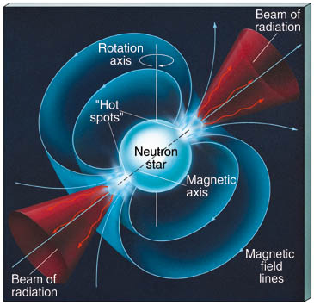
Transient changes in the off-diagonal components of MI and Q
These are distinctive predictions of our model. Changes in
Off-diagonal components will lead to wobbling of
star (on top of any present initially).
This will lead to modulation of pulse intensity
as the direction of radiation emission wobbles.
Thus, our model predicts that in association with
rapid changes in pulsar timings, there should
be modulation in pulse intensities.
This is distinctive prediction of our model. Vortex
de-pinning model cannot lead to off-diagonal components of MI
(all vortices point along the rotation axis).

Slide 39
Rapid changes in quadrupole moment Q will lead to gravitational waves.
Note: small value of Q/I arising from density fluctuations
(about 10⁻¹⁰) is more than compensated by the very short time
scale of microseconds.
Gravitational wave power ~
Fastest time scale for conventional mechanism of gravitational wave
emission is milliseconds (from rotation), with Q/I of order 1/1000.
Here Q/I is about 10⁻¹⁰, but time scale is at most microseconds.
In fact, for topological defect induced density fluctuations, the
time scale can be much shorter as defect network coarsens very
fast.
Thus density fluctuations arising during phase transitions in
compact astrophysical objects, like neutron stars, may provide
a new source of gravitational radiation.

Slide 40
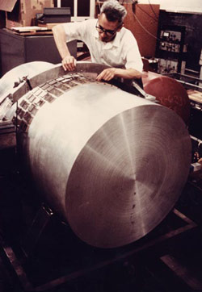
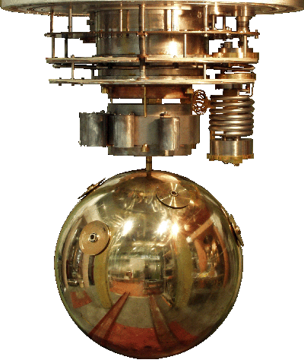
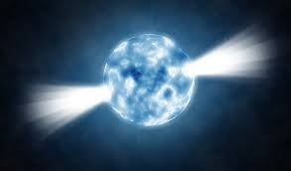
Present work: Pulsars as Weber gravitational wave detectors:
(Arpan das, Shreyansh Dave, Oindrila Ganguly, AMS, arXiv:1804.00453)
A gravitational wave passing through a pulsar will lead to a variation in the moment of inertia of the pulsar affecting its rotation.
This will affect the extremely accurately measured spin rate of the pulsar as well as its pulse profile (depending on source direction).
The effect will be most pronounced at resonance depending on EOS, (tidal deformability etc.) and should be detectable by accurate observations of the pulsar signal.
The pulsar, thus, acts as a remotely stationed Weber detector
of gravitational waves whose signal can be monitored on earth.

Slide 41
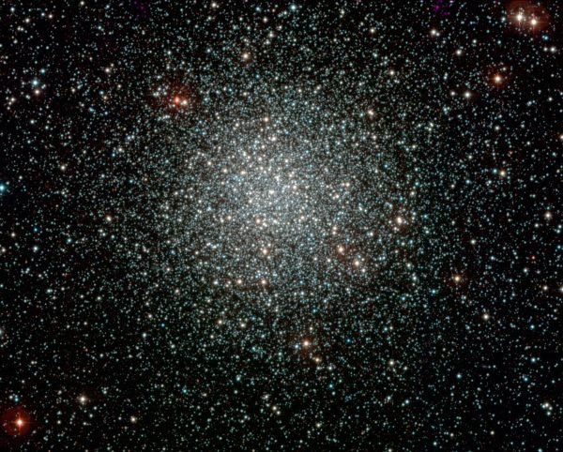
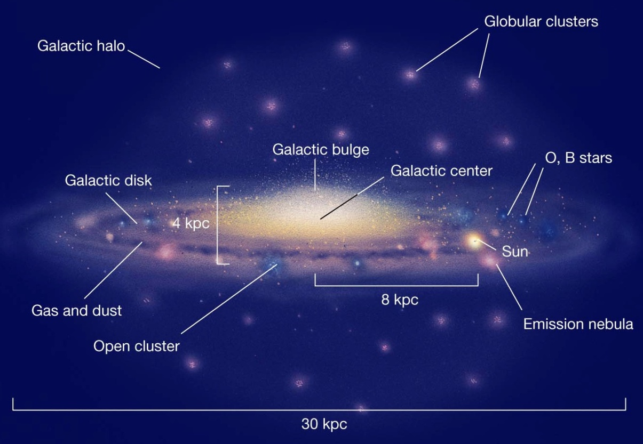
Pulsars in the neighborhood of GW sources can provide us a
family of remote detectors all of which can be monitored on earth
GW source:
e.g. neutron
star merger
A globular cluster
Milky Way
Pulse with
GW imprint
Pulsar
detector

Slide 42
Gravitational wave can be directly detected by earth based detectors
Even then: Such pulsar detectors can provide additional
information for accurate determination of the source location.
This can be of crucial importance for sources which do not emit any other form of radiation such as black hole mergers.
For recently detected GW sources, one should monitor appropriate
Pulsars whose perturbed signal will reach us in near future.
Information of EOS etc. for pulsars (determining resonant modes)
Far away
GW source
Denotes locations of Pulsar detectors which will detect GW at different times.
Combined with earth
Based GW detection, this can help in determining
location of GW source

Slide 43
Conclusions:
Very important to study evolution of magnetic field in the presence
of fluctuations. Can give clean signals of the presence of magnetic
field.
Fluctuations get strongly affected (elliptic flow, Power spectrum)
due to magnetic field.
At the same time, fluctuations can feed into magnetic field,
increasing it temporarily.
High baryon density phases may lead to vortex production:
With vortex induced turbulence, one may get dynamo like effect
(exciting possibilities for FAIR and NICA).
Deformed nuclei open up new possibilities: Anomalous elliptic flow,
quadrupolar magnetic field may lead to beam focusing effects,
suppressing transverse expansion (and also, deviation from
Bjorken scaling) in the longitudinal direction.
Interesting possibilities of detecting QCD phase transitions
From Pulsar observations (effects of density fluctuations)

Slide 44
Thank You

