Slide 1
Design of Automation Systems for Experimental Facilities
Task 2 (Architecture, functional decomposition)

Slide 2
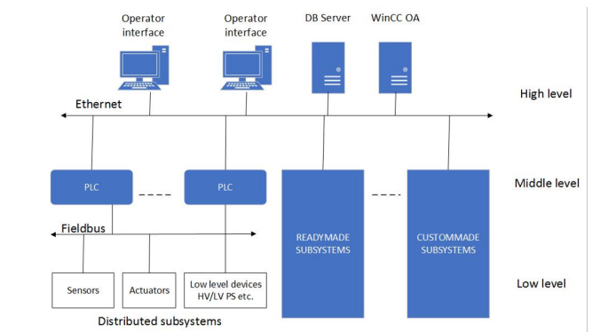

SPD
High Level
To provide human-machine interface for operators, communicate with the external world(accelerators)
Middle Level
Represented by programmable logic controllers and integrated ready-made and custom-made subsystems
Low Level
Includes measurement channels built into the front end electronics and DAQ of the detector part, I/O devices, and low and high voltage power supplies

Slide 3
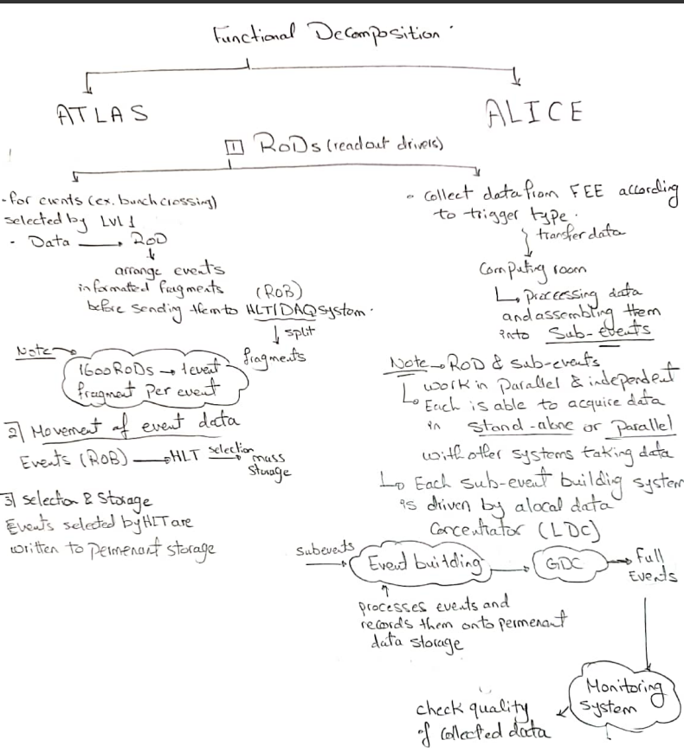

Slide 4
Valuable Insights from ALICE that can be beneficial to use in SPD
1
2
Vertexing and Tracking Techniques:
ALICE’s Inner Tracking System (ITS) and Time Projection Chamber (TPC) provide tracking and vertexing information.
SPD can adopt similar techniques for efficient track reconstruction and vertex determination.
Taking advantage of the ITS-like silicon pixel sensors in the SPD can enhance its tracking capabilities.
Global Tracking Strategy:
ALICE employs a global tracking approach by combining information from multiple detectors.
SPD can benefit from a similar strategy to improve overall tracking efficiency.
Collaborating with other detectors (such as the TPC) during track reconstruction can enhance the SPD’s performance.

Slide 5
3
4
Particle Identification (PID):
ALICE’s TPC plays a vital role in PID by measuring particle momentum.
The SPD can explore similar techniques for particle identification.
Investigate how the SPD can differentiate between different particle species based on their energy loss and momentum.
V0-Decay Reconstruction:
ALICE’s V0-decay reconstruction using TPC tracks is important for identifying particles.
SPD can adapt similar algorithms to identify particles produced in spin physics processes.

