Slide 1
ALICE subsistems
By Alexandru Culicov

Slide 2
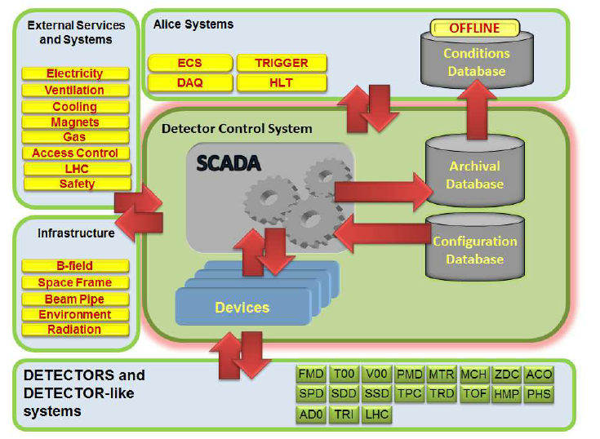
Overview and Operational Modes of ALICE DCS
Let's start with an introduction to the ALICE detector control system, which plays a key role in integrating more than ten different detectors, each utilizing unique technologies and operational conditions. The primary goal of the DCS is to ensure coordinated operation and control across all subsystems.

Slide 3
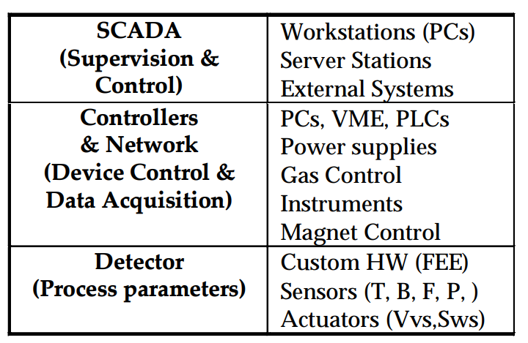
Detailed Architecture of ALICE DCS
Next, we will delve into the detailed architecture of the detector control system, emphasizing its importance for achieving modularity, scalability, and distributed intelligence. The description of each layer: The process layer includes field instrumentation, such as sensors and actuators, adapted to meet the needs of individual detectors. The control layer consists of multi-purpose control computers or PLCs, which manage the complex network of field instrumentation and ensure precise operation. The supervisory layer includes workstations that manage configuration data, control alarms, log activities, and facilitate communication and data exchange throughout the experiment. I will conclude the overview by emphasizing the strategic importance of this architecture for providing a unified and efficient control environment for the experiment.

Slide 4
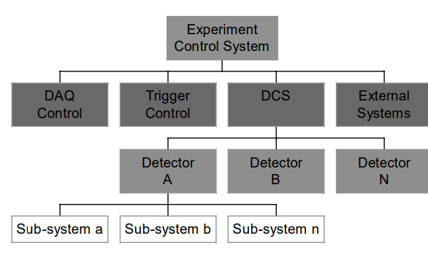
Communication and Software Integration in ALICE DCS
Let's move on to the communication infrastructure underlying the ALICE DCS and examine how it ensures reliable and secure data exchange and remote access capabilities. We will detail the various communication layers and protocols used, such as LAN, TCP/IP, and fieldbuses, and their role in supporting the DCS. Then, we will discuss the aspect of software integration, focusing on the use of industry standards such as OPC for interoperability and flexibility, and how this software layer facilitates connections between various control equipment, SCADA systems, and user interfaces, ensuring a responsive and adaptable control system.

Slide 5
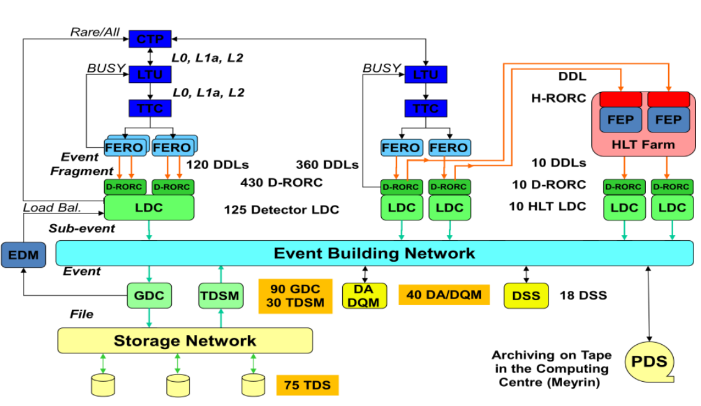
Architecture of ALICE Online Systems
ALICE includes five online systems that provide integration and management of various aspects of the experiment. The Central Trigger Processor (CTP) manages data readout decisions from the sub-detectors, the High-Level Trigger (HLT) provides a data filtering mechanism, and the Data Acquisition system (DAQ) manages the data flow from the detector to permanent data storage. The Detector Control System (DCS) controls the sub-detectors and their services, while the Experiment Control System (ECS) provides a simplified view of this complex experiment to the personnel

Slide 6
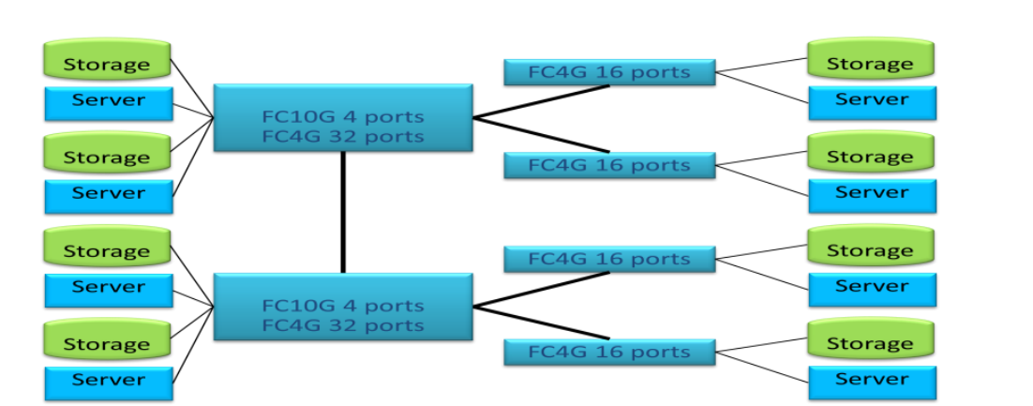
ALICE DAQ Local Data Storage
One of the unique features of the ALICE DAQ system is its high bandwidth and local data storage located at the experimental site, providing several hours of data storage autonomy. The storage is organized around a storage network based on a Fibre Channel Storage Area Network that connects servers and storage devices. A commercial file system is used to provide consistent access to all storage devices

Slide 7
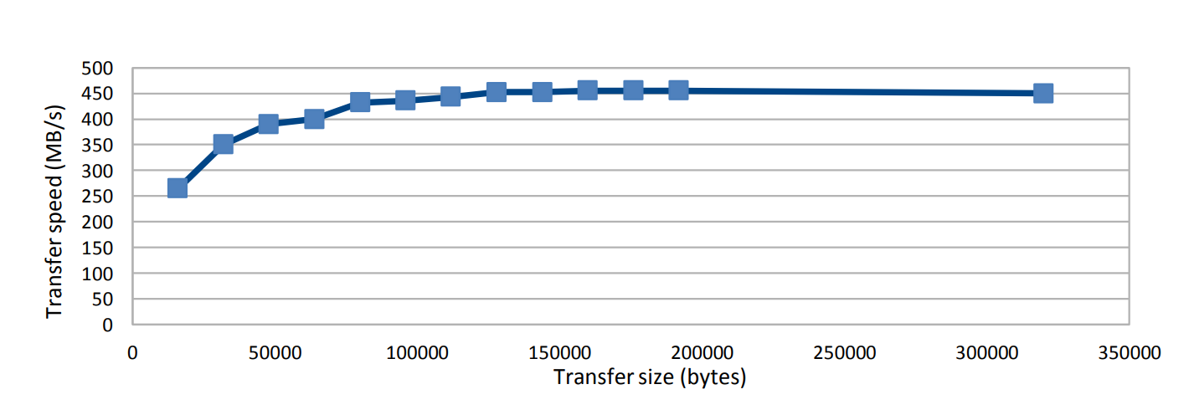
Experiment Upgrade and Data Readout System
Different upgrades are considered for the ALICE detector, which may include modifications or the creation of a new Inner Tracking System (ITS), the addition of a Forward Calorimeter (FOCAL), or a Very High Momentum Particle Identification system (VHMPID). These upgrades will require new data readout solutions, and the DAQ team has already started research and development to propose new solutions and upgrade the DAQ system itself.

Slide 8
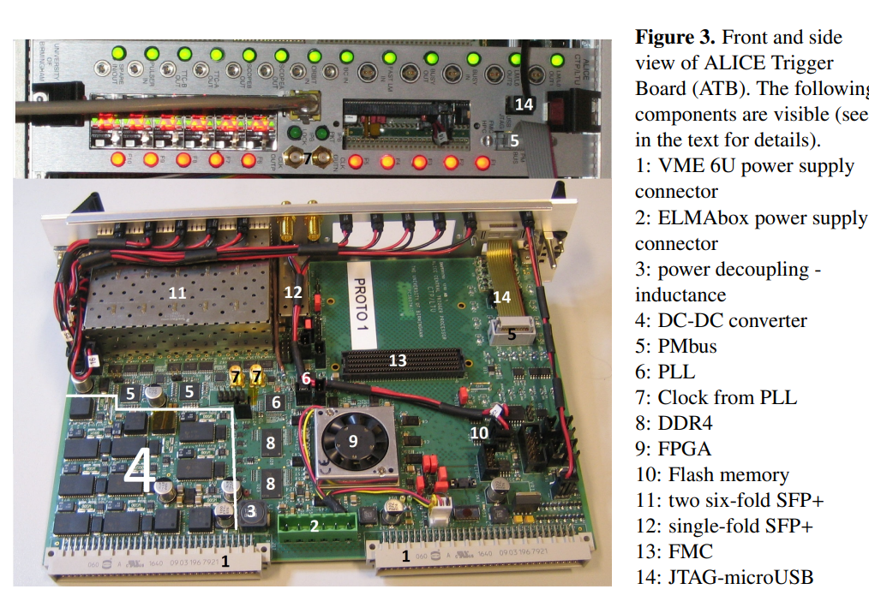
Overview of ALICE Central Trigger System (CTS)
The ALICE experiment is undergoing a significant update to adapt to high-speed data collection during LHC Run 3, significantly increasing interaction rates. A new Central Trigger System (CTS) is being introduced, utilizing advanced technologies such as Passive Optical Network (PON) and GigaBit Transceiver (GBT). This update allows ALICE to transition to a continuous data readout system, eliminating the need for hardware trigger selection and enabling real-time data processing. This slide details the motivations for the CTS update, its key components, and the expected improvements in data collection capabilities.

Slide 9
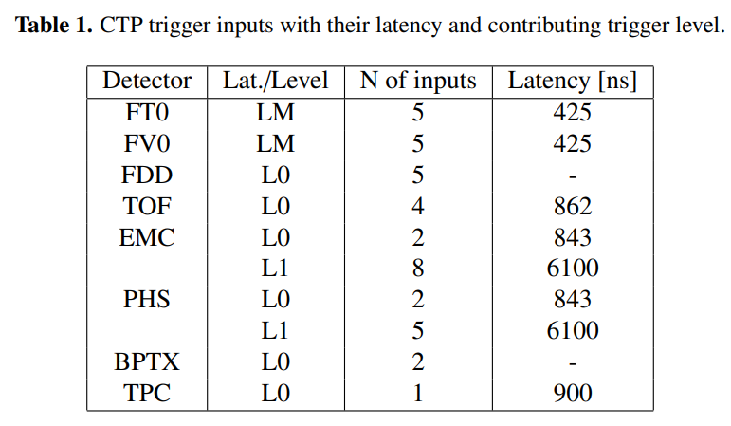
Time and Trigger Distribution in ALICE
With ALICE's transition to continuous data readout, a new approach to time and trigger distribution is introduced, corresponding to the increased interaction rates for different types of collisions. This new methodology requires sophisticated synchronization between ALICE detectors, ensuring accurate data correlation. This slide explores the complex trigger distribution mechanisms, the role of software filters in data selection, and how ALICE manages this transition, emphasizing seamless integration of continuous and trigger readout modes to maximize data integrity and efficiency.

Slide 10
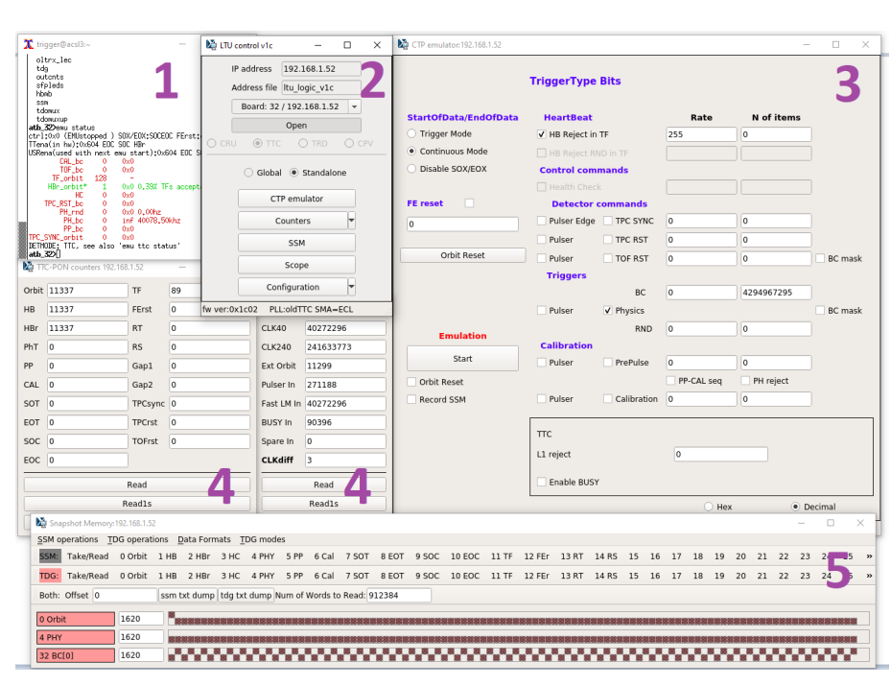
Technical Implementation of CTS and ALICE Trigger Board
In the new Central Trigger System, advanced trigger protocols and transceivers are utilized, including the development of the ALICE Trigger Board (ATB), which is a key component of the system. Based on Xilinx FPGA, ATB provides the flexibility and power needed for trigger processing and time stamping. The system supports two modes of operation, ensuring compatibility with both modern and legacy detectors. With respect to the further development of CTS, emphasis is placed on integration with the overall ALICE data readout infrastructure, anticipating improvements and adaptations necessary to maintain ALICE's leadership in high-energy physics research.

Slide 11
THANK YOU!

