Slide 1
Field Theoretic Renormalization Group Approach to a Problem
of a Running Sandpile in Turbulent Environment
N. V. Antonov*^, P. I. Kakin*, N. M. Lebedev^, and A. Yu. Luchin*
* Department of High Energy and Elementary Particles Physics, St Petersburg University
^ N. N. Bogoliubov Laboratory of Theoretical Physics, JINR
MMCP 2024

Slide 2
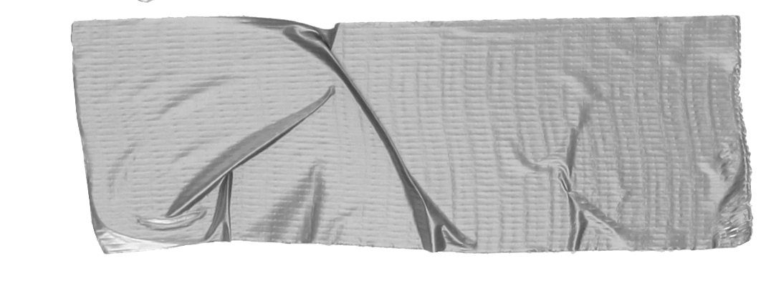
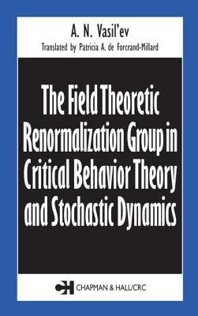
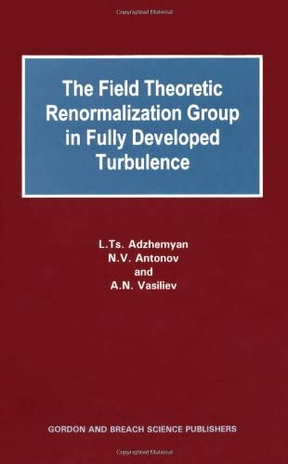
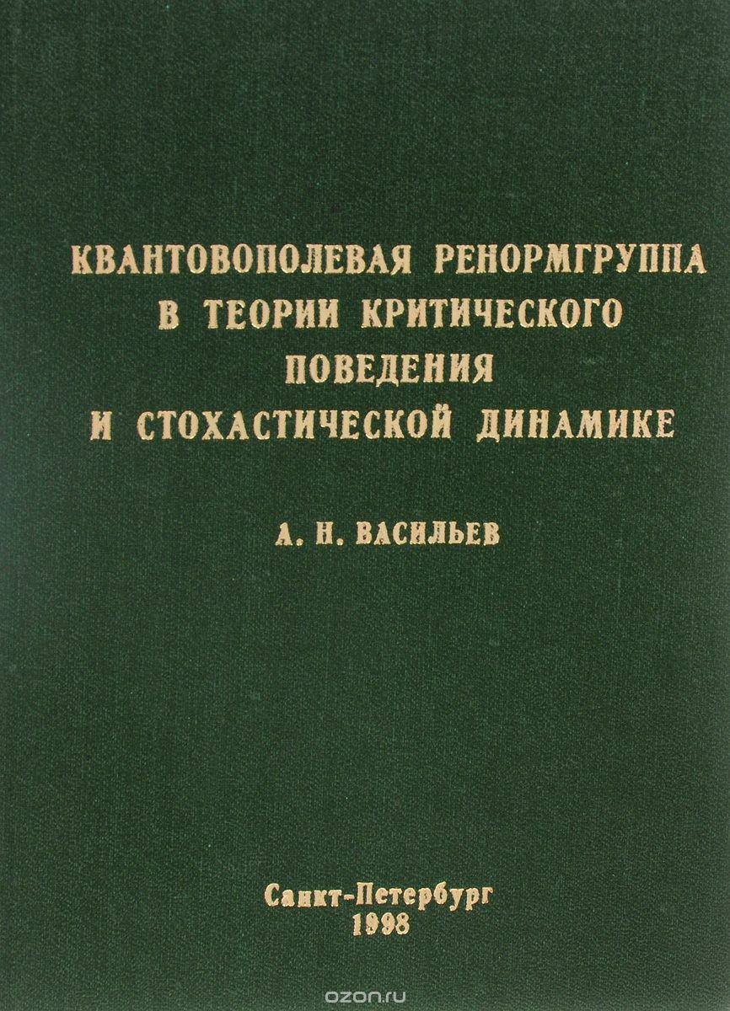
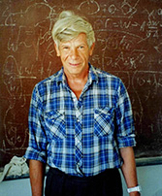
A. N. Vasil’ev’s Research Community
A. N. Vasil’ev’s students keep on his legacy by studying applications of quantum field theory methods to problems of statistical physics and critical phenomena.
Nikolai V. Antonov’s research team is focused on nonequilibrium dynamics.
A. N. Vasil’ev (1940-2006)

Slide 3
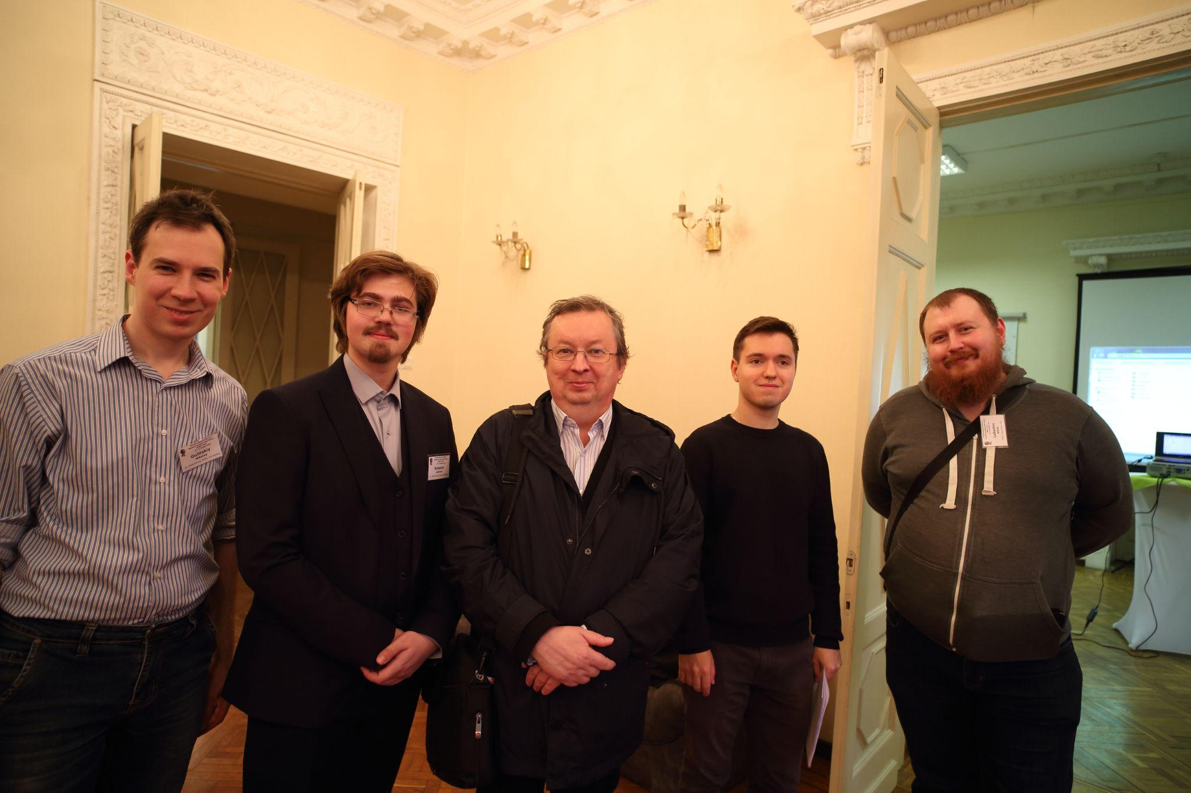
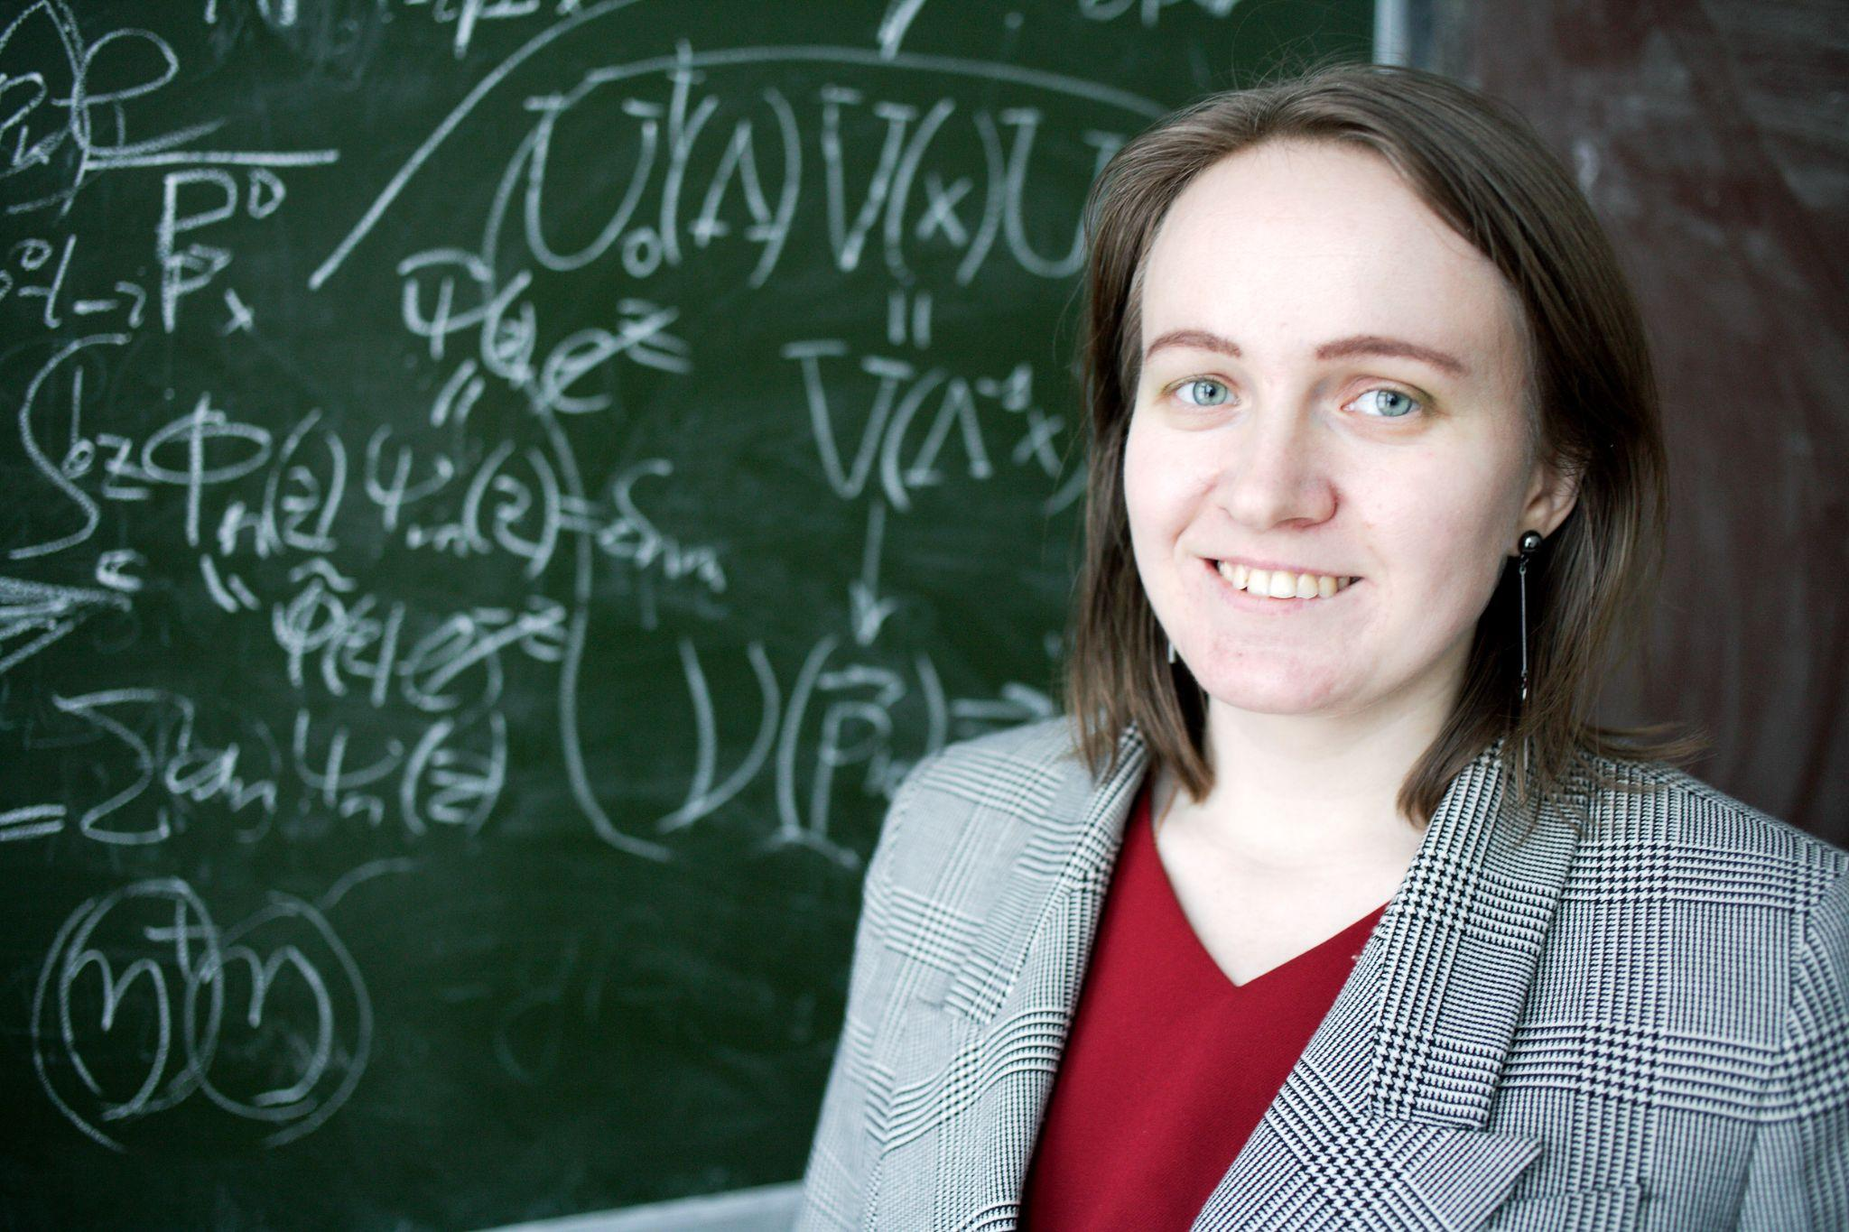
Polina Kakin
From L to R: Nikolay Gulitskiy, Andrei Babakin, Nikolai Antonov, Alexander Luchin, Nikita Lebedev

Slide 4
Research method recipe
Take a stochastic differential equation (e.g., a semi-phenomenological model for a coarse-grained field);
Apply Martin-Siggia-Rose-Janssen-de Dominicis formalism* to build a field theory;
Analyse constructed theory with perturbative renormalization group (RG) approach** (using various quantum field theory methods).
Result: universality classes of critical behavior for the studied system.
Precisely: critical exponents are found within perturbation theory.
*P. C. Martin, E. D. Siggia, H. A. Rose, Phys. Rev. A 8 (1973) 423; H.-K. Janssen, Z. Phys. B 23 (1976) 377; C. de Dominicis, J.Phys. (Paris) Colloq. 37 (C1) (1976) 247.
**Vasiliev A.N. The Field Theoretic Renormalization Group in Critical Behaviour Theory and Stochastic Dynamics; Chapman & Hall/CRC: Boca Raton, FL, USA,1998.
Notes:
степень свободы? формула коррелятора? усреднение по какому ансамблю?

Slide 5
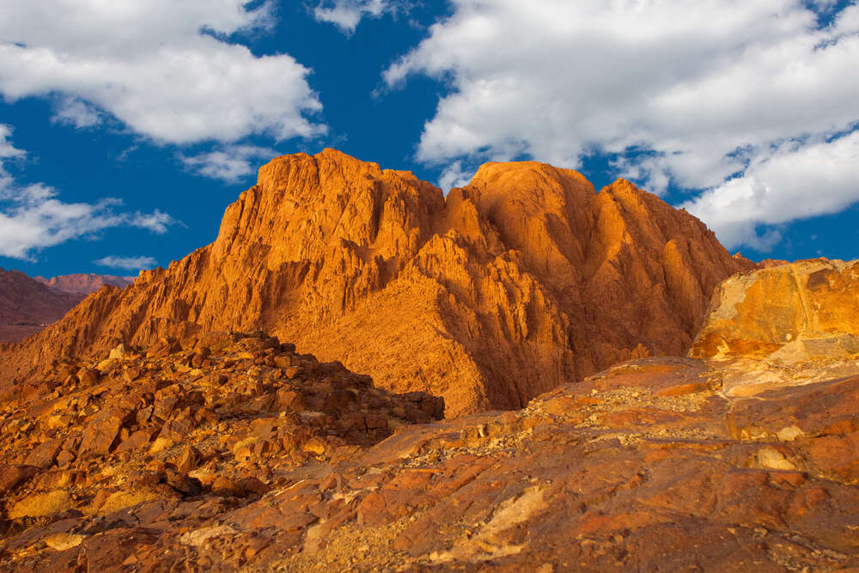
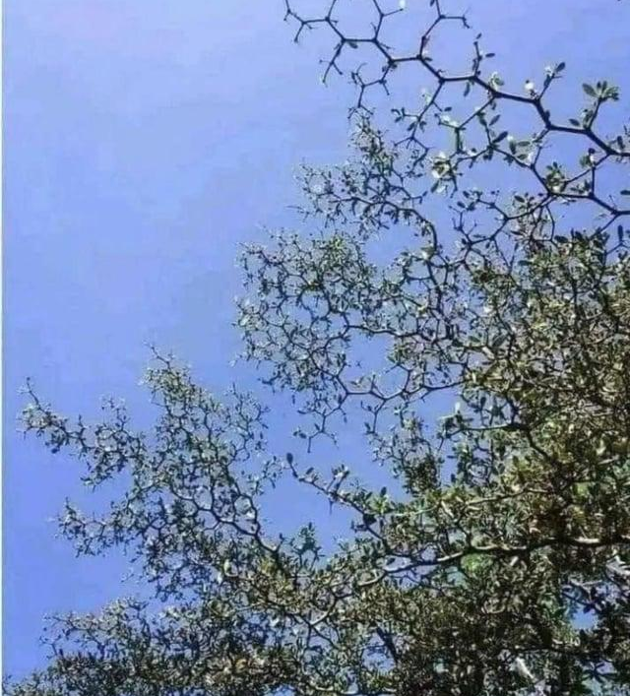
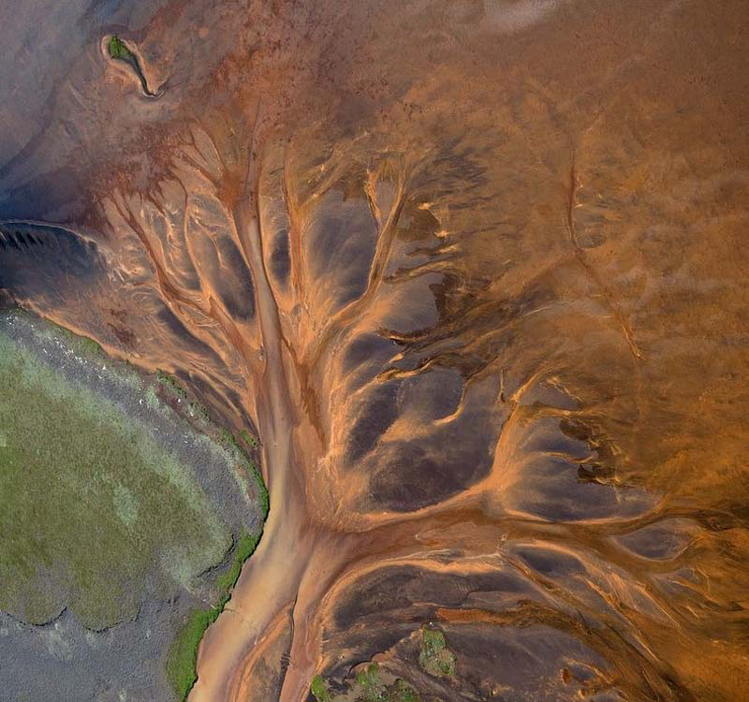
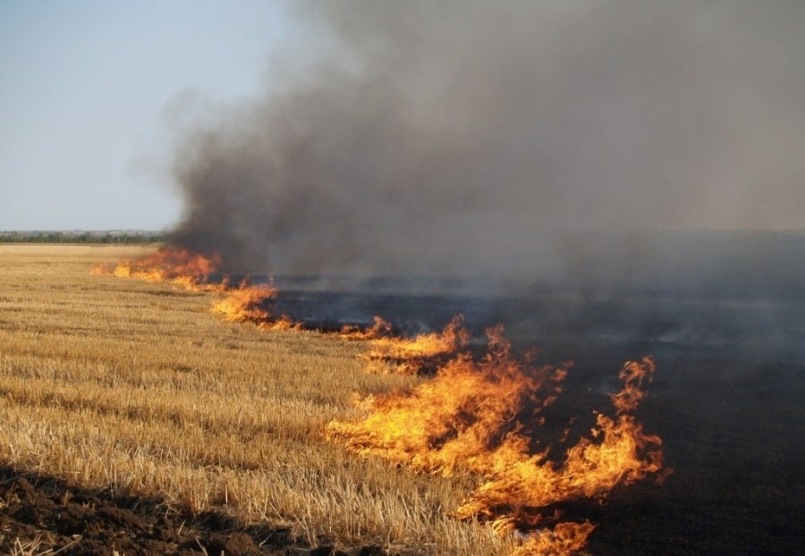
Nonequilibrium dynamics
Wide range of systems
Power laws for long-time large-distance behavior
Notes:
не все фракталы в пространстве проявляют прост-временной скейлинг

Slide 6
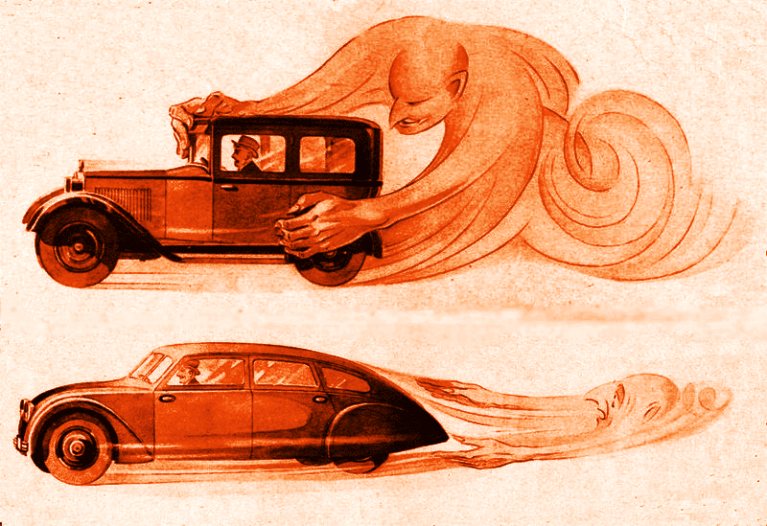
Adding flow
Critical behaviour of nearly-equilibrium nearly-critical systems can be dramatically affected by the motion of the medium*.
New universality classes with unexpected features?
Environment motion is almost impossible to exclude in real experimental settings.
It doesn’t hurt that turbulent flow can be studied with RG analysis.
Gaussian “synthetic” velocity ensembles or the Navier-Stokes stochastic equation can be used.
*Imaeda, T.; Onuki, A.; Kawasaki, K. Progr. Theor. Phys. 1984, 71, 16; Satten, G.; Ronis, D. Phys. Rev. A 1986, 33, 3415; Aronowitz, A.; Nelson, D.R. Phys. Rev. A 1984, 29, 2012; Antonov, N.V.; Hnatich, M.; Honkonen, J. J. Phys. A Math. Gen. 2006, 39, 7867.
Turbulence influence as portrayed in advertising

Slide 7
Hwa-Kardar model of SOC
Anisotropic model of “running sandpile” was introduced by Hwa and Kardar* to describe self-organized critical system.
Systems with self-organized criticality reach their critical points in the course of their evolution, not due to external “fine-tuning” of control parameters (such as temperature) as in the case of phase transitions.
Not all non-equilibrium dynamical behavior is SOC: there must be a separation of time scales (avalanches occur much faster than the converging material accumulates) amongst other additional features**.
self-organized criticality
*Hwa T, Kardar M, 1989 Phys. Rev. Lett. 62(16) 1813; 1992 Phys. Rev. A 45 7002.
**Pruessner G, 2012 Self-Organized Criticality: Theory, Models and Characterisation (Cambridge University Press)

Slide 8
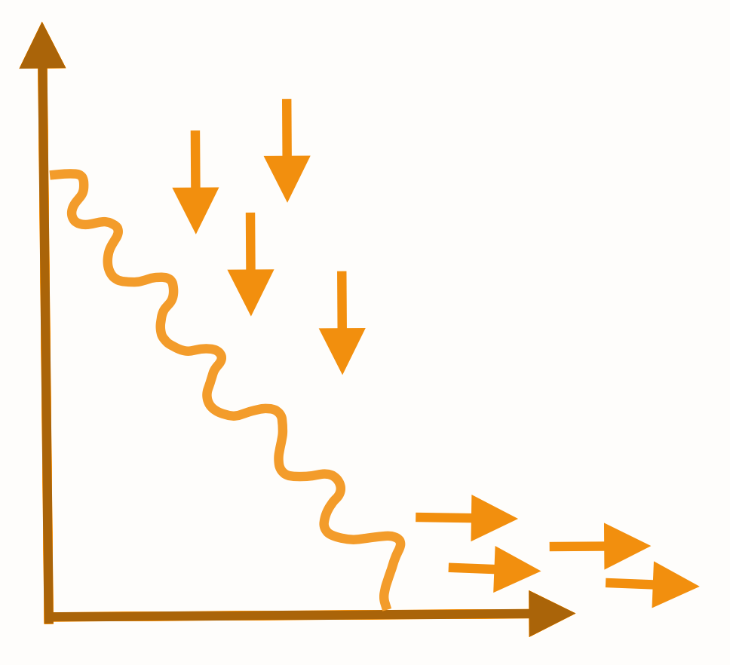
Hwa-Kardar model
Hwa-Kardar equation was to reconstruct the mechanism of SOC: dissipative transport in open systems with material conservation in the presence of boundary.
It can serve as a tool to find universal exponents (that depend only on global features) in scaling laws even if it is imperfect take on SOC mechanism.
— deviation of height profile from its average;
— Gaussian white random noise;
— kinetic coefficients;
— time derivative;
— space derivatives.
Notes:
в чем закон сохранения

Slide 9
Navier-Stokes equation
Navier-Stokes* stochastic differential equation for incompressible isotropic fluid with external random force:
Precise form of allows to model different types of motion.
Incompressibility:
— kinematic viscosity coefficient;
— pressure;
— transverse external random force;
*Forster D.; Nelson D. R.; Stephen M. J., Phys. Rev. Lett. 1976, 36, 8672.

Slide 10
Stochasticity source
Hwa-Kardar equation: white Gaussian random noise
Navier-Stokes equation: external random force with the correlator
Two problems: 1) sole local term and 2) both local and non-local terms

Slide 11
Local case: random “shaking”
Action constructed according to the Martin-Siggia-Rose-Janssen-de Dominicis formalism is equivalent to the original problem (Hwa-Kardar + Navier-Stokes, local):
Renormalized action:
Small parameter of perturbation theory is . There are 4 coupling constants:

Slide 12
One-loop calculations
irred
irred
Renormalization constants:

Slide 13
Renormalization functions
β-functions and anomalous dimensions γ
Exact expressions for β-functions and one-loop results for anomalous dimensions γ:
Fixed points of renormalization group equations correspond to regimes of critical behavior; fixed points are zeros of β-functions; eigenvalues λ determine whether a point is related to the long-time large-distance range.
FP1:
FP2:

Slide 14
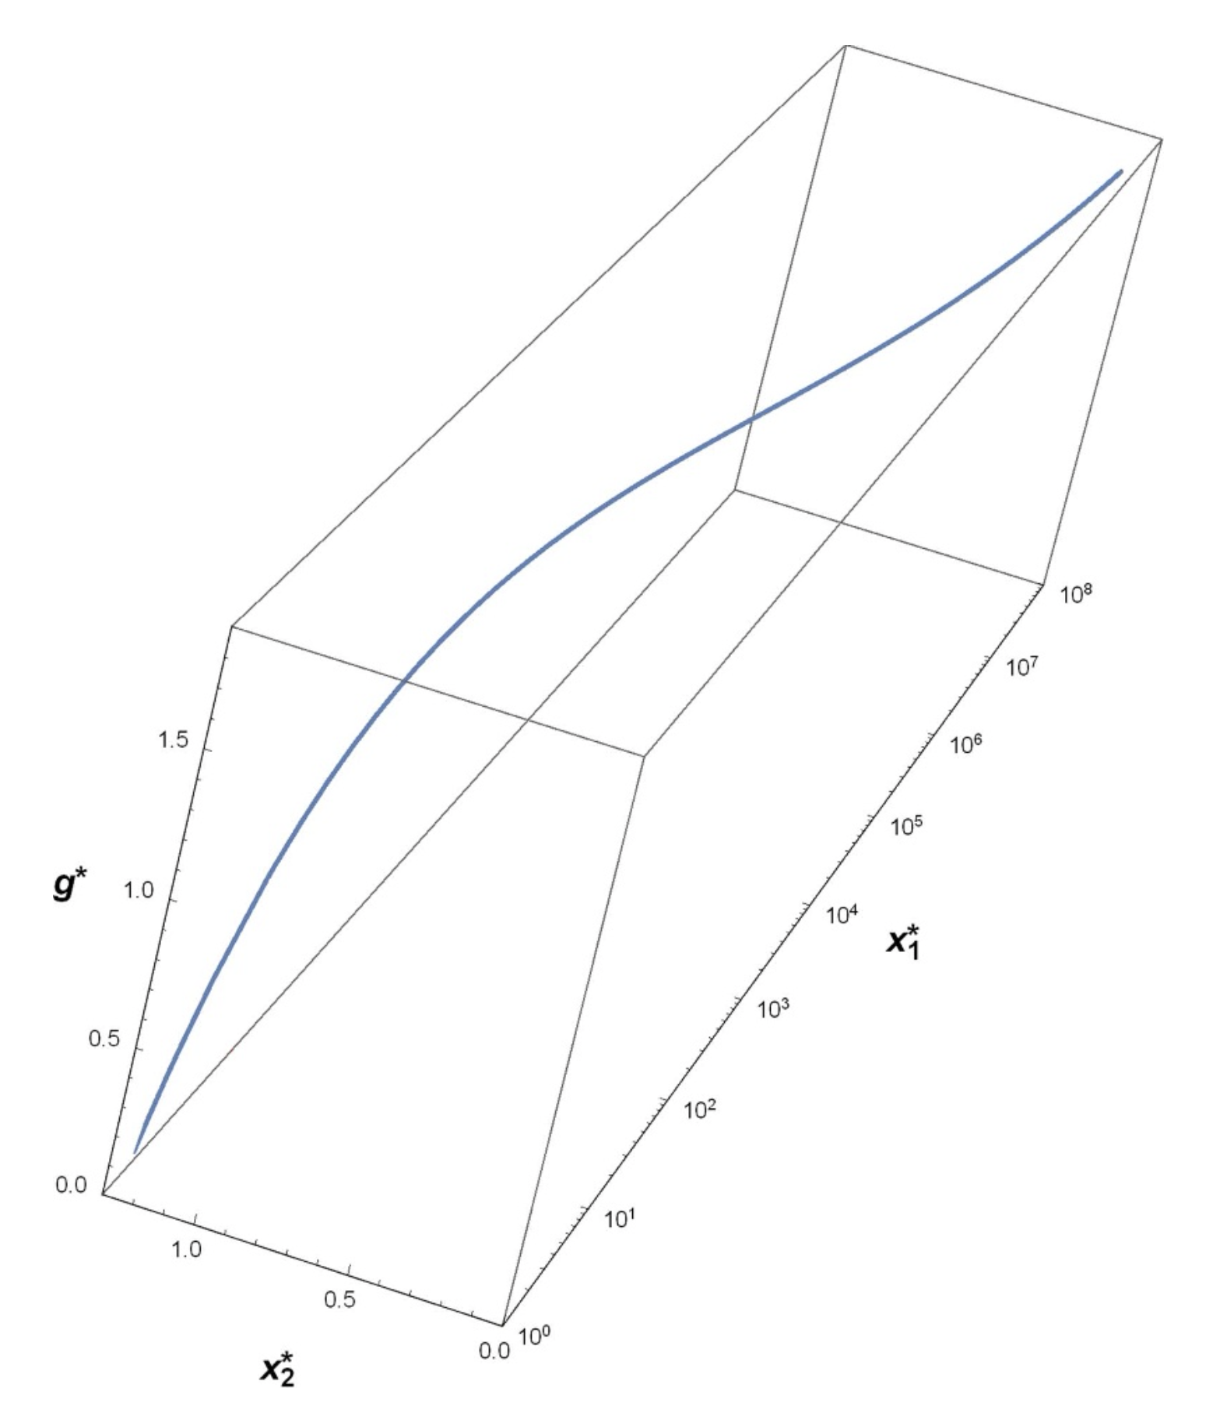
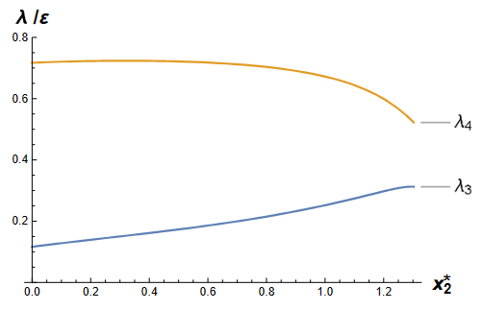
Semi-infinite curve
of fixed points
Curve of fixed points FP2 in three-dimensional space of coordinates
{g∗ (x∗2 ), x∗1 (x∗2 ), x∗2 } (we recall that w∗ = 8ε/3).
Eigenvalues for FP2 are positive together with ε.

Slide 15
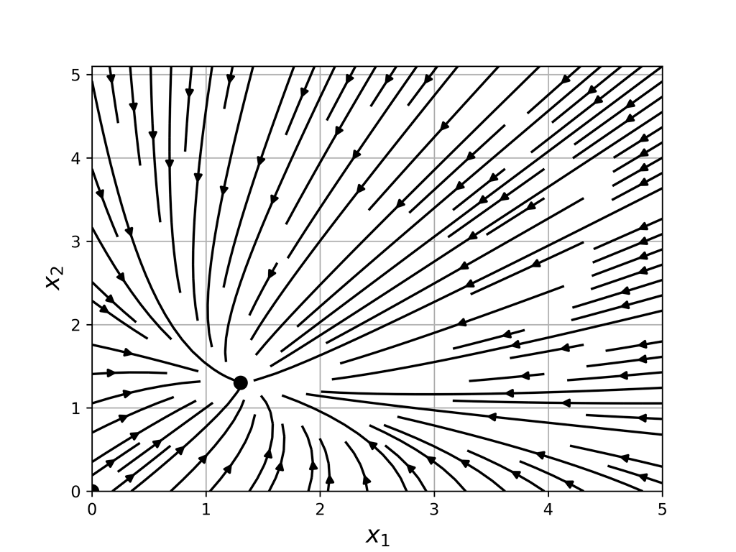
Critical dimensions and regimes
Critical dimensions (related to critical exponents) are found exactly:
FP1:
FP2:
Renormalization group flow for several points on FP2:
{g*=0,3ε, w*=8ε/3};
{g*=0,6ε, w*=8ε/3};
{g*=0,9ε, w*=8ε/3};
{g*=1,2ε; w*=8ε/3}.

Slide 16
Local case: results
There is no stable fixed point that corresponds to “pure” Hwa-Kardar model: strongly anisotropic regime vanished.
FP2 corresponds to a new crossover regime where the anisotropy survives, but becomes “weakened” in a sense that there is no longer two independent dimensions.
But would FP2 “collapse” to one sole point (fully isotropic regime) if one were to up the number of loops? Or is it a sign of nonuniversality?
Fully anisotropic universality class vanished while fully isotropic survived.

Slide 17
Full case: both local and non-local terms are in the correlator
Non-local term models turbulent motion.
The corresponding field theory is logarithmic at y = 0 and d = 4.
Notes:
проверить про вихри

Slide 18
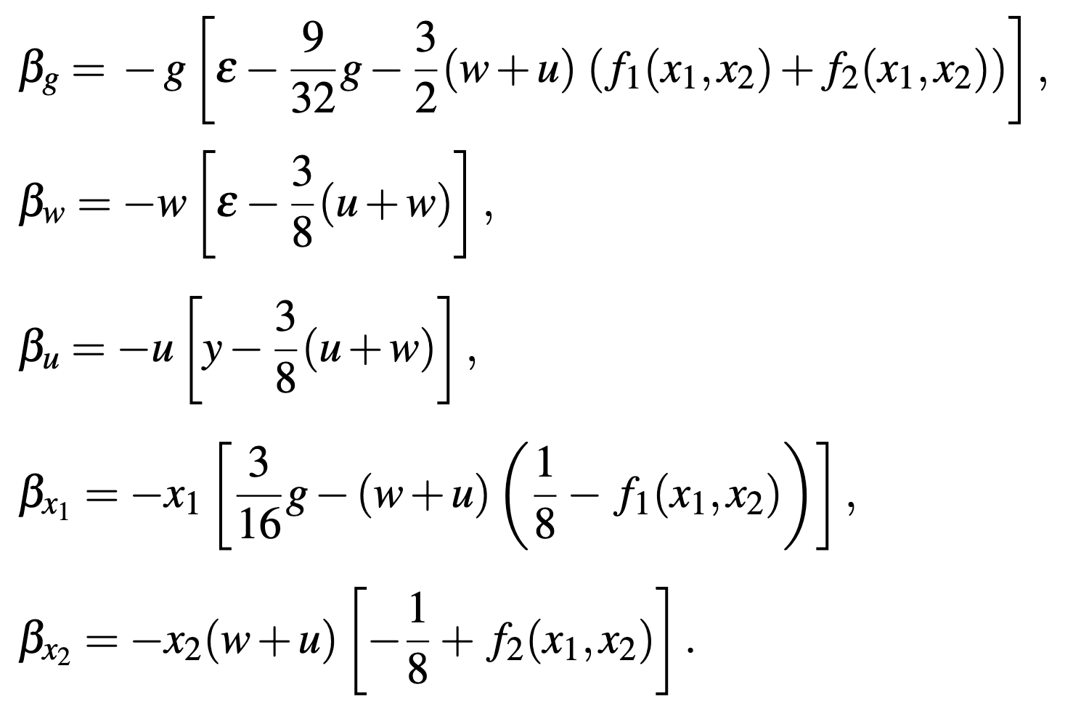
Full case: results
There is another coupling constant;
The only stable point for the physical values ε = 2, y = 4 corresponds to the “pure” isotropic passive advection.

Slide 19
Conclusion
Hwa-Kardar equation coupled to Navier-Stokes equation were studied with field-theoretic renormalization group analysis.
For two cases (local term and both terms), regimes of critical behavior were established and critical dimensions were found exactly.
In Local case (macroscopic shaking of a fluid container),
a curve of fixed points was found (either result of one-loop approximation or a sign of possible non-universality).
The corresponding regime describes weakened (but not completely washed away) anisotropy.
In Full case, anisotropy and non-linearity of Hwa-Kardar equation completely vanished.
For more about local case, see arXiv:2212.01913

Slide 20
This research was funded by the Russian Science Foundation grant number 24-22-00220,
https://rscf.ru/en/project/24-22-00220/.

Slide 21
Thank you for the attention!

