Slide 1
An approach to quantum channel state estimation based on machine learning models
The International Conference
Mathematical Methods and Computational Physics, 2024
Yerevan State University,
2024
Roman Nigmatullin, Nikolay Borisov, Bella Meretukova, David Kagramanyan, Andrey Tayduganov, Artem Ryzhikov, Denis Derkach
Laboratory of Methods for Big Data Analysis, HSE University
Laboratory of Quantum Information Technologies, National University of Science and Technology “MISIS”

Slide 2
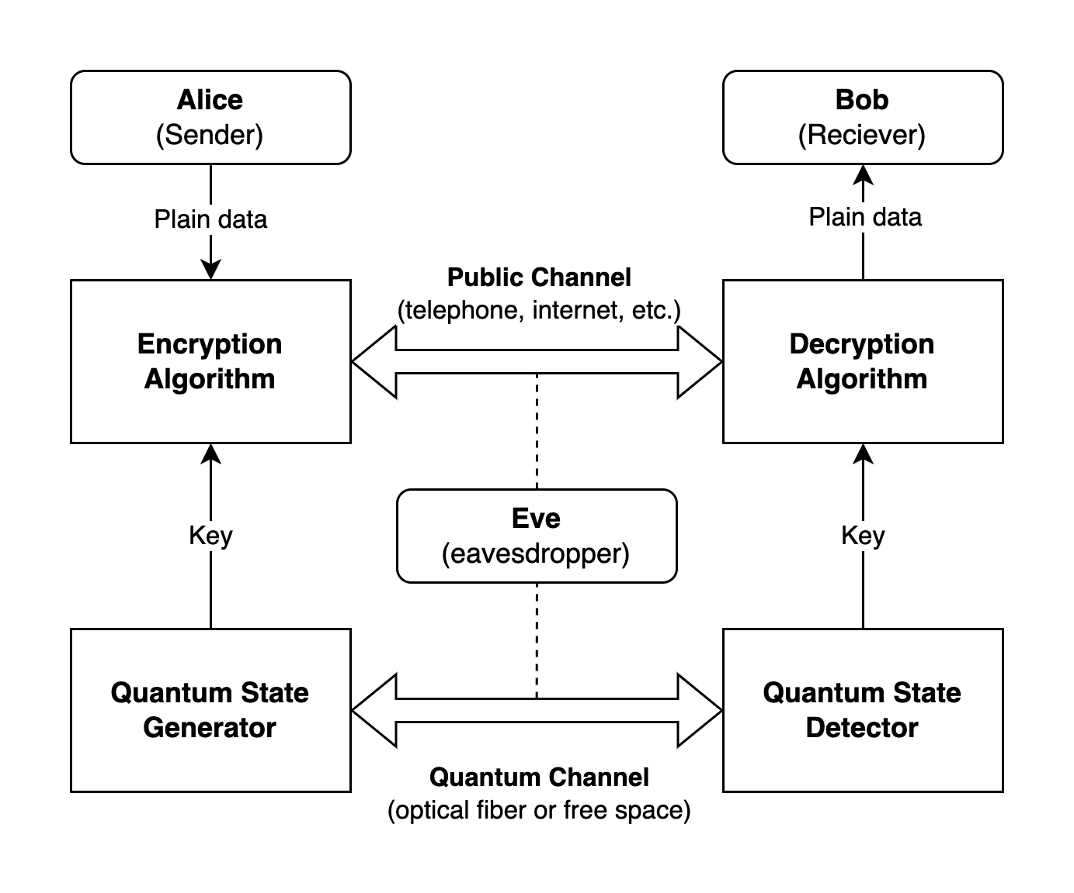
Subject area
The International Conference
Mathematical Methods and Computational Physics, 2024
Laboratory of Methods for Big Data Analysis
An approach to quantum channel state estimation based on machine learning models
Devices generate the secret key, used for message encryption
The errors in transmitted key are fixed during error correction procedure
LDPC-based correction is faster if initial parameters are optimal
Precise estimation of error rate (QBER) leads to more effective correction procedure

Slide 3
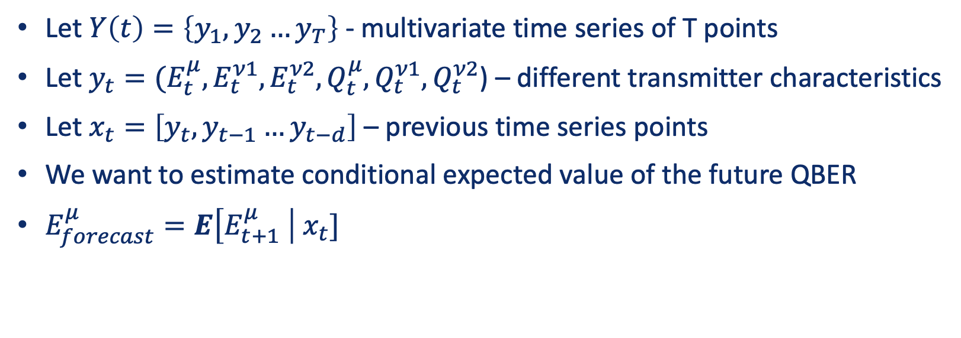
Problem definition
The International Conference
Mathematical Methods and Computational Physics, 2024
Laboratory of Methods for Big Data Analysis
An approach to quantum channel state estimation based on machine learning models
Let $Y\left(t\right)=\left\{y_{1}, y_{2}…y_{T}\right\}$ - multivariate time series of T points
Let $y_{t}=(E_{t}^{μ},E_{t}^{ν1},E_{t}^{ν2},Q_{t}^{μ},Q_{t}^{ν1},Q_{t}^{ν2}$) – different transmitter characteristics
Let $x_{t}=\left[{y_{t}, y}_{t−1}…y_{t−d}\right]$ – previous time series points
We want to estimate conditional expected value of the future QBER
$E_{forecast}^{μ}=E\left[E_{t+1}^{μ} \right| x_{t}]$

Slide 4
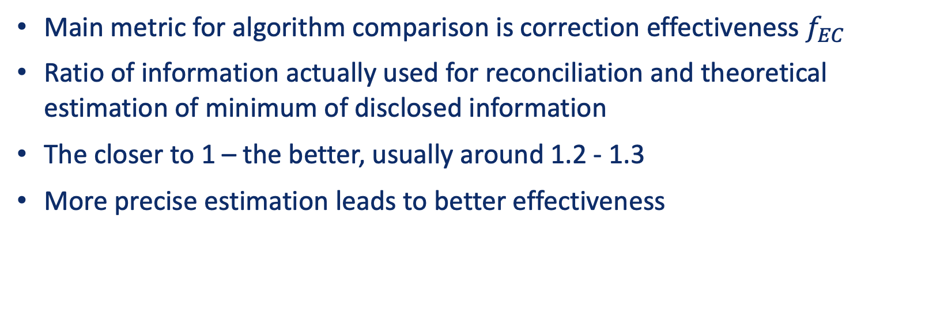
Problem definition
The International Conference
Mathematical Methods and Computational Physics, 2024
Laboratory of Methods for Big Data Analysis
An approach to quantum channel state estimation based on machine learning models
Main metric for algorithm comparison is correction effectiveness $f_{EC}$
Ratio of information actually used for reconciliation and theoretical estimation of minimum of disclosed information
The closer to 1 – the better, usually around 1.2 - 1.3
More precise estimation leads to better effectiveness

Slide 5
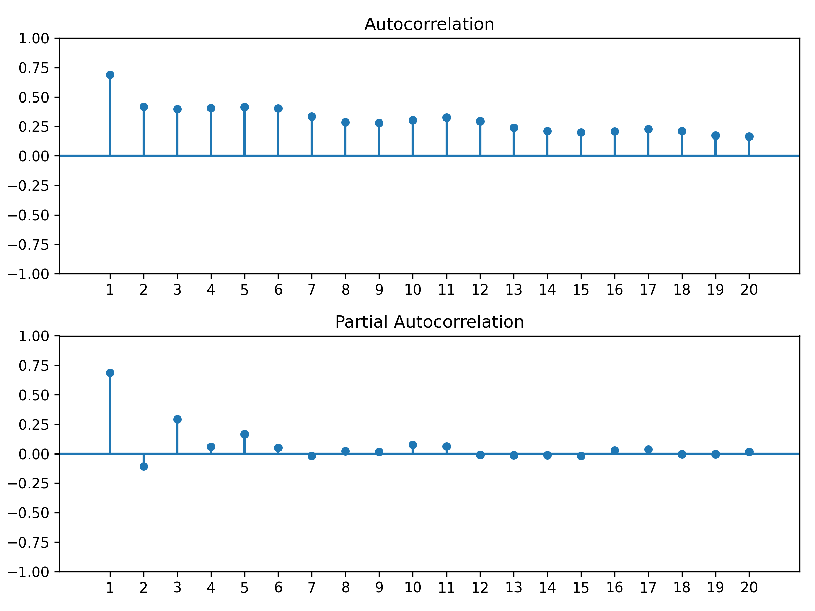
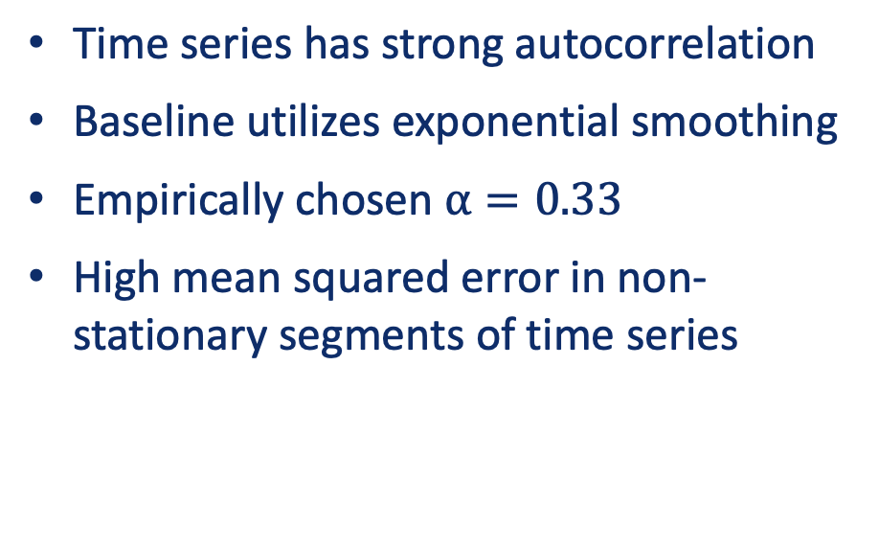
Existing solution
The International Conference
Mathematical Methods and Computational Physics, 2024
Laboratory of Methods for Big Data Analysis
An approach to quantum channel state estimation based on machine learning models
Time series has strong autocorrelation
Baseline utilizes exponential smoothing
Empirically chosen $α=0.33$
High mean squared error in non-stationary segments of time series

Slide 6
Machine learning approaches
The International Conference
Mathematical Methods and Computational Physics, 2024
Laboratory of Methods for Big Data Analysis
An approach to quantum channel state estimation based on machine learning models
Best algorithms for time series forecasting rely on machine learning
Statistical methods – exponential smoothing, ARIMA, regression
Fully-connected, recurrent and transformer neural networks
Gradient boosting on regression trees (GBRT)
Ensembles of these algorithms

Slide 7
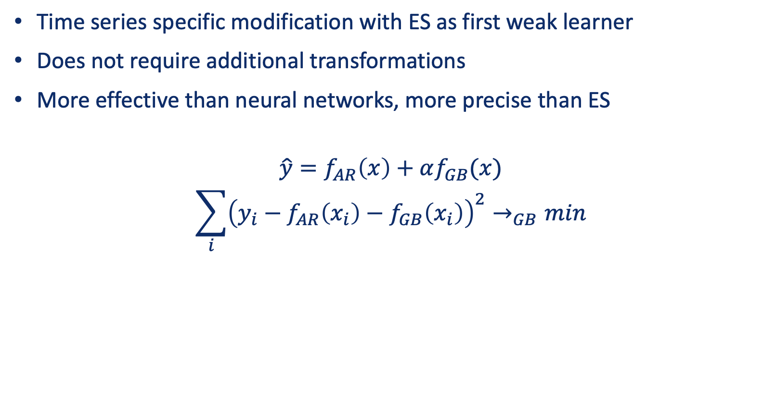
Gradient boosted exponential smoothing
The International Conference
Mathematical Methods and Computational Physics, 2024
Laboratory of Methods for Big Data Analysis
An approach to quantum channel state estimation based on machine learning models
Time series specific modification with ES as first weak learner
Does not require additional transformations
More effective than neural networks, more precise than ES
$$\hat{y}=f_{AR}\left(x\right)+αf_{GB}(x)$$
$$\sum_{i}{{\left(y_{i}−f_{AR}\left(x_{i}\right)−f_{GB}\left(x_{i}\right)\right)}^{2}→_{GB}min}$$

Slide 8
Forecasting metrics on test datasets
The International Conference
Mathematical Methods and Computational Physics, 2024
Laboratory of Methods for Big Data Analysis
An approach to quantum channel state estimation based on machine learning models
Model | Exponential smoothing | ARIMA | Kernel regression | Multilayer Perceptron | LSTM | Transformer | Gradient Boosting | Gradient Boosted ES
R^2 | 0.42868 | 0.55983 | 0.58688 | 0.58804 | 0.61842 | 0.38473 | 0.62576 | 0.62838
RMSE | 0.00543 | 0.00477 | 0.00462 | 0.00461 | 0.00452 | 0.00520 | 0.00435 | 0.00434
MAE | 0.00336 | 0.00279 | 0.00268 | 0.00267 | 0.00277 | 0.00303 | 0.00252 | 0.00245
MAPE | 0.13154 | 0.10892 | 0.10332 | 0.10085 | 0.10817 | 0.11804 | 0.09703 | 0.09463
Gradient Boosted ES is the best model by offline evaluation

Slide 9
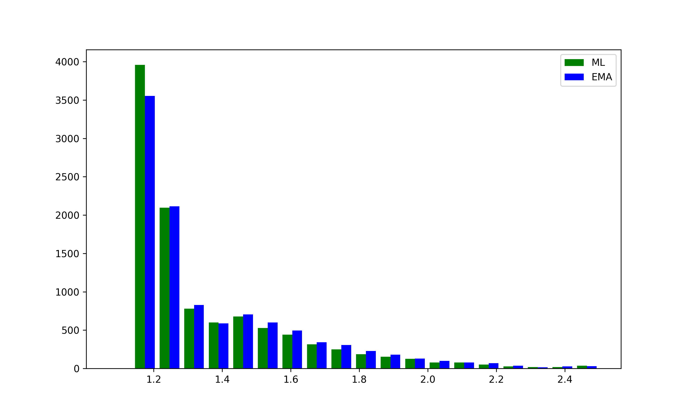
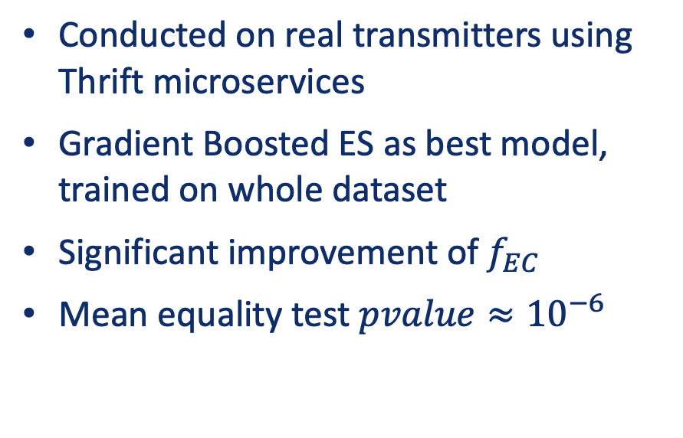
Experiments
The International Conference
Mathematical Methods and Computational Physics, 2024
Laboratory of Methods for Big Data Analysis
An approach to quantum channel state estimation based on machine learning models
Conducted on real transmitters using Thrift microservices
Gradient Boosted ES as best model, trained on whole dataset
Significant improvement of $f_{EC}$
Mean equality test $pvalue≈{10}^{−6}$
$$\overline{f_{EC}^{ML}}=1.349, \overline{f_{EC}^{EMA}}=1.368$$

Slide 10
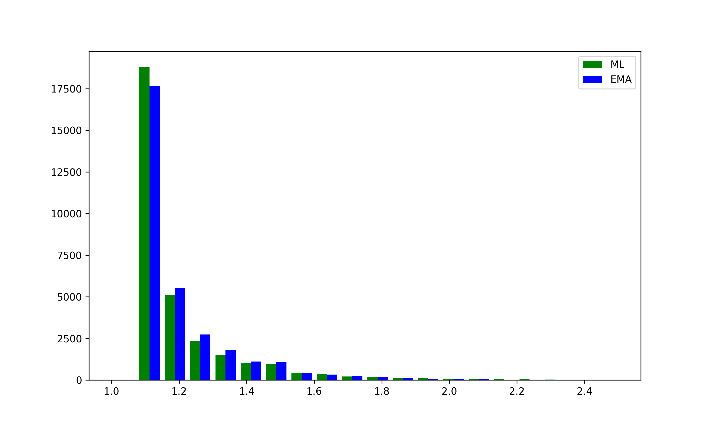
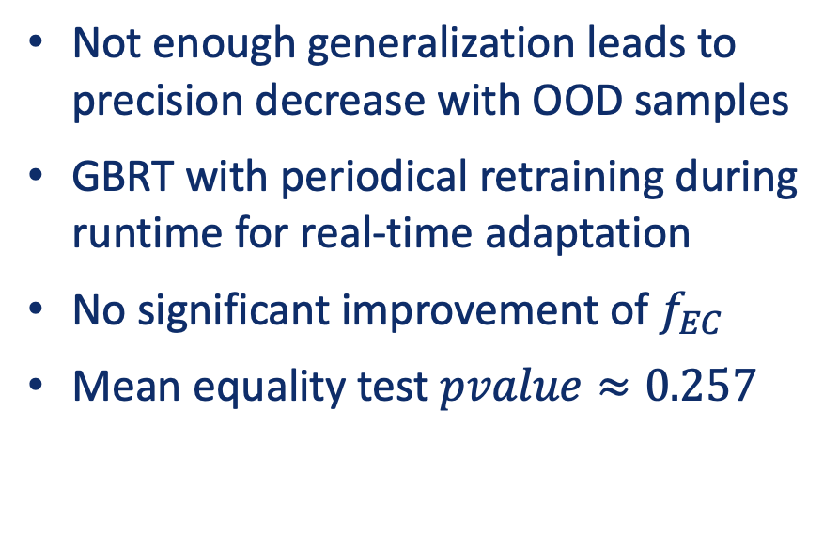
Experiments
The International Conference
Mathematical Methods and Computational Physics, 2024
Laboratory of Methods for Big Data Analysis
An approach to quantum channel state estimation based on machine learning models
Not enough generalization leads to precision decrease with OOD samples
GBRT with periodical retraining during runtime for real-time adaptation
No significant improvement of $f_{EC}$
Mean equality test $pvalue≈0.257$
$$\overline{f_{EC}^{ML}}=1.229, \overline{f_{EC}^{EMA}}=1.230$$

Slide 11
Conclusion
The International Conference
Mathematical Methods and Computational Physics, 2024
Laboratory of Methods for Big Data Analysis
An approach to quantum channel state estimation based on machine learning models
Proposed forecasting techniques improve the quantum key correction speed in experiments on real transmitters
In some condition model performance can decrease due to hard generalization and dominance of stable QBER time series in collected data
The study will help advance the research of quantum cryptography and increase the quantum key generation speed in QKD systems

Slide 12
Thank you for attention!
The International Conference
Mathematical Methods and Computational Physics, 2024
Laboratory of Methods for Big Data Analysis
An approach to quantum channel state estimation based on machine learning models

