Slide 1
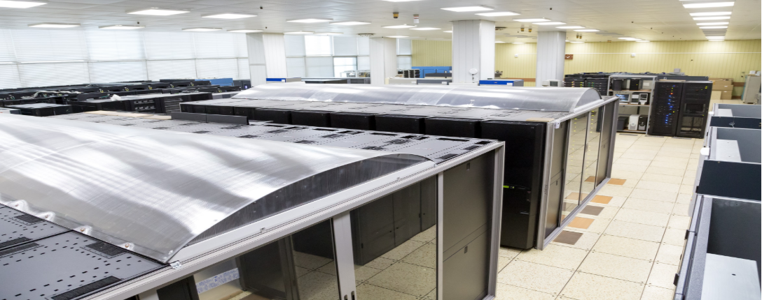

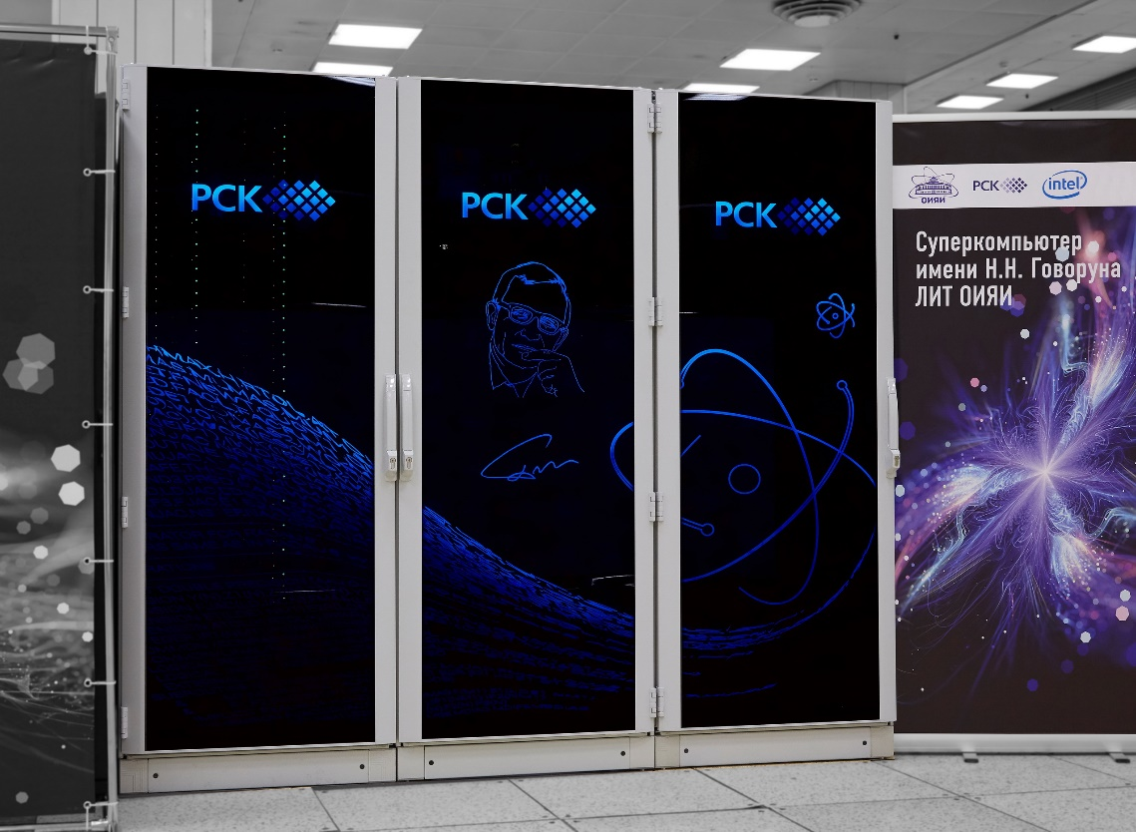


Simulation of a controllable magnetization reversal in a chain of Phi-0 junctions by an alternating voltage pulse
A.R. Rahmonova¹,O.I. Streltsova¹, M. I. Zuev¹, I.R. Rahmonov²
¹ Meshcheryakov Laboratory of Information Technologies, Dubna, Russia
² Bogoliubov Laboratory of Theoretical Physics, Dubna, Russia
This work was supported by Russian Science Foundation grant № 22-71-10022
Mathematical Modeling and Computational Physics
Erevan, Armenia
21-25 October

Slide 2

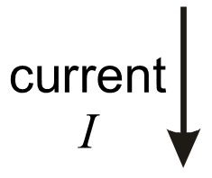

Josephson Effect
Josephson junction
Stationary Josephson effect
Nonstationary Josephson effect
2

Slide 3
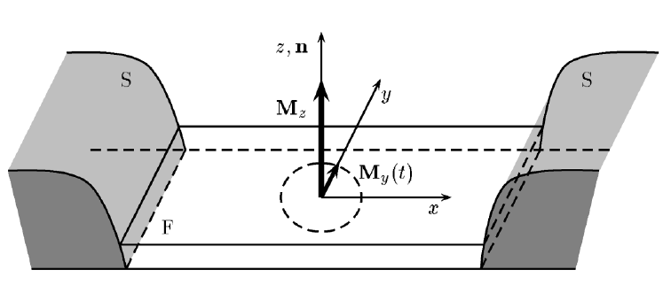
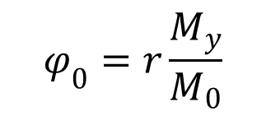

Anomalous Josephson Effect
► In SFS Josephson junction the spin orbit coupling in Ferromagnetic layer, leads to the direct coupling of magnetization dynamics and superconducting current.
► In the current phase relation of such junctions appears the phase shifting Phi-0, and they called Phi-0 junction and observed effect called Anomalous Josephson effect.
$$φ_{0}=r\frac{M_{y}}{M_{0}}$$
$$I_{s}=I_{c}\sin{(}φ−φ_{0})$$
A. Buzdin, Phys. Rev. Lett. 101, 107005 (2008).
F. Konschelle and A. Buzdin, Phys. Rev. Lett. 102, 017001 (2009)
3

Slide 4
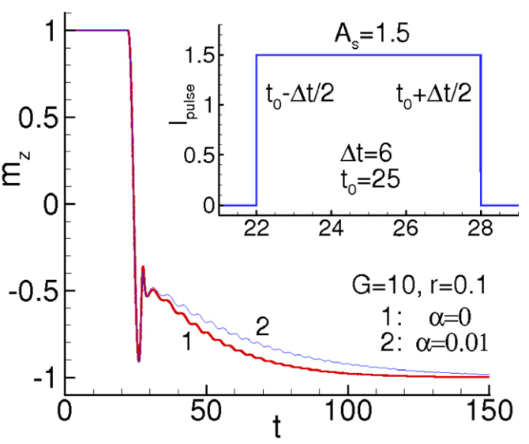
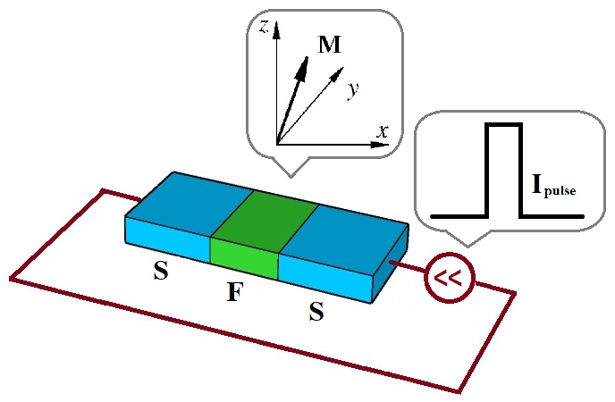
Magnetization reversal in Phi-0 junction
by the pulse of current
Yu. M. Shukrinov, I. R. Rahmonov, K. Sengupta, and A. Buzdin, Magnetization reversal by superconducting current in u 0 Josephson
Junctions, Appl. Phys. Lett. 110, 182407 (2017)
A toolkit for simulation of magnetization reversal in the form of Jupyter Book has been developed: http://studhub.jinr.ru:8080/books/intro.html
4

Slide 5
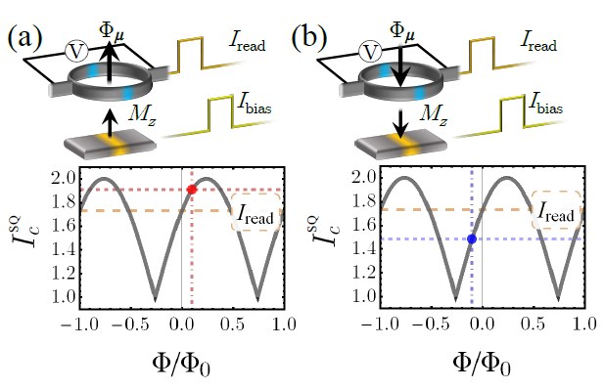
Magnetization reversal in Phi-0 junction
Based on the magnetization reversal in Phi-0 junction suggested the cryogenic memory element
S/F/S Josephson junction driven by a rectangular current pulse. The z-component of the magnetization, M_{z}, is the observable used to define the logic memory states 0 and 1.
SQUID-based memory readout and figure showing the critical current interference pattern of the SQUID, in the cases of both positive and negative orientation along the z-axis of the magnetization, see panel (a) and (b), respectively.
C. Guarcello and F.S. Bergeret, Cryogenic Memory Element Based on an Anomalous Josephson Junction, Phys. Rev. Appl. 13, 034012 (2020)
5

Slide 6
Motivation
An actual question: In case of development of many logic elements on single chip is it possible to realize controllable magnetization reversal in selected junction?
The answer is YES and we will consider this case below.
6

Slide 7
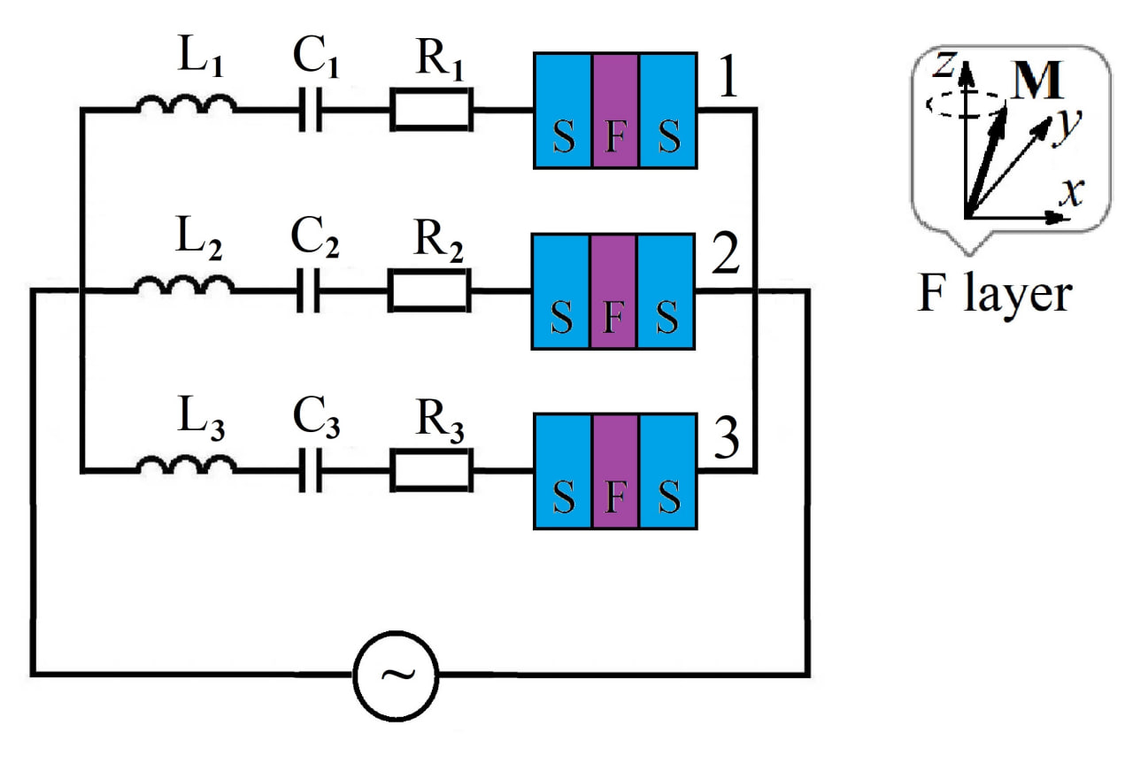



Equivalent scheme of considered system
We consider 3 Phi-0 junctions, each of which is connected in series to the LCR circuit.
Each of LCR circuit has its own eigenfrequency, which can be find by
expression
We can apply alternating voltage pulse with fixed frequency
$${\text{ω}}_{c} =\sqrt{\frac{1}{LC}}$$
$${\text{ω}}_{pulse}$$
By the tuning of to the eigenfrequency of selected circuit branch we can realize magnetization reversal in the selected Ph-0 junction.
Dynamical variables of considered system are: Magnetization vector M, Josephson phase difference φ and voltage in the capacitance of the circuit u_{c}.
Dynamics of M is described by the Landau Lifshits Gilbert equations, φ is described by the equation of Resistively capacitively shunted junction model and equation for u_{c} can be obtained by the Kirchhoff's rules
$${\text{ω}}_{pulse}$$
7

Slide 8



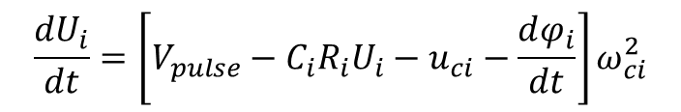




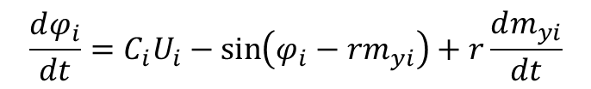






System of equations
Finally we can write coupled system of equations, which describes considered system
$$\frac{dm_{xi}}{dt}=−\frac{ω_{F}}{1+α^{2}m_{i}^{2}}\left\{m_{yi}h_{zi}−m_{zi}h_{yi}+α\left[m_{xi}\left(m_{xi}h_{xi}+m_{yi}h_{yi}+m_{zi}h_{zi}\right)−h_{xi}m_{i}^{2}\right]\right\}$$
$$\frac{dm_{yi}}{dt}=−\frac{ω_{F}}{1+α^{2}m_{i}^{2}}\left\{m_{zi}h_{xi}−m_{xi}h_{zi}+α\left[m_{yi}\left({m_{xi}h}_{xi}+m_{yi}h_{yi}+m_{zi}h_{zi}\right)−h_{yi}m_{i}^{2}\right]\right\}$$
$$\frac{dm_{zi}}{dt}=−\frac{ω_{F}}{1+α^{2}m_{i}^{2}}\left\{m_{xi}h_{yi}−m_{yi}h_{xi}+α\left[m_{zi}\left({m_{xi}h}_{xi}+m_{yi}h_{yi}+m_{zi}h_{zi}\right)−h_{zi}m_{i}^{2}\right]\right\}$$
$$\frac{dφ_{i}}{dt}=C_{i}U_{i}−\sin\left(φ_{i}−rm_{yi}\right)+r\frac{dm_{yi}}{dt}$$
$$\frac{du_{ci}}{dt}=U_{i}$$
$$\frac{dU_{i}}{dt}=\left[V_{pulse}−C_{i}R_{i}U_{i}−u_{ci}−\frac{dφ_{i}}{dt}\right]ω_{ci}^{2}$$
,
Effective field components
$$i=1, 2, 3$$
- number of circuit branch
$$\begin{matrix}h_{xi}=0 \\ h_{yi}=Gr\sin\left(φ_{i}−rm_{yi}\right) \\ h_{zi}=m_{zi} \end{matrix}$$
$m_{xi},m_{yi}$, $m_{zi}$
- components of magnetization
$$φ_{i}$$
- phase difference
$$u_{ci}$$
- voltage in capacitance
$$ω_{F}$$
- Ferromagnetic resonance frequency
$$ω_{c}$$
$$α$$
- Gilbert damping parameter
- eigenfrequency of LCR circuit
$$C$$
$$r$$
- spin orbit coupling parameter
- capacitance
8
$$R$$
$$G$$
- relation of Josephson energy to magnetic energy
- resistance

Slide 9




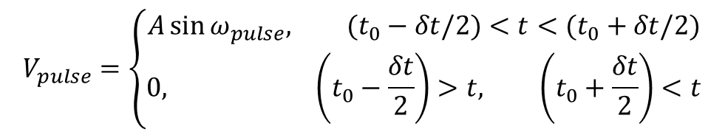
System of equatons
Here $V_{pulse}$is the alternating voltage pulse and defined as following
$$V_{pulse}=\left\{\begin{matrix}A\sin{ω_{pulse}, (t_{0}−δt/2)<t<(t_{0}+δt/2)} \\ 0, \left(t_{0}−\frac{δt}{2}\right)>t, \left(t_{0}+\frac{δt}{2}\right)<t\end{matrix}\right.$$
$$t_{0}$$
- time interval center, where is applied pulse
$$δt$$
- duration of time of pulse
$$ω_{pulse}$$
- frequency of pulse
$$A$$
- Amplitude of pulse
Initial condition for system of equations
$m_{xi}=0, m_{yi}=0$, ${ m}_{zi}=1,{{ φ}_{i} =0, u}_{ci}$=0, $U_{i}$=0
We have numerically solved system of equations using Fourth order Runge-Kutta method, where time stepsize was Δt=0.005. The calculation accuracy is about 10⁻¹³
9

Slide 10
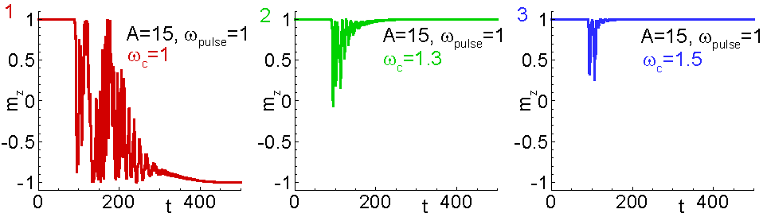
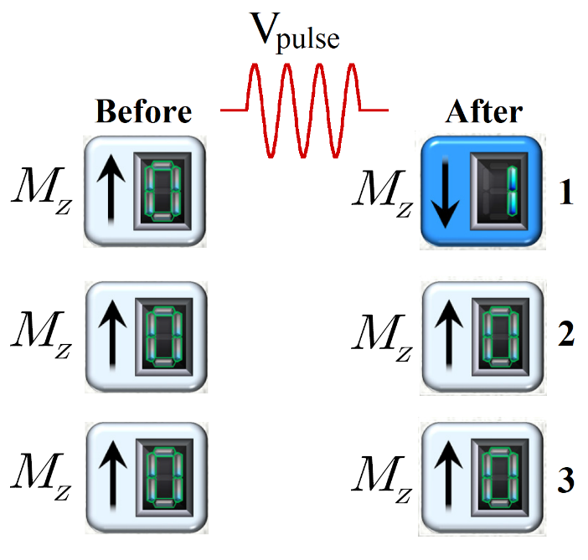
Results
Here we applied voltage pulse with frequency corresponding to the eigenfrequency of first LCR-circuit and obtain magnetization reversal of first Phi-0 junction
10

Slide 11
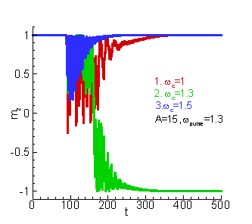
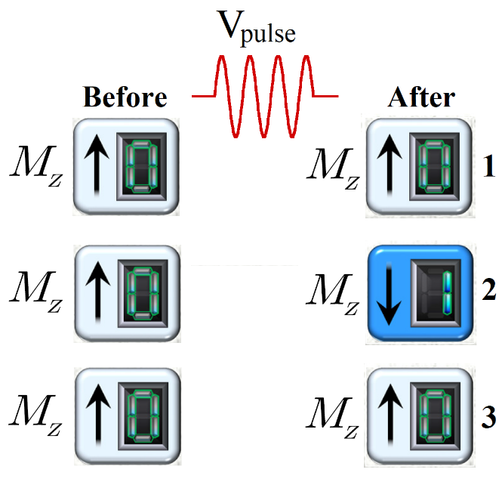
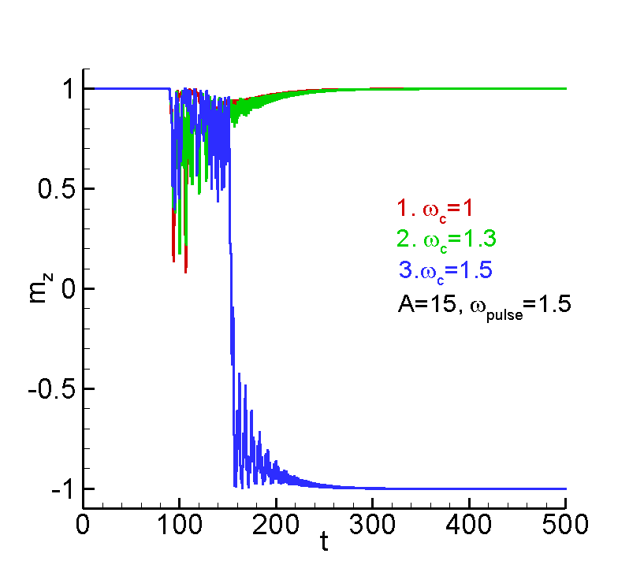
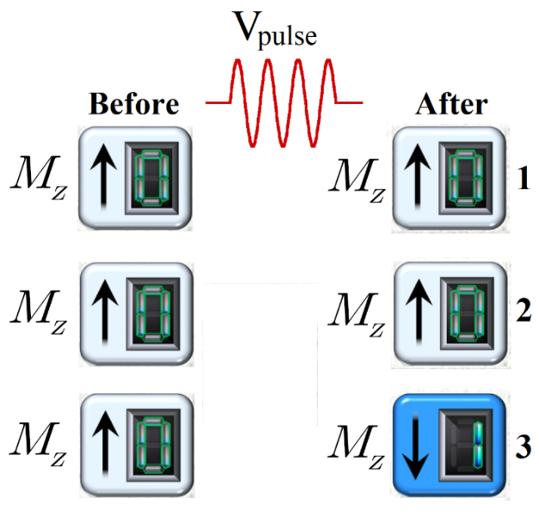
Results
Realization of magnetization reversal in second Phi-0 junction
Realization of magnetization reversal in third Phi-0 junction
11

Slide 12
Conclusions
We have investigated system of Phi-0 junction chain with coupled LCR circuits.
We have demonstrated the controllable magnetization reversal by the pulse of alternating voltage.
We expect that performed investigations and obtained results can be useful for development of cryogenic memory, based on Phi-0 junction.
12

Slide 13

Thank you for your attention!

