Slide 1
On a method for numerical solution of a time-dependent Schrödinger
equation based on Lee-Trotter-Suzuki formula.
Maxim Zakharov
FLNP, JINR
This work was supported by the Russian Science Foundation under grant no. 20-11-20257.

Slide 2
Contents
Review of the method for numerical solution time-dependent Schrödinger equation based on the Lee-Trotter-Suzuki product formula.
The way for optimization the method of
Lee-Trotter-Suzuki product formula.
Numerical tests
1/10

Slide 3
Evolution Operator
Time-dependent Schrödinger equation.
The solution can be represented as a result of action of the unitary evolution operator on the initial wave state.
The evolution operator can be expressed in terms of a time-ordered exponential.
ℏ = 1
2/10

Slide 4
Suzuki-Trotter formula
M. Suzuki, // Proc. Jpn. Acad. B, V. 69, P. 161 (1993)
Δt = t - t₀
The differential operator shifts the function by the value of τ into the past
3/10

Slide 5
Suzuki-Trotter formula
M. Suzuki, // Proc. Jpn. Acad. B, V. 69, P. 161 (1993)
Δt = t - t₀
The differential operator shifts the function by the value of τ into the past
Just few redesignations …
And finally:
The problem of the evolution operator approximation
is reduced to the approximation problem of the operator
3/10

Slide 6
Lee-Trotter-Suzuki product formula
(*)
M.D. Feit, Jr. J.A. Fleck AND A. Steiger // J. Comp. Phys., V. 47, P. 412 (1982)
M. Suzuki // Phys. Lett. A., V. 146, № 6, P. 319 (1990)
H. Yoshida // Phys. Lett. A, V. 150, P. 262 (1990)
4/10

Slide 7
Lee-Trotter-Suzuki product formula
(*)
M.D. Feit, Jr. J.A. Fleck AND A. Steiger // J. Comp. Phys., V. 47, P. 412 (1982)
M. Suzuki // Phys. Lett. A., V. 146, № 6, P. 319 (1990)
H. Yoshida // Phys. Lett. A, V. 150, P. 262 (1990)
Baker–Campbell–Hausdorff formula (BCH):
Classical presentation
Symmetrical presentation
4/10

Slide 8
Lee-Trotter-Suzuki product formula
(*)
M.D. Feit, Jr. J.A. Fleck AND A. Steiger // J. Comp. Phys., V. 47, P. 412 (1982)
M. Suzuki // Phys. Lett. A., V. 146, № 6, P. 319 (1990)
H. Yoshida // Phys. Lett. A, V. 150, P. 262 (1990)
Baker–Campbell–Hausdorff formula (BCH):
Classical presentation
Symmetrical presentation
Approximation of the operator (*)
of the first order of accuracy
Approximation of the operator (*)
of the second order of accuracy
4/10

Slide 9
Lee-Trotter-Suzuki product formula
Obtaining an approximation of a higher order of accuracy
Create symmetric construction
5/10

Slide 10
Lee-Trotter-Suzuki product formula
Obtaining an approximation of a higher order of accuracy
Create symmetric construction
Use BCH formulae
Neglect all terms up to the fifth order
5/10

Slide 11
Lee-Trotter-Suzuki product formula
Obtaining an approximation of a higher order of accuracy
Create symmetric construction
Use BCH formulae
Neglect all terms up to the fifth order
Approximation condition
Fourth order of accuracy
5/10

Slide 12
Lee-Trotter-Suzuki product formula
6/10

Slide 13
Lee-Trotter-Suzuki product formula optimization
Compose a symmetrical construction from a variety of exponential expressions S.
Step 1
Step 2
…N times…
Finally, we can get a condition for approximating the evolution operator of the required order of accuracy.
Obtain a system of nonlinear algebraic equations
for determining unknowns n₀, n₁,… n_{m}
7/10

Slide 14
Lee-Trotter-Suzuki product formula
Lee-Trotter-Suzuki product formula optimization with S₂
Lee-Trotter-Suzuki product formula optimization with S₄
8/10

Slide 15
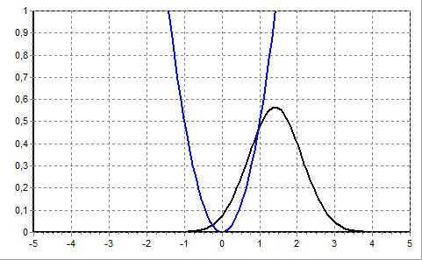
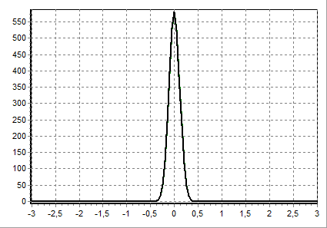
Numerical test of the constructed computational circuits
Motion of a wave packet in a “tapering” parabolic potential.
ω²(t) = 4 – 3exp(-t)
Chuluunbaatar O. et al. // J. Phys. A: Math. Theor. 2008. V. 41, P. 295203.
Puzynin I.V., Selin A.V. and Vinitsky S.I // Comput. Phys. Commun. 1999. V. 123. P. 1.
Square modulus of the wave function
Initial wave state
Spectrum
Rigorous solution
Functions X, Y, Z satisfy a system
of differential equations
9/10

Slide 16
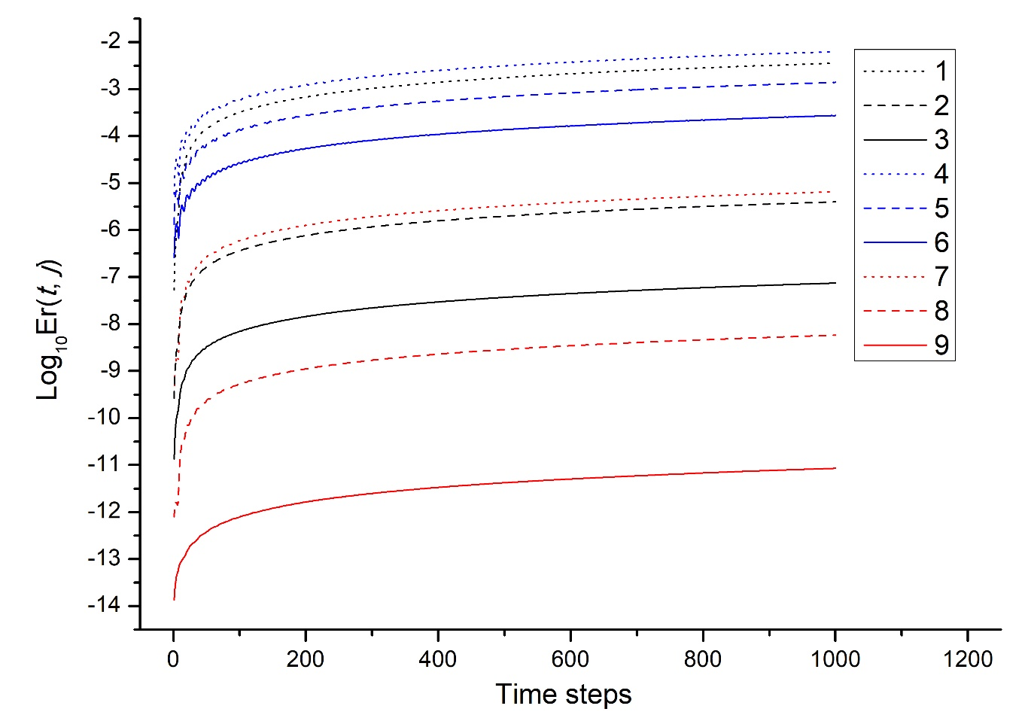
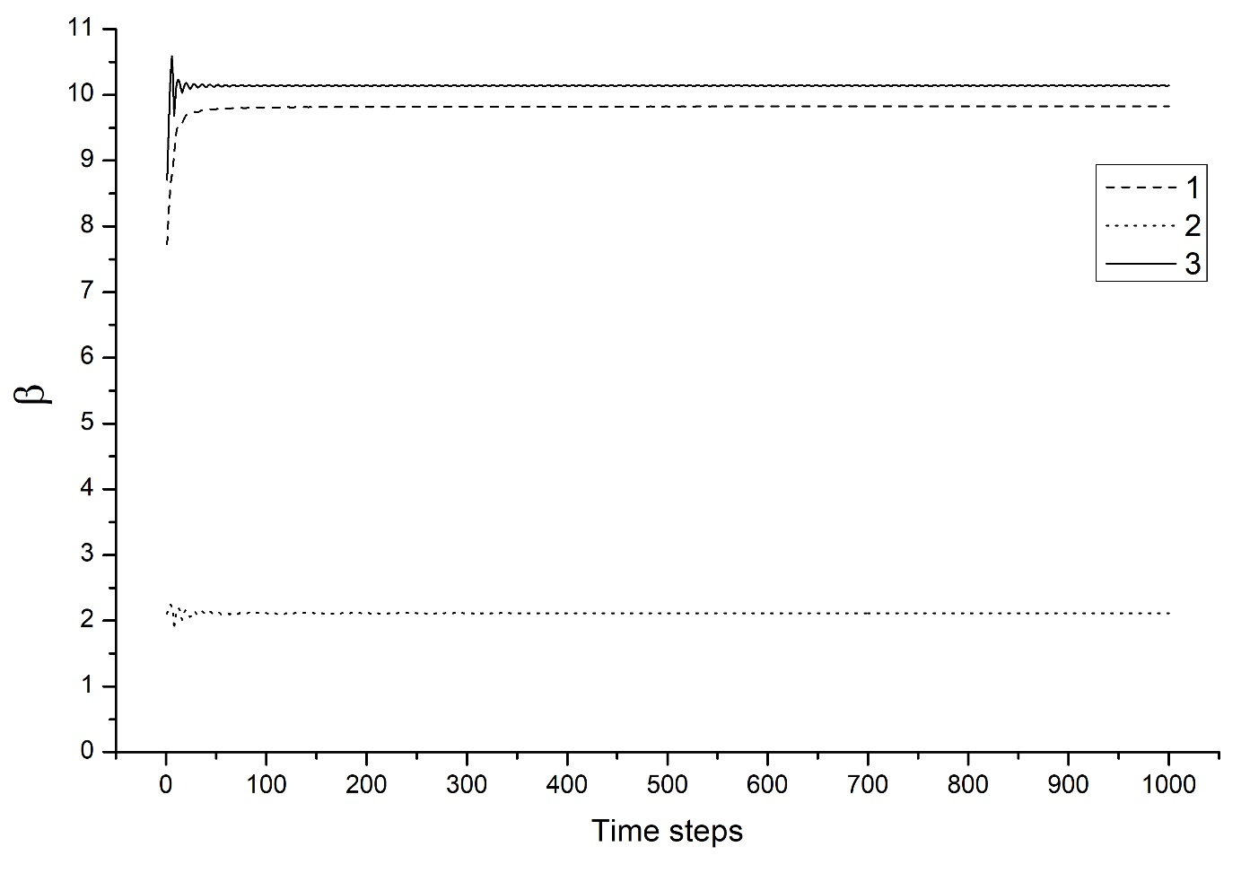
Numerical test of the constructed computational circuits
Error function
Runge coefficient
[x_{min} = -10, x_{max} = 10]
N_{x} = 1000 points
τ = 0.1
τ, τ/2, τ/4
Order of accuracy of the method
Optimized L-T-S with S₄
L-Т-S
Product formulae Li-Trotter-Suzuki
S₂
S₄
Optimized L-T-S with S₂
10/10

Slide 17
Thank you for attention!

