Slide 1
MATHEMATICAL MODEL OF FRACTAL THERMODYNAMICS AND ANALYSIS OF PRODUCED PARTICLE TRACKS WITHIN THE MPD EXPERIMENT OF THE NICA COLLIDER
S. Mikheev¹, V. Tsvetkov¹, I. Tsvetkov¹, N. Voytishin²
¹ Tver State University, Tver, Russia
² Joint Institute for Nuclear Research, Dubna, Russia

Slide 2
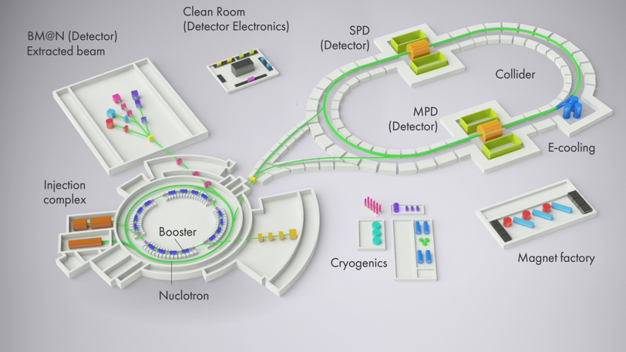
MPD @ NICA
The MPD experiment [1] is planned to start at the NICA accelerator complex in 2025 in order to investigate hot and dense baryonic matter produced in the collision of heavy nuclei up to Au after their interaction in the MPD detector at an energy of E = 11.5 GeV/nucleon.
The main objective of our work is to identify the fractal properties of the set of tracks produced by emitted particles during the collision of beams of Au atomic nuclei within the MPD experiment.
NICA collider facility
MPD detector setup

Slide 3
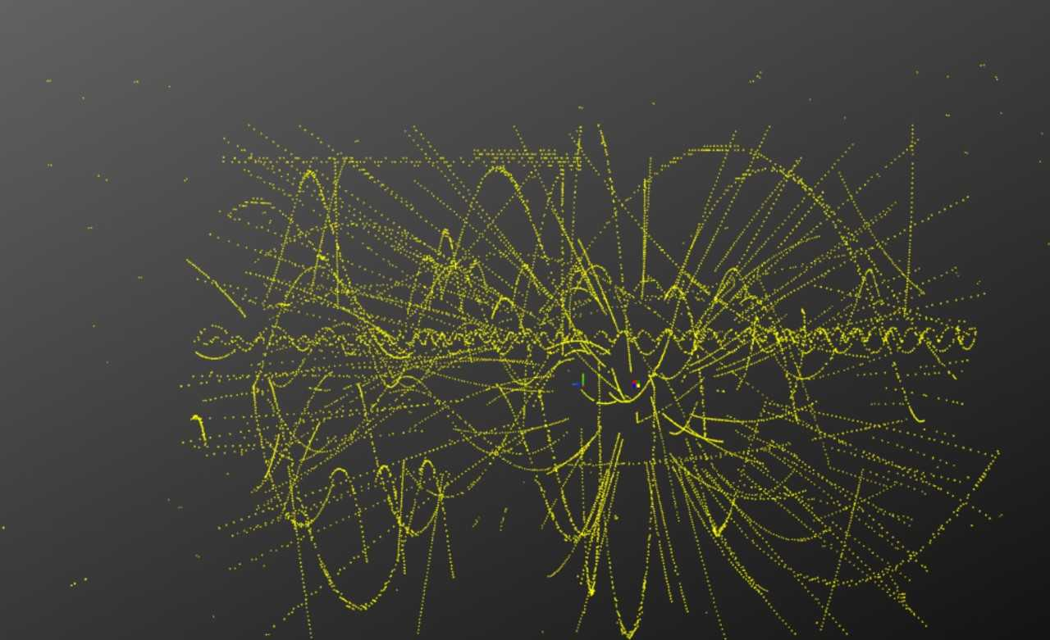
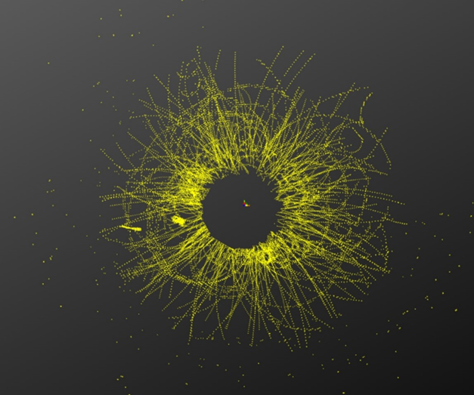
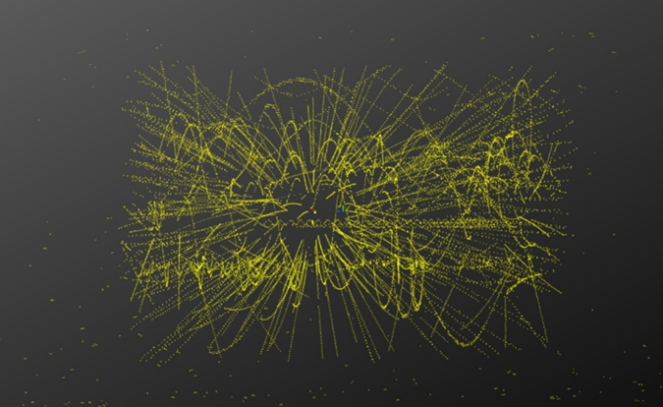
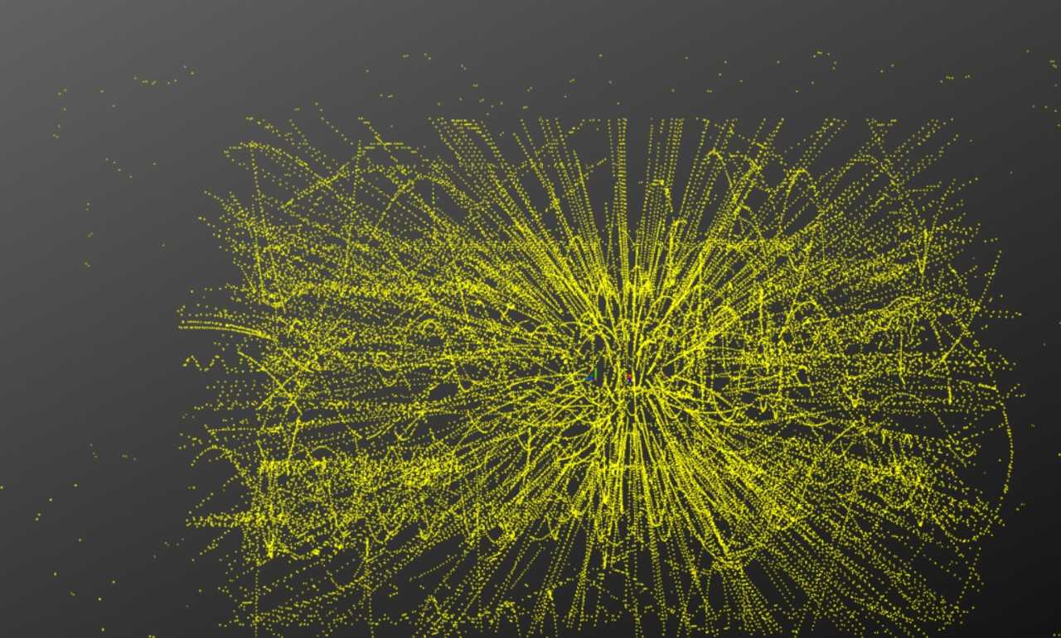
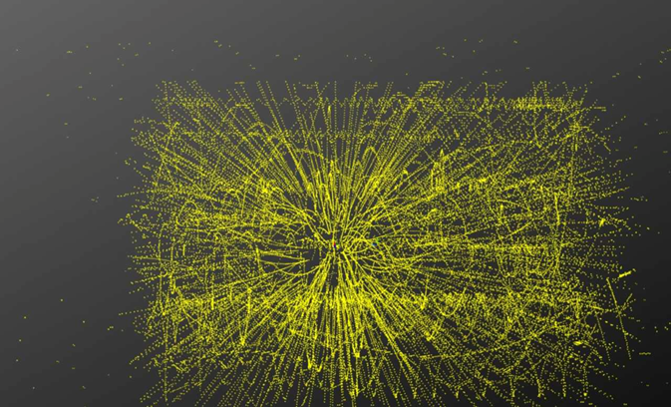
MPD event display
The computer reconstruction of particle tracks resulting from the interaction of Au heavy ion beams is demonstrated in five figures simulated with different event topologies. The MPD event display tool [2] is used for visualization.
https://mpd-edsrv.jinr.ru/

Slide 4
Introduction to fractals 1
The deviation criterion of the studied set of tracks from fractals was formulated in [3] based on a constructive definition of fractal sets (fractals), according to which:
ln N(h) = ln Γ – D ln h, (1)
Where N – number of cubes of the n-dimensional Euclidean space, that covers the given set of tracks, h – the size of the sides of the cubes, D – fractal dimension of the fractal set, Г – its D-dimensional (fractal) volume.
Let’s take a sequence of values h_{k}, k=1,2,…,K and introduce the notation
N_{k}=N(h=h_{k}) (2)
In the case where the discrete function N(h_{k}) is not quite close to a power function, then the set under study is not an exact fractal, but an approximate one. The degree of closeness will be estimated by the function δ(D, Γ):
$δ\left(D,Γ\right)=\frac{1}{K}\sum_{k=1}^{K}{\frac{{\left(lnN_{k}−lnΓ+D∙lnh_{k}\right)}^{2}}{\ln^{2}N_{k}}}$. (3)

Slide 5
Introduction to fractals 2
Therefore D and Г can be found from the condition of the minimum of the function δ,
$\frac{∂δ(D,Γ)}{∂D}=0$, $\frac{∂δ(D,Γ)}{∂Г}=0$. (4)
The number of the picture to be studied further will be designated by an index l.
Solving the system of equations (4) for each l we can find D^{(l)} and Γ^{(l)}. Then, as a criterion for the proximity of the studied sample pictures to fractals, we will use the parameter δ^{(l)}:
$δ^{(l)}=\frac{1}{K}\sum_{k=1}^{K}{\frac{\left|lnN_{k}^{(l)}−lnΓ^{(l)}+D^{(l)}∙lnh_{k}\right|}{lnN_{k}^{(l)}}}$. (5)
If δ^{(l)}<<1 then the picture l is close enough to a fractal and for its analysis the mathematical model of the fractal thermodynamics (FT) can be used.
Fractal thermodynamics (FT) is a mathematical model that describes the relationships between the main fractal thermodynamic parameters.
The main fractal thermodynamics parameters of state for this model are fractal entropy $S_{f}^{\left(l\right)}$ and fractal temperature $T_{f}^{\left(l\right)}.$

Slide 6
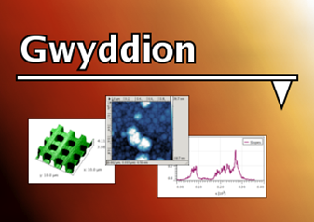
Analysis of sample pictures
The fractal dimension was defined using the Gwyddion - software package for analysis of graphical data.
http://gwyddion.net/
All 5 pictures were analyzed by Gwyddion and the relative deviations of the set of tracks from fractal δ^{(l)} were found using the formula (5)
The obtained values are:
δ⁽¹⁾ = 0.02701; δ⁽²⁾ = 0.02336; δ⁽³ ⁾= 0.02109; δ⁽⁴⁾= 0.02172; δ⁽⁵⁾= 0.02448,
all less than 3%.
As all δ^{(l)} are quite small, we can say that the structure of the set of the particles’ track emerging in the MPD experiment is close to a fractal one.

Slide 7
Fractal parameters calculation
The set of values ​​$S_{f}^{(l)}$ and $T_{f}^{(l)}$ is divided into subsets with index l_{m}, on each of which the state diagram of these subsets is approximated with a high degree of accuracy by power functions: according to
$S_{f}^{(l_{m})}=A_{m}∙{\left(T_{f}^{(l_{m})}\right)}^{γ_{m}}$, (6)
that we’ll call the fractal equation of state (FES). The value of the exponent $γ_{m}$ will be called the FES index, and the coefficient $A_{m}$ will be called the pre-power factor and they are the parameters that determine the FES.
For all five picture samples, the parameters of the state of fractal thermodynamics $D^{\left(l\right)}, S_{f}^{\left(l\right)}$ , $T_{f}^{\left(l\right)}$ were calculated for the set of tracks of emitted particles.
Table 1
№ | T_{f} | S_{f} | δ | D | A | γ
1 | 417.7589 | 40.9515 | 0.02701 | 2.4634 | 19.0664 | 0.1265
2 | 610.9799 | 42.9363 | 0.02336 | 2.6111
3 | 613.3344 | 42.9225 | 0.02109 | 2.6124
4 | 441.5790 | 41.0735 | 0.02172 | 2.4874
5 | 428.1101 | 41.0689 | 0.02448 | 2.4741

Slide 8
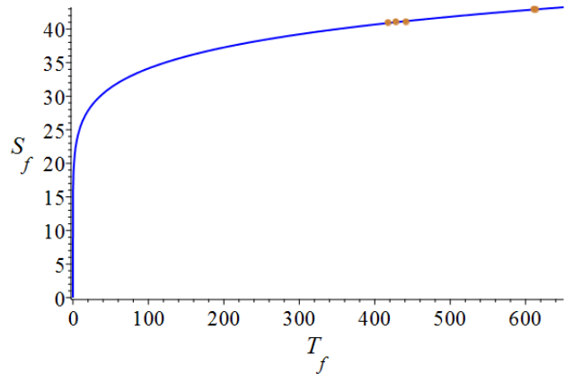
Fractal Equation of State for MPD
Using data from Table 1 a diagram of fractal states $S_{f}^{\left(l\right)}(T_{f}^{\left(l\right)}$) was constructed shown on the picture.
Fractal equation of state (FCS) for MPD event display samples
As it can be seen, all states $S_{f}^{\left(l\right)}(T_{f}^{\left(l\right)}$) form one subset, which is approximated with an accuracy of 0.003 by the FCS, the parameters of which were given in Table 1.

Slide 9
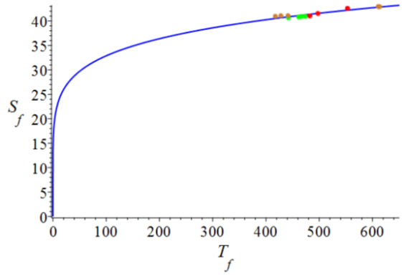
Comparison with other HEP experiments
Область для применимости предложенной нами математической модели ФТ в экспериментах MPD, BM@N, LHC [5] может быть оценена построением общего ФУС для этих экспериментов:
BM@N
MPD
ALICE
General fractal equation of state (FCS) for all considered experiments
The general FCS was determined with the following values ​​of the parameters: A = 16.7697, γ=0.1462.
The maximum deviation of the states of all experiments from the FCS curve does not exceed 1%.
This means that the mathematical model of the FT describes well all the experimental data we have considered.

